Slide 1
LDRD-C 25-043 project conclusion
Tunable Neutron Beam through Deuteron Disassociation
Xiaodong Jiang
December 18th, 2025

Slide 2
Tunable Neutron Beam through Deuteron Disassociation
p
B field
. . . . . . . .
. . . . . . . .
. . . . . . . .
. . . . . . . .
. . . . . . . .
. . . . . . . .
deuteron
p
p
n
n
n
2.22 MeV binding energy
_{1cm Be}
Method: (1947) disassociation reaction strips the loosely-bounded deuteron into (p + n) pair with similar energies, ~2% possibility for 100 MeV/n deuteron on a 1 cm Be.
This work focused on deuteron 100 MeV/u.
Goal: once “mono-energetic” neutron is demonstrated, a tunable neutron beam (15-200MeV) is achievable with existing technology, reaching 10¹⁰ neutrons/cm²/sec.
Approved for FY2025 (LDRD-C $75k, covers 8hr beam time at NSRL, engineer time, etc.).
Results of a beam test (Sept. 3rd, 2025), with deuteron and proton beams 100 MeV/u
Conclusion and next steps.

Slide 3
Why Fast Neutron (E_{kin} = 15MeV - 200MeV) ?
Applications of neutron technology are limited by the available neutron sources:
Reactors neutrons (thermal): E_{kin} << 1 MeV.
Fusion neutrons (Deuteron-Deuteron, Deuteron-Tritium): E_{kin} =2.5 MeV, 14.1 MeV.
Accelerator based proton-spallation neutrons: wide energy not easily selectable.
Fast neutron beam (E_{kin} = 15MeV-200MeV) with selectable energy is not currently available to satisfy the needs of:
Isotope production.
Aviation Industry: neutron induced radiation damages in electronics.
National Security:
  fast-neutron cross-sections for weapons design and simulation.
  imaging of subcritical nuclear material in high-energy and high-density states.
It’s well-known since 1940s that deuteron disassociation on a light nuclear target produces mono-energetic neutrons, a practical fast-neutron beam with tunable energies has never been demonstrated.

Slide 4
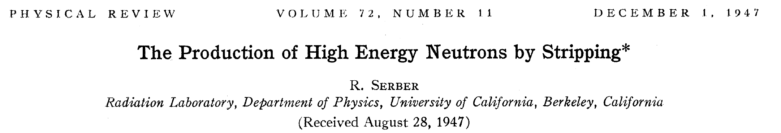
R. Serber, Phys. Rev. 72, 1008 (1947)
“…The yield of neutrons from a 1/2-inch Be target (in which the energy loss for 190-Mev deuterons is 20 Mev) is nearly 2 percent.”
This work focused on deuteron@100 MeV/u, on 1 cm Be target

Slide 5
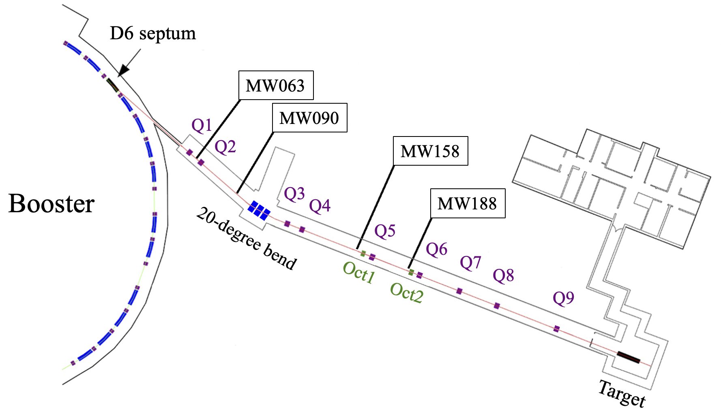
Deuteron Beam in the NSRL beam line (Booster R-line)
EBIS deuteron -> Booster -> R-line
deuteron beam 100 MeV/u
injected from EBIS
set for Q/M=1/2
set for Q/M=1/2
This work focused on deuteron@100 MeV/u
NSRL
The first time EBIS deuterons delivered to the Booster R-line.

Slide 6
Proton beam in the NSRL beam line (Booster R-line)
EBIS molecular H₂+ beam
Booster -> D6 foil
R-line 20º bend
proton beam in NSRL
0.25 mil AL foil
molecular H₂+
100 MeV/u injected from EBIS
set for Q/M=1/2
set for Q/M=1
NSRL
The first time EBIS protons (from H2+) delivered to the Booster R-line.

Slide 7
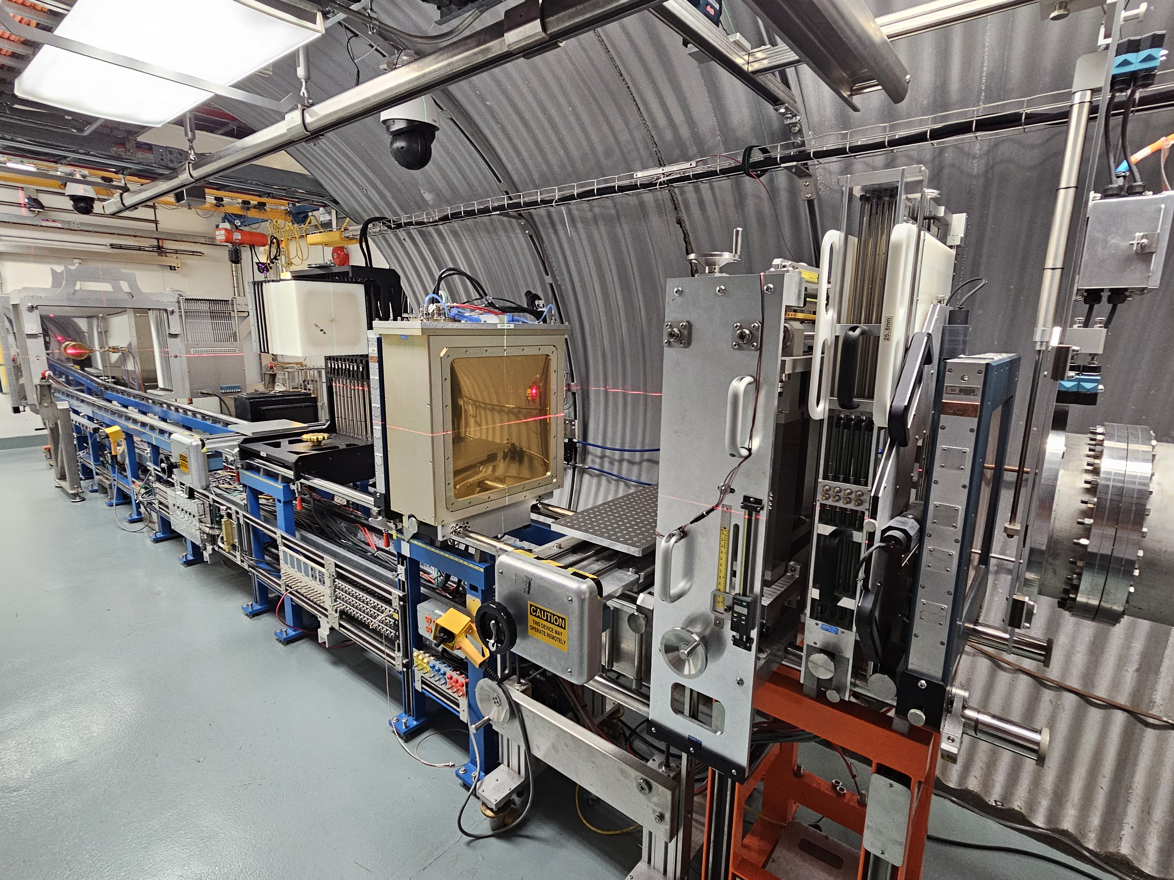
Beam
NSRL Target Room

Slide 8
Test Setup
p
B field
. . . . . . . .
. . . . . . . .
. . . . . . . .
. . . . . . . .
. . . . . . . .
. . . . . . . .
deuteron
p
p
n
n
n
_{1cm Be}
(1947) disassociation reaction strips the loosely bounded deuteron into p + n with similar energies, with a ~2% possibility for 100 MeV/n deuteron on a 1 cm Be target.
10cm x 10cm x 20cm thick
Dipole Magnet
S₃
charge veto
S₂
S₁
. . . . . .
. . . . . .
_{Calorimeter}
_{(Scintillator Block)}
Beam
~6m
_{1cm Be}
Trigger: (S₁+S₂)+Calorimeter
neutron detection through (n,p) interactions.
scintillator S1, S2, S3: 5”x5”x1/4”

Slide 9
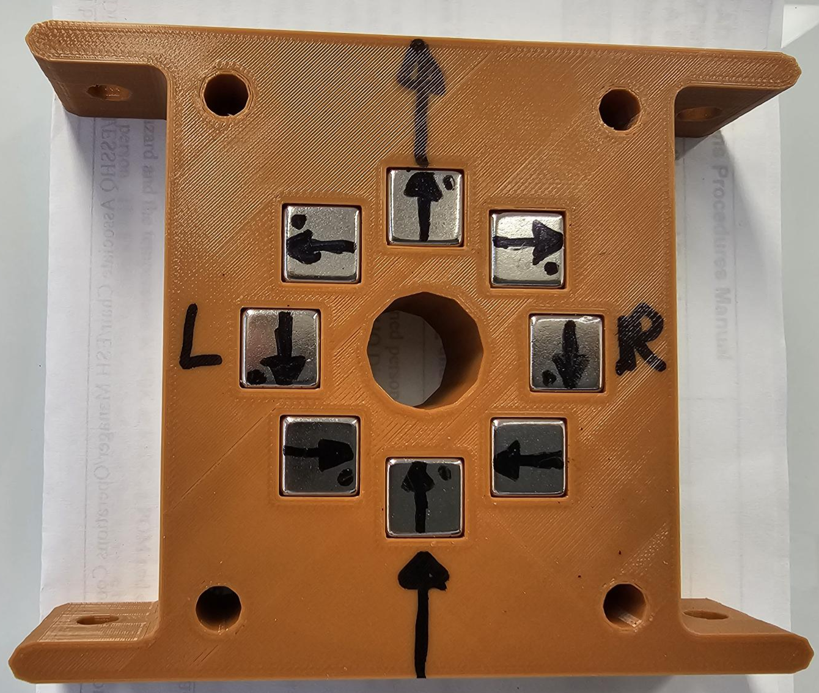
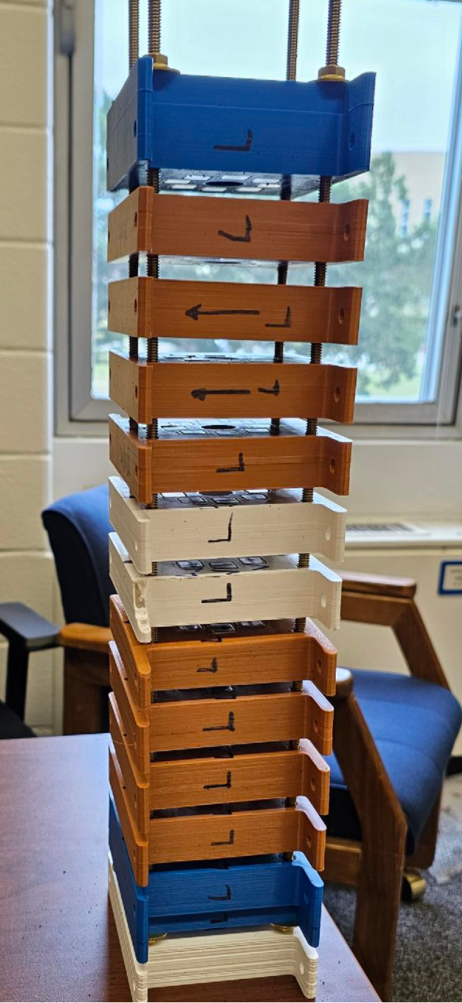
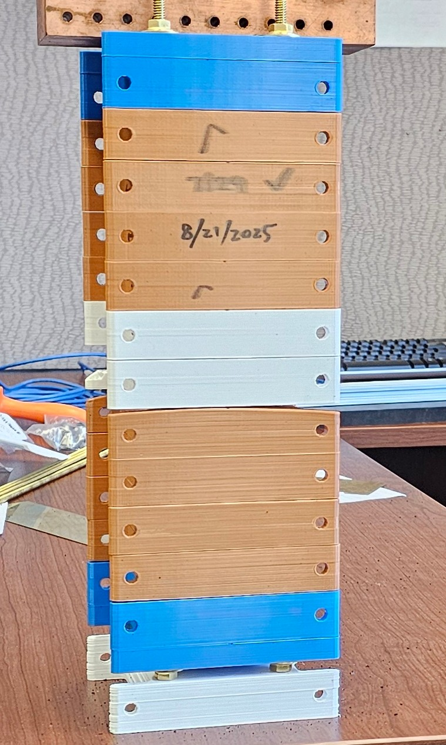
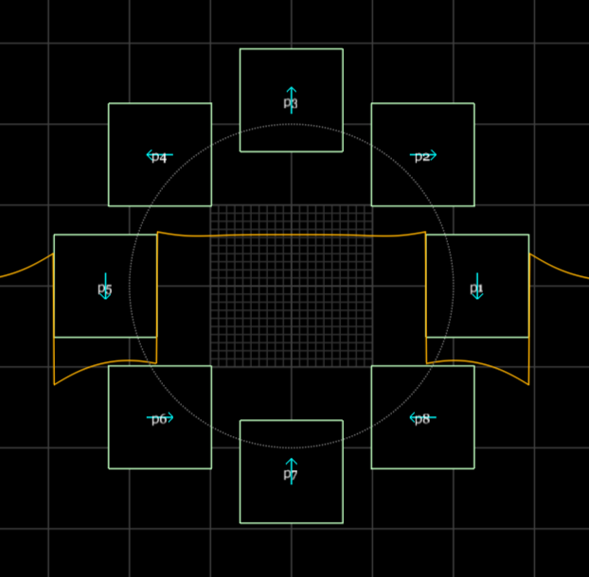

$$φ(3/4")$$
Dipole Magnet
B=0.475 tesla, L=12”
BdL ~ 0.145 Tesla.meter
center clearance:0.75”
Stephen Brooks

Slide 10
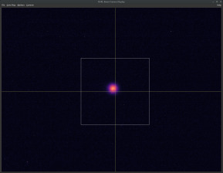
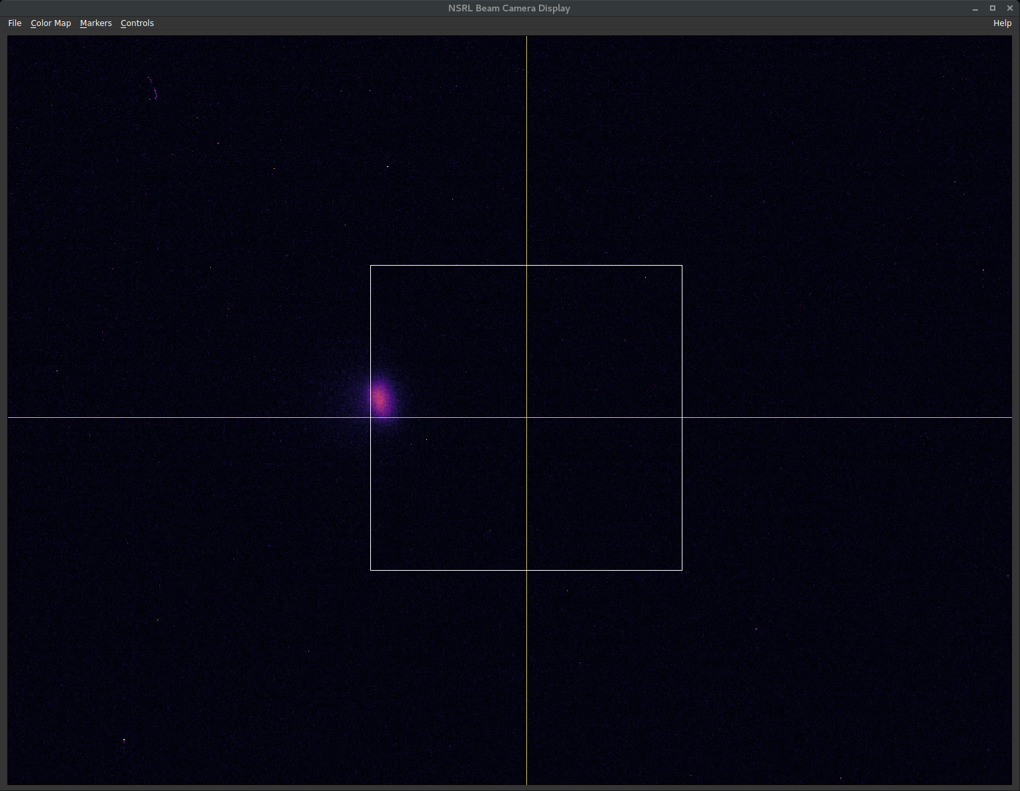
100 MeV/u deuterium beam, a 10x10cm square shown as a reference
Beam camera screen: ~ 130cm from center of magnet
Magnet OUT
Magnet IN
primary beam displacement: ~5 cm

Slide 11
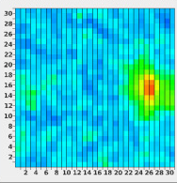
100 MeV/u deuteron beam through the magnet.
At the Strip-Chamber (1” pitch) behind the Calorimeter (~650cm from magnet-center),
Primary deuteron beam displacement: ~10” (25.4cm)
Magnet works
Calorimeter size:
scintillator block
(10cm x 10cm) x 20cm thick
At downstream:
the primary deuteron beam is kicked far away from the calorimeter

Slide 12
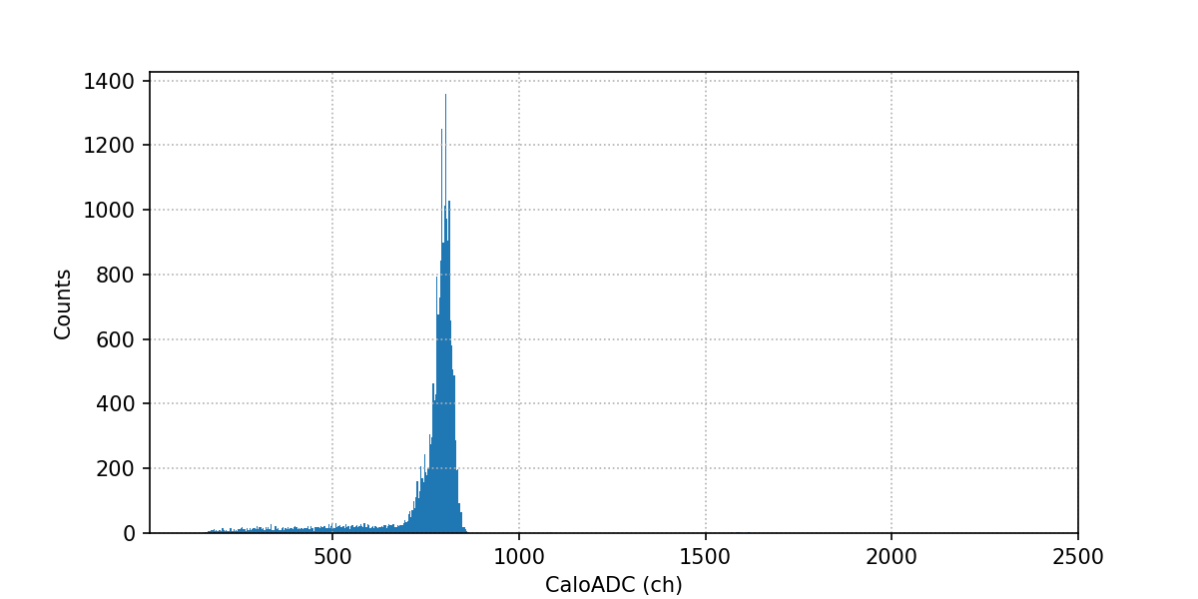
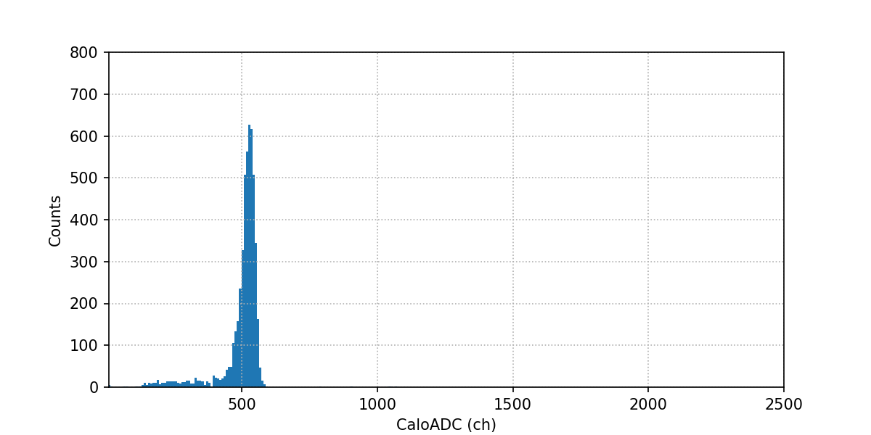
Calorimeter ADC
proton E_{kin} = 100 MeV/u
magnet out
~ch800
pass through 1cm Be
proton E_{kin} ~ 78 MeV/u
magnet out
~ch530

Slide 13
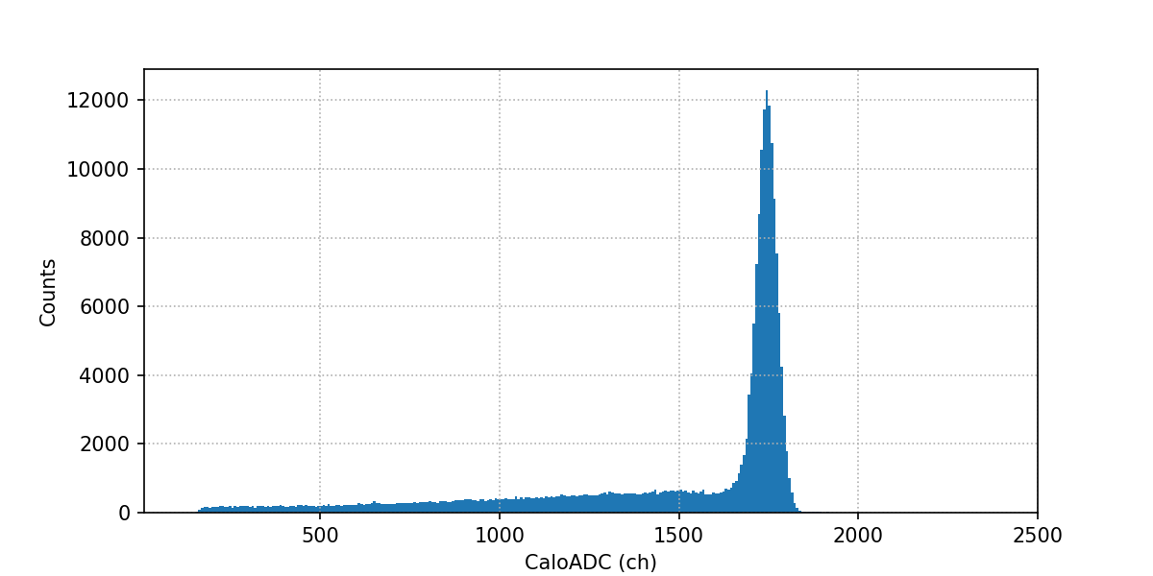
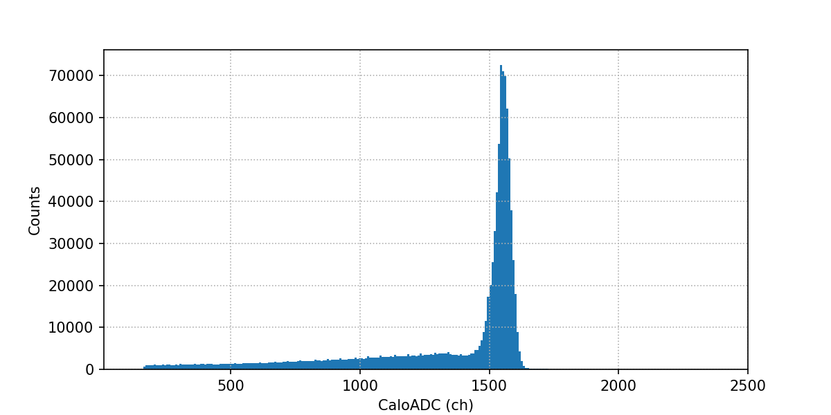
Calorimeter ADC
deuteron E_{kin} = 100 MeV/u
magnet out
~ch1740
pass through 1cm Be
deuteron E_{kin} ~ 89 MeV/u
magnet out
~ch1550

Slide 14
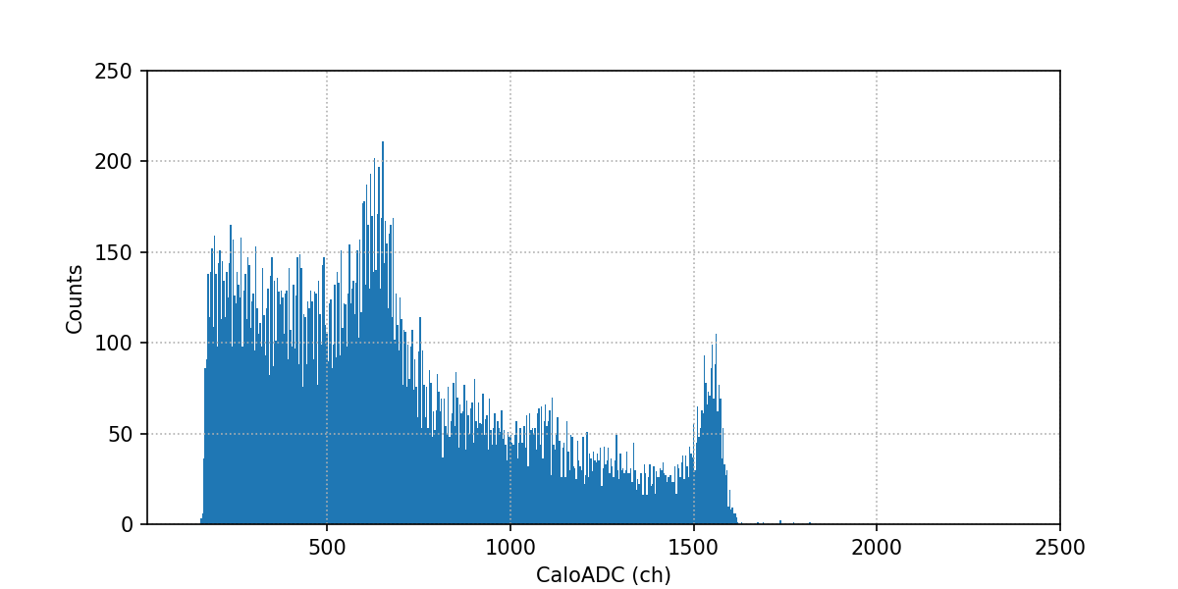
Calorimeter ADC
deuteron E_{kin} = 100 MeV/u
pass through 1cm Be
magnet IN
deuterons
~ch530
~ch1550
Scaler Rates (4.8 sec per spill):
(S₁+S₂): 200k/spill
S₃ : 1200/spill
Calorimeter: 270/spill
Trigger (S₁+S₂)+Calorimeter: 90/spill

Slide 15
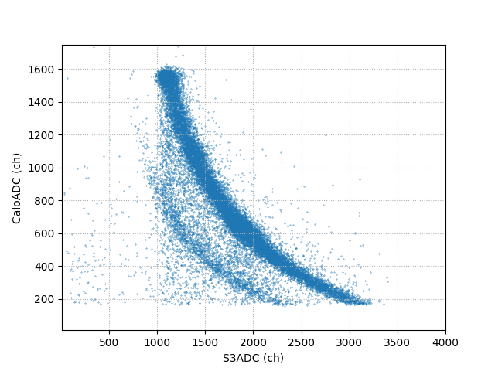
Calorimeter_ADC vs S3_ADC all events
most event have S3 hit
~ch1550
any neutrons ?
triggered events appeared to be charge particle background

Slide 16
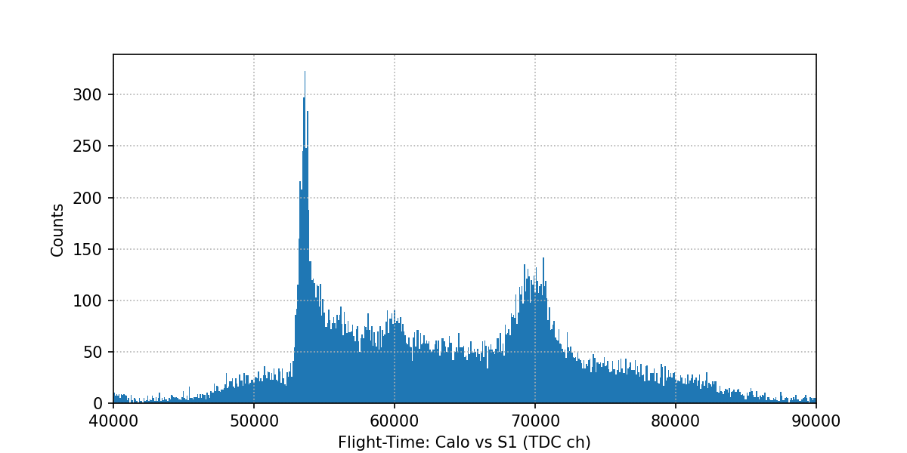
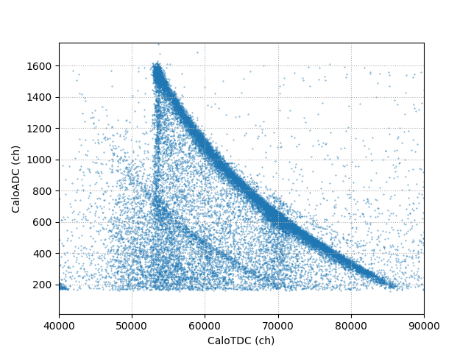
Calorimeter Flight-Time
any neutrons ?
deuterons
Calorimeter Flight-Time vs ADC

Slide 17
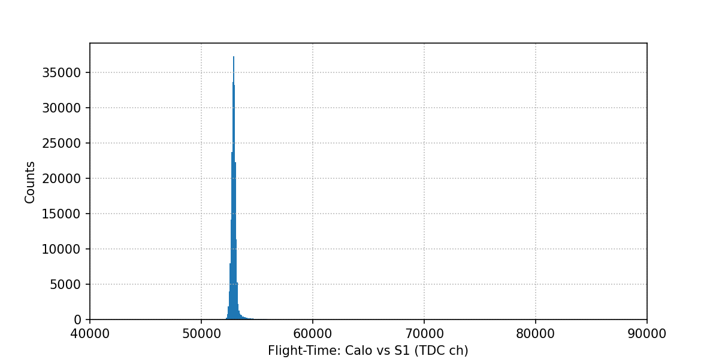
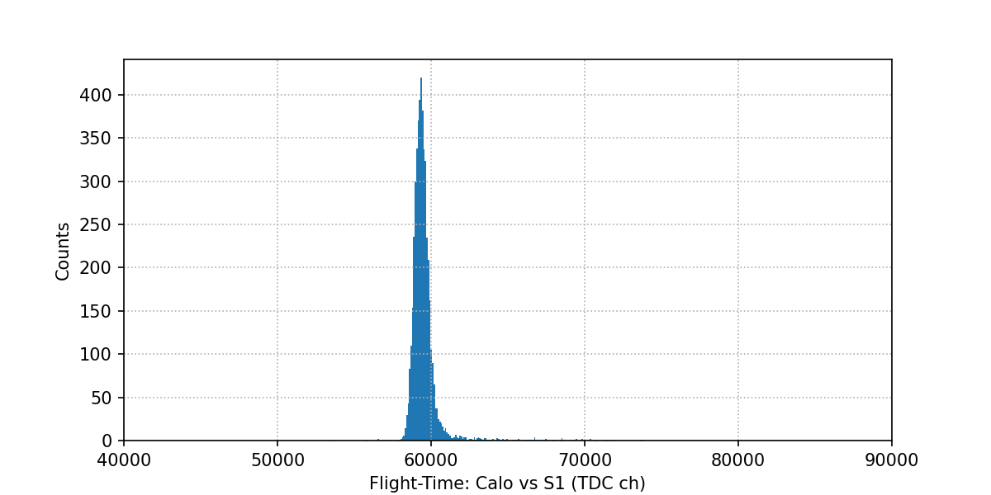
Calorimeter Flight-Time
any neutrons ?
peak1
peak3
peak2
deuteron E_{kin} =100 MeV/u
1cm Be, magnet out
proton E_{kin} =100 MeV/u
1cm Be, magnet out

Slide 18
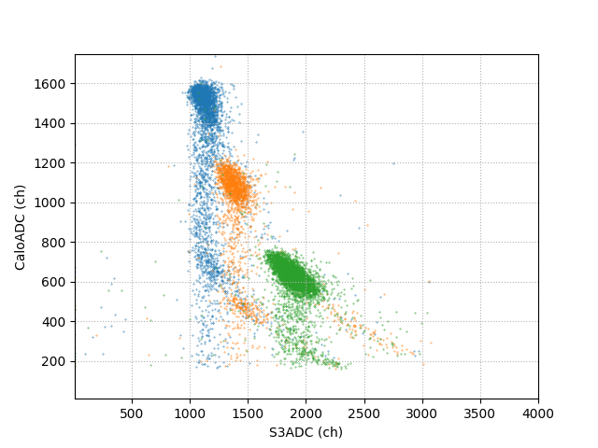
Calorimeter_ADC vs S3_ADC with Flight-Time Cuts
most event have S3 hit
peak1
triggered events appeared mostly charge particle background
peak2
peak3

Slide 19
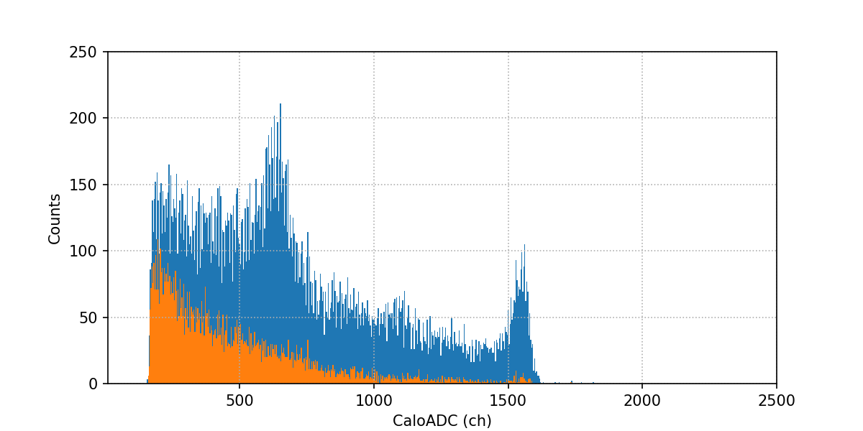
Calorimeter ADC
all events
deuteron E_{kin} = 100 MeV/u
pass through 1cm Be
magnet IN
events with S3ADC<500
possible neutron signal ?
events with S3ADC<500
~ch1550
Not expecting neutron conversion (n,p) reaction lead to protons with well-defined energy

Slide 20
Conclusions
It’s well-known since 1940s that deuteron disassociation on a light nuclear target produces mono-energetic neutrons, a practical fast-neutron beam with tunable energies has never been demonstrated.
BNL has all the facilities/technologies to make such a tunable neutron beam possible:
EBIS provides deuteron beam (and proton through H₂+).
Booster and slow extracted beam, for deuteron up to 1000 MeV/u.
NSRL beam line and the Target Room.
We conducted a beam test: did not pinpoint neutron signal, triggered events appeared mostly from background.
Improvements Planned (LDRD-C proposal submitted for FY2026):
An open-slot dipole magnet: to clearly sweep away all primary beam deuterons and the breakup protons.
Tag the breakup proton with scintillator strip detectors.
A neutron telescope detector: multi-layer segmented scintillators.
(charge-veto + flight-time, combined with a range-telescope)
Next Step:
Event-by-event tagged neutrons as a clear demonstration.

Slide 21
Next Step: event-by-event tagged neutron
proton-tag scintillator in the trigger
primary deuteron beam
p
B field
. . . . . . . .
. . . . . . . .
. . . . . . . .
. . . . . . . .
. . . . . . . .
. . . . . . . .
deuteron
p
p
n
n
n
multi-layer segmented scintillators

