Slide 1
R&D for high intensity electron sources in support of EIC (ECA FOA)
C-AD Machine Advisory Committee Meeting (MAC-22),
Dec 17-19, 2025
Mengjia Gaowei on behalf of the team
Collider-Accelerator Department, BNL

Slide 2
Introduction
Project timeline and task breakdown
Progress summary
Experimental results and discussion
Future plan for cathode R&D

Slide 3
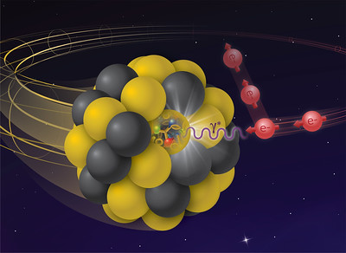
Introduction
It is desirable to have flat hadron beam achieved by the hadron cooling. And may upgrade to maintain hadron emittance by using high energy hadron cooling.
High average current
High bunch charge
Long lifetime
Low emittance
Electron beam for EIC Hadron Cooling
Our focus: High intensity electron source for EIC with epitaxial photocathodes.
Through epitaxial growth of photocathode, we are looking to achieve photocathode with ordered surface and low physical roughness; large grain or single crystal photocathodes with reduced grain boundaries→ low emittance and high QE.
3

Slide 4
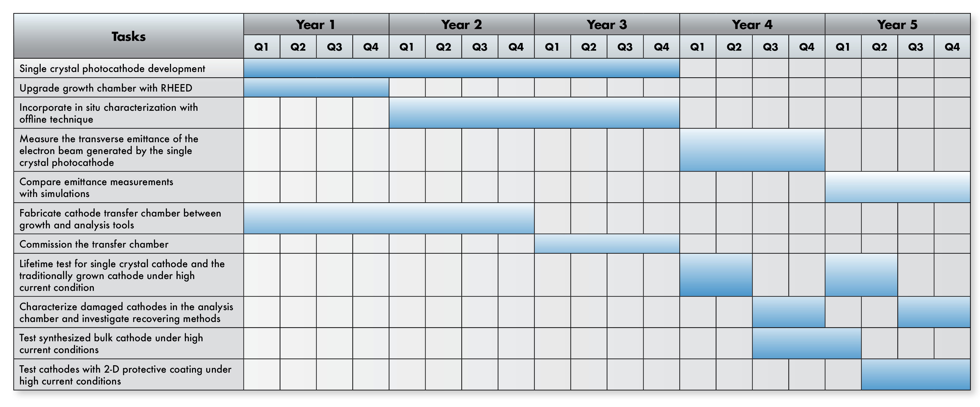
Project timeline
2021/8
2026/7

Slide 5

Project tasks breakdown
Single crystal photocathode development
K₂CsSb (year 3)
Na₂KSb (year 4)
Upgrade growth chamber with RHEED (Year 2)
Incorporate in situ x-ray characteristics with offline technique (year 1 & 2)
Fabricate cathode transfer chamber between growth and analysis tools
Design
Procurement
Modification and Fabrication
Assembly
Commission
High current test (in line with gun schedule)
Lifetime test for single crystal K₂CsSb
Measure transverse emittance of the electron beam generated by the single crystal K₂CsSb
Characterize damaged cathodes and investigate recovering methods

Slide 6
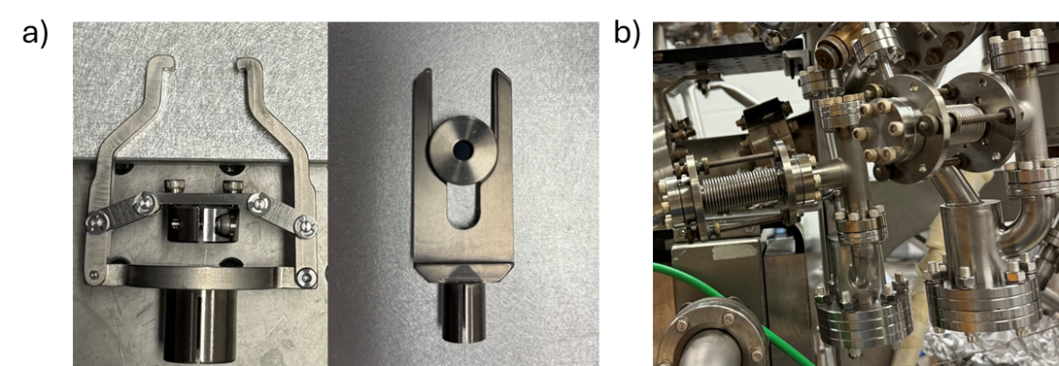
Progress summary – hardware development
Custom modifications are made to the transfer chamber parts. Leak check is performed for the main compartment of the transfer chamber. Custom connections for transfer chamber are fabricated. (Figure. 1a)
Equipped the experimental chamber with new evaporator design same as the EIC HC cathode growth system (Figure. 1b), to grow the cathode material in the same deposition conditions as will be used for EIC. New evaporators are conditioned and tested, with successful growth demonstrated.
Design new sample pucks which will incorporate the mounting of lattice matched single crystal wafers.

Slide 7
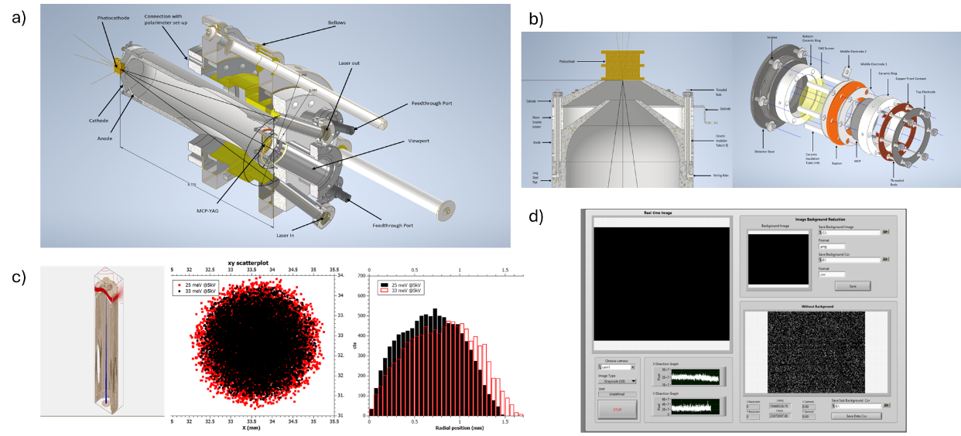
Progress summary - software development
Simulation work continues for emittance measurement.
Labview based control and data requisition for emittance measurement is developed.
Figure. 2 a) Schematic of cathode emittance measurement chamber b) Schematic details of cathode-anode connection and the MCP-YAG detector c) Scatter plot and histogram of electron distribution on MCP at 5kV with MTE of 25 and 33 meV, respectively. The rms beam size on the MCP screen with respect to its beam energy for its initial MTE is obtained from Simion simulations. The rms beam size on the cathode (σx) is 60 µm. d) Interface of the Labview based control and data requisition program for photocathode emittance measurement.

Slide 8
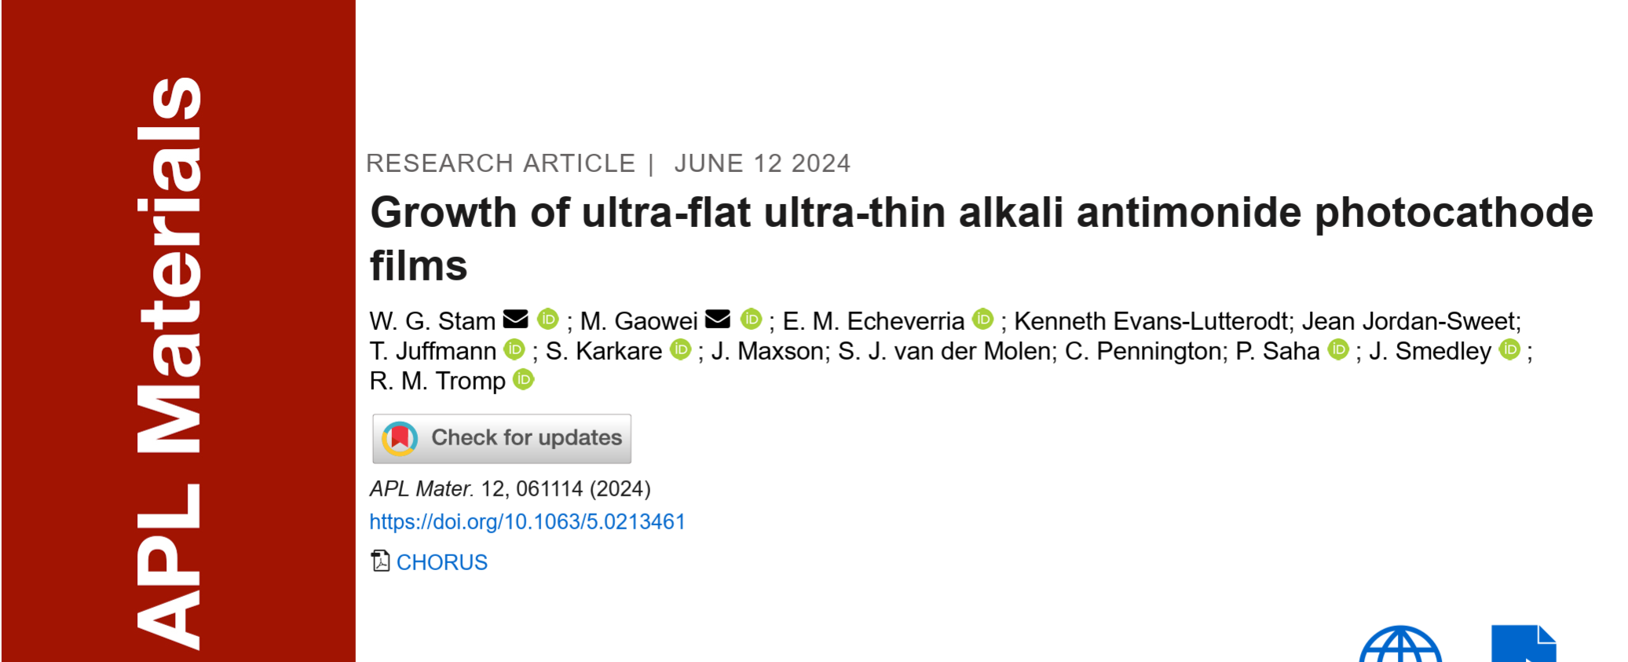
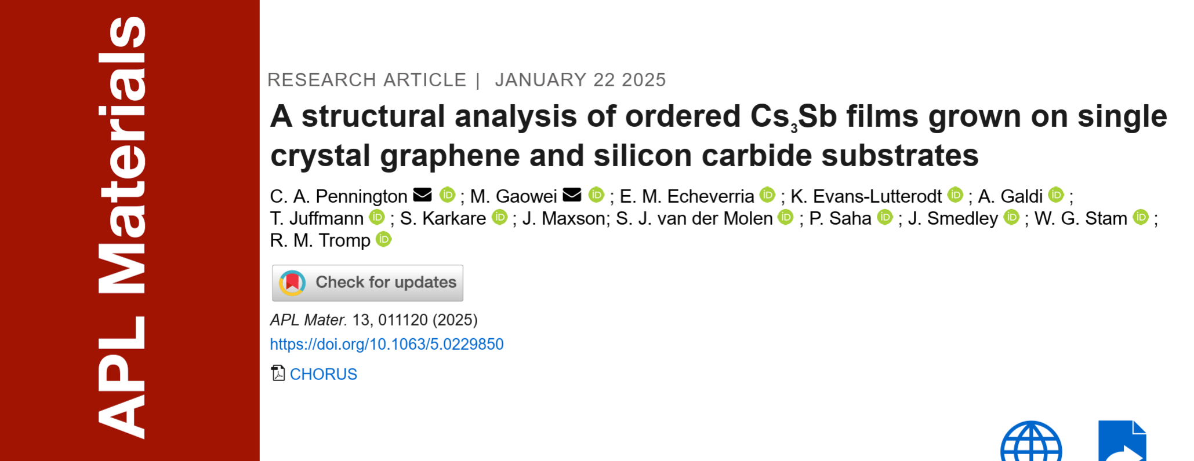
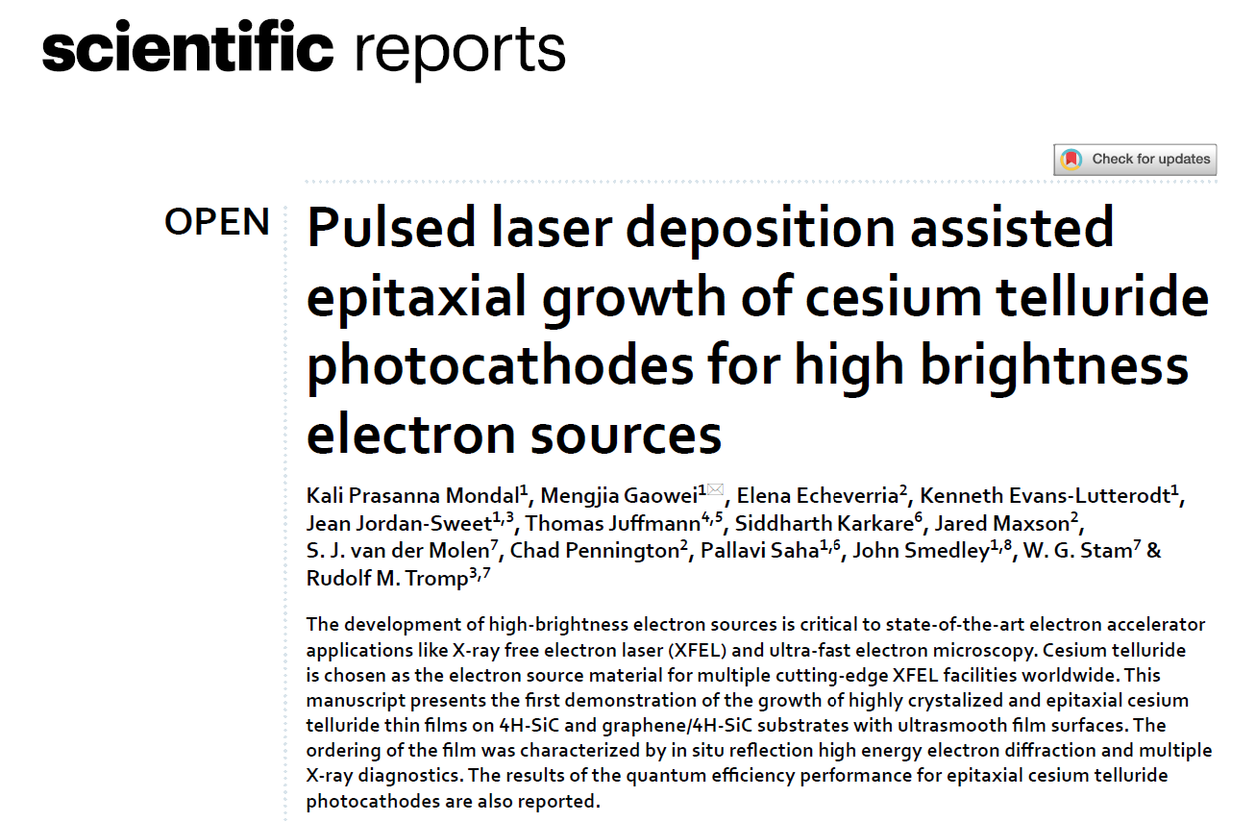
Progress summary - Material development
Epitaxial growth of Cs₃Sb, K₂CsSb and Cs₂Te were performed on various lattice matched substrates. High quantum efficiency, ultrasmooth and epitaxial thin film photocathodes are achieved.
Epitaxial growth of Na₂KSb with ultrasmooth surface (with EIC cathode evaporator configuration) is successfully realized.

Slide 9
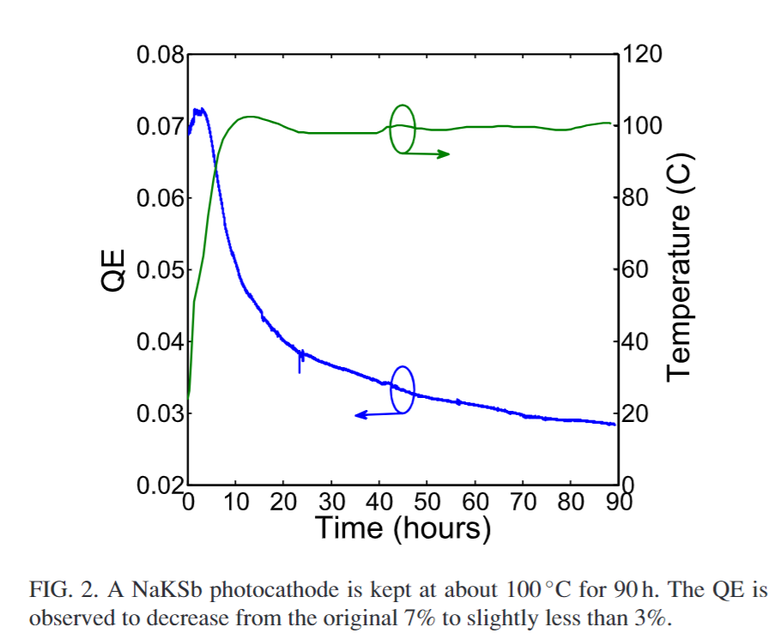
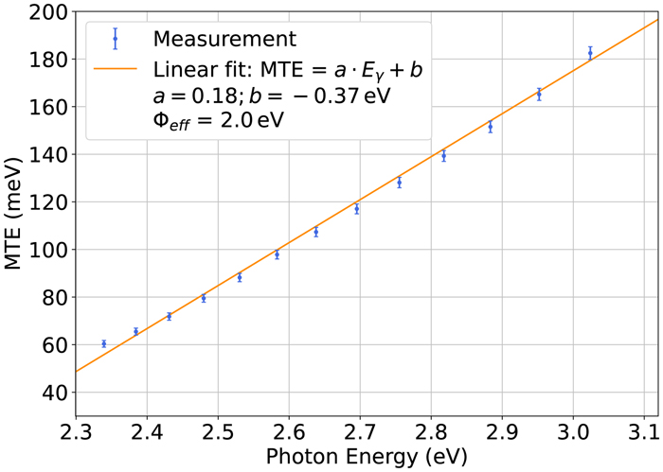
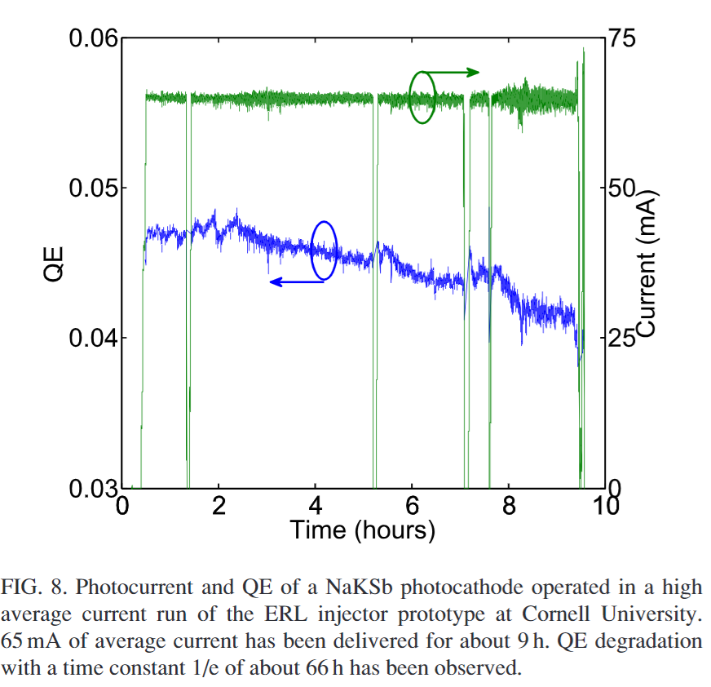
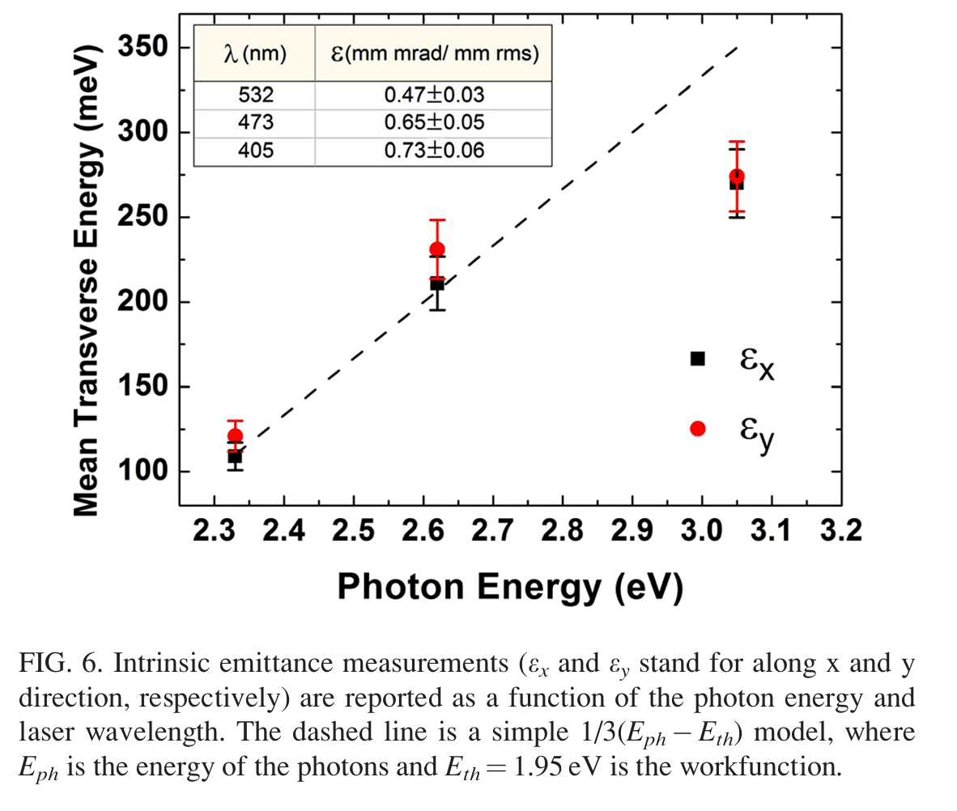
Na-K-Sb photocathode
Motivation: High current, high charge
Cathode overheating form high power laser is a concern
Possible use of NaKSb cathode is introduced as candidate that has better temperature resistance than K2CsSb.
Sodium potassium antimonide (NaKSb) photocathodes is one of the cathode choices for high-brightness applications. These materials offer high QE, fast response, and good thermal stability, making them viable candidates for high-brightness, high-average-current photoinjectors.
Thermal robustness: @100°C showed QE degradation from 7% to ~3% after 90h. QE recoverable by re-evaporating K.
Lifetime and High Current Operation: 1/e lifetime is 66 h.
Fit from MTE measurement gives a work function of ~1.95 eV;
Fit from MTE measurement gives a work function of ~2 eV.
135 meV @ 2.76 eV; 60 meV at 2.33 eV
J. Dube, J. Kühn, C. Wang, S. Mistry, G. Klemz, A. Galdi, T. Kamps; Triple evaporation growth and photoemission characterization of bialkali antimonide photocathodes. J. Appl. Phys. 28 July 2025; 138 (4): 045704.
Cultrera, L., et al. "Growth and characterization of rugged sodium potassium antimonide photocathodes for high brilliance photoinjector." Applied Physics Letters 103.10 (2013).
Notes:
Added to our scope for material development

Slide 10

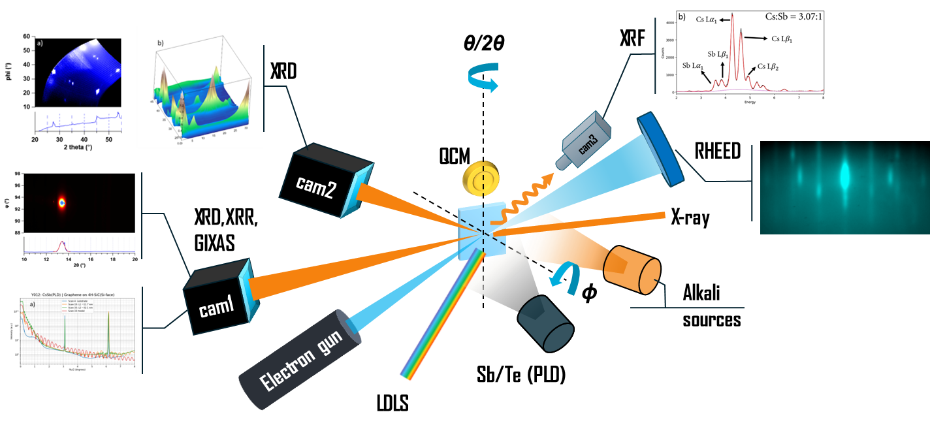




In situ in operando Characterization of photocathodes @ synchrotron light source
Unique program that interfaces with the beamlines at NSLS-II to study photocathode material with the state-of-the-art synchrotron light source
Develops new tools and recipes, which benefit the broad photocathode and accelerator community in providing insight into the fundamental material research
The only active synchrotron research facility for photocathode, attracts collaborators from various Nuclear Physics facilities and from international accelerator facilities.
11.48keV, 1.08 Å
Evaporators:
Thermal Sb
PLD Sb
Alkali effusion cells
Characterization:
QCM
XRD - crystal structure
XRR - surface roughness
XRF - stoichiometry
QE
RHEED
Cathode Candidates:
K₂CsSb/KCs₂Sb
Cs₃Sb
Cs₂Te
Na₂KSb
10

Slide 11
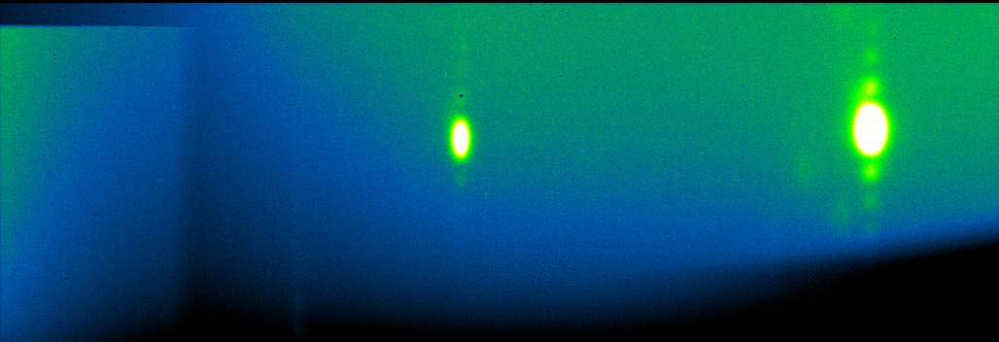
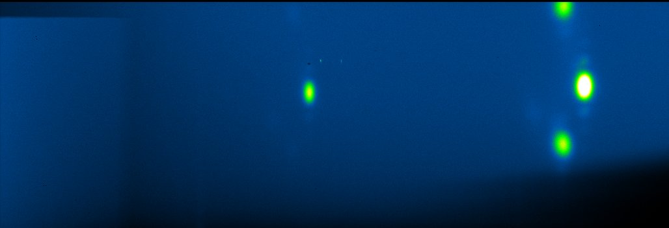
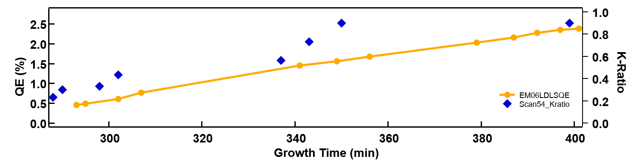
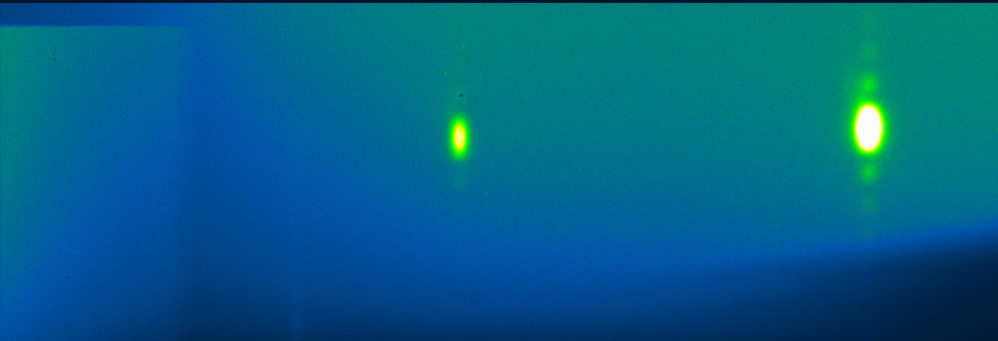
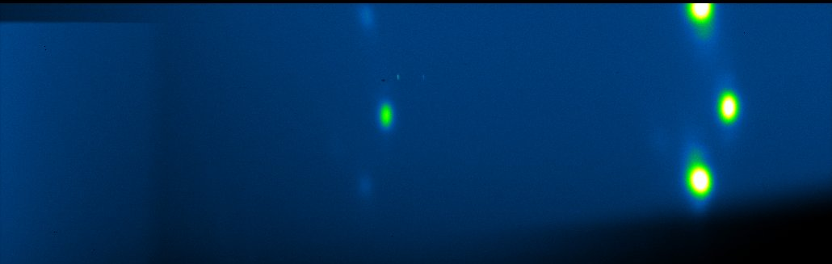
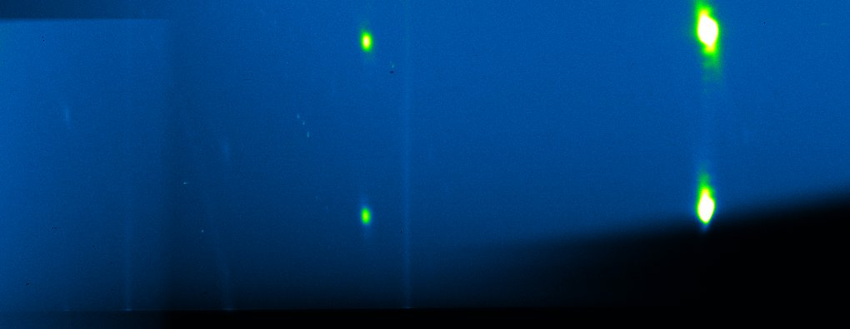
In situ, real time XRD: Structural evolution
As K ratio increases, QE is trending up. When K reaches 1 and kept stable, QE continue to rise and eventually saturates.
At K ratio~0.4 (ideal ratio is 1); QE 0.5% another phase shows up
When K ratio reaches ~1, new phase intensity is lower than original phase
As growth continues, new phase switch intensity with original phase, as QE keeps rising and eventually saturates.
After slight annealing, original phase disappears
Start
Final
Slight annealing

Slide 12
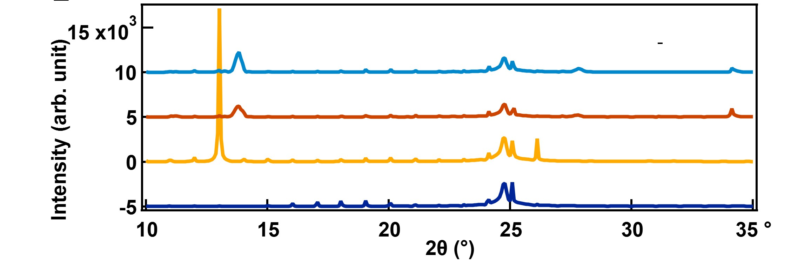
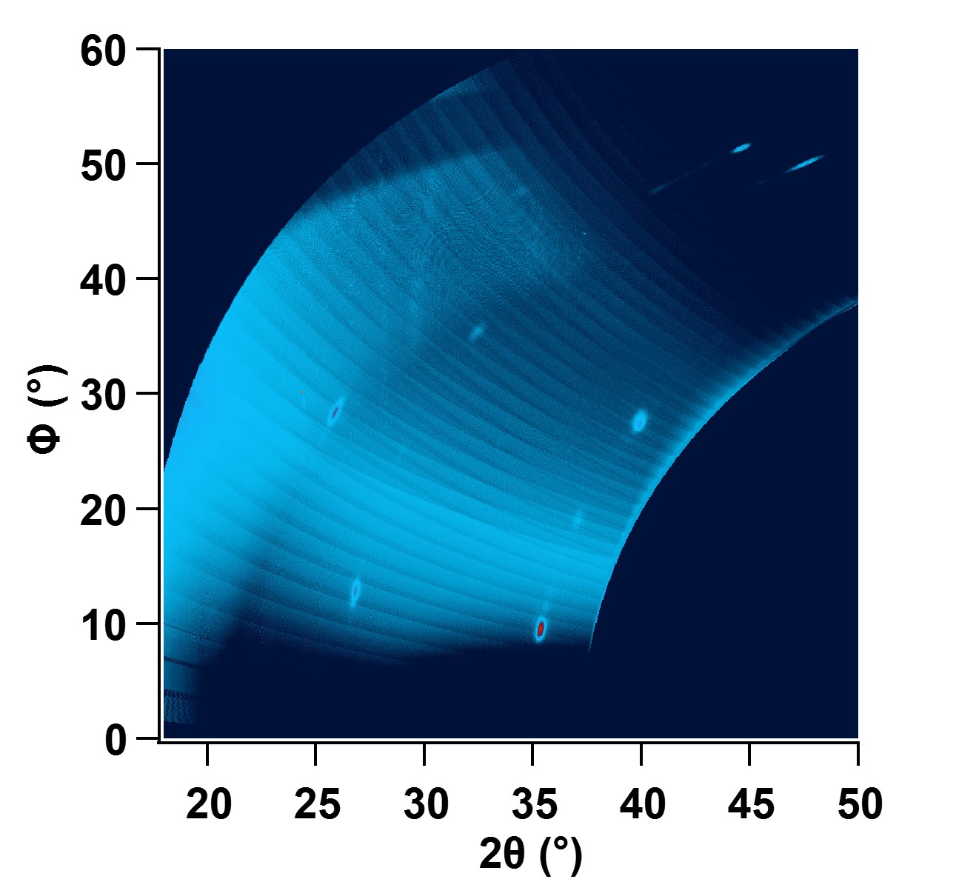
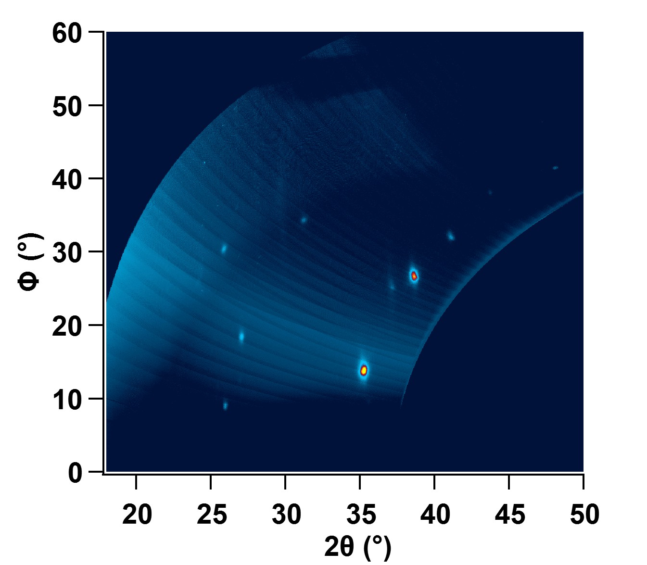
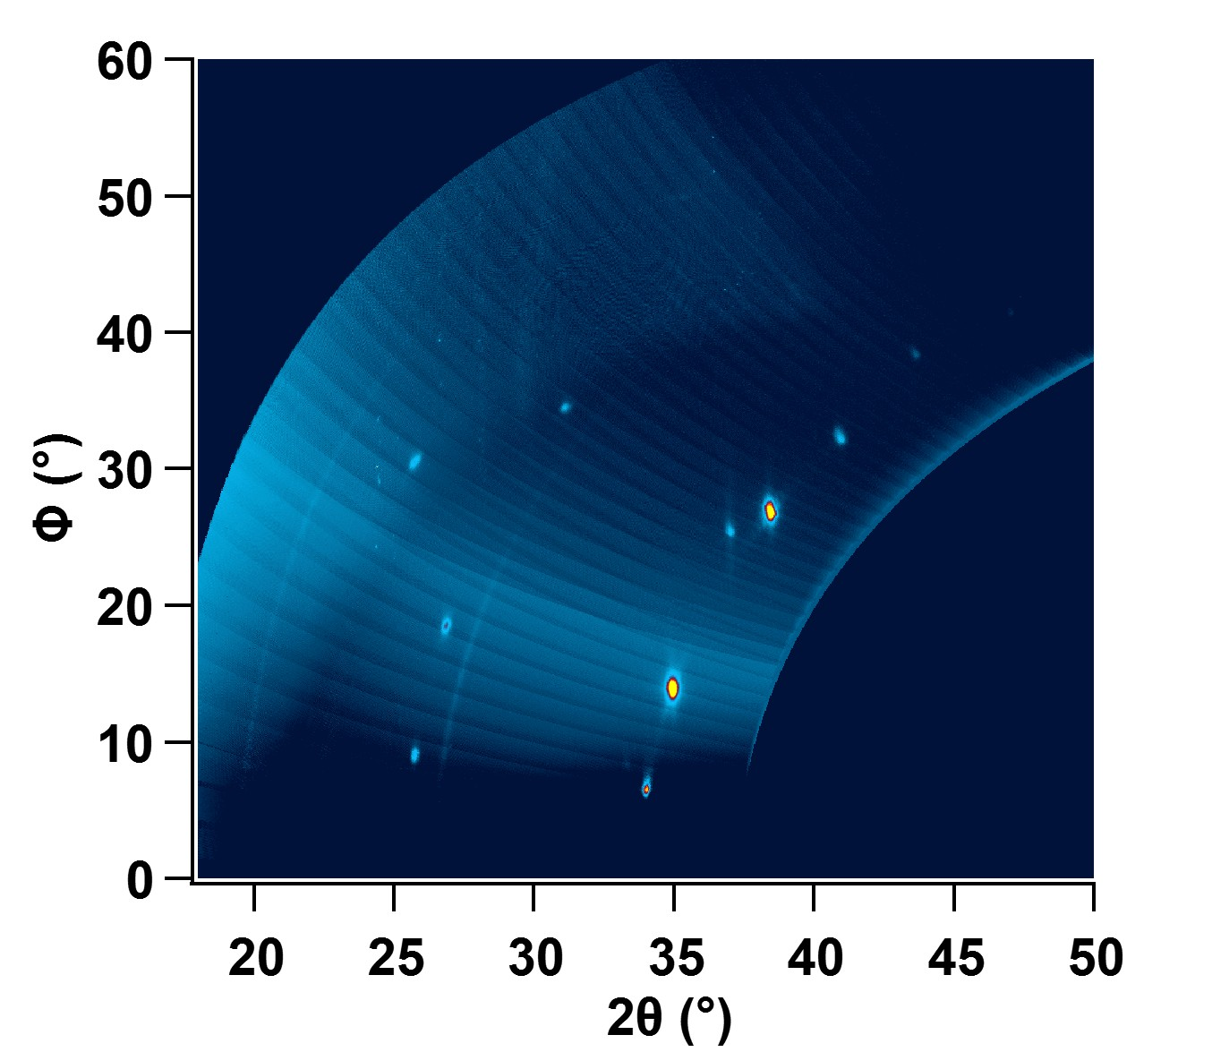
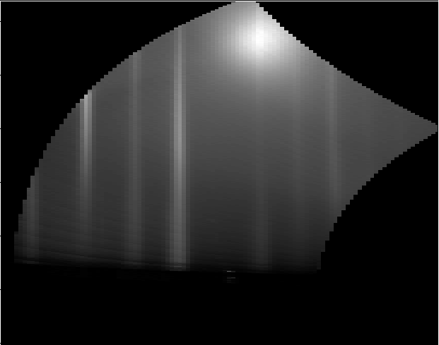
XRD: Structural evolution
Cam 1
Na₃Sb
(0002)
Na₂KSb
(111)
Substrate
Peak
Na₂KSb
(222)
Growth
Slight annealing
Single phase of Na2KSb
Na₃Sb
(0004)
Single phase of Na3Sb
Substrate
Cam 2
Polycrystalline

Slide 13
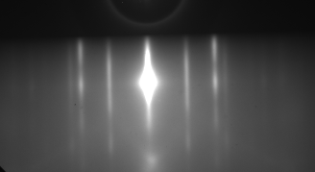
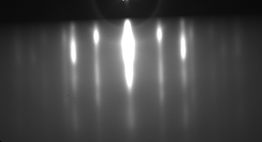
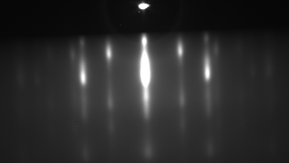
Na-K-Sb photocathode – RHEED, XRR
3~ 5 nm
3~5nm
Thickness: 18 nm
Roughness: 0.7-0.8 nm
12 nm
18nm
RHEED streaks
Azimuthal dependence
Ultrasmooth
18 nm

Slide 14
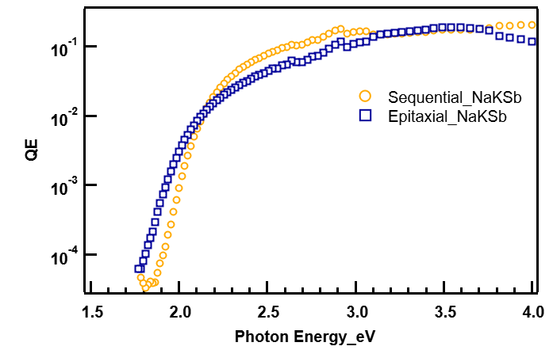
Results- QE
Sequential+ K-Sb yoyo
Spectral response gives a work function of ~1.9 eV.
530nm- QE 4.6%
450nm- QE 12.3%
Epitaxial growth
Work function estimated ~ 1.8eV
530nm- QE 2.8%
450nm- QE 7.1%

Slide 15
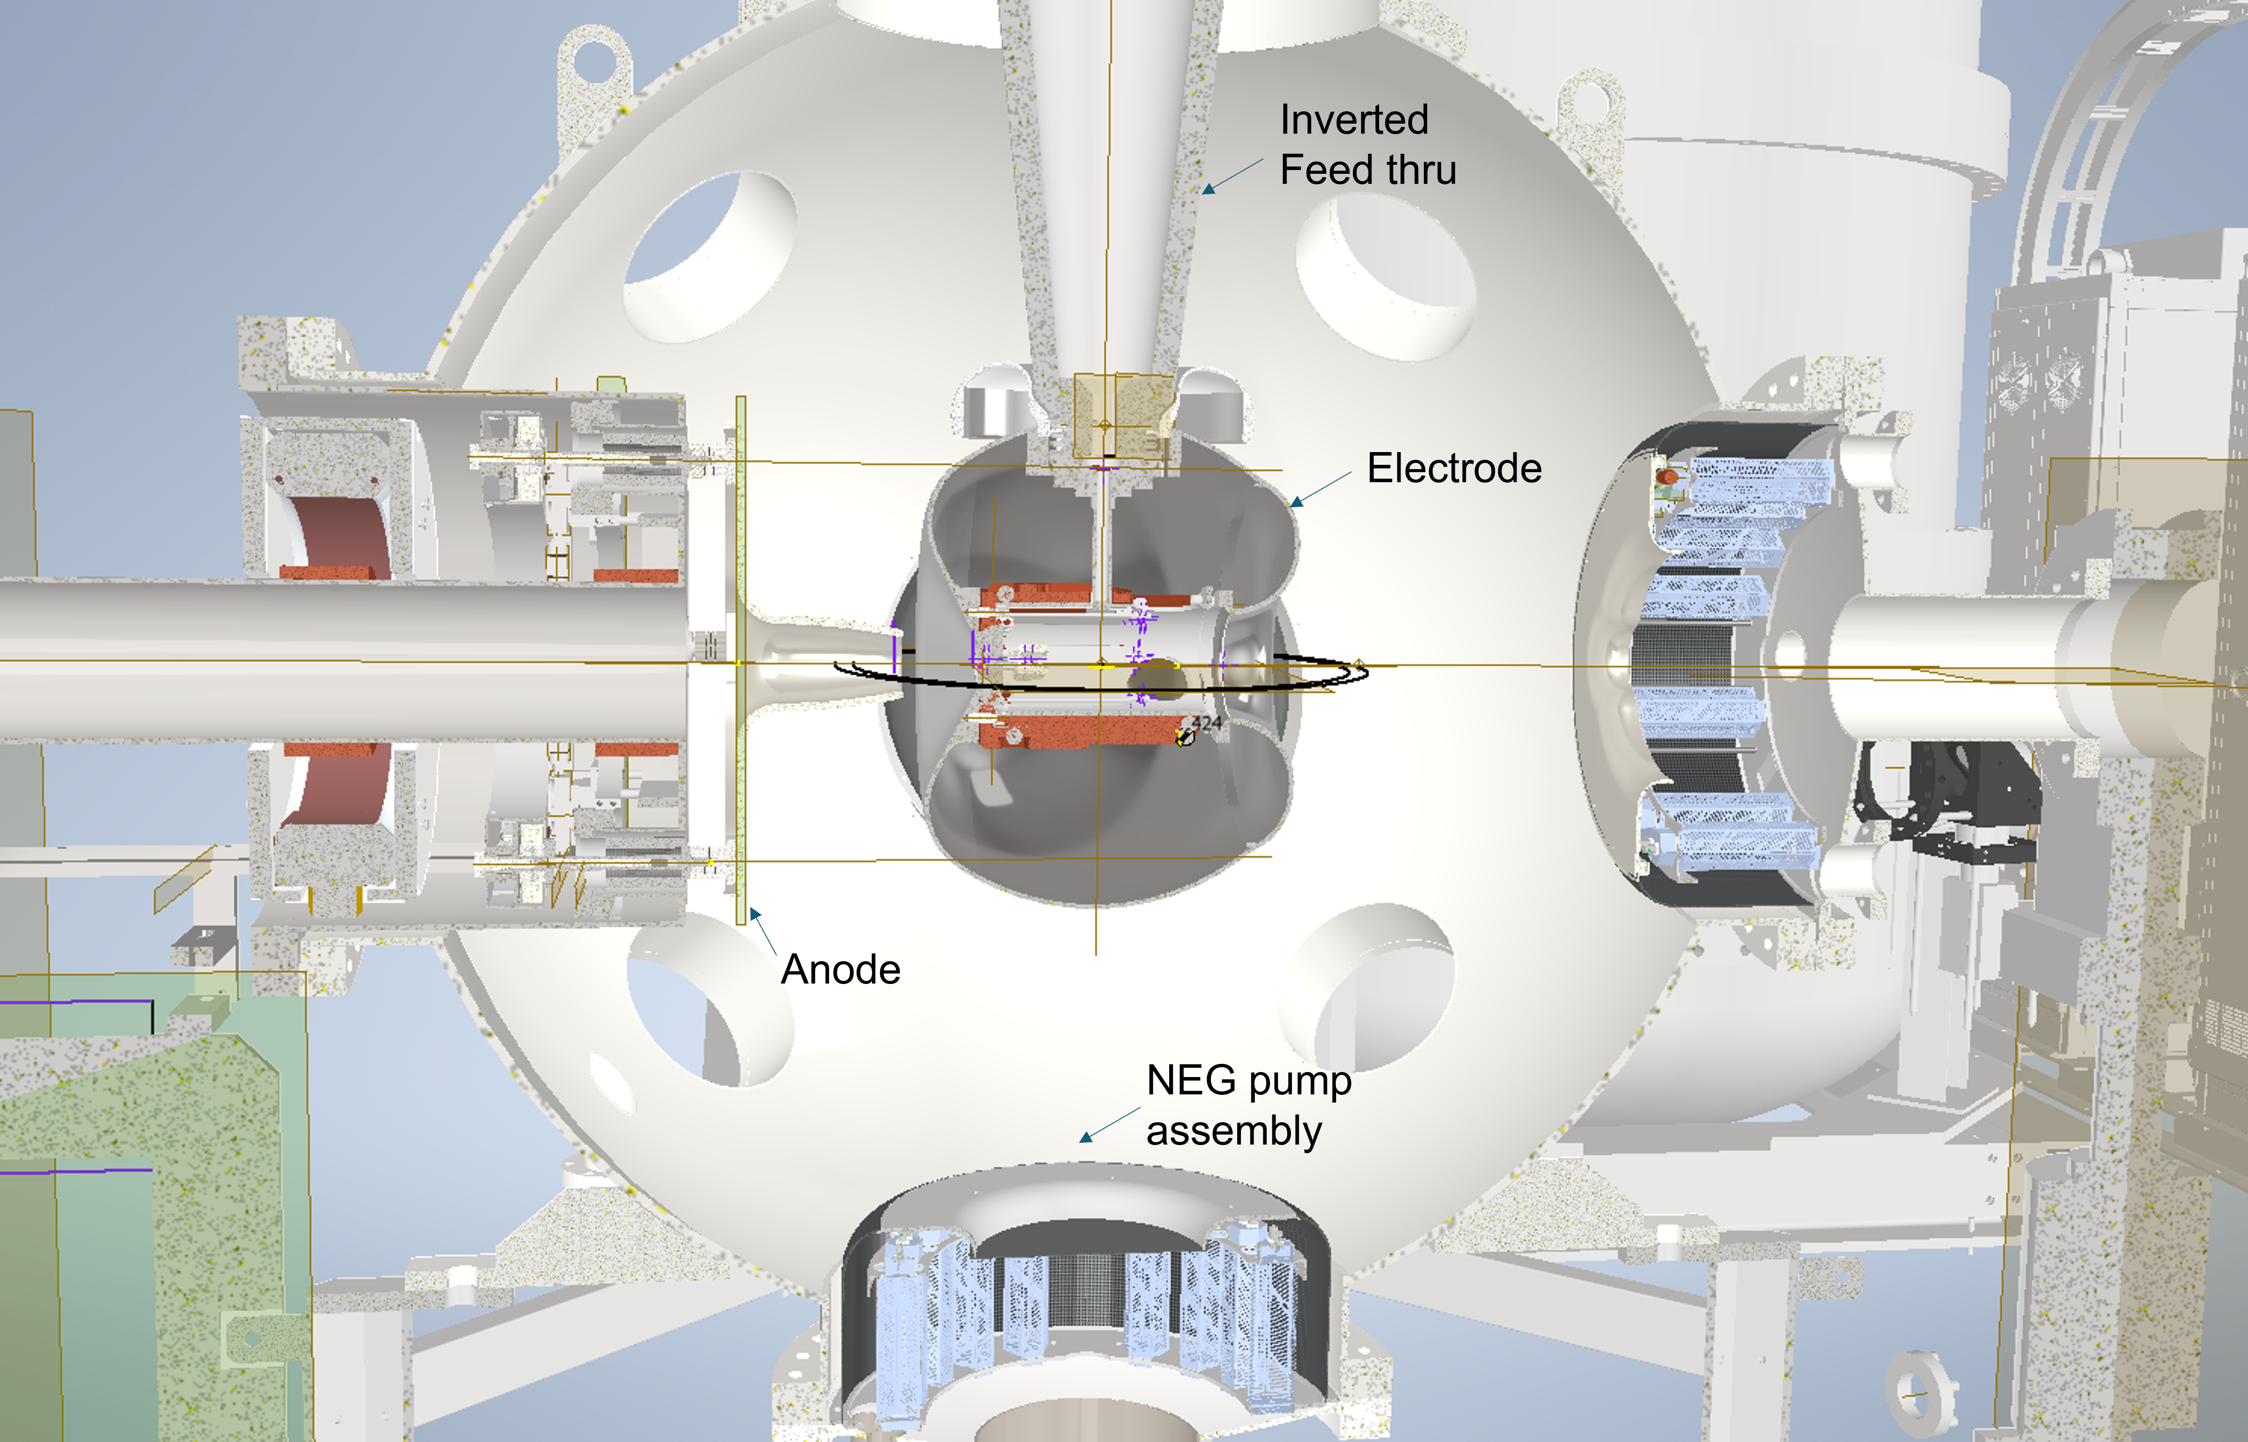
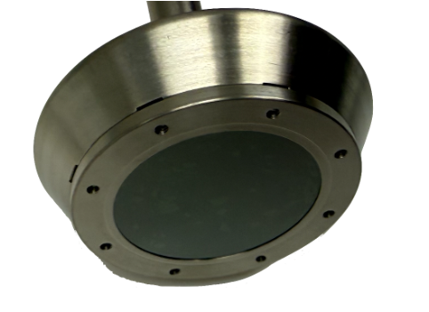
High current test (On schedule 2026~2027)
@High-Average-Current, High-Brightness HVDC Electron Gun for EIC Hadron Cooling at Stony Brook University
Lifetime test for single crystal K₂CsSb
Measure transverse emittance of the electron beam generated by the single crystal K₂CsSb
Characterize damaged cathodes and investigate recovering methods

Slide 16
Potential Future work for cathode R&D (long term)
Hardware & Infrastructure Development
Incorporate PLD laser for PLD growth.
Upgrade growth chamber with Energy-Dispersive X-ray Spectroscopy (EDX), sharing the same electron source with RHEED.
Design sample holders and transfer forks for the transfer chamber to interface with multiple characterization tools : XPS, ARPES.
Engineering for heterostructure photocathodes
Grow and characterize known heterostructure systems for multialkali photocathodes: S20 and alike
Use in situ XRR/XRF/XRD to monitor and characterize material interface
Optimize band alignment using DFT and experimental validation
Surface engineering for enhanced stability
DFT modelling of cathode surface + capping layer
Evaluate protective layers (2D materials, oxide capping)
Continued High current test for cathode materials
Lifetime test for single-crystal K₂CsSb and Na₂KSb
QE decay
QE mapping before/after test
Thermal load vs QE degradation
Transverse emittance measurement
MTE measurement at high charge
Correlate emittance with cathode material properties

Slide 17
Summary
High QE, ultrasmooth (sub-nm roughness) and epitaxial photocathodes of Cs₃Sb, K₂CsSb, Cs₂Te and Na₂KSb are achieved. The epitaxial growth of K₂CsSb, Cs₂Te and Na₂KSb are the first demonstration in the field.
Emittance measurement is in progress.
High current test is scheduled 2026-2027.
Photocathode material | Preparation method | QE | Roughness(nm)
Cs₃Sb | PLD | 3% @ 532 nm, thin | 0.3 @11 nm thickness
K₂CsSb | PLD; Co-dep | >9% @ 532 nm | 0.6 @ 11 nm thickness
Cs₂Te | PLD | 17~20%@270nm | 0.8 @ 22 nm thickness
Na₂KSb | Co-dep | 2.8% @ 532 nm | 0.8 @ 20 nm thickness
Match or exceed the best reported results in the field!

Slide 18

Acknowledgement
Many thanks goes to the contributors: Kali Prasanna Mondal, Elena Maria Echeverria Mora, Yilin Yang, John Smedley, Jared Maxson, Kenneth Evans-Lutterodt, Raul Acevedo-Esteves, John Walsh, Rudy Begay
Work supported by Brookhaven Science Associates, LLC under Contract No. DE-SC0012704. This research used resources 4-ID (ISR) of the National Synchrotron Light Source II, a U.S. Department of Energy (DOE) Office of Science User Facility operated for the DOE Office of Science by Brookhaven National Laboratory under Contract No. DE-SC0012704.
Thank you very much! Suggestions and comments are appreciated!

Slide 19
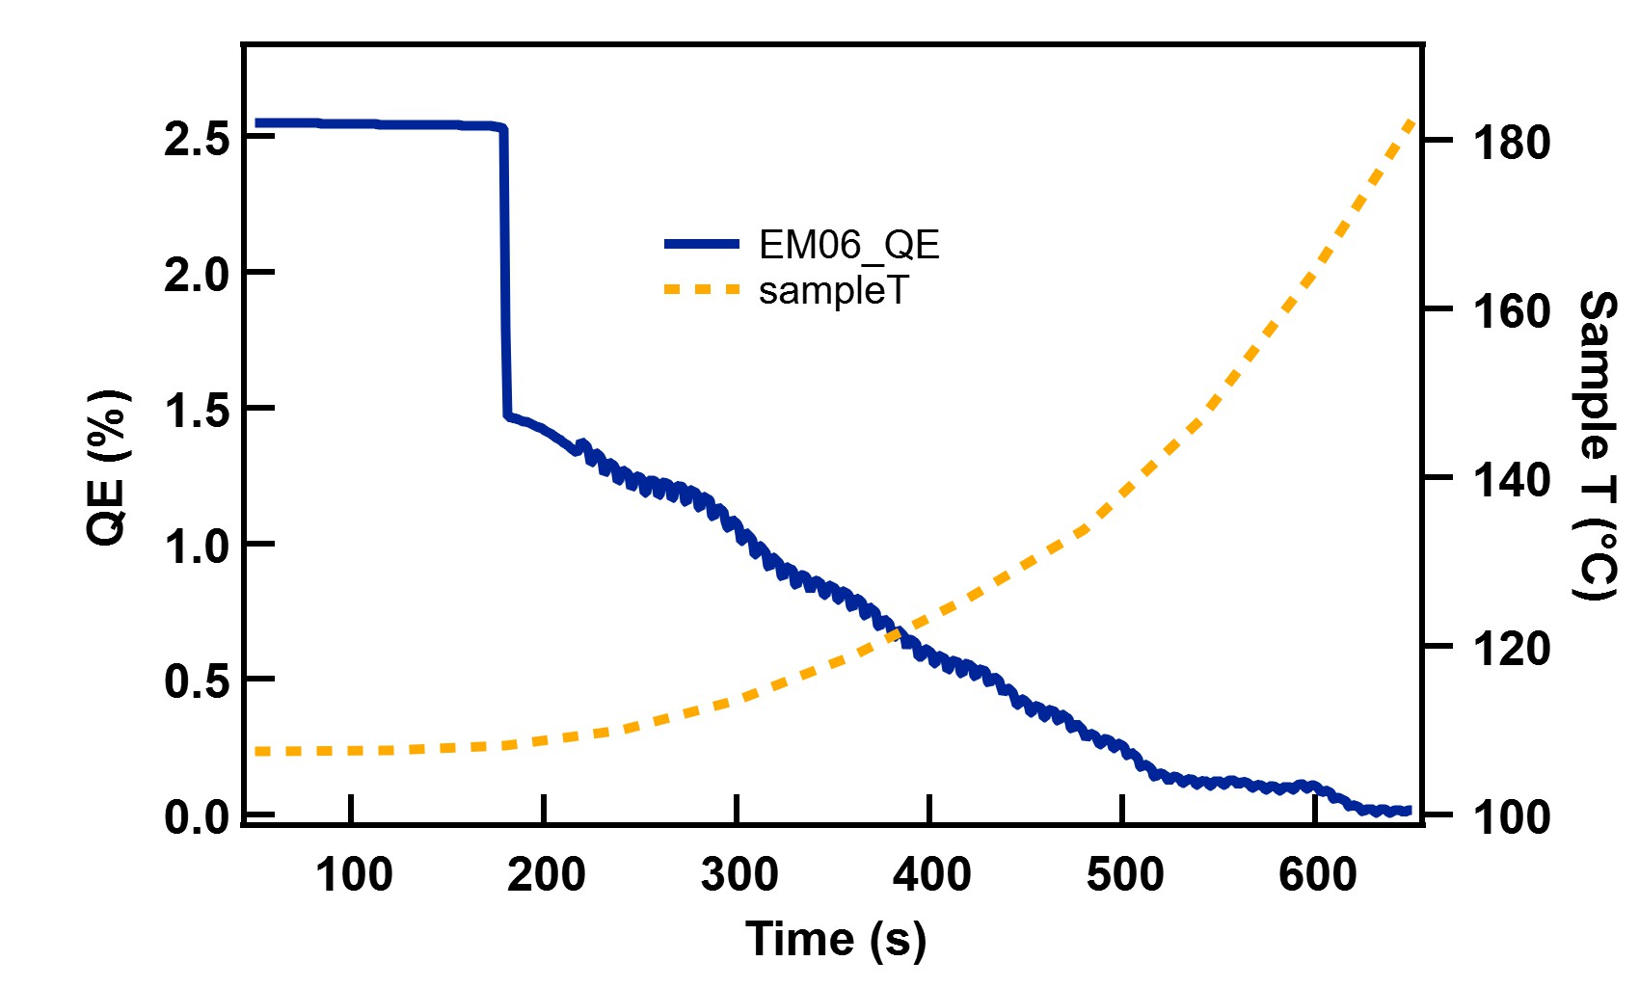
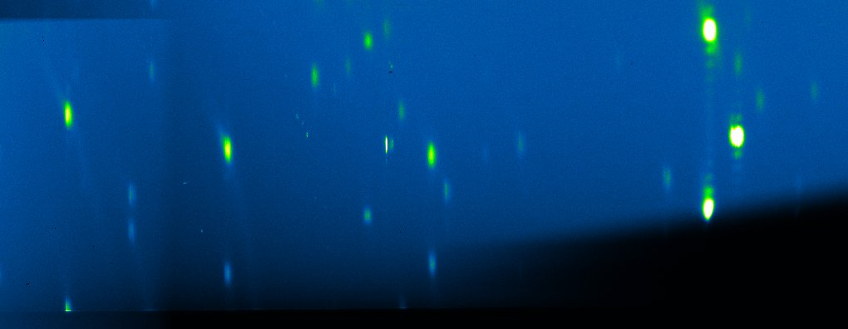
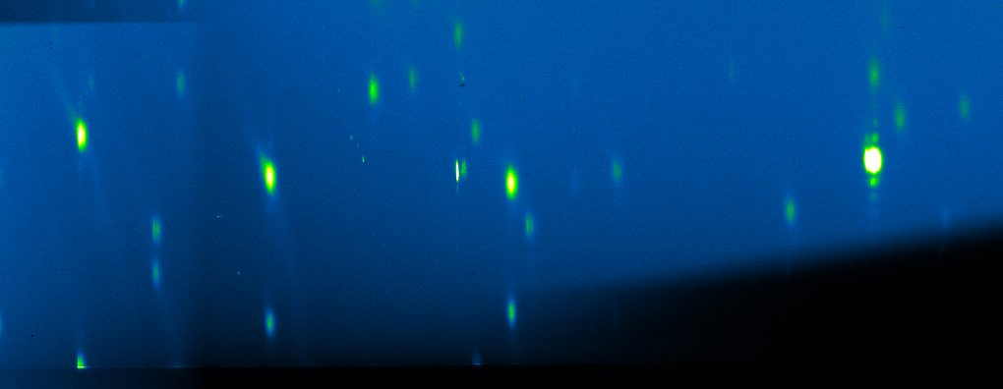
(Back up slides) XRD: Heat decomposition: Na₂KSb
K ratio~ 1
114.5 °C
1/e QE; 125.7 °C
162.4 °C
K ratio~ 0.6
108.2 °C
184.5 °C
K ratio~ 0.4
192.2 °C

Slide 20
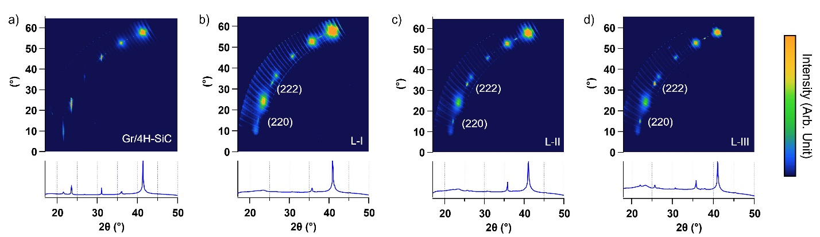
XRD of epitaxial K₂CsSb cathode
Substrate
5 nm
11 nm
20 nm
Polycrystalline
Textured
Sequential growth → Polycrystalline
Co-evaporation → fiber-textured
Epitaxial growth → ordered grains/single crystal
Crystallinity

Slide 21
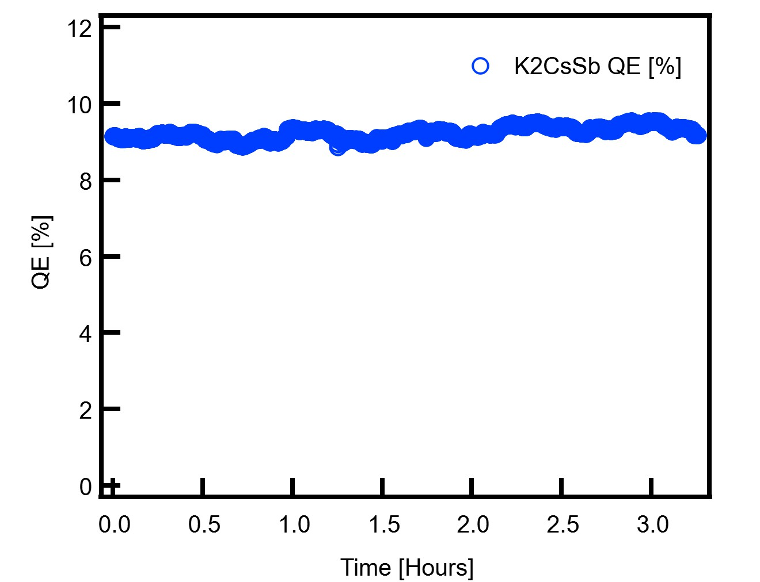
QE of epitaxial K₂CsSb cathode
Wavelength (nm) |  | Sample-3 QE (%)
 |  | L1 | L2 | L3 | L3 after 1 day
Green laser |  | 0.5 | 4.6 | 9.2 | --
LDLS source | 450 | 1.3 | 8.9 | 17.8 | 21.5
530 | 530 | 0.5 | 4.2 | 7.6 | 9.7
Green QE is > 9% !
Measured QE after 3-4 days of growth, no decay
Current draw is about 25 uA
Fluctuations are likely from laser power

