Slide 1
Proposal : Polarized Deuteron Ion Source
D. Steski
12/10/2025

Slide 2
Objectives
To install, commission, and operate the COSY polarized deuterium
ion source at the BNL Tandem Van de Graaff Facility. By delivering
polarized D− beams and establishing routine polarization
measurements this forms the basis for follow-on AGS/EIC
applications.

Slide 3
Motivation
“The EIC accelerator design team must make it a priority to develop ion spin control and manipulation from source to collisions of the deuteron, ³He, ⁶Li and ⁷Li nuclei.*”
  *from executive summary of “Realizing the Scientific Program with Polarized Ion Beams at EIC” (The EPIOS Scientific Consortium)
The availability of the COSY Polarized ion source to BNL for a fraction of the replacement value

Slide 4
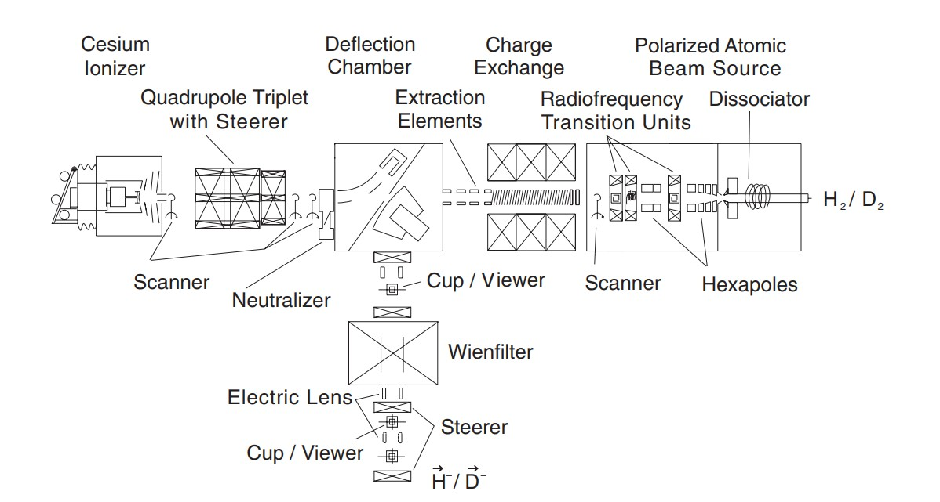
COSY Polarized D⁻ Ion Source

Slide 5
COSY Polarized deuterium source available to BNL
Two 40 ft shipping containers worth of equipment from Julich
Space is limited at EBIS
Proposed to locate the Polarized Deuterium Ion Source at the Tandem Van de Graaff Facility
Project divided into two parts: Ion Source and Polarimeter
Ion source to be located between the two Tandems (MP6 & MP7)
New HV platform to injected polarized deuterium into MP7
Polarimeter at the High Energy of MP7

Slide 6
Partial list of Equipment to be shipped
No. | Description | No. | Description
1 | 3 sets of permanent sextupole magnets | 10 | Several 27 MHz fixed frequency amplifiers
2 | 2 electromagnets | 11 | Siemens controllers
3 | Vacuum chambers for two atomic beam | 12 | Pressure regulators and flow regulators
4 | Time-of-flight spectrometer for atomic beams with chopper | 13 | Cold heads and compressors for 25K - 80K operation
5 | Vacuum equipment for two sources, diagnostic chambers, Valves | 14 | 9 RF transition units with spare parts
6 | 3 mass spectrometers | 15 | Amplifiers for RF transition units
7 | Scanner for profile measurements | 16 | 10 Signal generators
8 | Temperature controllers | 17 | Magnetic field controllers
9 | Dissociators | 18 | 10 EDDA holding field power supplies

Slide 7
Tandem Van de Graaff Facility

Slide 8
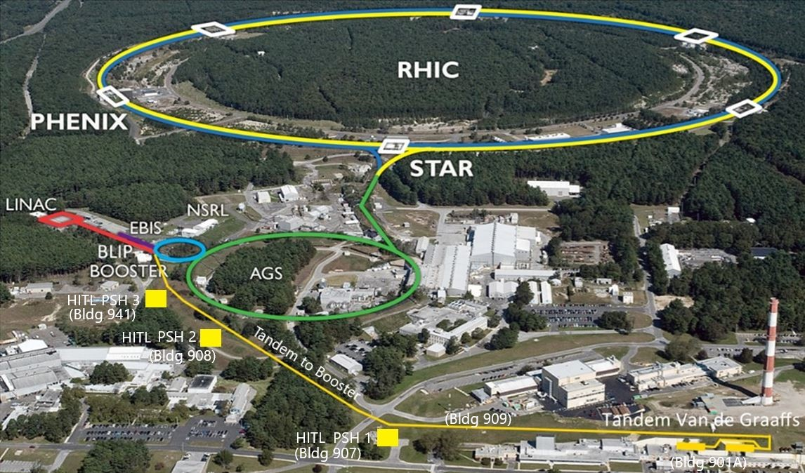
C-AD Complex

Slide 9
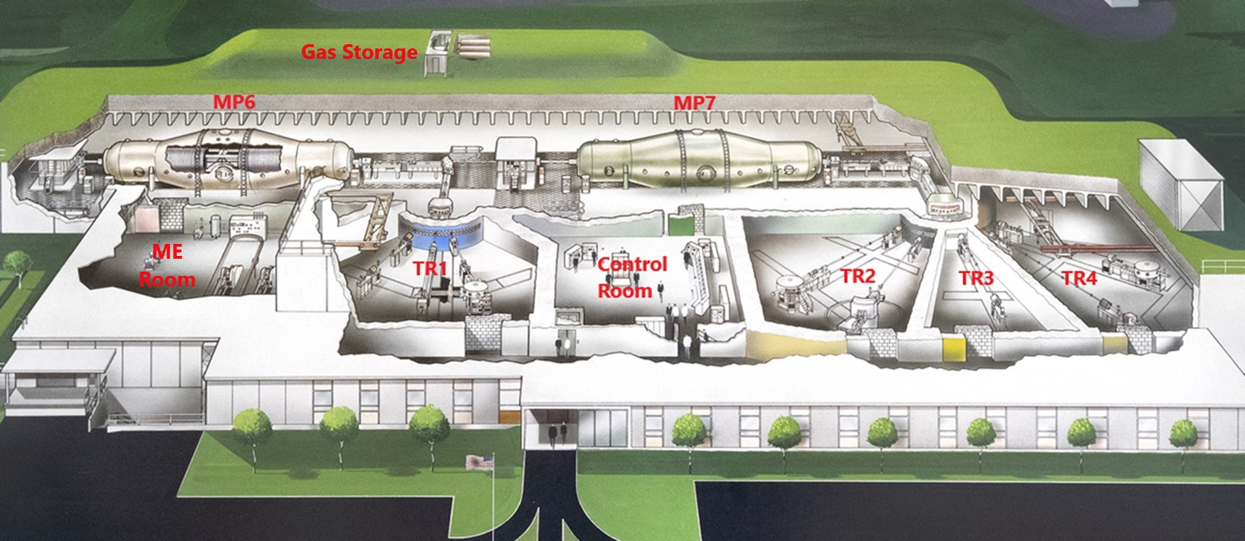
The BNL Tandem Van de Graaff Facility

Slide 10
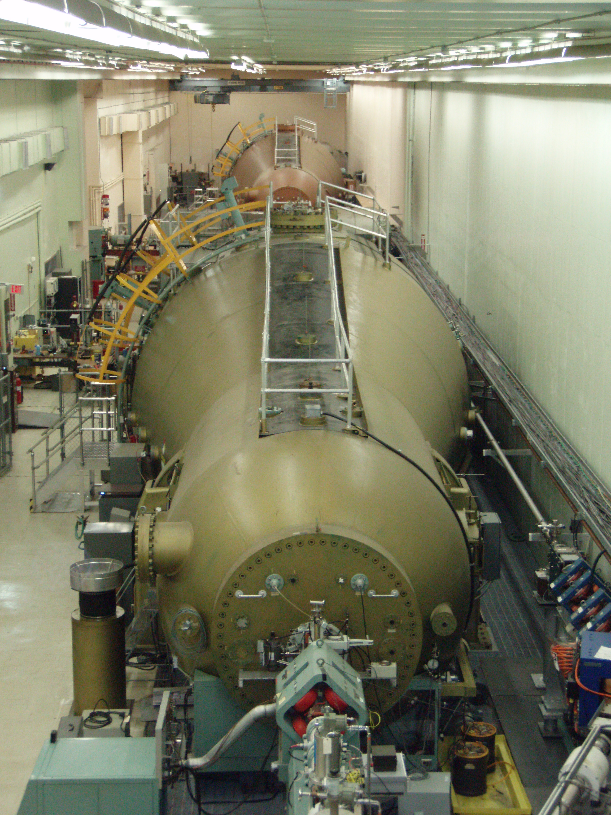
Tandem Van de Graaffs
Two MP class Tandem Van de Graaffs (MP6 & MP7)
Supplied the Au beam for the FY 23 and FY 25 Au-Au run
Provided unpolarized deuterons in 2003, 2008, 2016 and 2023 for Au-d collisions in RHIC

Slide 11
Polarized Deuterium Ion Source

Slide 12
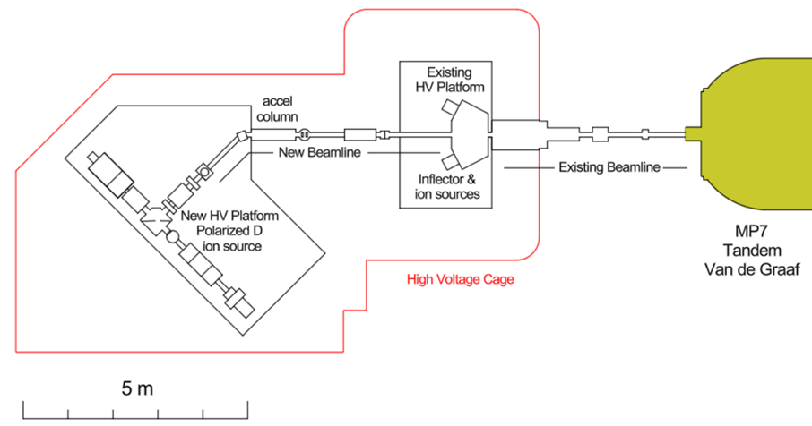
Location of Polarized Deuterium Ion Source

Slide 13
New beam line elements

Slide 14
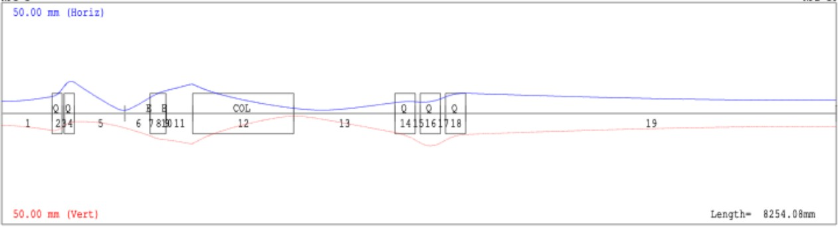
Beam Optics
Beam envelope along the transfer line (Horizontal: Blue, and Vertical: Red).

Slide 15
Tandem Polarimeter

Slide 16
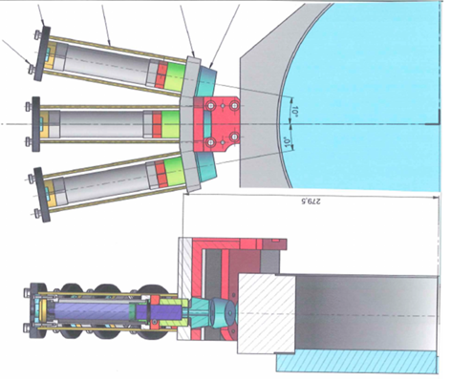
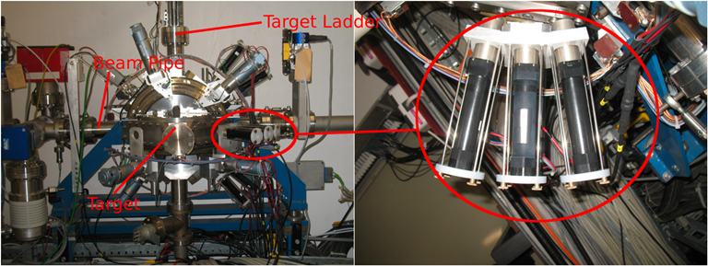
COSY Low Energy Polarimeter
COSY LE Polarimeter
Drawing of COSY LE Polarimeter

Slide 17
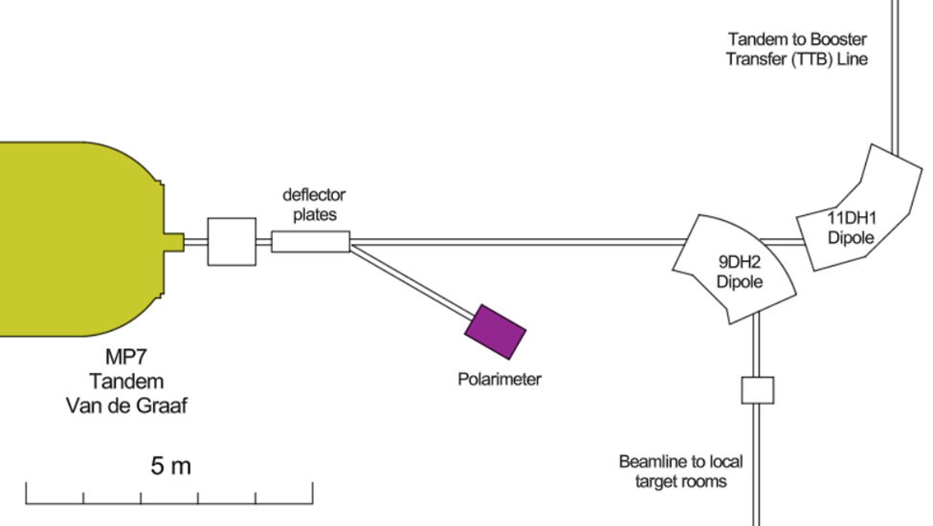
Location of Tandem Polarimeter

Slide 18
Proposal Organization

Slide 19
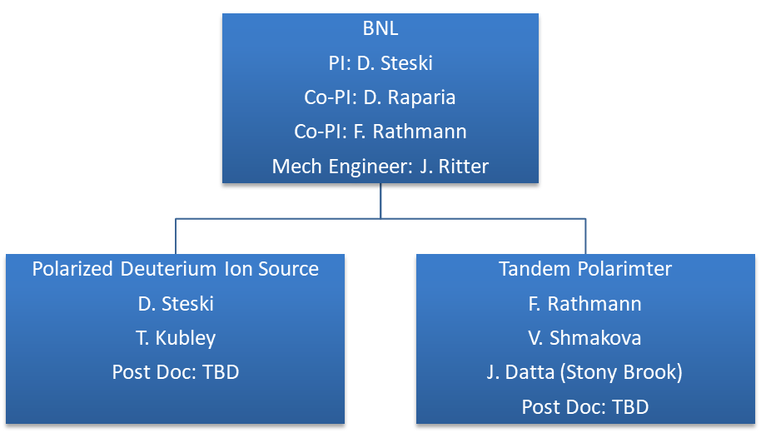
Proposal Organizational Chart

Slide 20
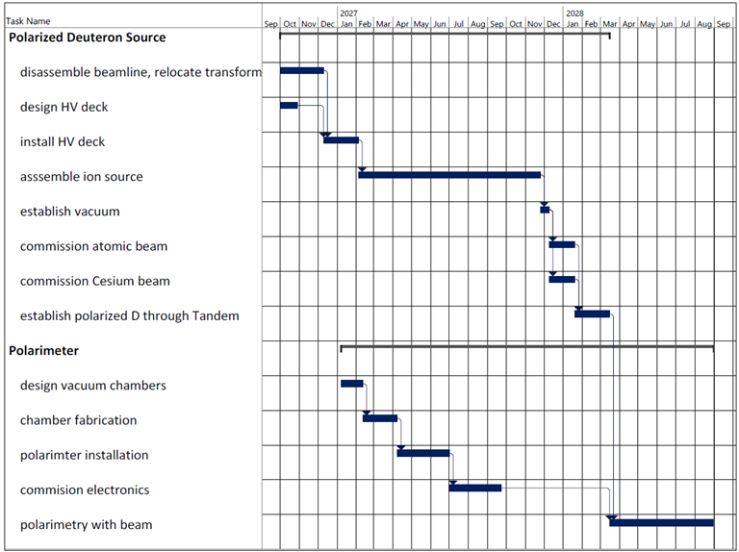

Slide 21
Summary
Proposal submitted 12/10/25, 2 Years, $2 million
Polarized Deuterium Ion Source available from COSY
Layout of Ion Source at the Tandem
Preliminary beam line design
Layout for Polarimeter High Energy end of the Tandem
Polarization preserved in Tandem to Booster (TtB) transfer line
Polarization preserved in EIC* (*H. Huang, F. Méot, V. Ptitsyn, V. Ranjbar, and T. Roser. “Polarization preservation of polarized deuteron beams in the electron ion collider at Brookhaven National Laboratory.” Phys. Rev. Accel. Beams, 23:021001, 2020)

