Slide 1
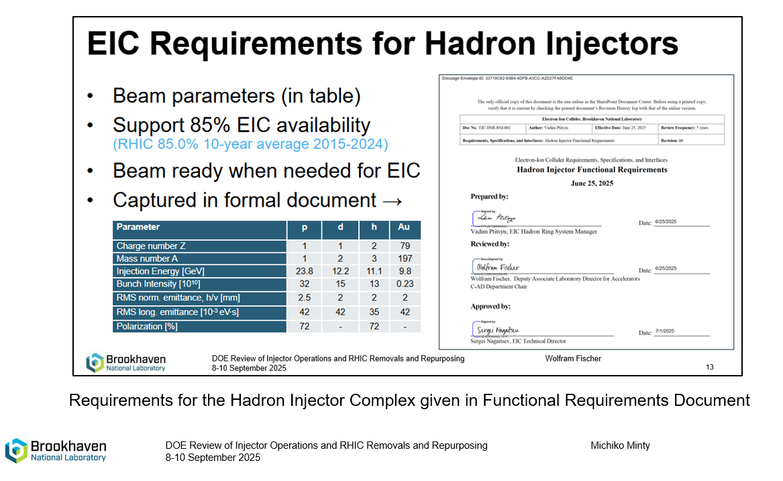
Homework #1: We would appreciate a reminder on the present status of the EIC goals over the next decade to assist with our work on Charge Question (b) : Are the C-AD plans aligned with the EIC goals over the next decade?
Timeline:
Accelerator storage ring construction per EIC funding profile from Aug 2025 EIC review through end of FY31. During this time we maintain the Hadron Injector Complex in a ready-state through regular maintenance and periodic validation with beam.
First 5 years of EIC operation with ion species and requirements given in the Functional Requirements Document (FRD).
Proposed first 5 years of EIC Science program:
year 1: Ag or Nb (new)
Ag: EBIS can provide, need enriched Ag, Ag-107, available from Trace Sciences International
Nb: EBIS can provide, easy because of purity (recommended alternative)
year 2: deuterium
year 3: polarized protons
year 4: polarized protons
year 5: polarized He-3
Next slides will present status and plans for meeting the FRD requirements.

Slide 2
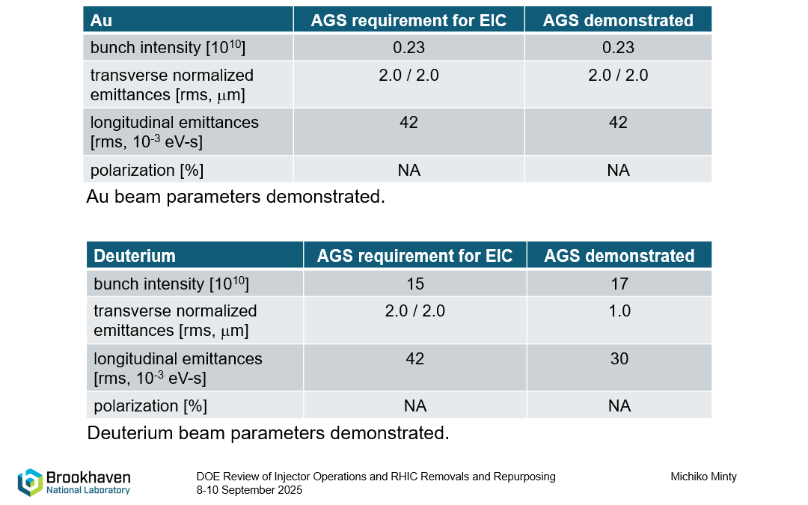


Slide 3
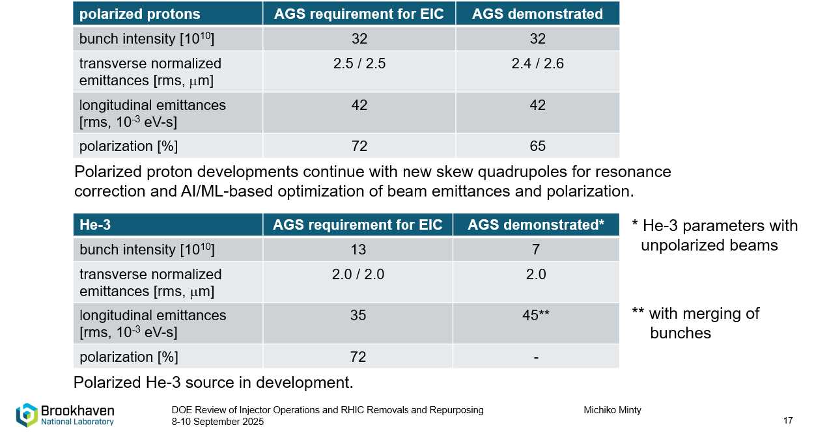

Slide 4
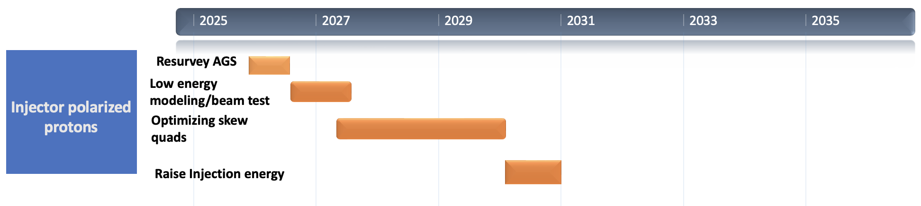
Polarized Beam Developments – protons
re-survey and align AGS magnets (summer 2026)
improve modeling of AGS lattice at lower energies; beam test with skew quads (Dec 2026)
upgrade AGS Booster and AGS BPMs (by Feb 2028)
optimize operations with skew quads over entire AGS energy range (Dec 2028)
optimize skew quads settings for polarization (Dec 2029)
test raising AGS injection energy from Gγ=4.5 to Gγ=5.5 (Dec 2030)

Slide 5
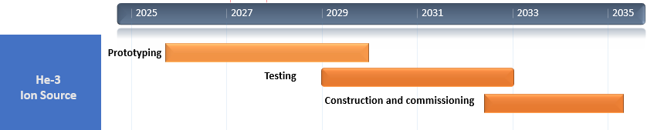
Polarized He-3 Ion Source Developments
EIC He-3 requirement: 13e10/bunch with 72% polarization
polarization (%)
Test Lab
Achievements to date
~ 90% polarization in test lab
~ 60% in electron beam ion source (EBIS) mockup
Next steps (for prototyping stage)
install He-3 gas cell in EBIS (summer 2026)
commission He-3 gas cell (end of CY26)
iterate He-3 cell design until >85% polarization is reached
EBIS mockup
He-3 gas cell

Slide 6
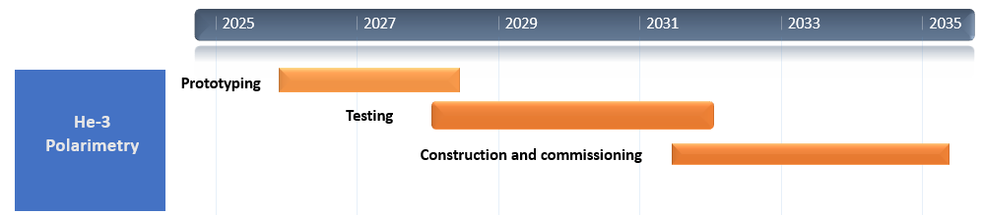
He-3 Polarimetry Developments
He-3 (6 MeV) absolute polarimeter, layout
6 MeV absolute polarimeter
commission (by end of CY26)
optimize He-3 beam parameters to optimize for absolute accuracy of 4-5 % and <1% statistical error
He-3 atomic beam polarimeter
in (ongoing) collaboration with MIT/BATES and BNL, develop an absolute He-3 beam polarimeter for the EIC based on a polarized He-3 atomic beam source
install and test in the AGS

Slide 7
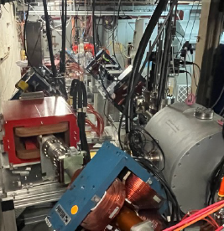
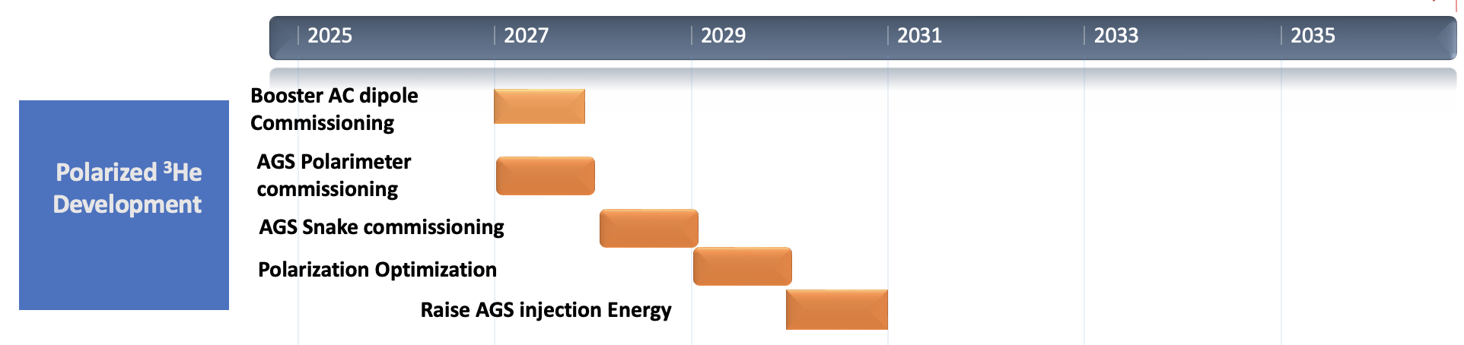
Polarized Beam Developments* – He-3
*K. Hock, 2021 PhD thesis: “Transport of Polarized Helions in Injector Synchrotrons for the Future Electron Ion Collider
Project at Brookhaven National Laboratory”
commission Booster AC dipole to overcome intrinsic resonances
commission AGS CNI polarimeter (Dec 2027)
commission AGS partial snakes (Dec 2028)
optimize polarization transmission efficiency via betatron tunes (Dec 2029)
test raising AGS injection energy (Dec 2030)
commission pulse-by-pulse spin flipper chicane (after AGS He-3 polarimeter commissioning)
spin flipper chicane

Slide 8
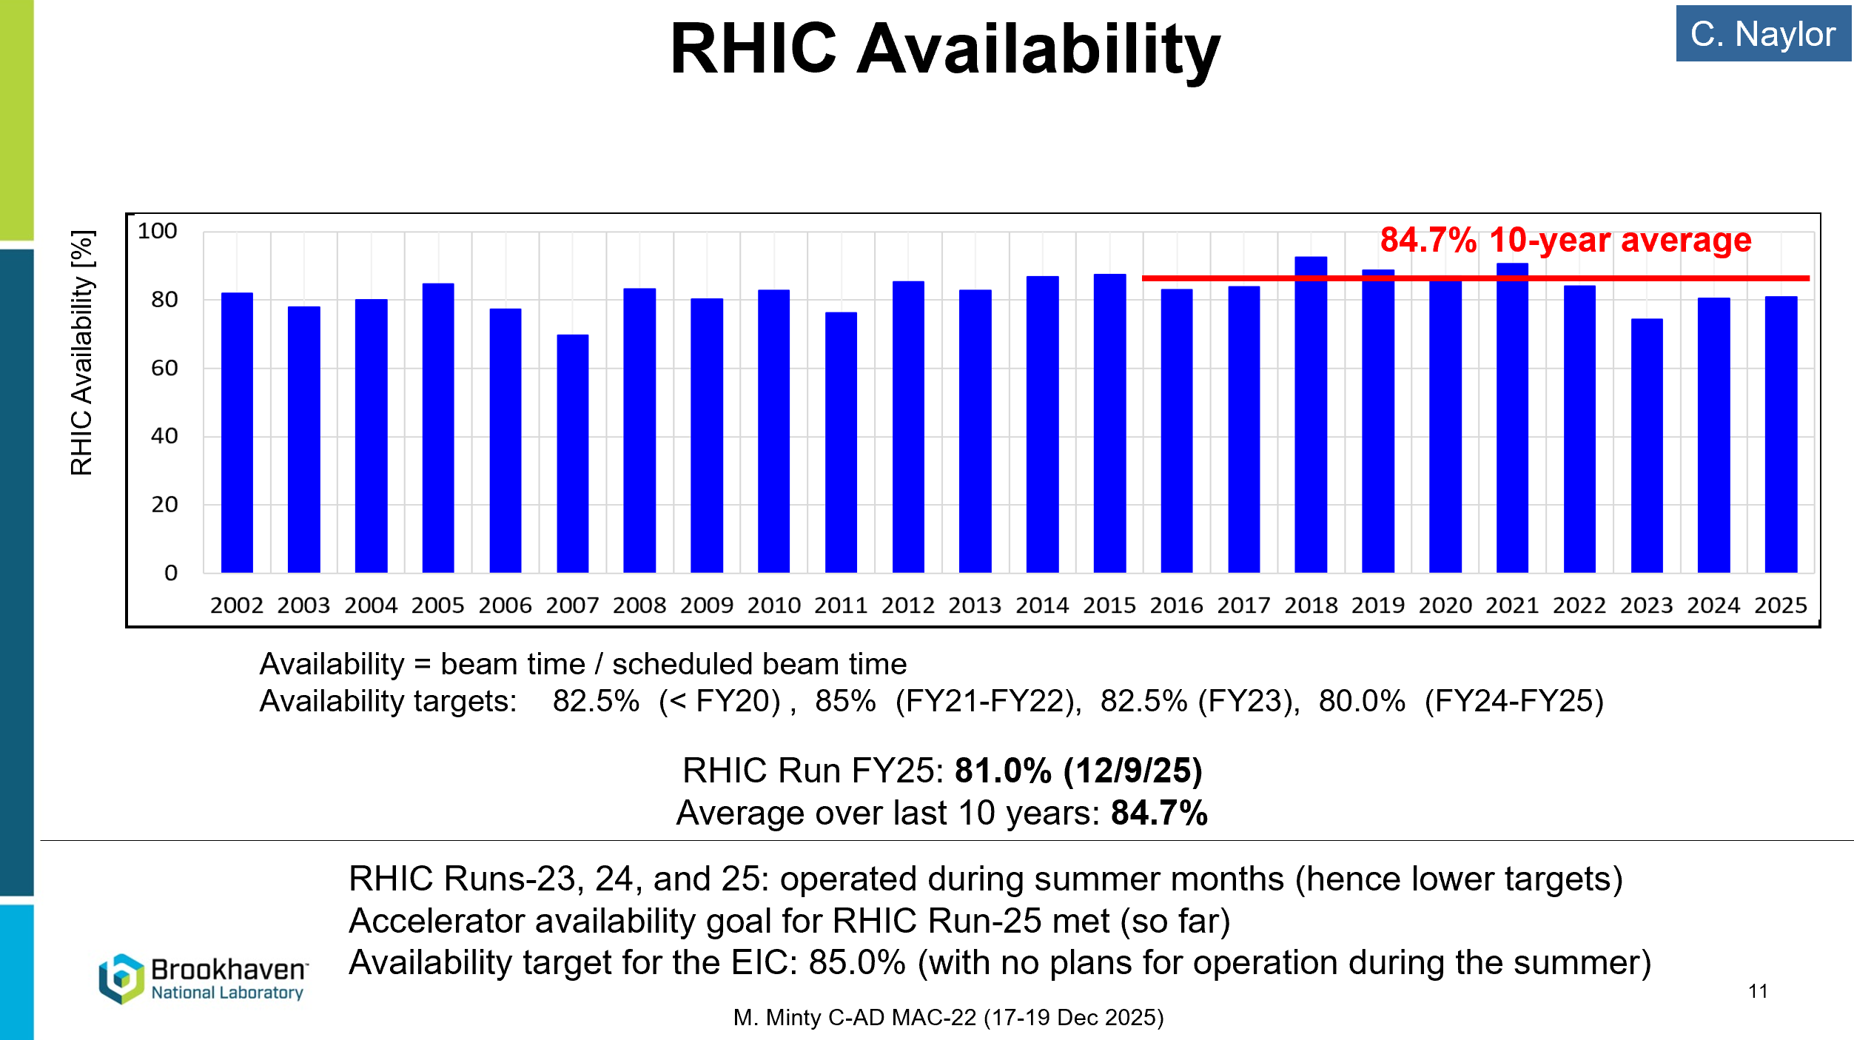
Homework #3: What is the recent availability record of the injector chain and individual machines? Are the injectors expected to perform better for EIC operation and by how much? Are the main drivers of the injectors’ downtime understood?
Reminder (from yesterday):
Next slides: details for Run-16 (Au+Au, d+Au) and Run-22 (pol’d p+p)

Slide 9
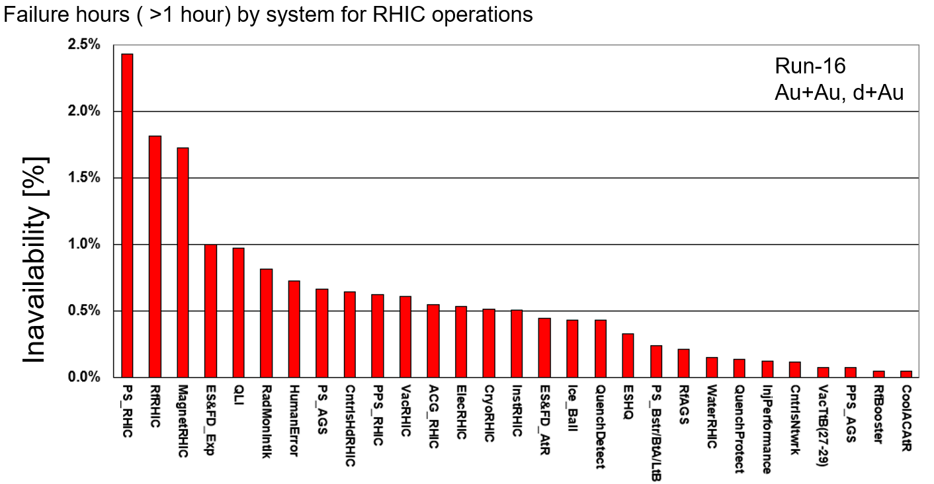
Accelerator Operations – typical distribution of failure hours
Key:
AGS
Booster and transfer lines
Sources

Slide 10
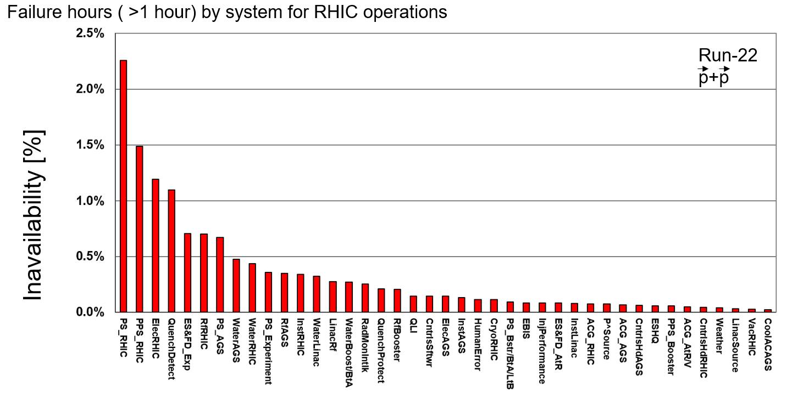
Accelerator Operations –distribution of failure hours (another example)
Key:
AGS
Booster and transfer lines
Sources and Linac

Slide 11
On the availability record in the injector chain and individual machines
The availability of individual machines has not been logged individually (i.e. downtime in the AGS during activities taking place behind RHIC stores - performing studies or preparing for new modes of operation).
What is logged is their contributions towards specific programs (e.g. RHIC, NSRL, isotope production). The cumulative (sources, AGS Booster, transfer lines and AGS) availability of the injector complex for the RHIC program, based on the statistics shown on the previous two slides, is below.
HIC: 94.9%
RHIC: 85.4%

Slide 13
Homework #3 (repeat):
What is the recent availability record of the injector chain and individual machines?
The availability of individual machines has not been logged individually. What is logged is their contributions towards specific programs (e.g. RHIC, NSRL, isotope production). The cumulative (sources, AGS Booster, transfer lines and AGS) downtime from the injector complex for the RHIC program was shown. The 15-year average (FY10-FY24) availability of the Hadron Injector Complex was 94.9%.
Are the injectors expected to perform better for EIC operation and by how much?
Most likely yes, since
EIC availability must be >85% and that is roughly the product of the (new) EIC electron injector complex and the existing hadron injector complex. If shared equally, each complex requires >92% availability
the availability requirement will increase dependent on presumably higher filling frequency (shorter store times).
Not included is possibly different MTTR, which depends strongly on ensuring well-trained staff.
Are the main drivers of the injectors’ downtime understood?
Yes, in-availability for RHIC exceeding >0.5% from AGS PS’s (and, from FY25, pulsed power devices).

Slide 15
HWQ2
Q2: Please provide a concise summary of the prioritization and roadmaps for the midterm R&D topics. How do these R&D topics align with the EIC performance goals? We would also appreciate information on the resource needs and availability for these R&D efforts.
15

Slide 16
EIC Science Program in the First Years
Year - 1
Year - 2
Year - 3
Year - 4
Year - 5
Start with Phase 1 EIC
New Capability:
Commission electron polarization in parallel
Run:
10 GeV electrons on 115 GeV/u Heavy Ion Beams (Ag or Nb)
Physics:
gives world-wide new data on nPDFs and a first look on saturation
Start with Phase 1 EIC
Commission electron polarization in parallel
New Capability:
Commission hadron polarization in parallel
Run:
10 GeV electrons on 130 GeV/u Deuterium
Physics:
gives world-wide new data → critical baseline for nPDFs and saturation
free vs. bound proton structure
Run:
Last weeks 10 GeV electrons and 130 GeV polarized protons
Physics:
first look to 3d imaging of the proton
Start with Phase 1 EIC
Commission electron polarization in parallel
Commission hadron polarization in parallel
New Capability:
Commission running with hadron spin rotators
Run:
10 GeV electrons on 130 GeV Transverse Polarized Protons
Physics:
3d imaging of the proton / mass of the nucleon
Run:
Last weeks switch to longitudinal proton polarization
Physics:
first look helicity structure of the proton – unravel quark, gluon and orbital angular contributions
Start with Phase 1 EIC
Commission electron polarization in parallel
Commission hadron polarization in parallel
Commission running with hadron spin rotators
New Capability:
Commission hadron accelerator to operate with not centered orbits
Run:
10 GeV electrons on 250 GeV transverse and longitudinal polarized protons
Physics:
3d imaging of the proton
at low x
helicity structure of the proton – unravel quark, gluon and orbital angular contributions
Start with Phase 1 EIC
Commission electron polarization in parallel
Commission hadron polarization in parallel
Commission running with hadron spin rotators
Commission hadron accelerator to operate with not centered orbits
Run:
10 GeV electrons on 166 GeV transverse and longitudinal polarized He-3
Physics:
3d imaging of the nucleons → flavor separation
helicity structure of the nucleon– unravel helicities for different quark flavors
first look to nuclear binding
E.C. Aschenauer
Time to install additional ESR RF and HSR PS to
reach design Current and max. Energies
Under development

Slide 17
Priority mid-term R&D efforts
Needed for present EIC baseline (baseline still to be finalized):
1. Proton polarization development in Booster and AGS (polarization and polarimetry)
2. He-3 development (source, polarization, polarimetry)
3. Electron sources (high-current cathodes)
4. Beam cooling (high-current LEReC and SB gun tests for the EIC LEC)
To increase future EIC performance (average luminosity):
5. High-energy cooling design

Slide 18
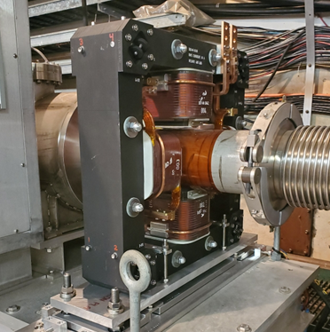
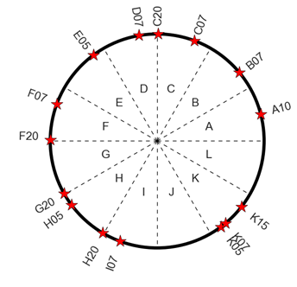
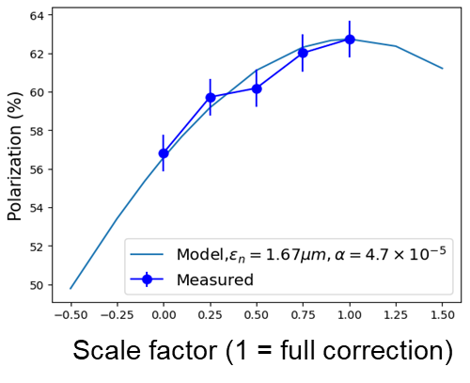
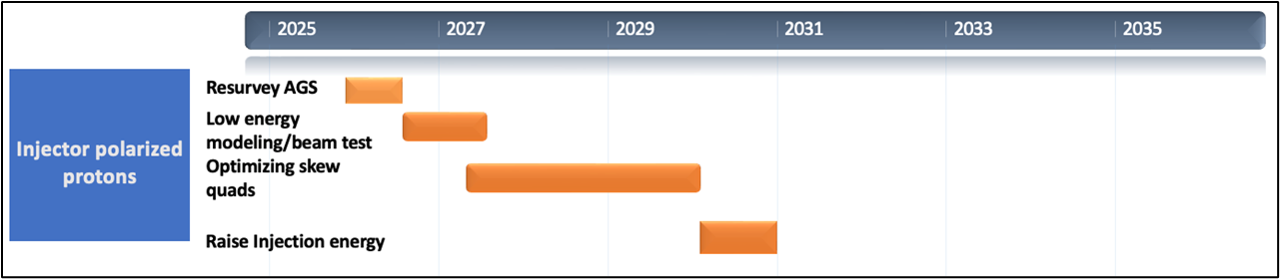

1. Protons: Polarized Beam Developments roadmap
SQ locations ( )
re-survey and align AGS magnets (summer 2026)
improve modeling of AGS lattice at lower energies; beam test with skew quads (Dec 2026)
upgrade AGS Booster and AGS BPMs (by Feb 2028)
optimize operations with skew quads over entire AGS energy range (Dec 2028)
optimize skew quads settings for polarization (Dec 2029)
test raising AGS injection energy from Gγ=4.5 to Gγ=5.5 (Dec 2030)
AGS skew quad
polarization (%)
correction with ~½ of the SQs

Slide 19
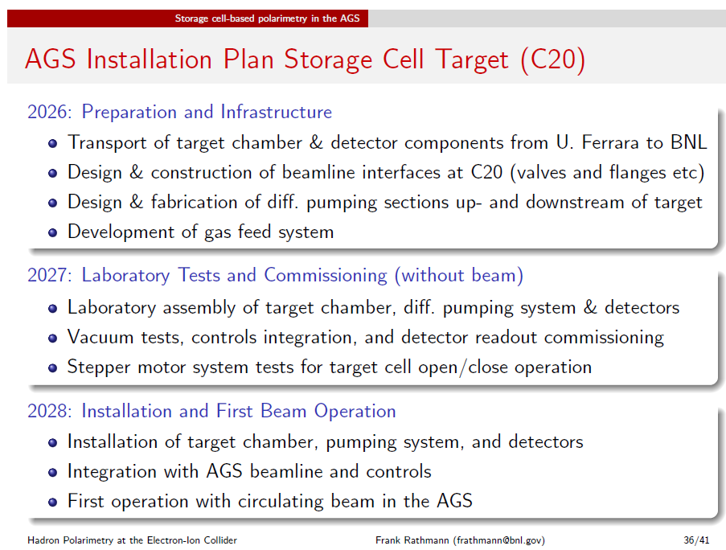
1 continued: fast polarimetry in AGS

Slide 20
2. He-3 development roadmap
Summer 2026: install He-3 gas cell in EBIS
End of CY26: commission He-3 gas cell
He-3 polarization development (K. Hock):
Dec 2027: commission Booster AC dipole to overcome intrinsic resonances;
commission AGS CNI polarimeter
Dec 2028: commission AGS partial snakes
Dec 2030: optimize polarization transmission efficiency via betatron tunes
Dec 2030: test raising AGS injection energy
iterate He-3 source design until >85% polarization is reached

Slide 21
Polarized He-3 Ion Source Developments*
*Developments in collaboration with MIT/BATES
EIC He-3 requirement: 13e10/bunch with 72% polarization
polarization (%)
Test Lab
Achievements to date
~ 90% polarization in test lab
~ 60% in electron beam ion source (EBIS) mockup
Next steps (for prototyping stage)
install He-3 gas cell in EBIS (summer 2026)
commission He-3 gas cell (end of CY26)
iterate He-3 cell design until >85% polarization is reached
EBIS mockup
He-3 gas cell

Slide 22
He-3 Polarimetry Developments
Source polarimeter (6 MeV absolute measurements)
commission (by end of CY26)
optimize He-3 beam parameters (pulse length, pulse peak current and polarization) to optimize for <1% statistical error
commission spin flipper chicane
spin flipper chicane
spin flipper chicane
Source
He-3 atomic beam polarimeter in the AGS
in (ongoing) collaboration with MIT/BATES and BNL, develop an absolute He-3 beam polarimeter for the EIC based on a polarized He-3 atomic beam source
install and test in the AGS

Slide 23
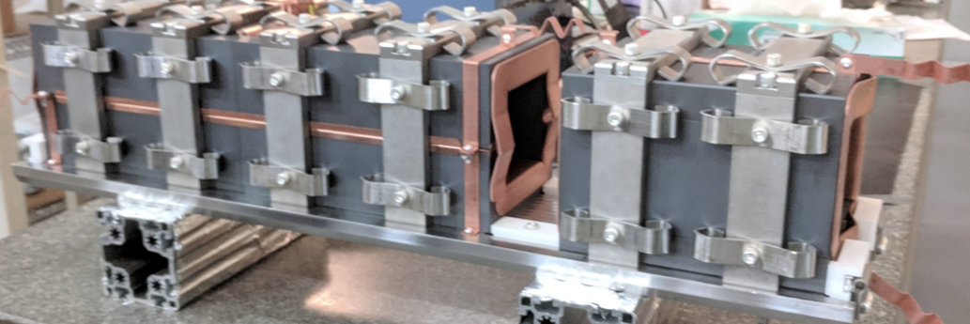
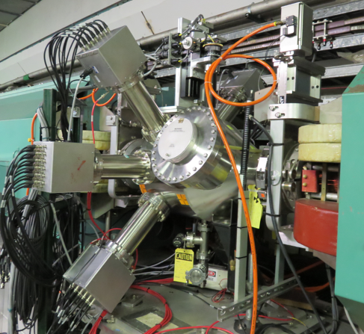
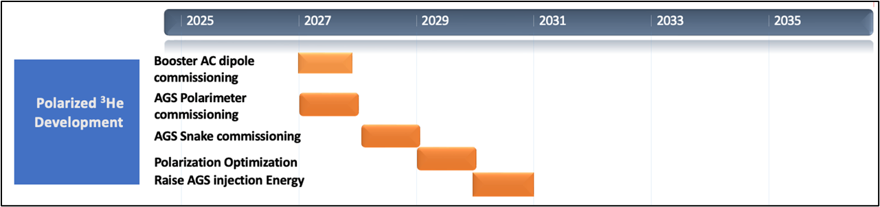
Polarized Beam Developments – He-3
commission Booster AC dipole to overcome intrinsic resonances
commission AGS CNI polarimeter (Dec 2027)
commission AGS partial snakes (Dec 2028)
optimize polarization transmission efficiency via betatron tunes (Dec 2029)
test raising AGS injection energy (Dec 2030)
Booster AC dipole
CNI polarimeter

Slide 24
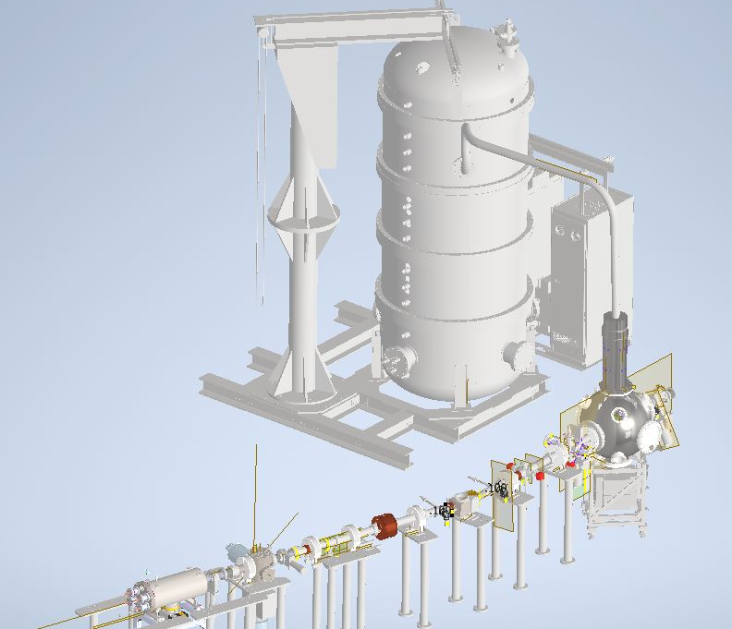
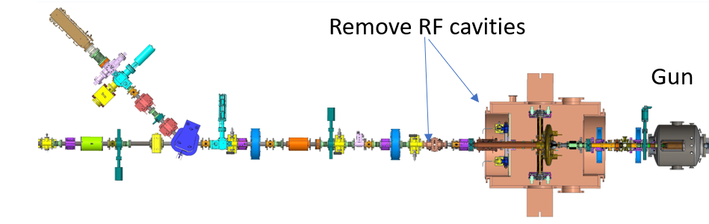
3 & 4: Electron sources and hadron beam cooling
2026-27: high-current cathodes development and tests in LEReC and SB Guns
2026: LEReC Gun test assembly and commissioning
2027: High-current tests in LEReC gun (goal: 75mA at 350-375kV)
2026: Stony Brook gun assembly and commissioning
2027: high-current tests with Stony Brook gun
2028: Gun and HVPS selection for the EIC low-energy electron cooler
2028-2030: Required Gun modifications and upgrades
.

Slide 25
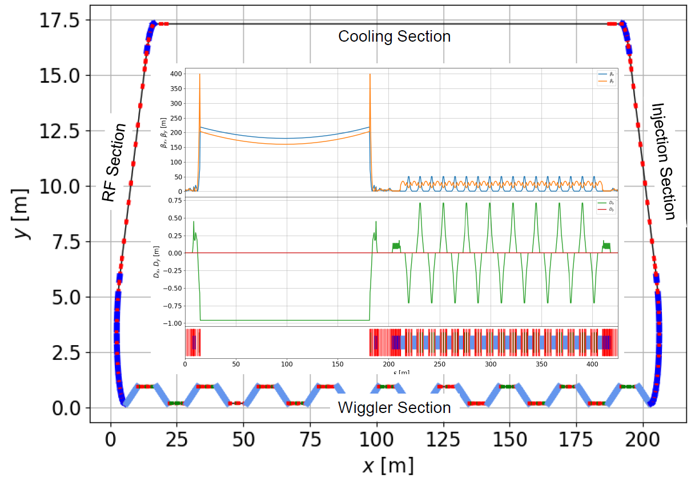
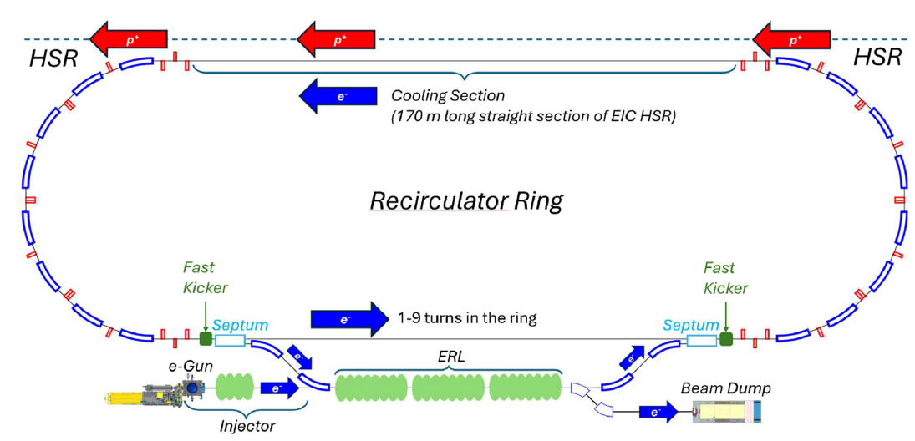
5: High-energy hadron beam cooling
Dec 2026: Conceptual Design Report for Ring-based High-Energy Cooler (REC)
2027-2028: Conceptual Design of ERL-based Recirculator Cooler (ERLEC)
2029: Evaluate risks and costs; Hold review to choose a most reliable and cost-effective approach for the HEC.
REC
ERLEC

Slide 26
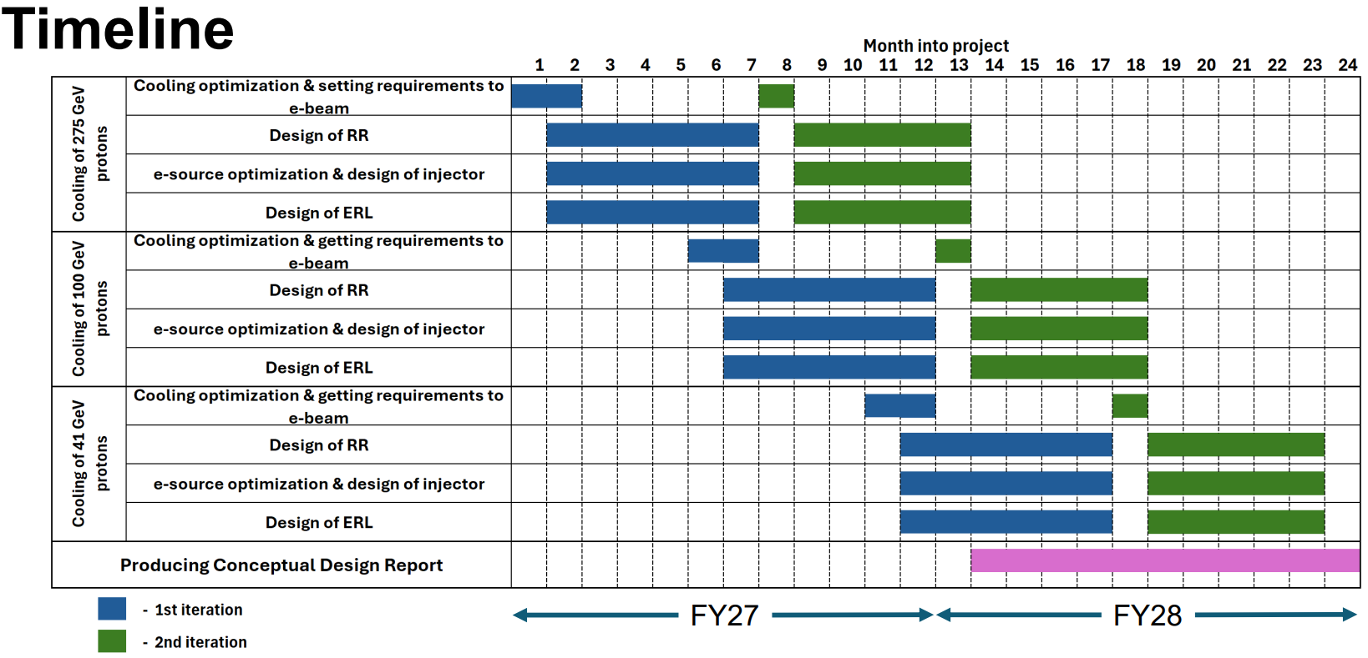
5 continued: ERLEC roadmap timeline

Slide 27
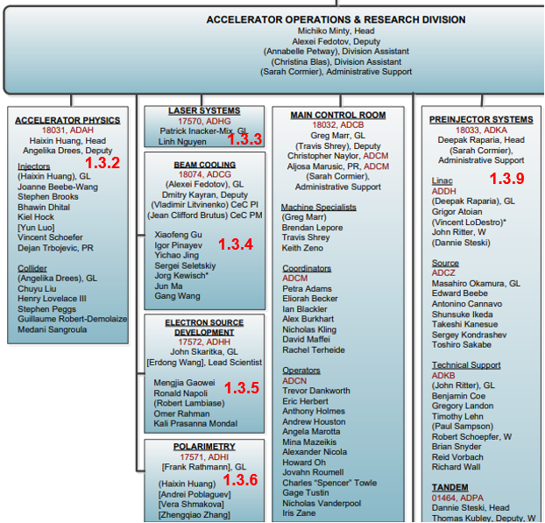
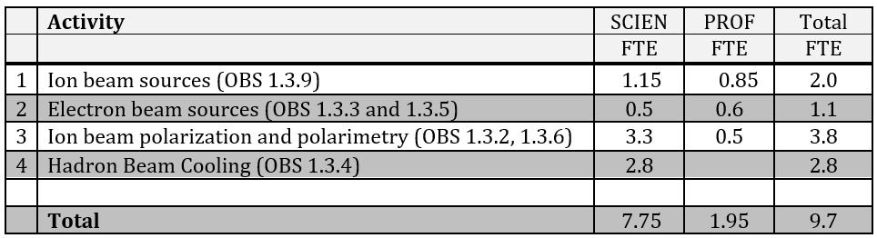
CAD Accelerator mid-term R&D staffing
Accelerator Mid-term R&D is distributed across several CAD groups (OBS 1.3.2-1.3.6 and 1.3.9):
Support of efforts in the groups by other sources
allows to optimize resources needed to maintain
critical R&D in the key areas.
Distribution of NP-supported R&D efforts (subset within the groups) across key areas:

