Slide 1
Q1: Concerning the “Production and acceleration of molecular ion beams at EBIS (LDRD 25-043)”: The proposal to have an alternative for delivering protons is very interesting. Can you clarify in 1 slide the objective within the LDRD that has been awarded, and a timeline to complete a test ECR source.
Objective: Production of a 10-mA H₃⁺ beam with pulsed mode (RF and gas).
LDRD C: 3/2025 to 9/2025
MW generator (supposed to be delivered in summer) has not been delivered.
Timeline:
1st month: Pulsed valve test and magnet fabrication
2nd: MW window optimization
3rd : High voltage test and parameter optimization with continuous mode
4th : Parameter optimization with pulsed mode
Achieve 10 mA beam

Slide 2
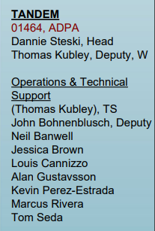
Question 2: Concerning the proposal on polarized deuteron ion source: We would appreciate you sharing a long-term vision and plan for making and keeping the source operational in the longer term (beyond delivery and installation).
Tandem is a self funded facility from external User program
Tandem operators are also responsible for maintenance of the facility with expertise in Vacuum, electronic and mechanical support.
During the installation and commissioning phase, local expertise in the source will be prioritized
Additional support from CA experts on demand.
Once commissioned the source can be maintained by a small core team

Slide 3
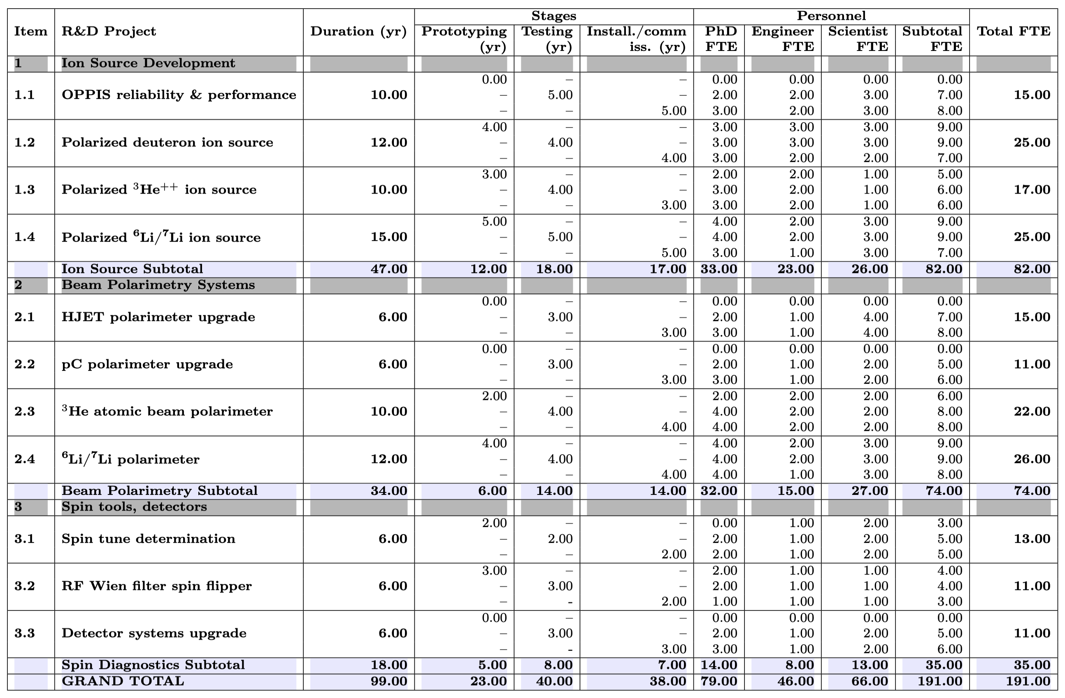
Personnel requirements for R&D projects supporting the EIC polarization program, by technical area
Realizing the Scientific Program with Polarized Ion Beams at EIC, EIC Polarized IOns Source scientific consortium, in https://arxiv.org/abs/2510.10794
Appendix B: Consideration of Personnel Needed to Construct Previous Polarization Experiments in Nuclear Physics

Slide 4
Homework #3: Please explain how the externally funded R&D projects (LDRD, FOA, etc) are managed, coordinated, and kept on track within C-AD.
Externally funded R&D projects (LDRD, FOA, PD, SBIR/STTR) are initiated by Principal Investigators (PIs) and (usually) developed with respective Division leaders.
Within C-AD, the C-AD department chair reviews proposals and advises on those to be further developed.
Proposal budgets are generated by the PI in coordination with the NPP Business Office.
After submission, further down-selection takes place within
NPP (for selection for submission to lab)
at lab-level (for final selections and awards)
Once approved,
scientific progress is tracked
LDRDs, they provide mid-year reports (several slides) to the lab strategic planning office
FOA/NOFO – quarterly reports (until recently) to the DOE
informally within the department (discussions, seminars, publications)
process progress is tracked and communicated monthly by the NPP Business officeunicated by the PI via annual status reports

