Slide 1
LED Driver
Eric J. Mannel
Oct 3, 2025

Slide 2
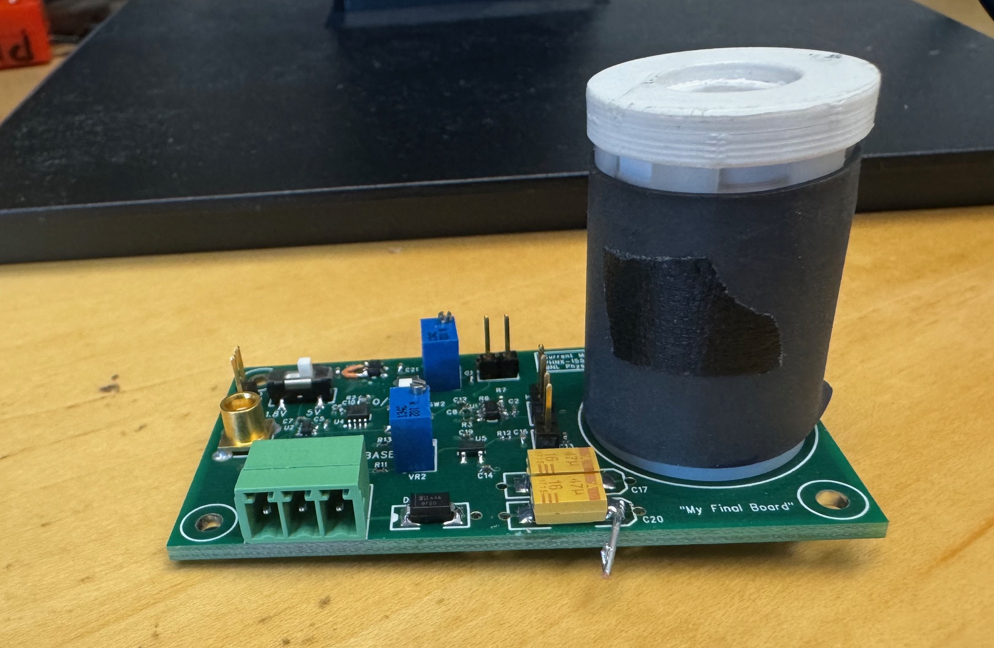
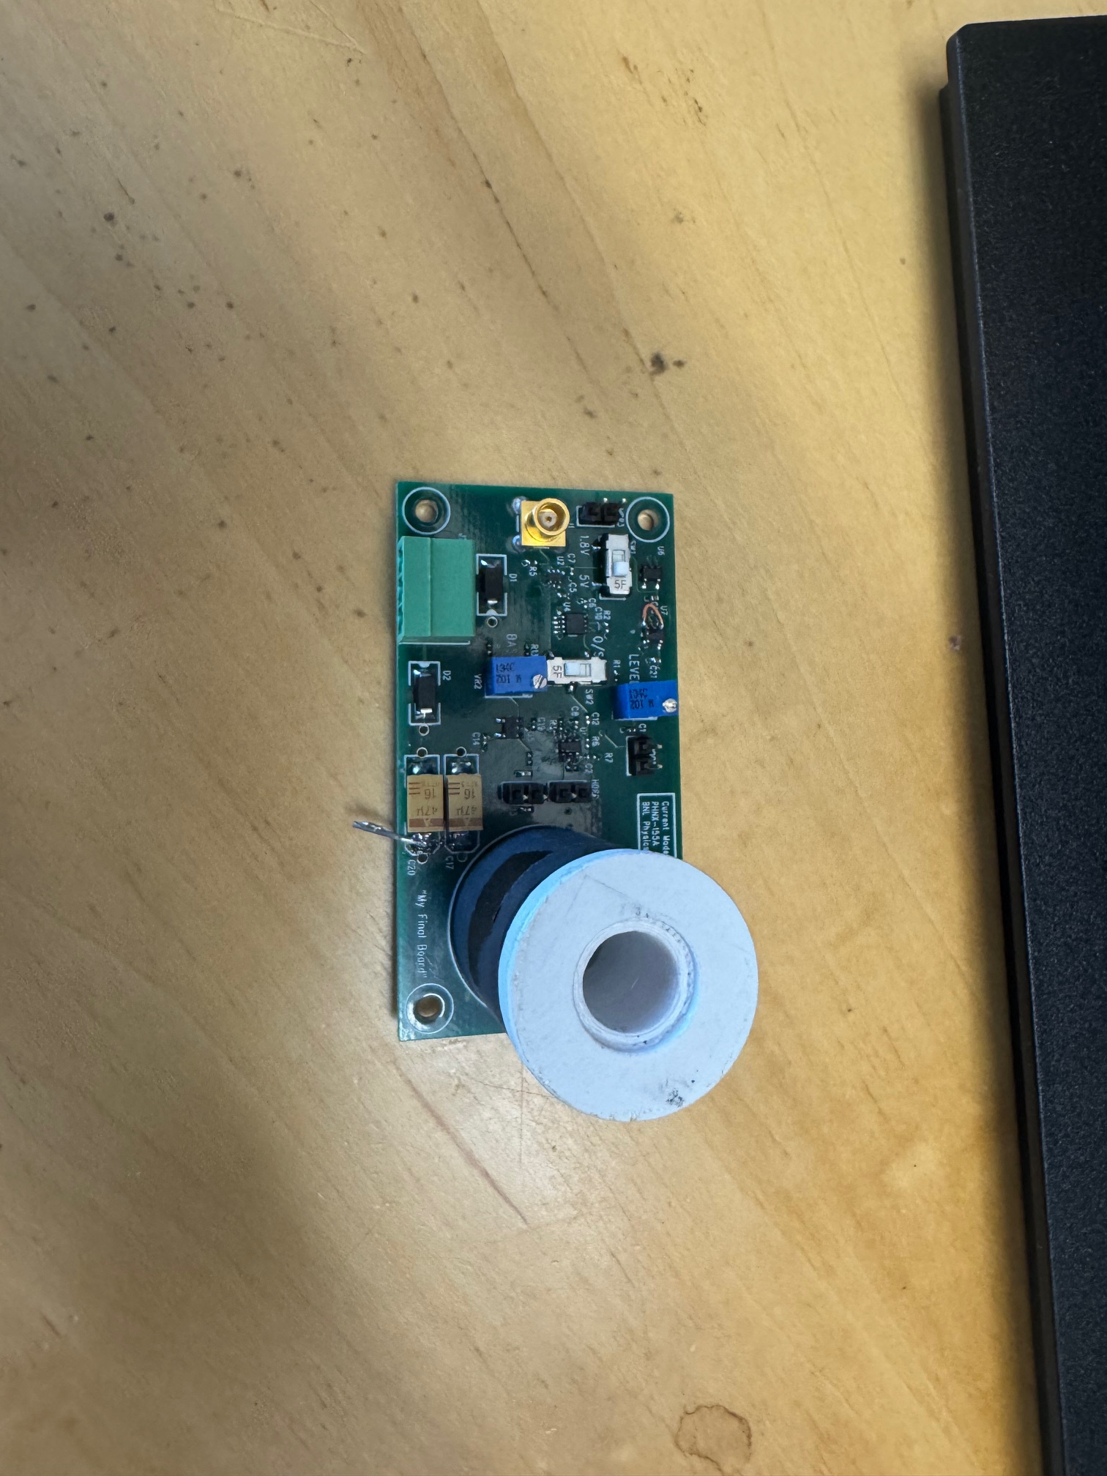
New LED Driver
Before leaving Steve Boose designed and prototyped a new LED driver board for sPHENIX calorimeters.
Uses sPHENIX HCal LED fiber cans
Improved stability
Uses 1V trigger signal (pulse width determines amplitude)
Kevin has assembled one and has parts for another 4
I am working on getting it setup for testing on HCal prototype
Question: Are sPHENIX protype LED fibers compatible with production tiles?

