Slide 1

ePIC Collaboration News
J. Lajoie, S. Dalla Torre
October 24th, 2025

Slide 2
Hey John, start the recording….

Slide 3
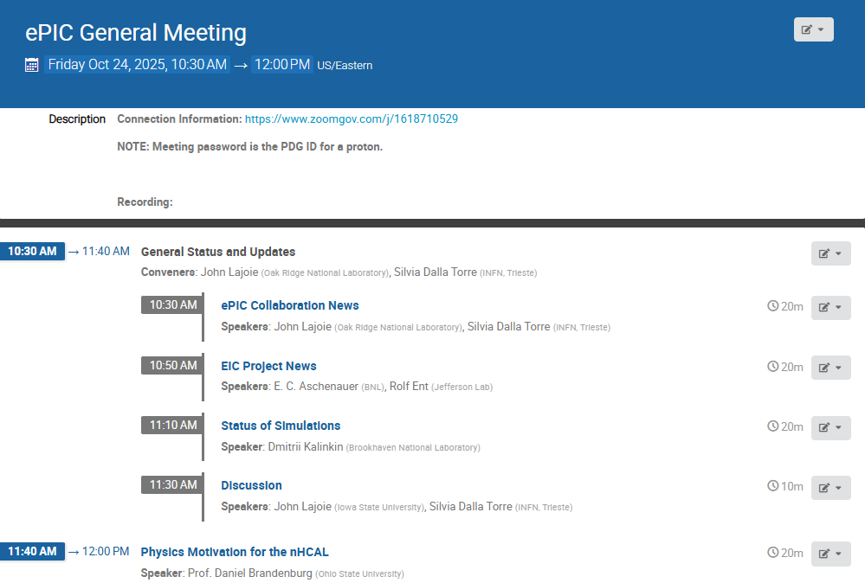
Agenda
Some news from the collaboration and EIC Project.
Status of the October simulation campaign, and a report on the nHCAL.

Slide 4
Recent and Upcoming Major Events
ePIC Software and Computing Review, JLab, October 6-7th, 2025
Followed by Second EIC Echelon 0-1 Mini-Workshop Oct. 8th
EIC RRB, BNL, November 4-5th, 2025
Now in hybrid format
Incremental Preliminary Design and Safety Review of the ePIC Hadron and Forward Electromagnetic Calorimetry, Oct. 30-31st
Detector Subproject Baseline Readiness Review, BNL, November 12-14th, 2025
Postponed until later in 2026
January 2026 ePIC Collaboration Meeting, Vancouver, Jan 12-16th
ePIC and EIC Physics Readiness Workshop, Calabria, March 17-19th
EIC IPR and ICR Review, BNL, March 9-12th, 2026

Slide 5
Effect of Lapse in Appropriations on ePIC
The unfortunate lapse in appropriations in the U.S. has had a number of consequences for ePIC already:
Restricted travel to conferences for U.S. lab personnel
Not just travel but participation at all in conferences has been curtailed
Upcoming CERN test beam:
Cancelled of part of MPGD test beam at CERN
Shuffled travel for LFHCAL CERN test beam
Delay in coating dRICH mid-sized mirror demonstrator
Slow down of hpDIRC bar refurbishment
Postponement of DET Subproject Readiness Review
Delays in research funding for university groups
…
Loss of productivity (enforced vacation, etc.)
Also lost time and effort either dealing with shutdown planning or worrying about it
Speaker needed for EINN (Oct 27th - Nov 1st , Athens) on “Status of ePIC Collaboration and the Science Program”
Virtual presentation OK!
Contact Brian or Daniel (Conf and Talks)

Slide 6
Effect of Lapse in Appropriations on Host Labs
BNL, from Abhay Deshpande:
“We are all eagerly awaiting news from the Congress on the FY26 budget. Three weeks into the fiscal year, the lack of movement is creating uncertainty and pressure—especially during this important year of finishing the RHIC operations mission and transitioning to the EIC. Please be assured that BNL management is carefully reviewing all available resources to sustain our scientific progress and minimize the impact of the budget delay on employees, RHIC operations and the transition to EIC. The Lab remains in good shape scientifically, operationally, and financially. Most directorates have reserves that will allow us to continue our scientific activities for at least a few months.”
JLab, from David Dean:
“We are working on being fully operational until mid November. After that, we are looking at a scenario to keep projects (like EIC) moving and taking the lab to a reduced staffing level. ”

Slide 7
How Does ePIC Respond?
Continue to support EIC project PDR’s and move these reviews forward as much as we possibly can
This is absolutely critical to baselining in 2026!
Adapt where we can:
If this continues, we may need to switch speakers for upcoming conferences. This is unfortunate and should be taken into account in future speaking opportunities.
Plan test beam participation and support so that it can be robust against missing personnel.
Keep in mind that coming out of the shutdown will take a while as well, and effects may linger event after it is over.

Slide 8





2025 -2026
PDR: DAQ - Slow Controls
Early 2026
PDR2: Polarimetry
Week of Feb 2, 2026
DOE OPA Status 5-7th August, 2025
PDR2: Si Tracking Detectors
Week of Jan 26, 2026
ePIC pre-TDR
Next Draft (Dec 2025)
ePIC Early Physics Workshop April 24-25, 2025
10th Detector Advisory Committee June 11-13th 2025
ePIC Physics Readiness Workshop Sept. 17-18th, 2025
PDR: HCals
Oct. 30-31, 2025
PDR2: Cerenkov PID
April 1-2, 2025
FDR: BABAR DIRC Bar Refurbishment
PDR2: MPGD Detectors
Jan 2026
ePIC Software and Computing Review Oct 6-7, 2025
PDR: Magnet/Cryo Infrastructure
Nov. 4-5th 2025
BIC In-Person Workshop April 9-11, 2025
ePIC Software and Computing Technical Interchange – May 12th
SVT Summer Workfest June 9-11, 2025
PDR3: IR Integ. & Aux. Det
March 2026
DOE IPR and ICR, 9-13th March. 2026
PDR3: Elec./DAQ
Sept. 3-4th, 2025
Frascati
Jan 20-24,2025
Jefferson Lab. July 14-18
Vancouver Jan. 12-16
Calorimetry Workshop June 5-9th, 2025
PDR3: Barrel EMCal
Sept. 17-18th 2025
6th EIC RRB Meeting Nov. 4-5th 2025
EICO 2-4th April 2025
FDR: Backward & Forward EM Calorimetry, Barrel & Forward HCAL
July 2025
PDR: Integ. + Installation (inside and outside GST)
Week of Dec. 8th, 2026
HSF-India/ePIC Workshop May 13-17th, 2025
CD-2 Review late 2026
5th EIC RRB Meeting
June 5-6th 2025
PDR2: AC-LGAD Detectors
Dec. 2025
Detector R&D Day (ePIC/Project) 16-17th April 2025

Slide 9
Editorial Board and pTDR
The Editorial Board was established at the July Collaboration Meeting with a mandate evolve the next draft of the pTDR.
John Haggerty and Silvia Dalla Torre (co-chairs)
Rosario Turrisi
Olga Evdokimov
Yulia Furletova
Yongsun Kim
Zhenyu Ye
(Peter Jones)
Ex-Offico:
Thomas Ullrich
Renee Fatemi
Elke Aschenauer
John Lajoie
This is a HUGE effort from both the Editorial Board and the DSC’s – pulling together a document of this scope and breadth is complicated and takes a lot of work!

Slide 10
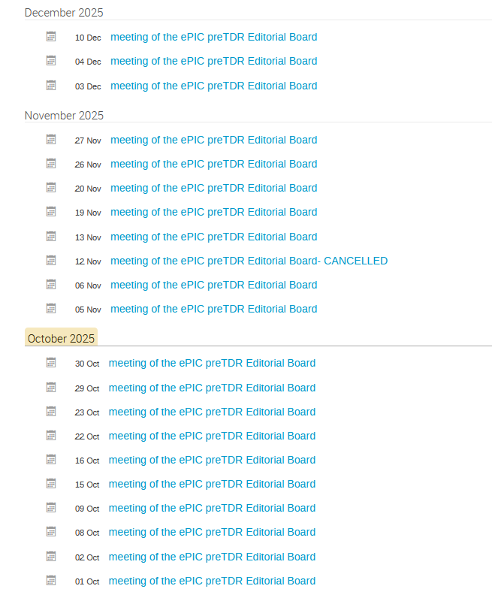
Progress on the preTDR
Version 2.2 of the preTDR posted in Zenodo
Google Form to collect comments from the whole Collaboration
Editorial Board meetings:
Kick-off: Organizational mtg. Aug 6th
15 meetings since then
Extensive EB meeting schedule through the rest of the year!
Editorial Board calendar at : https://indico.bnl.gov/category/683/
Context: the Detector preTDR as a stand-alone document → new document layout

Slide 11
The new layout of the Detector preTDR document Now available since September 24th
Executive Summary
CHAPTER 1 – Introduction
About the EIC project and the accelerator complex (high level approach)
CHAPTER 2 – Requirements
Requirements resulting as an evolution of the YR ones
CHAPTER 3 – Experimental Systems
Past “chapter 8”
Presenting the detector subsystems matching the requirements (mainly individual performance)
CHAPTER 4 – Detector Performance for the EIC physics program
Past “chapter 2”
Presenting the holistic detector performance by the performance for key physics measurements
CHAPTER 5 – Detector-Accelerator interfaces
INTEGRATION INTO THE FACILITY
Coming goal:
Next draft of these chapters in 2025

Slide 12
Progress on the preTDR - most recent updates
Inviting the authors of all sections/subsections (a few of them at each meeting) to discuss their text in detail
A first pass will be completed by ~ mid November
A few sections require a second pass
Authors are further editing in the official overleaf within the new layout
This further editing phase must be concluded by December 1
Detail text polishing will follow
A new more advanced version of the preTDR will be posted in ZENODO before the January ePIC Collaboration Meeting
The Editorial Board greatly appreciates the efforts of all those who are contributing to the pTDR! It’s going to get even more busy over the next month so please do your best to get your contributions into Overleaf so they will be part of the next draft released in December.

Slide 13
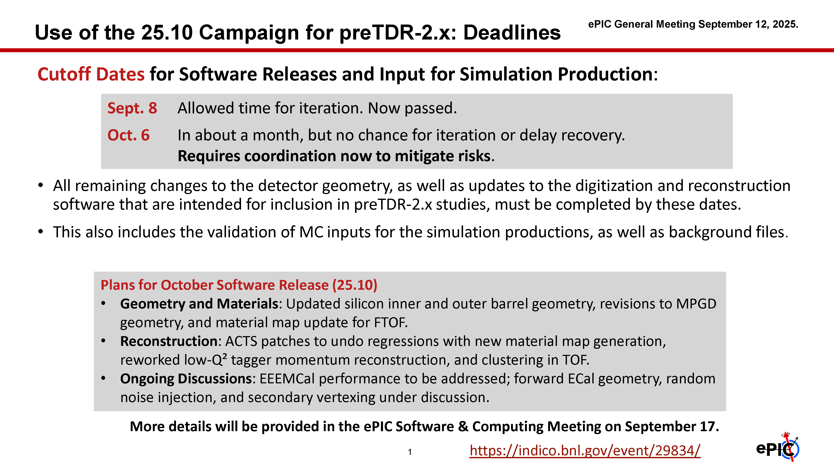
pTDR and October Simulation Campaign
Major focus over the past two months – lost of engagement and activity. Great coordination between S&C, PAC and DSC’s!
Report from Dmitry at this meeting.
Discussions ongoing with S&C and all coordinators to organize the effort for 2026.

Slide 14
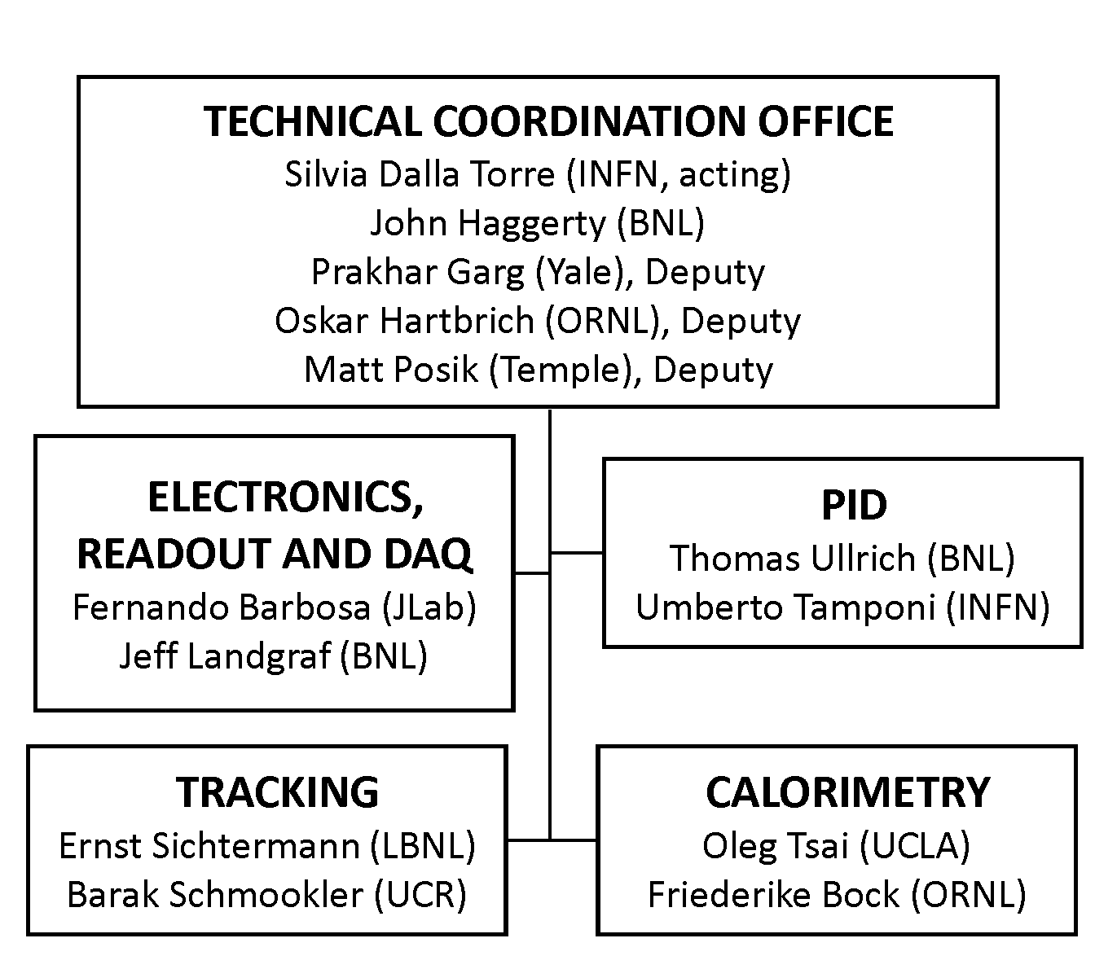
CC WG Charges and Conveners
SP Office wanted to focus the CC WG’s on tasks needed to baseline ePIC
Developed charges for each CC WG, in conjunction with the coordinators and the CC WG conveners
Posted in Indico
Several of the existing CC WG conveners have been serving for 2+ years and expressed a desire to step down.

Slide 15
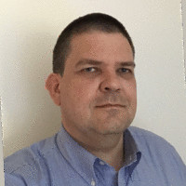
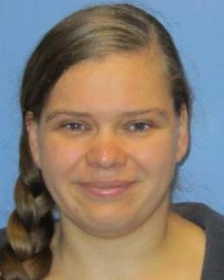
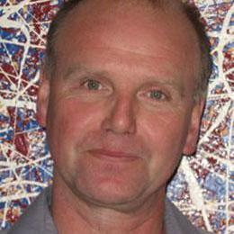
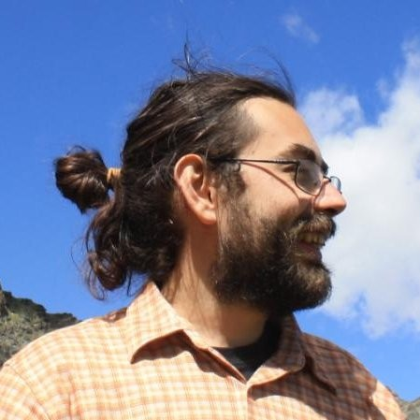

Outgoing CC WG Conveners
Ernst Sichtermann (Tracking)
Friederike Bock (Calorimetry)
Thomas Ullrich (PID)
Umberto Tamponi (PID)
A huge THANK YOU for all your time and effort on behalf of

Slide 16
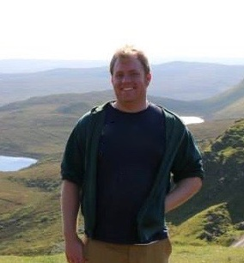
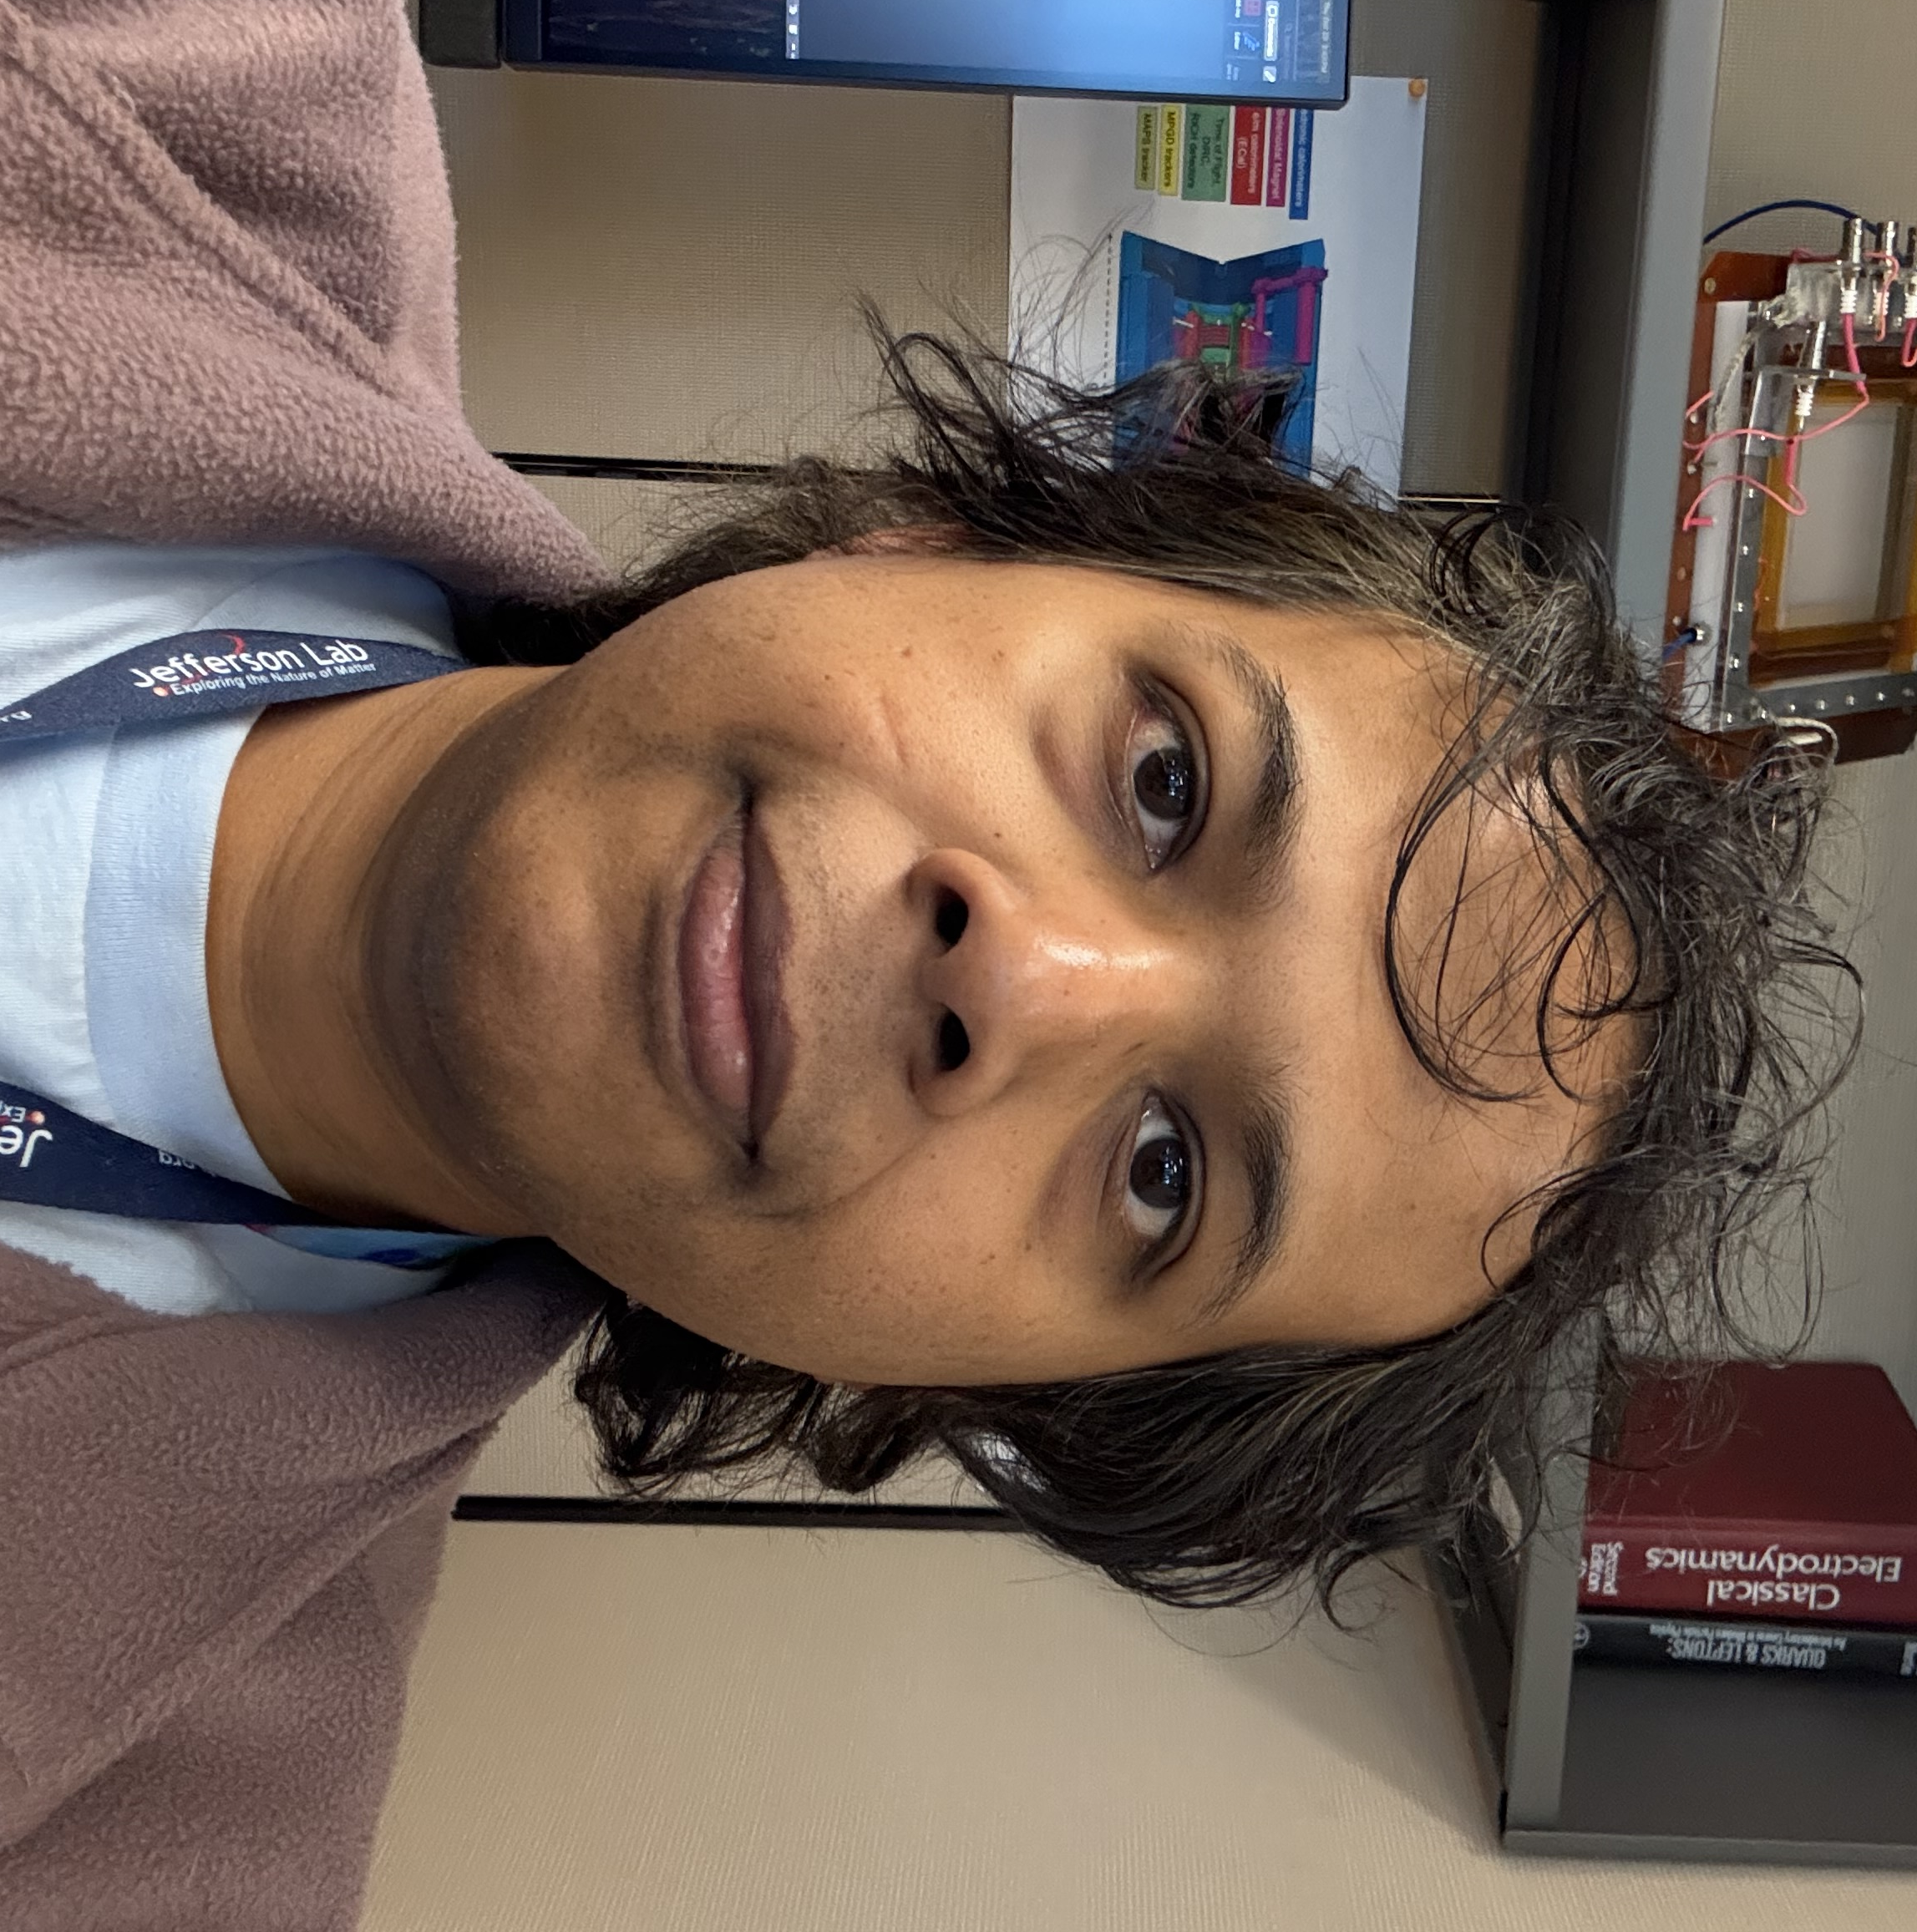
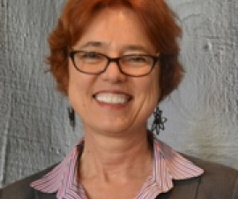

CC WG Convener Nominations
The following individuals will be nominated as CC WG conveners at the upcoming Collaboration Council Meeting:
Sourav Tarafdar (PID)
Brian Page (PID)
Barbara Jacak (Tracking)
TBD (Calorimetry)
THANK YOU for dedicating your time and effort to these important roles!

Slide 17
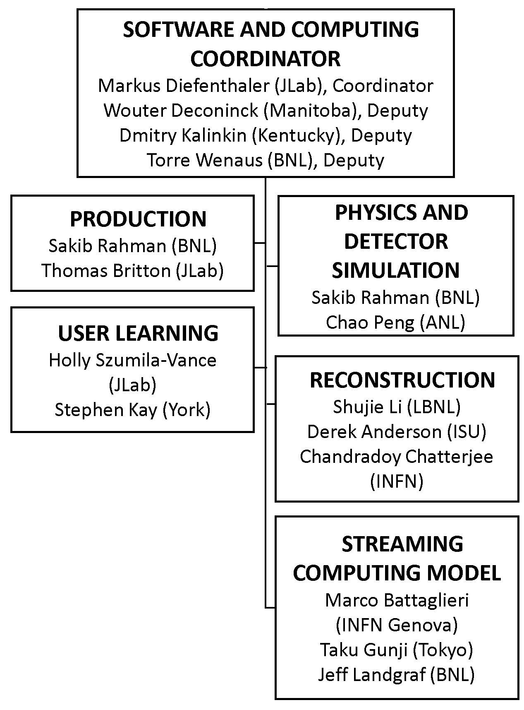
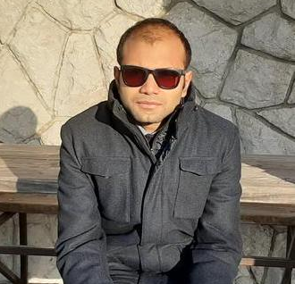
New Reconstruction WG Convener
Chandradoy Chatterjee
Chandra will organize the development of reconstruction software for the PID detectors.
His nomination will be presented to the Collaboration Council at the upcoming CC meeting.

Slide 18
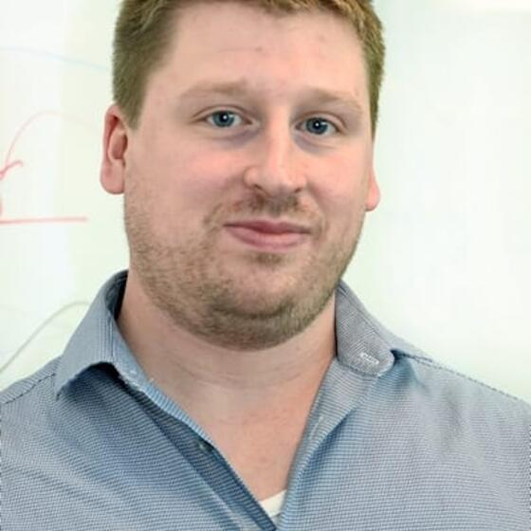

Thank You Matt Posik!
Matt Posik will be stepping down as a Deputy Technical Coordinator. His work to understand the resolution of track projections into the hpDIRC was an early driver for the development of the ACTS tracking and the development of the ePIC software stack. He also made important contributions to the MPGD simulations and is working on the aerogel test stand at Temple.

Slide 19
Elections Committee Call for Nominations
Email from election committee Oct. 20th:
Dear Colleagues, The ePIC Election Committee is seeking nominations to run for the following ePIC leadership positions:
Vice chair of the Publication Committee (Annalisa Mastroserio is now chair, with Rene Bellwied having completed his term as chair)
Vice chair of the Professional Conduct Office (Christine Nattras' term ends January 2026, at which time Susanna Costanza becomes chair)
Three at-large members of the Executive Board. The current members, who were elected in November 2023, are Barbara Jacak, Taku Gunj, and Paul Newman. Note that one is allowed to serve two terms, hence all current at-large members can be nominated again and run.
Nominate your colleagues. Self-nominations are welcome and encouraged. The call for nominations will be open for 3 weeks, until November 10. Please send your nominations to the Election Committee (email addresses in the cc). Elections will then take place using ranked ordered voting. Best regards, Ken for the ePIC Election Committee
Send nominations to the Elections Committee: Ken Barish (chair) (barish@ucr.edu) and Sylvester Joosten (vice) ( sjoosten@anl.gov )

Slide 20
Call for CERN Test Beam Information
Deadline for CERN test beam time application – Friday, Oct. 31st
Email from Oskar Hartbrich Oct 21st:
If you plan to apply for CERN beam time in the 2026 period, we kindly ask you for two small things:
Please reference your beam time request to "ePIC, CERN recognized experiment RE47".
Please inform the TC office of your application and include Oskar as one of the contact persons in the application form.
In addition, we invite each DSC planning to apply for beam time to present 1-3 slides at the next TIC meeting on October 27th (in one week) describing the general outline of your request, including:
Detector setup you intend to test
Requested beam time, particle types, beam energies
Main goals of beam time
How would a declined beam time request impact your subdetector engineering progress, especially with regards to the ePIC TDR?

Slide 21
2026 Collaboration Survey
Emails to CC members are being sent out requesting updates to the 2025 Statements of Service (SoS) and a new statement for 2026.
Spreadsheet for 2026 is similar to last year’s SoS
Response requested by October 31, 2025
Some clarifications:
The 2026 spreadsheet still includes the “Projections” tab. Projections are not requested for 2026, so this can be ignored.
As in last year’s survey, all information you provide will be used strictly for collaboration-related matters.
Contact the Membership Committee if you have any questions:
Eric Lancon (elancon@bnl.gov) and Carlos Munoz Camacho (carlos.munoz@ijclab.in2p3.fr)

Slide 22
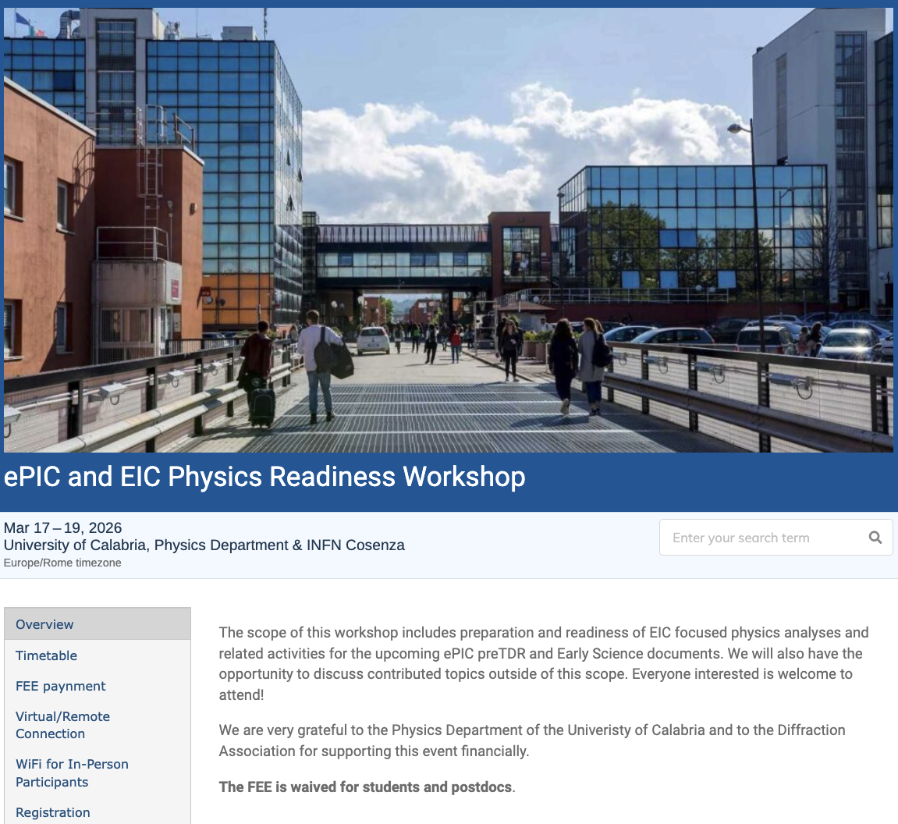
The discussion on performance continues!
Next Physics Readiness Workshop scheduled for March 17-19
Hosted by the University of Calabria & INFN Cosenza
Indico: https://indico.bnl.gov/event/30283/
Hybrid format - Please register even if attending online (select proper option)
€150 FEE waived for students/postdocs
Possibility (limited) for ECRs support
The workshop will focus on the finalization of studies and text for the TDR and early science documents

Slide 23


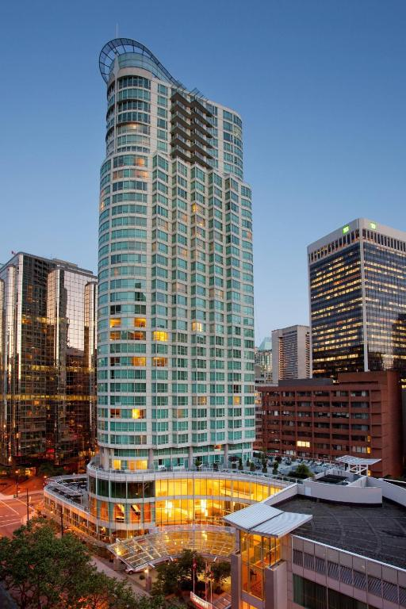

Jan 2026 ePIC Collaboration Meeting
The next ePIC Collaboration meeting will be January 12-16, 2026 in Vancouver BC, hosted by EIC Canada and TRIUMF.
The venue will be the Vancouver Marriott Pinnacle Downtown!
(logo shamelessly stolen from Estudiar en Canada)

Slide 24
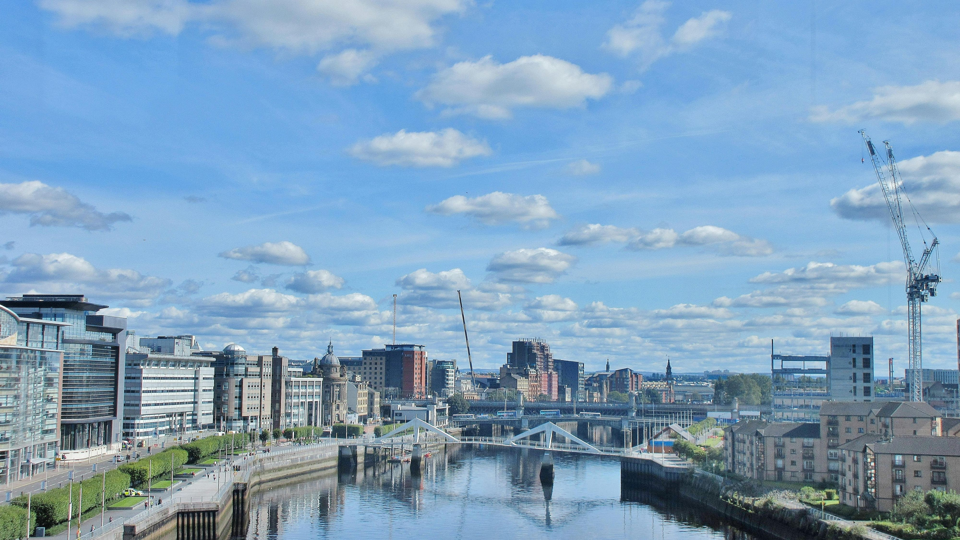
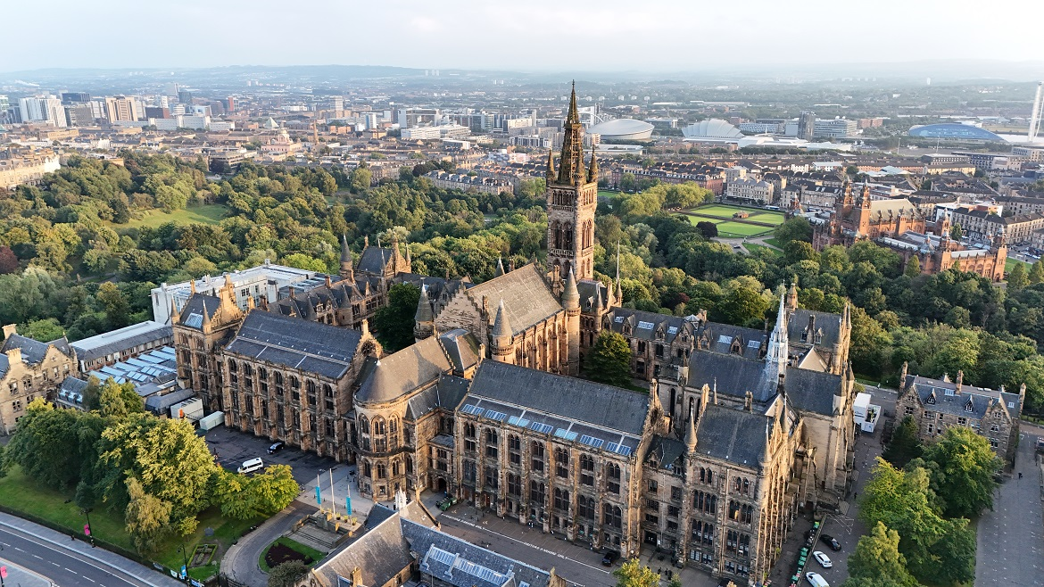
Summer 2026 Joint EICUG/ePIC Meeting
After discussions with the EICUG SC, the ePIC CC Chair/Vice-Chair, and the ePIC Spokespersons and coordinators, we have accepted a bid by the UK to host the Summer 2026 joint EICUG/ePIC meeting at the University of Glasgow July 13-17th , 2026.
More information coming soon!

Slide 25
Fall Time Change is Upon Us!
Sunday, Oct. 26th – Europe ends Daylight Savings Time
Sunday, Nov. 2nd – US ends Daylight Savings Time
ePIC Calendar is kept in US Eastern Time
This means that for one week, Oct. 26th – Nov. 2nd, meeting times in Europe will be one hour earlier than what you are used to.
If you import the ePIC calendar into your calendar software, the times should adjust automatically – trust but verify!

Slide 26
Conclusion
There is an enormous amount of activity in ePIC, and that activity is increasing rapidly!
Supporting the EIC project IPR/PDR and DET review process
Completing the next draft of the pTDR
This is a whole of the collaboration effort!
Development of the ePIC Streaming Computing Model
Physics WG’s developing analysis for pTDR and Early Science WP
None of this changes despite current uncertainties!
Next CC Meeting – November 7th
https://indico.bnl.gov/event/29048/
Next General Meeting – likely Nov. 13th (Thurs. eve)

Slide 27


Slide 28
ePIC Resources
Public Website - https://www.bnl.gov/eic/epic.php
Mailing Lists – https://lists.bnl.gov/mailman/listinfo
Indico Agenda - https://indico.bnl.gov/category/402/
ePIC Software and Computing: https://indico.bnl.gov/category/435/
Wiki - https://wiki.bnl.gov/EPIC
ePIC Software Training:
Landing Page: https://eic.github.io/documentation/landingpage.html
Tutorials: https://eic.github.io/documentation/tutorials.html
Mattermost: https://chat.epic-eic.org
ePIC Zenodo Community: https://zenodo.org/communities/epic

Slide 29
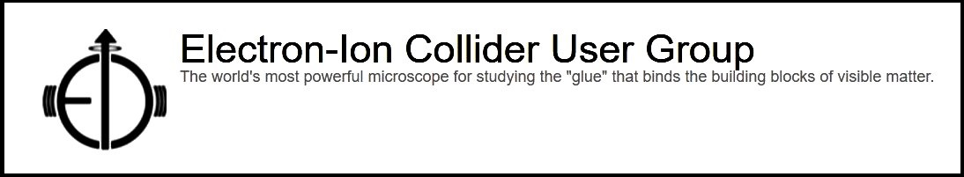

EICUG Membership
The EICUG is a vital organization to promote the interests of the EIC community!
Without the EICUG we would never have gotten far enough to form ePIC!
Please register your institution!
Check with your EICUG IB representative to get registered as a member
https://www.eicug.org/content/join.html

Slide 30
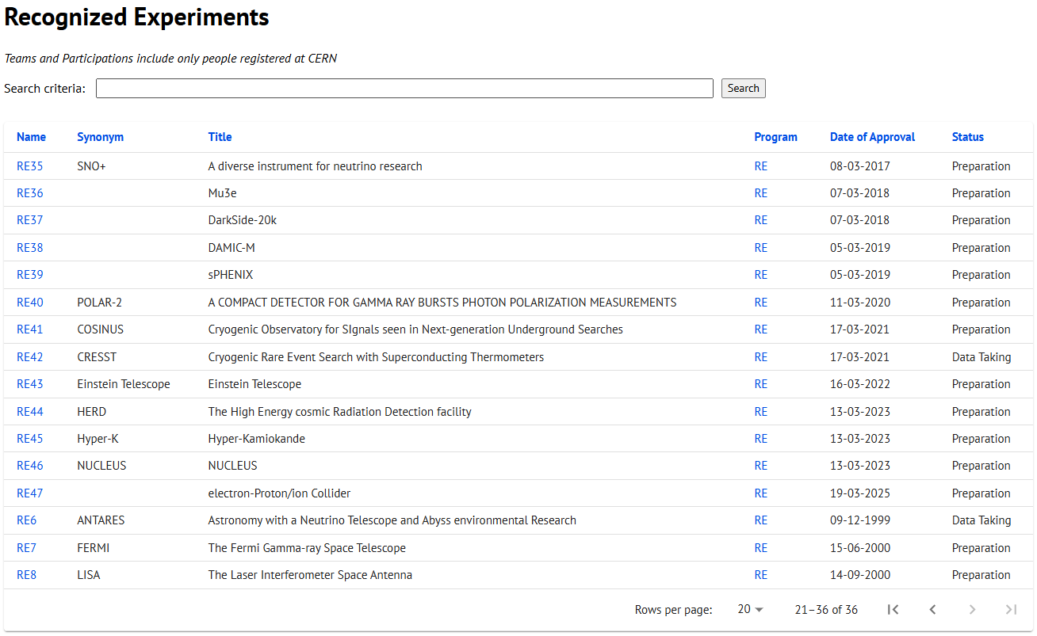
CERN Recognized Experiment Status: RE47
ePIC now appears in the CERN Grey Book database as RE47: https://greybook.cern.ch/experiment/recognized
Two steps to get ePIC Collaborators registered at CERN:
CC Representative needs to register as team leader with CERN Users Office:
https://usersoffice.web.cern.ch/
https://usersoffice.web.cern.ch/team-leaders-corner
Users.Office@cern.ch
CC member can then certify registrations of team members
Contact us if you run into problems!

