Slide 1
EIC Project News
E.C. Aschenauer (BNL), R. Ent (JLab)
Co-Associate Directors for the EIC Experimental Program
ePIC Bi-Weekly General Meeting
October 24th, 2025

Slide 2
Outline
Detector Reviews and Meetings 2025/2026
Detector Baseline Readiness Assessment Review - Postponed

Slide 3
Detector Reviews & Meetings planned for 2025/2026
Preliminary Design Reviews (60% design maturity equivalent, called PDR, PDR2 or PDR3, pending the subsystem)
PDR2: Cherenkov-based Particle Identification Detectors (6.10.04; pfRICH, hpDIRC, dRICH) – April 1-2, 2025
PDR3: Electronics/DAQ-computing (6.10.08. 6.10.09.01) – September 3-4, 2025 (this does not include slow controls)
PDR3: Barrel EM Cal (6.10.05.02) – September 17-18, 2025
PDR (60%) Barrel & Forward & Backward HCAL (6.10.05.01; 6.10.06.02; 6.10.06.03) and forward ECAL – October 30-31, 2025
PDR: Magnet Cryogenics and infrastructure (6.10.07) – November 4-5, 2025 (integrated in overall EIC Project Cryogenics PDR)
PDR2: AC-LGAD-based Particle Identification Detectors (6.10.04; BTOF, FTOF, common systems) – week of Dec. 1
PDR: Integration, Infrastructure and Installation (6.10.10) – everything outside GST, includes cradle, HCAL, etc. – Dec. 8-9
PDR: Integration, Infrastructure and Installation (6.10.10) – December 15th 2025 – everything inside GST – Dec. 8-9
PDR: MPGD Tracking Detectors (6.10.03.02) – aim for Dec. 15
PDR2: Silicon Tracking Detectors (6.10.03.01) – week of Jan. 26, 2026
PDR2: Polarimetry (6.10.14) – aim for February 18-19, 2026
PDR: DAQ-Slow Controls (6.10.09.02) – Spring 2026 – Separated from electronics/DAQ to ensure integration in the collider common platform
PDR3: IR Integration and Auxiliary Detectors (6.10.11) – March/April 2026 – includes 6.10.14 lumi detector
Final Design Reviews (FDR):
FDR: Final Design Review of the BABAR DIRC Bar Refurbishment for the High Performance DIRC Particle Identification Detector – April 1, 2025
FDR: Backward EM Calorimetry – Mid February 2026
Project Reviews:
DOE OPA CD-3B Review – January 7-9, 2025
“Red Team” Review (acts as Director’s Review for DOE OPA Focused Status Review) – May 20-21, 2025
Comprehensive ePIC/EIC Detector Review by Detector Advisory Committee – June 11-13, 2025
DOE OPA Focused Status Review – August 5-7, 2025
Detector Baseline Readiness Review November 12-14, 2025 → postponed
DOE Status Review March 9-12, 2026
CD2 IPR & ICR June 2026?
Other Meetings:
EIC International Computing Organization (EICO) – April 2–4, 2025 @BNL
Detector R&D Day hosted by ePIC and EIC Project – April 16-17, 2025
Technical interchange meeting with EIC Computing and Software Advisory Committee (ECSAC) – May 12, 2025
5th RRB Meeting: June 5-6, 2025 – Prague, Czech
10th DAC Meeting – Comprehensive look to design status and readiness for CD-2. June 11-13, 2025.
EIC Software & Computing annual review – October 6-7 @ JLab (and Echelon 0–1 mini-workshop on October 8)
6th RRB Meeting: November 4-5, 2025 - BNL

Slide 4
Assessments of Baseline Readiness
Assessments of baseline readiness for each subproject will measure status and evaluate future work needed to be ready for a DOE CD-2 IPR. The charge for these reviews includes technical, cost, schedule, and management. The charge will also evaluate plans to design to cost.
The charge for the Detector and Accelerator Storage Rings will be consistent with a CD-2 baselining review mid-late 2026; the charge for the other subprojects will reflect their lower design maturity.
Emphasis of the charge is on management, cost and schedule for baseline readiness, not on technical scope
Director’s Reviews will be completed by mid-2026.
Co-Chairs: Steve Nahn (FNAL) and Andy White (UTA)
Committee:
Parallel 1 Electronics and DAQ, PID, Tracking | Parallel 2, Magnet, Calorimetry, Mechanical, Auxiliary, Polarimetry | Parallel-3: Mgmt, Cost and Schedule
(POC: Elke Aschenauer) | (POC: Oleg Eyser/Dan Cacace) | (POC: Rolf Ent)
Michael Begel (Chair) | Chris Polly (Chair) | Allison Lung (Chair)
Ken Wyllie (remote) | Michelle Stancari | Whitney Hughes
Hucheng Chen | Glenn Young (remote) | Jay Marx (remote)
Antonis Papanestis | Roman Poeschl | Patty McBride (remote)
Eraldo Oliveri | Jim Strait | Raj Gutta
Anna Macchiolo (remote)

Slide 5
November 12-14 Detector Baseline Readiness Assessment Postponed
*Sent on behalf of Jim Yeck Dear Review Committee Members,
The Assessment of Baseline Readiness for EIC Detector, ePIC, must be postponed. The plan for a predominately in person review is no longer viable given the current constraints on U.S. government funding and related travel restrictions.
We apologize for the significant inconvenience and ask for your flexibility in helping us find a new date, hopefully in January. Please complete the following survey.
Survey link: (removed)
The preparation for the review is nearly complete. Once the new review date is determined we will make a new plan for engagement with the committee, e.g., pre-meetings, posting documents for review, etc.
Thank you for your understanding.
Sincerely,
Jim Yeck
EIC Project Director / BNL Associate Laboratory Director

Slide 6
DOE and EIC Planning Dates
Milestone |  | Milestone
DOE Independent Project Review (IPR) | Jan. 7-9, 2025 | DOE RHIC R&R/Injector Operations Review | Sept. 8-10, 2025
Start Developing Scope of Subprojects | January 10, 2025 | Machine Advisory Committee Meeting | Sept. 16-18, 2025
IR SC Magnet Steering Group Meetings - Monthly | January 17, 2025 | Infrastructure Construction Advisory Committee | October 2025
Project Advisory Committee Meeting | February 11, 2025 | Resource Review Board Meeting (BNL) | Nov. 4-5, 2025
EIC Advisory Board Meeting | February 25, 2025 | Assessments of Baseline Readiness for SPs Detector Interaction Region Accelerator Storage Rings Global and Energy and Luminosity Ramp-Up Electron Injector (follow-up to Apr ‘25 Review) | Nov. 12-14, 2025 Nov. 18-20, 2025 Jan. 14-16, 2025 February 2026 April 2026
Electron Injector Design and Cost Review | April 8-10, 2025
Infrastructure Construction Advisory Committee | April 16-17, 2025
Project Advisory Committee "Red Team" Review | May 20-21, 2025
Resource Review Board Meeting (Prague) | June 5-6, 2025
Detector Advisory Committee Meeting | June 11-13, 2025 | RHIC Operations Conclude | ~End 2025
EIC Advisory Board Meeting | June 17, 2025 | RHIC Removal and Repurposing (R&R) Starts | ~Early 2026
DOE CD-3B ESAAB Approval | Pending | DOE IPR Comprehensive Review | Mar 9-13, 2026
DOE IPR Focused Status Review | August 5-7, 2025 | DOE CD-2 Detector Subproject Review | ~ June 2026
 |  | DOE CD-2/3 Accelerator Storage RIngs | ~ June 2026
For Assessment of Baseline Readiness for Detector now checking with committee weeks of Jan. 19, 26 and Feb. 2

Slide 7
Detector Baseline Readiness Assessment – Prep was well in motion
To be ready: Must have:
Draft Preliminary Design Report == Draft Pre-TDR Version as is
WBS dictionary updates with scope descriptions and deliverables – done
P6 updates done (as applicable) - great progress made in various detector systems, working on tracking. Often just reshuffles without cost additions. Have now approved cost additions for electronics, a second engineering test article run for HRPPDs, an air bearing system for detector installation driven by (accelerator) alignment needs, rigging labor, and a more complex global support tube allowing for detector serviceability.
Basis Of Estimates in good order such that they are traceable – ongoing, thanks for providing input to CAMs!
Remaining review (PDR, FDR) dates finalized – have almost all weeks defined, exact dates pend on reviewers
Some Interface Control Documents – Interfaces cleaned up and made consistent with Subprojects, have many draft ICDs and final Magnet and Hadron Polarimeter ICDs. Working on ICD for detector envelope.
Some Subsystem Individual Quality Control Plans – Have Magnet, DAQ, will soon have EEMCAL
Some Inspection and Test Plans (component and unit tests, transportation) – good progress, see later
Multi-Party ICRADAs started and Draft (In-Kind) Project Planning Document – ICRADA for magnet went to INFN but may take until January for signing, BNL & JLab working on synchronized submission to DOE. Started work on ICRADA for detector/UK.
Should have:
Many Inspection and Test Plans – many posted on eic.jlab.org/Detector, some more in progress – THANKS!!!
(In-Kind) Project Planning Documents - postpone
Updated Budget Estimate Quotes (need them early 2026)

Slide 8
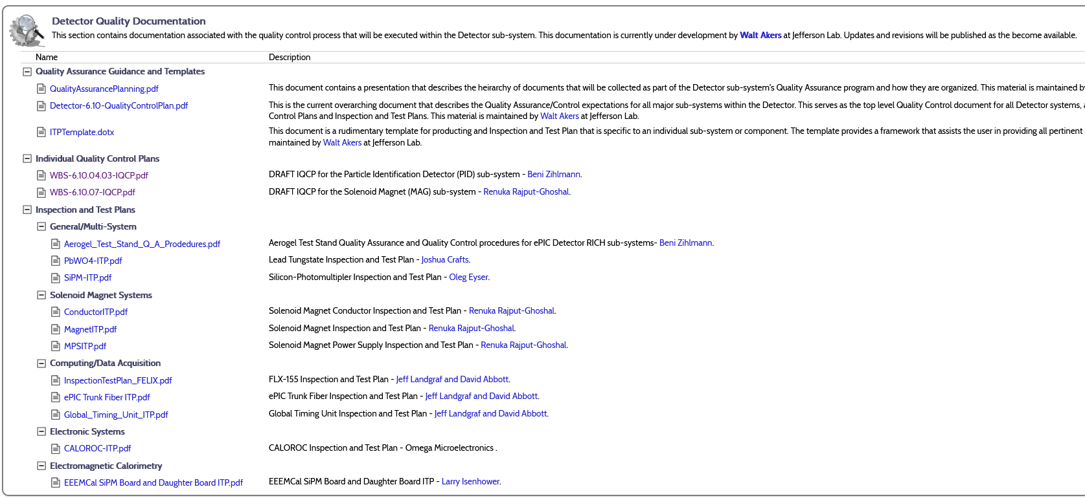
Requirements, Interfaces, Quality Assurance
Documenting the Information
8

Slide 9


