Slide 1

Technical Internal Review TOF Sensor
Satoshi YANO
(Hiroshima University)

Slide 2
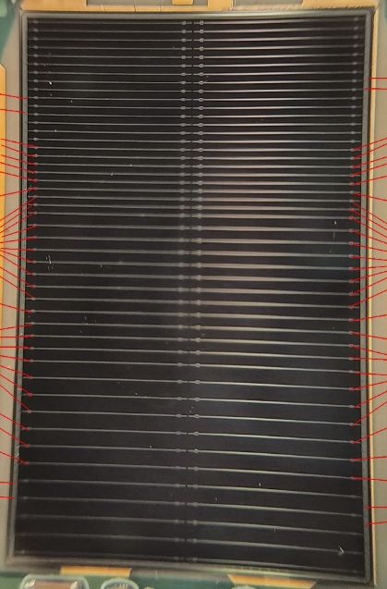
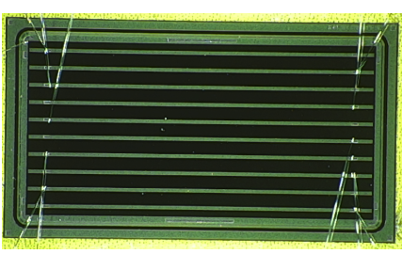
Current Status of Sensor
eRD112 FY24
”Baseline” sensor fundamental parameters
Size: 32x20 mm²
Strip-size / Pich: 10x0.05 mm² / 500 um
Strip geometry: 64x2=128 ch
Active thickness: 50 um
Sheet resistance: 1600Ω/◻︎
Coupling capacitance: ︎240 pF/mm²
Current best performance
eRD112 FY23 sensor
5x10 mm², 10x0.05 mm² / 500 um
The sensor was tested at FNAL 120 GeV proton
Timing resolution: 35 ps
Spatial resolution: 15~20 um (depend on hit position)
20mm
eRD112 FY23
10mm
32 mm
5 mm

Slide 3
Upcoming Deliverable
First full-size sensor (eRD112 FY24) result
eRD112 FY24 sensor is the first full-size sensor (32x20 mm²)
Different strip pitches are implemented on one sensor
Test beam results at JLab will be released soon
“Real” full-size sensor reult
First “real” full-size sensor with 20/30/50um was received this September
Lab-test, I/V measurement, TCT-scan, and Sr90 will start soon
Test beam at DESY is scheduled in December-2025

Slide 4
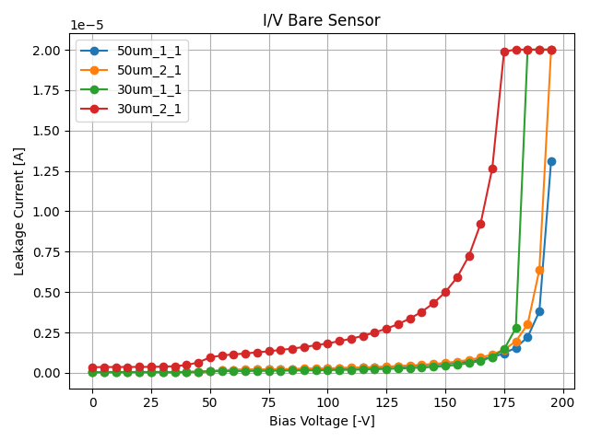
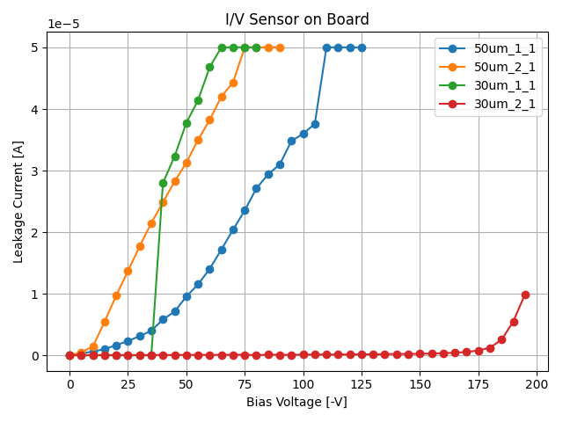
Unresolved Problem
“Modified” eRD112 FY24 sensor
Wire-bonding’s damage of sensor
Instability of l/V curve after wire-bonding was observed in eRD112 FY24 sensor
Oxidization film damage by wire-bonding is suspected
Thicker oxidization film has been adopted to ”modified” eRD112 FY24 sensor
The same sensor as the eRD112 FY24 sensor delivered to Japan in May incorporates this improvement
Solution:
Optimization of wire-bonding is necessary
HPK suggested us to use ball-bonding instead of wedge-bonding
Coating bonding pad design will be used for the next production (Beginning of 2026 if possible)
Before bonding
“Modified” eRD112 FY24 sensor
After bonding

Slide 5
“Baseline” Sensor R&D History
Original eRD112 FY24 sensor
Ordered by eRD112 budget (FY24)
The first sensor of 32x20 mm² (full-size)
Variable pitches 1mm, 0.75mm, 0.5mm pitches with 50um
Observed very low-yield of 50um active thickness sensors
Observed damage of sensor after wire-bonding
Tested @ Jlab
Modified eRD112 FY24 sensor
Provided by HPK as sample
Same mask as original eRD112 FY24
Applied improved wafer making process
Applied thicker oxide layer than original
Real Full-size sensor
Ordered by Japanese budget (JFY25)
The first real sensor, 32x20 mm², 64x2=128ch, 10x0.05 mm², 500 um pitch
Same parameters as Modified eRD112 FY24 sensor except geometry
Plan to test @ DESY (December 2025)
Modified Real Full-size sensor
Ordered by Japanese budget (JFY25)
Same mask as original real full-size sensor
Pad reinforcement
Plan to test @ RARiS (March 2026)
Only if delivered before the test

Slide 6
Sensor R&D other than “Baseline” Plan-B
Sensors that meet the requirements under any conditions are needed
Timing resolution of 35ps and spatial resolution of 15~20um was measured under best environment
Performance degradation during operation due to unstable conditions can be expected
Continuing to strive for superior performance is important
Fall back solution for the stave design is necessary
Consideration of backup plan when the sensor's inherent performance cannot be achieved in designs using an interposer is necessary
It is not obvious if it is possible to accurately extract tiny high-frequency analog signals from 64 parallel traces within a thin FPC
Double-metal layer design can expand design flexibility
E.g. Double metal layer design to enable readout perpendicular to the strip direction
It is possible to mount the ASICs perpendicular to the strip direction

Slide 7
Strategy & Schedule
“Baseline” sensor
Solving wire-bonding’s damage on sensor is the top priority for the “baseline” sensor
Optimal bonding condition & Pad reinforcement
Compatibility checks with FCFD are essential
New evaluation board is necessary (to be check)
Plan: October ~ March 2026
Optimal wire-bonding conditions is looked for
Test beam @ DESY is schedules (15~21 Dec.)
Goal: First “real” sensor test & measurement of charged particle penetrating angle effect
Beam test @ RARiS is scheduled (2~5 Mar.)
Goal: Modified “real” sensor test & Resolve issues identified at DESY & if possible compatible check with FCFD

Slide 8
Strategy & Schedule
Double-metal sensor (Plan-B sensor)
First, the performance must be measured
Double metal effect will be extracted by comparison with “baseline” sensor
Plan: October ~ March 2026
Beam test @ RARiS is scheduled (2~5 Mar.)
Goal: measurement of the performance

Slide 9
Backup

Slide 10
Acceptance Hole
Full-Stave
Front-side
Back-side
Left-Half-Stave
Right-Half-Stave
Between half-staves, there are large acceptance holes
2 mm at right in the middle, 10 mm at little sideways from the middle
Between modules, there are small 2 mm acceptance holes
Due to 1 mm inactive area in a sensor

