Slide 1

New Convener Candidates
J. Lajoie, S. Dalla Torre
November 25th, 2025

Slide 2
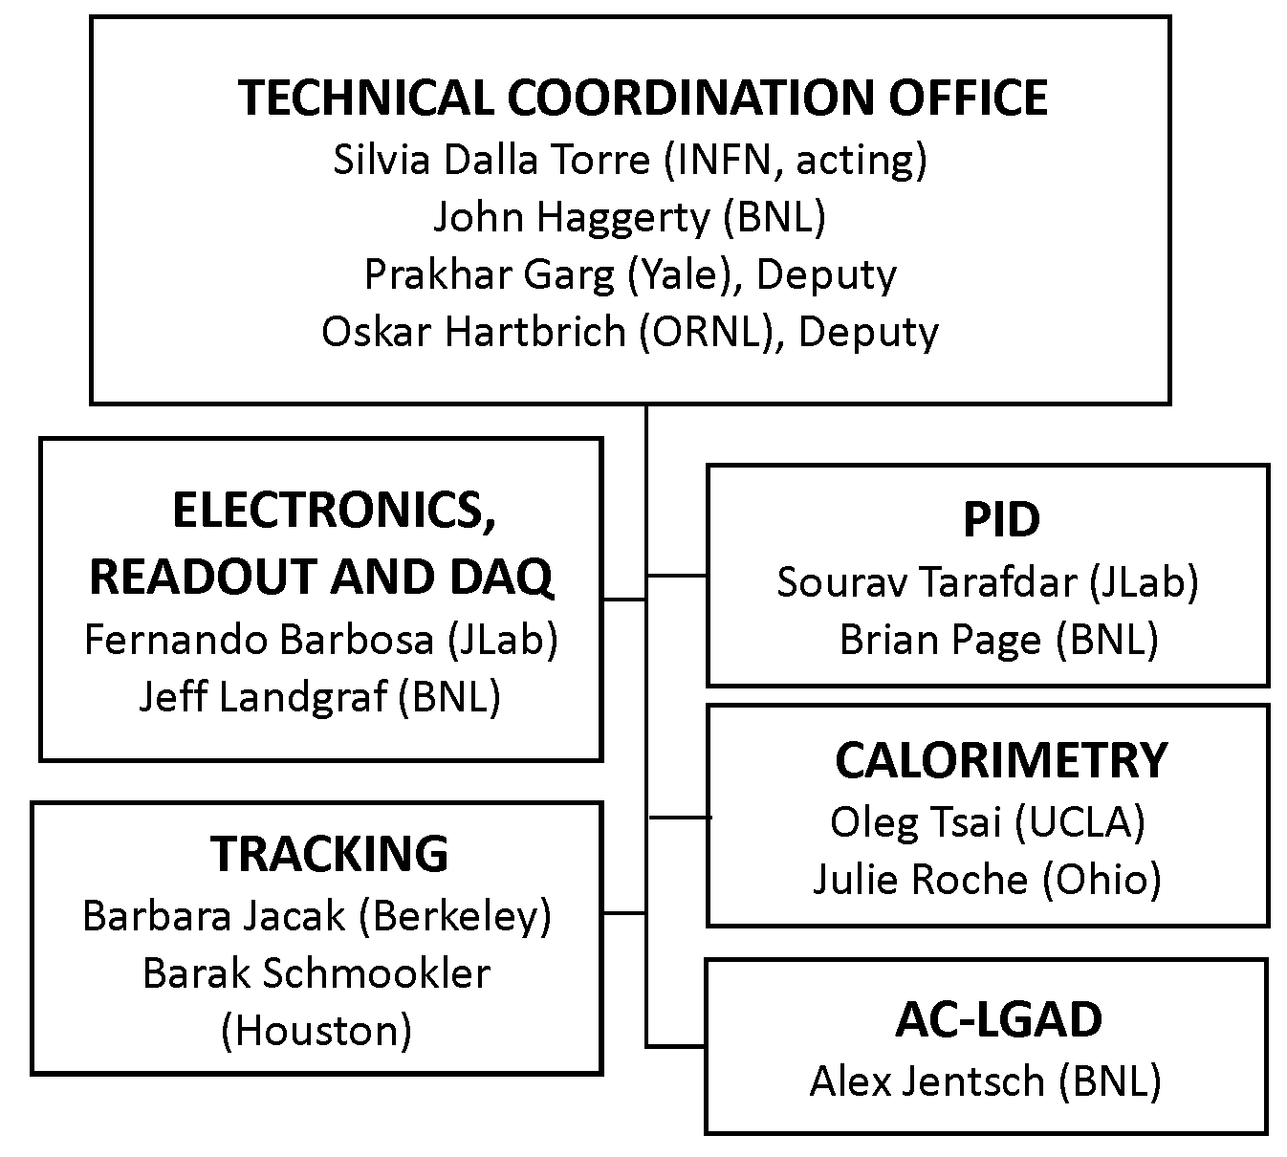
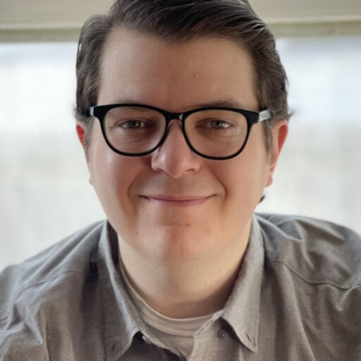
New CC WG : AC-LGADs
This is a real need for a common forum to help coordinate activities across the multiple uses of AC-LGADs in ePIC.
Nominate Alex Jentsch as AC-LGAD CC WG convener.

Slide 3


Slide 4
AC-LGAD Working Group
Coordinate communication and action items between the Far-Forward and TOF DSC’s and the Electronics and DAQ CC WG regarding common interests in sensor development, ASICs, and readout and front-end electronics.
Exploit synergies where possible to reduce and complexity of AC-LGAD subsystems. This includes, but is not limited to:
Development and characterization of strip and pixel AC-LGAD sensors
Test beams – establish goals, coordinate common efforts, report results
Testing of the EICROC and FCFD ASICS and development of readout electronics. Provide a communication link between the ASIC efforts and this WG
Work with the DSC’s and other WG’s to avoid duplication of meetings. Ideally this WG would subsume parts of existing meeting without substantially increasing the overall meeting load
Maintain communication with the EIC project regarding common AC-LGAD efforts within ePIC

