Slide 1

Internal project review for TOF AC-LGAD sensors
Satoshi YANO
(Hiroshima University)

Slide 2
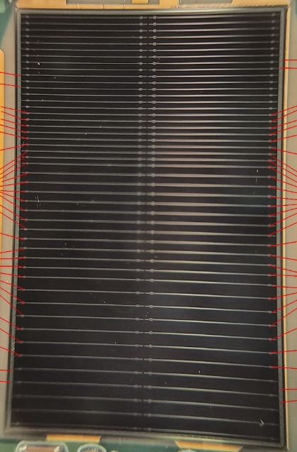
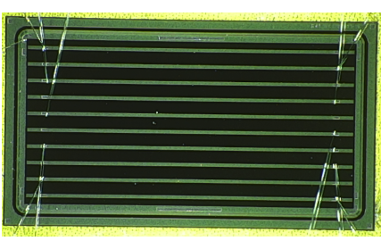
Current Status of Sensor (Strip-Type)
eRD112 FY24
”Baseline” sensor fundamental parameters
  Size: 32x20 mm²
  Strip-size / Pich: 10x0.05 mm² / 500 um
  Strip geometry: 64x2=128 ch
  Active thickness: 50 um
  Sheet resistance: 1600Ω/◻︎
  Coupling capacitance: ︎240 pF/mm²
Current best performance
  eRD112 FY23 sensor
    5x10 mm², 10x0.05 mm² / 500 um
  The sensor was tested at FNAL 120 GeV proton
    Timing resolution: 35 ps
    Spatial resolution: 15~20 um (depend on hit position)
20 mm
eRD112 FY23
10mm
32 mm
5 mm

Slide 3
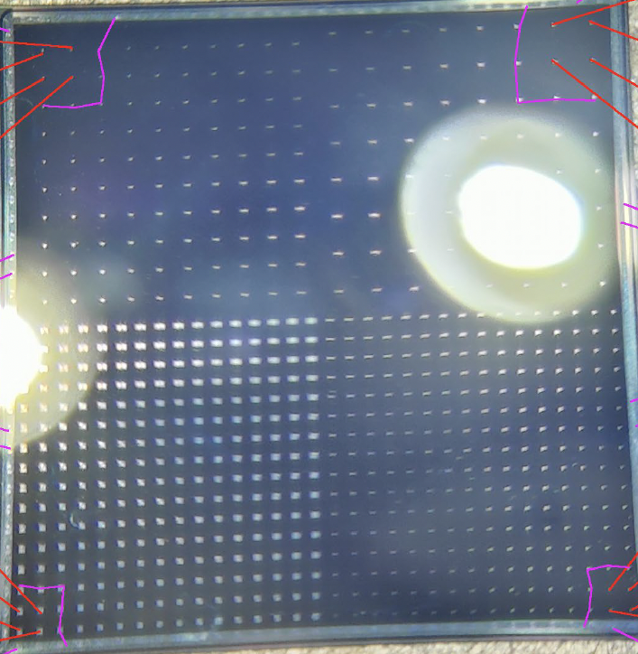
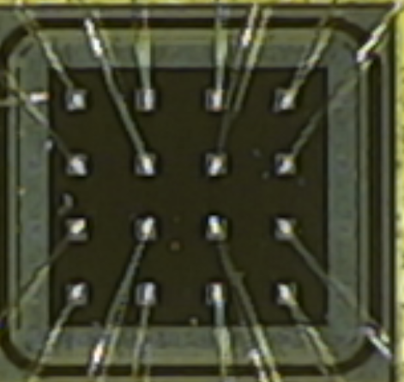
Current Status of Sensor (Pixel-Type)
eRD112 FY24
”Baseline” sensor fundamental parameters
  Size: 16x16 mm²
  Pixel-size / Pich: 0.15x0.15 mm² / 500 um
  Pixel geometry: 32x32=1024 ch
  Active thickness: 20 um
  Sheet resistance: 400Ω/◻︎
  Coupling capacitance: ︎600 pF/mm²
Current best performance
  eRD112 FY23 sensor
    2x2 mm², 0.15x0.15 mm² / 500 um
  The sensor was tested at FNAL 120 GeV proton
    Timing resolution: ~20 ps
    Spatial resolution: 20~35 um (depend on hit position)
16 mm
eRD112 FY23
2 mm
16 mm
2 mm

Slide 4
Upcoming Deliverable
First full-size sensor (eRD112 FY24) result
  The first full-size sensors (eRD112 FY24 sensor) is delivered
  Different strip and pixel pitches are implemented on one sensor
  Test beam results at JLab will be released soon
“Real” full-size sensor for strip result
  First “real” full-size strip sensor has been received this September
  Lab-test, I/V measurement, TCT-scan, and Sr90 will start soon
  Test beam at DESY is scheduled in December-2025

Slide 5
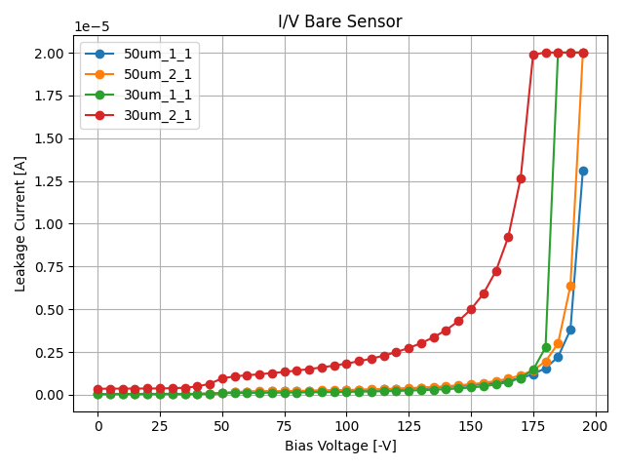
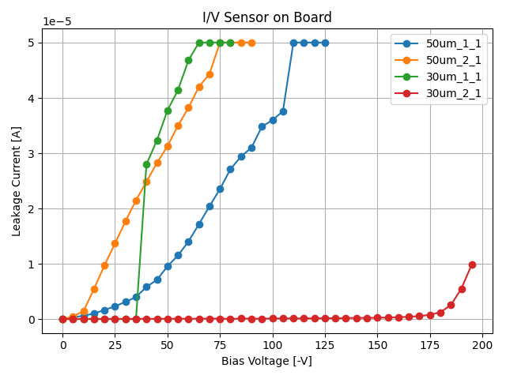
Unresolved Problem
“Modified” eRD112 FY24 sensor
Wire-bonding’s damage of sensor
  Instability of l/V curve after wire-bonding was observed in eRD112 FY24 sensor
  Oxidization film damage by wire-bonding is suspected
  Thicker oxidization film has been adopted to ”modified” eRD112 FY24 sensor
    The same sensor as the eRD112 FY24 sensor delivered to Japan in May incorporates this improvement
Solution:
  Optimization of wire-bonding is necessary
    HPK suggested us to use ball-bonding instead of wedge-bonding
  Coating bonding pad design will be used for the next production (Beginning of 2026 if possible)
Before bonding
“Modified” eRD112 FY24 sensor
After bonding

Slide 6
Full-Size Sensor History (Strip)
Original eRD112 FY24 sensor
  The first sensor of 32x20 mm² (full-size)
  Variable pitches 1mm, 0.75mm, 0.5mm pitches with 20/30/50um
  Observed very low-yield of 50um active thickness sensors
    Yield < 20%
  Observed damage of sensor after wire-bonding
  Tested @ Jlab (July 2025)
Modified eRD112 FY24 sensor
  Provided by HPK (provide free of charge)
  Same mask as original eRD112 FY24
  Applied improved wafer making process
    Yield > 80%
  Applied thicker oxide layer than original
    Oxide film + Nitride film (~ 5 times thicker)
Modified Real Full-size sensor (in progress)
  Same mask as original real full-size sensor
  Pad reinforcement
  Plan to test @ RARiS (March 2026)
    Only if delivered before the test
  Covered by JPN budget
Real Full-size sensor
  The first real sensor, 32x20 mm², 64x2=128ch, 10x0.05 mm², 500 um pitch
  Same parameters as Modified eRD112 FY24 sensor except geometry
  Store in RIKEN (Received in September 2025)
  Plan to test @ DESY (December 2025)

Slide 7
Full-Size Sensor History (Pixel)
Original eRD112 FY24 sensor
  The first sensor of 16x16 mm² (full-size)
  Variable pitches pitches with 20/30um
  Tested @ Jlab (July 2025)
Real Full-size sensor
  The first real sensor, 16x16 mm², 32x32=1024ch, 0.15x0.15 mm², 500 um pitch
  Covered by the PED request

Slide 8
Strategy & Schedule
Solving wire-bonding’s damage on sensor is the top priority for the “baseline” sensor for strip
  Optimal bonding condition & Pad reinforcement
  Possibly bump-bonding faces the same problem
Compatibility checks with ASICs are essential
  EICROC1 will be released soon (32x32 ch)
  FCFDv2 (or something v1.2) will be released in a year (6ch analog+digital)
  New evaluation board is necessary (to be checked)
Plan: October ~ March 2026
  Optimal wire-bonding conditions is looked for
  Test beam @ DESY is schedules (15~21 Dec.)
    Goal: First “real” sensor test & measurement of charged particle penetrating angle effect
  Beam test @ RARiS is scheduled (2~5 Mar.)
    Goal: Modified “real” sensor test & Resolve issues identified at DESY & if possible compatible check with FCFDv1.1

Slide 9
Backup

Slide 10
Acceptance Hole
Full-Stave
Front-side
Back-side
Left-Half-Stave
Right-Half-Stave
Between half-staves, there are large acceptance holes
  2 mm at right in the middle, 10 mm at little sideways from the middle
Between modules, there are small 2 mm acceptance holes
  Due to 1 mm inactive area in a sensor

Slide 11
Sensor R&D other than “Baseline” Plan-B
Sensors that meet the requirements under any conditions are needed
  Timing resolution of 35ps and spatial resolution of 15~20um was measured under best environment
  Performance degradation during operation due to unstable conditions can be expected
  Continuing to strive for superior performance is important
Fall back solution for the stave design is necessary
  Consideration of backup plan when the sensor's inherent performance cannot be achieved in designs using an interposer is necessary
  It is not obvious if it is possible to accurately extract tiny high-frequency analog signals from 64 parallel traces within a thin FPC
  Double-metal layer design can expand design flexibility
E.g. Double metal layer design to enable readout perpendicular to the strip direction
It is possible to mount the ASICs perpendicular to the strip direction

Slide 12
Strategy & Schedule
Double-metal sensor (Plan-B sensor)
  First, the performance must be measured
    Double metal effect will be extracted by comparison with “baseline” sensor
  Plan: October ~ March 2026
    Beam test @ RARiS is scheduled (2~5 Mar.)
      Goal: measurement of the performance

