Slide 1




BOTF production plans
Dr. Simone M. Mazza (SCIPP, UC Santa Cruz)

Slide 2
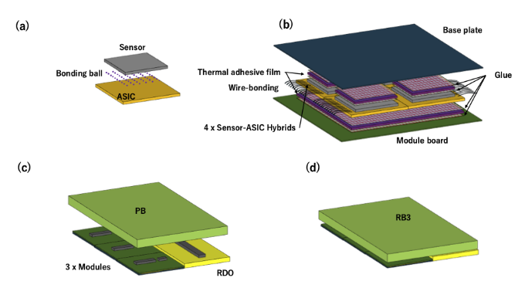
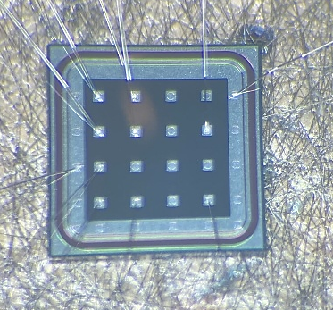
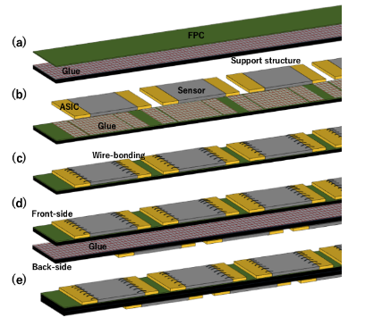
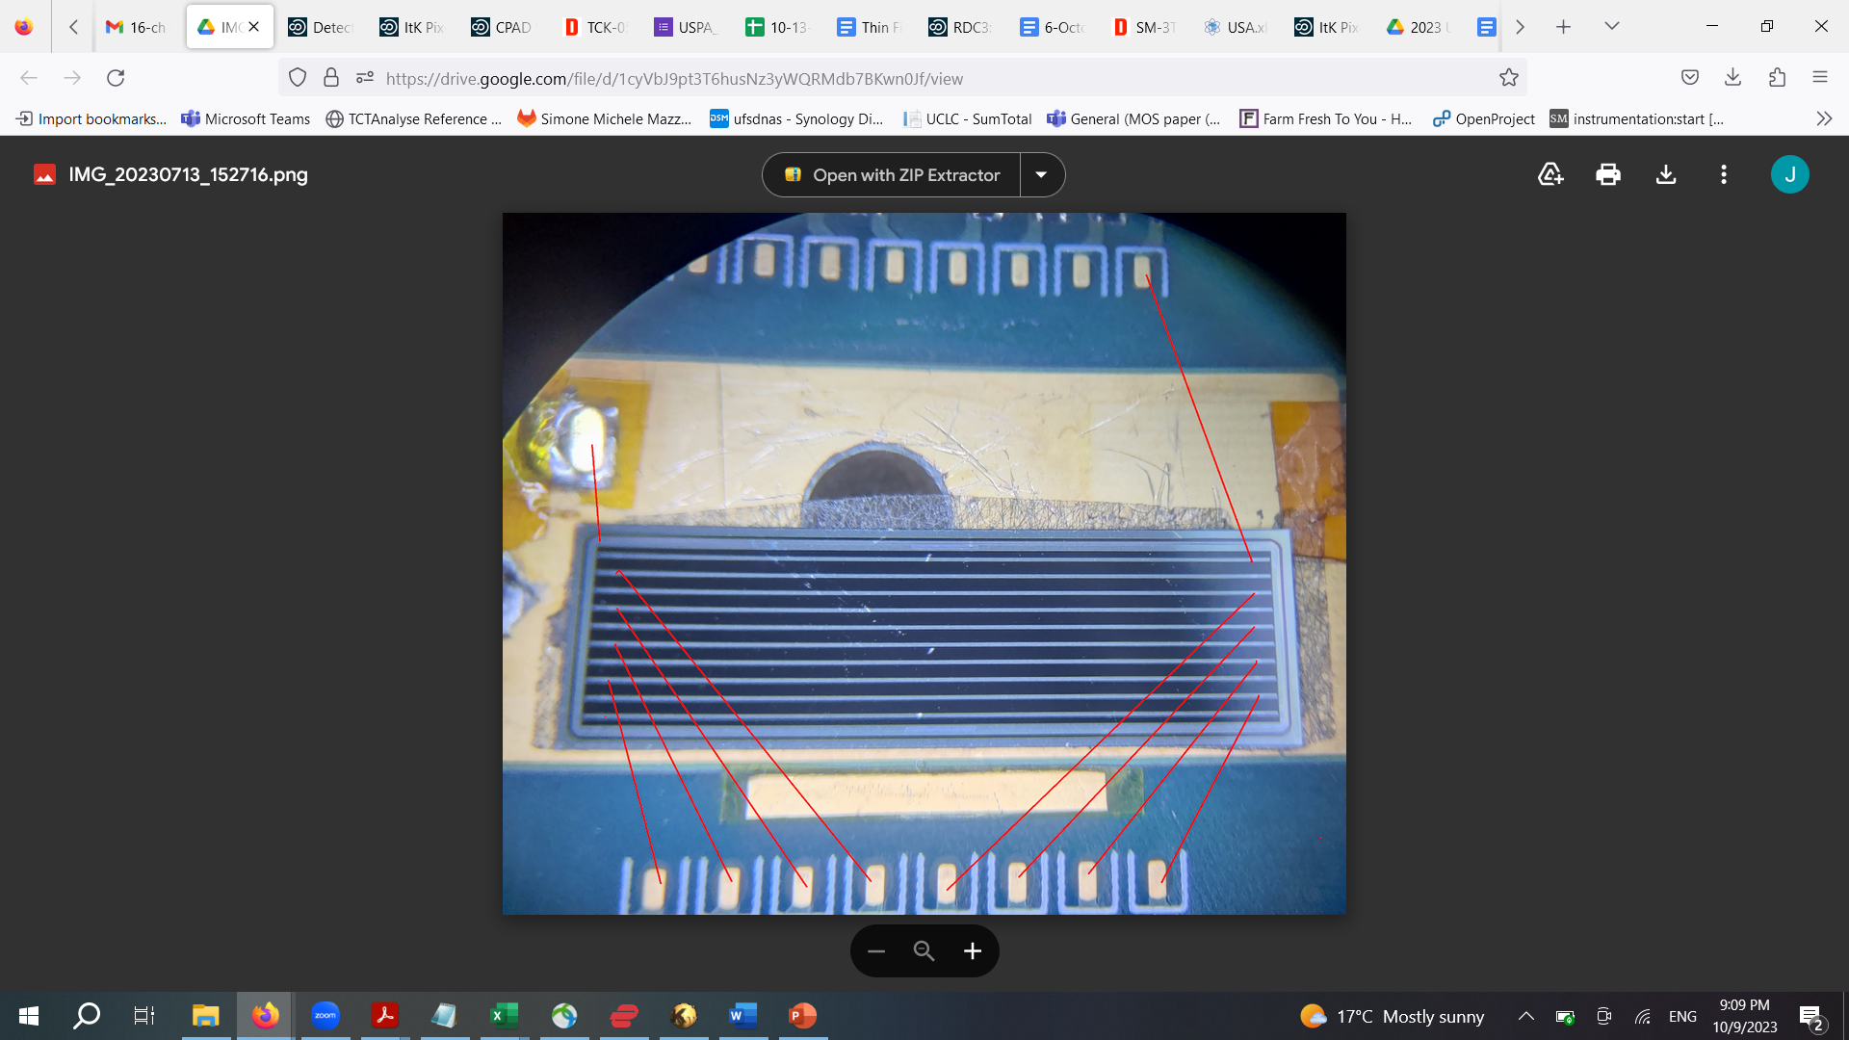
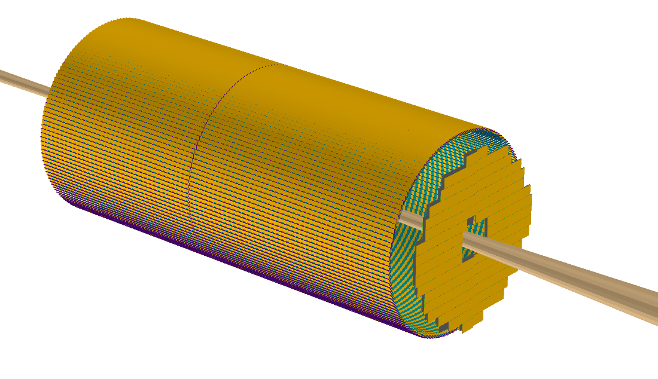
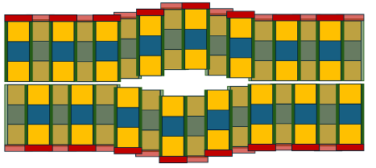
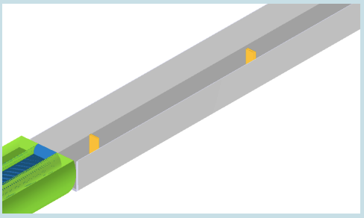
TOF layout in ePIC
Sensors: pixels
Readout: EICROC
Divided in two halves
Sensors: strips
Readout: FCFD
Sensors: pixels
Readout: EICROC
Off-Momentum Detectors (OMD)

Slide 3
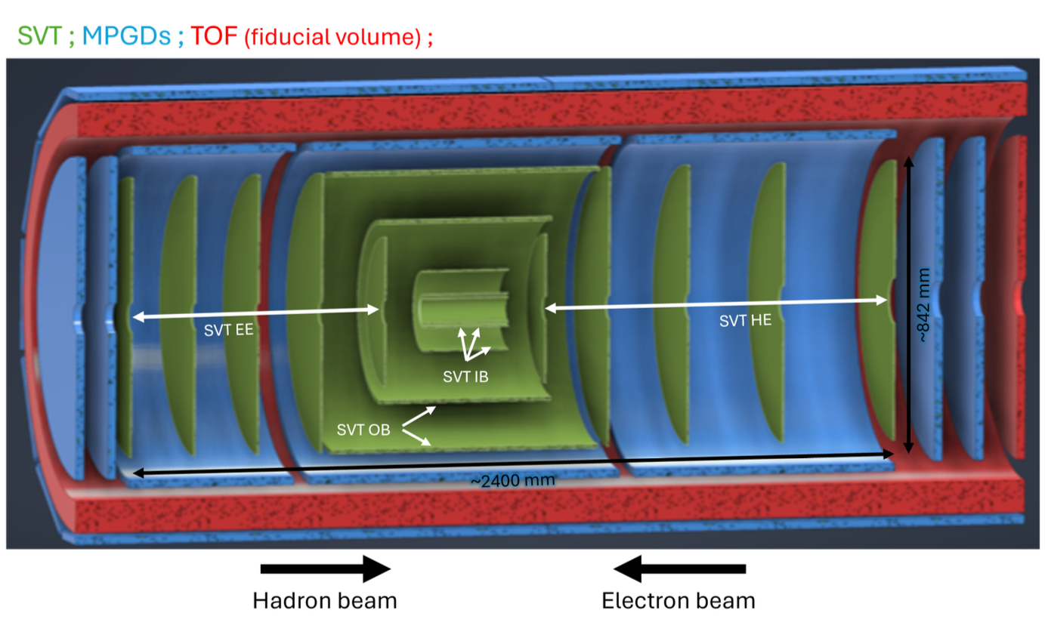
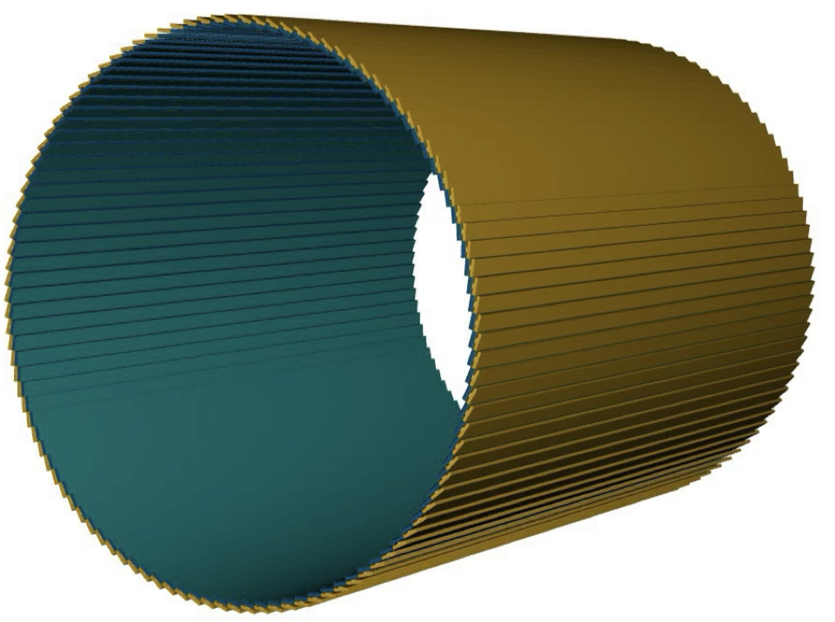
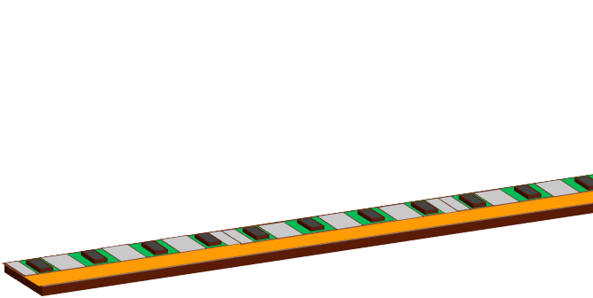
Barrel-TOF
Staves mounted in ‘trays’ that can be removed for servicing
Barrel-TOF (BTOF)
144 x Staves
0.64 m
~2.8 m
-1.33<η<1.74
The ePIC AC-LGAD TOF is PID, tracking and background rejection detector for mid-rapidity (BTOF: -1.33<η<1.74)
Cylindrical shape is composed of 144 tilted staves (288 half-staves)
Strip-type AC-LGAD sensor is used to meet the requirement of ~35 ps and ~30 um timing and spatial resolution respectively

Slide 4
Stave Assembling Steps (Opt1)
Sensor + ASIC
Module Assembly Site
Glue dispenser
Wire bonding
Interposer
FPC
Support structure (Carbon fiber)
FPC
Module-to-Module bonding machine
Cooling pipe and return (10-20C)
Stave Front/Back
Final Construction Site
Glue dispenser

Slide 5
Data Transmission
Half-Stave = 8 x Modules = ~ 1320 [mm]
Front-side
Back-side
Module (Stavelet) ~ 160 [mm]
3 x 8 x 2 x 288
=13824
8 x 2 x 288 =4608
2 x 8 x 2 x 288
=4608

Slide 6
Stavelet production volume
BTOF has 18432 ASICs that need to be connected to sensors. Assuming 4/5 yield, we need to connect 23040 ASICs. ASICs and sensors are assembled on a stavelet.
Volume: 144 staves, 288 half staves made of 16 stavelets (top and bottom)
Wirebonds per stavelet: ((128 + 128)x2 (sensors-> interposer ->chip) + ~20(chip))x4 -> ~2000 bonds.
4608 stavelets +10-20% yield adjustment, ~5300 to assembly in 2 years
Assuming 4 BTOF assembly sites: ~1300 stavelets per site in 2 years, around 3 stavelet per day -> possible

Slide 7
Assembly time of one stavelet
Glue placement: 20 minutes
Component placement: 20 minutes
Glue cure: UV 5-10 minutes, bi-component 12h, thermal ~1h
QC on glued component: 30 minutes (metrology)
Wire bonding: 20 minutes
QC on full stavelet: 1h
Full time: ~2-3h per stavelet (minus long glue cure time)
With parallelization it can be lowered (e.g. glue deposit on a jig with multiple stavelets). Likely QC will be most time consuming.

Slide 8
Assembly procedure for stave tray
Co-cure two halves of the stave with FPC
Glue stavelets on stave
Wirebond stavelets on to FPC
QC on half stave?
Assemble two halves with cooling pipe in between
QC on full stave
Assemble in trays

Slide 9
Crucial activities for the next year or two
Interposer board finalized design, to do when FCFD is available
Interposer board simulation in HFSS to understand transient signal effects
Identification of correct glue (UV or bi-component), viscosity, thermal conductivity
It might be necessary to use two different types of glue: thermally conductive glue for ASIC, electrically conductive for sensor
If UV glue, design of UV curing box. If bi-component glue, glue robot calibration vs viscosity. If thermal cure, check effects on components
Identification of glue robot configuration or glue panning with jigs
Define QC procedure before assembly
Define QC during assembly (metrology)
Define QC procedure after assembly (DAQ?) and testing PCB
Design jigs for stavelet assembly, movement and shipping
Define wire bond encapsulation needs and procedure
Define and build database
To identify the correct components, it might be useful to go to fairs, like Semiconductor West

Slide 10
Plans
Thermo mechanical test – 2025
Ongoing with PED funds 2025, production of a simple 1 stavelet demonstrator front and back mounted on a carbon fiber support with cooling pipe. ASICs are mimicked with Si heathers.
Assembly R&D - 2026
Define glue and first version of Jigs. Define assembly procedure and QC procedure before assembly
Prototype 1 – 2026
Production of a full stave demonstrator front and back mounted on a carbon fiber support with cooling pipe. ASICs are mimicked with Si heathers.
Assembly R&D – 2027
Shipping tests, finalize assembly and identify assembly machines, finalize jigs. QC procedure before-after assembly. Build first QC test station for stavelet
Prototype 2 – 2027
Production of a full stave rack demonstrator (4 staves) front and back mounted on a carbon fiber support with cooling pipe. ASICs are mimicked with Si heathers. Production of a stavelet with working ASIC and development of PCB for stavelet testing.
Pre-production – 2028
10% of production, 500 stavelets
Production – 2028-2030
Remaining 90% of production, 5000 stavelets

Slide 11
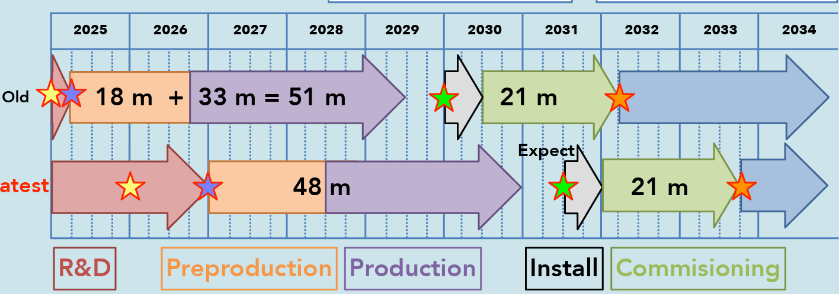
BTOF road-to-assembly
Demonstrator assembly
Develop tooling
Pre-production: assembly N stavelets
Full assembly
ITk (ATLAS) assembly
Having issues

Slide 12
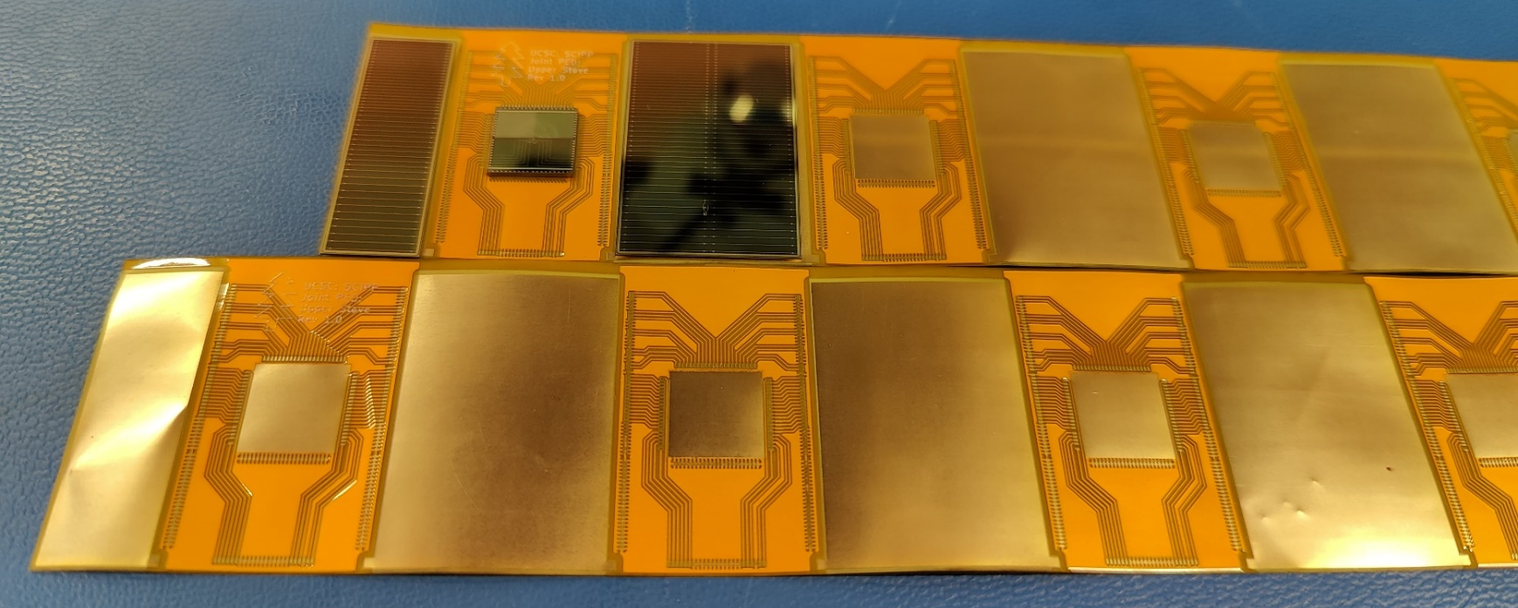
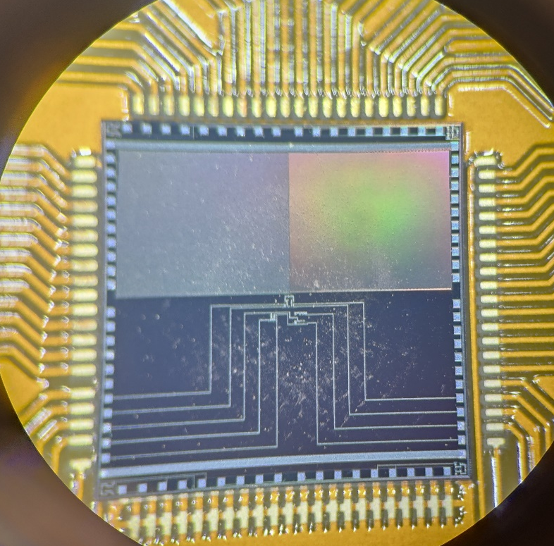
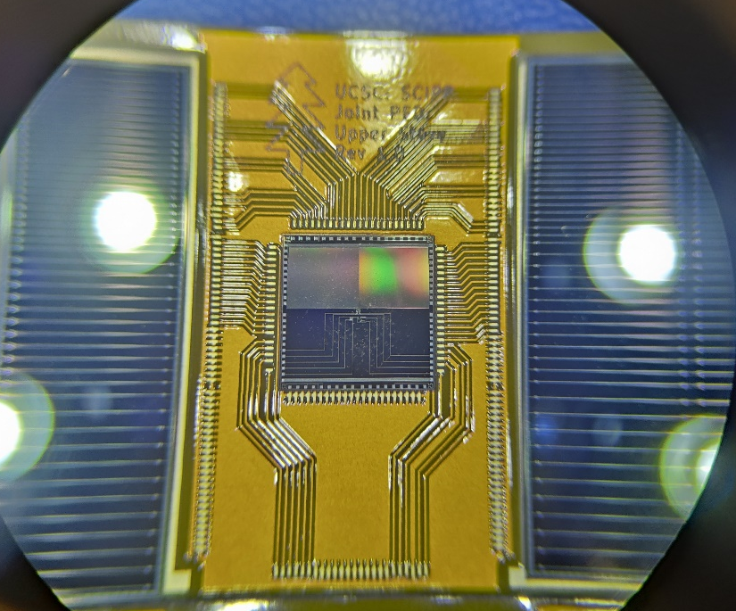
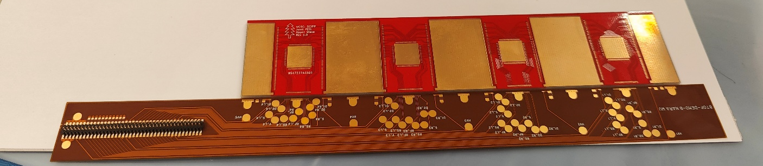
Stavelet demonstrator - 2025
Plan to demonstrate the assembly procedure and study the thermal characteristic of a stavelet
First prototype of interposer board produced
Using non-working detectors from the HPK production
Si heaters to simulate ASIC
Fully load a double-sided stavelet with active pipe cooling and check thermal dissipation in prototype

Slide 13
Institutes involved and roles – pre-assembly
Hiroshima – define FPC QC/QA, define interposer QC/QA. Wirebond and assembly tests
Riken – design FPC, define FPC QC/QA. Wirebond and assembly tests
UCSC – Identify glue, define needed machines (glue robot, storage), design interposer. Wirebond and assembly tests
UIC – holding jigs, shipping jigs, gluing jigs
FNAL – design FCFD, test FCFD
Purdue – Test stave production, test assembly, define supports
? – stavelet QA development (PCB design and test station)
? – database set up
PRELIMINARY, TO BE DISCUSSED!

Slide 14
Institutes involved and roles - assembly
Hiroshima – sensor, FPC QC, assembly, stavelet QA
Riken – sensor, FPC QC, assembly, stavelet QA
UCSC – sensor, FPC QC, assembly, stavelet QA
? – assembly (4th site?)
Purdue – Stave production, final stave assembly and double-side gluing
BNL – Final tray assembly
? – stavelet QA, ASIC QA/QC
PRELIMINARY, TO BE DISCUSSED!

Slide 15
Detector Assembling Workflow
Interposer
Production
Company C
Sensor Production
HAMAMATSU
ASIC Production
TSMC
FPC Production
Company D
RB Assembling
Company E
PB Assembling
Company E
Interposer QA
Hiroshima
Interposer QA
RIKEN
Interposer QA
UCSC
Sensor QA/QC
Hiroshima
Sensor QA/QC
RIKEN
Sensor QA/QC
UCSC
ASIC QA
Institute A
ASIC QA
Institute B
FPC QA
Hiroshima
FPC QA
RIKEN
FPC QA
UCSC
RB QA
Rice
PB QA
Rice
SH Assembling
Rice
SH QA
Rice
Module assembling
Hiroshima
Module assembling
RIKEN
Module assembling
UCSC
Mechanical
Production
Purdue/Academia Sinica
Module QA
Hiroshima
Module QA
RIKEN
Module QA
UCSC
Mechanical QA
Purdue/Academia Sinica
Module
Check
Purdue /BNL
Stave assembling
Purdue/BNL
Stave QA
Purdue/BNL
BTOF construction
BNL
BTOF QA
BNL
Install to ePIC
BNL

Slide 16
Discussion with FCFD developers
Fan-in lines can be an issue for the chip readout, degrade the signal and introduce extra capacitance
Solution: use 4 chips per 2 half-sensors, long and narrow with same pitch as sensor
Direct connection to sensor
4 chips will be condensed in only one set of lines, no increase in connections
Stavelet design remains the same, we can’t split in the middle the interposer (need lines between chips)
FCFD
To FPC

Slide 17


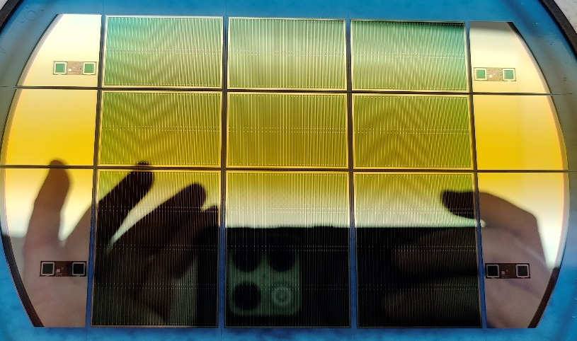
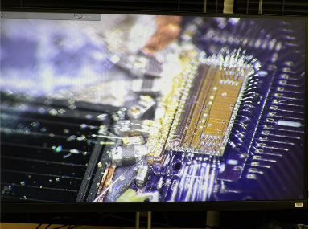
Conclusions
Still a lot to do to finalize assembly procedure!

Slide 18
Backup

Slide 19
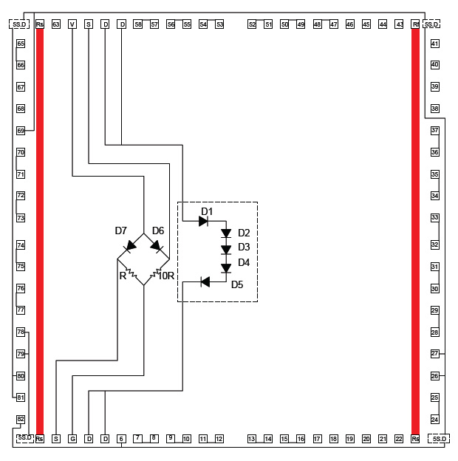
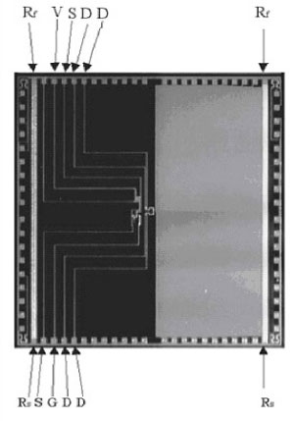
Test Si heater
1x1 cm size, 20 in SC right now
9 needed for the design
Each one need 1 line for heaters and 5 (?) for sensors
Has 2 sensors, one for absolute (less precise) and one for relative (more precise)

Slide 20
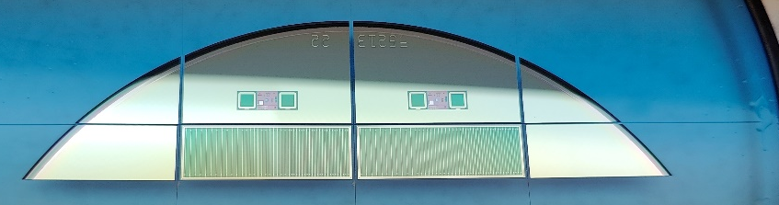
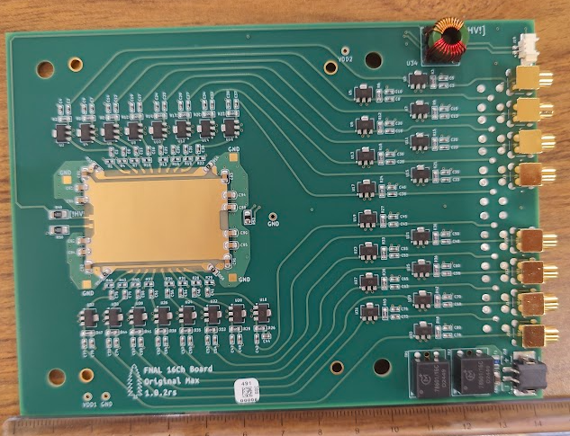
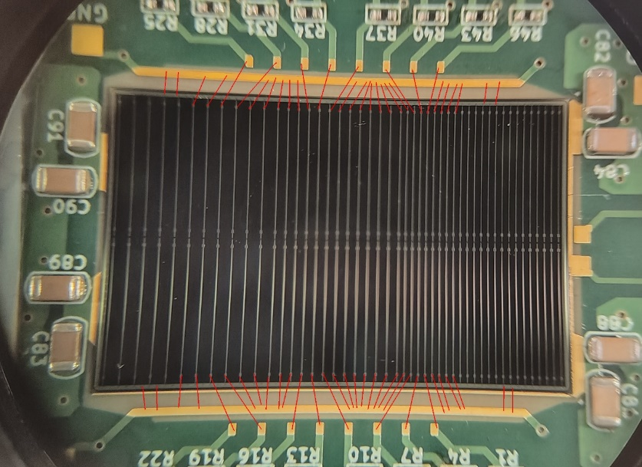
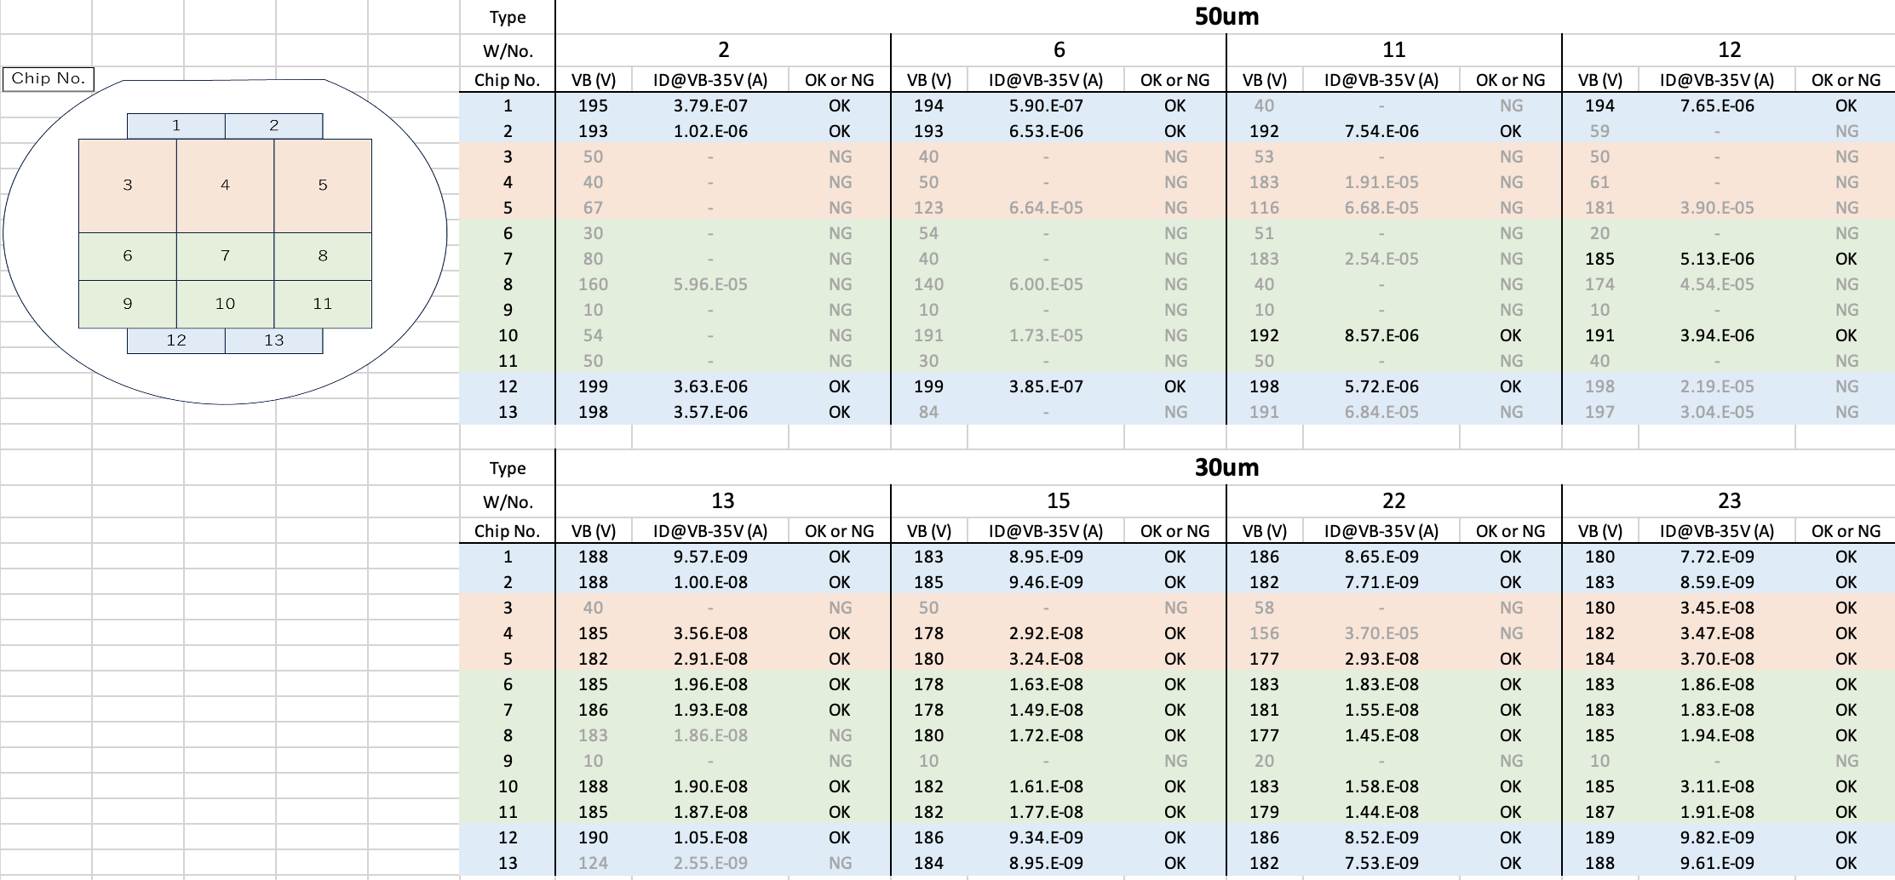
HPK AC-LGAD strip production
Half sensors
ePIC full-size production of HPK strip AC-LGADs with devices up to 3.2x4.2 cm
Nominal size 3.2x2.2 cm with 1cm strip ‘segments’
Strip width: 40-50um, strip pitch 500, 750, 1000 um
8 wafers in hand, four 50um thick and four 30um thick
Full sensors
Double sensors

Slide 21
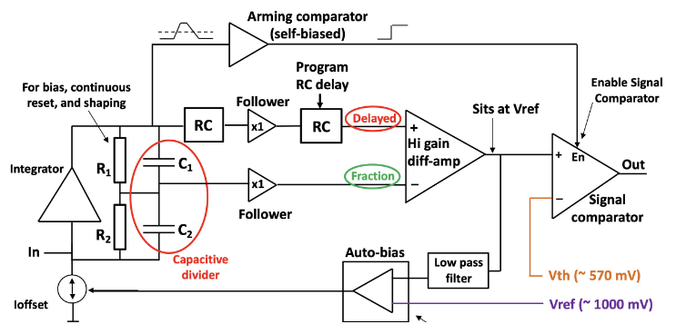
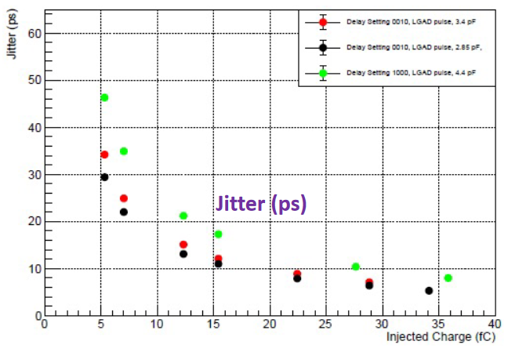
AC-LGAD strip readout – FCFD (FNAL)
AC-LGAD strip readout developed at Fermilab
Can accept high input capacitance o(10pF)
Target Jitter <10ps
FCFDv1 – 6 channel received Jan 2024.
Tested at FNAL in May/June 2024, AC & DC-LGAD (1 mm):
DC-LGAD @ 50 ps; AC-LGAD @ 52 ps
AC-LGAD should get ~35 ps with improved comparator.
FCFDv1.1 – TSMC May 2025; DESY tests in July 2025.
128 ch strip readout
65 nm CMOS
Constant Fraction Discriminator
Plus TDC, ADC, interfaces
Cdin: <15 pF
Dynamic Range: 5-40 fC
Timing: 10-30 ps
Links: ~Gbps, multiple
Radiation tolerant.
21

Slide 22
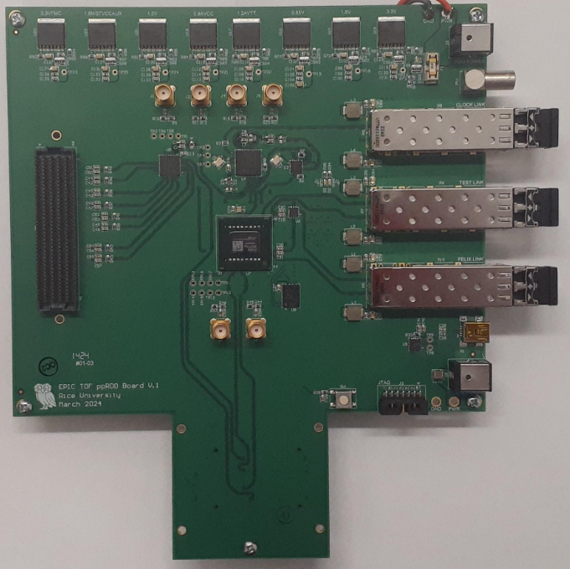
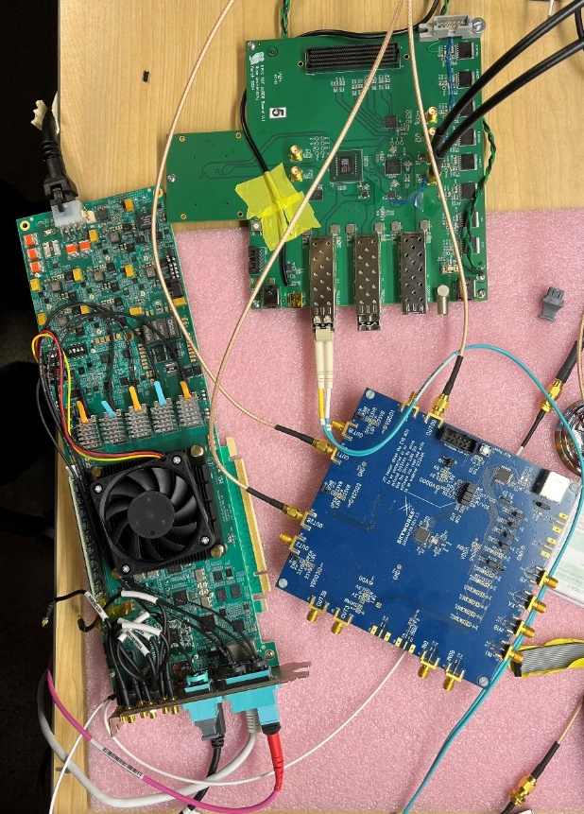
High Precision Clock Distribution
ppRDO – pre-prototype Readout Board:
Generalized to allow readout from various ASICs – FMC connector
Xilinx Artix+ FPGA (low cost, CERN TCLink compatible)
Clock Jitter cleaner – 5 ps
Clock recovery on Rx of SFP or direct clock on dedicated fiber
Establish procedures to readout ePIC’s ASICs prototype PCBs
Develop common streaming readout scheme with DAQ’s protocols
Platform for radiation tests (SEU measurement and handling)
Produced and tested 6 PCBs.
Jitter measured at 3 ps (Ref clock – FLX182 Tx serializer – ppRDO)
ppRDO
(ADCLK944)
Si5344H
(ref Clock)
FLX182
22

