Slide 1
C-AD AI/ML Activities, Results, and Plans
Kevin Brown (C-AD)
Collaborations with Cornell, RPI, CMU, JLab, SLAC, Fermilab, LBNL, PNNL, and growing.
11 December 2025 2025 C-AD MAC Review

Slide 2
Outline
Overview of AI/ML funded projects to date
Genesis Mission Connections
EIC-BeamAI
NARAD project
polarization improvements project
Longitudinal emittance monitor
Transverse emittance
Optics measurements and ORM analysis
List of publications (including submitted or in-progress) and Presentations

Slide 3
Overview of AI/ML funded projects to date
Higher RHIC polarization by Physics-informed Bayesian Learning
  NP funded, $1.5M, duration 2 years, start 09/01/2023
  BNL, Cornell, JLAB, SLAC, RPI
  Plans presented in 2023 C-AD MAC
Toward higher brightness and polarization of hadron beams: Digital-Twin-based autonomous control of BNL’s hadron accelerator chain
  NP funded, $1.5M, 2 years, continuation/renewal
  BNL, Cornell, JLAB, SLAC, FNAL, RPI
Developing AI-Ready Data Framework for DOE NP Particle Accelerators
  Now called NARAD = NP AI-Ready Accelerator Data
  ASCR/NP funded, $4M, duration 2 years, start 10/1/2025
  JLAB (lead), BNL, Cornell, LBNL, PNNL (+ informally, FNAL and SLAC)
Additional collaborations
Particle Accelerator Lattice Standard (PALS)
python Accelerator Middle Layer (pyAML)
Multi-Office particle Accelerator Team (MOAT)

Slide 4
Genesis Mission Connections
All our efforts fall under the umbrella of the Genesis Mission.
MOAT aims to build national accelerator physics knowledge into a national AI infrastructure that can be used across all platforms to inform on accelerator design and operation.
PALS aims to build a standard language for describing particle accelerators.
NARAD aims to build a standard framework for streaming accelerator data to AI agents.

Slide 5
EIC-BeamAI
Our growing collaboration has joined the EIC Accelerator Collaboration (EICAC), as a working group named EIC-BeamAI.
We have been participating in the AI4EIC workshops each year since they started. For the next workshop we will have a special session on AI in accelerators.
2021 – Auralee Edelen, Accelerator control
2022 – Todd Satogata, AI/ML overview for accelerator design activities
2023 – 1st year with Accelerator session: Led by K. Brown, Elena Fol
7 talks on community efforts that relate to the EIC
Lucy Lin, Machine learning for digital twin development and polarization
optimization at BNL hadron injectors
2025 - AI/ML for Accelerators session: led by K. Brown and B. Mustapha
Eiad Hamwi, Use of AI/ML for higher brightness and higher polarization of hadron beams
Chris Kelly, Machine-Learning–Accelerated Bayesian Uncertainty Quantification for
Digital Twin Modeling …
Chris Hall, Machine Learning Approaches to Improved Ion Profile Monitor Measurements
K. Rajput, Explainable and Differential Reinforcement Learning for Multi Objective
Optimization in Particle Accelerators

Slide 6
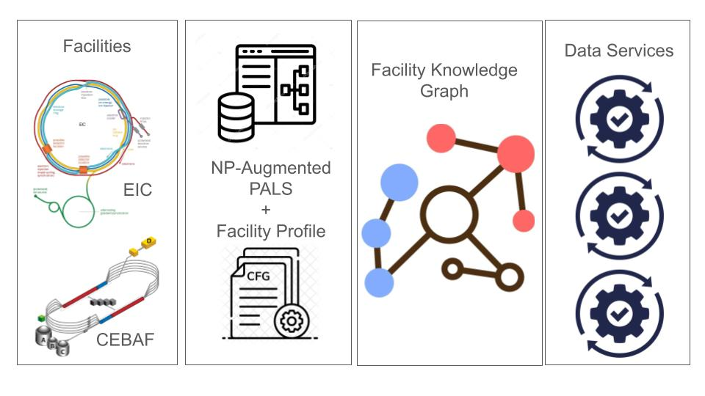
NARAD project
American Science
Cloud, Foundation
Models, AI systems,
ModCon
Local Machine
Description
PALS
Description

Slide 7
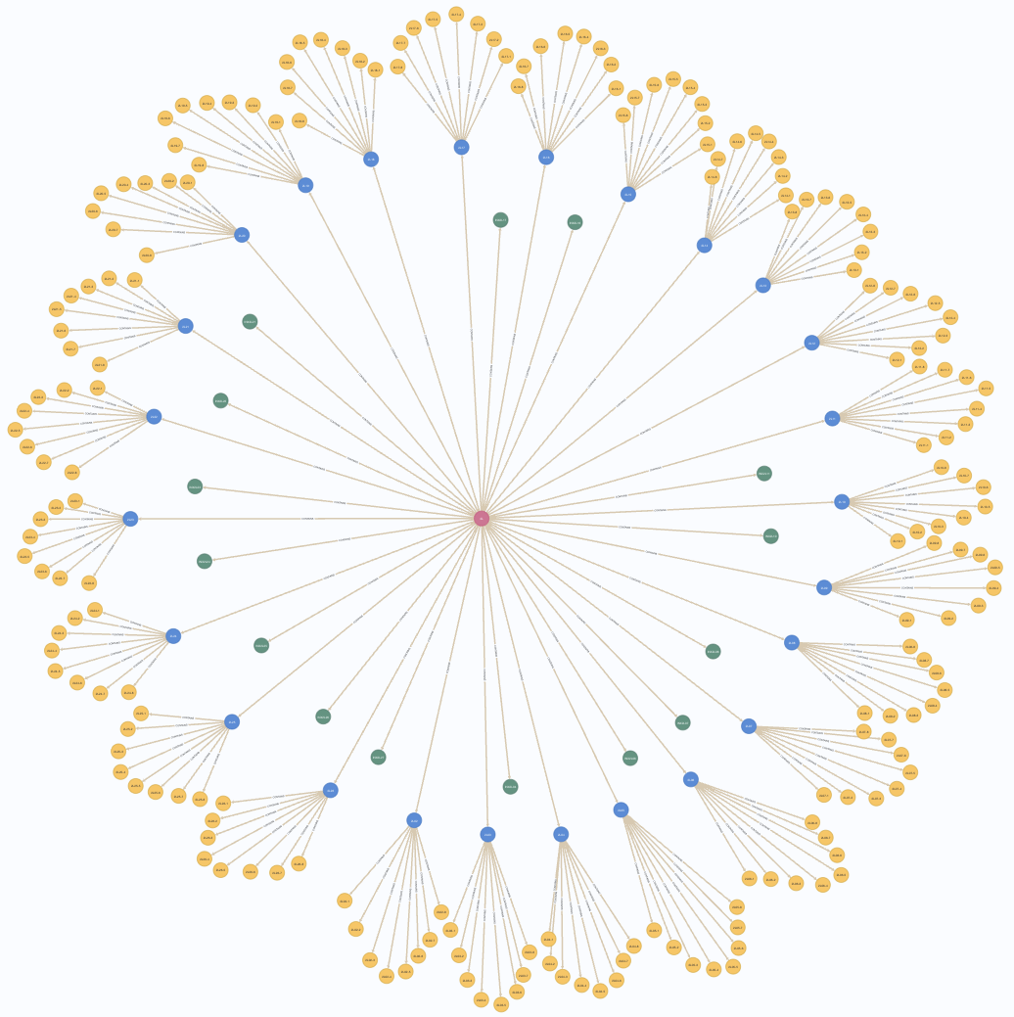
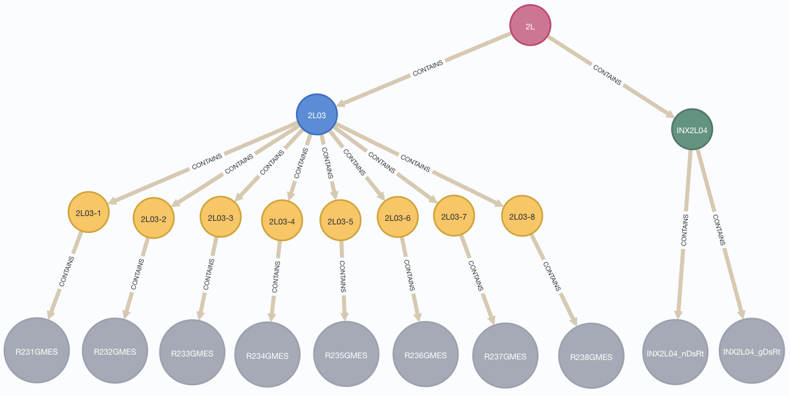
Example Workflow
Example Query:
Estimate the radiation level at radiation detector “INX2L04” using PVs of the previous CryoModule “2L03”
Some Query Method
MATCH (l:Linac)-[:CONTAINS]->(m:CryoModule {name: "2L03"})-[:CONTAINS]->(c:CryoCavity)-[:CONTAINS]->(pc:PV)
WHERE pc.name ENDS WITH "GMES"
MATCH (l)-[:CONTAINS]->(d:NeutronDetector {name: "INX2L04"})-[:CONTAINS]->(pd:PV)
RETURN l, m, c, pc, d, pd
Contextual Subgraph Extraction
Facility Knowledge Graph
AI Supervised Learning:
Y = NN(X) ⇒Traditional
or
Y = GNN(X) ⇒ Advanced
Temporal Data Extraction
X
Y
Notes:
End-to-end … traditional vs new methods … V&V
Simulation might have finer resolution than the real system
Facilities are “by design” diagnostic limited … so we can use the model to enhance the knowledge
What is best capture in the KG (sim and real)
Link prediction … missing information .. information can be inferred

Slide 8
Why is this useful? EIC as an example
We are developing AI/ML methods at the AGS and AGS Booster, learning experimentally how to get these tools to work in operations.
Once EIC is built, we will use what we learned to efficiently apply to EIC systems.

Slide 9
Polarization Improvement Projects
NP AI-Ready Accelerator Data
LINAC models, magnetized beams
Diagnostic for measuring coupling in LtB
LtB injection optimization
NSRL Digital twins (bumps and beam line optics)
BtA injection optimization

Slide 10
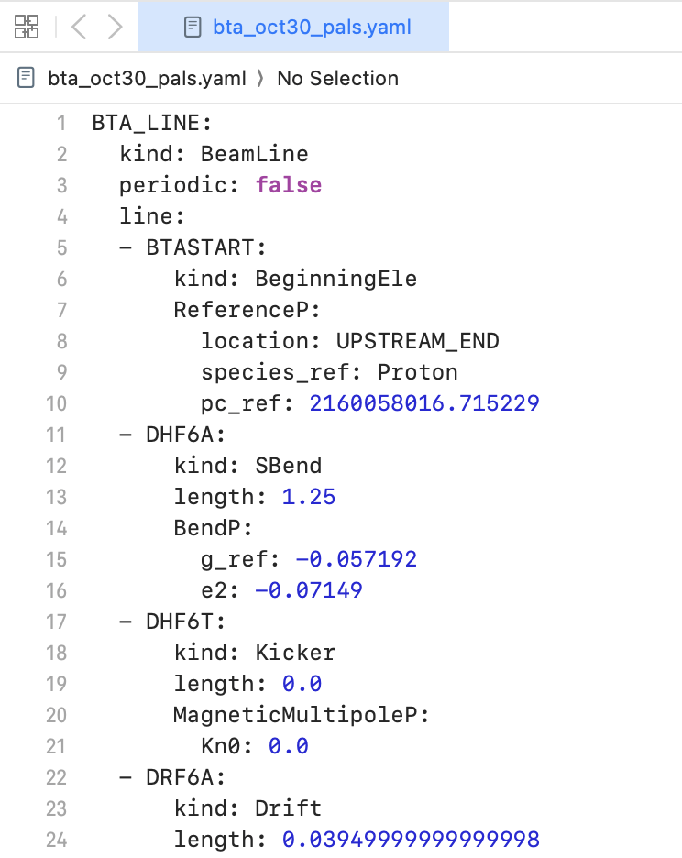
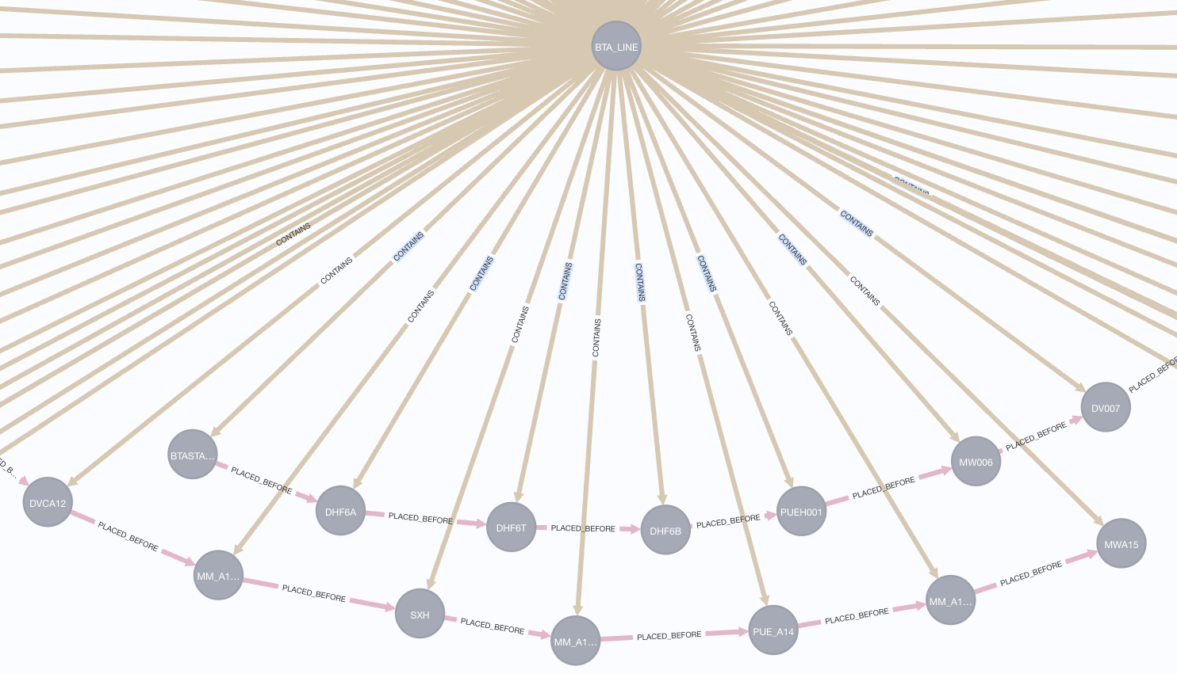
NP AI-Ready Accelerator Data (NARAD)
The BNL use case focuses on the Booster to AGS (BtA) transfer line. The use case demonstrates how a standardized, AI-ready lattice and data representation can support modeling, diagnostics, and optimization workflows.
We have produced a complete PALS representation of the BtA line and built corresponding parsers between PALS and Bmad to enable consistent simulation studies.
We have also begun reviewing operational data sources to identify format gaps and required metadata for integration into the NARAD framework.

Slide 11
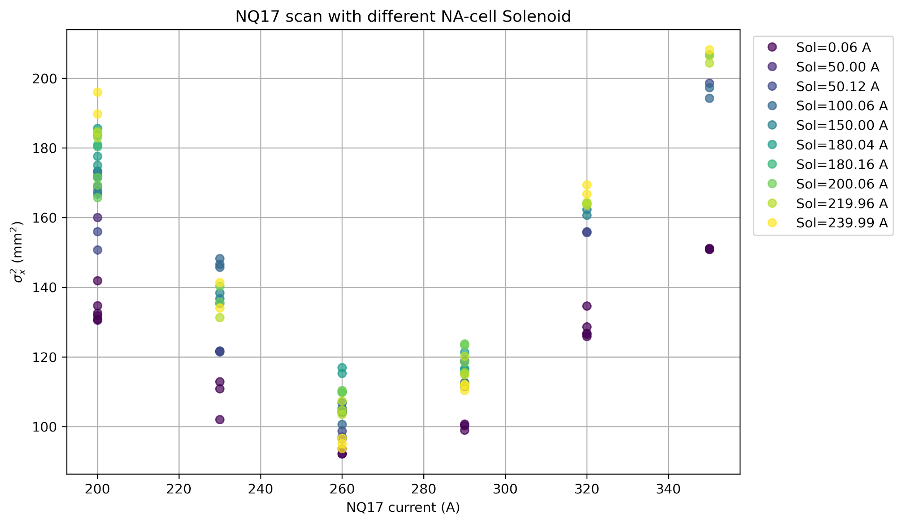
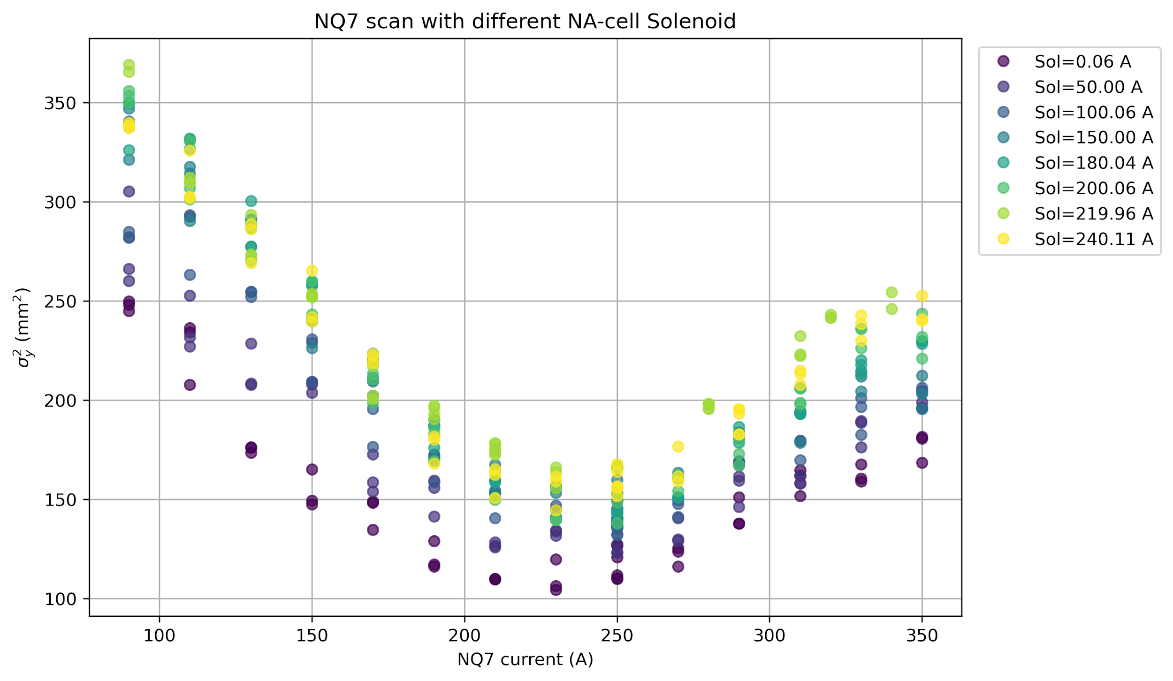
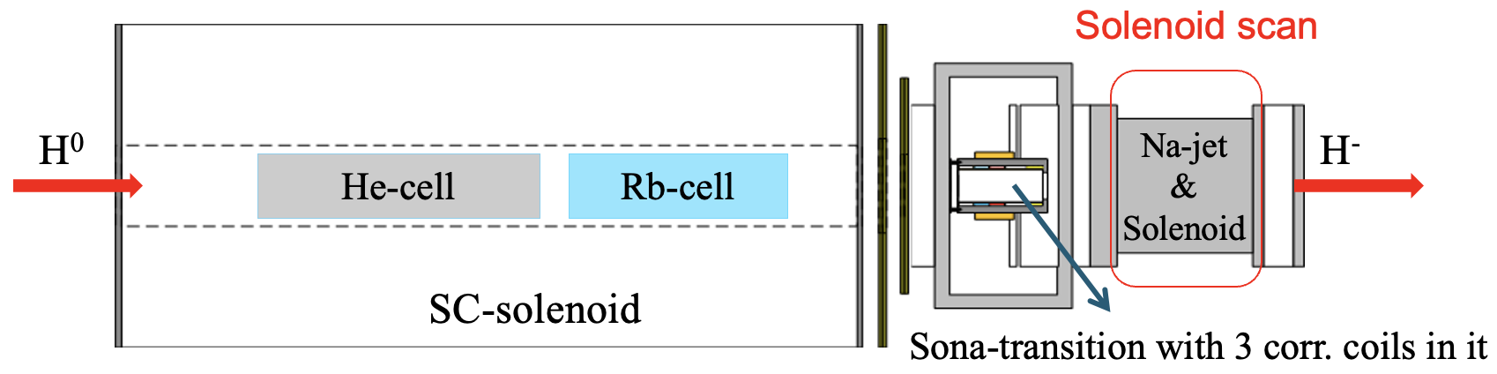
Coupling measurement in LtB
H⁻ beam is born inside a solenoid in OPPIS as transversely coupled beam
Multiple quadrupole scans have been performed at various locations of the LtB beam line, while changing the solenoid strength
Data analysis and simulation studies to quantify coupling is in progress

Slide 12
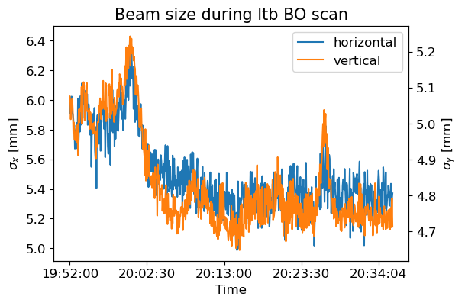
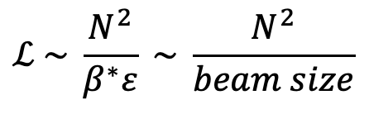
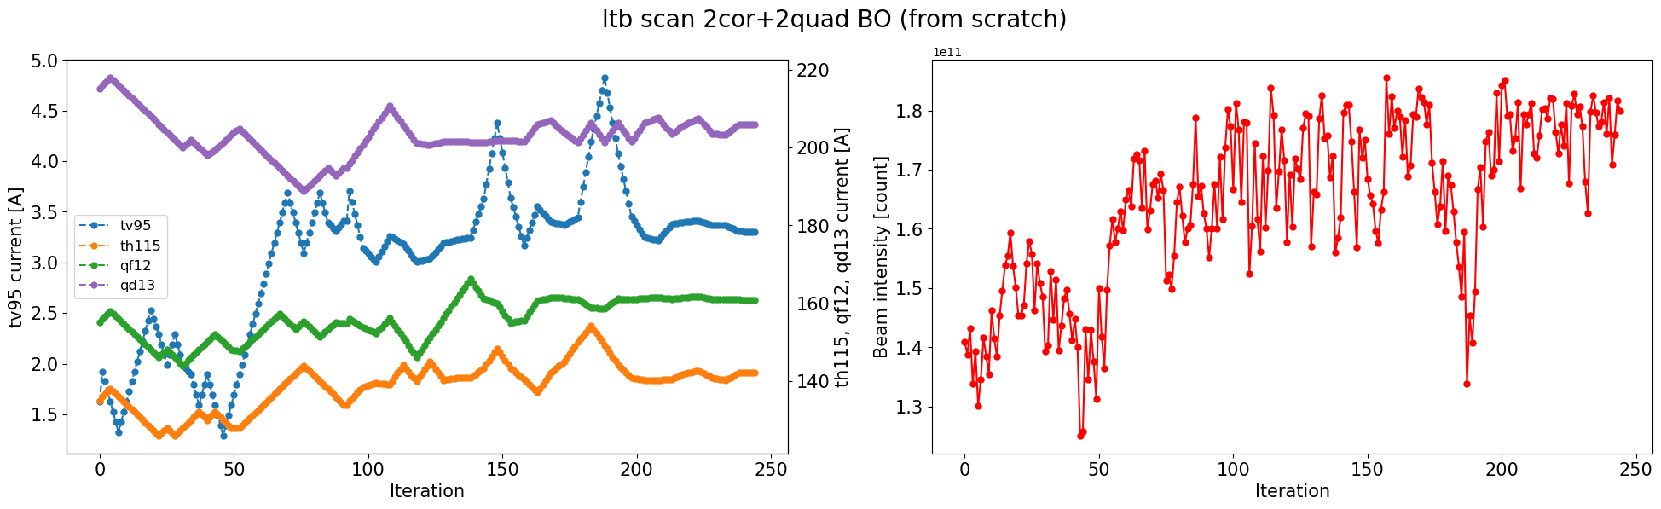
LtB Injection Optimization with BO
Bayesian Optimization algorithm automatically maximizes Booster beam intensity using LtB optics
Higher intensity after fixed scrapers → smaller beam size → higher luminosity L
Beam size decrease observed in both planes in the BtA line corresponds to intensity increase

Slide 13
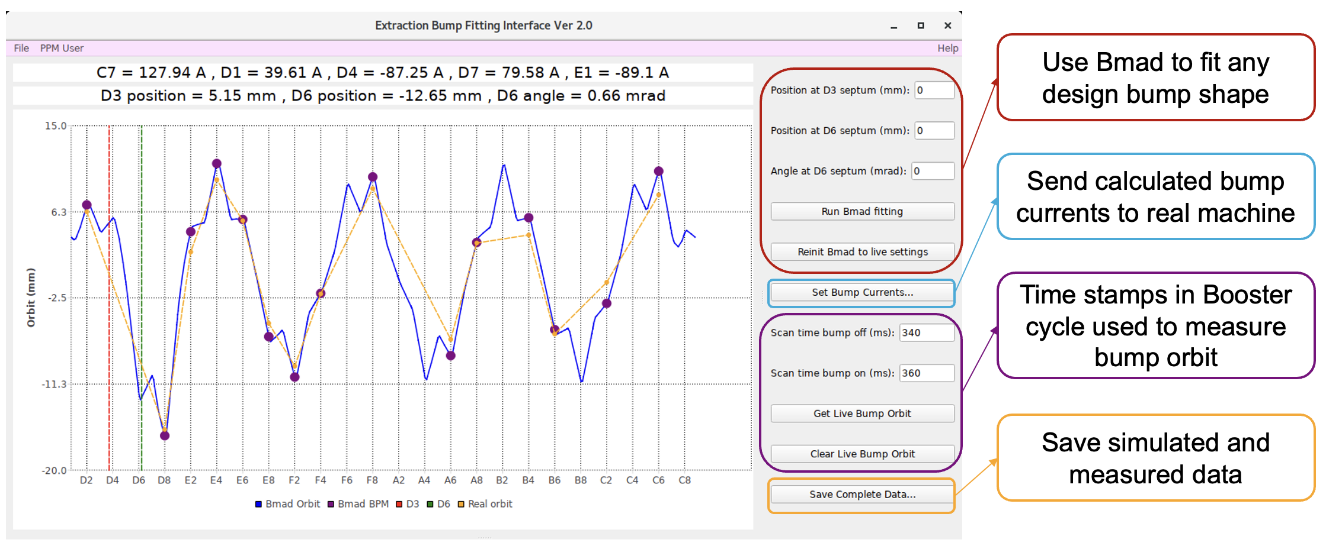
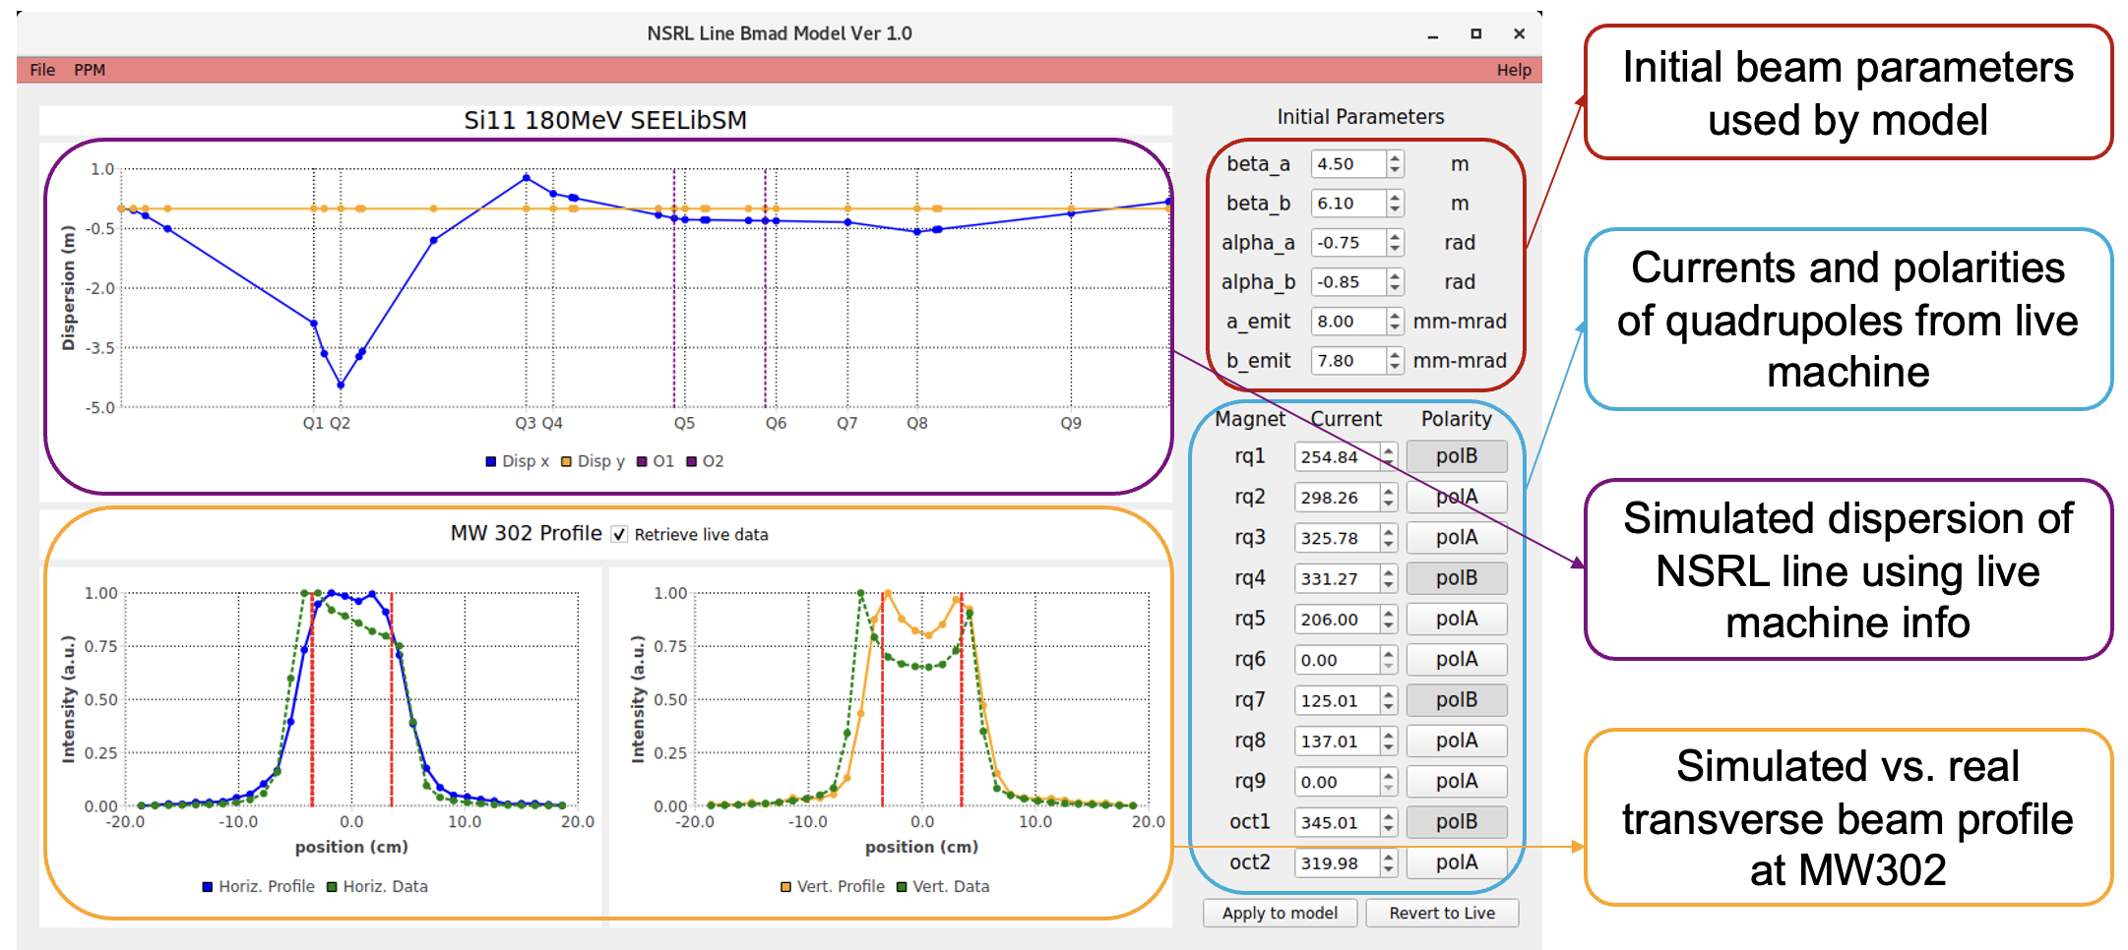
Digital Twin for NSRL
We developed and tested a complete digital twin (DT) system for the Booster extraction bumps, with bidirectional interaction between physical and virtual accelerators.
DT for NSRL line also under development, will facilitate beam uniformity optimization
Future NSRL tuning will be easier and more streamlined with the help of DT applications

Slide 14
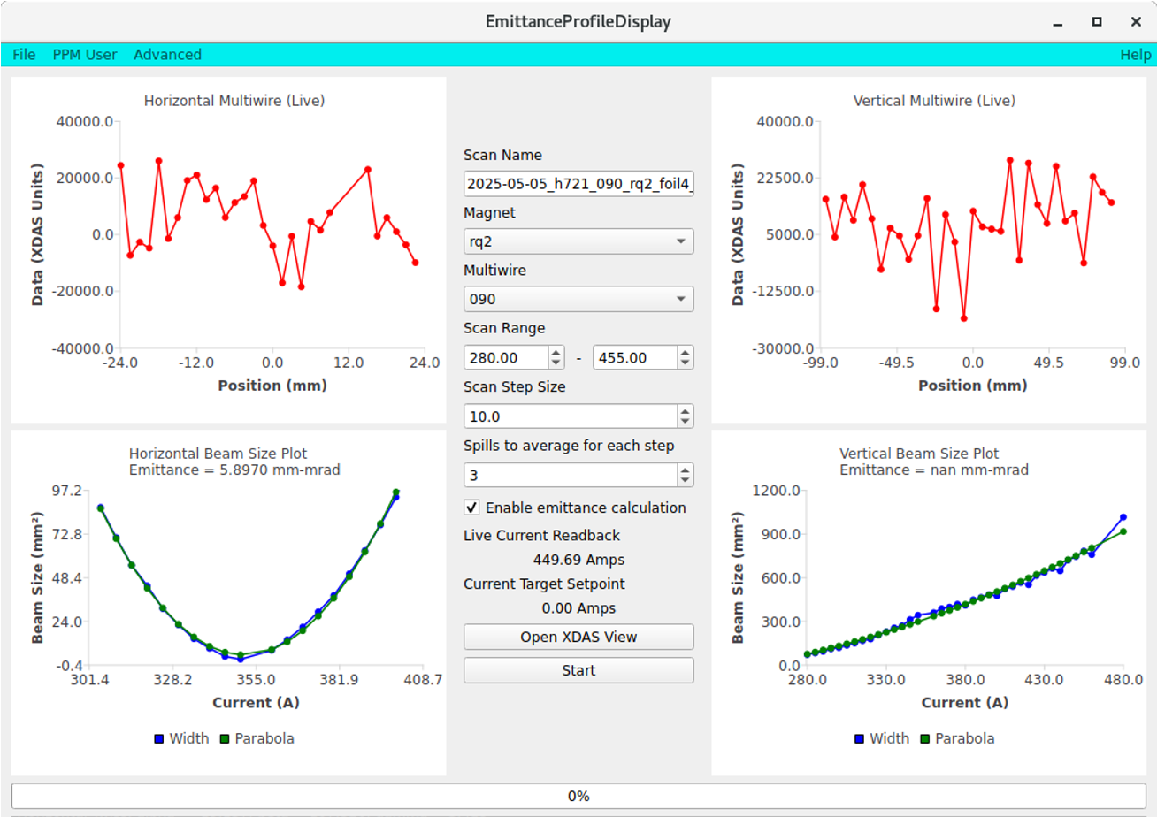
In operation: quad scan application
Quadrupole scan application to automate quad scans and emittance calculations

Slide 15
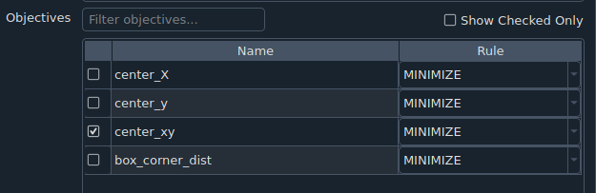
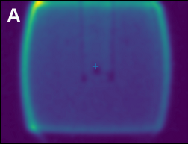
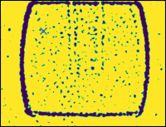
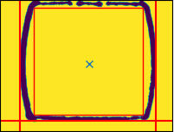
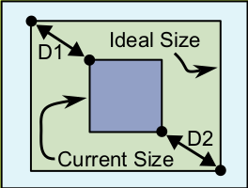
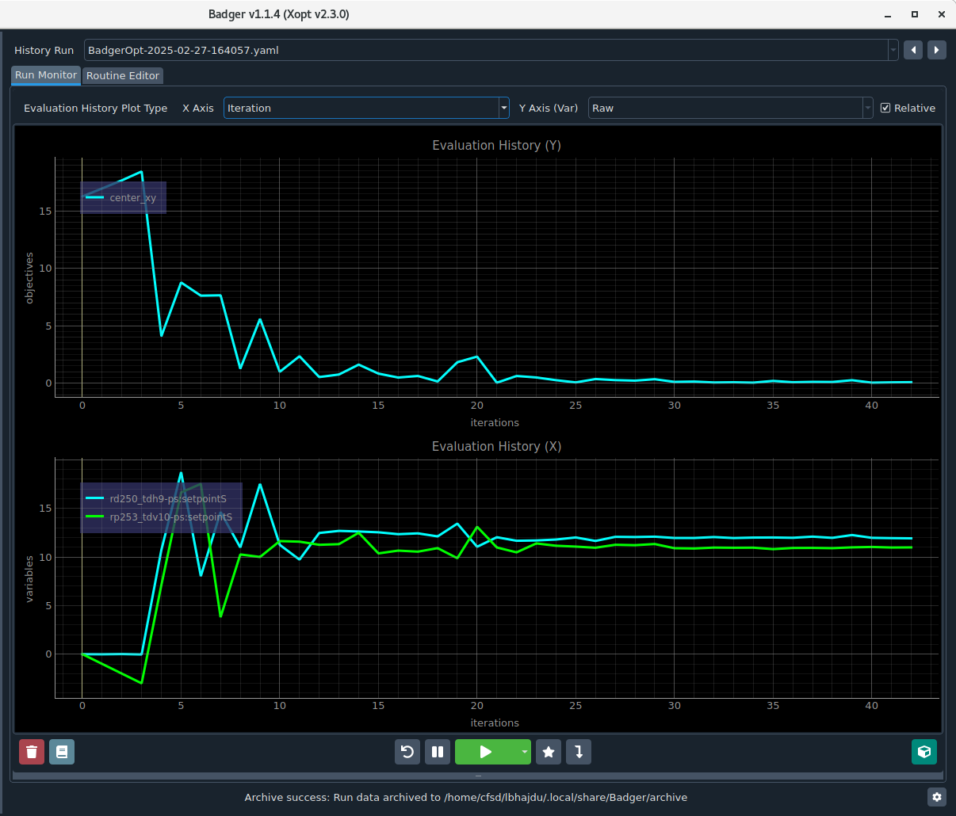
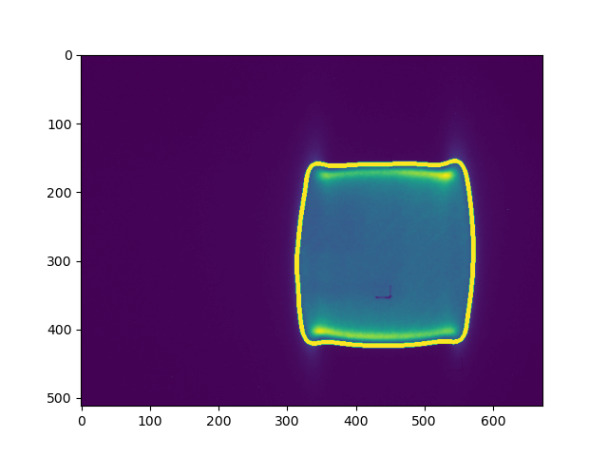
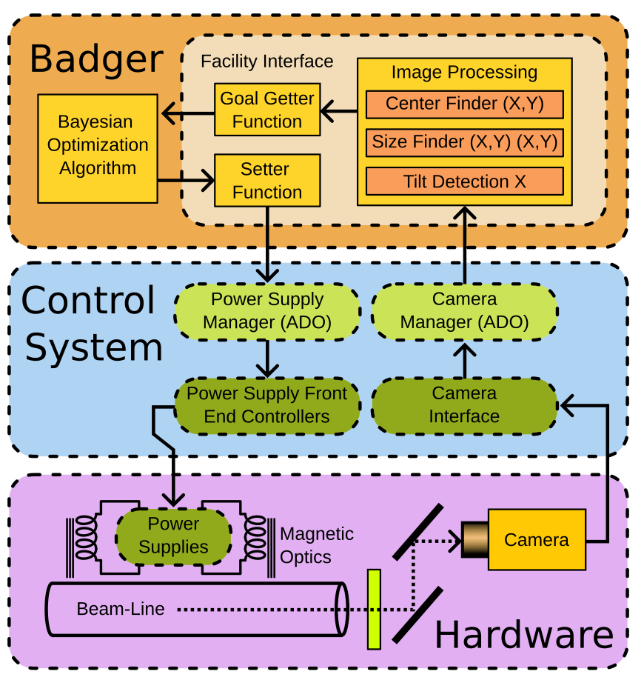
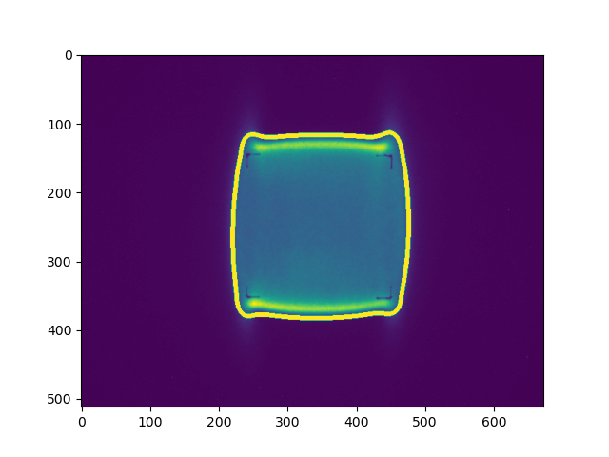
NSRL BO Beam Optimizer with Badger Interface
NSRL beam optimizer with Badger user interface for centering and sizing beam of different rigidities for different size experiments
Beam Sizing Algorium

Slide 16
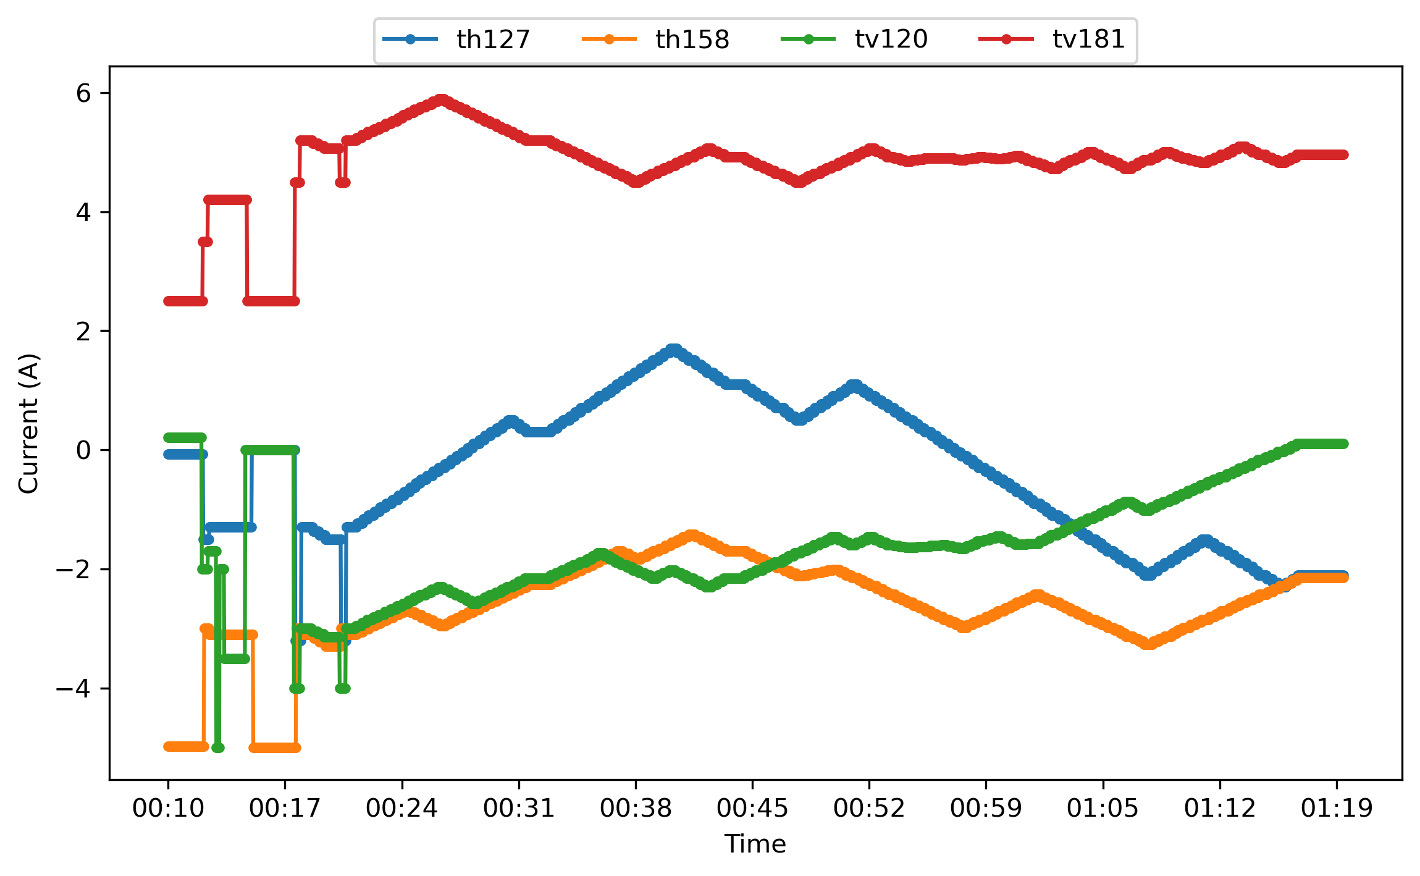
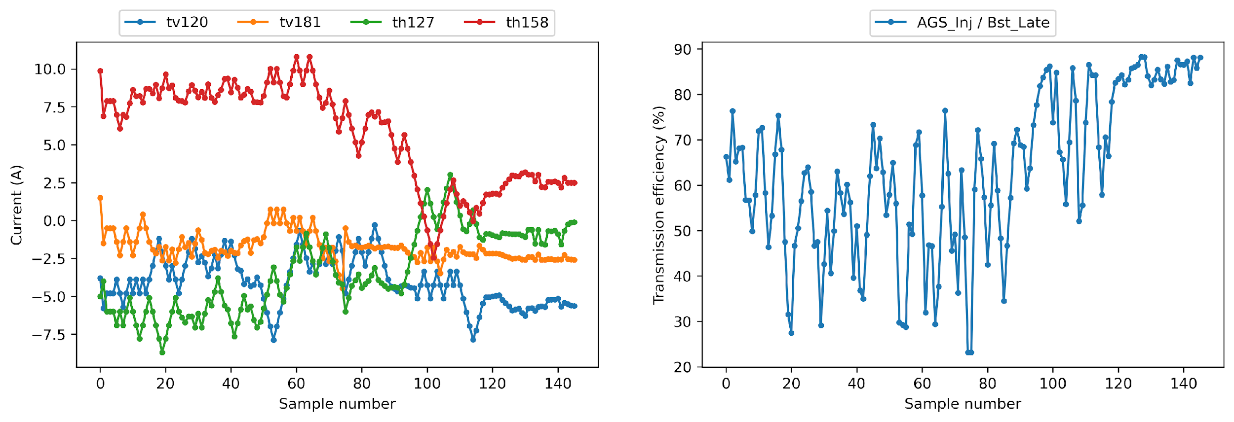
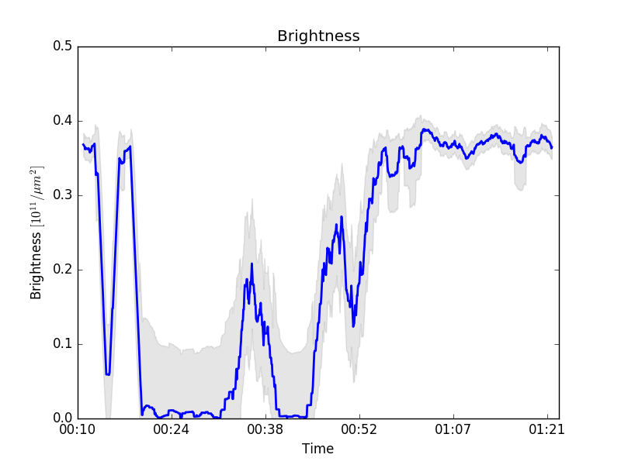
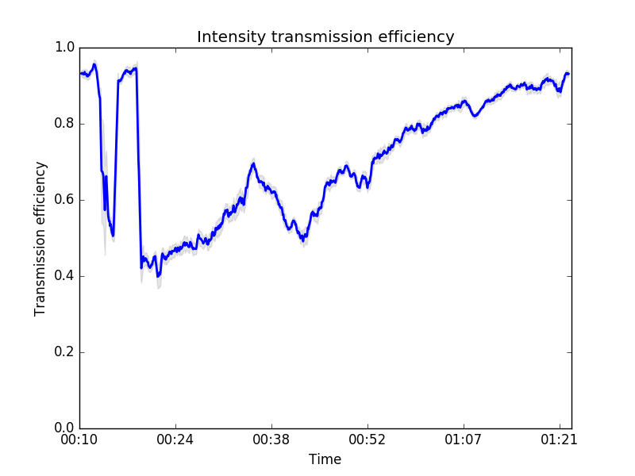
BtA Injection Optimization with BO
Bayesian Optimization algorithm automatically maximizes beam transmission using BtA optics
Measure transmission efficiency via DCCT and emittance growth via IPM
Real-world test starting from operational settings show 20% improvement
2024 Test
2025 Test

Slide 17
List of operational tools / applications
Badger (Xopt) for Bayesian Optimization, available for LtB, BtA, NSRL
Booster extraction bump fitting interface
NSRL line tuning interface
Quadrupole scan application, available for BtA and NSRL, in development for LtB and TtB
Orbit response measurement script, available for Booster and AGS

Slide 18
Emittance
Longitudinal Profile Data Acquisition
Longitudinal Emittance Manager
Bunch merging
Transverse Emittance in AGS
Optics Measurements

Slide 19
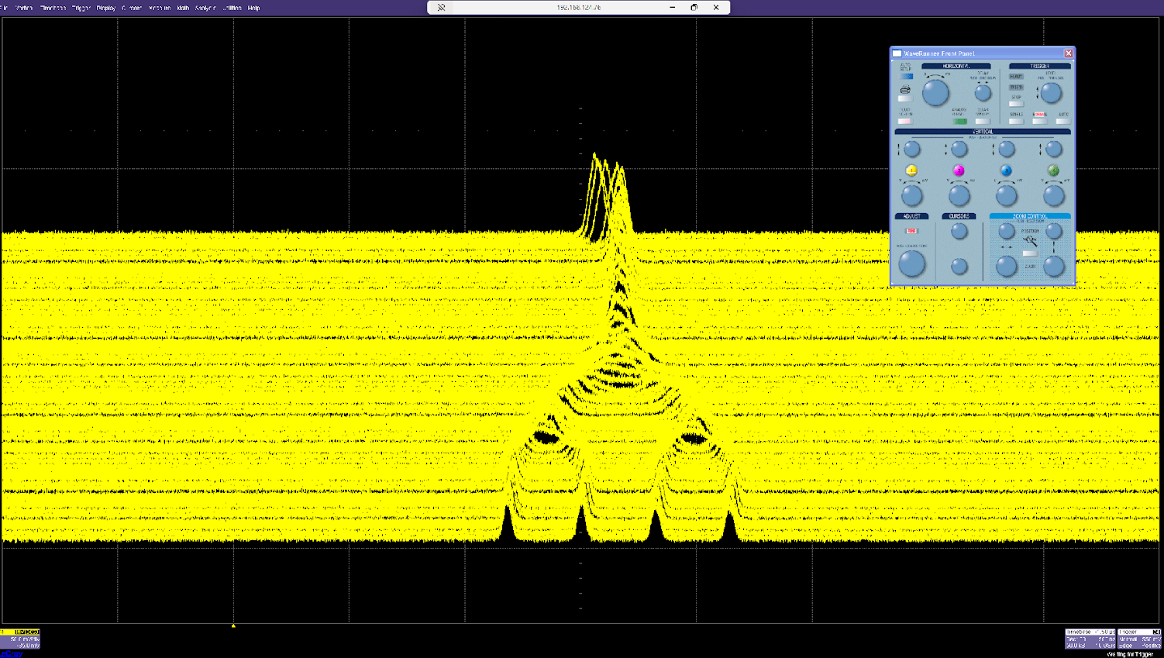

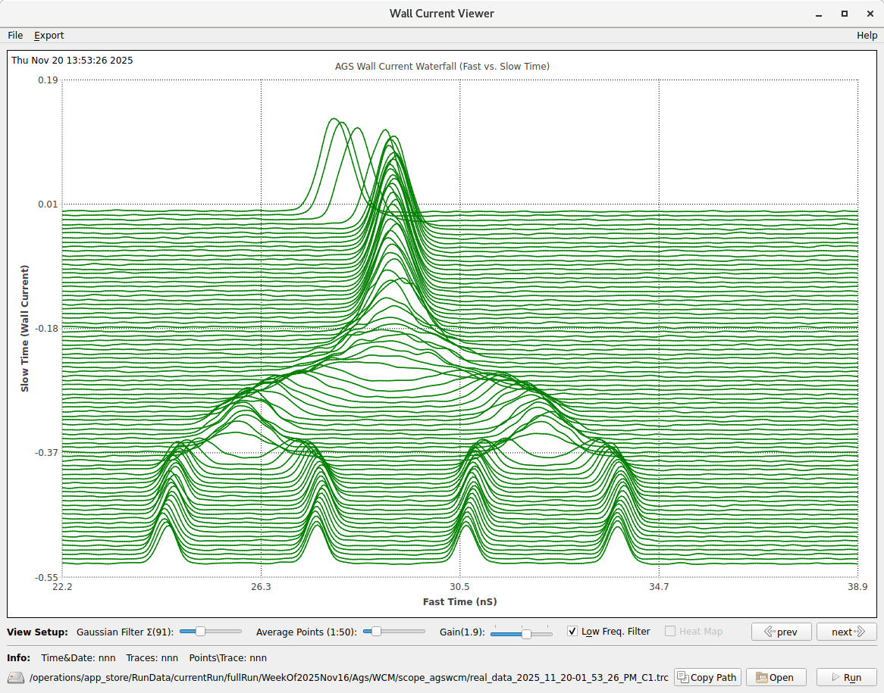
Line Current Profile Data Acquisition
Triggering
System
Wall Current Monitor
RF
Ext.
Trig.
Pick up
Signal
Events
Ch4
Ch1
Viewer Application
Acquisition Manager
Request data
Oscilloscope
Data Files
Receive data
To storage location, save every AGS cycle

Slide 20
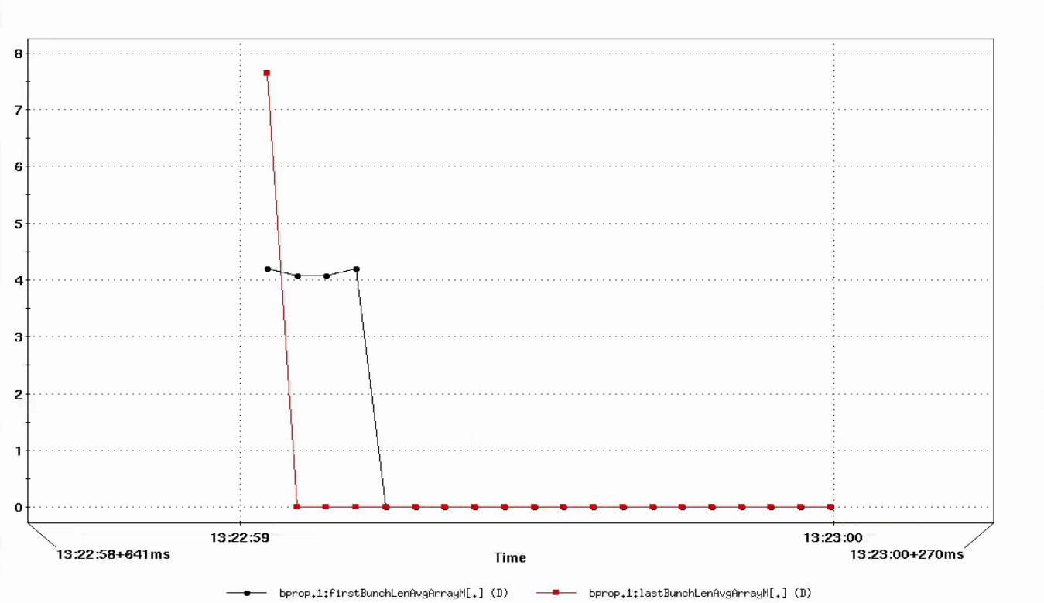
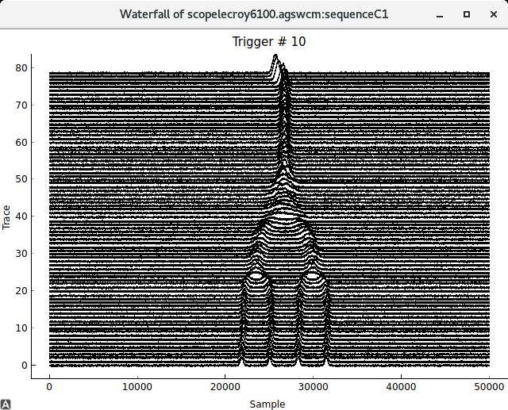
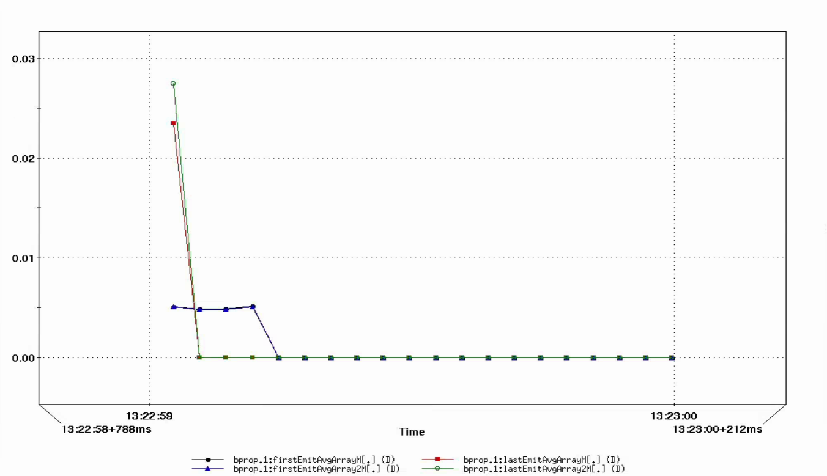
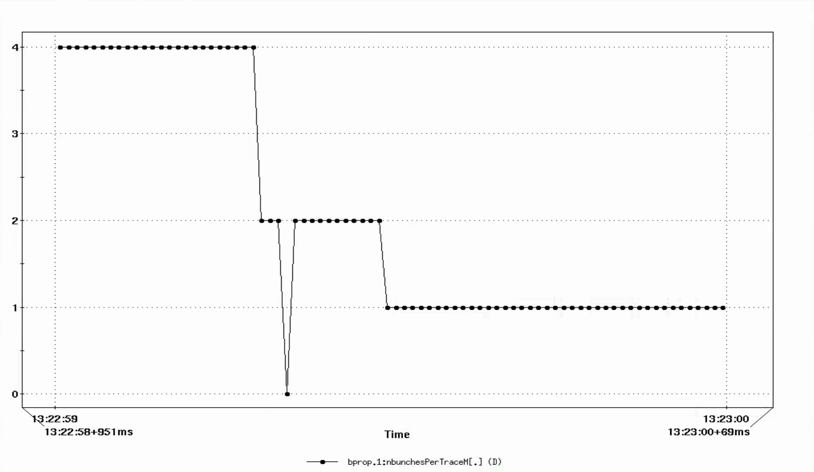
Beam Property Manager
Example: 4-2-1 Merge
Read from systems:
Particle species, charge, energy, RF volt, Rev freq, B dot, etc.
Bunch length
Measure Synch Freq
Explore different setups:
Input different RF volt
Calculate & Publish:
Corrected RF volt, Emittance, dpp, etc.
Calculate & Publish:
Synch Freq, Emittance, dpp, etc.
Emittance
Number of bunches
The goal is to publish beam parameters, such as bunch length, dpp, emittance, etc., in real time, for any beam.
Those parameters will also be logged, so they can be accessed later for further analysis.
Analyze the bunch profile evolutions.
Two different ways to calculate parameters, cross-checking.
Two methods agree with each other

Slide 21
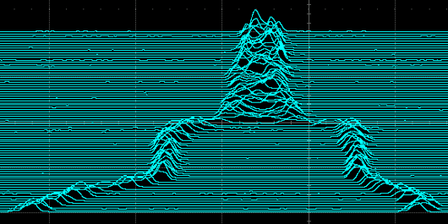
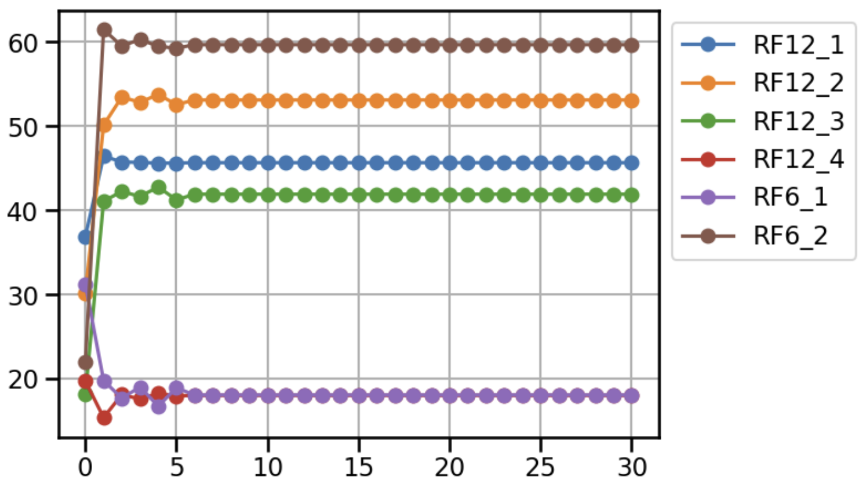
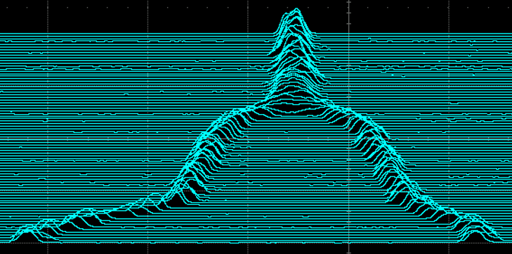
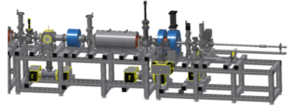
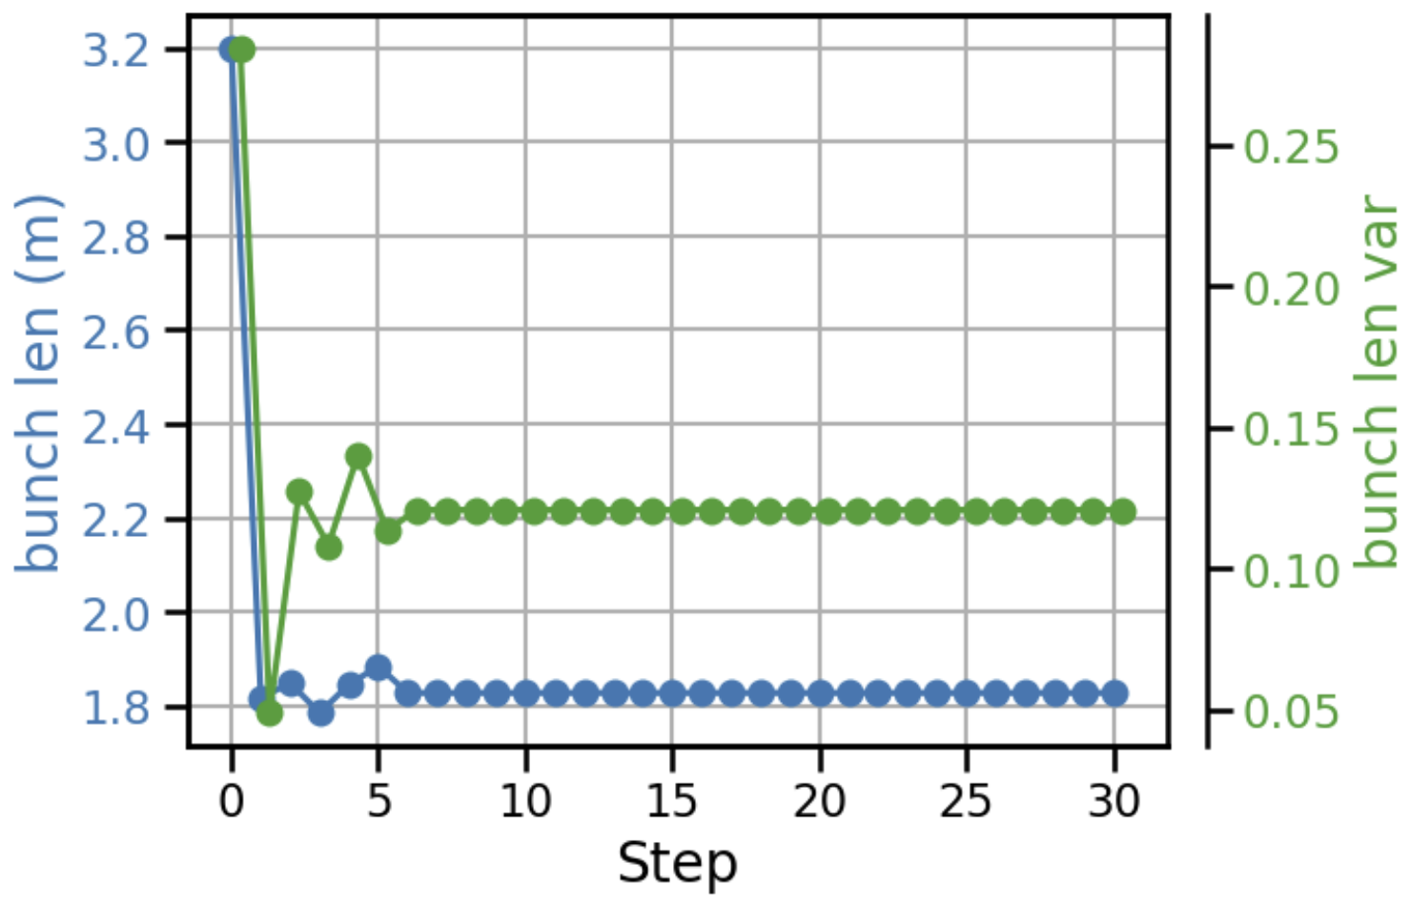
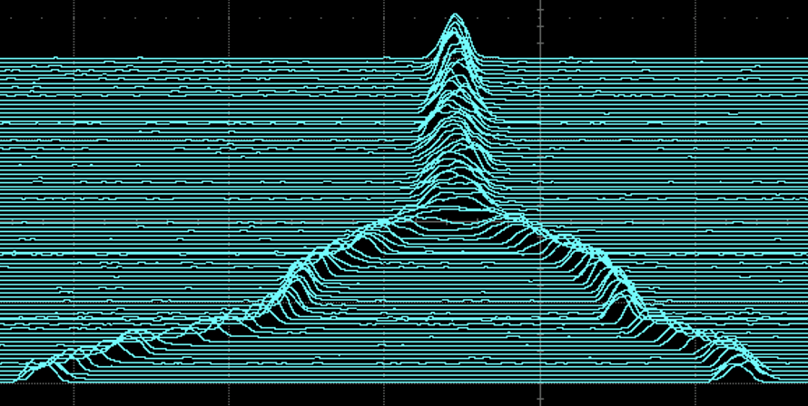

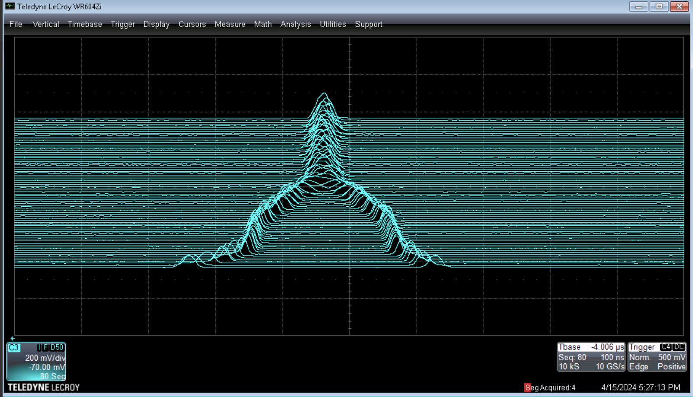

Reinforcement Learning in AGS Bunch Merging
Intentionally break the merging process to start
All actions converge in one step
RL agent regulates AGS bunch merging by tuning RF voltages; The observable is the WCM signals, which is saved to files on every AGS cycle.
RL agent is able to achieve the optimal merge in one step from a bad state; The result is comparable to the operational merge.
The RL agent was able to quickly correct the merge and maintain it
RF settings:
5 cavities with 6 voltages
Accelerator system
RL Agent
Both the bunch length and bunch variations were optimized effectively
RMS bunch length,
Center variation,
Bunch length variation
Generate
Merge process achieved by operators
Saved to files on every cycle
System workflow
WCM signals

Slide 22
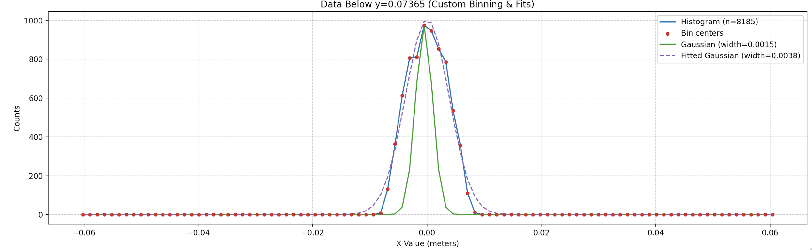
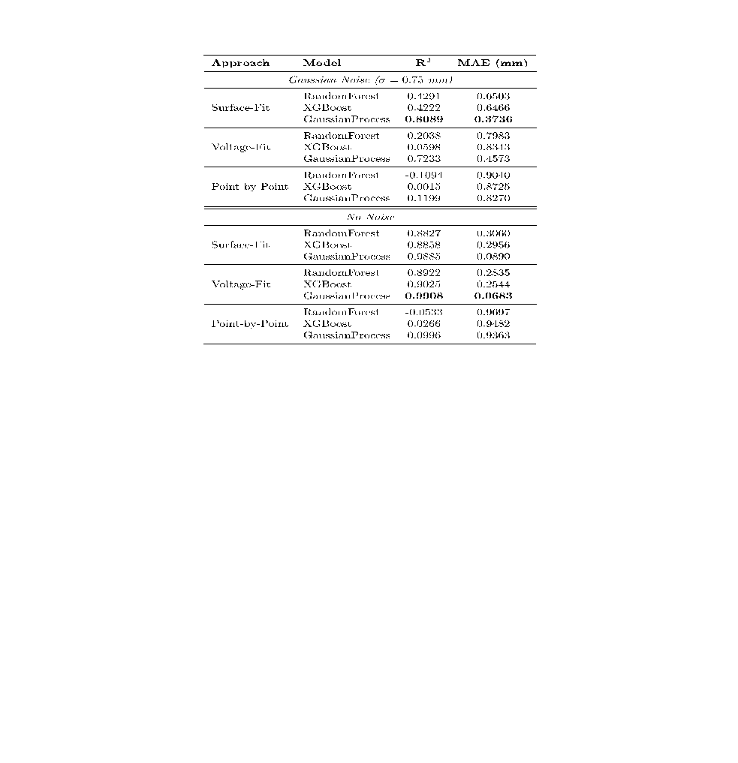
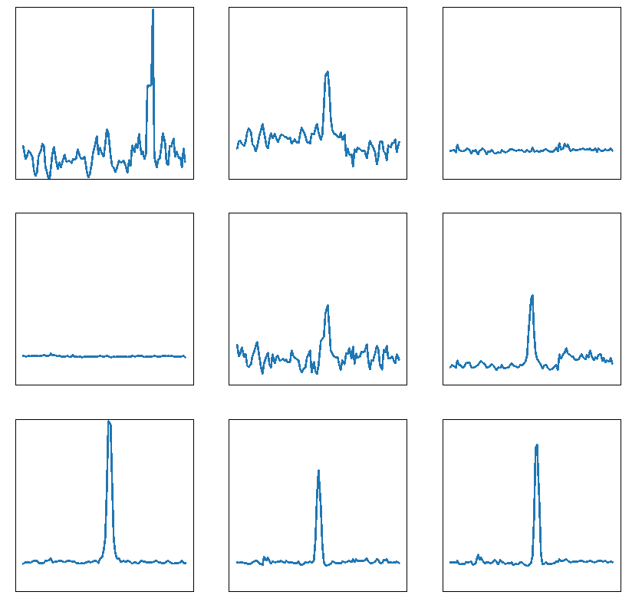
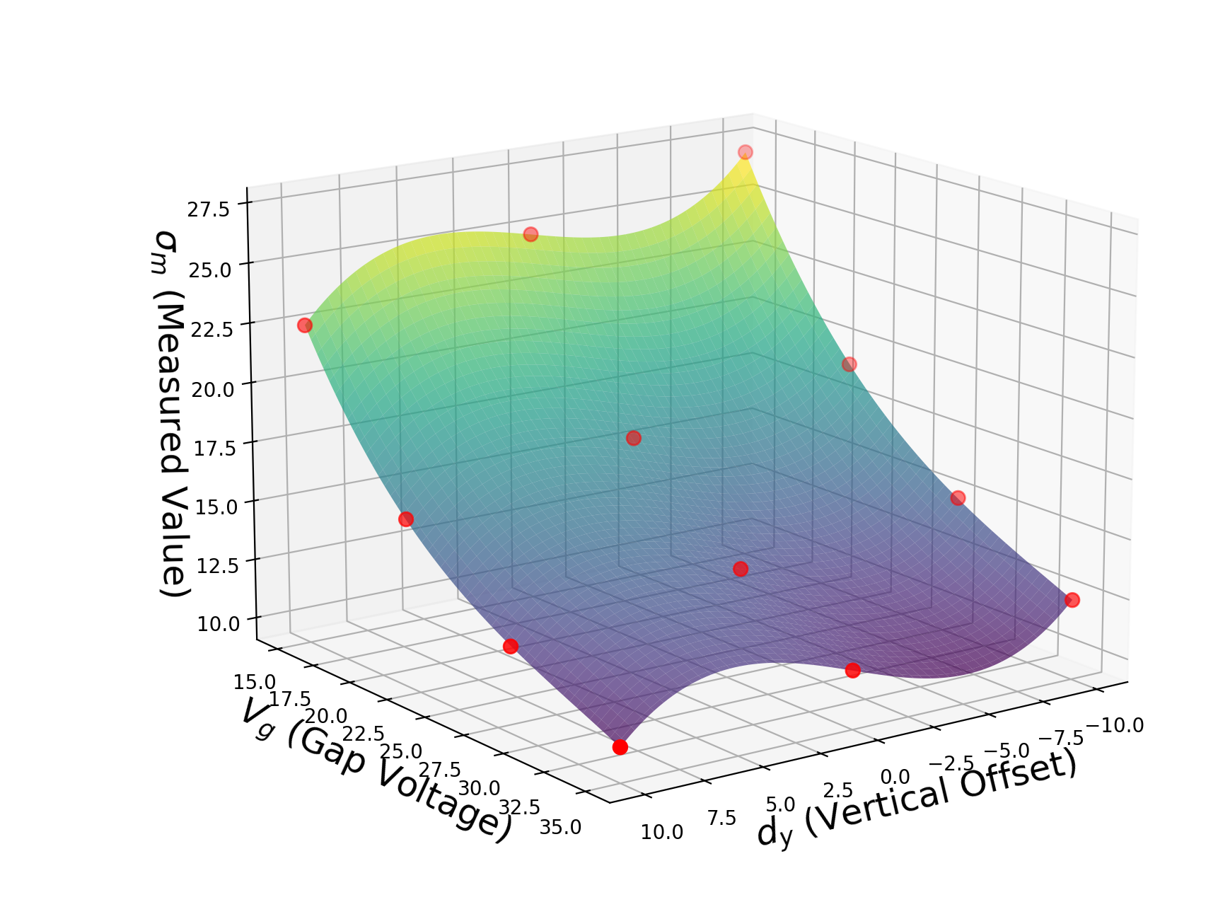
Improving IPM Emittance Measurements with ML
Developed 3D PIC model of AGS IPM operation
Exploring use of Gaussian Process-based surrogate for fast evaluation
  Infer true beam size from short scans of IPM operating points without other beam measurements
IPM profile at collector wires in simulation
Unsupervised anomaly classifier from transformer-encoder embeddings to detect atypical IPM profiles
Model prediction accuracy for true bunch size
Classifier predictions on logger data
Simulated scan with surface fitting
Anomalous
Normal

Slide 23
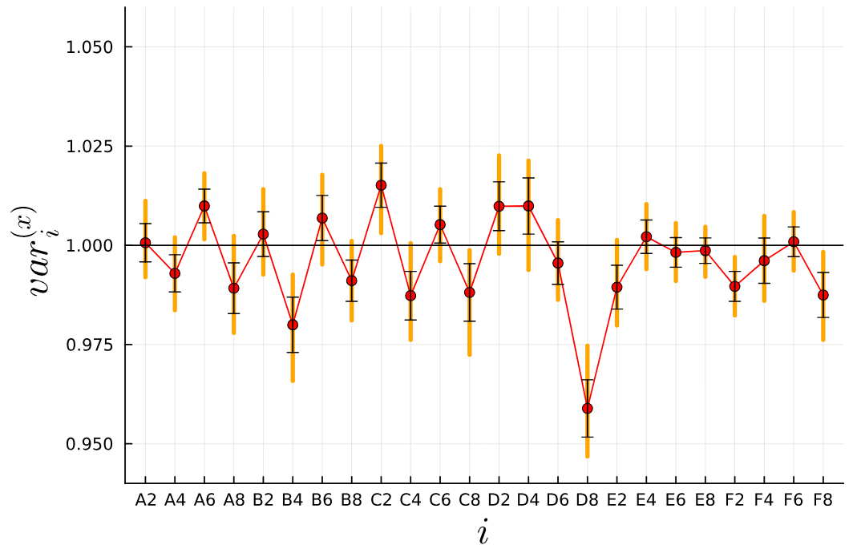
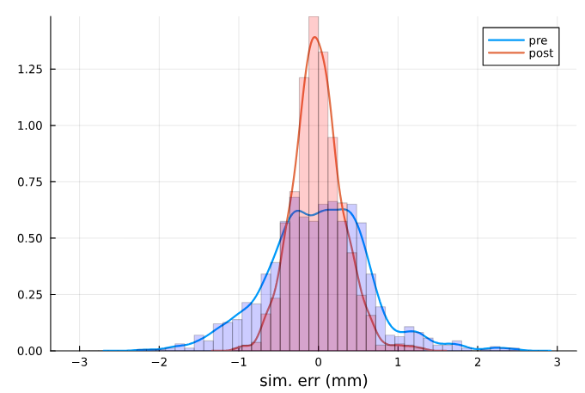
Machine-Learning–Accelerated Bayesian Uncertainty Quantification for Digital Twin Modeling and Control of the AGS Booster
A precise Digital Twin for AGS Booster would enable more reliable beam control, improving beam quality for RHIC and EIC.
Comparison of existing Digital Twin (Bmad) to real beam orbit data shows discrepancies of unknown origin.
We used Bayesian Uncertainty Quantification (UQ) to study the discrepancies.
The values of the nuisance parameters for the x-plane quadrupoles. A value of 1.0 represents the null result. We observe clear deviations from null for, in particular, the D8 quadrupole.
We introduced quadrupole-dependent nuisance parameters to the Bmad simulation.
UQ provides estimates of those parameters and their uncertainties by combining orbit-response data with expert foreknowledge.
A machine-learned surrogate was employed to obtain a fast, differentiable model required for the UQ procedure.
We find strong evidence of position-dependent deviations from the null result.
Including these nuisance parameters in the simulation significantly improved the model errors.
A comparison of the absolute simulation error for a subset of our data with and without including the nuisance parameters (central values only), showing a significant improvement in simulation error.

Slide 24
Summary
Many efforts are ongoing to bring AI into operations with a focus on optimizing the performance of the accelerators.
AI/ML work is supported by a strong and very active community. All major laboratories, including strong international collaborations, are working together to standardize and share well tested tools for autonomous accelerator operation.
C-AD and the EIC-BeamAI collaboration are deeply involved in all the community efforts.
And we are really having Fun!

Slide 25
Publications
[1] Y. Gao et al., “Applying Bayesian Optimization to Achieve Optimum Cooling at the Low Energy RHIC Electron Cooling System”, Physical Review Accelerators and Beams 25, 014601 (2022).
[2] W. Lin et al., “Simulation Studies and Machine Learning Applications at the Coherent electron Cooling experiment at RHIC”, in Proc. IPAC'22, Bangkok, Thailand, Jun. 2022, pp. 2387-2390.
[3] W. Lin et al., “Machine learning applications for orbit and optics correction at the Alternating Gradient Synchrotron”, in Proc. IPAC'23, Venice, Italy, May 2023, pp. 4460-4463.
[4] W. Lin et al., “AGS Booster model calibration and digital-twin development”, in Proc. IPAC’24, Nashville, TN, May 2024, pp. 3449-3452.
[5] R. Roussel et al., “Bayesian Optimization Algorithms for Accelerator Physics”, Physical Review Accelerators and Beams 27, 084801 (2024).
[6] T. Balasooriya et al., “Reinforcement Learning for Charged Particle Beam Control to Minimize Injection Mismatch in Particle Accelerators”, ICASSP 2025 - 2025 IEEE International Conference on Acoustics, Speech and Signal Processing (ICASSP), Hyderabad, India, 2025, pp. 1-5.
[7] W. Lin, “Maintaining optimal beam brightness and luminosity using machine learning”, in Proc. HIAT2025, East Lansing, MI, Jun. 2025, pp. 79-84.
[8] W. Lin et al., “Improve beam brightness with Bayesian optimization at the AGS Booster injection at BNL”, in Proc. NAPAC’25, Sacramento, CA, Aug. 2025, pp. 157-159.
[9] E. Hamwi et al., “Application of Bayesian optimization to BtA injection at BNL”, in Proc. NAPAC’25, Sacramento, CA, Aug. 2025, pp. 58-60.
[10] W. Lin et al., “Machine learning assisted Bayesian calibration of accelerator digital twin from orbit response data”, in Proc. NAPAC’25, Sacramento, CA, Aug. 2025, pp. 177-180.
[11] Y. Gao et al., “Exploring Reinforcement Learning for Optimal Bunch Merge in the AGS”, in New York Scientific Data Summit 2025, pp. 13-16 (2025).
[12] T. Miceli et al., “Twinac: initiation of a community-driven accelerator digital twin framework”, in Proc. ICALEPCS’25, Chicago, IL, USA, Sep. 2025, pp. 72-79.
[13] L. Hajdu et al., “Image processing with ML for automated tuning of the NASA Space Radiation Laboratory beam line”, in Proc. ICALEPCS2025, Chicago, Sep. 2025, pp. 1008-1011.
[14] W. Lin et al., “Digital twin development for the NASA space radiation laboratory”, submitted to Physical Review Accelerators and Beams, Nov. 2025.

Slide 26
Presentations / Talks
[1] A. Edelen, “Physics Informed and Bayesian Machine Learning for Maximization of Beam Polarization at RHIC”, presentation at the 4th ICFA Beam Dynamics Mini-Workshop on Machine Learning Applications for Particle Accelerators (MaLAPA 2024), Gyeongju, South Korea, March 5, 2024.
[2] W. Lin, “Maintaining optimal beam brightness and luminosity using machine learning”, presentation at the 16th International Conference on Heavy Ion Accelerator Technology (HIAT 2025), East Lansing, MI, USA, June 24, 2025.
[3] W. Lin, “Extraction bump digital twin for NSRL slow extraction”, presentation at the 6th Slow Extraction Workshop (SX 2025), Stony Brook, NY, USA, October 8, 2025.
[3] E. Hamwi, “Use of AI/ML for higher brightness and higher polarization of hadron beams”, presentation at the Artificial Intelligence for the Electron Ion Collider (AI4EIC 2025), Boston, MA, USA, October 27, 2025.
[4] C. Kelly, “Machine-Learning–Accelerated Bayesian Uncertainty Quantification for Digital Twin Modeling and Control of the AGS Booster”, presentation at the Artificial Intelligence for the Electron Ion Collider (AI4EIC 2025), Boston, MA, USA, October 27, 2025.
[5] C. Hall, “Machine Learning Approaches to Improve Ion Profile Monitor Measurements”, presentation at the Artificial Intelligence for the Electron Ion Collider (AI4EIC 2025), Boston, MA, USA, October 27, 2025.

