Slide 1
Proposal : Polarized Deuteron Ion Source
D. Steski
12/10/2025

Slide 2
Motivation
“The EIC accelerator design team must make it a priority to develop ion spin control and manipulation from source to collisions of the deuteron, ³He, ⁶Li and ⁷Li nuclei.*”
*from executive summary of “Realizing the Scientific Program with Polarized Ion Beams at EIC” (The EPIOS Scientific Consortium)
The availability of the COSY Polarized ion source to BNL for a fraction of the replacement value

Slide 3
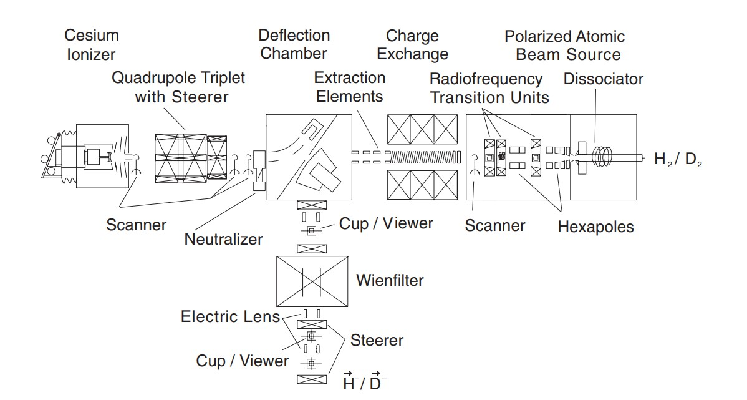
COSY Polarized D⁻ Ion Source

Slide 4
COSY Polarized deuterium source available to BNL
Two 40 ft shipping containers worth of equipment from Julich
Space is limited at EBIS
Proposed to locate the Polarized Deuterium Ion Source at the Tandem Van de Graaff Facility
Project divided into two parts: Ion Source and Polarimeter
Ion source to be located between the two Tandems (MP6 & MP7)
New HV platform to injected polarized deuterium into MP7
Polarimeter at the High Energy of MP7

Slide 5
Partial list of Equipment to be shipped
No. | Description | No. | Description
1 | 3 sets of permanent sextupole magnets | 10 | Several 27 MHz fixed frequency amplifiers
2 | 2 electromagnets | 11 | Siemens controllers
3 | Vacuum chambers for two atomic beam | 12 | Pressure regulators and flow regulators
4 | Time-of-flight spectrometer for atomic beams with chopper | 13 | Cold heads and compressors for 25K - 80K operation
5 | Vacuum equipment for two sources, diagnostic chambers, Valves | 14 | 9 RF transition units with spare parts
6 | 3 mass spectrometers | 15 | Amplifiers for RF transition units
7 | Scanner for profile measurements | 16 | 10 Signal generators
8 | Temperature controllers | 17 | Magnetic field controllers
9 | Dissociators | 18 | 10 EDDA holding field power supplies

Slide 6
Tandem Van de Graaff Facility

Slide 7
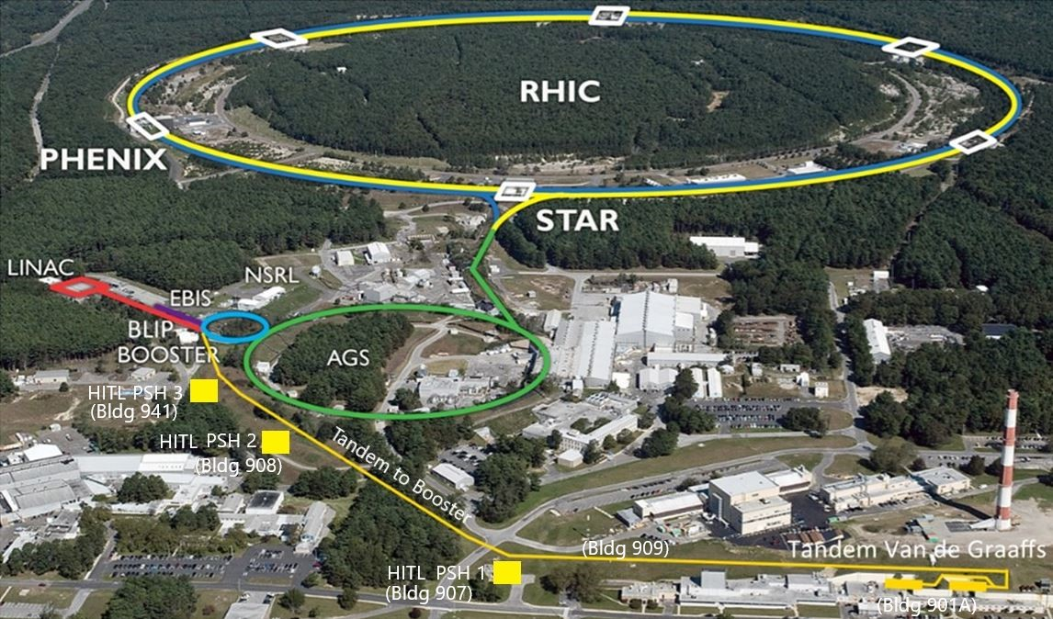
C-AD Complex

Slide 8
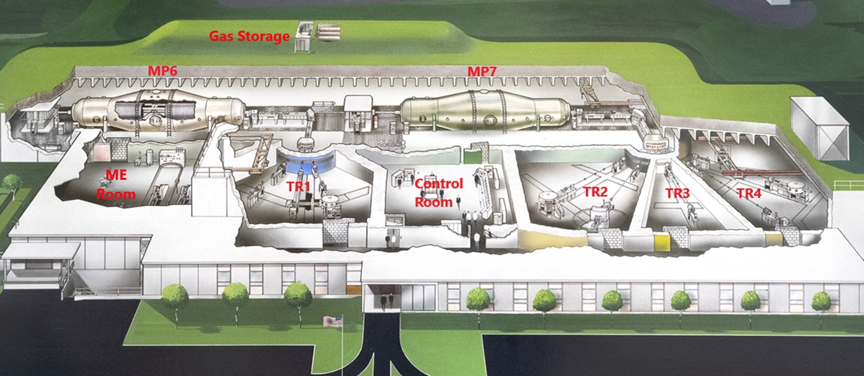
The BNL Tandem Van de Graaff Facility

Slide 9
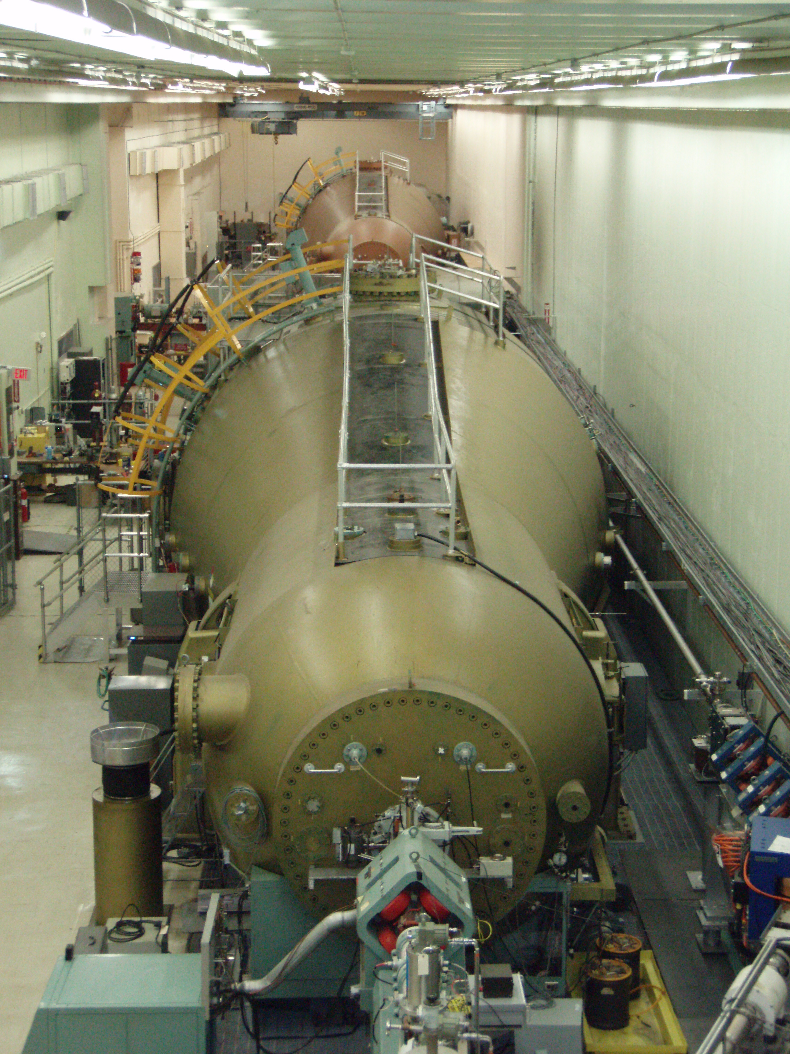
Tandem Van de Graaffs
Two MP class Tandem Van de Graaffs (MP6 & MP7)
Supplied the Au beam for the FY 23 and FY 25 Au-Au run
Provided unpolarized deuterons in 2003, 2008, 2016 and 2023 for Au-d collisions in RHIC

Slide 10
Polarized Deuterium Ion Source

Slide 11
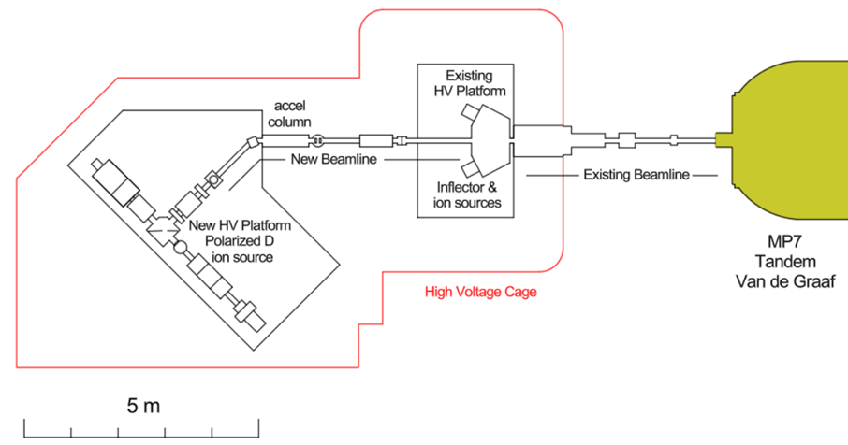
Location of Polarized Deuterium Ion Source

Slide 12
New beam line elements

Slide 13
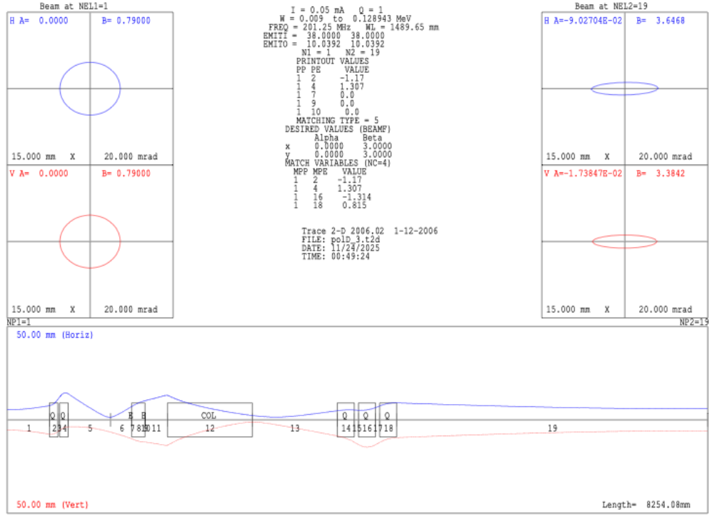
Beam Optics
Phase spaces at the input and output, as well as the beam envelope along the transfer line (Horizontal: Blue, and Vertical: Red).

Slide 14
Tandem Polarimeter

Slide 15
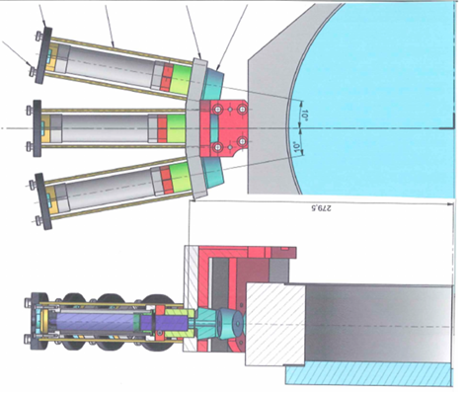
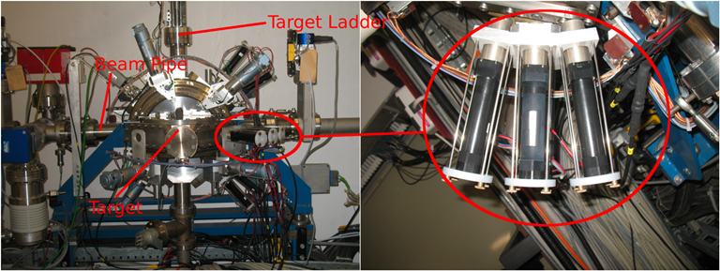
COSY Low Energy Polarimeter
COSY LE Polarimeter
Drawing of COSY LE Polarimeter

Slide 16
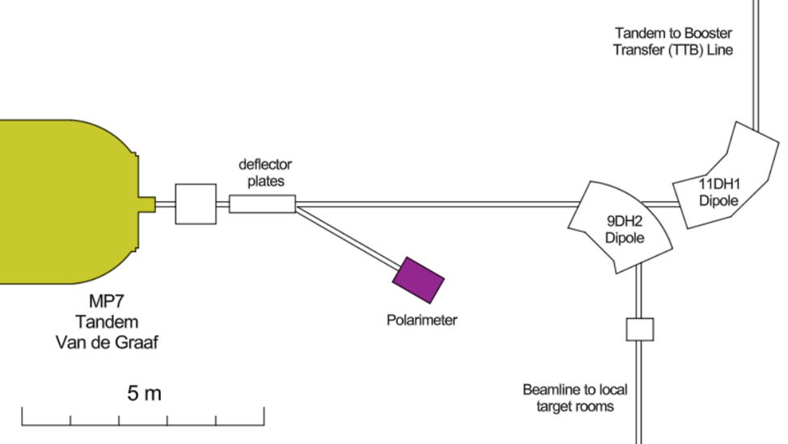
Location of Tandem Polarimeter

Slide 17
Proposal Organization

Slide 18
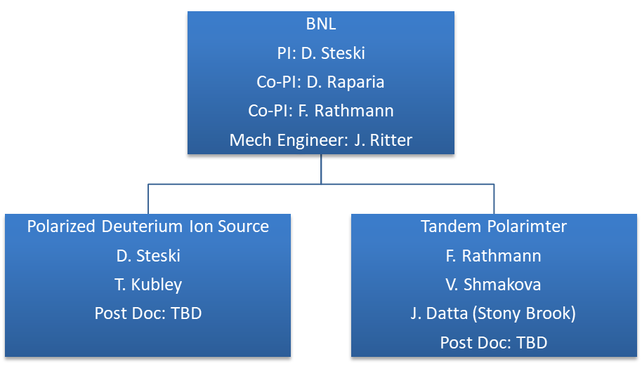
Proposal Organizational Chart

Slide 19
