Slide 1
Fast Cycling Permanent Magnet Fixed Field Alternating (FFA) Synchrotron (LDRD24-010)
Dejan Trbojevic
December 18, 2025

Slide 2
Fast Cycling Permanent Magnet Fixed Field Alternating (FFA) Synchrotron (LDRD24-010)
Dejan Trbojevic
December 18, 2025

Slide 3

Fast Cycling Permanent Magnet Fixed Field Alternating (FFA) Synchrotron (LDRD24-010)
Dejan Trbojevic, Stephen J Brooks, George J Mahler, Nicholaos Tsoupas, Scott J Berg - Brookhaven National Laboratory, & Professor MD Samuel Ruy, Qian Xin – Radiation Oncology, Stony Brook University Hospital [SBUH]
Abstract: In the recent decades there have been new investigations in cancer radiation therapy with FLASH effect where a very large radiation dose is delivered in a very short time, 40 Grays per second (40 Gy/s). It was found that the FLASH radiation significantly improves healthy tissue recovery. The FLASH therapy requirements of 40 Gy/s are to be compared to the dose of 0.01 Gy/s used in conventional radio therapy. The current SBUH permanent magnet proton therapy project is based on the previous successful permanent magnet Cornell University Brookhaven National Laboratory Electron Test Accelerator (CBETA) project. Electrons were accelerated in the Energy Recovery Linac (ERL) by passing four times through the similar permanent magnet racetrack and superconducting linac with energies of 42, 78, 112, and 150 MeV and obtained 99.98% efficiency. The proton therapy SBUH accelerator delivers protons with required energies in a 100 ms without changing the magnetic field. The fast-cycling permanent magnet synchrotron has cycles repeating at a frequency of f_{REV}~500Hz. Variable magnetic field requirements for different energy settings are major limitations at all existing cancer hadron radiation therapy facilities. This proton therapy accelerator removes such limitations.

Slide 4
OUTLINES
A. FLASH
CANCER THERAPY
A.1. LIMITATIONS OF EXISTING FACILITIES
B. ACCELERATOR PHYSICS
DESIGN OF THE
NEW CONCEPT
EXPERIMENTAL RESULTS
PERMANENT MAGNETS COMMISSIONING
ASSEMBLY SET-UP NSRL-TANDEM EXPERIMENTS
MAGNETIC FIELD EXPANSION
A.2. DESIGN OF THE FLASH THERAPY FACILITY
DYNAMICAL APERTURE STUDIES
A.3. COMPARISON WITH THE PRESENT FACILTIES
BETATRON FUNCTIONS
A.4. FLASH THERAPY FACILITY
BEAM MEASUREMENTS RESULTS
To be presented at CAD

Slide 5
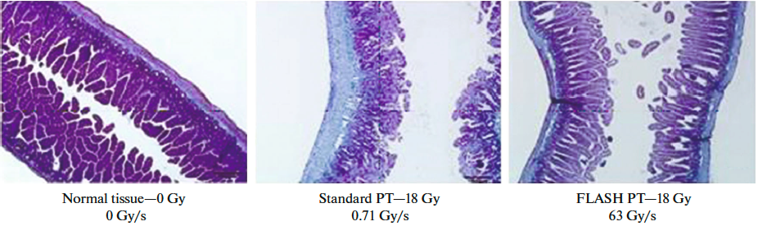
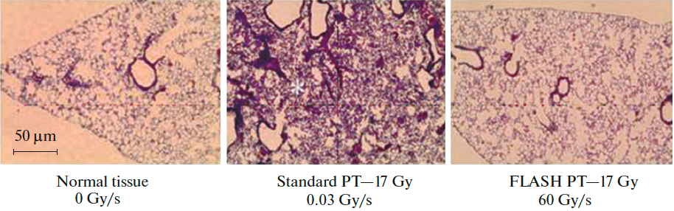
A. FLASH Radiation Therapy
It has been demonstrated, mostly through multiple experiments with animals and just a few human exposures that the FLASH radiation can decrease the normal tissue injury while maintaining destruction of the tumor cells as in conventional radiotherapy. This proposal removes limitations of the existing proton therapy facilities. It delivers protons with required energies in a very short time without varying the magnetic field. It uses the permanent magnets except in the spot scanning part. Permanent magnets proposal is based on already achieved technology recently demonstrated in the Cornell-Brookhaven National Laboratory Electron Test Accelerator “CBETA” commissioning.
The proton FLASH therapy requirements are 40 Gy/s with respect to 0.01 Gy/s in conventional RT.
To obtain the dose of 40 Gy/s in 100 ms for a volume of 1000 ml (10x10x10 cm) this becomes 4 Gray in 100 ms.
3.8x10¹¹ protons or 60 nC are delivered in 100 ms equivalent to 600 nA.
It is not yet clear why the high radiation in a flash spares the healthy tissue. It looks like that radiochemical depletion of oxygen occurs and induces the healthy tissue radio resistance.
Normal Tissue
Regular PT
FLASH
Normal Tissue
Regular PT
FLASH

Slide 6
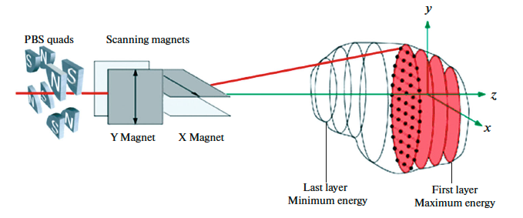
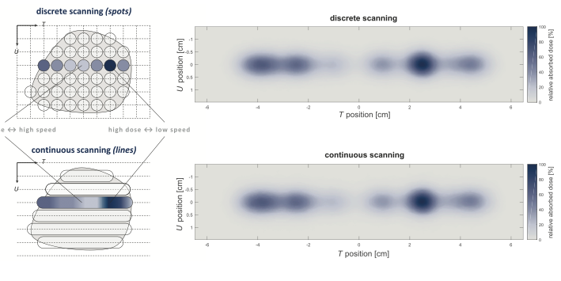
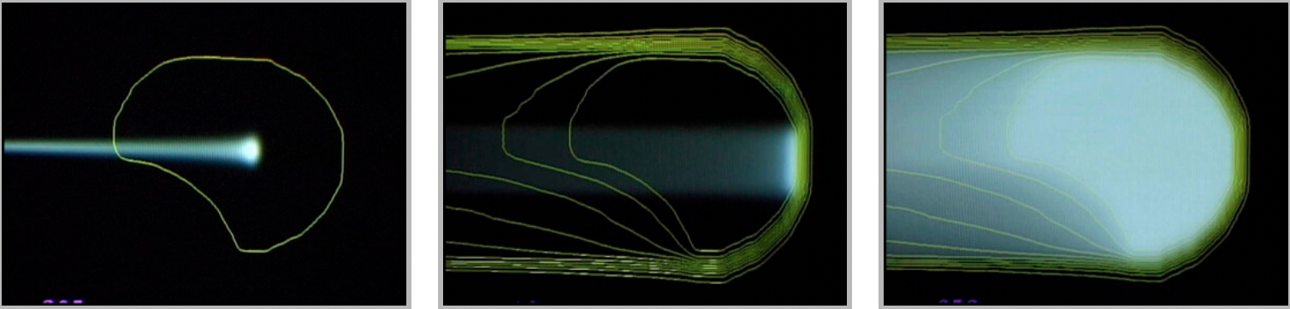

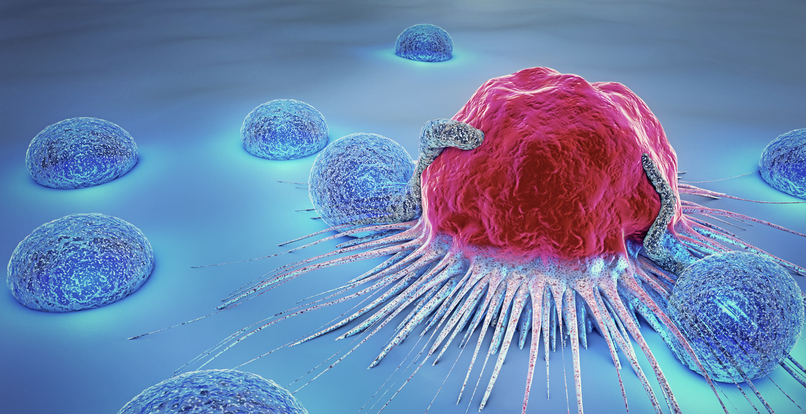
FLASH Radiation Therapy
Photographs of two cancerous tumors from 100 of different types
The scanning directs the pencil beam to the desired spot within the treatment volume. The spot-scanning is provided by steering magnets within the nozzle or upstream of the last bending magnet. The present systems require that every magnet within the entire beamline must adjust to match the beam energy for a given energy layer. This is avoided in our proposal. An important quote from the review shown in reference [5]: ...”In the future, rapid energy variation will demand beam delivery systems with large energy acceptance; rather than adjust the magnet settings for each energy layer, the beam dispersion is limited by a suitable beam-optical arrangement and sufficient aperture within the magnets and vacuum system provided to obtain a large energy acceptance.“
5. S. Jolly, H. Owen, M. Schippers, C. Welsch, “Technical challenges for FLASH proton therapy.” Phys. Med. 2020, 78, 71–82. https://www.sciencedirect.com/science/article/pii/S1120179720301964

Slide 7
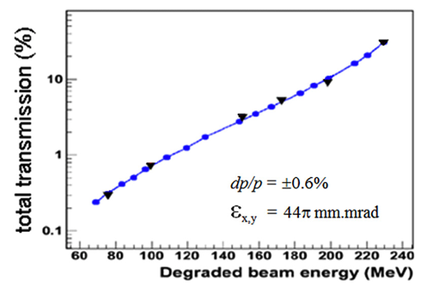
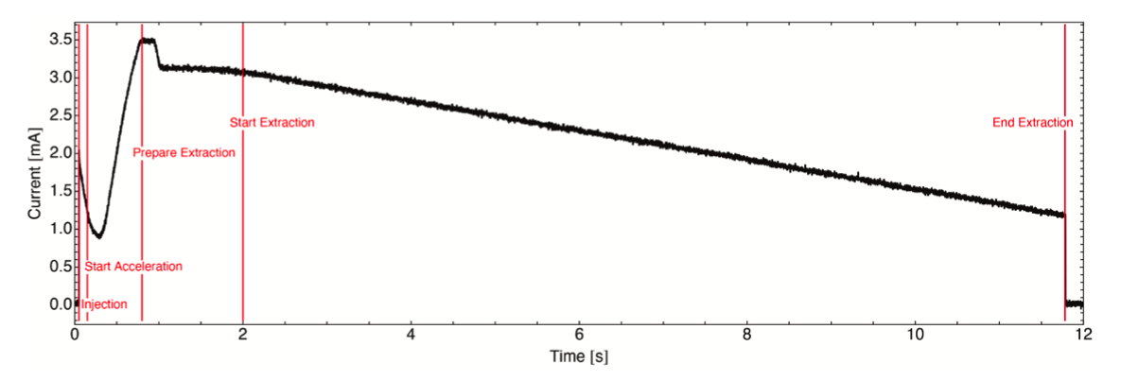
A.1. Flash Therapy Limitations of the Present Facilities
Major limitations at any existing cancer hadron radiation therapy system or facility are the variable magnetic field requirements for different energy settings. It is hard to adjust the magnetic field within the short time (hysteresis) required for FLASH.
CYCLOTRON based treatment centers required energy degraders as a single 230-250 MeV energy is extracted. At low energies only 1% of the initial beam is delivered to the patient. The beam size – emittance is always significantly enlarged. The synchrotrons are presently cycling with low frequencies and the slow extraction of the beam towards the patients is (Fig. 2) too long for FLASH.
For Synchro-cyclotrons (MEVION and IBA S2C2) the spot scanning has serious problems. It is unlikely that synchro-cyclotrons would be the eventual technology of choice for a pure spot-scanning FLASH proton therapy system.
At present, for AVO system the repetition rate of 200 Hz is simply too slow to enable delivery to anything but small volumes. The pulse repetition frequency of 200 Hz makes it possible to irradiate only 20 separate energy layers within a time window of 100 ms. An increase in this rate by a factor of >500 would be necessary [4] for spot-scanned FLASH delivery to a 1-liter volume.
Transmission due to Degrader
Beam extraction from synchrotrons requires much longer time with respect FLASH time

Slide 8
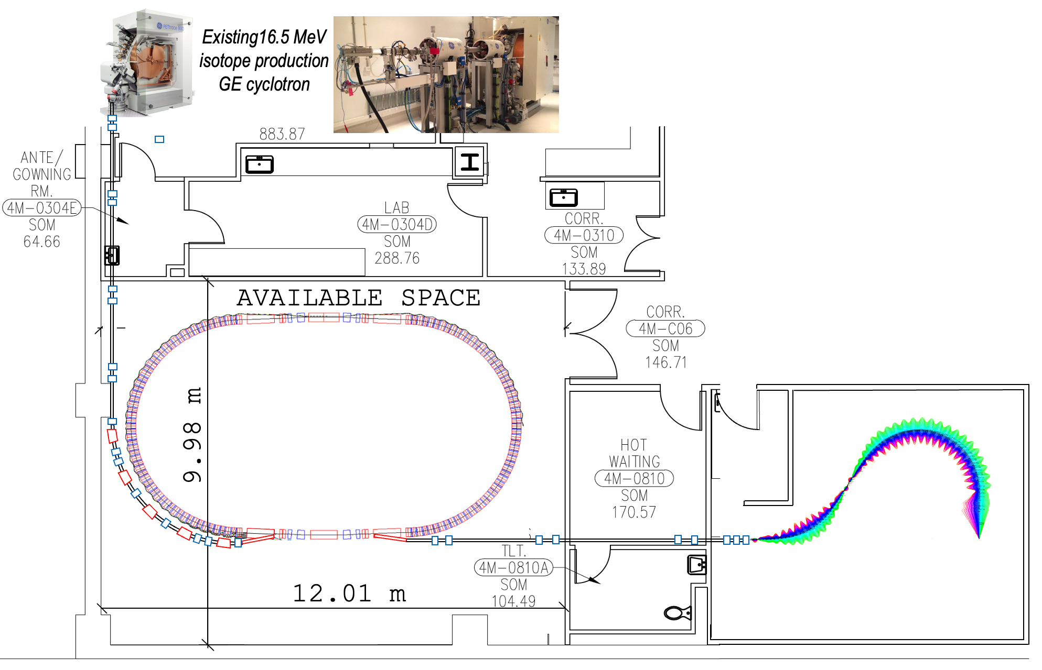
Proposal for the FLASH Radiation Cancer Therapy Facility at Stony Brook University Hospital: Fast-Cycling Permanent Magnet Synchrotron and Permanent Magnet Gantry
Advantages of our concept:
In proton acceleration within the non-relativistic energy range the main problem is the limitation the speed of magnetic field response to the change of energy. This limitation is now eliminated by using the permanent magnets for the same energy range.
Cost reduction: the cost proposed FLASH radiation therapy facility is estimated to be ~$40M to be compared to ~$200M (Varian Facility in New York city in Harlem)
Simplified operation as there is not a need to change the magnet settings for different proton energies.
Assembly
TEST
REDUCTION OF:
The power consumption as the permanent magnets do not require electrical power.
The radiation shielding as the beam losses in synchrotron if any are controlled.
magnet sizes and weights ( The gantry weight is significantly reduced).

Slide 9
Comparison of our proposal to the existing facilities
Accelerator Type | Isochronous Cyclotron |  | Synchrocyclotron |  | Synchrotron | Linear | FFA facility
Vendor | IBA | Varian | IBA | Mevion | Hitachi | AVO | BNL
System | C230 | ProBeam | S2C2 | S250 | ProBeam | LIGHT | FFA
Maximum Energy (MeV) | 230 | 250 | 250 | 250 | 250 | 250 | 250
Minimum Energy (MeV) | 70 | 70 | 70 | 70 | 70 | 37.5 | 10 - 30
Peak Current | 0.3μA | 0.8μA | ~18μA | ~7μA | 4.8 mA | ~40μA | 1.2 mA
Max Ave. Current (nA) | 300 | 800 | ~130 | ~32 | 4.8 | 32 | 530 - 897
Accel. Frequency (MHz) | 106.1 | 72.8 | 87.6-63.2 | 133-90 | 1.3-10 | 3,000 | 378 MHz
Repetition Rate | CW | CW | 1 kHz | 500-750 Hz | CW | 200 Hz | 540-809 Hz
Treatment Pulse Length | >400μs | >400μs | 7μs | 6μs | 0.5 - 5s | 4μs | 725μs
Bunch Length | ~2ns | ~2 ns | ~2 ns | ~2 ns | 25-200 ns | 0.5 ns | ~10–405 ns
Max Part. Per Bunch/Pulse | 100,000 | 70,000 | 8 x 10⁸ | 4 x 10⁸ | 1.5 x 10¹¹ | 10¹⁰ | 1.8 x 10¹¹
Electric Central Field | 1.7 T | 2.4 T | 5.75 T | 9 T | 1.7 T | 25 MV/m | Max 1.8 T
[1] S. Jolly, H. Owen, M. Schippers, C. Welsch, “Technical challenges for FLASH proton therapy.” Phys. Med. 2020, 78, 71–82. https://pubmed.ncbi.nlm.nih.gov/32947086/

Slide 10
A.4. Fast Cycling Acceleration with Ferrite cavities
By Stephen Brooks
 | Choices for injector cyclotron |  |  |  | Units
 | ACSI | GE | TR-19 | IBA
Energy of Injector Cyclotron | 14 | 16.5 | 19 | 30 | MeV
Cyclotron current | 400 | 200 | 400 | 1200 | μA
Treatment charge | 60 | 60 | 60 | 60 | nC
Injection turns | 4 | 4 | 4 | 2 | #
RF acceleration per turn | 29.70 | 29.70 | 29.70 | 44.55 | kV
Calculation | Treatments Options
Turn duration | 585.74 | 540.6 | 504.8 | 405.1 | ns
Charge per turn | 0.234 | 0.108 | 0.151 | 0.486 | nC
Charge per injection | 0.937 | 0.432 | 0.606 | 0.972 | nC
Machine cycles | 65 | 139 | 100 | 62 | #
Machine cycle rate | 540 | 540 | 540 | 809.95 | Hz
Outputs
Treatment time | 120 | 257 | 185 | 76.54 | ms

Slide 11
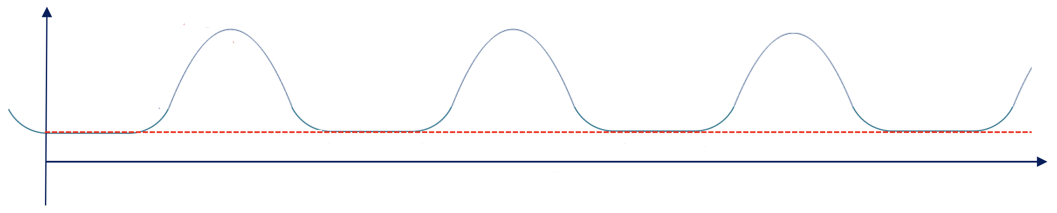
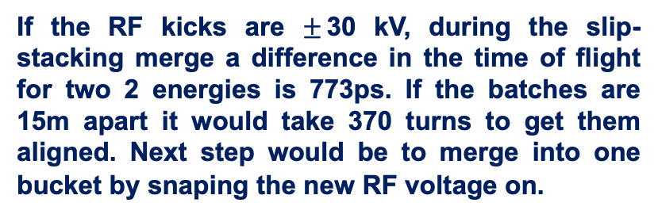
A.4. Facility Cancer Treatment Cycles
Kinetic
Energy
(MeV)
Extraction #2
250
Ex.1
Ex.2
RF manipulation
Ex.3
16.5-30
Injection
Energy
Second synchrotron cycle
t(ms)
Injection
Porch
One synchrotron cycle
Extraction kicker wave forms
0.8ms < t < 1.85ms
1.3kHz< f < 540 Hz
If the RF kicks are $±$30 kV, during the slip-stacking merge a difference in the time of flight for two 2 energies is 773ps. If the batches are 15m apart it would take 370 turns to get them aligned. Next step would be to merge into one bucket by snaping the new RF voltage on.
Time of bunch flight 405-550 ns
At the injection porch time of 926 ms there are 1680 turns. 15 turns for 15 Cyclotron bunches and 1650 turns for RF manipulations

Slide 12
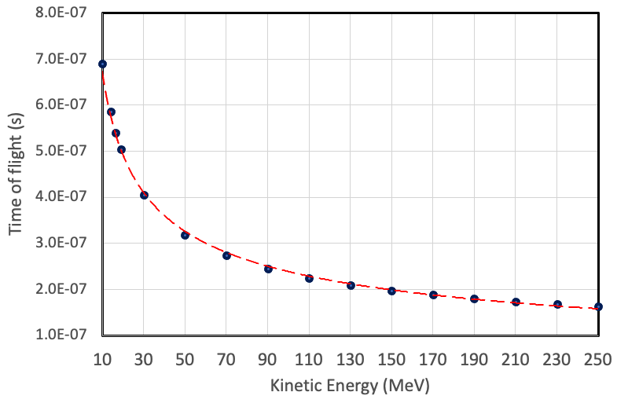
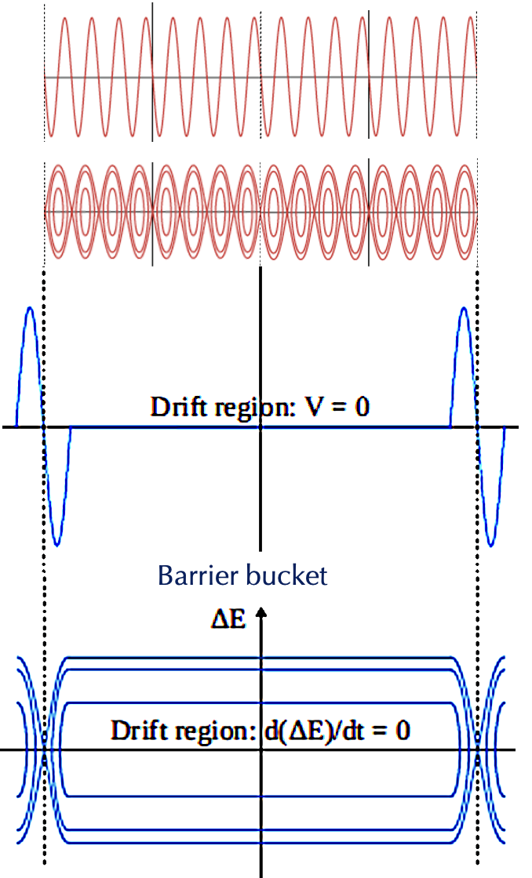
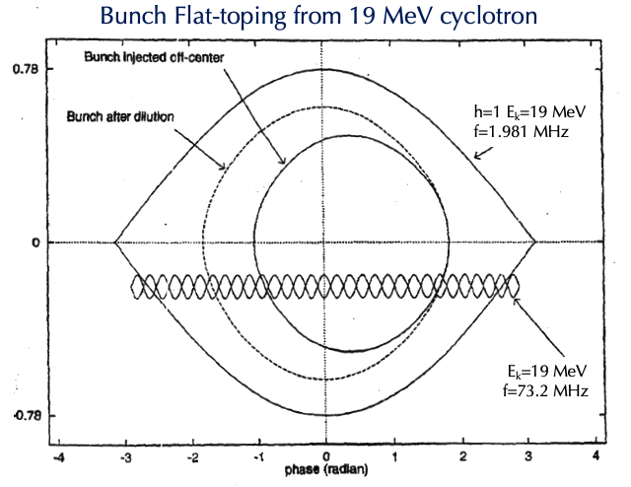
A.4. Time of flight dependence @ acceleration – Bunch Merging
Radio Frequency (RF)-Acceleration:
Using the harmonic number h=1 the frequency must follow the time of flight: f=1.981 MHz at 19 MeV
f=6.132 MHz at 250 MeV t₂₅₀=163.08 ns
Barrier Bucket merging of multiple bunches
Time of flight for one turn at injection:
τ(10 MeV) = 690.9 ns, h=1→ 1.447 MHz
τ(14 MeV) = 585.7 ns, h=1→ 1.707 MHz
τ(16.5 MeV)= 540.6 ns, h=1→ 1.850 MHz
τ(19 MeV) = 504.8 ns, h=1→ 1.981 MHz
τ(30 MeV) = 405.2 ns, h=1→ 2.468 MHz
Time of flight for one turn at maximum energy:
τ(250 MeV) =163.08 ns, h=1→ MHz

Slide 13
To be shown at CAD review
ACCELERATOR PHYSICS
B.1. DESIGN OF THE
NEW CONCEPT
C.1. EXPERIMENTAL RESULTS
B.2. MAGNETIC FIELD EXPANSION
C.2. PERMANENT MAGNETS COMMISSIONING
B.3. BETATRON FUNCTIONS
C.3 ASSEMBLY SET-UP NSRL TANDEM EXPERIMENTS
B.4. DYNAMICAL APERTURE STUDIES
C.4. BEAM MEASUREMENTS RESULTS
B.5. SYNCHROTRON
C.5. ACCOMPLISHED TASKS EXPERIMENT CONCLUSION SUMMARY

Slide 14
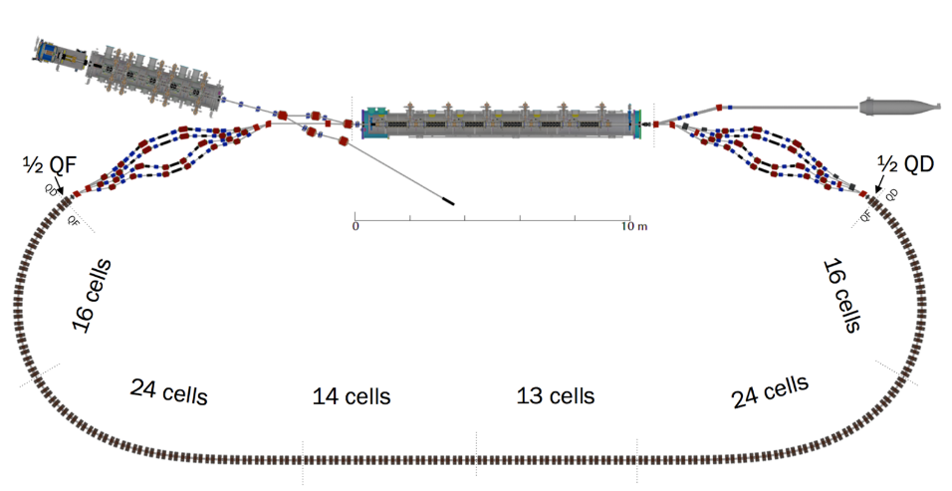
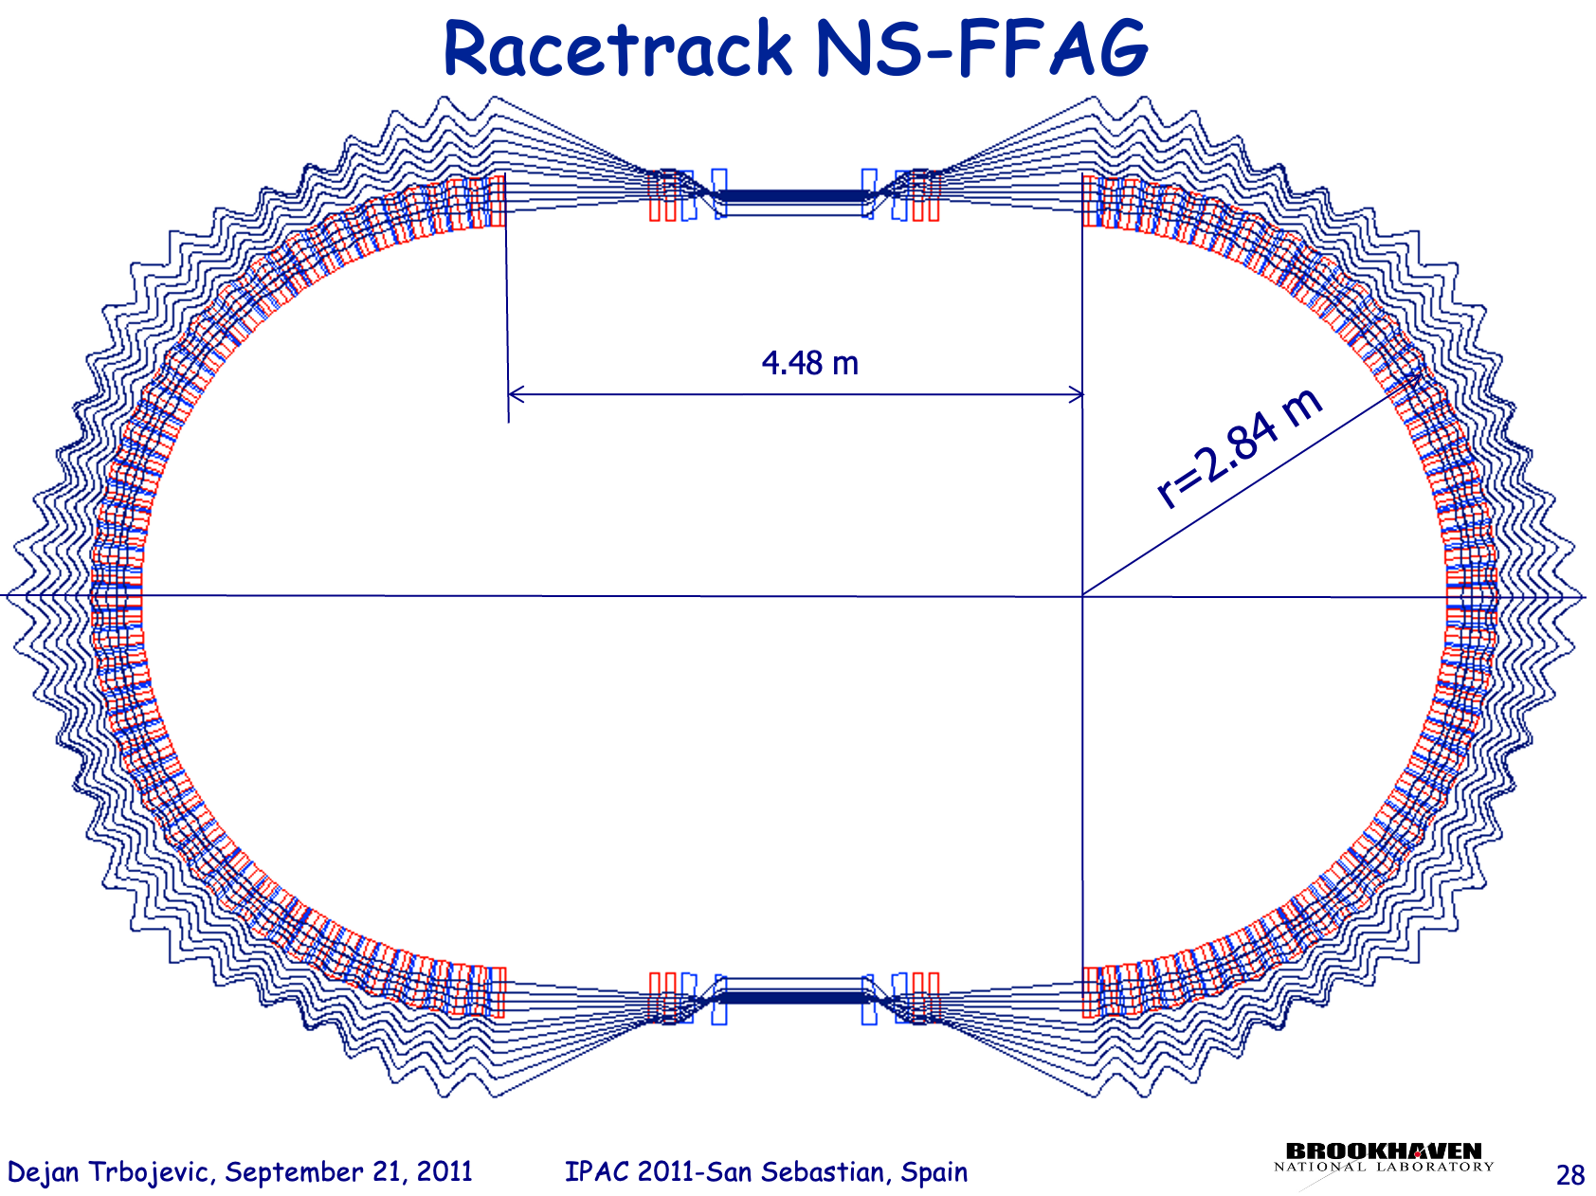
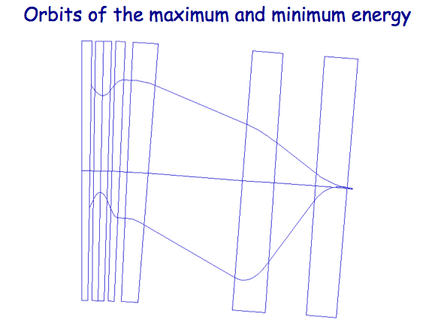
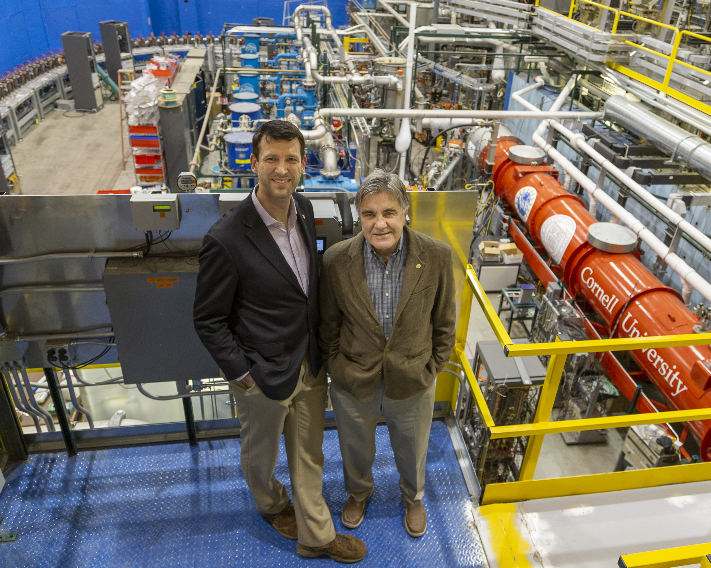
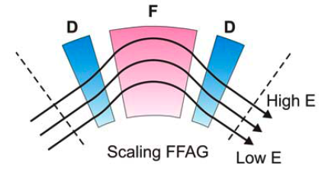
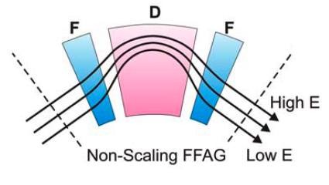
B.1. NOVEL ACCELERATOR PHYSICS CONCEPT
Background – FFA Gradient Accelerator
IPAC 2011 Contributed at San Sebastian
‘CBETA’ Project is a Proof of Principle
The proposal is based on the existing US patent D. Trbojevic, Title: “Non-scaling fixed field alternating gradient permanent magnet cancer therapy accelerator”, patent number: US 9661737 B2, Date of the patent: May 23, 2017.
https://patentimages.storage.googleapis.com/42/5e/92/f7da1cf617d6e3/US9661737.pdf
3 cm
0.9 meters
B = B_{o}+r G_{o}

Slide 15
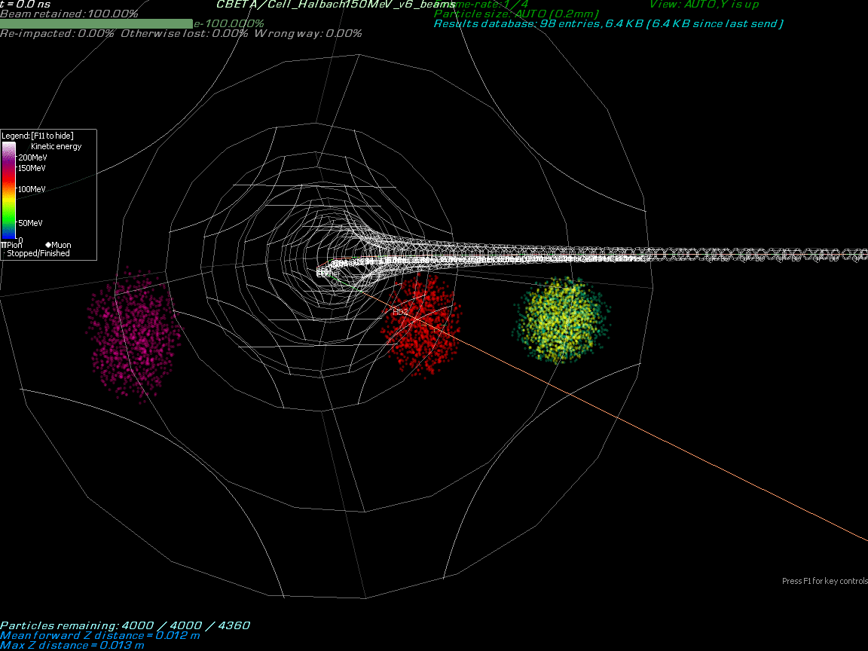
B.1. Background: Particles with multiple energies are accelerated in the same Fixed Field Alternating (FFA) Gradient magnets.
Stephen Brooks’ simulation of particles’ motion in FFA with 42, 78, 114 and 150 MeV electrons

Slide 16
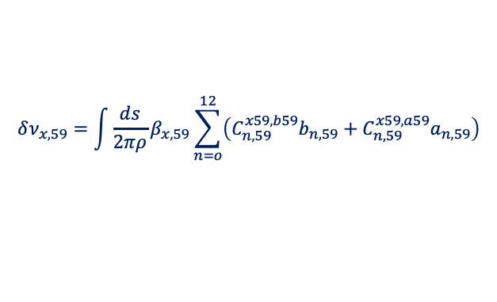
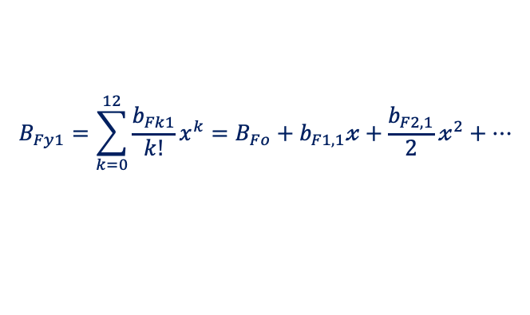
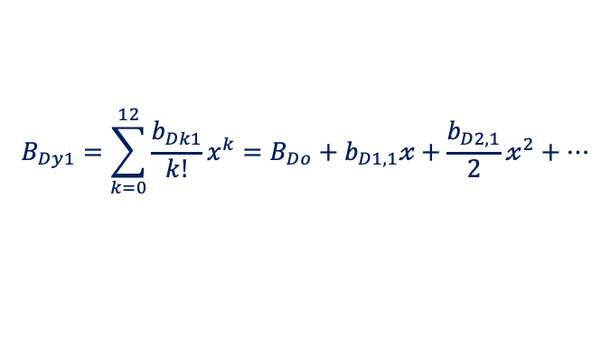
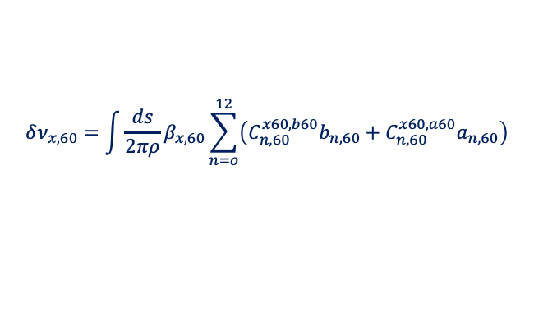
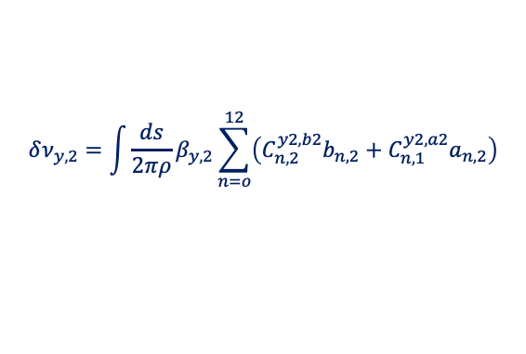
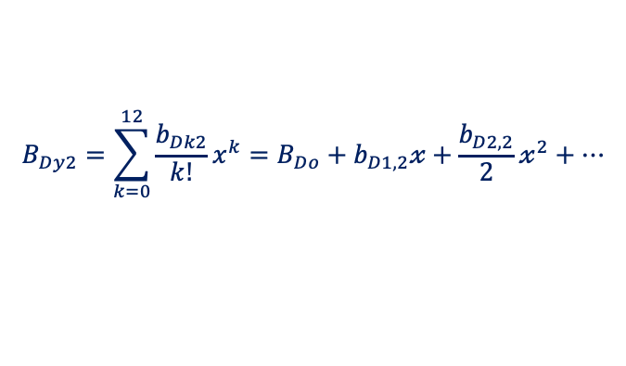

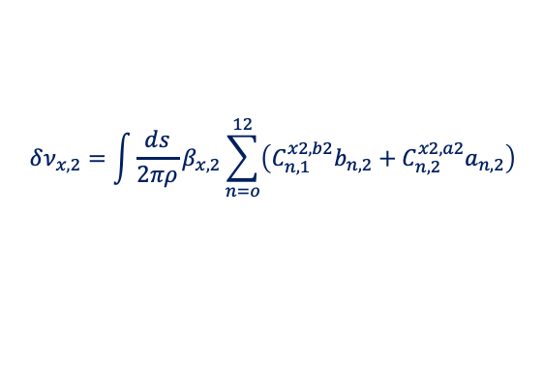
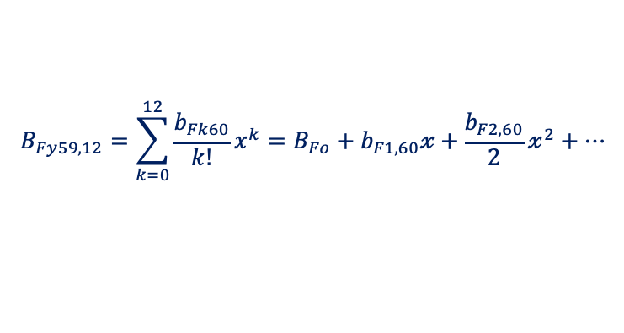



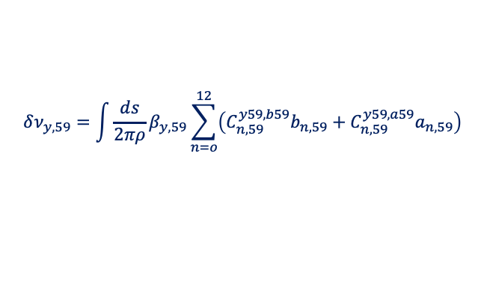
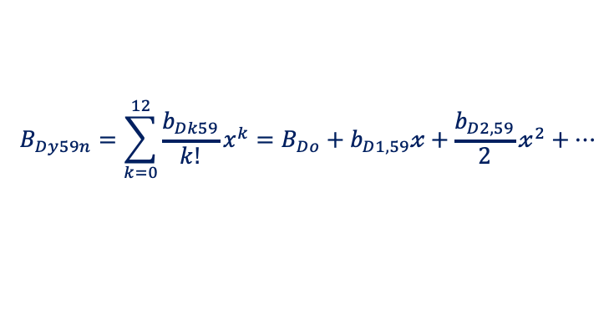
B.2. Magnetic Field Expansion
Multipole Field Components vs. Tunes
Energy 1:
$$B_{Fy1}=\sum_{k=0}^{12}{\frac{b_{Fk1}}{k!}}x^{k}=B_{Fo}+b_{F1,1}𝓍+\frac{b_{F2,1}}{2}𝓍^{2}+…$$
$$δν_{x,1}=\int{\frac{ds}{2πρ}}β_{x,1}\sum_{n=o}^{12}{\left(C_{n,1}^{x1,b1}b_{n,1}+C_{n,1}^{x1,a1}a_{n,1}\right)}$$
$$B_{Dy1}=\sum_{k=0}^{12}{\frac{b_{Dk1}}{k!}}x^{k}=B_{Do}+b_{D1,1}𝓍+\frac{b_{D2,1}}{2}𝓍^{2}+…$$
$$δν_{y,1}=\int{\frac{ds}{2πρ}}β_{y,1}\sum_{n=o}^{12}{\left(C_{n,1}^{y1,b1}b_{n,1}+C_{n,1}^{y1,a1}a_{n,1}\right)}$$
Energy 2:
$$B_{Fy2}=\sum_{k=0}^{12}{\frac{b_{Fk2}}{k!}}x^{k}=B_{Fo}+b_{F1,2}𝓍+\frac{b_{F2,2}}{2}𝓍^{2}+…$$
$$δν_{x,2}=\int{\frac{ds}{2πρ}}β_{x,2}\sum_{n=o}^{12}{\left(C_{n,1}^{x2,b2}b_{n,2}+C_{n,2}^{x2,a2}a_{n,2}\right)}$$
$$B_{Dy2}=\sum_{k=0}^{12}{\frac{b_{Dk2}}{k!}}x^{k}=B_{Do}+b_{D1,2}𝓍+\frac{b_{D2,2}}{2}𝓍^{2}+…$$
$$δν_{y,2}=\int{\frac{ds}{2πρ}}β_{y,2}\sum_{n=o}^{12}{\left(C_{n,2}^{y2,b2}b_{n,2}+C_{n,1}^{y2,a2}a_{n,2}\right)}$$
……
Energy 59:
$$B_{Fy59n}=\sum_{k=0}^{12}{\frac{b_{Fk59}}{k!}}x^{k}=B_{Fo}+b_{F1,59}𝓍+\frac{b_{F2,59}}{2}𝓍^{2}+…$$
$$δν_{x,59}=\int{\frac{ds}{2πρ}}β_{x,59}\sum_{n=o}^{12}{\left(C_{n,59}^{x59,b59}b_{n,59}+C_{n,59}^{x59,a59}a_{n,59}\right)}$$
$$B_{Dy59n}=\sum_{k=0}^{12}{\frac{b_{Dk59}}{k!}}x^{k}=B_{Do}+b_{D1,59}𝓍+\frac{b_{D2,59}}{2}𝓍^{2}+…$$
$$δν_{y,59}=\int{\frac{ds}{2πρ}}β_{y,59}\sum_{n=o}^{12}{\left(C_{n,59}^{y59,b59}b_{n,59}+C_{n,59}^{y59,a59}a_{n,59}\right)}$$
Energy 60:
$$B_{Fy59,12}=\sum_{k=0}^{12}{\frac{b_{Fk60}}{k!}}x^{k}=B_{Fo}+b_{F1,60}𝓍+\frac{b_{F2,60}}{2}𝓍^{2}+…$$
$$δν_{x,60}=\int{\frac{ds}{2πρ}}β_{x,60}\sum_{n=o}^{12}{\left(C_{n,60}^{x60,b60}b_{n,60}+C_{n,60}^{x60,a60}a_{n,60}\right)}$$

Slide 17
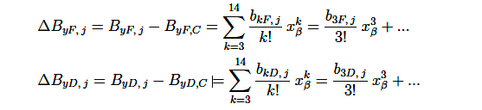
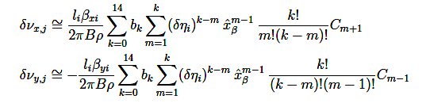

B.2. Magnetic Field Expansion Least Square Minimization Towards the Right Multipoles
Script for adjusting the magnetic multipoles
A new approach to the Non-Scaling Fixed Field Alternating Gradient Accelerators where additional multipoles in the magnets are added following the Taylor expansion of the magnetic field in the focusing and defocusing alternating gradient magnets. The goal is to obtain very large momentum or energy range with the fixed betatron tunes throughout the whole range between -69%< Δp/p < 64% or for example for proton accelerator to cover the kinetic energy range between 10 MeV< E_{k}< 250 MeV.
First step is, setting the reference energy. The reference energy I define as the circular orbit without betatron oscillations. The closed orbit is found by variation of the gradients using the dipole bending field B_{o} which defines the circular orbit.
At the energies higher or lower from the reference orbit the closed orbit oscillates with higher or lower radii, respectively. Additional multipoles are required to obtain the closed orbit with the same betatron tunes established at the reference orbit. They start with the sextupoles. As the energy is growing or reducing, with maximum orbit offsets getting larger, to keep the same tunes additional multipoles like octupoles, decapoles and twelve poles are needed.

Slide 18
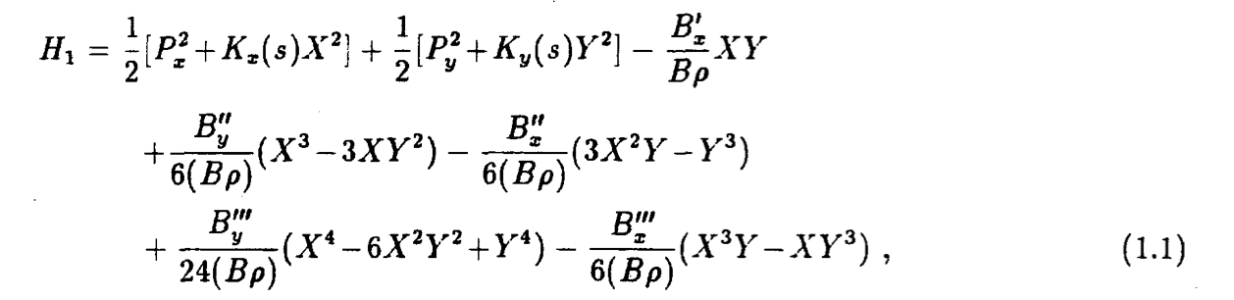
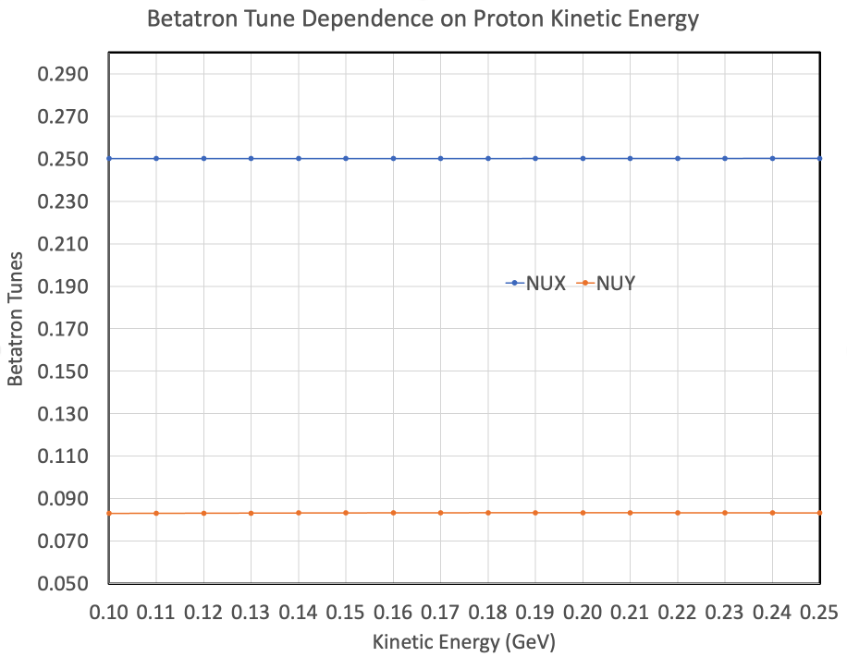
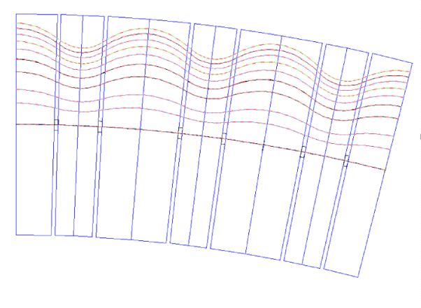
B.2. Lattice Perturbation and Amplitude Dependent Tune spread – Distortion Functions
Hamiltonian describing the motion of a single particle beam from N. Merminga and K.Y. Ng Fermilab Note FN-403 1988:
Skew quadrupole potential
Normal Sextupole potential
Skew Sextupole potential
Skew Octupole Potential
First Solution
Normal Octupole
Potential
ν_{x}=0.25
P_{x} and P_{y} are the canonical momenta to the horizontal and vertical displacements X and Y, K_{x}(s) and K_{y}(s) are proportional to the restoring forces due to the ring’s curvature and the field gradients of the normal quadrupoles.
250 MeV
26.8 mm
ν_{y}=0.076
10 MeV
0 mm
The first results with respect to the tune dependence and betatron functions were satisfied but the dynamical aperture at low energies did not show satisfying results. A conclusion was that the beam size with respect to the non-linear magnetic field dependence was too large.

Slide 19
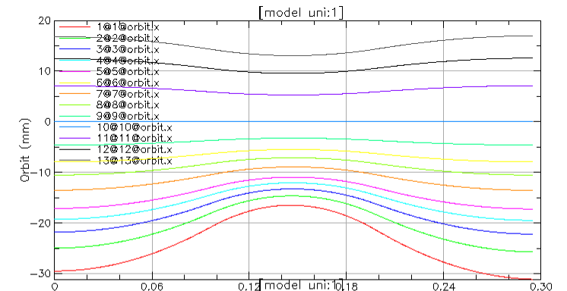
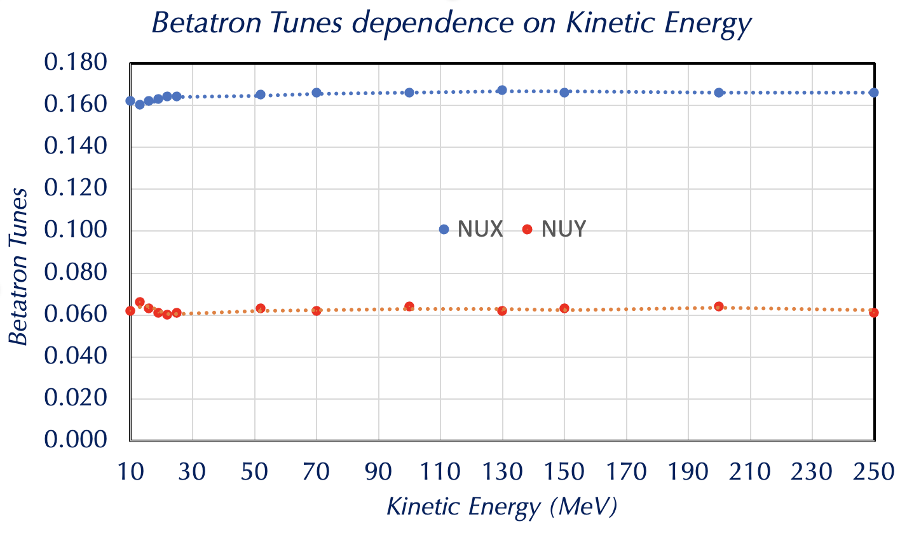
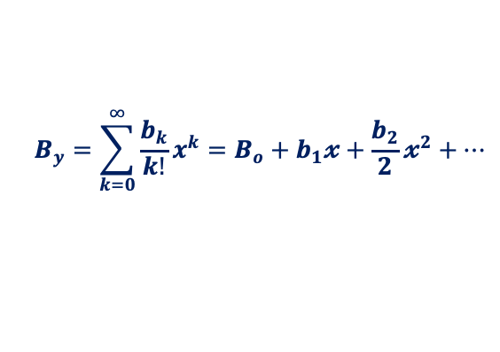
B.2. Magnetic Field Expansion
Taylor expansion by PTC and Bmad had disagreements with MUON1-by S. Brooks and ZGOUBI-by F. Meot due to the end fields presentation
250 MeV
110 MeV
Taylor Expansion:
$$B_{y}=\sum_{k=0}^{∞}{\frac{b_{k}}{k!}}x^{k}=B_{o}+b_{1}𝔁+\frac{b_{2}}{2}𝔁^{2}+…$$
10 MeV
b_{1F} = K_{BF} = 38.054 QUADRUPOLES
b_{1D} = K_{BD} = -54.87
b_{2F} = K_{SF} = 1524.60 SEXTUPOLES
b_{2D} = K_{BD} = -3073.40
b_{3F} = K_{OF} = 23660 OCTUPOLES
b_{3D} = K_{OD} = -30300
b_{4F} = K_{FDEC} = 277500 DECAPOLES
b_{4D} = K_{DDEC} = -1.085E6
B_{5F} = K_{FDDC} = 4.6E6 TWELVE POLES
B_{5D} = K_{DDC} = -1.54E6

Slide 20
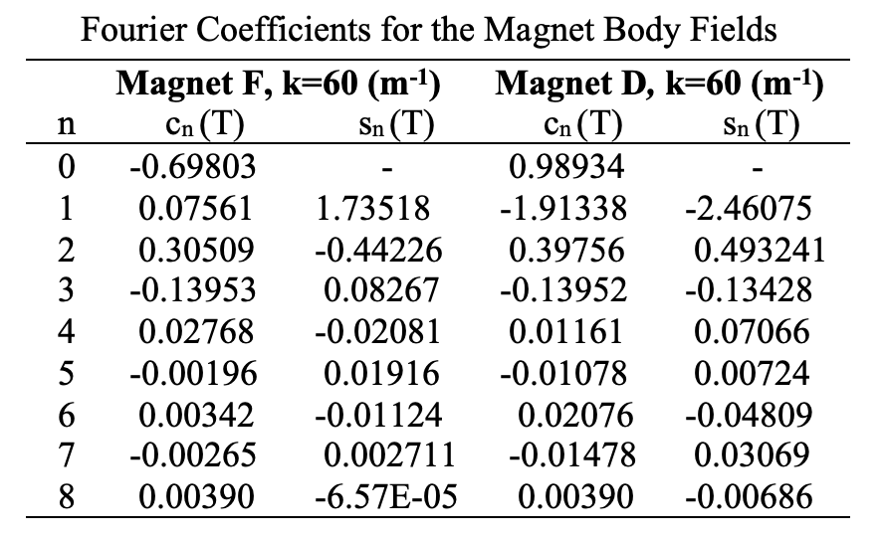
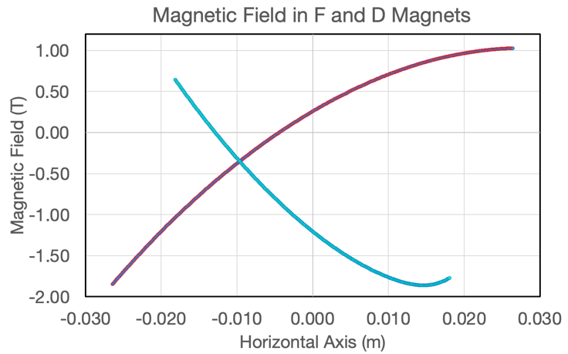
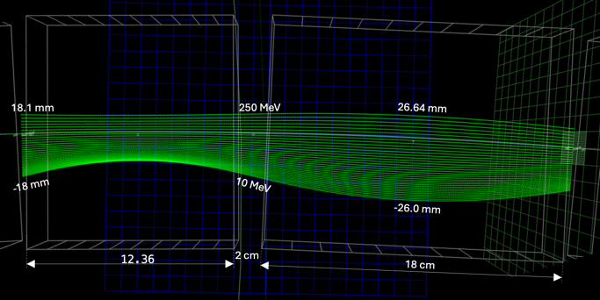
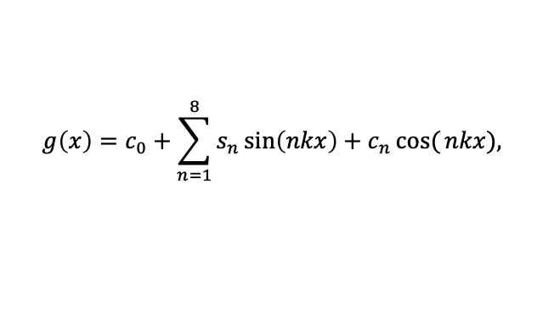
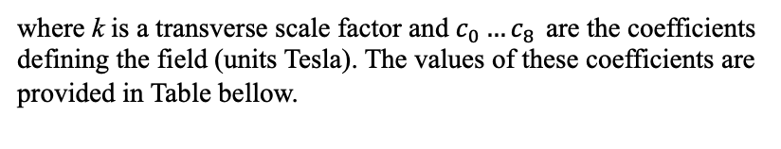
B.2. Transverse Magnetic Field Taylor expansion is replaced by Fourier series by S. Brooks
$$g\left(x\right)=c_{0}+\sum_{n=1}^{8}{s_{n}\sin\left(nkx\right)}+c_{n}\cos{(}nkx),$$
where k is a transverse scale factor and $c_{0}…c_{8 }$are the coefficients defining the field (units Tesla). The values of these coefficients are provided in Table bellow.
The stable orbits in a wide energy range are obtained by adjustments of the F and D sextupoles and additional multipoles up to eighteen poles.
D magnet
F magnet
Orbit dependence on energy with rectangular non-linear D and F permanent magnet layout

Slide 21
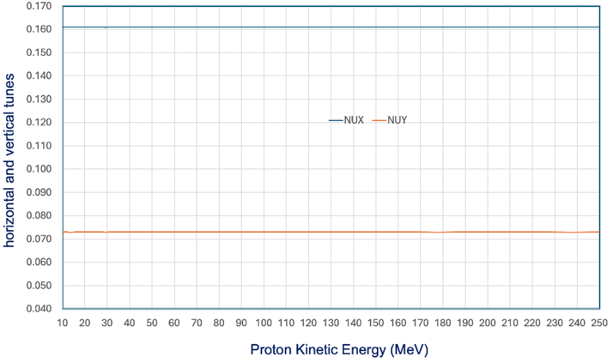
  B.3. Fixed Betatron Tunes in Range 10< E_{k} <250 MeV or in momentum space -73% < Δp/p < 43.4%
ν_{x}=0.1608
ν_{y}=0.0738

Slide 22
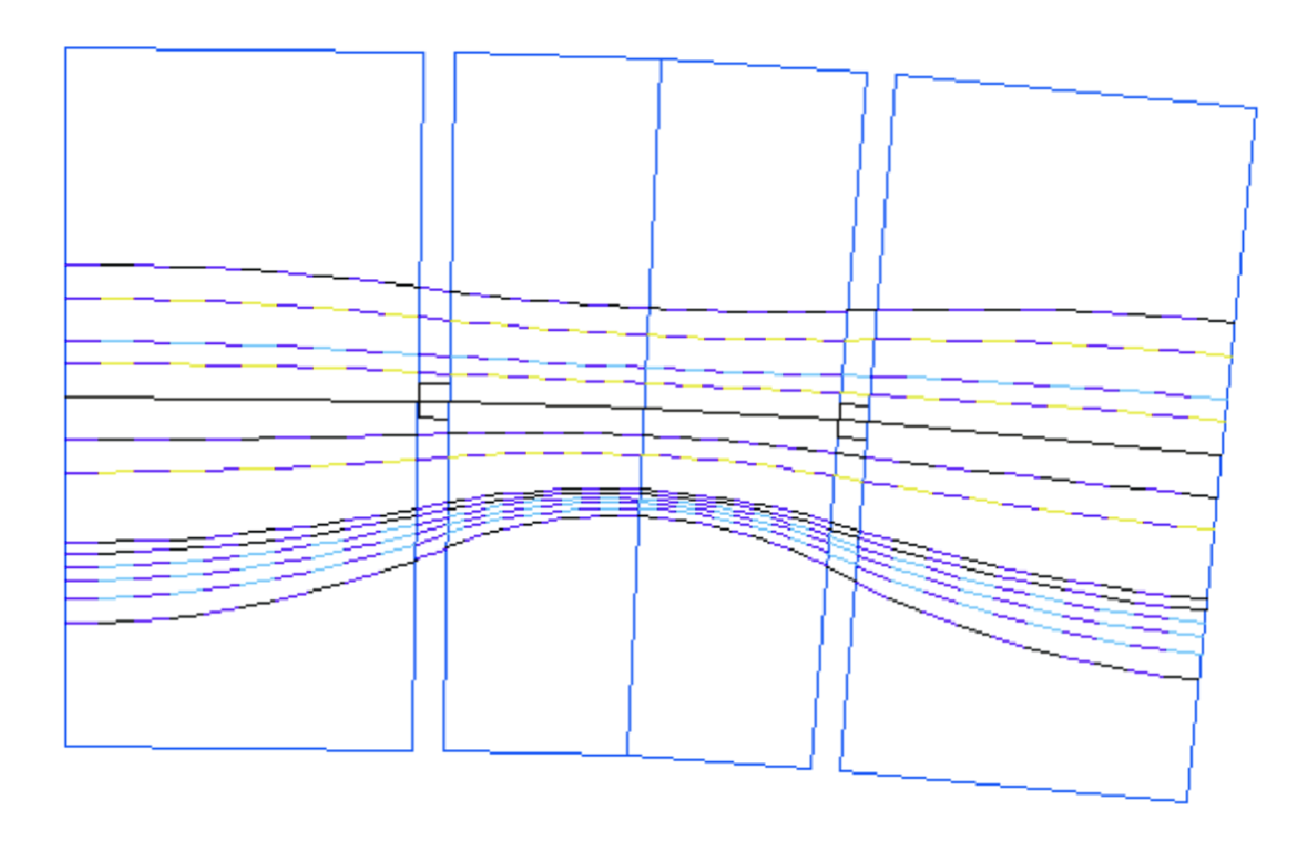
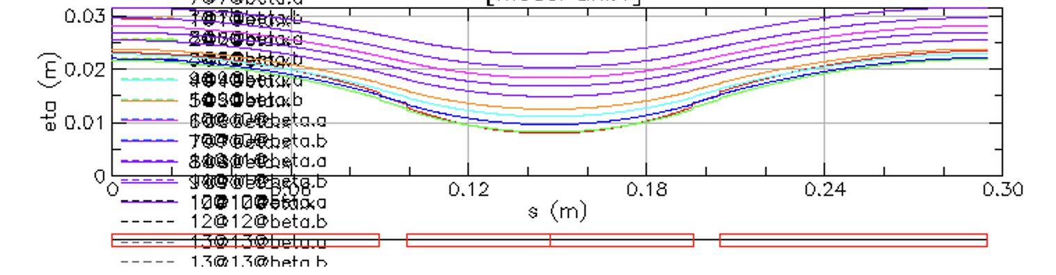
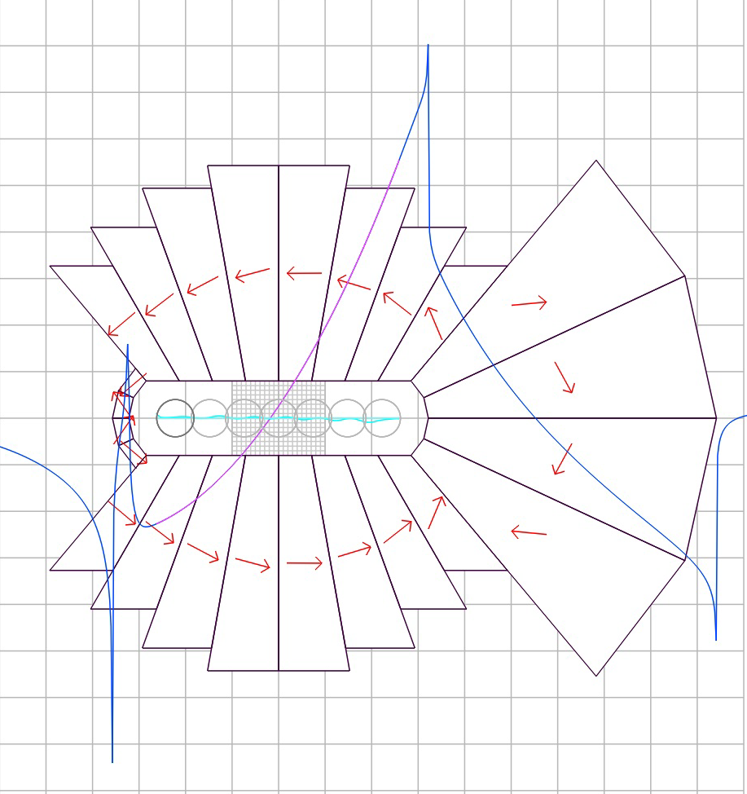
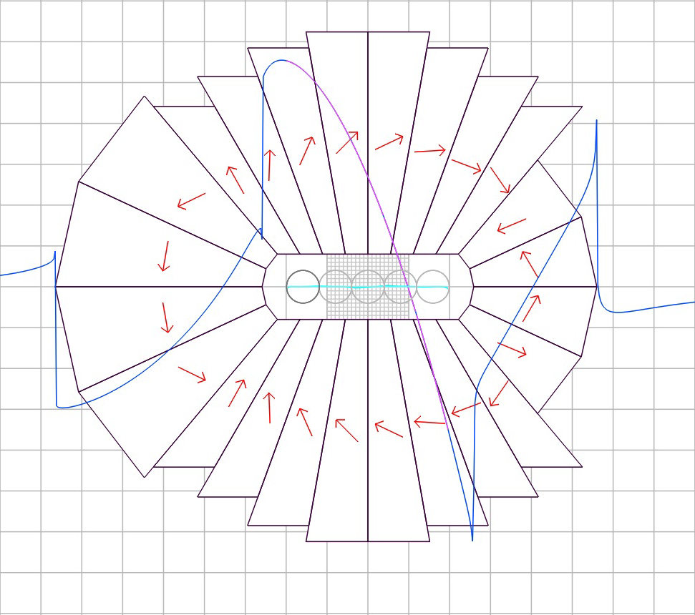
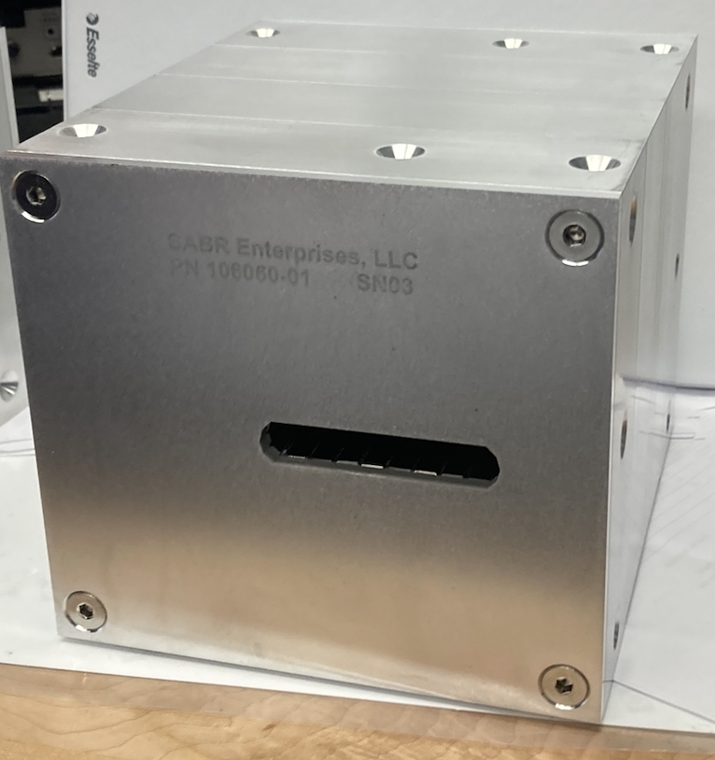

  B.3. Orbit Dependence on Energy
20 mm
250 MeV
129 MeV
250 MeV
19.6 mm
202 MeV
150 MeV
129 MeV
70 MeV
50 MeV
-30 mm
10 MeV
25 MeV
10 MeV
-33.2 mm
DISPERSION
FUNCTION
F magnet length 18 cm
D magnet Length 9.652 cm
~12.5 cm
~11 cm
~13 cm
~14 cm

Slide 23





B.4. Dynamical Aperture Studies
The kinetic energy E_{k}=10MeV
Energy 14 MeV
2.0 cm
2.0 cm
6 mm
5.05 mm
y (cm)
12 mm
10.1 mm
y (cm)
-2.0 cm
25.27 mm
-2.0 cm
25.39 mm
-2.5 cm
2.5 cm
-2.5 cm
2.5 cm
Energy 18 MeV
Energy 50 MeV
2.0 cm
2.0 cm
4.46 mm
2.46 mm
8.9 mm
5.3 mm
y (cm)
y (cm)
-2.0 cm
-2.0 cm
-2.5 cm
2.5 cm
-2.5 cm
25.95 mm
2.5 cm
25.47 mm
2.5 cm
Energy 250 MeV
x (cm)
1.1 mm
2.26 mm
-2.5 cm
2.5 cm
-2.5 cm

Slide 24


B.5. An example of Matching the Multiple Orbits from Arc to the Single Orbit in the Straight Section

Slide 25

B.5. Permanent Magnet Synchrotron
x (m)

Slide 26







B.5. Synchrotron: Injection, Acceleration, Extraction
Protons orbit at δp/p=+68%
Magnified injection
orbit
Magnified injection
orbit
Magnified extraction
orbit
RF-1
RF-1
2.7 m
RF-2
RF-2
RF-3
RF-3
Cyclotron 10 MeV

Slide 27






C.1. Permanent Magnet Production: SABR company (Massachusetts)

Slide 28




C.1. Permanent Magnet Design, Building & Measuring Magnetic Field

Slide 29

C.1.Field-map of one magnet (Stephen Brooks)

Slide 30







  C.2. Arc Assembly with Nine Magnets
F/2
D
F
D
F
D
Magnet
Assembly
F
D
F/2
r =3.5 m
½ F
D
F
D
½ F
30

Slide 31

C.2. Magnet Apertures
31

Slide 32


C.3. Beamline Assembly
32

Slide 33


C.3. Camera and Beam Screen Plates
These were attached to both ends of the beamline.
4 cameras and 4 screens in total.
33

Slide 34


C.3. Installation (@Tandem)
Different beam energies marked on a ruler for alignment.

Slide 35













C.4. Beam Position Measurements at Few Positions
M₄
M₃
M
M₂
M₁
[4]
[3]
[2]
[1]
Beam
l₄
l₃
l₂
l₁
$${x_{4},x}_{4}^{′}$$
$${x_{3},x}_{3}^{′}$$
$$z,z’$$
$$x,x′$$
$${x_{1},x}_{1}^{′}$$
$${x_{0},x}_{0}^{′}$$
l₁=254mm, l₂=280.9mm, l₃=264mm, l₄=254mm
The values at different energies ‘e’ of $z_{e}$ and $z_{e}^{′}$and $x_{e}$and $x_{e}^{′ }$are determined from the beam flag positions $x_{4,e}$ $x_{3,e}$ and $x_{4,e}^{′}$ $x_{3,e}^{′}$ for the $z_{e}$ and 1 and 2 for the $x_{1,e}, x_{2,e}$ and $x_{1,e}^{′}$ $x_{1,e}^{′}.$
$\overset{⃑}{z}$ =$\left[\begin{matrix}z \\ z^{′}\end{matrix}\right]$
$\overset{⃑}{x}$ =$\left[\begin{matrix}x \\ x^{′}\end{matrix}\right]$
$$\cos\left(ν\right)=\frac{1 }{2} Trace M$$
$${\overset{⃑}{z}}_{t}=M\overset{⃑}{x}$$
$$M=\left[\begin{matrix}a & b \\ c & d\end{matrix}\right]$$
There were three beam runs: the first one at NSRL without the assembly checking the beam-air interaction and the second one with the assembly. The last run in October-25 was at Tandem. The more different beam input positions the better accuracy of the betatron function measurements would be.
${\left[\begin{matrix}z \\ z^{′}\end{matrix}\right]}_{t}={\left[\begin{matrix}x & x^{′} \\ 0 & 0\end{matrix} \begin{matrix}0 & 0 \\ x & x^{′}\end{matrix}\right]}_{t}$ $\left[\begin{matrix}a \\ \begin{matrix}b \\ \begin{matrix}c \\ d\end{matrix}\end{matrix}\end{matrix}\right]$

Slide 36

C.4. At lower energies, the output beam gets very large due to the beam gas interaction and starts to assume a crescent shape as shown in dynamical aperture studies

Slide 37









C.4. BEAM MEASUREMENTS

Slide 38

C.4. Beam Position Measurements at Few Positions

Slide 39

C.4. Calibration and 1s Ellipse Fit

Slide 40




C.4. NASA Space Radiation Laboratory 250MeV protons
FLAG#2
FLAG#1
18.1mm
18.4mm
Beam in
FLAG#3
θ = 46.353^{ο}
FLAG#4
2 cm
Beam out
11.56mm
11.968mm
4 cm
(2.7609cm)

Slide 41
C.4. NSRL 250MeV protons
FLAG#2
FLAG#1
Beam in
FLAG#3
FLAG#4
Beam out

Slide 42




C.4. NSRL 200MeV protons
Beam in
Beam out

Slide 43




C.4. NSRL 150MeV Protons
Beam in
Beam out
Obscured by stray light on screen 3

Slide 44




C.4.NSRL 100MeV protons
Beam in
Beam out

Slide 45




C.4. NSRL 70MeV protons
Beam in
Beam out

Slide 46




C.4. NSRL 50MeV protons
Beam in
Beam out

Slide 47




C.4. Tandem 28MeV d ~ 50MeV p
Beam in
Beam out

Slide 48




C.4. Tandem 24.2MeV d ~ 40MeV p
Beam in
Beam out

Slide 49




C.4. Tandem 20MeV d ~ 30MeV p
Beam in
Beam out

Slide 50




C.4. Tandem 16MeV d ~ 20MeV p
Beam in
Beam out

Slide 51




C.4. Tandem 14.3MeV d ~ 15MeV p
Beam in
Beam out

Slide 52




C.4. Tandem 12.9MeV d ~ 10MeV p
Beam in
Beam out
Beam may have stopped in air before screen 4

Slide 53




C.4. Tandem All Energies
Beam in
Beam out

Slide 54




All 12 Ellipses
Beam in
Beam out

Slide 55




C.4. Centroid x Positions
Beam in
15
20
30
40
50
60
80
150
200
250
15
20
30
40
50
60
80
150
200
250
Beam out
15
20
30
40
50
60
80
150
200
250
15
20
30
40
50
60
80
150
200
250

Slide 56




C.4. Centroid Y Positions
Known Y shift from reassembly of camera screens between NSRL and Tandem
Beam in
Beam out

Slide 57

C.4. Preliminary tune measurement
Cell tune ranges:
ν_{x} = 0.1608 ± 0.0004
ν_{y} = 0.0738 ± 0.0011
4ν_{x,cell} = 0.644 → cos(φ_{x}) = -0.618
Agrees at high energy
15
20
30
40
50
70
150
200
250

Slide 58
C.5 ACCOMPLISHED TASKS
  The magnets were assembled at the aluminum plate, positions adjusted by the surveying team and covered by the aluminum chamber with Kevlar windows at the entrance and exit.
  The magnet assembly was transported to the NSRL laboratory and positioned for the first part of the experiment 50-250 MeV proton beam transport. The proton beam with energies between 50 MeV and 250 MeV was propagated through the assembly with radial horizontal positions adjusted for each energy. The proton beam positions were measured with two sequential flags in front and at the exit.
  The second part of the experiment was performed at Tandem BNL accelerator using deuterons to provide equivalent proton kinetic energies between 10 and 50 MeV.

Slide 59
C.5. EXPERIMENT CONCLUSION
Beams at all energies were transmitted through the 4-cell test girder (22.5° or 1/8 arc)
  Protons at NSRL and deuterons at Tandem
10-250MeV is a factor of 5.3× in momentum
  Very large for a non-scaling FFA, especially one with a flattened tune
  250MeV is highest ever energy in any NS-FFA line
Beam ought to propagate several cells around a ring at the start of commissioning
  (even without magnet shimming/correction here)

Slide 60
C.5. SUMMARY
Further goals of the LDRD is to transfer the existing technology to the FLASH therapy cancer radiation facility at the Radiation Oncology Department of the Stony Brook University Hospital.
The LDRD results will be used as a proof of principle for the concept of fast-cycling permanent magnet synchrotron for get funding to complete the synchrotron.
This is a proof of principle for a novel type of accelerator where the magnetic field is fixed, and the acceleration rate depends only on the RF.
The present collaboration includes the FLASH therapy experiments on mice at the BNL TANDEM accelerator with the 28.5MeV proton beam.
When the whole proton therapy facility is built the FLASH radiation therapy could be explored. This is significant advantage to any other existing radiation therapy facility as due to fixed magnetic field the treatment could be done is 100ms.
This accelerator opens the door for new proton drivers, Muon collider accelerator as the muon lifetime is very short, and for ADS.

