Slide 1
BIC Update
Triple I Engineering Meeting Update
Kevin Bailey & Tom O’Connor
October 20, 2025

Slide 2
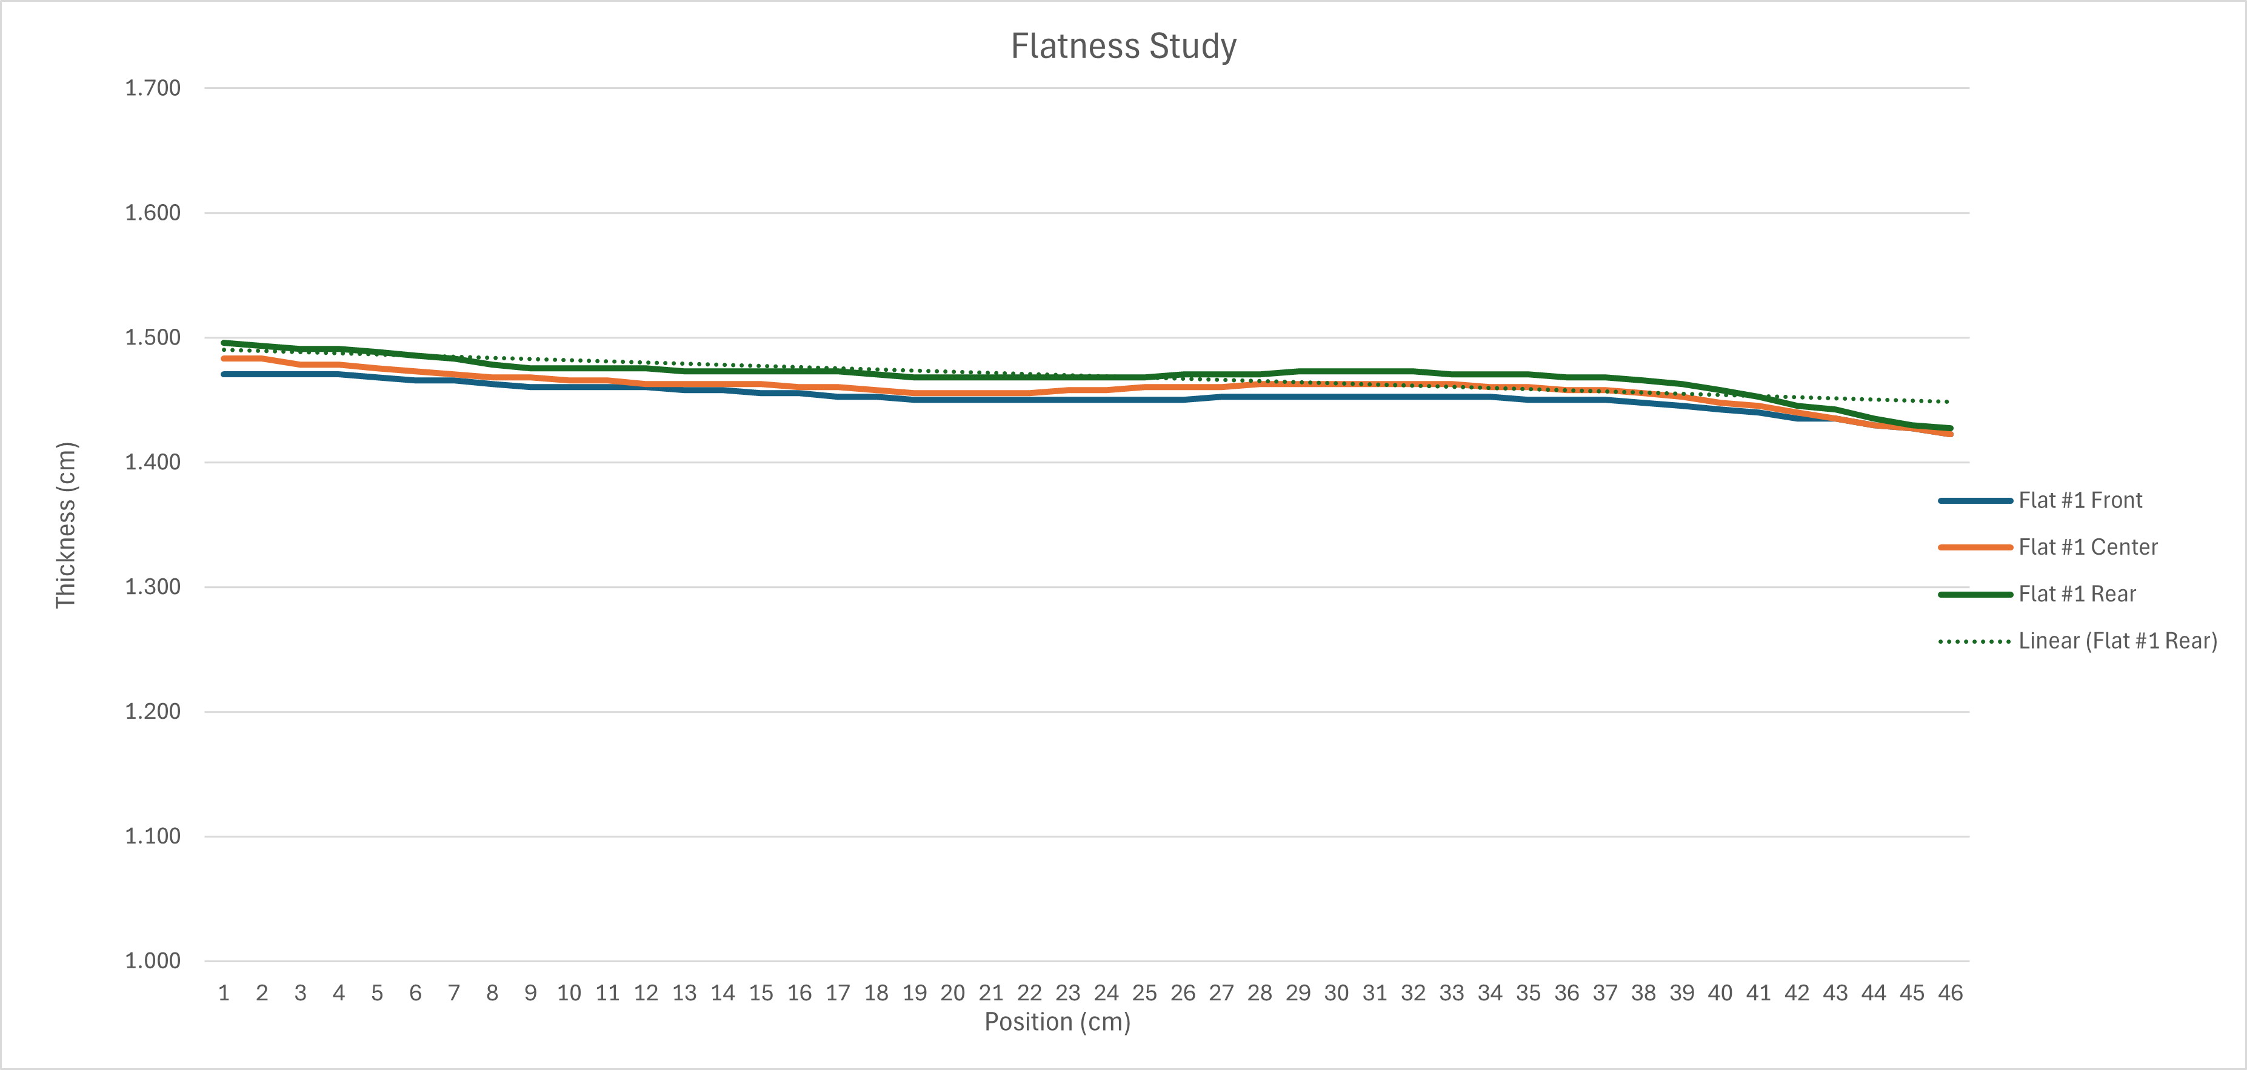
Lead/SciFi Matrix Flatness
Built 9 lead sheets/8 layers of fiber, L = 50cm, for flatness study
Improved flatness but misalignments remain
Fiber/lead misalignments still appear to match slope error
All misalignments appear on “left” end

Slide 3
Lead/SciFi Matrix Flatness - continued
Curvature seen in swaged lead could explain misalignment
Swage longer pieces to amplify curvature and massage swaged lead to remove it
Swager is known to induce curvature from GlueX
No slope or taper in swaged lead
New matrix in process (9 lead sheets/8 layers of fiber; L = 50cm)
Wider prototype lead (16cm and 17cm) ready to ship.

Slide 4
CFRP Destructive Testing and Drawer Design
Testing continues for tension and shear
Drawer design continues with single piece and 4-piece options
No updates but meeting scheduled for this afternoon

Slide 5
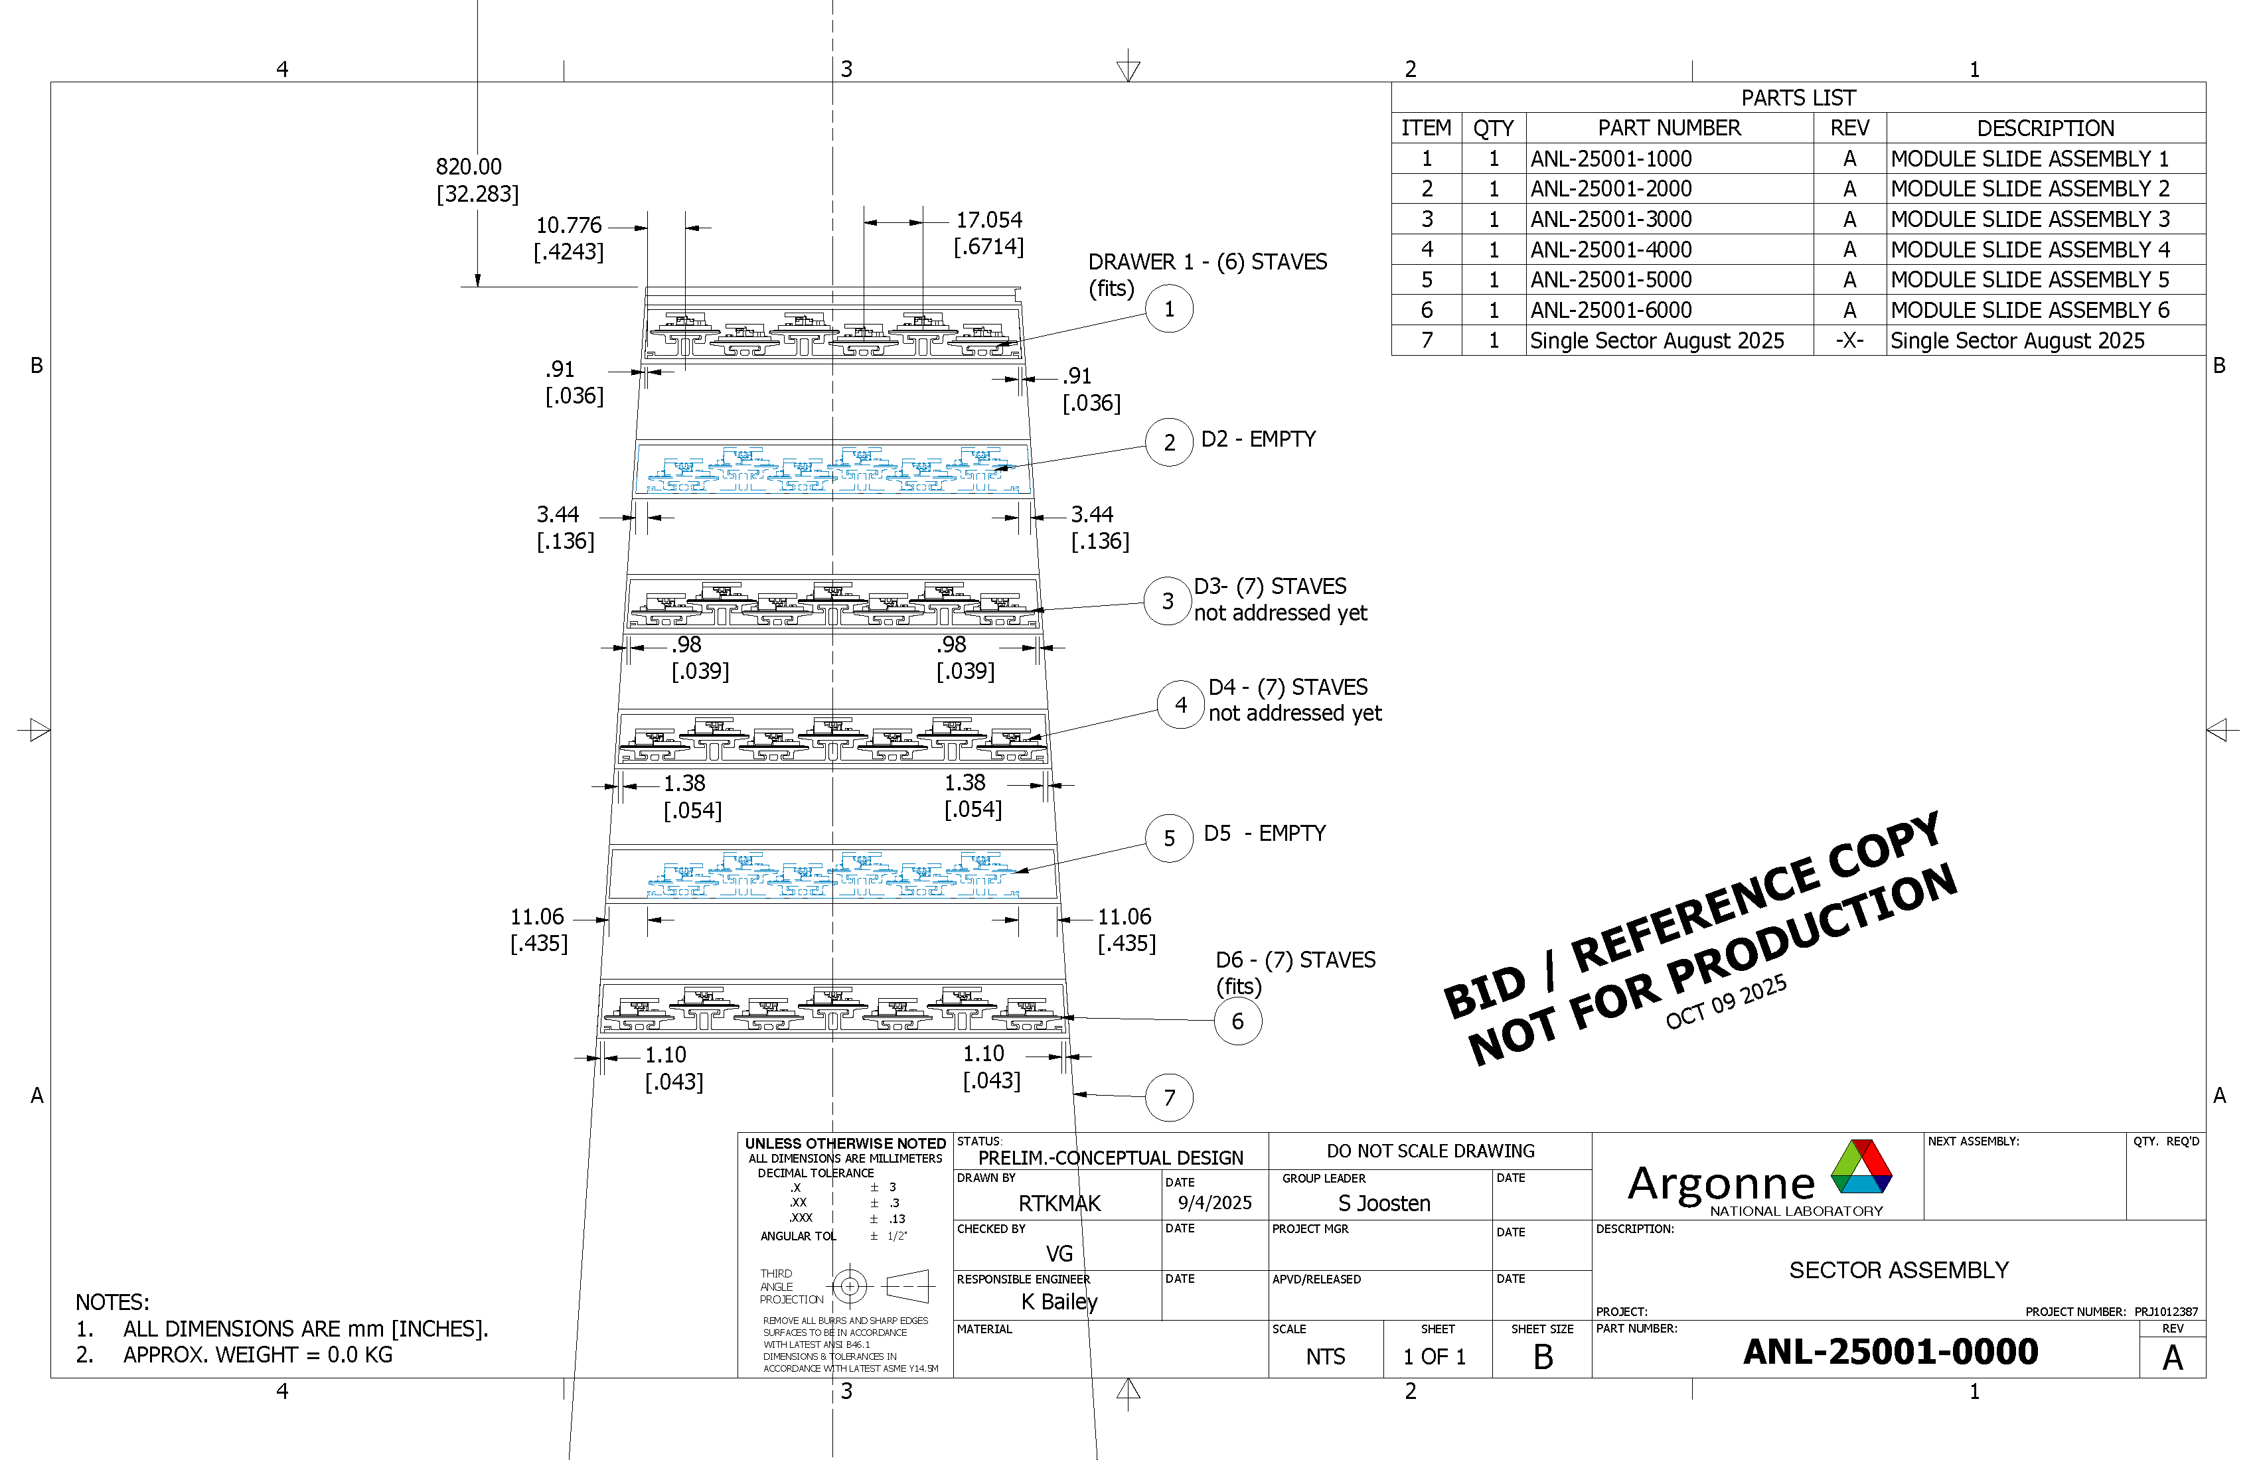
Astropix Stave/Drawer Design
Emphasis on D1 and D6 for now
Only 7 staves in D6

Slide 6
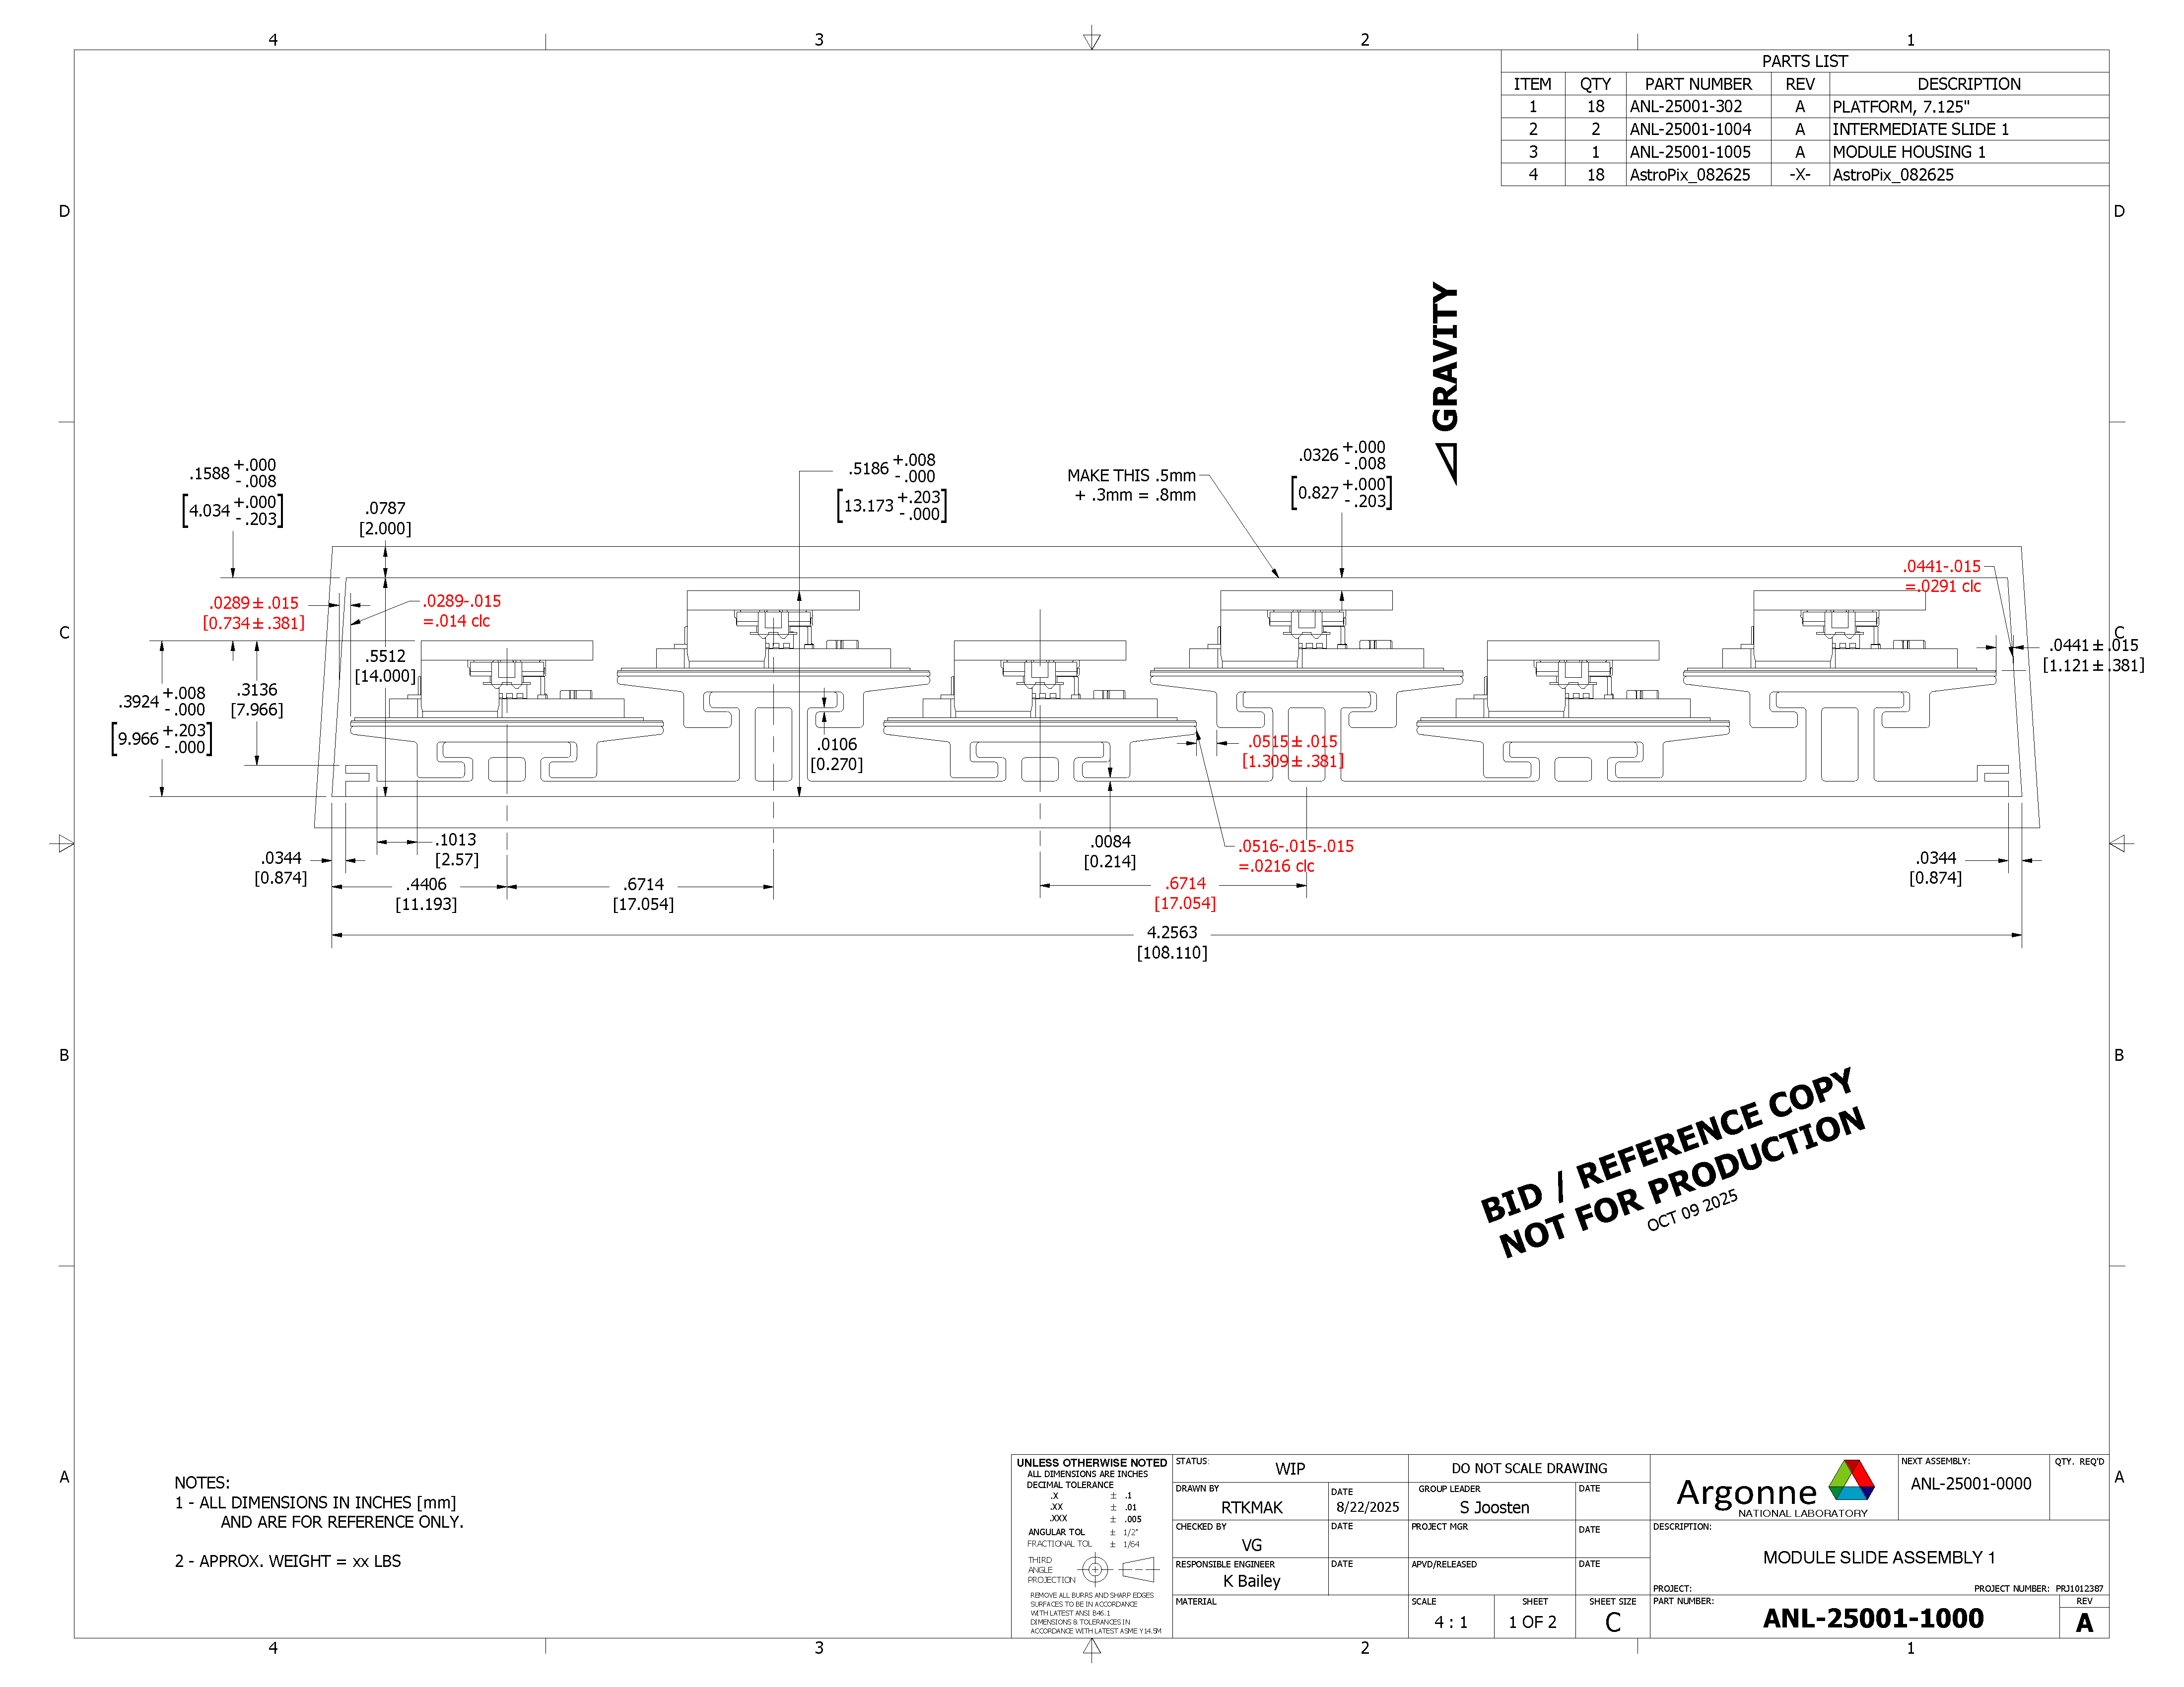
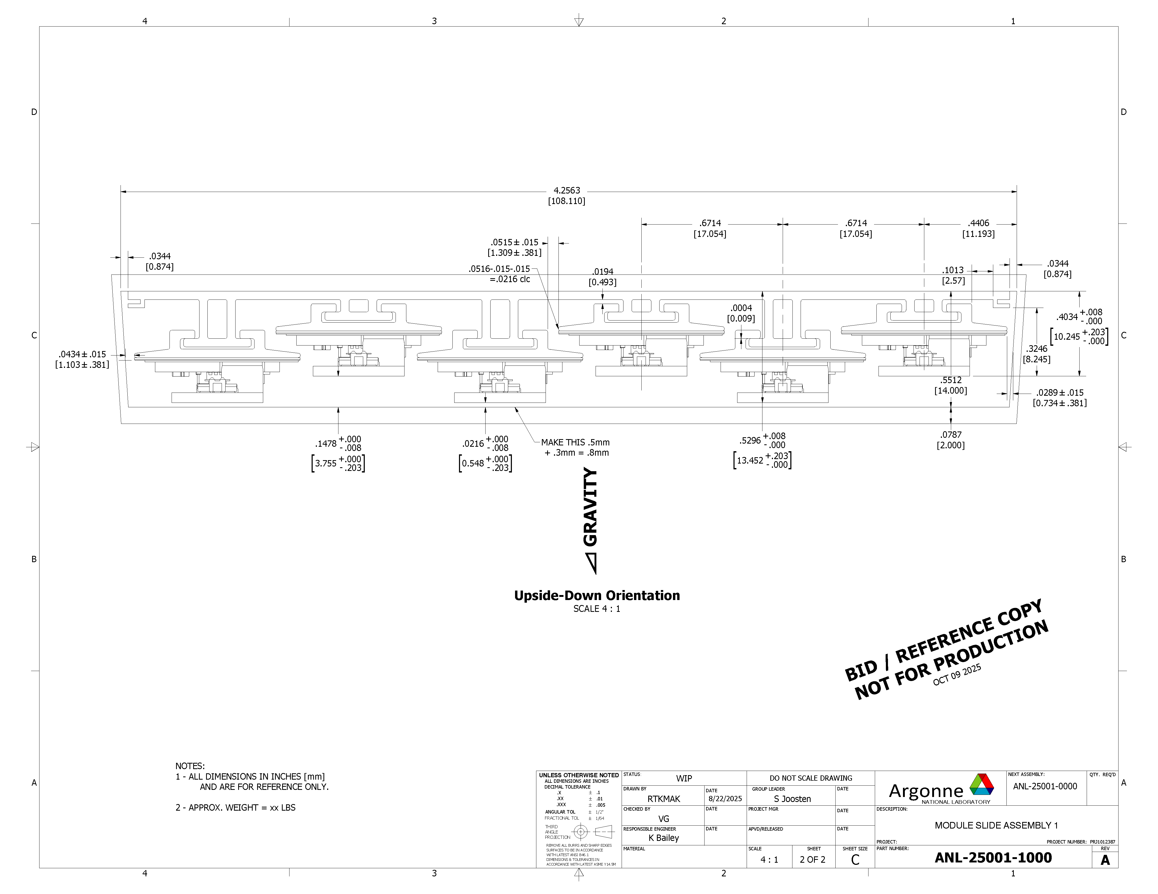
Astropix Stave Design - continued
D1 – two orientations

Slide 7
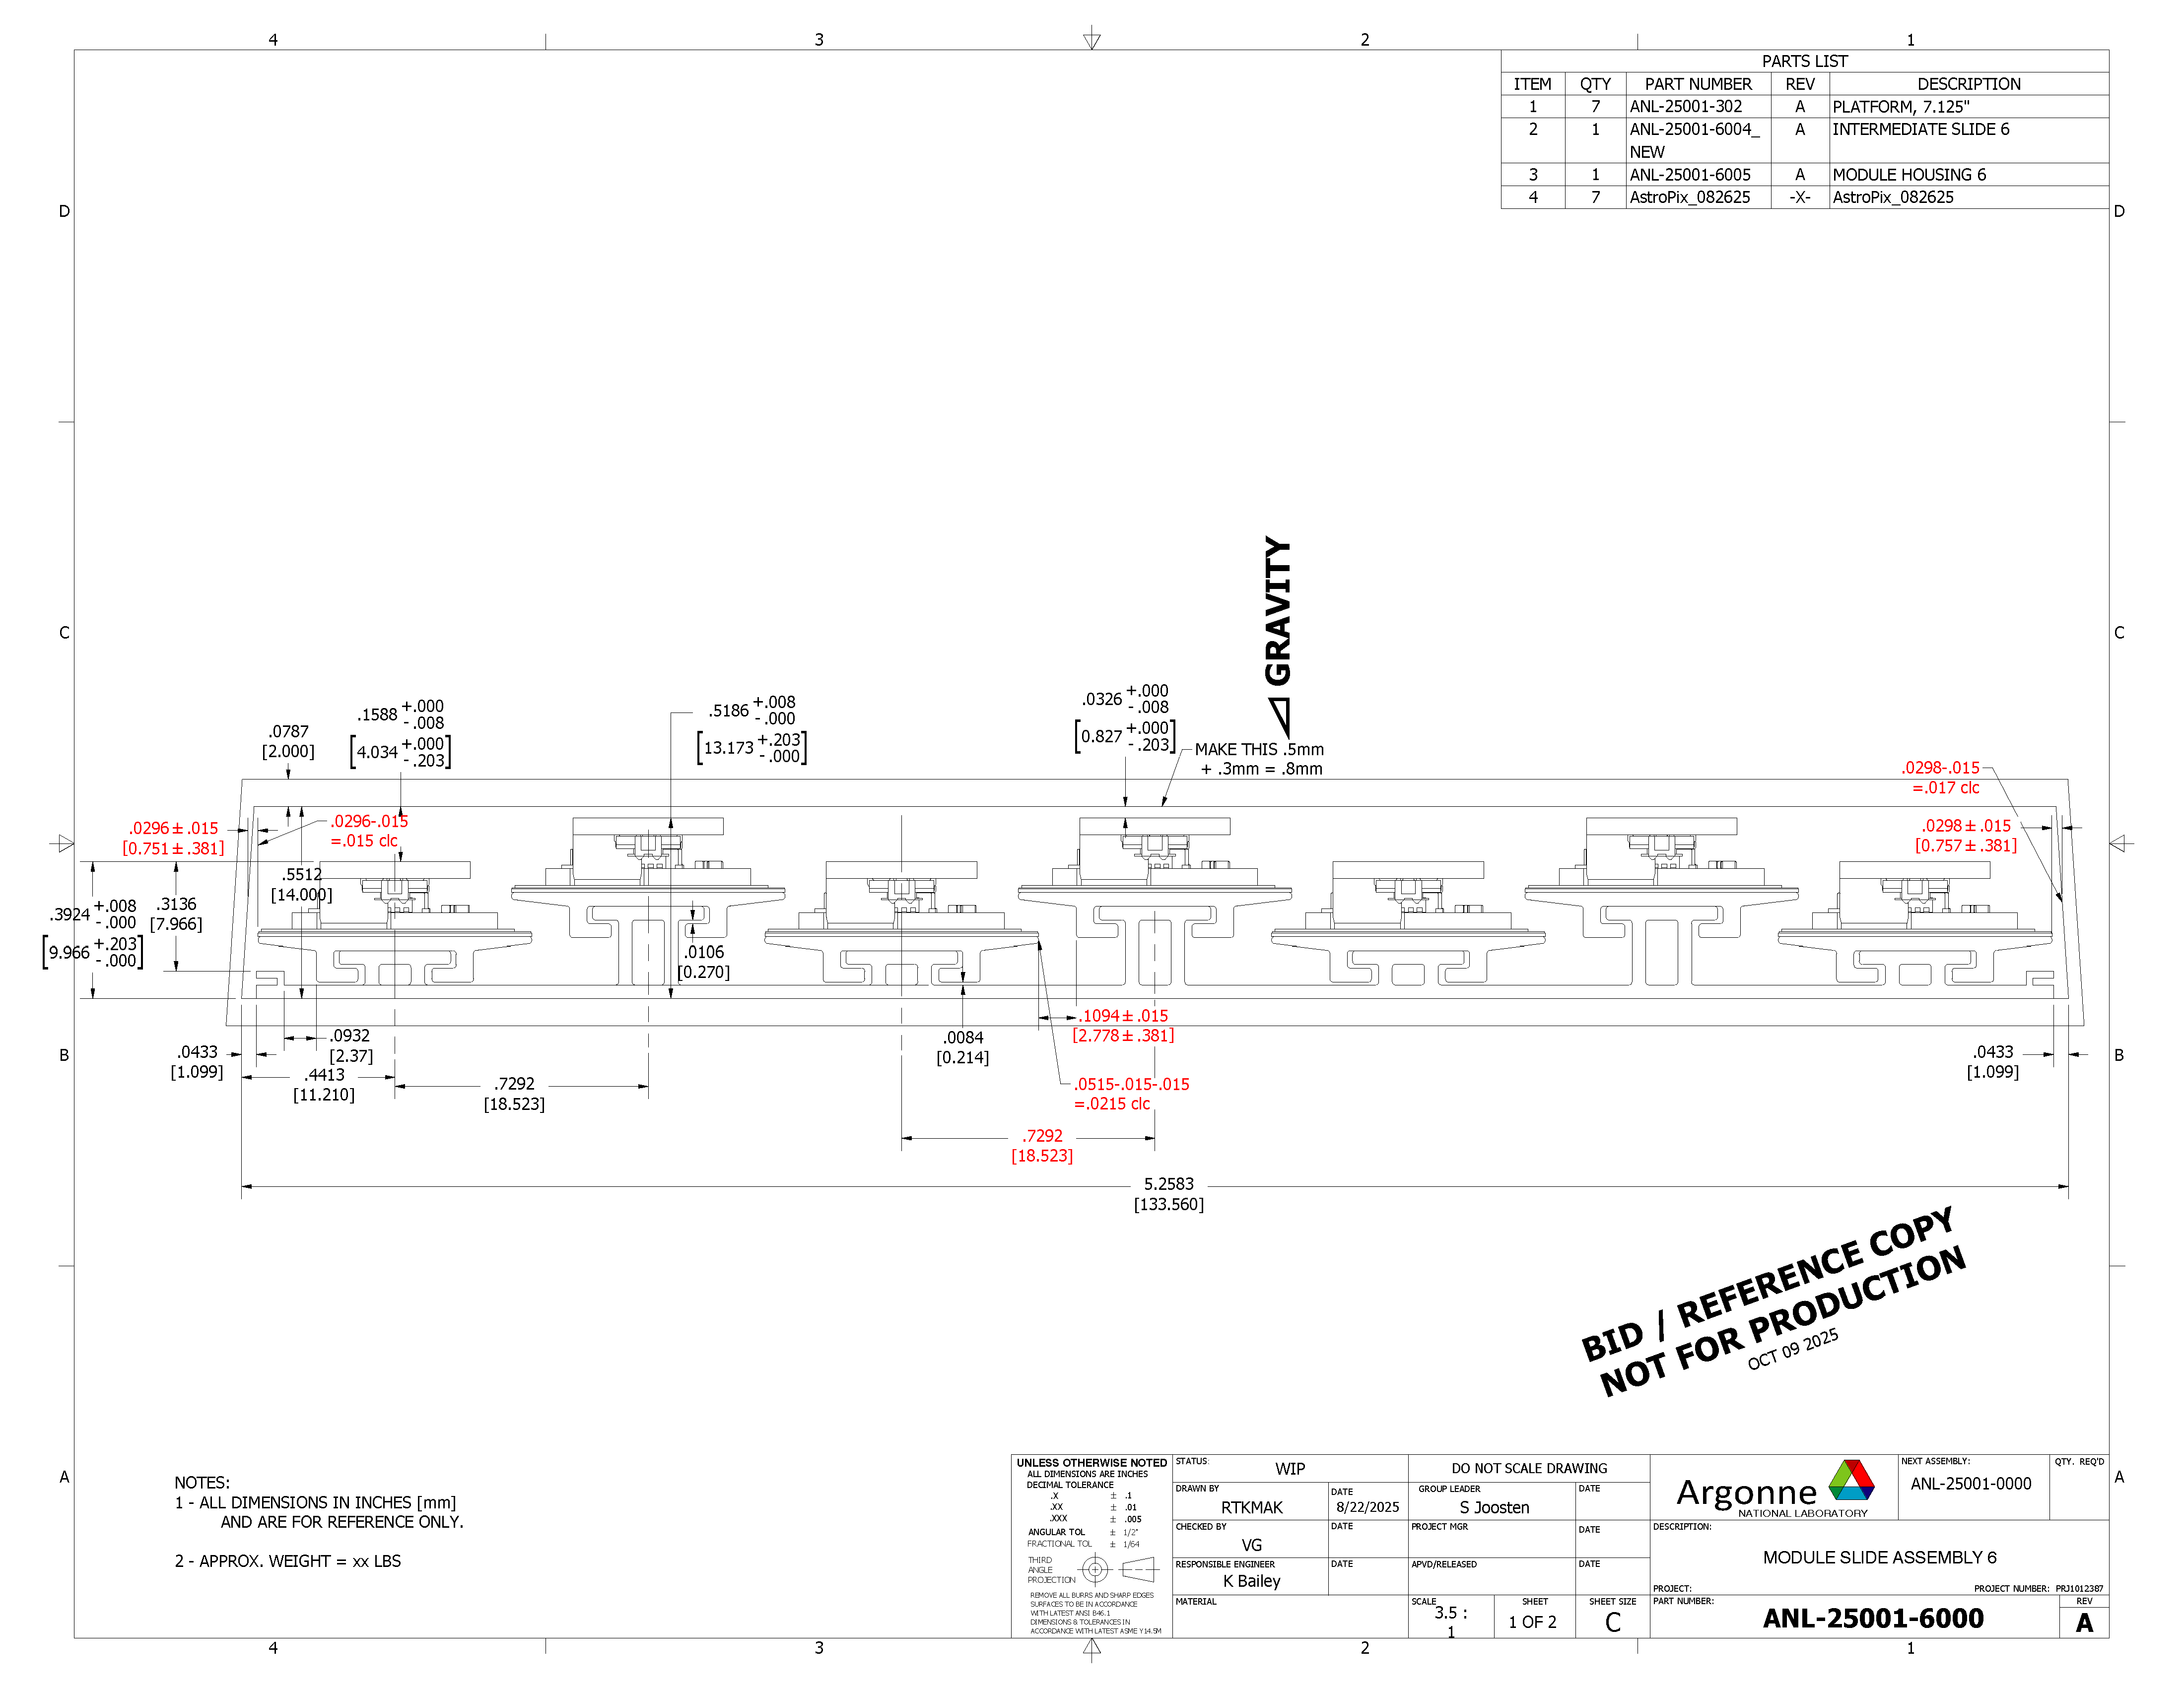
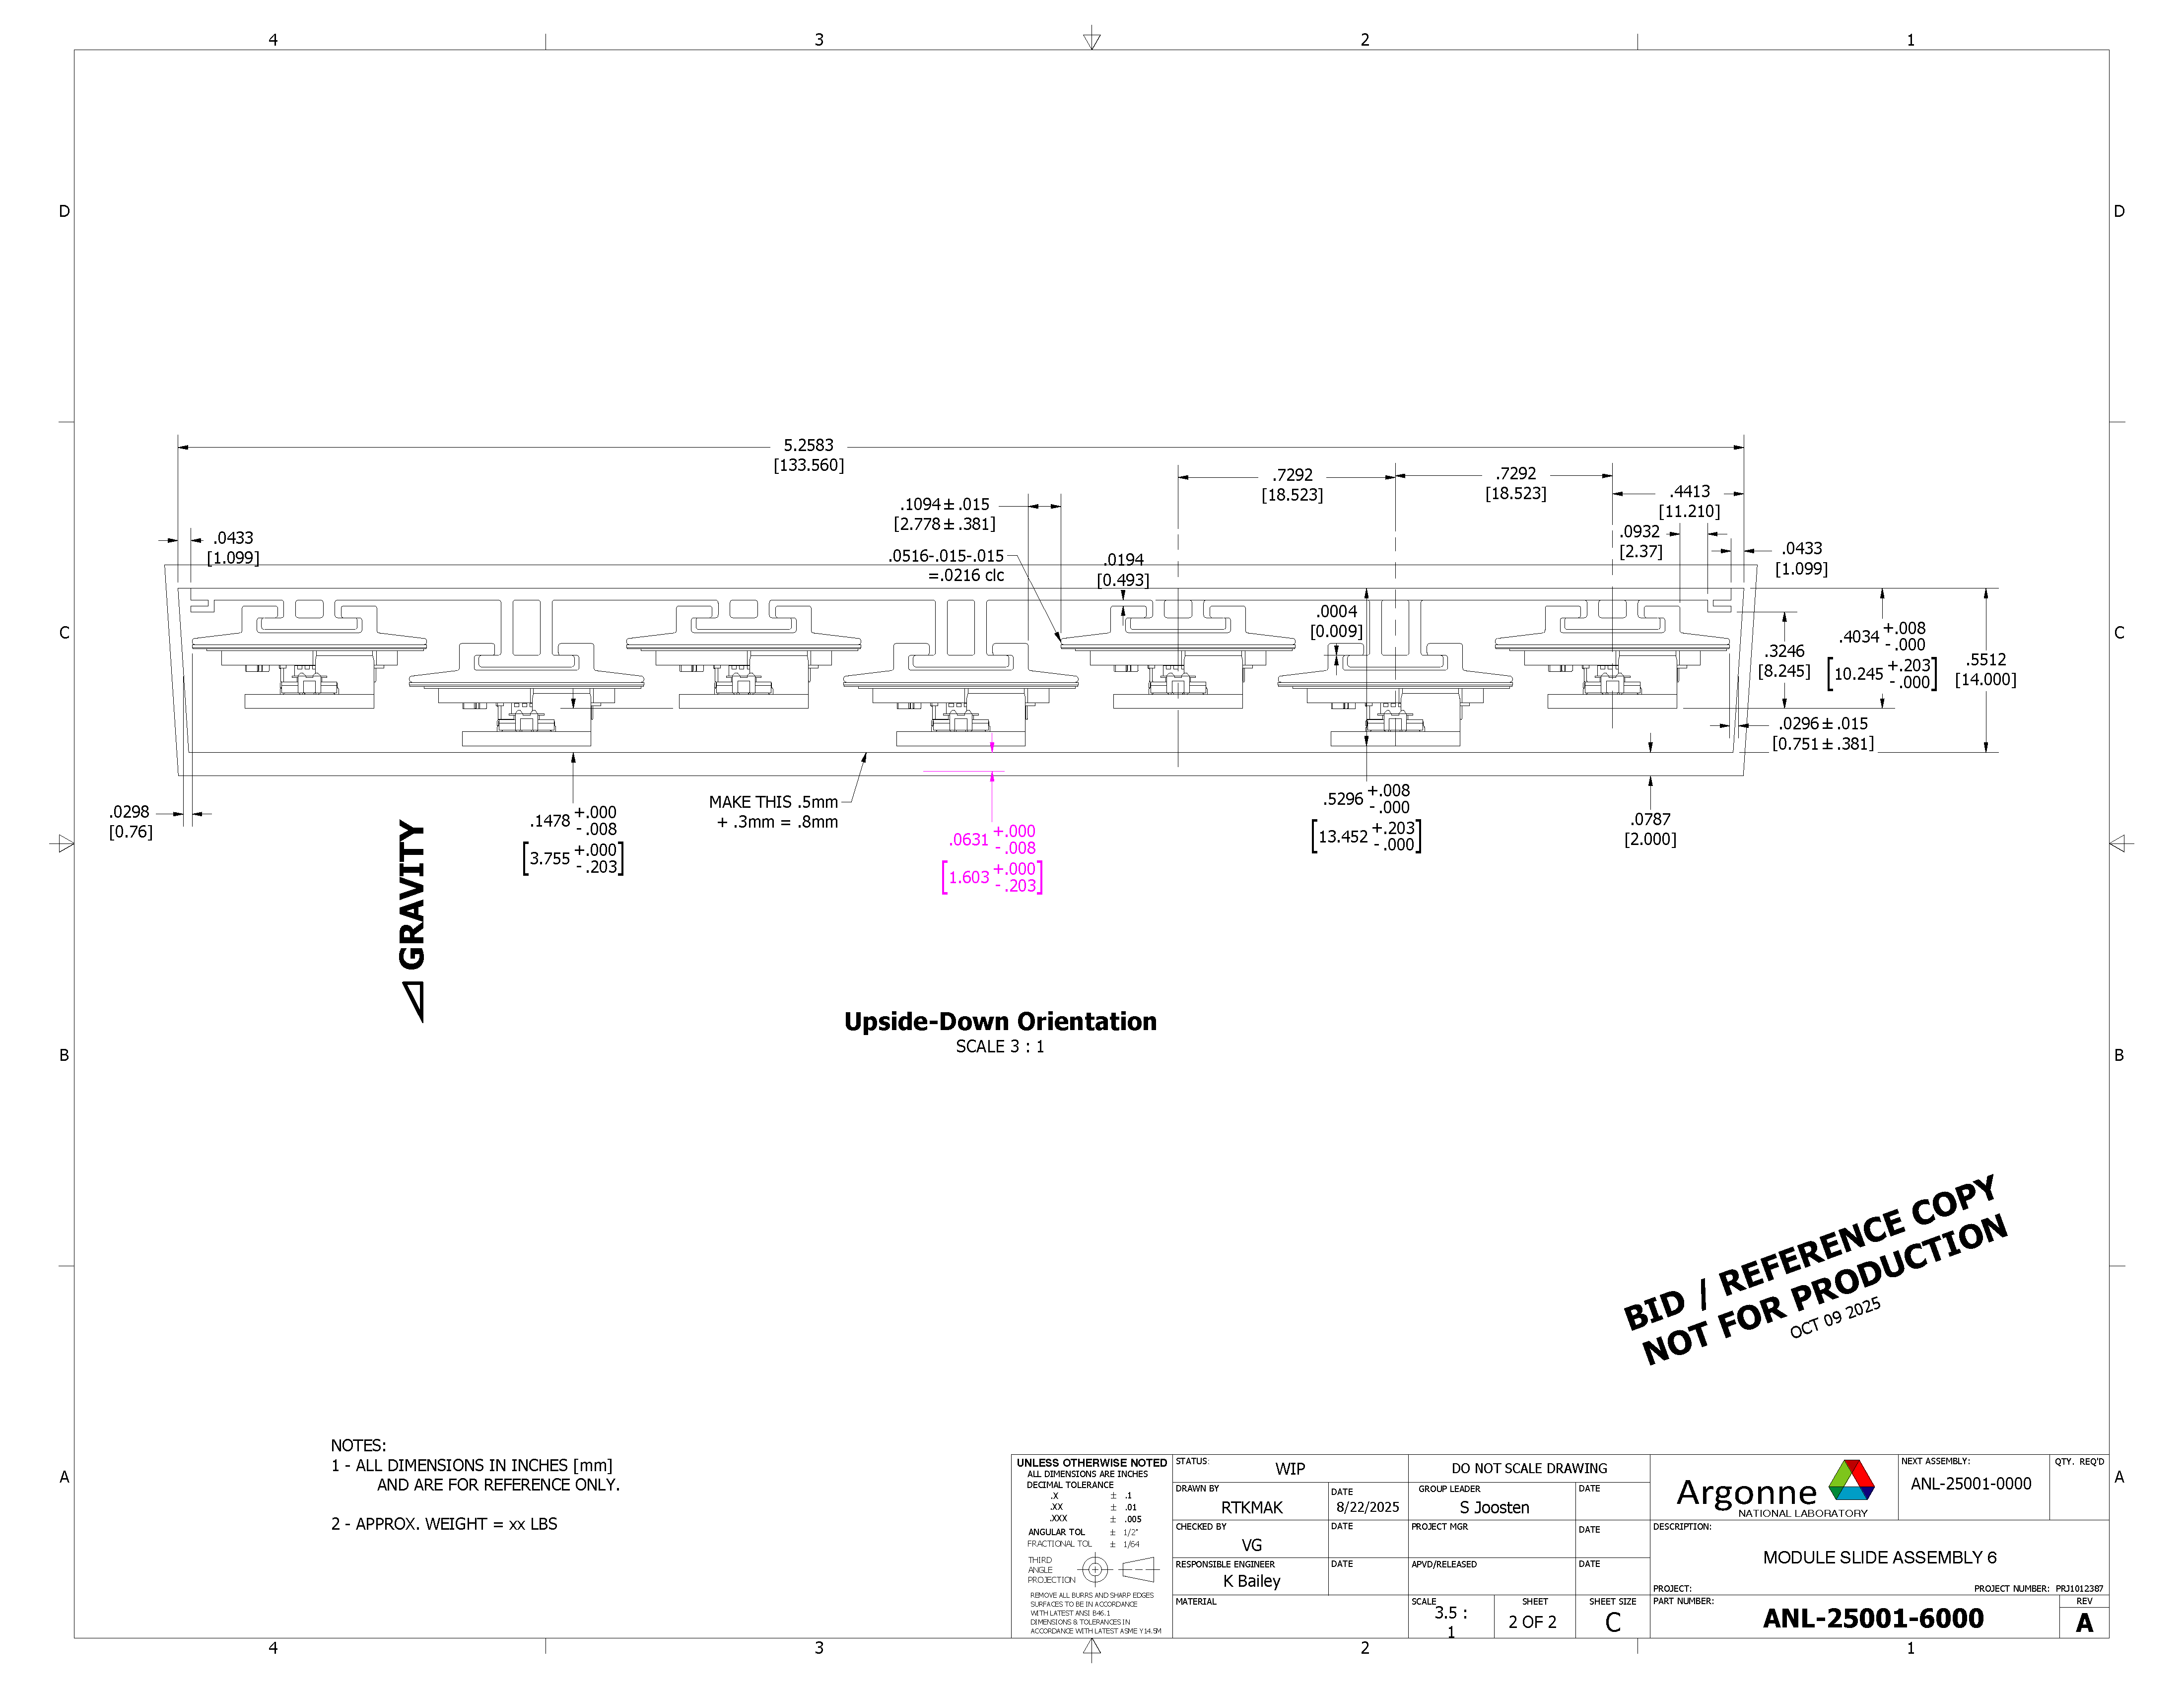
Astropix Stave Design - continued
D6 – 7 staves, two orientations

Slide 8
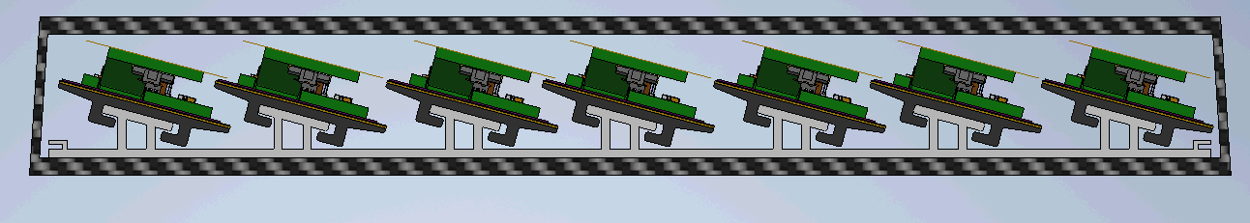
Astropix Stave Design - continued
D6 – Alternative Geometry

Slide 9
Detailed Drawings

Slide 10
Detailed Drawings - continued

