Slide 1
BIC Update
Triple I Engineering Meeting Update
Kevin Bailey & Tom O’Connor
November 3, 2025

Slide 2
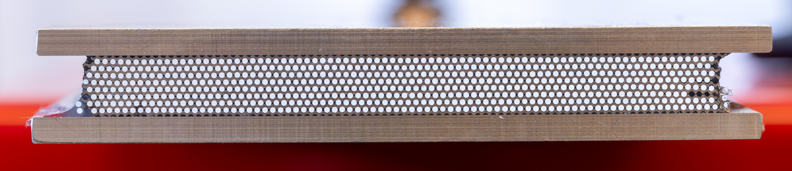
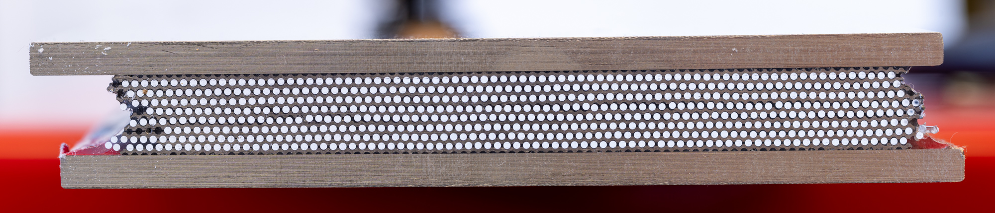
Flatness Test #2

Slide 3
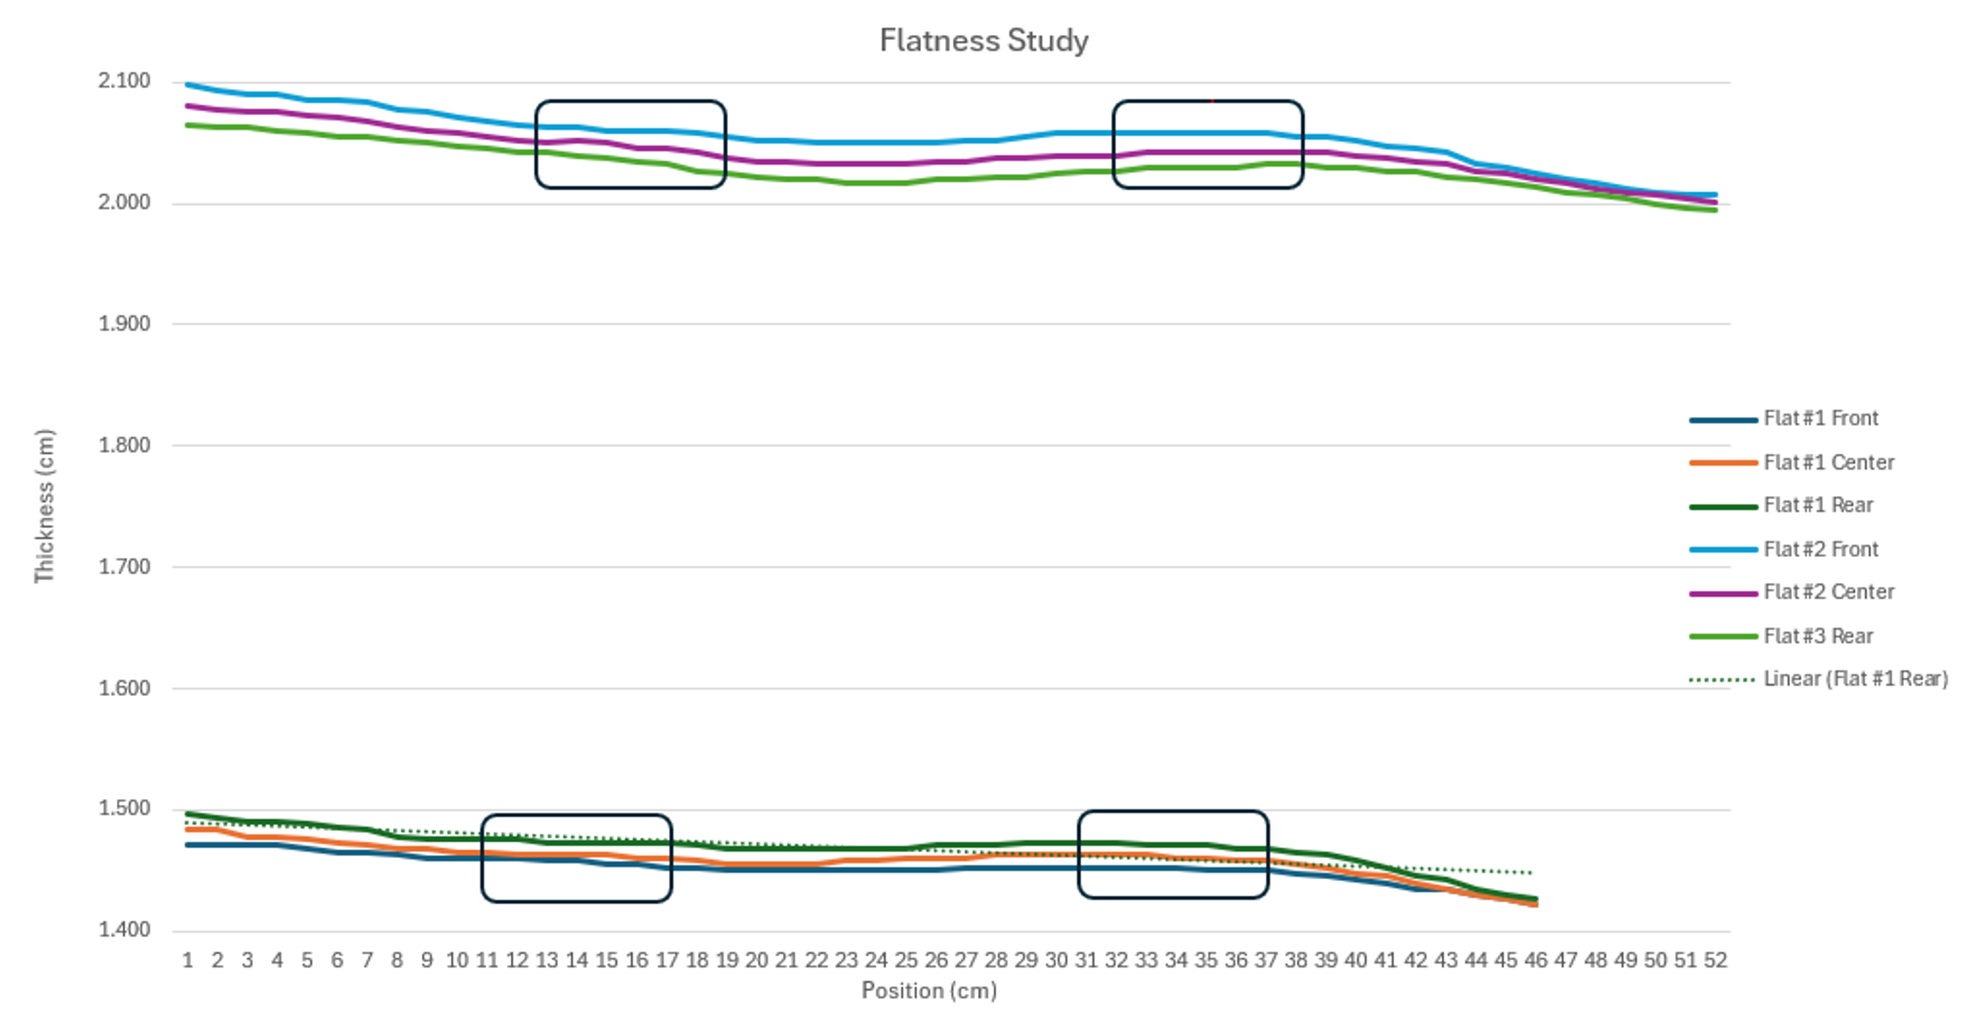
Flatness measuremets

Slide 4
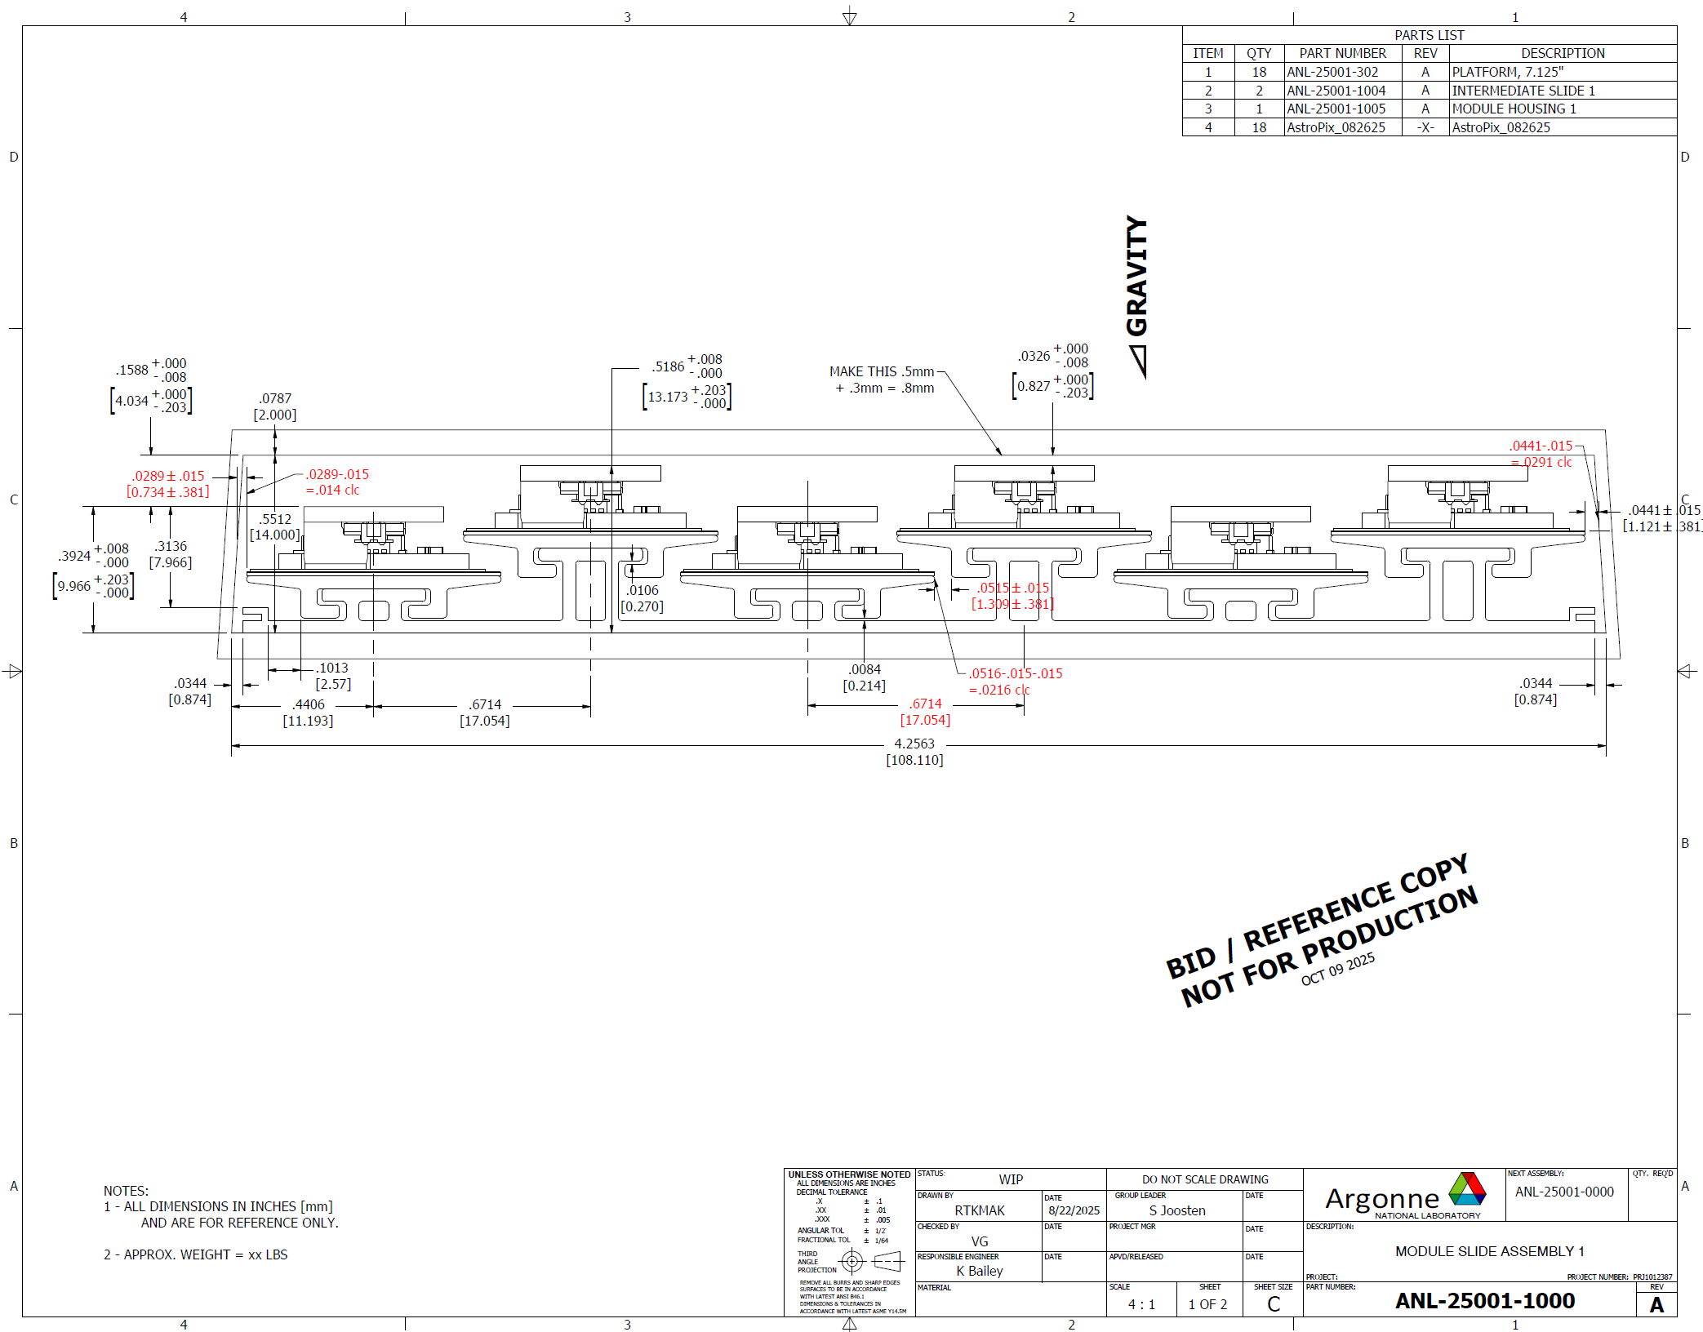
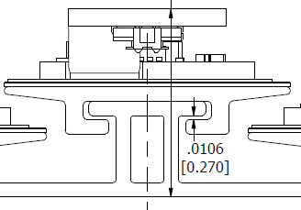
Modules and Staves
Fabrication Tooling impacts on design
– Discussion scheduled
Angle a problem
Radius a problem
Available vacuum area

Slide 5
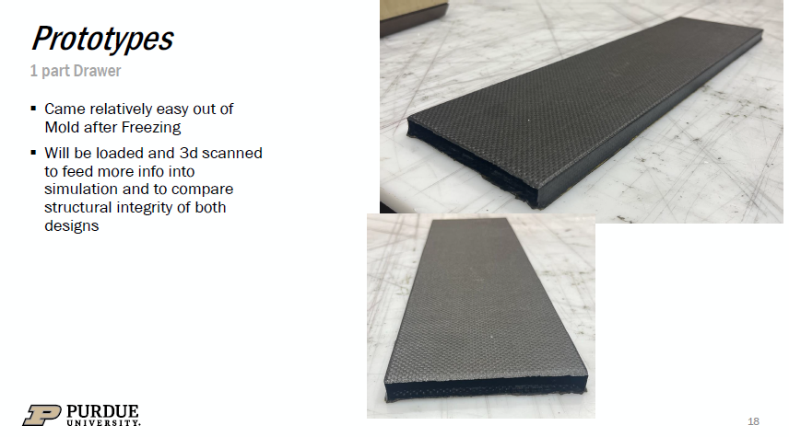
Two CFRP samples
-Deflection testing and analysis
-On route to ANL
Plan to add Lead/SiFI
-More deflection testing planned

