Slide 1
BIC Update
Triple I Engineering Meeting Update
Kevin Bailey & Tom O’Connor
November 17, 2025

Slide 2
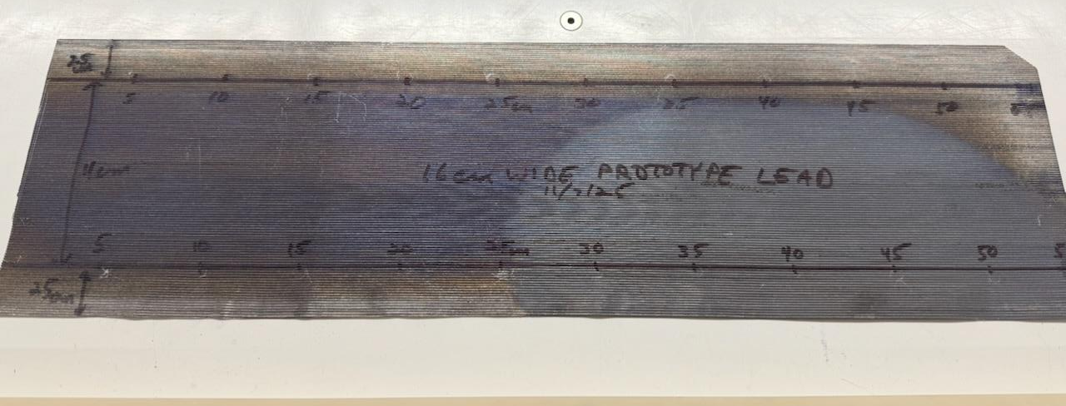
Prototype Lead Evaluation
Ripples on edge

Slide 3
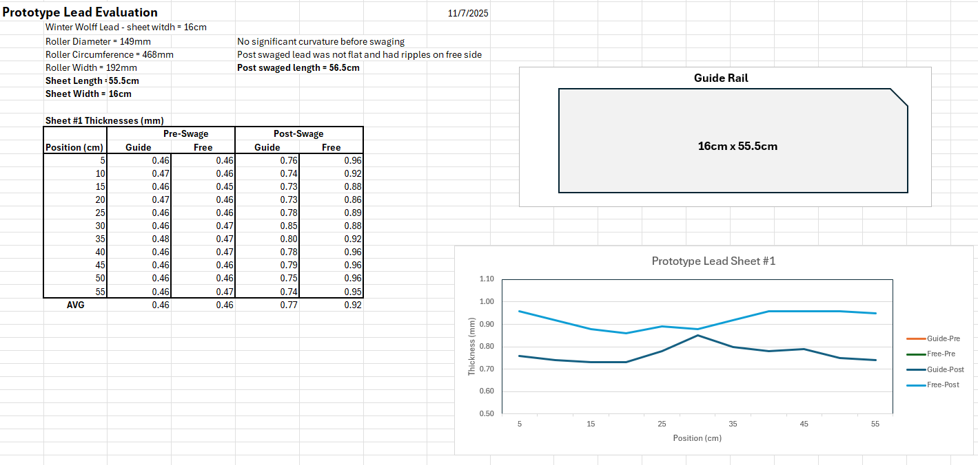
Prototype Lead Evaluation
Lower thickness but meets GlueX Spec.
Swages easily but parts are rippled
Adjustments required

Slide 4
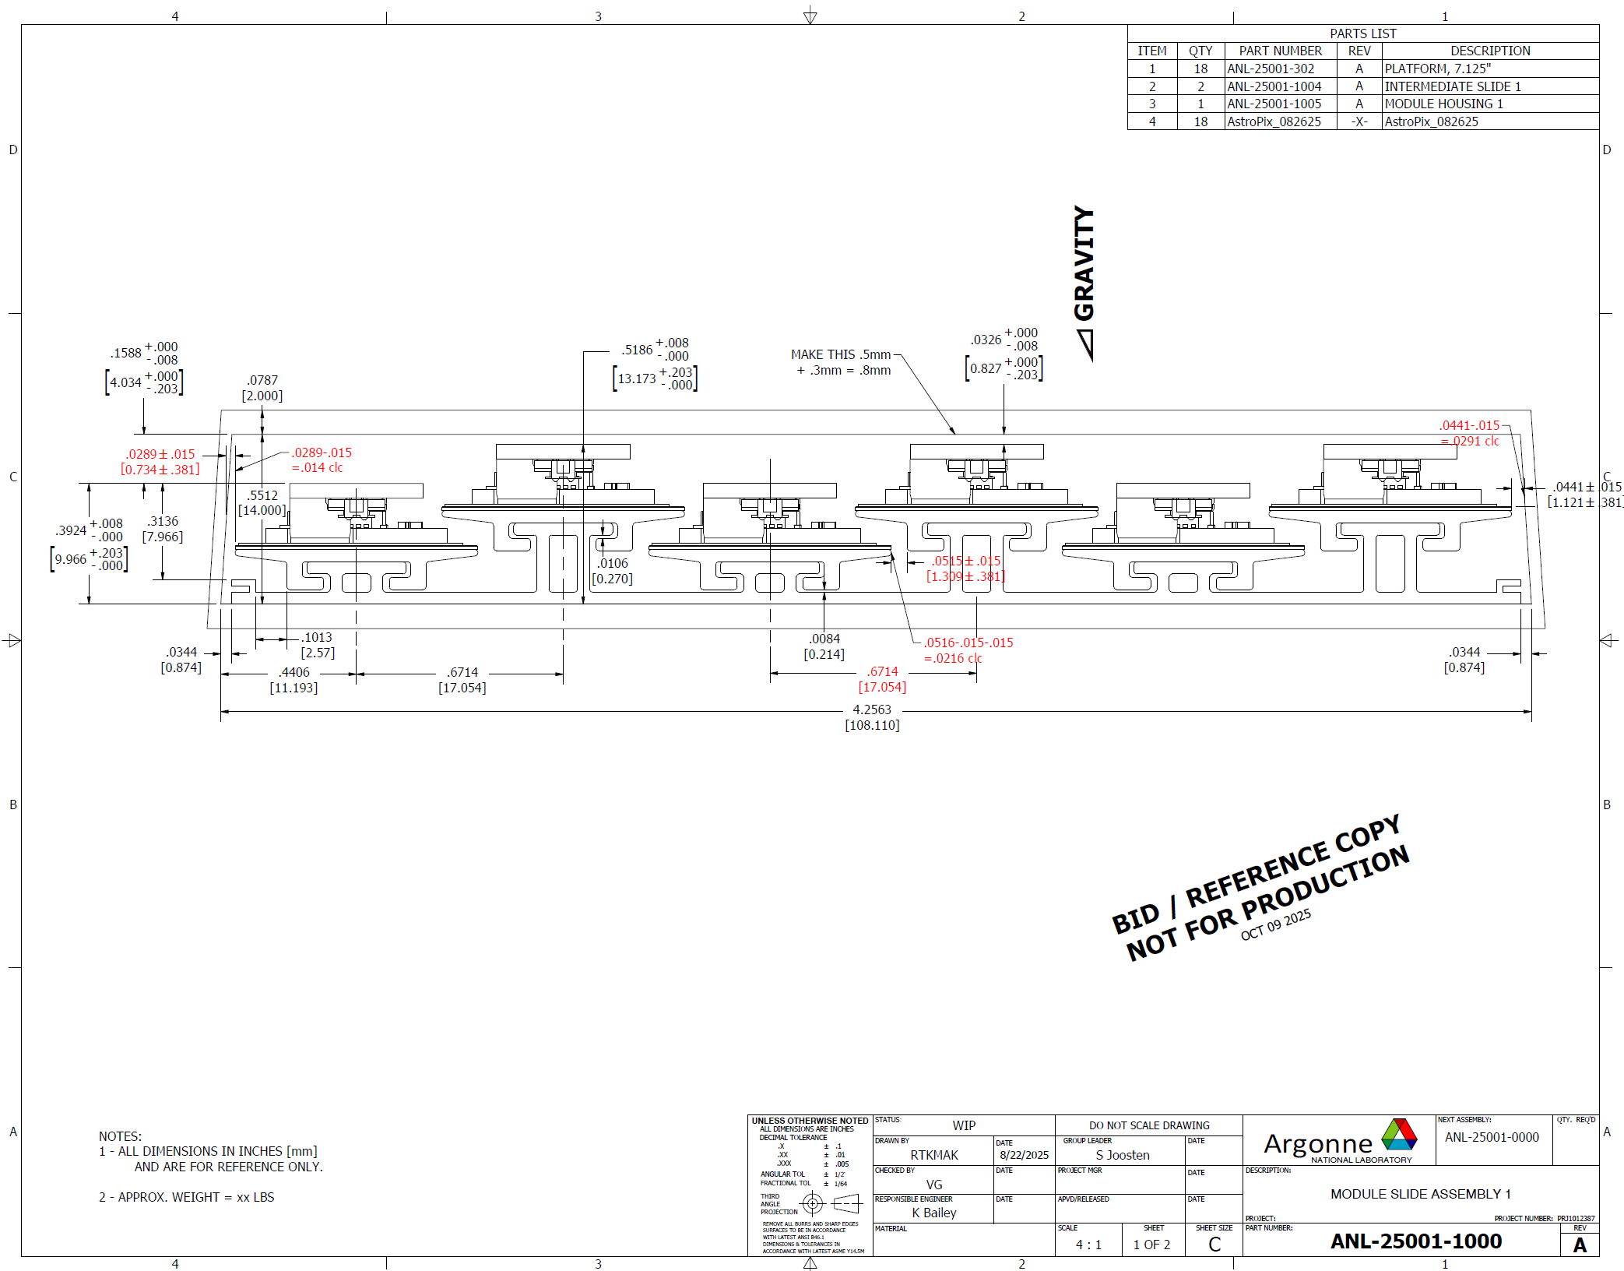
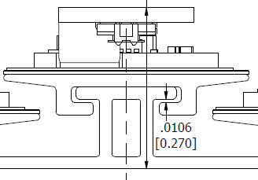
Modules and Staves
Met with extrusion vendor
Vendor is reviewing drawings
Width may be an issue
Angle is ok after all
Solid region is preferred

Slide 5
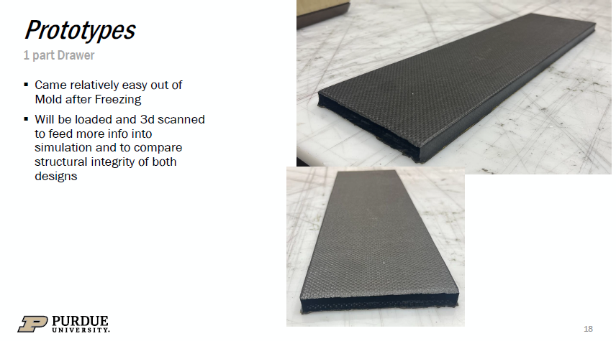
Two CFRP samples at ANL
Plan to build SFIL/Drawer with new lead
FEA simulation work continues (incorporation support rings)

