Slide 1
Variational Simulation of Quantum Field Theories with Local Constraints
Ananda Roy
Rutgers University
Brookhaven National Laboratory, October 30, 2025

Slide 2
Complexity Hierarchy*
Quantum Hard (QMA)
Classical Hard (NP)
Quantum Easy (BQP)
What is in here?
Quantum Fourier transform
Shor’s algorithm
Phase Estimation
Quantum simulation
…
classically easy (P)
Classical Easy (P)
*Currently believed

Slide 3
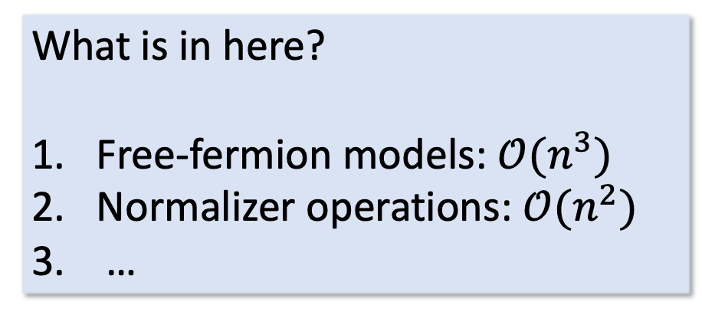
Complexity Hierarchy*
What is in here?
Free-fermion models: $𝒪(n^{3})$
Normalizer operations: $𝒪(n^{2})$
…
Quantum Hard (QMA)
Classical Hard (NP)
Quantum Easy (BQP)
What is in here?
Quantum Fourier transform
Shor’s algorithm
Phase Estimation
Quantum simulation
…
classically easy (P)
Classical Easy (P)
*Currently believed
Bravyi and Kitaev (2002, 2005), Gottesman, Knill ($\sim$1997)

Slide 4
Entanglement and Complexity*
A target state with more entanglement between regions is more complex
For pure states, von-Neumann entropy is a quantitative measure
B
A
*Intuitive, but not quite correct

Slide 5
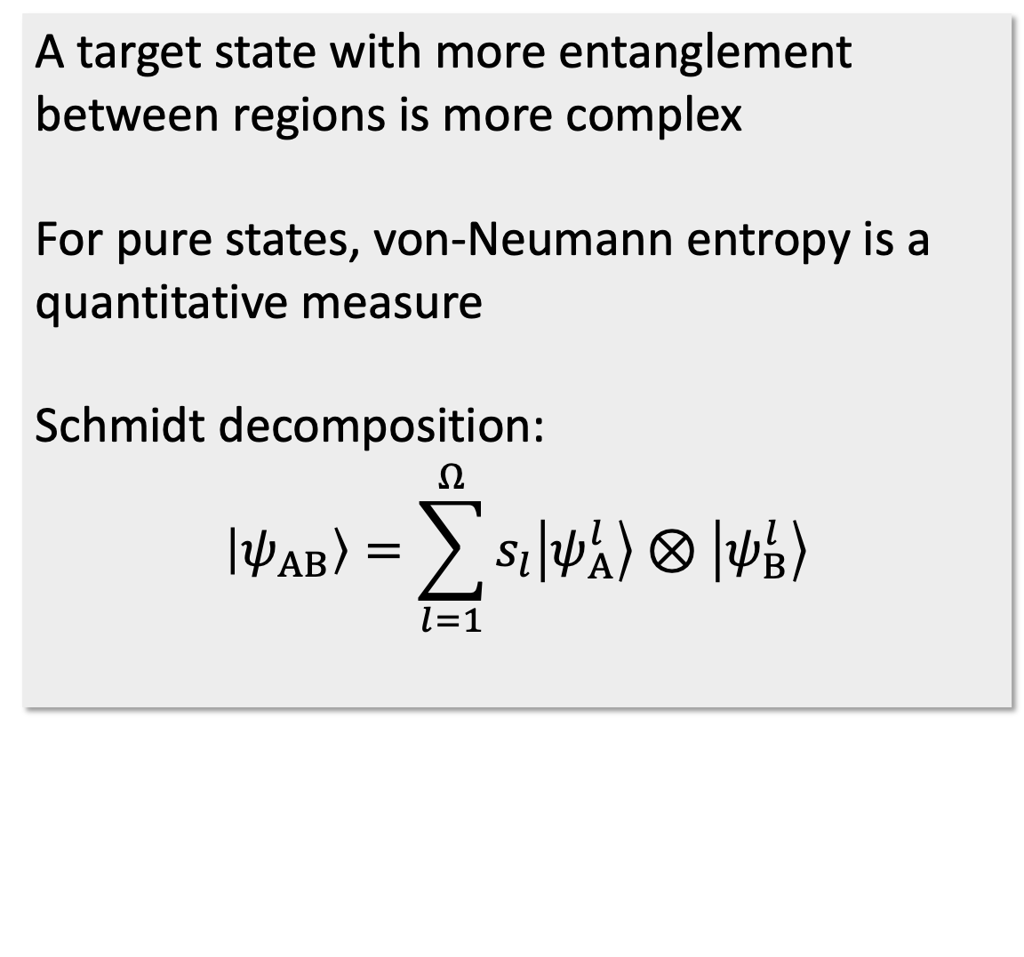
Entanglement and Complexity*
A target state with more entanglement between regions is more complex
For pure states, von-Neumann entropy is a quantitative measure
Schmidt decomposition:
$$\left|ψ_{AB}\right\rangle =\sum_{l=1}^{Ω}{s_{l}\left|ψ_{A}^{l}\right\rangle ⊗\left|ψ_{B}^{l}\right\rangle }$$
B
A
*Intuitive, but not quite correct

Slide 6
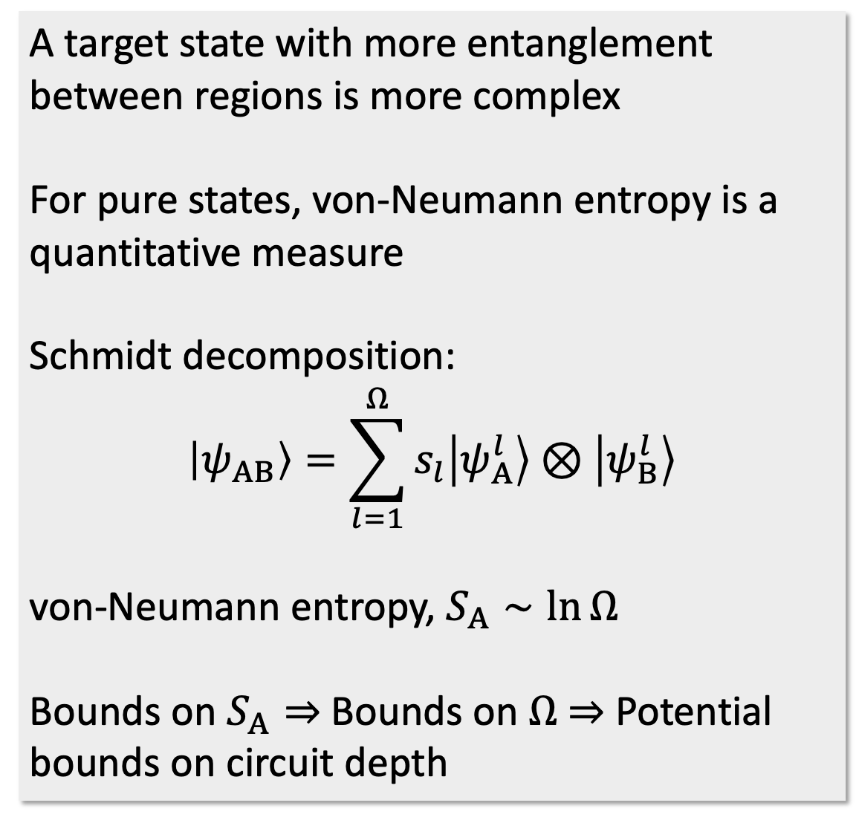
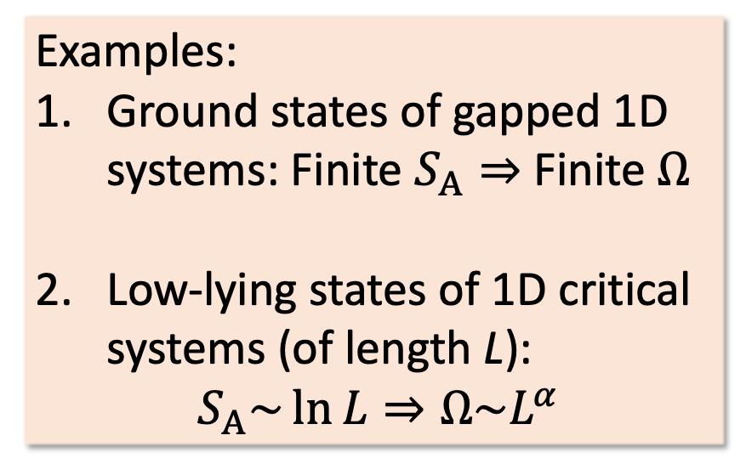
Entanglement and Complexity*
A target state with more entanglement between regions is more complex
For pure states, von-Neumann entropy is a quantitative measure
Schmidt decomposition:
$$\left|ψ_{AB}\right\rangle =\sum_{l=1}^{Ω}{s_{l}\left|ψ_{A}^{l}\right\rangle ⊗\left|ψ_{B}^{l}\right\rangle }$$
von-Neumann entropy, $S_{A}∼\ln{Ω}$
Bounds on $S_{A}⇒$ Bounds on $Ω$ $⇒$ Potential bounds on circuit depth
B
Examples:
Ground states of gapped 1D systems: Finite $S_{A}⇒$ Finite $Ω$
Low-lying states of 1D critical systems (of length L): $S_{A}\sim \ln{L}⇒Ω\sim L^{α}$
A
Hastings (2007), Vidal (2008), …
*Intuitive, but not quite correct

Slide 7
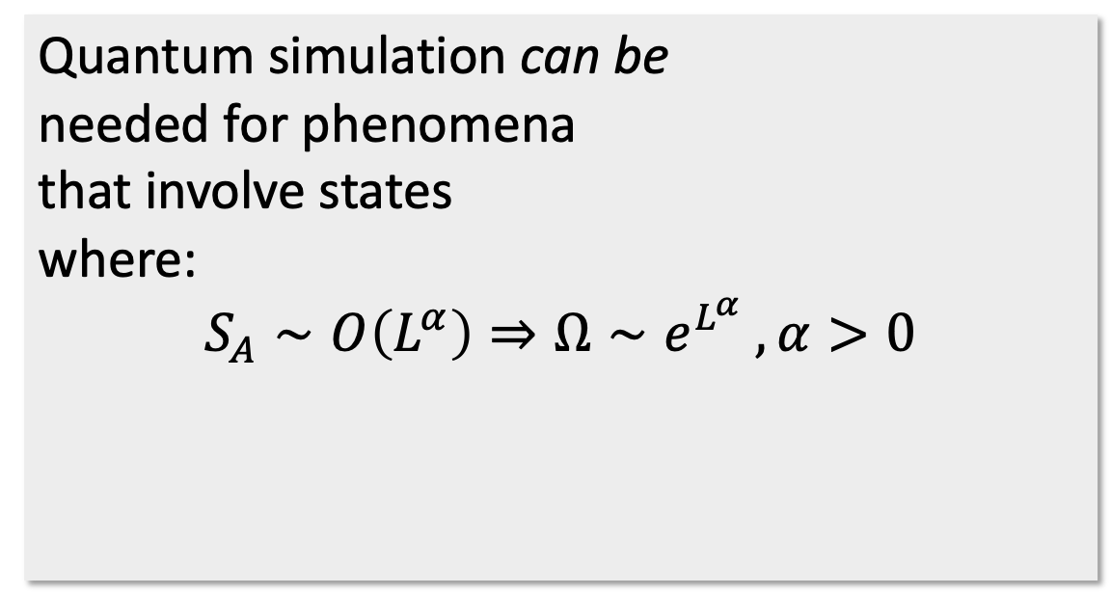
Quantum Simulation
Quantum simulation can be needed for phenomena that involve states where: $$S_{A}∼O\left(L^{α}\right)⇒Ω∼e^{L^{α}} , α>0$$
B
A
exponentially large classical resources

Slide 8
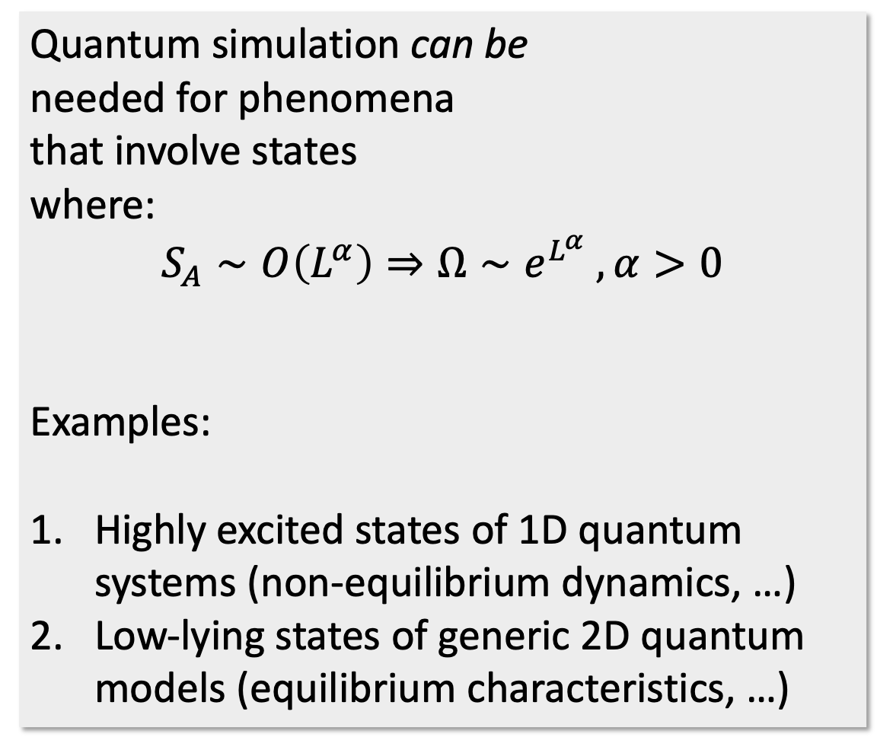
Quantum Simulation
Quantum simulation can be needed for phenomena that involve states where: $$S_{A}∼O\left(L^{α}\right)⇒Ω∼e^{L^{α}} , α>0$$
Examples:
Highly excited states of 1D quantum systems (non-equilibrium dynamics, …)
Low-lying states of generic 2D quantum models (equilibrium characteristics, …)
B
A
exponentially large classical resources

Slide 9
Quantum Simulation of Quantum Field Theories
Quantum simulation can be needed for phenomena that involve states where: $$S_{A}∼O\left(L^{α}\right)⇒Ω∼e^{L^{α}} , α>0$$
Examples:
Highly excited states of 1D quantum systems (non-equilibrium dynamics, …)
Low-lying states of generic 2D quantum models (equilibrium characteristics, …)
B
A
Hamiltonian picture useful for:
Real-time dynamics, thermalization
Models with sign problems
Models with topological terms
…
exponentially large classical resources
More examples in: Di Meglio et al, PRX Quantum (2024),
Bauer et al, PRX Quantum (2023)

Slide 10
Quantum Simulation of Quantum Field Theories
Quantum simulation can be needed for phenomena that involve states where: $$S_{A}∼O\left(L^{α}\right)⇒Ω∼e^{L^{α}} , α>0$$
Examples:
Highly excited states of 1D quantum systems (non-equilibrium dynamics, …)
Low-lying states of generic 2D quantum models (equilibrium characteristics, …)
B
A
Plan:
A scheme for simulating lattice Hamiltonians with local constraints
Proof of principle experiment on IBM Kingston
exponentially large classical resources
AR, arXiv:2412.17781,
D. Rogerson, J. Barata, R. Konik, R. Venugopalan, AR (in prep)
More examples in: Di Meglio et al, PRX Quantum (2024),
Bauer et al, PRX Quantum (2023)
C. Lamb, R. M. Konik, H. Saleur, AR, arXiv:2510.14817

Slide 11
Simulating models with local constraints
Physical states are those that satisfy certain constraints
Relevant for particle physics and strongly-correlated condensed matter systems
Examples: anyonic chains, lattice gauge theories, …
Needed:
Encoding into qubit arrays
Mechanism for constraint conservation
- state-preparation, time-evolution, measurements
Error-correction scheme if the state leaves the physical sector
…
…
…
anyonic states
gauge
matter
…

Slide 12
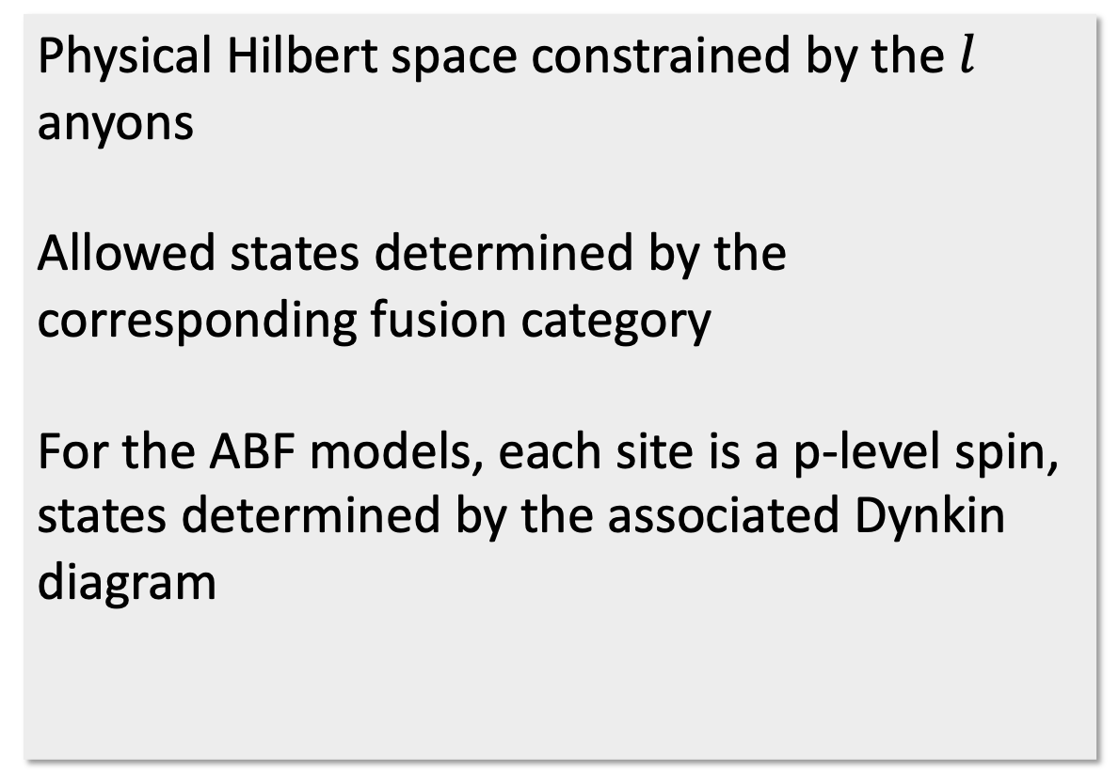
Mapping anyonic chains to qubits
Physical Hilbert space constrained by the $l$ anyons
Allowed states determined by the corresponding fusion category
For the ABF models, each site is a p-level spin, states determined by the associated Dynkin diagram
Andrews, Baxter and Forrester (1987), Feiguin et al (2007)
…
1
2
3
4
…
p
1
2
3
4
…
p
1
2
3
4
…
p
A B
AR, arXiv:2412.17781

Slide 13
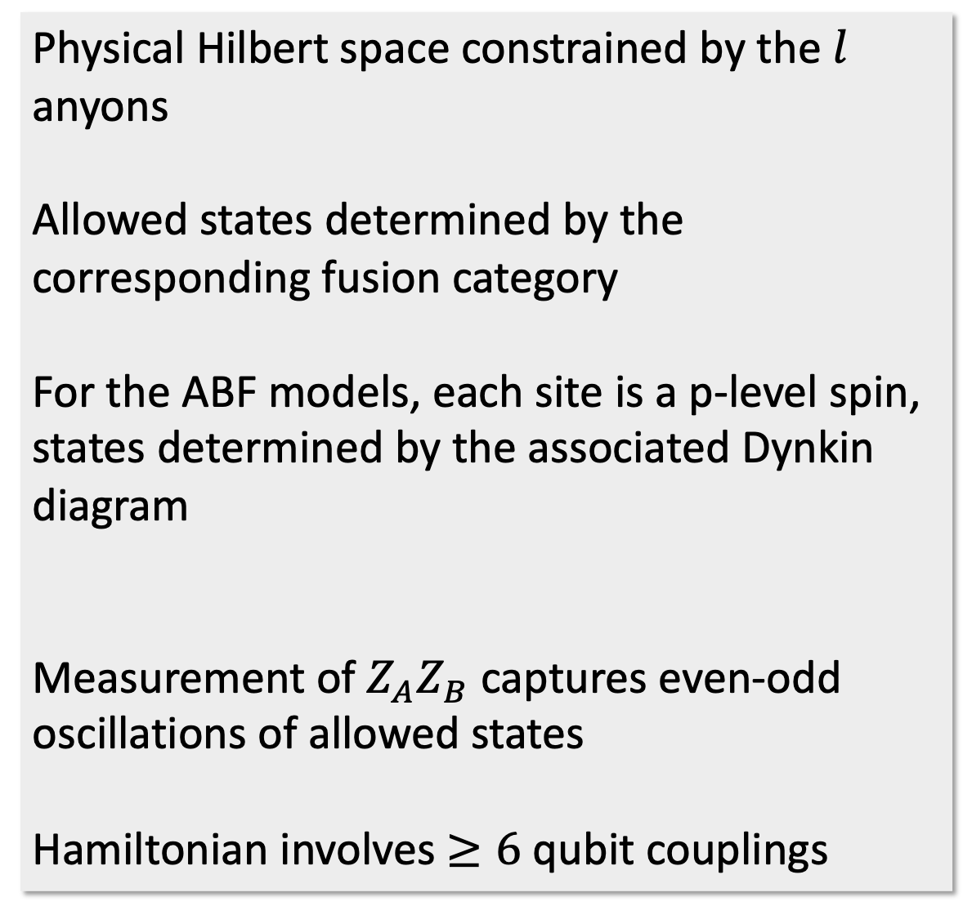
Mapping anyonic chains to qubits
Physical Hilbert space constrained by the $l$ anyons
Allowed states determined by the corresponding fusion category
For the ABF models, each site is a p-level spin, states determined by the associated Dynkin diagram
Measurement of $Z_{A}Z_{B}$ captures even-odd oscillations of allowed states
Hamiltonian involves $≥6$ qubit couplings
Andrews, Baxter and Forrester (1987), Feiguin et al (2007)
Hamiltonian:
Temperley-Lieb generators:
…
1
2
3
4
…
p
1
2
3
4
…
p
1
2
3
4
…
p
Operators to project to the physical space:
AR, arXiv:2412.17781

Slide 14


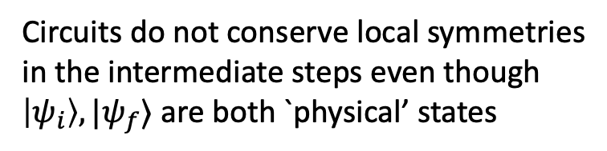
State preparation for anyonic chains
Eigenstates can be prepared using a hybrid quantum-classical algorithm
Unitary in each layer parametrized using Euler and Cartan’s decomposition of nearest-neighbor SU(4) matrices
Circuit parameters iteratively optimized using ADAM optimizer
to CPU
…
AR, R. Konik, D. Rogerson, arXiv:2407.21278
$$|ψ_{i}⟩$$
1
2
…
N
$$|ψ_{f}⟩$$
…
AR, arXiv:2412.17781
layer unitary
Updated set of parameters
Circuits do not conserve local symmetries in the intermediate steps even though $\left|ψ_{i}\right\rangle , |ψ_{f}⟩$ are both `physical’ states

Slide 15
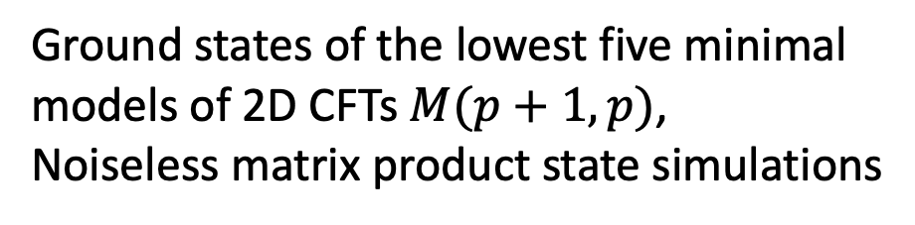
State preparation for anyonic chains
Eigenstates can be prepared using a hybrid quantum-classical algorithm
Unitary in each layer parametrized using Euler and Cartan’s decomposition of nearest-neighbor SU(4) matrices
Circuit parameters iteratively optimized using ADAM optimizer
AR, R. Konik, D. Rogerson, arXiv:2407.21278
AR, arXiv:2412.17781
Ground states of the lowest five minimal models of 2D CFTs $M(p+1, p)$,
Noiseless matrix product state simulations
Circuits do not conserve local symmetries in the intermediate steps even though $\left|ψ_{i}\right\rangle , |ψ_{f}⟩$ are both `physical’ states

Slide 16
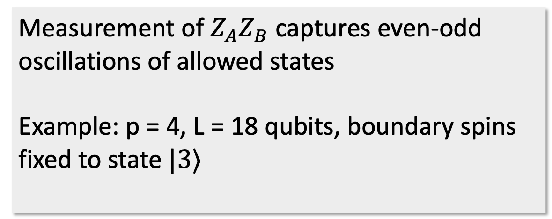


Measurements for detecting anyonic nature of states
Measurement of $Z_{A}Z_{B}$ captures even-odd oscillations of allowed states
Example: p = 4, L = 18 qubits, boundary spins fixed to state $|3⟩$
1
2
3
4
$⟨Z_{A}Z_{B}⟩$
1
2
3
4
$$j$$
AR, arXiv:2412.17781

Slide 17
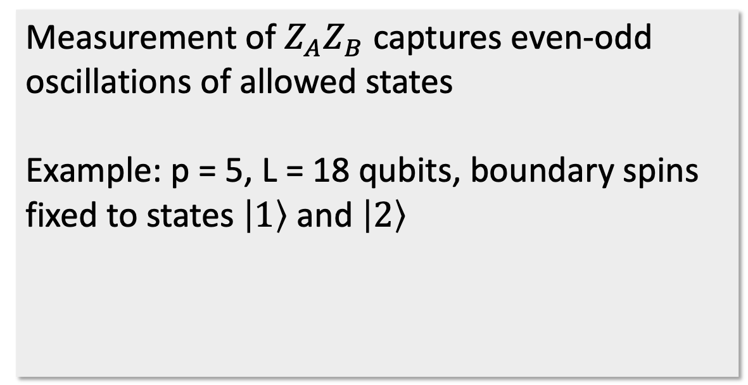
Measurements for detecting anyonic nature of states
Measurement of $Z_{A}Z_{B}$ captures even-odd oscillations of allowed states
Example: p = 5, L = 18 qubits, boundary spins fixed to states $\left|1\right\rangle$ and $\left|2\right\rangle$
AR, arXiv:2412.17781

Slide 18
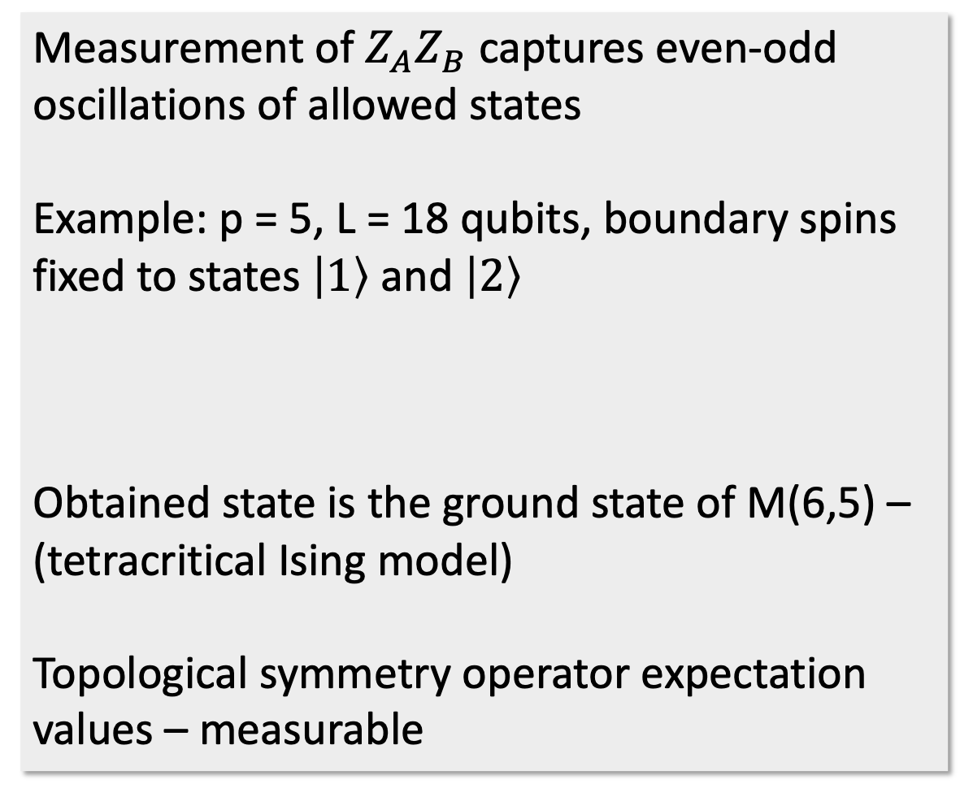
Measurements for detecting anyonic nature of states
Measurement of $Z_{A}Z_{B}$ captures even-odd oscillations of allowed states
Example: p = 5, L = 18 qubits, boundary spins fixed to states $\left|1\right\rangle$ and $\left|2\right\rangle$
Obtained state is the ground state of M(6,5) – (tetracritical Ising model)
Topological symmetry operator expectation values – measurable
1
2
3
4
5
1
2
3
4
5
AR, arXiv:2412.17781

Slide 19
Interlude: quantum simulation experiments

Slide 20
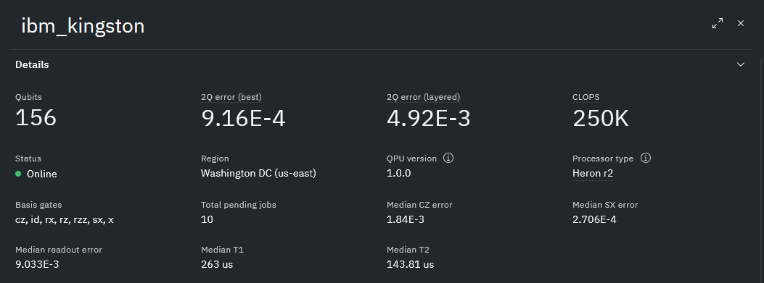
Results from IBM Kingston
Critical Ising chain with topological impurities – simplest of the ABF models
Parameter dependent Hamiltonian interpolating between two fixed points
Signatures of topological symmetries in correlation functions and loop operator expectation values
T. Tavares, M. Sinha, L. Grans-Samuelsson, AR, H. Saleur, JHEP 04, 148 (2025)
C. Lamb, R. M. Konik, H. Saleur, AR, arXiv:2510.14817

Slide 21
Results from IBM Kingston
‘smoking-gun’ signature of Kramers-Wannier defect
C. Lamb, R. M. Konik, H. Saleur, AR, arXiv:2510.14817

Slide 22
Results from IBM Kingston
Direct access to topological symmetry operator and other observables difficult to probe in condensed matter experiments!
C. Lamb, R. M. Konik, H. Saleur, AR, arXiv:2510.14817

Slide 23
Back to classical: setting up simulations of lattice gauge theories

Slide 24

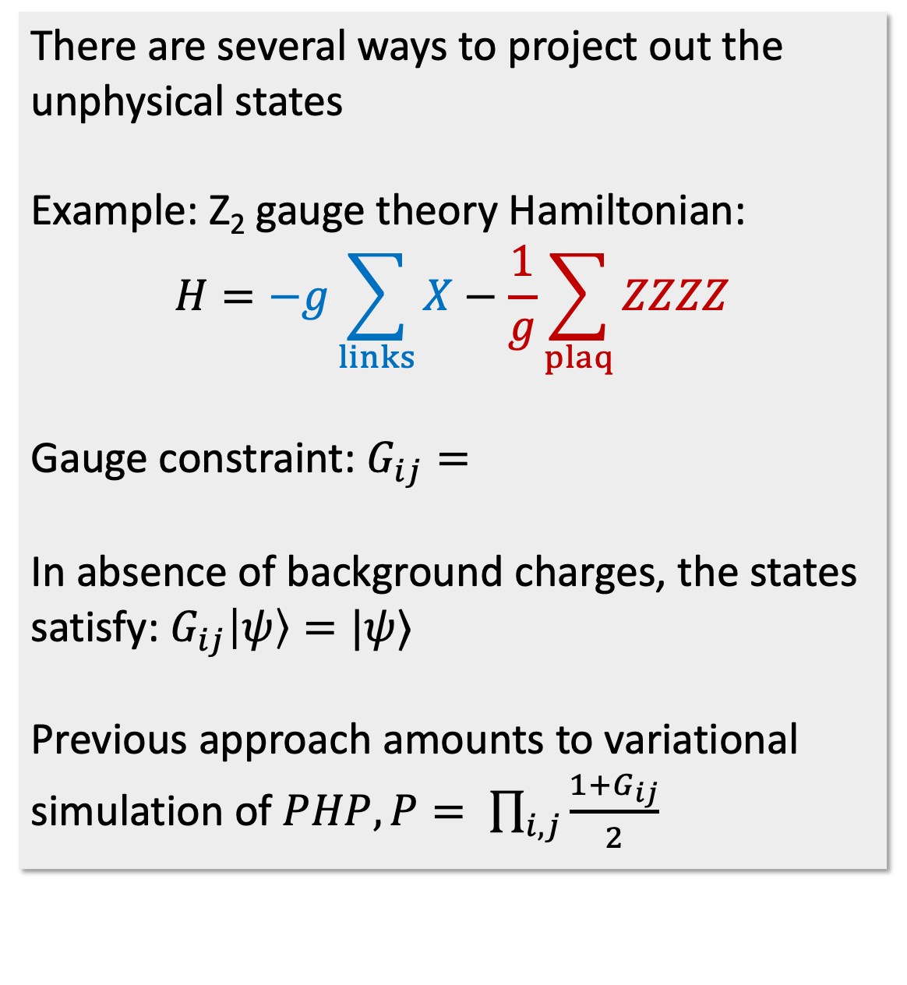
Simulating lattice gauge theories
There are several ways to project out the unphysical states
Example: Z₂ gauge theory Hamiltonian:
$$H=−g\sum_{links}{X}−\frac{1}{g}\sum_{plaq}{ZZZZ}$$
Gauge constraint: $G_{ij}=$
In absence of background charges, the states satisfy: $G_{ij}\left|ψ\right\rangle =|ψ⟩$
Previous approach amounts to variational simulation of $PHP, P= \prod_{i,j}{\frac{1+G_{ij}}{2}}$
…
…
…
X
X
($i,j$)
X
X
…
Alternatives:
Add energy penalties
Quantum link construction
…

Slide 25

Scheme for U(1) gauge theories
Example: 1+1D multi-flavor Schwinger model
Hamiltonian:
Gauge constraint:
Everyone’s favorite model
Generalized four flavor model toy model for string fragmentation
Interesting phase diagram, contains Ising, SU(N)₁ Wess-Zumino-Witten models, …
Steinhardt (1977), Demspey, et al (2024)
Coleman Jackiw, Susskind (1975), Banks, Susskind, Kogut (1976)
$a$ = lattice spacing, $g$ = coupling, $m_{n}$= masses

Slide 26
Scheme for U(1) gauge theories
Example: 1+1D multi-flavor Schwinger model
Hamiltonian:
Gauge constraint:
For open boundary conditions, gauge fields can be eliminated – nonlocal model of fermions
Still, difficult to probe critical regimes even with classical methods, large finite size effects
Other boundary conditions, higher dimensional models are even more challenging
Coleman Jackiw, Susskind (1975), Banks, Susskind, Kogut (1976)

Slide 27
Scheme for U(1) gauge theories
Example: 1+1D multi-flavor Schwinger model
Hamiltonian:
Gauge constraint:
We develop a quantum-classical scheme keeping the gauge degrees of freedom
Map states of the electric field at each site to qubits
Use the virtual rishon construction of quantum link models to project onto the physical states
Coleman Jackiw, Susskind (1975), Banks, Susskind, Kogut (1976)
Chandrasekharan and Wiese (1997), Silvi et al (2014)

Slide 28
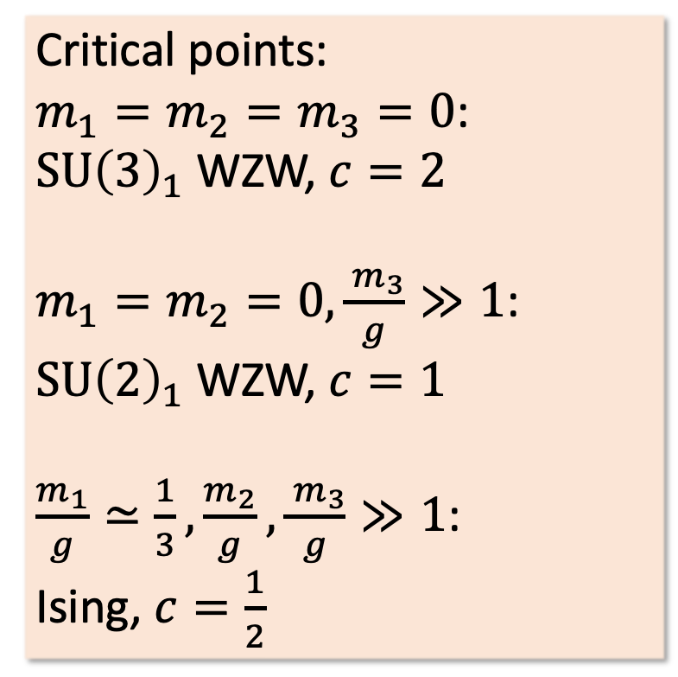
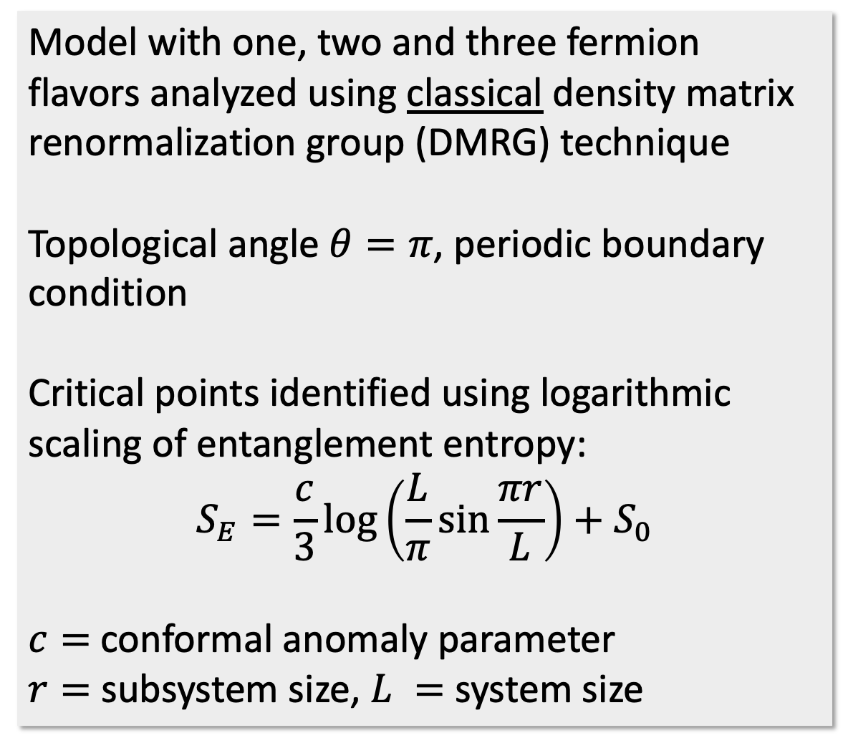
DMRG Results
Model with one, two and three fermion flavors analyzed using classical density matrix renormalization group (DMRG) technique
Topological angle $θ=π$, periodic boundary condition
Critical points identified using logarithmic scaling of entanglement entropy:
$$S_{E}=\frac{c}{3}\log\left(\frac{L}{π}\sin{\frac{πr}{L}}\right)+S_{0}$$
$c=$conformal anomaly parameter
$r=$subsystem size, $L =$ system size
Critical points:
$m_{1}=m_{2}=m_{3}=0$:
$SU{\left(3\right)}_{1}$ WZW, $c=2$
$m_{1}=m_{2}=0, \frac{{ m}_{3}}{g}≫1$:
$SU{\left(2\right)}_{1}$ WZW, $c=1$
$\frac{m_{1}}{g}≃\frac{1}{3},\frac{m_{2}}{g}, \frac{{ m}_{3}}{g}≫1$:
Ising, $c=\frac{1}{2}$
Cardy and Calabrese (2004)
Critical points most difficult to reach with DMRG

Slide 29
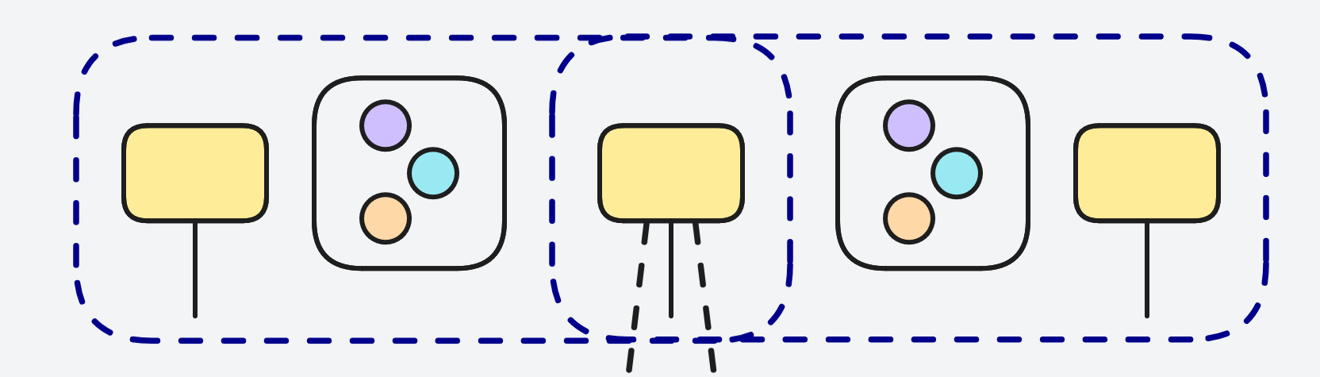
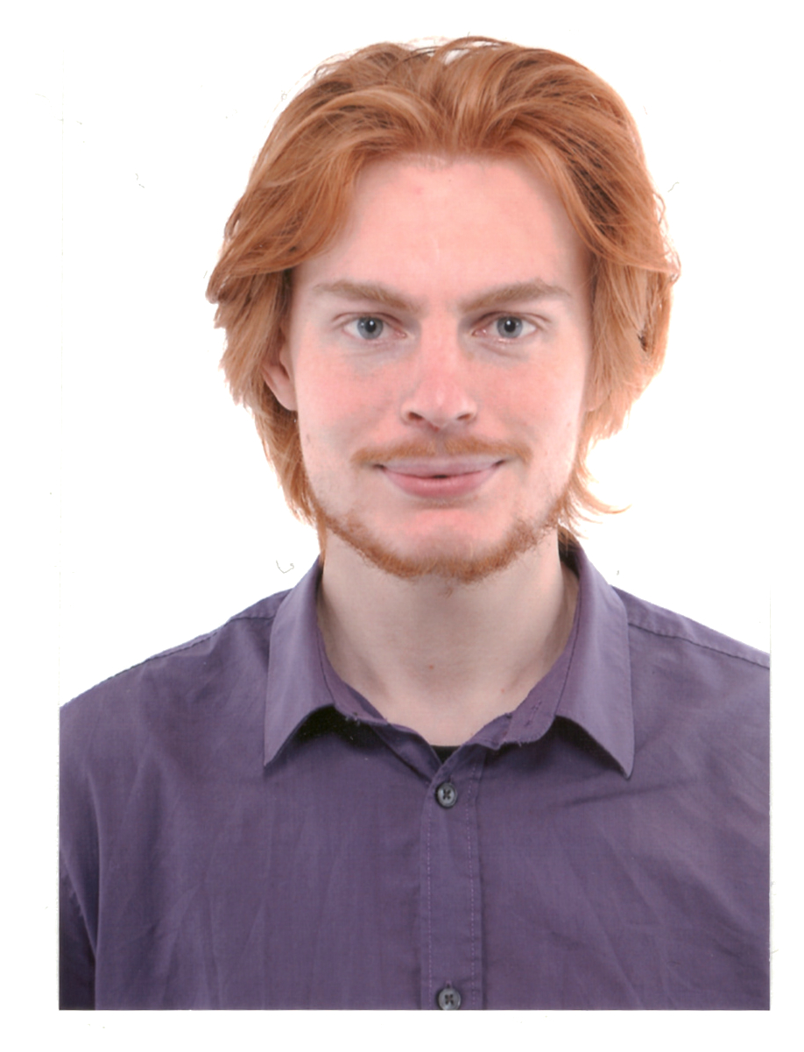
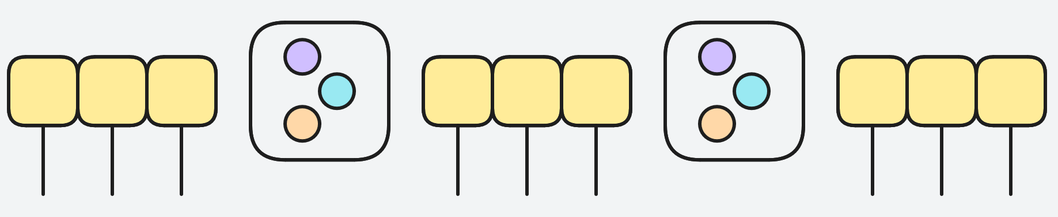

DMRG Results
Gauss law
three fermions
electric
field
Rishon + David’s tensor network magic
Three qubits per
electric field link
$$r$$
Classical DMRG results with 6L qubits
D. Rogerson, J. Barata, R. Konik, R. Venugopalan, AR (in prep)

Slide 30

DMRG Results
Gauss law
three fermions
electric
field
$$r$$
Classical DMRG results with 6L qubits
D. Rogerson, J. Barata, R. Konik, R. Venugopalan, AR (in prep)

Slide 31
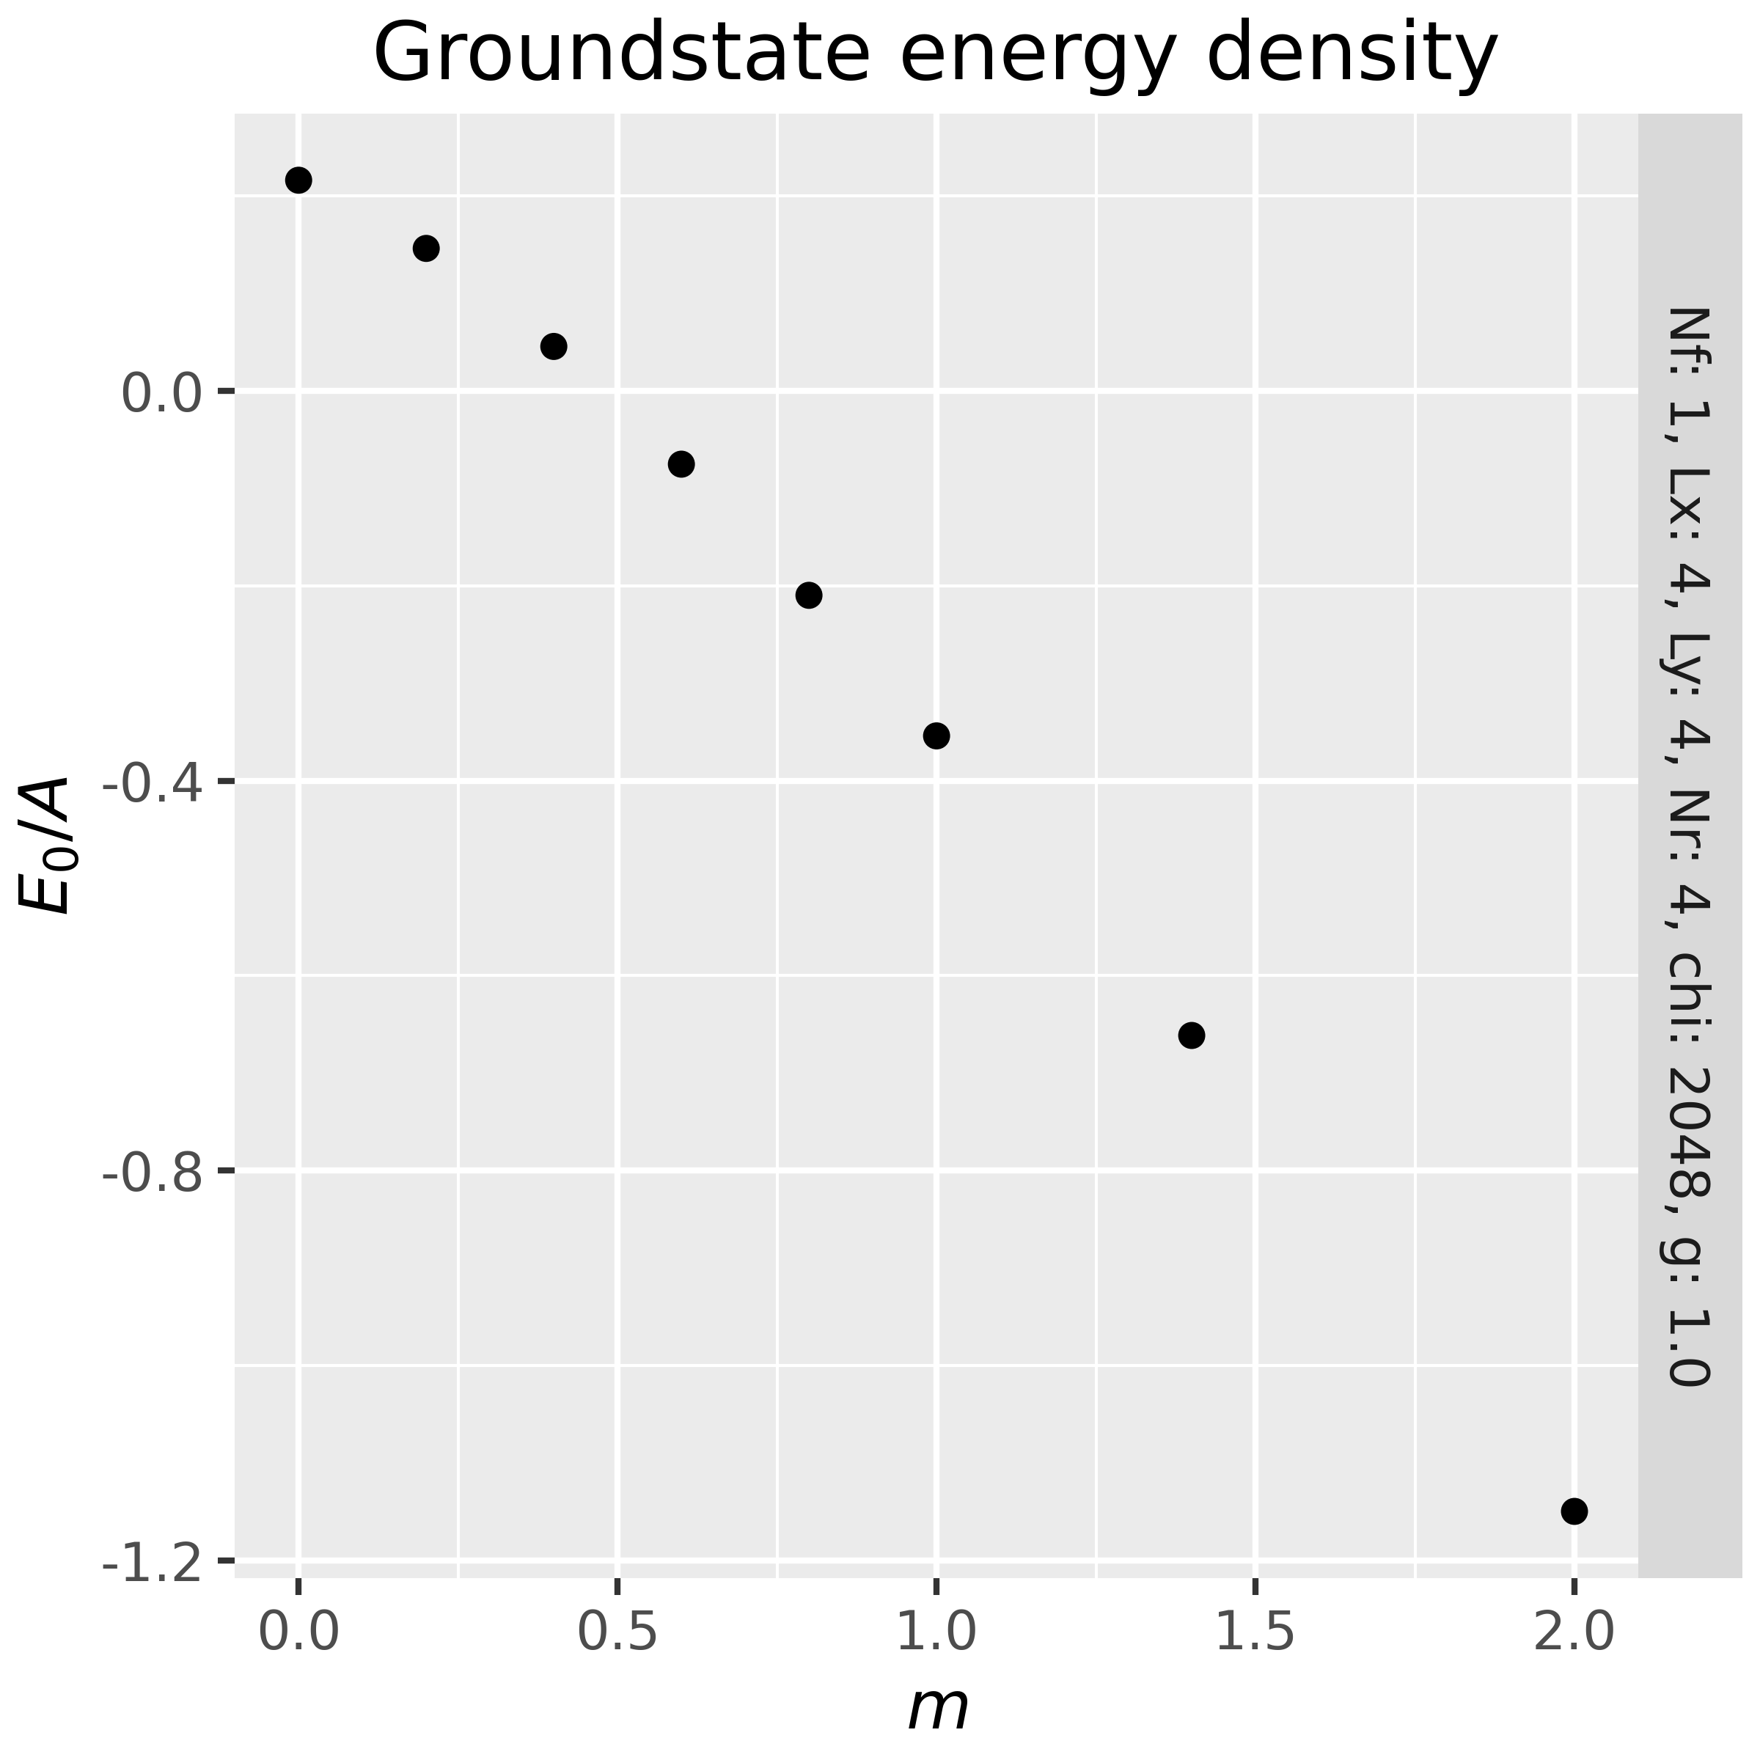
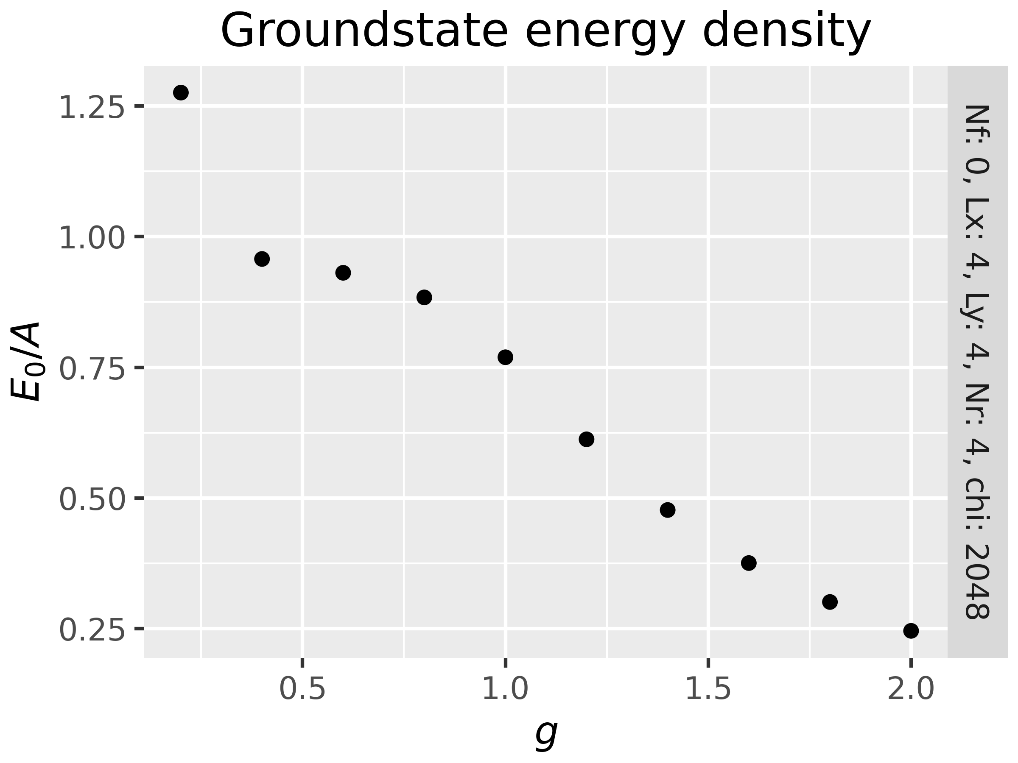
DMRG Results for 2+1D models
one flavor, massive Schwinger model
2+1D U(1) gauge theory
Used: 1 matter qubit + 4 rotor qubit/link

Slide 32
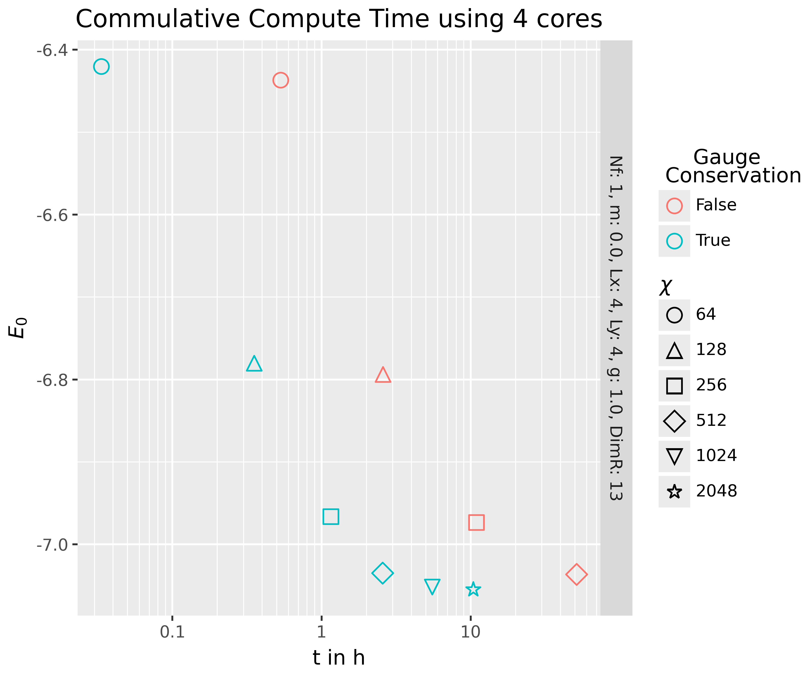
Speed-up due to local charge conservation
DMRG simulations that conserve the extensive number of local constraints are substantially faster and require much less memory

Slide 33
Summary
Outlook
Developed a scheme for simulation of lattice Hamiltonians with local constraints
Hybrid quantum-classical setup for anyonic chains
Classical DMRG results for 1+1D and 2+1D lattice gauge models
Charge conserving variational circuit optimization framework
Circuit complexity and charge conservation
D. Rogerson and AR, arXiv: 2408.12583

Slide 34
Thank You!
Joao Barata (CERN)
Robert Konik (Brookhaven)
Christopher Lamb (Rutgers)
David Rogerson (Rutgers)
Raju Venugopalan (Brookhaven)

