Slide 1
SPHENIX High Power Test without subcooler

Slide 2
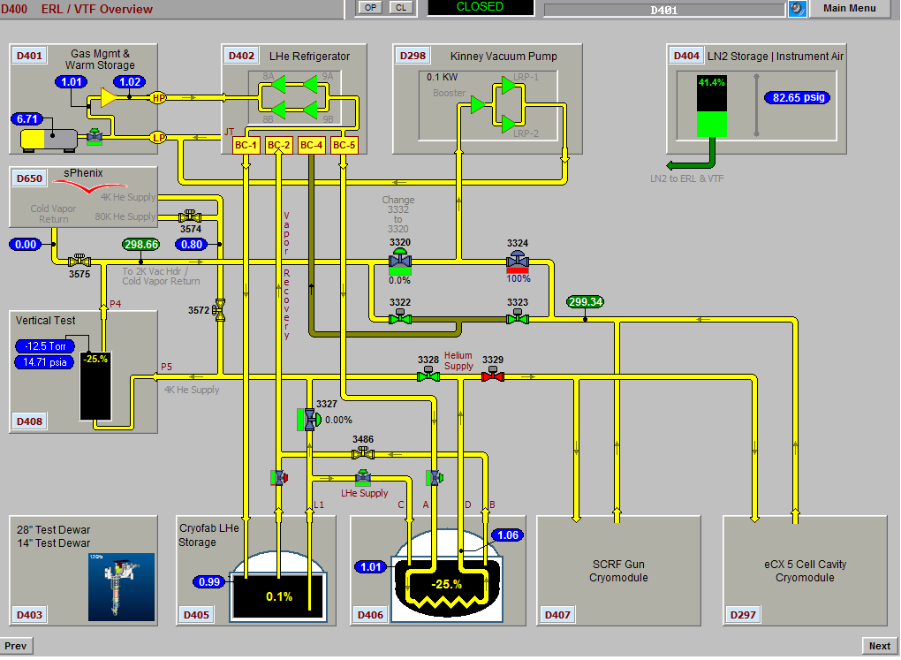

Slide 3
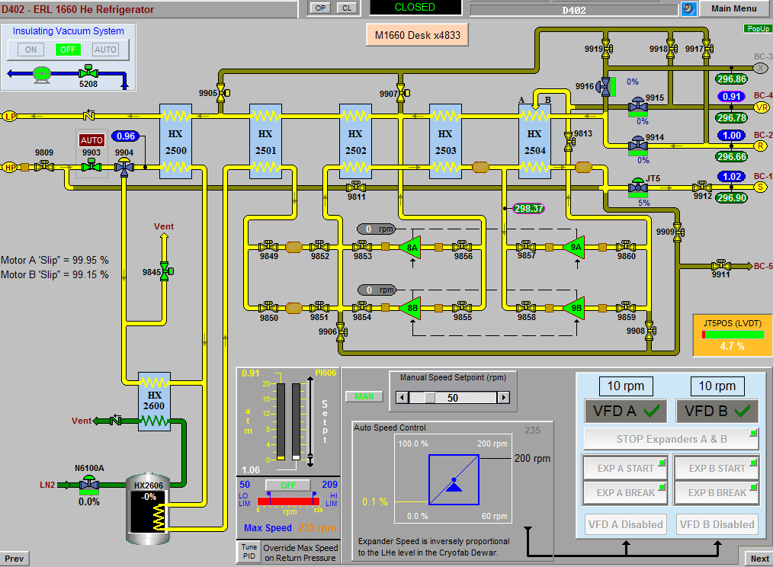

Slide 4
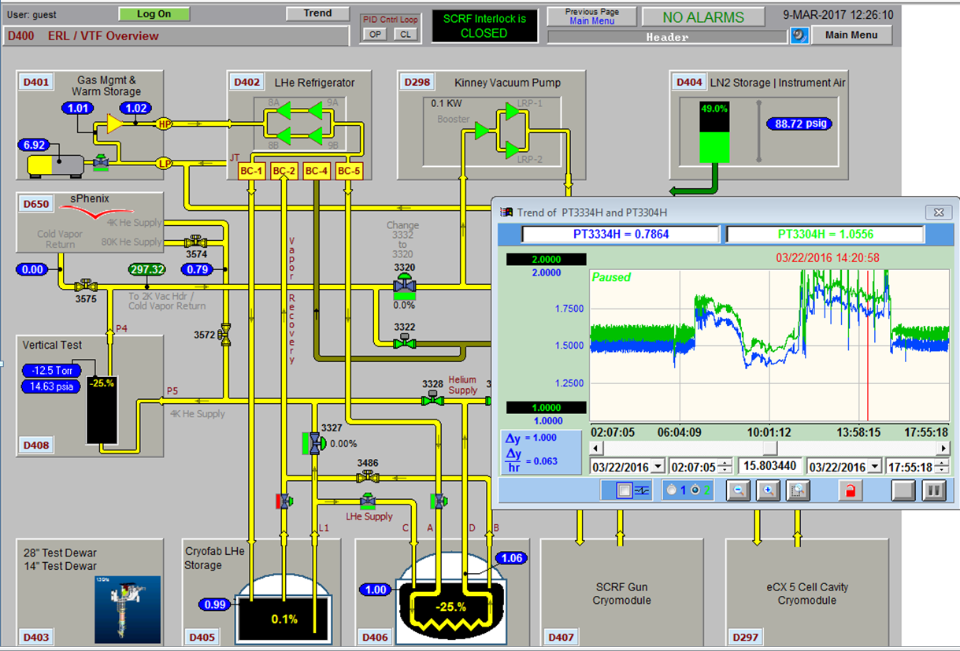
REQUIRES LIQUID HELIUM SUPPLY PRESSURE OF 1.8 BAR

Slide 5
SPHENIX High Power Test without subcooler
Basically: Restart the plant and operate the with the storage dewar at 1.8 bar [ normally 1.35 bar]
Liquid carry-over back to plant: Results is collapse of plant cold end, less efficient operation.
superconducting level probe stops working
Need to add DP cell with 4-20mA back to PLC to measure net liquid head and therefore liquid level.

