Slide 1
SPHENIX CRYO CONNECTORS/CABLES FOR EXTENSION CABLES

Slide 2
SPHENIX CRYO CONNECTORS/CABLES FOR EXTENSION CABLES

Slide 3
SPHENIX CRYO CONNECTORS/CABLES FOR EXTENSION CABLES

Slide 4
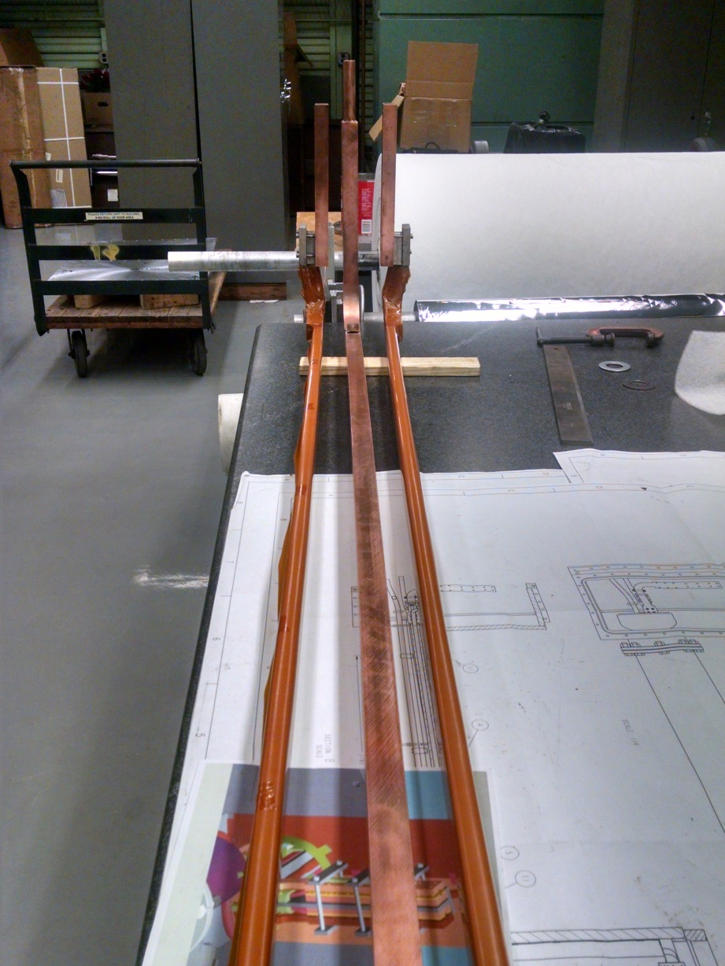
SPHENIX CRYO CONNECTORS/CABLES FOR EXTENSION CABLES

Slide 5
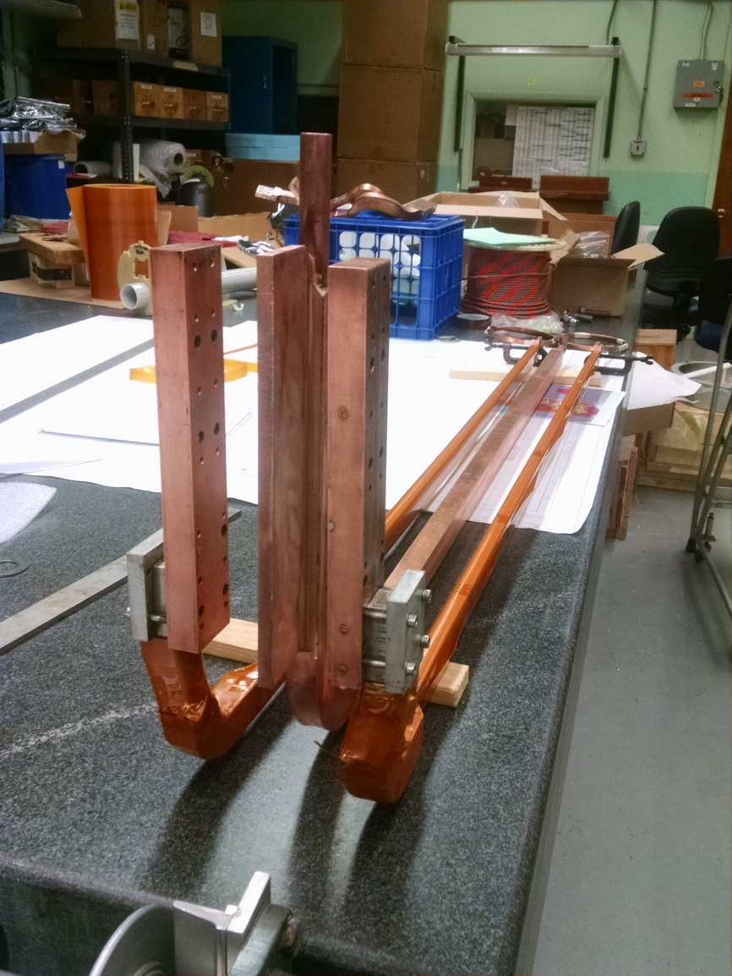
SPHENIX CRYO CONNECTORS/CABLES FOR EXTENSION CABLES

Slide 6
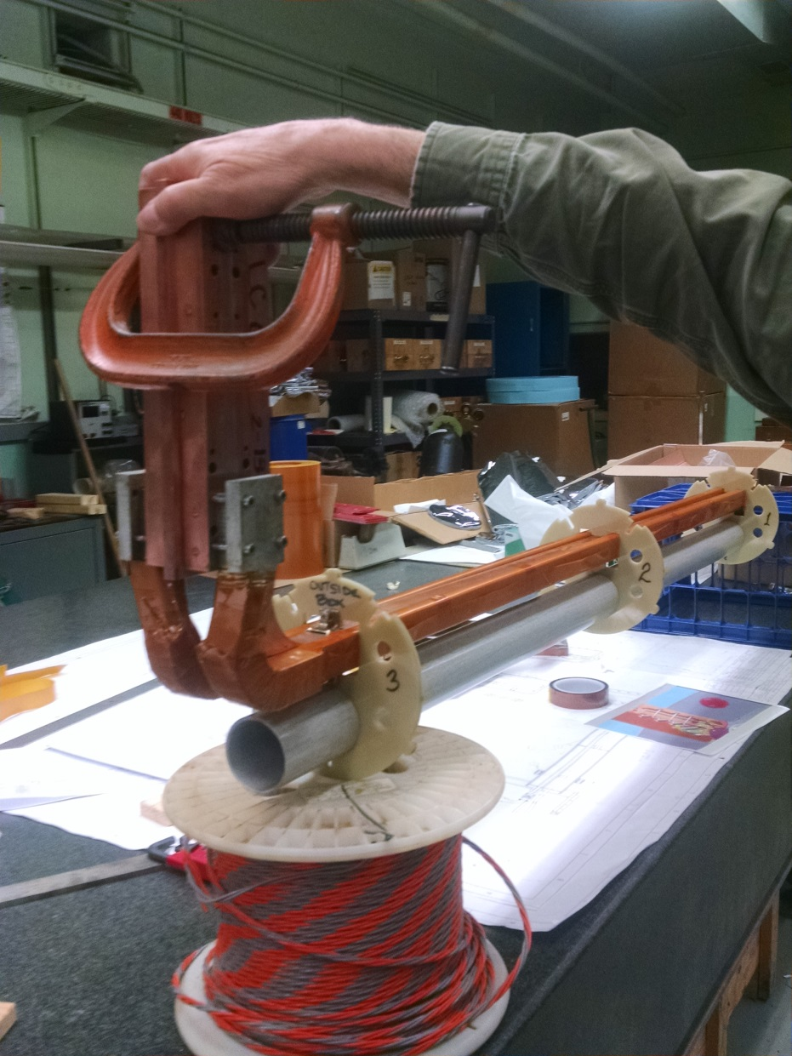
SPHENIX CRYO CONNECTORS/CABLES FOR EXTENSION CABLES

Slide 7
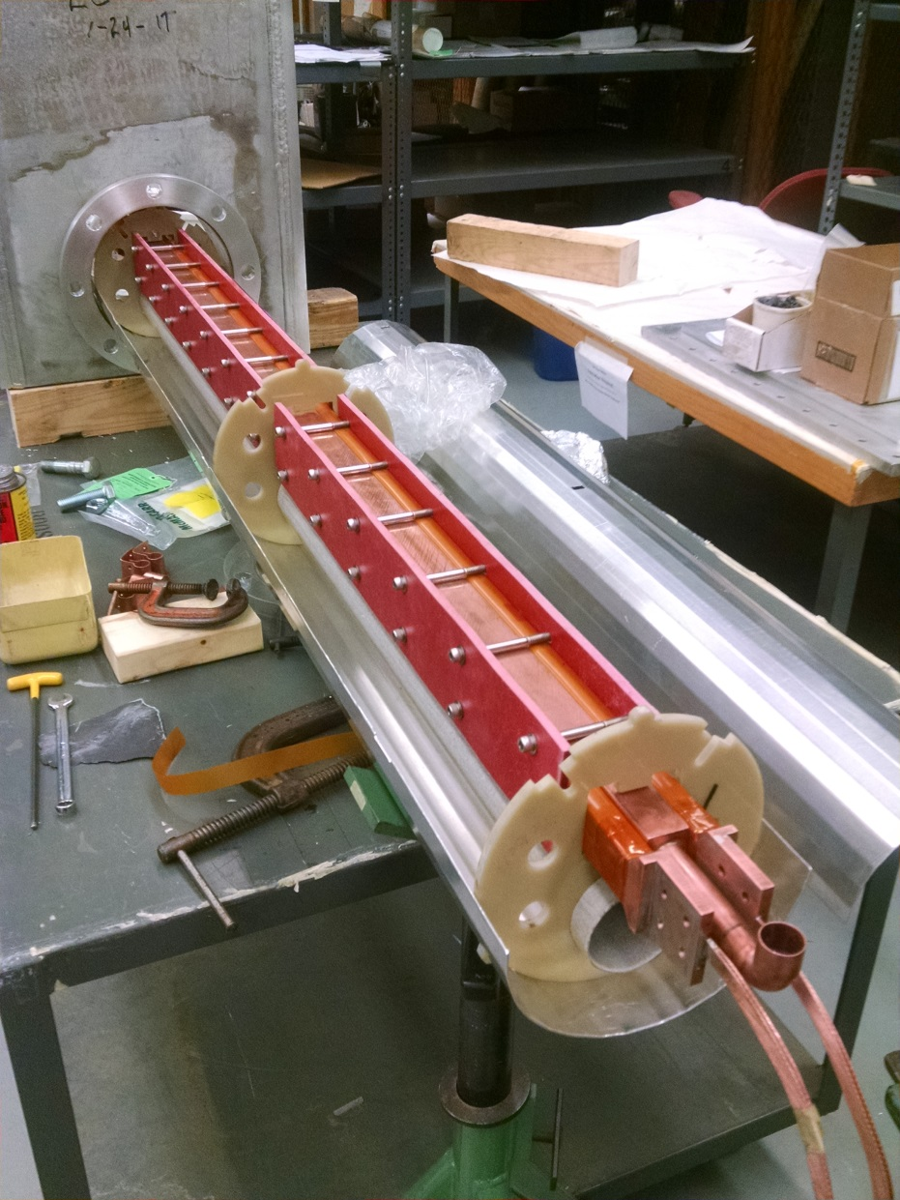
SPHENIX CRYO CONNECTORS/CABLES FOR EXTENSION CABLES

Slide 8
TEFZEL/KAPTON I ORDERED see attached data sheet for 20con 28awg Kapton cable

Slide 9
Missing connectors quote
Please see attached quote 17-0421D for your review. I was unable to locate any stock. This item has a 8-10 week delivery. It is made to order. Req has been placed and sent of approval.

Slide 10
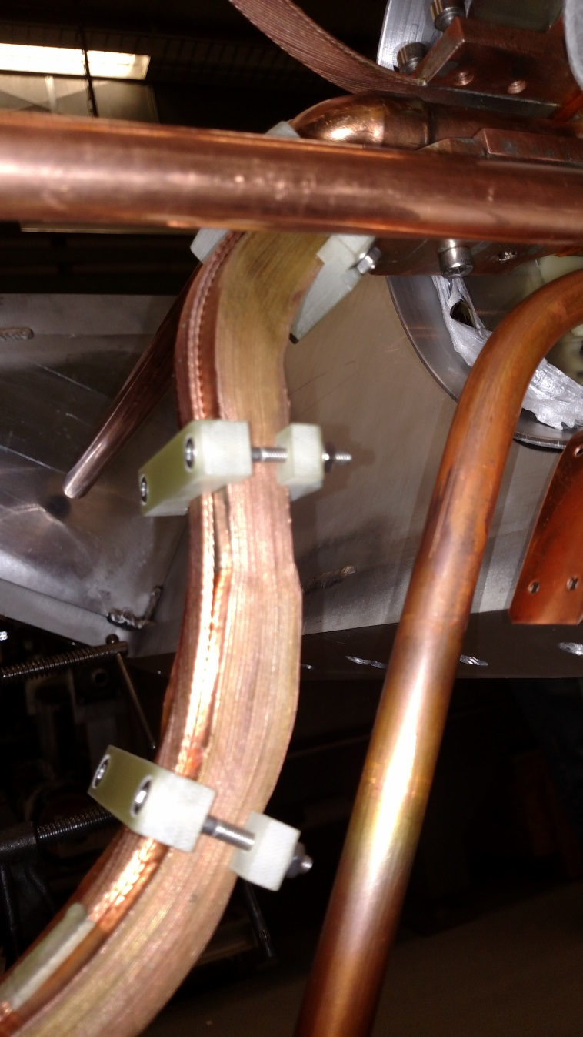
Redundant sensors

Slide 11
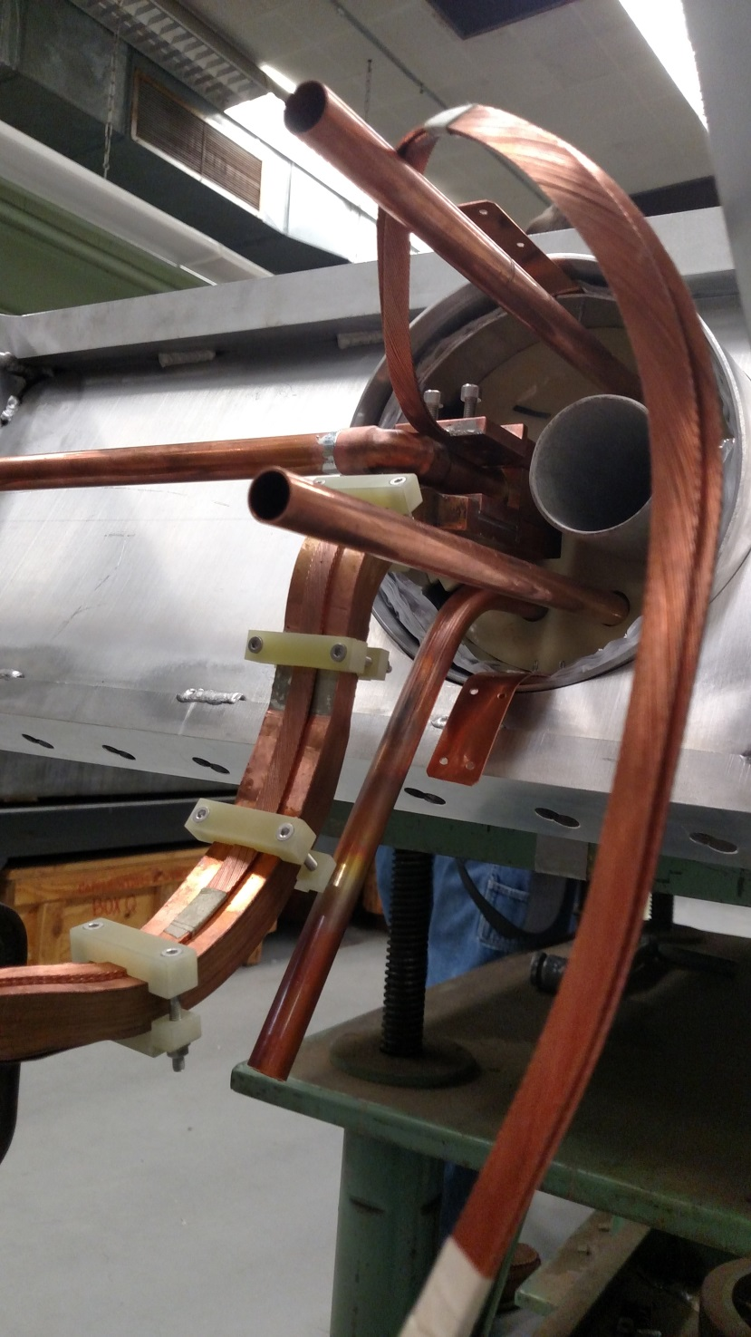

Slide 12
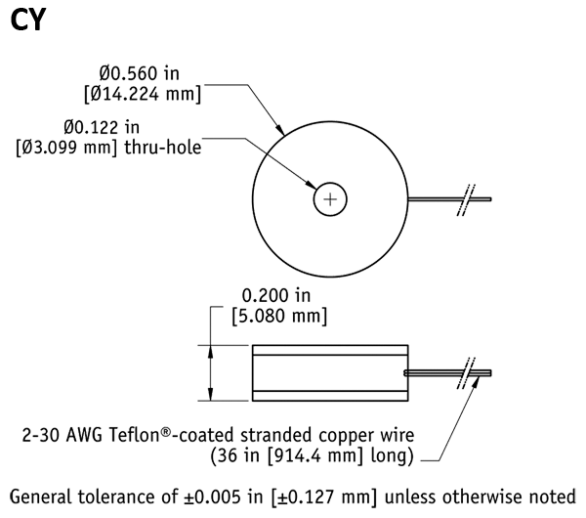

Slide 13
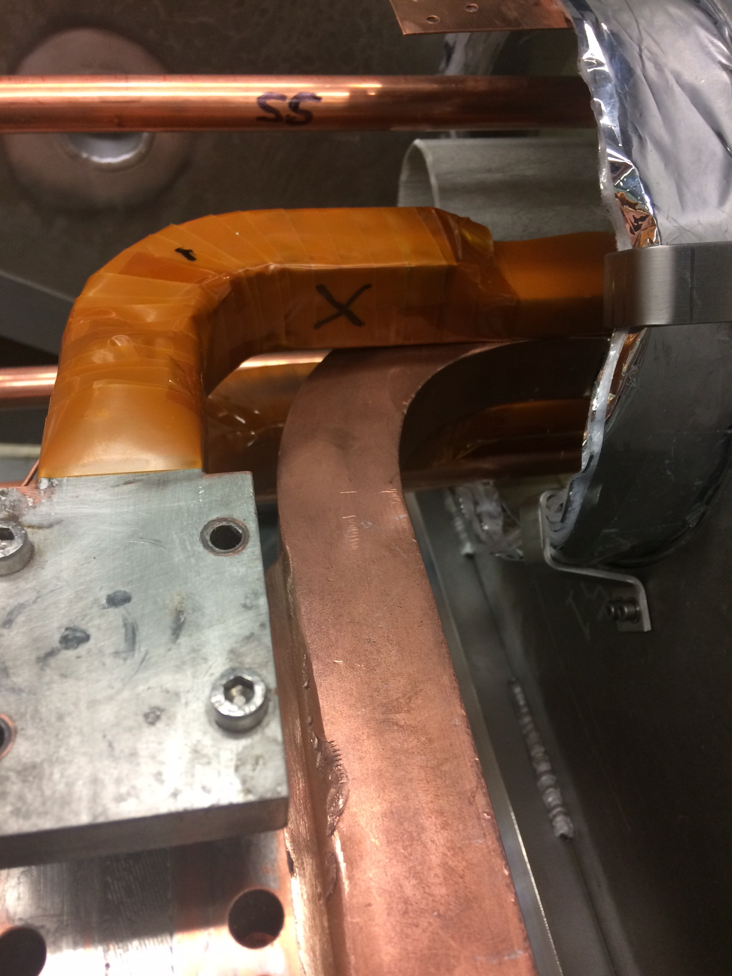

Slide 14
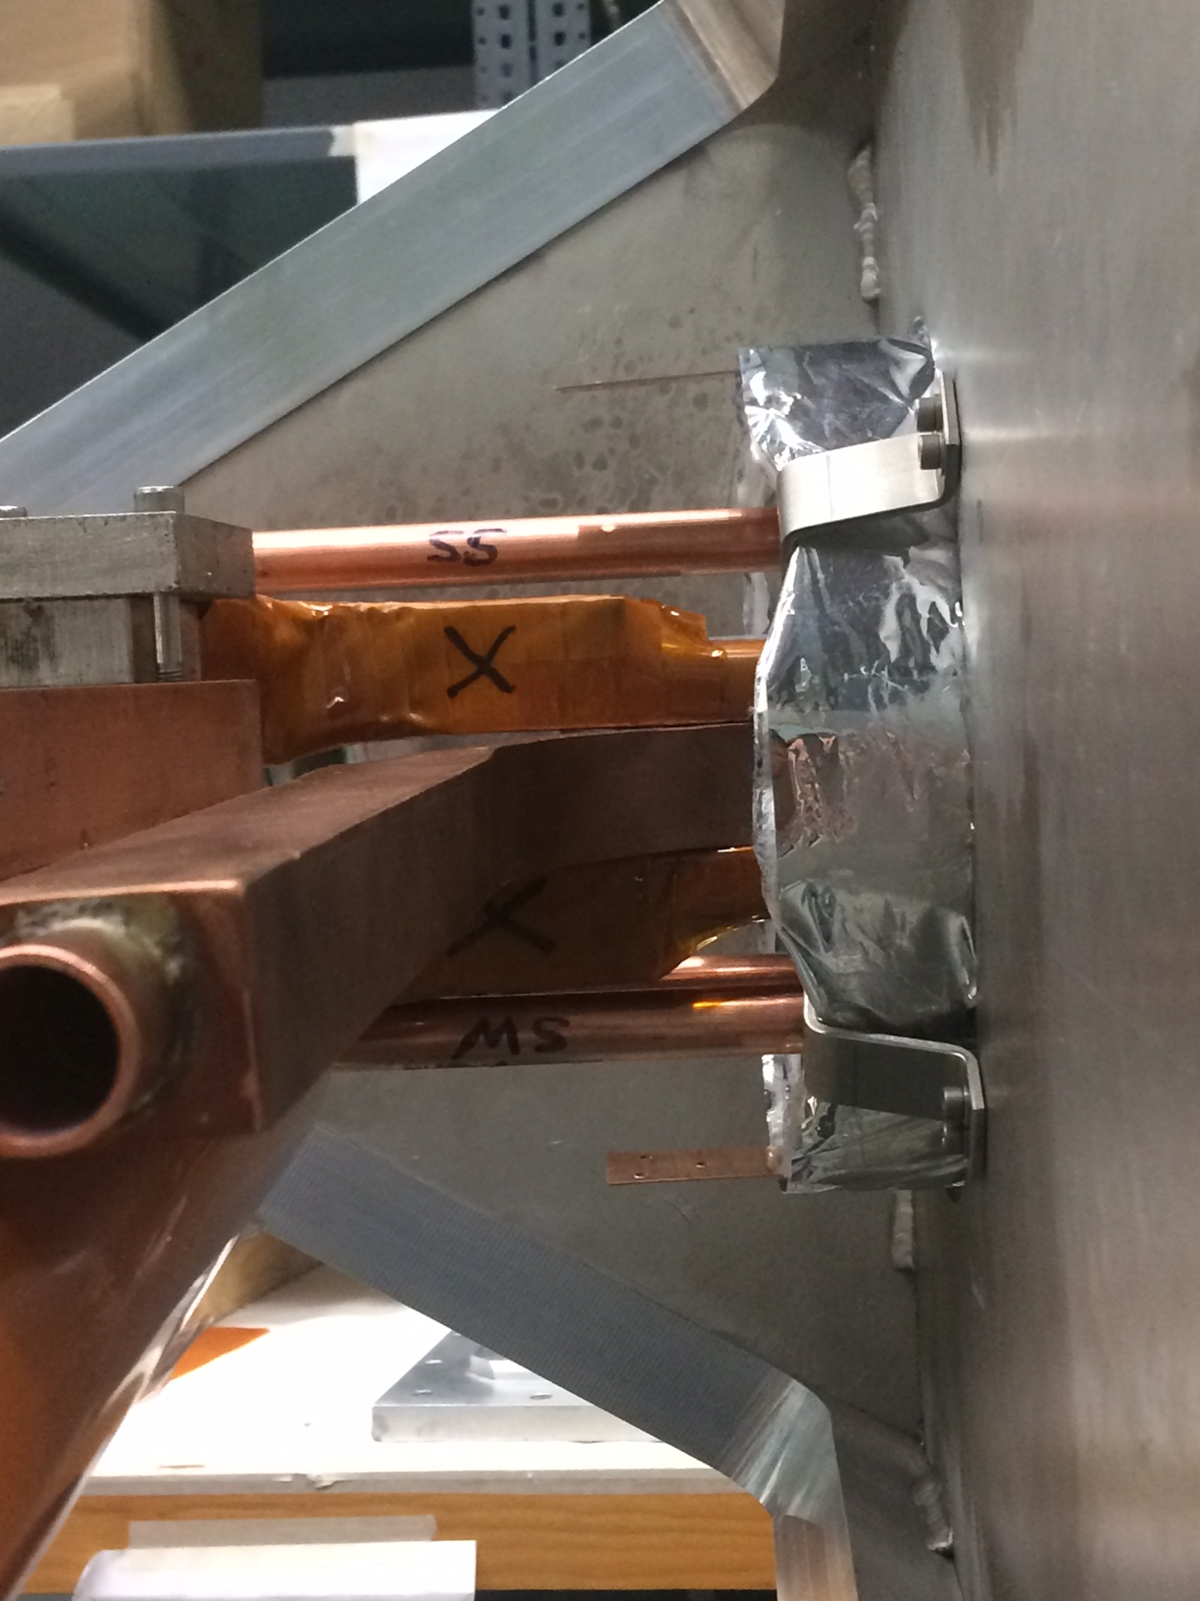
Redundant sensors

Slide 15
Sonny et.al will handle all aspects of Voltage taps.
Carl will do the Voltage tap and strain gauge data collecting.
I will handle strain gauge and Cryo extension cables and the cryo group will handle cryo related signals.
Rich Meier is the ET and Brian Van Kuik is the programmer.

Slide 16
Awaiting on all strain gauge wiring info.

