Slide 1
EIC running conditions and scenarios for the first 5 years
E.C. Aschenauer (BNL)
ePIC and EIC Physics Readiness Workshop
March 17th – 19th, 2026

Slide 2
Introduction
In the following, I will discuss changes in:
IR layout
Collider configuration
Start up configuration
these changes are critical to keep the EIC cost under control and in the $3B range
despite these changes the goal is and remains to deliver an EIC
that fulfills the Mission Need Parameters to do the NAS science
A high degree of beam polarization* ( ~ 70%) for electrons and light ions
Availability of ion beams from deuterons to the heaviest stable nuclei
Variable center of mass energies ~20-100 GeV, upgradable to ~140 GeV (e-p)
High collision luminosity* ~10³³⁻³⁴ cm⁻²s⁻¹
Possibly more than one interaction region
* Both luminosity and polarization are interpreted as average polarization and luminosity over a fill.

Slide 3
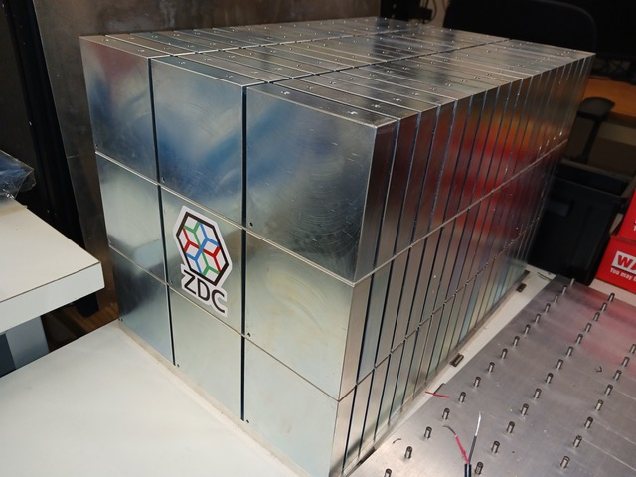
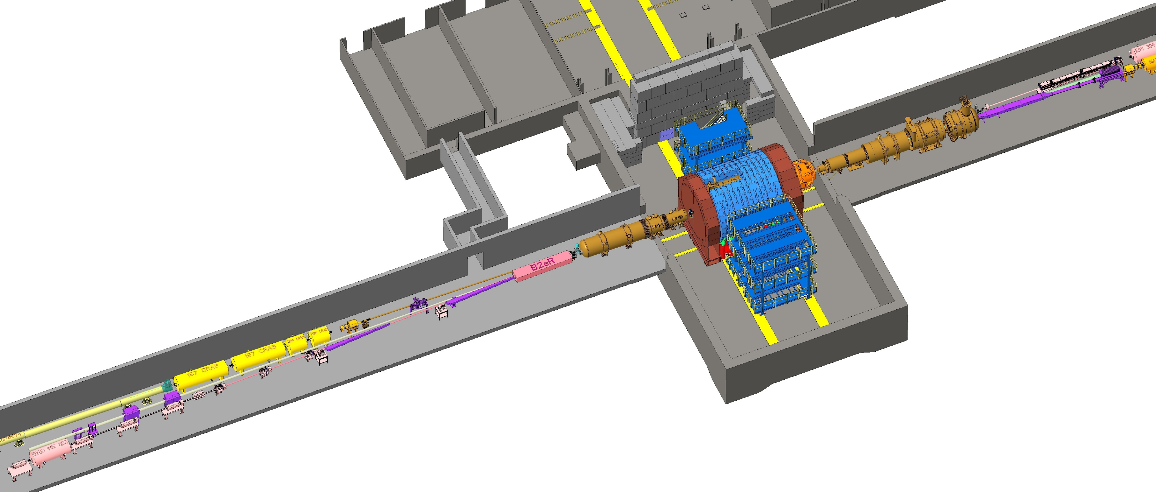
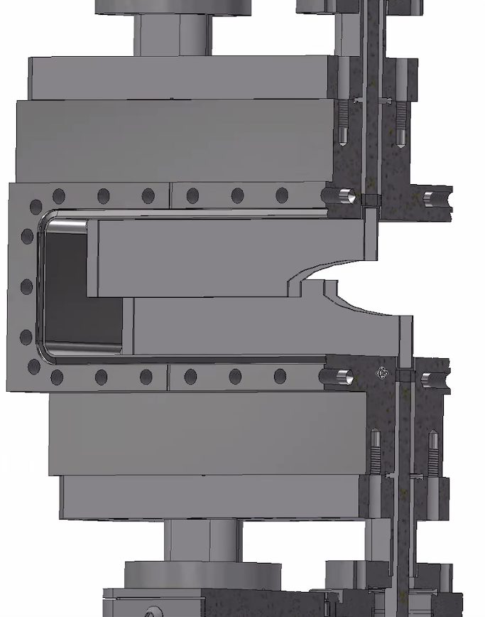

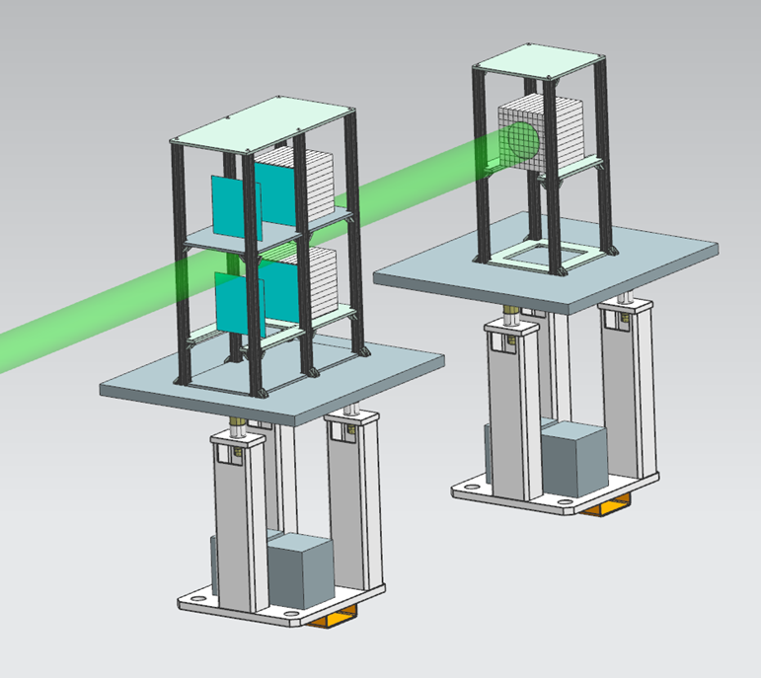
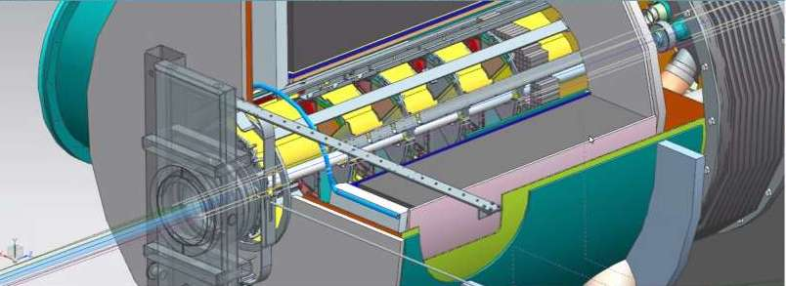
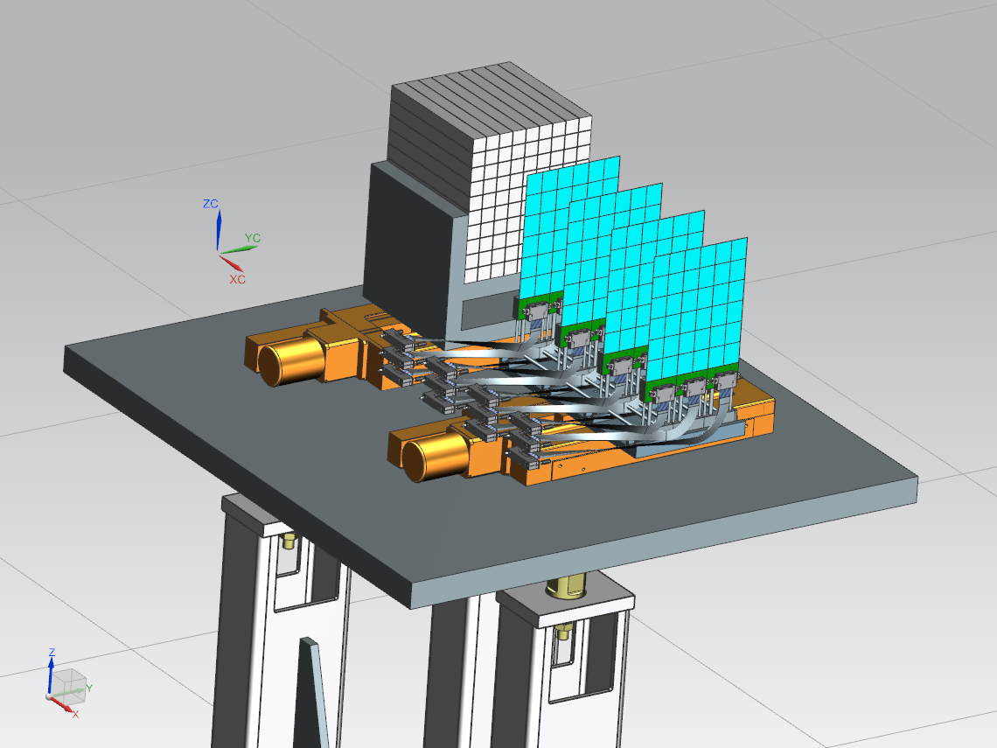
Current IR Layout
Zero Degree Calorimeter
e beam
Roman Pots and
Off-Momentum Detectors
B0 Magnet Spectrometer
p/A beam
Luminosity System
 | Particles | Angle [mrad] |  | Distance from IP
B0-tracker | Charged particles Photons ( tagged) | 5.5 - 20 |  | ca 6-7 m
Off-momentum | Charged particles | 0-5.0 | 0.4< xL< 0.65 | ca 23-25 m
Roman Pots | Protons Light nuclei | 0*-5.0 | 0.6 < xL< 0.95 | ca 27-30 m
ZDC | Neutrons Photons | 0-4.0 (5.5) |  | ca 35 m
Low-Q2 Taggers

Slide 4
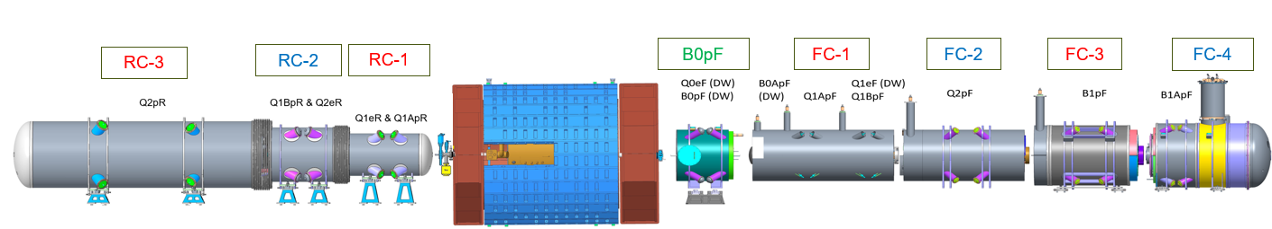
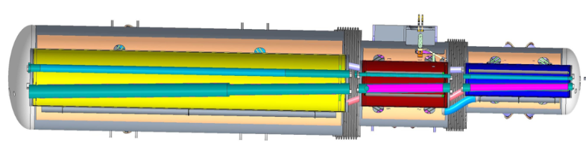
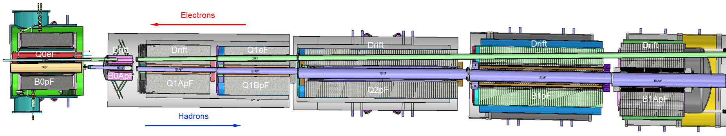
Front and Rear cryo-assemblies
In the front side, all cold-masses and cryo-assemblies from FC#1 to FC#4 will be connected in one full length cold-mass and one full length cryo-assembly
In the rear side, the cold-masses from RC#1 to RC#3 will be separated, and the cryo-assemblies will be connected in one full length cryo-assembly

Slide 5
Superconducting magnets for the EIC IR
Cryostat | Cold mass | Magnet | Type | # | Fab | Coil ID | I_{op} | B_{op} | G_{op} | B_{peak} | T_{op} | Magn. L | Loadline | Yoke OD | Correctors/shielding
 |  |  |  |  |  | mm | kA | T | T/m | T | T | m | % | mm
FC_B0pF | FC_B0pF_CM | B0pF | Q/D | 1 | DW | 652 | 1.1 | 1.6 | 0.5 | 5.3 | 1.9 | 1.0 | 70 | 1400
 |  | Q0eF | Q/D | 1 | DW | 90 | 0.07 | -- | 14 | 0.7 | 1.9 | 1.2 | 16 |  | (Q0eF_QTC), Q0eF_QSC, (Q0eF_DTC), Q0eF_DSC
FC#1 | FC#1_CM1 | B0ApF | D | 1 | DW | 114 | 470 | 3.9 | -- | 4.3 | 1.9 | 0.51 | 69 | 900 | B0ApF_SKQ
 | FC#1_CM2 | Q1ApF | Q | 1 | Ruth. | 142 | 11 | -- | 87 | 7.2 | 1.9 | 1.4 | 72 | 1100 | Q1eF-VC
 | FC#1_CM3 | Q1BpF | Q | 1 | Ruth. | 186 | 16 | -- | 56 | 6.3 | 1.9 | 1.4 | 73 | 1200
 |  | Q1eF | Q | 1 | DW | 154 | 0.6 | -- | 9 | 1 | 1.9 |  | 35
FC#2 | FC#2_CM | Q2pF | Q | 1 | Ruth. | 280 | 8.5 | -- | 38 | 6.4 | 1.9 | 3.5 | 62 | 1200 | Q1eF-SkQ
FC#3 | FC#3_CM | B1pF | D | 1 | Ruth. | 300 | 10.6 | 3.9 | -- | 5.1 | 1.9 | 2.7 | 59 | 1500 | B1pF_SKQ
FC#4 | FC#4_CM | B1ApF | D | 1 | Ruth. | 370 | 13.4 | 4.2 | -- | 6.4 | 1.9 | 1.0 | 70 | 1500x1800
FC_B2pF | FC_B2pF_CM | B2pF | D | 1 | Ruth. | 120 | 8.5 | 6.3 | -- | 6.8 | 1.9 | 2.5 | 65 | 575
RC#1 | RC#1_CM | Q1ApR | Q | 1 | DW | 66 | 0.5 | -- | 78 | 3.2 | 4.5 | 1.8 | 75 | 600 | Q1ApR_VC
 |  | Q1eR | Q | 1 | DW | 104 | 0.5 | -- | 25 | 2.0 | 4.5 | 1.0 | 61
RC#2 | RC#2_CM | Q1BpR | Q | 1 | DW | 83 | 0.5 | -- | 70 | 3.5 | 4.5 | 1.5 | 79 | 600 | Q1BpR_SkQ
 |  | Q2eR | Q | 1 | DW | 135 | 0.3 | -- | 13 | 1.4 | 4.5 |  | 43 |  | Q2eR_SkQ
RC#3 | RC#3_CM | Q2pR | Q | 1 | DW | 141 | 0.8 | -- | 30 | 3.1 | 4.5 | 4.0 | 66 | 698 | Q2pR_HC, B2eR_VC
SC#1 | SC#1_CM | Spin short | S | 4 | WIC | 172 | 0.8 | 8.2 | -- | 8.4 | 1.9 | 19 | 78 | 1200
SC#2 | SC#1_CM | Spin long | S | 4 | WIC | 172 | 0.8 | 8.2 | -- | 8.5 | 1.9 | 5.6 | 79 | 1200

Slide 6
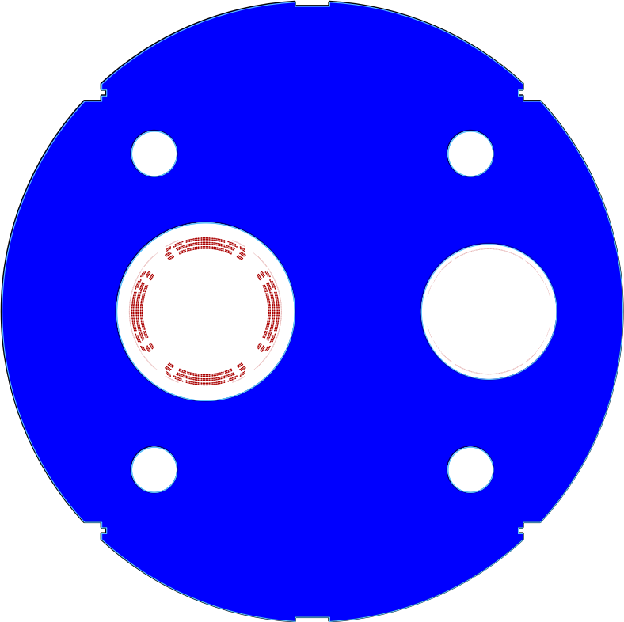
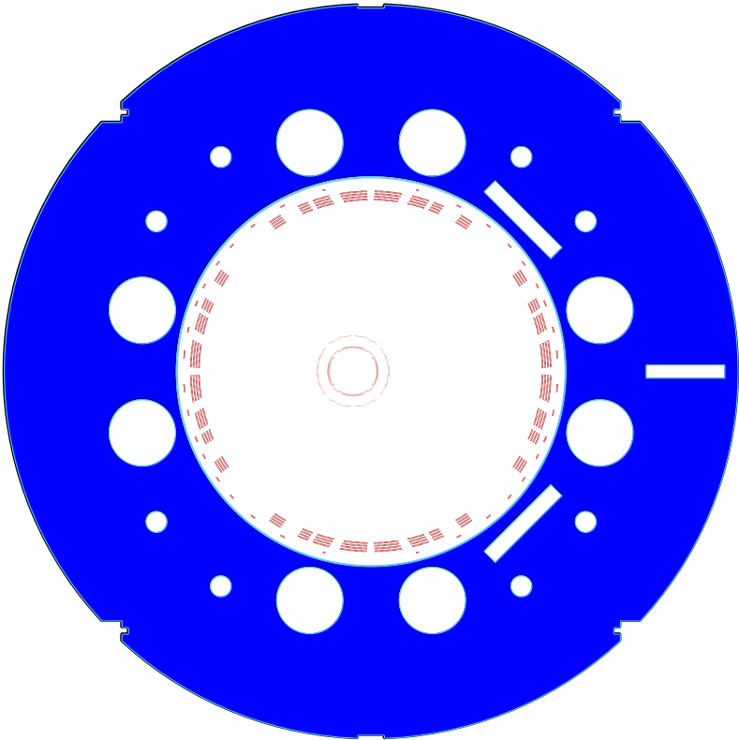
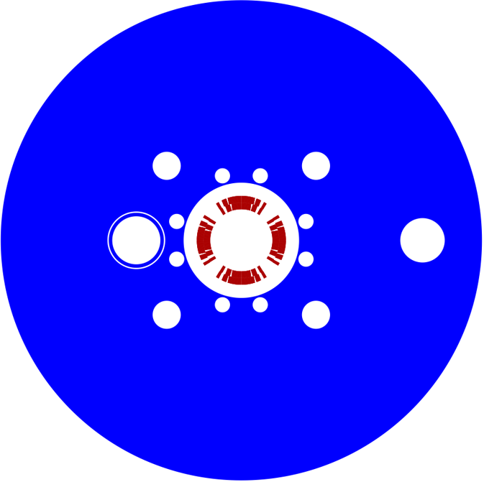
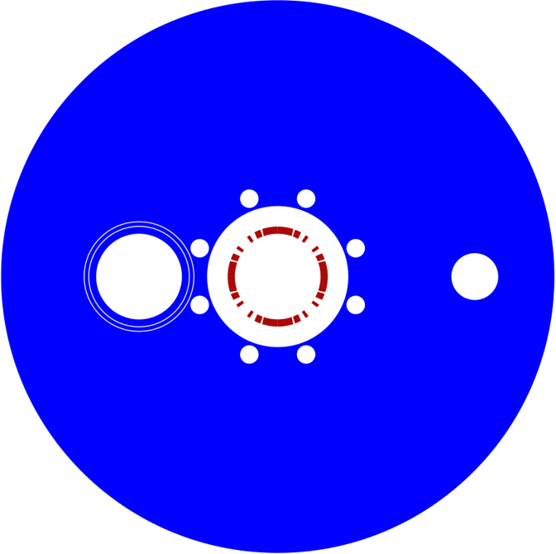
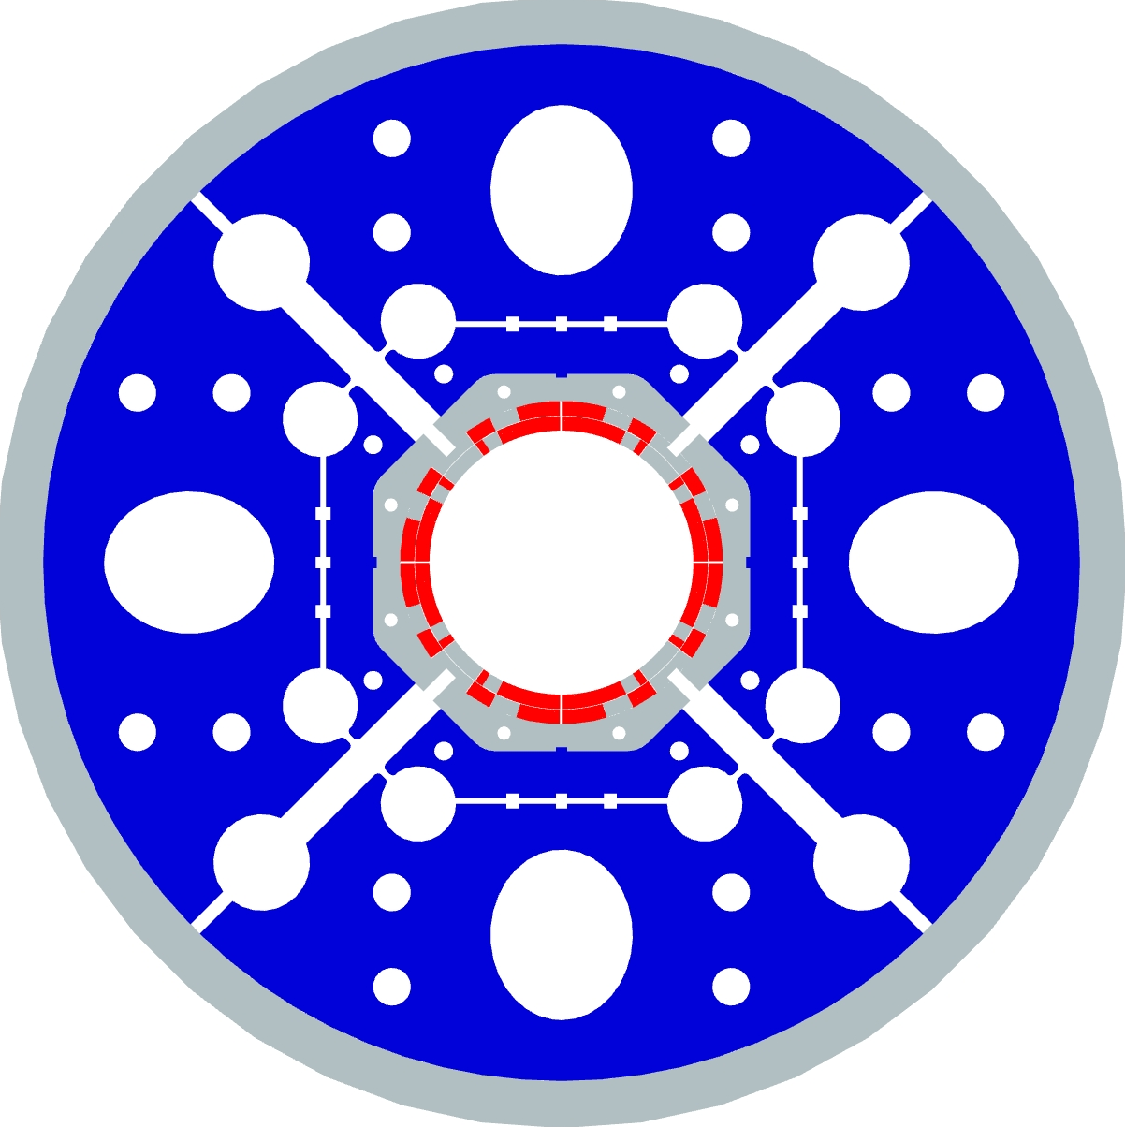
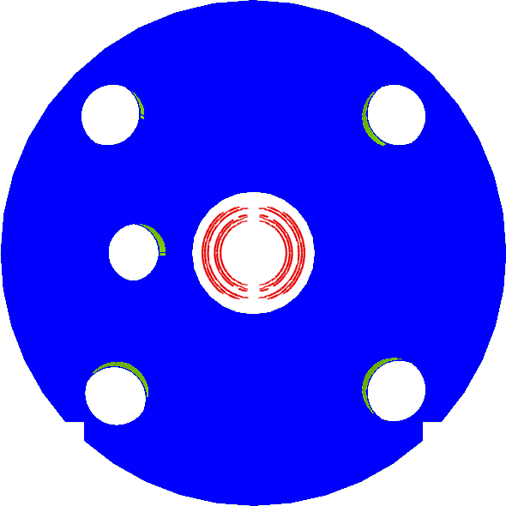
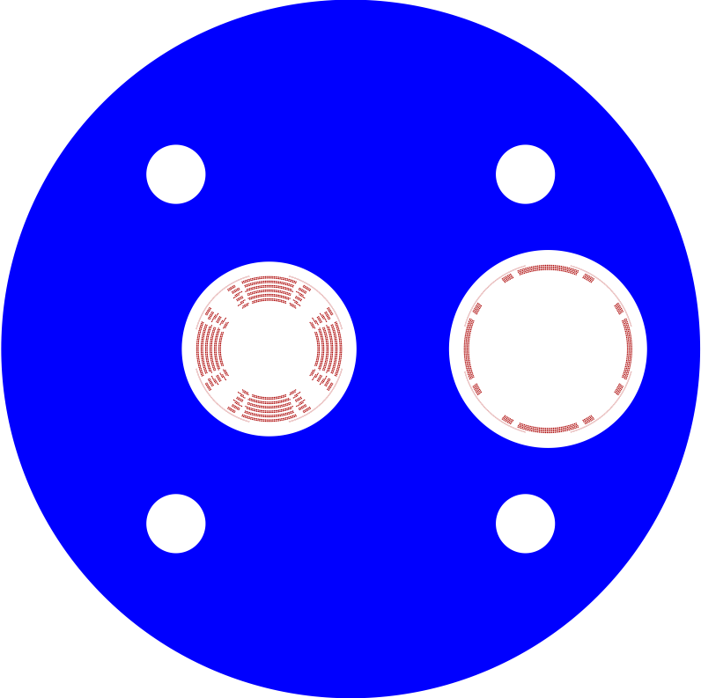
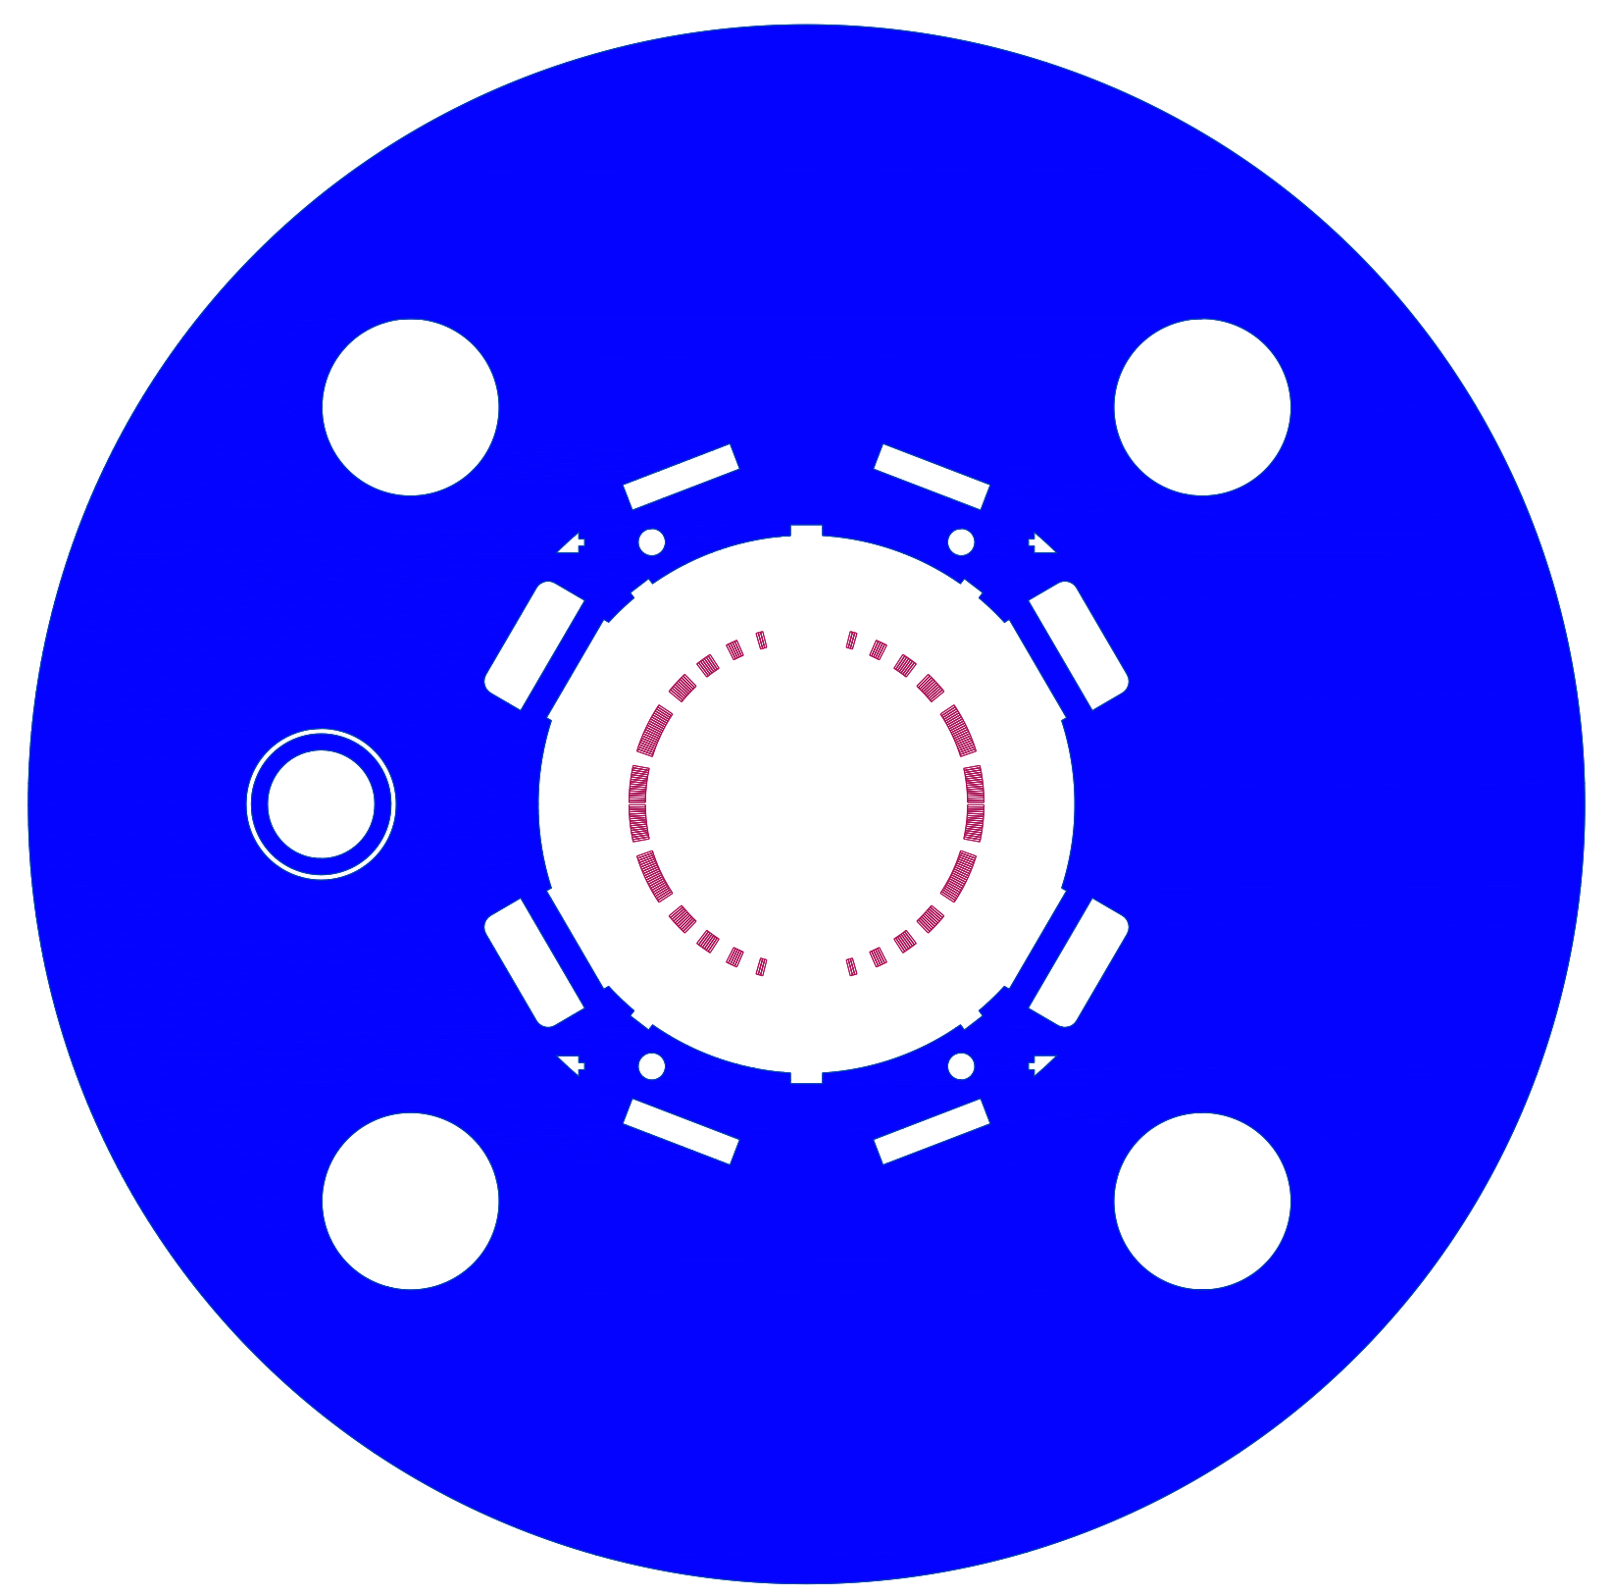
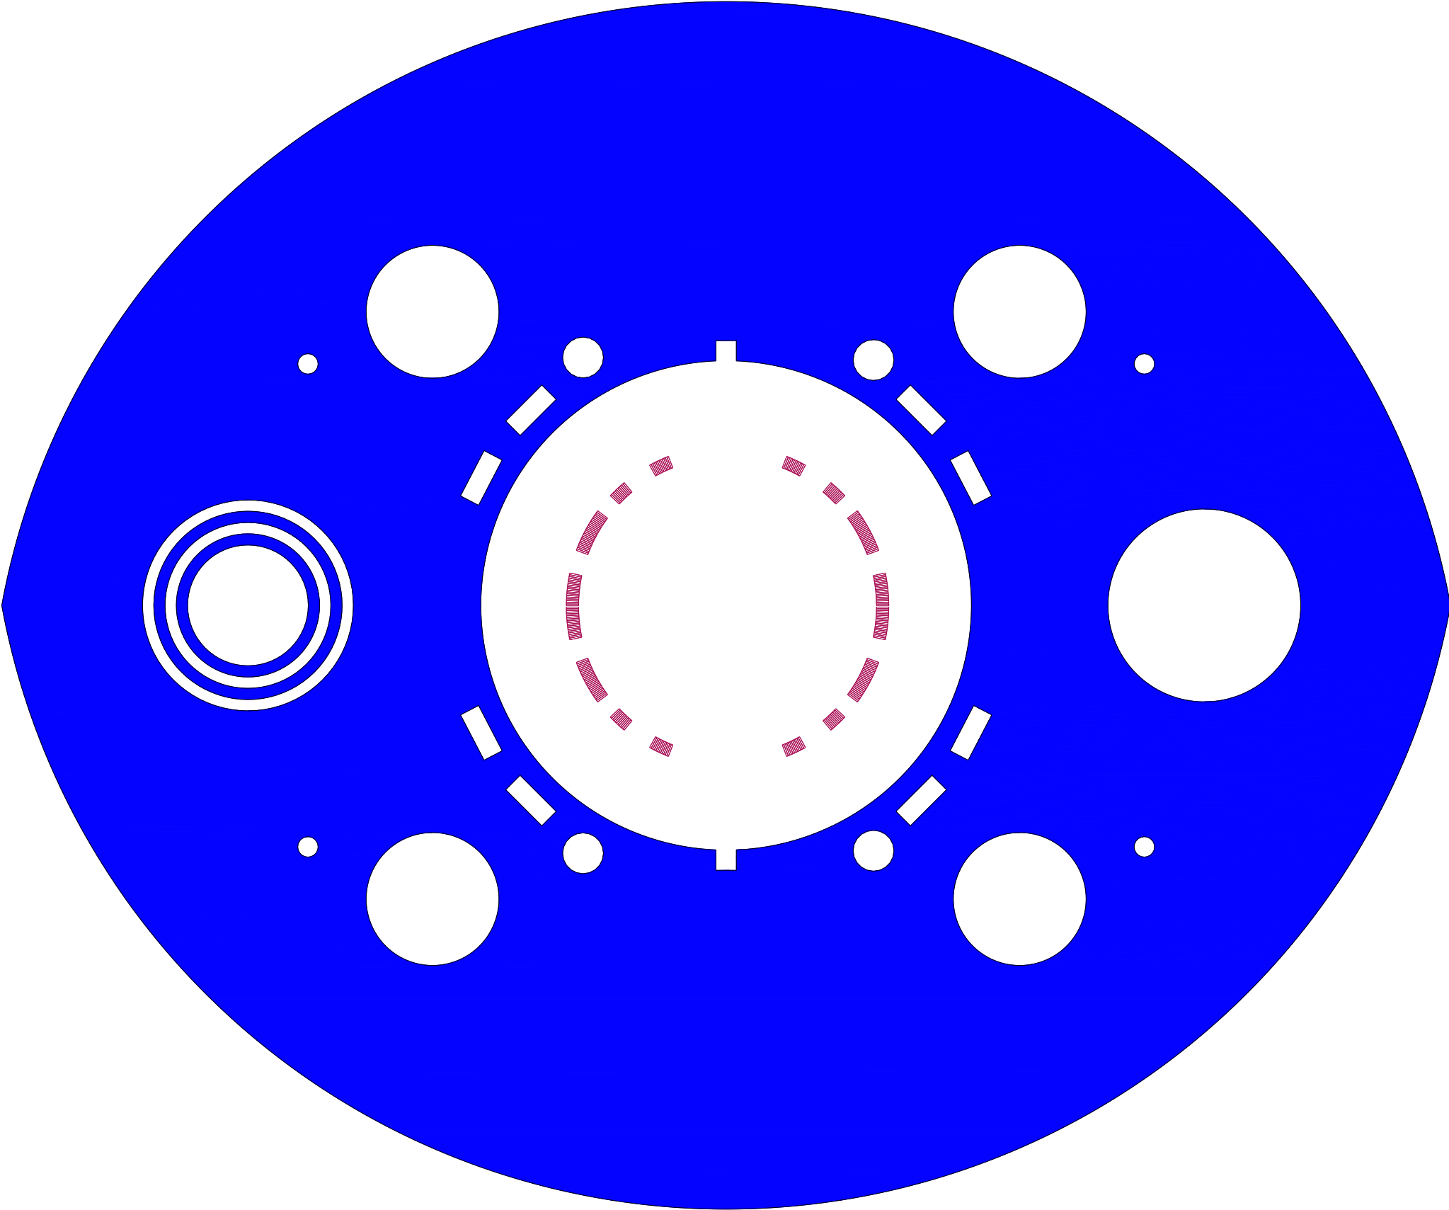
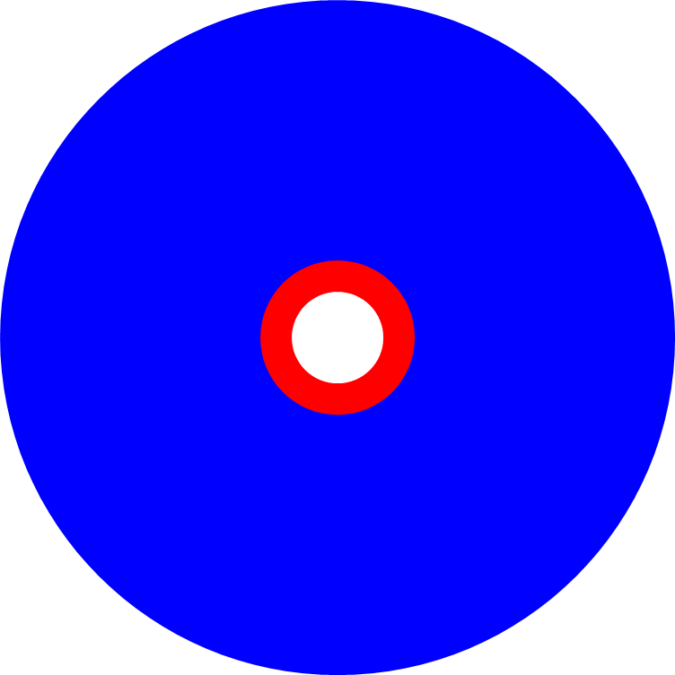
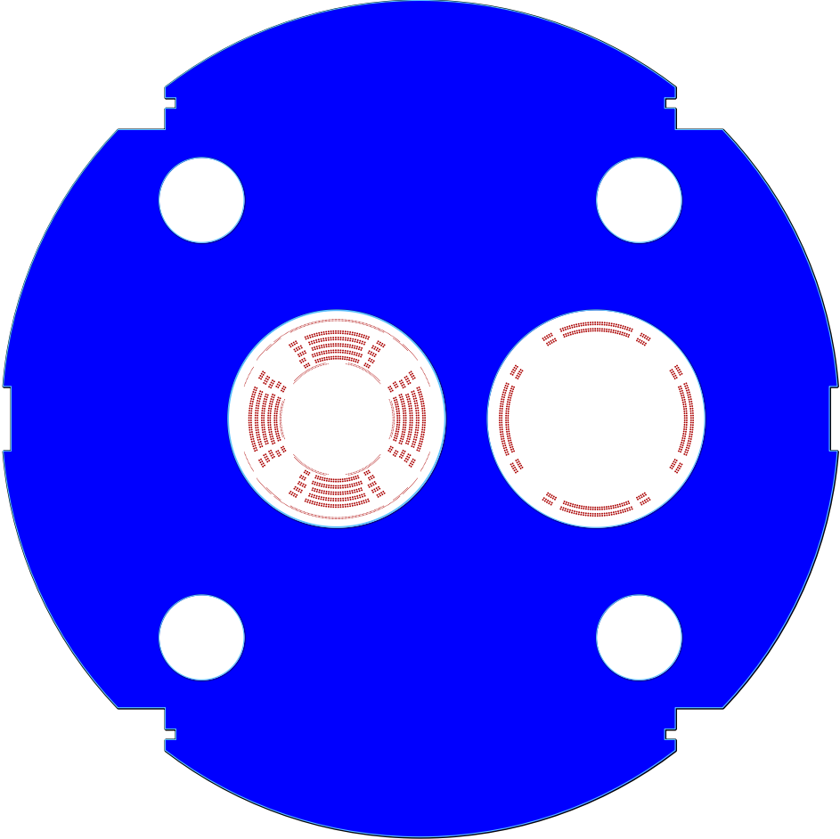
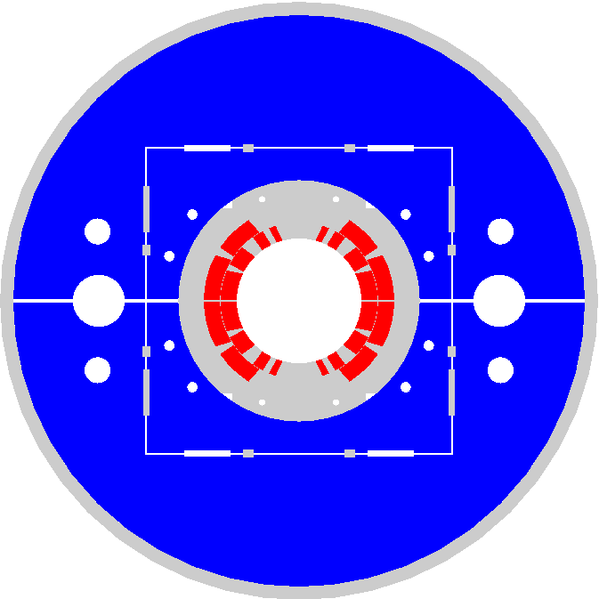
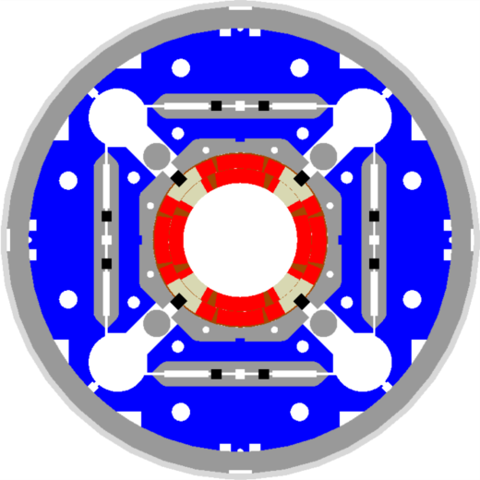
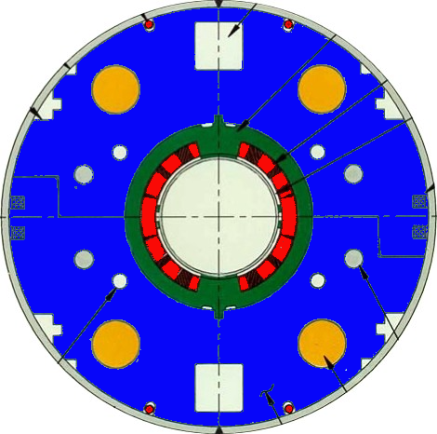
EIC IR Superconducting Magnets
Charge #1, #3
View from the IP
Q2pR-eDrift
  The EIC SC magnets are all one of a kind with a high risk and a high cost
  Can we make things easier?
B0ApF-eDrift
Q1ApF-eDrift
Q1BpF-Q1eF
Q2pF-eDrift
B0pF-Q0eF
Q1BpR-Q2eR
LHC MB
MQXF
B2pF
Q1ApR-Q1eR
Spin rotator
RHIC MB
B1pF-eDrift
B1ApF-eDrift

Slide 7
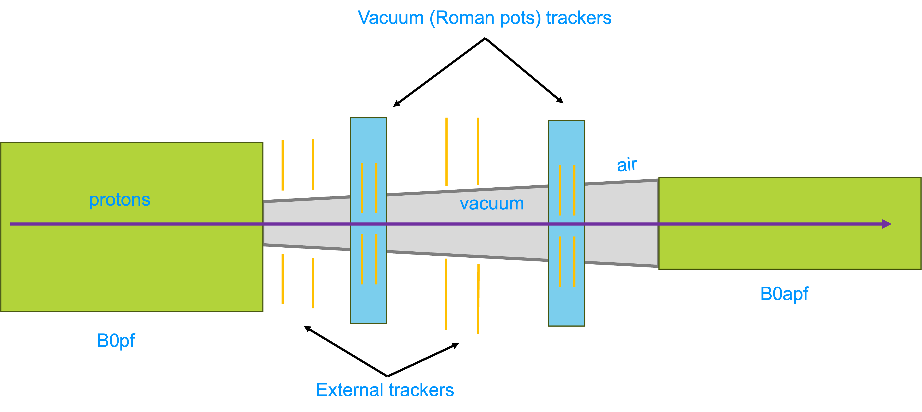
New IR layout to reduce Risk and Cost of SC Magnets
Magnet apertures mostly come from transverse momentum requirement to capture particles with pT < 1.3 GeV in forward detectors → see slide 3
General Idea: Capture transverse momentum earlier between B0ApF and B0pF
→ Add space between B0pF and B0ApF and Increase B0pF integrated field
  → Integral field from B0pF of 2.4 T·m
  → reduce B0 aperture to 15 mrad and removee trackers and ECal
1.5 m after B0pF for detector hardware → Roman Pots, Off momentum detectors and B0 detectors
Important;
  Need sufficient separation between circulating beam and ZDC
  Need sufficient separation between HSR and ESR at crab cavities
Investigate right now if there is a real gain to apertures, if we transport only the 4mrad neutron cone to the ZDC
PbWO4
calorimeter

Slide 8
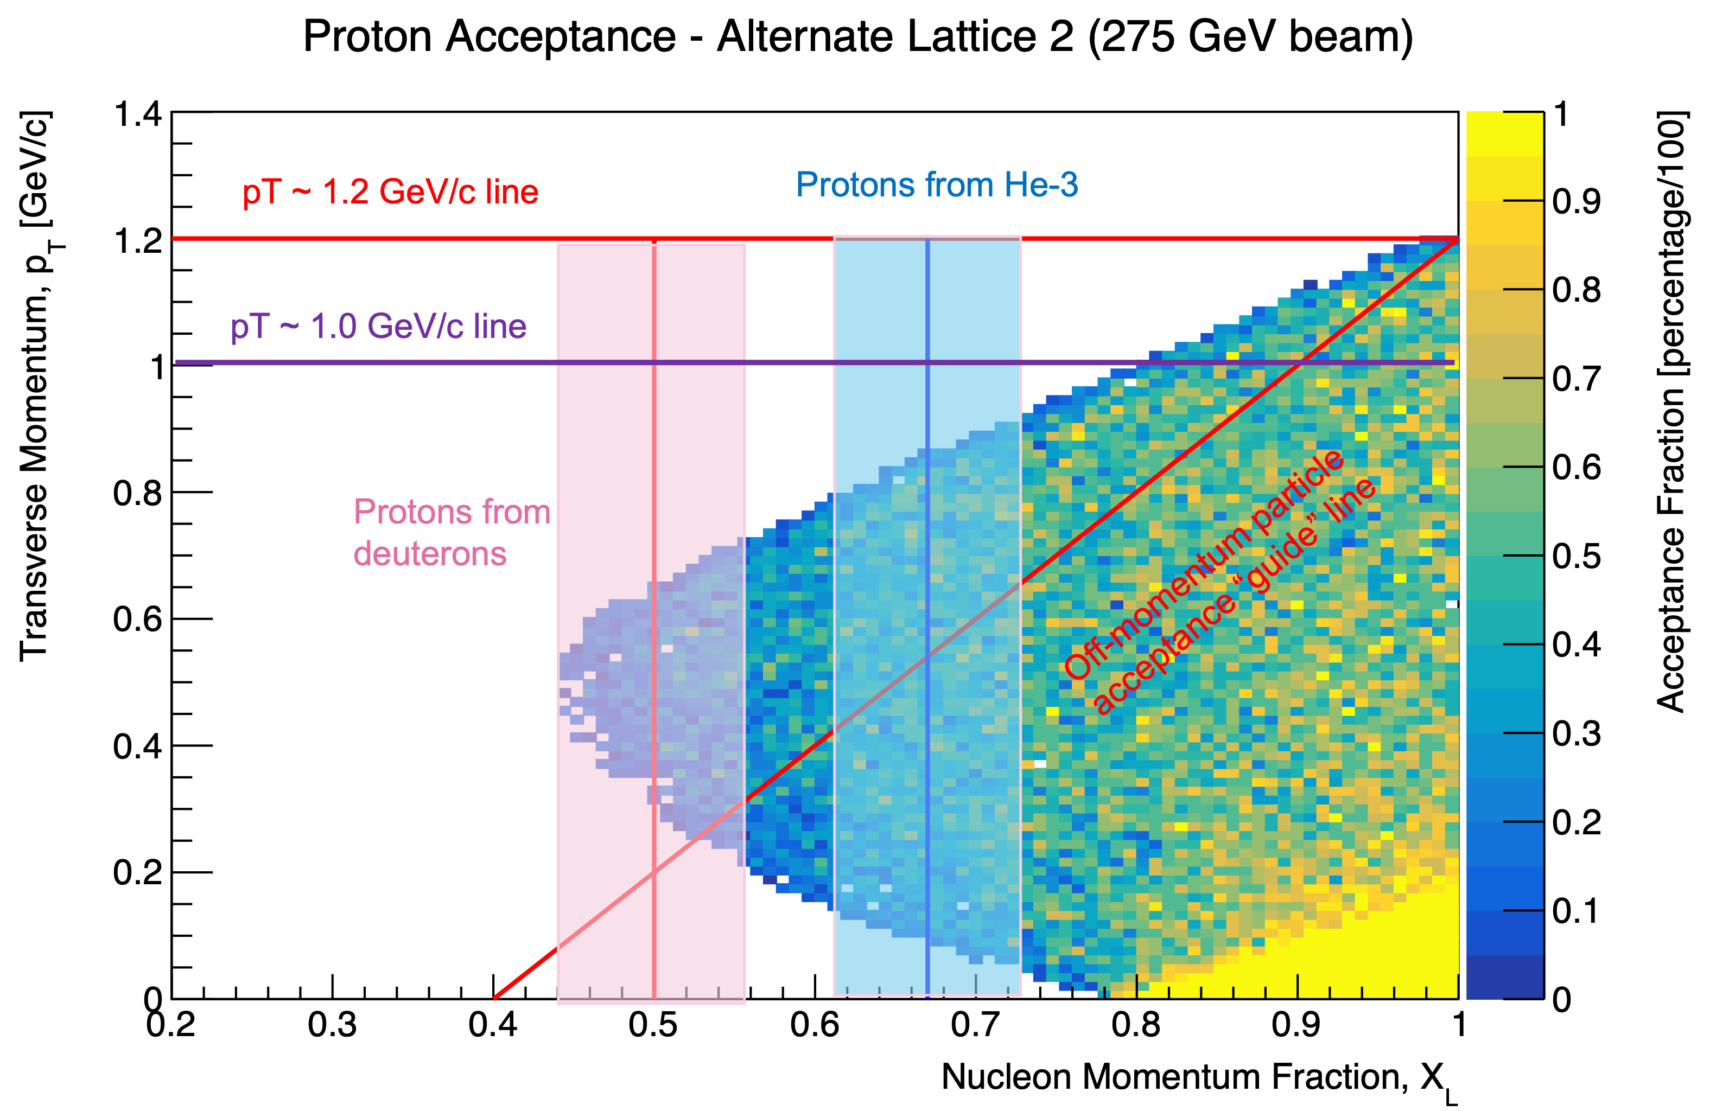
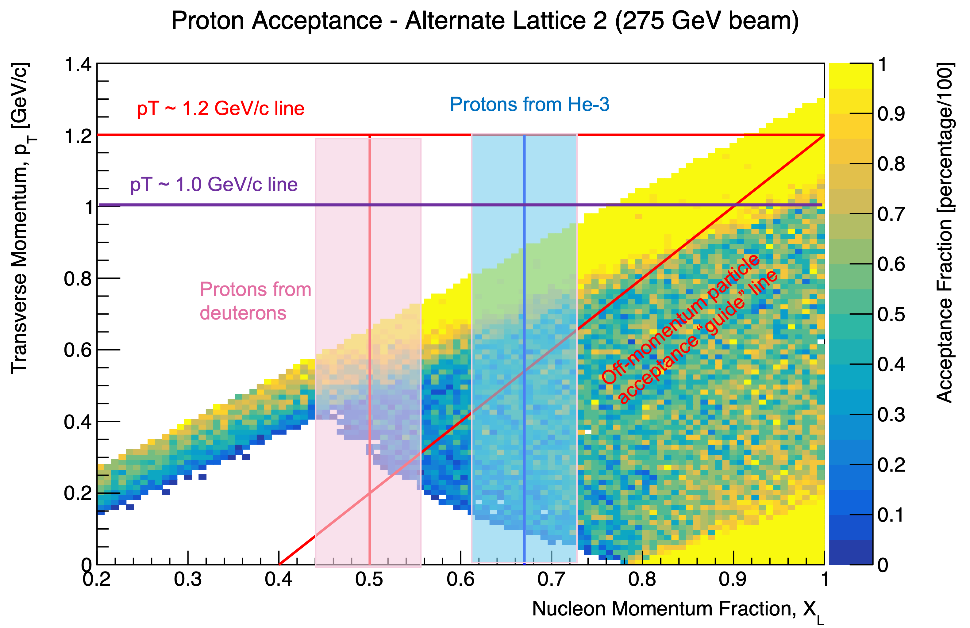
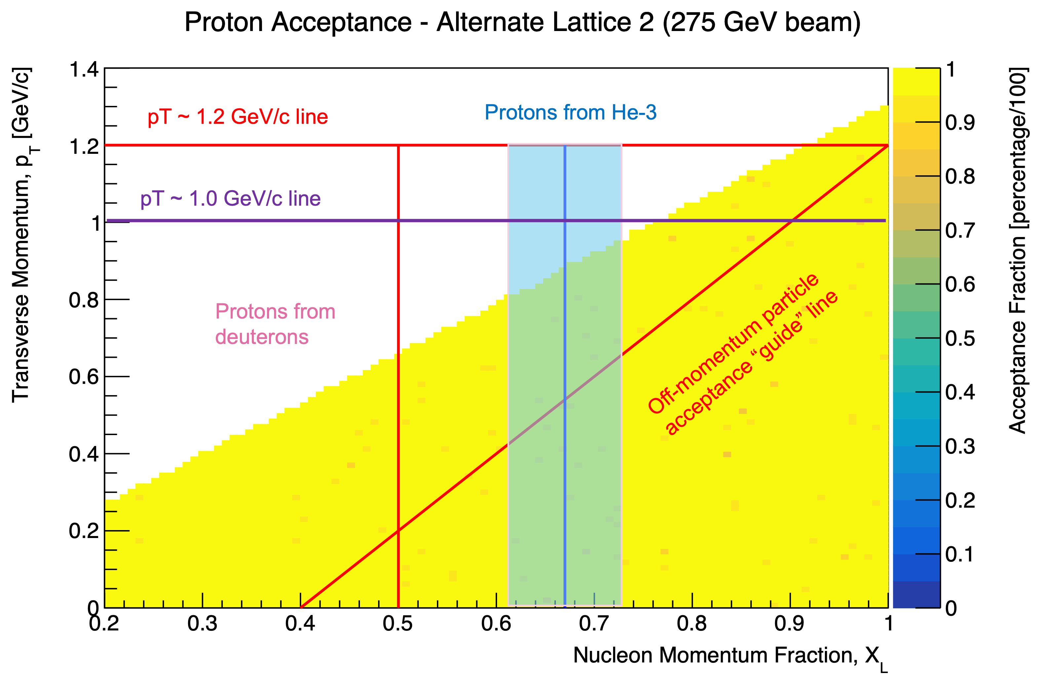
A very very very preliminary performance study
Proton acceptance AFTER B1APF
magnets are not aligned
Proton acceptance AFTER B1APF + acceptance of an “outside of beam pipe” tracker between B0 and B0A, with roughly current beam pipe taper going from B0 to B0A, and no Roman pots in that region.
Nothing is decided !!!!!
Will only be done, if there is a significant gain in making the magnets simpler and there is no significant loss in science
Plot shows what aperture in-principle allows (after B0pf).
  Issue is placement of detectors in the region between the magnets → need > 1.5m
Actual detector configuration with beam pipe + vacuum is what will ultimately determine acceptances.
Initial “acceptance” not driven by upstream aperture, so this is the “best” we could ever do.
Proton detection combines B0 + Roman pots
Also passes 4.0 mrad neutral cone.

Slide 9
Changes in Collider Configuration

Slide 10
Changes in collider configuration
18 GeV electron beam energy will be an upgrade, but all preconditions to do so are included in the project
ESR Main SRF systems are relocated from the currently planned IR-10 location to IR-08.
  Potential 2nd detector location would move to IR-12​
  Would require a new Hall at IR-12 for a later EIC Detector 2 project​
  IR-12 has the same machine layout as IR-8, so design feasibility studies for 2nd IR/detector remain valid
Production and installation of half of the RCS main arc girders (half-cells) deferred to upgrade.
revise infrastructure to adapt to the changes
several other smaller changes to safe money
→ no impact on Mission need and NAS science program
Reduce ESR Main SRF Systems from 6x to 2x. Defer remaining ESR Main SRF Systems to incremental operational upgrades. Relative to SRF capability to support maximum ESR design beam current:
  9 GeV: 2x SRF systems supports 10nC per bunch x 1160 bunches, 35% of maximum ESR beam current capability.
  10 GeV: 2x SRF systems supports 7nC per bunch x 1160 bunches, 25% of maximum ESR beam current capability.
→ the 10 GeV solution is equal to the start up solution for EIC already provided

Slide 11
Luminosity

Slide 12
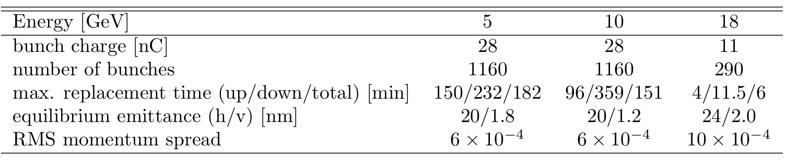
Recap: What do we need to commission
RCS:
  operate the RCS
  get polarization in the RCS
  swap out of electron bunches in the ESR
ESR:
  operating with spin rotator to get longitudinal polarization
  swap out of electron bunches to preserve polarization, needed because Sokolov Ternov depolarizes ”up” spin direction
HSR:
  operating beams off center
  transverse and longitudinal beam polarization (needs spin rotator) for protons and He-3
  pre-cooling of hadron beams
  operating with crab cavities
Maximum replacement times (= max. allowable storage times in ESR) are based
on 85% injected polarization and 70% time averaged polarization

Slide 13
Beam Energy and Average Orbit Radius in the HSR
3He
p
20 mm
130 GeV
100 GeV
store
275 GeV
70 mm $∅$ beam pipe
Since the electron revolution frequency is fixed, the hadron orbit must be adjusted with energy to keep the collisions in sync.
Zr
d
Au,
p
U
Ru
Cu
Prefer ~130 GeV/u, which corresponds to a ‘centered’ hadron beam (path length difference ΔR ~ 0, this is achieved for a beam where Z ~ 0.5A) → Ru, Cu, Ag, …..
Do not want to exceed the present RHIC maximum dipole fields (corresponds to 250 GeV protons or 833 T-m)

Slide 14
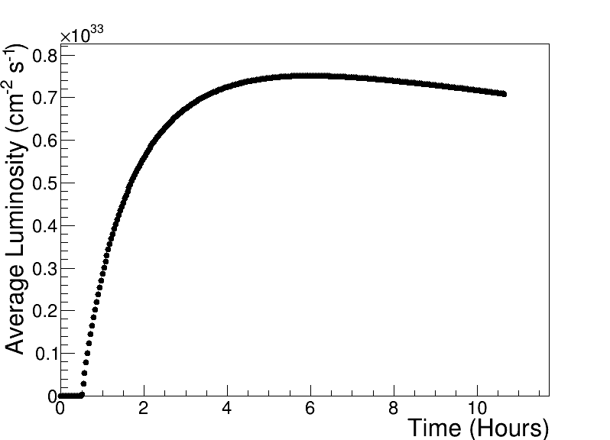
Assumptions and Luminosity Calculation as of 01/2025
7 nC electron bunch charge compared to 28 nC (CDR)
Constant proton beam IP divergencies are maintained throughout the store by gradual increase of proton IP beta-functions as the beam emittance increases.
The electron IP beta-functions are adjusted accordingly to match electron and proton transverse beam size.
Ion beam is cooled at low energy (24 GeV/u) but no stochastic cooling is used in the store
1 Run is 30 weeks of operation at 80% uptime
2 h store turnaround time
30 min at the beginning of the store is taken by the ESR fill and detector turn-on
250 GeV x 10 GeV
Luminosities for 30 weeks are updated to better take into account cycle time

Slide 15
Proposal for EIC Science Program in the First Years as of 01/2025
Year - 1
Year - 2
Year - 3
Year - 4
Year - 5
Start with Phase 1 EIC
New Capability:
Commission electron polarization in parallel
Run:
10 GeV electrons on 115 GeV/u heavy ion beams (Ru or Cu)
Physics:
Add your preferred science topic
Phase 1 EIC
+ long. electron polarization
New Capability:
Commission proton polarization in parallel
Run:
10 GeV long. polarized electrons on 130 GeV/u Deuterium
Physics:
Add your preferred science topic
Run:
Last weeks 10 GeV long. polarized electrons and 130 GeV polarized protons
Physics:
Add your preferred science topic
Phase 1 EIC
+ long. electron polarization
+ proton polarization
New Capability:
Commission running with hadron spin rotators
Run:
10 GeV long. polarized electrons on 130 GeV transverse polarized protons
Physics:
Add your preferred science topic
Run:
Last weeks switch to longitudinal proton polarization
Physics:
Add your preferred science topic
Phase 1 EIC
+ long. electron polarization
+ proton polarization
+ operation of hadron spin rotators
New Capability:
Commission hadron accelerator to operate with not centered orbits
Run:
10 GeV long. polarized electrons on 100 GeV Au
Physics:
Add your preferred science topic
Run:
10 GeV long. polarized electrons on 250 GeV transverse and longitudinal polarized protons
Physics:
Add your preferred science topic
Phase 1 EIC
+ long. electron polarization
+ proton polarization
+ operation of hadron spin rotators
+ operation of hadron beams with not centered orbits
Run:
10 GeV long. polarized electrons on 100 GeV Au
Physics:
Add your preferred science topic
Run:
10 GeV long. polarized electrons on 166 GeV transverse and longitudinal polarized He-3
Physics:
Add your preferred science topic
Time to install additional ESR RF and HSR PS to
reach design Current and max. Energies

Slide 16
Importance of different Hardware
for Luminosity

Slide 17
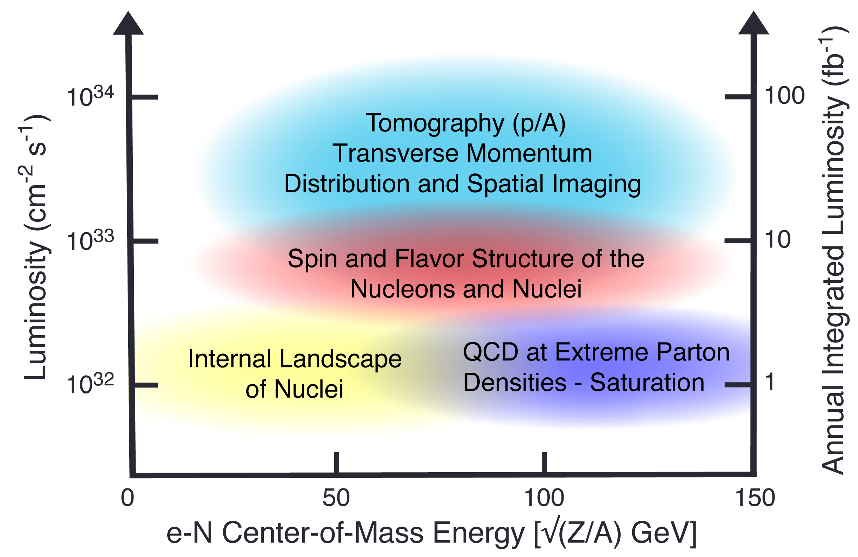
EIC Science Reach for ep
+
EIC Full Capability
5 GeV x 100 GeV
+
EIC
RF for 7nC/bunch
equals to EIC at startup in 01/2025
+
+
+
+
EIC
RF for 7nC/bunch
no 394 MHz crab cavities
Average Luminosity (cm⁻² s⁻¹)
+
+
+
+
+
+
EIC
RF for 7nC/bunch
no 394 MHz crab cavities
no low energy cooling
no 41 GeV bypass
+
+
+
+
+
e-p Center-of-Mass Energy [GeV]

Slide 18
EIC Science Reach - eA
Note:
eA luminosity is per nucleon
5 GeV x 100 GeV
+
EIC full capability
EIC
RF for 7nC/bunch
no 394 MHz crab cavities
+
EIC
RF for 7nC/bunch
no 394 MHz crab cavities
no low energy cooling
no 41 GeV bypass
Average Luminosity (cm⁻² s⁻¹)
+
+
+
+
+
EIC
RF for 7nC/bunch
no 394 MHz crab cavities
no low energy cooling
no 41 GeV bypass
But including updated RHIC stochastic cooling
+
+
+
+
e-A Center-of-Mass Energy [GeV]

Slide 19
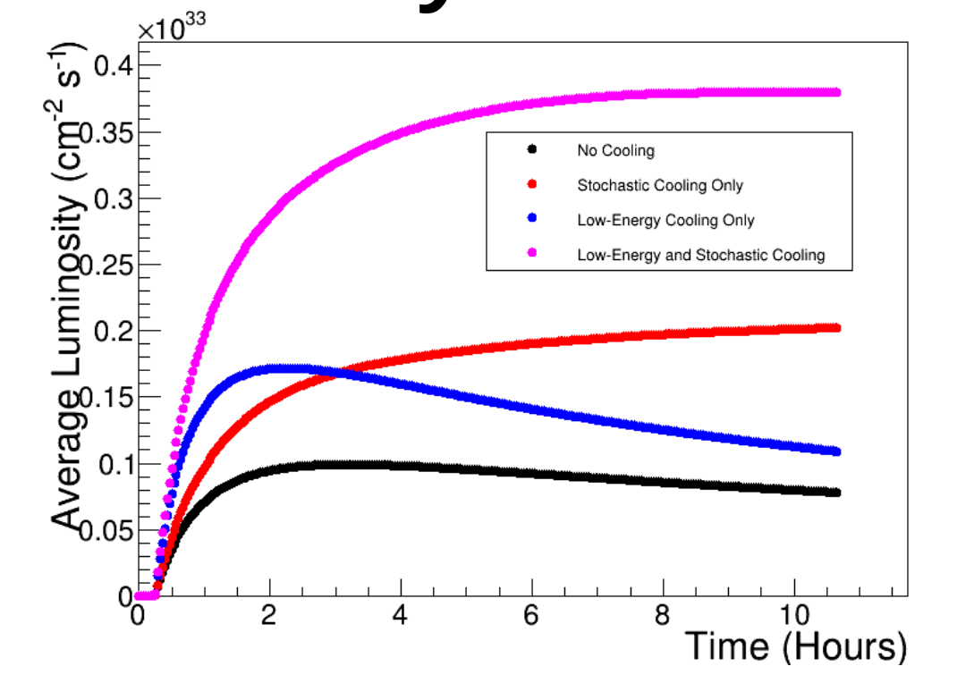
Does the RHIC Stochastic Cooling help
Silver@118 GeV
Average luminosity with no cooling: 1.0 x 10³² cm⁻² s⁻¹
Average luminosity with stochastic cooling only: 2.0 x 10³² cm⁻² s⁻¹
Average luminosity with low-energy cooling only: 1.7 x 10³² cm⁻² s⁻¹
Average luminosity with both low-energy and stochastic cooling: 3.8 x 10³² cm⁻² s⁻¹

Slide 20
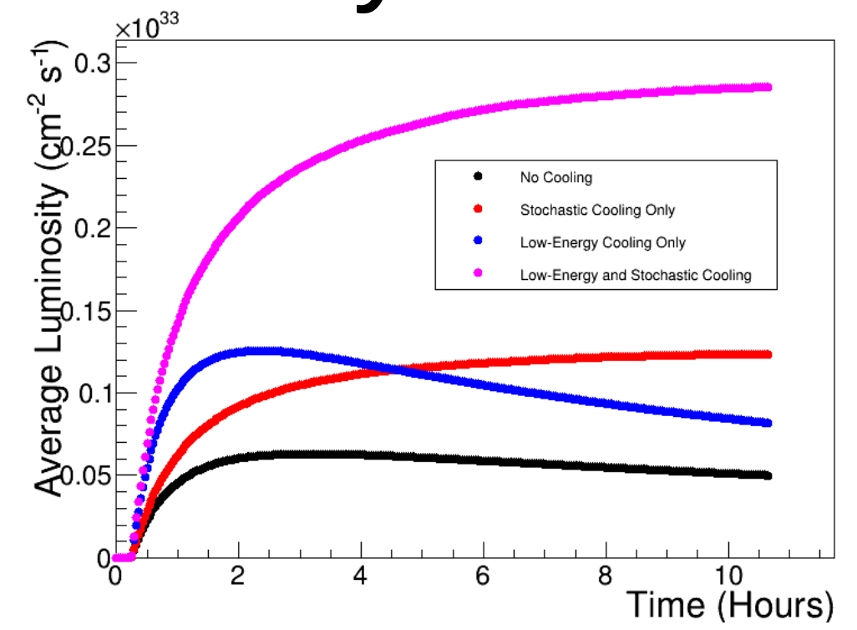
Does the RHIC Stochastic Cooling help
Au@110 GeV
Average luminosity with no cooling: 0.6 x 10³² cm⁻² s⁻¹
Average luminosity with stochastic cooling only: 1.2 x 10³² cm⁻² s⁻¹
Average luminosity with low-energy cooling only: 1.3 x 10³² cm⁻² s⁻¹
Average luminosity with both low-energy and stochastic cooling: 2.9 x 10³² cm⁻² s⁻¹

Slide 21
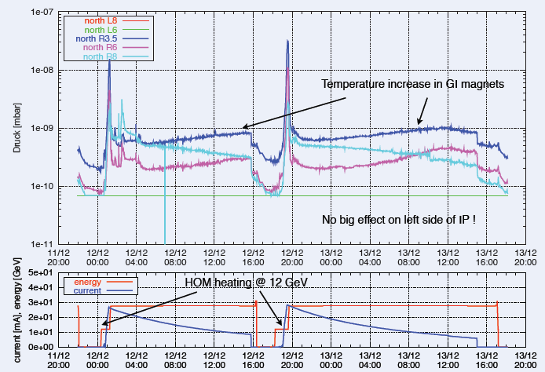
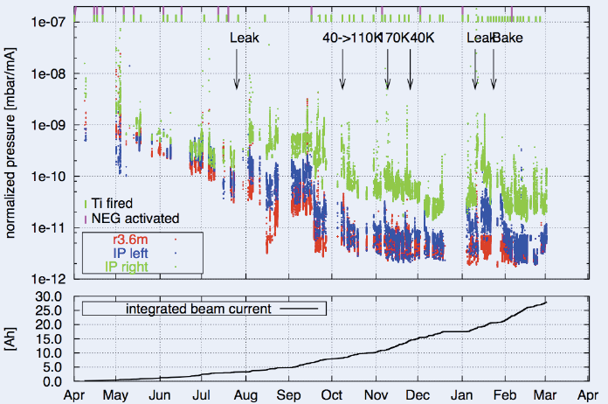
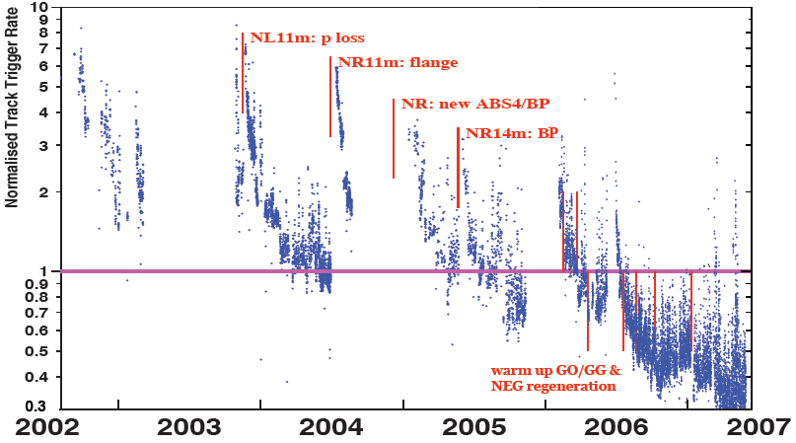
Remember: Lessons from HERA II upgrade
Dynamic pressure increase due
to thermal and photo desorption
Pressure vs. integrated electron
current 2002 - 03
Proton Beam Gas Background
Two time constants for vacuum
conditioning
Short term after leaks 20 – 30 days
Long term 600 days

Slide 22
Remember: Finding Correlation between Vacuum and Beam Current
Beam Currents:
$I^{ESR}=100 mA$, $\frac{I^{ESR}}{I^{HSR}}\sim \frac{5}{2}$
Beam Dose:
$$BD=100 Ah$$
Detector Limit:
$$DL=1 MHz$$
Acceptable Beam Lifetimes:
$τ_{acc}^{ESR}\sim 10 hr$, $τ_{acc}^{HSR}\sim 3 hr$
Loop Until: $I^{ESR}<I_{nominal}^{ESR}(2.5 A)$
Initial Parameters @ 10x275 GeV
Estimate Gas Pressure:
$P^{ESR}$,$P^{HSR}$
Calculate Detector Backgrounds and Beam Lifetimes (Beam-gas, Touschek, SR, Collision, IBS, etc.):
${BG}_{i}^{ESR}$,${BG}_{j}^{HSR}$,${BG}^{COL}$, $τ_{i}^{ESR}$,$τ_{j}^{HSR}$
$$\sum{BG\sim DL}$$
AND
$$\sum{\frac{1}{τ^{ESR/HSR}}≲}\frac{1}{τ_{acc}^{ESR/HSR}}$$
NO
YES
Increase Beam Dose:
$$BD+=I^{ESR}∙∆t(1 day or 1 week)$$
$$\sum{BG>DL}$$
OR
$$\sum{\frac{1}{τ^{ESR/HSR}}>}\frac{1}{τ_{acc}^{ESR/HSR}}$$
Log: $I^{ESR}=f(\sum{∆t})$, $L_{peak}=g\left(\sum{∆t}\right)$, etc.
NO
YES
Reduce Beam Current:
$$I^{ESR}−=∆I(10 mA)$$
Increase Beam Current:
$$I^{ESR}+=∆I(10 mA)$$

Slide 23
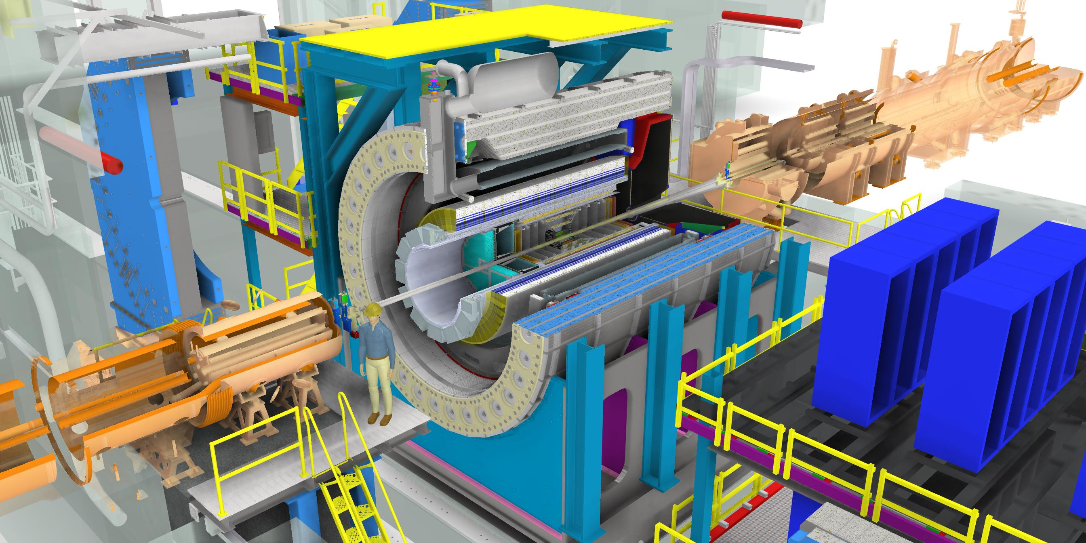
Summary
Every single piece of EIC hardware is unique and critical for delivering the ultimate EIC performance.
This makes the EIC one of the most challenging and exciting, high-energy, high-luminosity, polarized beam accelerator complexes ever built.
There is currently a lot of movement in the EIC collider and its start-up configuration
BUT
the goal is and remains to build the EIC we need to do the NAS science program and more
Everybody is dedicated to discuss potential changes early and their impact openly

Slide 24


Slide 25


Slide 26
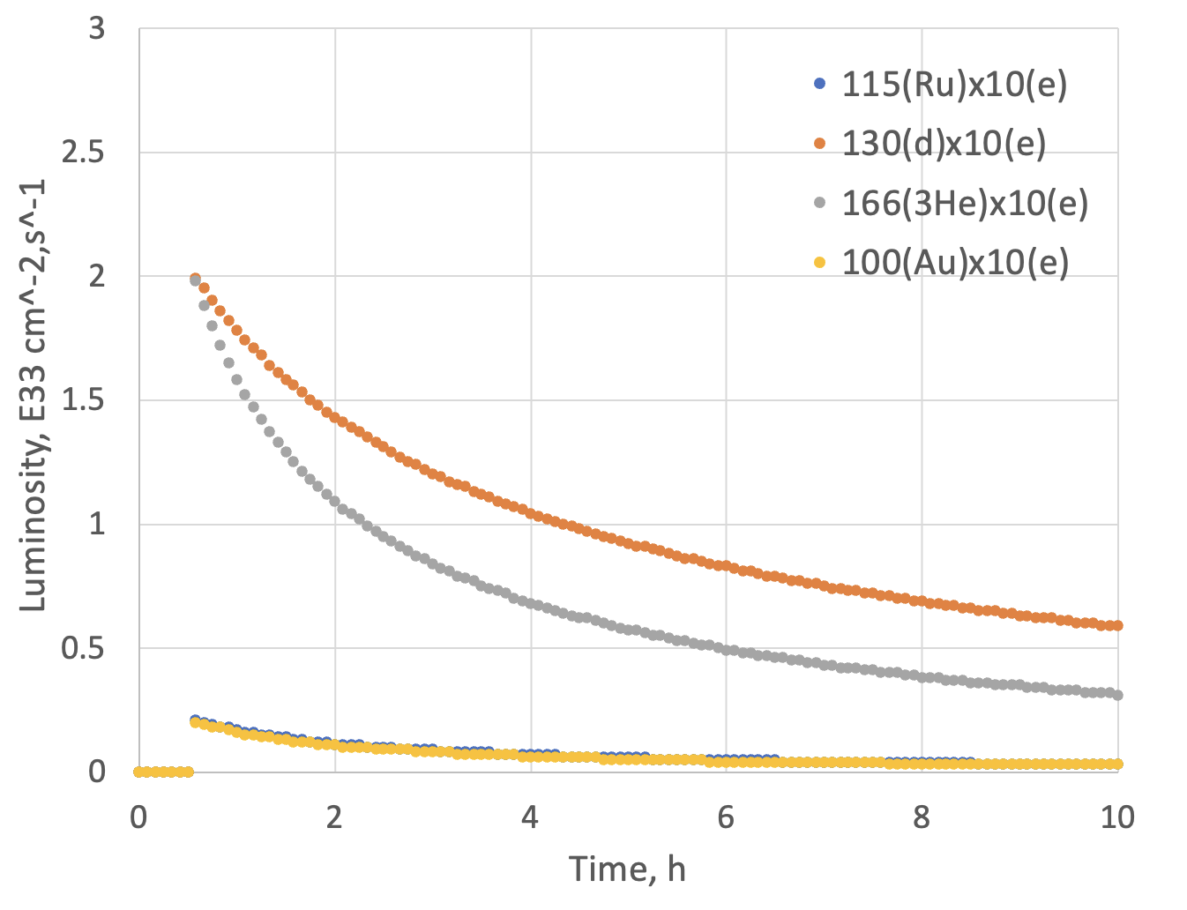
Assumptions and Luminosity
Possible Beam energies:
electron: 5 GeV, 10 GeV and ultimately 18 GeV
proton: 41 GeV, 100 GeV to 255 GeV ultimately 275 GeV
Au: 41 GeV, 100 GeV to 110 GeV ultimately
A: 41 GeV, 100 GeV to Max ~255 / (A/Z) ultimately ~275 / (A/Z)
eA luminosities for Phase-I
 | Lumi per Day | Lumi per Year
10 GeV e x 115 GeV Ru | 6.1 pb⁻¹ | 1.0 fb⁻¹
10 GeV e x 100 GeV Au | 5.6 pb⁻¹ | 0.95 fb⁻¹
10 GeV e x 130 GeV d | 78 pb⁻¹ | 13.1 fb⁻¹
10 GeV e x 166 GeV ³He | 58.5 pb⁻¹ | 9.8 fb⁻¹
Note:
eA luminosity is per nucleon

Slide 27
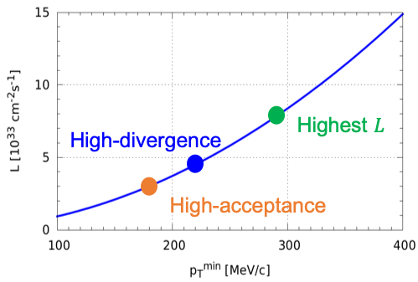
ep Luminosity for Early Years
High Divergence | Lumi per Day | Lumi per Year
5 GeV e x 250 GeV p | 44.7 pb⁻¹ | 7.5 fb⁻¹
10 GeV e x 250 GeV p | 62.9 pb⁻¹ | 10.6 fb⁻¹
5 GeV e x 130 GeV p | 29.8 pb⁻¹ | 5.0 fb-1
10 GeV e x 130 GeV p | 36.2 pb⁻¹ | 6.09 fb⁻¹
Low Divergence | Lumi per Day | Lumi per Year
5 GeV e x 250 GeV p | 32.7 pb⁻¹ | 5.5 fb⁻¹
10 GeV e x 250 GeV p | 42.1 pb⁻¹ | 7.07 fb⁻¹
5 GeV e x 130 GeV p | 27.9 pb⁻¹ | 4.7 fb⁻¹
10 GeV e x 130 GeV p | 33.6 pb⁻¹ | 5.6 fb⁻¹
Compare to HERA integrated luminosity 1992 – 2007: 0.6 fb⁻¹
Remember:
high divergence: higher lumi, but reduced acceptance
for low forward particle p_{T}^{min}
low divergence: lower lumi, but increased acceptance
for low forward particle p_{T}^{min}
→ important for exclusive processes
Illustration
Low-divergence

Slide 28
Accelerator at Day One and at full Capability
EIC commissioning and Ramp Up
Full EIC Capabilities
RCS:
7nC / bunch
5 – 10 GeV polarized e-
Add an accumulation ring to reach 28 nC / bunch and add RF to accelerate to 18 GeV electrons
ESR:
7nC / bunch
5 – 10 GeV polarized e-
Add more RF cavities to operate at 18 GeV electrons and 28 nC / bunch
HSR:
100 – 250 GeV polarized p
100 GeV/u nuclear beams
cooling at injection energy
Update PS to reach 275 GeV protons and 110 GeV/u nuclei add 41 GeV bypass to get full HSR beam
Increasing the bunch current for electrons from 7nC to 28 nC
→ increase in luminosity ~4
need to re-calculate the luminosities at full capability as things change a bit without cooling at store
for the pre-TDR one should use 10 GeV x 275 GeV as it will be the highest luminosity combination and will impact occupancy, radiation and so on

