Slide 1


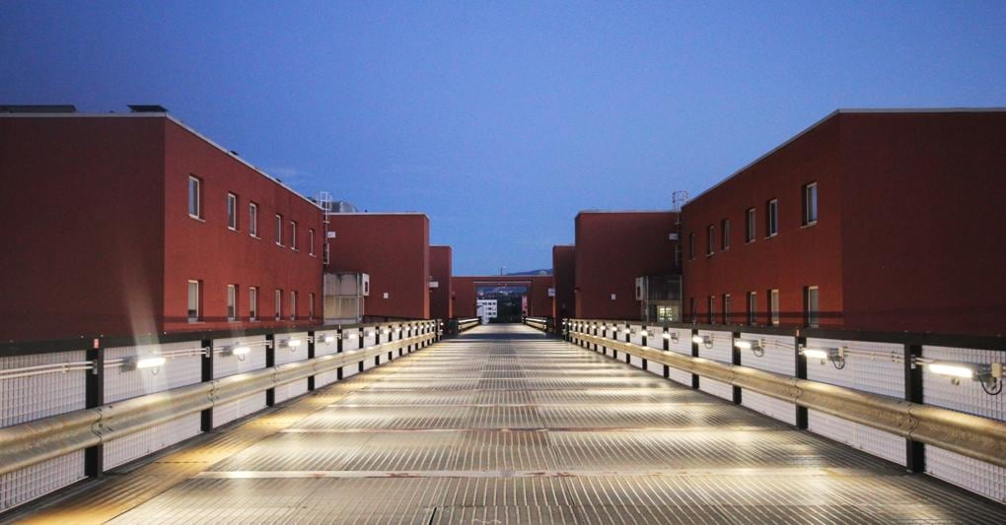

Orientation
Salvatore Fazio
Università della Calabria & INFN Cosenza
EIC Detector-1BNL-INT Joint Workshop: Bridging Theory and Experiment at the Electron-Ion Collider
ePIC and EIC Physics Readiness Workshop
Krakow - September 22-24, 2025

Slide 2
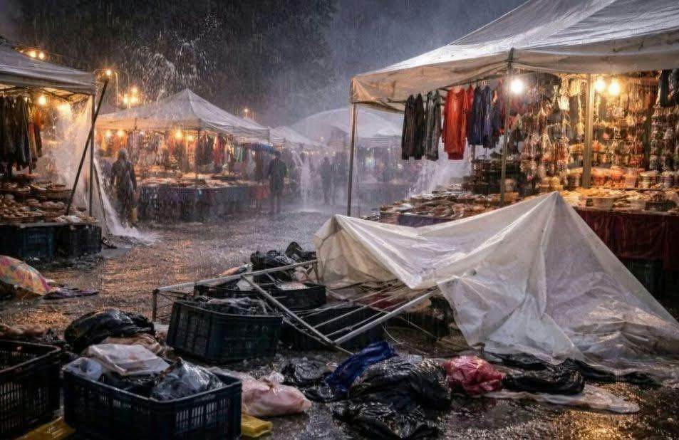
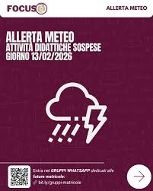
Weather alert!
Never in the historical memory there was a weather alert at this campus in March since it was established
→ until now!
On Monday March 16 a tornado stroke Cosenza’s area. This Wrecked a local fair going on to celebrate St. Joseph.
The University was closed!

Slide 3
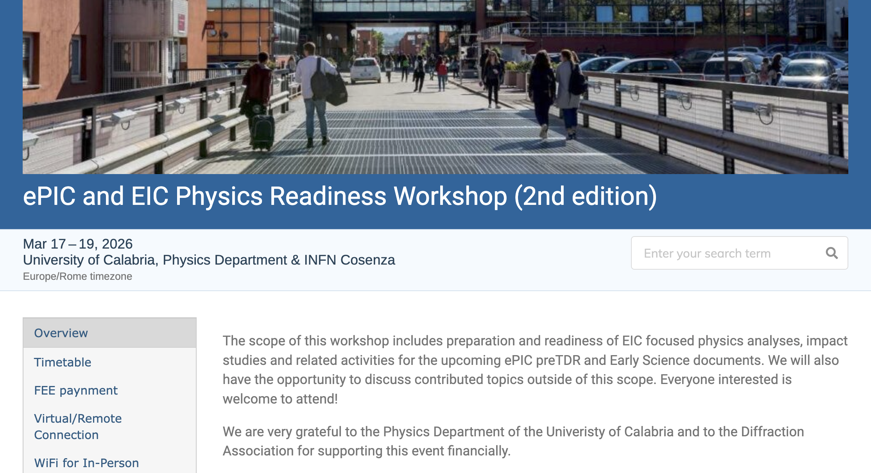
Welcome to the 2nd edition
Some key numbers
92 registered
36 in person
14 ECRs
Thank to sponsoring by
The U. of Glasgow
BNL
The Diffraction Association
The UNICAL Physics Department
we could wave the ECRs fee and financially support 4 ECRs
We have an intense agenda in front of us
More details will be given by Rachel
We wish you all (in person and remote participants) a productive workshop

Slide 4
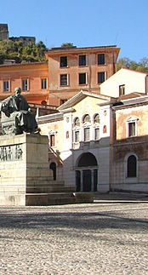
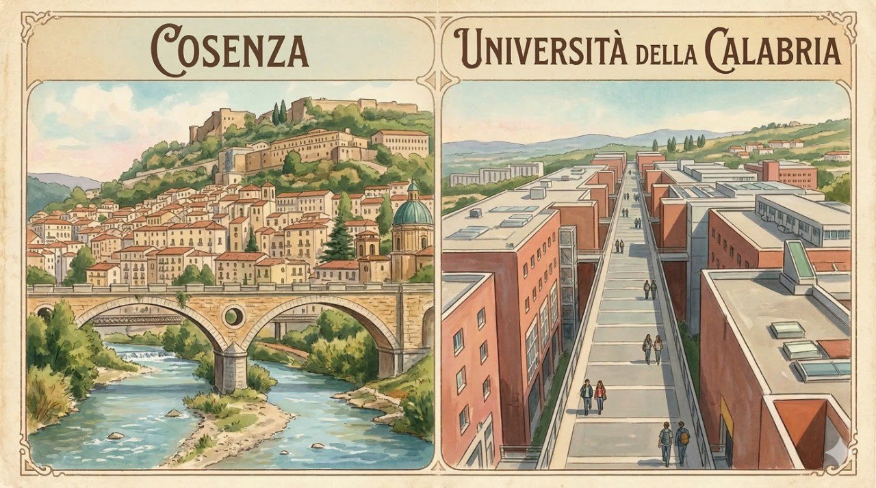
Where are we?
Cosenza is a small city with ancient origins:
~VIII Sec. BC- an Italic city known as “Kossa”
~IV Sec. BC – capital of the Brettii
Eventually conquered by the Romans it became “Consentia” an important stop along the Via Popilia, one of the Roman highways connecting with the South
XI Sec. AD – capital of the dukedom of the Normans
XVI Sec. AD – home of “Academia Cosentina”,
among its most renowned members was Bernardino Telesio, philosopher and natural scientist. His research method introduced “emphasis on observation”, making him a pioneer of the s.c, “scientific method”, developed by Galilei ½ Sec. later

Slide 5
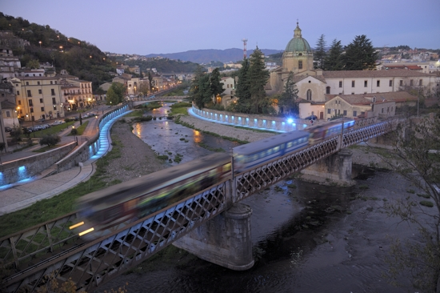
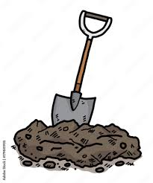




Are you into treasure hunting?
In 410 AD, king Alaric of the Visigoths, sacked the city of Rome, and amassed a great fortune
After the sack of Rome, Alaric headed south with his troops, until reaching the area of Cosenza, where he died of unknown causes
His troops allegedly buried him in a tomb in Cosenza, at the confluence two rivers.
Alaric was buried with his horse and great treasure
Once the tomb was completed, the river was returned to its bed and the tomb covered with water, never to be found again
… until now…

Slide 6
The University of Calabria
Established in 1972, it’s considered a very young university in Italy
It can be conceptually compared to a U.S. “State University”
The idea was ”revolutionary” for Italy at that time:
Outside the city center
Centering all the academic activities around a “campus”, residential in nature: student dorms, cafeterias, libraries, sports facilities…
Today UNICAL has a population of ~25k students and ~800 faculties

Slide 7
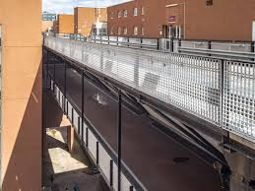
The ``Bridge”
Upper bridge
also used by shuttles
and service vehicles
Lower bridge
only for walkers
useful on rainy days

Slide 8
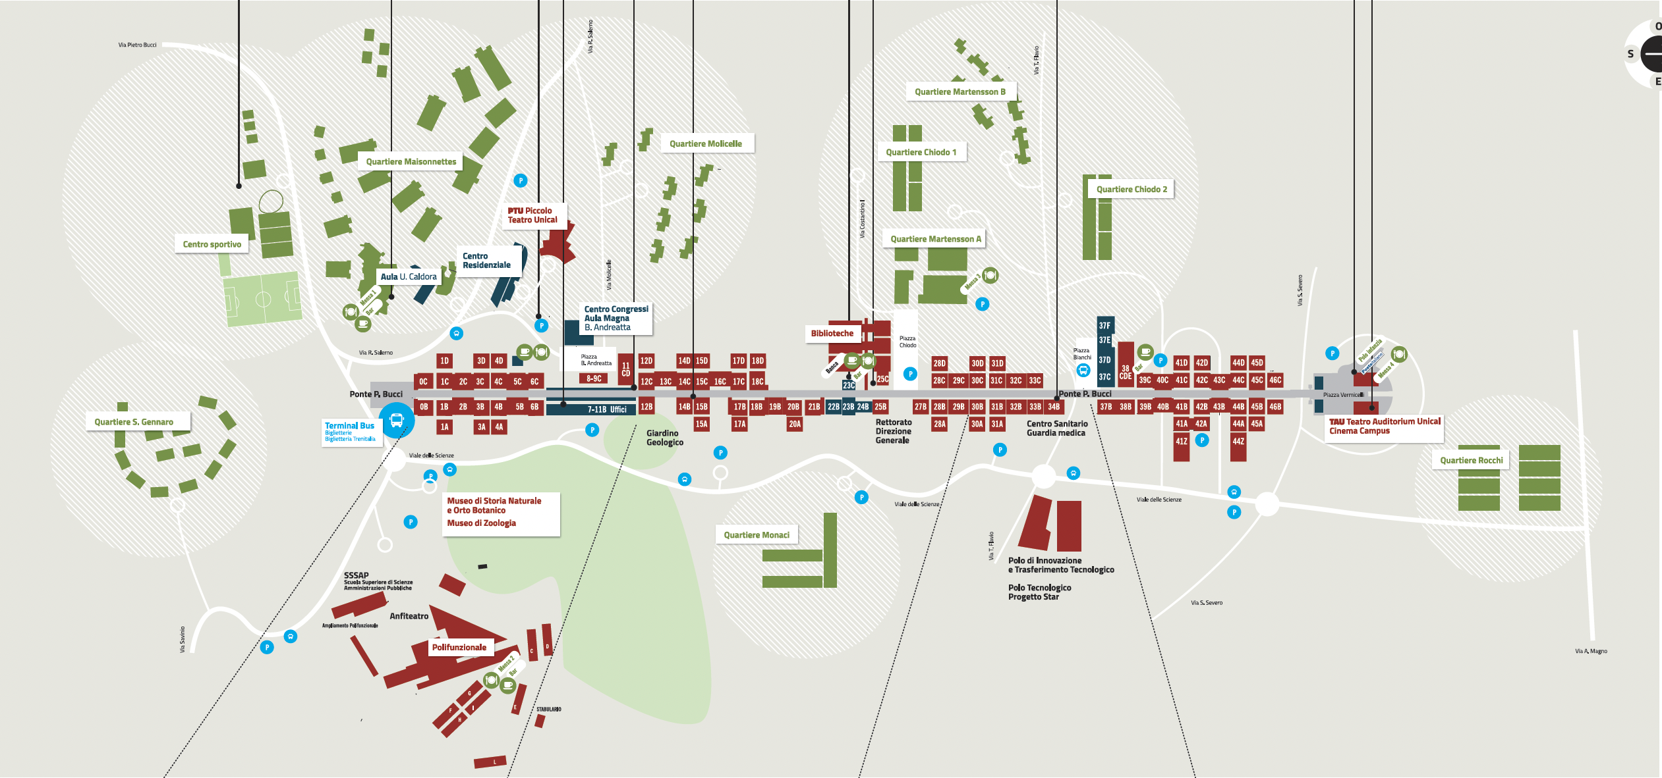
Campus Map
Pick up for tour and social dinner
PHYSICS
Main bus stop

Slide 9
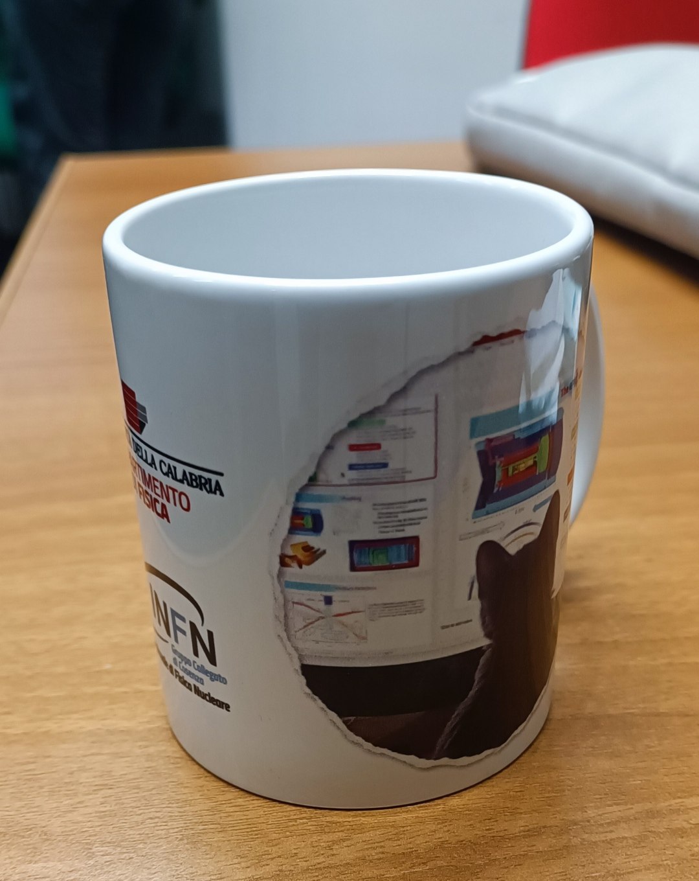
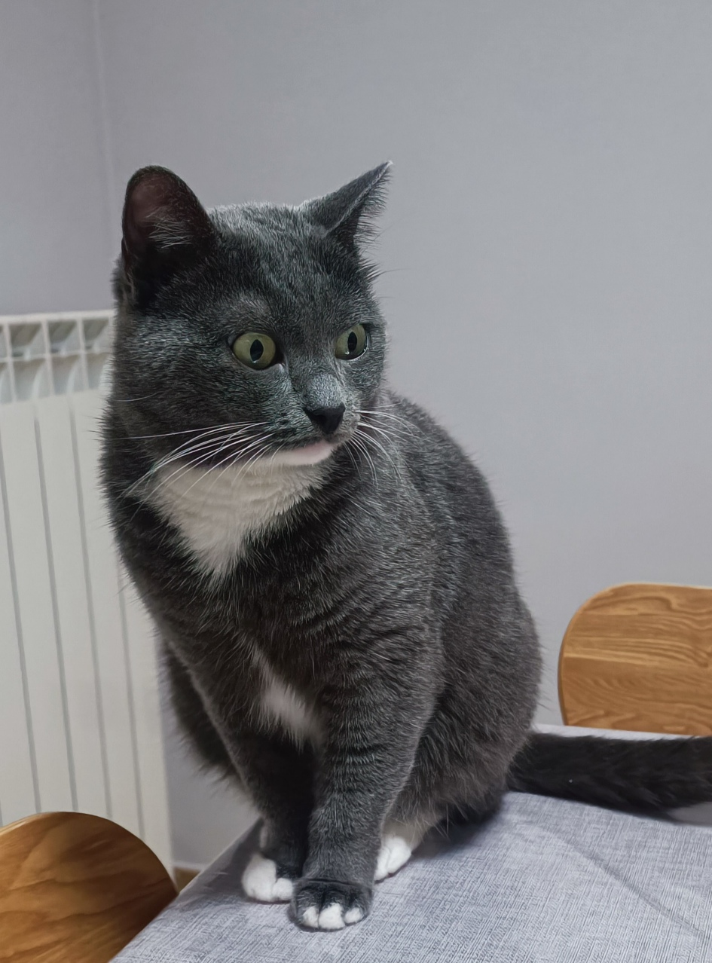
This isn’t just a gadget
It’s a working tool!
make coffee -> drink -> refill
María approved

Slide 10
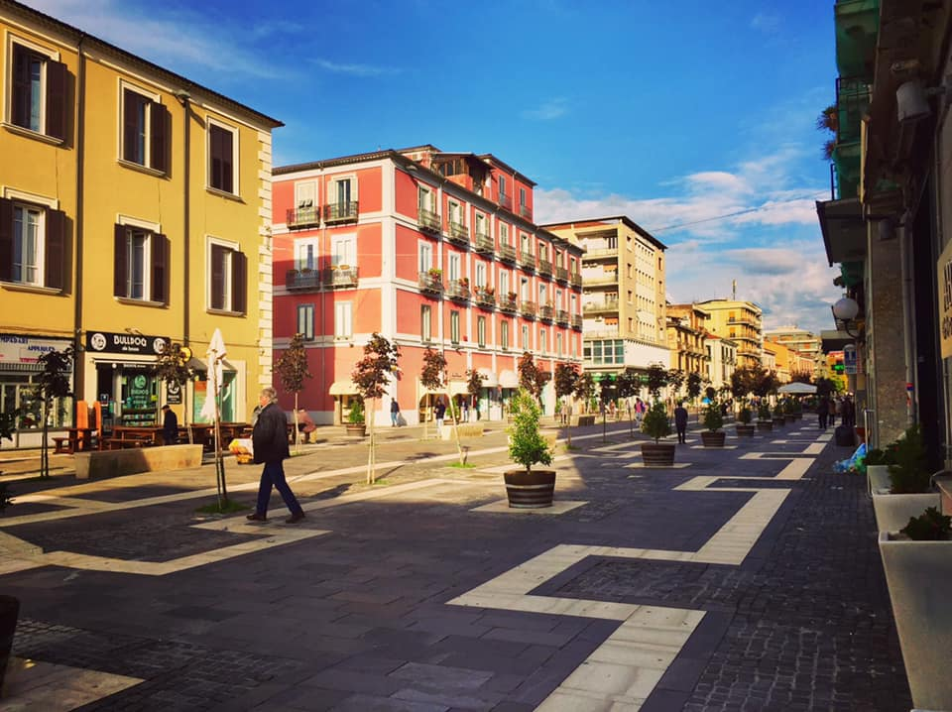
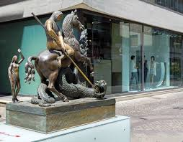
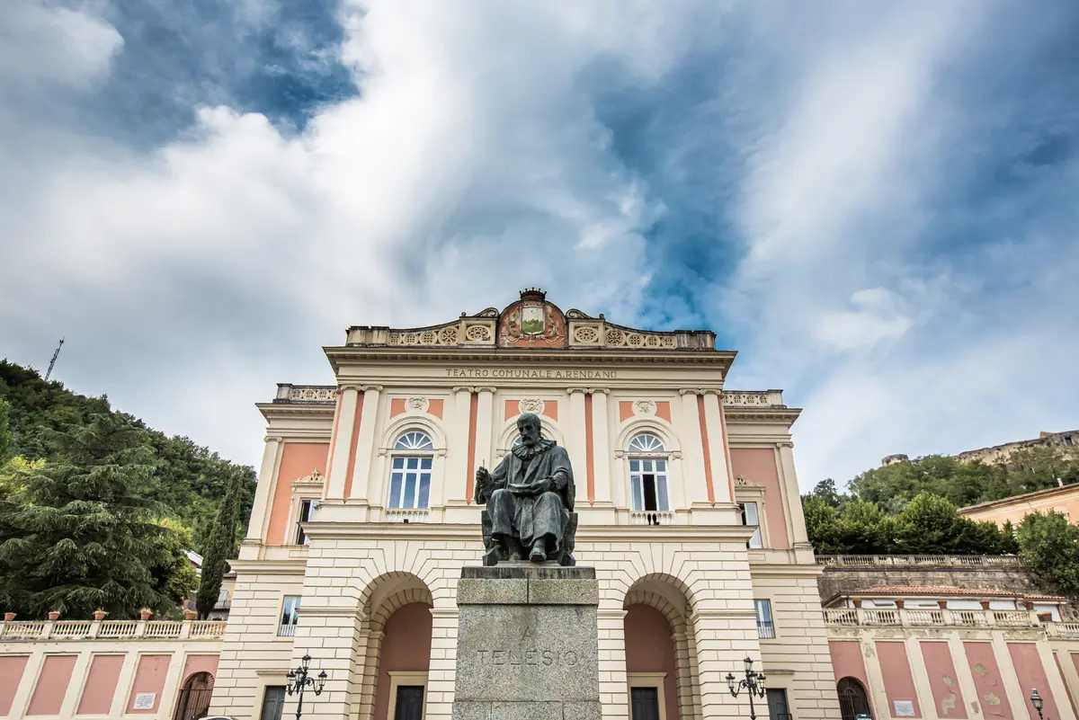
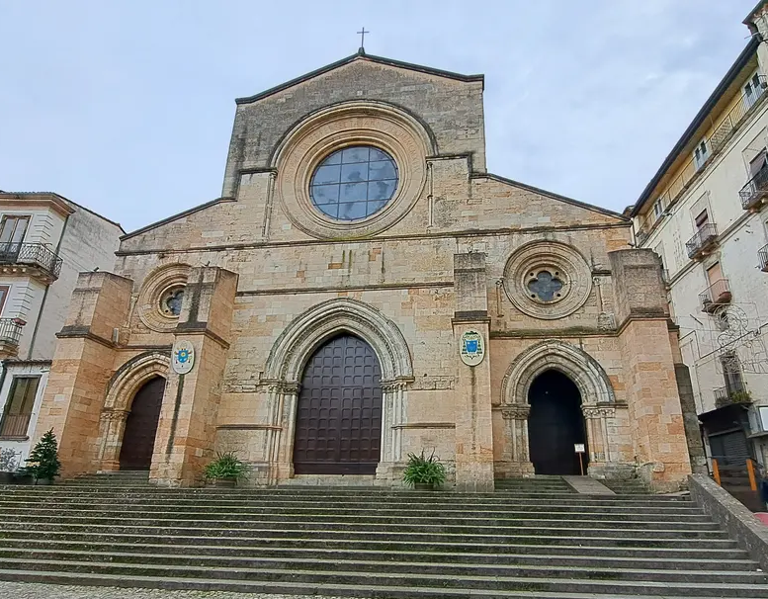
Guided Tour
A transfer bus is provided
Tour starts at Piazza Bilotti at 6:30PM
walk through Corso Mazzini (main street)
Se artwork of the MAB open air museum
Stop at Antica Gelateria Zorro (optional ice cream)
Walk Corso Telesio, (main street in old town)
Reach Teatro Rendano (Opera Theater)
Visit the Romanesque Cathedral
… head for the Social Dinner
~3km walk -> but we are ePICs !

Slide 11
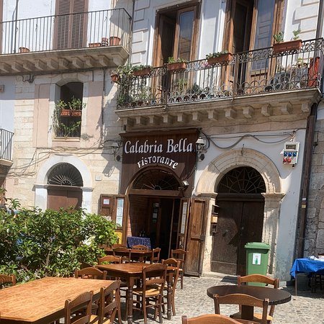
Social Dinner
Social Dinner at Calabria Bella, starts at 8:30PM
Reserved and got your ticket?
Location is right besides the Cathedral
chance to taste some local dishes and wine
Bus transfer back to the hotels is provided
Want to come on your own? Yes, you can!
Just meet us at 8:30 PM at Calabria Bella

Slide 12
Diffraction and low-x 2026

Slide 13
Enjoy the Workshop
Rachel, Rosi, Marcella, Enrico, Salvatore

