Slide 1
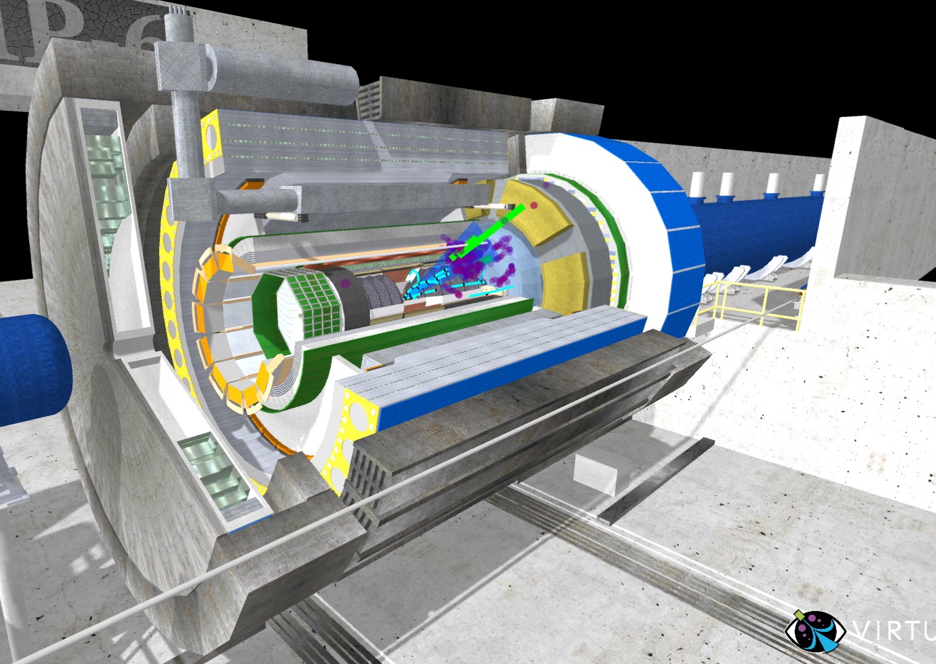
VIRTUE Event Display
Sean Preins
3/18/26

Slide 2
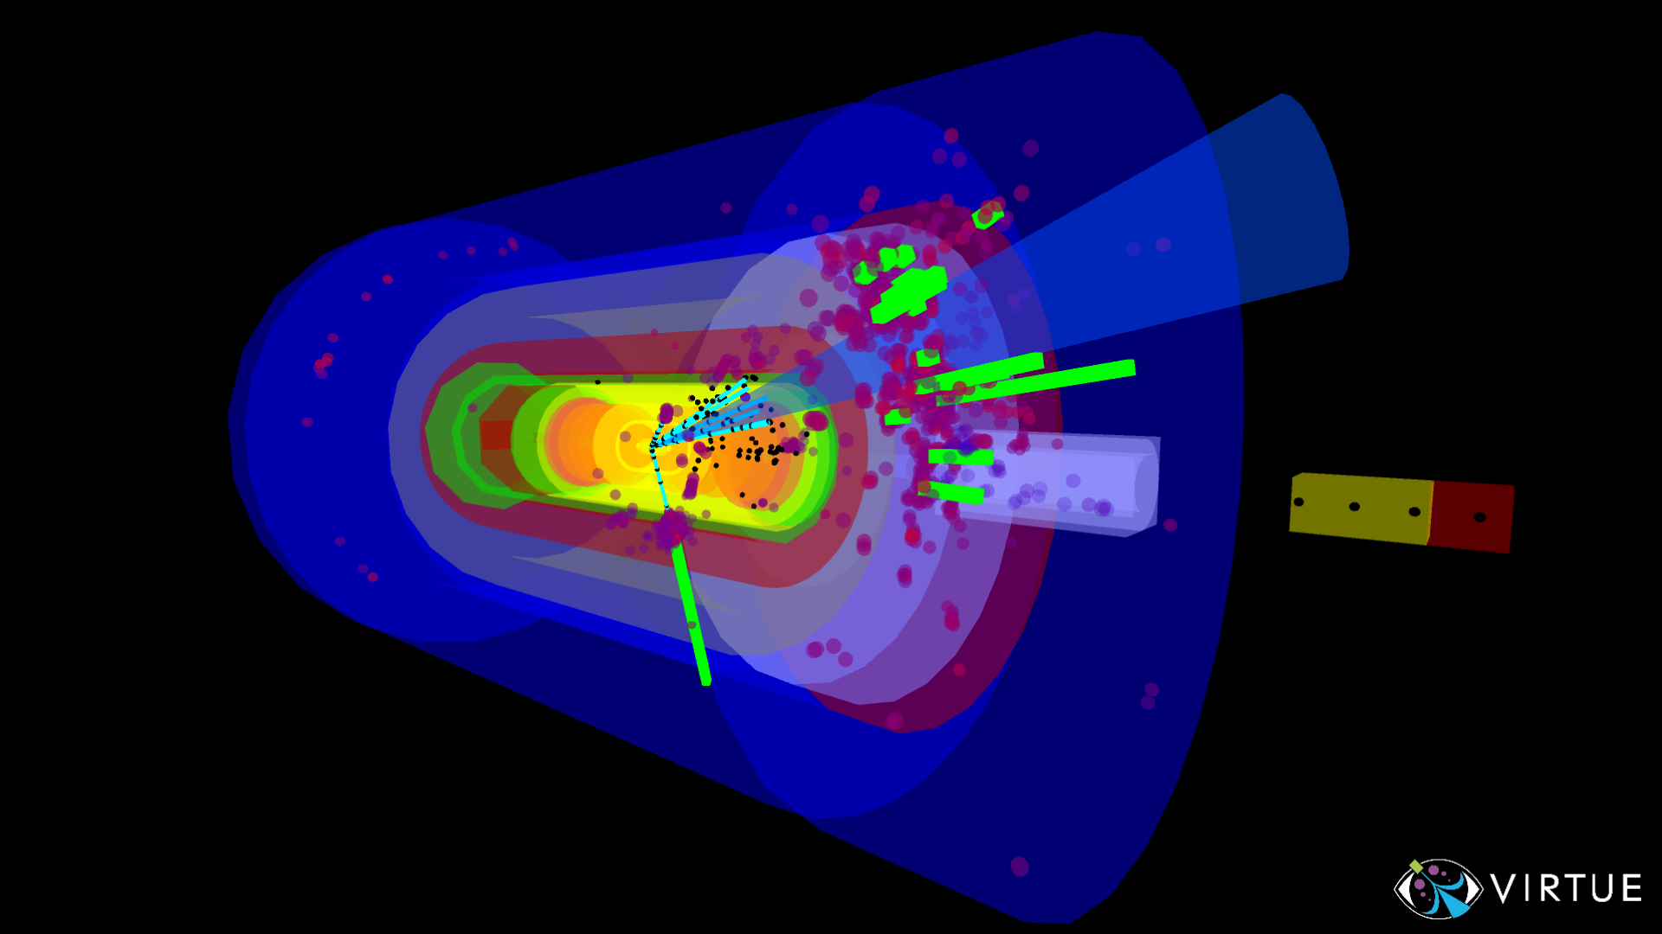
VIRTUE is a customizable event display app for VR, desktop, and android
Detector models and event data can be uploaded directly to the app
Videogame-like controls make it intuitive to move around the space
The user can control the event animations and expand the detector to actively engage

Slide 3
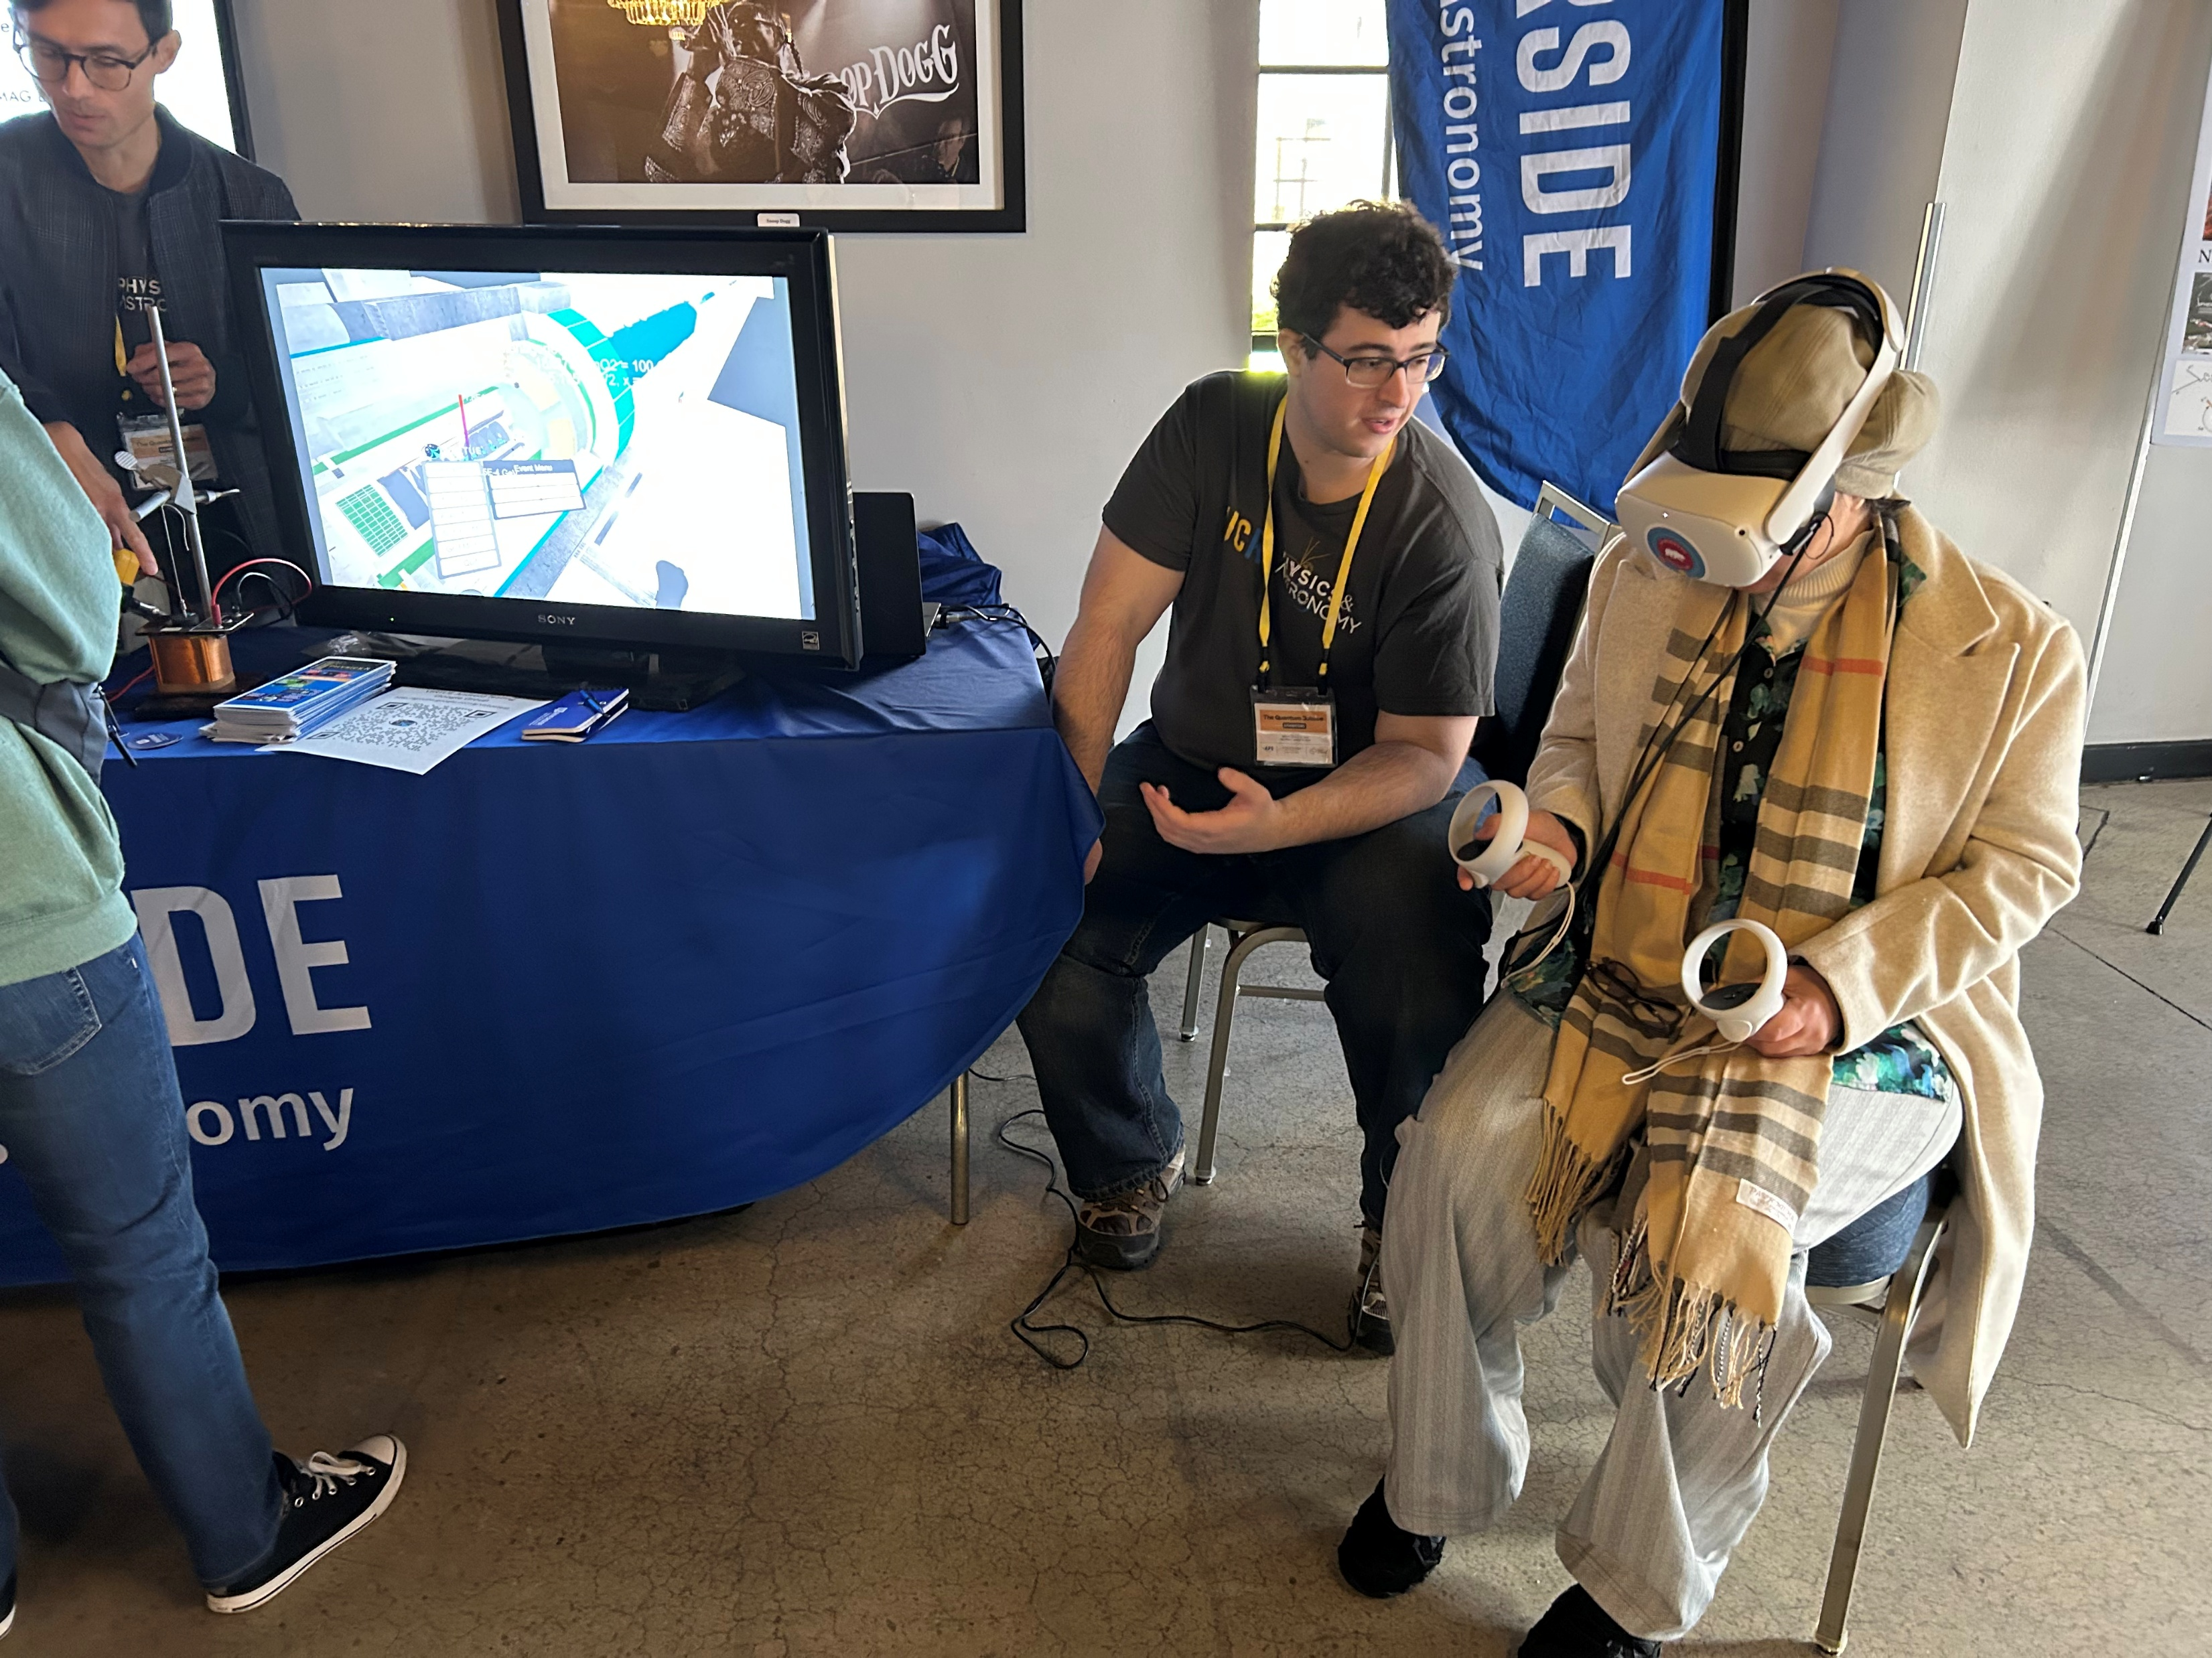
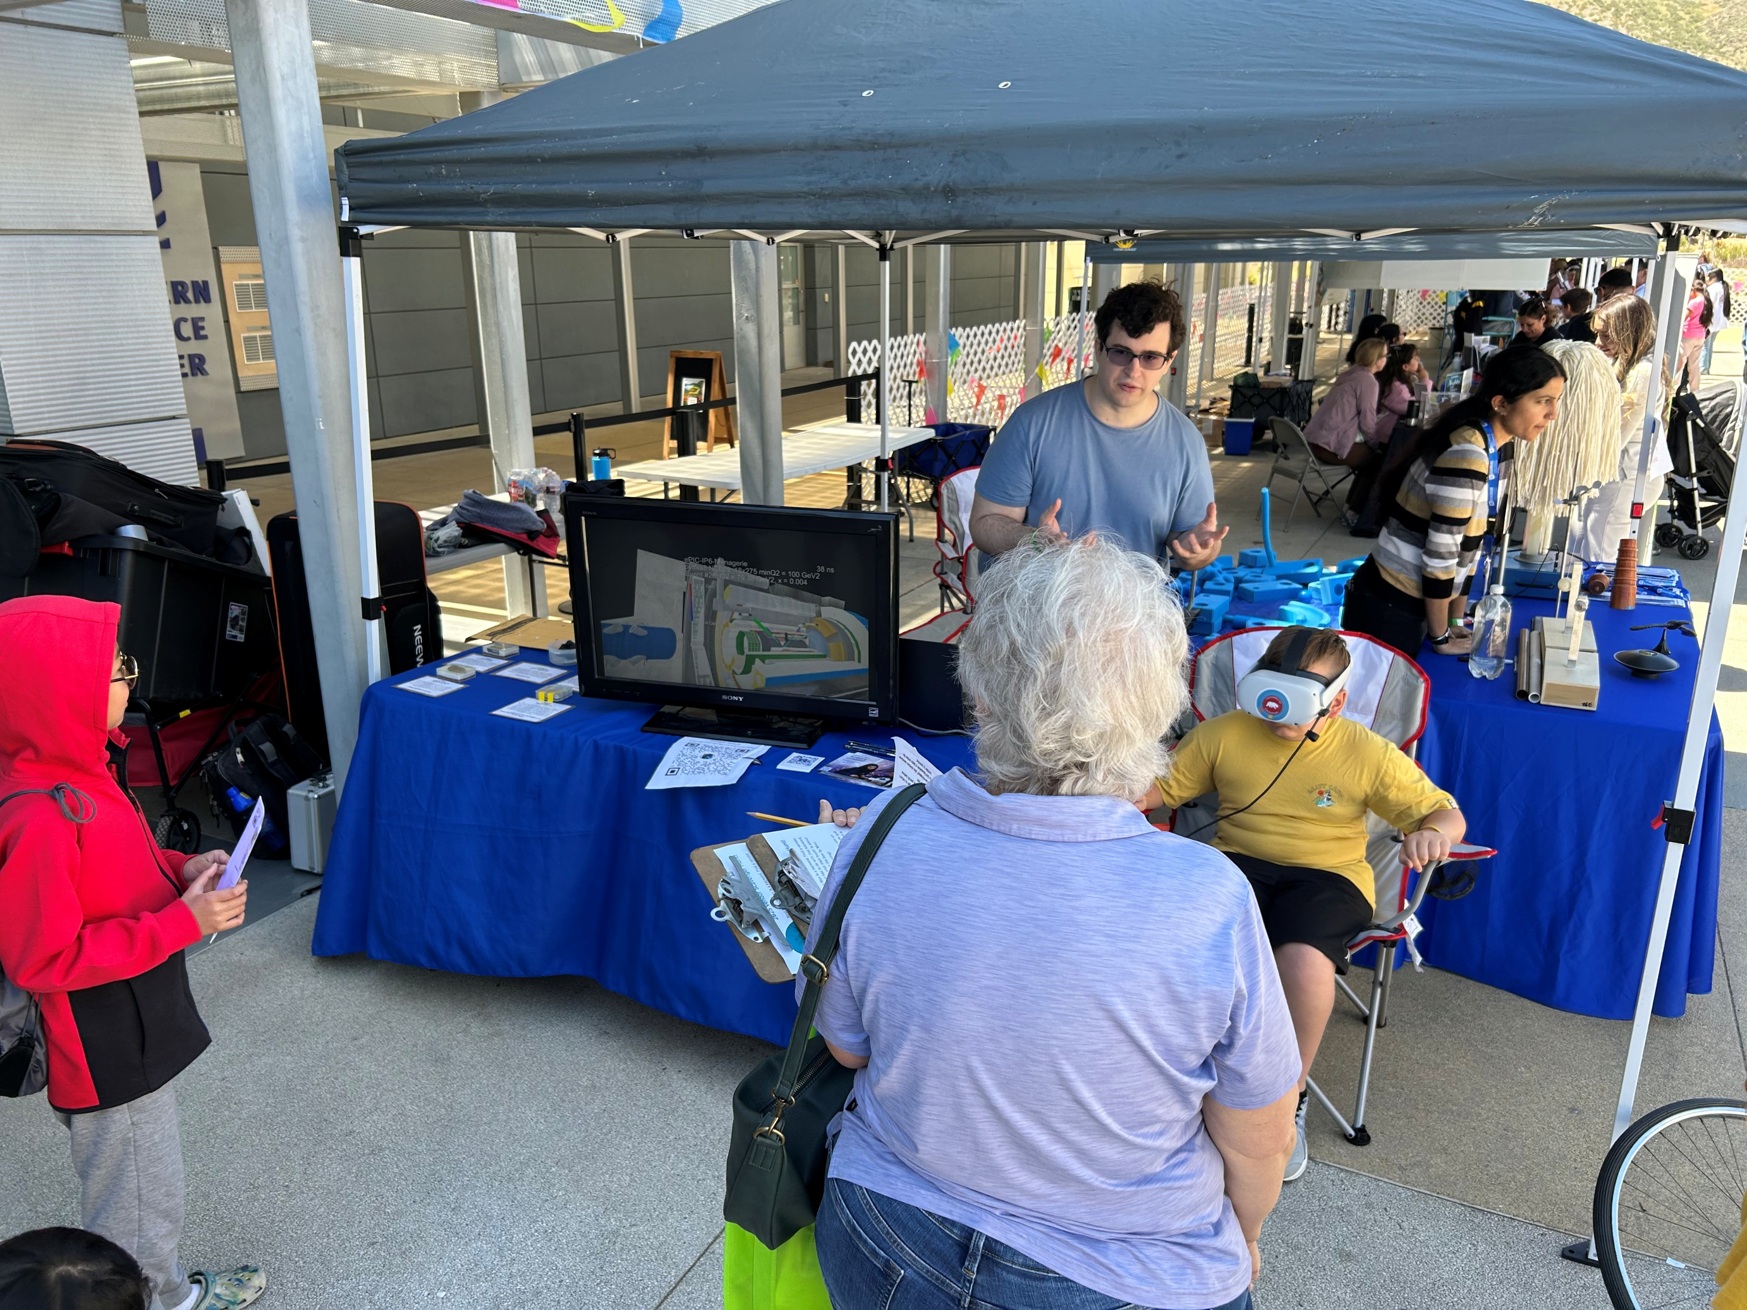
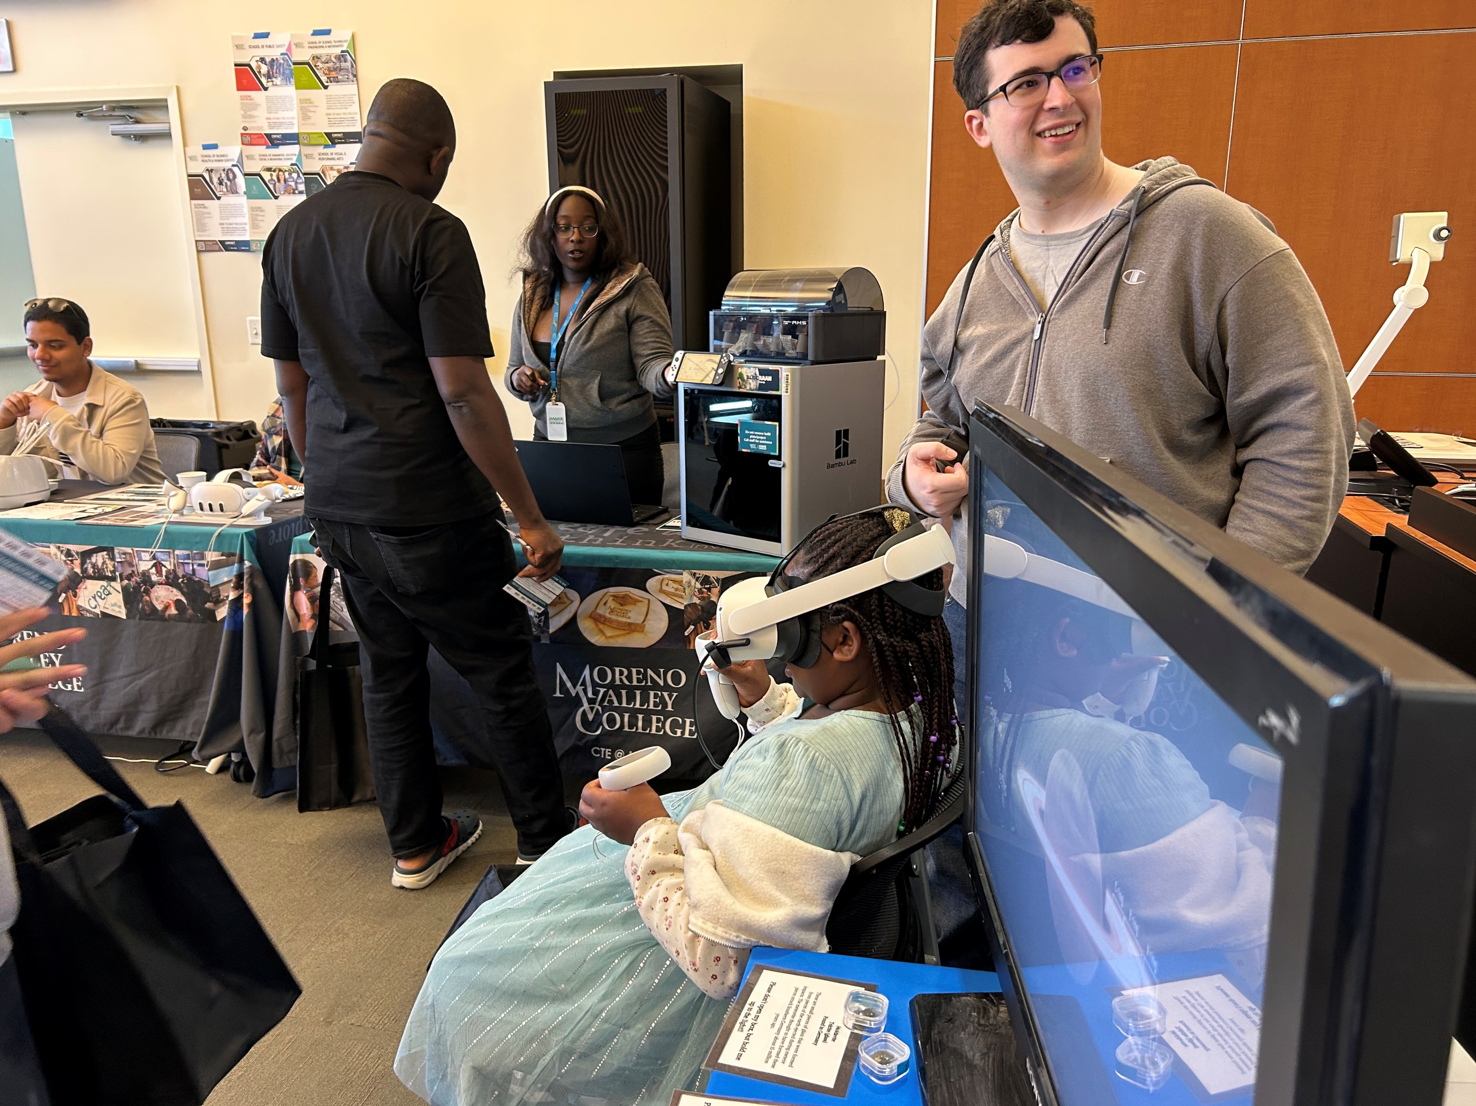
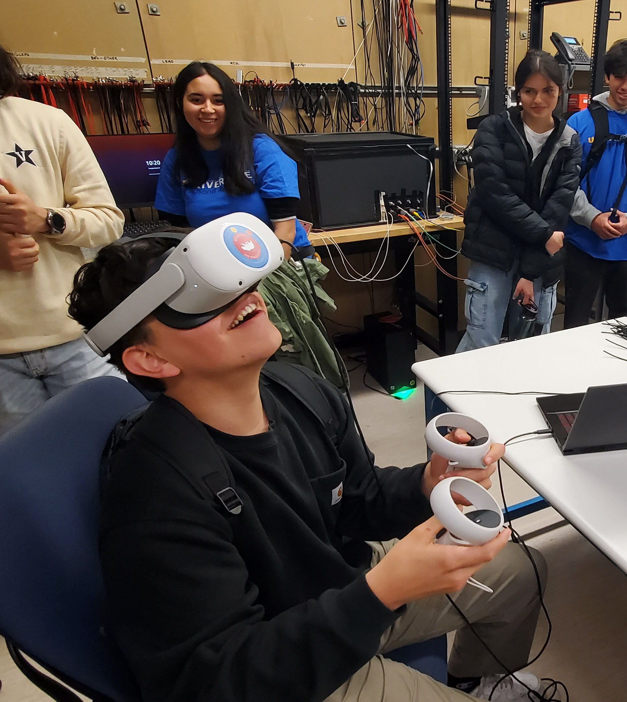
Inland Empire Science Festival
4/19/25
APS Quantum Jubilee
3/15/25
TRIO Day at Moreno Valley College
2/22/25
International Particle Physics Masterclass
3/20/23
Riverside’s Long Night of Arts and Innovation
10/13/22
UCLA’s Exploring Your Universe
11/7/21
Varius other open houses and tours

Slide 4
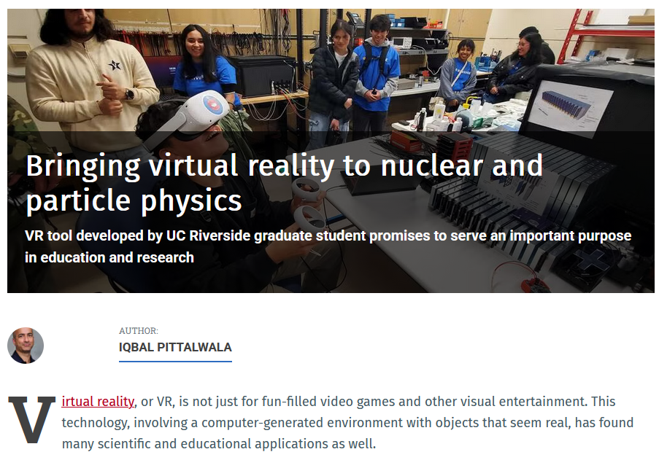
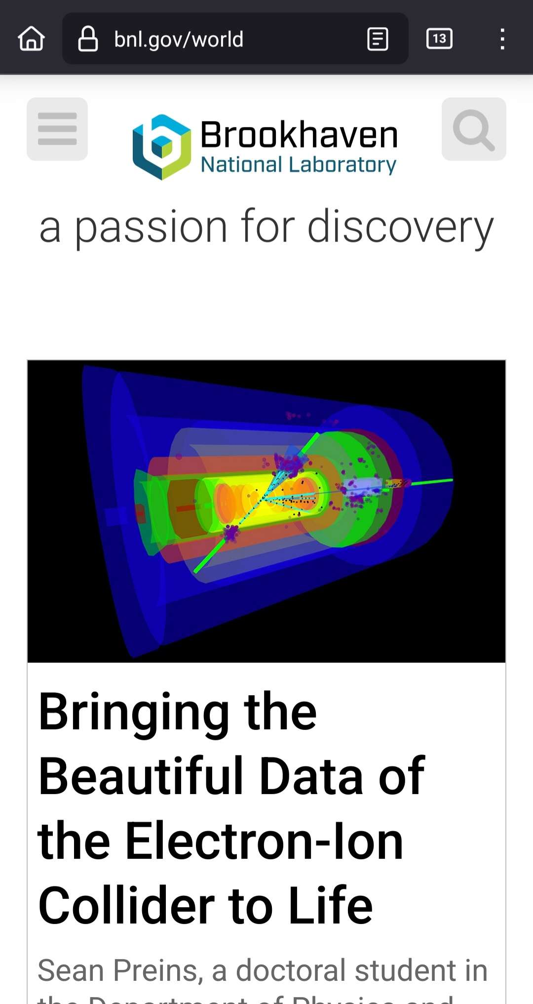
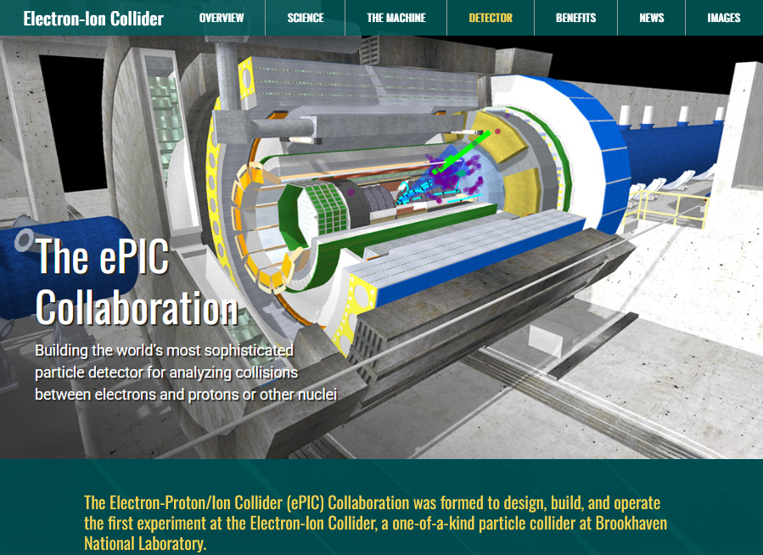

Slide 5
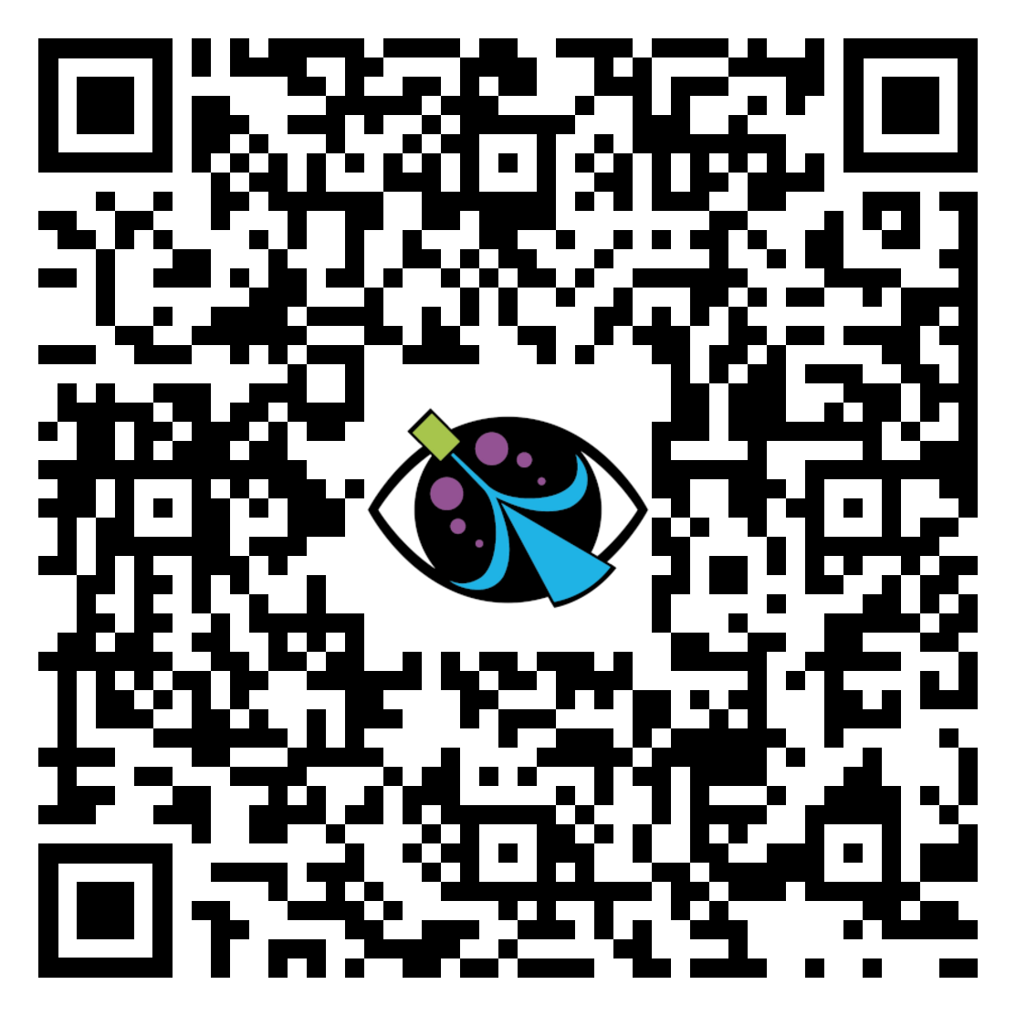
https://store.steampowered.com/app/2728380/VIRTUE/
https://play.google.com/store/apps/details?id=com.Quantanaut.VIRTUE
https://zenodo.org/records/14934340

