Slide 1
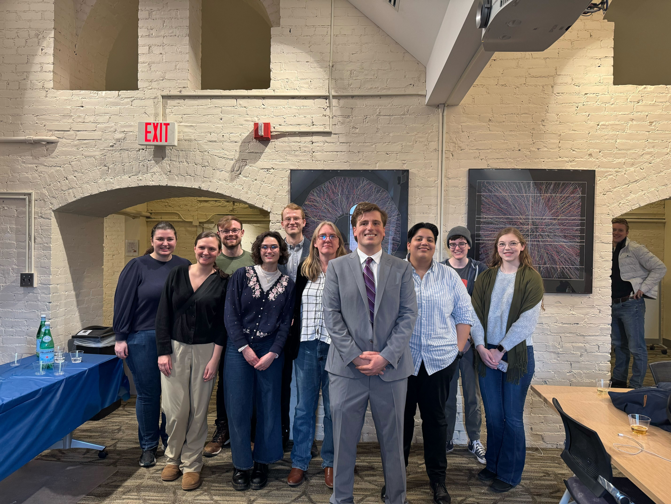


EIC related Outreach Activities through
Yale Pathways to Science
Laura Havener (for RHIG members)
Relativistic Heavy Ion Group
Wright Laboratory, Yale University
https://rhig.physics.yale.edu/

Slide 2
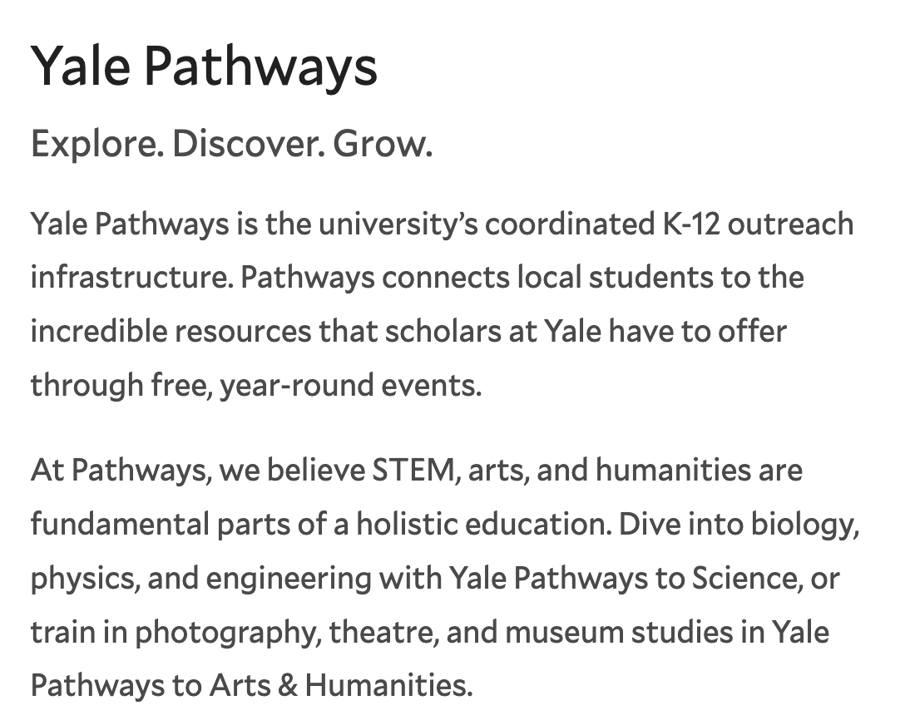
Yale Pathways to Science
Yale Pathways to Science is a free enrichment program connecting New Haven public school students (grades 6–12) with STEM opportunities at Yale.
The program partners with New Haven, West Haven, and Amity schools to provide hands-on workshops, lab tours, mentoring, and selective summer research opportunities.
Our RHIG group contributes through three outreach efforts:
1. Escape the Control Room
1-hour enrichment activity
2. Let’s Smash Some Protons!
1-week high school course
3. Summer Research Internship
7-week research experience in Wright Lab
pathways.yale.edu

Slide 3
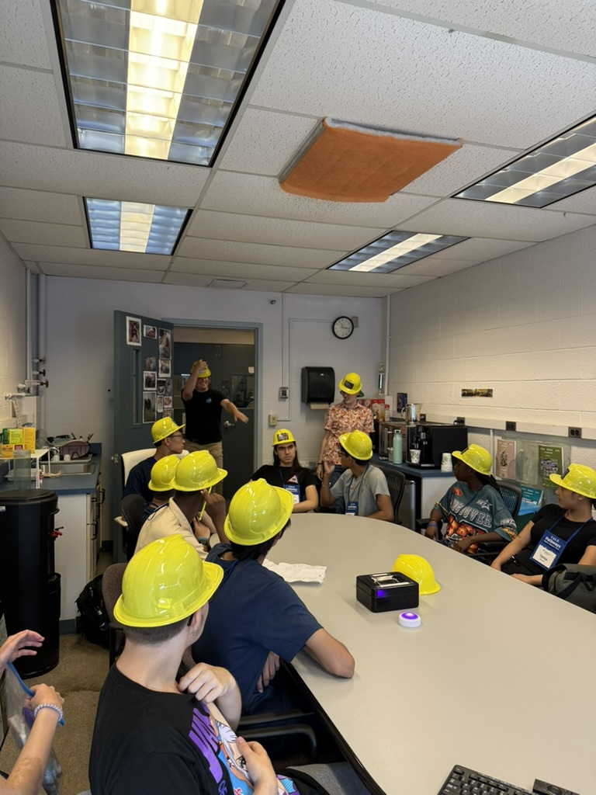
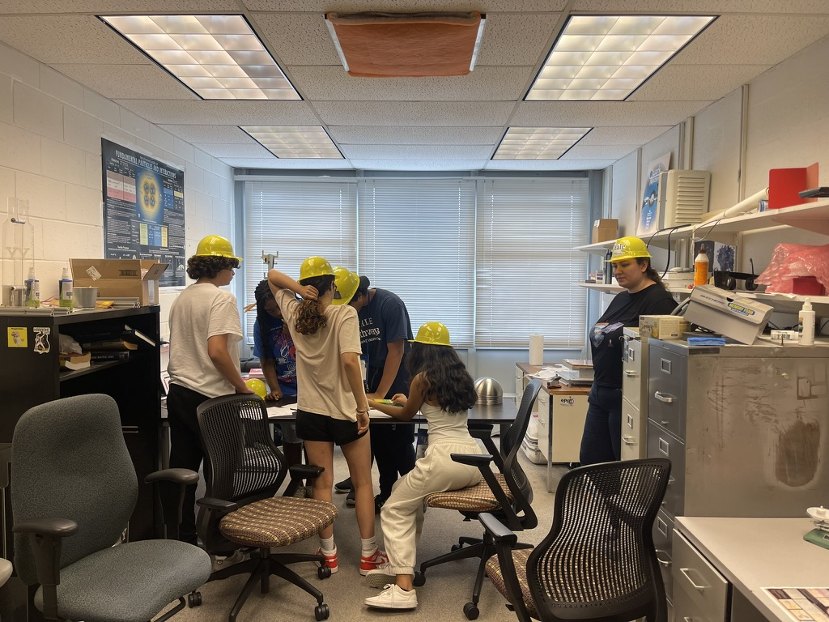
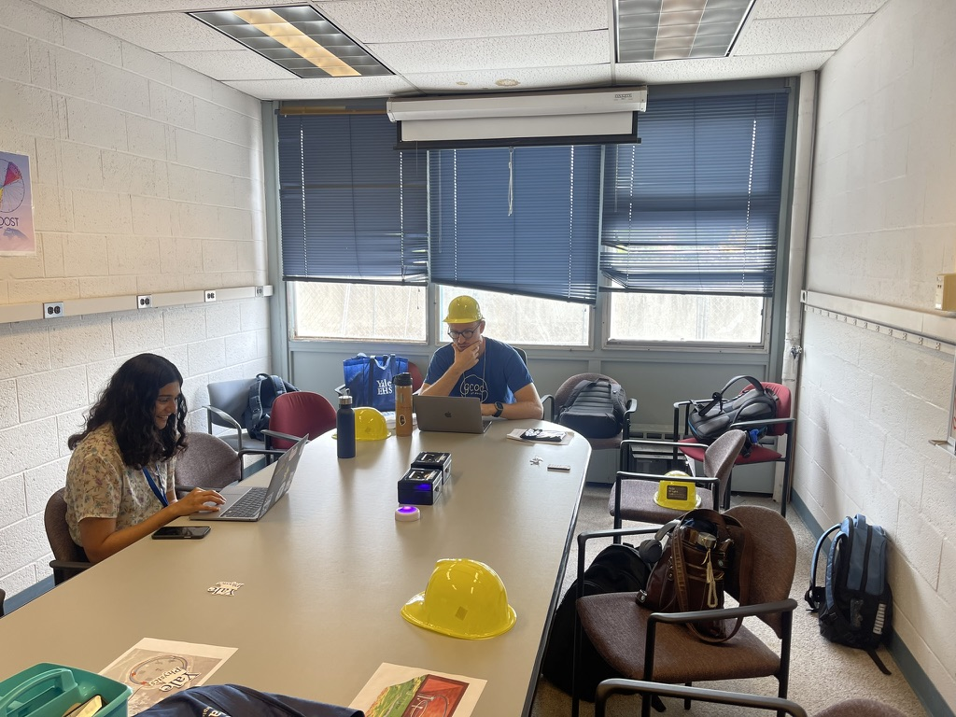
Escape the Control Room
1-hour enrichment activity • Pathways Summer Scholars Program
An immersive escape-room-style activity where students step into a simulated particle physics control room (based on a CERN version!)
Divide students up into to ”Detector control rooms” (our offices) and connect to collider control room
Students work in teams to solve hands-on puzzles rooted in high-energy physics, learning about detectors and particle colliders along the way.

Slide 4
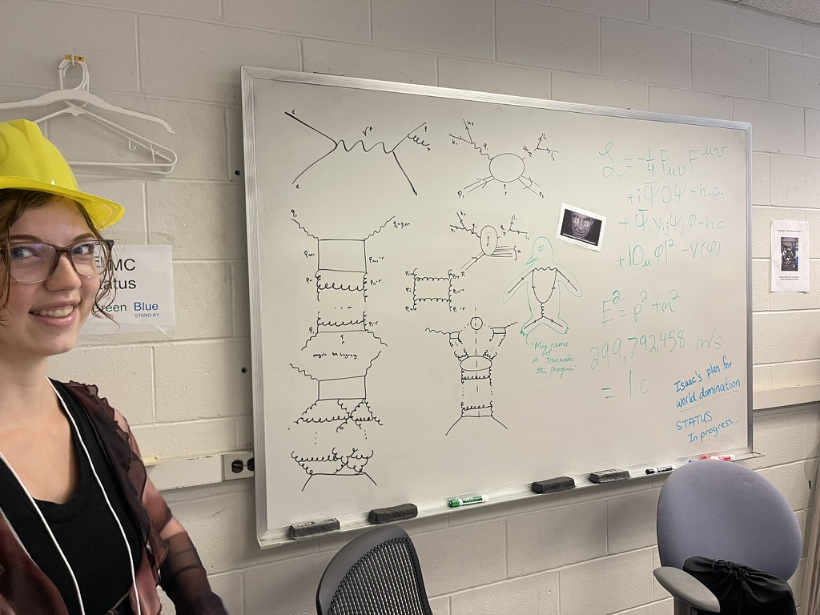
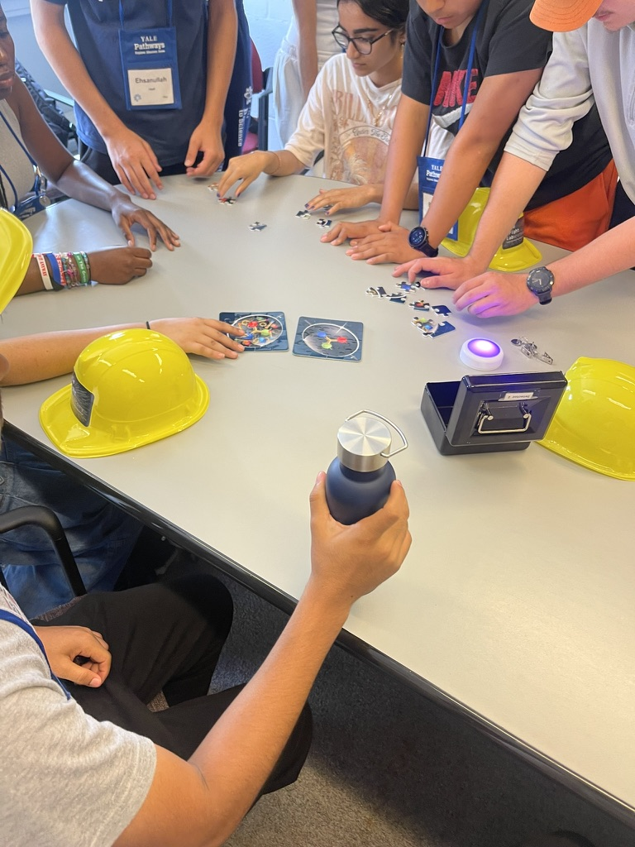
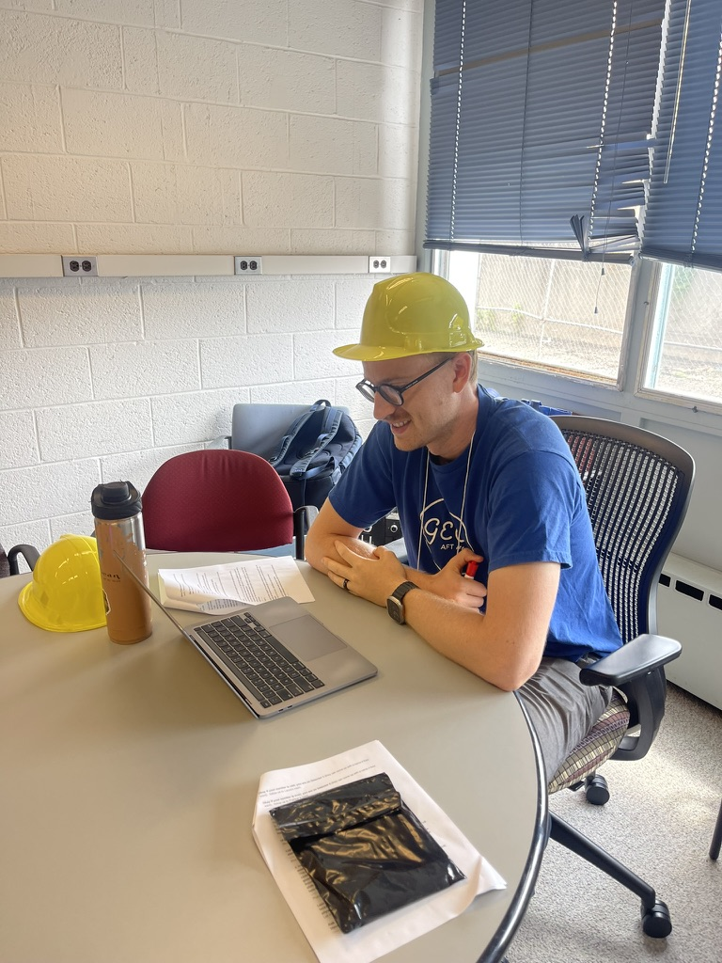
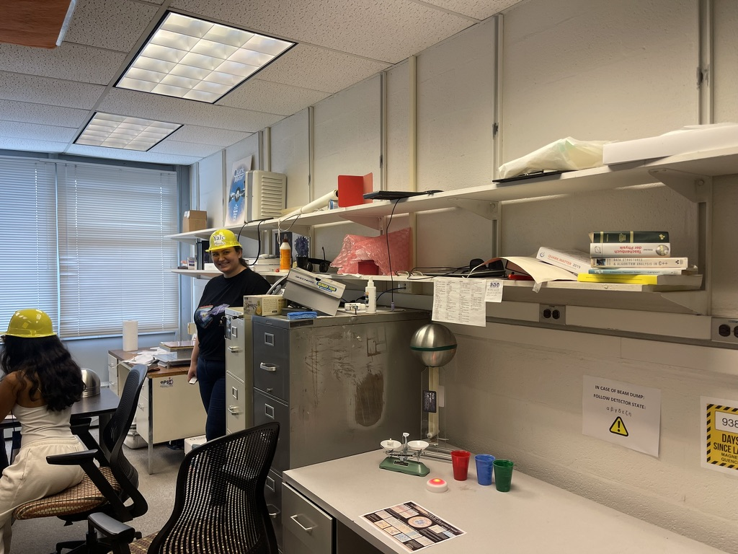
Escape the Control Room
1-hour enrichment activity • Pathways Summer Scholars Program

Slide 5
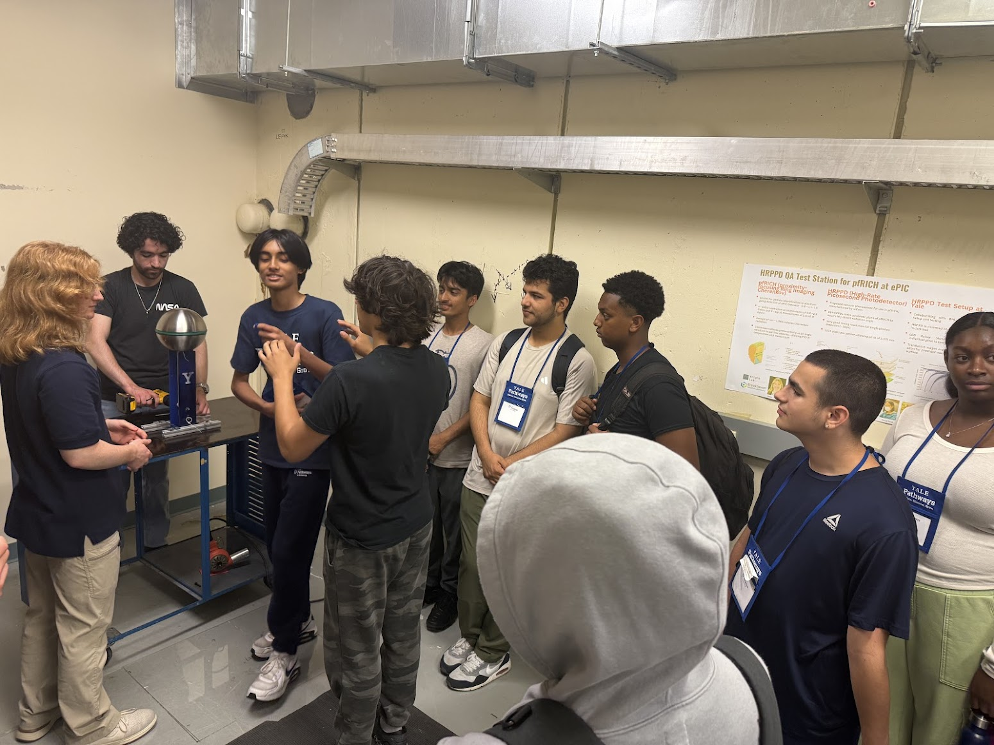
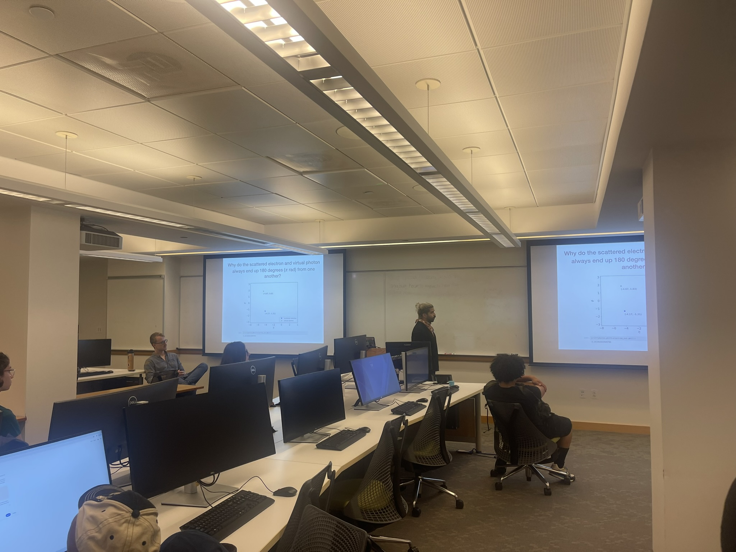
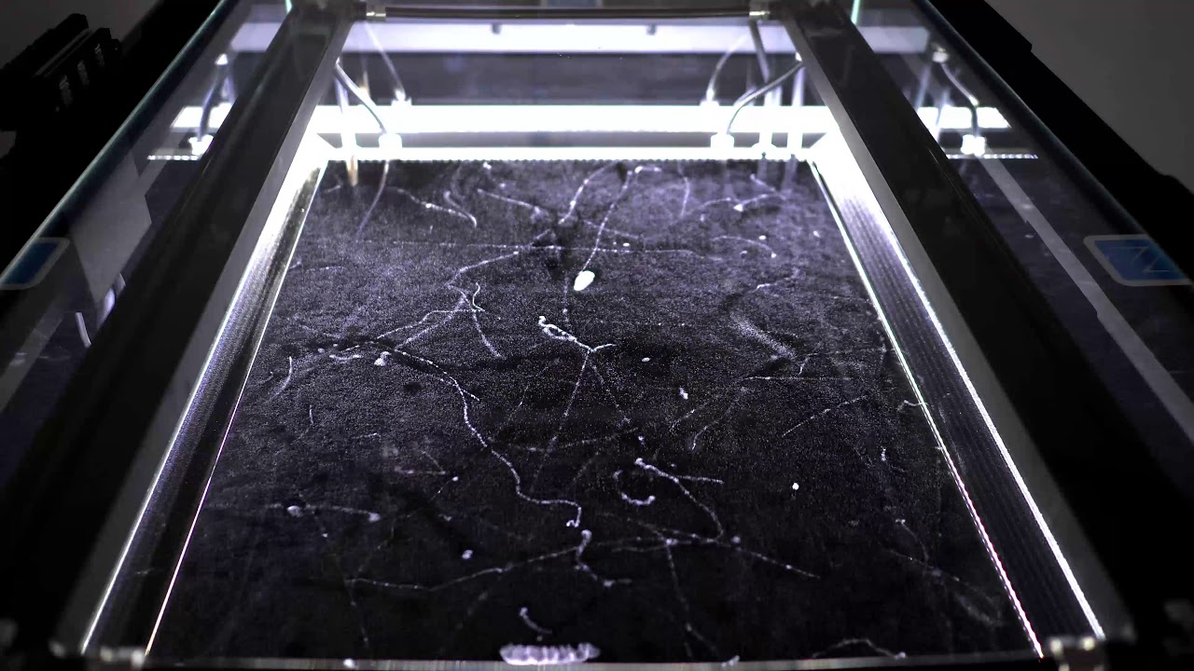
Let’s Smash Some Protons!
1-week high school course • Pathways Summer Scholars Program
A 4-day interactive workshop combining brief lectures with hands-on Python coding to explore particle physics and the Electron-Ion Collider.
Initial by Rithya Kunnawalkam Elayavalli before she became as Assistant Professor at Vanderbilt
Consists of: lectures on EIC physics, hands-on coding in jupyter notebooks, lab tours, and cloud chamber
Day 1: Simulate e-p collisions at varying energies
Day 2: Explore momentum conservation
Day 3: Investigate particle production rates
Day 4: Detect electrons to probe proton structure
github.com/rkunnawa/Yale_Pathways

Slide 6
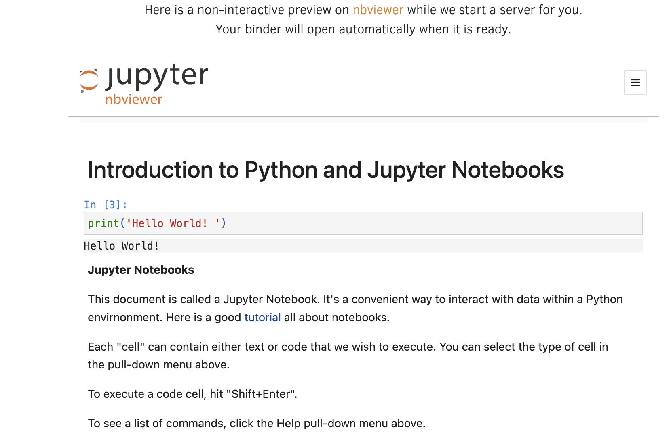
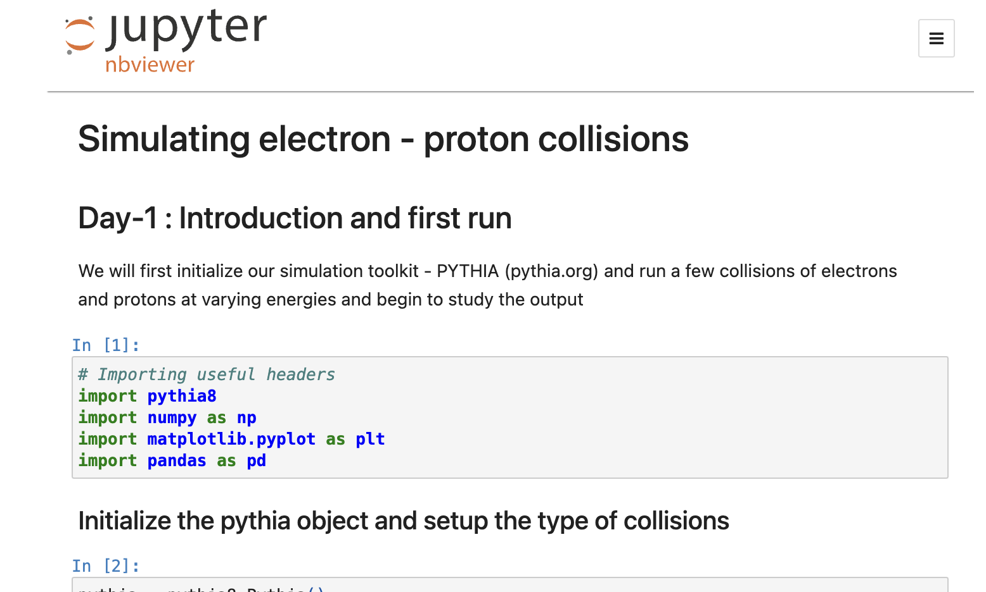
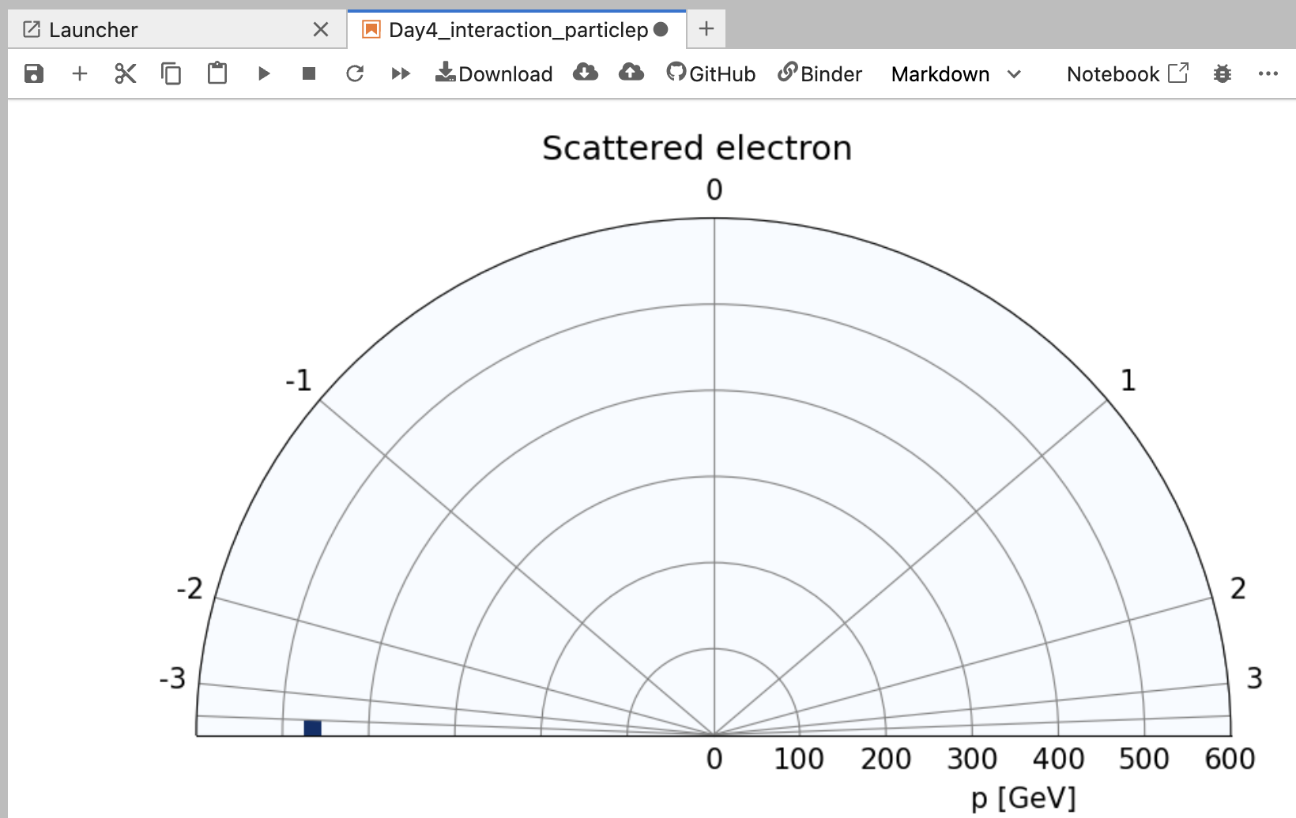
Let’s Smash Some Protons!

Slide 7
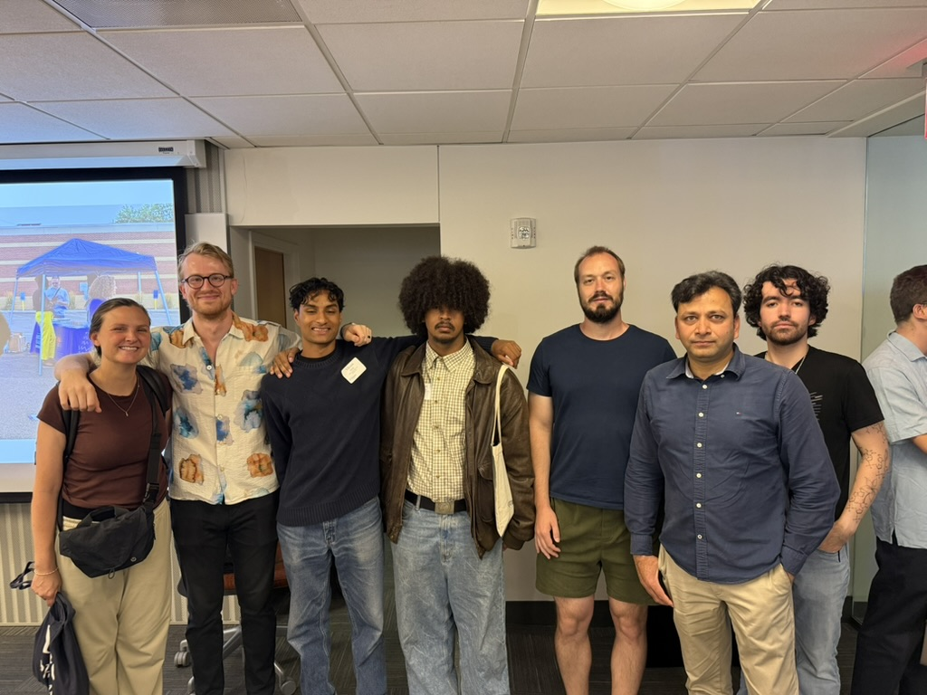
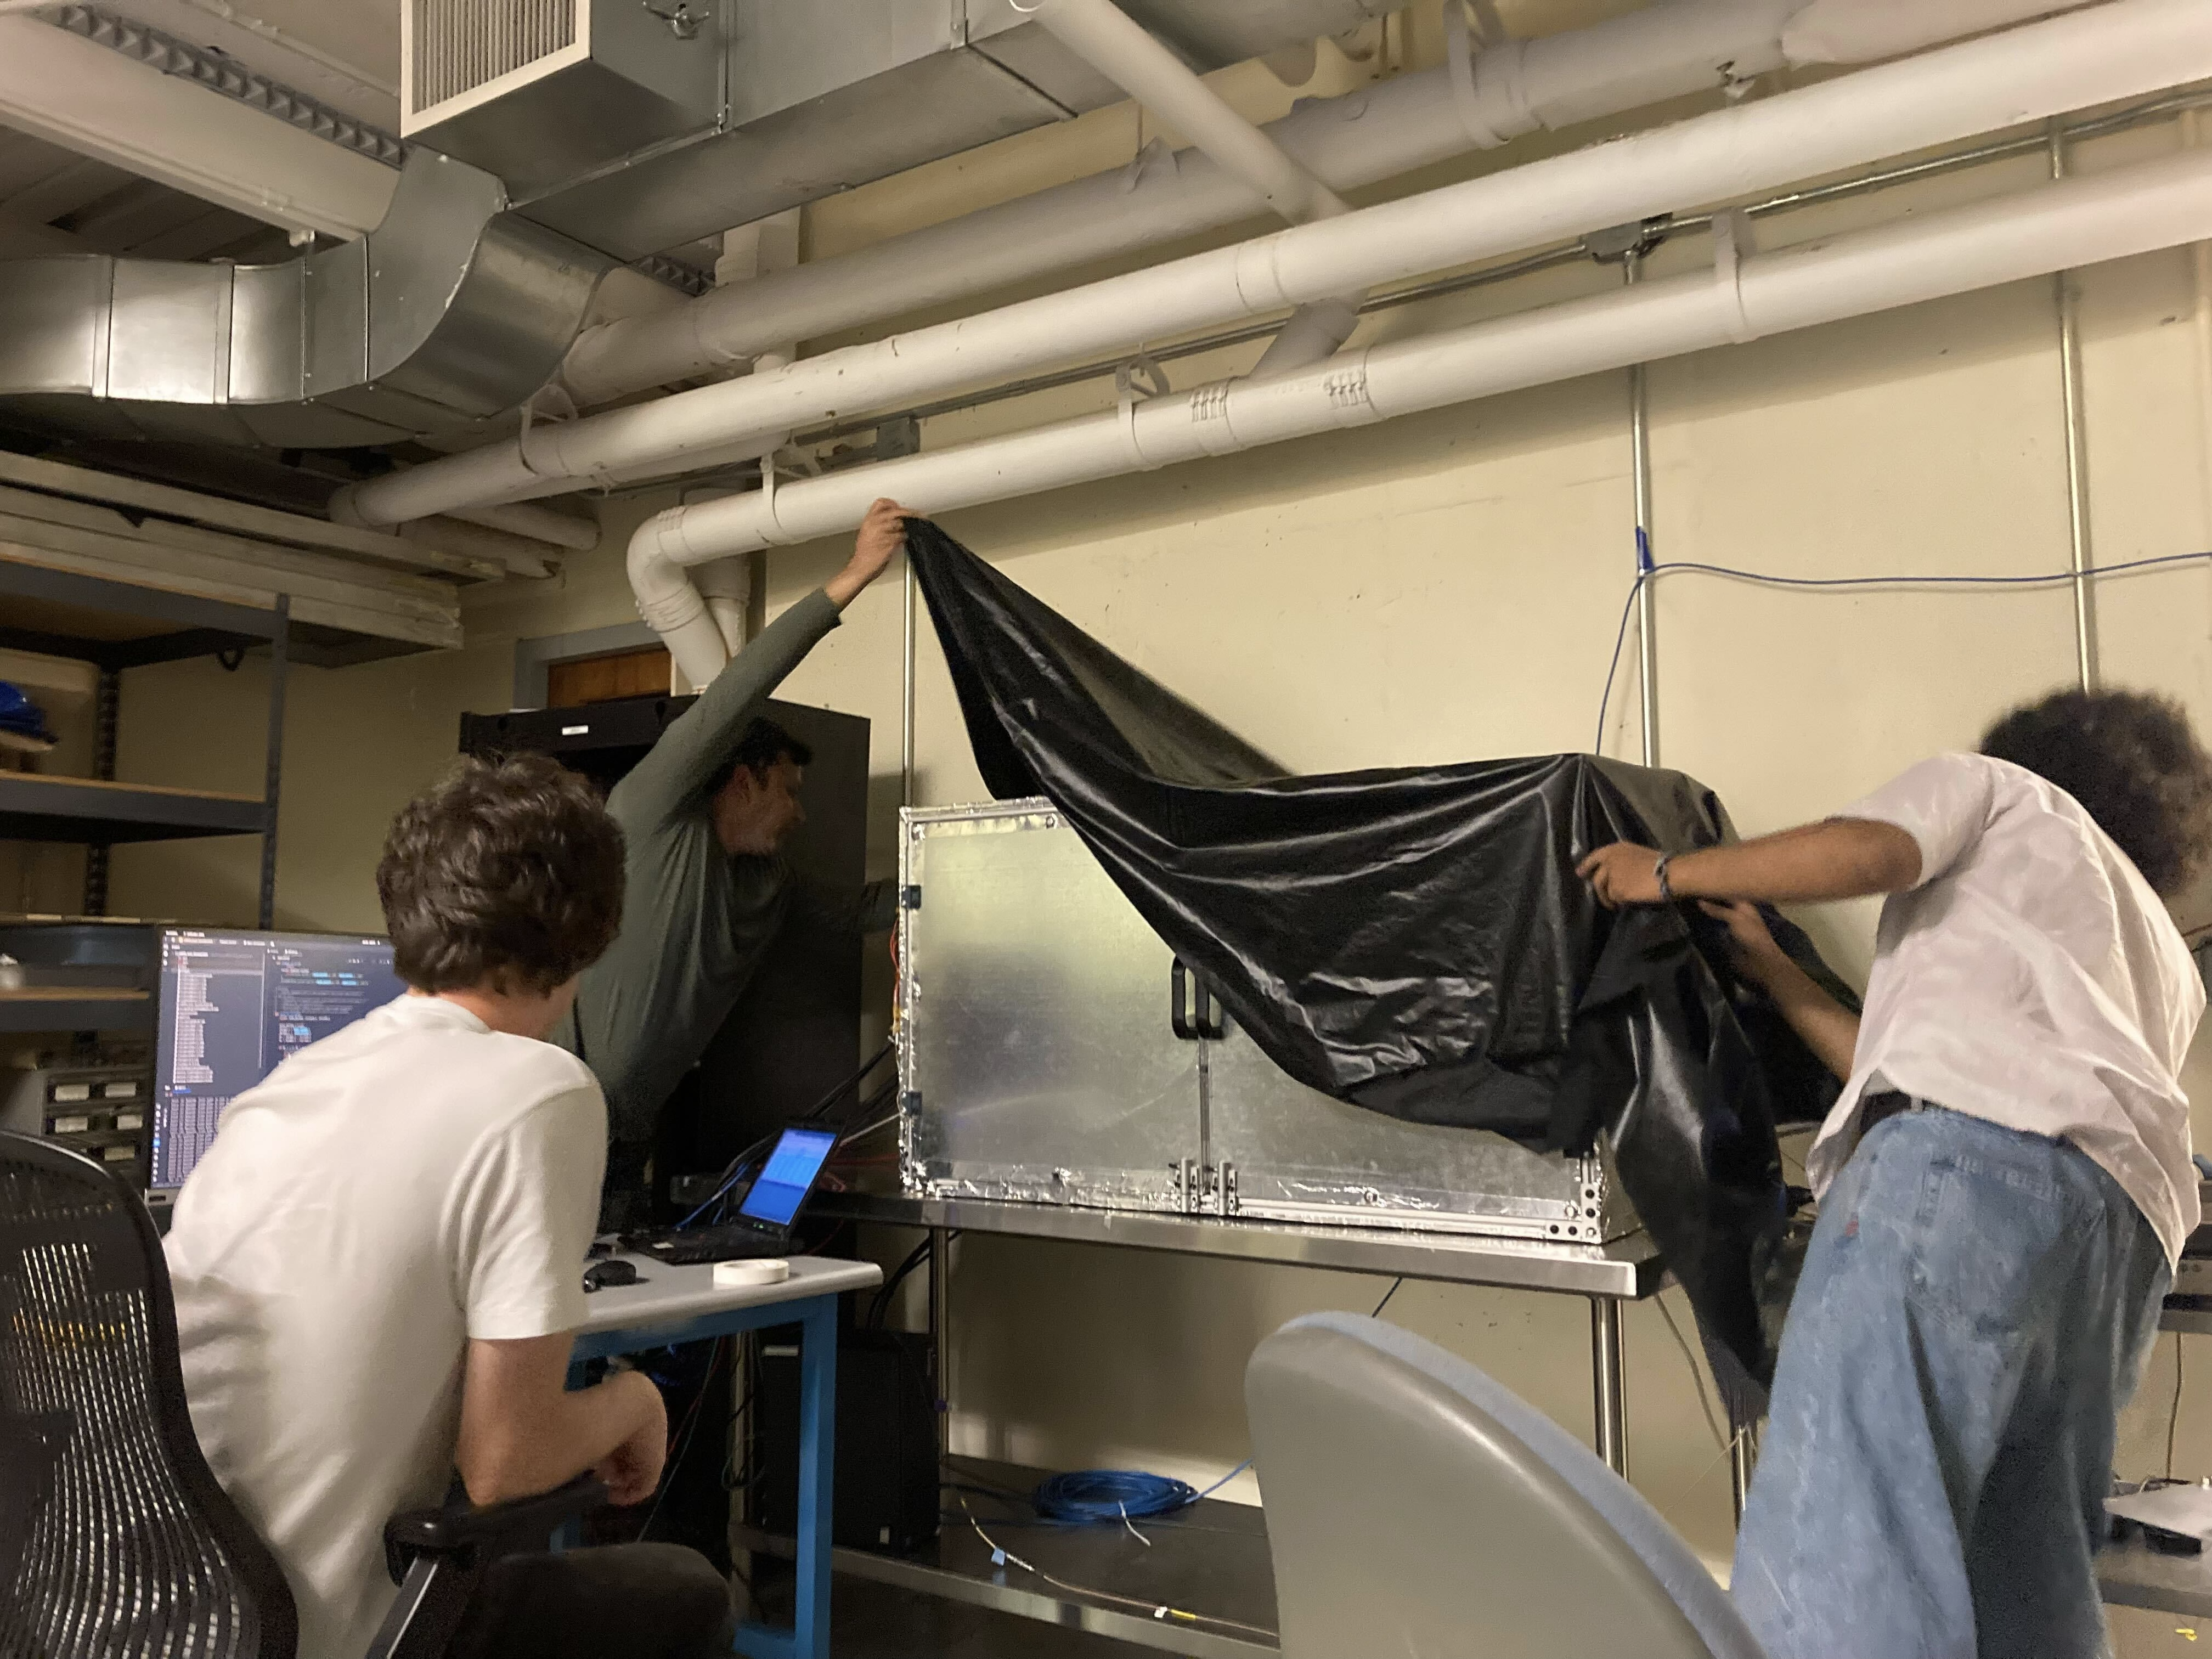
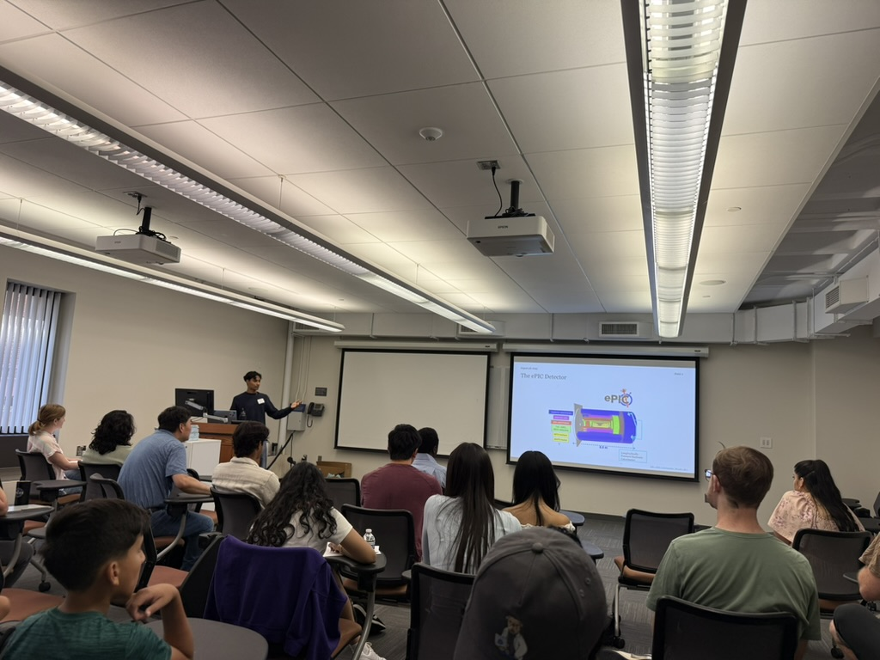
Pathways Summer Research Internship
7-week summer internship in Wright Lab • ssri.sites.yale.edu
Hosting high school interns in Wright Lab this summer to construct an optical setup for our RICH detector photosensor test station.
Students gain real research experience working alongside physicists on detector hardware for the Electron-Ion Collider.
Pathways handles all the logistics and coordinates programming for them weekly, as well as meet and greets and preparation in advance.
2025 Interns:
Omare Goodson (mentored by Postdoc Zoltan Varga) – Hill Regional Career High School
Vikram Dalal (mentored by Postdoc Isaac Mooney) – Wilbur Cross High School
Photo

