Slide 1
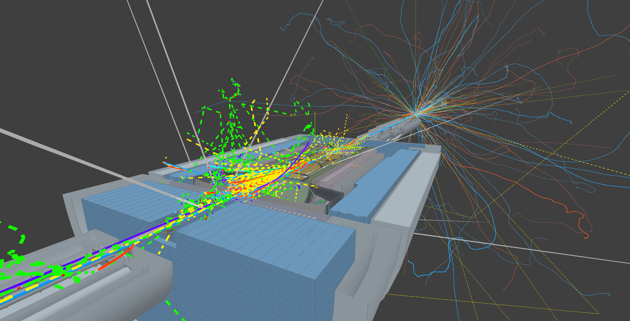

Background data structure and analysis
Mini tutorial
March Something 2026
Dmitry Romanov
Notes:
Tip: Keep titles under 60 characters for readability
To change the photo: Right-click on photo and select change photo

Slide 2
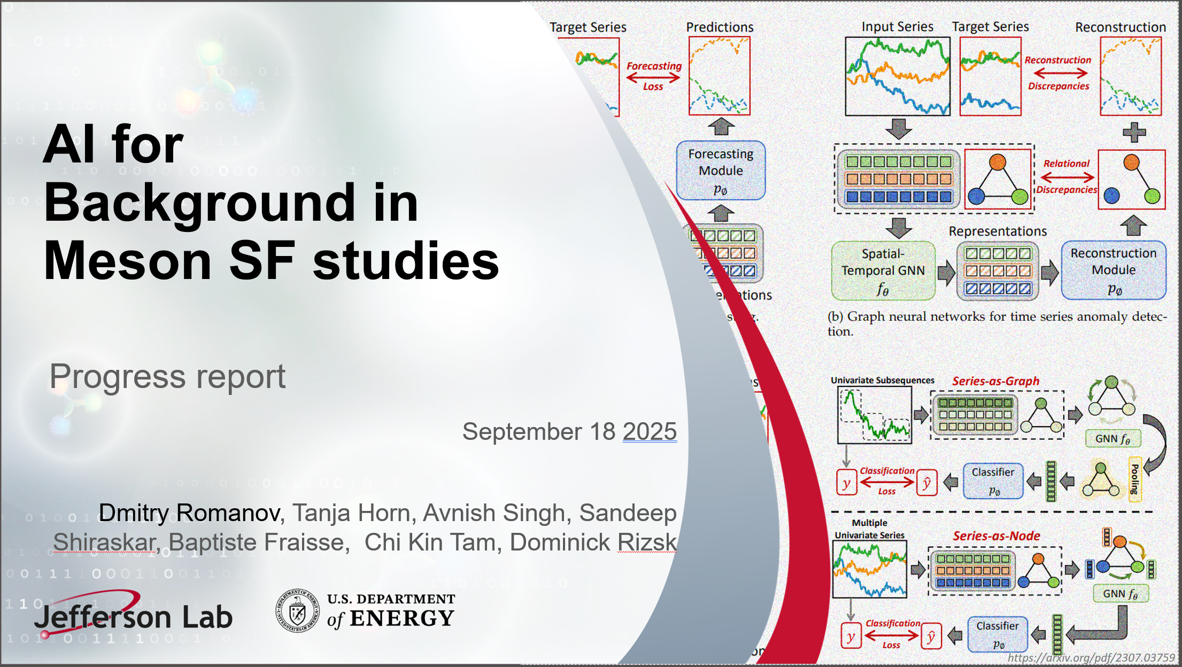
Our experience with Background Data
Primary Goal: Demonstrate that an AI-driven analysis of streaming-like frame-based data can:
1. Improve the identification of key physics events in high-background environments
2. Increase the throughput of scientific results
Key steps:
Train AI to clean the background data
Quantify the performance over traditional methods:
Discriminate events in physics background
Discriminate detector background
Integrate models within JANA2 / Epic reconstruction

Slide 3
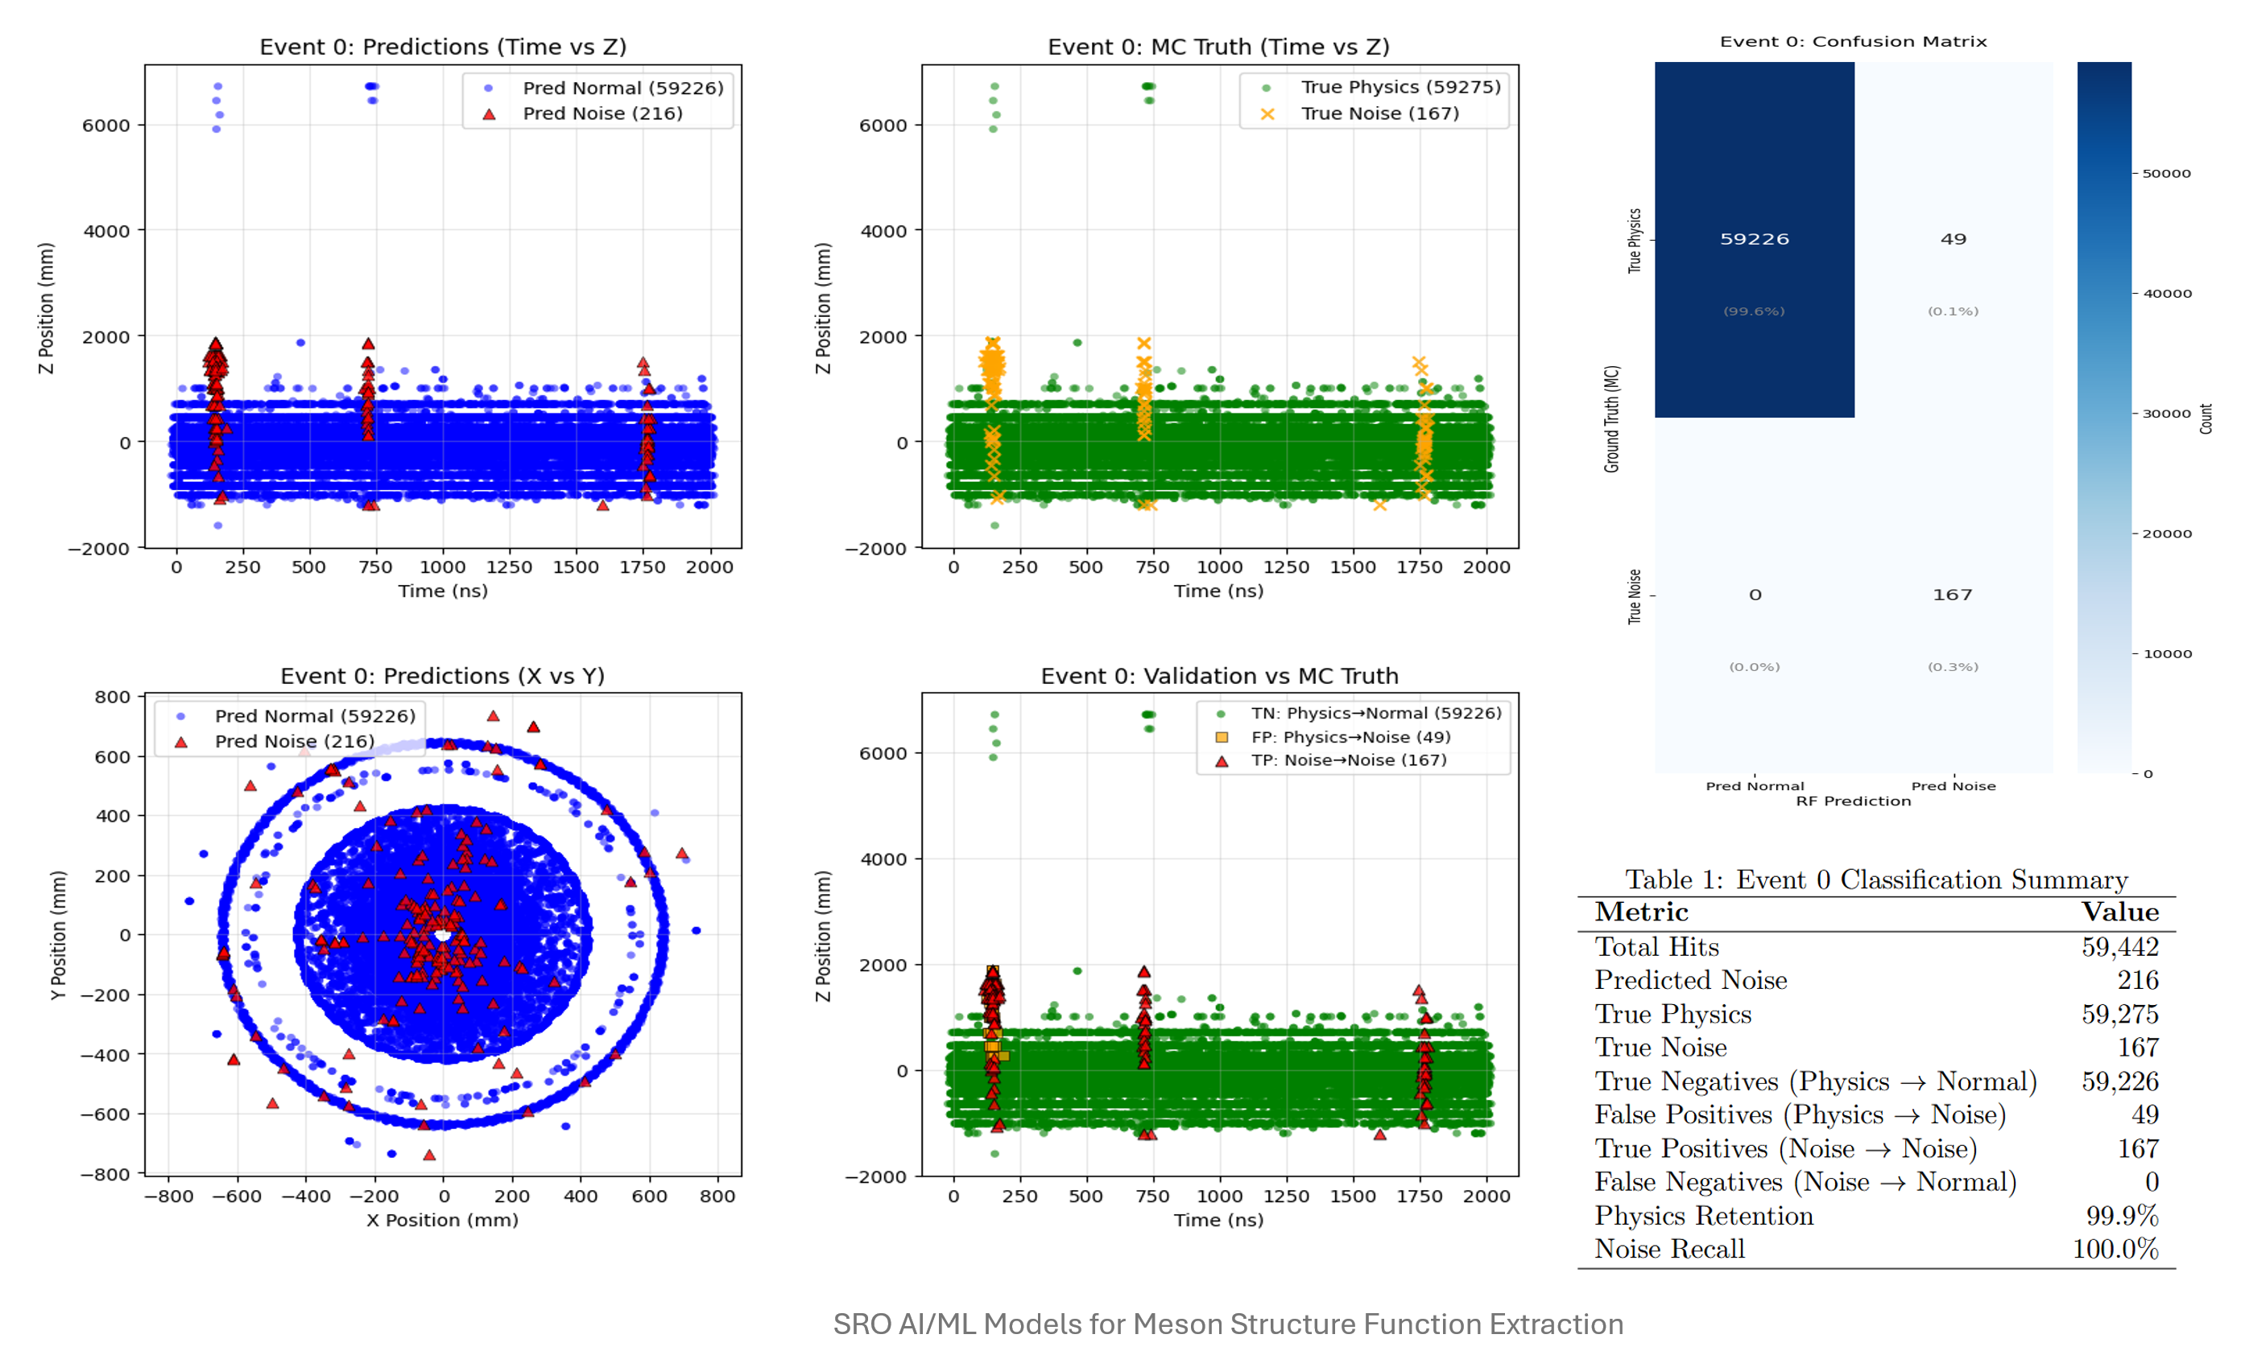
AI trying to identifying background hits
Talk: SRO Guided AI for Meson Structure Extraction and Background Distinction

Slide 4
Where to find information
Background mixed samples
Background wiki This tutorial code:
https://github.com/eic/example-background-data/

Slide 5
Were to find the data
Initial data (from page):
DD4Hep : root://dtn-eic.jlab.org//volatile/eic/EPIC/FULL/25.06.1/epic_craterlake
EICRecon: root://dtn-eic.jlab.org//volatile/eic/EPIC/RECO/25.06.1/epic_craterlake
Latest data: Check yourself: xrdfs root://dtn-eic.jlab.org/ ls /volatile/eic/EPIC/FULL/26.03.0/
EICRecon: root://dtn-eic.jlab.org//volatile/eic/EPIC/RECO/25.06.1/epic_craterlake
DD4Hep : root://dtn-eic.jlab.org//volatile/eic/EPIC/FULL/25.12.0/epic_craterlake
Event generator files (tricky!): /volatile/eic/EPIC/EVGEN/BACKGROUNDS/MERGED/HEPMC_merger-1.0.2/10x100/1SignalPerFrame/

Slide 6
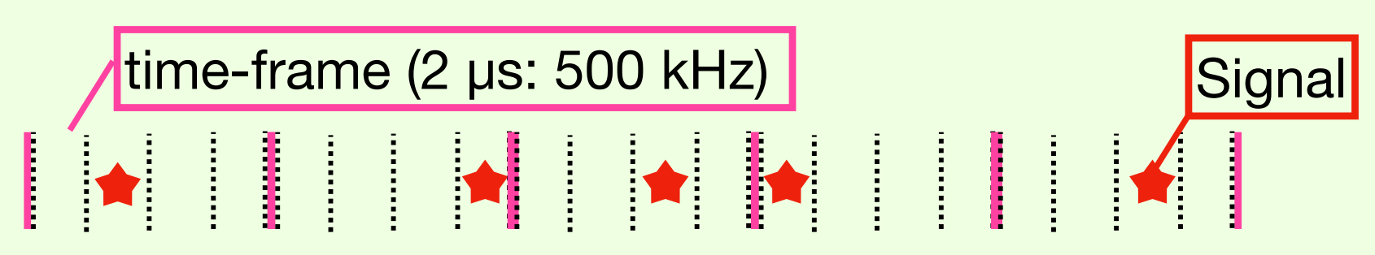
What is the data
A run is a collection of events and each event represents a 2000 nano second long integration frame.

Slide 7
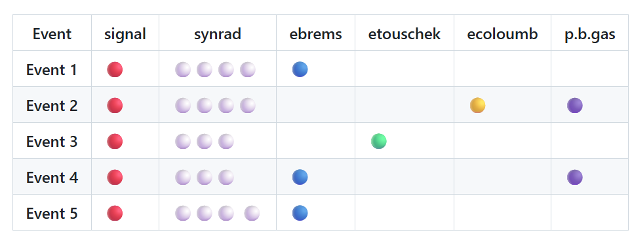
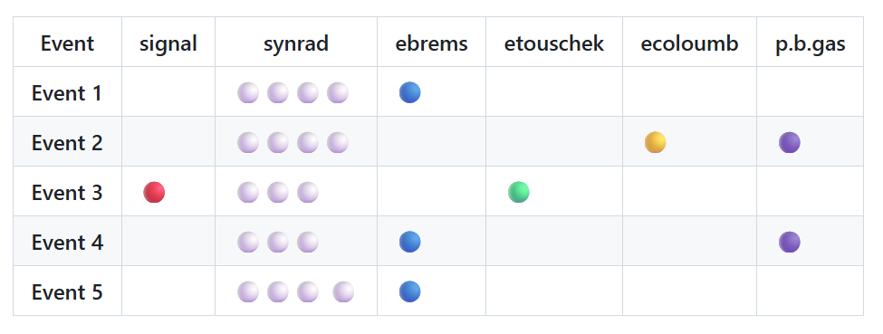
What data is there
Case 1: At least 1 Signal in Every Event of a Run
Case 2: Realistic Signal Contribution Per Event of a Run
If a signal frequency is 500 kHz, each event contains at least 1 signal contribution. The background get allocated per event based on their sampling frequency. Processes with less than 500 kHz sampling frequency are not guaranteed a contribution in every event.
For the SIDIS pythia6 18x275 Q²<1, the signal frequency is 83 kHz which would result in 1 signal contribution every ~5 events.

Slide 8
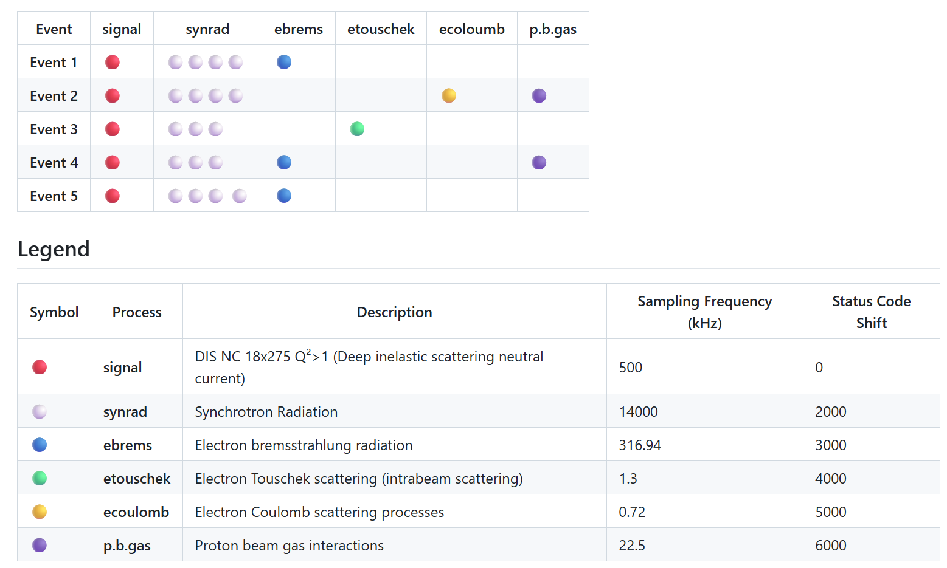
Physics + background data
Background mixed samples
Background wiki

Slide 9
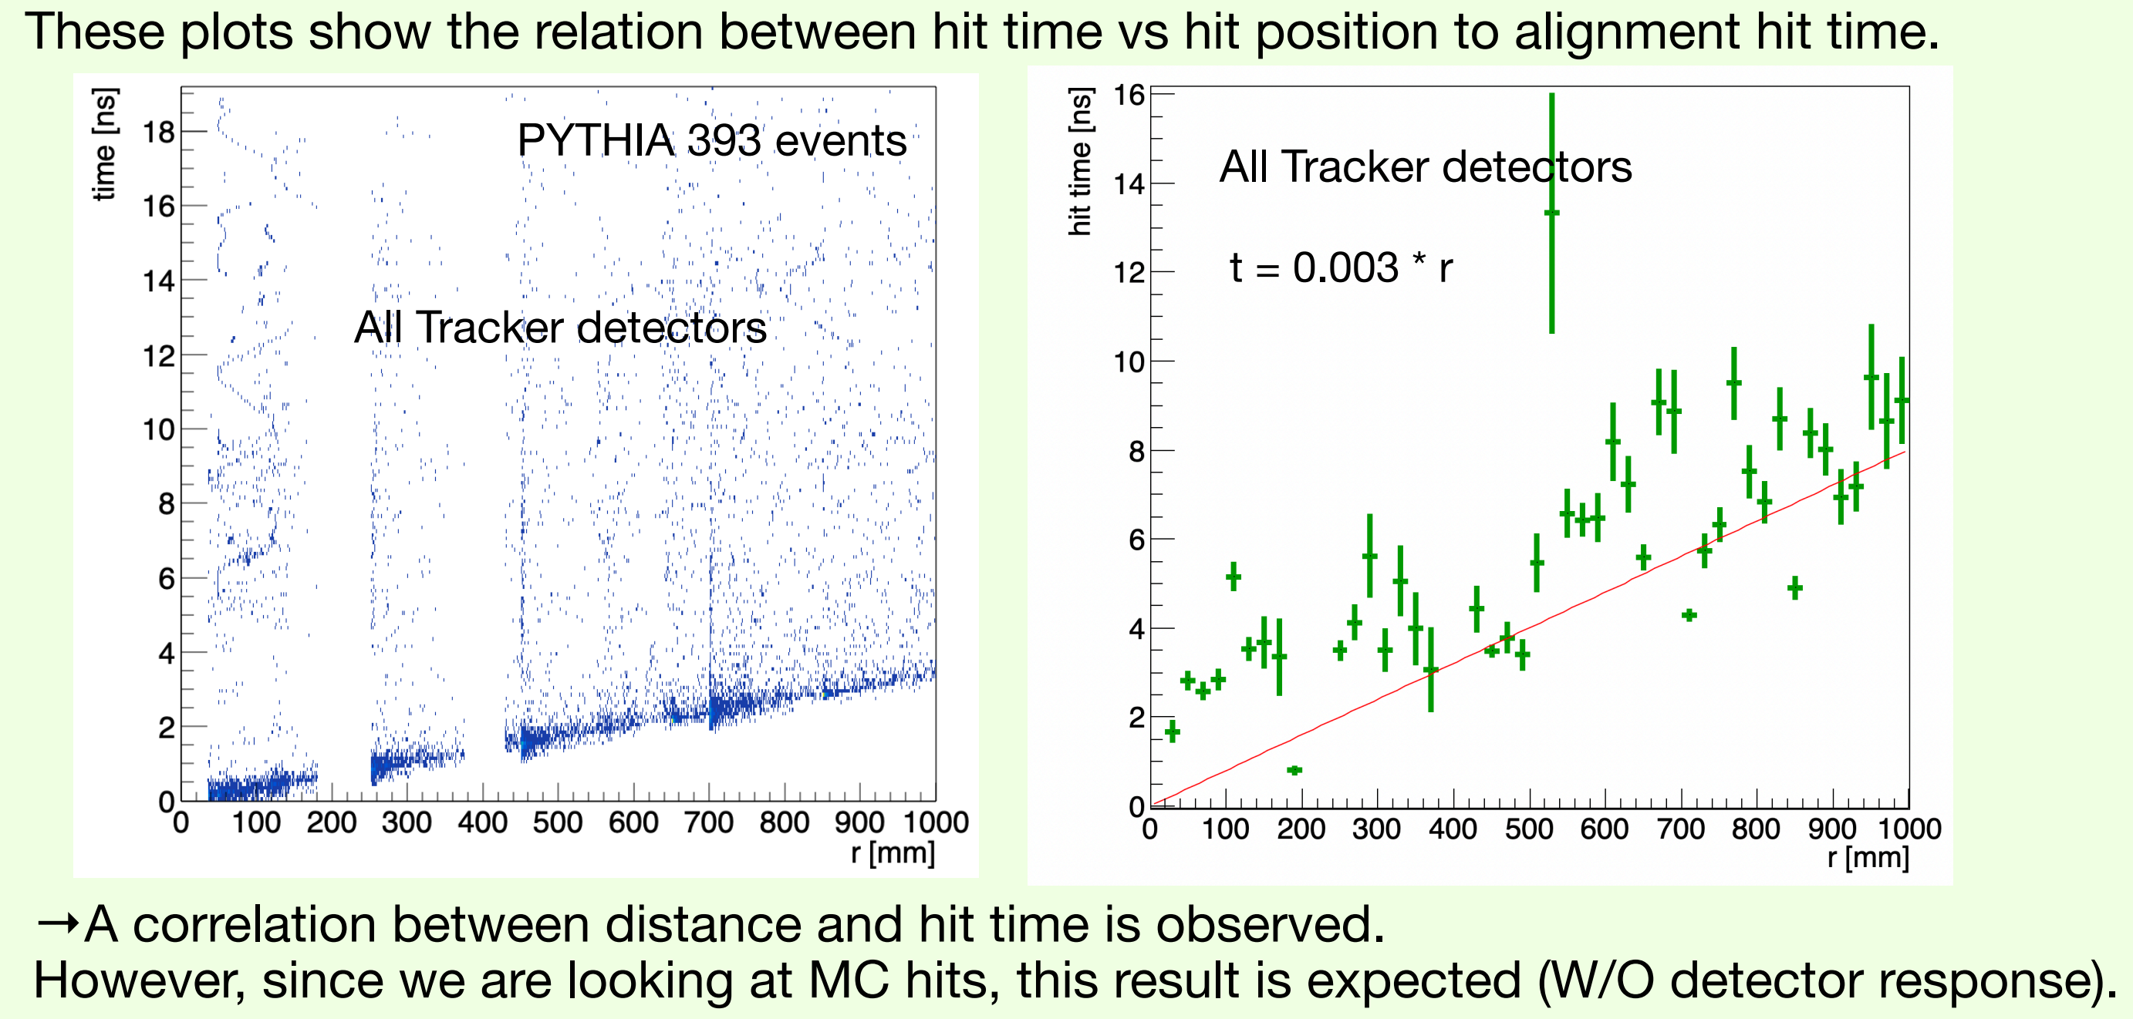
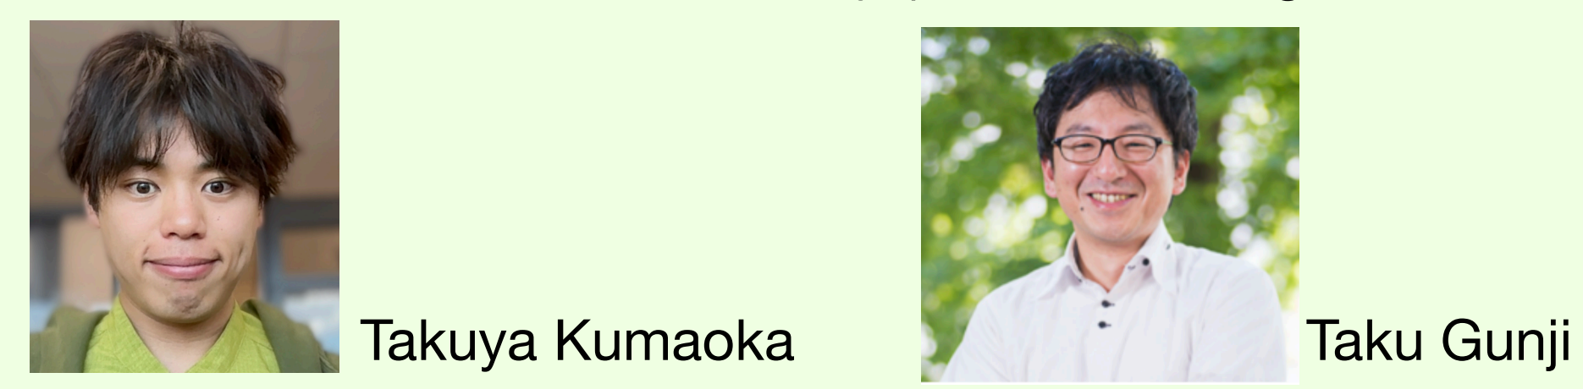
Non-AI processing
One of the preTDR goals is software able to work with data frames

Slide 10
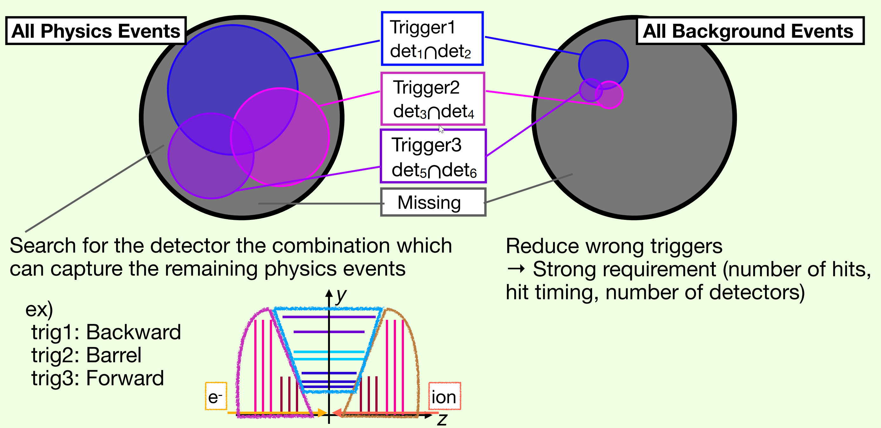
Non-AI looking into events
T.Kumaoka

Slide 11
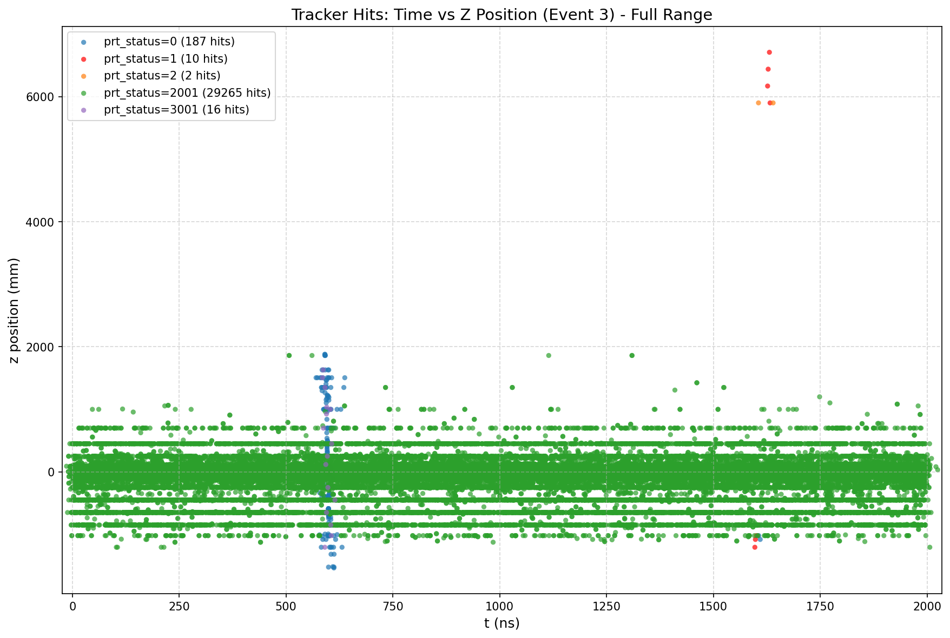
How data looks

Slide 12
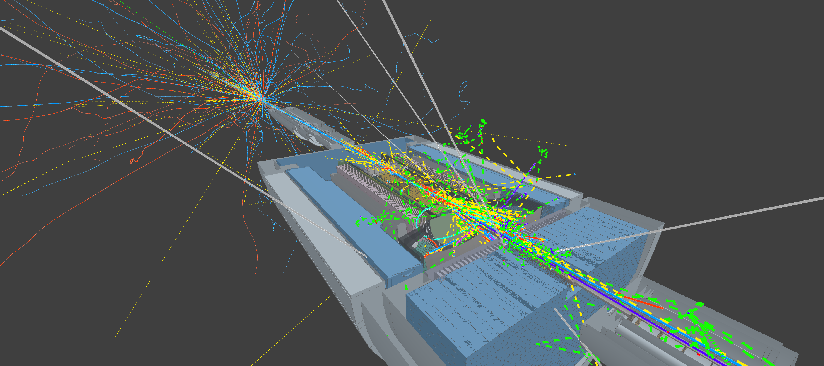

Firebird background examples
Go seeEIC.org -> Configure -> Examples -> “Event + Background ePIC Beam=10x100 (Large file)”
To animate full frame : Set End Time 2000, Animation speed 20

Slide 13
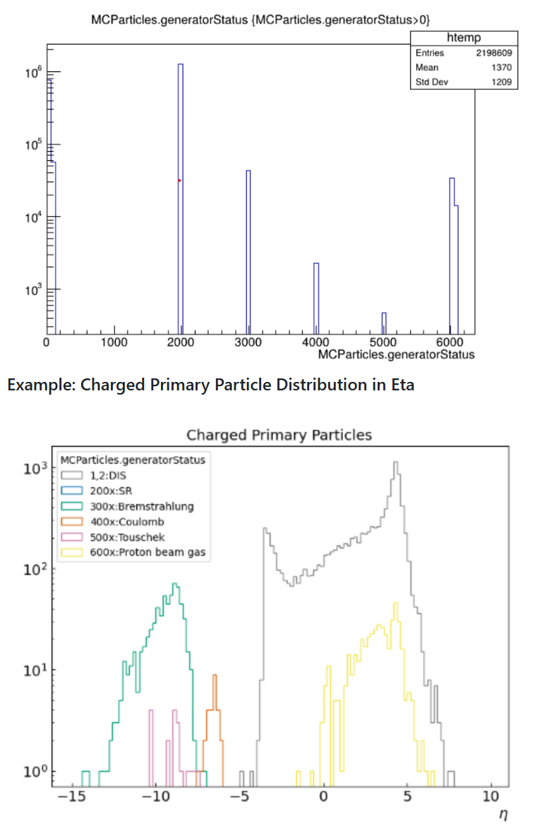
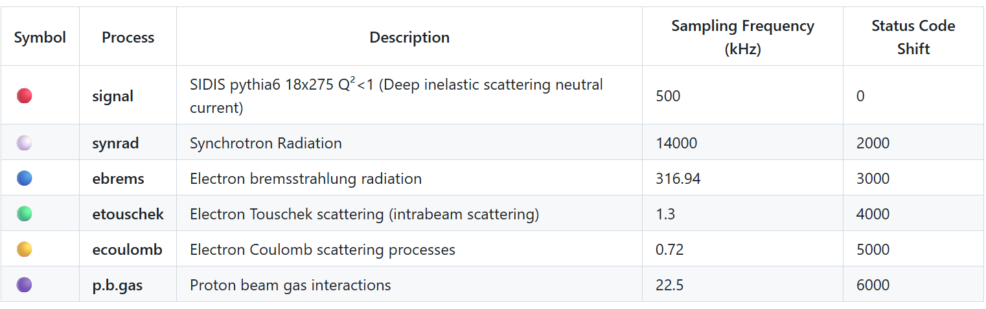
Identification of background or not?
Table of particle status codes:

Slide 14
C++ simplest ever draw something
TChain *T=new TChain("events");
T->Add("root://dtn-eic.jlab.org//volatile/…/*010*");
T->Draw("MCParticles.generatorStatus", "MCParticles.generatorStatus>0");
gPad->SetLogy();

Slide 15
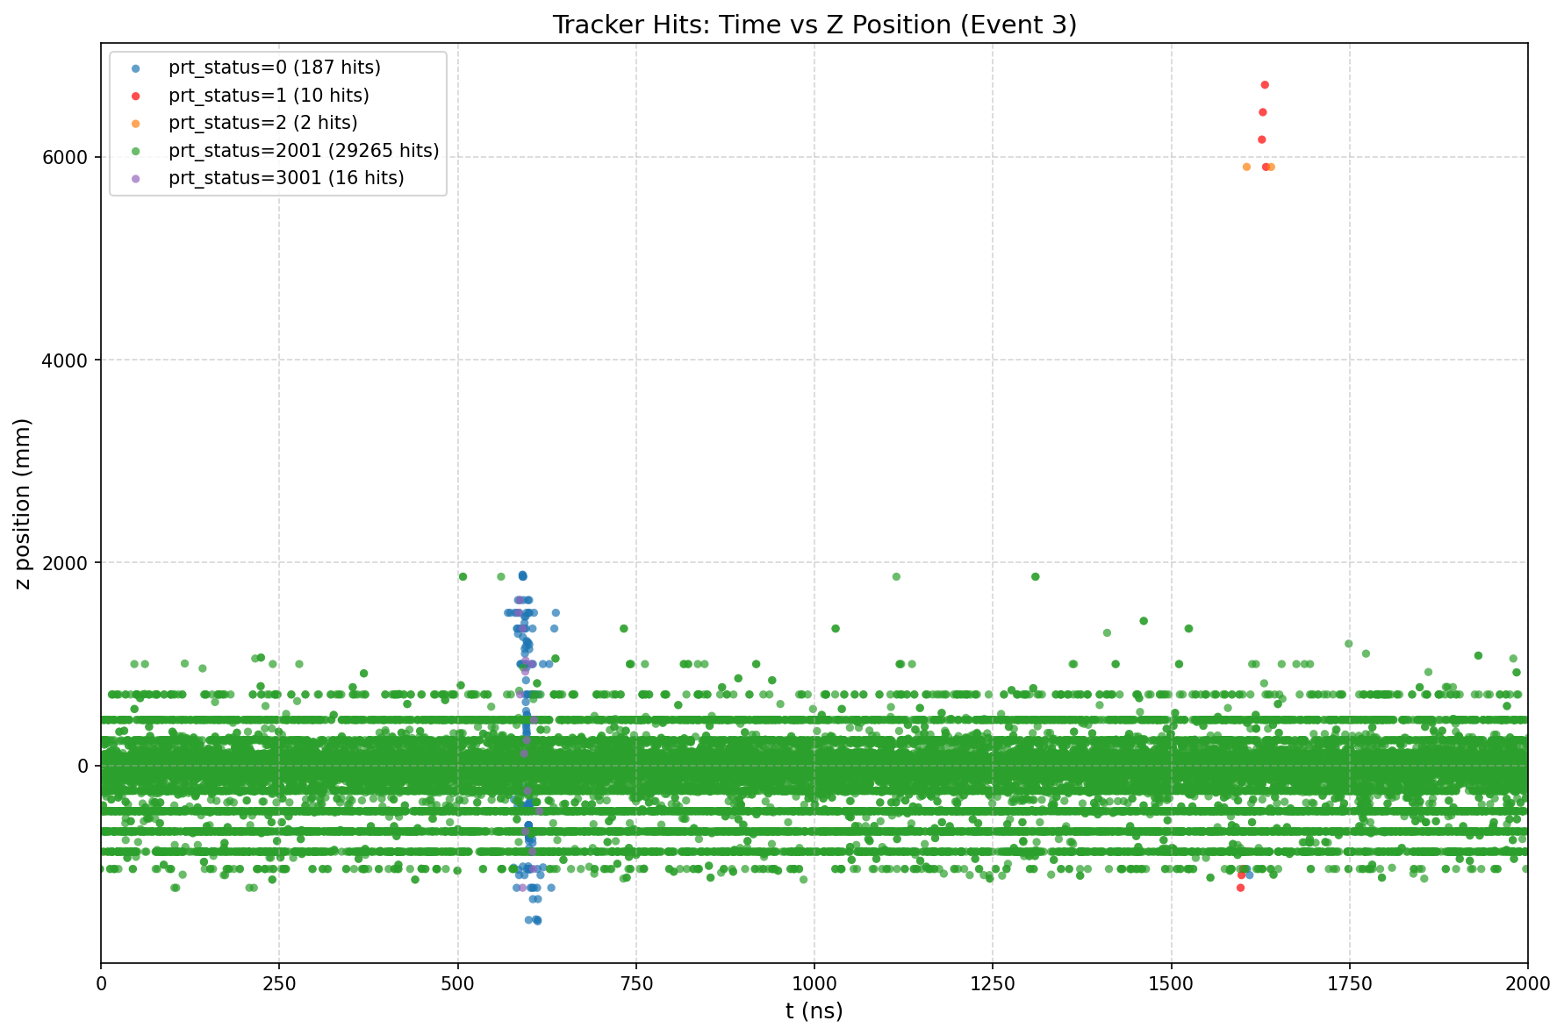
Tricks with identifying what is background
Gean4 adds its own particles, and you have to check where it comes from
Geant4 added
Signal
Background

Slide 16
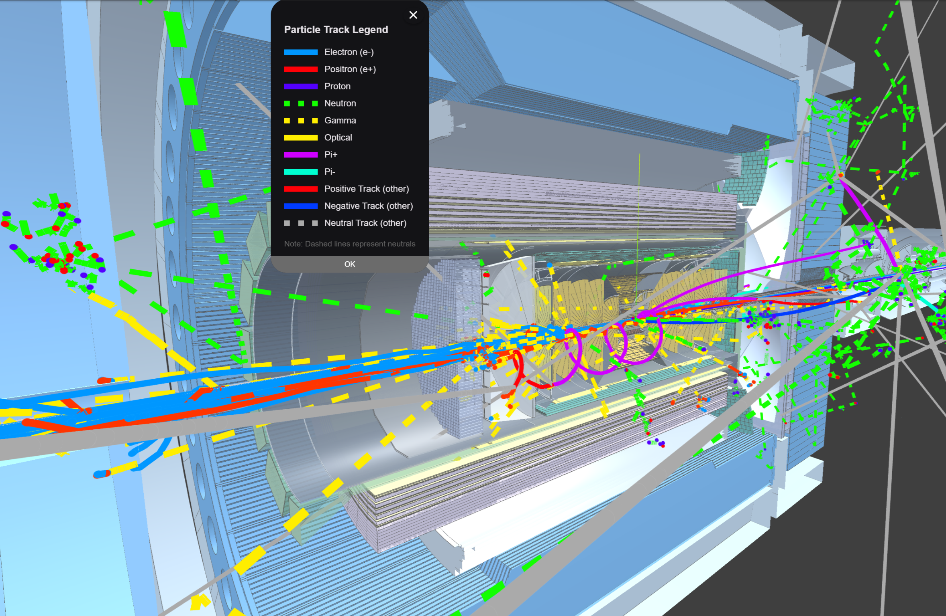
Live (a bit crazy) example
Pi+ -> e+ + ve

Slide 17
Live (a bit crazy) example
Pi+ -> e+ + ve

Slide 18
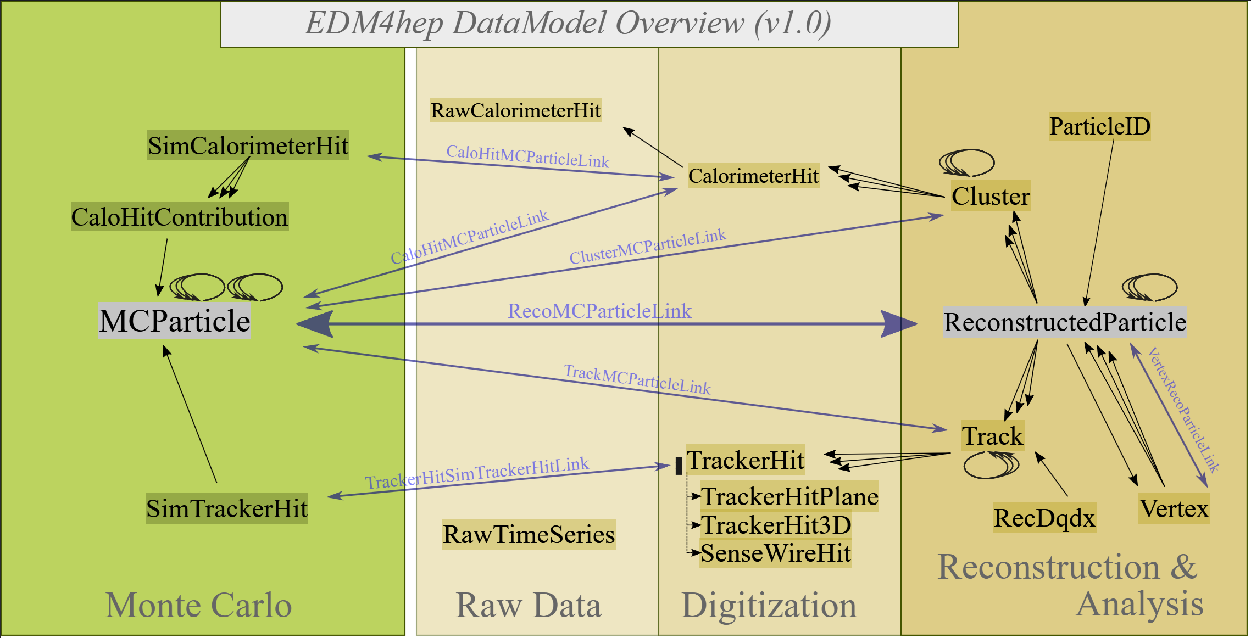
Getting connections Tracking

Slide 19
Getting connections Calorimetry

Slide 20
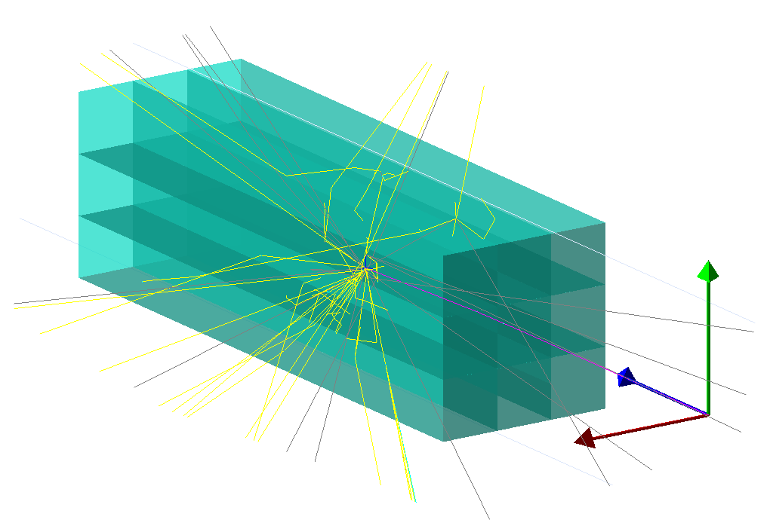
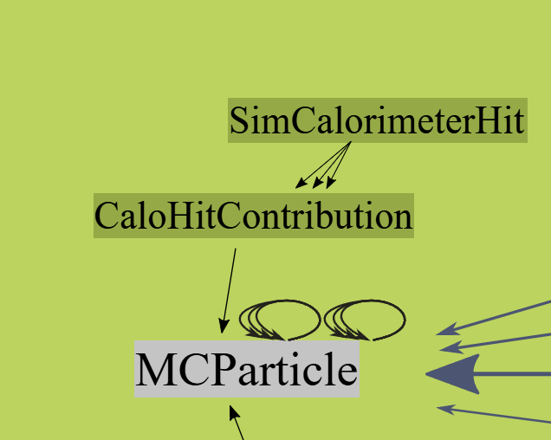
Calorimetry hits problems
For calorimeters the data is structured as: - Calorimeter hits consists of contributions, - Contributions are linked to MCParticles
Consequences: - Contributions are not saved in campaigns
- Calorimeter hits can have 3 states: - Background - Physics - Mixed
Hit
Contributions
Particle

Slide 21
Approaches to data analysis
Different approaches to analyze our trees
UPROOT
ROOT/RDATA FRAME
EDM4EIC / EDM4HEP
Using EDM4EIC allows to easily go over connections

Slide 22
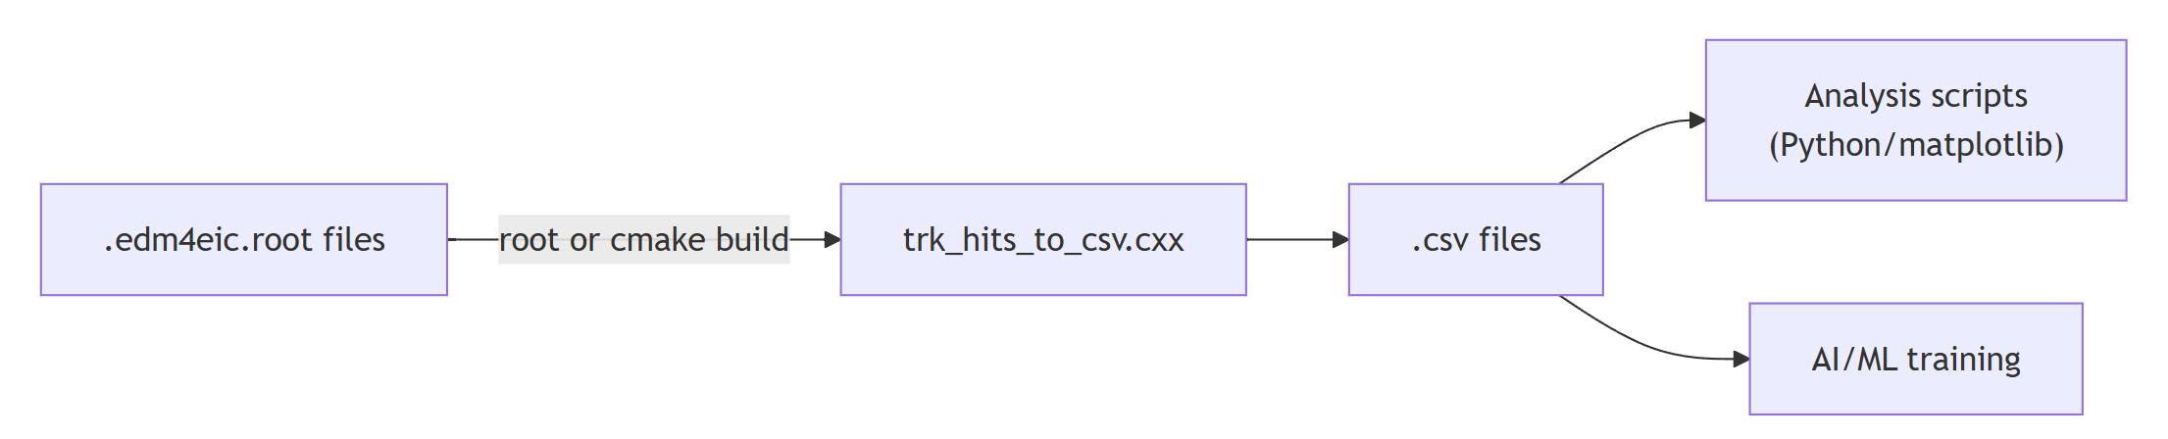
C++ code to navigate EDM4HEP / EDM4EIC
This tutorial code:
https://github.com/eic/example-background-data/
Key files:
trk_hits_to_csv.cxx - C++ converter: reads .edm4eic.root → writes .csv (run as ROOT macro or build with CMake)
background_analysis.py - Python plotting script: reads CSV → produces hit scatter plots
Snakefile - Snakemake workflow: batch-processes many ROOT files on a cluster
run_jlab_slurm.sh - SLURM submission helper for JLab

Slide 23
Saving to CSV and building plots in python
We store the extracted data as CSV because:
- Easy to produce in C++ - just format and write lines, no extra dependencies
- Easy to plot with Python - pandas + matplotlib (convenient with LLMs generating plot code)
- Easy to use in AI/ML - CSV loads directly into numpy, pandas, PyTorch datasets, etc.
- Easy for students - no special libraries needed to inspect or work with the data

Slide 24
Questions, ideas, collaboration?

