Slide 1
sPHENIX Project Issues
The integration of the sPHENIX Resource-loaded Project files are going well. You may expect to get questions from Irina, Jim and Bob.
BNL has agreed to pick up the cost of a P6 consultant. This person will start working with Irina immediately. Because of this development we will likely show some results in P6 at the OPA CD-1 review.
Maria Chamizo Llatas formerly of ATLAS and CMS, will both coordinate the sPHENIX MVTX work and the take over for Jon Kotcher in supervising the detector projects in Berndt’s Directorate which includes helping to organize the sPHENIX reviews.
  She is setting up bi-weekly MVTX meetings.
There is no update on the Extraordinary Project Rate approval from the CFO’s office.
The OPC accounts opening delayed until the end of April, but I got BNL to agree that we can start spending “urgent” OPC funds.
4/13/17
sPHENIX L2 Meeting
<number>

Slide 2
sPHENIX Project Issues - continued
There will be a sPHENIX simulations meeting this afternoon with Dave, Gunther and the Topical Conveners to discuss simulation plots we will want for the CD-1 review and the Director’s review.
  The issue that we need to address is how to we demonstrate to a review committee that the sPHENIX detector design meets our physics performance requirements?
The OHCal prototype contract has not yet been awarded. PPM says that it should take another week.
Alexei Denisov is at BNL for 3 months with a goal of deciding the contribution IHEP would like to make to sPHENIX. We will work with him to encourage that the IHEP contribution is directly related to the baseline detector. We can use the help. May have interest in the IHCal.
Dave and Gunther’s visit to Saclay in March was positive. They are interested in joining sPHENIX to work on the TPC. Their expertise is MicroMegas. Could be used as component in TPC readout modules
This is the time to start planning on acquiring additional funding from outside sources such as NSF.
4/13/17
sPHENIX L2 Meeting
<number>

Slide 3
CD-1 Preparation and Review Schedule
ALL DATES TENTATIVE
sPHENIX CD-1 “Dry Run” with BNL internal Review committee (Jun 12-13)
  Review state of the documentation, Project files with drill down, project controls
  Tentatively scheduled for 1.5 days. Presentations June 12 , homework and close-out June 13.
  We will need some kind of practice the first week of June. Will wait until we see the charge before setting the agenda
sPHENIX Director’s Review. (Week of Aug 7)
  Jay Marx will chair. Likely DOE will observe either Jim Sowinski or Elizabeth Bartosz.
  2.5 days. 1 day of plenary. 1 day of breakout. ½ day of report writing and close out
DOE-OPA CD-1 Review (Week of Nov 6)
  Likely Ethan Merril from OPA will chair
  2.5 days. 1 day of plenary. 1 day of breakout. ½ day of report writing and close out
4/13/17
sPHENIX L2 Meeting
<number>

Slide 4
Short Term Document Production Schedule
Schedule of Preparation for CD-1:
Draft -Revised RLS w/ bottom-up cost estimate mid Apr
Draft -Cost book(BOE), WBS Dictionary, Activity List etc. mid Apr
Draft – Hazard Analysis plan, Risk Registry, Risk Mgmt Plan May 1
Draft PEP and CDR May 1
Final versions for all documents mid-May
In addition the draft report of the Inner Detector Integration Task Force is due mid Apr.
4/13/17
sPHENIX L2 Meeting
<number>

Slide 5
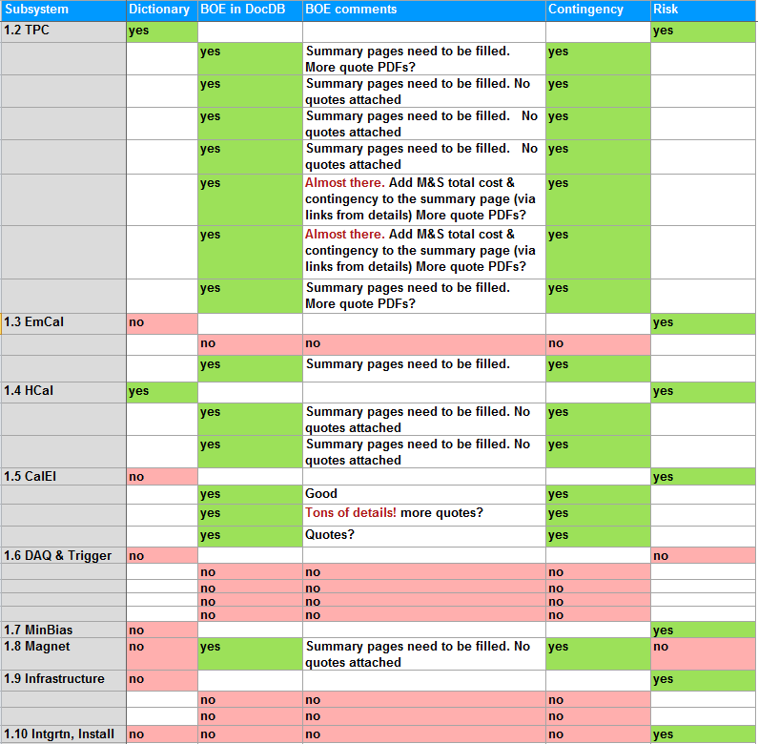
L2 Documentation Scoresheet
4/13/17
sPHENIX L2 Meeting
<number>

Slide 6
Documents To Be Available Prior to the CD-1 Director’s Review
Acquisition Strategy - Work has been assigned. Not yet started
Conceptual Design/Conceptual Design Report – Advanced/Writing started this week
Preliminary Project Execution Plan – Writing has started
Preliminary Hazard Analysis Report- Started
Preliminary Risk Management Plan – Started
Preliminary Risk Assessment and Risk Registry – Started
Preliminary Security Vulnerability Assessment (Short security equipment protection & cyber security) - Work has been assigned. Not yet started
Alternate Analysis – For the PEP includes scientific alternatives Not yet started
Management Organization - complete
Cost Range (Cost Books)
WBS (WBS Dictionary)
Activity List & Activity Attributes
Critical Milestones
Project Schedule
Proposed Funding Profile
Contingency Risk/Analysis
Integrated Safety Management Plan - Pro forma
NEPA form - complete
Close all previous review recommendations – sPM, L2s
A team of 20-25 people have been working on this for the past 2 months. All derived from WBS MS-Project file
By sPM, L2s, CAMs
<number>

