Slide 1
Status of developing a global thermal model and cooling of ePIC
Girish Gowda
Mechanical Engineer
6.03.09 Integration, Installation and Infrastructure
PDR and Safety Review for ePIC Integration, Installation and Infrastructure
Dec 8 & 9, 2025

Slide 2
Outline
Charge Questions
Detector Cooling Overview
Detector Cooling Water Treatment
Pre Brief
Detector Heat Load
Cooling Circulator – Negative Pressure Water
Detector Cooling Systems
Summary / Next Steps

Slide 3
Charge Questions Addressed
Charge # 5
Is the progress and design maturity for all detector systems, support structures, and moving mechanisms technically sound, feasible, and sufficiently mature to advance toward final design and aligned with being baselined in June 2026 (>60% maturity is required)?
Have the required building and facility modifications (floor loading, rails, crane capacity, utilities, service routing, etc.) been adequately analyzed, addressed, or planned?
Have ES&H and QA considerations been adequately incorporated into the designs at their present stage?
Do the designs and installation plans for the Outer Detectors (Barrel HCAL, Barrel EMCAL, Magnet), Inner Detectors within the GST (DIRC, MPGD, TOF, Silicon, EEEMCAL, pfRICH), and the Endcaps (Forward EMCAL/HCAL) meet support, alignment, movement, access, and integration requirements within building/rail constraints?
Are preliminary cooling schemes adequately developed and documented, do they meet thermal and reliability requirements, and are interfaces across subsystems and to facility cooling/HVAC clearly defined?
Is the project team ready to proceed to final design for the scope under review, and what recommendations should be addressed beforehand?
Have the recommendations from previous reviews been adequately addressed?

Slide 4
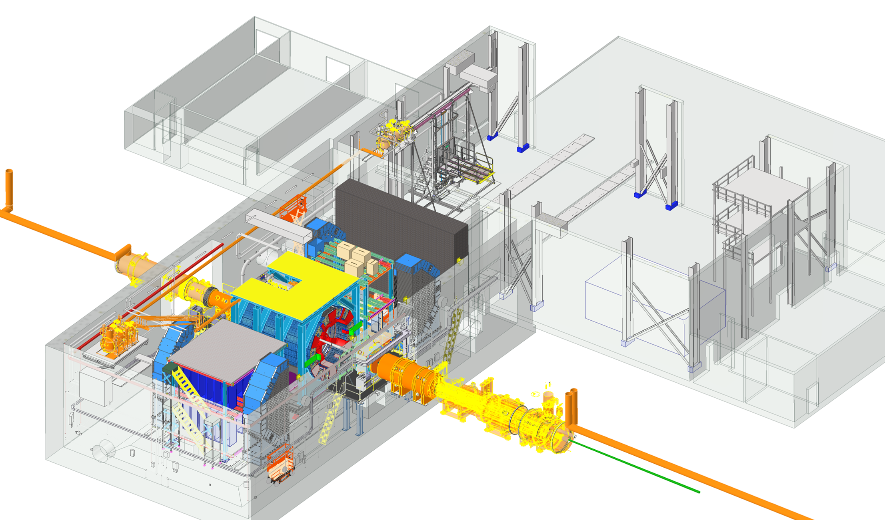
Detector Cooling Overview
Charge # 5
Air Conditioning for Wide Angle Hall (WAH) – Building 1006 :
Existing HVAC upgrading for environmental control demands of the detector
System must maintain ambient temperature between 68F to 72F
RH should be below 65 %
Air Conditioning for Assembly Hall – Building 1006 :
Climate control requirements of ambient temperature between 65F to 75F
RH should be below 75 %
Control Room
Ring Inside
DAQ Room
Assembly Hall
Facility Water System :
Main loop that takes in cool water from cooling towers, circulates through chillers, heat exchangers and then sends it back out.
Generate and manage bulk of facility's chilled water supply efficiently.
Operates with constant-speed pumps and maintains a consistent temperature
Rear
Wide Angle Hall
Clean Room
Pump & Elec Rooms
Technology Cooling System:
Secondary Loop is directly connected to equipment. Heat from the detector components is transferred to the primary loop via an intermediary device Cooling Distribution Unit (CDU).
To provide precise cooling for equipment.
Variable speed pumps used to precisely match the cooling demand and heat is ultimately rejected to the primary loop.
Cooling Distribution Unit (CDU)
Ring Outside
Forward
Cooling Distribution Unit (CDU) :
Using negative pressure water circulators to mitigate leak concerns (draws air into lines instead of leaking water out)
This two-loop design allows primary loop to remain more stable while secondary loop can be dynamically adjusted to meet the varying cooling needs.

Slide 5
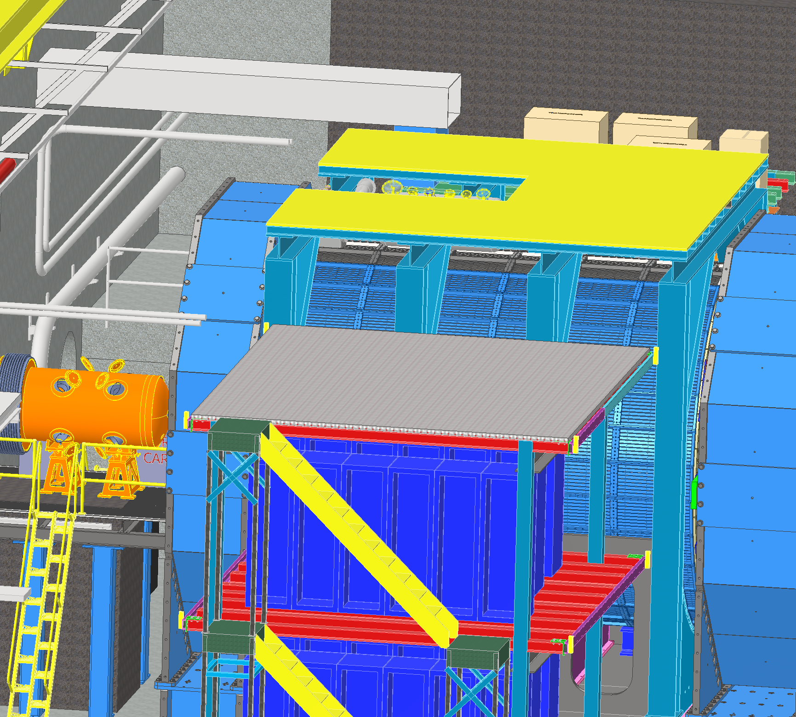
Detector Cooling – Water Treatment
Charge # 5
Modified Chilled Water
Cooling Lines on Ring Inside
Modified Chilled Water - 400 gpm (MCW) :
Delivers water at temperature of 64 F (18 C)
RH considered is 65 %
Used for sub detector cooling, electronic rack cooling and manifolds made of material other than Aluminum
Cool the Cooling Distribution Unit (CDU)
Primary Facility Cooling loop for Support Infrastructure
Aluminum Compatible Water (ACW) :
Chemically treated water system to prevent corrosion
Used for sub detector cooling of Aluminum manifolds and tubing
Modified Chilled Water
Cooling Lines on Ring Outside

Slide 6
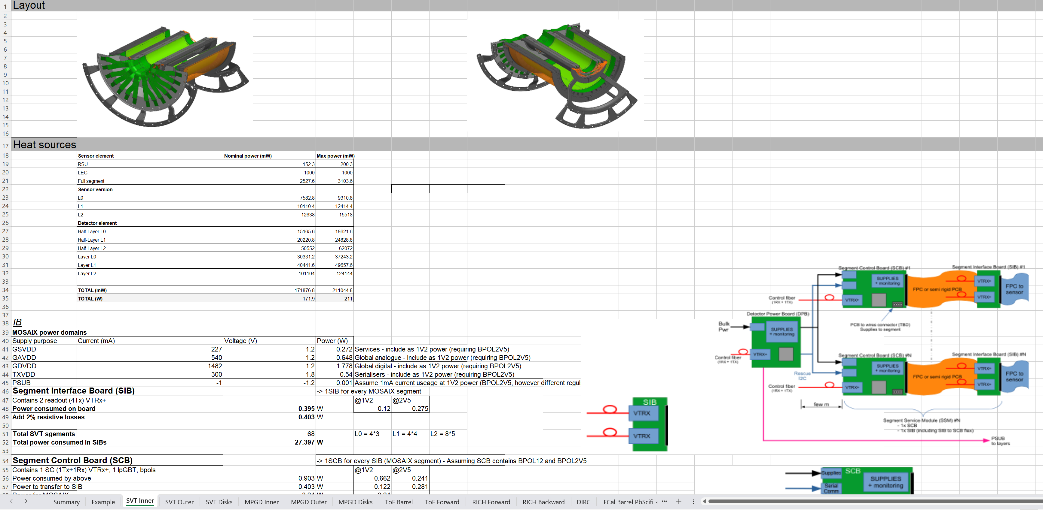
ePIC Detector – Cooling Requirements
Charge # 5
See Pre-brief Detectors Parameters and Services per Subsystem.xls

Slide 7
ePIC Detector – Cooling Plan
Charge # 5
See Pre-brief cooling plan_c.xls
Detector | Cooling Method | Design Tasks | Description | Status
 |  | Cooling system | Cooling requirements, Calculation of heat load, flow rate, pressure drop, | In Progress
Forward Emcal | Water Cooling |  | dew point temperature for condensation, Tubing diameter, Insulation requirement.
 |  | Modeling of Cooling system | CAD Model of the 1/4 inch copper tubing with heat sink integrated with board assembly | Completed for PDR
 |  | Cooling of FEB | Thermal simulation of FEB's | Completed for PDR
 |  | Active cooling of the SiPM's to be assesed | Design change with and without thermal pad downstream of SiPM board | Completed for PDR
 |  | Optimisation of cooling system design | Reduce FEB temperatures to 3C above dew point | Final Design Review FDR
Barrel Emcal | Water Cooling | Cooling system for Barrel Pb/Scifi | Cooling requirements, Calculation of heat load, flow rate, pressure drop | In Progress
 |  | ESB Cooling of Astropix heat removal | Thermal simulation of Astropix through PbScifi to assese need for active cooling | Completed for PDR
 |  | ESB Cooling for SiPM stability | Thermal simulation of cold plate design optimisation as per temperature specification | Completed for PDR
Forward Hcal | Convective Cooling | Cooling system | Cooling requirements, Calculation of heat load, flow rate, pressure drop | In Progress
 |  | Cooling of PCB | Thermal Simulation of Insert Assembly | In Progress
Barrel Hcal | Convective Cooling | Assese the need for Active Cooling | Cooling requirements, Calculation of heat load, flow rate, pressure drop | In Progress
EEEMCAL | Water Cooling | Cooling system | Cooling requirements, Calculation of heat load, flow rate, pressure drop | In Progress
 |  | Cooling of SiPM | Thermal Simulation of of SiPM in contact with crystals | Completed for PDR
 |  | Cooling of FEB | Thermal Simulation of FEB | In Progress

Slide 8
ePIC Detector – Heat Load
Charge # 5
Liquid Cooling System
Air Cooling System
 |  | Units
Cooling media | Water
Forward EMCAL | 3428 | W
Barrel EMCAL | 3101 | W
Cymbal | 1944 | W
Outer MPGD | 2856 | W
pfRICH | 294 | W
DIRC | 310 | W
EEMCAL | 1010 | W
TOF | 30000 | W
SVT Outer | 301 | W
SVT Disks | 655 | W
SVT Inner | 385 | W
MPGD Endcap Disks | 1280 | W
Total Heat Load | 45564 | W
 |  | Units
Cooling media | Air
Barrel HCAL | 1280 | W
Forward HCAL | 1656 | W
SVT Inner | 211 | W
SVT Disks | 5819 | W
SVT Outer | 3218 | W
Total Heat Load | 12184 | W
Special Cooling System
 |  | Units
Cooling media | Glycol
dRICH | 19968 | W
Platform Electronics & Racks
 |  | Units
Cooling media | Water
Platform | 80000 | W
DAQ Room | 250000 | W
Total Heat Load | 330000 | W
See Pre-brief Cooling design Update.pptx

Slide 9
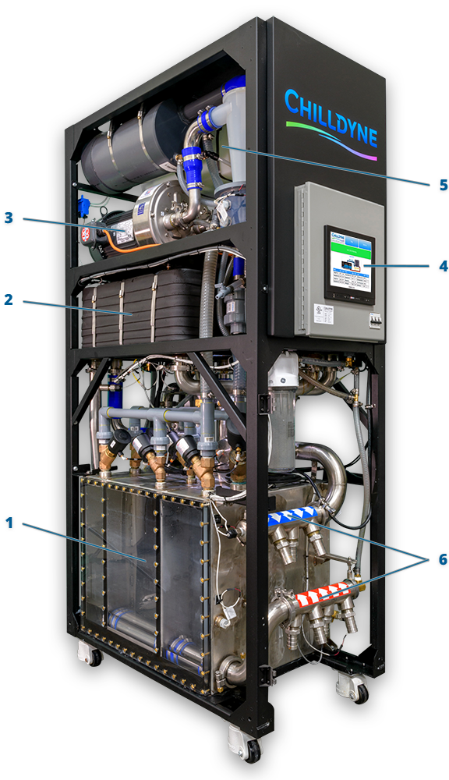
Negative Pressure Water – Cooling Circulator
Charge # 5
Chilldyne CDU 300 Components :
1. Pump Chambers
The pump chambers control the flow of fluid into and out of the CDU. The proprietary three-chamber arrangement allows the CDU to pull fluid through the loop while maintaining a steady flow.
2. Heat Exchangers
The heat exchangers move heat from the technology cooling system to the facility water system. The two series heat exchangers allow the CDU to move up to 300 kW of heat even on hot and humid days.
3. Liquid Ring Pump
Liquid ring pumps use water as a seal that never needs to be replaced. The CDU’s liquid ring pump provides the vacuum used to pull the coolant through the load.
4. Microprocessor Control
The intelligent, network-enabled core of the CDU automatically manages coolant temperatures, flow rates, water quality, and more. The Cool-Flo Software allows the CDU to be easily integrated into popular DCIM and BMS systems.
5. Water Quality Control
The CDU automatically monitors and controls the quality of the water in the technology cooling system. The water quality system dispenses coolant additives as-needed to prevent corrosion and biological growth.
6. Coolant Handling Manifolds
Up to 4 cooling loops exit either the top or bottom of the CDU to support both raised floor and overhead configurations.
Product Line: CF-CDU300
Cooling Capacity: Up to 300kW with 15 °C rise.
Flow Rate: Up to 300 LPM at 0.5 bar differential
sPHENIX Detector is using Chilldyne Cooling Circulator

Slide 10
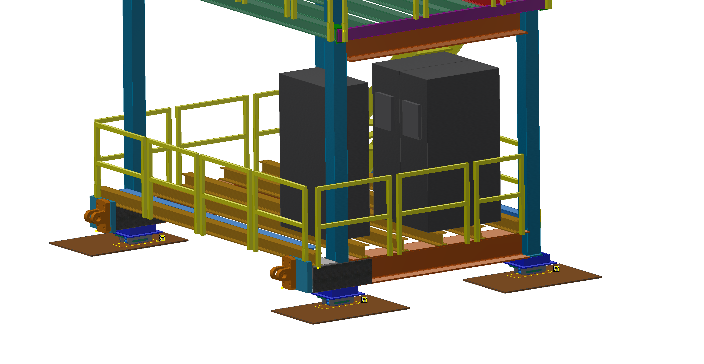
ePIC Detector – Cooling Distribution Unit - CDU
Charge # 5
Chilldyne Option 1
 |  | Units
Cooling media | Water/Glycol
Total Heat Load of Electronics | 46 | kW
CDU Cooling Capacity | 40 | kW
Number of CDUs required | 1.15 | 2
Single CDU | 57.50 | %
Margin CDU | 3 | CDUs
density | 1000 | kg/m^3
Specific Heat | 4186 | J/kg C
Temperature rise, ΔT | 2 | C
Pressure available | 0.5 | bar
Pressure available | 50000 | Pa
Mass flow rate | 5.49 | kg/s
Volumetric flow rate | 0.00549 | m^3/s
Volumetric flow rate per unit | 0.00275 | m^3/s
Volumetric flow rate per unit | 164.84 | lpm
Volumetric flow rate per unit | 43.52 | gpm
CDUs
Cooling Distribution Units on Ring Inside
Each CDU will operate at 23 kW – 57.5 percent of it’s rated capacity
Active CDUs – 2, Standby CDU – 1 for backup
Dimensions (L*W*H) inches : 45’’ * 24’’ * 80’’
Decrease in temperature rise decreases CDU cooling capacity
Decrease in temperature rise increases flow rate at given pressure

Slide 11
ePIC Detector – Global Thermal Model
Charge # 5
Forward Emcal Detailed Calculation :
 |  | Units
Cooling media | Water
Chiller flow rate | 400 | gpm
Chiller flow rate | 1514 | lpm
Chiller flow rate | 0.02523 | m^3/s
Chiller flow rate | 25.23 | kg/s
density | 1000 | kg/m^3
Specific Heat | 4186 | J/kg C
RH | 65 | %
Ambient Temp | 72 | F
Ambient Temp | 22.2 | C
Dew Point Temp | 60 | F
Dew Point Temp | 15.3 | C
Inlet Temp | 64.4 | F
Inlet Temp | 18.0 | C
FEB Full Board Heat | 4.5 | W
FEB Half Board Heat | 2.25 | W
Number of FEB Full Board North half | 277
Number of FEB Half Board North half | 44
Total Heat Generation FEB Full Board North half | 1246.5 | W
Total Heat Generation FEB Half Board North half | 99 | W
Number of FEB Full Board South half | 274
Number of FEB Half Board South half | 24
Total Heat Generation FEB Full Board South half | 1233 | W
Total Heat Generation FEB Half Board South half | 54 | W
SiPM Board Heat | 0.17 | W
Number of SiPM Board North half | 2392
Number of SiPM Board South half | 2288
Total Heat Generation SiPM Board North half | 406.64 | W
Total Heat Generation SiPM Board South half | 388.96 | W
Total Heat Load | 3428.1 | W
Temperature rise ΔT | 2 | C
Required flow rate | 0.409 | kg/s
Required flow rate | 0.000409 | m^3/s
Required flow rate | 25 | lpm
Dynamic Viscosity | 0.001 | Ns/m^2
Copper Tube length | 6 | m
Maximum number of FEB per detector row | 10
Maximum number of SiPM per detector row | 76
Maximum total power per cooling loop | 58 | W
Maximum total power per cooling loop NS half | 116 | W
Number of cooling loops | 18
Cooling loops | Parallel
Required flow rate per loop | 1.38366E-05 | m^3/s
Required flow rate per loop | 0.83 | lpm
Required total flow rate | 15 | lpm
Velocity | 0.757 | m/s
Copper tube outer diameter | 0.25 | inch
Copper tube outer diameter | 0.00635 | m
Copper tube inner diameter | 0.19 | inch
Copper tube inner diameter | 0.004826 | m
Area | 0.0000183 | m^2
Reynolds Number | 3652
Pipe Absolute Roughness | 0.0000015 | m
Pipe Relative Roughness | 0.0003 | m
Pressure drop per loop | 0.3 | bar
Pressure drop per loop | 4.35 | psi
Friction factor | 0.08
Ambient temperature | 20 | C
RH | 80 | %
Dew point temperature | 16.4 | C
Minimum water temperature | 18 | C

Slide 12
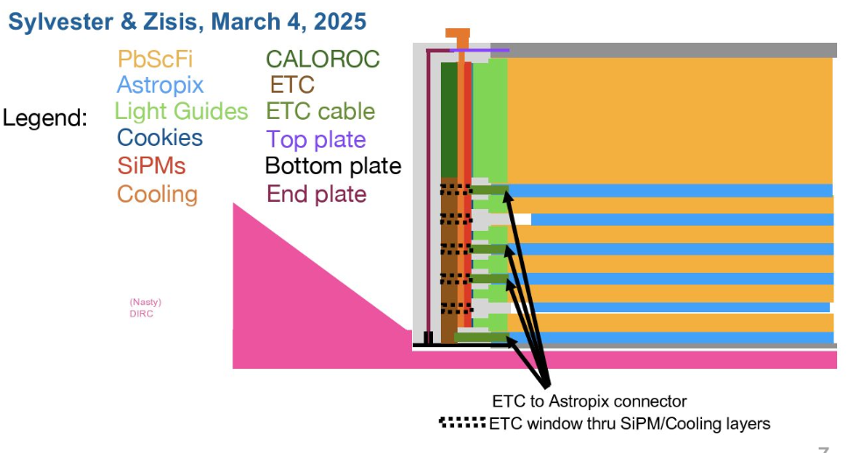
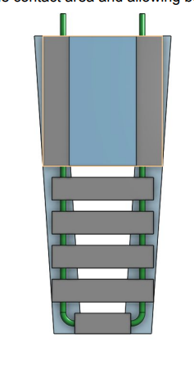
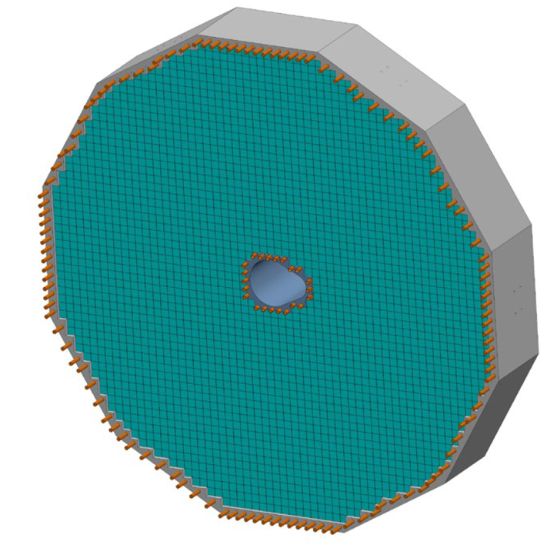
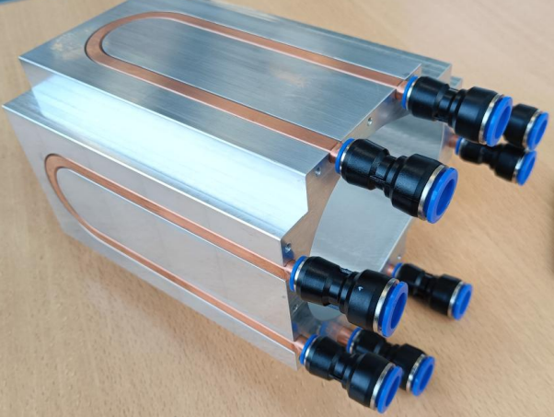
Liquid Cooling – Detectors
Charge # 5
Forward EMCAL :
Electronics : FEB, SiPM
Temperature : 2 to 3C above dew point
Barrel EMCAL :
Electronics : SiPM, Astropix, ETC, Caloroc, Astrolinx
Temperature : SiPM : +/- 2 C (7C on SiPM’s)
Astropix, Astrolinx : 20 +/- 3 C, ETC, Caloroc: below 40 C
DIRC :
Electronics : ASIC
Temperature : ASIC: +/- 2 C
Outer MPGD :
Electronics : FEB
Temperature : ASIC : 30 +/-3C, Operation : 22 to 25C
Cymbal :
Electronics : FEB, DC-DC Converters
Temperature : FEB : +/- 2C, Detector Operation : 15 to 25 C
pfRICH :
Electronics : ASIC
Temperature : ASIC : +/- 2 C
EEMCAL :
Electronics : FEB, SiPM
Temperature : +/- 0.1 C on crystals, Crystal temperature : 15 to 25 C
Cold plate, double-sided cooling:
- Side 1: ESB PCB with SiPMs
- Side 2: CALOROC and AstroPix ETC
Barrel Emcal
EEmcal
Internal Structure - Copper Tubes

Slide 13
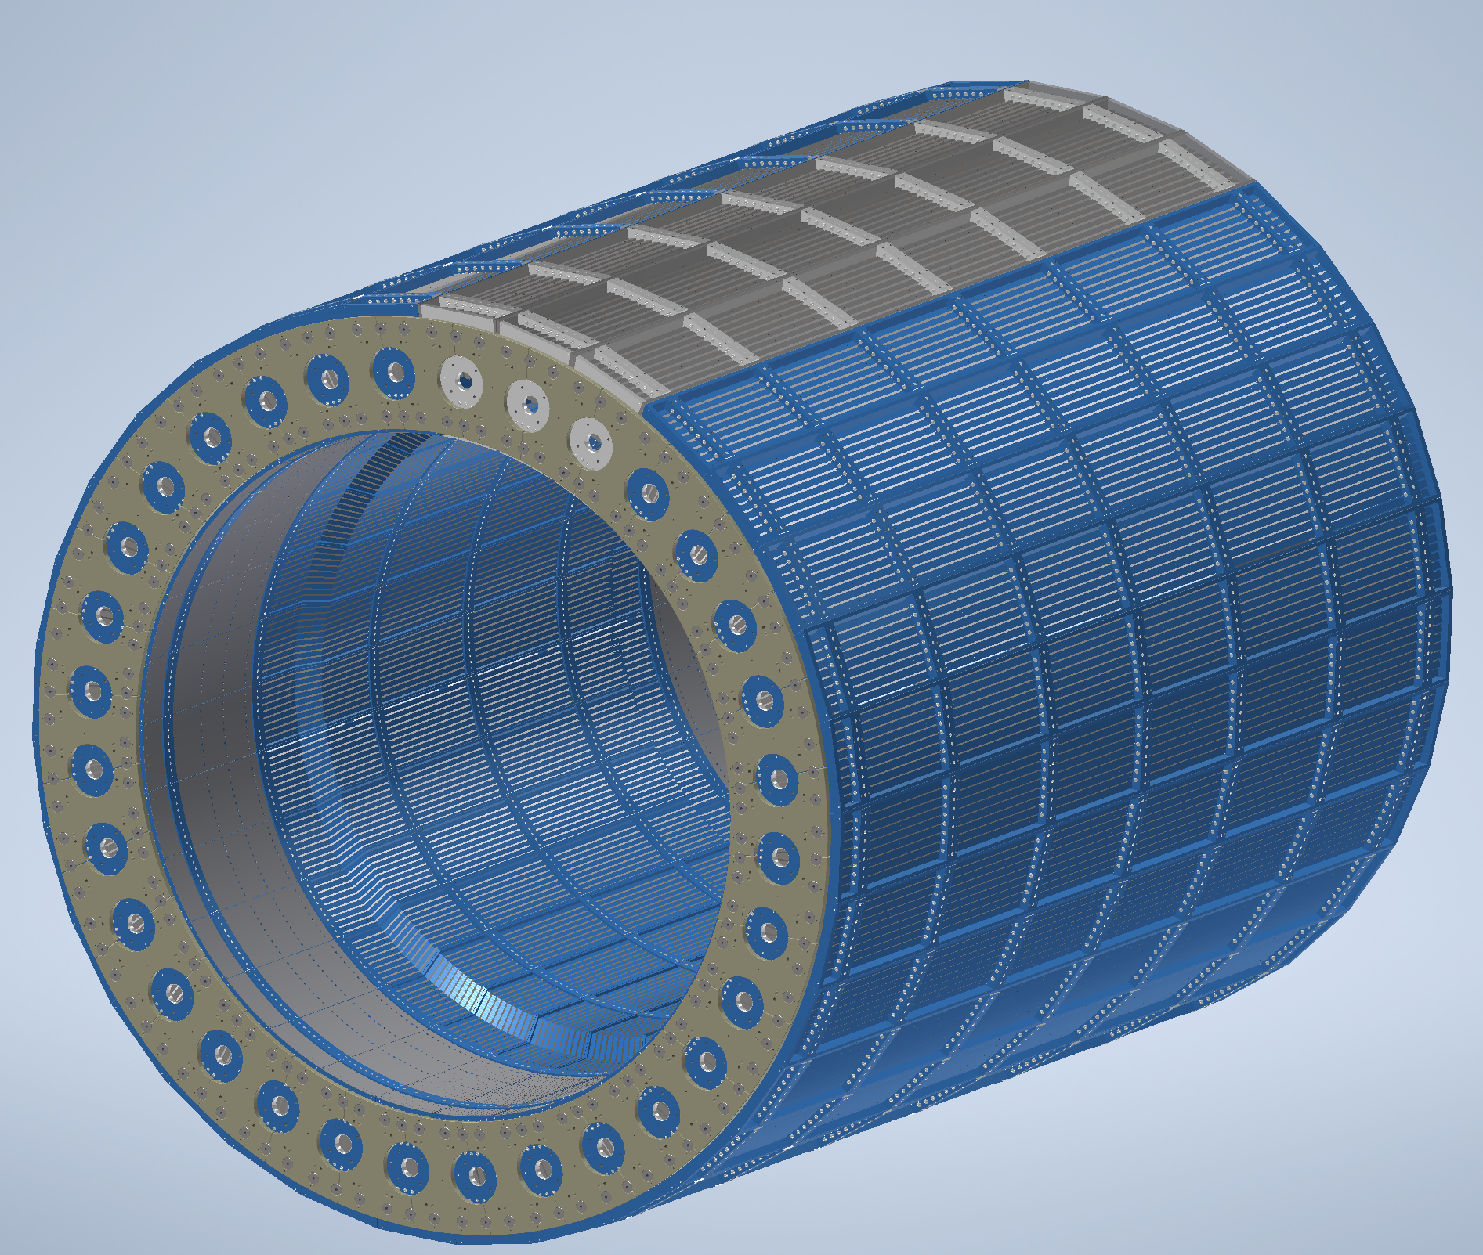
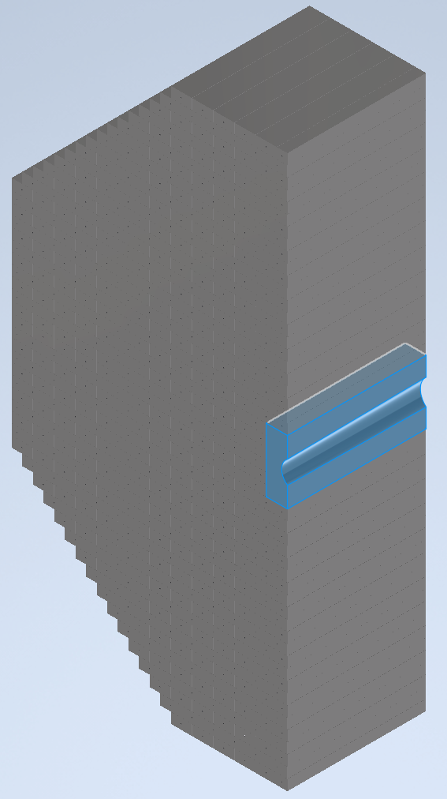
Air Cooling – Detectors
Charge # 5
Barrel HCAL :
Convective Cooling : Electronics : SiPM
Operating Temperature : Room temperature – 25C
Forward HCAL :
Convective Cooling : PCB
Operating Temperature : <40C
SVT Outer:
Air Cooling : L4 and L3 staves
Temperature : +/- 1 C for stability
SVT Inner:
Air Cooling : L0, L1 and L2 staves
Temperature : <5C for stability, Detector Operation : Sensors <30C
SVT Disks:
Air Cooling : ED and HD
Temperature : <5C for stability, Detector Operation : Sensors <30C
Electronics is placed on outside surface in the middle of each sector at z=0
Barrel Hcal
Insert Layers of PCB Carbon Steel thermal analysis under progress to predict air temperature on cone shaped beam pipe
Forward Hcal

Slide 14
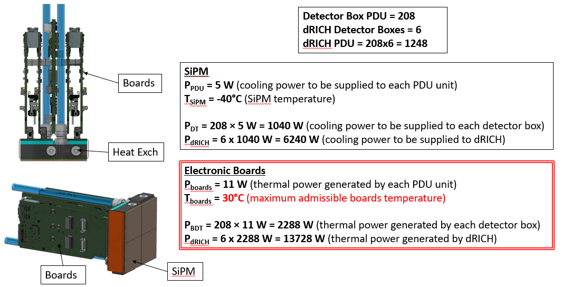
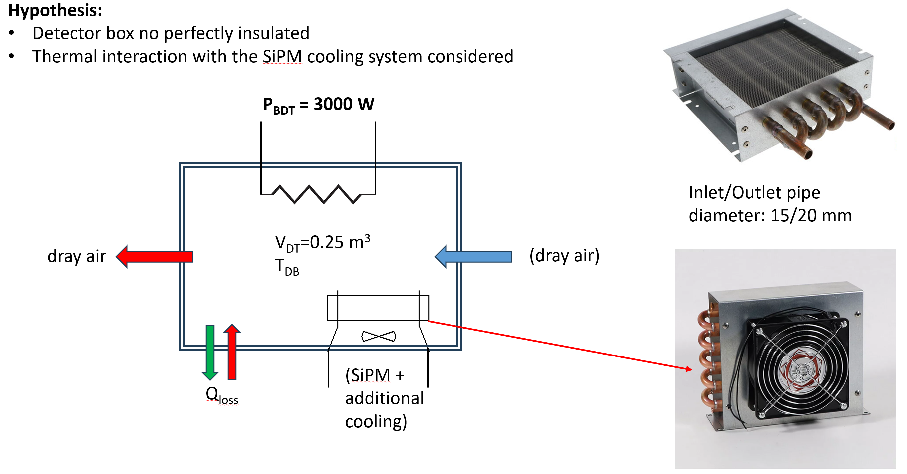
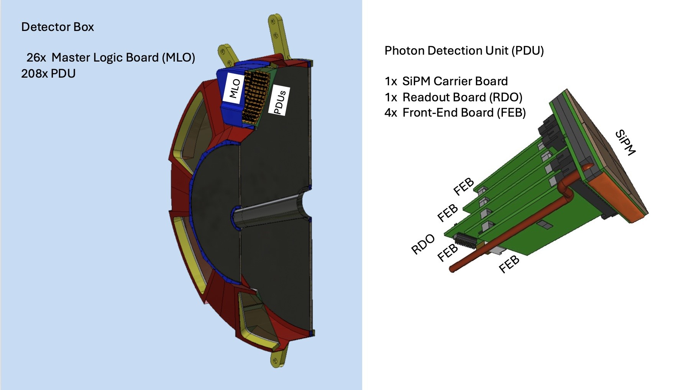
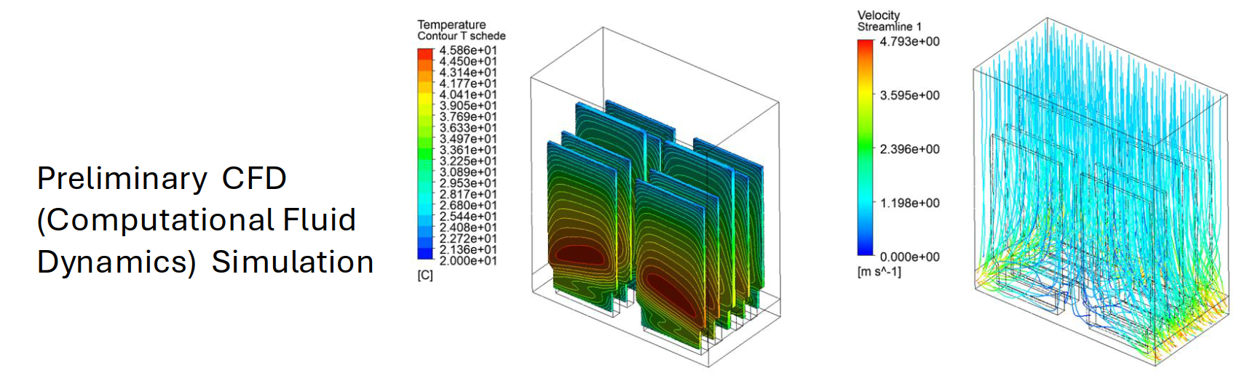
Special Cooling System – Detector
Charge # 5
dRICH :
Heat Sources – Primarily located in Photon Detector Box
Uniform distribution - Physics operation mode
Non-Uniform distribution - Annealing operation mode
Cooling/Heating System – Main Requirements
Heating mode (annealing): Maximum temperature 100 °C
Cooling mode: Minimum temperature –40 °C
Coolant options: Glycol, Silicone oil, or HFE 7100
Cooling system type: Closed-loop system with freeze protection, ideal for both cooling and heating operations, and designed to prevent leakage.
Detector box air cooling

Slide 15
Summary & Next Steps
Summary :
Existing MCW, ACW and Cooling circulator with number of CDUs is sufficient to cool the heat load of the various detector components which are liquid cooled.
Convective Cooling is used to cool other detector components which are air cooled.
Special Cooling systems such as Glycol or Novec is used to cool the dRICH detector.
Global Thermal model development is in progress for various detectors.
Next Steps :
Refine cooling calculations
Decide manifolding sizes and locations
Work with detector groups to determine temperatures, tube sizes, flow rates
Consider cooling interface details

Slide 16
QUESTIONS?

Slide 17
Backup Slides

Slide 18
ES&H
Charge # 3
Minimize potential damage from cooling system (since inner detectors are difficult to service)
Using negative pressure water circulators to mitigate leak concerns (draws air into lines instead of leaking water out)
Make manifolds and cooling services disconnects as accessible and serviceable as possible.
Stringent separation between Modified Chilled Water and Aluminum Compatible Water circuits must be maintained to prevent cross-contamination or chemical incompatibility.

Slide 19
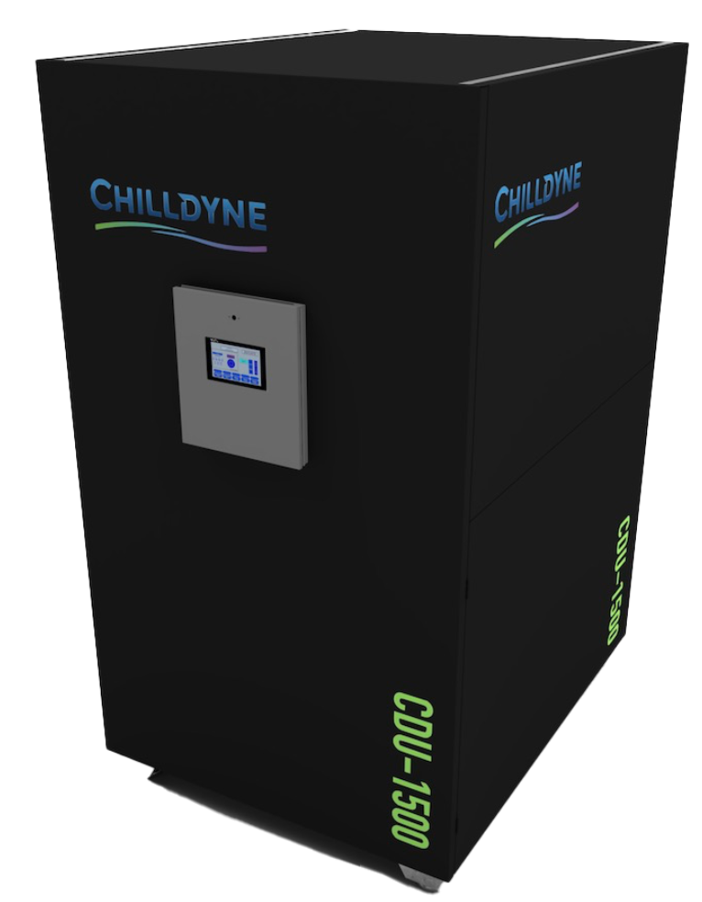
ePIC Detector – Cooling Distribution Unit - CDU
Charge # 5
Chilldyne Option 2
Chilldyne CDU 1500 :
Cooling media | Water/Glycol
Total Heat Load of Electronics | 46
CDU Cooling Capacity | 200
Number of CDUs required | 0.23
Single CDU | 23.00
Margin CDU | 2
density | 1000
Specific Heat | 4186
Temperature rise, ΔT | 2
Pressure available | 0.5
Pressure available | 50000
Mass flow rate | 5.49
Volumetric flow rate | 0.00549
Volumetric flow rate per unit | 329.67
Volumetric flow rate per unit | 87.03
Rated Cooling Capacity (kW) : 1500 kW (1,500 lpm) @ 15°C ΔT
Primary (FWS) Loop: 400 GPM (1,500 lpm) or 25% more than TCS loop max 8 psi (55 kPa) ΔP
Secondary (TCS) Loop: 400 GPM (1,500 lpm) @ 10-29 psi (69-269 kPa) ΔP
Each CDU will operate at 46 kW - 23 percent of it’s rated capacity
Active CDUs – 1, Standby CDU – 1 for backup
Dimensions (L*W*H) inches : 60’’ * 48’’ * 74’’

Slide 20
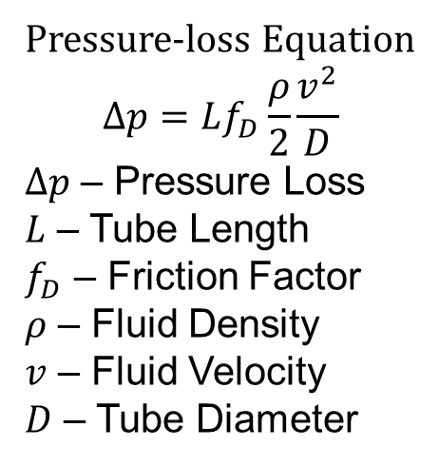
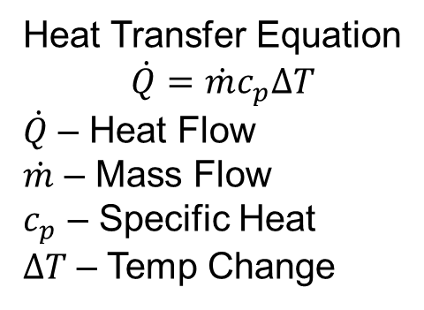
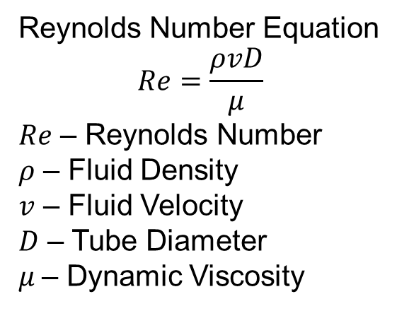
ePIC Detector – Cooling Calculation
Charge # 5
Heat Transfer Equation
$$\dot{Q}=\dot{m}c_{p}∆T$$
$\dot{Q}$ – Heat Flow
$\dot{m}$ – Mass Flow
$c_{p}$ – Specific Heat
$∆T$ – Temp Change
Pressure-loss Equation
$$∆p=Lf_{D}\frac{ρ}{2}\frac{v^{2}}{D}$$
$∆p$ – Pressure Loss
$L$ – Tube Length
$f_{D}$ – Friction Factor
$ρ$ – Fluid Density
$v$ – Fluid Velocity
$D$ – Tube Diameter
Reynolds Number Equation
$$Re=\frac{ρvD}{μ}$$
$Re$ – Reynolds Number
$ρ$ – Fluid Density
$v$ – Fluid Velocity
$D$ – Tube Diameter
$μ$– Dynamic Viscosity

Slide 21
ePIC Detector – Detailed Calculation
Charge # 5
Barrel EMCAL
Barrel HCAL
 |  | Units
Cooling media | Natural Convection
Caloroc Board Heat Load | 5 | W
Number of Caloroc boards in each sector | 8
Sector Heat Load | 40 | W
Total Number of Sectors | 32
Total Heat Load | 1280 | W
Density | 1.2 | kg/m^3
Specific Heat | 1005 | J/kg C
Temperature rise | 22 | C
Flow Rate | 0.0482 | m^3/s
Flow Rate | 102.22 | cfm
Heat transfer coefficient required | 5.87 | W/m^2- C
Read out box width | 0.2 | m
Read out box length | 0.4 | m
Read out box area | 0.08 | m^2
Number of electornics read out boxes | 8
Total Surface Area | 9.92 | m^2
Total Length | 6.2 | m
Total Width | 1.6 | m
 |  | Units
Cooling media | Water
Chiller flow rate | 400 | gpm
Chiller flow rate | 1514 | lpm
Chiller flow rate | 0.02523 | m^3/s
Chiller flow rate | 25.23 | kg/s
density | 1000 | kg/m^3
Specific Heat | 4186 | J/kg C
RH | 65 | %
Ambient Temp | 72 | F
Ambient Temp | 22.2 | C
Dew Point Temp | 60 | F
Dew Point Temp | 15.3 | C
Inlet Temp | 64.4 | F
Inlet Temp | 18.0 | C
Temperature rise ΔT | 0.029 | C
Outlet Temp | 18.029 | C
Astropix Chip | 43.5 | W
End of Tray Card | 7.2 | W
Astropix Module PCB | 10.9 | W
FEB | 3 | W
ESB Sector Heat load | 64.6 | W
Number of sectors | 48 | W
Total Heat Load | 3100.8 | W
Temperature rise ΔT | 2 | C
Required flow rate | 0.370 | kg/s
Required flow rate | 0.000370 | m^3/s
Required flow rate | 22 | lpm
Dynamic Viscosity | 0.001 | Ns/m^2
Length | 5 | m

Slide 22
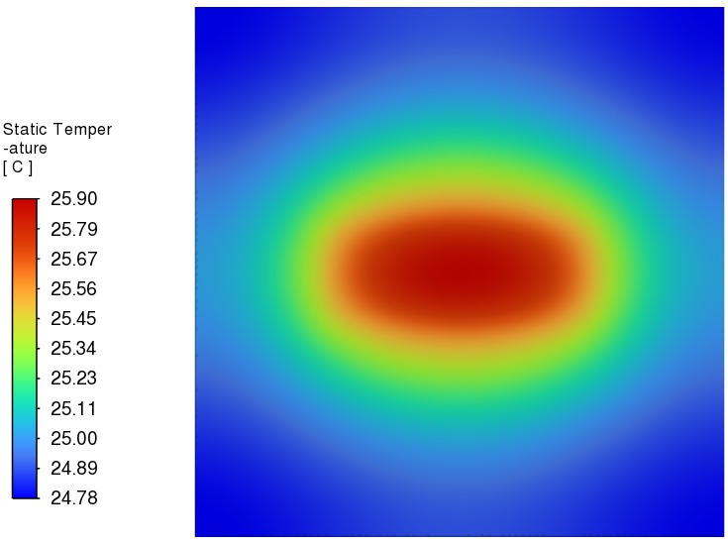
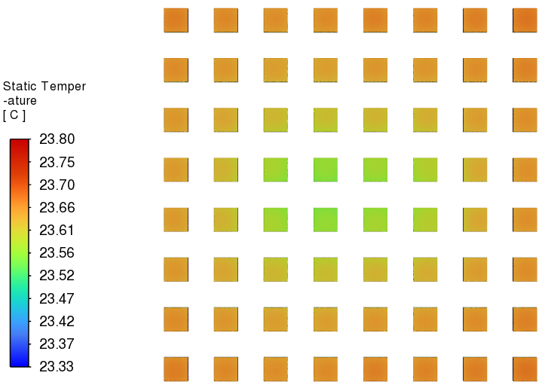
ePIC Detector – Global Thermal Model
Charge # 5
Forward Emcal CFD Simulation :
FEB Temperature
SiPM Temperature
Ambient Temperature (C) | Flow velocity (m/s) | Half FEB Heat load (W) | SiPM Heat load (W)
20 | 0.76 | 2.25 | 0.17
Heat Transfer Coefficient (W/m^2 C) | Water Inlet Temperature (C) | FEB Temperature (C) | SiPM Temperature (C)
5 | 22 | 25.9 | 23.8

Slide 23
Liquid Cooling – Detectors
Charge # 5
TOF :
Electronics :
SVT Outer :
Electronics : FIB, FIB-CB, FPC-CB
Temperature : +/- 5 C, Detector Operation : 18 C
SVT Inner :
Electronics : SIB, SCB, DPB
Temperature : +/- 5 C, Detector Operation : 18 C
SVT Disks :
Electronics : FIB, FIB-CB, FPC-CB
Temperature : +/- 5 C, Detector Operation : 18 C
MPGD Endcap Disks :
Electronics : FEB
Temperature : FEB: +/- 2C, Detector Operation : 15 to 25 C

