Slide 1
Power cables
IBs to PP
Georg Viehhauser with lots of help from Nico Rotolo (Oxford)

Slide 2
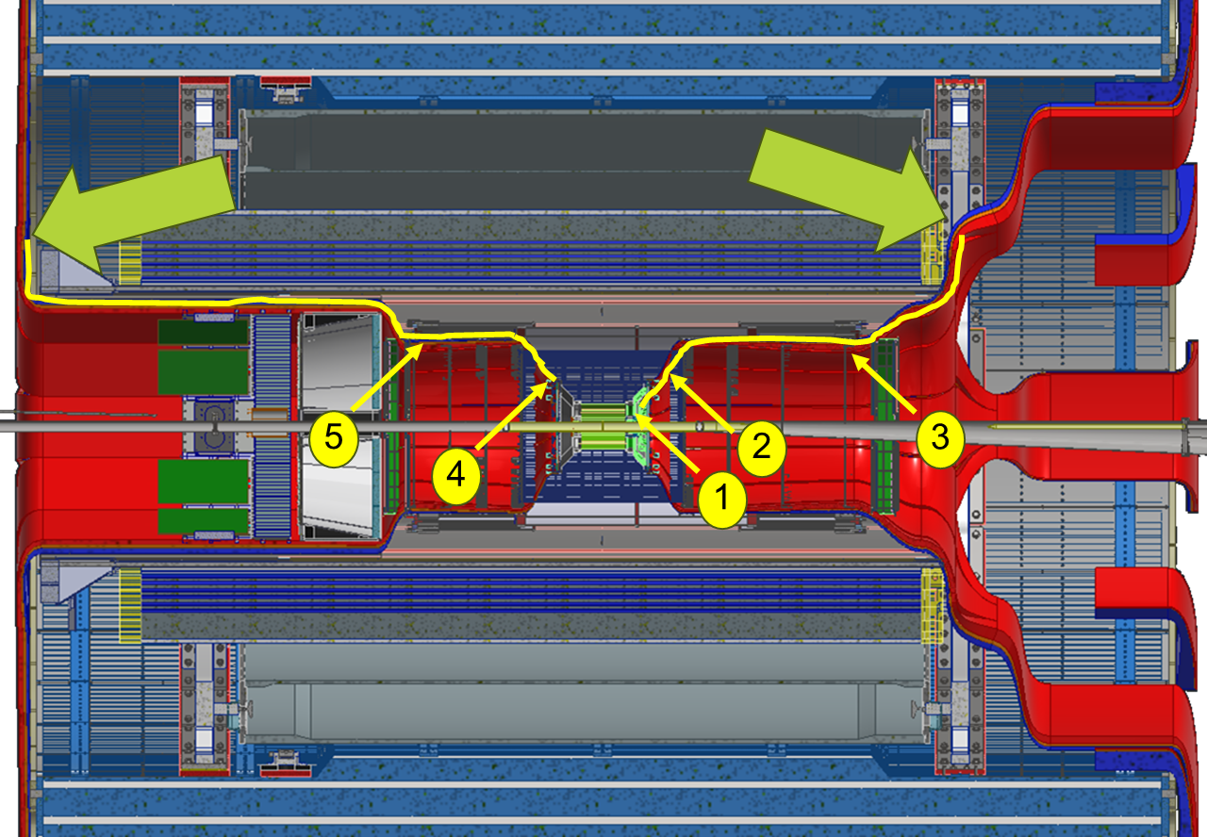
Geometry
Service installation up to the PPs will be responsibility of SVT
Installed as part of the SVT half-barrel integration
Service supports need to be present for that
Will need to pivot inside for TOF and cymbal installation (which is after SVT insertion) at the blue arrows
Service supports need to allow for that
Angle will need to be defined
Lengths (courtesy Roland):
EPP
HPP
Forward (Hadron) Side | Length [cm]
End of L1 to HPP | 245
Point 1, end of L2 to HPP | 250
Point 2, end of L3 to HPP | 225
End of L4 to HPP | 195
Point 3, HD4 to HPP | 100
Backward (Electron) Side
Point 4, end of L3 to EPP | 350
End of L4 to EPP | 320
Point 5, ED4 to EPP | 225

Slide 3
What we know (sort off)
Connectors at both ends
Low material and size at FIB end (pair of conductors)
PP connector needs to convert from AWG18 to AWG10
Length between 1 and 3.5 m
Max. current 2A, max. voltage 48 V (same cable for serial powering chains and control boards)
Total number about 1300 pairs
AWG18 Cu-clad Aluminium
Twisted pairs – one pair per FIB
Need to decide on the number of pairs in one cable
Need some form of cladding for mechanical protection
We don’t know yet whether we need shielding on the power cables
We suspect no, as we are supplying current, but that needs some more thinking. Input welcome
Inside the SVT, multi-core cable will need to fan out to individual FIBs
Cables need to satisfy NEC 2021 NFPA 70 based standards

Slide 4
Schematics
SVT
Cable trays
Patch Panel
(is this a PCB board
or just a faceplate with
connectors mounted on it?)
Overall length between 1 and 3.50 m
FIB
2 wires (a twisted pair)
C2-M
C2-F
HPP
EPP
FIB
2 wires (a twisted pair)
10AWG copper
C1-M
C1-F
2 A constant current
18AWG copper-clad Aluminium
FIB
2 wires (a twisted pair)
What is smallest conduit cross-sectional area?
What is sharpest conduit bend radius?
Faceplate (PP)
Branch length XX mm
18AWG aluminium
10AWG copper
FIB
2 wires (a twisted pair)
C1-M
C1-F
How do you do the transition from 18awg to 10awg
do you create a PCB with two different connectors
or do you use the same connector that can accommodate
both wire sizes with the same crimp terminal?
D-Sub power connector terminal can do the transition

Slide 5
Discussion with supplier
We have started communication with Axon
We have worked with Axon on cables for ATLAS (much more complicated, different wire gauges and pins in cables and connectors)
They are aware of the constraints and technical and financial aspects of PP projects
Pricing will be decided after the design is finalised and depending on quantities and other factors such as the sourcing of third party components such as the wire themselves and the low mass cable screen
Most of the process is done in-house
In this case insulation, stranding, overbraiding and jacketing
For Copper conductors they plate, draw and strand most variants themselves, but Aluminium conductors they buy in
Copper-clad Al cores were surprisingly the most expensive for them to procure with the silver-plated copper-clad Al in the middle and silver-plated Cu the cheapest
Difference in the final assembled cable cost between all three should be <20% and for final assemblies <10%
They offer cables rated for 300 Mrad (as in ATLAS), we need ~ 10 krad

Slide 6
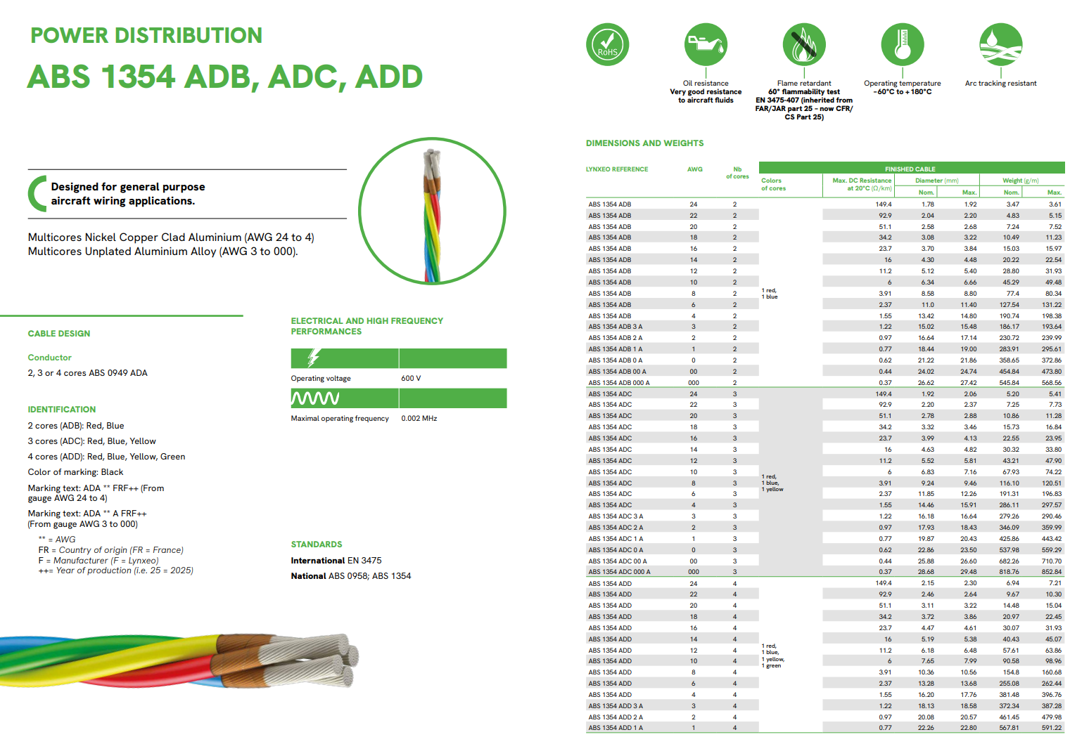
Some examples: cable option 1
Lynxeo Catalogue Aeronautique.pdf

Slide 7
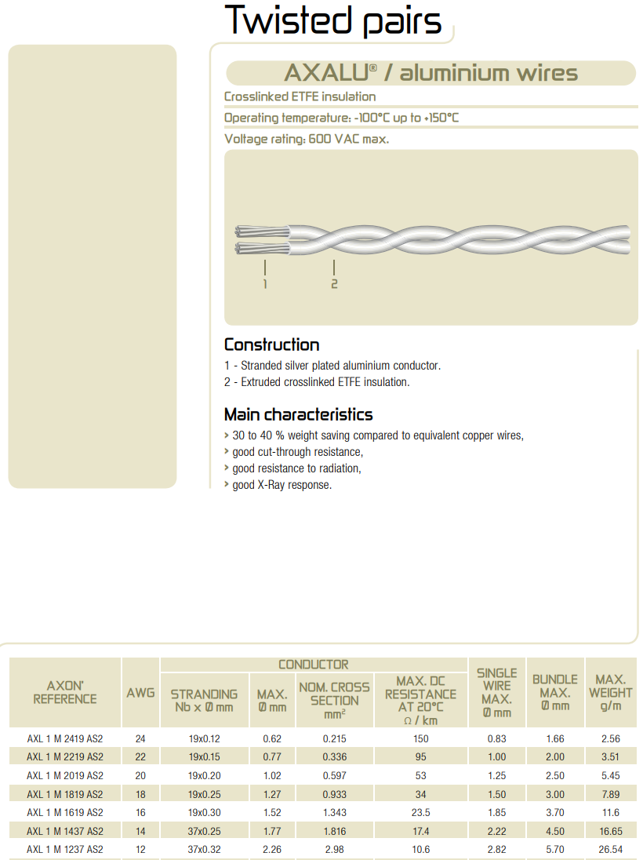
Some examples: cable option 2
axon-space-ESA-Axalu_cg.pdf

Slide 8
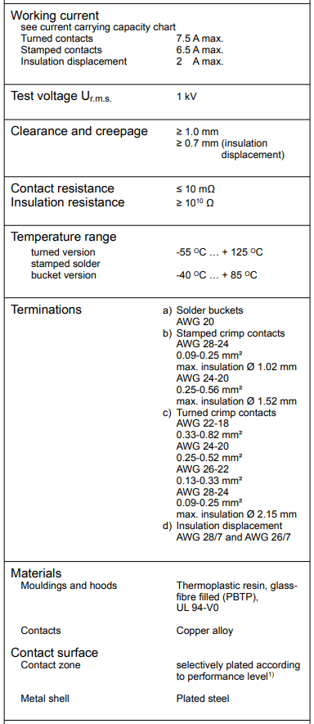
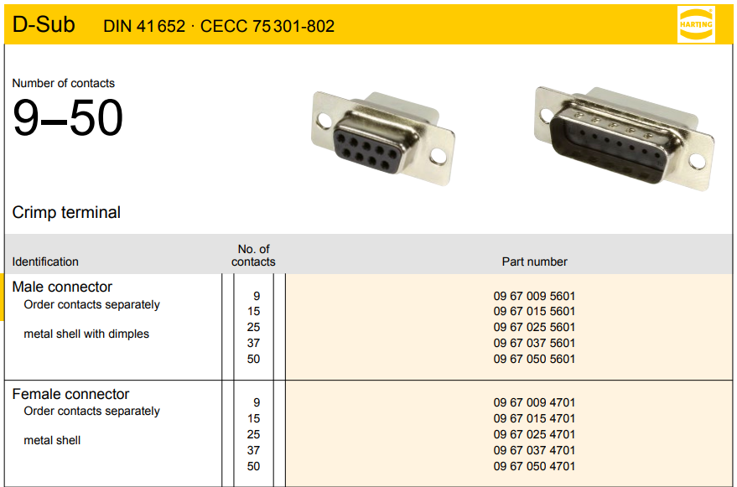
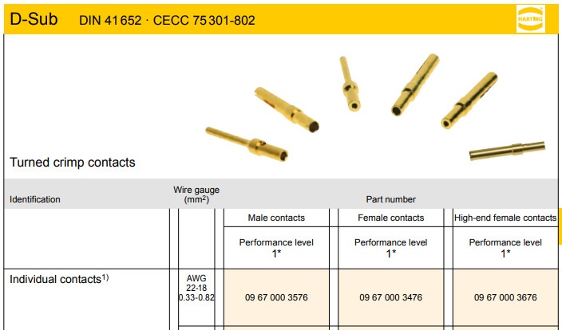
Some examples: connector option 1
livebook.pdf
Standard D-Sub connectors from Harting

Slide 9
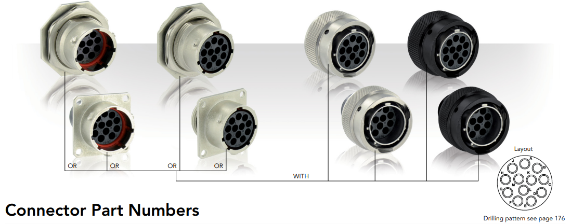
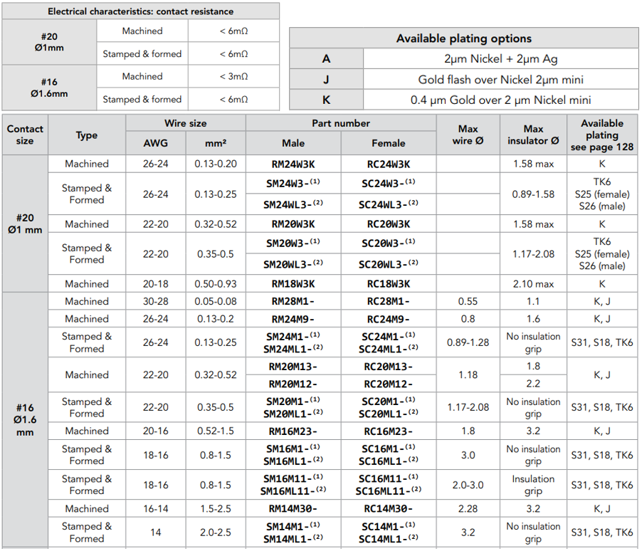
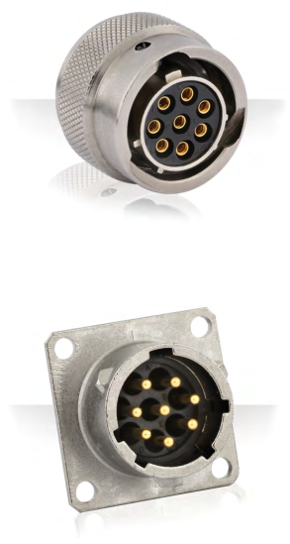
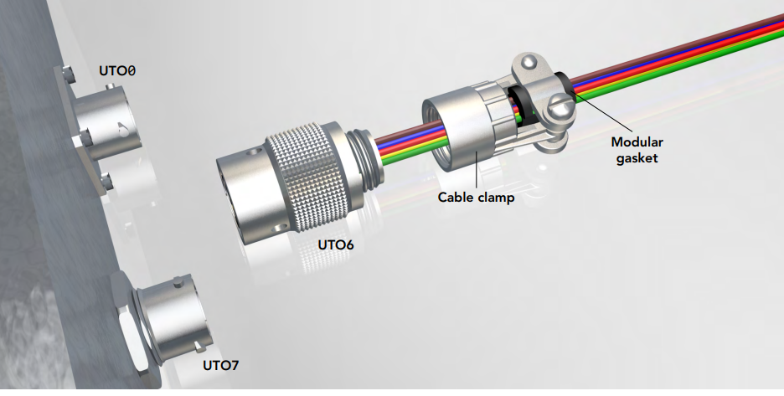
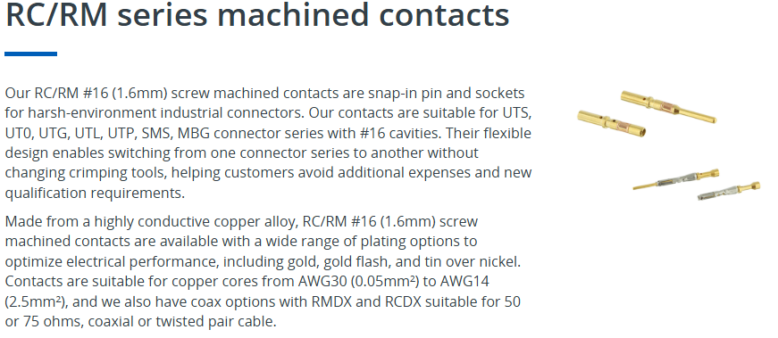

Some examples: connector option 2
eaton-souriau-robust-metal-shielded-connector-UTO-catalog-en-eu.pdf or UTG series | Eaton

Slide 10
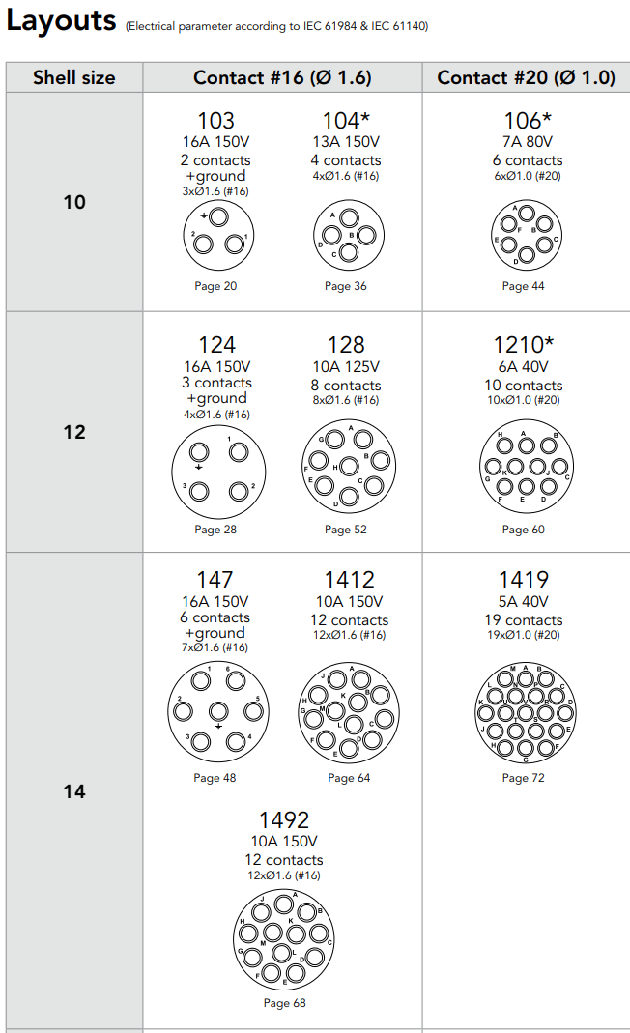
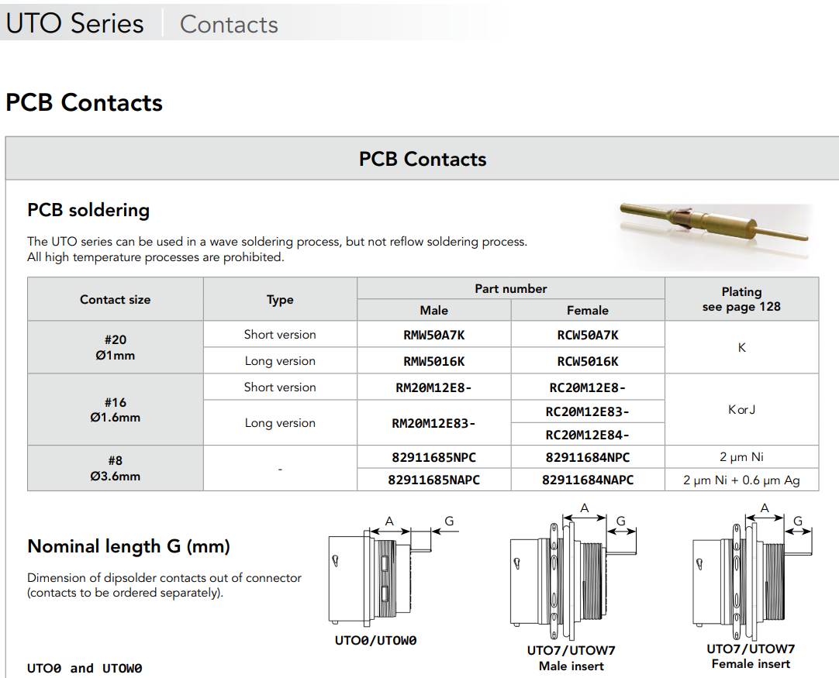
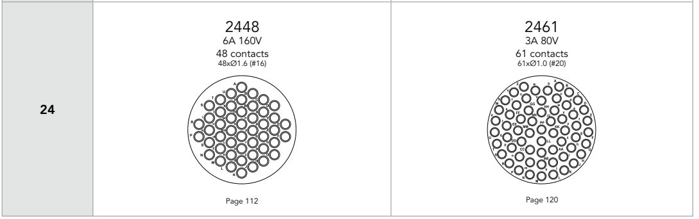
Some examples: connector option 2 cont’d
With the use of the ‘PCB contacts’ the connectors can be mounted on a PCB,
but note, no right-angle contacts
Connector available from 4 to 48 or 61 contacts

Slide 11
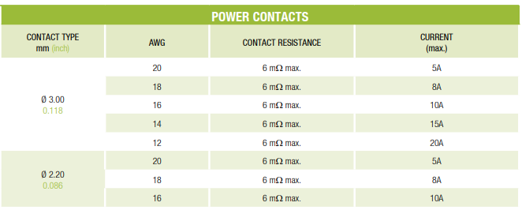
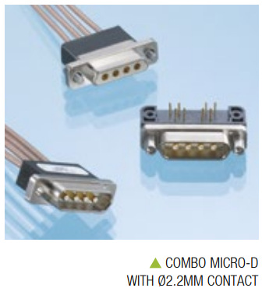
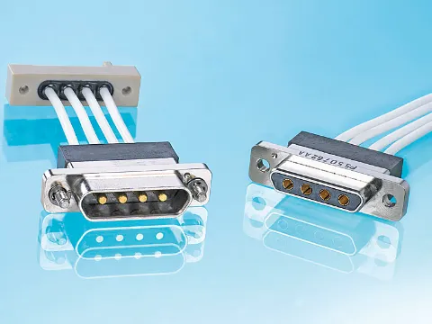
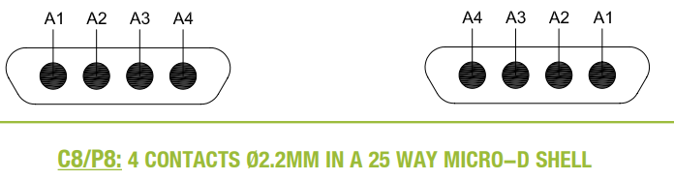
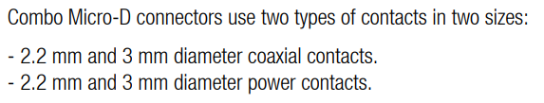
Some examples: connector option 3
axon-micro-D-connectors-rectangular_cg.pdf
Micro-D connectors with ‘power pins’ to accommodate 18AWG wire
Note, Micro-D connectors come pre-wired with wire ‘pigtails’, there are no separate crimp terminals

Slide 12
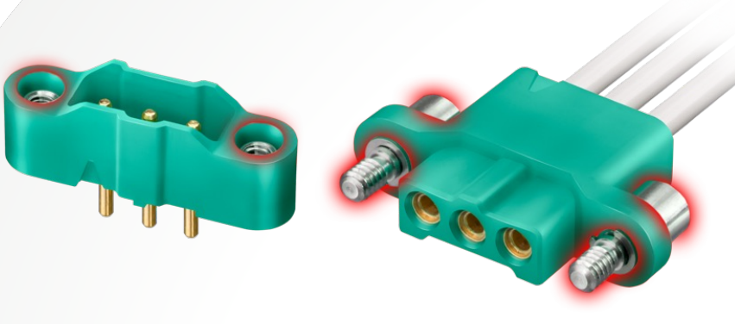
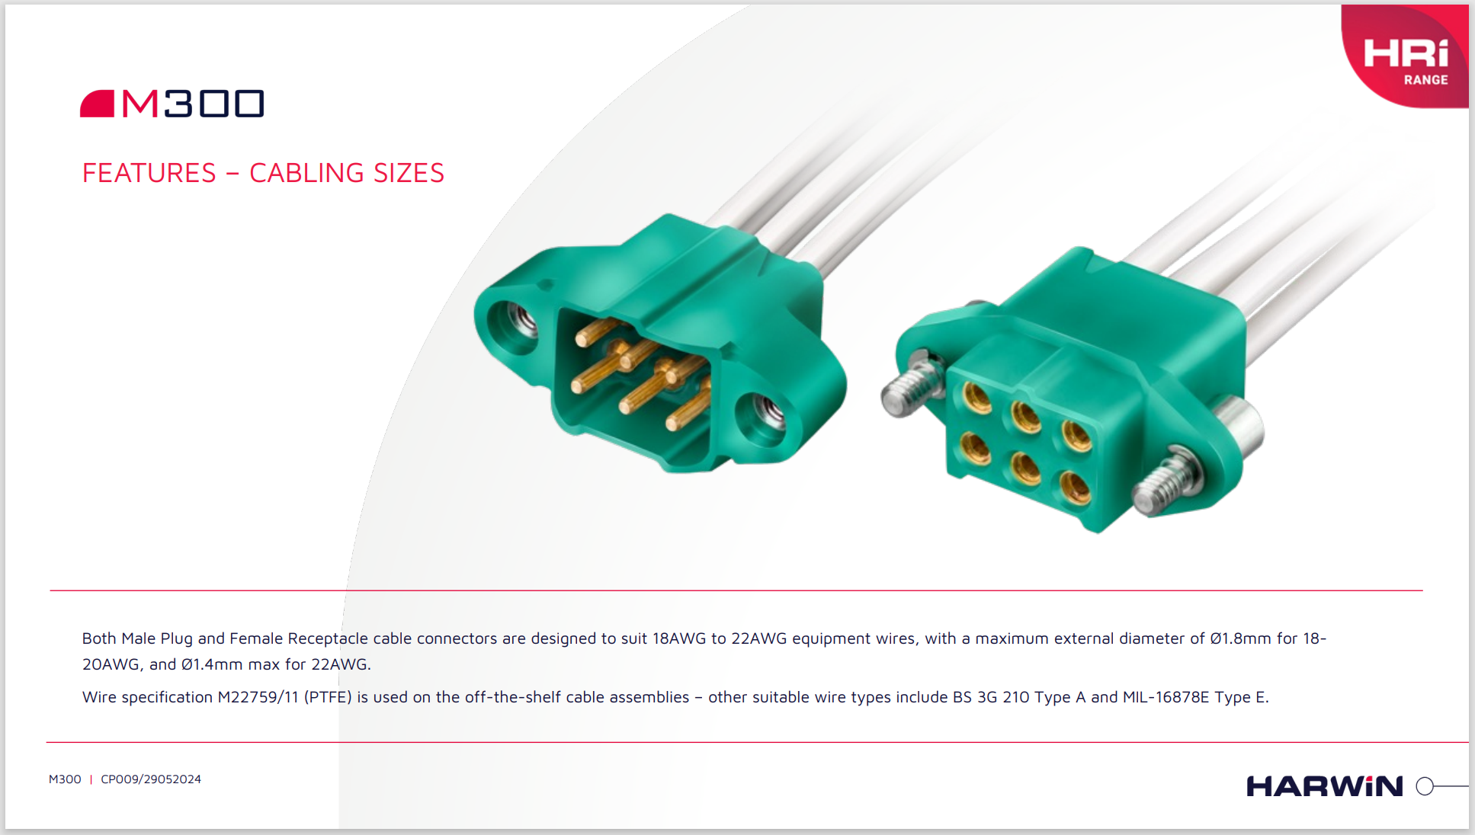
Some examples: connector option 4
Harwin Hi Rel Brochure July 25 v3.indd

Slide 13
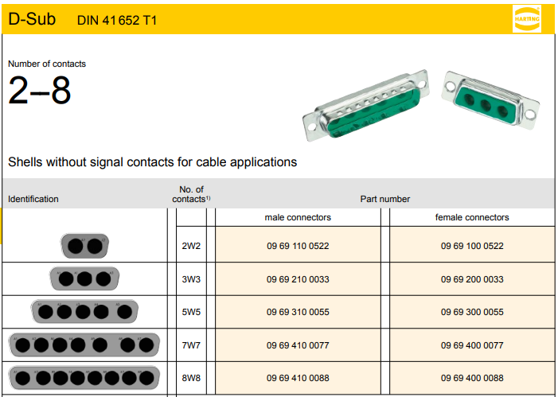
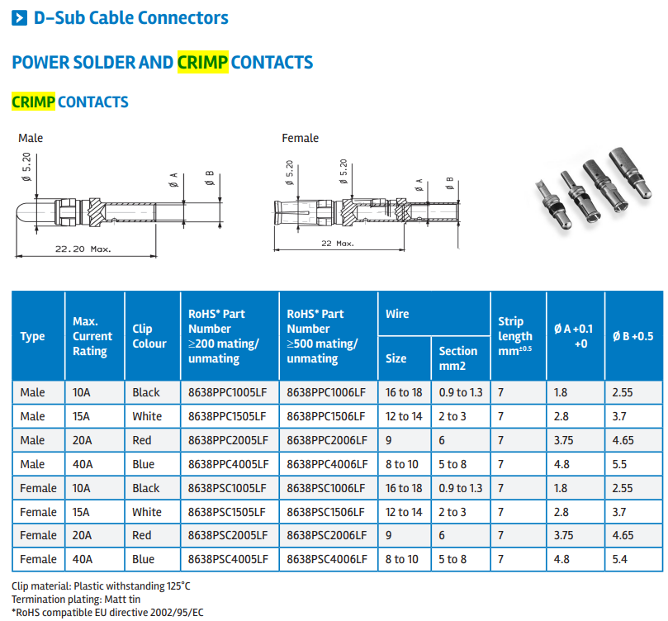
Some examples: connector option 5
io_dsub_brochure.pdf
Amphenol, D-Sub Mixed and Full Power DW Series

Slide 14
Further comments from Axon
One of the questions that came up in the discussion with them was whether the connector material must be non-magnetic
In ATLAS this was a requirement (although never quantified), and this has been solved by using metal-coated PEEK connector housings
For the FIB connector:
‘Combo Micro-D C8/P8’, do you have a plastic version of it? Do you have anything similar to ‘Harwin M300’ connectors?
Whilst not a catalogue part they can make PEEK versions of Combo P8 and other similar connectors shown in our catalogue
Have used custom 1-way, 2-way and 6-way connectors before
The M300 connectors will only come with the standard options so if we need <200nT this is likely not to be suitable whereas they can adapt/customise their design to meet tighter requirements
PP connector:
‘Souriao UTG (or UTO)’ series of multi-way circular connectors - Do you have anything similar?
Again this is not a catalogue option but they have made Circular Micro-D with combo style inserts utilising the same larger gauge contacts from their combo Micro-Ds
There may be other inherently low-mag options off-the-shelf

Slide 15
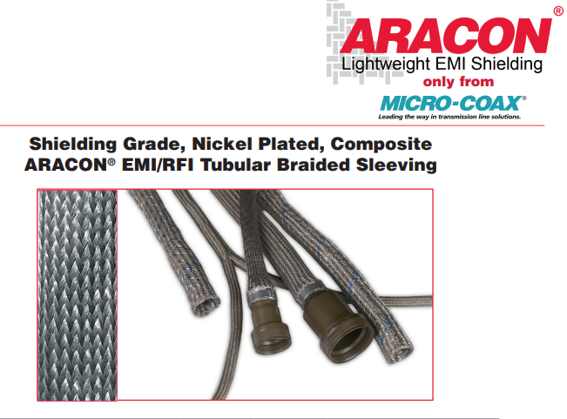
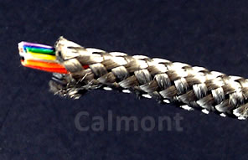
Some examples: Low-mass shielding
330185-Micro-Coax-datasheet-41316139.pdf
This is used in ATLAS power cables

Slide 16
CB to FIB

Slide 17
Specifications
We currently think a 25-way nano-D connector will be sufficient
Current geometry:
Surface mount, right-angle connector on the CB
Through-hole, straight connector on the FIB
Connected with a multicore cable of the required 25 wires with common shield
Signals are not particularly fast
Material is again copper-clad aluminium
Each wire a maximum of 30AWG (nano-D cannot fit larger)
Cable with different diameters possible, cables will be customised anyway, standard procedure for Axon (and other suppliers)
ARACON low mass shielding
Cable assembly will be terminated at both ends with connectors
Nano-D connectors cannot be terminated by user

Slide 18
Open questions
How many assemblies?
What is the estimated maximum length of the assembly?
Calculation of the voltage drop along the wires may be needed because it is a very thin (30AWG) aluminium wire
Any preference for the gender of the connectors on the boards?

Slide 19
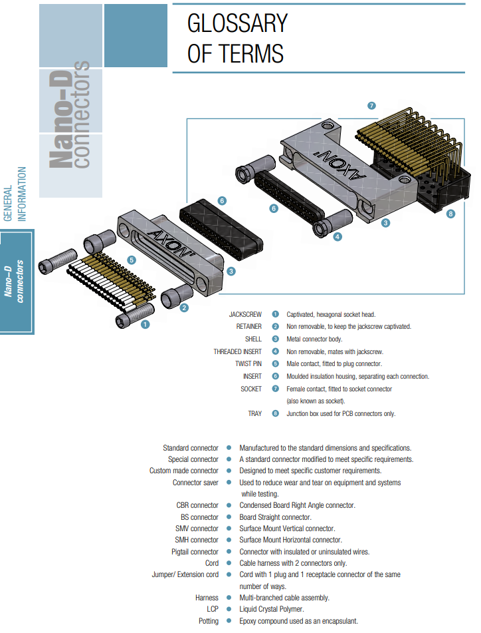
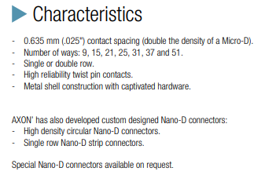
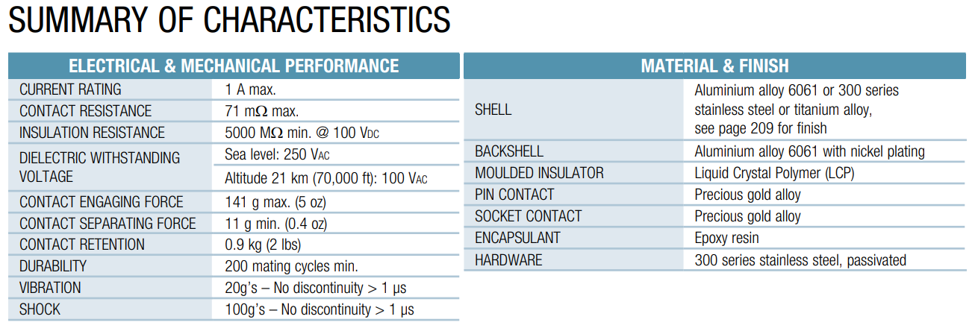
‘AXON cable’ nano-D connectors
A link to the datasheet\catalogue axon-nano-D-connectors_cg.pdf

Slide 20
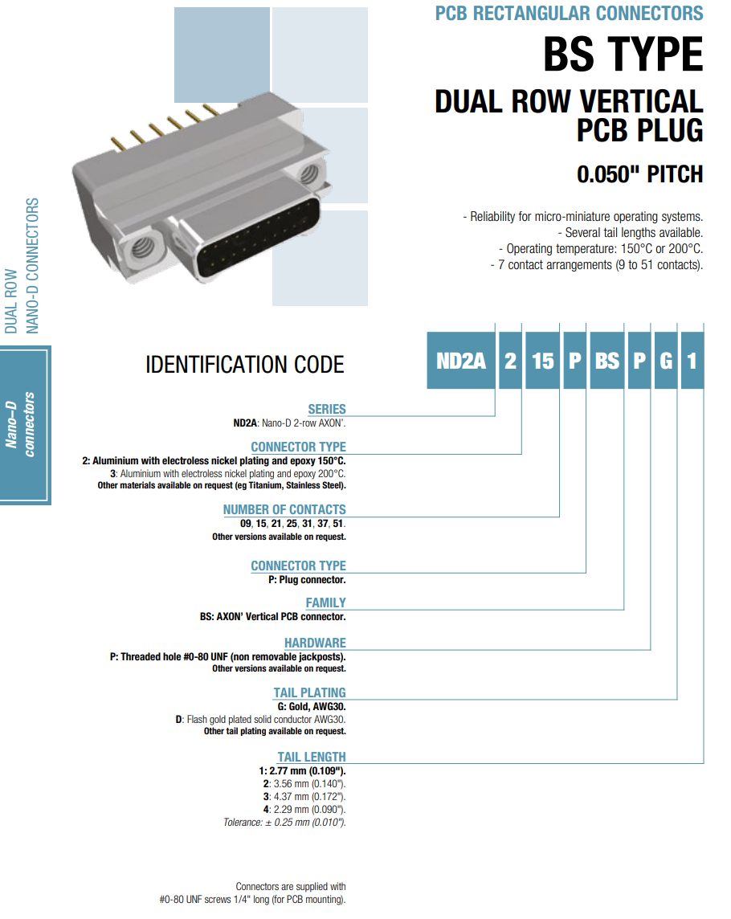
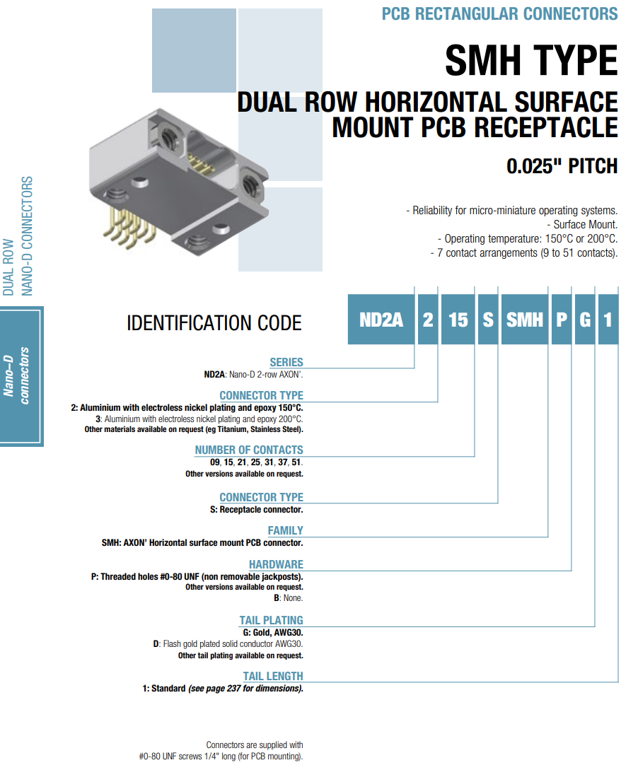
Connector for the FIB board
ND2A 2 25 P BS P G 1 ?
Connector for the CB board ND2A 2 25 S SMH P G 1 ?

Slide 21
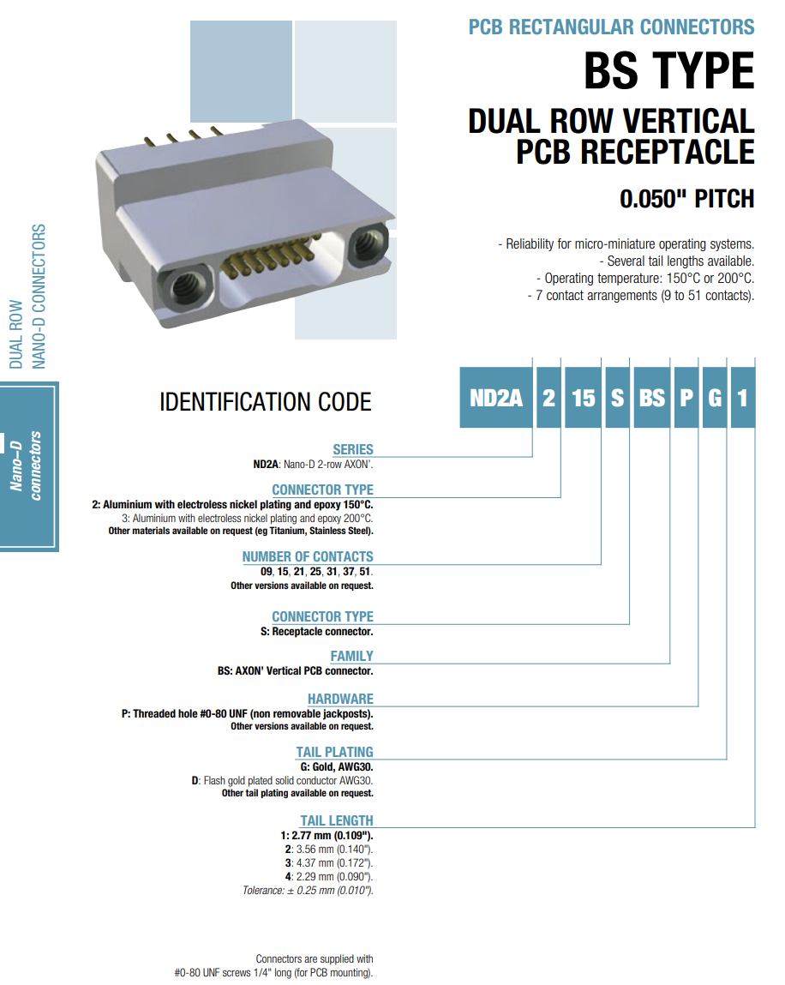
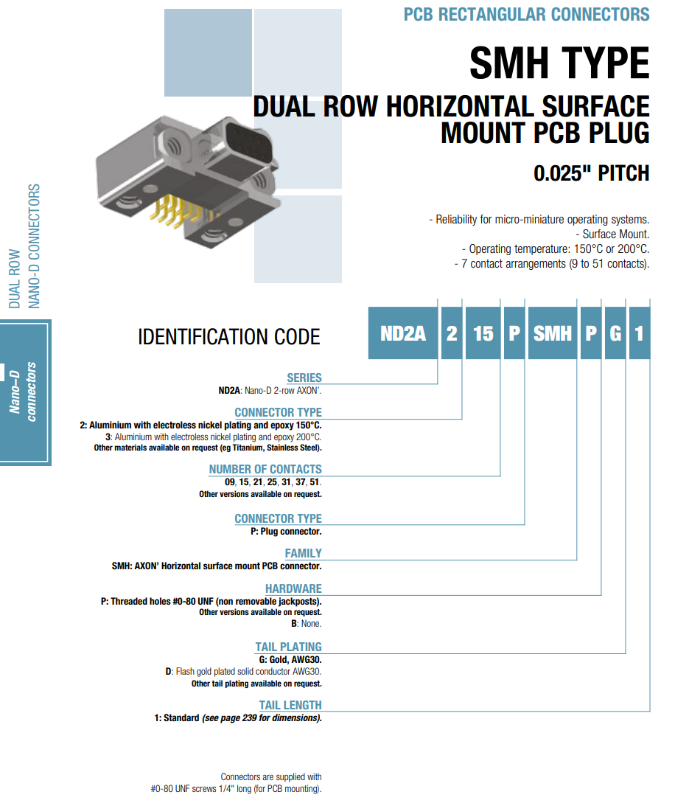
Connector for the FIB board
ND2A 2 25 S BS P G 1 ?
Connector for the CB board ND2A 2 25 P SMH P G 1 ?

Slide 22
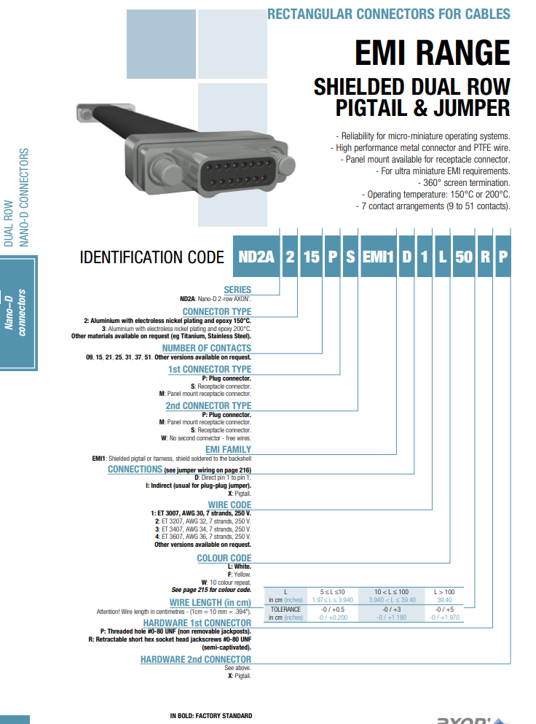
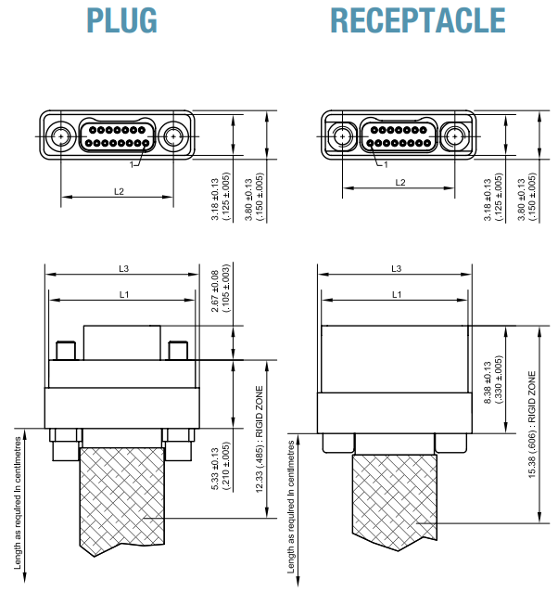
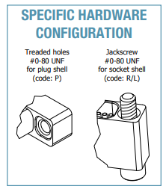
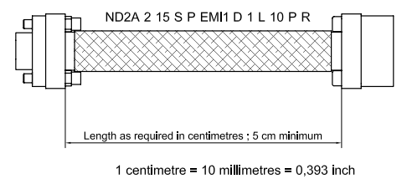
CABLE ASSEMBLY
Cable to be ordered as ‘jumper cable’
plug with jackscrews at one end
and receptacle with jackscrews at other end
likely identification code:
ND2A
2
25
S
P
EMI (custom spec, ARACON, clamp, not soldered)
Connections (D, pin1 to pin1, custom?)
Wire code (custom spec, 30 AWG AXALU wire)
L
Wire Length in cm
R
R
Note: orient the connectors on the boards so that the cable is not twisted when connected

Slide 23
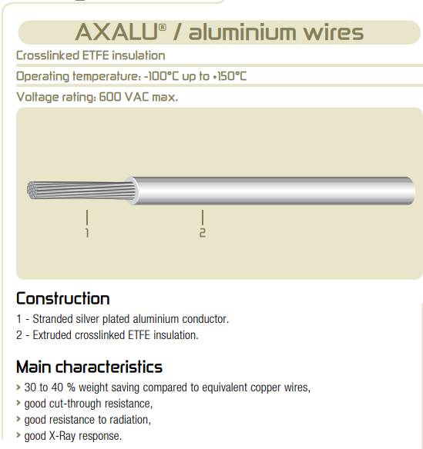
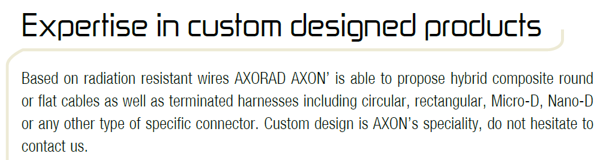
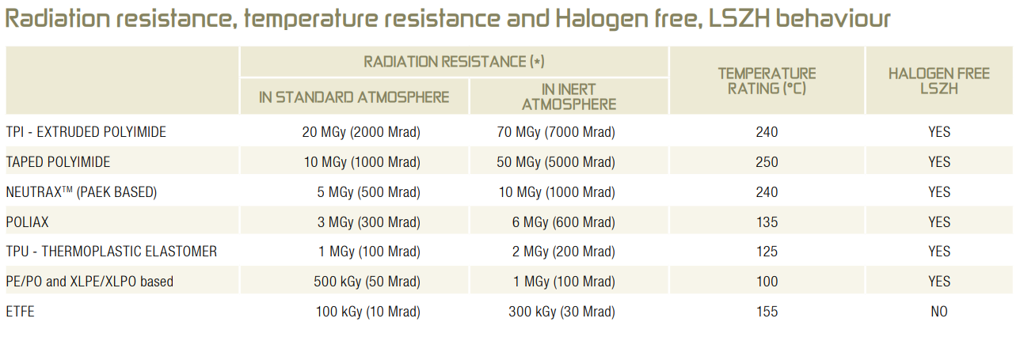
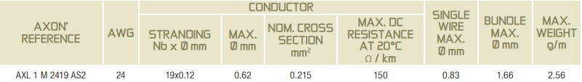
Wire for the cable
Insulation for the wire
AXALU® silver plated aluminium conductor, thickness of silver plating is 2um
A Link to datasheet\catalogue here: axon-space-ESA-Axalu_cg.pdf
Note: insulation of the standard catalogue product is ‘Extruded crosslinked ETFE’ which is not LSZH but they can custom produce the wire with a radiation resistant and LSZH insulation, see below for available wire insulation types.
A link to datasheet\catalogue here: axorad-radiation-resistant-cables_cg.pdf
wire
insulation
Note: it is not Copper Clad Aluminium wire, but if necessary, AXON should be able to source them
Note: wire gauge of the standard catalogue product is 24 AWG, but AXON should be able to custom produce a 30 AWG gauge wire
Note: wires to be made into a custom made cable

Slide 24
Further material

Slide 25
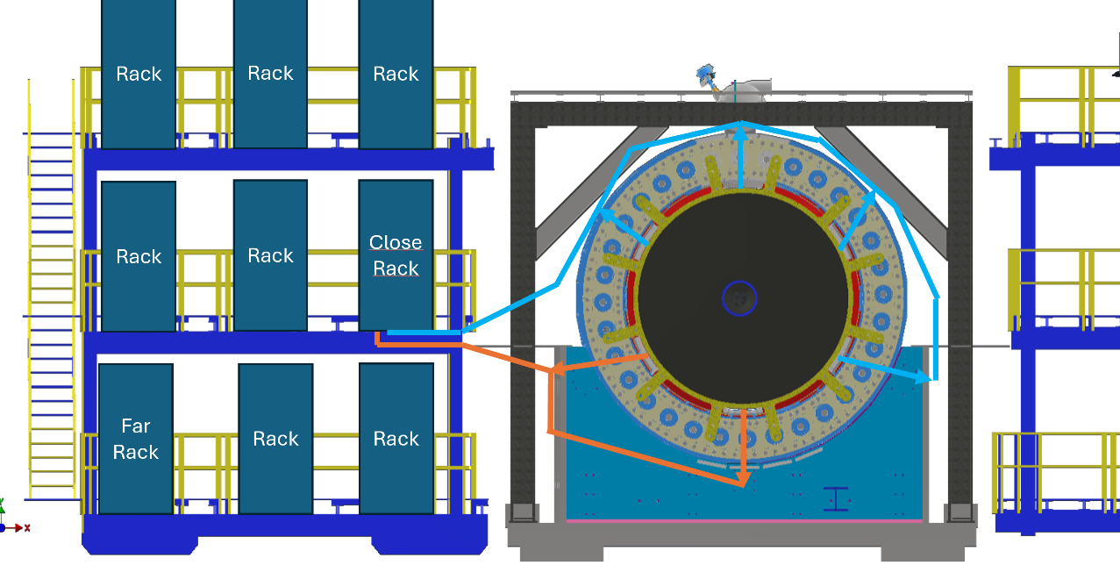

Outside cable lengths
External cables have to run around dRICH service boxes
Will get split into 6 runs as evenly as possible around those 6 boxes
Cable lengths from PPs to power supplies will depend on
Phi of cable exit from ePIC
3 o’clock position versus 9 o’clock position is about an 8 m difference
Rack allocation
Closer racks cable lengths would be 4 m to 12 m
Far away racks cable lengths would be 10 m to 18 m
Electron side versus Hadron side doesn’t really matter for this

Slide 26
CB-to-FIB cable wires
3 x diff pair for FPC S/Cs (6 wires)
VTRx+ power (2V5 domains could be supplied by 1 source, GND could be shared for all domains) (3-6 wires)
1V2 Tx domain (VCCT1V2)
2V5 Tx domain (VCCT2V5)
2V5 Rx domain (VCCR2V5)
GND needed
VTRx+ I2C (share GND with power domains?) (2-3 wires)
SCL
SDA
Laser driver controls (2 wires)
Reset
Disable
RSSI (Rx current monitor) (1 wire)
VTRx+ thermistor (2 wires)
2 terminal interface
Voltage sense (for VTRx+ domains) (3-4 wires)
1V2 domain
Shared or separate 2V5 domains?
GND sense (to account for V-shift on both rails)
Minimum only includes 1 x GND wire (we probably want more)! Minimum is 19, we go for 25

