Slide 1
AncASIC Overview - Powering
Iain Sedgwick
Co-convener WP1
SVT Working Meeting
Oxford December 15th – 19th, 2025

Slide 2
Introduction
AncASIC – Updated Plans and Integration
  Updated Plan
  Pad List
  DSA and SOS
Update on Power Numbers
  Summary of Previous Data
  Updates
  Re-simulation
Subtleties of Powering
  Tolerances, variation and operating region
  Failure Modes
  Startup
Conclusion
  Summary
  Points for later discussion
SVT Workfest, Dec 15th – 19th

Slide 3
AncASIC – Updated Plan and Integration

Slide 4
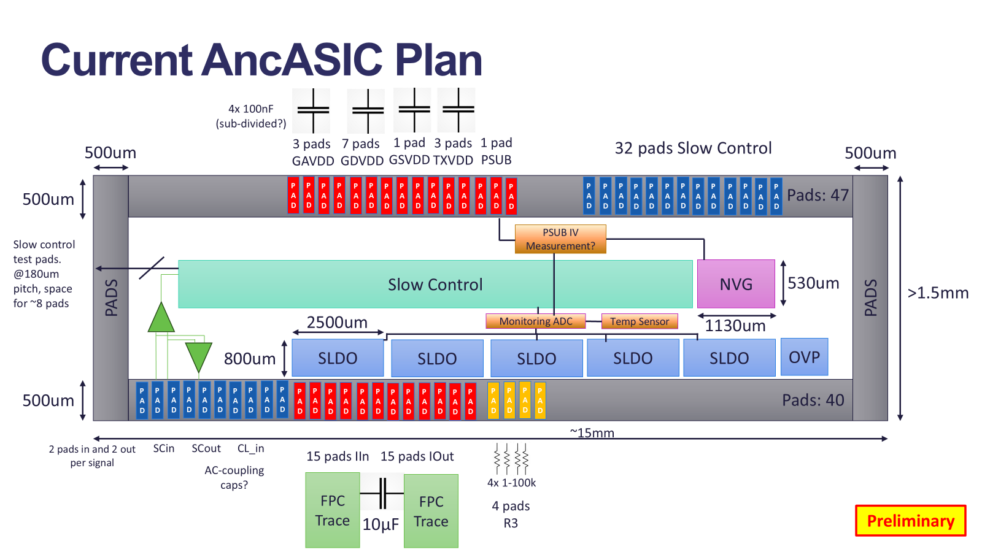
AncASIC - Updated Plan
SVT Workfest, Dec 15th – 19th

Slide 5
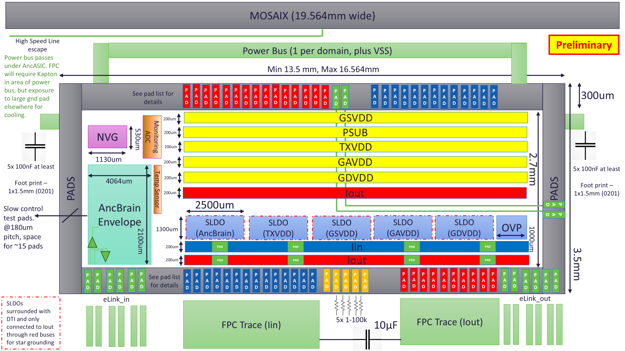
AncASIC - Updated Plan
Still being developed…
SVT Workfest, Dec 15th – 19th

Slide 6
AncASIC - Updated Plan
Grzegorz’s talk - AncBrain and Software interfacing
This talk - Power and FPC interfacing
SVT Workfest, Dec 15th – 19th

Slide 7
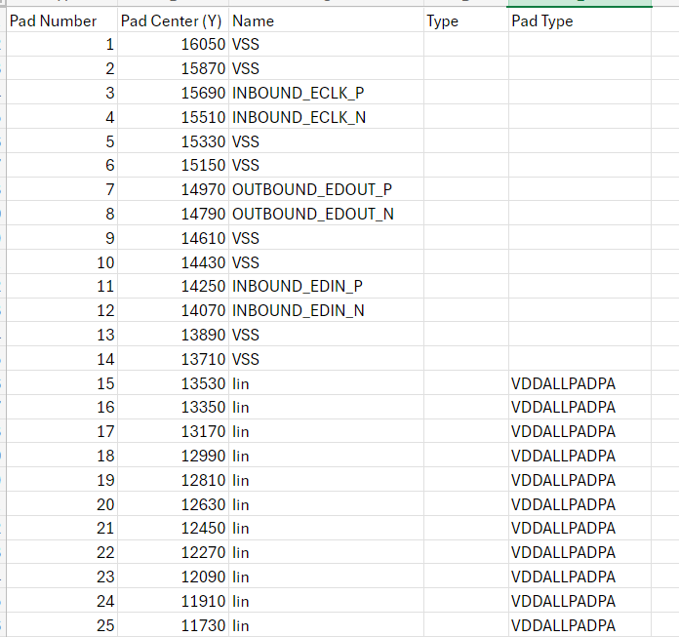
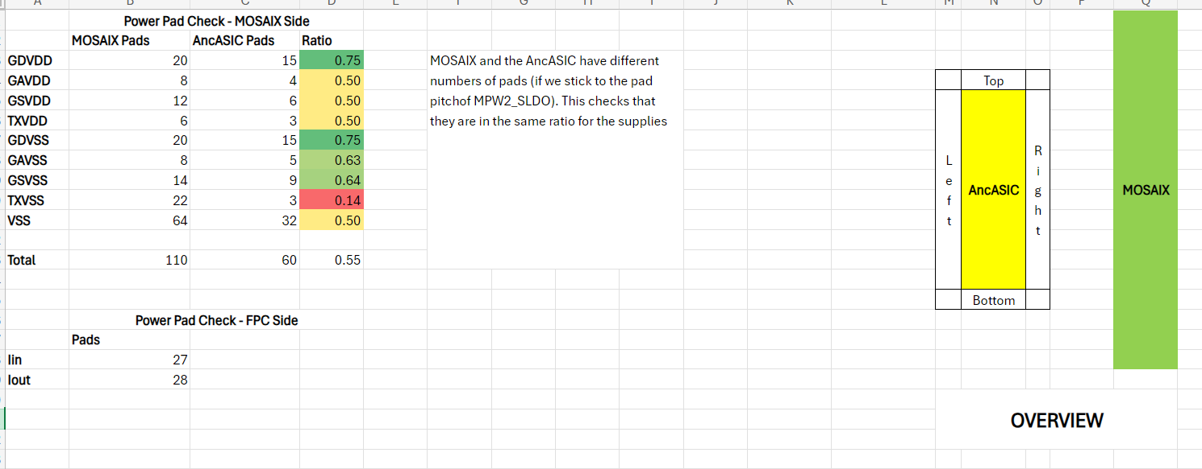
AncASIC - Integration
Also started preparing pad list
Shared with a limited group for now, but not secret! Just ask for access.
SVT Workfest, Dec 15th – 19th

Slide 8
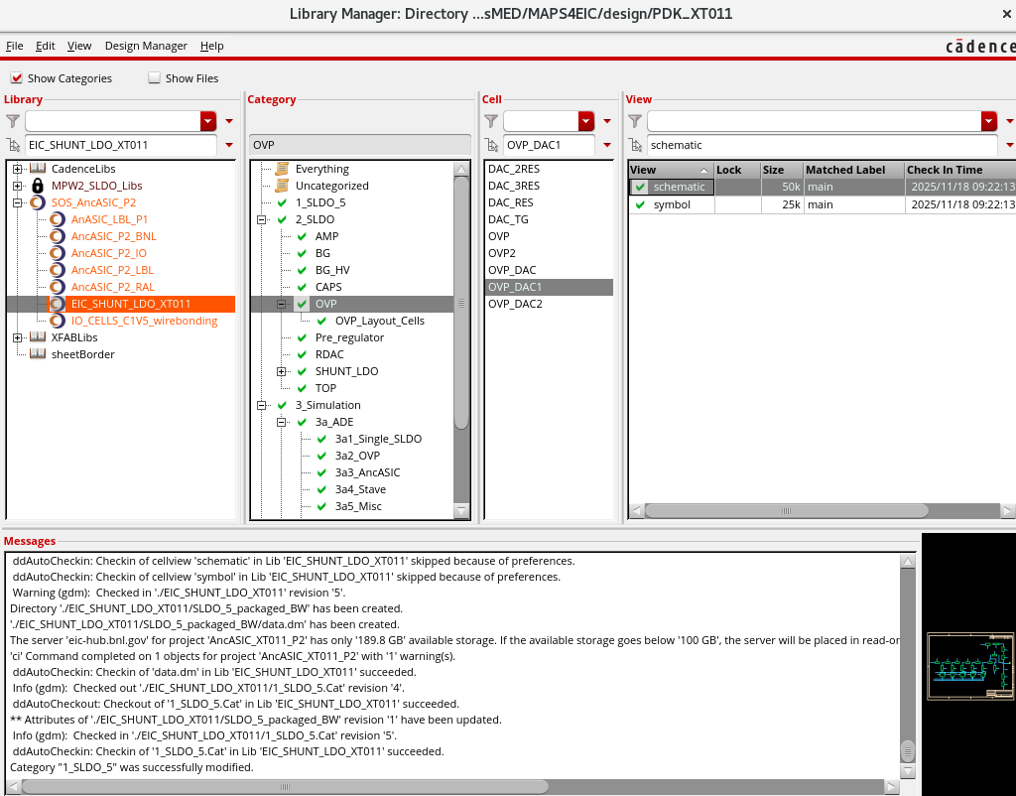
AncASIC - Integration
Can now share data both legally and technically amongst the design institutes
DSA in place!
SOS fully functional!
Many thanks to all at BNL, Cadence, Europractice, Keysight, LBNL and RAL who made this possible
Really key tool for AncASIC completion

Slide 9
Update on Power Numbers

Slide 10
Summary of Previous Data
Since the MOSAIX design is evolving, power estimates are regularly updated. Key points at which we have updated our data in the past are:
  ITS3 TDR (Feb 2024)
  MOSAIX Engineering Specification Review (May 2024)
  MOSAIX Sign-off Review (Nov 2024)
  ITS3 Chamonix Meeting (May 2025) – provided detail on effect of number of links
These have been refined into estimates for the LAS and combined with AncASIC simulations to produce estimates for the SVT
Most recent is here, where Joao also updated the estimates based on EIC hit rates
Will need to be refined further following test results
SVT Convener’s Meeting – 12th August

Slide 11
Update for Chamonix
Have updated power estimates used in SLDO for the Chamonix numbers
Assumes 1 Link, but not any power benefit of slower clock
 | Voltage(V) | Typ Power (mW) |  |  | Max Power (mW)
 |  | ESR | Cham | Cham-SC | ESR | Cham | Cham-SC
GAVDD | 1.32 | 222 | 222 | 222 | 356 | 356 | 356
GDVDD | 1.32 | 908 | 1052 | 349 | 1148 | 1280 | 560
GSVDD | 1.32 | 52 | 38 | 38 | 78 | 55 | 55
TXVDD | 1.2 | 240 | 71 | 66 | 360 | 100 | 91
Total (LAS) |  | 1422 | 1382 | 675 | 1942 | 1791 | 1062
Notes:
ESR: Based on Engineering Specification Review
Cham: Based on updated numbers from Chamonix
Cham-SC: Based on updated numbers from Chamonix and assuming the tile clock speed can be reduced
Numbers are for the LAS. AncASIC overhead adds 35-45%
Simulations also include AncBrain at 100mA and 200mA
10th EIC DAC Meeting, June 11th – 13th 2025

Slide 12
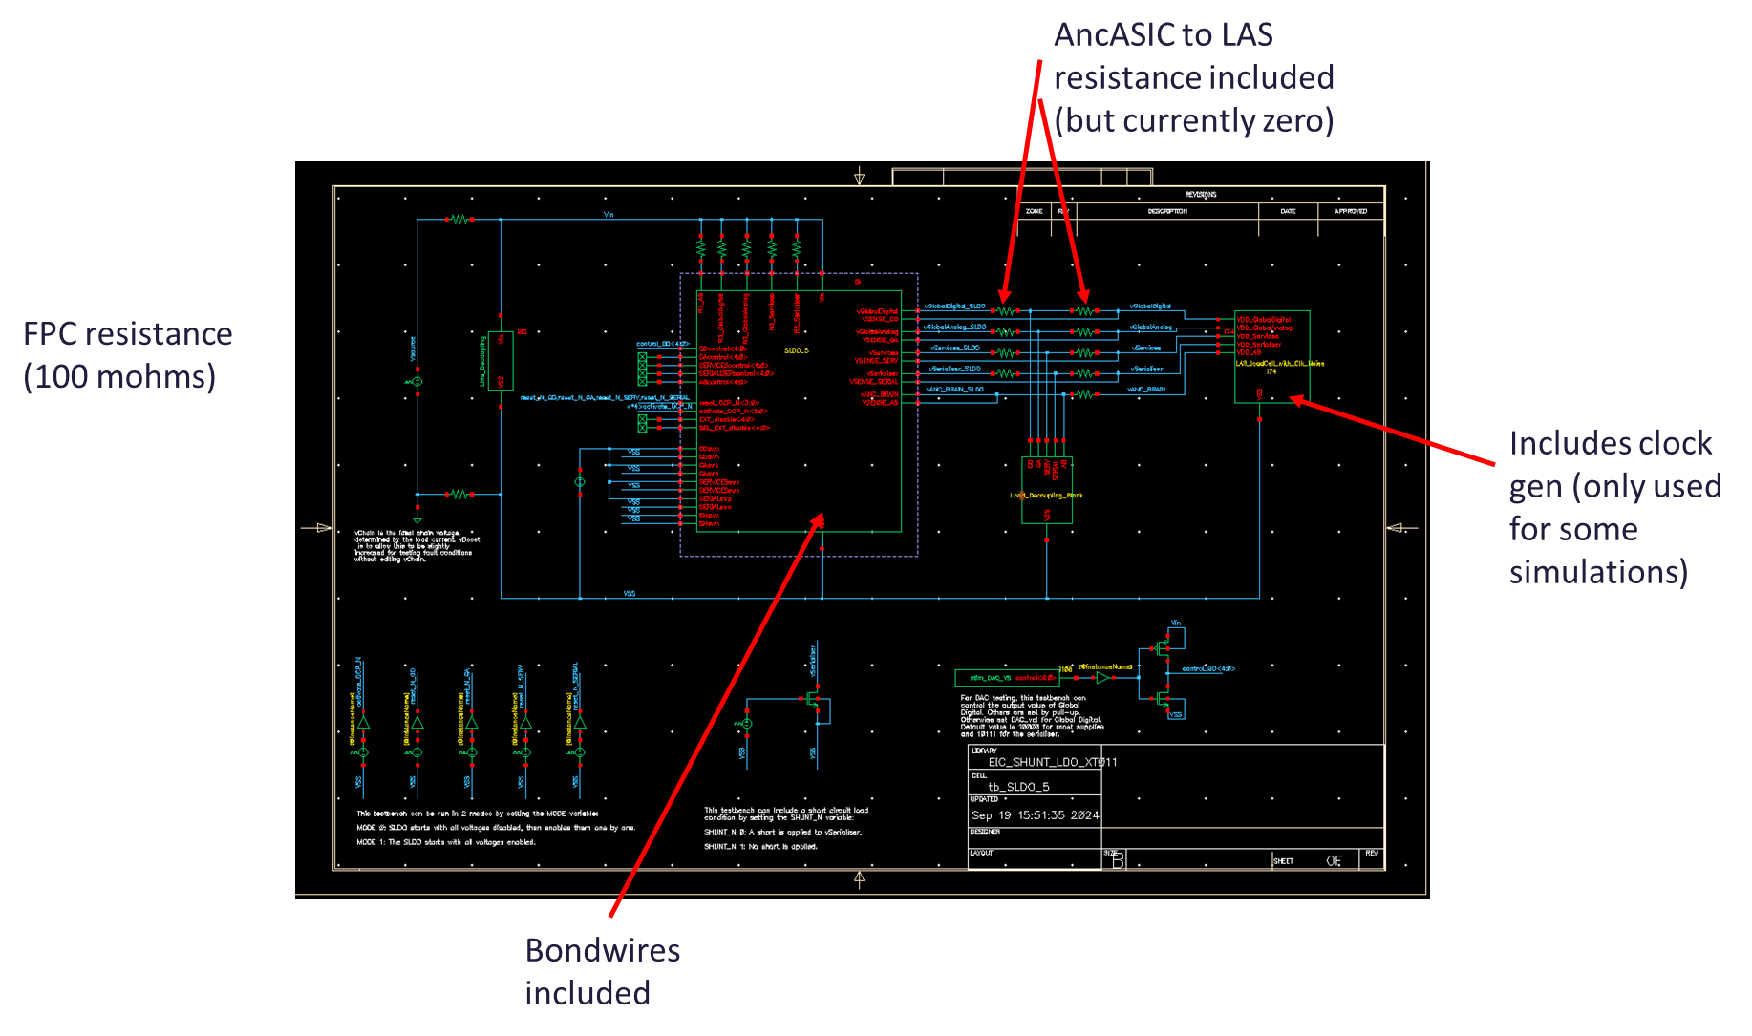
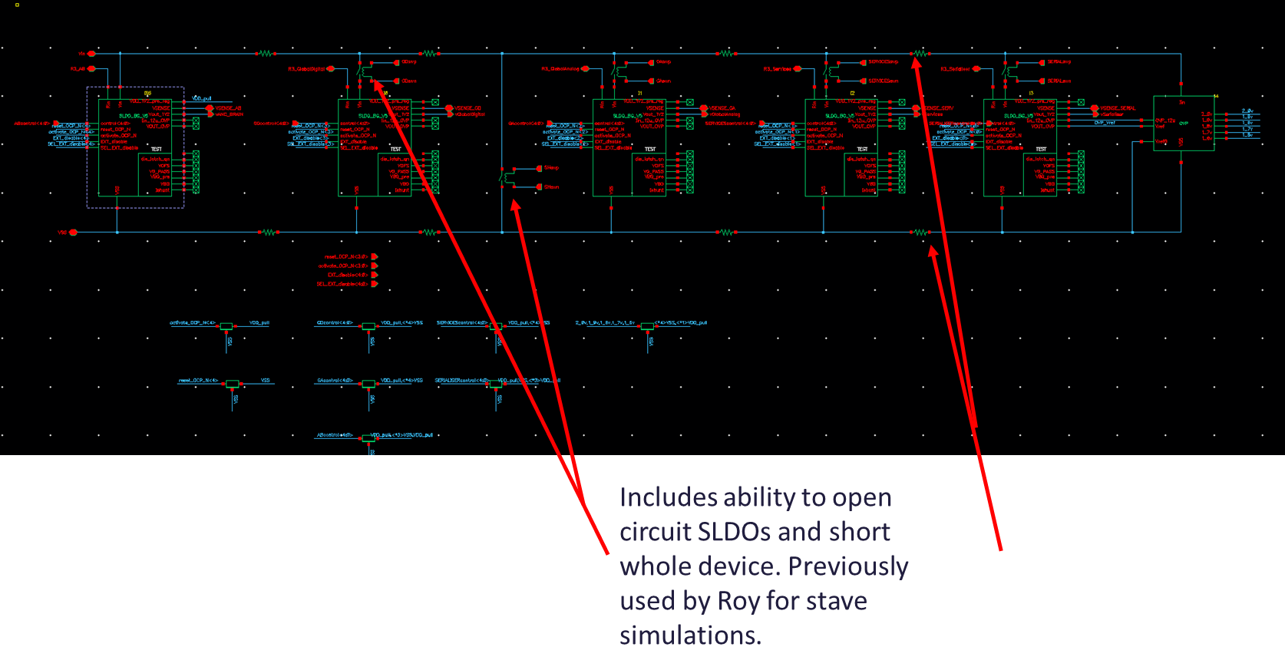
Update for Chamonix
Re-run previous simulations (see many old presentations…)
Updated for:
  Chamonix numbers
  5 SLDOs
  AncBrain (nominal value)
  Power bus resistance
Intended to represent power block of AncASIC

Slide 13
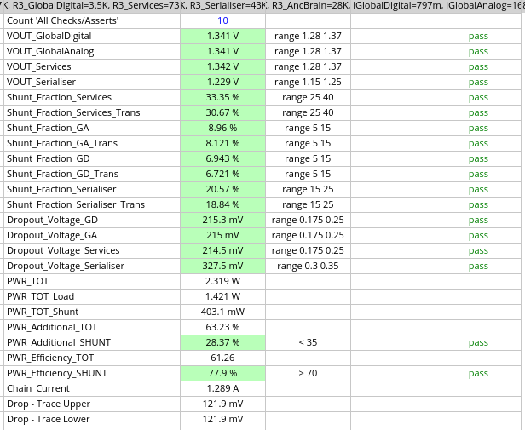
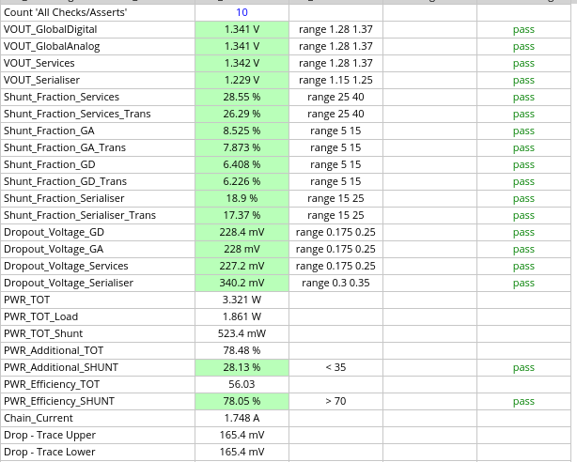
Update for Chamonix
Typ
Max

Slide 14
Subtleties of Powering

Slide 15
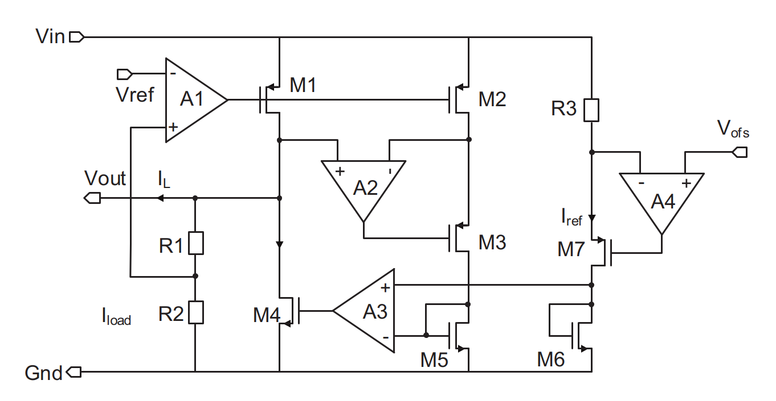

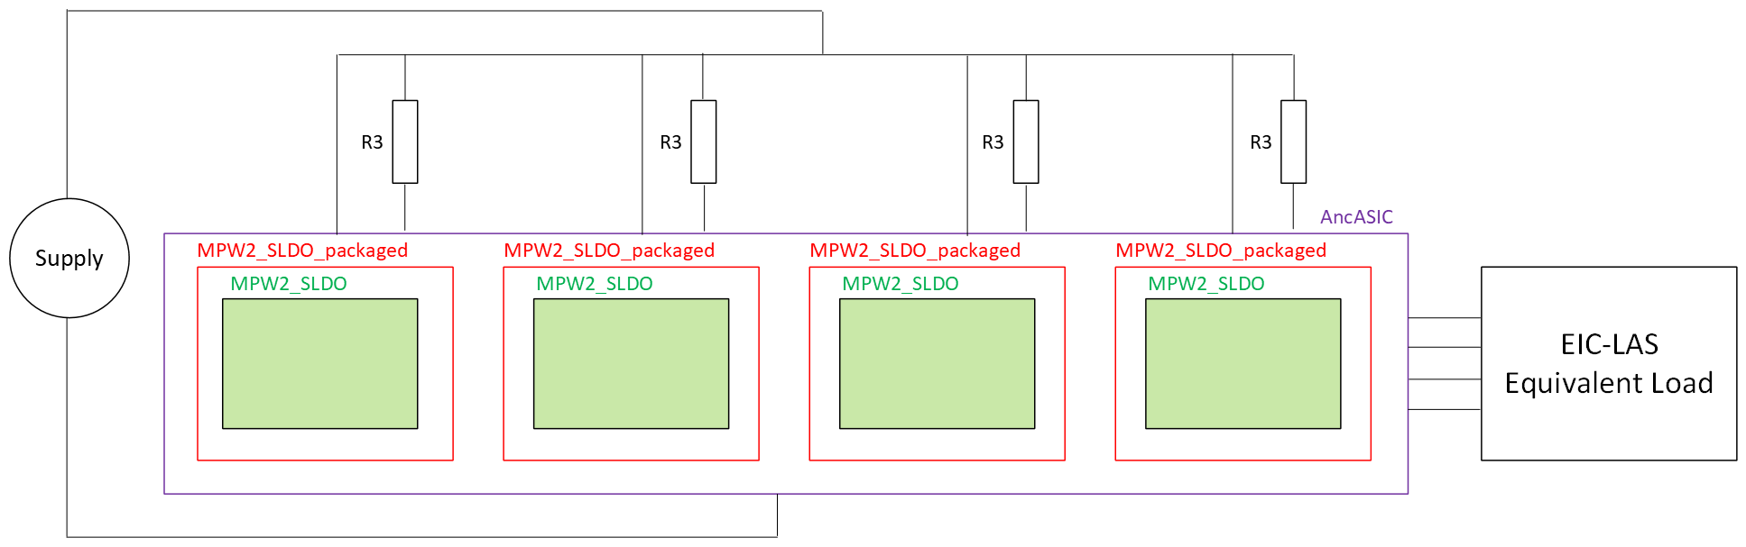
R3, Offset Voltage and the Operating Region
SLDO appears as equivalent resistance
Resistance set by Voffset and (external) R3 resistor
R3 effectively sets how current divides across the parallel resistances

Slide 16
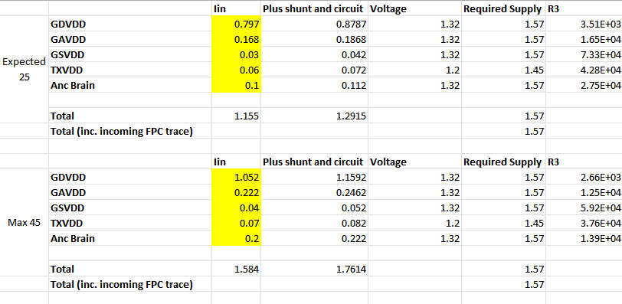
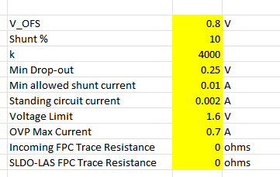
R3, Offset Voltage and the Operating Region
Have spreadsheet for calculating R3 values based on desired shunt percentage, load current, etc.
Note that ideal R3 different in different condition
This, and other conditions such as tolerance will lead to reduced power efficiency
Needs to be thought about at system level

Slide 17
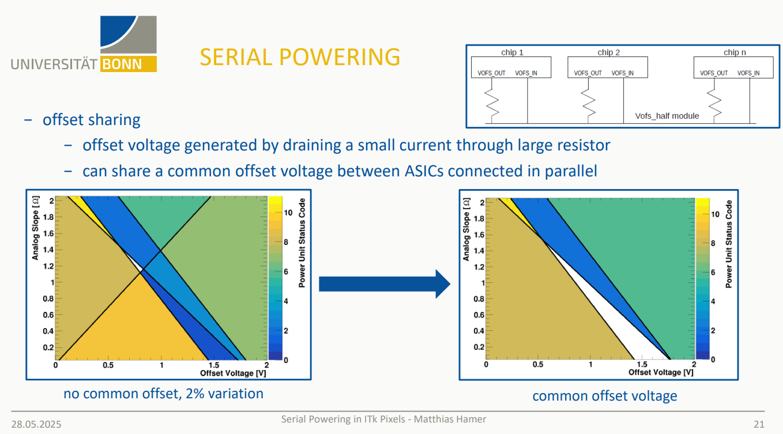
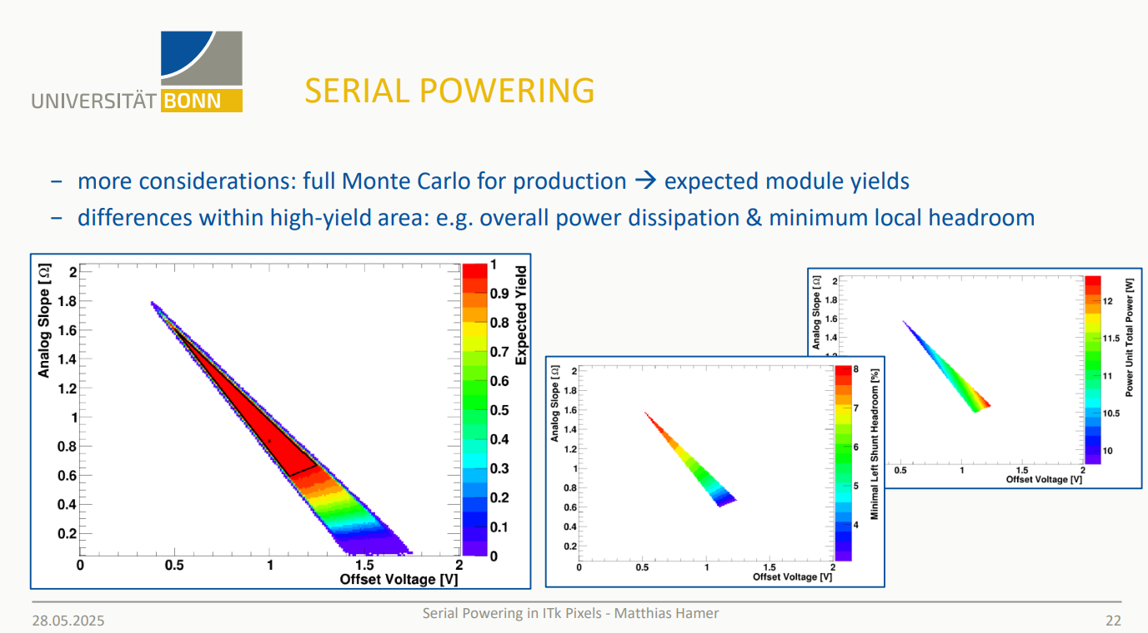
R3, Offset Voltage and the Operating Region
Much experience with serial powering exists in other projects
Have had much assistance not just from circuit designers, but those involved in system integration
Need to start thinking about this:
  Effect of resistor tolerances
  Effect of bias variation
  How does this affect power efficiency, allowed operating region?
https://indico.bnl.gov/event/28162/

Slide 18
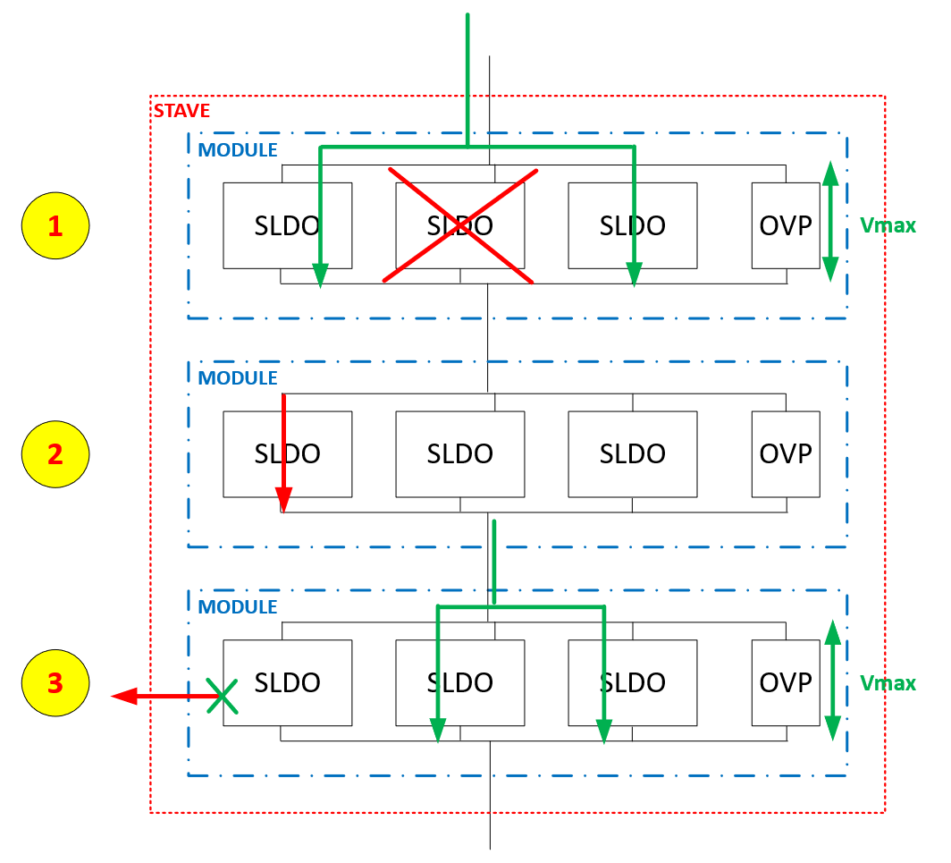
Failure Modes
Three failure modes covered:
  (1) An SLDO behaves as an open circuit
  (2) An SLDO develops a short
  (3) The load develops a short
These are dealt with as:
  (1) Input current re-distributed to other SLDOs, chain uninterrupted
  (2) For a constant current supply, the remainder of the chain continues to operate. For a constant voltage supply, the voltage will be re-distributed over fewer devices
  (3) The SLDOs high impedance mode triggers. The remaining current is distributed over the other devices
For (1), (3) and some case of (2), the OVP may be triggered

Slide 19

Start Up
How to start-up the serial chain?
  MOSAIX requires power sequencing:
    GSVDD, GAVDD,GDVDD, TXVDD
  AncASIC needs to be on at start-up to control this
  How to achieve?
  What are the problems?

Slide 20
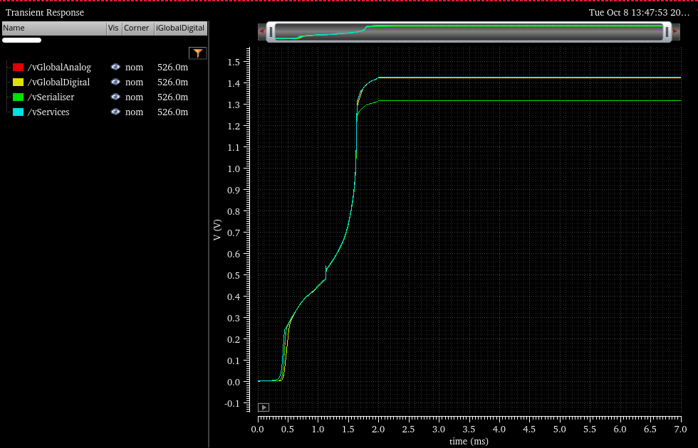
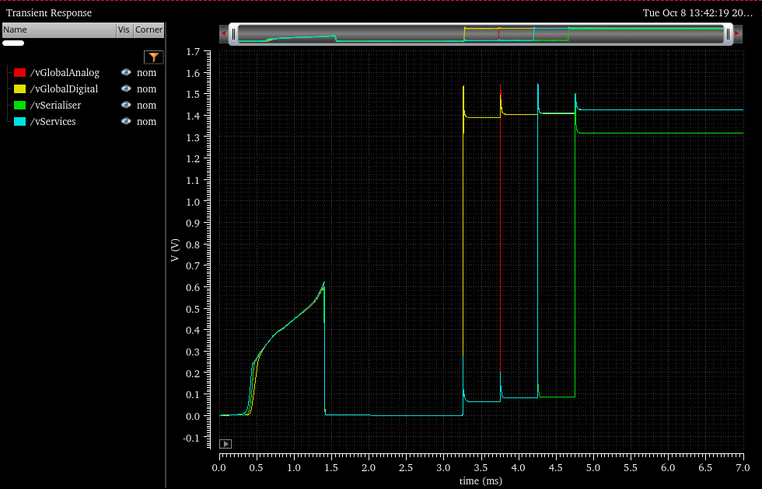
Startup
Some existing features of the SLDO can help with startup
Can start in two modes:
  Mode0: Output is off by default, and enabled by command
  Mode1: Output is on by default and disabled by command
Mode is selected by single pin, which can have pull-up or down resistor to enforce default condition
OVP can take excess current during startup
MOSAIX itself can ramp its current demand
MODE 1
MODE 0

Slide 21
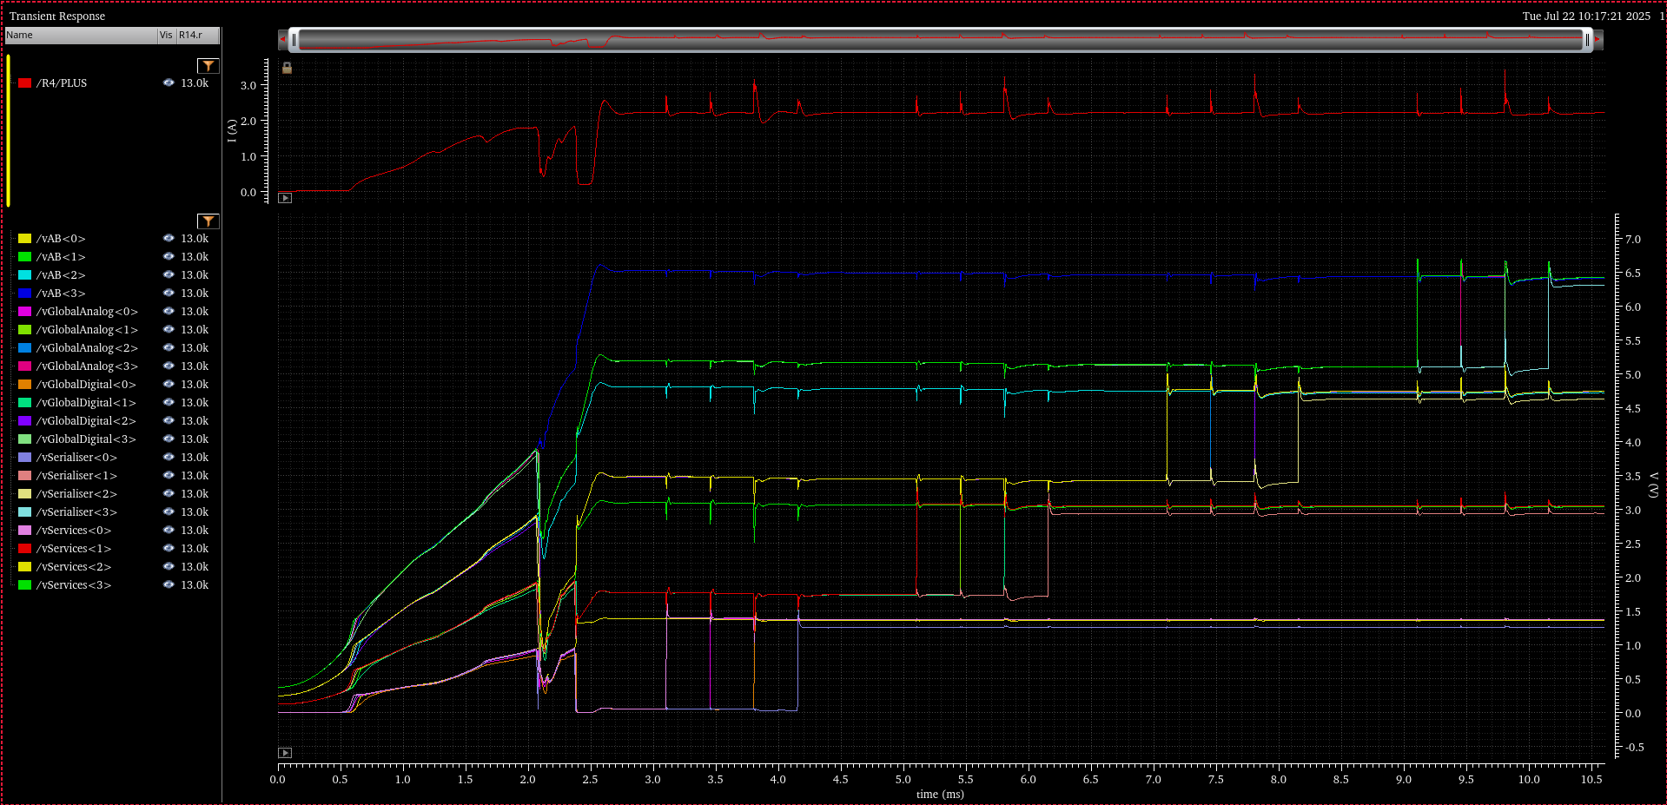
Startup Simulation Results – Full Current with OVP
I Current Source
GS GA GD GTX
LAS3
GS GA GD GTX
LAS2
GS GA GD GTX
LAS1
GS GA GD GTX
LAS0

Slide 22
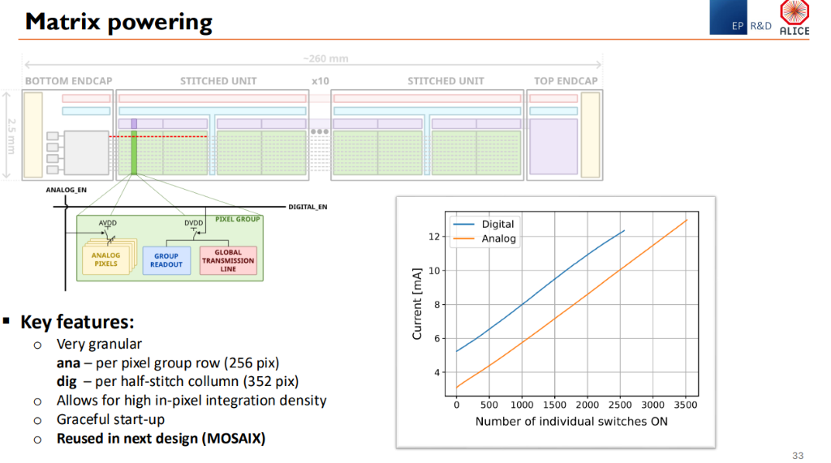
MOSAIX Startup
MOSAIX tiles are independently powered for yield reasons
However, this also allows them to be turned on individually at start-up
This could allow a gentler start-up for us compared to the previous slide
https://indico.cern.ch/event/1502285/contributions/6554391/attachments/3148421/5592094/2025_TWEPP_MOST_v2.pdf
SVT Workfest, Dec 15th – 19th

Slide 23
Conclusion

Slide 24
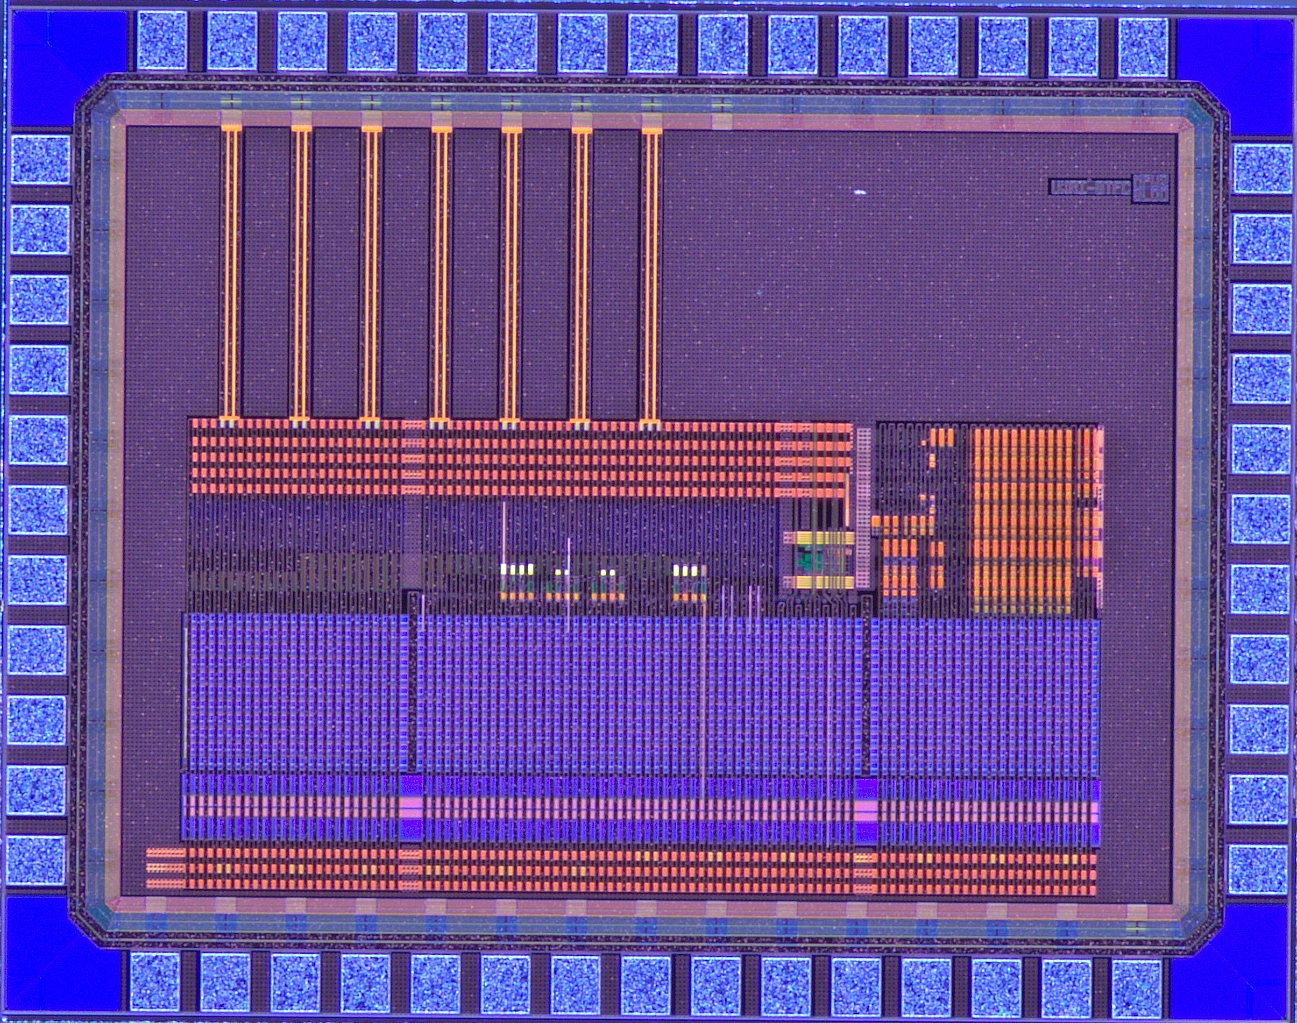
Conclusion
AncASIC design advancing well. Integration of design teams now much better.
Plan discussed with FPC designers to ease integration
Targeting next MPW in early March. Later than planned:
  AncBrain complexity
  Procurement issues
Power numbers updated and re-simulated
Schemes for failure modes and startup have been developed and simulated
Not covered here (see other talks), but first test structures for some functions now in testing
SVT Workfest, Dec 15th – 19th

Slide 25
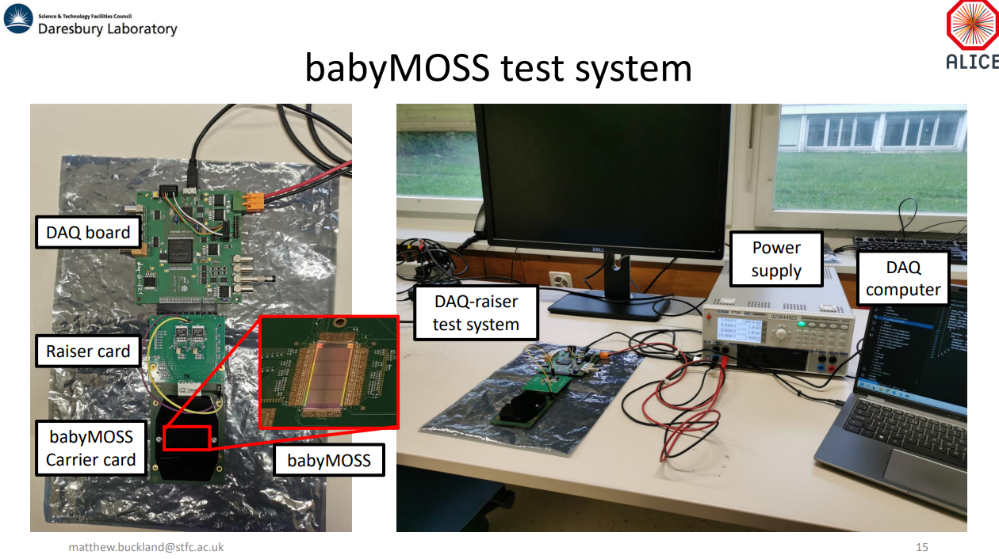
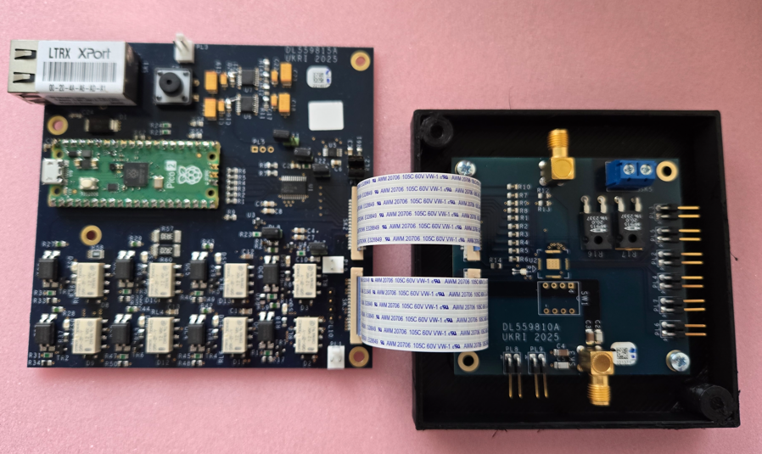
Discussion Points
https://indico.bnl.gov/event/24723/contributions/96279/attachments/57524/98763/20240923-babyMOSSTraining_results.pdf
AncASIC Layout:
  Further comments welcome!
Practical integration of the serial powering chain:
  Need to plan a startup sequence
  Need to think about impact of non-idealities on operating region and power efficiency
  Which WP does this sit with?
Further serial powering tests:
  Validation of MPW2_SLDO
  SP chains
  Tests with babyMOSS? babyMOSAIX? Real MOSAIX? Who? Where?
  Making a basic prototype? Who? Where?
SVT Workfest, Dec 15th – 19th

Slide 26








Amanda Krieger, Ernst Sichtermann
Grzegorz Deptuch, Dominik Gorni, Arif Iqbal, Nicolas StJohn, Soumyajit Mandal, Joao de Melo, Prafull Purohit
James Glover
Jelena Lalic
Jo Schambach
Jaya John John, Roy Wastie
Laura Gonella
Marcello Borri, Iain Sedgwick
SVT Workfest, Dec 15th – 19th

