Slide 1

Quo Vadis AncASIC? Work to do, Plans, Problems to Address, Resources
G.W. Deptuch, D. Górni, Fu-Hwei, N. Gallice, A. Iqbal, P. Maj, S. Mandal, J. de Melo, P. Purohit, N. St John, E. Tamura,
and S. Hassan, W. Weldon
12/16/2025

Slide 2
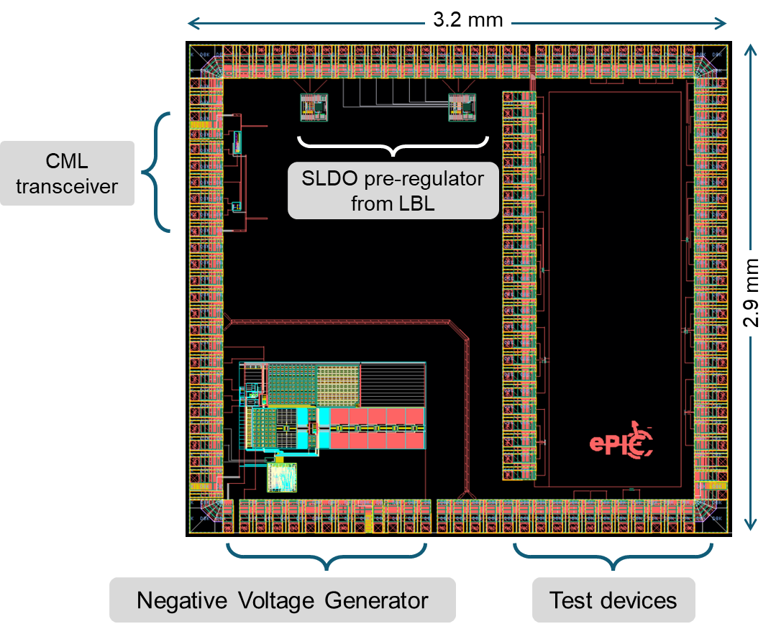
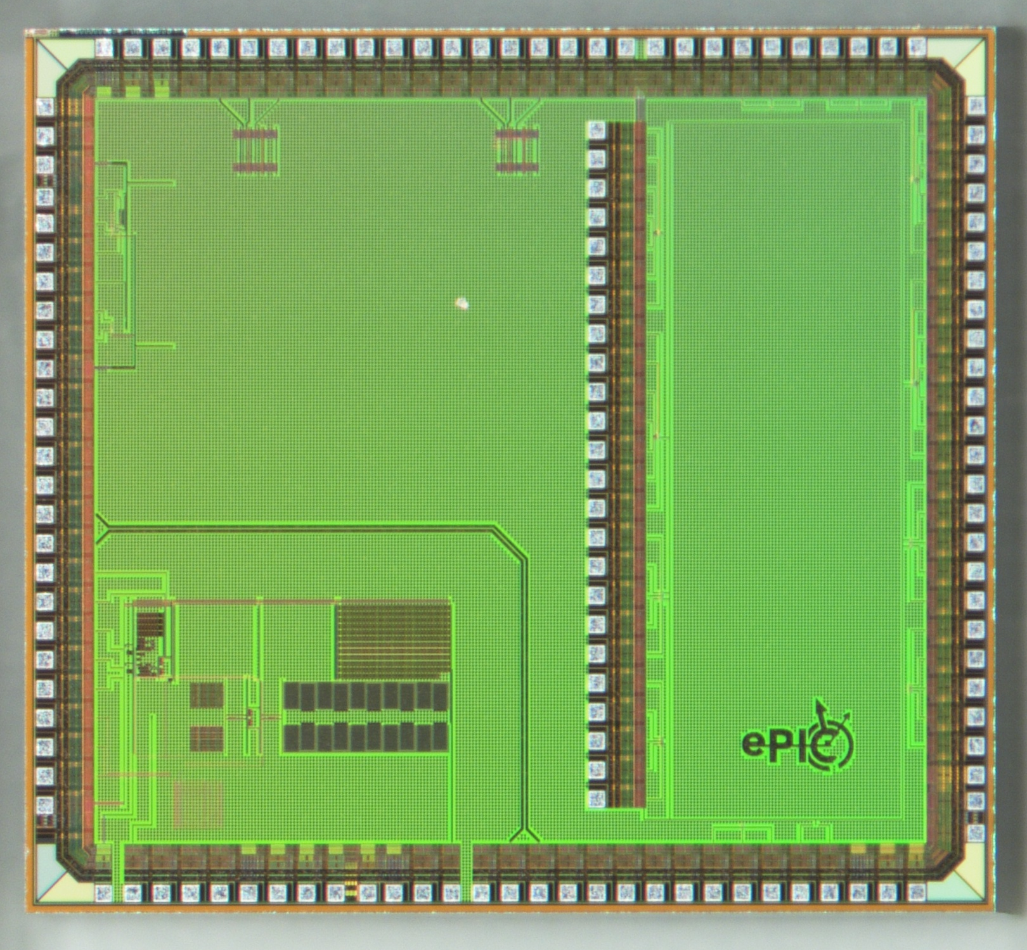
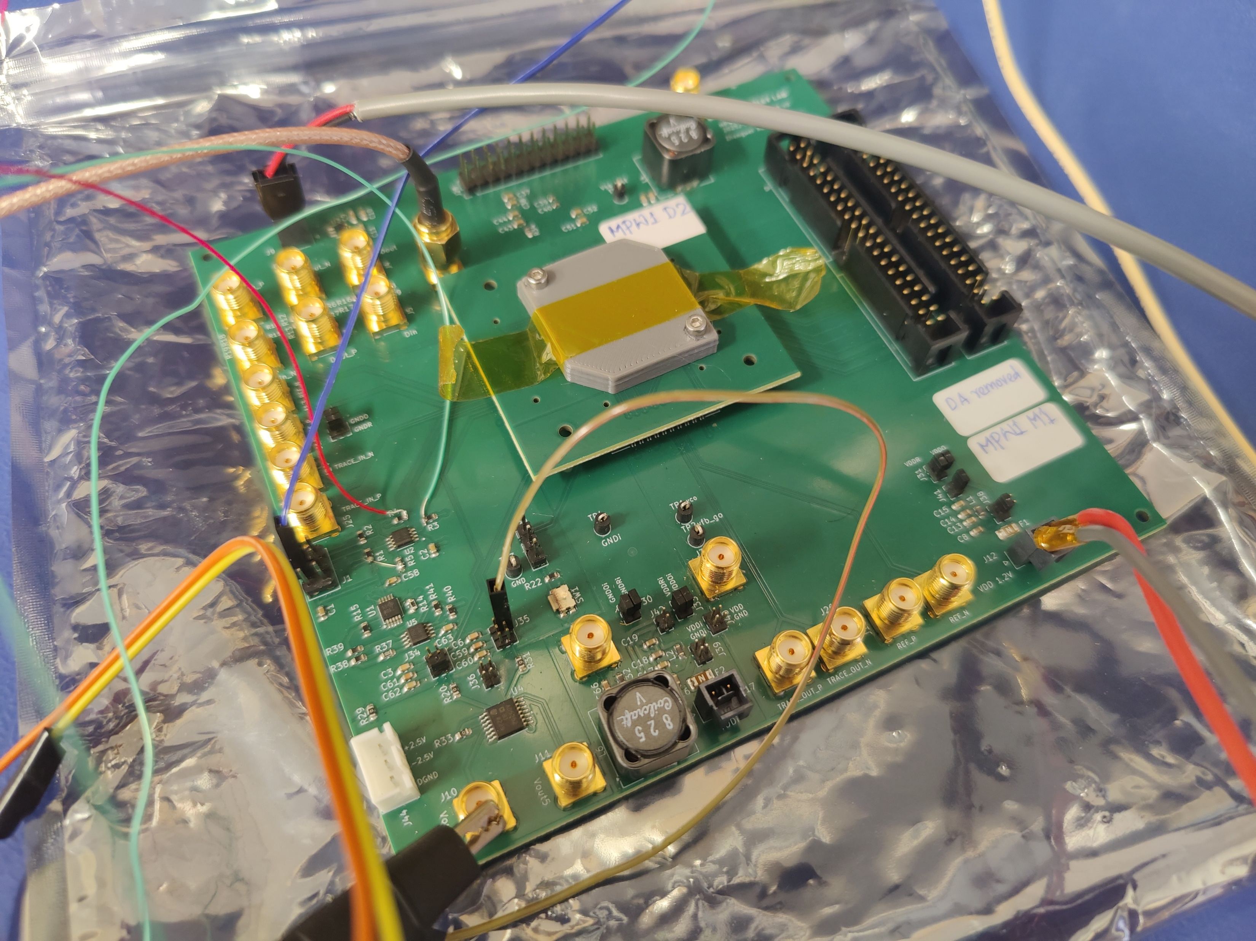
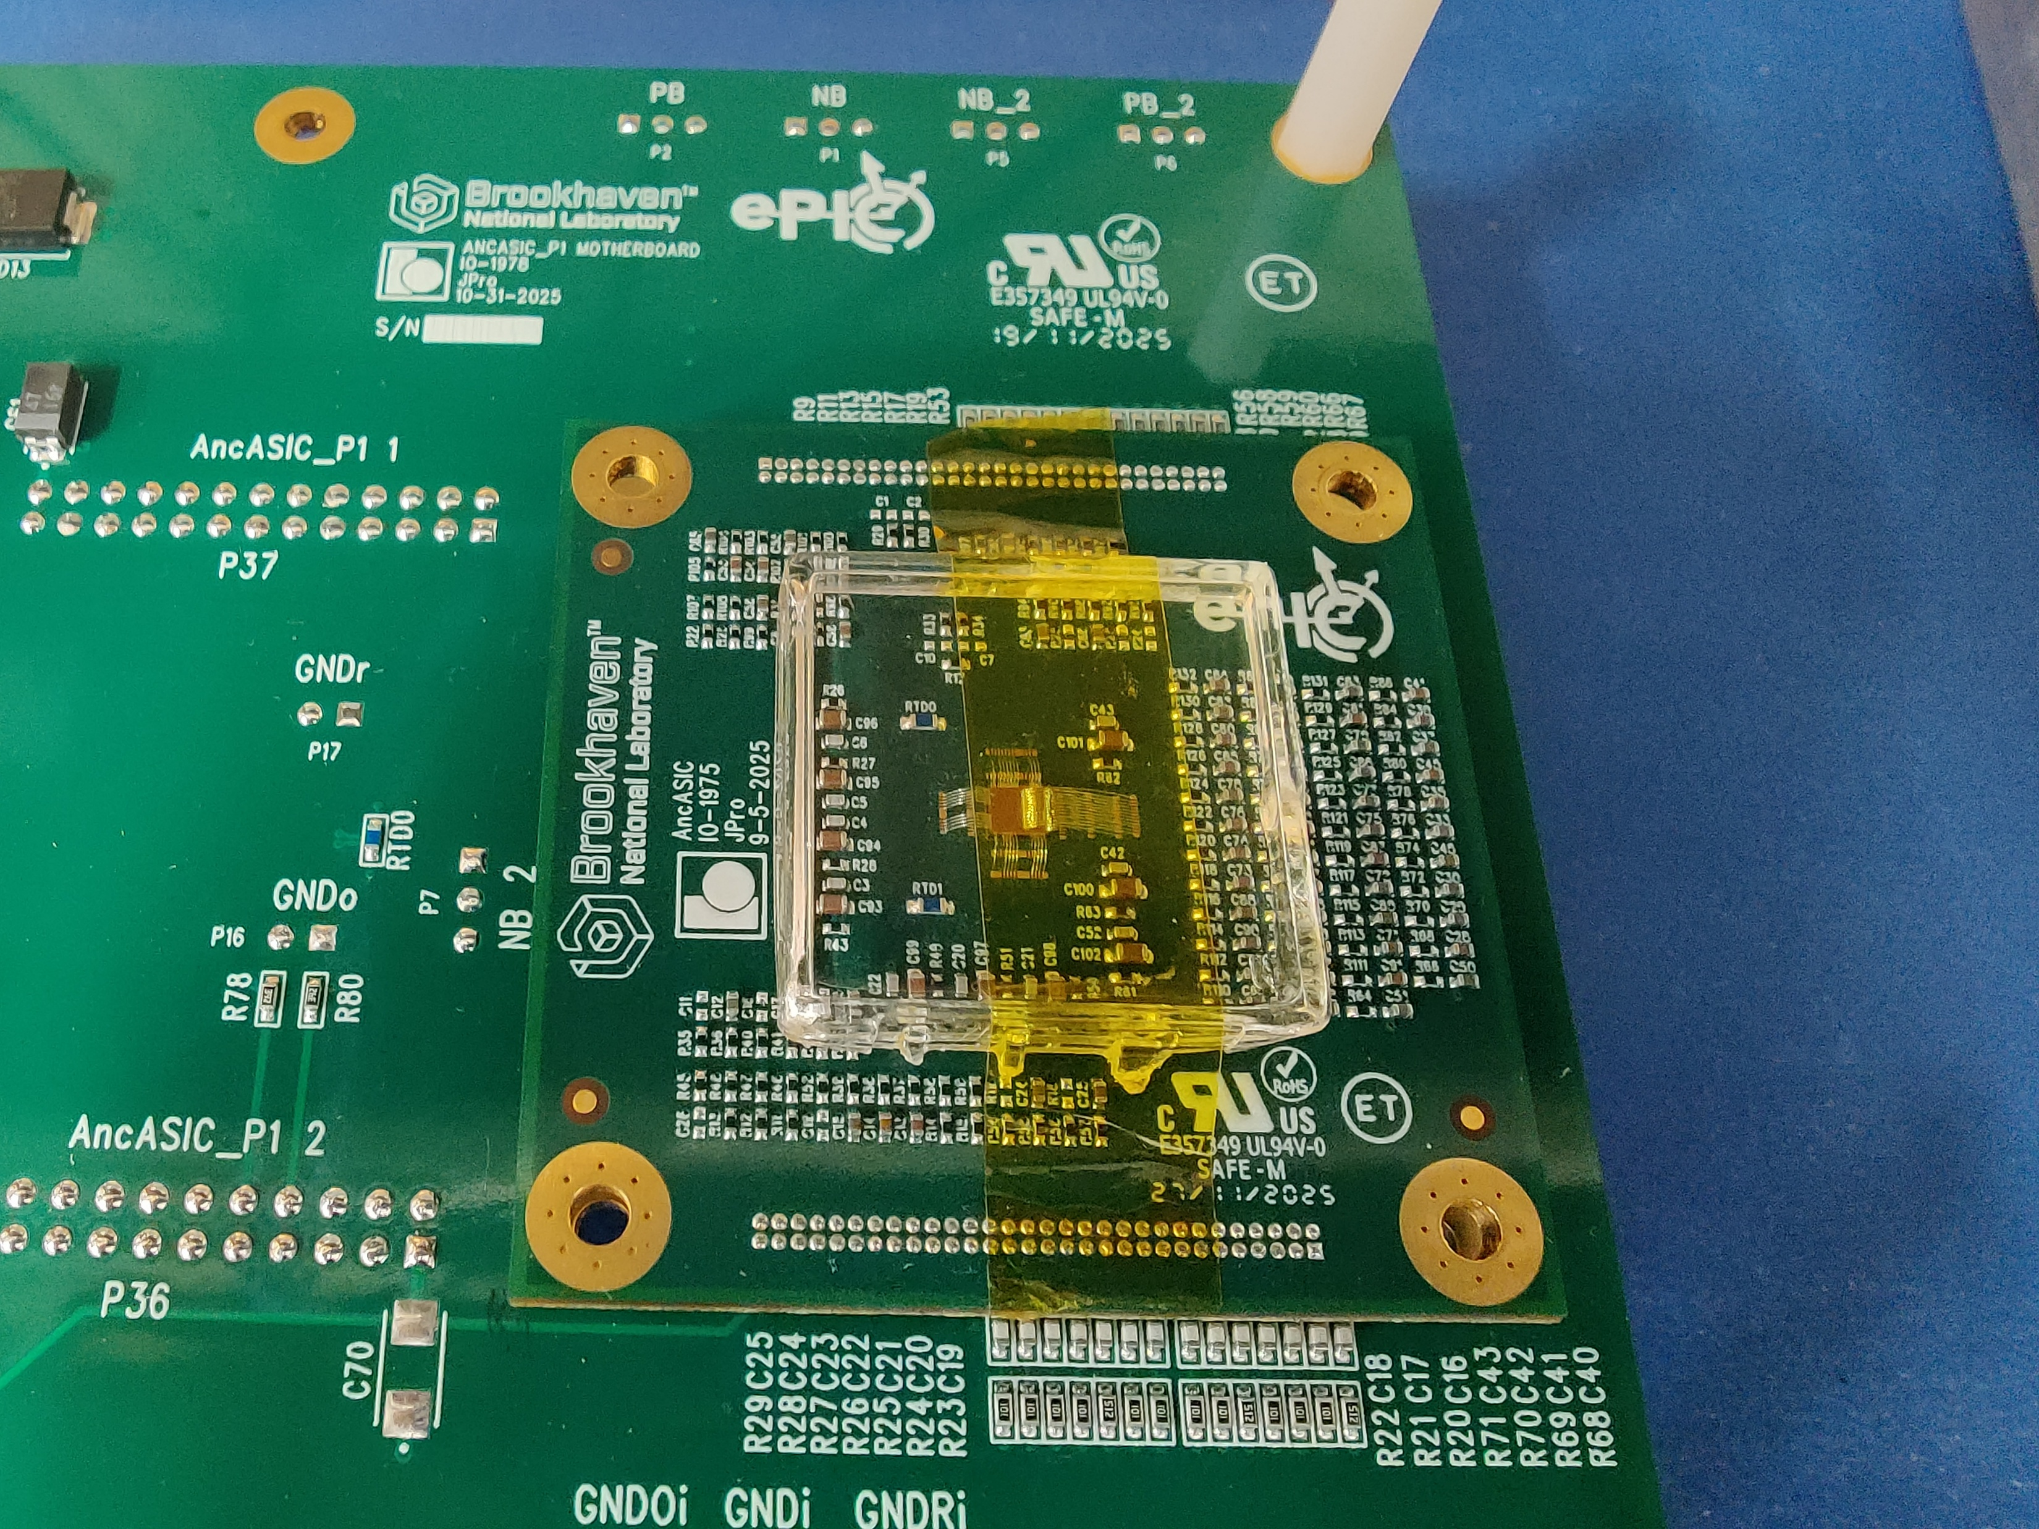
Starting point
AncASICXT01_P1 aka MPW1
Received: beginning of October 2025, 50 die
Includes: NVBG, I2C, CML TX/RX chains testing, passthrough, differential t-line, SLDO pre-regulator and test devices (MOSFET, BJT, resistors, etc.)
Characterization Setup (LBL)
Irradiation Setup (BNL)

Slide 3
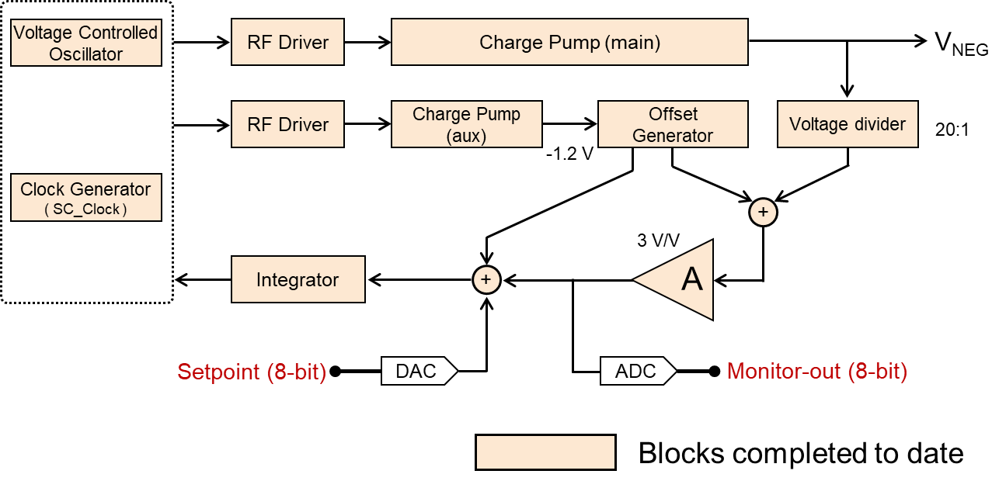
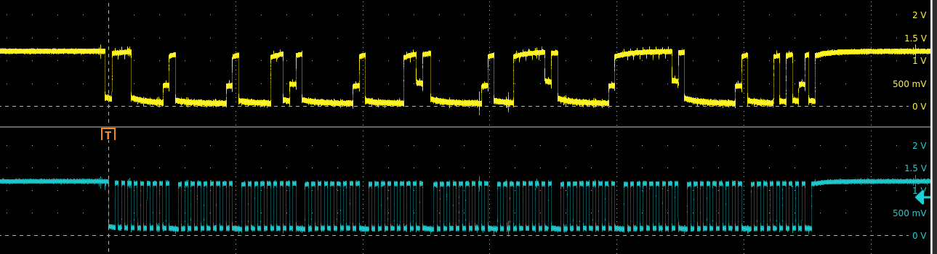
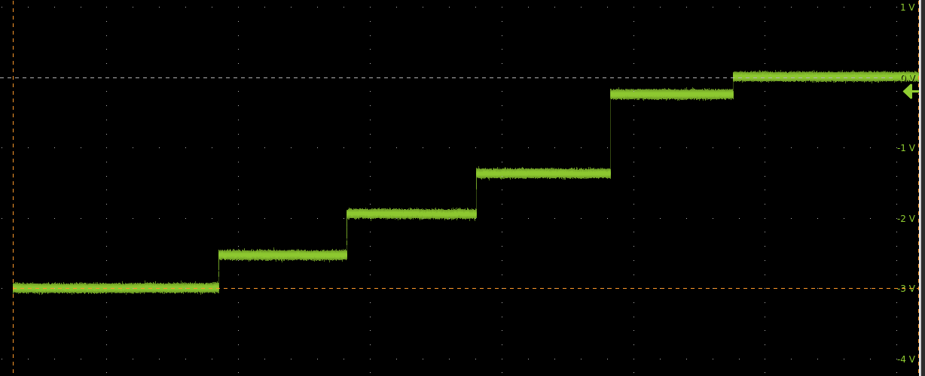
Starting point: testing
Curently under test:
I2C works
NVBG produces voltages down to - 5V
And gearing up towards irradiations
Test | Swept parameter | Measurement
Output range | V_{REF}, load current (I_{L}) | Output voltage (Vout), estimate load regulation
Line regulation | Supply voltage (Vdd) | Output voltage (Vout), estimate line regulation
Transient response | V_{REF}, load current (I_{L}) | Output rise time, settling time, and peak overshoot as a function of V_{REF}
Loop bandwidth | V_{REF}, load current (I_{L}) for different values of f_{SC} | Verify loop stability by changing value of f_{SC}
Power supply rejection ratio (PSRR) | Ripple in supply voltage | Amplitude of output ripple vs. ripple frequency
Output noise and ripple | V_{REF}, load current (I_{L}) | Output histogram, peak and rms variability, and frequency spectrum
Temperature effects | Repeat above tests for different temperatures between 25⁰ C and 85⁰ C
• I2C communication (LBL board, pull-up resistors could be increased) •
- 1.2 V
summary of all required tests for verifying the functionality of the NVBG
Vout5
• programmed NVBG under constant load •

Slide 4
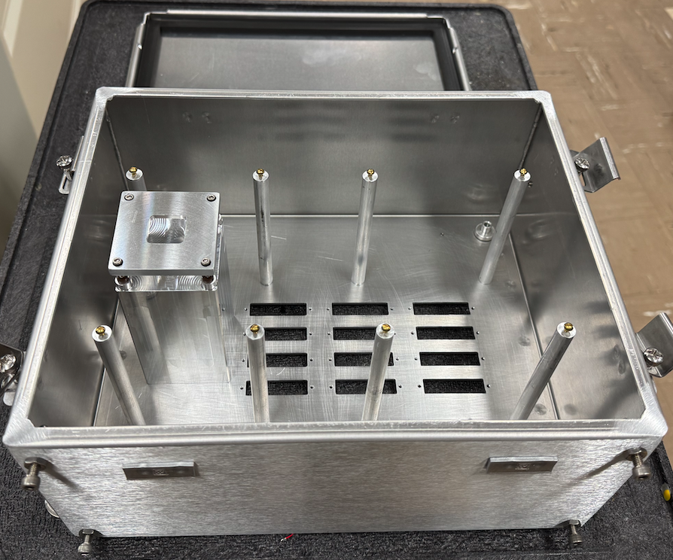
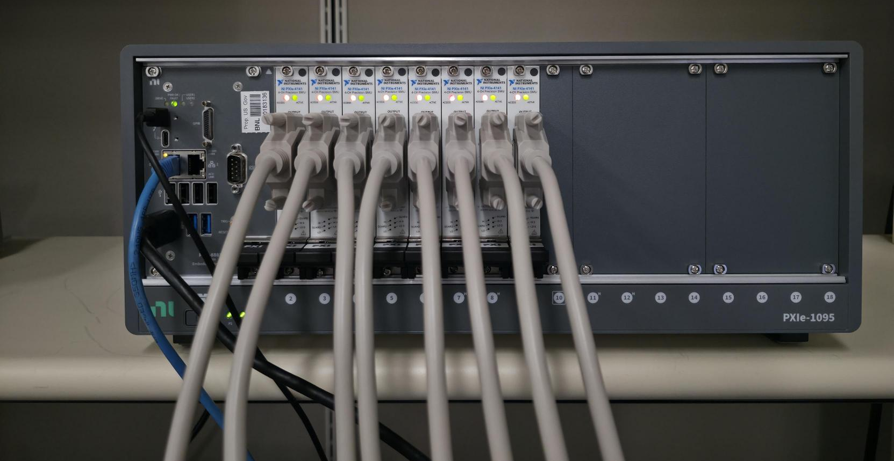
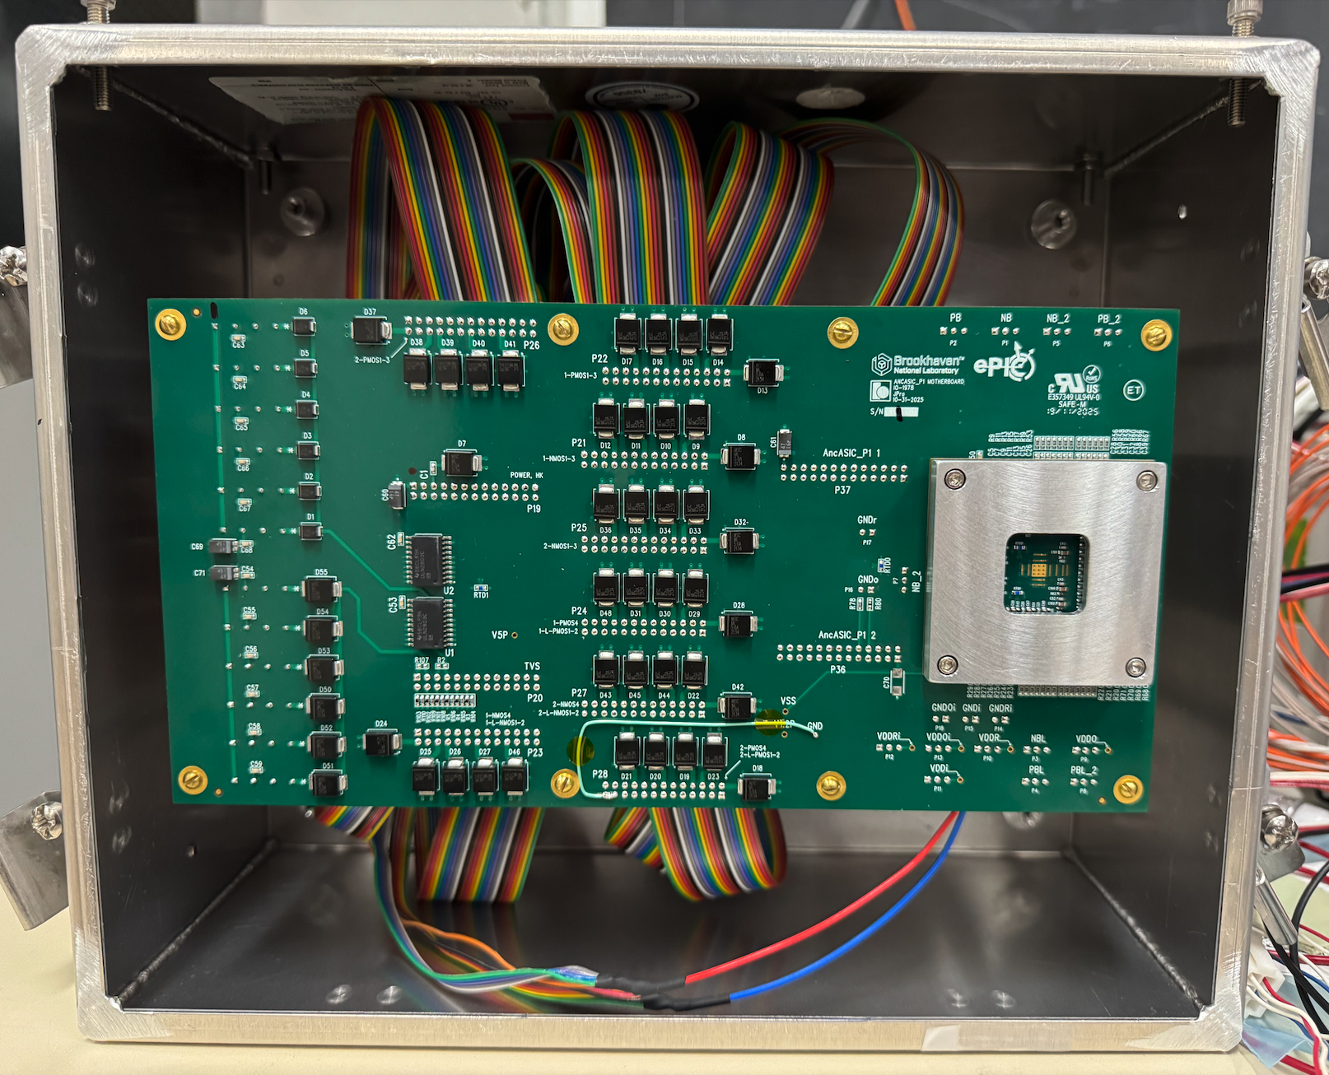
Towards Device Irradiations
Test setup prepared for device irradiation characterization
TID up to 3 Mrad, under and without bias exposures, 3 selected temperatures, all 20 + devices irradiated and characterized in parallel
NiPXIe crate with 8 × 4 input SMUs with 100 pA precision
No connect / disconnect between doses
measurements made in situ
• metal box for hosting motherboard/daughter board • slots cut for DB20 sockets • suitable for filling with nitrogen during irradiation/measurements •
• motherboard/daughterboard with temperature control fixture and pig-tail connectors to DB20 socket inside metal box (no chip mounted) •
• NiPXIe chassis with 8 Ni 4141 SMUs, each with 4 source/measurements ports •100 pA precison • DB20 plug cables allows 32 terminals to be connected •

Slide 5
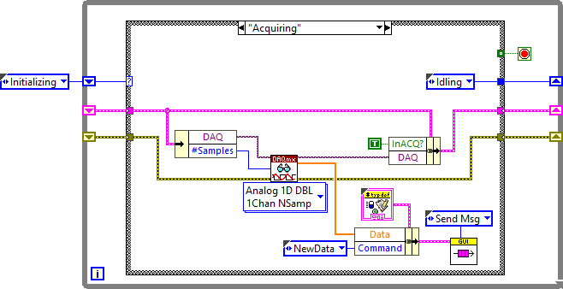
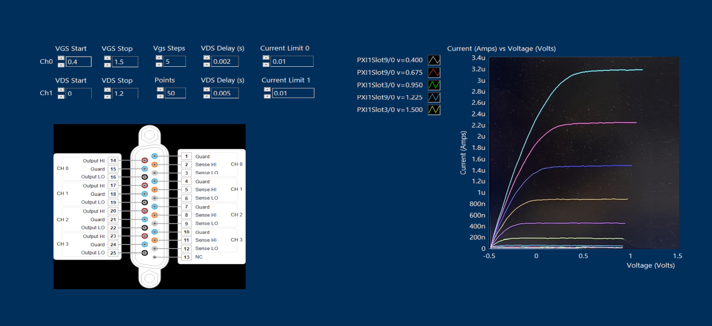
Towards Device Irradiations
Test irradiation / measurements application (underway)
All in LabView:
Controlling bias / no bias during irradiations
Sequencing irradiation /measurements steps from 0 to 3 Mrads in progressing steps
Performing measurements of I_{DS}(V_{GS}) and I_{DS}(V_{DS}) characteristics in ranges and with compliance from simulations for transistors
Performing measurements of other devices: diodes, resistors
Application is under development
• application for automated single transistor measurements •
• GUI for application for automated single transistor measurements •

Slide 6
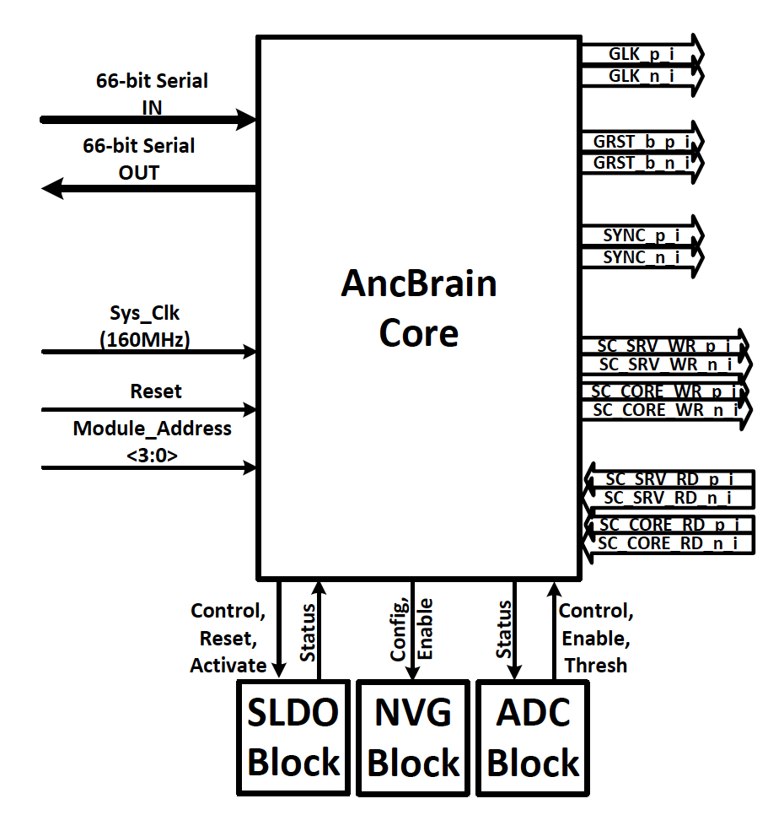
AncBrain Core: Top-level Block Diagram
Interface | Pin Name | Direction | Description
System | rst_n (Reset) | IN | Active-Low Reset
 | module_addr_i[3:0] | IN | Module ID Straps
lpGBT Wrapper | sc_in_bit (66-bit) | IN | Serial Command Input
 | tx_bit (66-bit) | OUT | Serial Response Output
 | clk | IN | 160 MHz System Clock
LAS CH0 | core_mng_chn_tx | OUT | Manchester TX (Core)
 | core_mng_chn_rx | IN | Manchester RX (Core)
LAS CH1 | srv_mng_chn_tx | OUT | Manchester TX (Service)
 | srv_mng_chn_rx | IN | Manchester RX (Service)
Broadcast | bc_reset_pulse | OUT | Global Reset to Mosaix
 | bc_sync_pulse | OUT | Global Sync to Mosaix
SLDO | sldo_control_o[4:0][4:0] | OUT | 5 SLDOs
 | sldo_reset_ocp_n_o[4:0] | OUT | Reset OCP (active-low)
 | read_overcurrent_status_i[4:0] | IN | OCP Status
 | SLDO_activate_ocp_n[4:0] | OUT | Enable/Disable
NBVG | nbvg_en[2:0] | OUT | Enable Bits
 | nbvg_iinteg/ivco/ioff[15:0] | OUT | Current Settings
ADC | adc_enable | OUT | ADC Enable
 | adc_status[2:0] | IN | Status Inputs
×ðð
ð
ð
AncBrain wrapper
ð
lpGBT EPort interface
Completeness of signaling across interfaces needs to be verified
Hook-up for alarms: temperature, OVP, PSUB
Operation of ADC (data exchange)
Settings registers
etc.

Slide 7
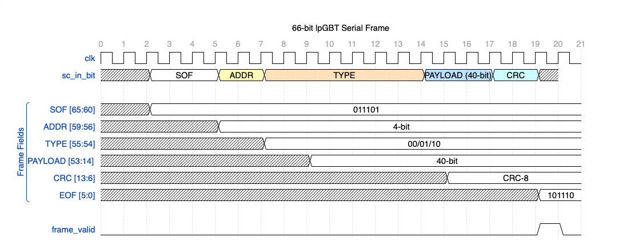
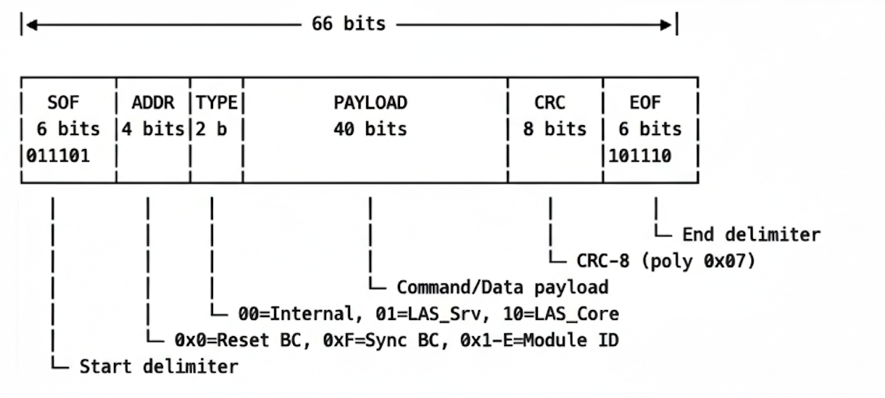
AncBrain: In/Out Frame Definition
AncBrain frame needs to made compatible with lpGBT Eport (e-Link) data structure

Slide 8
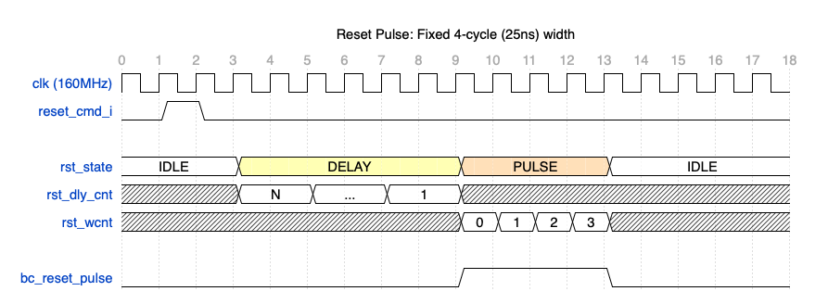
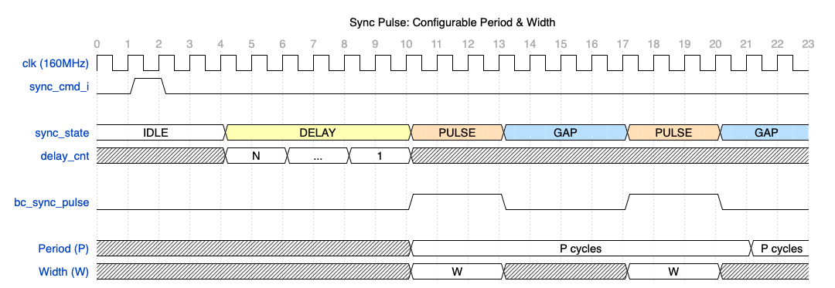
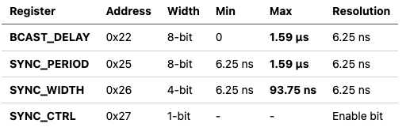
AncBrain: Synchronization of EIC-LAS - 1
RESET and SYNC pulses are needed to synchronize operation of EIC-LAS (MOSAIX)
Programming registers managing timing of RESET and SYNC pulses / AncASIC
Sending broadcast signal to execute sending RESET and SYNC pulses to all AncASICs
Reset (One-Shot)
Sync (Periodic)
Key Timing Registers
Broadcast/Sync Timing (@160 MHz = 6.25 ns/cycle)
Reset Pulse
Width: 4 cycles = 25 ns
Configurable Delay: 0-255 cycles before pulse
Independent for RESET and SYNC
Sync Pulse
Periodic: Repeats with configurable period
Auto-correction: Period adjusted to (width+1) if configured too small
result of 160 MHz clock
needs to be made longer (tbd)

Slide 9
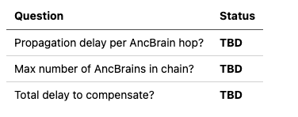
AncBrain: Synchronization of EIC-LAS - 2
RESET and SYNC timing programming ranges to be discussed
SYNC Alignment:
Delay, period, width, enable programmed per AncASIC
Resolution 6.25ns (160 MHz clock)
Delay Range Sufficiency:
Questions to Resolve
answers expected from System design
Current Implementation
Delay Register: 8-bit (0-255 cycles)
Max Delay: 255 × 6.25 ns = 1.59 µs
needs to be made longer (tbd)
If Delay Range (1.59 µs) is Insufficient
Option 1: Extend to 16-bit delay register
New range: 0 to 409 µs
Option 2: Use multiple delay registers
Coarse + Fine adjustment
Action Required
Assessment of propagation delays through system is needed

Slide 10
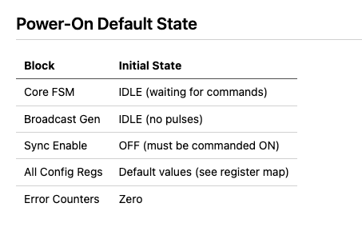
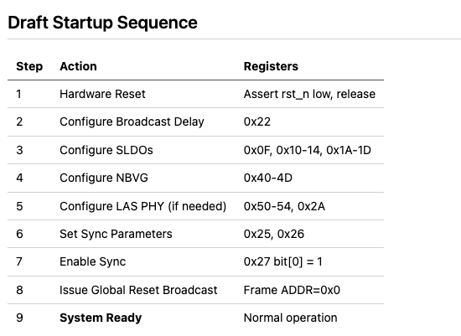
AncBrain: Initial State & Startup Sequence - 1
System role of Reset
there is no “reset”, it would have to be merged into AncBrain wrapper
this reset is issued by AncBrain
DRAFT
Note: This is a draft startup sequence - actual order depends on system requirements.
Definition and verification of startup sequence requires joint efforts, finally to be confirmed in software and hardware mock-ups when are built.

Slide 11
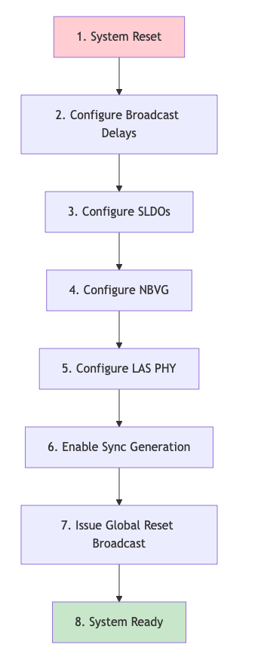
AncBrain: Initial State & Startup Sequence - 2
Command sequence to be executed
Verify if every step is feasible
Verify if no step is missing
Verify if no dangerous results
Verify if no contradicting results
Verify if each step is executed (watch errors)
Verify if errors are communicated
Verify ...
DRAFT
System Reset
Assert rst_n low, wait for stable clock, release rst_n
All registers return to defaults
Configure Broadcast Delays (for chain synchronization)
Write ADDR_BCAST_DELAY (0x22) with computed delay value
Delay = (chain_position * propagation_delay) / 6.25ns
Configure SLDO
Write SLDO_MODE0..4 (0x0F, 0x1A-1D) = 0x02 (Normal mode)
Write SLDO_CTRL0..4 (0x10-14) with DAC values
Configure NBVG
Write NBVG_REG0 (0x40) enable bits
Write NBVG current/voltage registers (0x41-4D)
Configure LAS PHY Timing (if non-default needed)
Write PHY timing registers (0x50-54)
Write PHASE_ALIGN (0x2A) if needed
Enable Sync Pulse Generator
Write SYNC_PERIOD (0x25)
Write SYNC_WIDTH (0x26)
Write SYNC_CTRL (0x27) bit[0] = 1
Issue Global Reset Broadcast
Send command with ADDR=0x0000
System Ready for Normal Operation
Draft Startup Flowchart

Slide 12
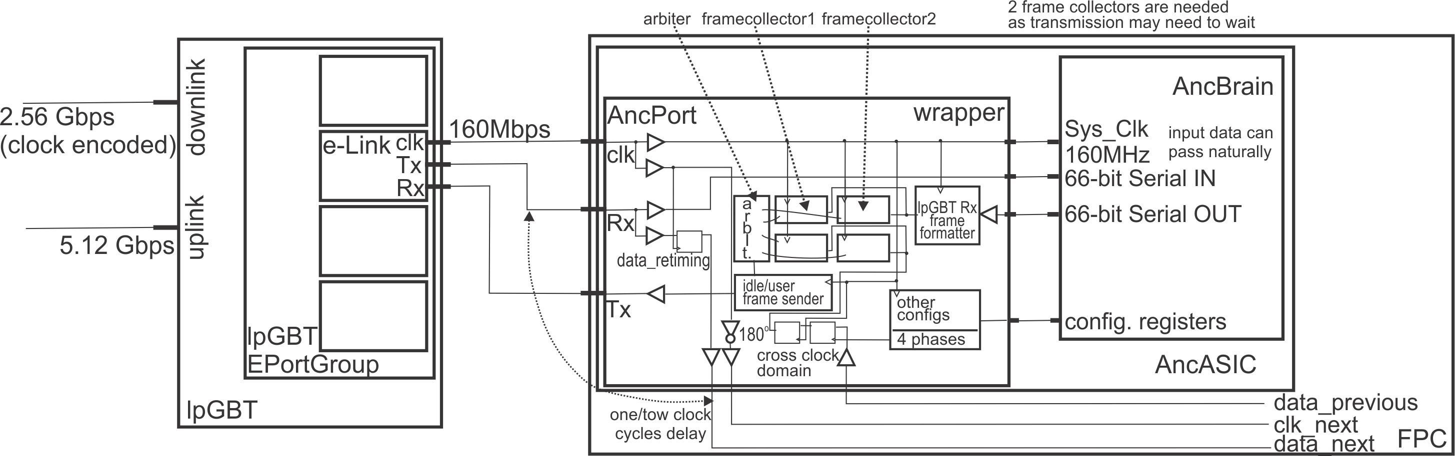
AncBrain: Wrapper - 1
Why wrapper is needed?
Receive 160 MHz clock and provide it to AncBrain
Interface data stream from e-LinkTX to AncBrain
Output e-LinkTX data and clock to next AncBrain
Receive data from previous AncBrain and buffer (it needs use programmed phase and retime data to own clock)
Receive own data from AncBrain and buffer
Arbitrate between own data and data from previous AncBrain (any response to any command result in no longer data than 66 bits)
Construct data frame suitable for e-LinkRx (pad bits to complete full frame, set to right data format)
Transmit data STREAM to e-LinkRX from AncBrain (when no actual data available, send IDLE data)
specification of wrapper’s functionality is underway
Question: should it recognize reset command to reset AncBrain (hardware reset)?
- maybe POR will suffice?

Slide 13
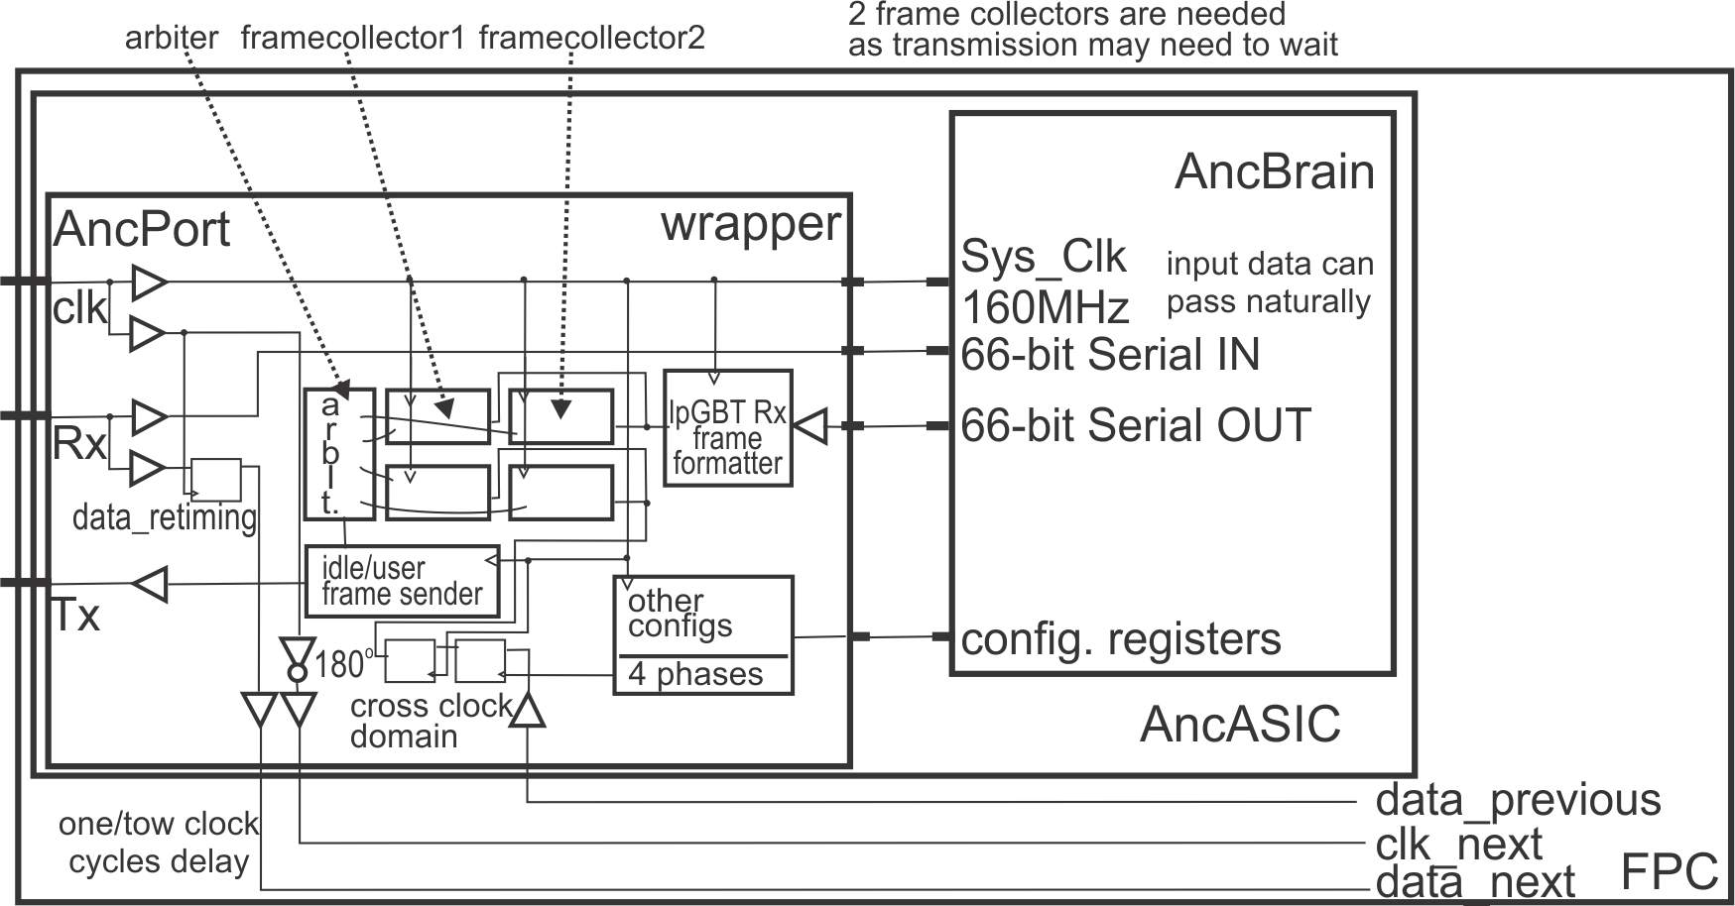
AncBrain: Wrapper - 2
What happens in wrapper
D-channel data from lpGBT Tx can be sent in naturally, though user data needs to be 68 bit
lpGBT Rx frame format needs to be built internally by the wrapper
downlink data needs to be retimed in each AncASIC in daisy chain, thus 1 or 2 clock delays will be added
Uplink data from each AncASIC I chain needs to be retimed and brought to local clock domain, thus 1 or 2 clock delays will be added
Simple retiming using 4 selectable phases is to be executed on incoming data (no lpGBT automatic phase adjustment)
Selection of phase done in cascade first AncASIC closest to lpGBT for feasibility
(1) lpGBT Rx frame formatting will be taking 66 bit AncBrain data and putting it into Rx format handshaking with AncBrain
(2) frame collectors will be used on own frames and incoming frames to manage uplink transmission without collision
(3) 2 Frame collectors are needed allow resolving collisions (Rx fame is ~2x longer than AncBrain frame)
(4) Arbiter will be monitoring two directions for frames and commuting between own and incoming data
(1), (2), (3) and (4) will result in delays, but should not be critical on uplink – still needs to be estimates
BNL has access to lpGBT_model, lpGBT_FPGA, lpGBT_FPGA_simulation, etc. to built complete software mockup

Slide 14
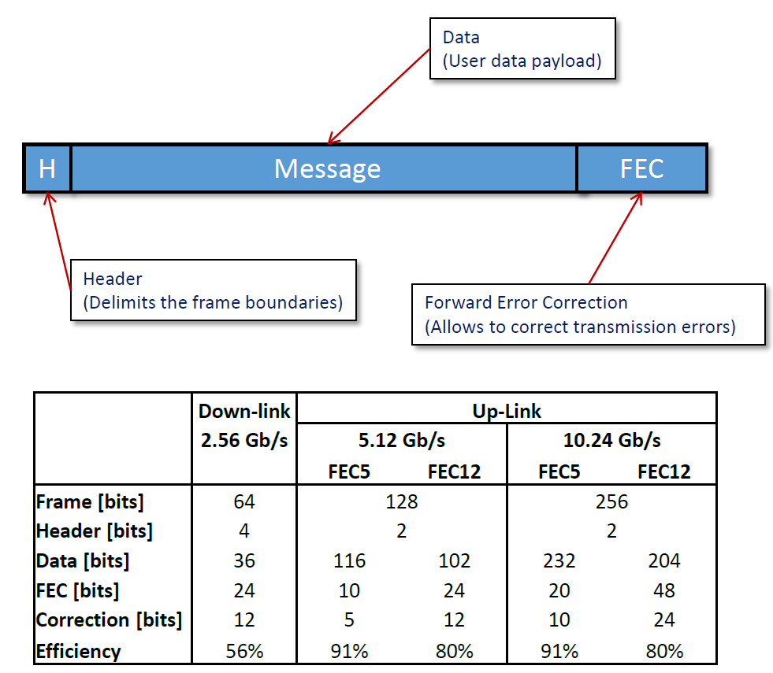
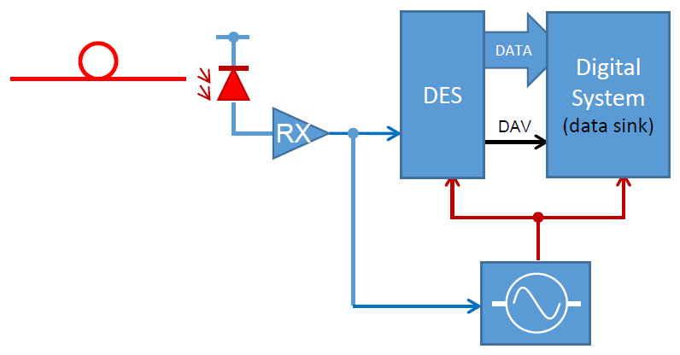
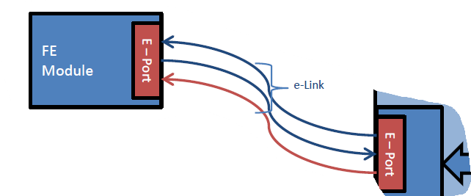
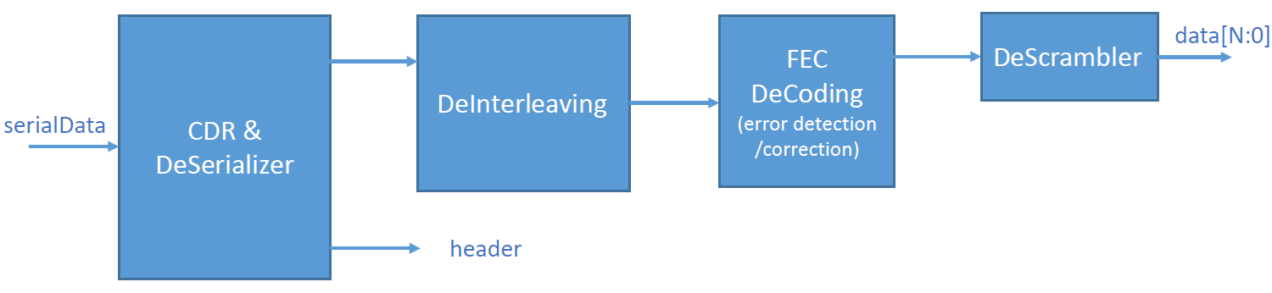
From and To AncBrain
Down-link to AncASICs
Down link:
FEC12
2.5Gbps
CDR
40MHz
Data rates:160 /320 / 640 / 1280 Mb/s
Count: FEC5 Up to 28 @ 160 Mb/s, Up to 7 @ 1.28 Gb/s
FEC12 Up to 24 @ 160 Mb/s Up to 6 @ 1.28 Gb/s
It needs to be operated in the transceiver mode
• 2bits Header • The data field: 2bits IC, 2bits EC, 32bits D (1.28Gbps), 24 bits FEC • Forward error correction field: FEC12 • data field is scrambled to allow for CDR at no [additional] bandwidth penalty CDR 40MHz •
• downlink •

Slide 15
From and To AncBrain
Understanding of protocol modes (ePortTx.pptx)
D-field (D) transmit user’s data (D) to the frontend device eLinks. The user available bandwidth is 1.28 Gb/s.
At 160 Mbps 8 eLinks down-links can be used
x4 data rate (2x160Mbps): “normal” data present on channels 0,2; If shadow enabled and ePortTxGroupDataPortEnable[1/3] data from channel 0,2 are sent to channels 1,3 respectively
MSB first
FRAMEDWN[63:0]
• @ 160 MHz -> 8 eLinks are active • eLinks (channels) are associated in ePorts • ePorts are grouped in eGroups • each eGroups composed of 4 ePorts • data on eLinks can be inverted in lpGBT •
Data Rate Select
Data Rate Mbps
Links per group
Active eLinks (channels)
Frame-eLink(channel) mapping
eLink outputs, EDOUTCP (EDOUT[3:0][3:0]P / EDOUT[3:0][3:0]N)
• E: eLink; D: data; OUT: downlink output;
• G: group number, 0 to 3 (there are 4 groups);
• C: channel number, 0 to 3 (there are 4 eLinks associated with every group);
• P/N: polarity,
2’b10 160 2 0, 2 {chn2[3:0], chn0[3:0]}
shadow{chn3[3:0], chn1[3:0]}
data coming from the downlink frame to each ePortTx group can be replaced with test patterns.

Slide 16
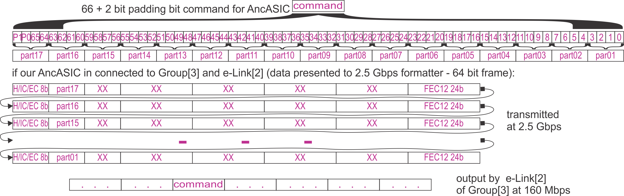
From and To AncBrain
Understanding of protocol modes (ePortTx.pptx)
E-links output MSB first
Shadow disabled:
Shadow enabled:
Knowing that AncBrain uses 66-bit long data format, we need to send:
DataRate[1:0] | DataIn[7:0] | DataOut
 |  | e-Link[3] | E-Link[2] | E-Link[1] | E-Link[0]
2’b10 (x4) 160Mbps | {chn2[3:0],chn0[3:0]} | - | DataIn[7:4] | - | DataIn[3:0]
2’b10 (x4) 160Mbps | {chn2[3:0],chn0[3:0]} | DataIn[7:4] | DataIn[7:4] | DataIn[3:0] | DataIn[3:0]
• data out on falling edge of 160 MHz clock •
• lpGBT does not look into user data • users must assure that their data is DC-balanced if needed • 4 bits out of 64-bit fame yield 160 Mbps •
• each command need to be distributed between 17 user’s data blocks of 4 x 8 bits •

Slide 17
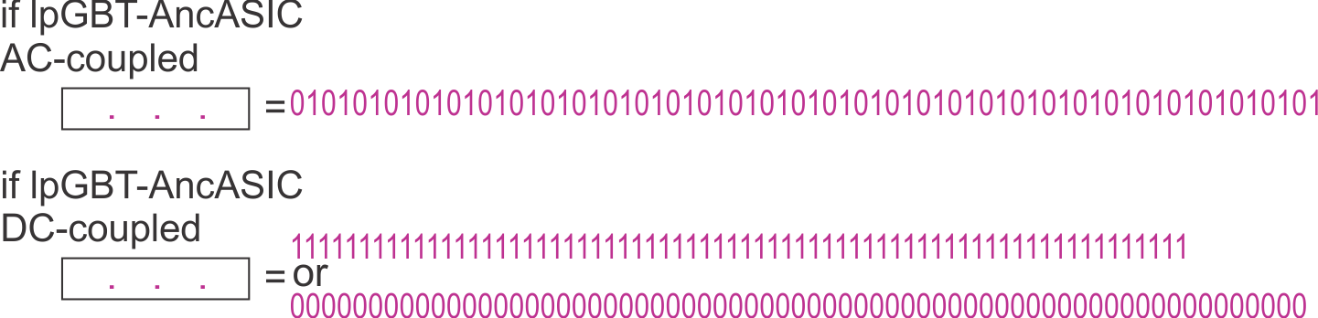
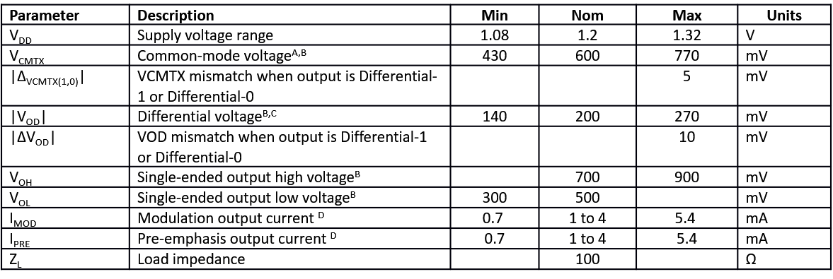
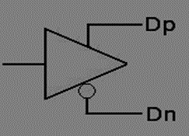
From and To AncBrain
Electrical properties (eLinkTxRx.pptx)
• user must assure overall DC – balance of data if such is neded •
^{A} Common mode: (V_{DP} + V_{DN}) / 2. ^{B} Value when driving into differential load impedance 100 Ω. Termination load is external. ^{C} Differential voltage: V_{DP} - V_{DN} ,values for 2mA setting, scales accordingly for other currents.
^{D} Modulation and pre-emphasis currents are programable in 0.5 mA steps from 1 mA to 4 mA. Default setting for the LpGBT is 2mA.

Slide 18
From and To AncBrain
Up-link from AncASICs
5.12 or 10.24 Gbps
D – field (payload):
– FEC12: 3.84 Gb/s
– FEC5: 4.48 Gb/s
If FEC12:
– Bandwidth 160 / 320 / 640 Mb/s
– # eLinks: 24 / 12 / 6
Uplink link:
source 160 Mbps
• 2bits Header • The data field: 2bits IC, 2bits EC, 96bits D (3.84Gbps), 24 bits FEC, 2 bits LM • Forward error correction field: FEC12 • data field is interleaved and scrambled at no [additional] bandwidth penalty •
3.84Gbps ð (4 bits from each e-Link – 4 eLinks – in 1 EPort Group) =4×160Mbps=640Mbps ð 640Mbps ×6 EPort Groups = 3.84Gbps
bandwidth is more than needed, but probably cannot be set differently
• uplink •

Slide 19
From and To AncBrain
Understanding of protocol modes (ePortRx.pptx)
lpGBT provides clock to AncASIC
AncASIC will send data synchronous with lpGBT clock
phase of incoming data from lpGBT is unknown but taken care of by lpGBT
Internal lpGBT bus output is 16-bit for eLinks @ 160 Mbps
DataRate[2:0] |  | Sampling Clocks | Bit rate clock | Master DLL reference Clock | LowDataRate
TxDataRate | DataRate[1:0]
1'b0 (5.12 Gb/s) | 2’b01 (x4) | 160 MHz | 160 MHz | 160 MHz | 1’b1
DataRate[2:0] |  | SerialDataIn |  |  |  | DataOut
TxDataRate | DataRate[1:0] | e-Link[3] | e-Link[2] | e-Link[1] | e-Link[0] | High [15:0] | Low [15:0]
1’b0 (5.12 Gb/s) | 2’b01 (x4) | e-Link3[3:0] | e-Link2[3:0] | e-Link1[3:0] | e-Link0[3:0] | - | {e-Link3[3:0], e-Link2[3:0, e-Link1[3:0], e-Link0[3:0]}
AncBrain uses 66-bit data format ð 2 bit padding is needed

Slide 20
From and To AncBrain
Summary (ePortTX.pptx / ePortRx.pptx)
Main questions:
(1) should down-link and uplink data be DC-balance encoded?
can be naturally transmitted if DC-coupled
If transmission padded with 101010 transitions between commands this probably can probably be also transmitted naturally if AC-coupling (we transmit rare 66 bit long sequences only)
If down-link and up-link data needs to be DC-balanced wrapper would need to take care of DC-balancing (descramble down-link data and scramble up-link data)
Good news:
longer data sequences will need to be transmitted, but AncBrain will feel 66 bit long sequences (unchanged)
descrambling / scrambling is to be localized uniquely in wrapper
design scrambler transmitting naturally now, and if findings in tests on mock-up point to need of DC-balancing, only wrapper will be modified
this will allow safe efforts (= $$) towards March

Slide 21
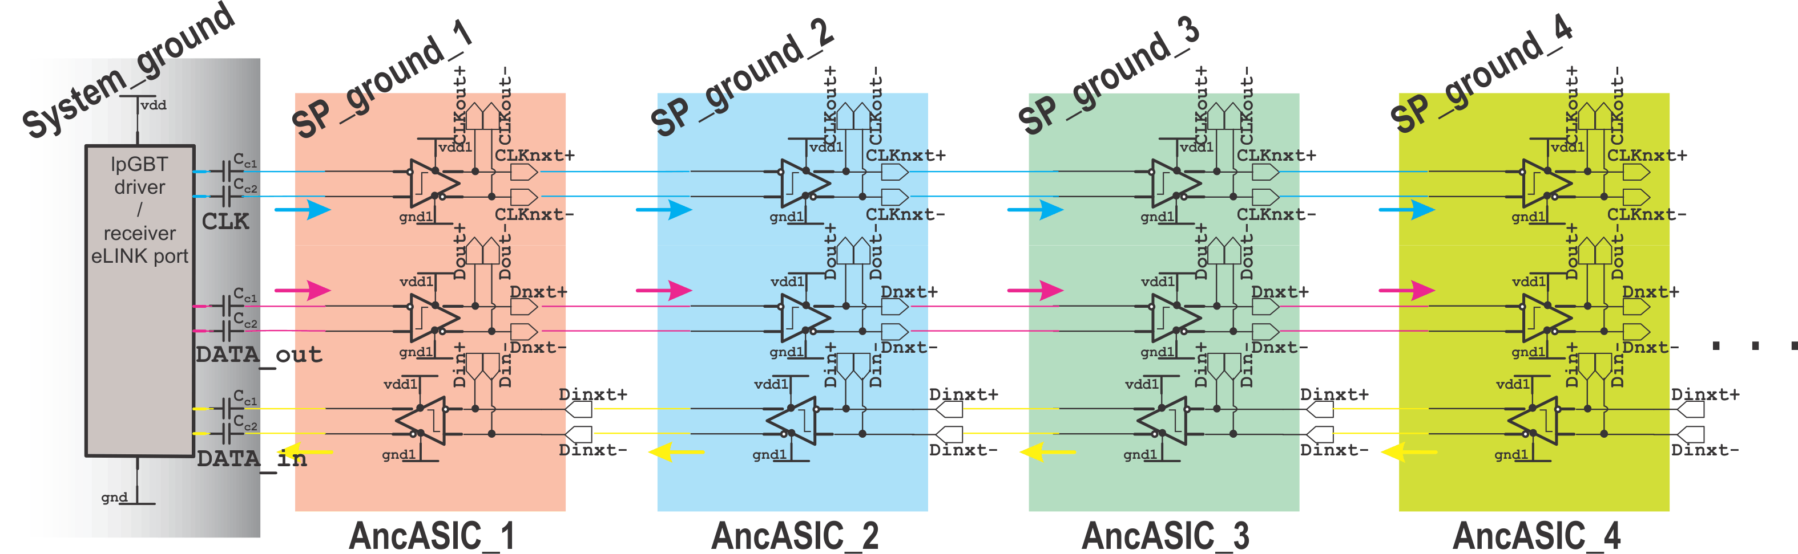
From and To AncBrain
Summary (ePortTX.pptx / ePortRx.pptx)
Main questions:
(2) where AC and DC coupling should be used and how wired to EPort Group / eLinks ?
Proposal:
AC-coupled only to lpGBT (up-link and down-link), with coupling capacitors next to lpGBT
DC-coupled down from first AncASIC in chain
Advantages:
Best for long chain of AncASICs,
All but first AncASIC can entirely stop trsnamission
Do we really need lpGBT?

Slide 22
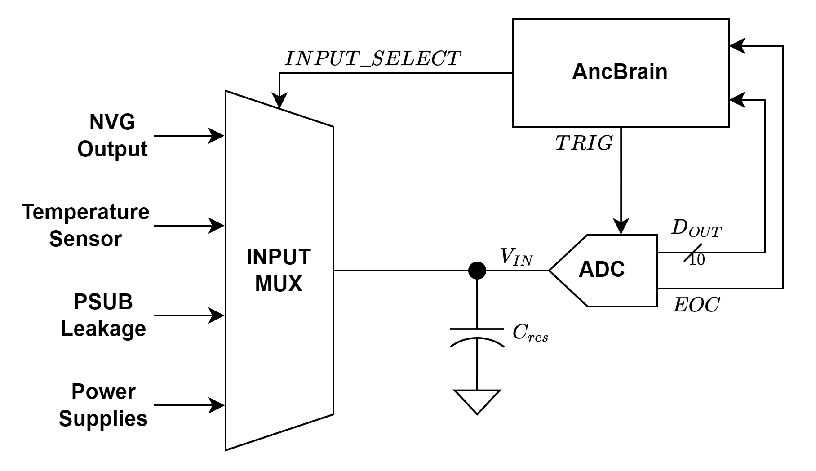
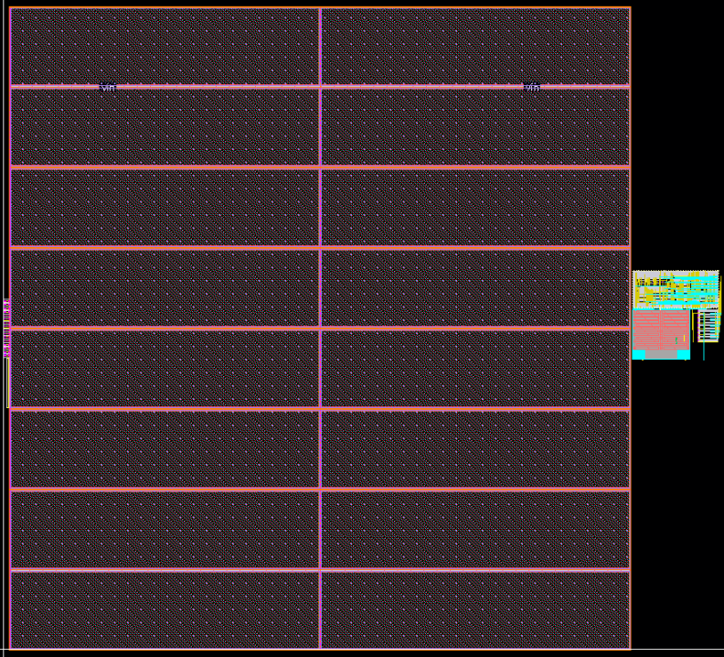
Monitoring ADC
10-bit ADC, 16 input available
converts in principle static signal after selection and requesting conversion
no input buffer (to avoid offsets, nonlinearities, to allow rail-to-rail compliance), instead large (~1 nF) reservoir capacitor
6 – 10 ms for capacitor to charge is needed
10-bit data and “end-of-conversion” (EOC) flag generated
• 930 μm •
ADC, reservoir capacitor and input MUX are currently laid out
Reservoir capacitor implemented as DMOS transistor
Pre-regulator VBR used as Vref (however, does bandgap have the appropriate drive strength? If not, modification to BGR or driver must be developed)
To be done:
divide-by-2 gain stage must be implemented to measure SLDOs’ power supply levels that may be over the ADC power supply
XFAB PDK upgrade (1.13)
updated size and layout of certain standard cells
simulations need to be caried out
design work must still be done on peripheral circuitry
decisions on the powering scheme for the ADC is underway (5th SLDO within the AncASIC?)
• 830 μm •
• reservoir capacitor •

Slide 23
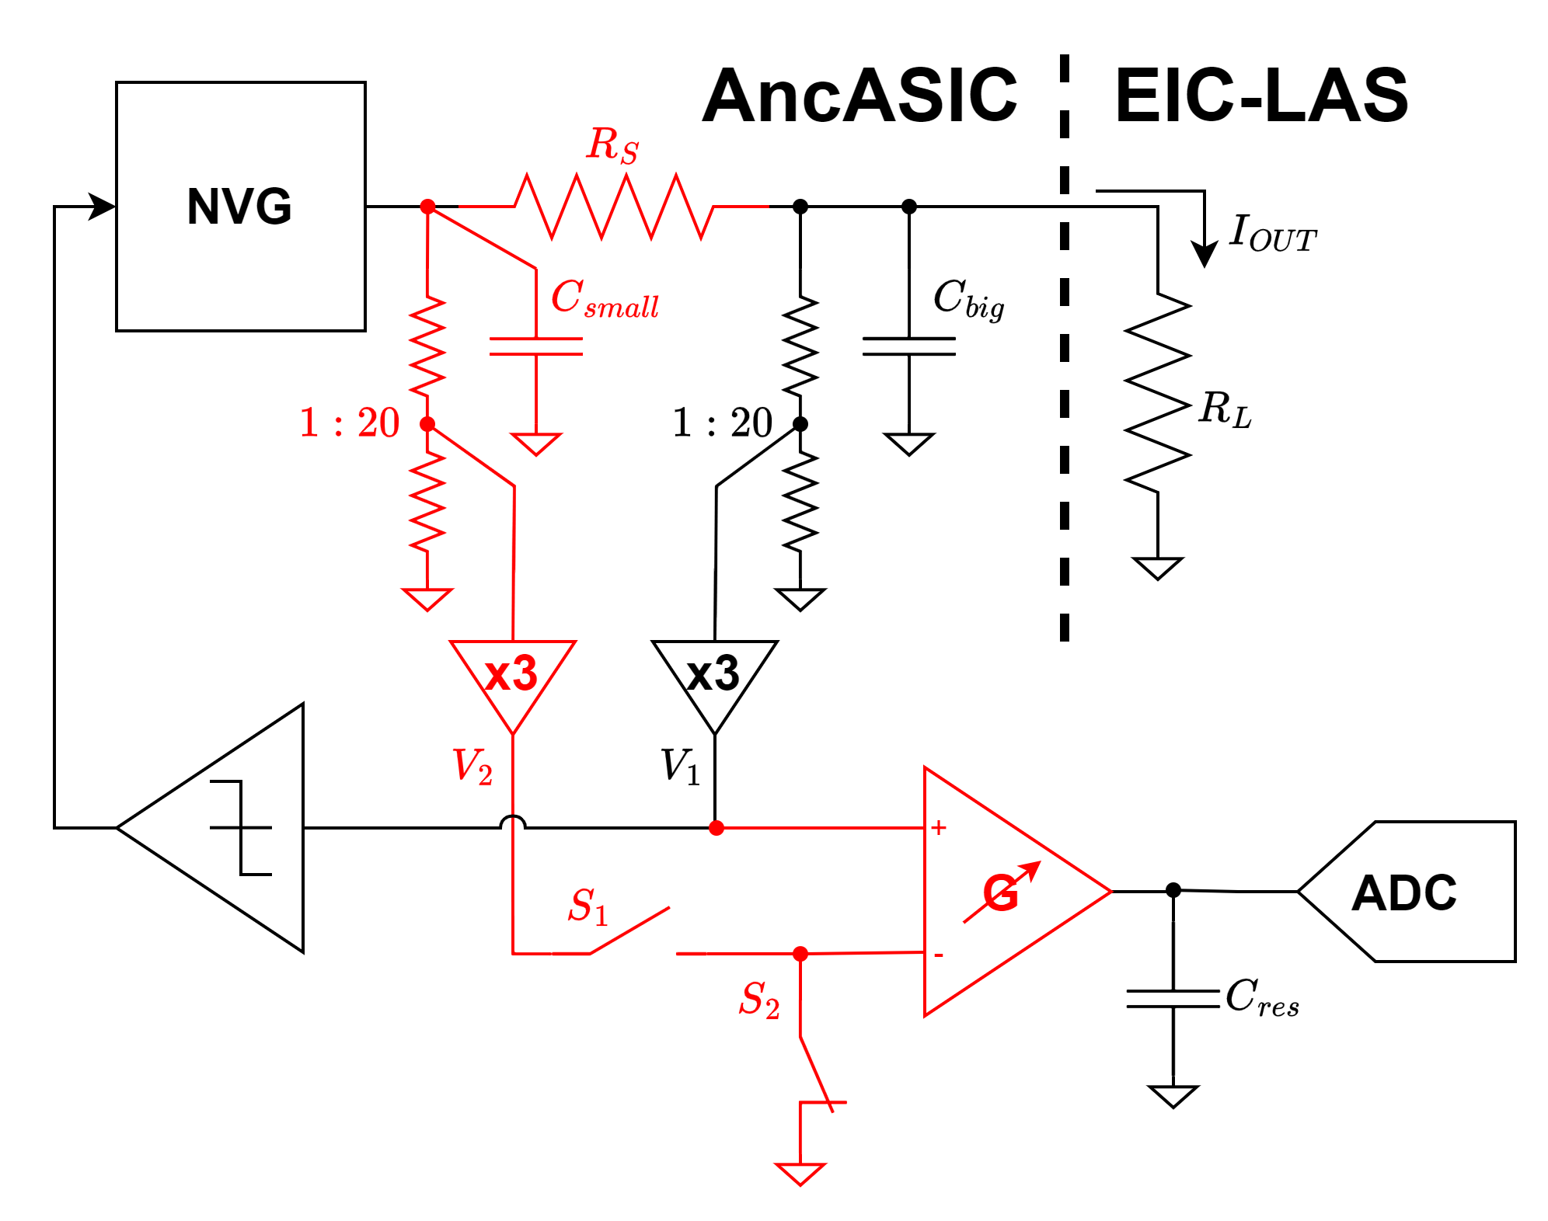

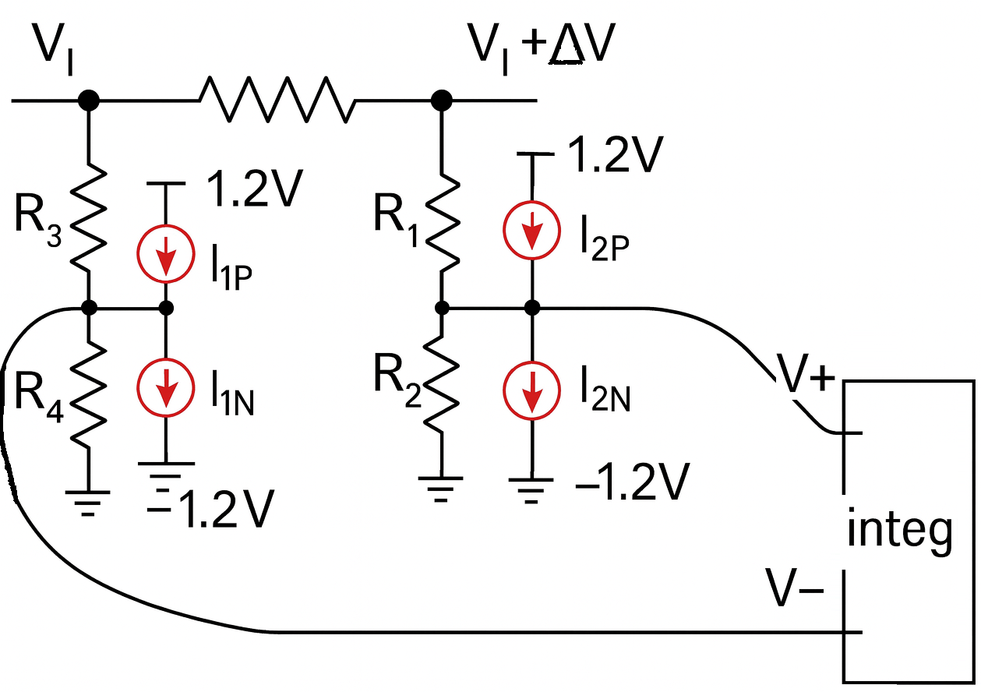
Monitoring of PSUB current
PSUB current (= MAPS leakage) measurement specifically requires additional circuitry: (in red)
series resistor R_{s}=~100Ω
1:20 divider bridge needs to be balanced with 4 current sources for reduction of errors / offsets (calibration will be needed)
must be designed, laid out and verified
leakage measurements ranging from 10’s of uA’s up to 10’s of mA’s
ΔV
V_{NVBG}-ΔV
V_{NVBG}
(V_{NVBG}-ΔV)/k’ |k’=20
V_{NVBG}/k |k=20
k’=k(1+ε) (ε=error)
and
ΔV’=| (V_{NVBG}-ΔV)/k’ - V_{NVBG}/k|= |ΔV/k(1+ε V_{NVBG}/ΔV )|
as ε=X% and V_{NVBG}/ΔV=~100 ð ΔV’ differs from ΔV/k a lot !
difference depends on V_{NVBG} and this can be measured independently, but k and k’ needs to be determined at least for one V_{NVBG} or corrected
Options for handling this devil:
Add circuitry balancing these voltage division resistors (complexity),
During wafer testing, measure k and k’ for each AncASIC; how? switch off NVBG, force external V_{NVBG}, measure V_{NVBG}/k and ΔV/k and extract k and k’ – acceptable?
Operation:
Division by k is needed as there is no negative power supply on AncASIC
when S₁ open and S₂ closed ð V_{NVBG}/k is measured,
when S₁ closed and S₂ open ð ΔV/k is measured
variable (programmed) gain G is needed to match resolution of ADC as ΔV will be small
all need to be DAC - defined

Slide 24
Summary
Work completed:
AncBrain functionally completed (with small caveats), idem RTL code ð implementation
AncBrain standalone verification
Skipping not necessities, but need to decide about intake of threshold alarms
NVBG loop
Monitoring ADC
Work ahead:
Software Mockup
to develop specification of AncBrain wrapper
BNL has access to lpGBT_model, lpGBT_FPGA, lpGBT_FPGA_simulation, etc. to built complete software mockup
to run system verification
specify power-on and startup procedures
handling stack-ups and reported errors
definition of expected command sequences
AncBrain wrapper
Complete auxiliary functions, like PSUB measurements, decide what to do with threshold alarms (design DAC/comparators)
AncASIC complete integration
Modify should any feedback from testing and irradiations

Slide 25
Backup

Slide 26

Error Map - 1
TIER 0: CRITICAL SYSTEM ERRORS (Safety-Critical)
Code | Error Name | Tier | Priority | Sev | Status | Integration | Source Module | Implementation Notes
0x01 | ERR_TEMP_CRITICAL | T0 | 1 | CRIT | ✗ | IMM | temp_sensor | TODO: Add temp sensor + comparator**
0x02 | ERR_POWER_FAILURE | T0 | 2 | CRIT | ✗ | IMM | power_monitor | TODO: follow the overcurrent signal from SLDO May require masking other error signals
0x04 | ERR_VOLTAGE_OUT_RANGE | T0 | 4 | CRIT | ✗ | IMM | voltage_monitor | TODO: Comparator
**should there be any on chip action by AncBrain for overheating is under discussion and maybe included for future versions.

Slide 27
Error Map - 2
TIER 1: COMMUNICATION/LINK ERRORS
Code | Error Name | Tier | Priority | Sev | Status | Integration | Source Module | Implementation Notes
0x10 | ERR_PROTOCOL_ERROR | T1 | - | ERR | ✗ | HYB | frame_chk | TODO: Add protocol violation detector or check if other link layer error signal serve the same purpose
0x11 | ERR_CRC_ERROR | T1 | - | ERR | ✓ | REG | frame_chk | Reg only. Control room will do the polling
0x14 | ERR_DATA_TYPE_ERROR | T1 | 11 | ERR | ✓ | IMM | cmd_parser | Active: data_type_err_pulse (reserved type 0b11)
0x19 | ERR_LAS_TIMEOUT_NO_RESPONSE | T1 | 13 | ERR | ✓ | IMM | LAS interface | Active: las_timeout_pulse
0x1C | ERR_LINK_FAILURE | T1 | 45 | ERR | ✓ | IMM | deser65 | Active: link_failure_pulse (SOF timeout 5ms) actual timeout will be configured after the completion of the design with all the timing analysis at hand

Slide 28
Error Map - 3
TIER 2: COMMAND VALIDATION ERRORS
Code | Error Name | Tier | Priority | Sev | Status | Integration | Source Module | Implementation Notes
0x20 | ERR_PARITY_ERROR | T2 | 24 | ERR | ✓ | IMM | cmd_parser | Active: parity_err_pulse
0x21 | ERR_INVALID_COMMAND | T2 | 20 | ERR | ✓ | IMM | cmd_parser | Active: invalid_cmd_pulse (no valid type)
0x23 | ERR_INVALID_ADDRESS | T2 | 25 | ERR | ✓ | IMM | cmd_parser | Active: invalid_addr_pulse + subcode (addr)
0x24 | ERR_INVALID_RW_FIELD | T2 | 21 | ERR | ✓ | IMM | cmd_parser | Active: invalid_rw_pulse
0x25 | ERR_PAYLOAD_STRUCTURE | T2 | 22 | ERR | ✓ | IMM | cmd_parser | Active: payload_struct_pulse (unused ≠ 0)
0x26 | ERR_COMMAND_LENGTH | T2 | 23 | ERR | ✓ | IMM | cmd_parser | Active: cmd_length_pulse

Slide 29
Error Map - 4
EXECUTION LAYER ERRORS
Code | Error Name | Tier | Priority | Sev | Status | Integration | Source Module | Implementation Notes
0x36 | ERR_OPERATION_FAILED | T2 | - | ERR | ✓ | IMM | core_fsm | Active: operation_failed_pulse (LAS done, no valid resp)
0x37 | ERR_STATE_VIOLATION | T2 | - | ERR | ✓ | IMM | core_fsm | Active: state_violation_pulse (invalid FSM transition)

Slide 30
Error Map - 5
TIER 4: INTERNAL/DEBUG ERRORS
Code | Error Name | Tier | Priority | Sev | Status | Integration | Source Module | Implementation Notes
0xF0 | ERR_INTERNAL_ERROR | T4 | 40 | INFO | ✓ | IMM | core_fsm | Active: internal_err_pulse (timeout in RESPONSE_WAIT)
0xF1 | ERR_SIMULATION_ERROR | T4 | 41 | INFO | ✓ | SUP | testbench | Sim only: Testbench error injection
0xF2 | ERR_DEBUG_ASSERTION | T4 | 42 | INFO | ✓ | SUP | assertions | Sim only: SVA assertion failure
0xF3 | ERR_COVERAGE_ERROR | T4 | 43 | INFO | ✓ | SUP | coverage | Sim only: Coverage collection issue
0xFF | ERR_UNKNOWN | T4 | 44 | INFO | ✓ | IMM | core_fsm | Active: unknown_err_pulse

