Slide 1

20251216
MPW2-SLDO:
Initial tests
WP2 Sensor and AncAsic characterization
andrew.hill@stfc.ac.uk

Slide 2
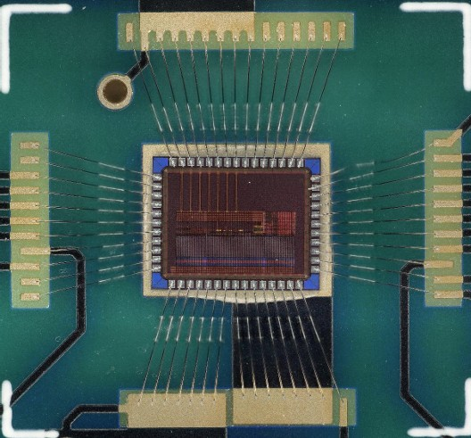
Outline
MPW2-SLDO
Test systems distribution.
Initial tests on MWP2-sLDO.
Serial Powering.
Conclusion.

Slide 3



Distribution and test plan
Distribution:
Bham: 1 DUT + 1 DAQ, J.Glover, L.Li;
Brun : 1 DUT + 1 DAQ, L.Teodorescu, L.Ranatunge;
DL : 2 DUT + 3 DAQ, A.Hill;
DL : Spare: 1 unpopulated DUT carrier PCB;
[DUT assembly @ Bham]
Test:
Smoke testing of DAQ set-up; [A.Hill]
Smoke testing of DUT; [A.Hill]
Chip characterisation; [Shared Bham, Brun, DL]

Slide 4
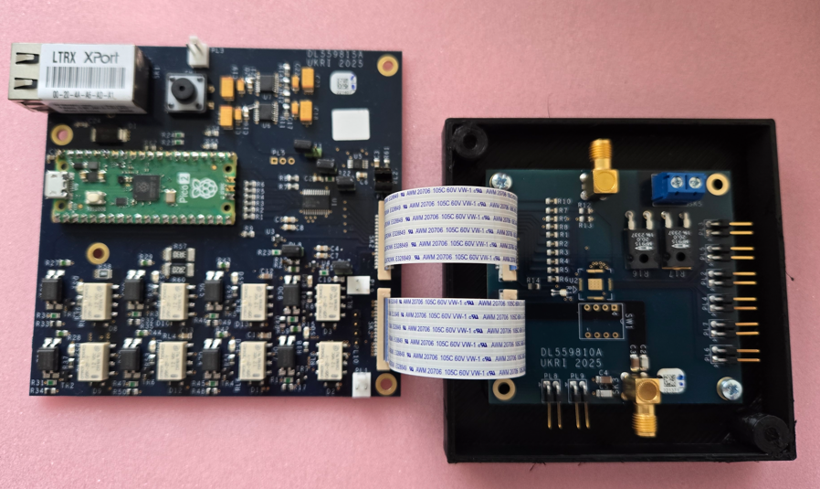
Smoke testing of DAQ set-up
DAQ card
Ethernet port
DUT carrier card
Micro-controller
Successfully commissioned w/o DUT

Slide 5
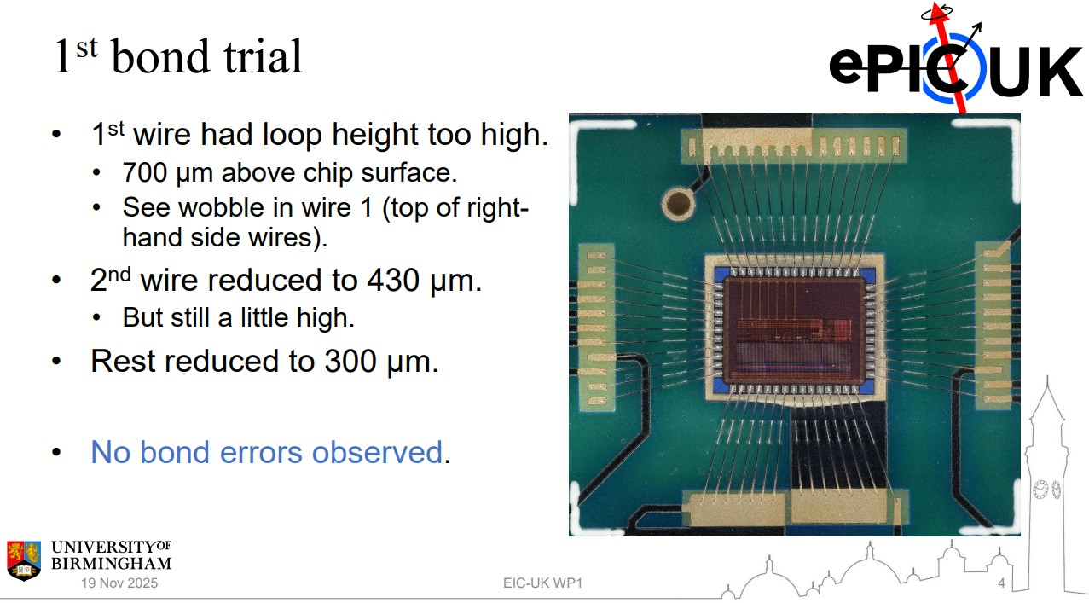
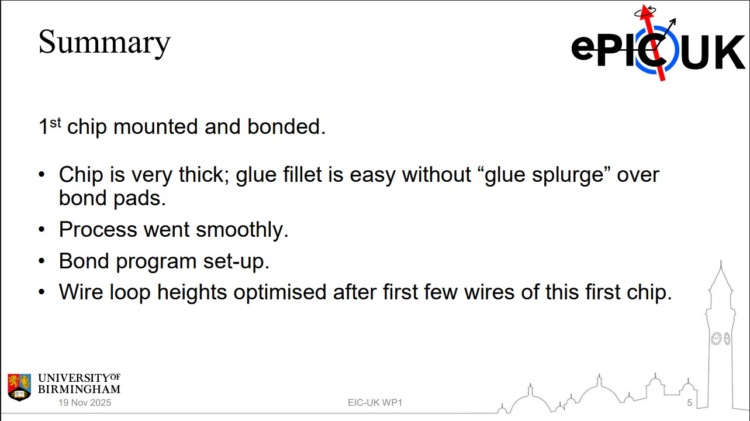
DUT interconnection on carrier PCB
A total of 4 DUTs were mounted and wirebonded to 4 carrier PCBs.

Slide 6
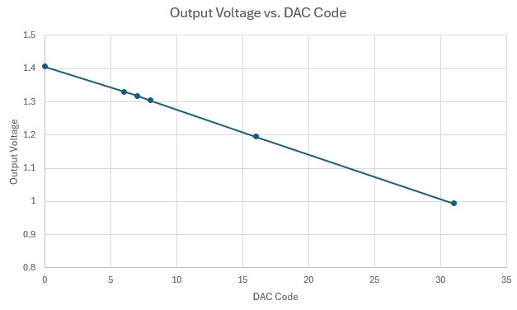
Smoke testing of DUT-TW1
Powered up the DUT (nominal values) and performed a DAC Scan: Scan DAC codes. Record the value of Vout and plot against the code.
The DUT output voltage successfully responded to commands.

Slide 7
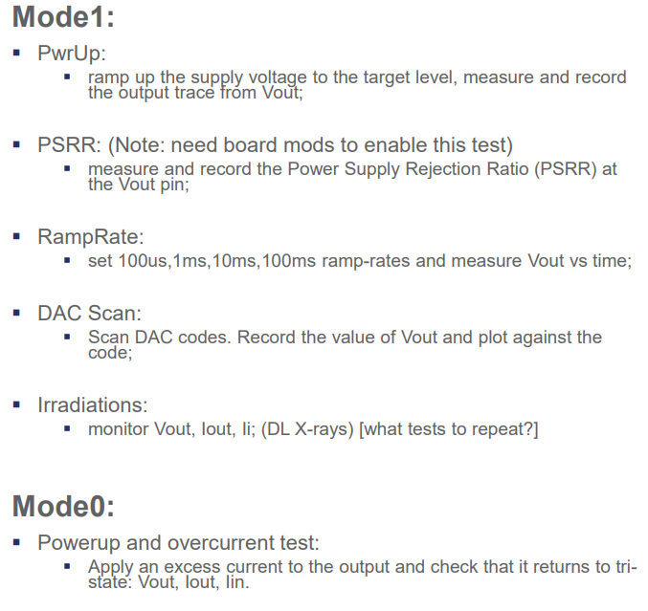
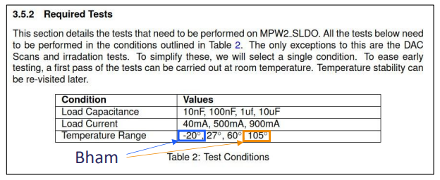
Chip characterisation
Focus on standalone sLDO.
Evaluation of performance against specified range of
parameters.
Bham -> perform all characterisation at +27C and -20C, +105C;
Brun -> perform all characterisation at +27C and +60C;
DL -> select sub-set of tests for irradiation [repeat
before/during/after irradiation][+27C and +60C(TBC)]

Slide 8
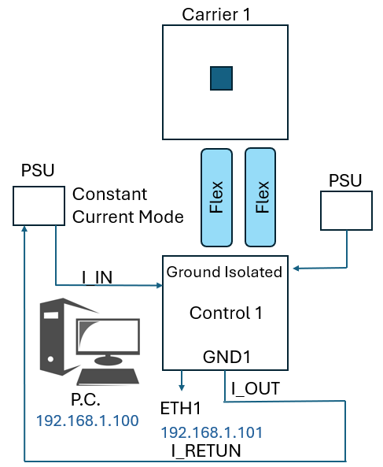
Test setup

Slide 9
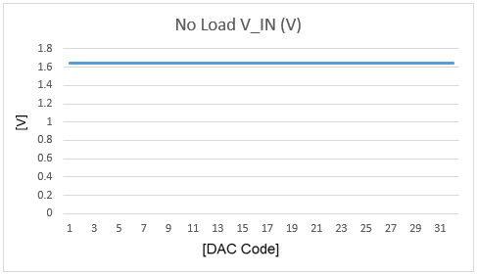
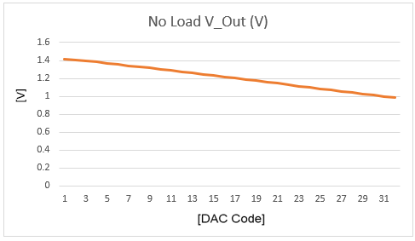
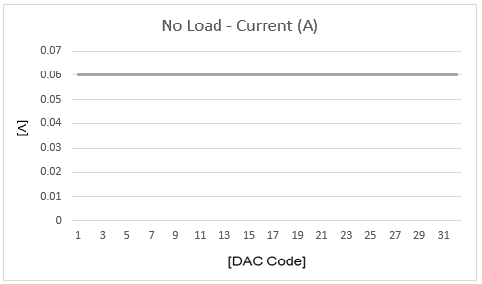
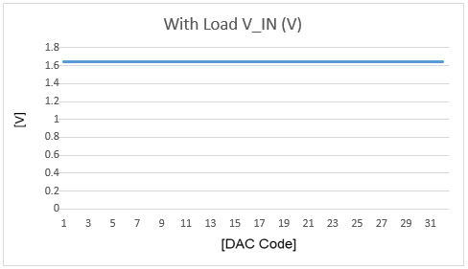
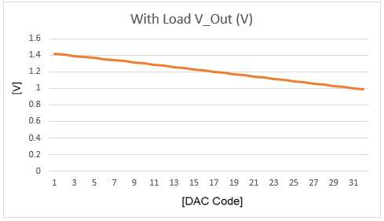
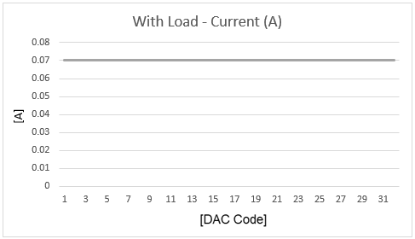
DUT-TW1: 40mA region of interest (ROI)
PSU V_OUT = 1.65V
V_IN = 1.646V : V_DROP = 0.004V

Slide 10
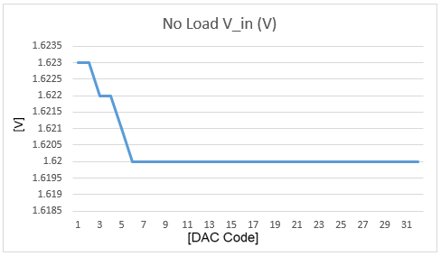
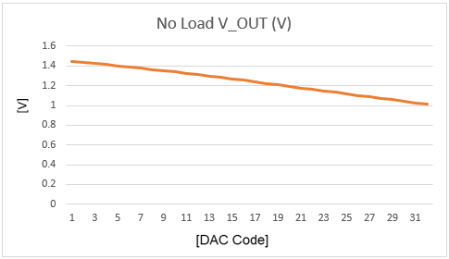
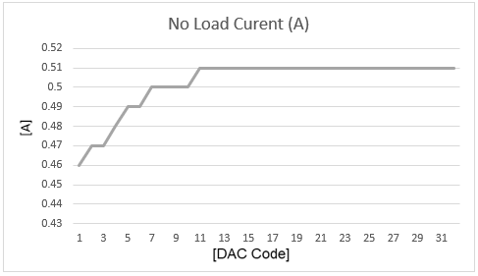
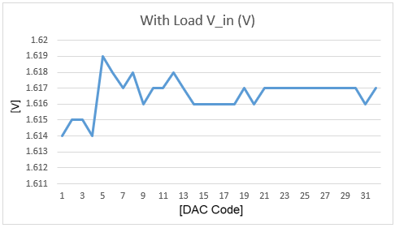
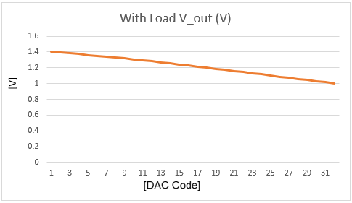
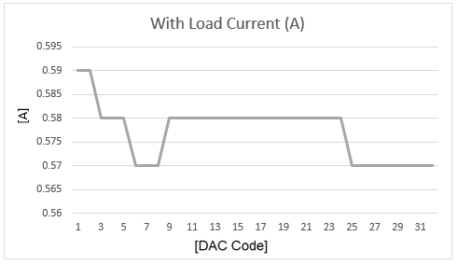
DUT-TW1: 500mA ROI
PSU V_OUT = 1.65V
V_IN = 1.623V : V_DROP = 0.027V

Slide 11
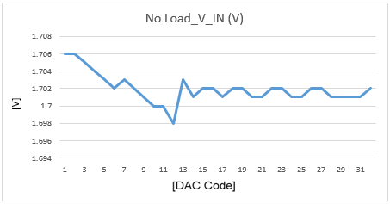
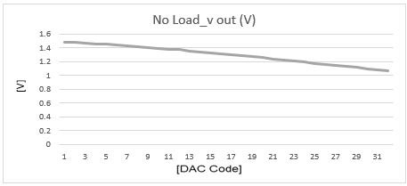
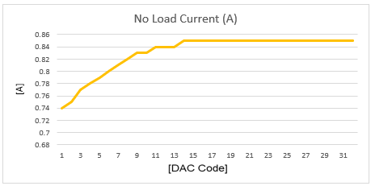
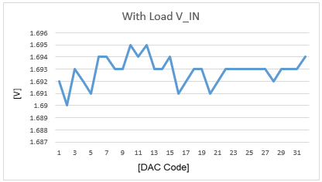
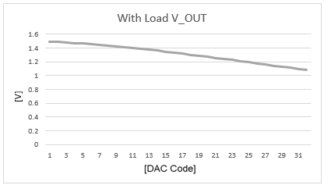
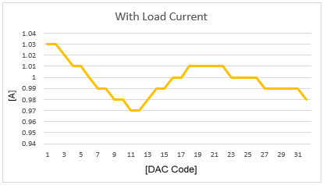
DUT-TW1: 900mA ROI
PSU V_OUT = 1.75V
V_IN = 1.706V

Slide 12
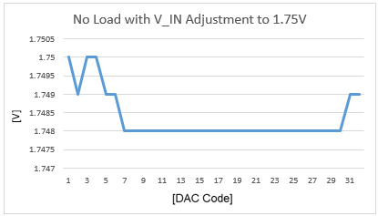
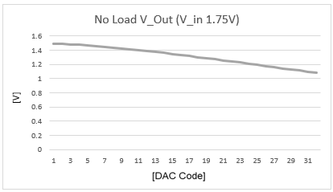
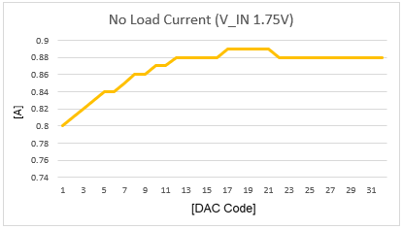
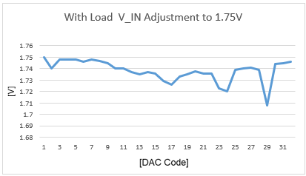
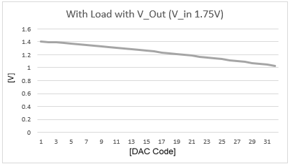
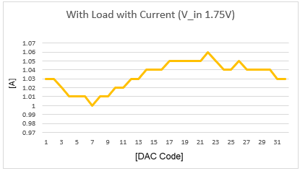
DUT-TW1: 900mA ROI (V_in = 1.75V @ Chip)
PSU V_OUT = 1.883V
V_IN = 1.75V : V_DROP = 0.133V

Slide 13
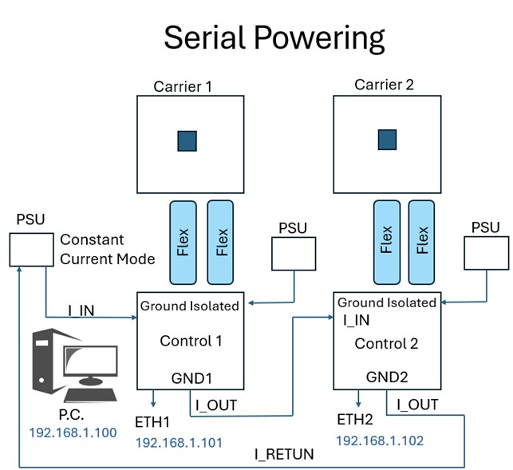
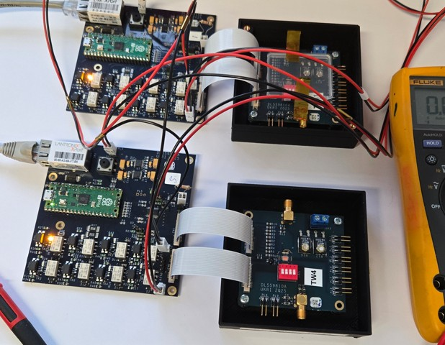
Serial powering – sanity check
PSU V_OUT 3.2V 0.05A CC Mode
Board 1 V_IN =1.556V
Board 2 V_IN = 1.641V
Overall V_Drop = 0.003V
Test Set Up.
Both set to 40mA ROI
No Load test::-
Board 1 Dac set to 0 ∴ V_out = 1.416V
Board 2 Dac set to 0 ∴ V_out = 1.479V
PSU V_out = 3.2V 0.06A CC Mode
Board 1 Dac set to 31 ∴ V_out = 0.984V
Board 2 Dac set to 31 ∴ V_out = 1.055V
PSU V_out = 3.2V 0.06A CC Mode
With Load test:-
Board 1 Dac set to 0 ∴ V_out = 1.414V
Board 2 Dac set to 0 ∴ V_out = 1.478V
PSU V_out = 3.2V 0.06A CC Mode
Board 1 Dac set to 31 ∴ V_out = 0.985 V
Board 2 Dac set to 31 ∴ V_out = 1.058V
PSU V_out = 3.2V 0.06A CC Mode

Slide 14
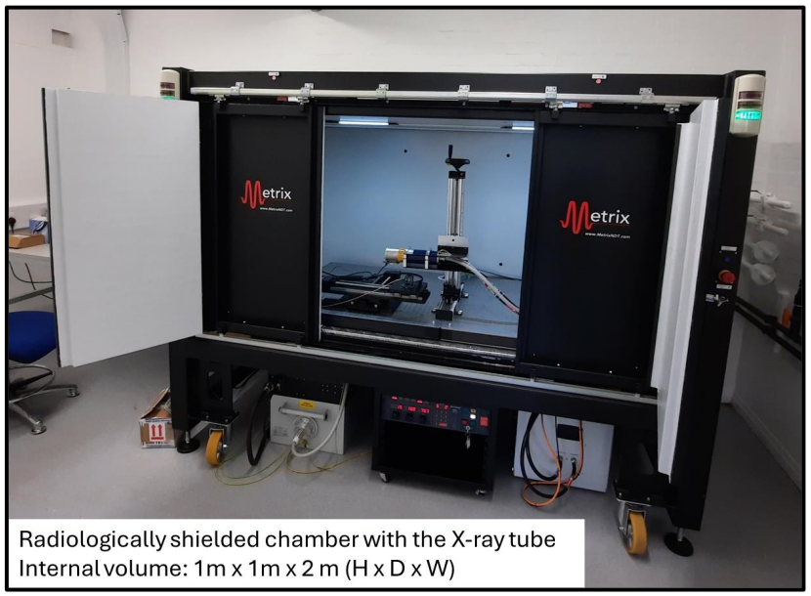
Conclusion

Slide 15
Thanks for your time
Any questions

