Slide 1
Services
Roland Wimmer
Mechanical Engineer
6.03.09 Integration, Installation and Infrastructure
Incremental Preliminary Design and Safety Review of the ePIC Outer and Inner Support Structures
December 8th – 9th, 2025

Slide 2
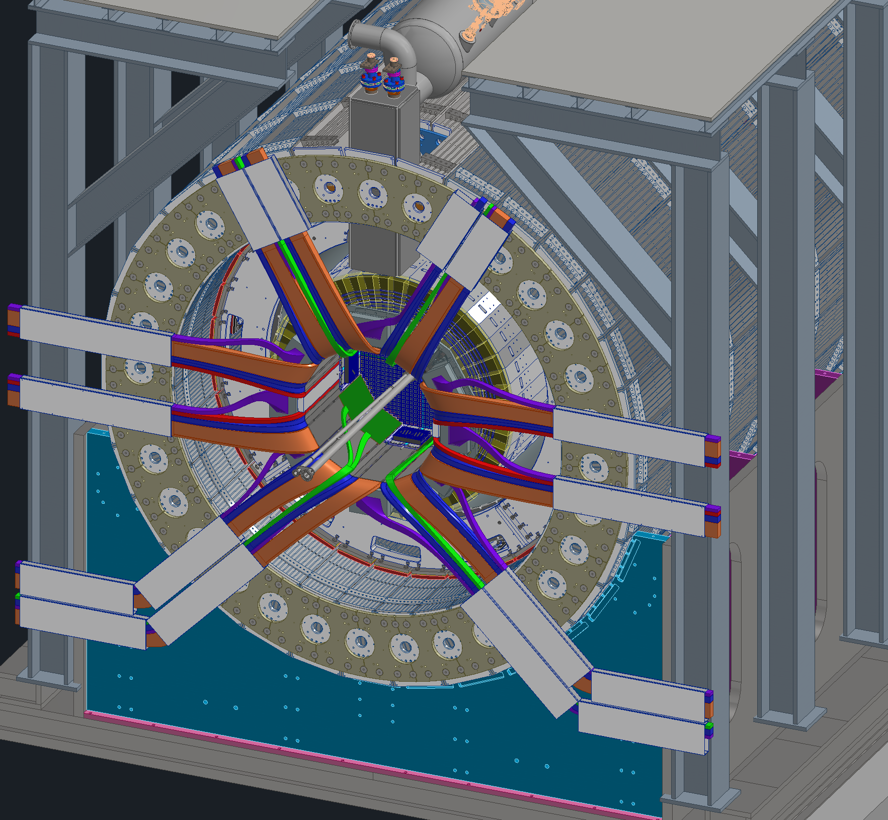
Outline
Detector Overview
Platforms
Services Overview
Bending & Routing
RDO placement
Forward & Backward Cable trays
Disconnects
Summary/Next Steps

Slide 3
Charge Questions
Charge questions addressed by slide
#
Is the progress and design maturity for all detector systems, support structures, and moving mechanisms technically sound, feasible, and sufficiently mature to advance toward final design and aligned with being baselined in June 2026 (>60% maturity is required)?
Have the required building and facility modifications (floor loading, rails, crane capacity, utilities, service routing, etc.) been adequately analyzed, addressed, or planned?
Have ES&H and QA considerations been adequately incorporated into the designs at their present stage?
Do the designs and installation plans for the Outer Detectors (Barrel HCAL, Barrel EMCAL, Magnet), Inner Detectors within the GST (DIRC, MPGD, TOF, Silicon, EEEMCAL, pfRICH), and the Endcaps (Forward EMCAL/HCAL) meet support, alignment, movement, access, and integration requirements within building/rail constraints?
Are preliminary cooling schemes adequately developed and documented, do they meet thermal and reliability requirements, and are interfaces across subsystems and to facility cooling/HVAC clearly defined?
Is the project team ready to proceed to final design for the scope under review, and what recommendations should be addressed beforehand?
Have the recommendations from previous reviews been adequately addressed?

Slide 4
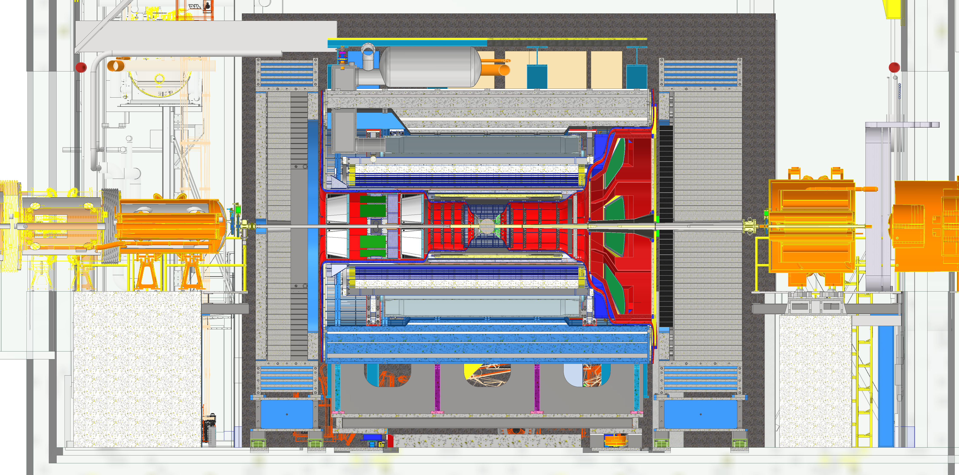
Detector Overview
Central Barrel
Backward direction, Electron, West side
Forward direction, Hadron, East side
Backward End Cap
Forward End Cap
Services Gap
Services Gap

Slide 5
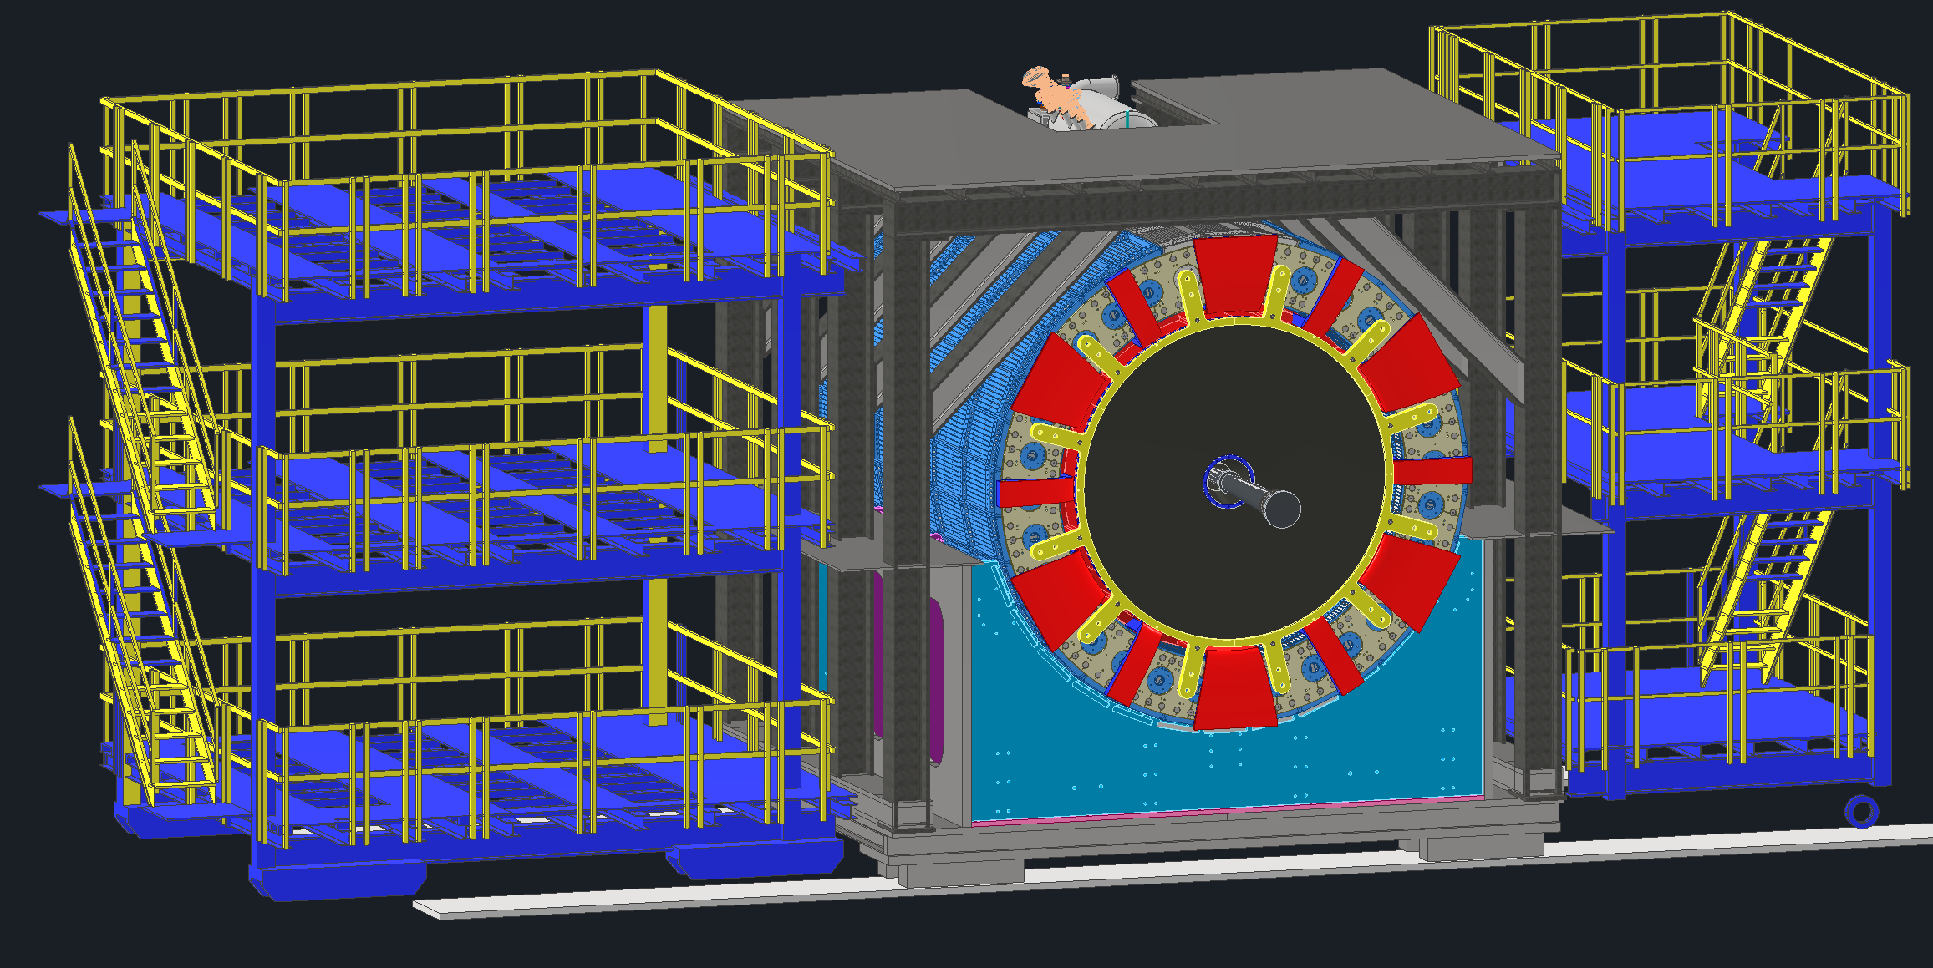
Platforms
1
Ring Outside Platform:
Will house all the detector and DAQ racks
Due to height restrictions the 3rd level will only have half height racks as needed
Ring Inside Platform:
Will house detector service panels (such as gas & cooling) and other various service needs
Central Platform:
For access purposes only
Will not have any equipment or racks
Central Platform
Central Detector
Ring Inside Platform
Ring Outside Platform

Slide 6
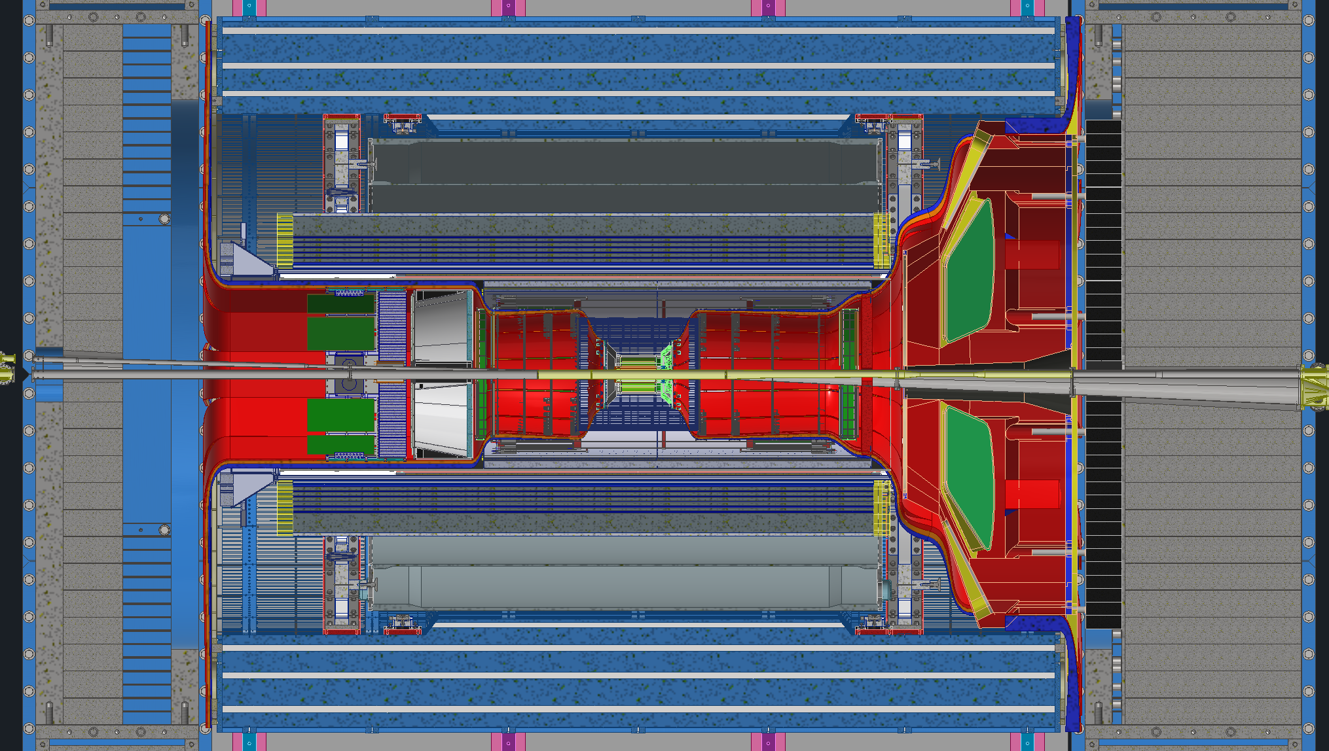
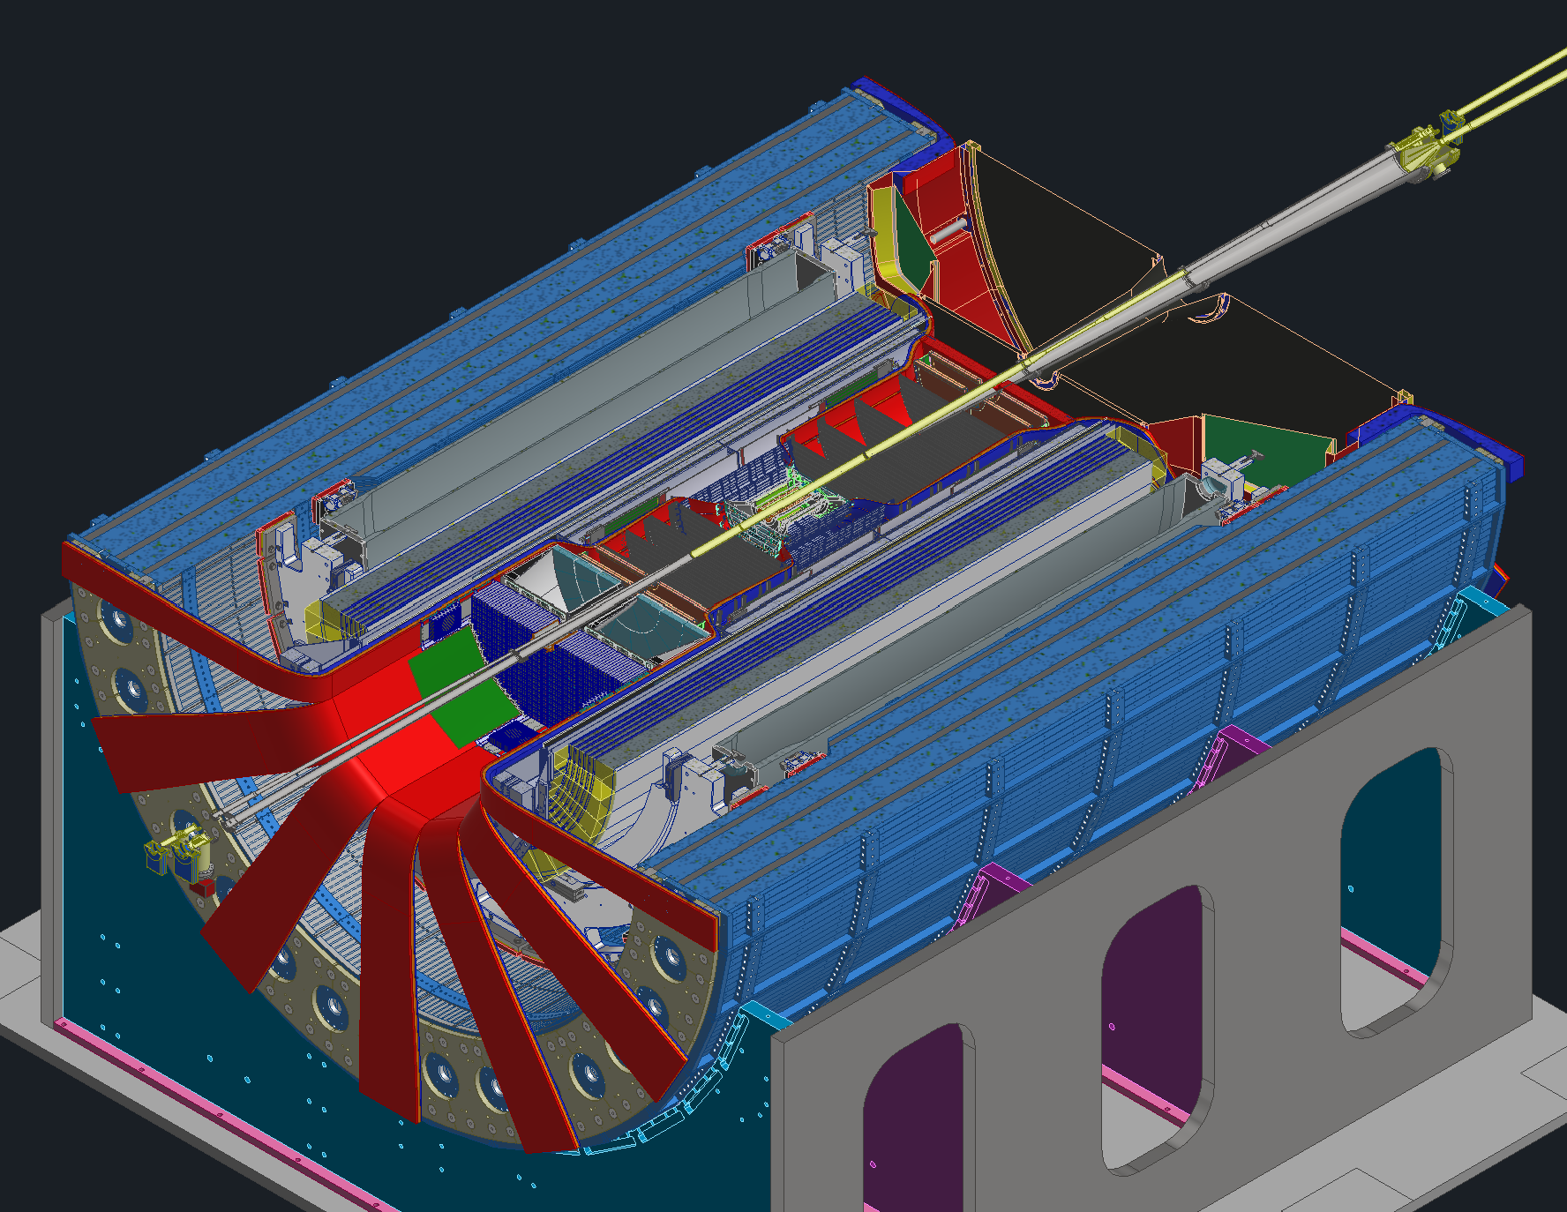
Service Routing Overview
1
Services follow one of two main paths to get out of the detector, forward and backward paths.
Starting from the IP, services work their way out of the detector to the services gaps between the barrel and the endcaps.
The large volumes represent the services, red is power, orange is signal, blue is cooling & gas
Blue is Cooling
Orange is Signal
Red is Power
Backward direction, Electron, West side
Forward direction, Hadron, East side

Slide 7
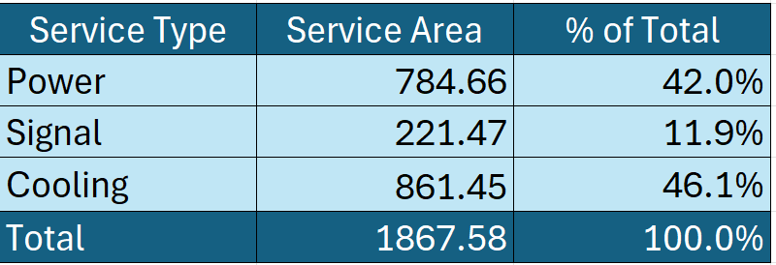
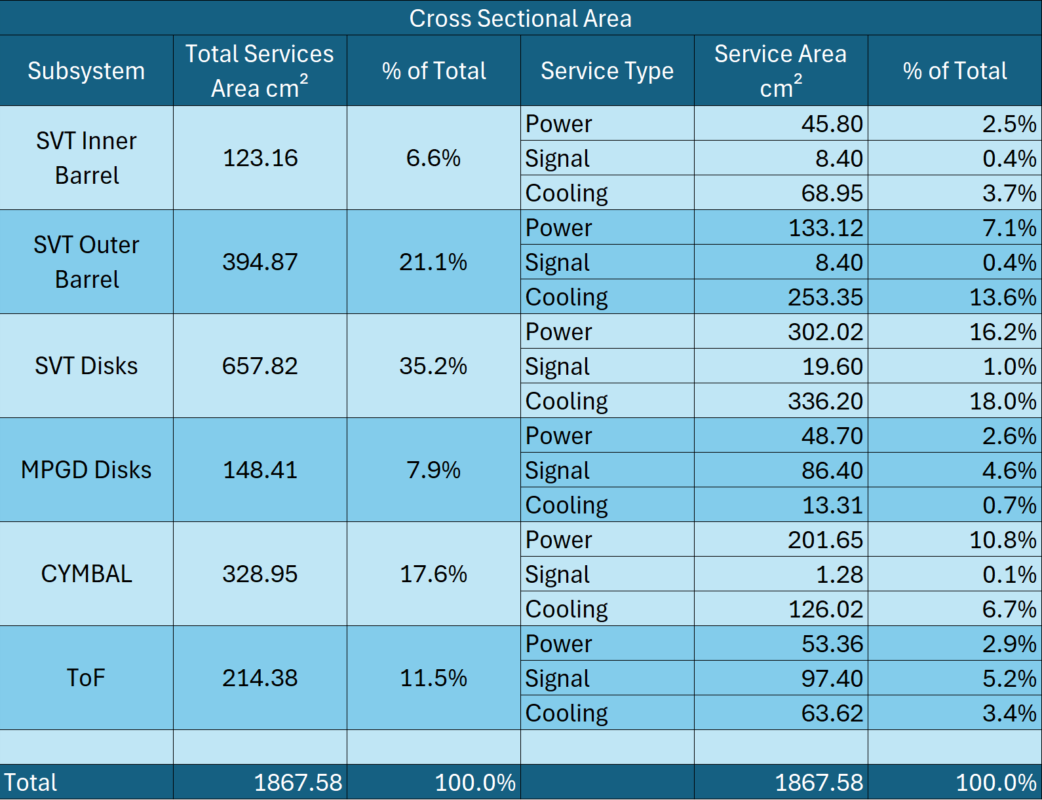
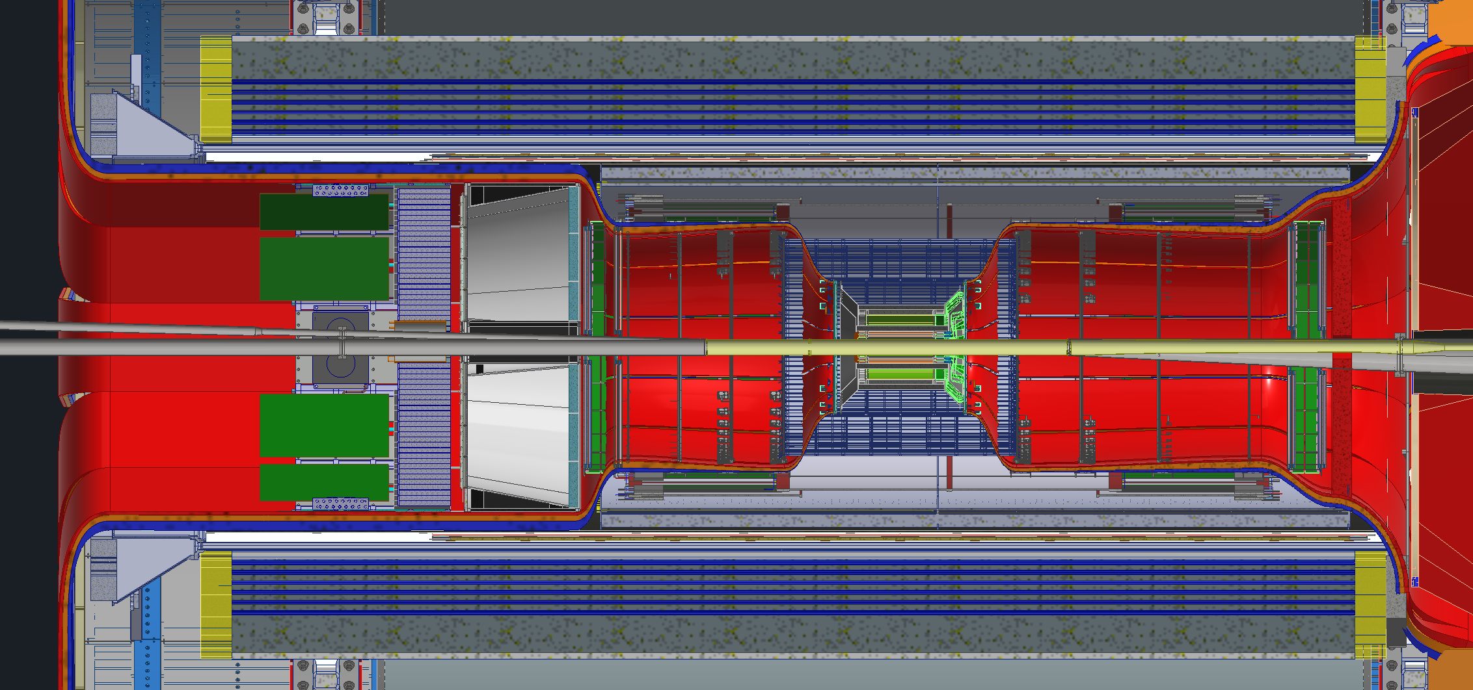
Services Overview
1
These tables are snapshots from the master services spreadsheet
The table below shows the backward direction services from each detector, and what percentage of their services are power, signal and cooling
The table to the right shows what percentage of the total backward direction services are power, signal and cooling
Backward Services (9400 total cables)
Forward Services (6300 total cables)

Slide 8
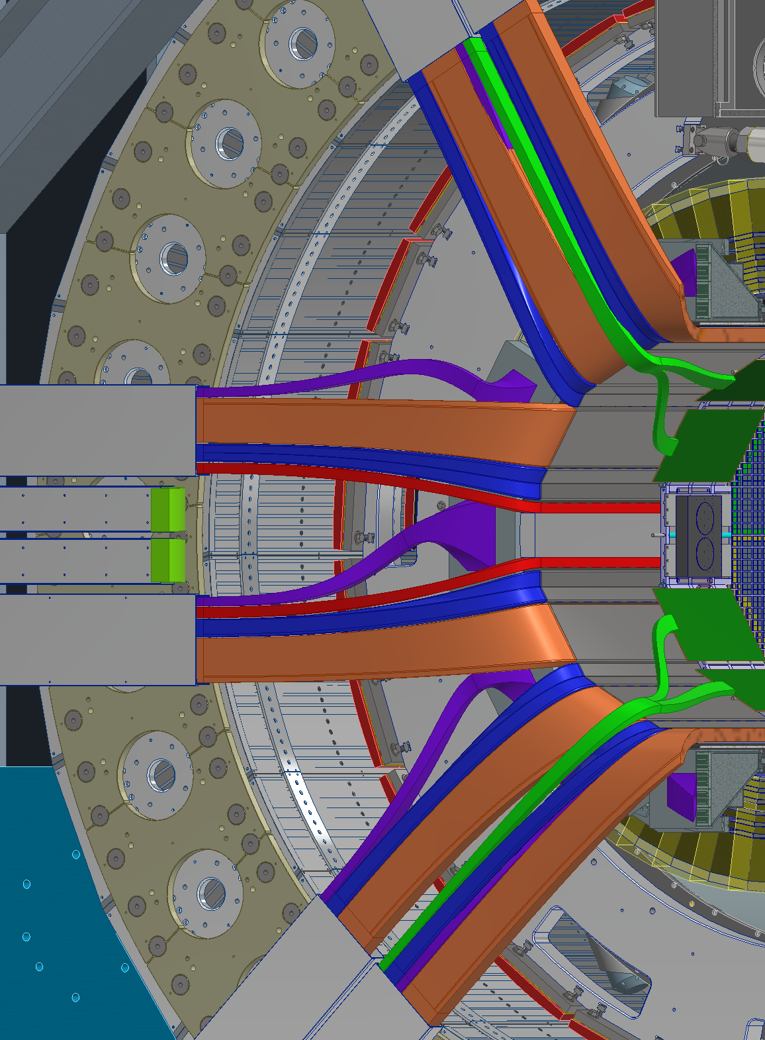
Bend Radii & Routing
1
The bend radius for services drove how the routing in the detector was planned.
In most cases optical fibers were the services of most concern regarding bend radius.
We used 10x the diameter as a rule of thumb for an acceptable bending radius.
For example, if a cable has a 5mm diameter, then it would have a 5cm bend radius.

Slide 9
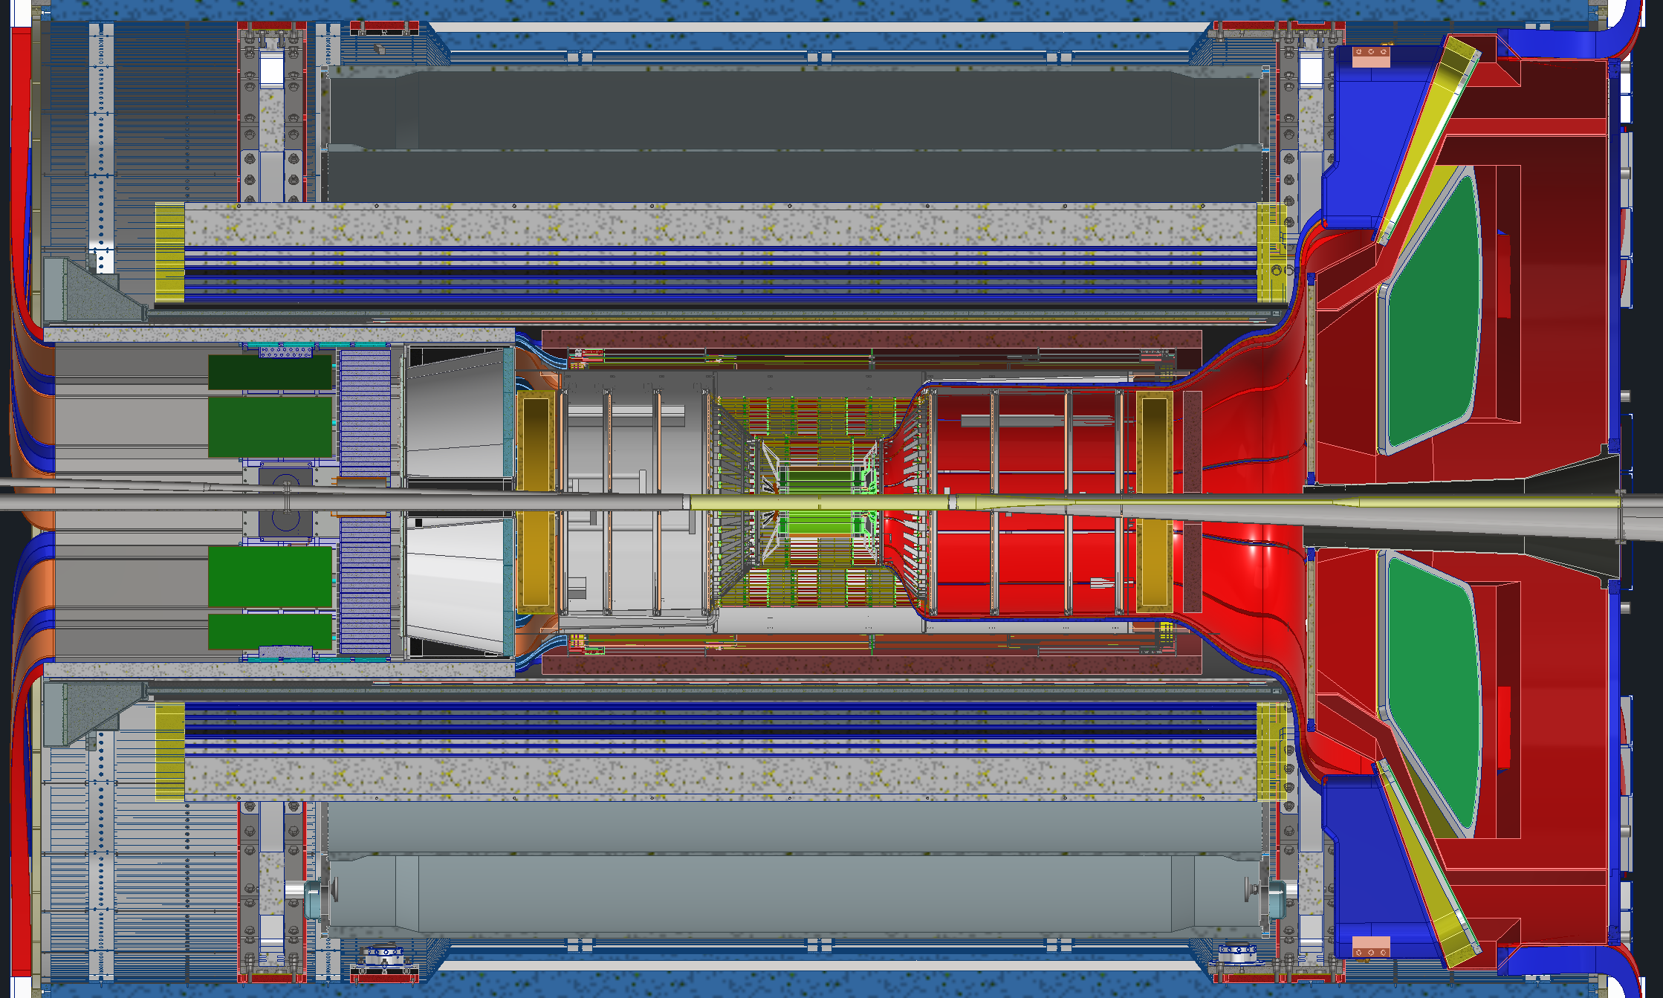
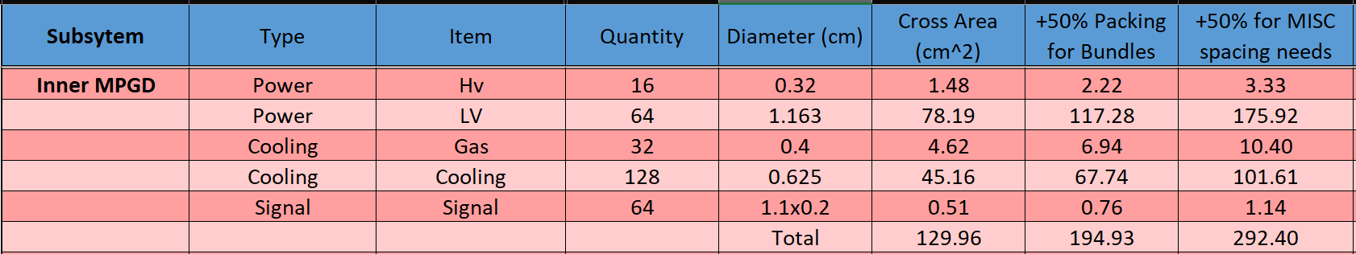
Bottlenecks & Pinch Points
Service estimates were gathered from all the various subgroups and compiled together where the total cross-sectional area needed was calculated for each detector.
Then a +50% bonus was added twice to that number. The first time to account for packing and the second time to account for cable trays and other cable management items
That last number was used to calculate space needed at various bottlenecks inside the detector
Services leaving the Barrel 47%
Services going past the EEEMCal 84%
Services between dRICH and EMCal 73%
Services leaving PST 53%
Services leaving GST 63%
Services leaving the barrel 72%
Example

Slide 10
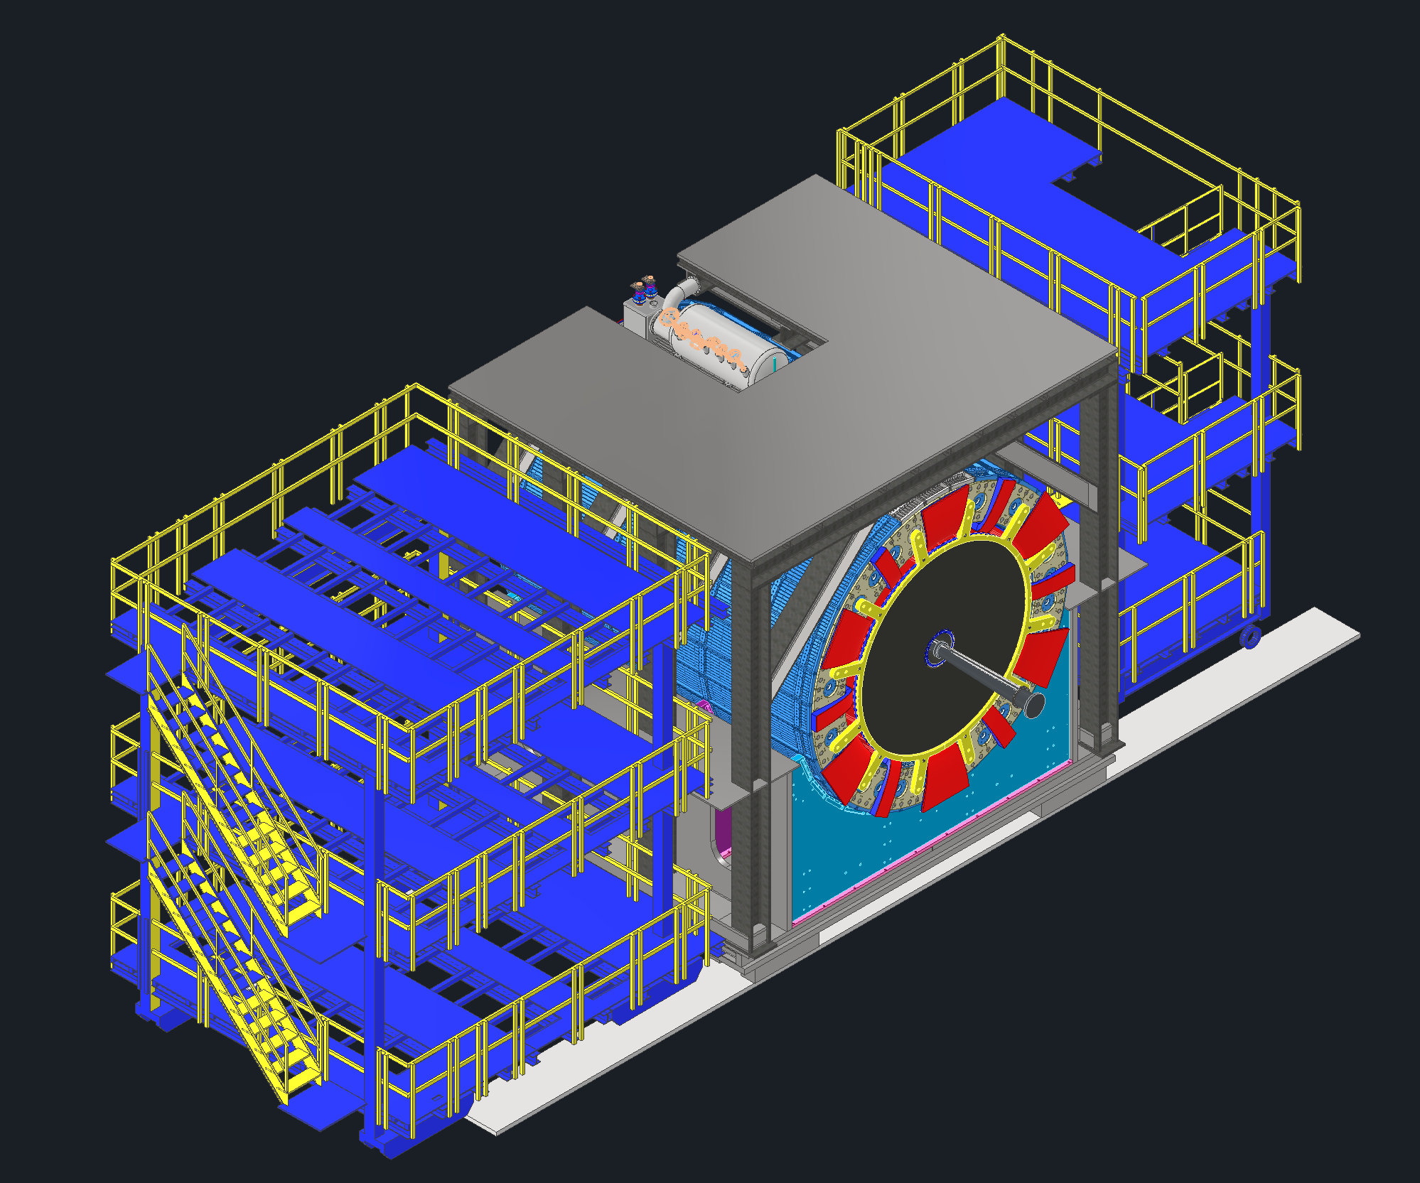
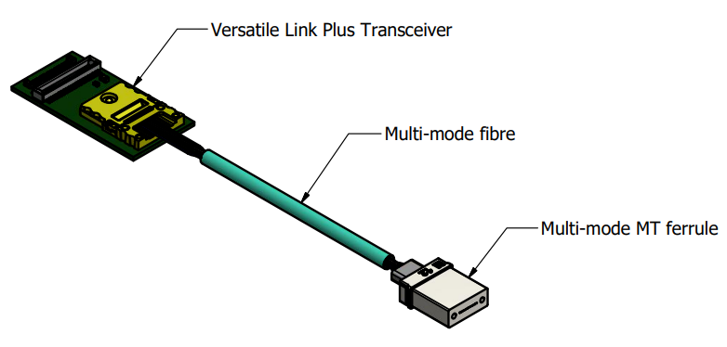
RDO Placement
1
VTRX+ modules inside the detector all us to transitions to fibers as quickly as possible
The RDOs can now be placed much farther away, outside the detector
RDOs will be mounted inside of racks located on the ring outside platform
VTRX+ Modules will be placed on each detector adjacent to their FEBs
A few detectors will have their RDOs integrated into their electronics inside the central barrel
Central Platform
Ring Inside Platform
Ring Outside Platform
Central Detector

Slide 11
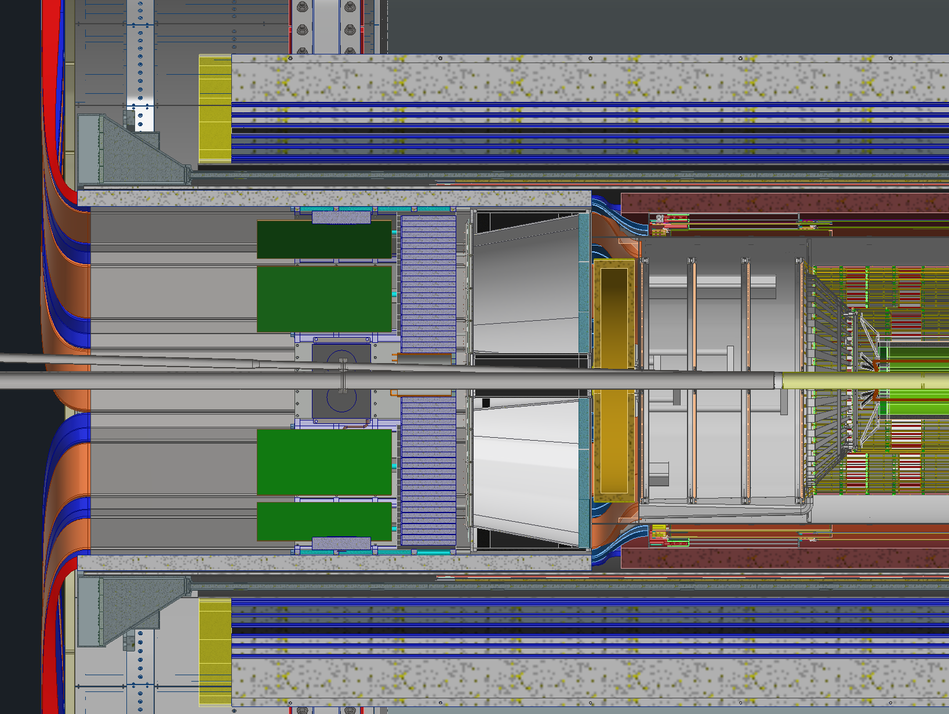
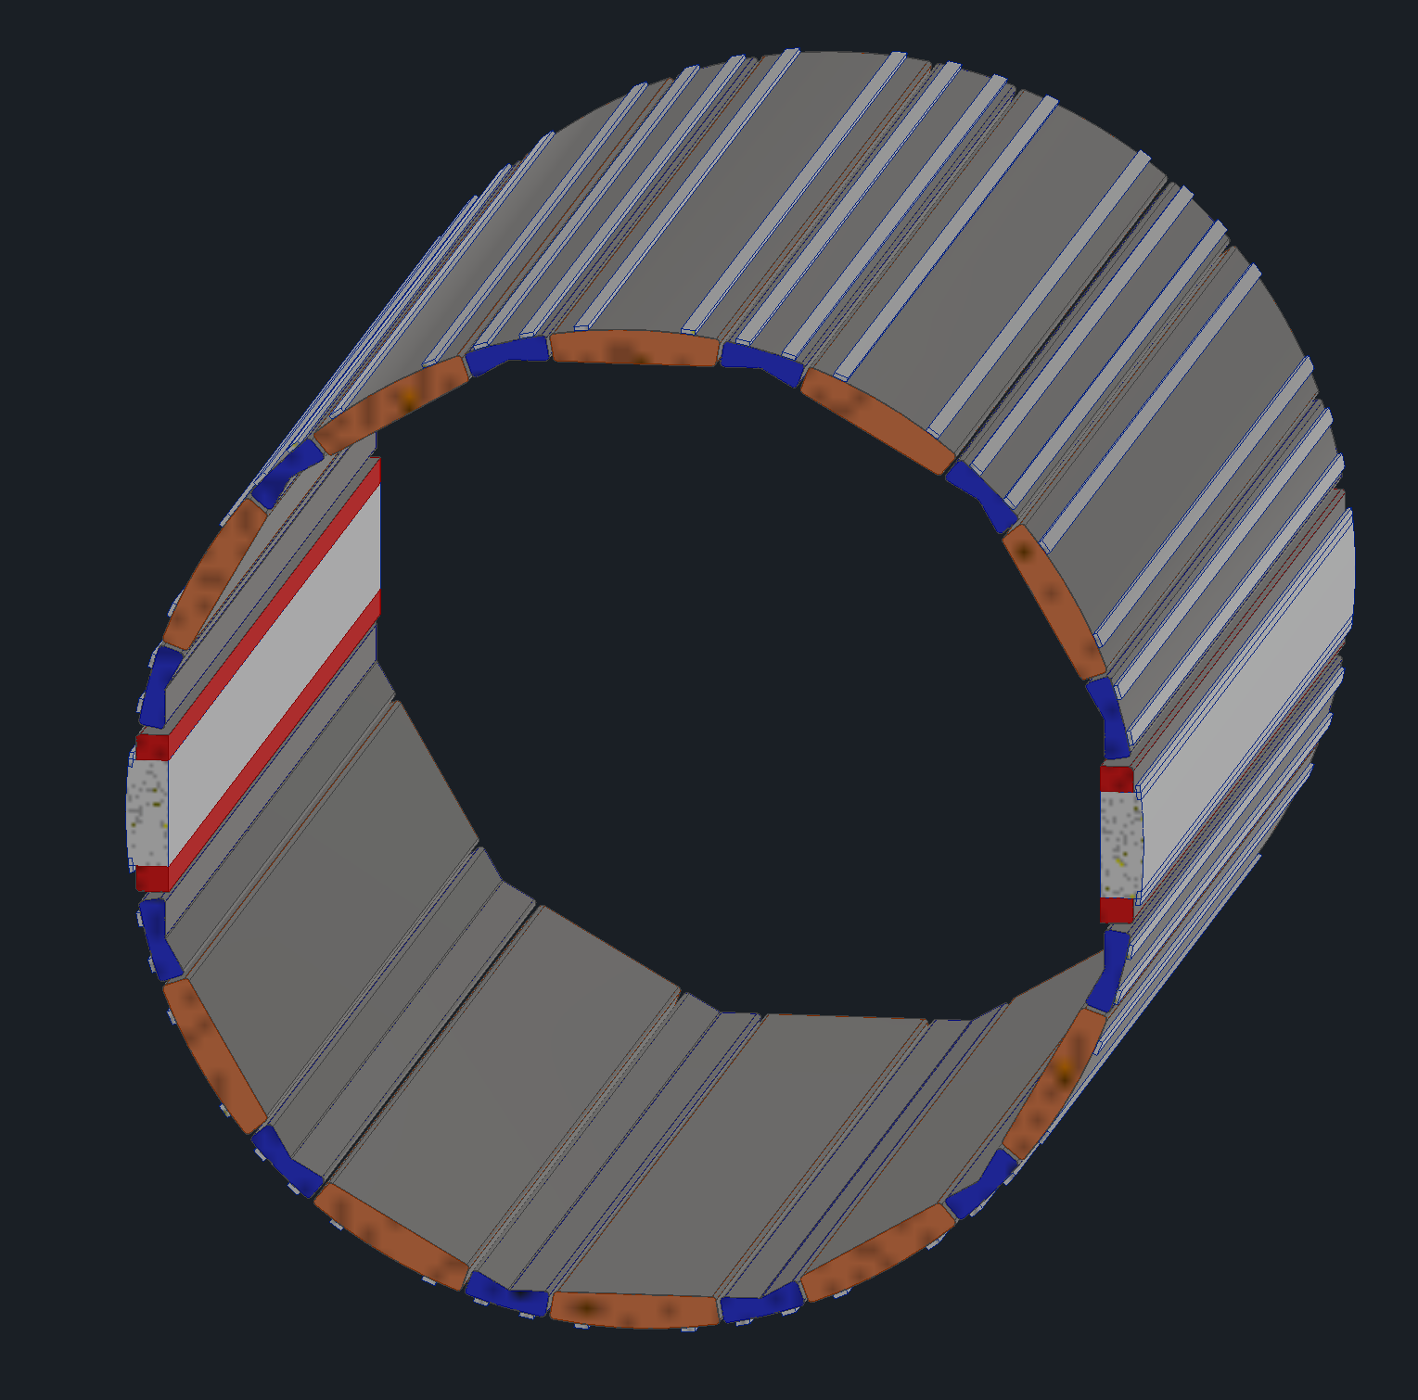
Backward Direction Services
1
The yellow is the path services take to get from the IP to outside the detector
Each box points to the location where services from respective detectors get added to the service bundle leaving
Services are organized by trays or partitions inside of trays
DIRC Services
pfRICH Services
ToF & CYMBAL Services
SVT & MPGD Disks Services
EEEMCal Services
Service Path
Backward Trays
*Top-Down View*

Slide 12
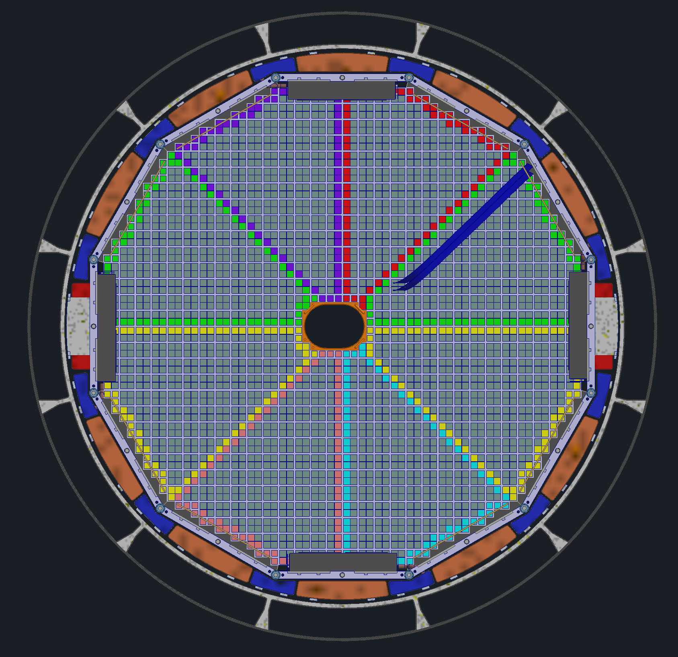
Backward Direction Cable Trays
1
Cables trays around the EEEMCAL and pfRICH are broken up by detector
There are (4) service trays for the pfRICH which will be integrated into the space for the rails
There are (10) service trays for the SVT and MPGD disks
There are (12) service trays for the ToF and CYMBAL
All trays are independent from one another, allowing for partial removal and maintenance
All trays are supported via rails connecting to the GST
Installation and support rails for the pfRICH and EEEMCal are located at 3 and 9 O’clock. These rails are located where the 11th and 12th SVT services trays would have been.
GST
pfRICH & EEEMCal Rails
pfRICH Services
ToF & CYMBAL Services
EEEMCal
SVT & MPGD Disks Services
*Front view looking at IP*

Slide 13
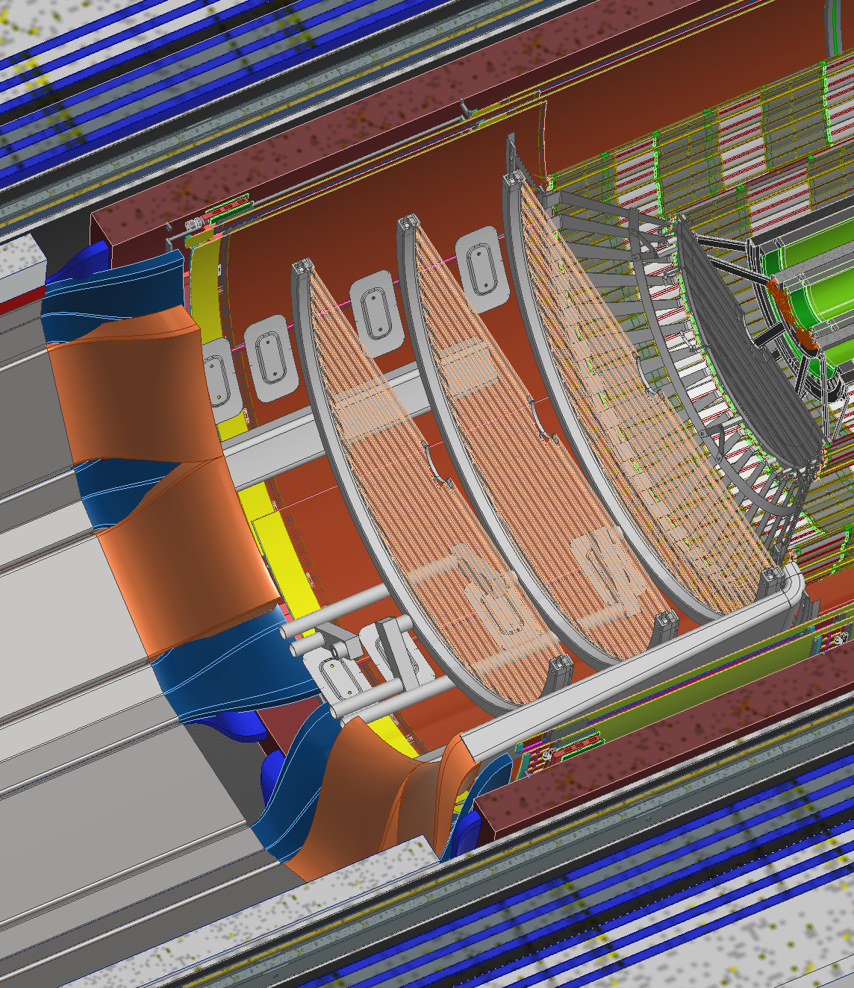
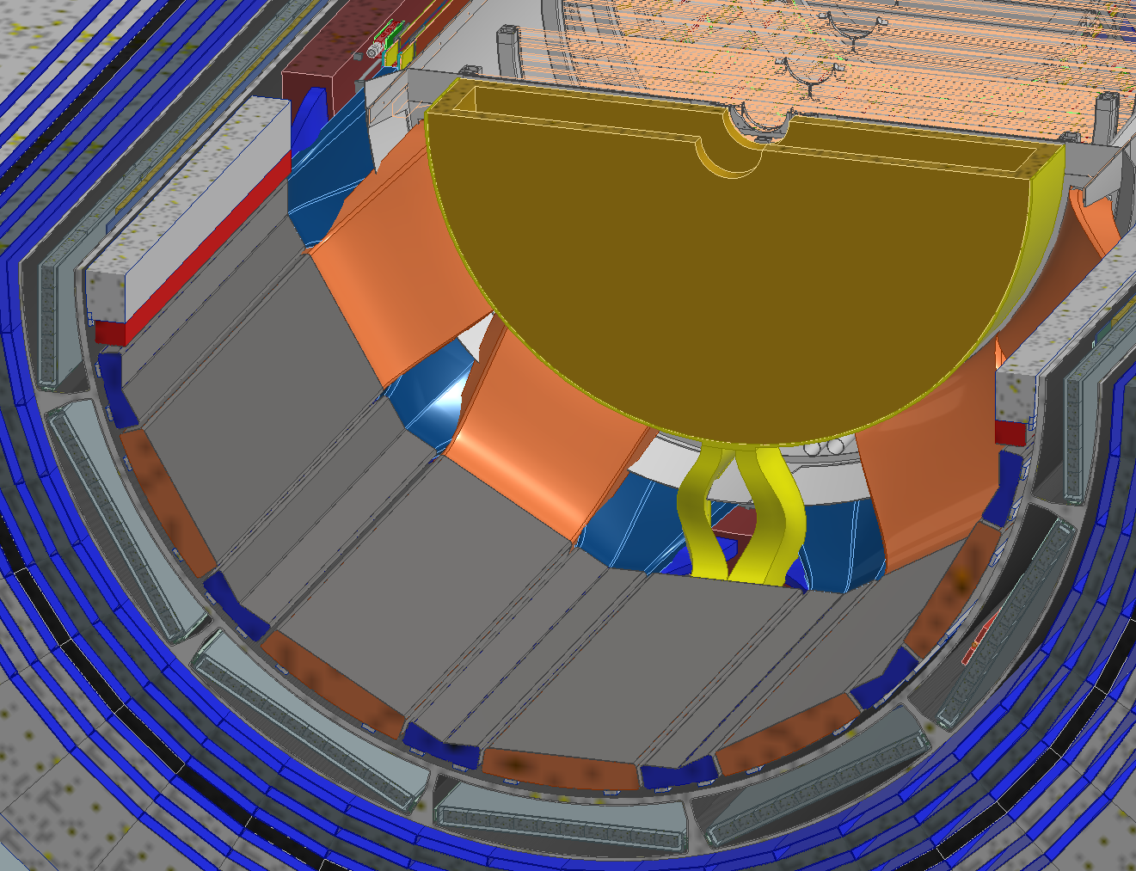
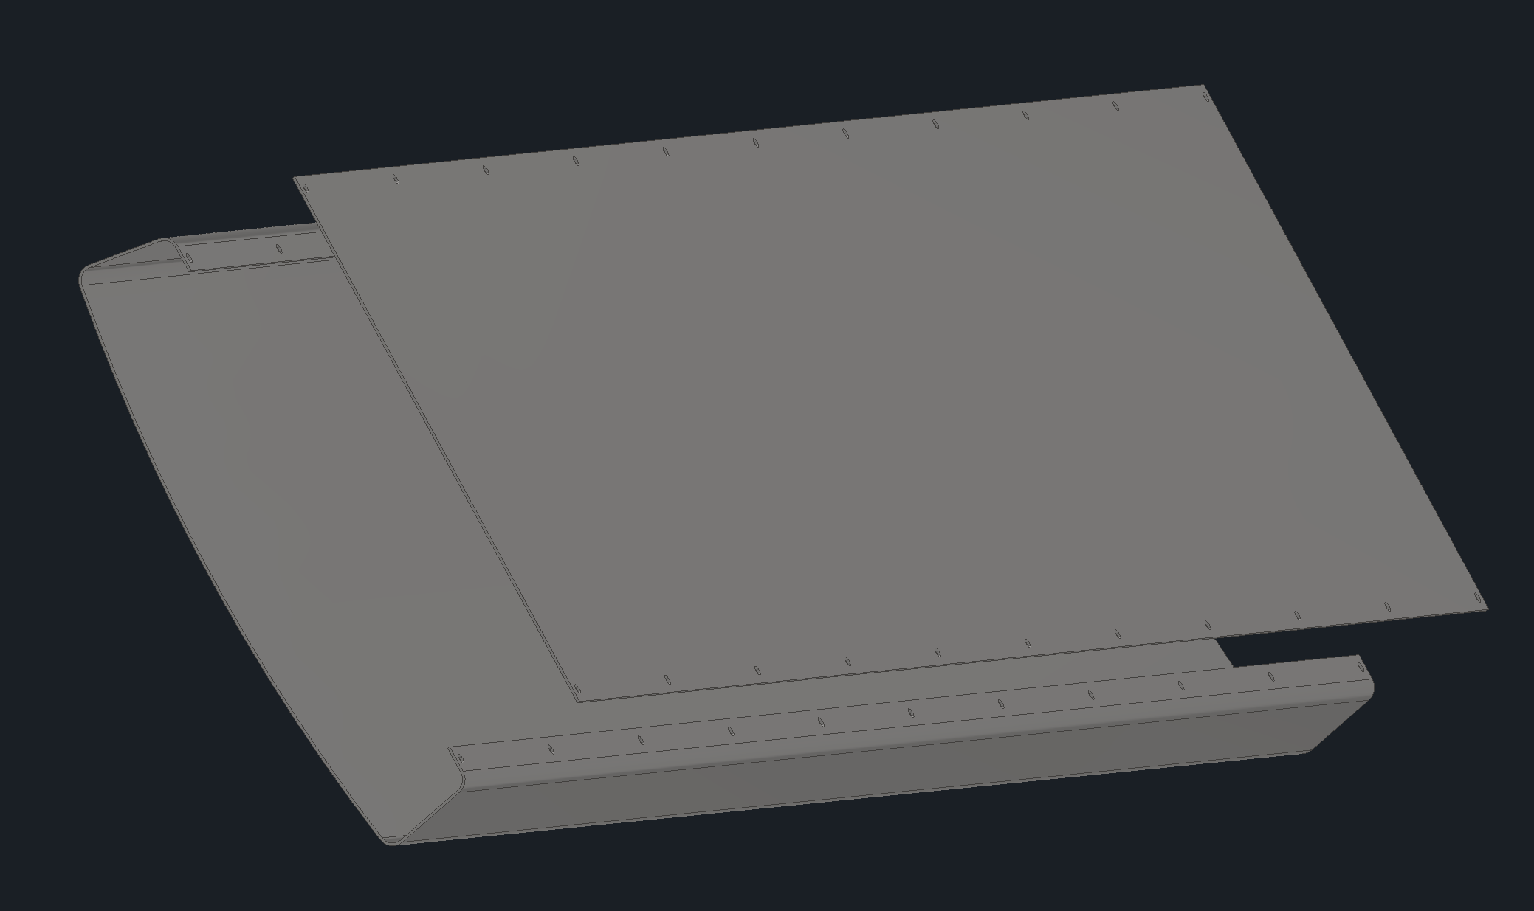
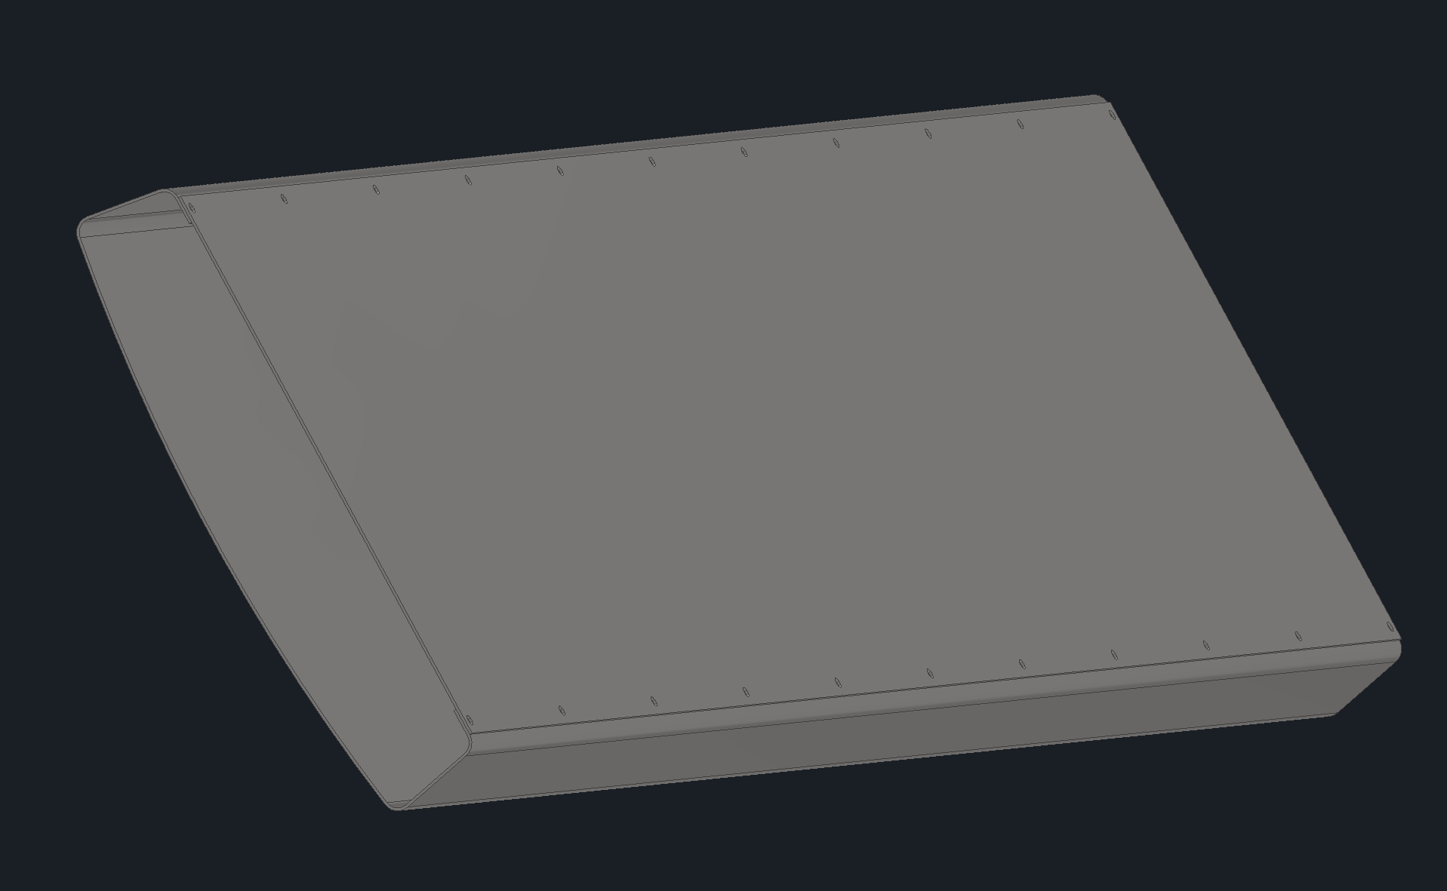
Backward Direction Cable Trays
1
The area between the PST and the back of the pfRICH is a tight location where services from several detectors need to get organized into their trays.
CYMBAL and Barrel ToF were rotated to be off center from the SVT such that their services could be routed cleanly
Were planning on using stainless steel trays with removable covers for now, this may change as the designs develop
Per recommendations from a previous review, we will be making mockups of this area
ToF & CYMBAL Services
SVT & MPGD Disks Services
MPGD Disk Services

Slide 14
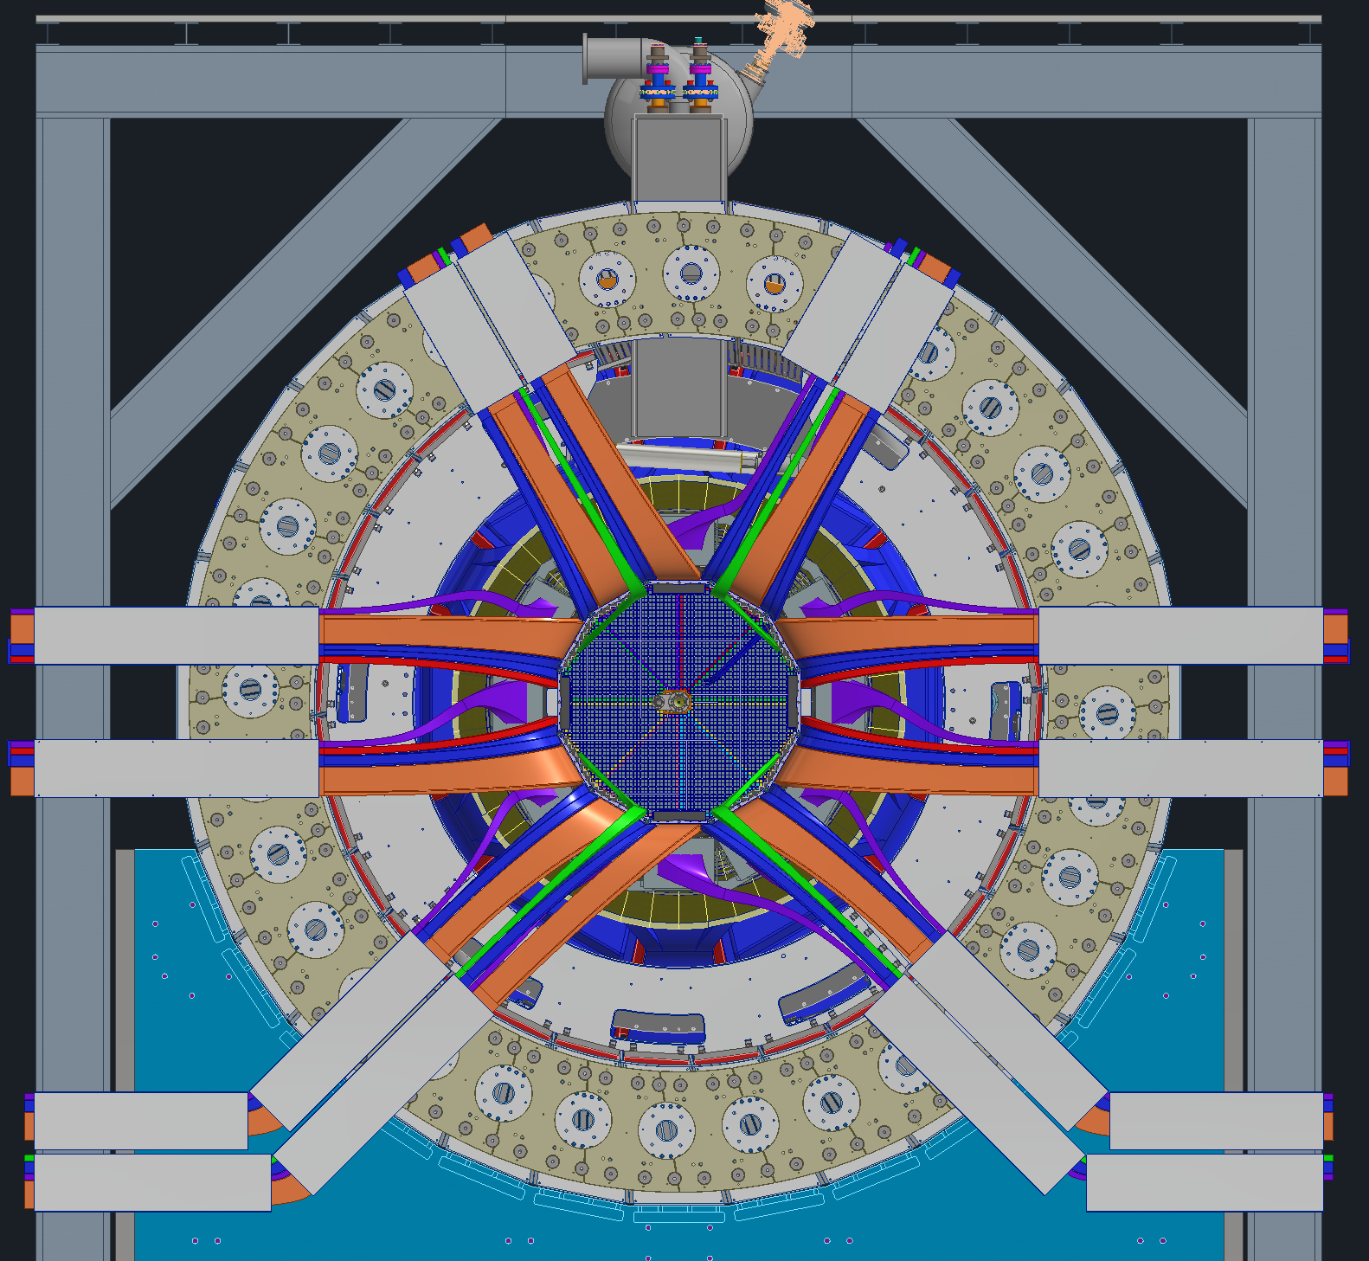
Backward Direction Cable Trays
1
All services from the inner trackers then get fanned out along the face of the HCAL.
10cm gap between HCAL Dogbones and backward Endcap
The 3 and 9 O’clock positions are kept open for the endcap service trays (not shown)
More trays will be added to support the services once cable types and disconnect locations are finalized
Once outside the barrel, most services will go to the ring outside platform. Only a few cooling and gas lines will go to the ring inside platform
Ring Inside
Ring Outside
Keep Clear Zone
CYMBAL & Barrel ToF: Blue | SVT & MPGD Disks: Orange
DIRC: Purple | EEMCal: Green
pfRICH: Red | Not shown: Barrel EMCal services

Slide 15
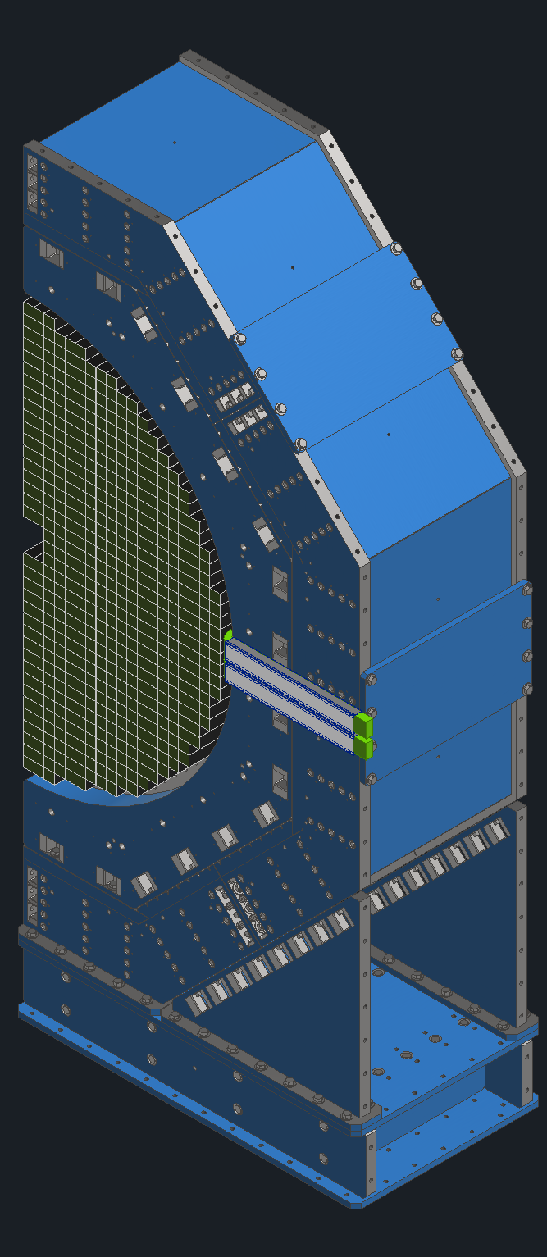
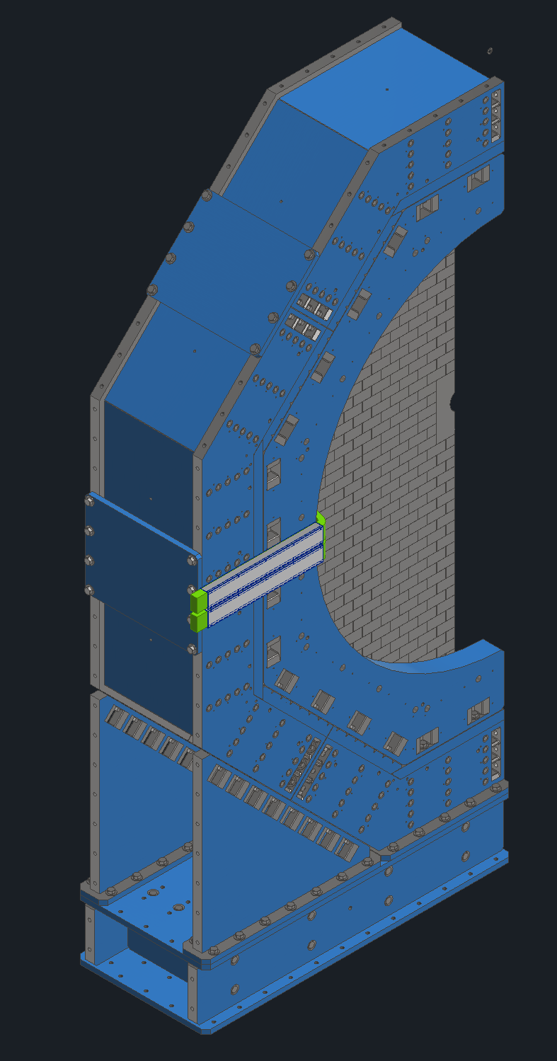
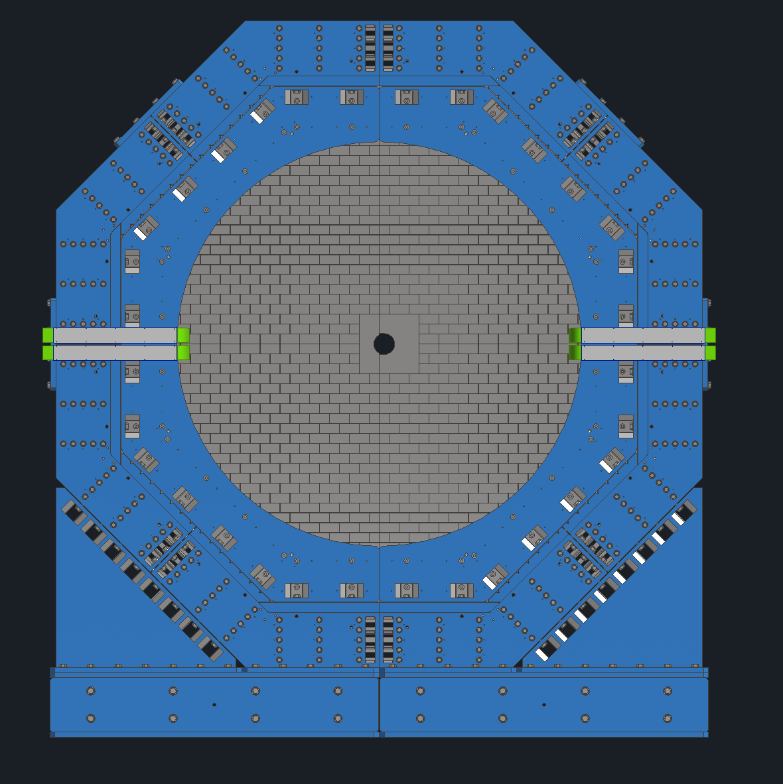
Endcap Service Trays
1
Since the endcaps will slide toward ring inside and ring outside so their service trays will need clearance space along the entire path
The entire horizontal path at 3 and 9 O’clock is kept clear on the central barrel side for both forward and backward endcaps
Keep Clear Zone
Services
Backward Endcap
Backward Endcap Half
Forward Endcap Half

Slide 16
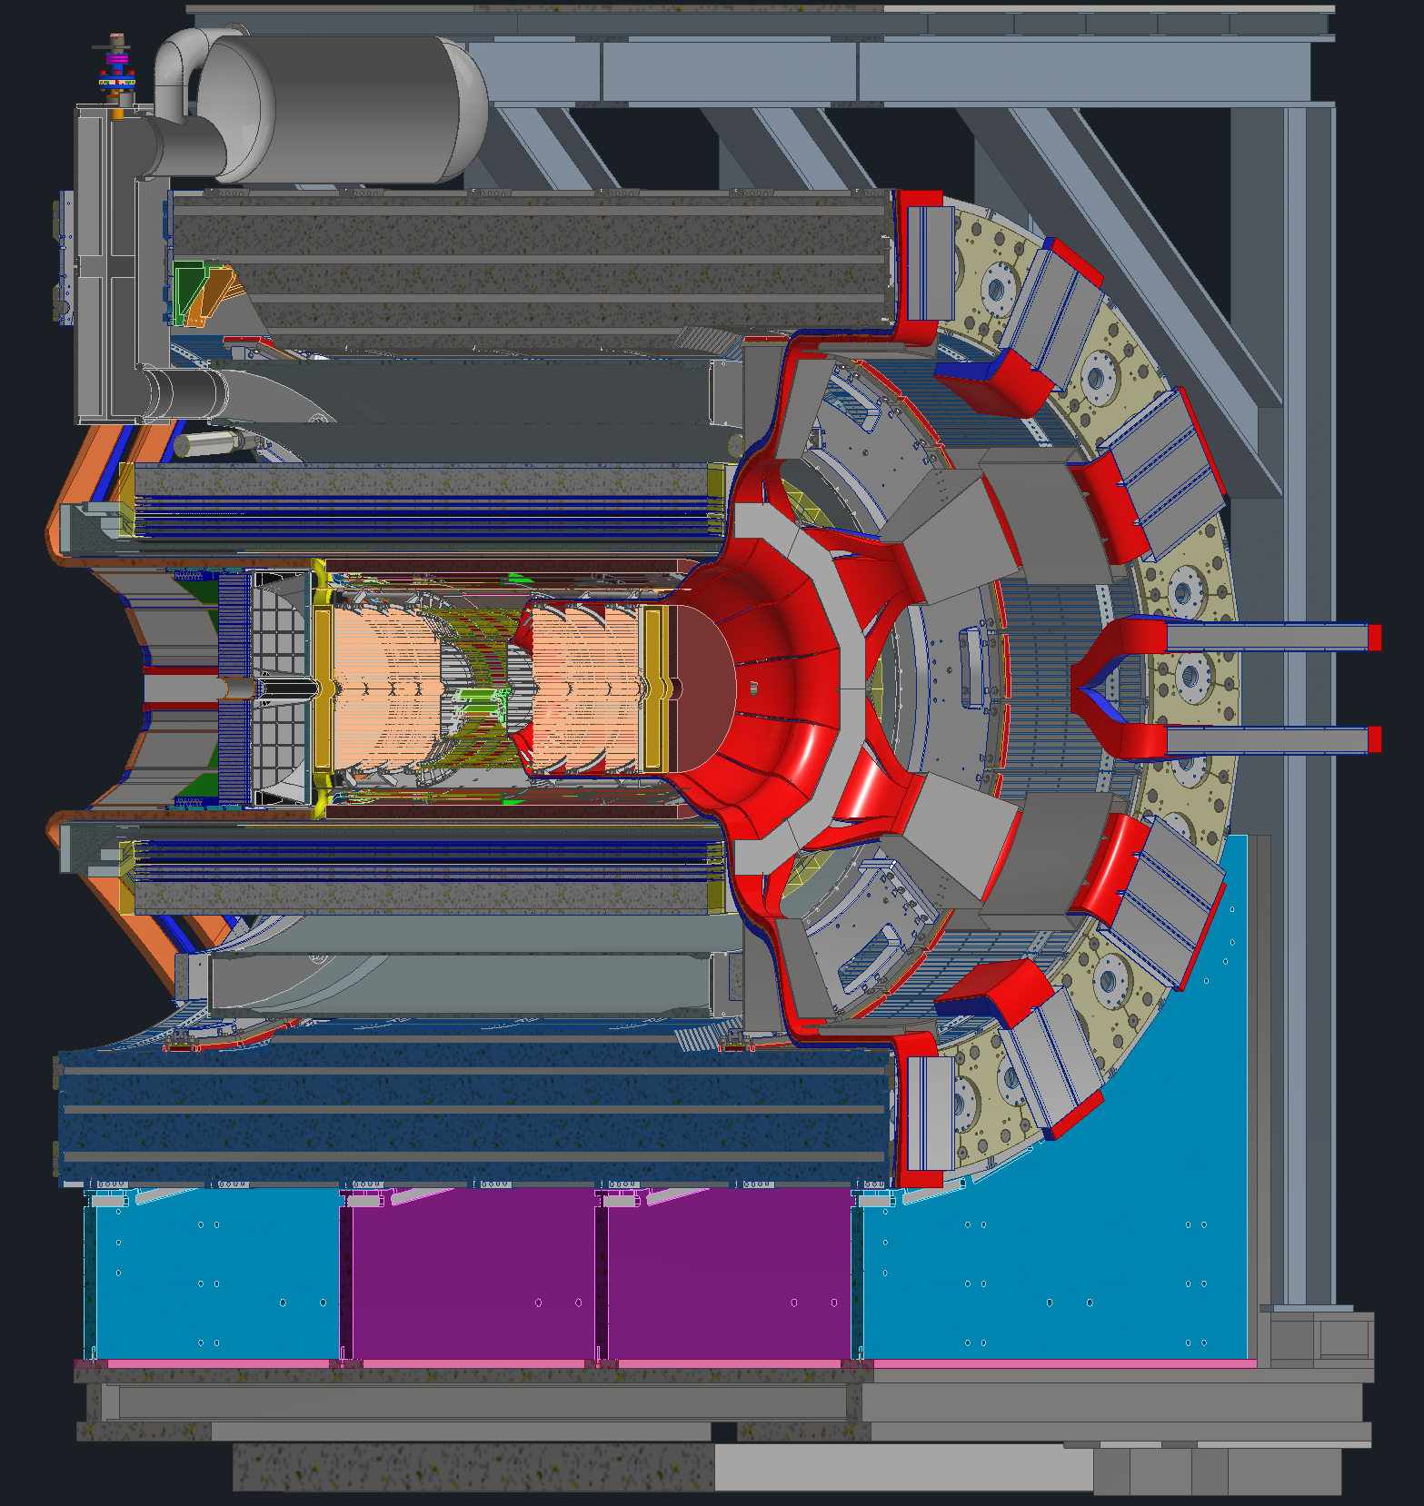
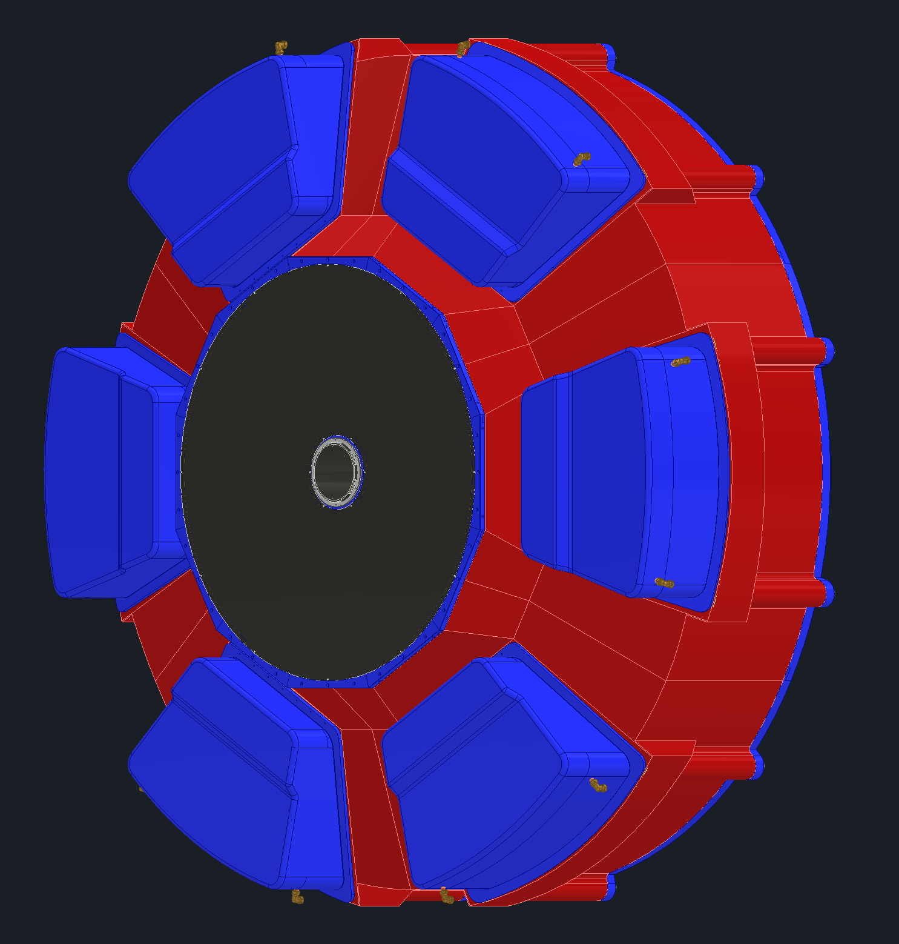
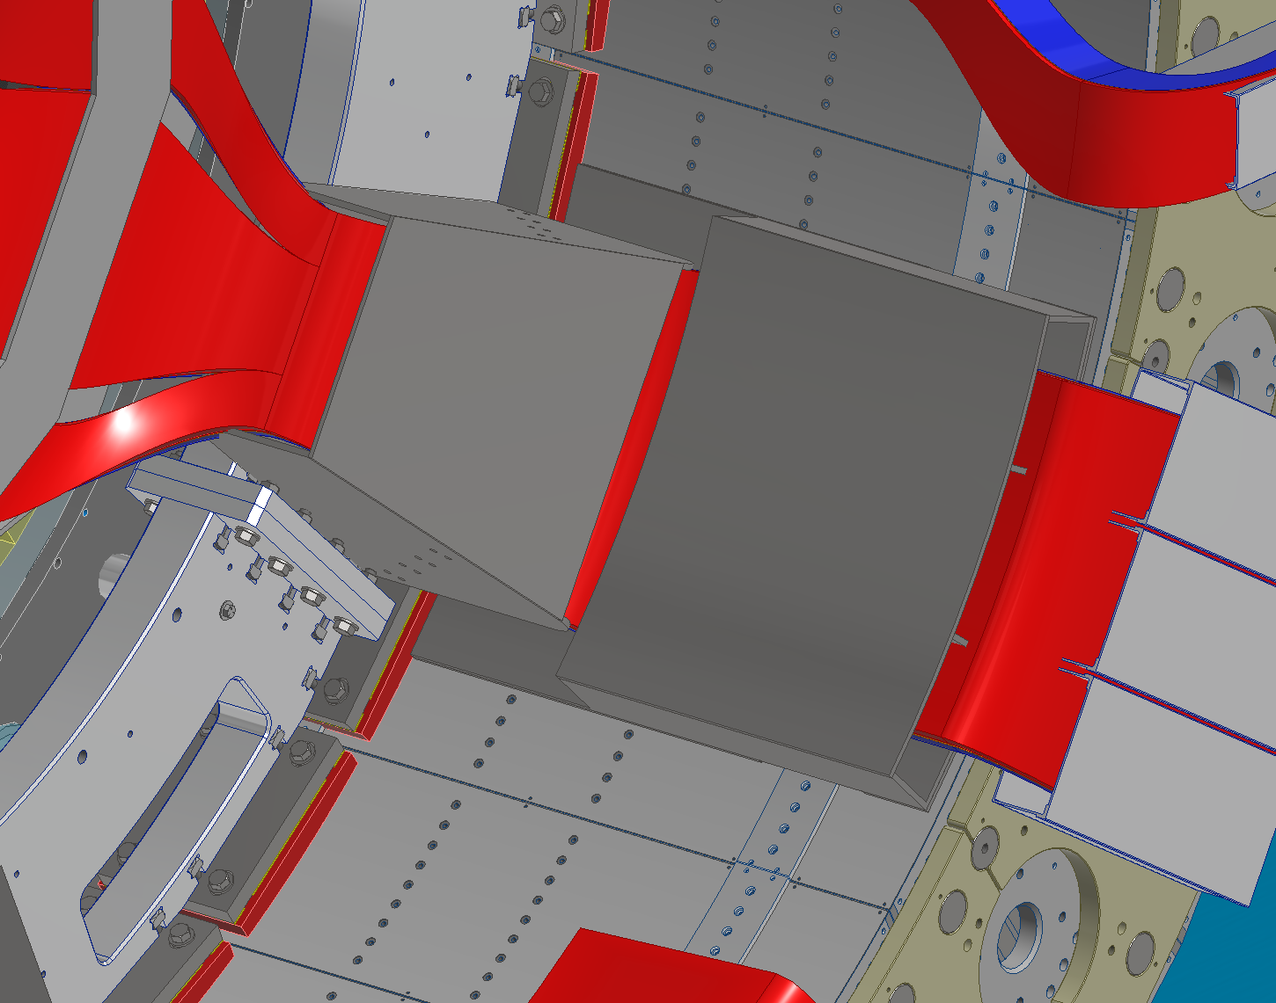
Forward Direction Cable Trays
1
Trays inside GST are segregated similarly to the backward side
After the GST, services travel in trays that match the shape of the dRICH such that available space is maximized
At this point, the segmentation of the services goes from 12 down to 6
Services shown aren’t broken up by detector but rather service type (Power, signal, cooling & gas)
This is because historically, space was a concern on the backward side but not on the forward side.
dRICH Services
Inner Detector Services
Trays around the dRICH
dRICH Sensor Boxes

Slide 17
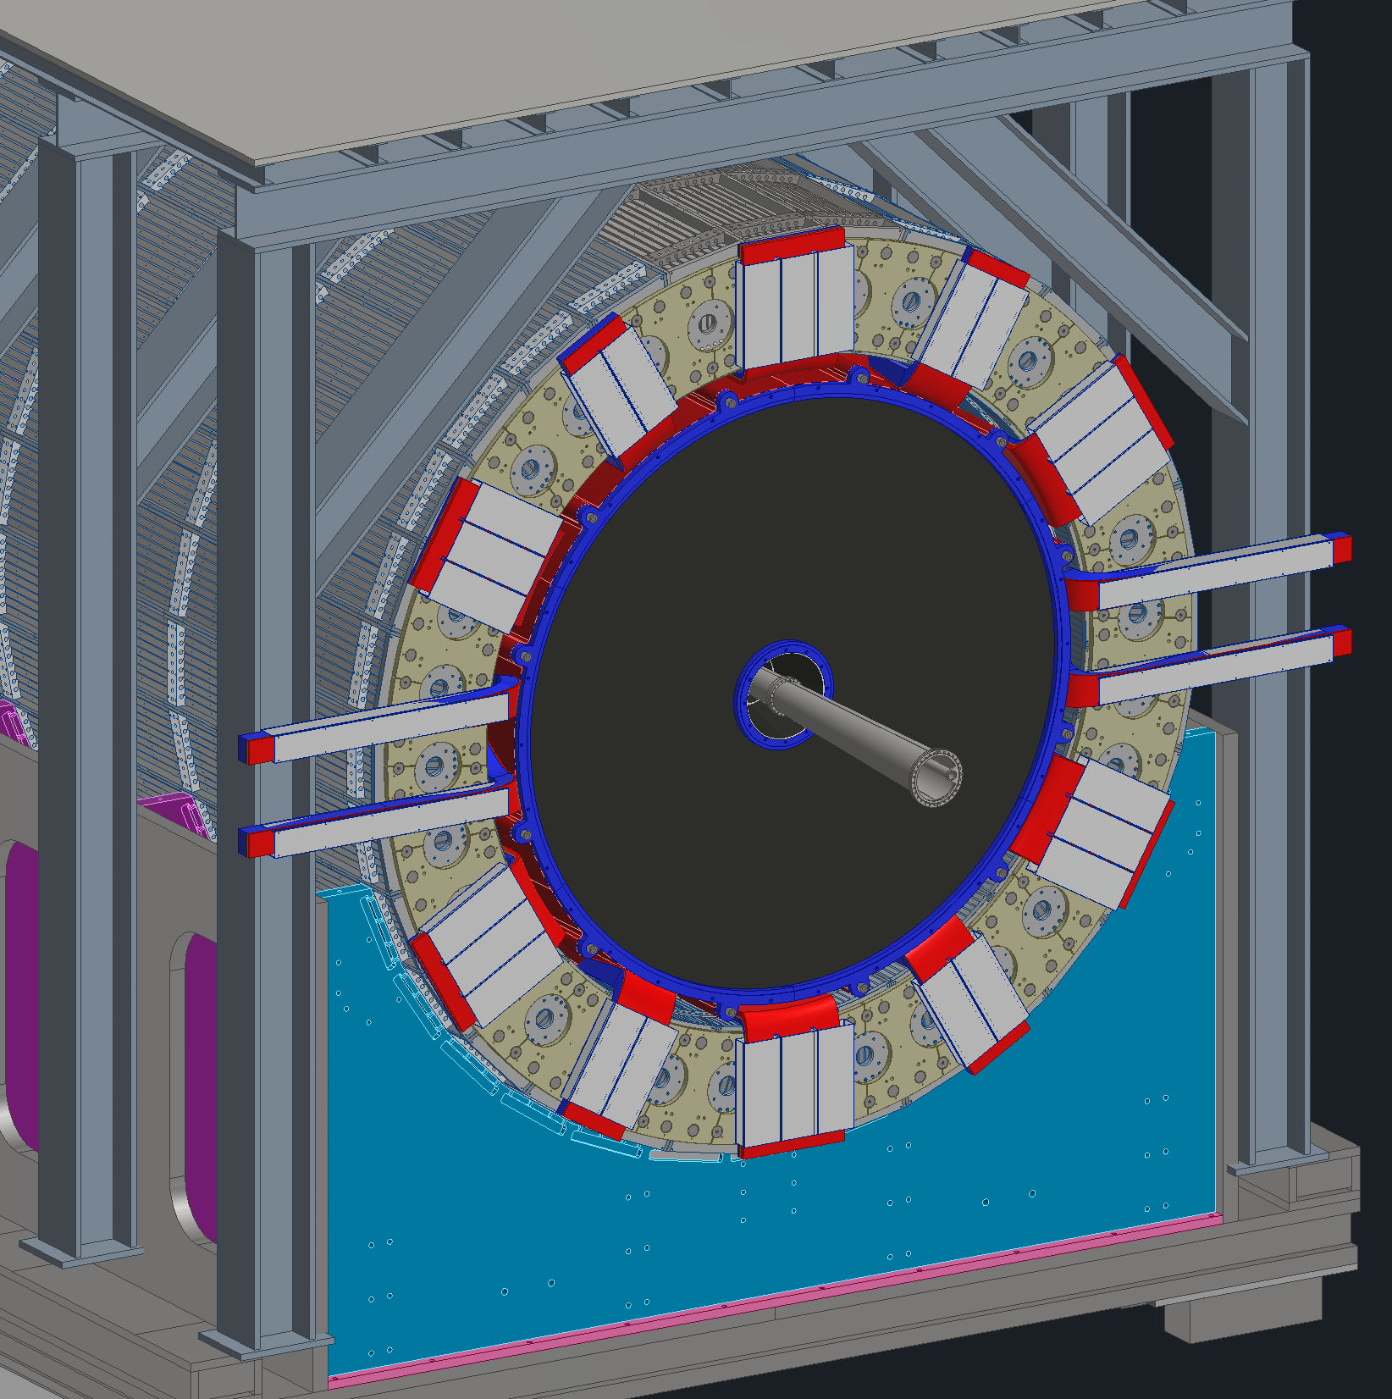
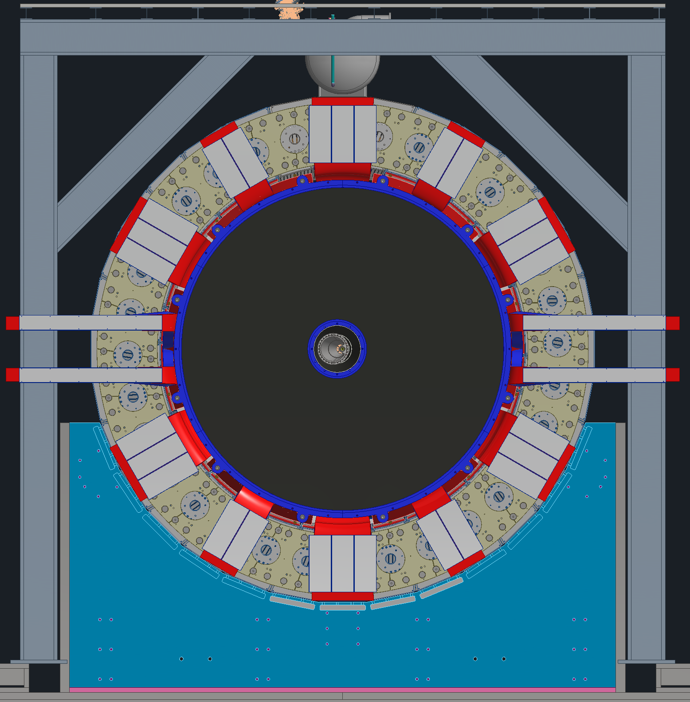
Forward Direction Cable Trays
1
All services from the inner detectors and the dRICH get fanned out along the face of the HCAL.
15cm gap between HCAL Dogbones and forward Endcap
The 3 and 9 O’clock positions are kept open for the endcap service trays (not shown)
Inner Detector Services
dRICH Services
Keep Clear Zone

Slide 18
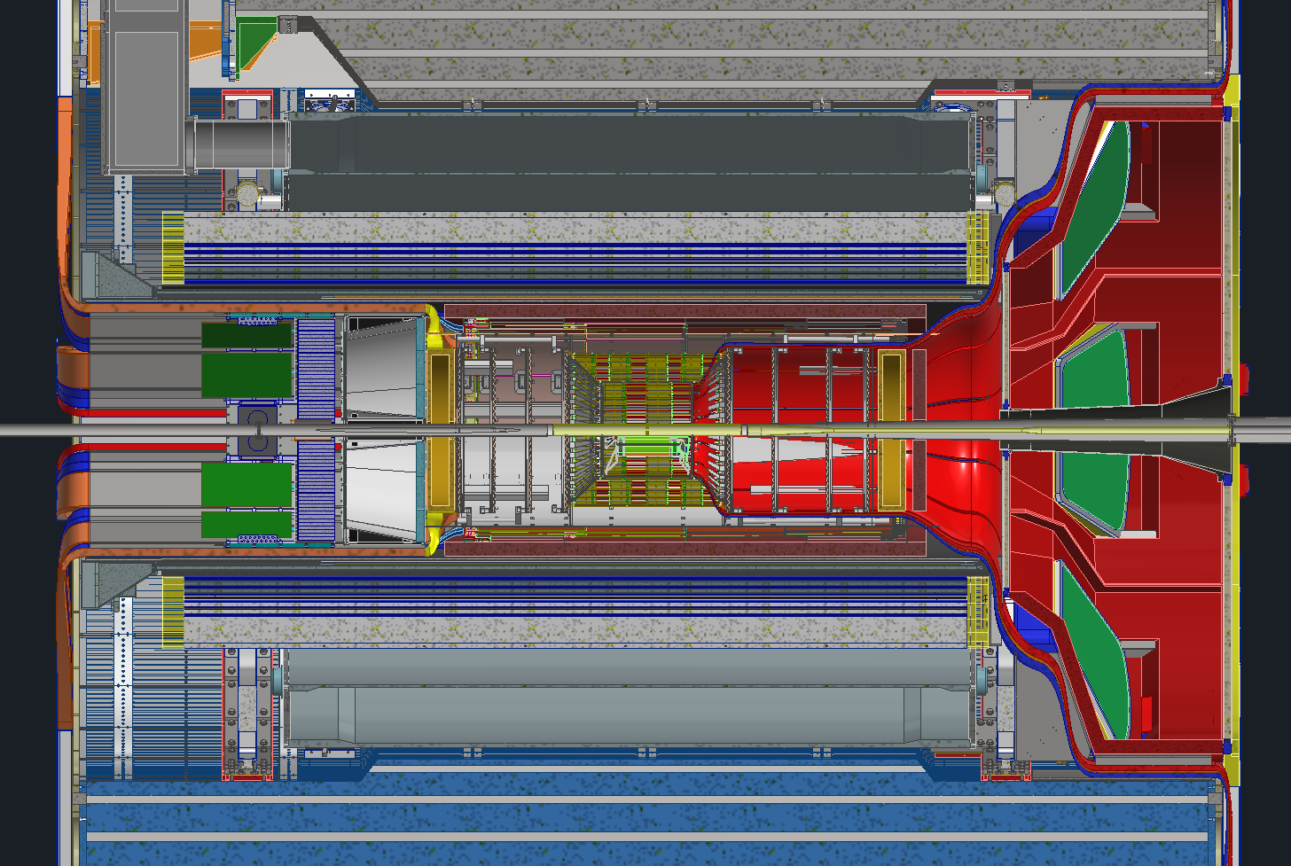
Planned Disconnects & Future Mockups
1
Planning on having 1 disconnect location on each side of the detector
Backward disconnect will be past the DIRC electronics
Forward disconnect will be between the barrel EMCAL and the dRICH
These are the only two locations with enough space for connectors
Rule of thumb for the size of connectors is that they take twice the space as the cable itself
Per recommendations from a previous review, we will be making mockups of a few of the bottlenecks
Disconnect Location
Disconnect Location
Future Mockup
Future Mockups
Future Mockup

Slide 19
Summary & Next Steps
Detector services follow the two main escape paths, forward and backward, broken up into power, signal, and gas & cooling. Most power and signal services get routed to the ring outside platform where the racks are housed, while most of the cooling and gas lines get routed to the ring inside platform.
Disconnect locations have been selected such that detector servicing and maintenance is made easier
RDO distribution and VTRX+ placement allow for quicker fiber routing
Bend radius constraints drive routing geometry, especially for optical fibers
Next Steps:
Need to place sniffer lines, water sense cables and VESDA systems into the model at appropriate locations
Continue to work with the subgroups to ensure there is enough space to route their services and that acceptable bend radii can be met
Cooling and power requirements for various detectors and electronics are constantly being refined
Begin modeling mockups of the service bottlenecks

Slide 20
QUESTIONS?

Slide 21
Backup Slides

Slide 22
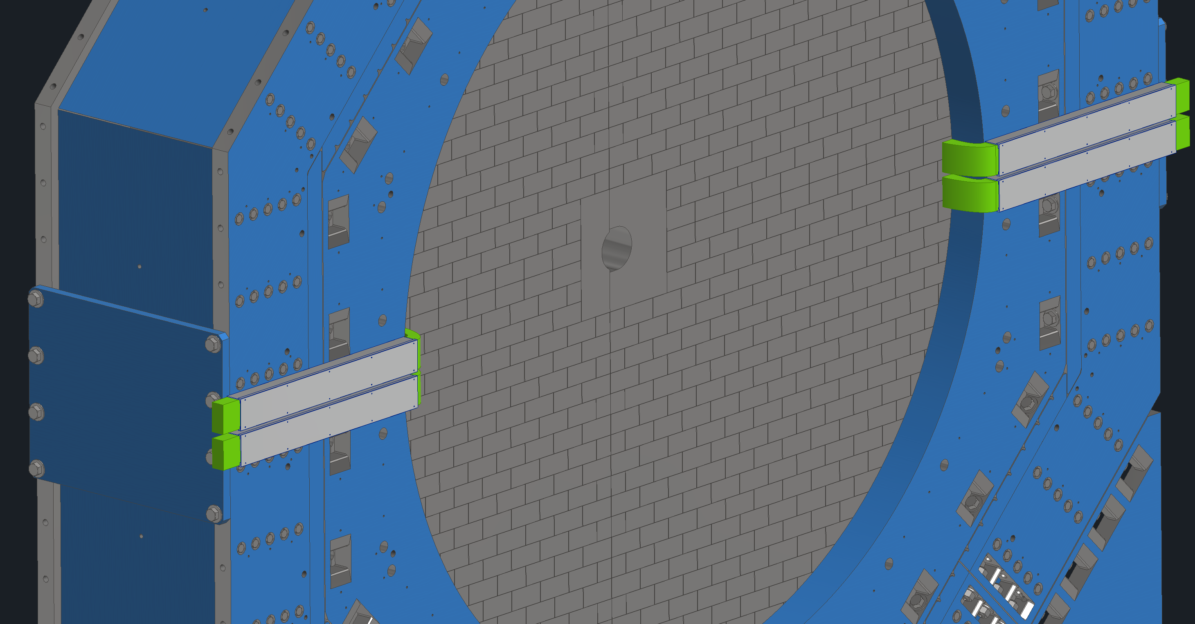
Endcap Services
Backward Endcap

Slide 23
ES&H
Harnesses, safety glasses, work gloves and other PPE will be identified for work required.
Follow all OSHA guidelines and BNL SBMS for designing scaffolds and other access provisions for assembly and installation of all components.
All components are designed and analyzed to a reasonable factor of safety to mitigate any risk of structural failure.
Cranes and other access equipment such as scissor lifts and bucket lifts are periodically inspected as per guidelines in SBMS.
Safety systems (Fire Suppression and Smoke Detection):
Are part of existing bldg. 1006 and need to be updated during refurbishment of facility.
Sniffers will be installed next to MPGD detectors on both Forward and Backward Ends to detect leakage of any flammable gas.
ODH Safety standards will need to be evaluated.

Slide 24
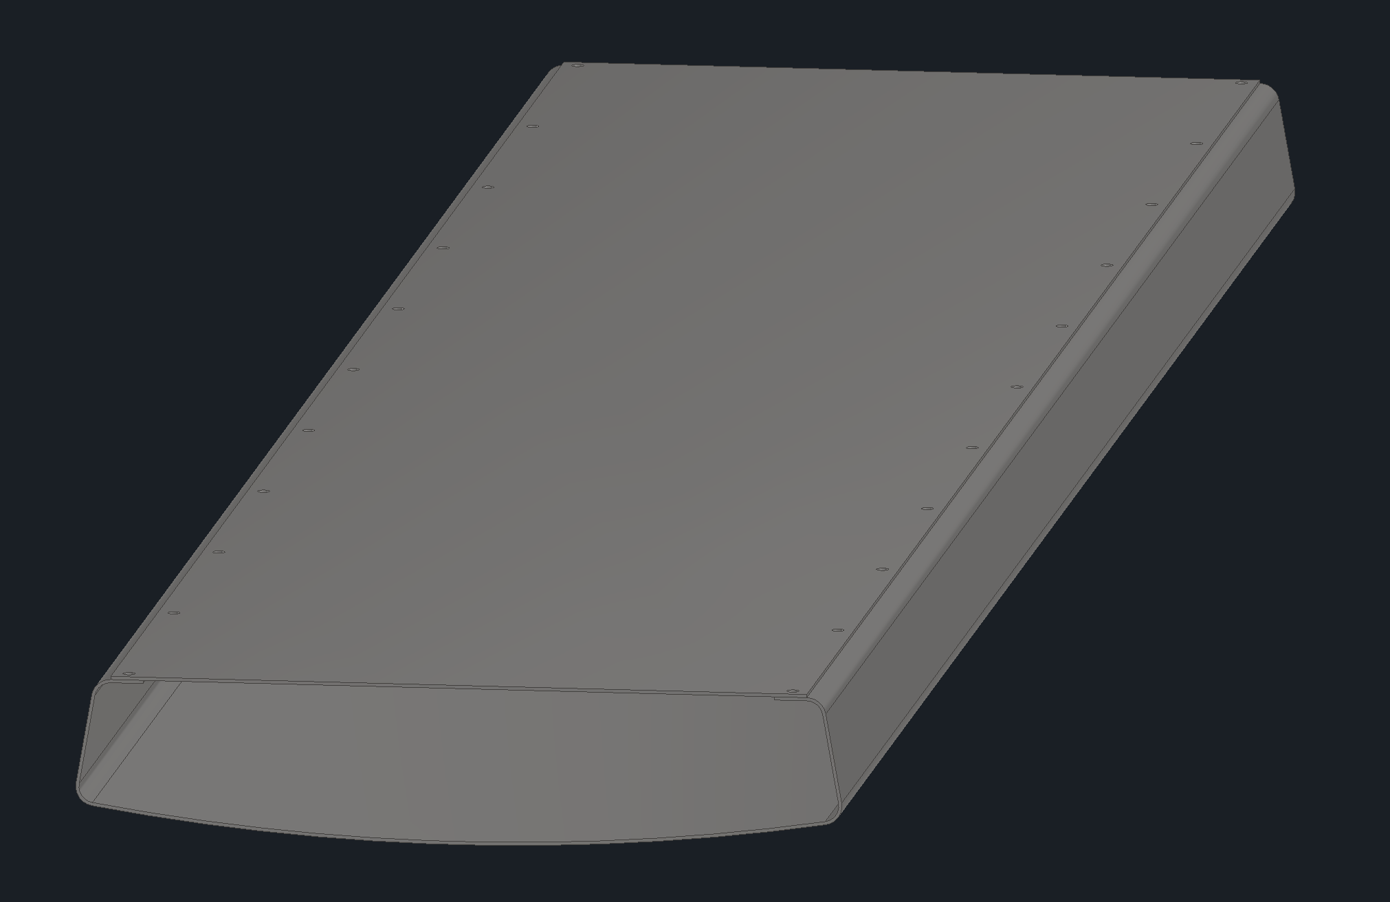
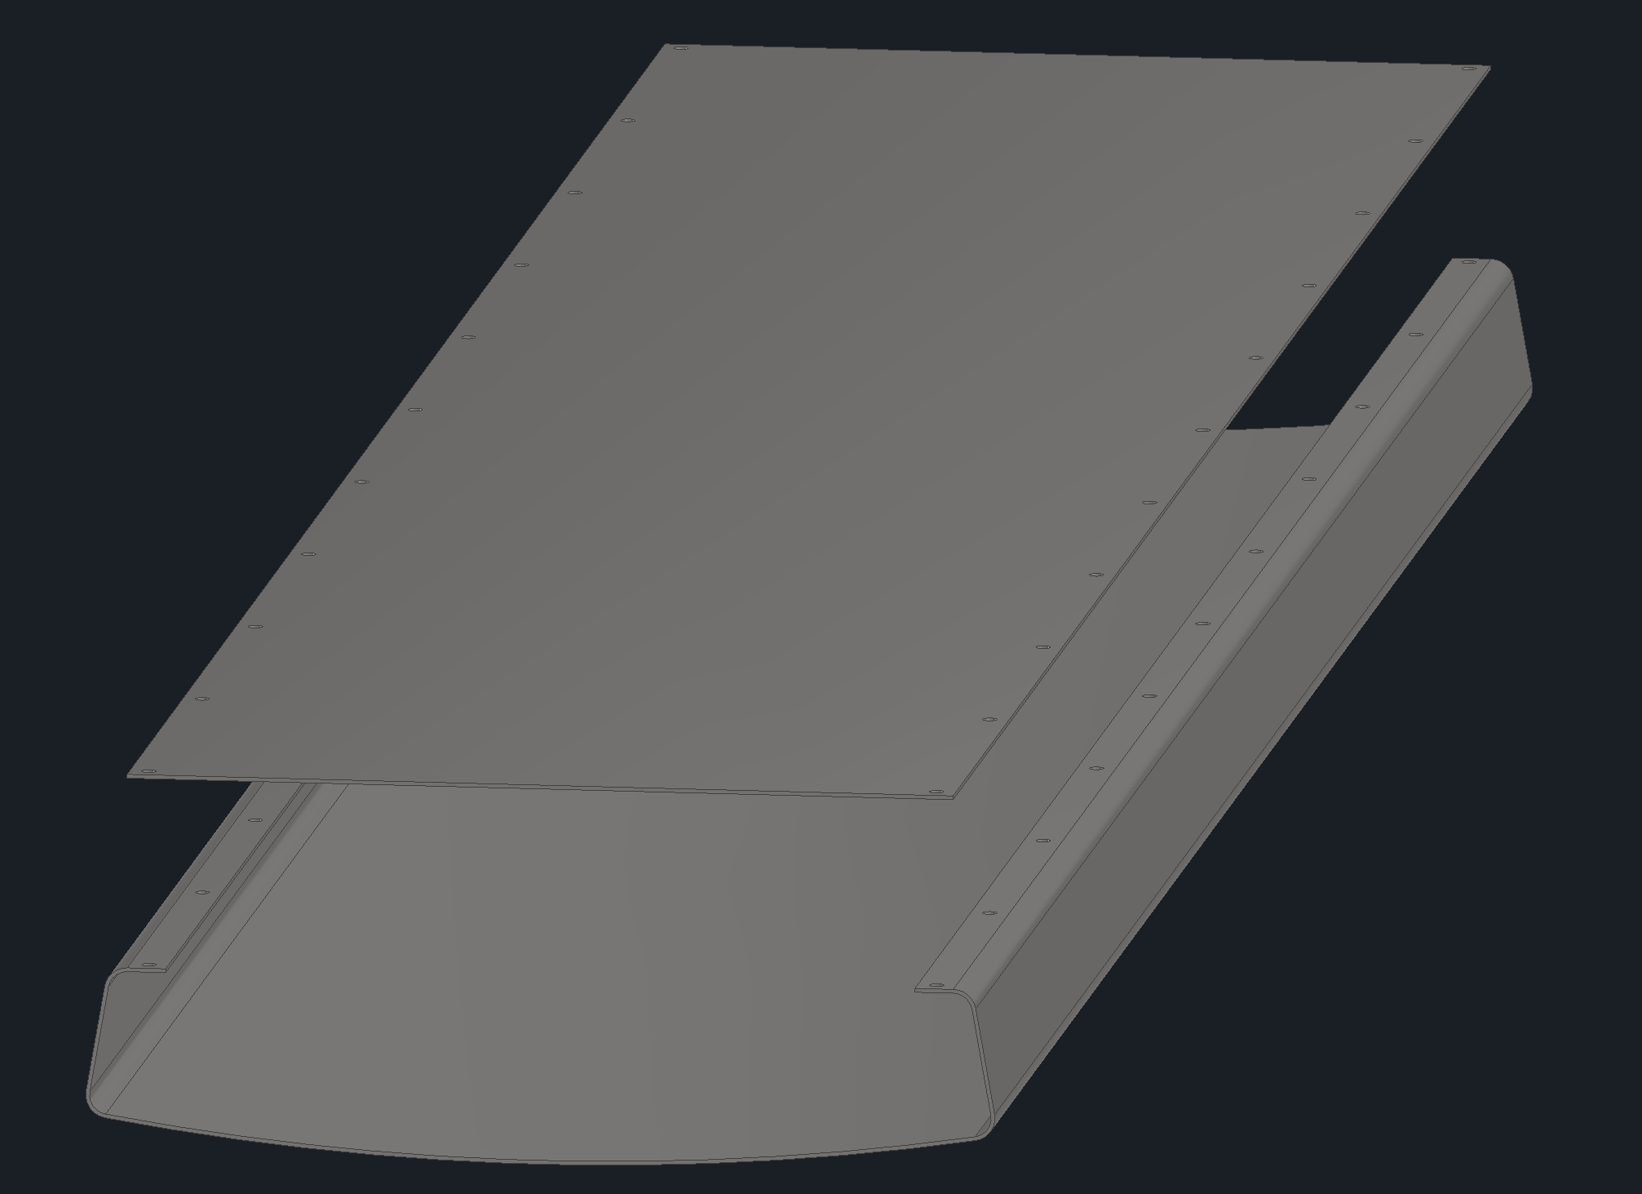

Slide 25
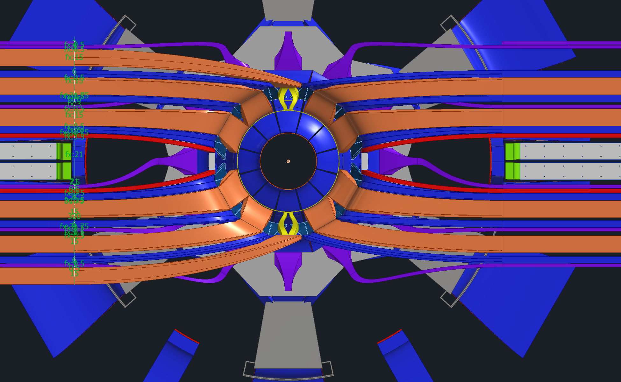

Slide 26
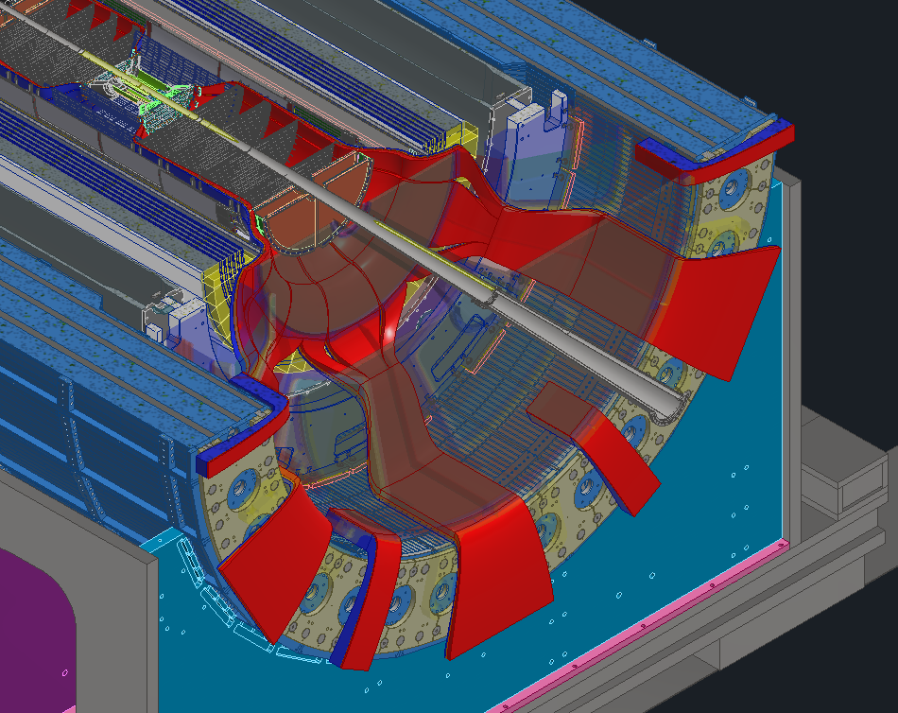

Slide 27
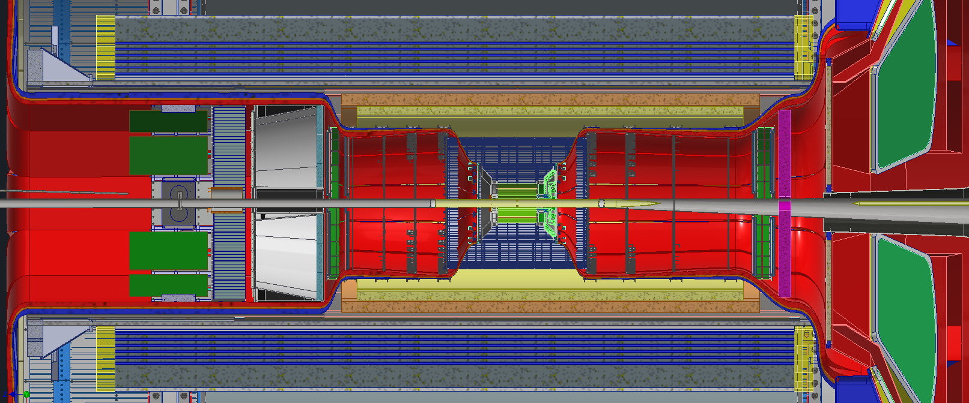
Maintenance Updates
With the ToF and CYMBAL update the services will need a slight rerouting. The MPGD disk will need to be smaller and allow for services to pass by it without hindering the removal of CYMBAL
New services route

Slide 28
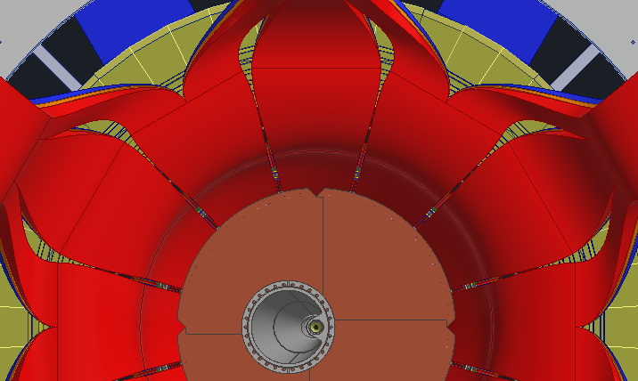
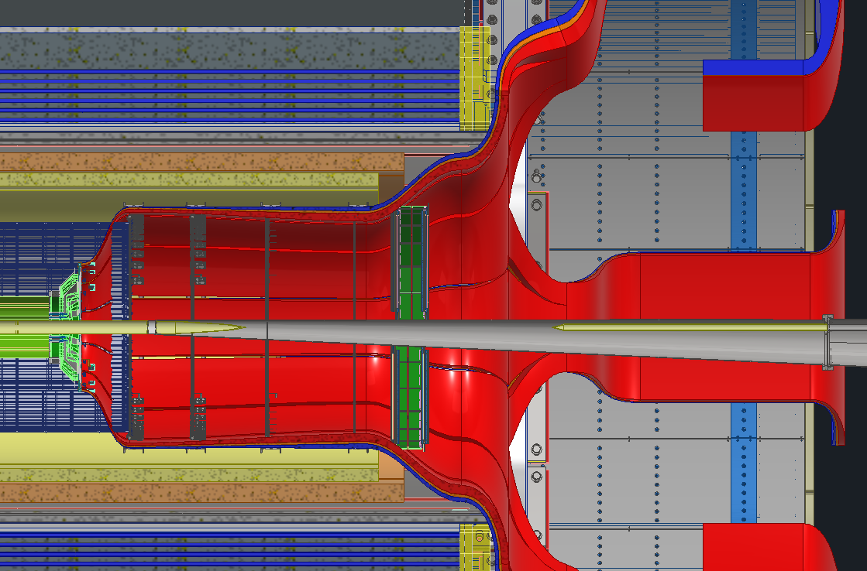
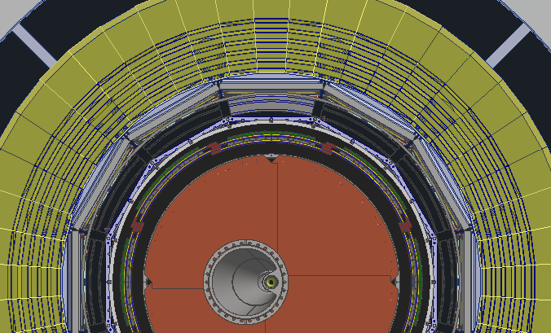
Maintenance Updates
As an example, if we wanted to get access to the 12 O'clock position ToF and CYMBAL, we would have to disconnect the SVT services that are in front of that sector and move them out of the way such that we can pull that sector out.
Disconnect

Slide 29
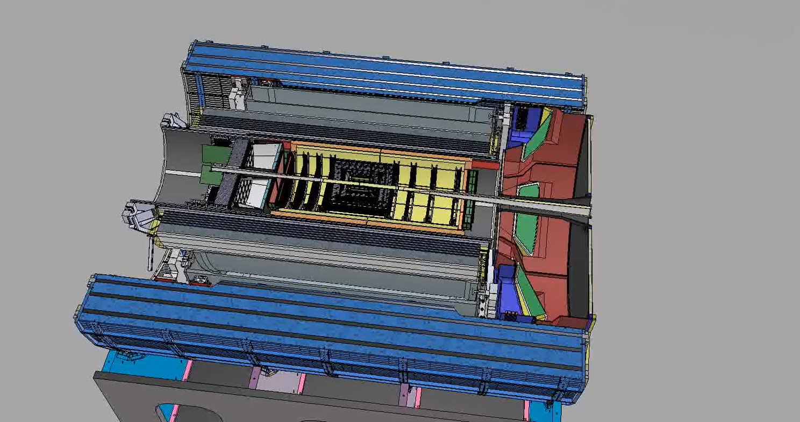
Maintenance done in Experimental Hall

Slide 30
Maintenance Update
Recent changes were made to CYMBAL and ToF to make maintenance easier
This had a few minor impacts to the surrounding detectors and their services. This drove the location of the disconnect on the forward side
If we want to get access to ToF and CYMBAL, we must disconnect the forward SVT services that are in front of that sector and move them out of the way such that we can remove that sector
Disconnect location
CYMBAL
ToF

Slide 31
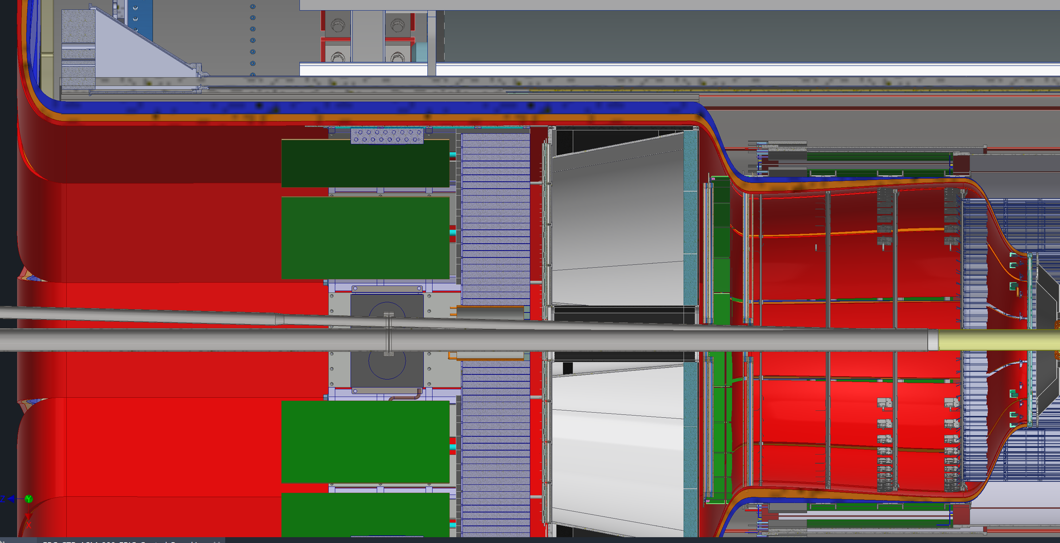
GST Cable Tray Updates

