Slide 1

Cone design and interfaces
SVT Working Meeting at Oxford
2025-12-17
Joe Silber (LBNL) - mechanical engineer, presenting
Elaine Buron (LBNL) - CAD design

Slide 2
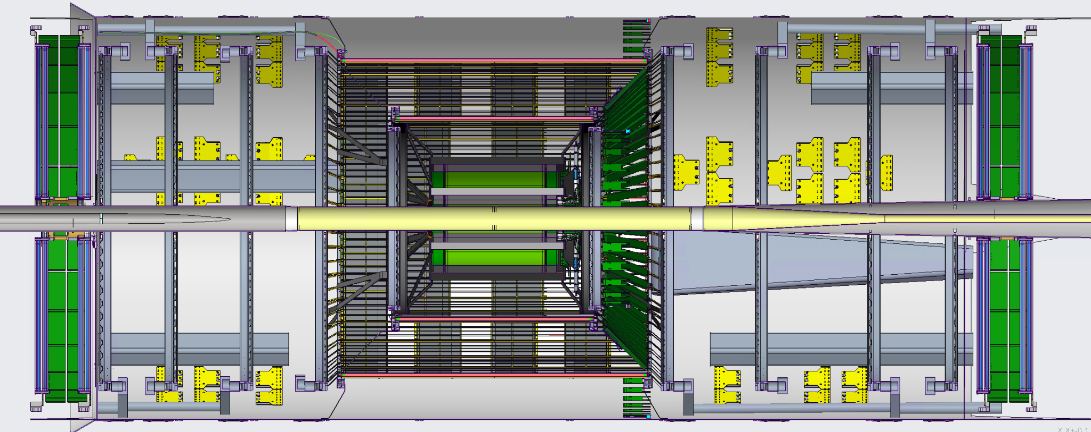
Current CAD model
(SVT team’s Nov 2025 snapshot + some new LBNL stuff for Dec)

Slide 3
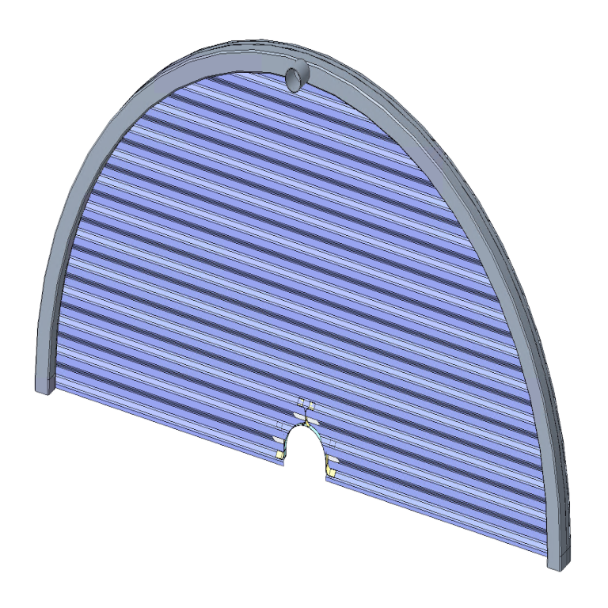
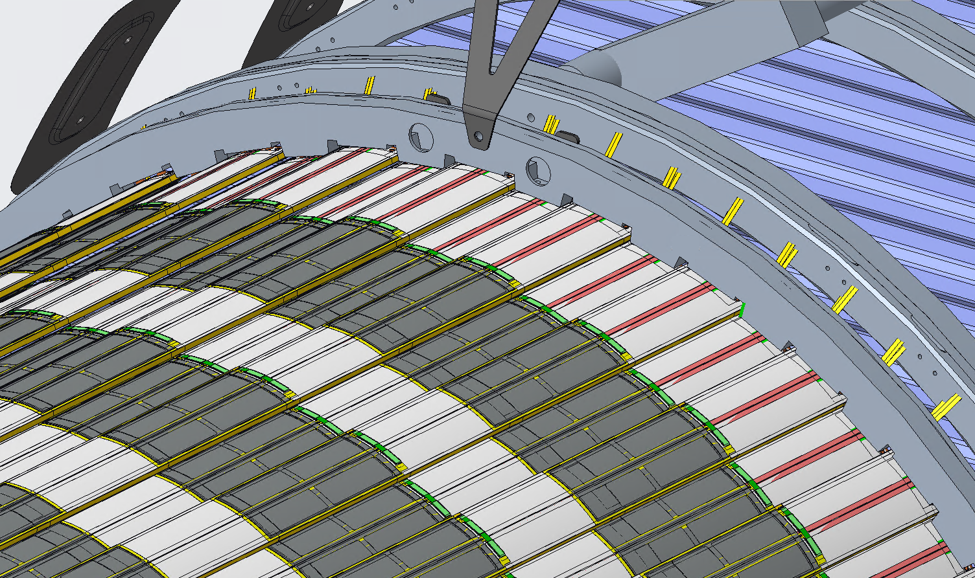
Rims support each disk or outer barrel layer
Rims are:
Stiff
Held at 3 points
Air manifold for many corrugations or staves
Always a half circle

Slide 4
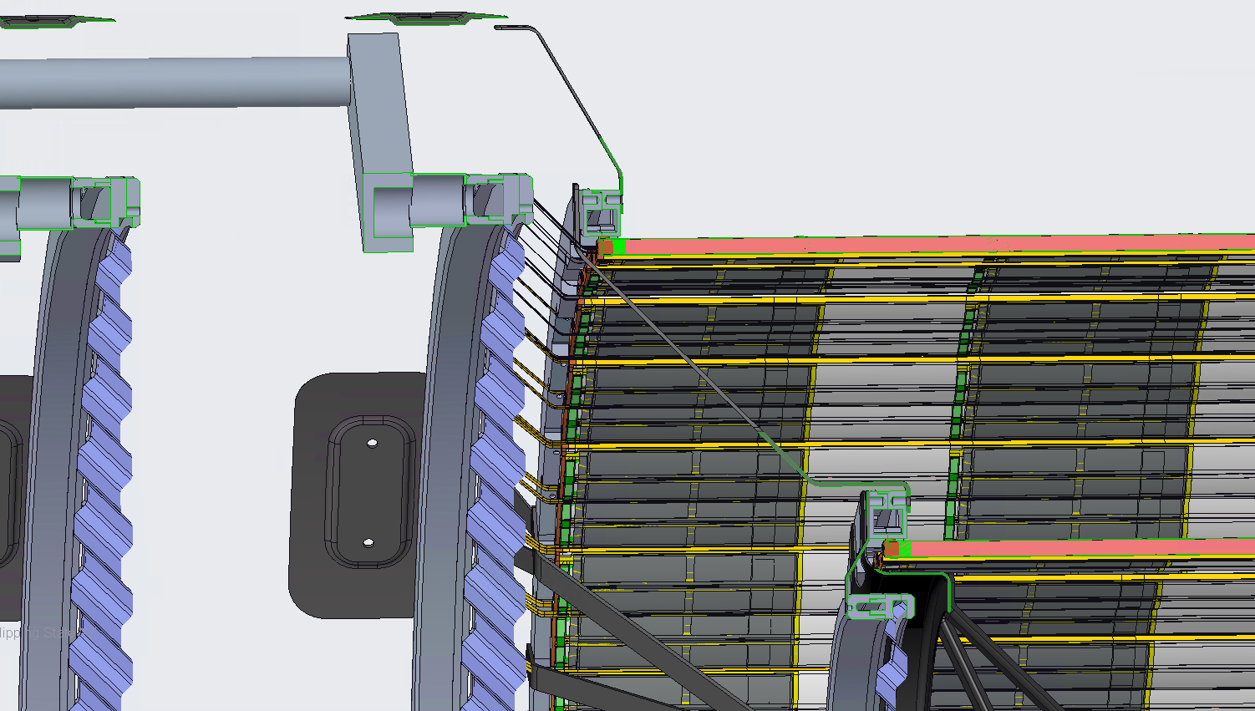
AIR INLET PIPE
D1 air passage
L4
L3
D0
SNORKEL

Slide 5
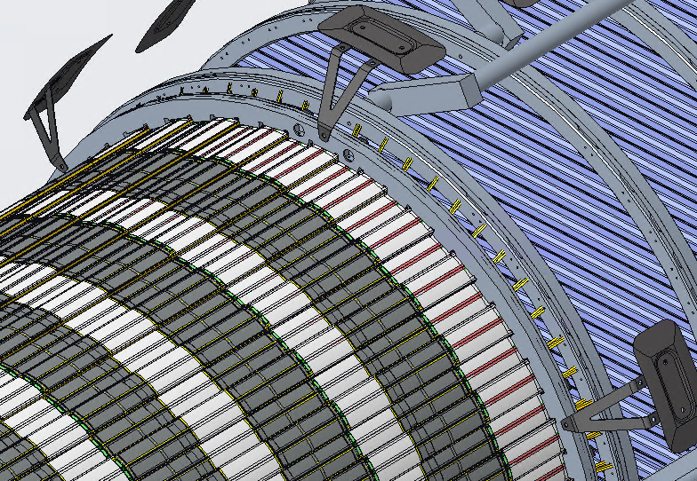
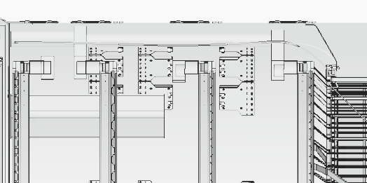
Bipods support large disks and L4
60°
60°
Z

Slide 6
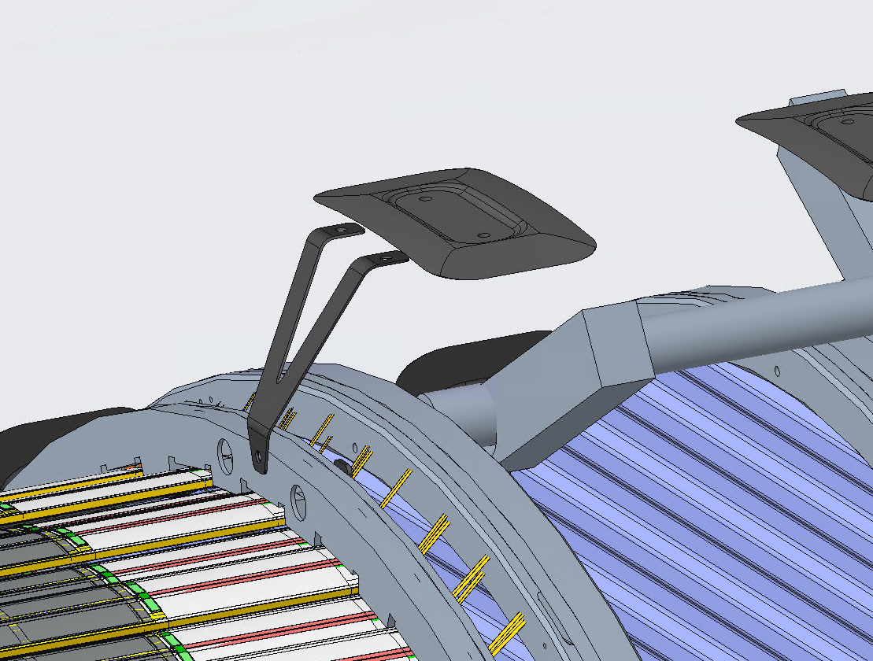
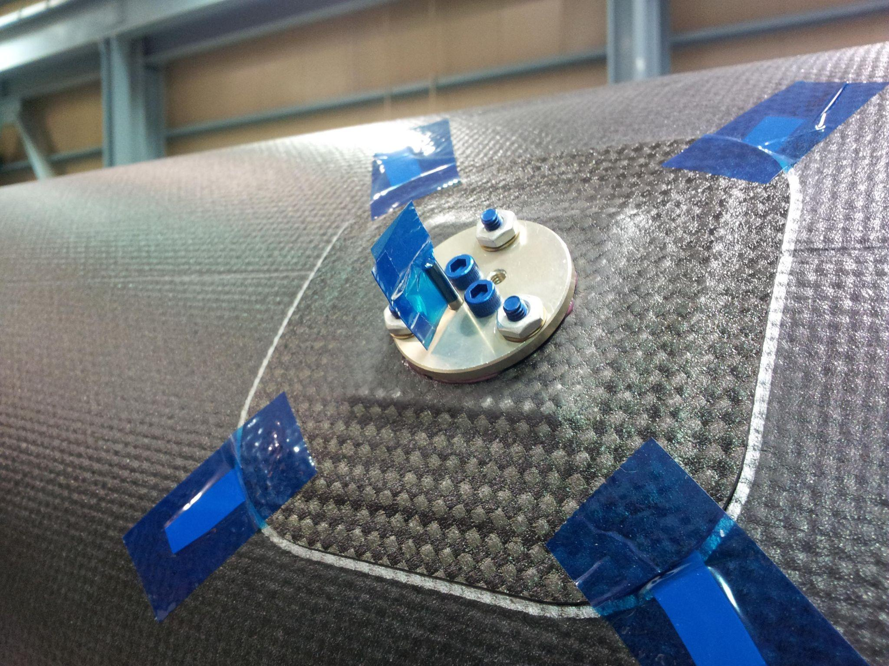
Mount pads are glued to outer surface of PST
Mount pads based on heritage designs from STAR-HFT, ATLAS
3 bipods per half-rim approximates kinematic support, while allowing some Z flexure
No structural analysis done yet, just laying out the concept in CAD
MOUNT PAD
BIPOD
L4 RIM
STAR-HFT example

Slide 7
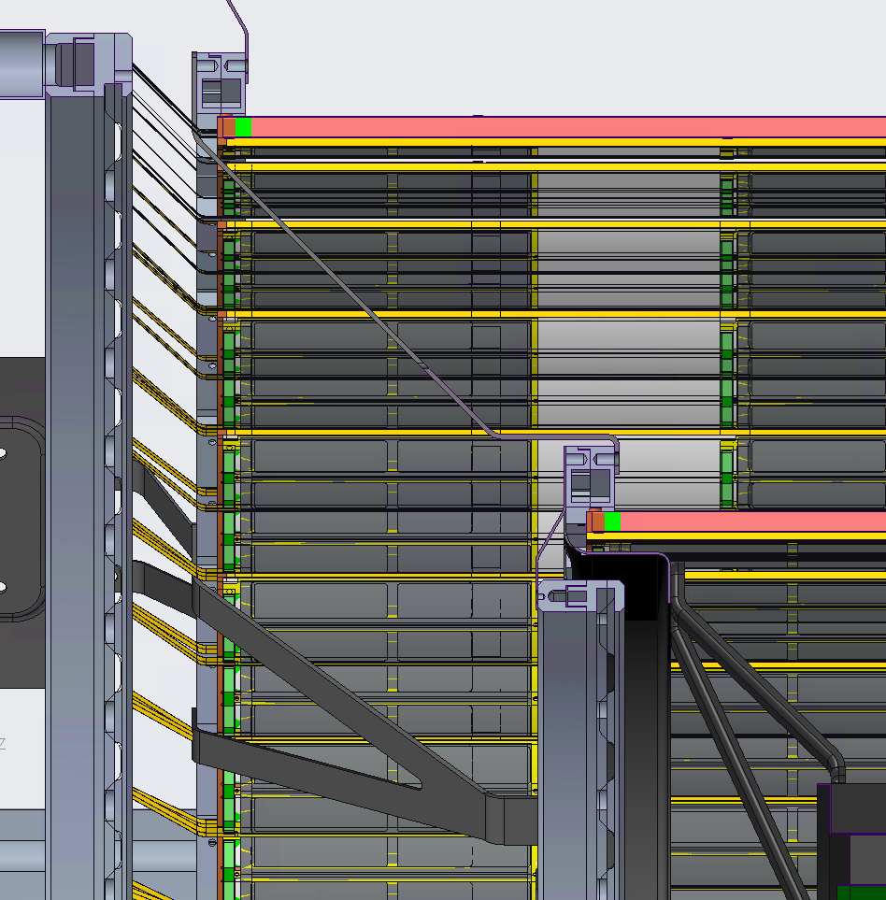
L0-L3 and D0 all supported via L4
PST to L4
This allows the baseline assembly sequence: L4, L3, IB, D0, D1, …
L4 to L3
L3 to D0
L3 to IB

Slide 8
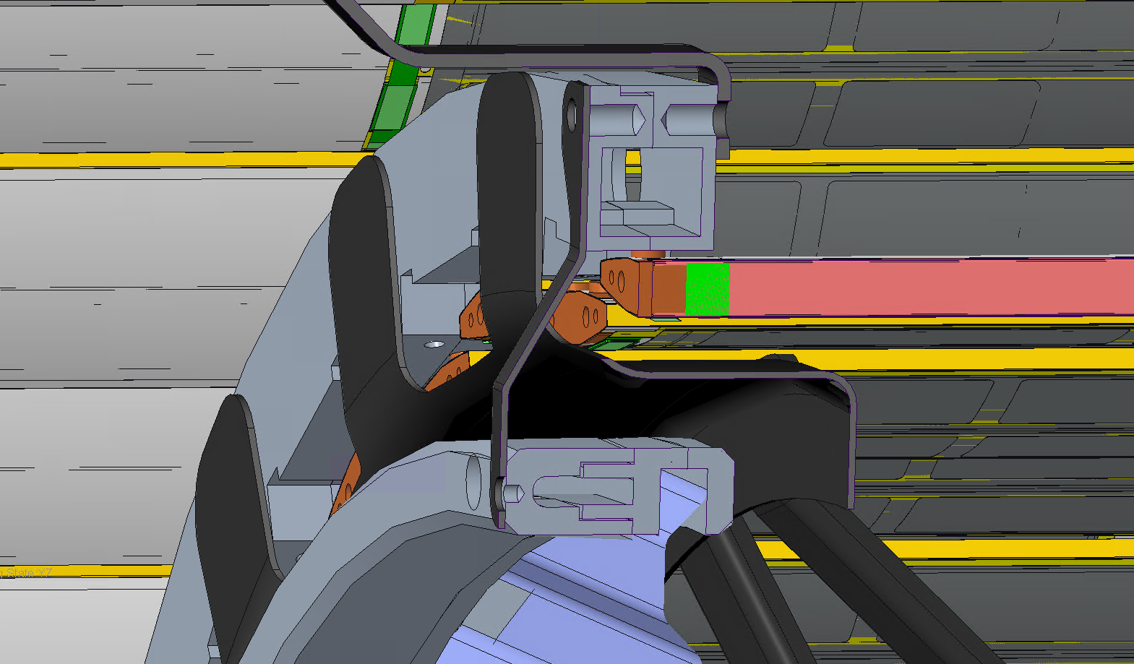
IB-L3 Support protects L3 staves when installing Inner Barrel services
IB-L3 Support

Slide 9
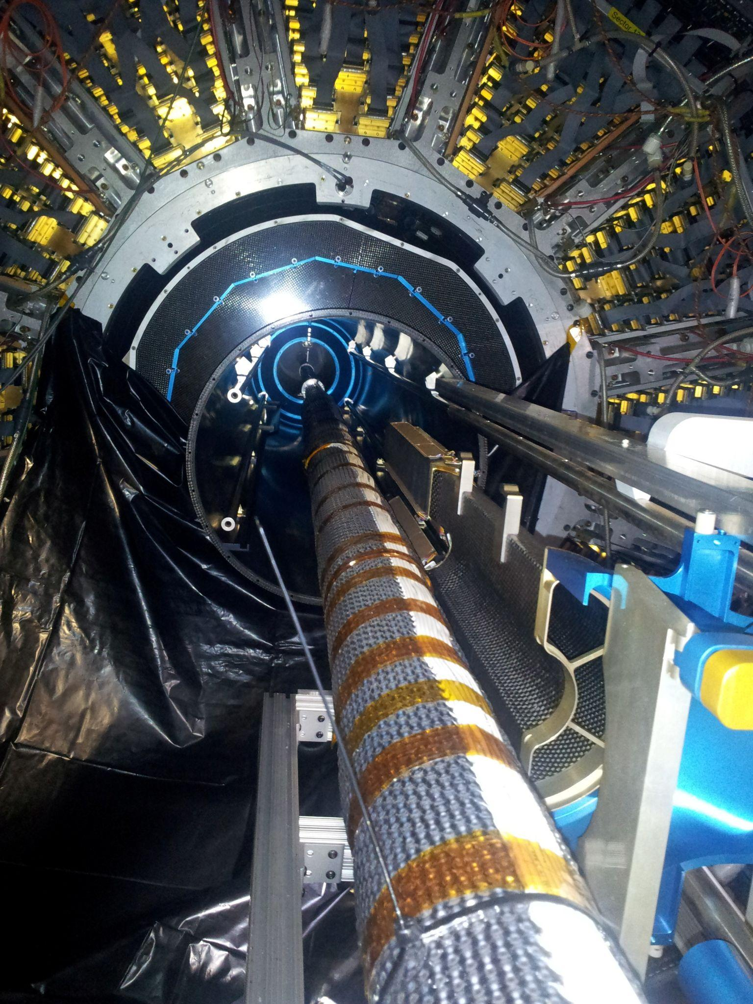
Structural support - Beampipe @ low |Z|
STAR-HFT interior beampipe support
Not yet provided at low |Z|
Experience with STAR HFT and similar systems suggests we will likely need it
Beampipes and detector structures are relatively long and compliant
Presume they will each deflect something like ~3-4 mm
SVT nominal radial gap between BP and L0 is only 5.65 mm
That gap also must fit bakeout insulation
Deflected shapes will be different, as well as orientation-dependent
SVT assembly sequence includes a 90° rotation about Z
Therefore
I think we should baseline mechanically coupling BP to the small disks
Simple support (radial forces, not axial, not bending moments)
Possibly the large disks, too
Whose scope to design?
Purdue - already designing BP supports at high |Z|
LBNL - naturally fits with cone supports design task

Slide 10
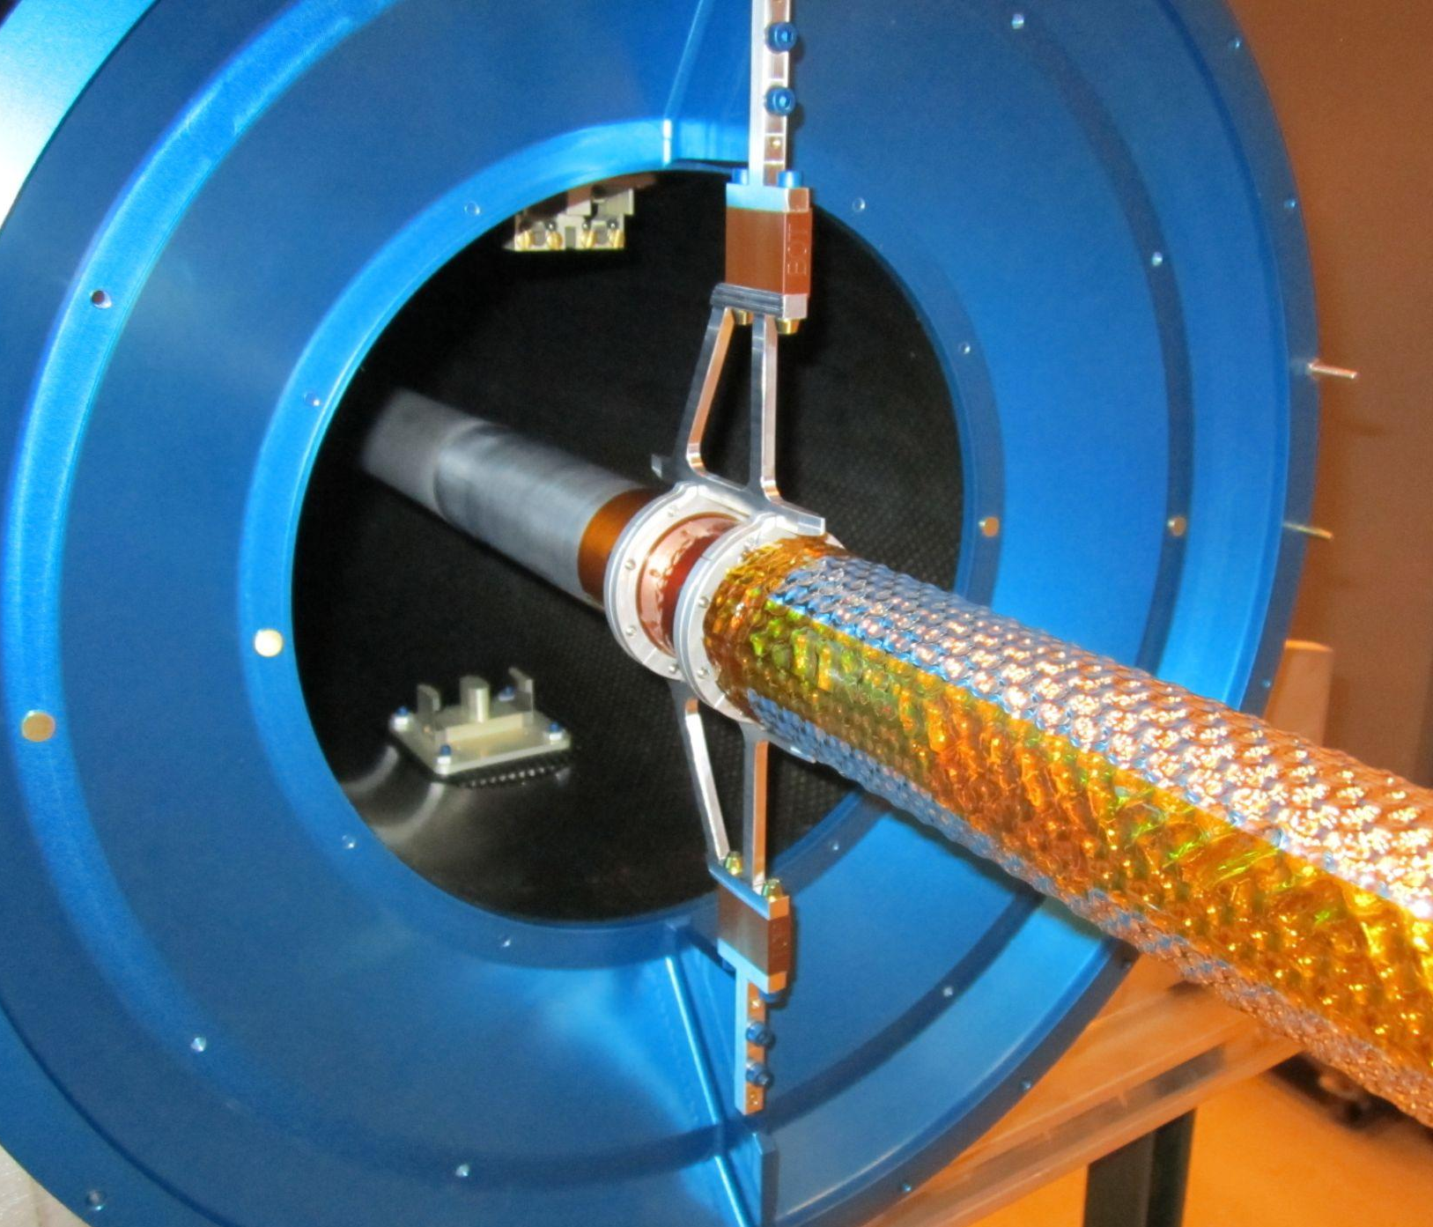
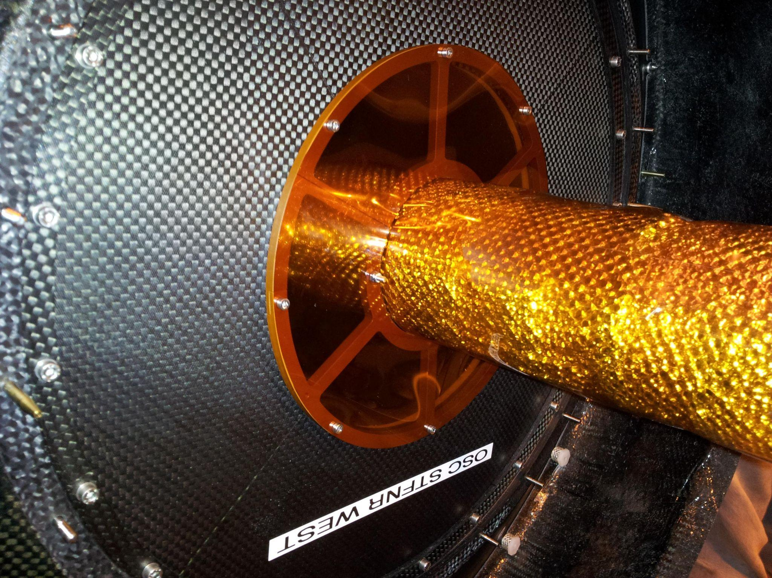
STAR-HFT beampipe supports
inner
outer

Slide 11
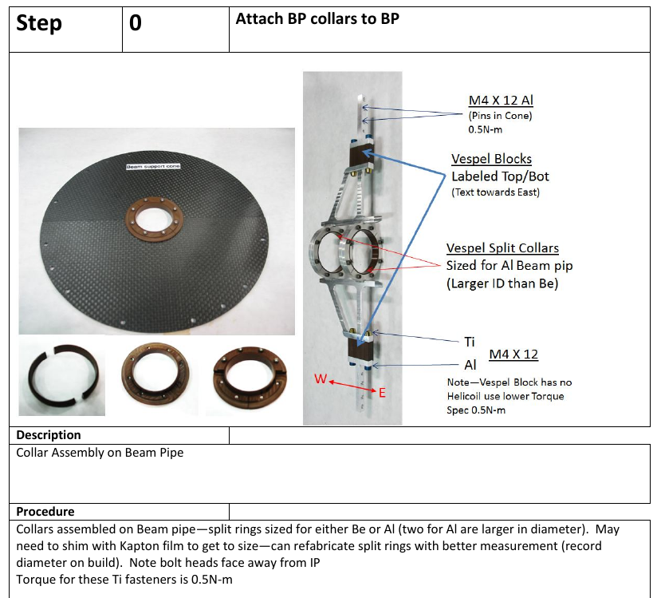
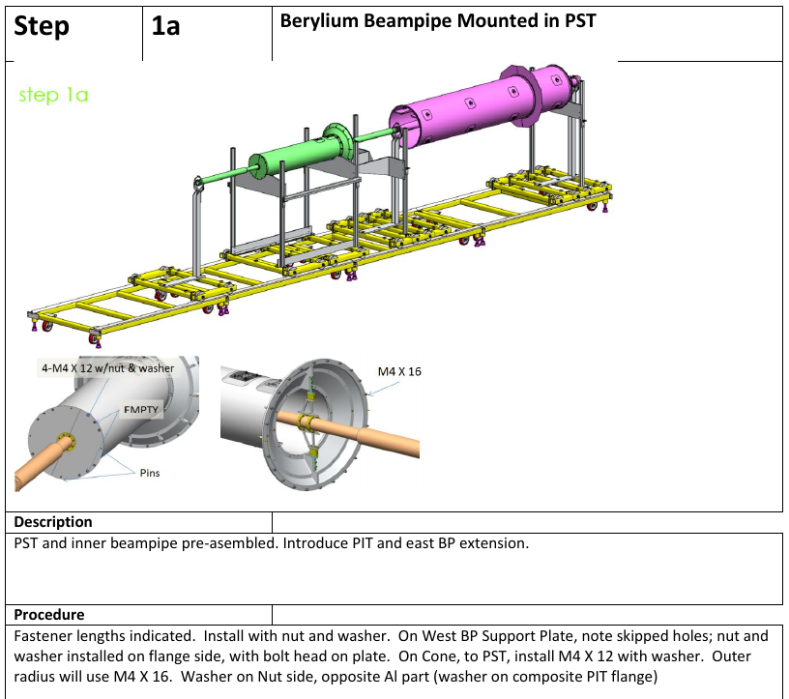
From STAR-HFT’s IDS assembly procedure doc (v1.0, 2012)

Slide 12
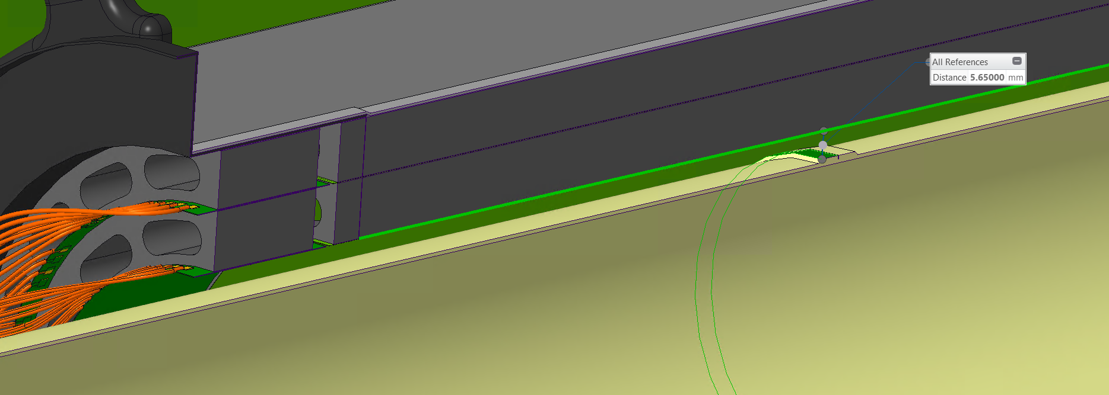
Beampipe / Inner Barrel gap questions
Do we need to flow air to this gap for beampipe bakeout?
Do we have a definition yet how thick the insulation on the pipe will be?

Slide 13
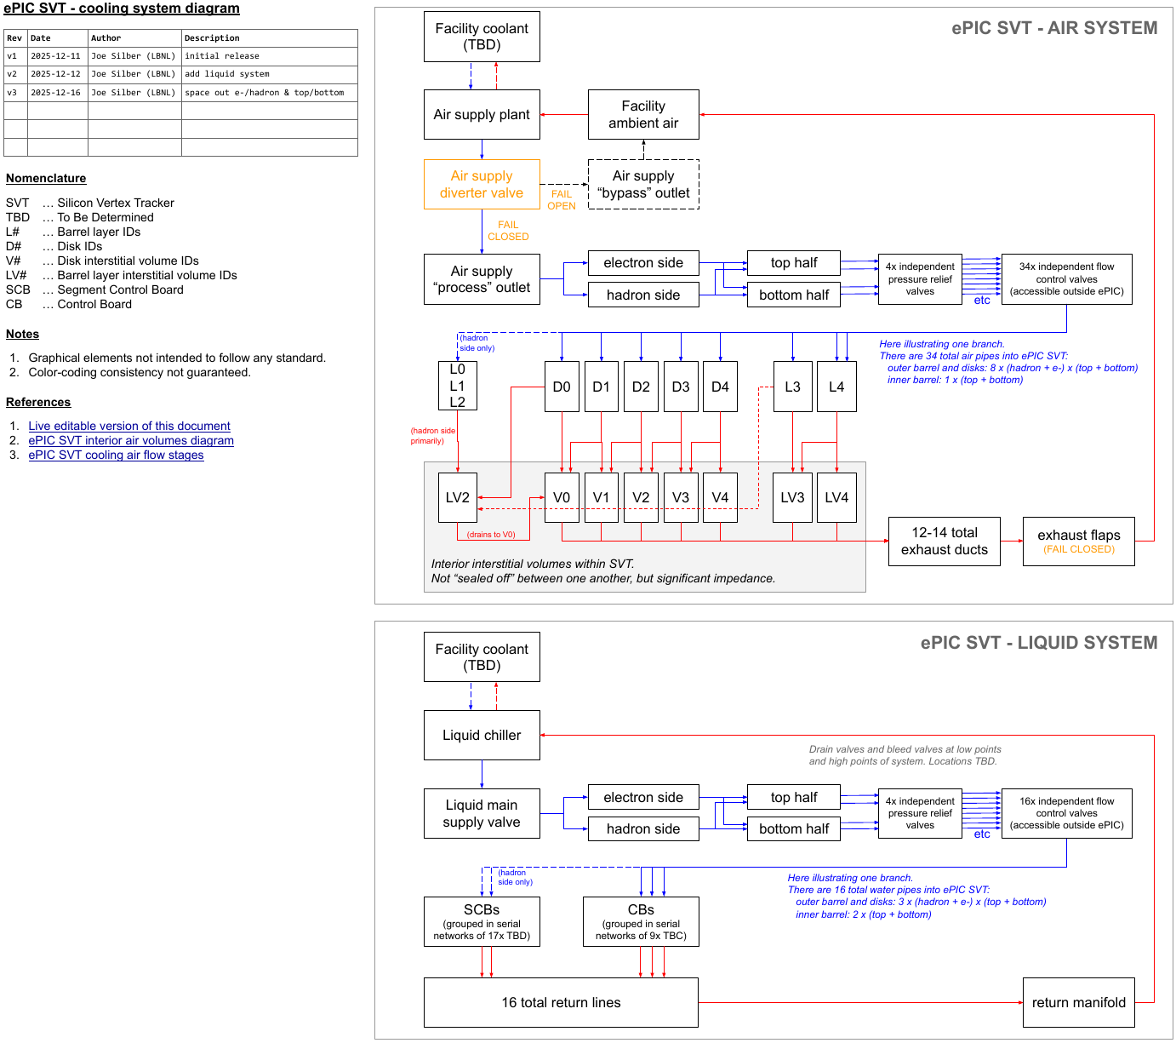

Slide 14
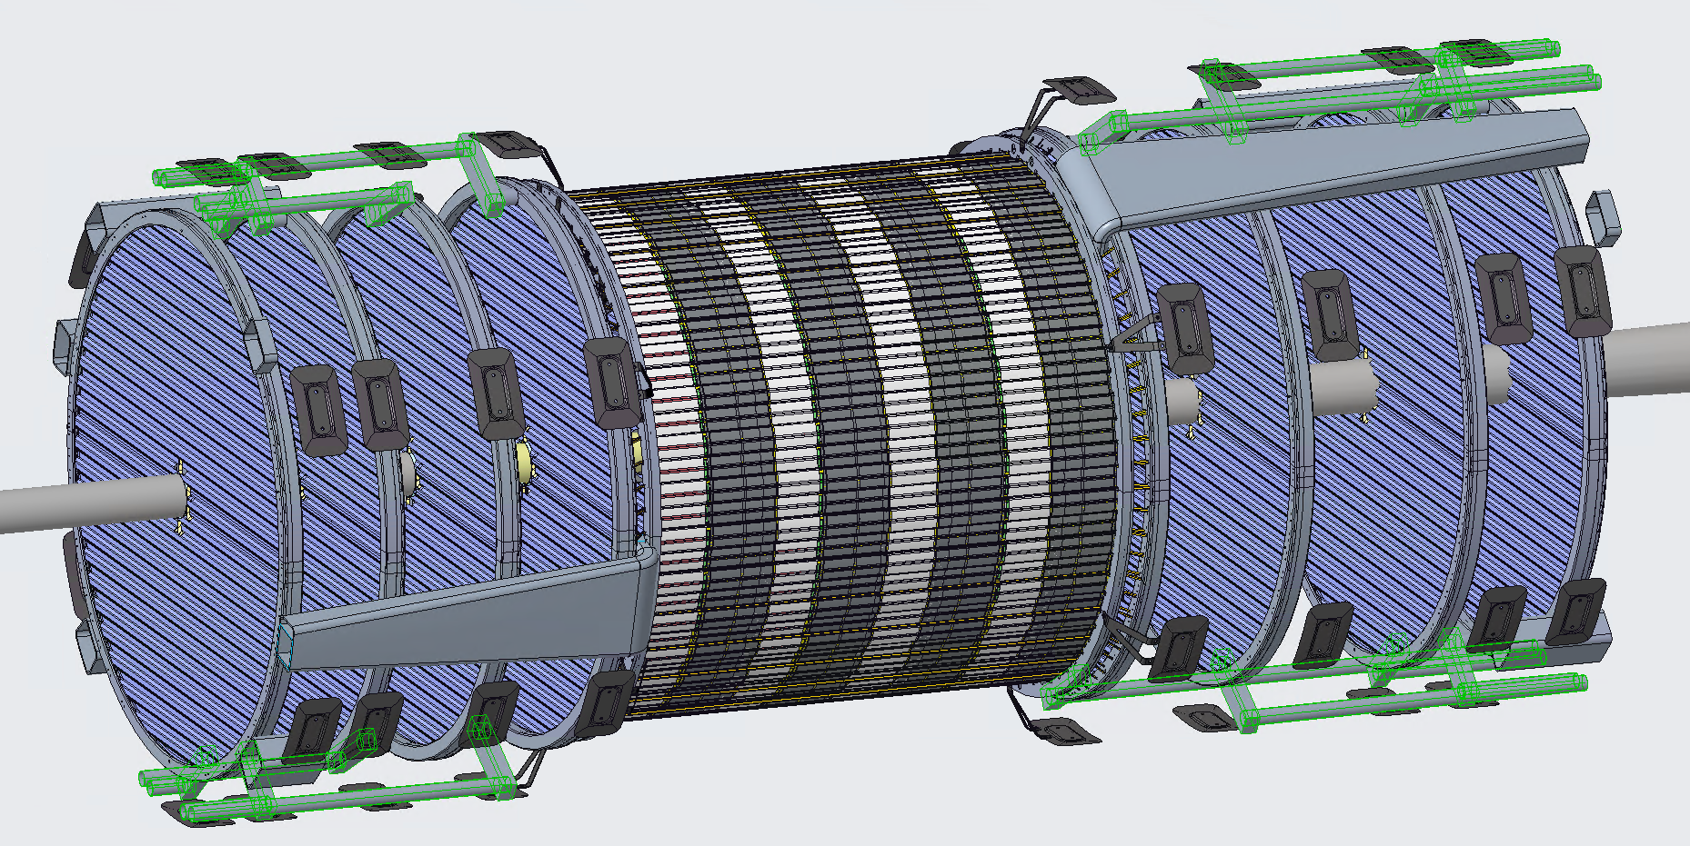
Air supply pipes

Slide 15
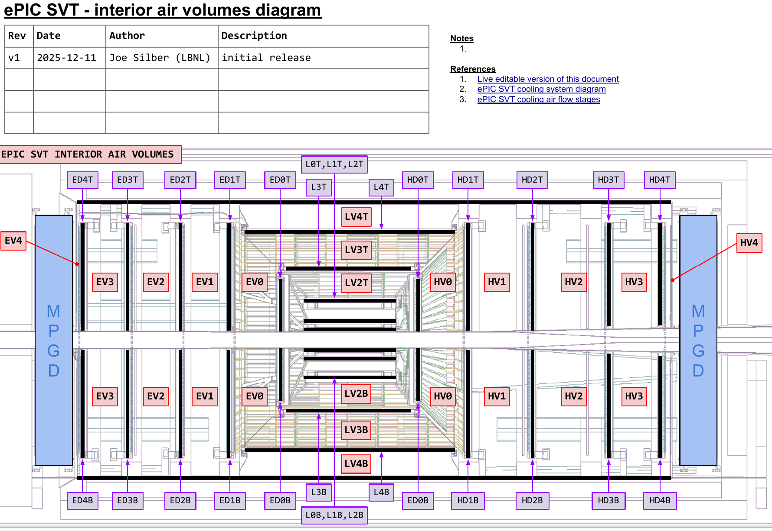
Air exhaust
Exhaust via 12-14 ducts
Duct hydraulic ⌀62 mm
I.e. much greater cross-section than input pipes (4 x ⌀50 mm)
Ducts draw from interior volumes (see diagram)
These volumes aren’t “sealed” from each other, but significant impedance
Suction could be done but prob not necessary
Flapper valves at outlets to prevent ingress when flow off

Slide 16
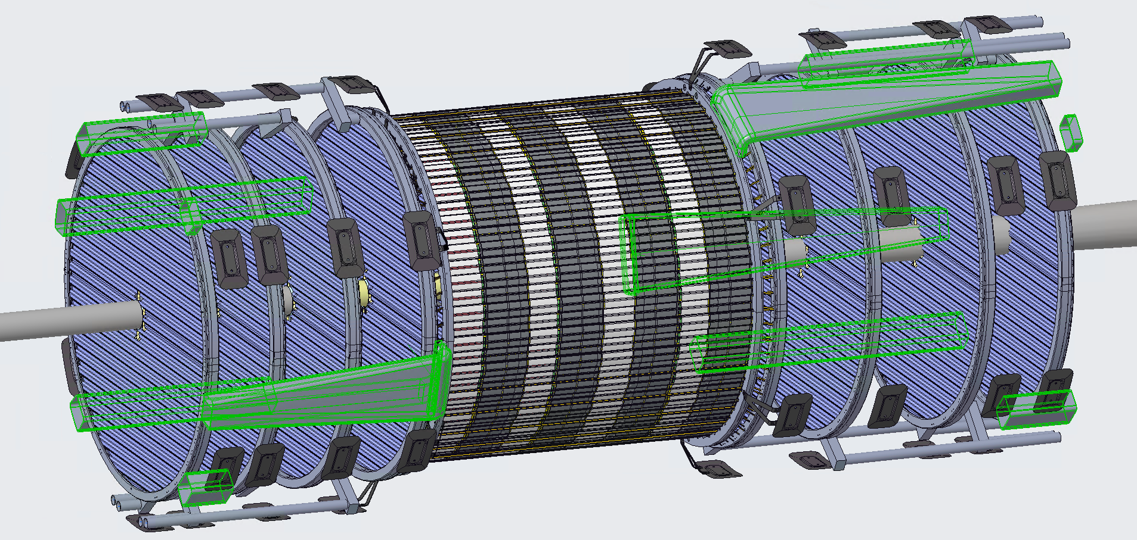
Air exhaust ducts

Slide 18
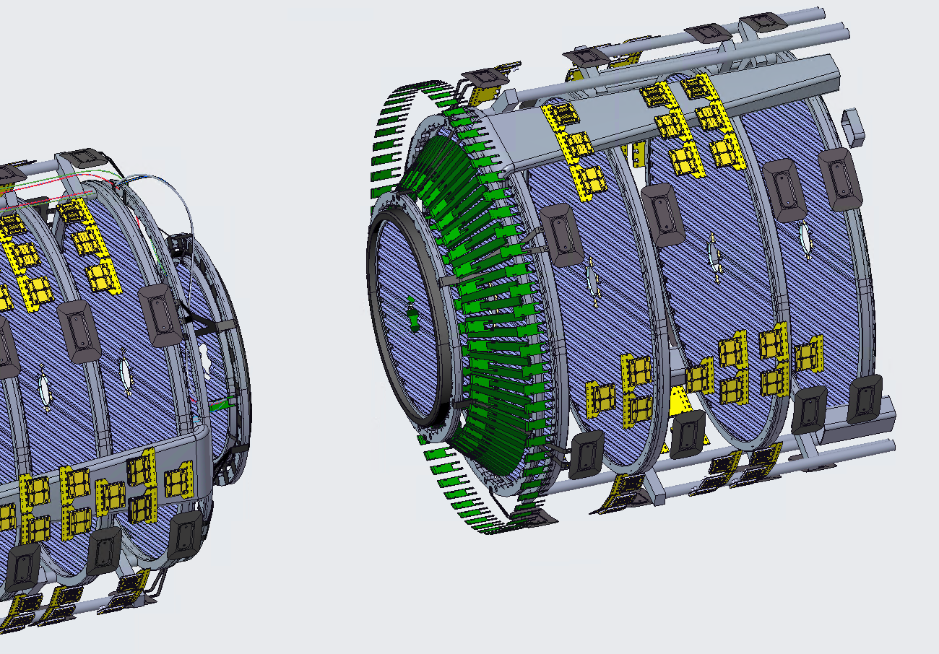
Liquid cooling of CBs and SCBs
Current thought is to group CBs into serial cooling chains of ~9x
i.e. 12x such networks
assemble and test a network outside detector, prior to assembly
still working on patterning
might make sense to unify multiple CBs into fewer cold plates
And group SCBs into networks of 17x
Very much a work in progress
Segment Control Boards (SCBs)
Control Boards (CBs)

Slide 19
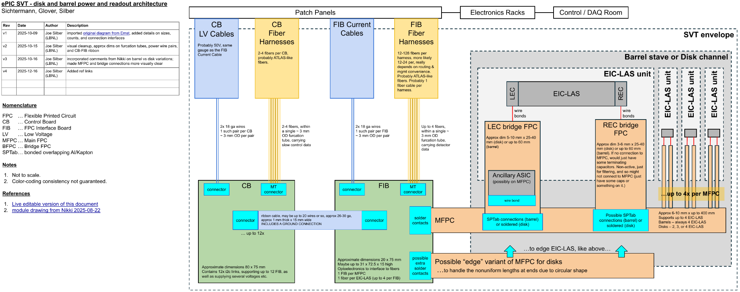
Power and readout architecture for disks and outer barrel

Slide 20
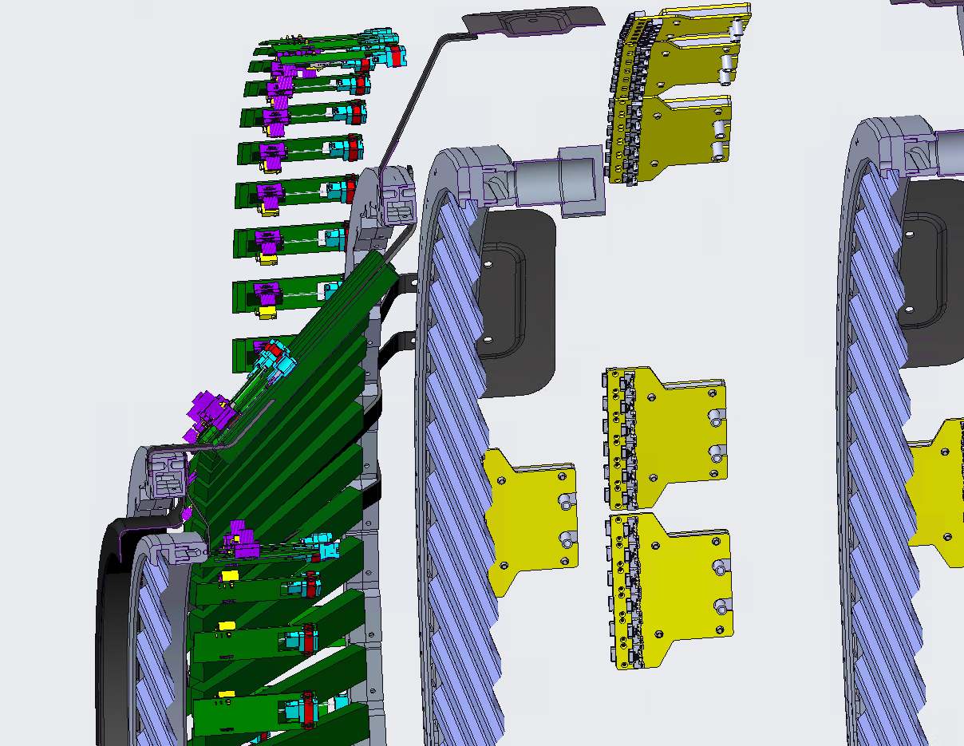
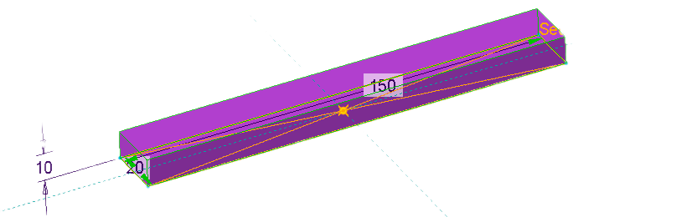
FIBs, CBs and SCBs
Very much a work in progress
Don’t take anything in the CAD screenshot at right too seriously
L4/L3 bipod interlinks may become more cone-like to support boards, TBD
Except for the SCB envelopes
We think the following SCB envelope can fit within the cone
Yep: L 150 x W 20 x H 10 mm
Nope: 220 x 28
Q: How long could the SCB cables remote from the SIBs?

Slide 21
Interface Control Documents (ICDs)
We have not been provided a clear mandate or framework for ICDs from the project
But they will be helpful for us the SVT team to ensure clear understandings between institutions
Let us be practical and minimally bureaucratic
Let us focus them internal to SVT only
I suggest the high value ICDs to develop are:
These ICDs should state clearly:
mounting concept
air connection
inlet air pressure, velocity, and temperature
expected pressure drop at nominal velocity
power dissipated
where the exhaust air goes
maximum cable distances to FIB, CB, SCB
mass estimate
grounding of…
structure
cooling pipes
active components
module, stave, segment, and cable counts
conceptual assembly sequence
And not much more than that.
Outer Barrel (UK) / Cones & Services (LBNL)
Inner Barrel (INFN) / Cones & Services (LBNL)
Global Supports (Purdue) / Cones & Services (LBNL)

