Slide 1
Cooling requirements

Slide 2
Inputs
LAS
Based on input from Joao Sept 2025
5-RSU LAS typ. 890mW max. 1246mW
6-RSU LAS typ. 1025mW max. 1454mW
AncASIC typ. 35% max. 45
FPC typ. 20% max. 30
Geometry
OB L4: 5-RSU LAS, 16 LAS/stave, 70 staves
OB L3: 6-RSU LAS, 8 LAS/stave, 46 staves
Disk ED0/HD0: 5-RSU LAS, 102 LAS/disk
Disk ED1/HD1: 6-RSU LAS, 258 LAS/disk
Disk ED2/HD2: 6-RSU LAS, 266 LAS/disk
Disk ED3/HD3: 6-RSU LAS, 266 LAS/disk
Disk ED4/HD4: 6-RSU LAS, 266 LAS/disk
MOSAIX
MOSAIX 3x10Gbps: typ. 140 mW/RSU, 700 mW/LEC, max. 194 mW/RSU, 905 mW/LEC
MOSAIX 6x5Gbps: typ. 140 mW/RSU, 1045 mW/LEC, max. 194 mW/RSU, 1360 mW/LEC

Slide 3
Stave and disk power
OB |  | # of LAS/stave | # of staves | Power/stave [W] |  | Total power [W]
 |  |  |  | Typ. | Max. | Typ. | Max.
L4 | 5-RSU LAS | 16 | 70 | 22.1 | 34.9 | 1545 | 2442
L3 | 6-RSU LAS | 8 | 46 | 11.2 | 16.9 | 514 | 776
Disks | # 5-RSU LAS | # 6-RSU LAS | Power/disk [W]
 |  |  | Typ. | Max.
ED0 | 102 |  | 141 | 222
ED1 |  | 258 | 414 | 656
ED2 |  | 266 | 427 | 677
ED3 |  | 266 | 427 | 677
ED4 |  | 266 | 427 | 677
HD0 | 102 |  | 141 | 222
HD1 |  | 258 | 414 | 656
HD2 |  | 266 | 427 | 677
HD3 |  | 266 | 427 | 677
HD4 |  | 266 | 427 | 677
Total | 204 | 2112 | 3670 | 5819
All numbers include
AncASIC & FPC losses

Slide 4
System power numbers (local supports)
 | Total air-cooled power/system [W]
 | typical | max
L0 | 30 | 37
L1 | 40 | 50
L2 | 101 | 124
L3 | 514 | 776
L4 | 1545 | 2442
Disks | 3670 | 5819
Total power [kW] | 5.90 | 9.25

Slide 5
RDO cooling
SIBs/FIBs only have VTRX+ as active component
Limited power, and packaged as a plug-in board where thermal contact is difficult
Cool by natural convection (need to verify by CFD)
CB higher power, more compact and accessible by liquid cooling
System | SIBs/FIBs |  | SCBs/FCBs |  | DPBs/FPC-CBs |  | Total [W]
 | # | Power [W] | # | Power [W] | # | Power [W] | air | liquid
IB | 68 | 27 | 68 | 297 | 6 | 88 | 27 | 385
OB | 372 | 75 | 8 | 171 | 32 | 55 | 75 | 226
Disks | 740 | 149 | 18 | 385 | 70 | 121 | 149 | 506
 |  |  |  |  |  |  | 251 | 1117
Still old (split CB) configuration

Slide 6
Temperature requirements
Requirement | LEC | RSU | REC | AncASIC
Maximum T [◦C] | 65 | 40 | N/S | 80
Maximum T variation [◦C] | 10 | 1 over 3 mm 10 over full length | N/S | 10
N/S is not specified
Beampipe bakeout
Need to specify: beam pipe T xxx°C, max sensor T xxx°C

Slide 7
Further material
Slides from Iain

Slide 8
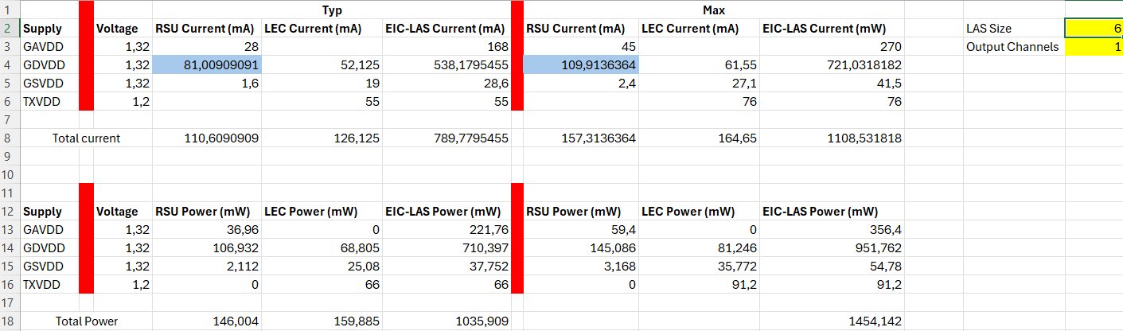

Power numbers used (from Joao)
-27% (typ.)/-25% (max.) from my previous numbers
-14% from my previous
numbers

