Slide 1

Cooling system design and humidity management
ePIC SVT Working Meeting at Oxford
2025-12-18
Joe Silber (LBNL) - mechanical engineer, presenting
Jaime Cruz Duran (LBNL) and Nick Payne (formerly LBNL) - CFD analyses
Nicole Apadula (LBNL) - thermal tests
Elaine Buron (LBNL) - CAD design

Slide 2
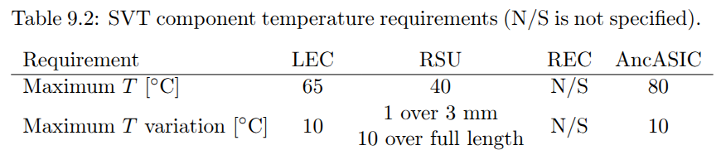
High level cooling requirements
From draft Preliminary Design Report (PDR):

Slide 3
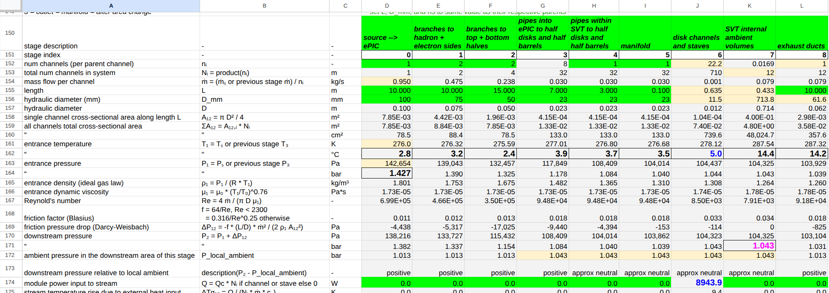
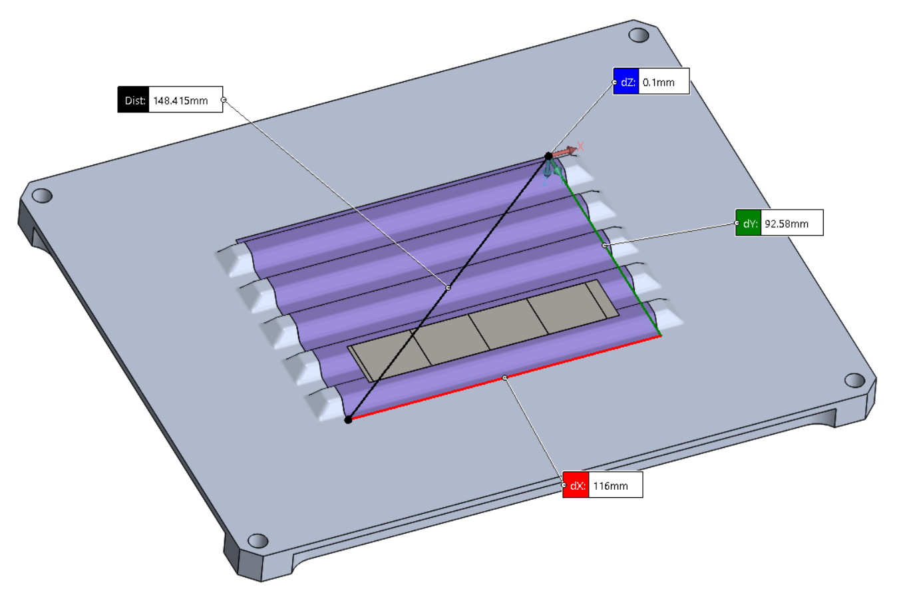
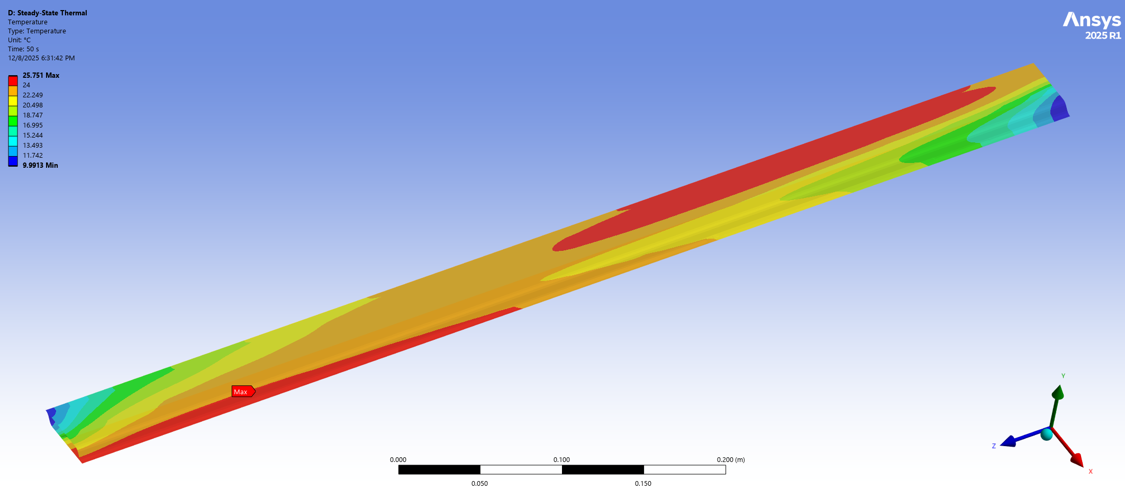
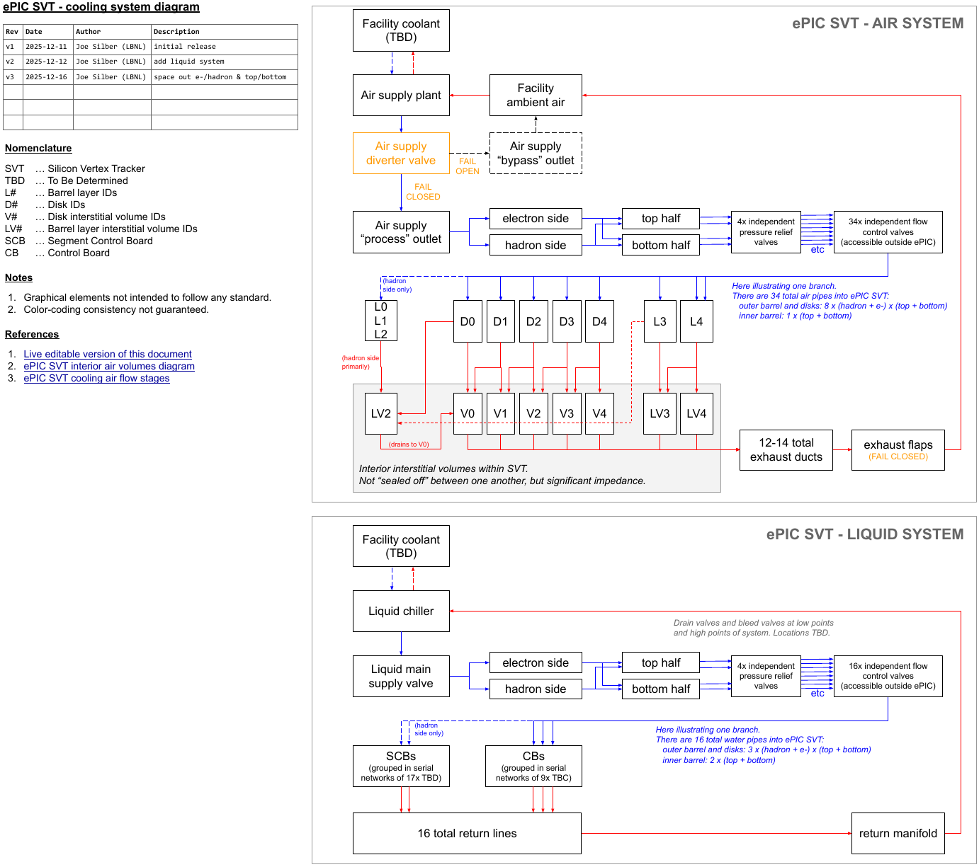
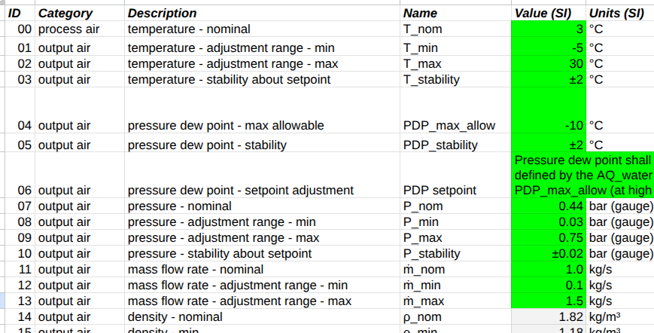
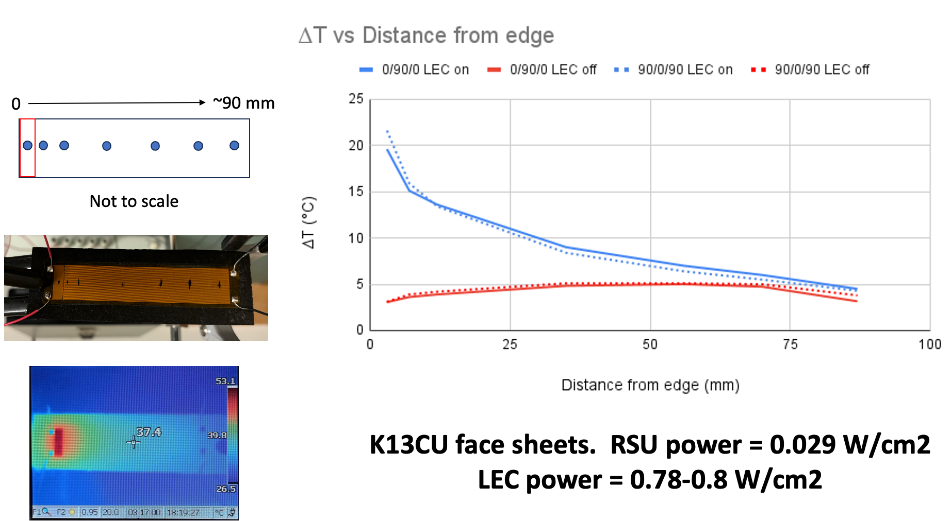
Design process from high level req’ts to detailed specs
High level requirements
End-to-end system performance calculation
Req’t on Tmax
Constraints on ΔT, ΔP, air speed
CAD design
Local supports heat transfer analysis
System architecture
Temperatures, pressures, flow rates
System layout
Detailed specs on cooling plant
Local supports physical test
Operational logic

Slide 4
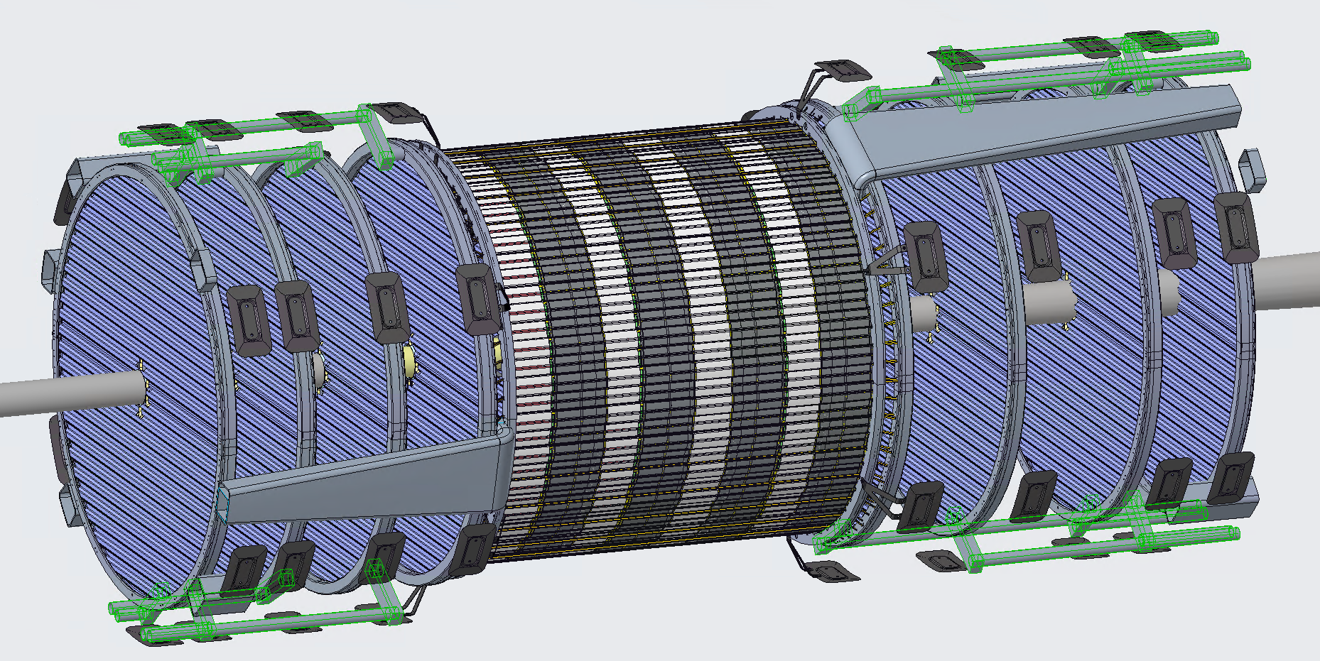
Air supply pipes

Slide 5
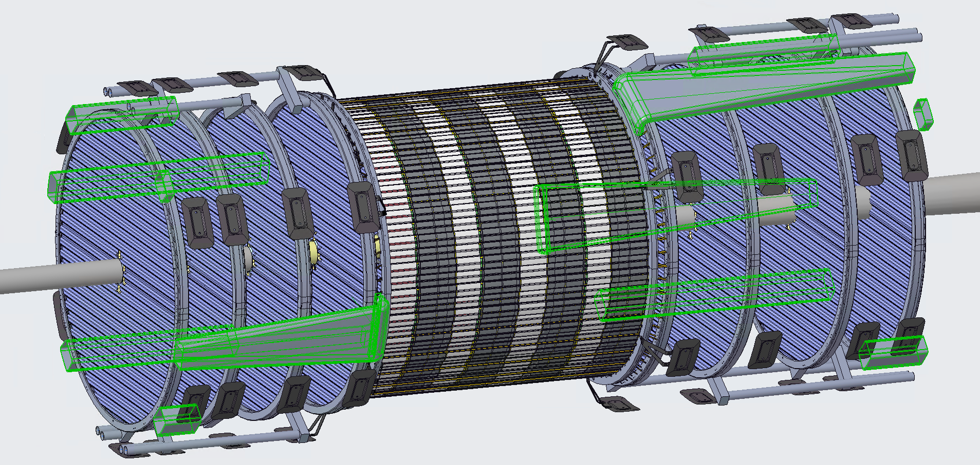
Air exhaust ducts

Slide 6
Link:
ePIC SVT cooling system diagram - v3.pdf

Slide 7
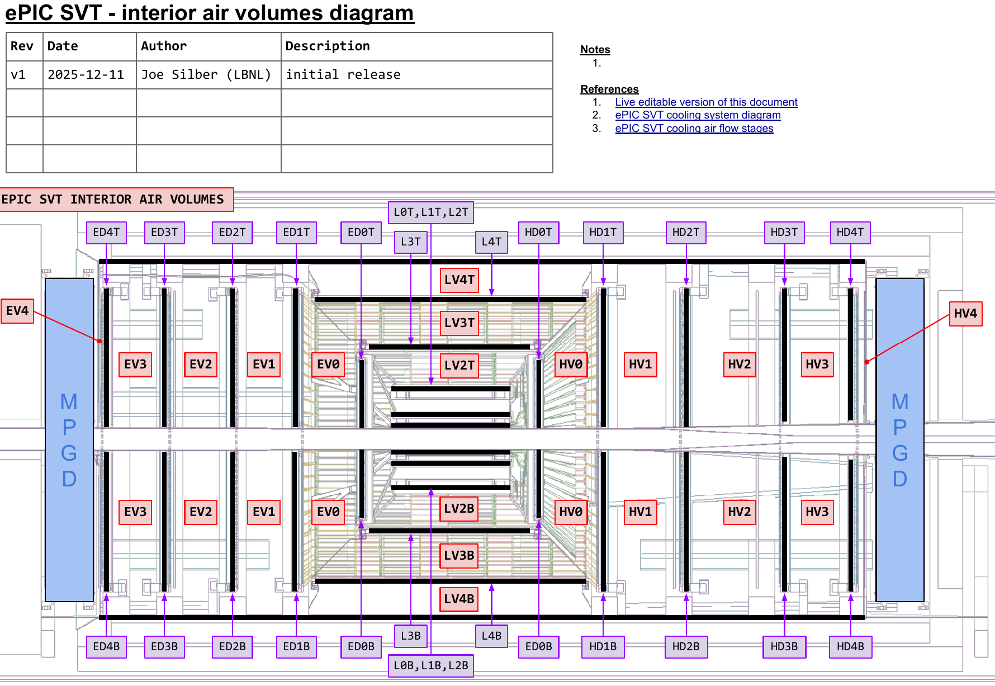
Air exhaust
Exhaust via 12-14 ducts
Duct hydraulic ⌀62 mm
I.e. much greater cross-section than input pipes (4 x ⌀50 mm)
Ducts draw from interior volumes (see diagram)
These volumes aren’t “sealed” from each other, but significant impedance
Suction could be done but probably not necessary
Flapper valves at outlets to prevent ingress when flow off
Link: ePIC SVT interior air volumes diagram - v1.pdf

Slide 8
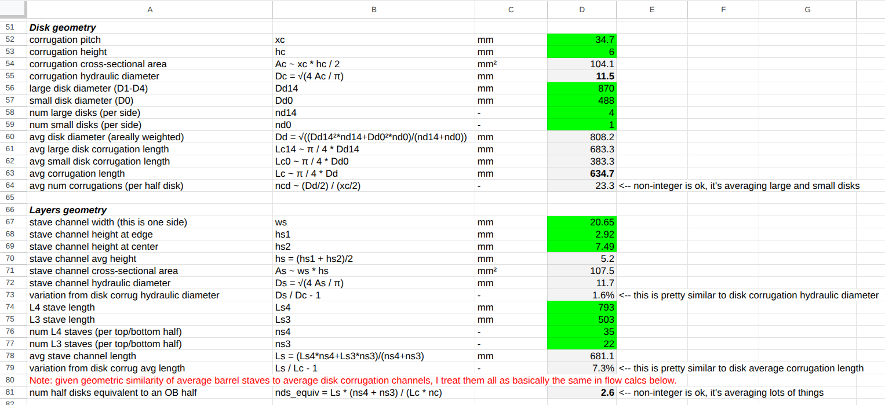
System calculator inputs: local supports geometry

Slide 9
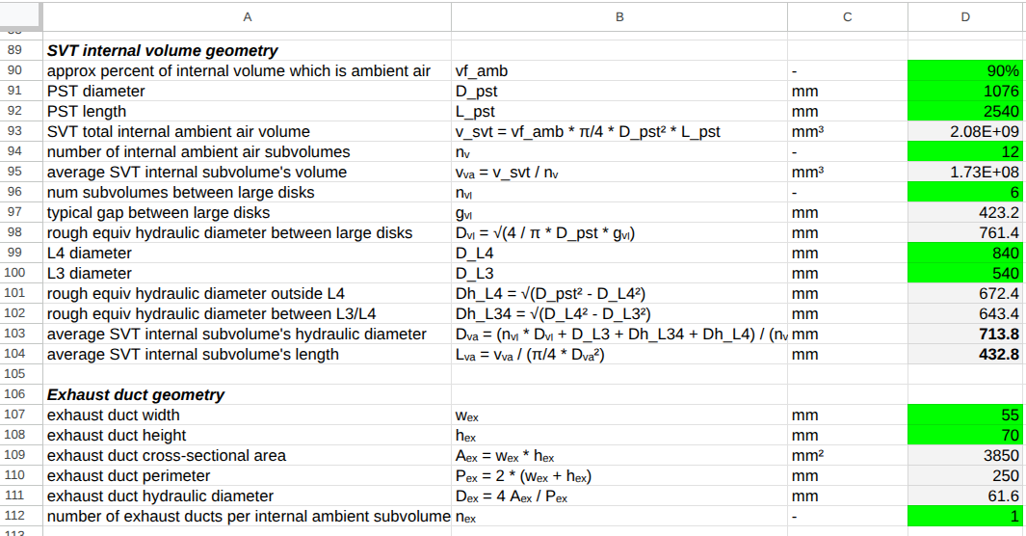
System calculator inputs: internal volumes and exhaust

Slide 10
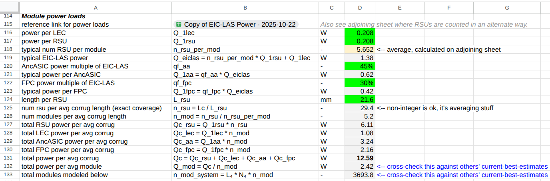
System calculator inputs: module power loads

Slide 11
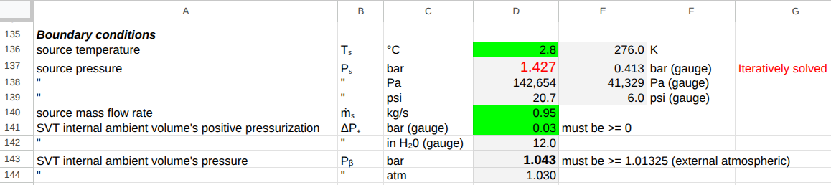
System calculator inputs: boundary conditions

Slide 12
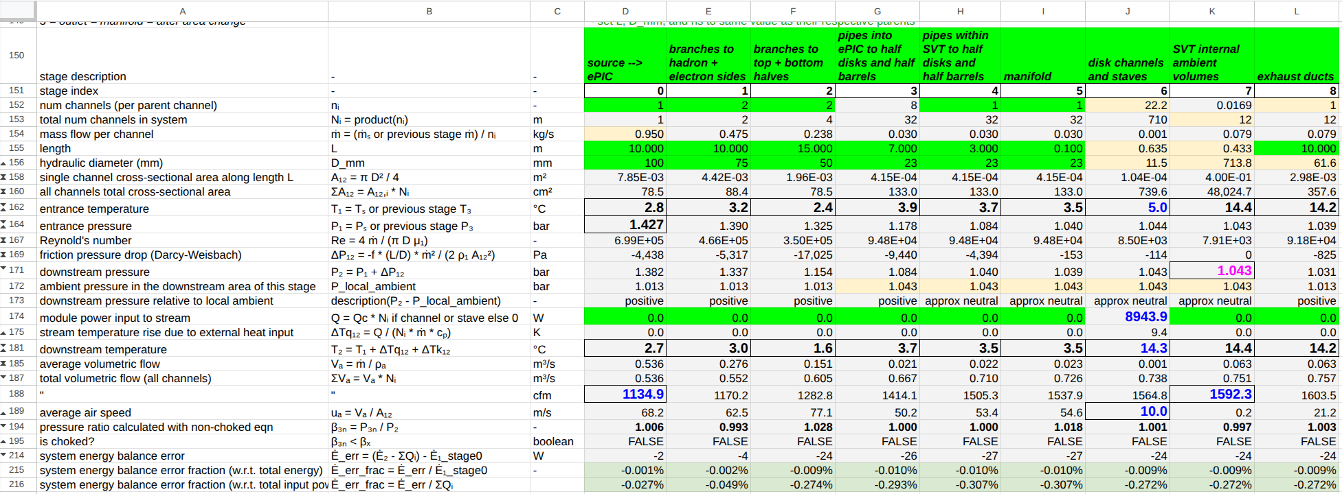
Cooling system performance baseline
source temperature = 2.8°C
total mass flow = 0.95 kg/s
total volume flow = 1135 cfm @ source pressure, 1604 cfm @ exhaust
source pressure = 1.43 bar → 1.03 bar positive pressure @ exhaust
channel/stave entrance temperature = 5.0°C
channel/stave air speed = 10.0 m/s
total power extracted = 8.9 kW
SVT internal ambient temperature = 14.4°C
Link: ePIC SVT cooling air flow stages - v15.xlsx

Slide 14
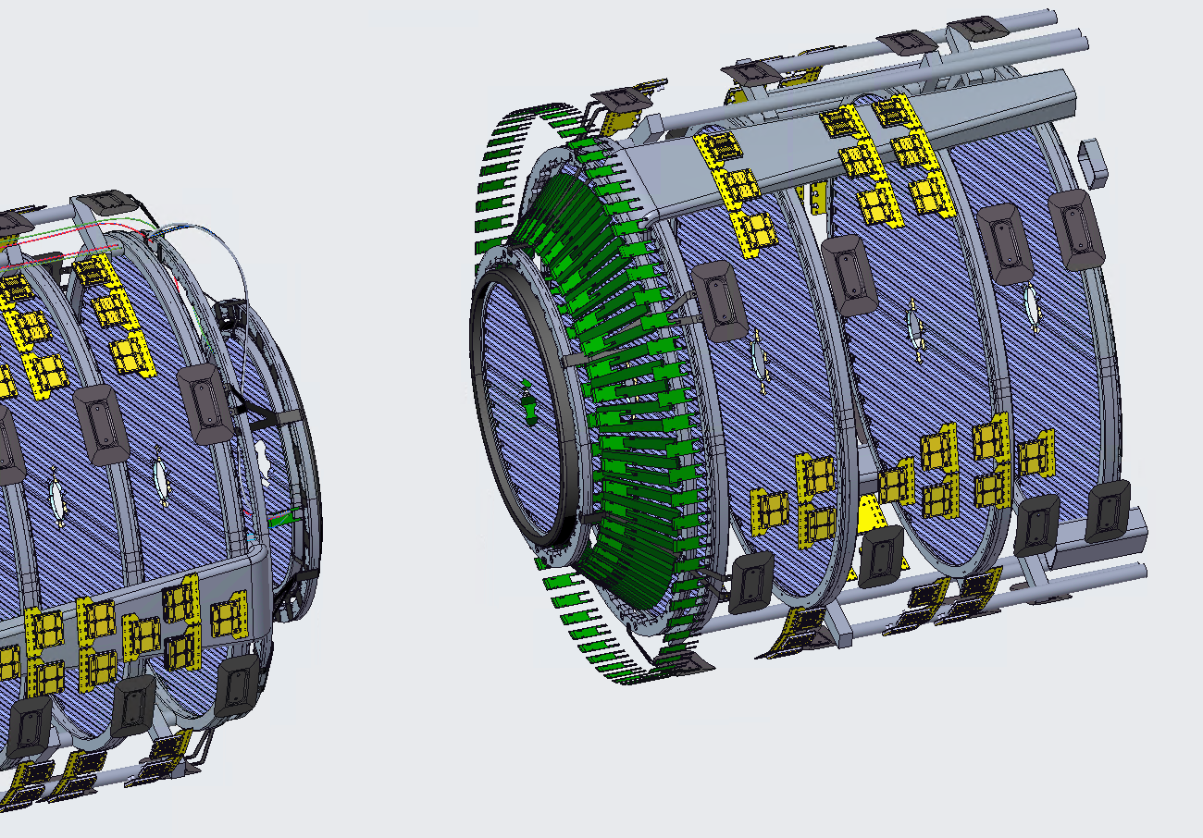
Liquid cooling of CBs and SCBs
Current thought is to group CBs into serial cooling chains of ~9x
i.e. 12x such networks
assemble and test a network outside detector, prior to assembly
still working on patterning
might make sense to unify multiple CBs into fewer cold plates
And group SCBs into networks of 17x
Very much a work in progress
Segment Control Boards (SCBs)
Control Boards (CBs)

Slide 15
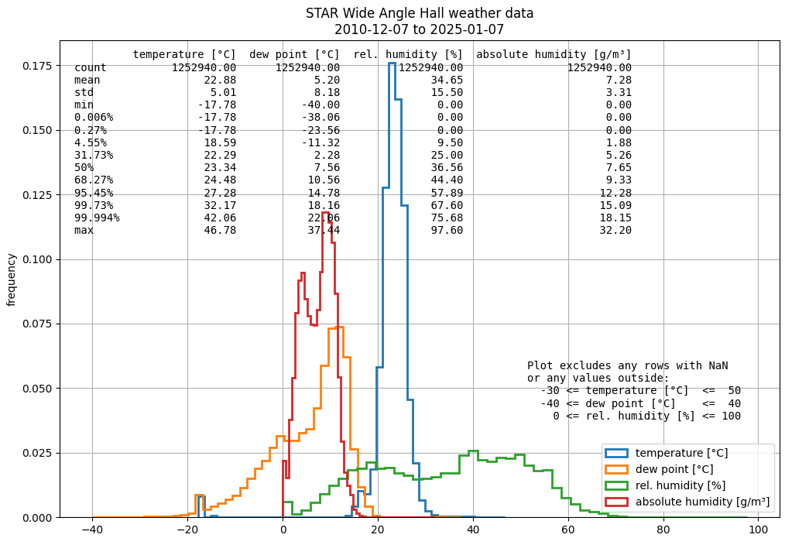
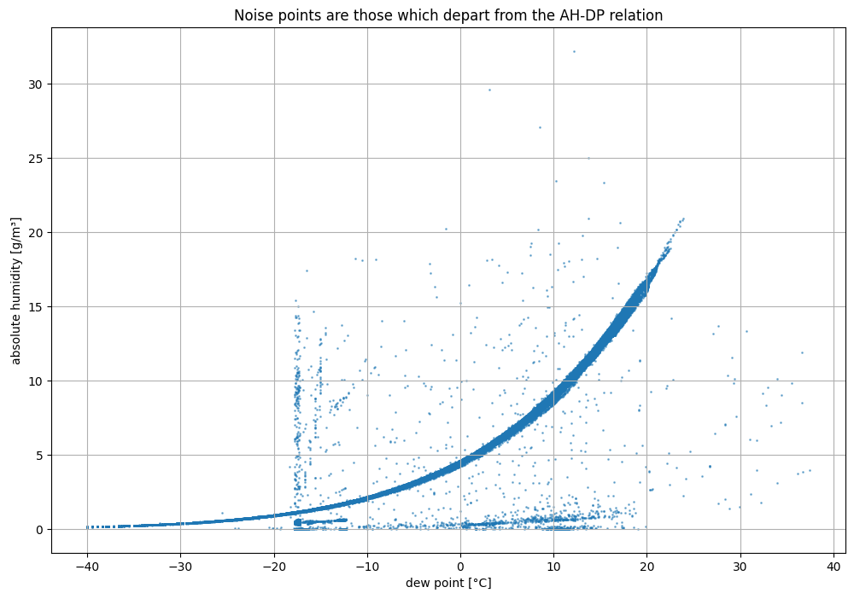
STAR WAH environmental data over 14 years
extreme hot/wet condition:
dew point ~ 22.1 C
ambient temp ~ 35.0 C
Some noise in the WAH data
Especially early in time history
But I'm pretty confident the hot/wet condition stated above was a real event – see abs humidity vs dew point (these are physically correlated)

Slide 16
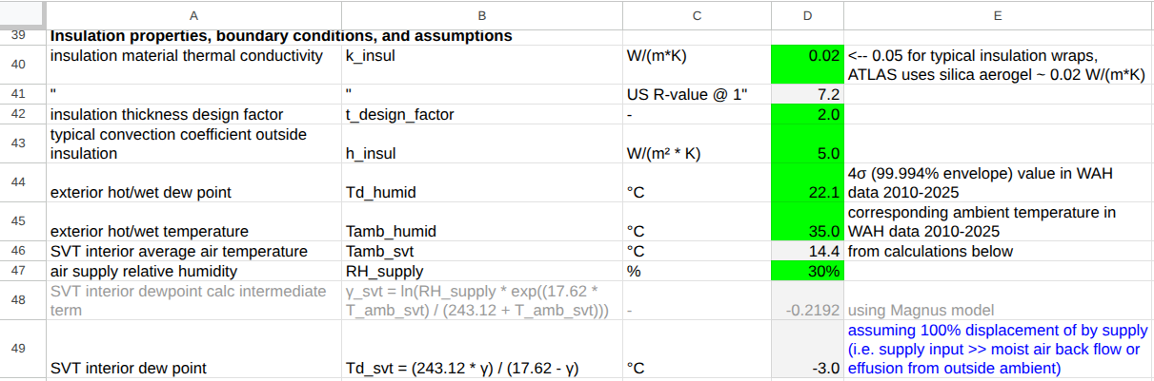
System calculator inputs: humidity and insulation
This assumed -3°C dew point value is used to size the insulation (next slide). It assumes an HVAC-like supply (30% RH). I expect it will end up being quite conservative because we more likely will buy a compressed air system with Class 2 (-40°C) or Class 3 (-20°C) pressure dew point.

Slide 17
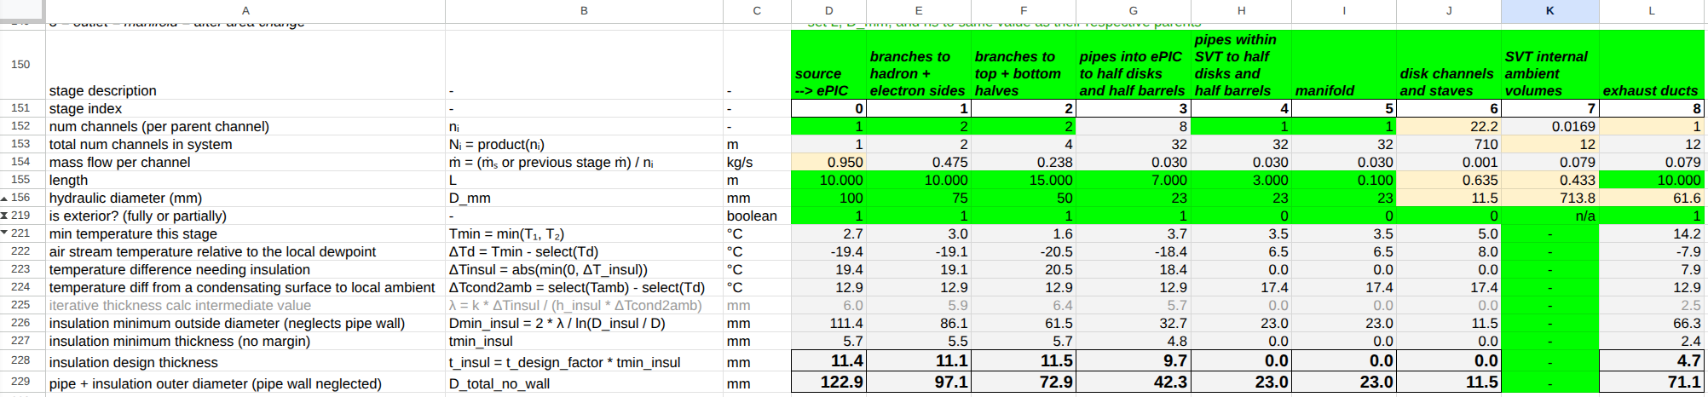
Baseline calculations of insulation thickness
With respect to either the exterior extreme dew point value (22.1°C) or the interior (-3°C).
This 10 mm thick insulation around the hydraulic ⌀23 mm air pipes occurs in the region of uncertain dryness within ePIC but outside SVT. May be challenging to cross-sectional area.

Slide 18
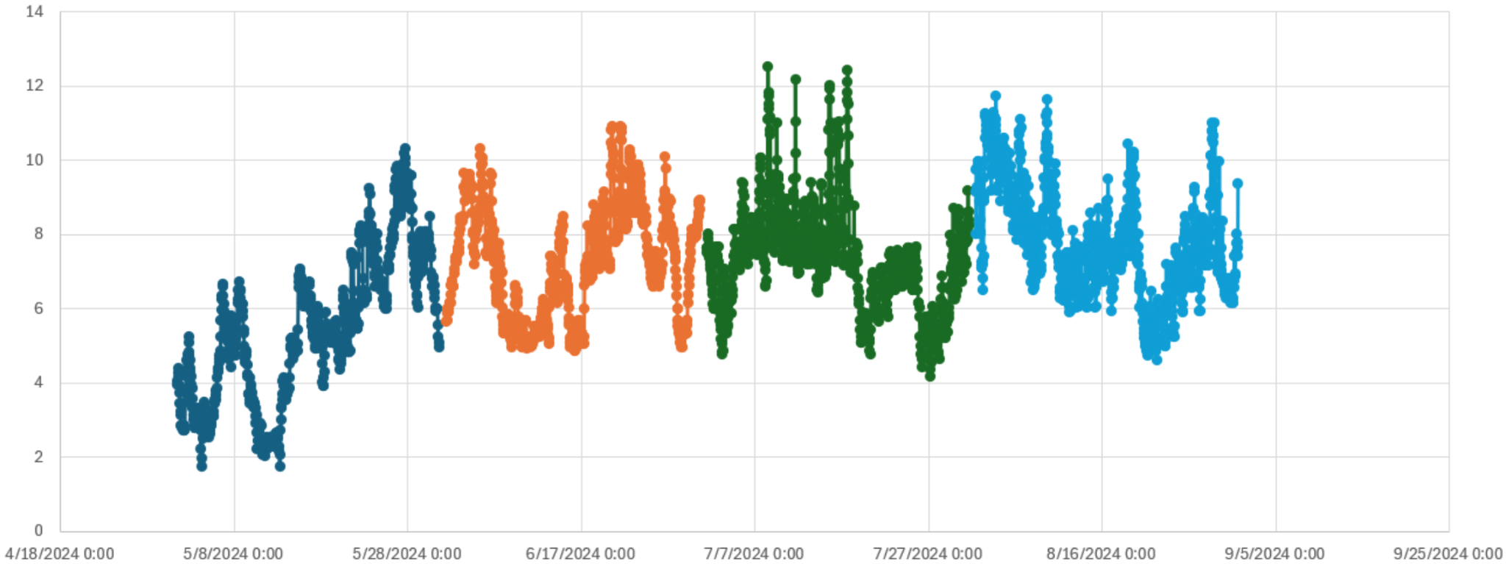
sPHENIX Hall (IR) dewpoint data May-Aug 2024
(courtesy Dan Cacace)

Slide 19
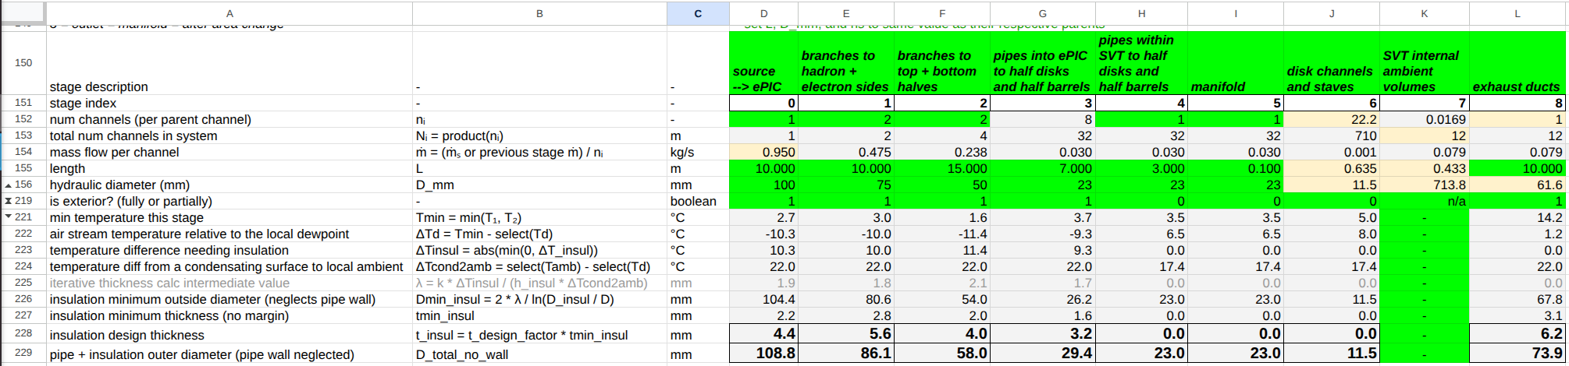
Same insulation calcs as before, but assuming:
max exterior dew point in the Wide Angle Hall is 13°C rather than 22.1°
interlock stops operation when DP > 13°C (i.e. WAH HVAC goes down)
Insulation thickness at the entrance pipes is much reduced

Slide 20
Humidity management strategy
Supply air quality: water content
≤ Class 3 (i.e. -20°C pressure dew point)
per ISO 8573-1:2010
Insulate exterior cold pipes
from air supply plant to ePIC: efficiency, good housekeeping
from exterior to SVT: prevent condensation on detectors
once inside SVT we have guarantees on air dryness
Interlock if WAH HVAC fails and/or exterior dew point above insulation design value (e.g. 13°C TBC)
If air flow shuts down while interior structures are cold…
must prevent significant backflow into system from exterior
i.e. provide high impedance (not an airtight seal) against moisture effusion
flapper valves on exhaust duct outlets
closeouts elsewhere
Air supply diverter valve
vents air to bypass outlet if fault condition
during startup no air flow to SVT until guaranteed dry
supply plant can be tested / operated / fixed without running air to SVT

Slide 21
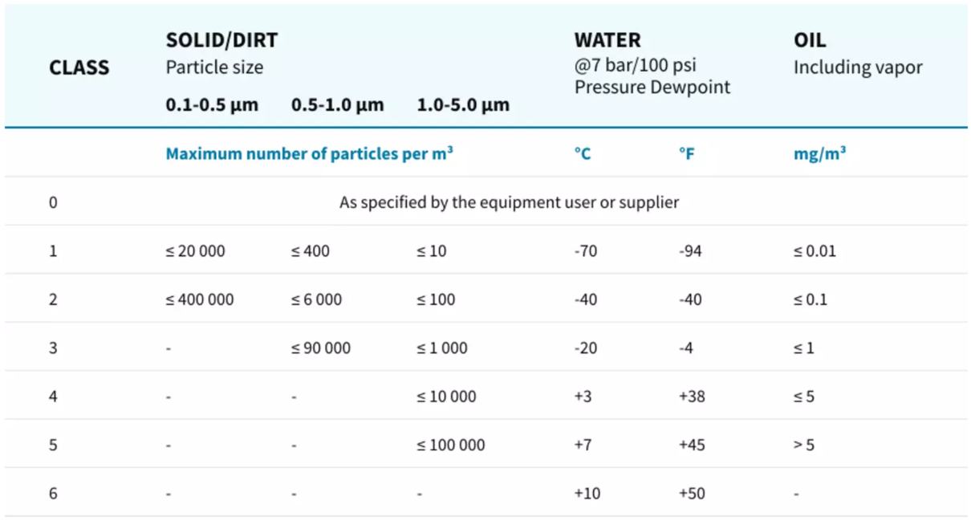
Air quality strategy
ISO 8573-1:2010 defines compressed air purity classes
Supply air quality
solid particulate: Class 1
total oil: Class 1
water: ≤ Class 3
Air supply diverter valve
vent supply air to bypass outlet for startup, air quality test, etc
Additional air filters at manifolds just outside ePIC
extra line of defense
Source: Atlas Copco

Slide 22
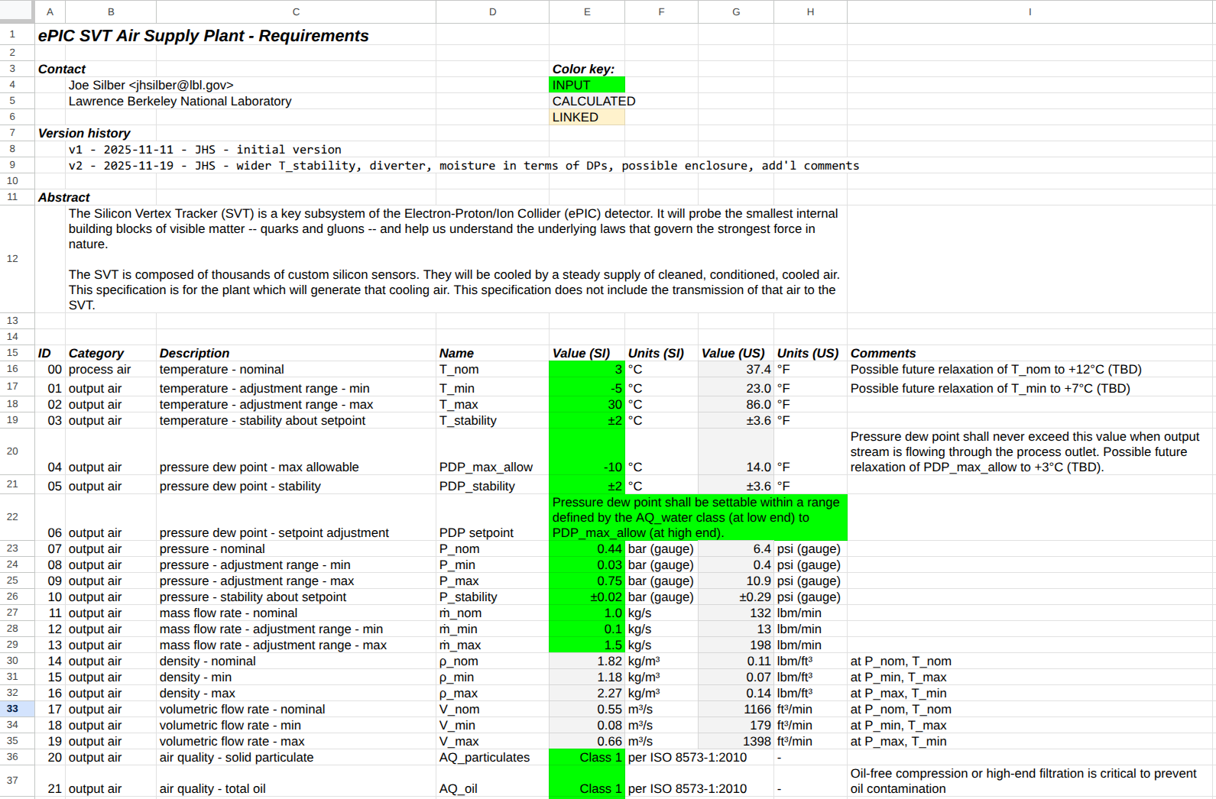
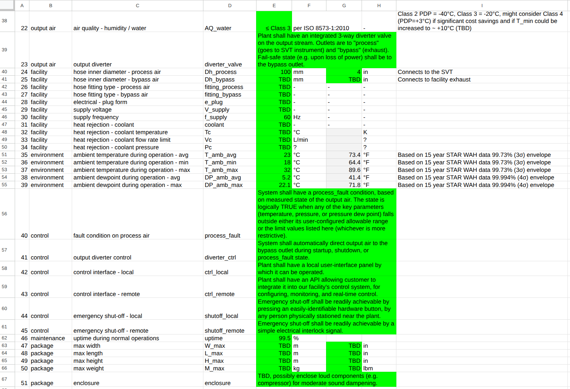
System calcs + humidity management + air quality + control considerations → detailed specs on air supply plant
Link: ePIC SVT air supply plant reqts - v2.xlsx

