Slide 1


OB Mechanics and Integration
19 December 2025
UK EIC SVT Working Meeting, University of Oxford

Slide 2
Contents
Global Integration
  OB layout changes
    Dimensions / Counts / Overlaps
  Support Cone Interface
FPC/FIB/Module mechanical considerations
  FPC width limitations
  Module Alignment
  FIB pre-attachment to FPC

Slide 3
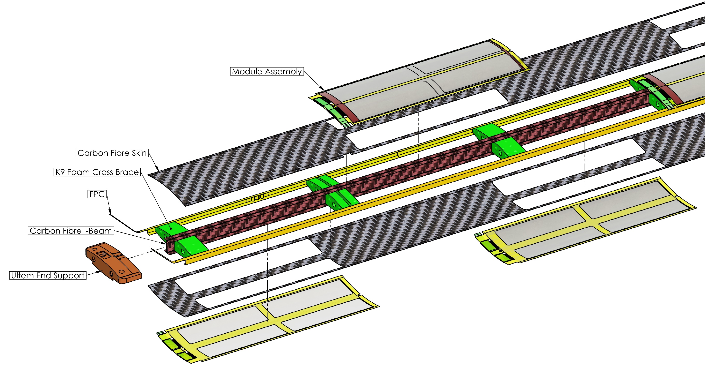
Overview of OB Stave Construction
L4 X 8 Modules (5 RSU)
L3 X 4 Modules (6 RSU)
AncASIC & LEC backed by K9 foam
Kapton carrier and bridge FPC may be combined in module assembly
Out of date diagram - FPC design & end supports have changed

Slide 4
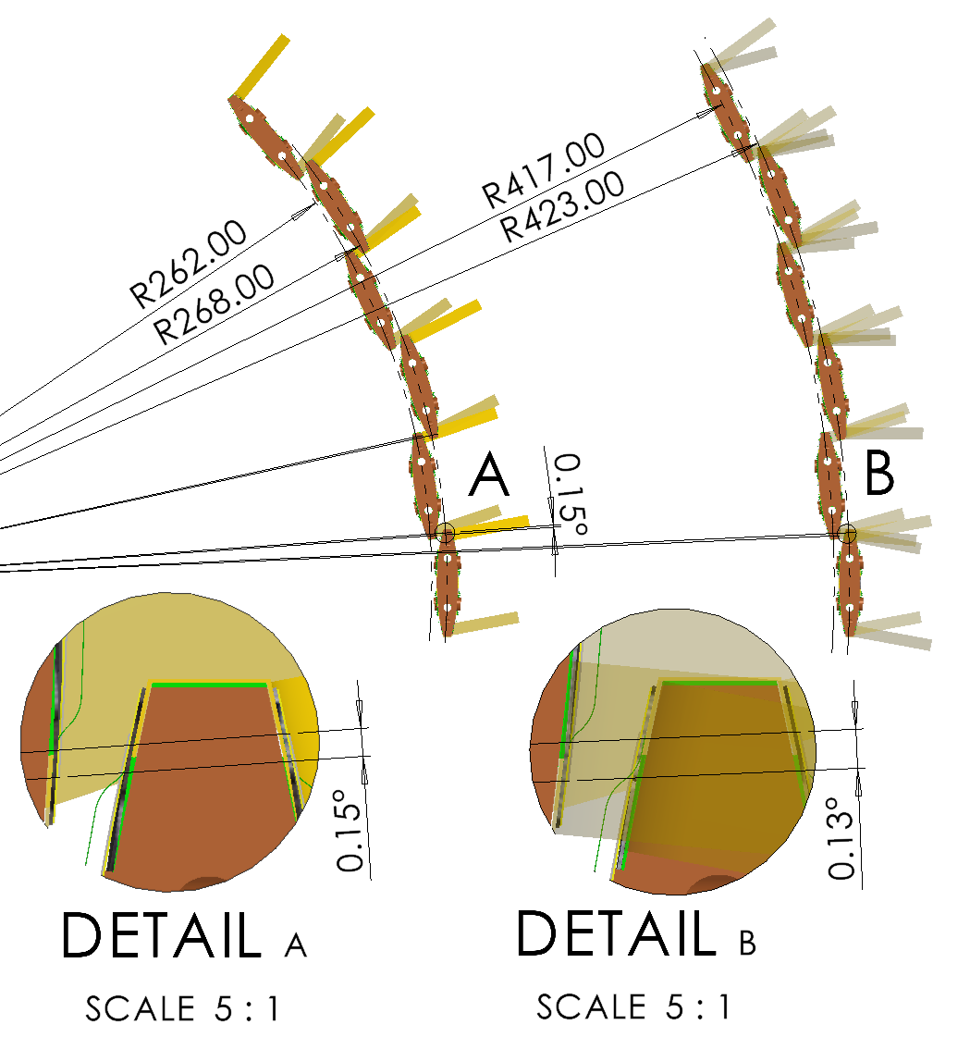
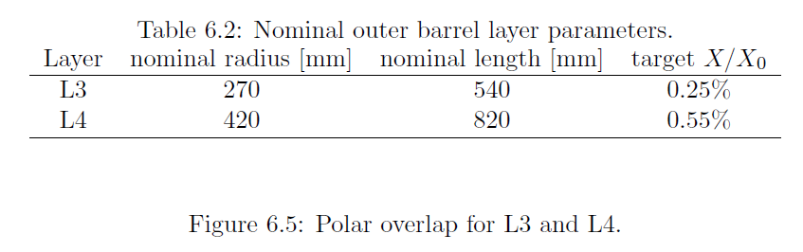
OB Layout and Stave Counts
L3 radius reduced (by 5 mm) to give overlap in azimuthal direction (Sept 2025)
  Radii now 262 mm & 268 mm
  44 Staves shown in figure, gives similar overlap to L4
  Active length reduced by 10 mm (Z overlap 5.7 mm)
  Overall length now 550 mm (active length 503 mm)
L4
  Radius 417 mm & 423 mm
  70 Staves
  Overall length 840 mm (active length 793 mm)

Slide 5
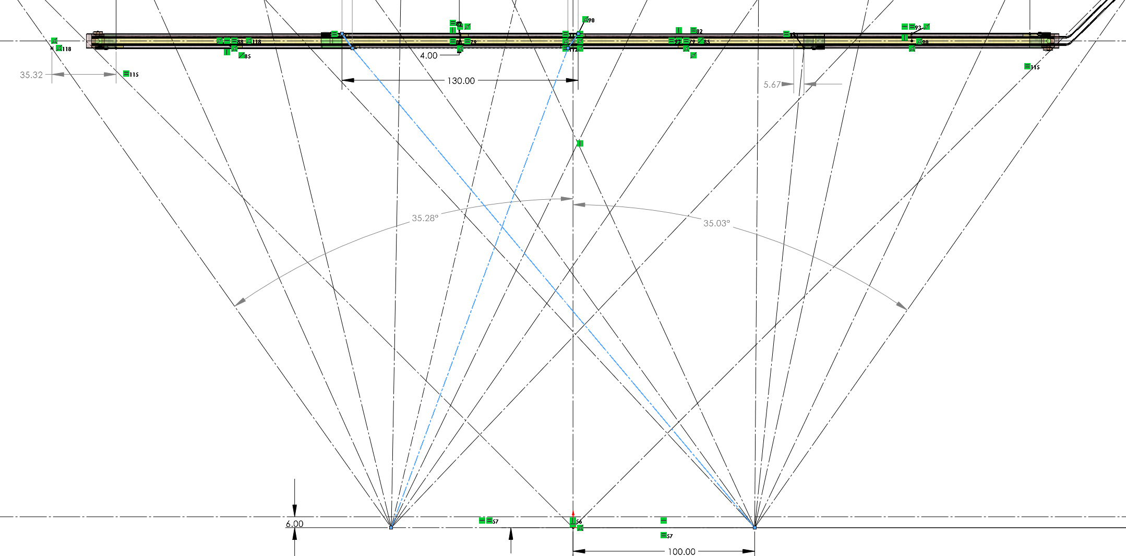
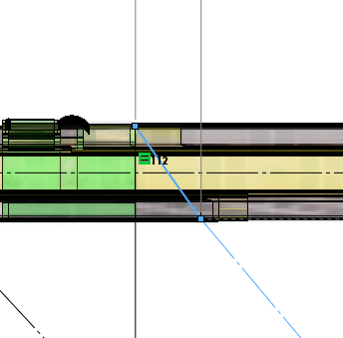
Overlap L3
L3 active length decreased by 10 mm
  Z Overlap of 5.67 mm (equal between modules)

Slide 6
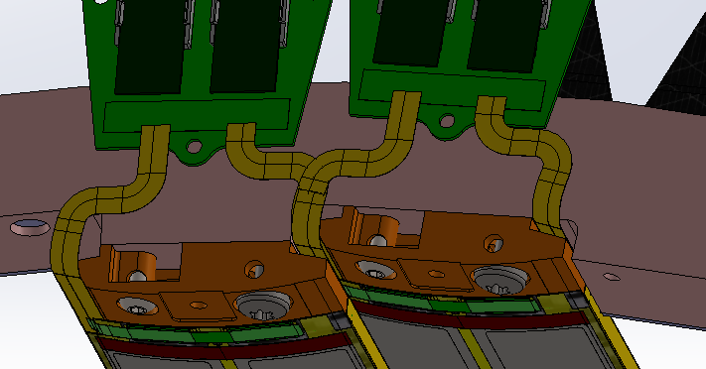
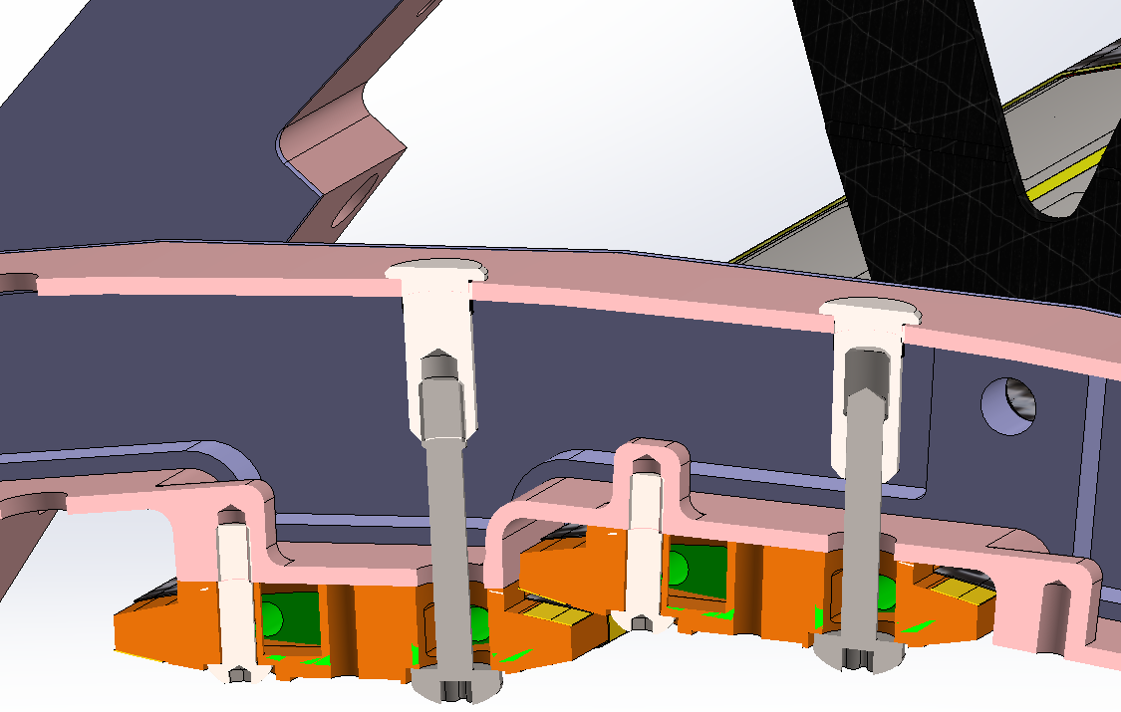
Global Integration – Stave End Support
FIB
Stave end has been redesigned to suit half barrel manifold
  End support interface flattened
  Annular flow gap around mounting screw for air inlet
    Area ratio of 1:4 between inlet and stave cross section
    Typical flow velocity at inlet around 40 m/s
  End support set up for counter current flow
  Outlet exhausts in Z direction
    Sufficient room at stave end for flow redirector/diffuser
    Could flow exhaust gases in the direction of the VTRX+ to provide some basic forced convection
Exhaust
Inlet

Slide 7
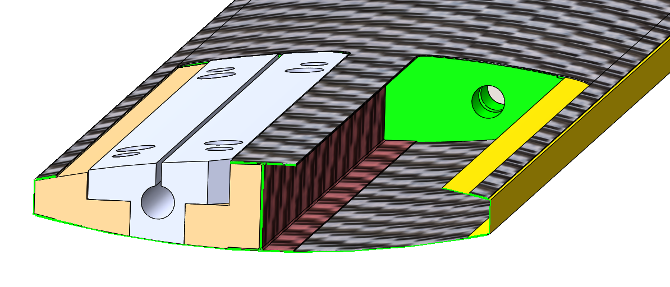
Stave Internal Layout – FPC Considerations
Hollow structure achieved through interlocking internal tooling segments
Current mechanical FPC prototypes differ from electrical FPC prototypes
Internal tooling design limits the maximum internal overhang & width of the FPC to 6 mm
Limitation applies only in region with tooling removal aperture (under EIC-LAS RSU), FPC can be wider where bridge FPC bond pads mount
Design refinement could increase the maximum allowable FPC width to ~8 mm
6 mm
6 mm
EIC-LAS
K9 Foam
FPC

Slide 8
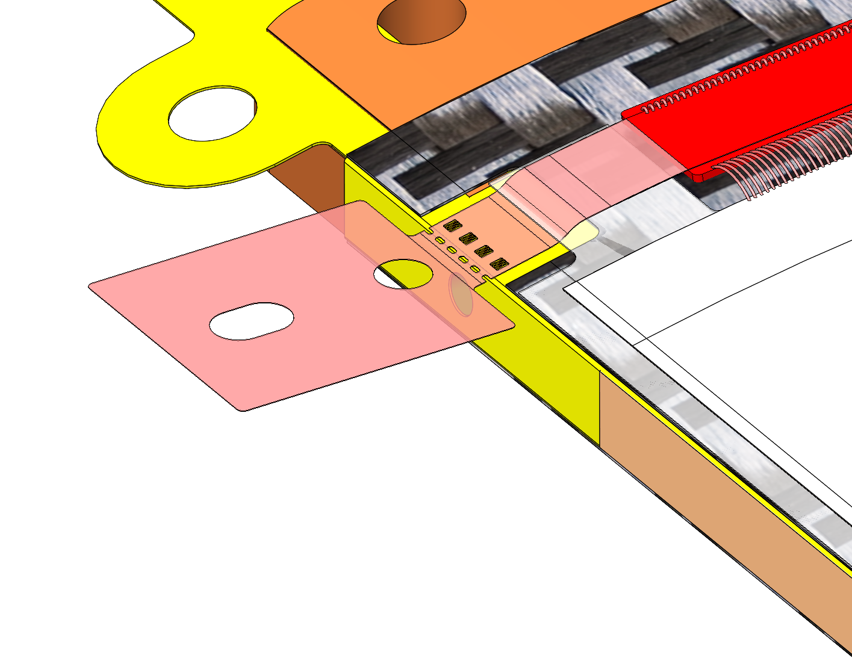
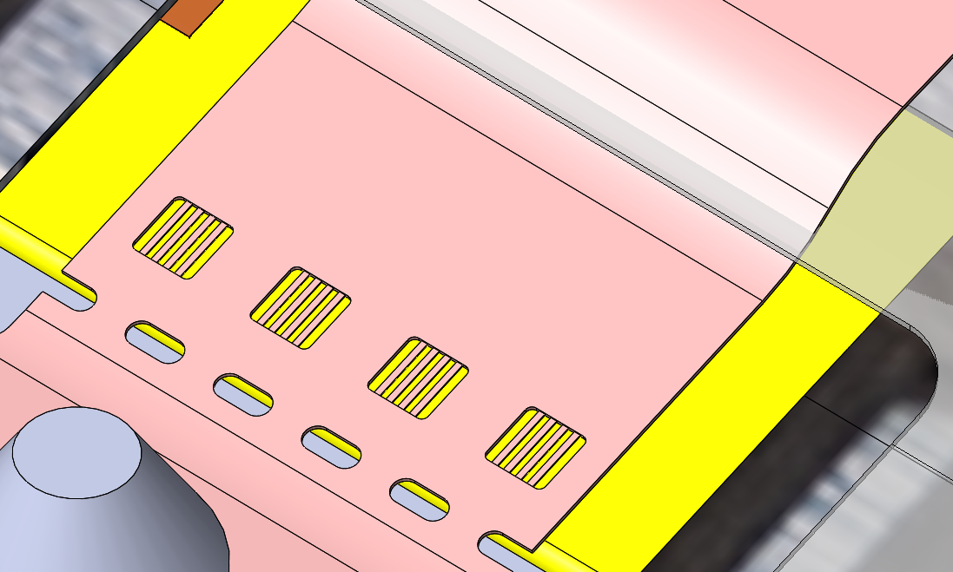
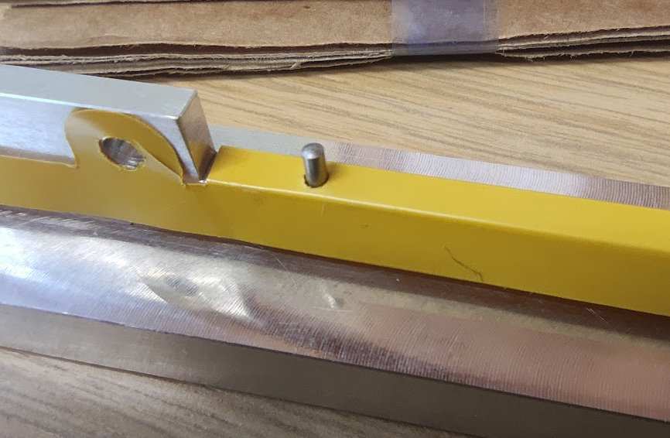
FPC to Module Alignment
spTAB require FPC to bridge FPC alignment of ±0.025 mm (25 microns)
Module will be aligned based on local reference features on the FPC instead of a global module alignment
Module positional tolerance may be an order of magnitude higher
Prototypes for FPC have alignment pins on the side aligned in Z with the FPC bond pad locations, tooling will align the bridge FPC sacrificial alignment features to the FPC

Slide 9
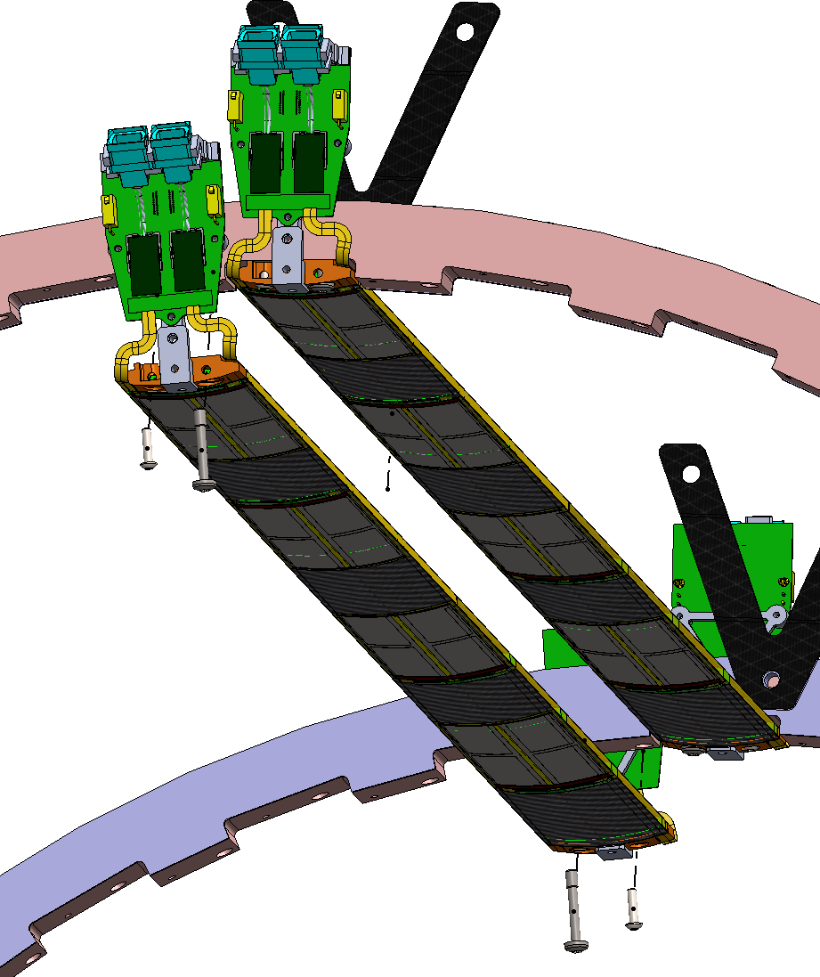
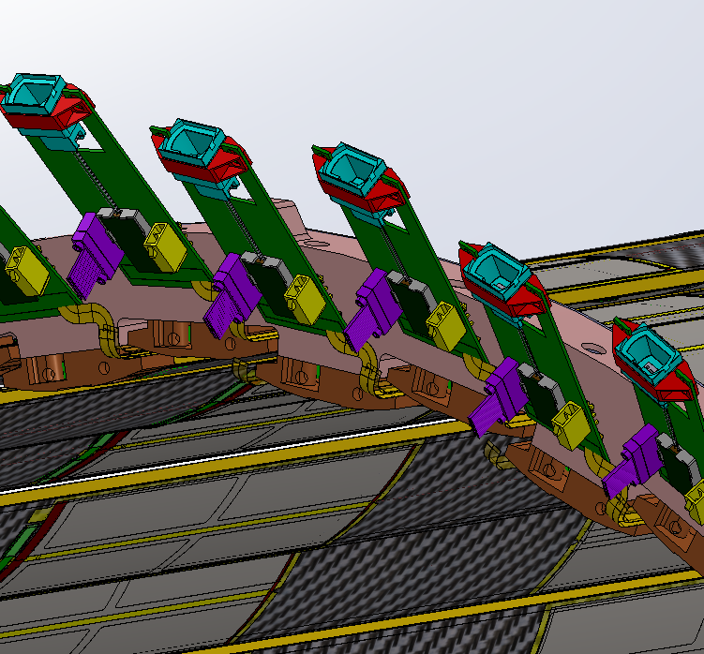
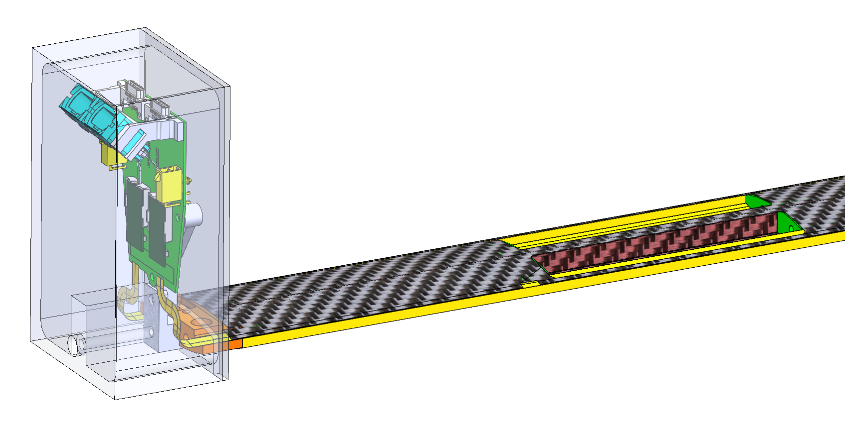
FIB/FPC Interface
FPC will be pre-attached (soldered) to FIB before stave structure
FIB will be held in its final position relative to the stave during the autoclave cure & installation
  Enclosure protects FIB during whilst in autoclave
  Load transfer from tooling to manifold during installation
VTRX+ Removed
L4 FIB
L3 FIB

Slide 10
Questions

Slide 11
Additional Slides

Slide 12
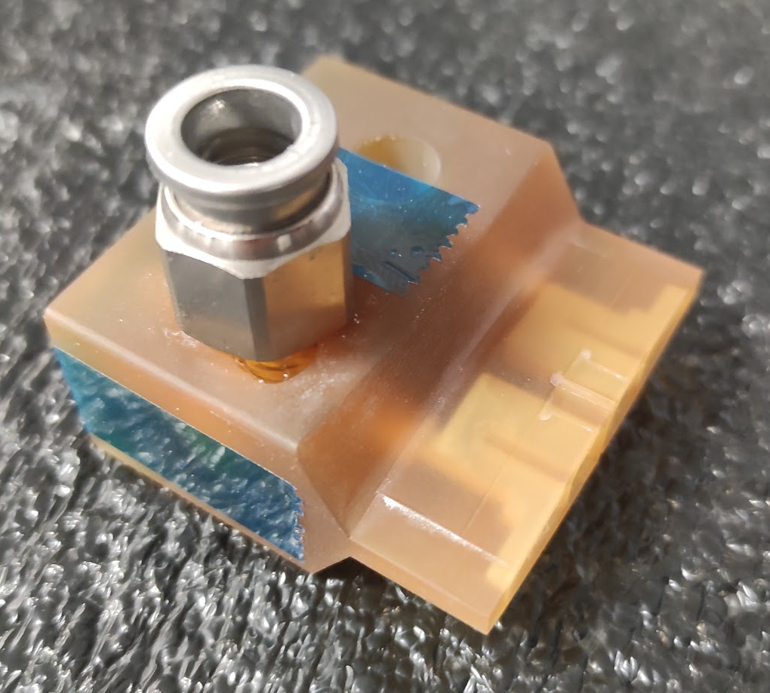
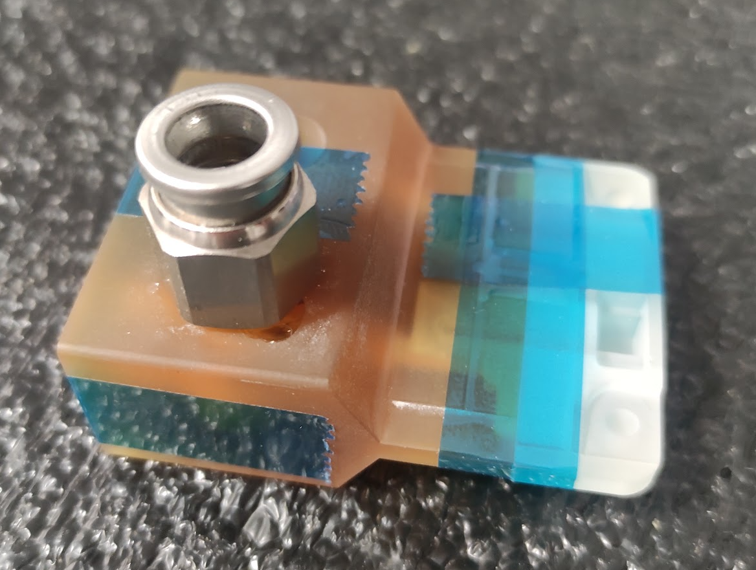
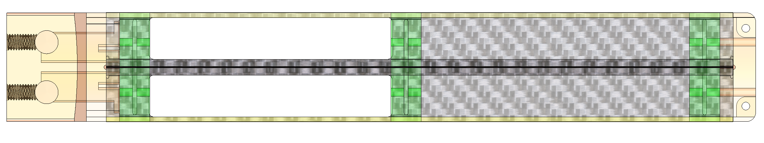
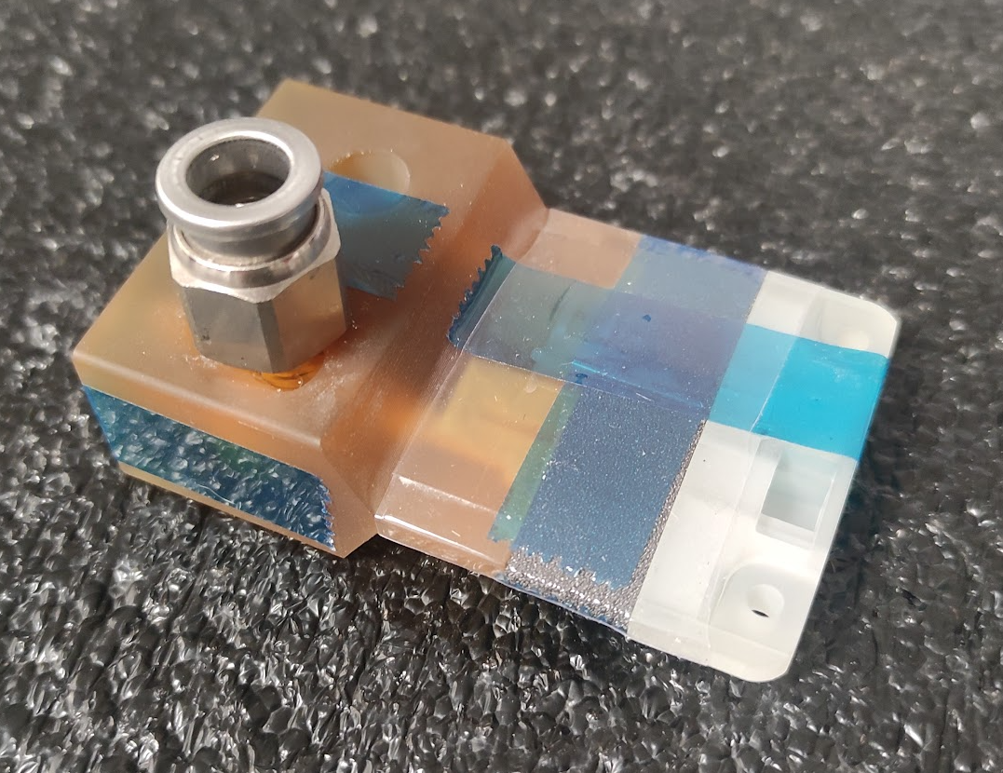
Pressure Loss Contributions
Subassemblies used to isolate contribution
59 ltr/minute pressure drop contributions
  Inlet - 0.124 bar
  K9 Foam – 400 Pa
  Outlet – 400 Pa
Scaled for full L4 stave
  Pressure at first K9 foam block
    59 lpm → 0.062 Bar
    Scaled to 110 lpm → 0.207 bar
Inlet Block
0.0216 Bar
Inlet & Outlet Blocks
Inlet, Outlet & K9

Slide 13
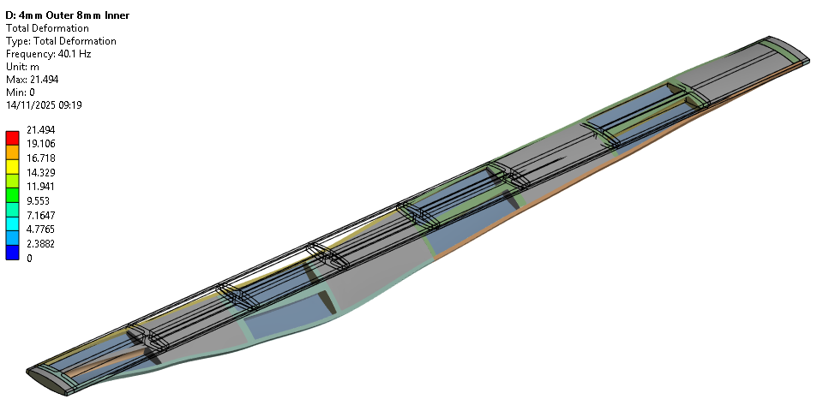
Modal Analysis – Open Structure 0.1mm face sheet

Slide 14
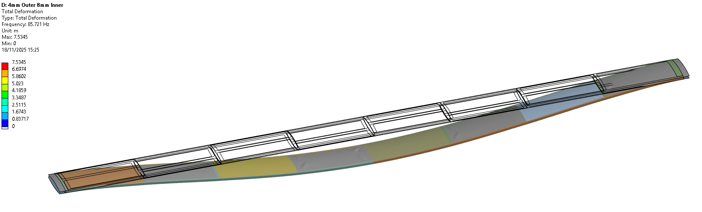
Modal Analysis – Closed Structure 0.1mm face sheet

Slide 15
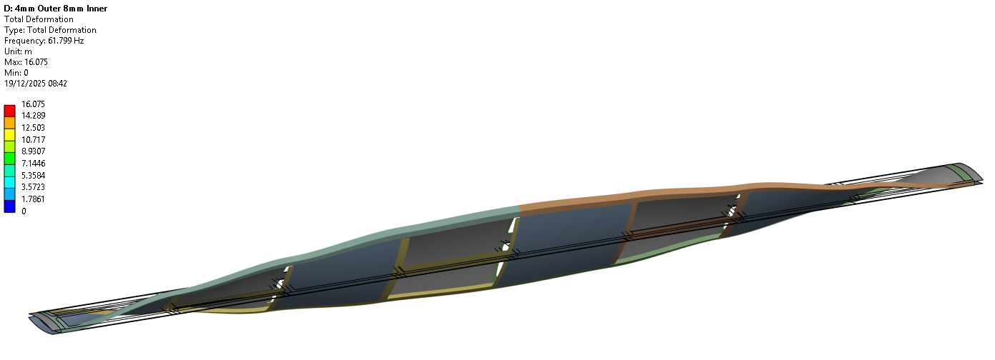
Modal Analysis – Open Structure 0.15mm face sheet

Slide 16
Mass & Radiation Length
ITEM NO. | PART NUMBER | Material | DENSITY(kg/m^3) | MASS(g) | QTY. | TOTAL VOLUME | TOTAL MASS (g) | X0(cm) | X/X0
1 | Cross Brace | K9 Carbon Foam | 200 | 0.41 | 9 | 1.85E-05 | 3.69 | 260.82 | 0.02%
2 | Longerons | 8% Rel Vol Aluminium Foam | 216 | 1.66 | 1 | 7.69E-06 | 1.66 | 296.5666667 | 0.01%
5 | Mid Brace | 3% PRV Foam | 45 | 0.10 | 8 | 1.78E-05 | 0.8 | 644 | 0.01%
6 | Carbon Top Plate | Carbon Fibre | 2000 | 4.14 | 2 | 4.14E-06 | 8.28 | 19.32 | 0.07%
7 | ALICE SENSOR ASSEMBLY | Silicon | 2330 | 0.50 | 8 | 1.70E-06 | 3.961072 | 9.37 | 0.06%
9 | Kapton FPC - 2-4 | Kapton | 1420 | 0.85 | 2 | 1.19E-06 | 1.693468 | 28.57 | 0.01%
10 | MirrorLongerons |  | 216 | 1.66 | 1 | 7.69E-06 | 1.66 | 296.5666667 | 0.01%
11 | Kapton FPC - 1-3 | Kapton | 1420 | 0.70 | 2 | 9.86E-07 | 1.4 | 28.57 | 0.01%
12 | Stave End Gas Feed | Ultem | 1280 | 0.84 | 1 | 6.56E-07 | 0.84 | 28.57 | 0.01%
13 | Stave End Gas Feed | Ultem | 1280 | 0.92 | 1 | 7.19E-07 | 0.919726 | 28.57 | 0.01%
 |  |  |  |  |  | Total Mass | 24.90 | Total Radiation Length | 0.21%
EXCLUDES CONTRIBUTIONS FROM FPC,BRIDGE FPC OR ASIC

Slide 17
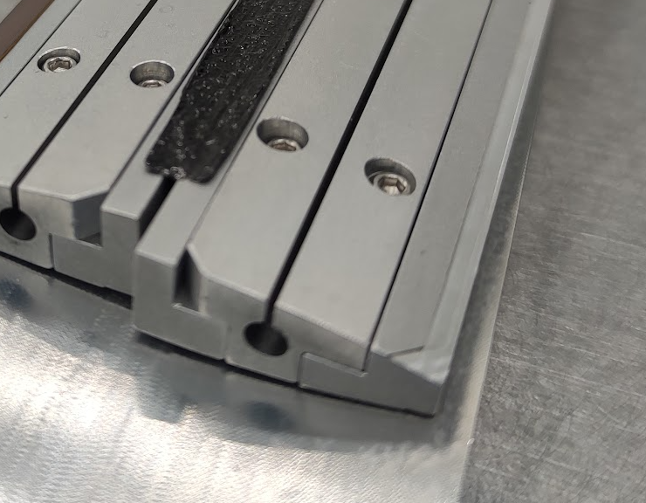
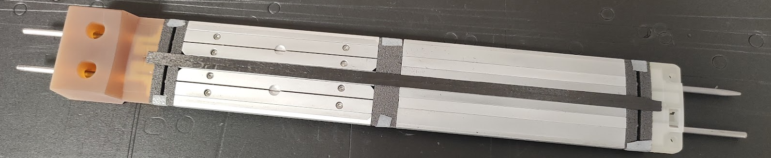
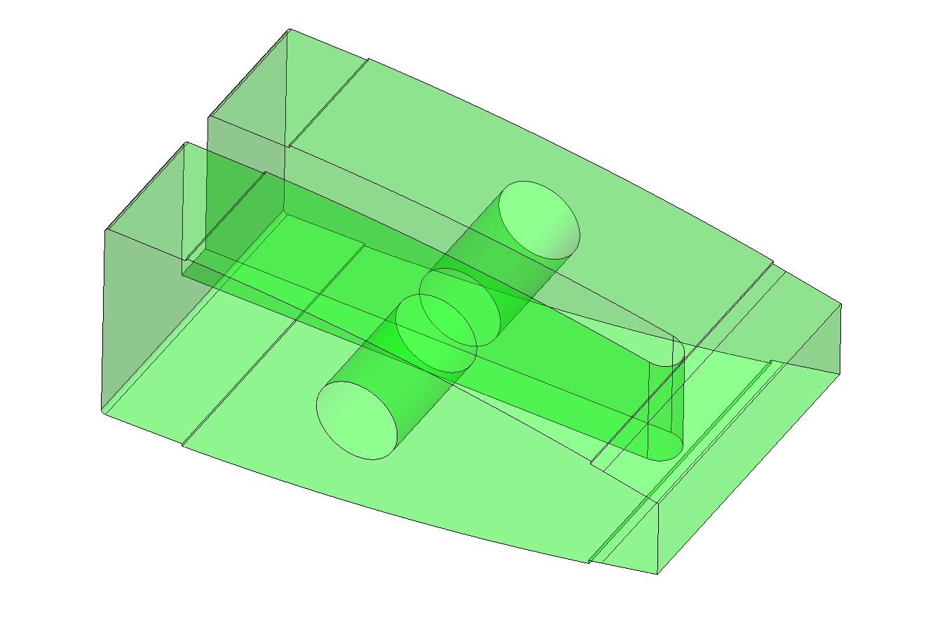
Stave Inner Structure
Aluminium Internal Formers
K9 Foam Heatsink
⌀ 3 mm Silver Steel rods

Slide 18
