Slide 1


OB module prototyping
Prepared with input from Birmingham, Daresbury, Liverpool, and Oxford
Jian Liu
on behalf of the OB Module Team
19 December 2025
UK EIC SVT Working Meeting, University of Oxford

Slide 2
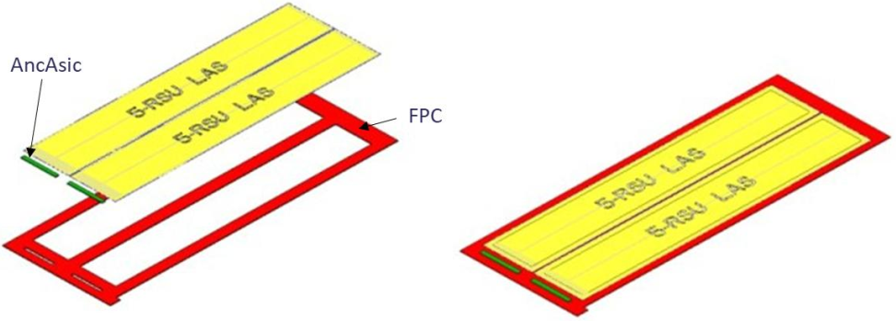
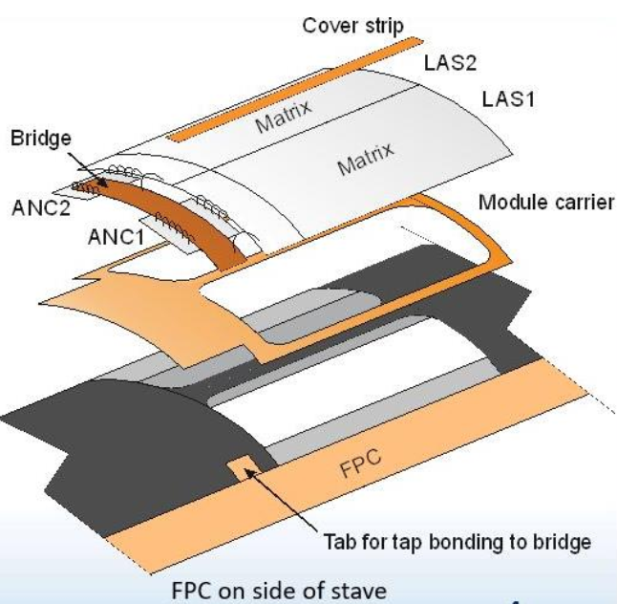
Module concept
Module description
2 LAS
2 AncASIC
1 FPC
Glue Si dies to FPC
Wire bonding Si dies to FPC
Currently working on prototyping for flat module assembly
Adapting this concept to a curved stave would require
  Updates to the assembly jigs to match the curvature
  Fabrication of the module in a curved geometry
Updates covered today
Interconnection
Prototyping jigs
Dummy silicon parts

Slide 3
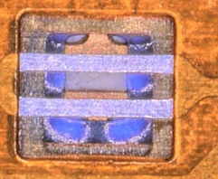
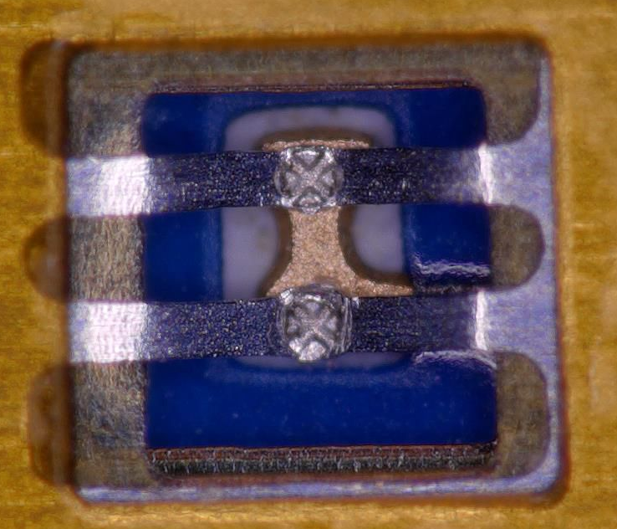
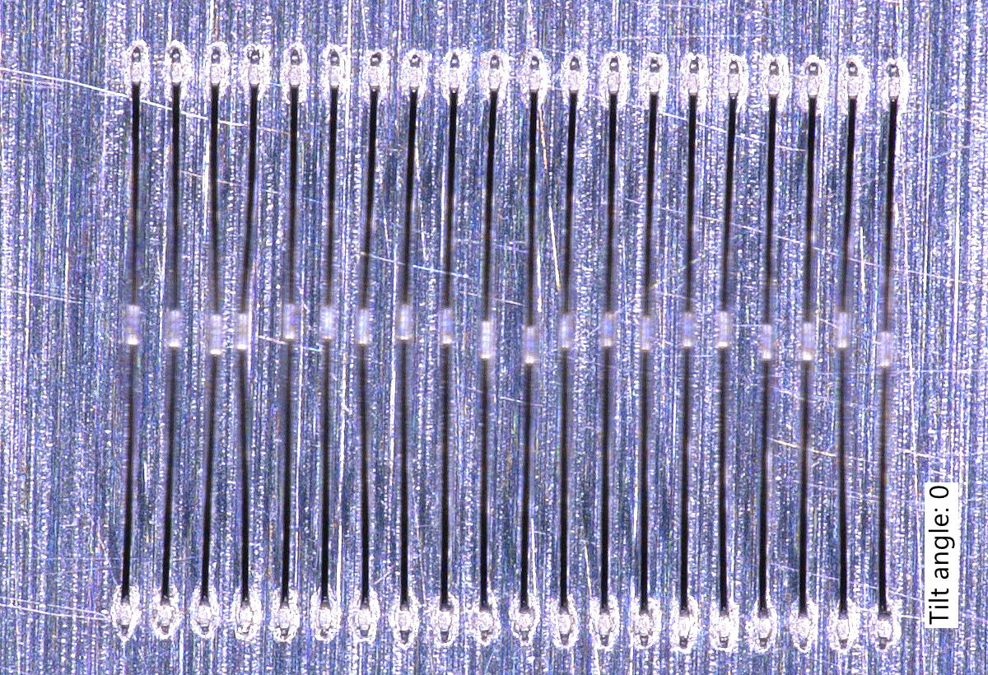

Interconnections
Wire bonds
  Sensor → module Bridge-FPC
  AncASIC → module Bridge-FPC
spTAB
  Bridge-FPC → Main-FPC

Slide 4
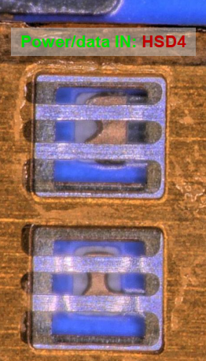
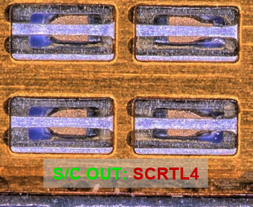
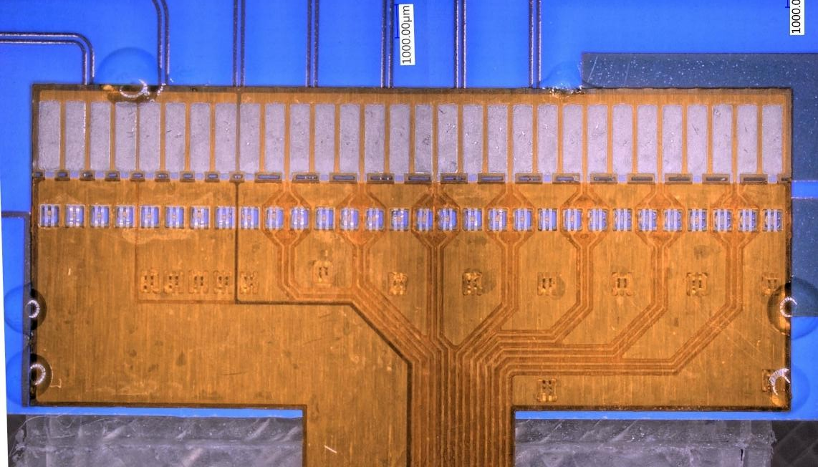
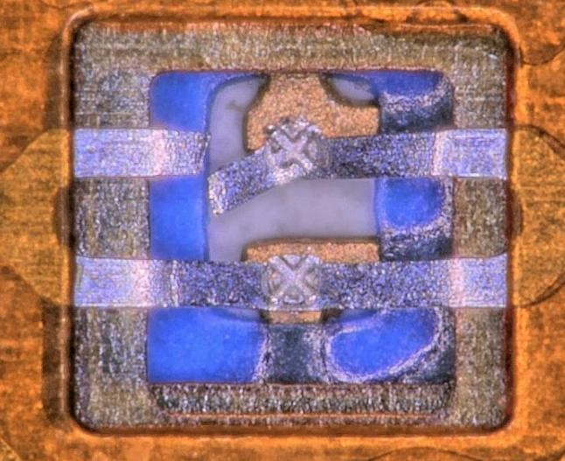
spTAB – 1st trials
Initial setup
  First-generation FPCs, PCBs, and jigs
  Early optimisation of bonding parameters
  Initial mounting procedure development
Goal
  Establish feasibility of spTAB bonding
  Identify critical mechanical and process limitations
Errors identified
  Differential lines did not align as expected
    FPC mounted upside down
    Aluminium foil stretched more than designed
    Bonding performed on top foil layer instead of bottom
    Consequence
      Foils pushed close to mechanical limits
      Significant damage to aluminium traces
Key findings
  FPC–PCB alignment is critical (~50 µm tolerance)
  Step height between FPC and PCB must be minimised
PCB differential lines
FPC differential lines
Bond trials (here)
Initial PCB mounting (here and here)

Slide 5
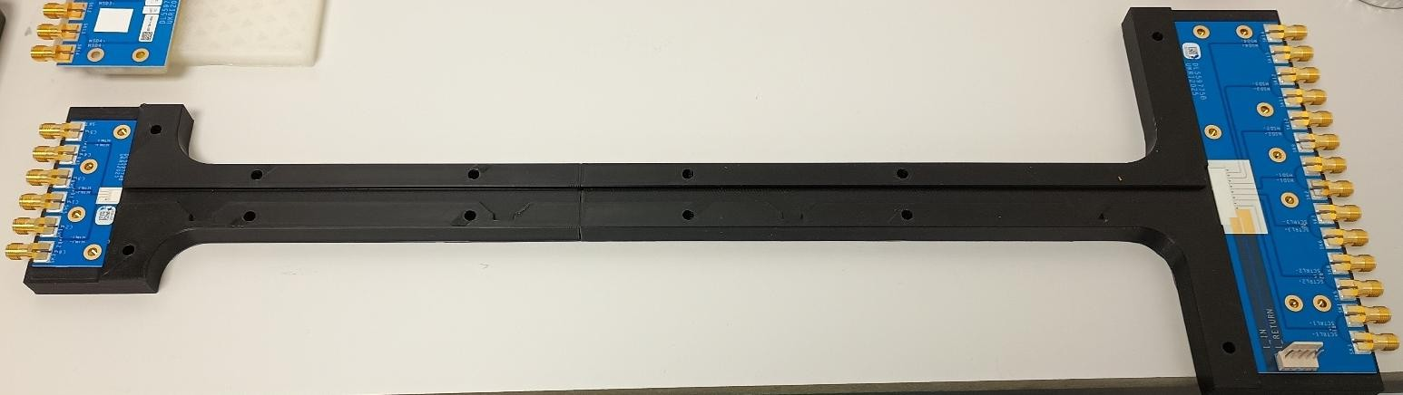
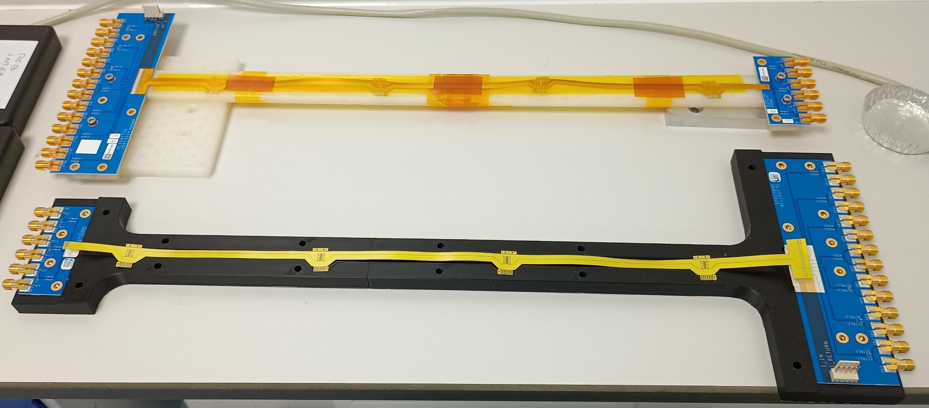
spTAB with updated design
Updated jig from
  Updated jig ensures the FPC fits only in the correct orientation
Updated PCBs
  Solder resist removed beneath the FPC
    Minimises height difference between FPC aluminium layers and PCB pads

Slide 6
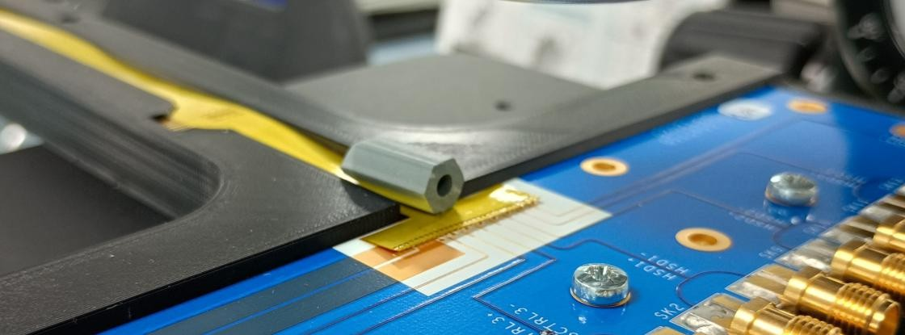
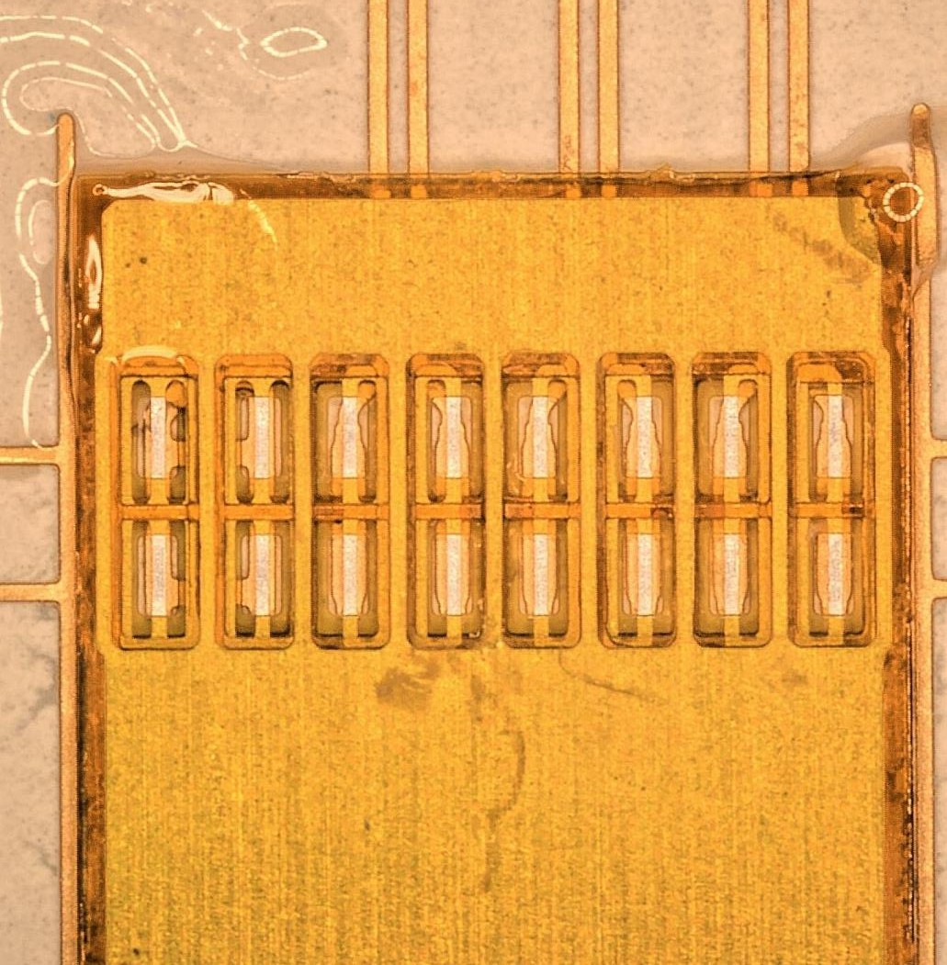
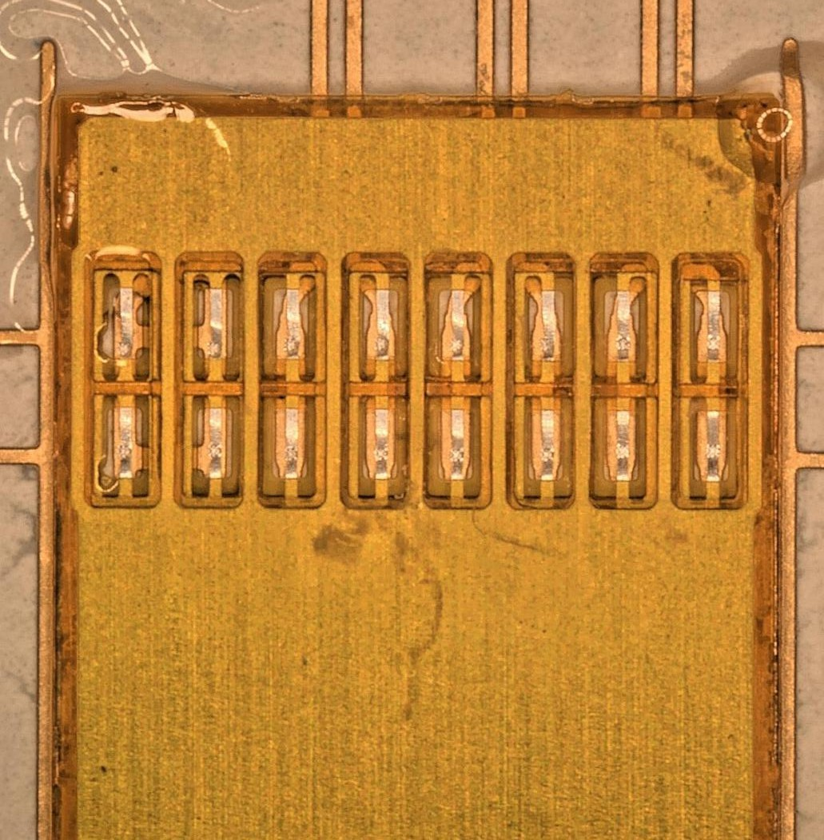
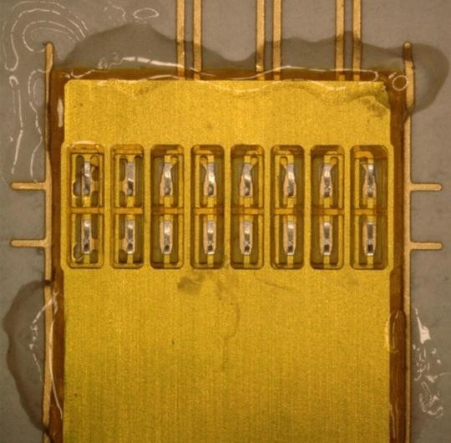
spTAB – 2nd trials
Assembly approach
  Nylon stand-offs used as weights to improve FPC alignment
  UV-curing glue dots used to hold FPC flat during bonding
  Additional glue applied along FPC edges after bonding
Bonding successful, no visible damage, and basic electrical continuity confirmed

Slide 7
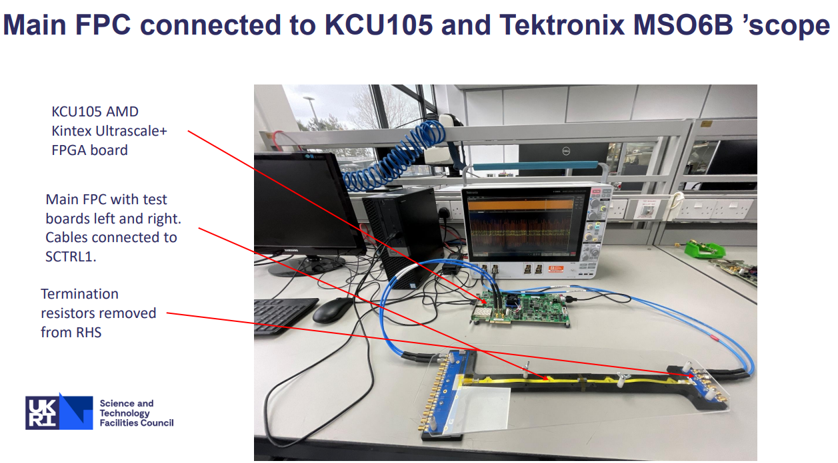
Main-FPC
The assembled M-FPC is currently under testing (see the report presentated on Monday)

Slide 8
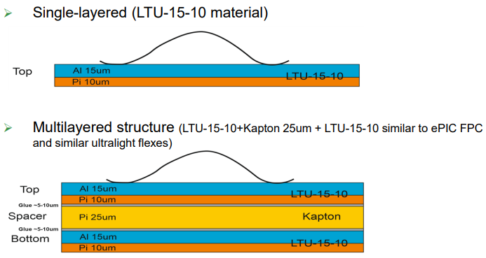
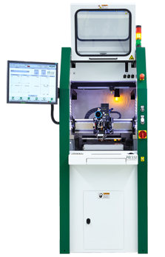
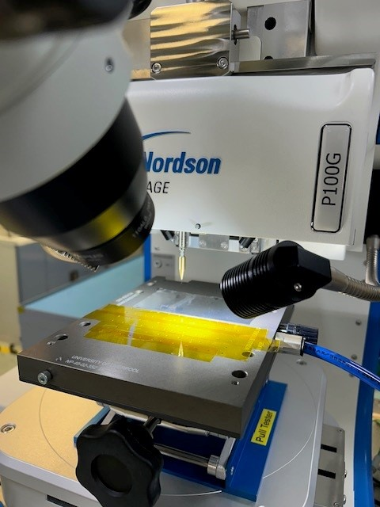
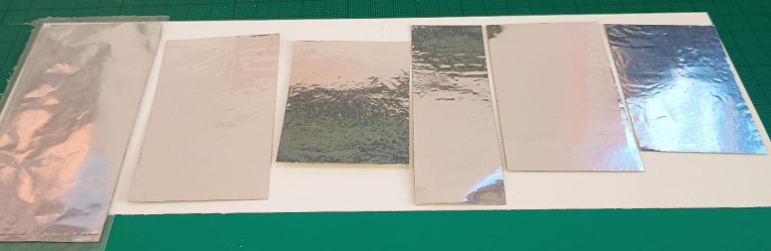
Wire-bonding on the foils
Two types of foils from LTU received in March (details see the presentation by LTU)
Equipment used in Liverpool
  Hesse BJ820 Wire Bonder
  Dage 4000 Pull Tester

Slide 9
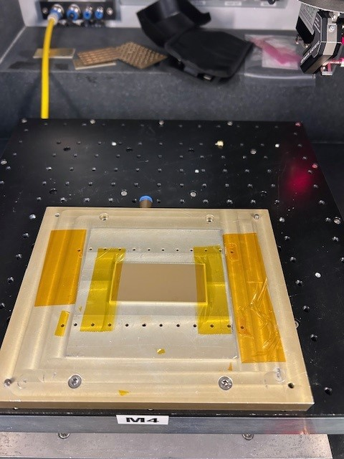
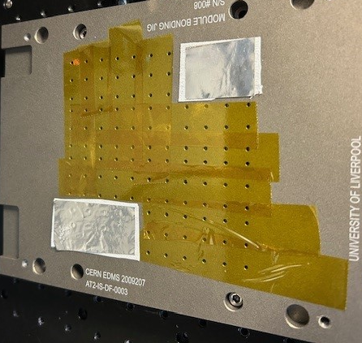
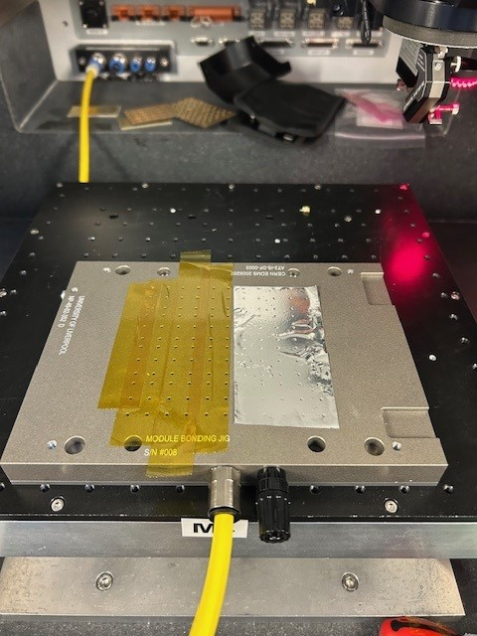
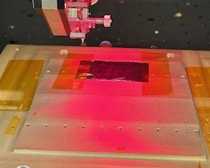
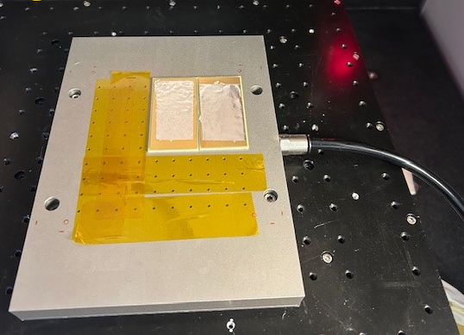
Wire-bonding configurations
Substrates
Gold boards (reference)
Single-layer and multi-layer aluminium foils
Mounting methods
Taped flat (no vacuum)
Vacuum-mounted directly to jig
Vacuum-mounted to foils glued on FR4 PCB
Vacuum-mounted using a diffuser
Cleaning
Safewash (default)
Acetone
Methanol
Wires
CCC (used only in initial tests): Al-1%Si, 25 µm diameter, EL % 1-4, TS 15-18g
Heraeus (default): Al Si-M, 25 µm diameter, EL > 1%, BL 15-17 cN
Heraeus H74-41 (softer): Al 25µm, AlSi-S, EL 1,0-4,0%, BL 14-16g
Gold board
Foils on jig
Taped foil
Foils with diffuser
Foils on PCB

Slide 10
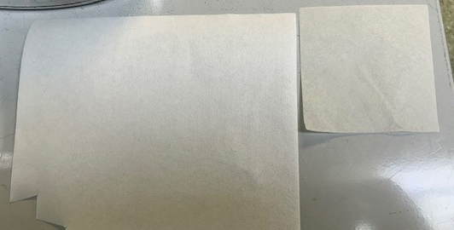
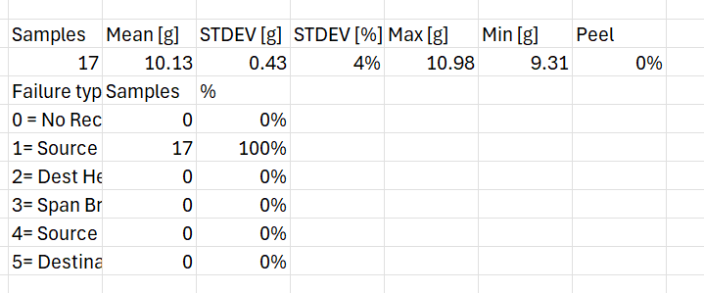
Bonding parameter
Standard settings
  Ultrasonic: 22%
  Bond force: 22 cN
  Deformation: 40%
  Overtravel: 25 µm
25 µm wire with 100 µm spacing, 1500 µm bond length → ~30° pull angle
Two diffuser types
  Thick (0.225 mm) and Thin (0.068 mm)
A gold reference board was bonded to establish baseline pull strength and standard deviation
Gold board

Slide 11
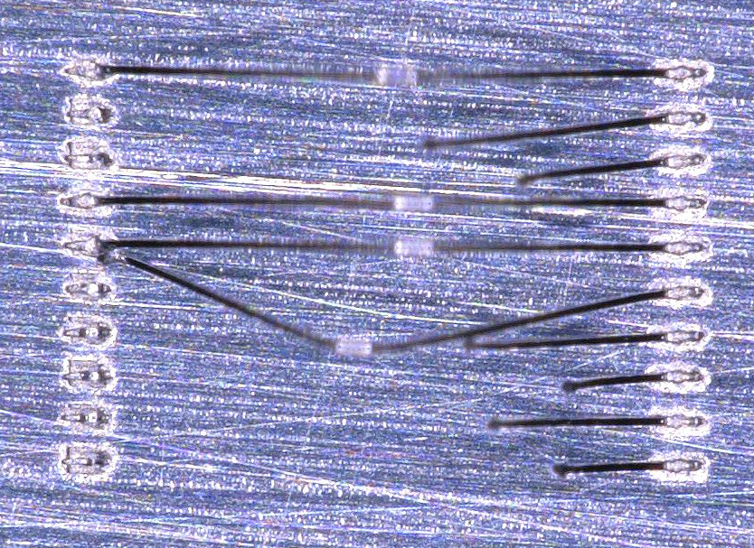
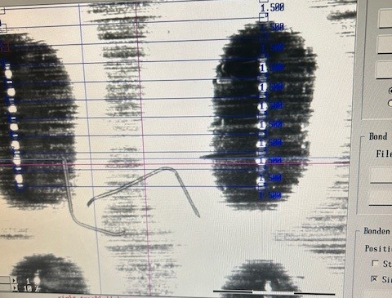
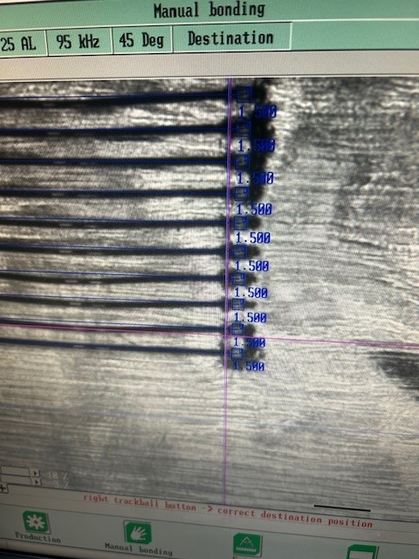
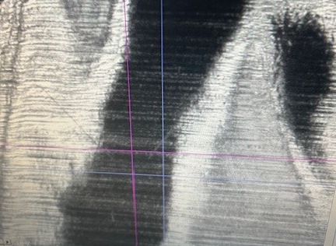
Wire-bonding failures
Bond force or ultrasonic power below 22 resulted in high failure rates
Thick diffuser on single-layer foils
  Dark rings observed around many bond feet
  Indicates insufficient local support
  Suggests suboptimal vacuum contact
Thin diffuser
  Significantly fewer wire failures
  Dark regions around bond feet disappeared
  Residual shadow on single-layer foil
    Indicates incomplete vacuum flattening
Maintaining flatness is challenging for single-layer foils due to flexibility

Slide 12
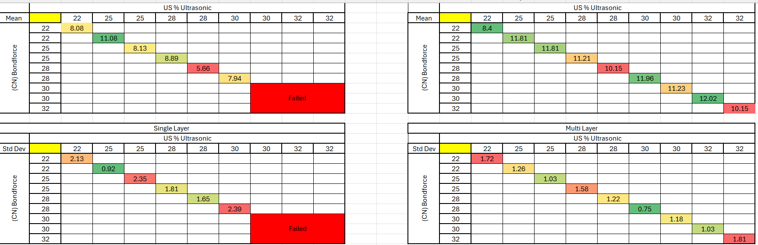
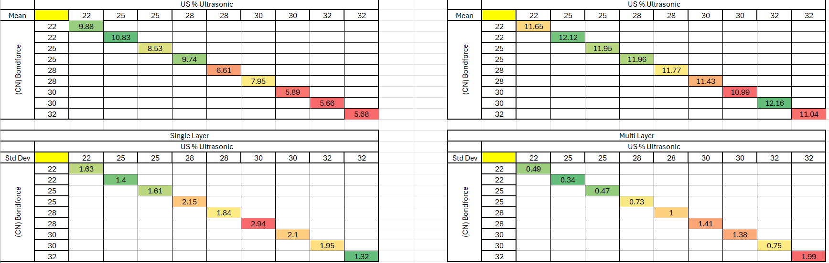
Pull test matrix with the thinner diffuser
Initial test
Thin diffuser provided a significant improvement over the thick diffuser
Single-layer foils
  Failures still observed at higher parameter settings
Multi-layer foils
  Performance remained good
Results validated with repeated testing
Detailed results can be found here.
Repeated test

Slide 13
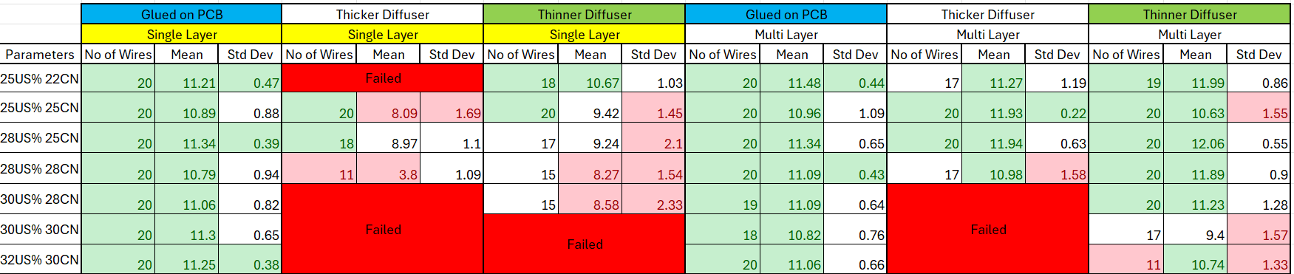
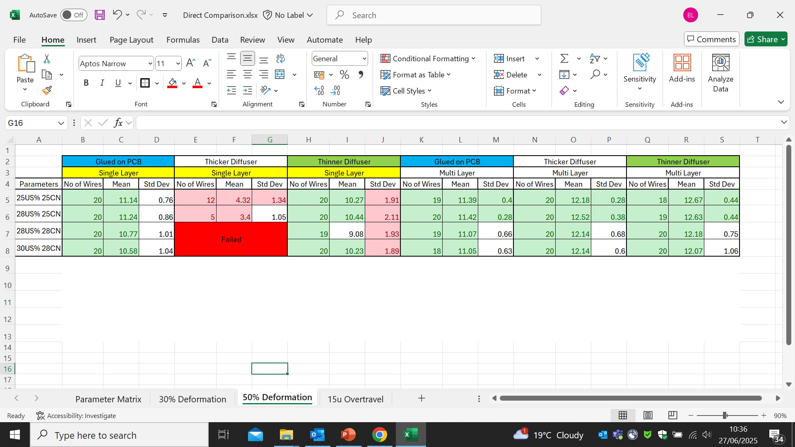
Wire-bonding comparison
Better bonding quality when foils were glued to the PCB
The thinner diffuser significantly improved bonding quality, though some stability challenges remain
Multi-layer foils consistently offered easier and more reliable bonding, regardless of method
The tests demonstrated that acceptable mean strength and standard deviation values can be achieved
15 µm Overtravel
50% Deformation

Slide 14
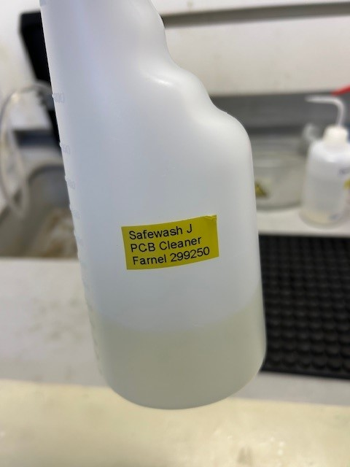
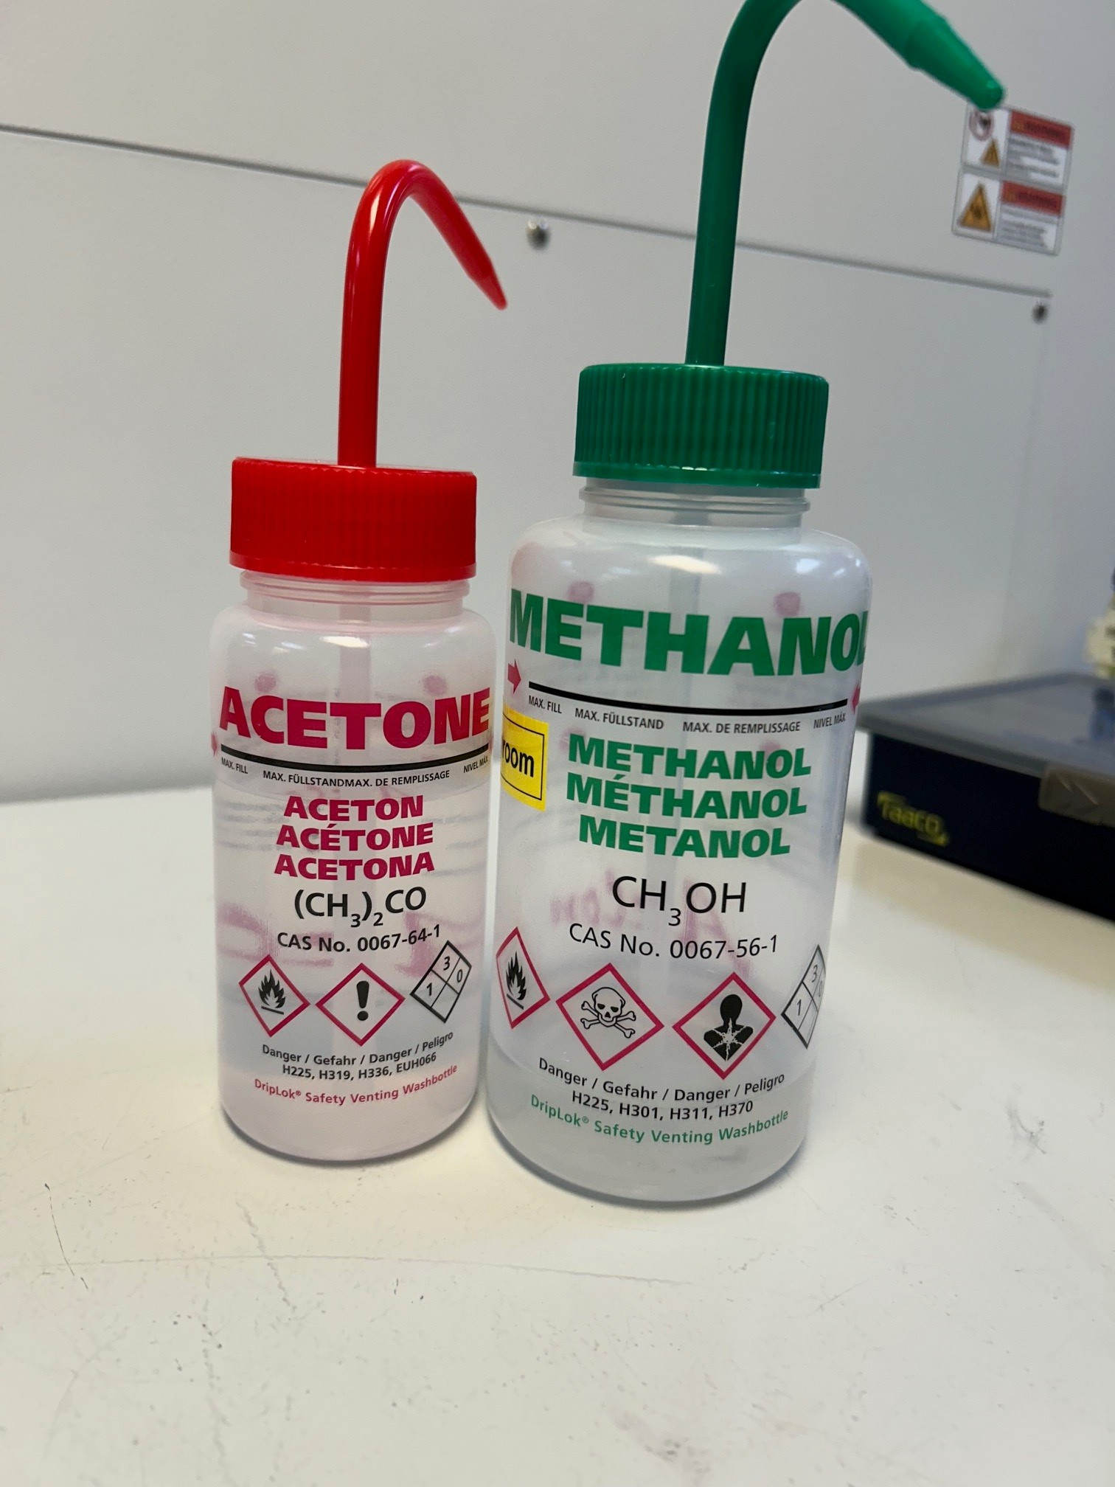
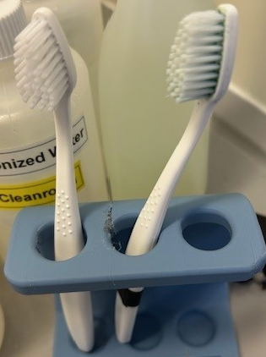
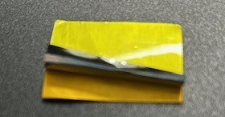
Cleaning
Cleaning solvent
  Safewash (PCB cleaning agent)
  Acetone (recommended by LTU)
  Methanol (used for some ATLAS module frames)
A soft toothbrush was used to gently clean the surface and remove residues such as fingerprints
Standard PCB cleaner previously used is unsuitable due to foil fragility
Delamination was observed in the multilayer foil during the cleaning process!
  Most likely caused by the drying process with the compressed air gun → should be avoided

Slide 15
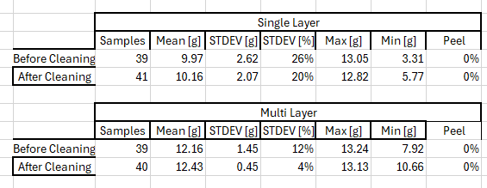
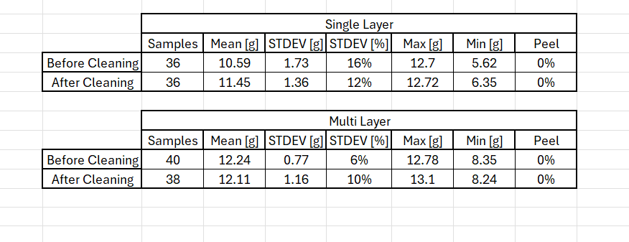
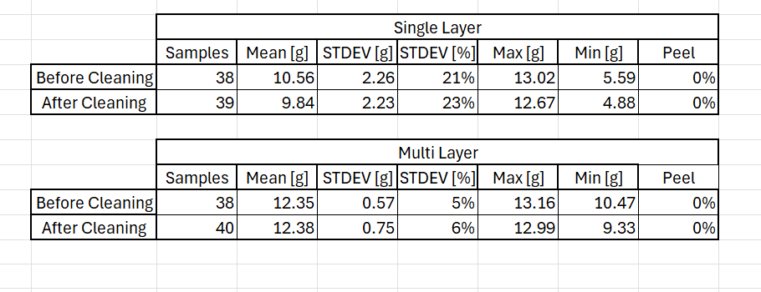
Cleaning comparison
Safewash
Acetone
Safewash appears to be the most effective cleaning method
No significant difference is observed before and after cleaning with acetone or methanol
Note
  The observed impact depends on the initial condition of the foil, and the tests were performed over several months
Methanol
Bonding parameters with the thin diffuser (0.068mm)
Overtravel 25 µm
Deformation 50%
Ultrasonic % - 25%
Bondforce 25 CN

Slide 16
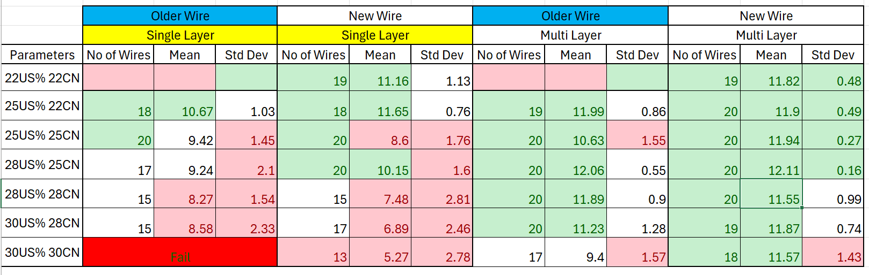
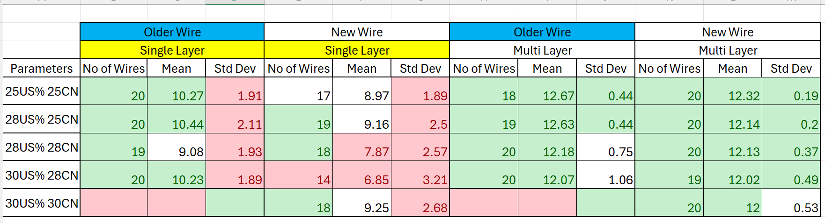
Wire comparison
Heraeus (default, older): Al Si-M, 25 µm diameter, EL > 1%, BL 15-17 cN
Heraeus H74-41 (softer, new): Al 25 µm, AlSi-S, EL 1,0-4,0%, BL 14-16g
15 µm Overtravel
50% Deformation
Tests performed using the thin diffuser (0.068mm)
No major difference between the default and the softer wire

Slide 17
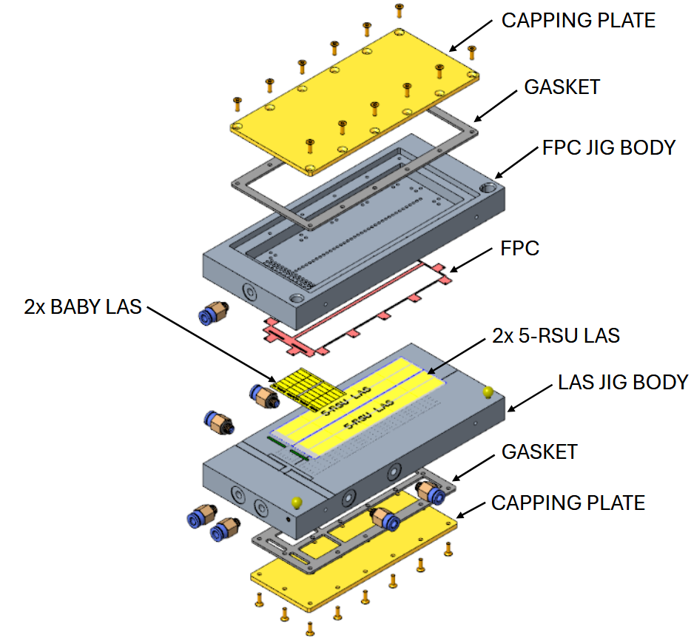
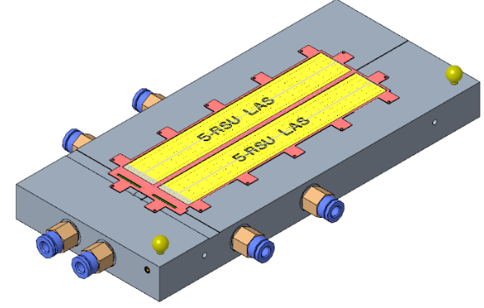
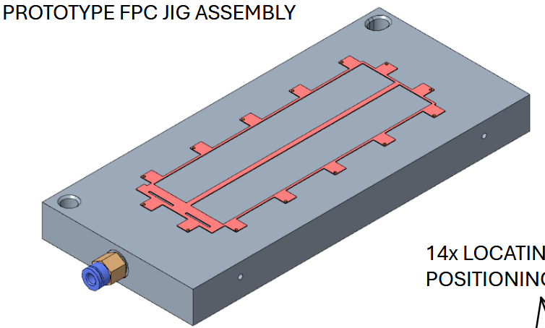
Prototyping jigs
Design completed in October
LAS jig
FPC jig

Slide 18
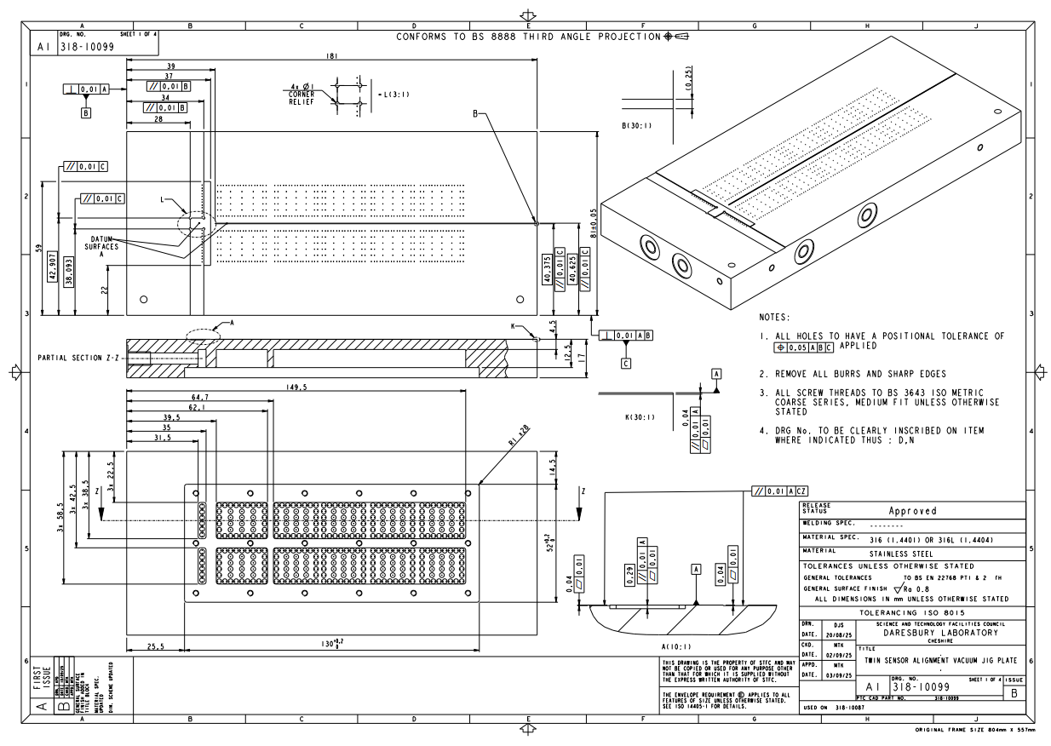
Prototyping jigs – mechanical draws
Tolerancing
Flatness: 10 µm
Surface finish: Ra=0.8 µm
The drawings and step files are with the Liverpool workshop
Some tolerances are still under discussion
The manufacturing takes about 20 - 25 days
Expected to start in January
Deploy for assembly → March onwards

Slide 19
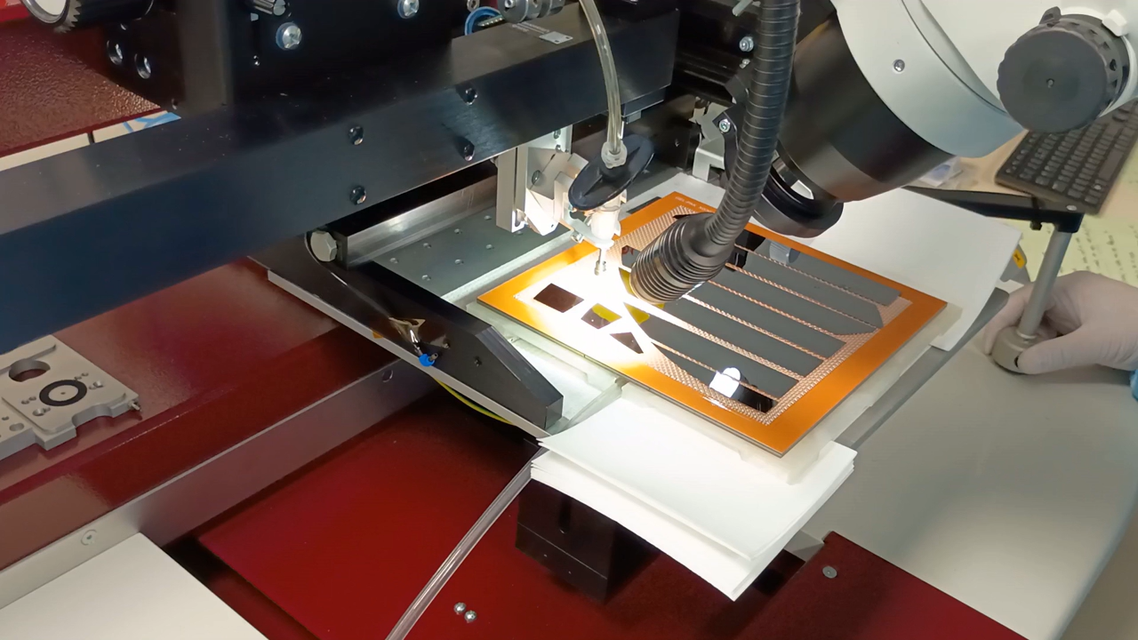
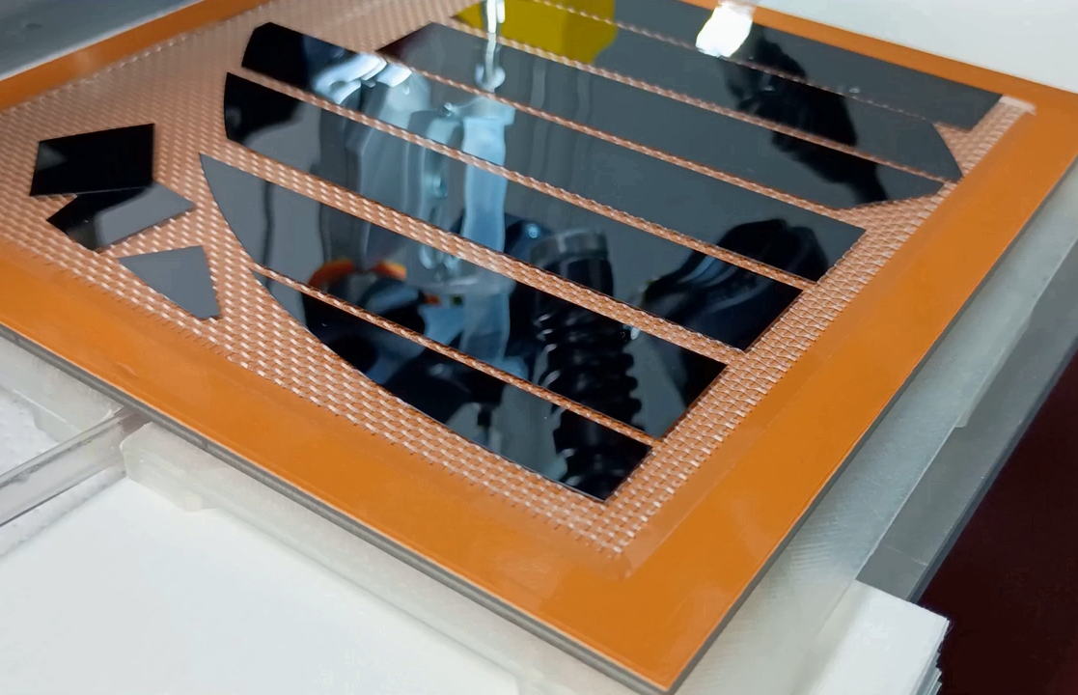

Pure dummy silicon
Pure silicon dummy sensors prepared at CERN → removed from backing foil → shipped to UK
Packaging
  Membrane boxes
  Gel-paks
No breakages observed
Modules moved within membrane boxes
Removal from gel-paks using vacuum jig and suction cups was successful
  Silicon is flexible but does not break
  Using more than one suction cup would improve stability

Slide 20



Dummy silicon with pads – design
5RSU dimensions
Thickness: 50 µm
Dicing Requirements
  Length: 114.330 mm
  Width: 19.567 mm
AncASIC dimensions
Thickness: 300 µm
Dicing Requirements
  Length: 15 mm
  Width: 1.5 mm
Processes from the supplier
  Procure Silicon wafer 625 µm
  Photomask fabrication
  ~1 µm Al patterning and etching
  Backgrinding to 50 µm and 300 µm respectively
  Dicing & Chip tray packing
  Shipping
Metalization
Material: Aluminum
Thickness: around 1 µm
Pads
  Pad size: 91 µm × 144 µm
  Pad pitch: 100 µm

Slide 21


Dummy silicon with pads – fabrication
AncASIC: 500-600 chips
5RSU LAS: ~50 chips
The supplier is completing the drawings
Expected delivery date: by the end of February

Slide 22
Summary
Flat module prototyping is currently ongoing
Interconnection
  spTAB-bonded M-FPC prototype is under testing
  Wire-bonding results show that acceptable mean strength and standard deviation can be achieved with LTU foils
  Further bonding optimisations to be done with more realistic designs and final-grade components
Manufacturing of the prototype jigs ongoing
Pure dummy silicon sensors are available; dummy LAS and AncASIC are expected in January/February
Assembly practice is expected to start in March

Slide 23
Backup

Slide 24

Packaging
Nanosystems JP packaging details
  Dummy LAS: “given the three different chip sizes, instead of fabricating a custom case from scratch, we propose a standard method where we will remove the chips from the dicing ring and pack them using a cushioning system as shown below. The pink layer will serve as a cushion, and a black spacer will secure the chips between the layers. This is a standard packaging method we frequently use.”
  Dummy AncASIC: “a similar-sized chip tray (15 × 1.5 mm) is available, which we will use for packaging.”

Slide 25



Standard bonding parameters

Slide 26

Module assembly

