Slide 1
OB prototyping

Slide 2
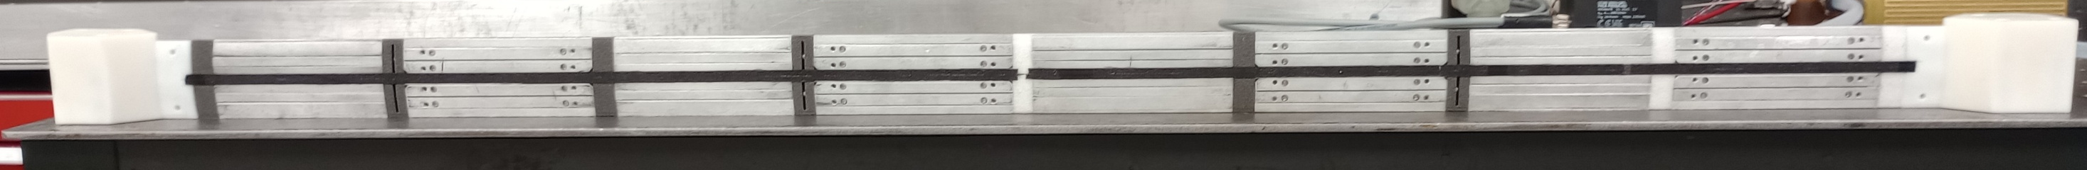
Introduction
After several quarterstaves we have made one full length L4 stave
Materials (CF prepreg, K9 foam) are scraps/rejects/expired from ATLAS
  In this stave some substitute foam pieces (actually will allow us to look at different thermal behaviour)
We are still learning how to best do that
  The prime challenge is removal of the internal mould tool
  To study this, we have reverted to production of quarterstaves
3D-printed end pieces with optimised air flow
K9 cross-ribs
Non-conductive cross-ribs

Slide 3
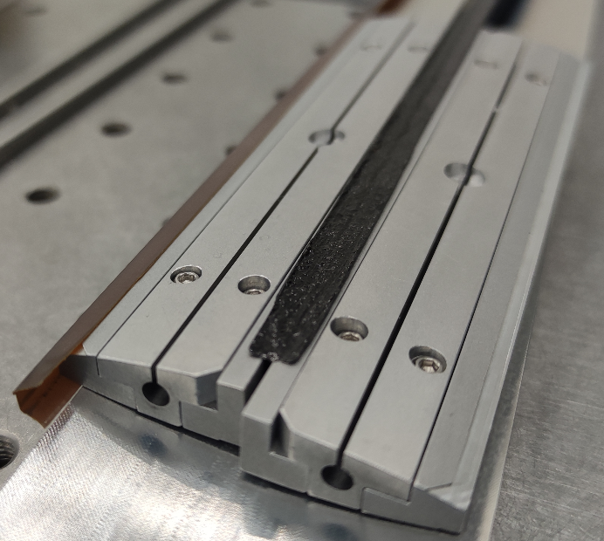
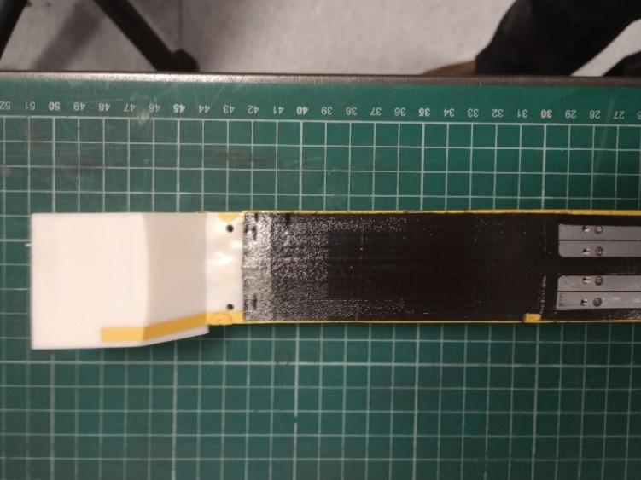
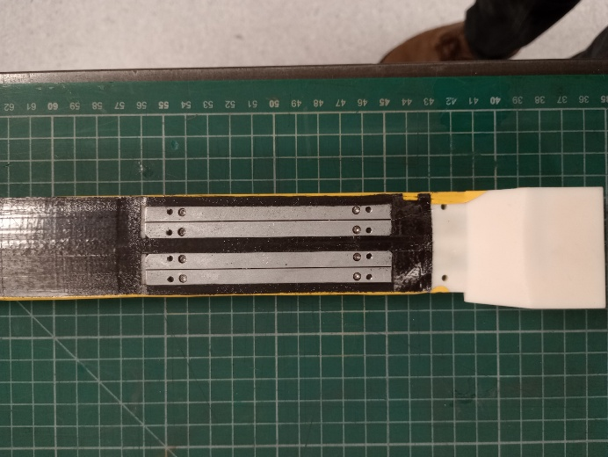
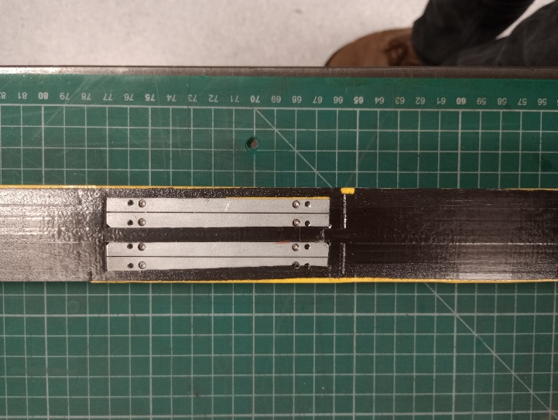
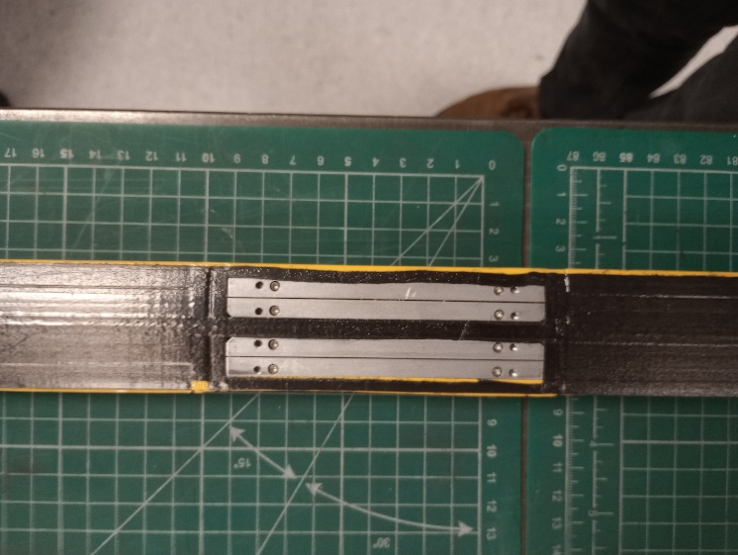
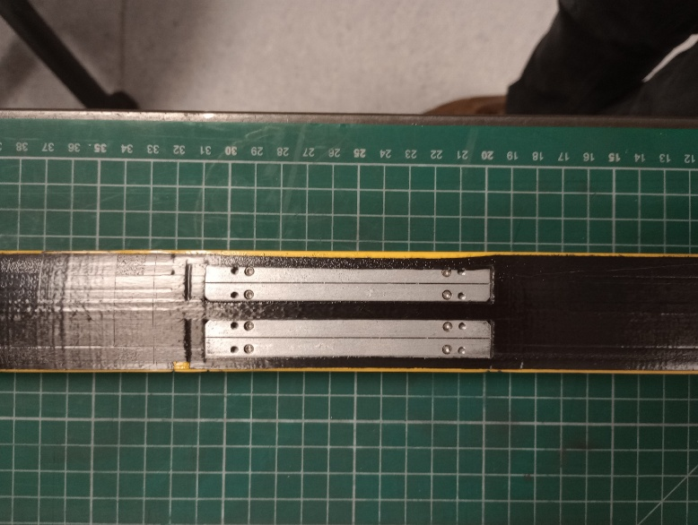

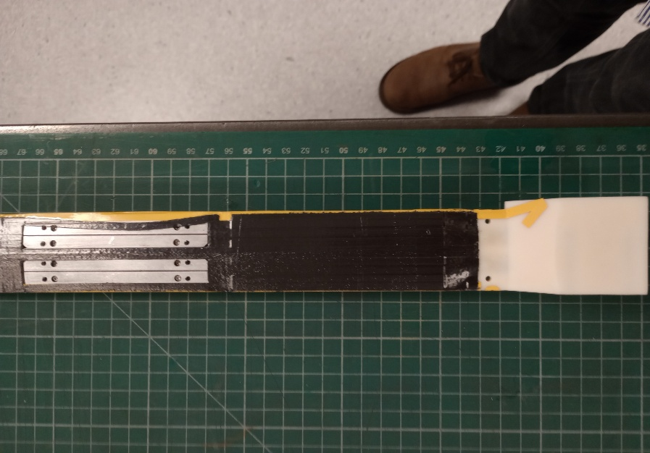
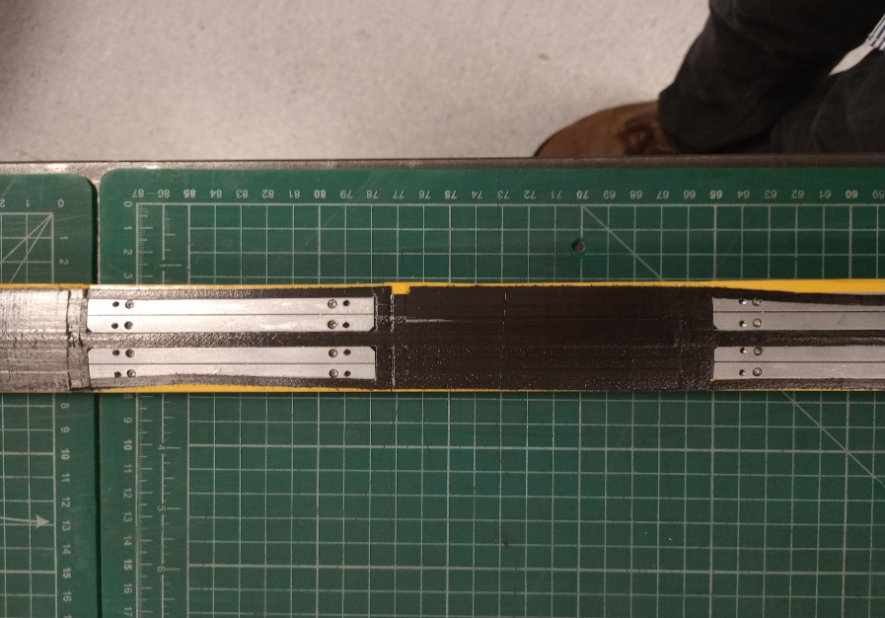
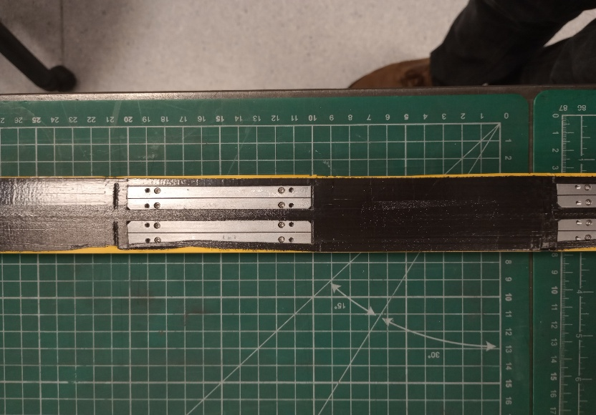
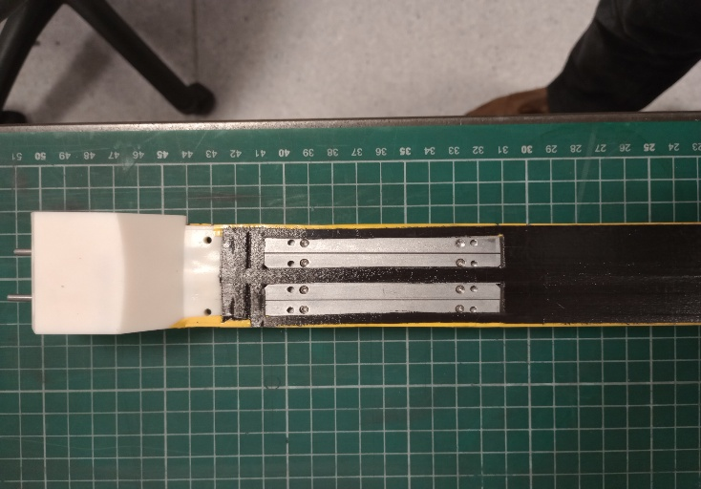
Stave prototyping II
Several issues during cure:
  Material not tacky: thin parts at the edge of cut-outs have moved
    Could be caused by humidity – will try to keep material drier in the future, but the material is expired…
    Alternative is that we keep the thin parts in place using flashbreaker tape
  Inner and outer mould parts stuck in stave
    Baked into surface and also glue seeping between the mould parts – cannot be removed without damaging stave…
    We have used mould release agent
    Need to find another solution (e.g. use flashbreaker tape, alternative material like PTFE…)

Slide 4
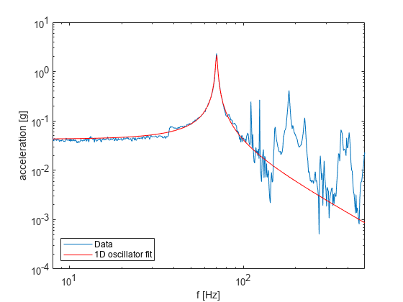
L4 Stave Prototype Vibration Response
Stave suffered some damage during mould removal
  Some holes in CF facesheet (expect only cosmetic effect)
  More seriously: gaps underneath CF bridges on top of I-beams (5 out of 8)
    Not clear whether this is facesheet bridge not bonded to I-beam, or split at the top of the vertical section I-beam
    Applied Araldite to gap, and cured with tape holding down
Frequency scan of the stave response (fixed-fixed constraint):
  1st mode at ~70 Hz (was 57 Hz before repair)
  Currently taking data with more sensors so that we can study mode-shapes in more detail (longitudinal and torsional)
First mode frequency: 70.23 ± 0.03 Hz,
Q = 27.4 +1.3 -1.2

Slide 5
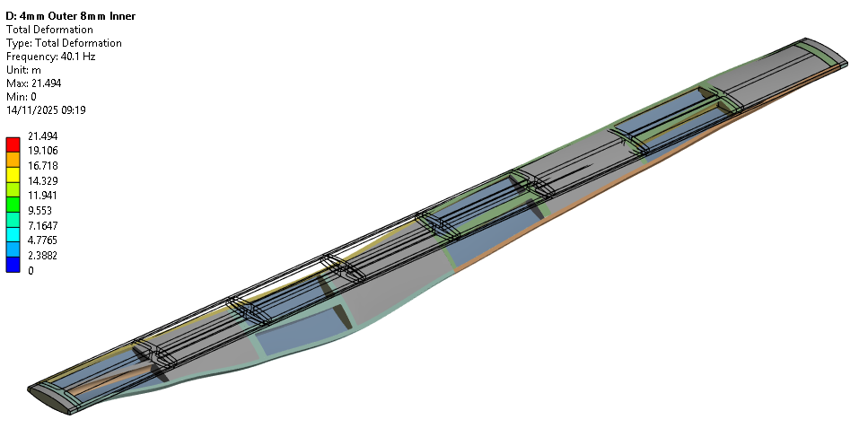
FEA Modal Analysis – No Modules
FEA with 2 plies (0/90) – actual stave build with 3 (0/90/0)

Slide 6
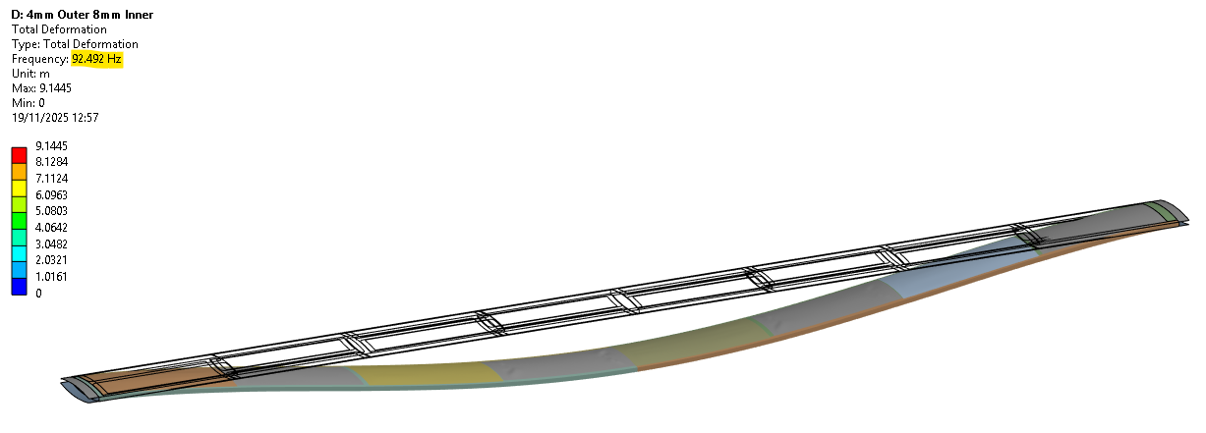
FEA Modal Analysis – 50-micron Steel Shim

Slide 7
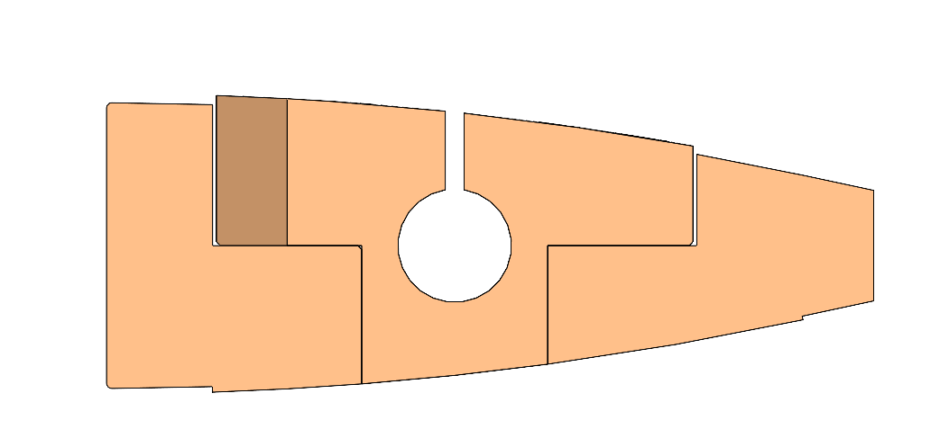
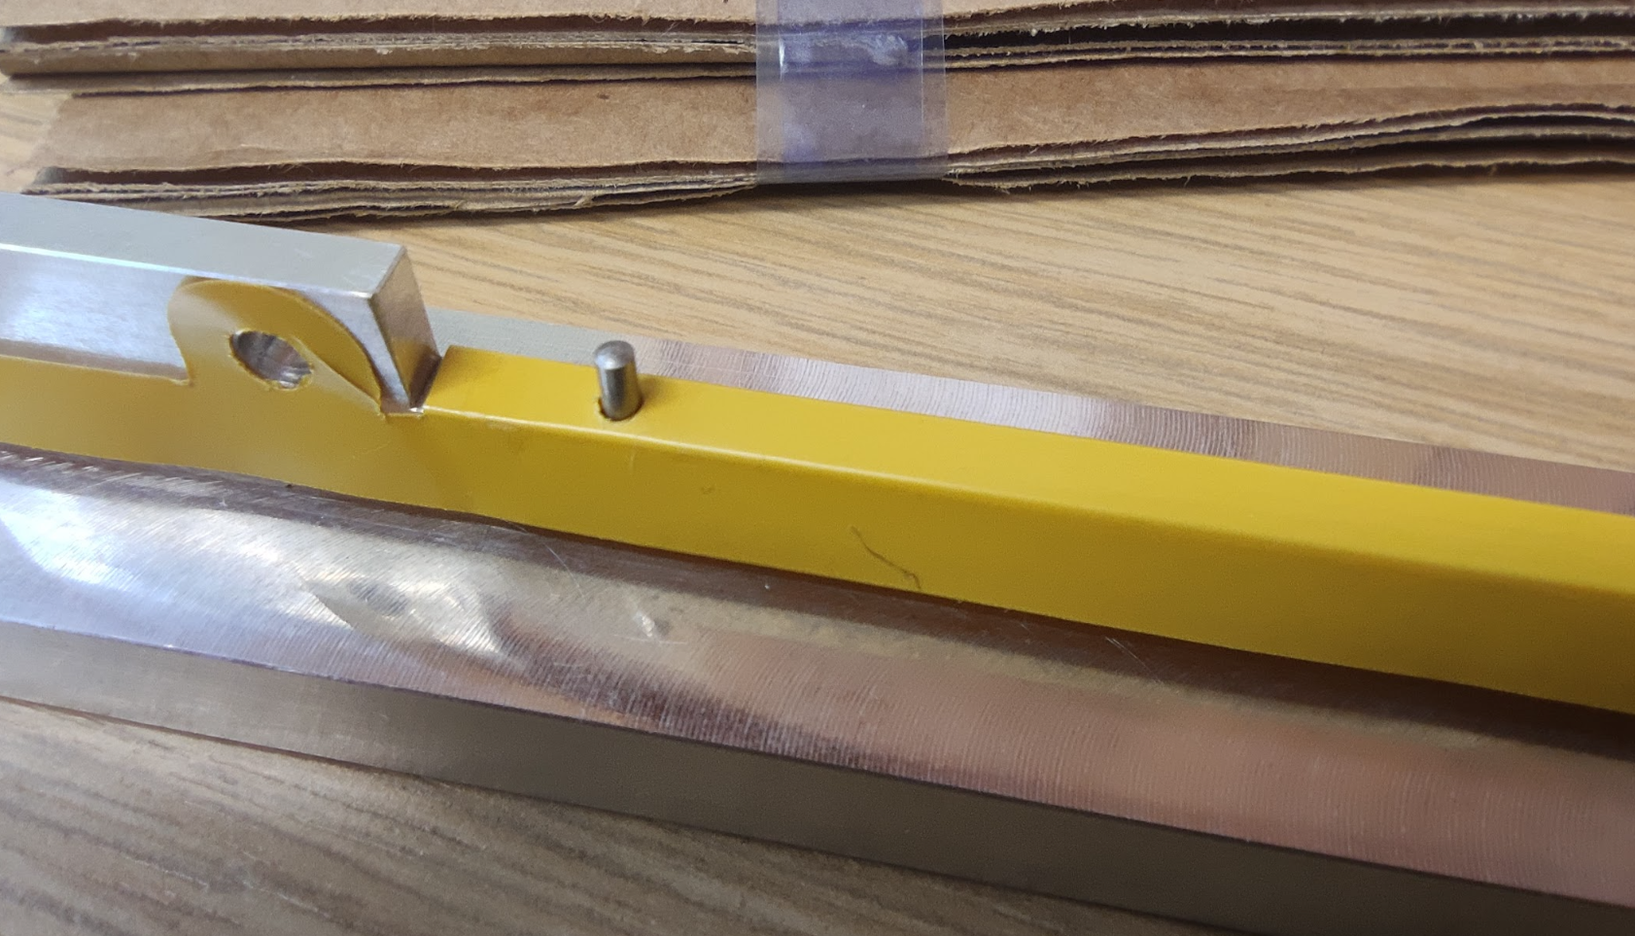
Improvements tried
Further QSPs will be used to test tooling/assembly improvements
  Step 1
    Flashbreaker tape to cover module tooling part joints
      Stops epoxy leaking into tooling,
      But CF sticks to flashbreaker…
  Step 2
    FPC alignment with pin holes in FPC & cross braces
      FPC position will be the driver of module position
        Positional tolerance sub-mm
      ~10 µm positional accuracy requirement for bridge FPC to FPC alignment
  Step 3
    Curing I-beam in-situ
      Reduces risk of damage
      Works very well
Seepage Area
Flashbreaker

Slide 8
Next steps
Make more quarterstave prototypes to understand manufacturing issues
  Once we have confidence with the process we will make more full length L4 staves
Finish mechanical studies (mode shapes) of unloaded L4 prototype
  Then load with steel shims/Kapton-Cu heater circuits
  Repeat mechanical studies
  Then look at heat + air flow (setup is ready)
Once we got the production steps down
  Make full L4 prototypes with more realistic FPCs (including metal layer)
  Load prototypes with dummy Si (encapsulated with heater circuits)

Slide 9
Further material

Slide 10
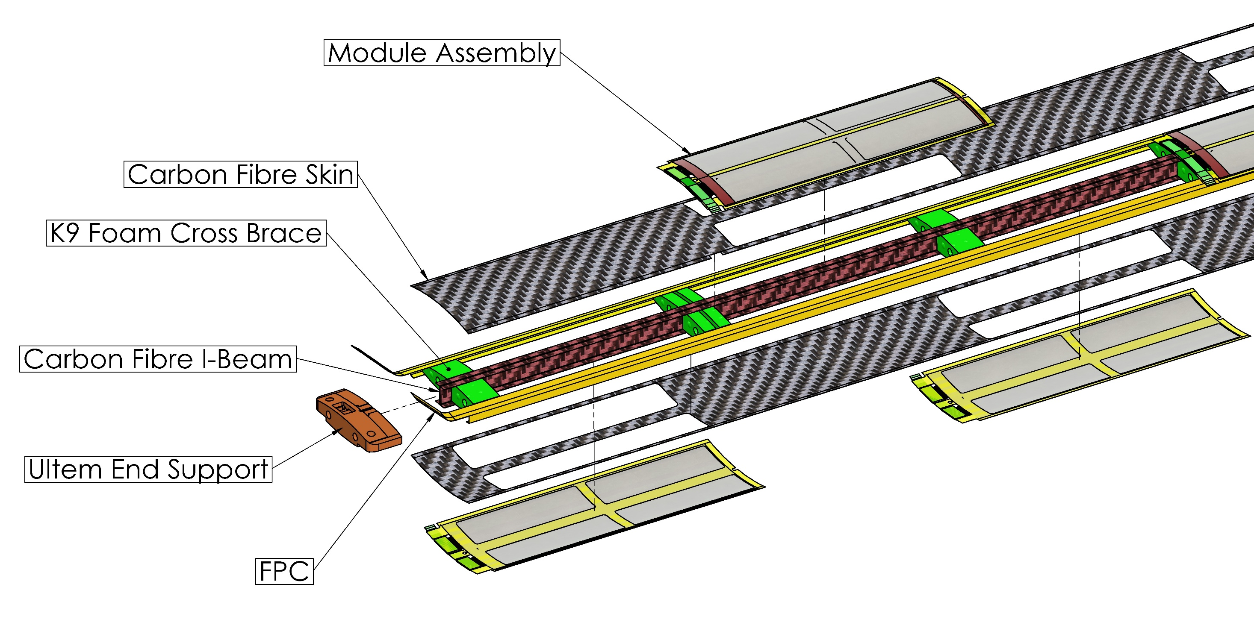
Stave design

Slide 11
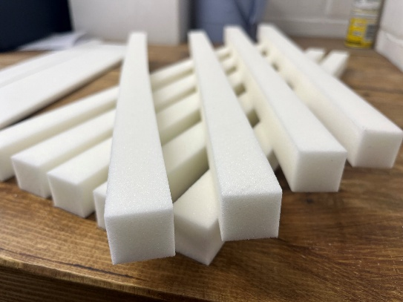
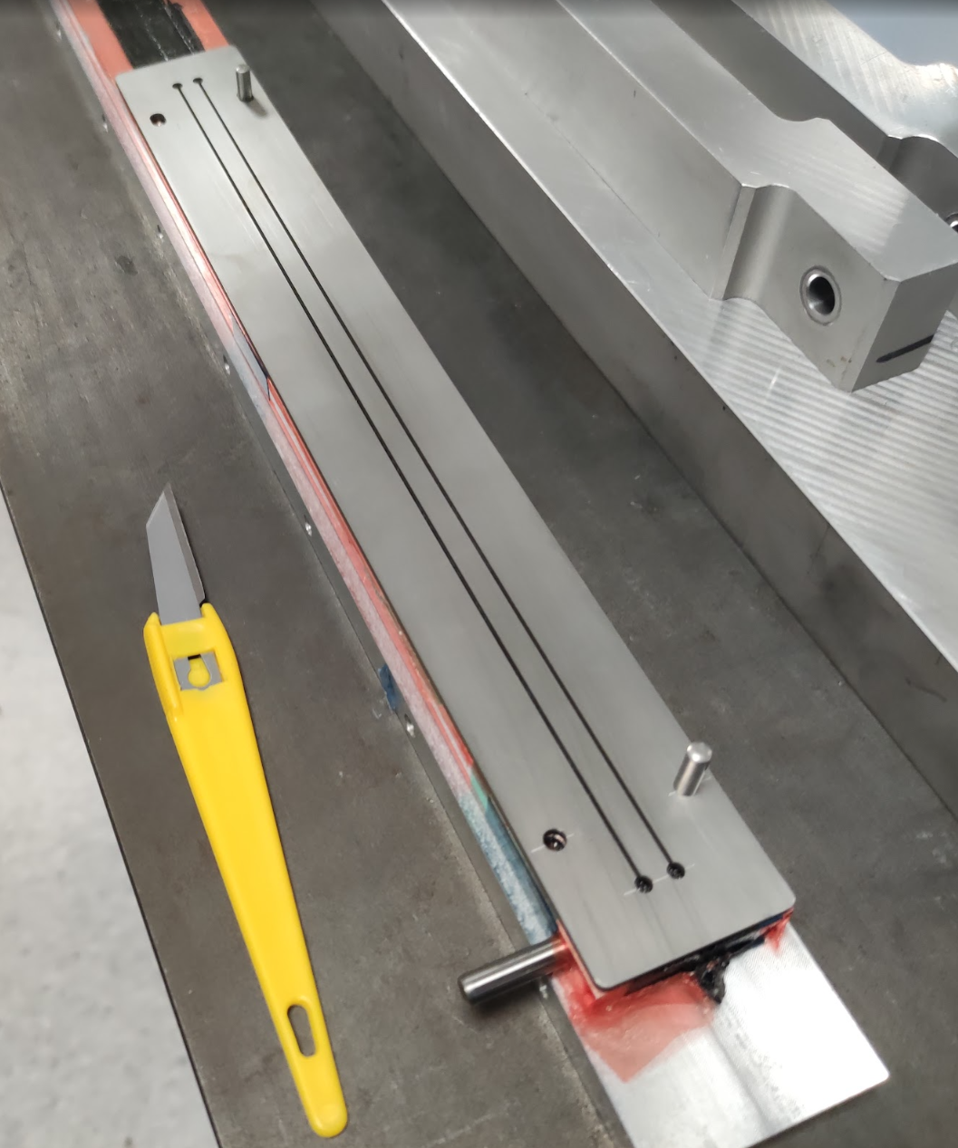
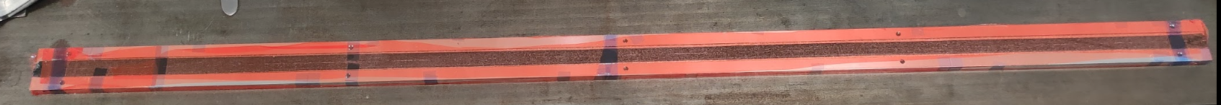
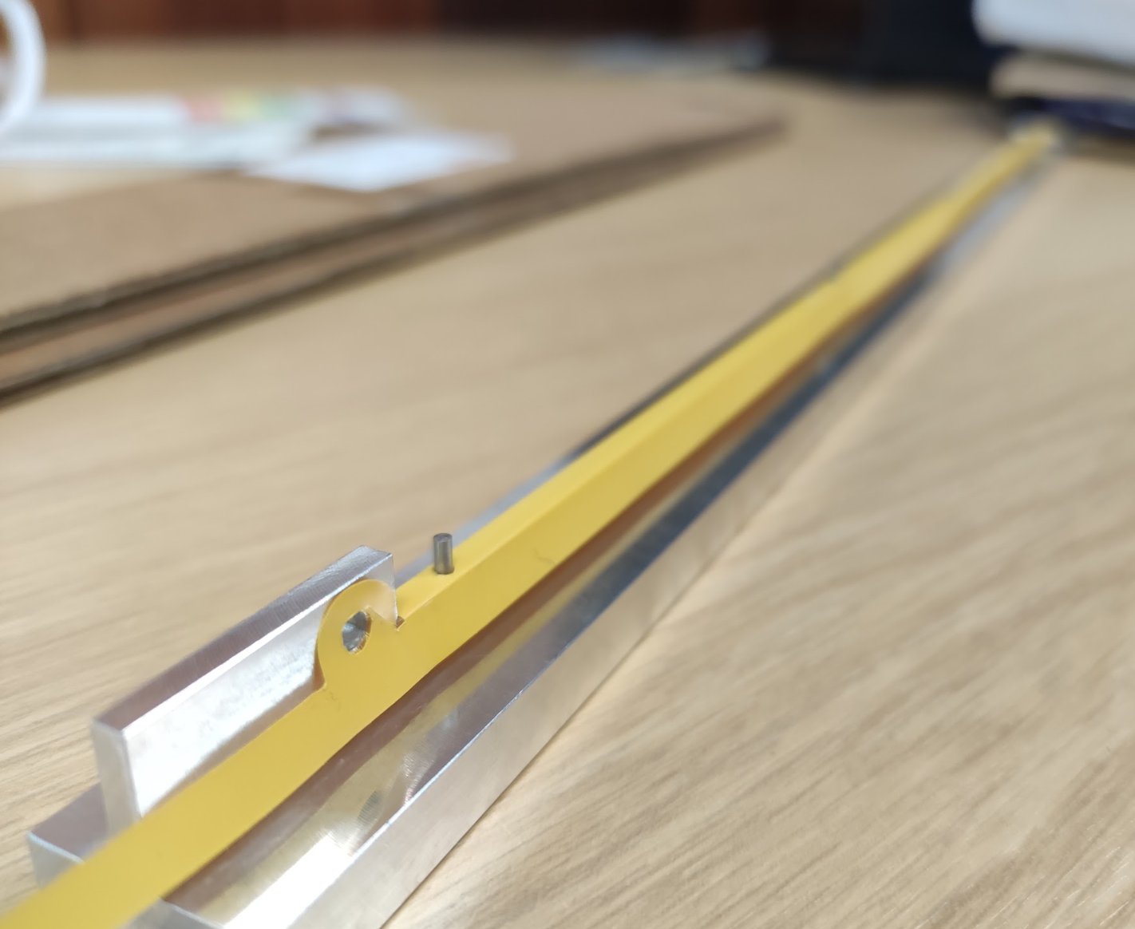
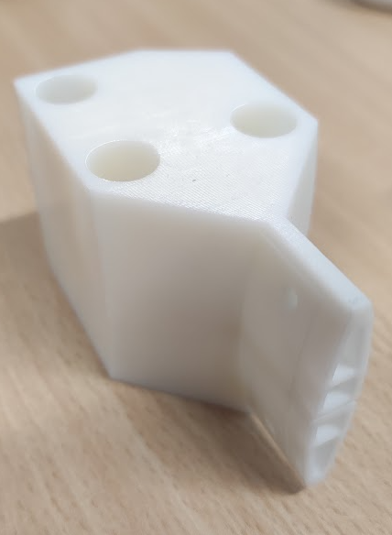
First Full Length L4 Prototype
Based on old geometry with minimum overlap between modules
  Up to date L4 stave would be shorter (by approx. 50 mm)
New tooling for FPC & I-beam manufacture tested
  Kapton thermal forming tooling works well, alignment holes are very effective
  I-beam tooling may need refinement, very difficult to remove
6 of 18 K9 foam blocks replaced with Rohacell 110
  Low thermal conductivity, closed cell foam, holes added to allow airflow
Redesigned stave ends for vibration & flow testing
CF Trimming Tool
Kapton FPC Forming Tooling
Stave End Supports

Slide 12
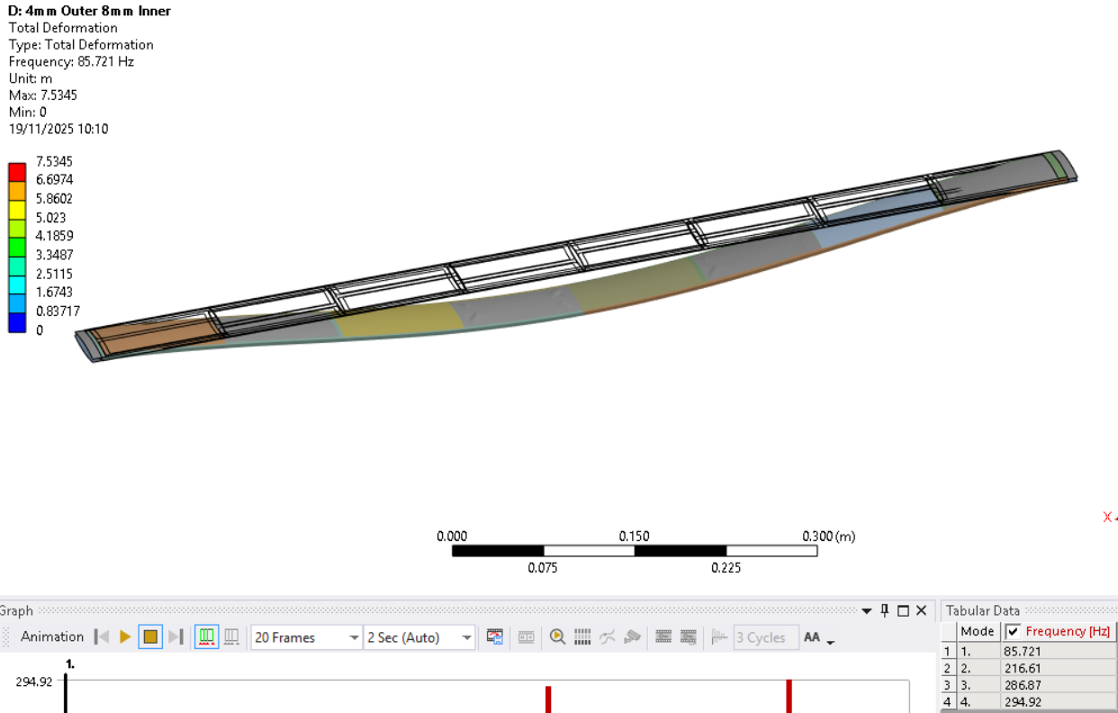
100-micron Steel Shim

