Slide 1
pfRICH test beam setup @ CERN PS/SPS
Short dark box
Long dark box
PS/SPS
beam
Photonis
FT-16
MCP-PMT
aerogel
Photonis
FT-16
MCP-PMT
1x HRPPD
2x2 HRPPD matrix
S2
G3
G4
G1
G2
S1
Beam time request (TBC; parasitic with dRICH): one week at SPS and one week at PS
S1&S2: trigger scintillators, G1..G4: GEM trackers (optional?)
Frontend electronics: available 512 DRS4 channels (also will test first FCFD evaluation boards)
Equip about 1/8 of the “imaging” HRPPD pads (3-4 pad wide band along a saturated ring circumference)
Will require custom passive backplanes and more MCX adapters (<$10k total)
Main deliverable is a direct simultaneous demonstration of
π/K separation at ~7 GeV/c via imaging, with and without an acrylic filter
HRPPD performance as a t₀ reference sensor for ePIC ToF subsystems
Timing resolution using aerogel Cherenkov photons (2x2 HRPPD ring “imaging” dark box)
Timing resolution using Cherenkov photon flashes in HRPPD window (optional single HRPPD “timing” dark box)

Slide 2
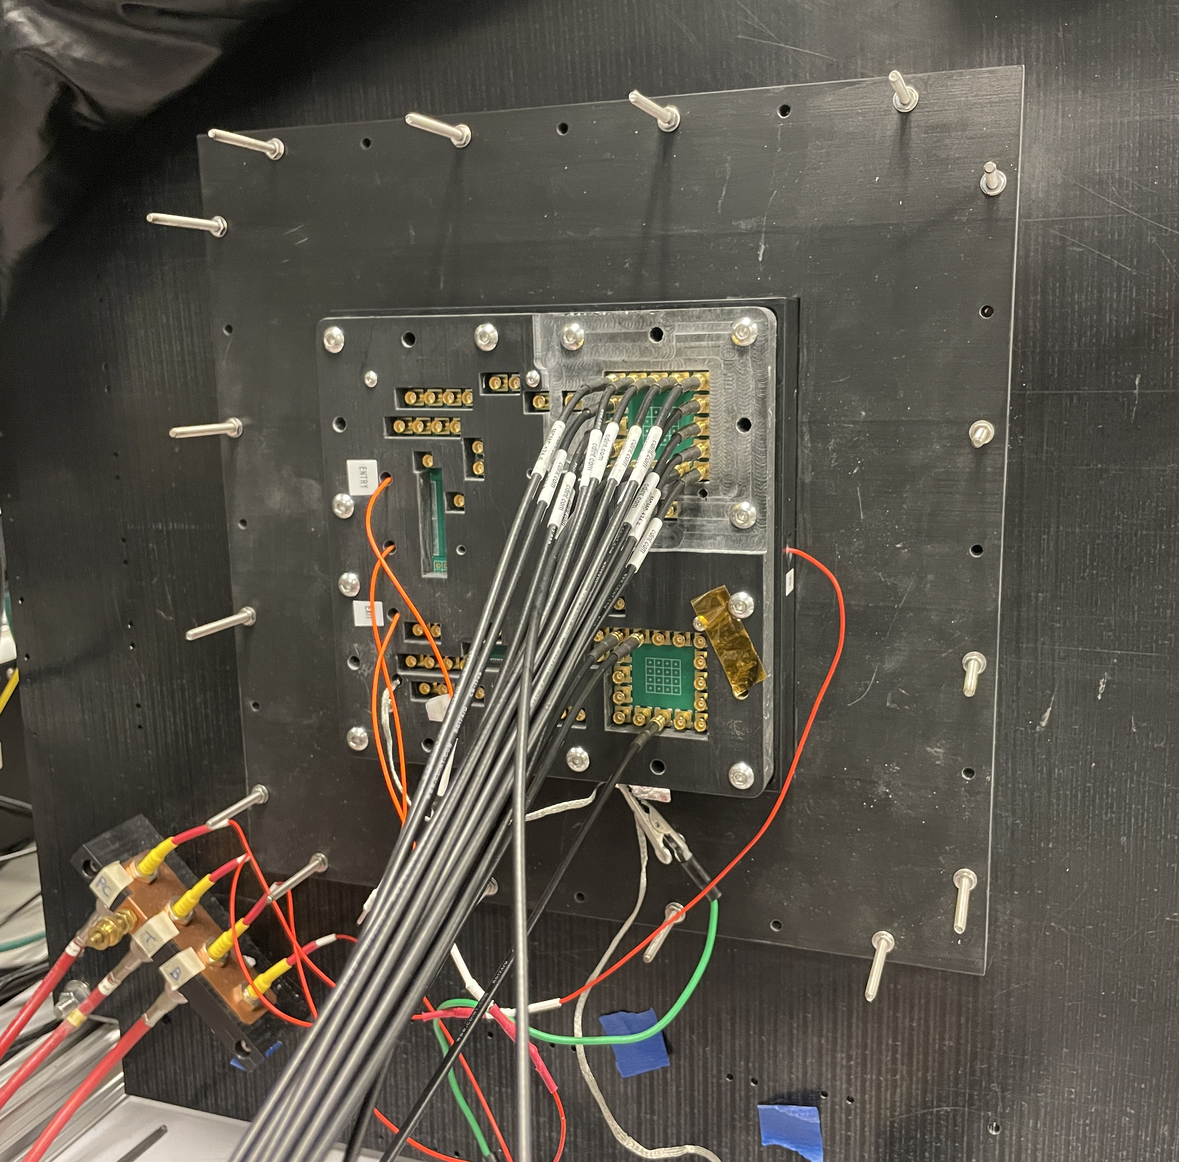
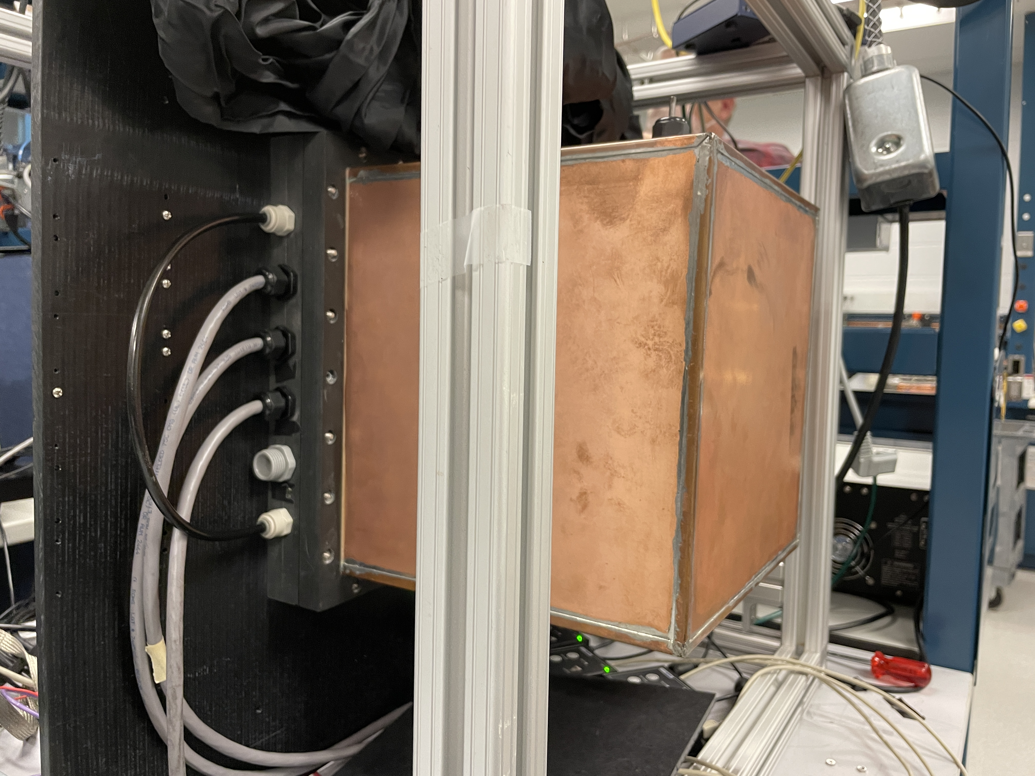
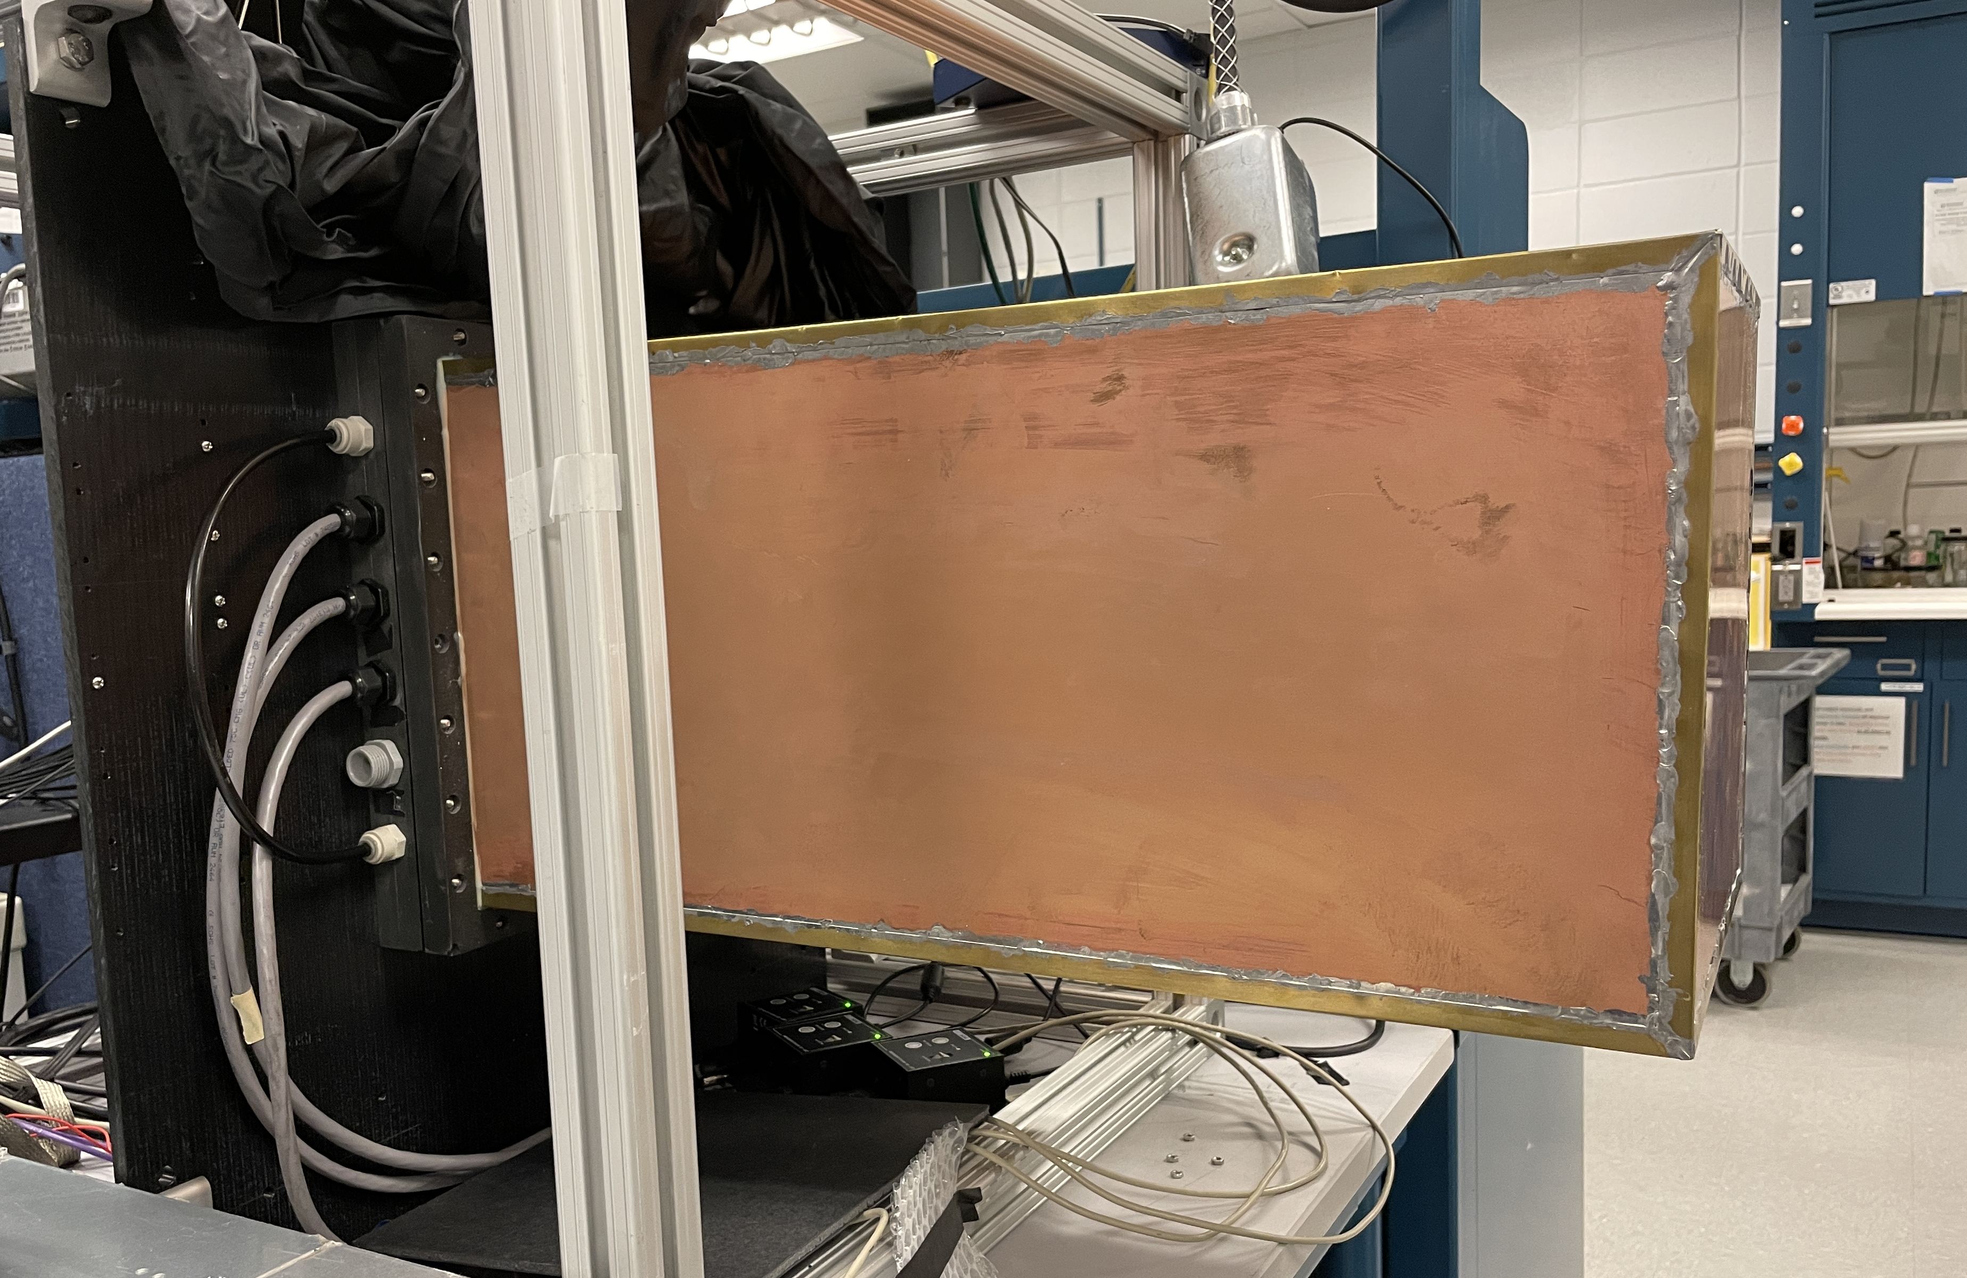
Existing dark boxes & mechanical assemblies
rear side plate with a single HRPPD
front side with a short dark box
front side with a long dark box
A long dark box cover has length >20” and a square opening of 262mm x 262mm
Obviously sufficiently wide to place a 2x2 matrix of 120mm x 120mm HRPPDs …
… and see an un-obscured ring with a ~230mm nominal diameter
Obviously sufficiently long to imitate a ~400mm long pfRICH expansion volume
Need to design and 3D print a 2x2 HRPPD mounting plate (considered a trivial task)

Slide 3
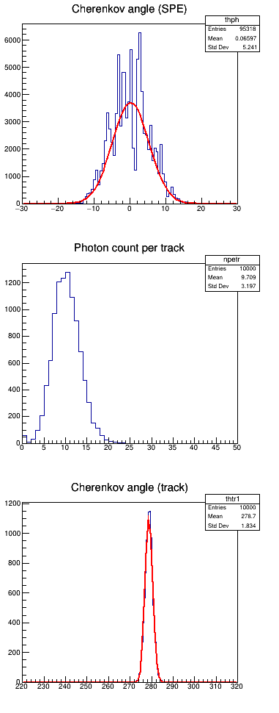
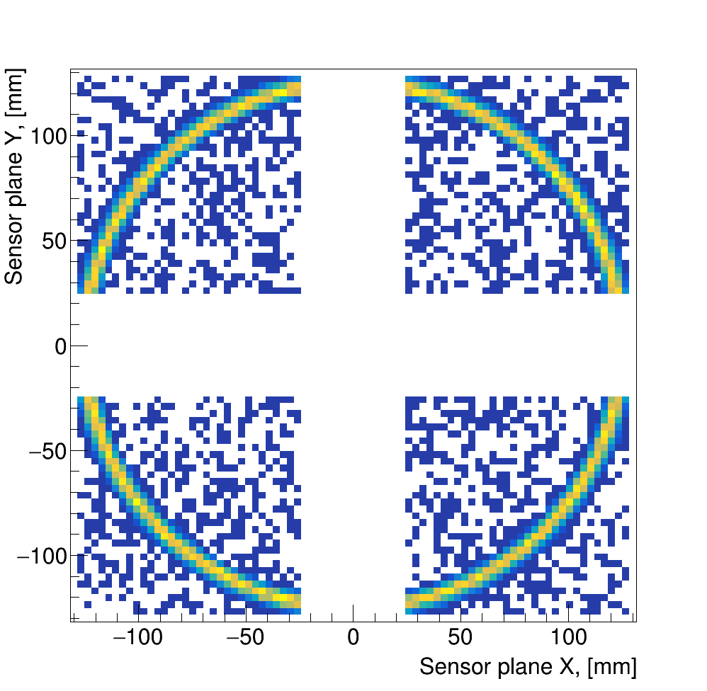
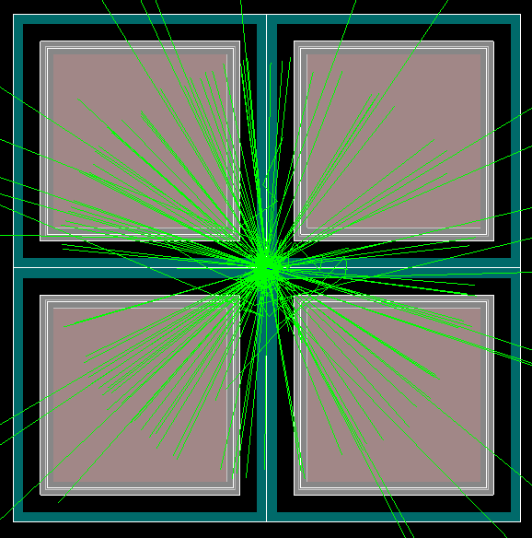
Expected performance
θ_{SPE} ~ 5.2 mrad
<N_{pe}> ~ 10
A saturated ring barely fits into the box acceptance, but it fits
<N_{pe}> ~ 10, assuming that HRPPD CE is ~0.7 (our safety factor)
Track-level Cherenkov angle resolution ~1.8 mrad
Compare to ~7.5 mrad π/K separation at 7 GeV/c for <n> ~ 1.04
θ_{track} ~1.8 mrad

