Slide 1
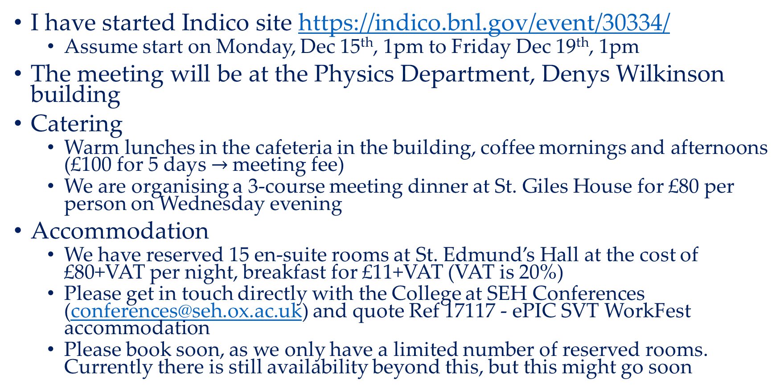
SVT workfest Oxford December 15-19
I have started Indico site https://indico.bnl.gov/event/30334/
Assume start on Monday, Dec 15th, 1pm to Friday Dec 19th, 1pm
The meeting will be at the Physics Department, Denys Wilkinson building
Catering
Warm lunches in the cafeteria in the building, coffee mornings and afternoons (£100 for 5 days$→$ meeting fee)
We are organising a 3-course meeting dinner at St. Giles House for £80 per person on Wednesday evening
Accommodation
We have reserved 15 en-suite rooms at St. Edmund’s Hall at the cost of £80+VAT per night, breakfast for £11+VAT (VAT is 20%)
Please get in touch directly with the College at SEH Conferences (conferences@seh.ox.ac.uk) and quote Ref 17117 - ePIC SVT WorkFest accommodation
Please book soon, as we only have a limited number of reserved rooms. Currently there is still availability beyond this, but this might go soon

Slide 2
SVT workfest Oxford December 15-19
Travel
The best airport getting to Oxford is London Heathrow. From Heathrow there is a direct coach (https://www.theairline.co.uk/) that goes frequently to Oxford city centre (about 90 minutes, depending on traffic
Gatwick airport is connected by the same bus company (https://www.theairline.co.uk/, 150-180 minutes depending on traffic)
London Luton or Stansted airports are connected less frequently by coach (https://www.nationalexpress.com/en). Birmingham International airport is connected by train (https://www.nationalrail.co.uk/)
Transport to London is either by train (https://www.nationalrail.co.uk/) or by coach (https://www.oxfordtube.com/)
The best coach stop for St. Edmund's Hall is High Street
Within Oxford
The physics department, St. Edmund's Hall, Oxford central bus station and Oxford an train station are all in walking distance from each other
Current status
Finalising registration (payment setup)
Will distribute link when ready

