Slide 1


SVT Sensors Inspection and Wafer Probing Test Plan
Ivan Amos Cali, Lukas Tomasek, Anhelina Kostina
28/10/2025

Slide 2
Introduction
Ensure functional and electrical compliance before thinning and dicing.
Verify communication, powering, and sensor integrity.
Enable device classification
Provide traceable documentation for production and detector integration.

Slide 3
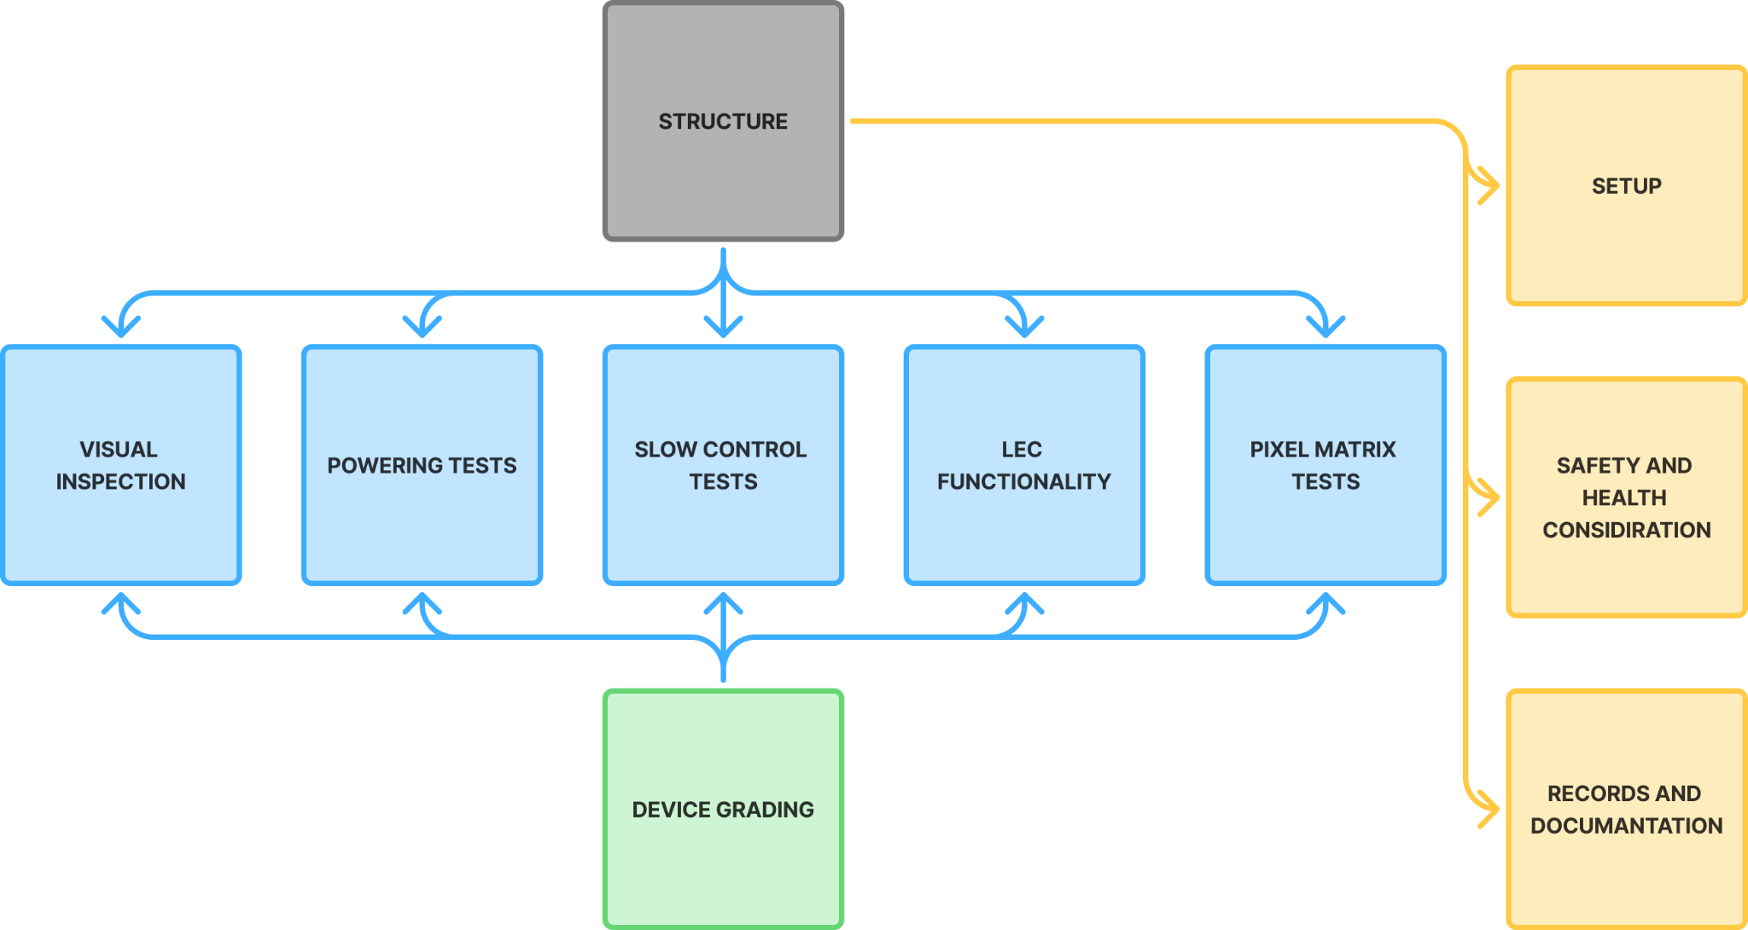

Slide 4
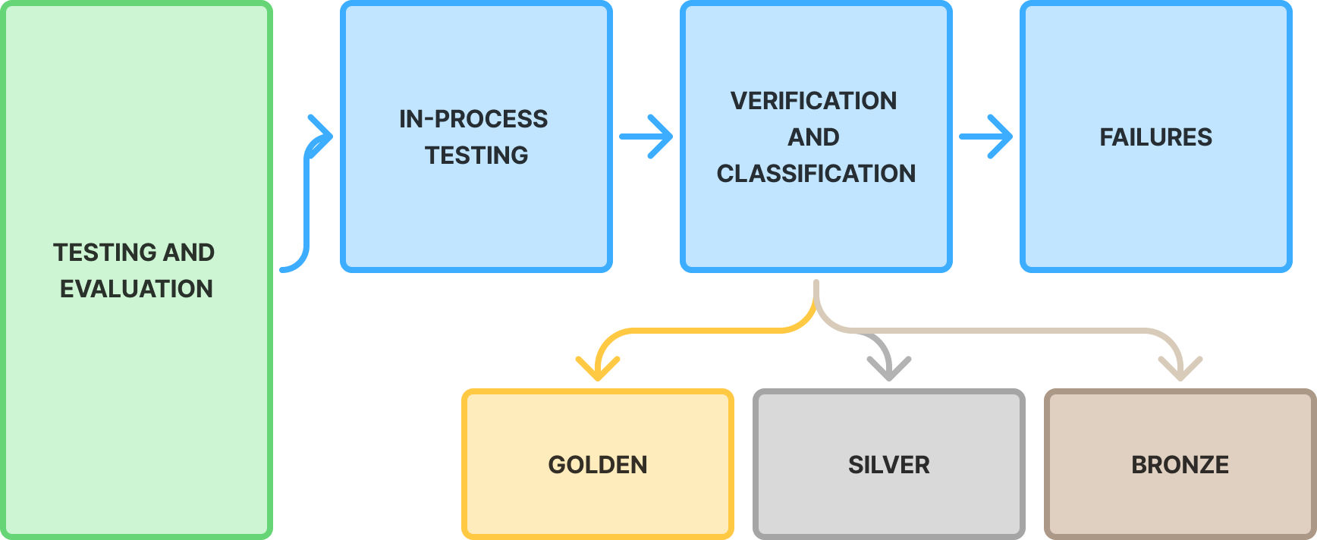
Chapter 2 Processes and Procedures

Slide 5

OTHER CHAPTERS
Equipment specifications and instrument requirements
Testing schema and setup configuration
Illustration of the existing prototype implemented at CERN
Applicable institutional safety frameworks
Laboratory best practices and ESD control
Required PPE and authorized personnel rules
Manufacturer and process records
Experimental and equipment documentation
Deliverable test data and reports

Slide 6
Thank you for your attention!
Your feedback and suggestions are highly appreciated.

