Slide 1
OB update
With input from Marcello Borri, Ken Davies, James Glover, Adam Huddart

Slide 2
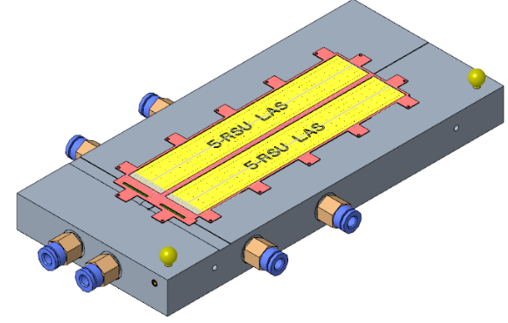
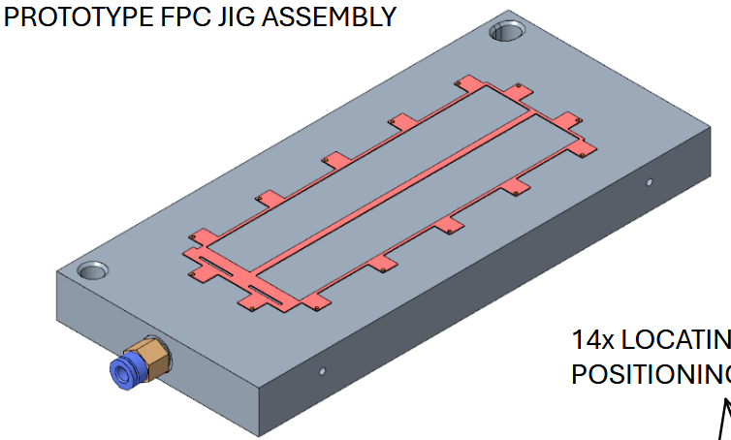
Modules
Current work on module tooling is for flat modules
  For a curved stave module would need to be built curved and jigs would need to be modified accordingly
  Prototype module assembly jig has been designed
  Currently scraping together funds for procuring parts & bondable dummy sensors and AncASICs
Prototype LAS jig
Prototype FPC jig

Slide 3
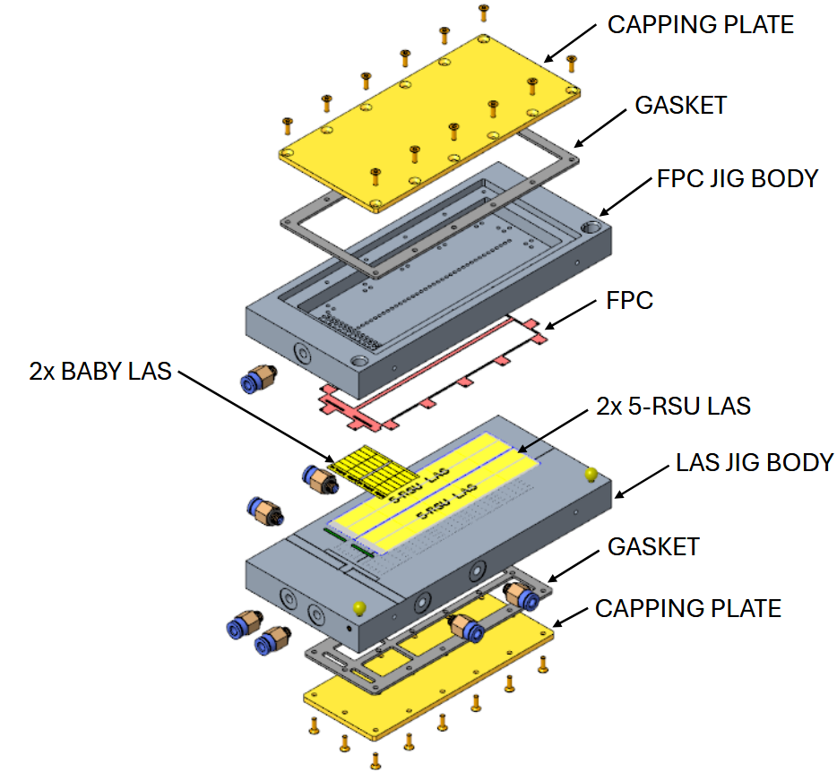
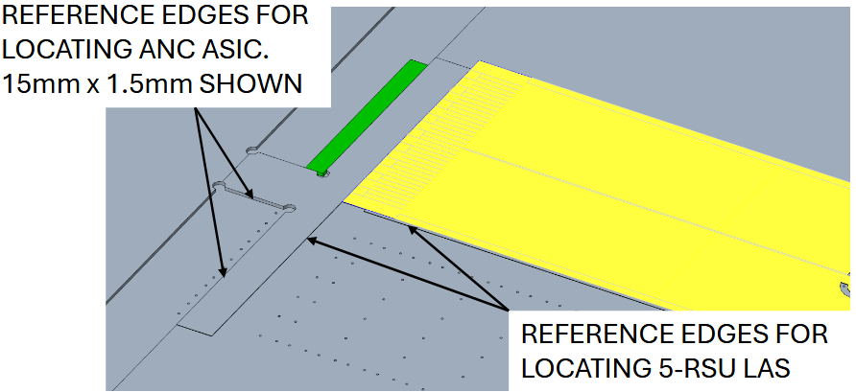
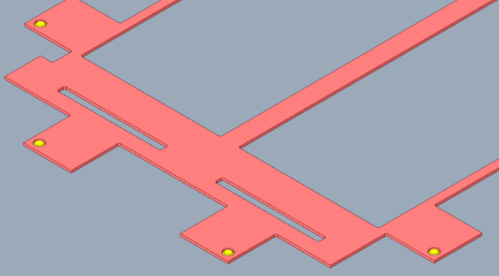
Module assembly jig details
14x locating pins for
module FPC
FPC sucked down by vacuum

Slide 4
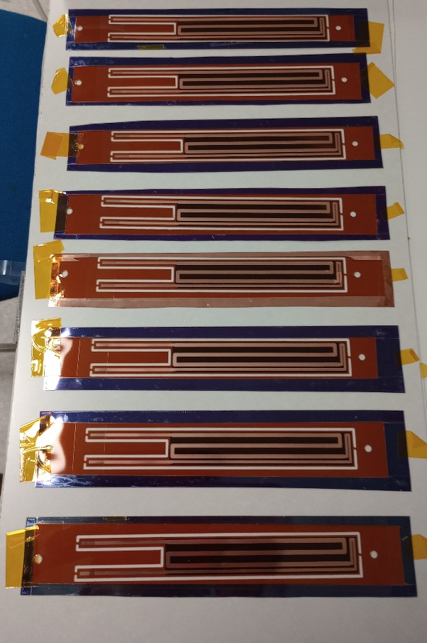
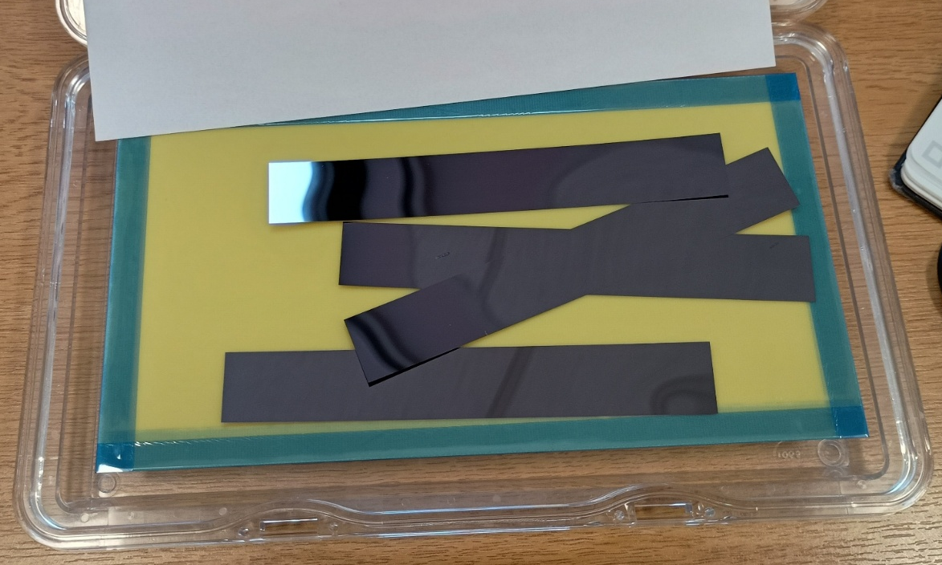
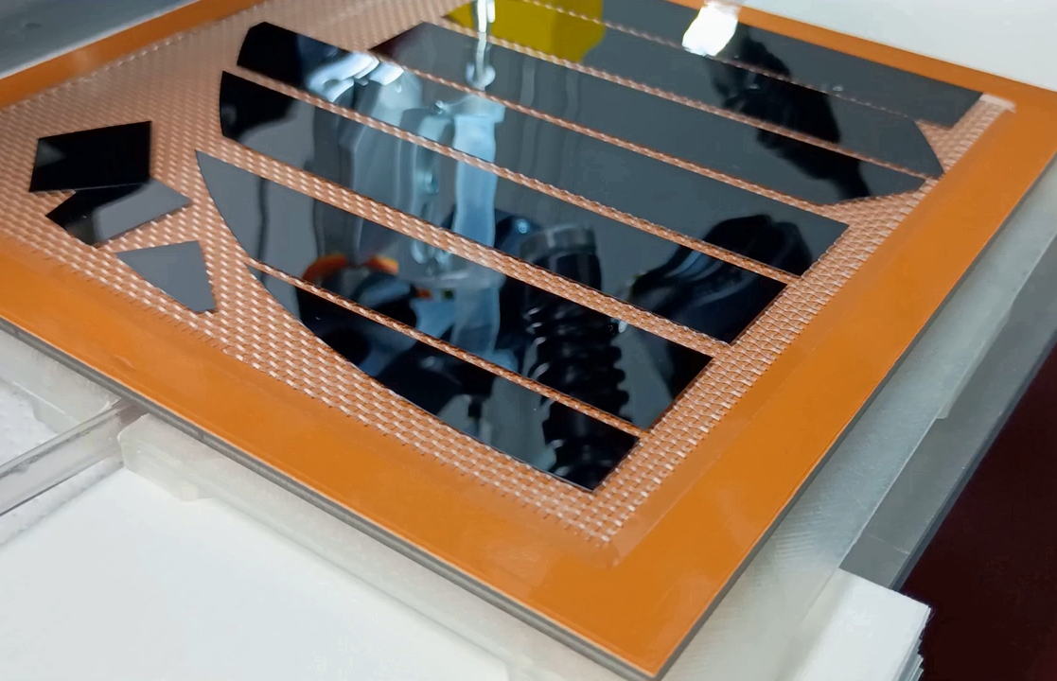
Dummy sensors
Pure silicon dummy sensors
  Removed from backing foil at CERN, then shipped to UK
    Use membrane boxes and gelpaks
    No breakages
      Modules have moved in membrane boxes
      Removal from gelpaks in vacuum jig, using suction cups worked (more than one suction cup is better)
Encapsulated dummies have arrived in UK

Slide 5
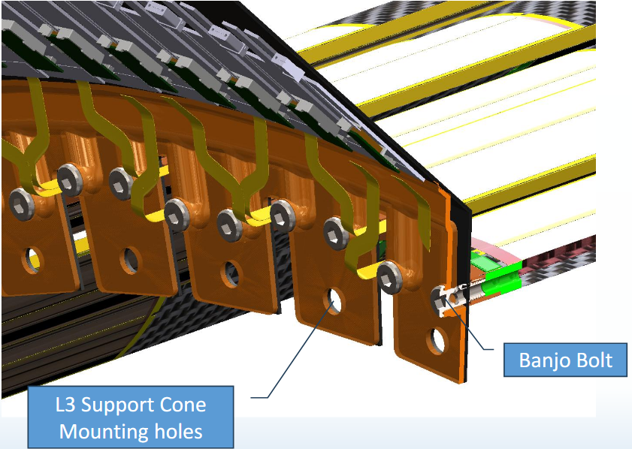
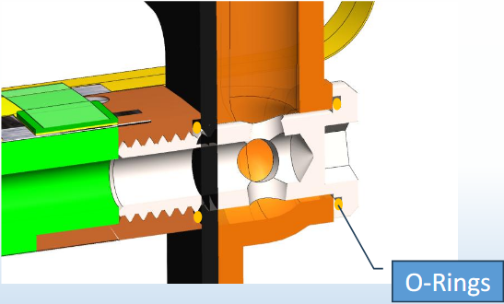
Stave & FIB support
Design stave support with minimal z-extension
Investigating banjo bolts
  Hollow bolts for air flow
  Still investigating how to supply counter-flow

Slide 6
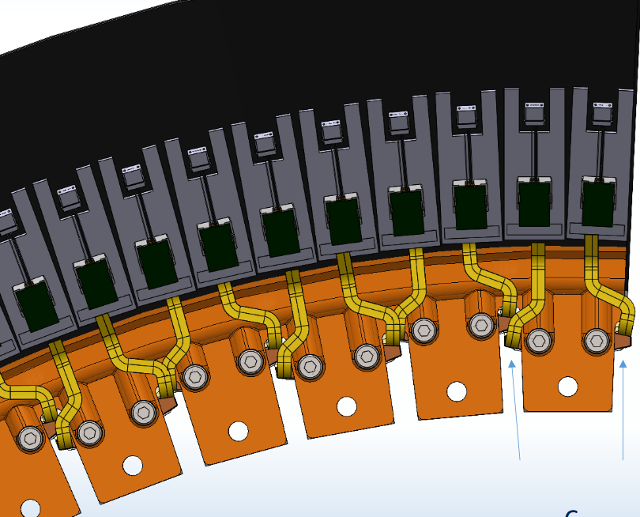
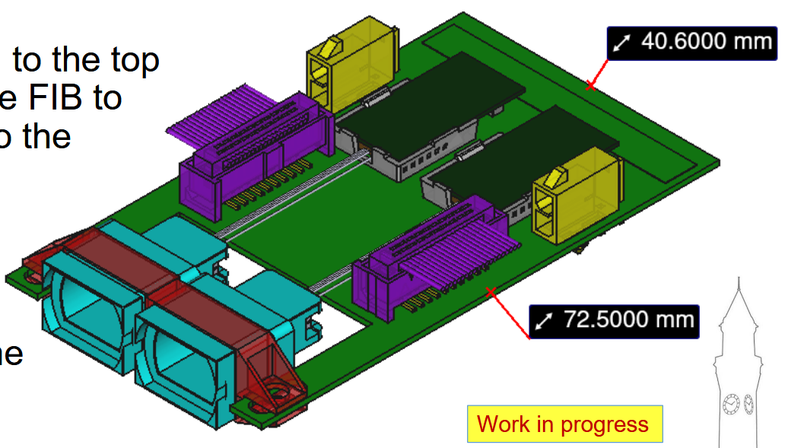
FIB placement
FIB design ongoing, but currently single FIBs too wide
  Mostly driven by MTP connectors
Investigating double-FIB
Previous iteration of FIB: too small

Slide 7
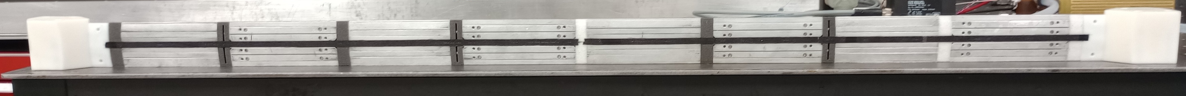
Stave prototyping
Still haven’t been able to complete full length L4 stave
  But we are very close now
  All tooling and material is in hands and has been assembled
    We currently don’t have machined K9 cross-ribs for all positions, substitute with non-conductive cross-ribs, interested to see effects
3D-printed end pieces with optimised air flow
K9 cross-ribs
Non-conductive cross-ribs

Slide 8
Further material

Slide 9
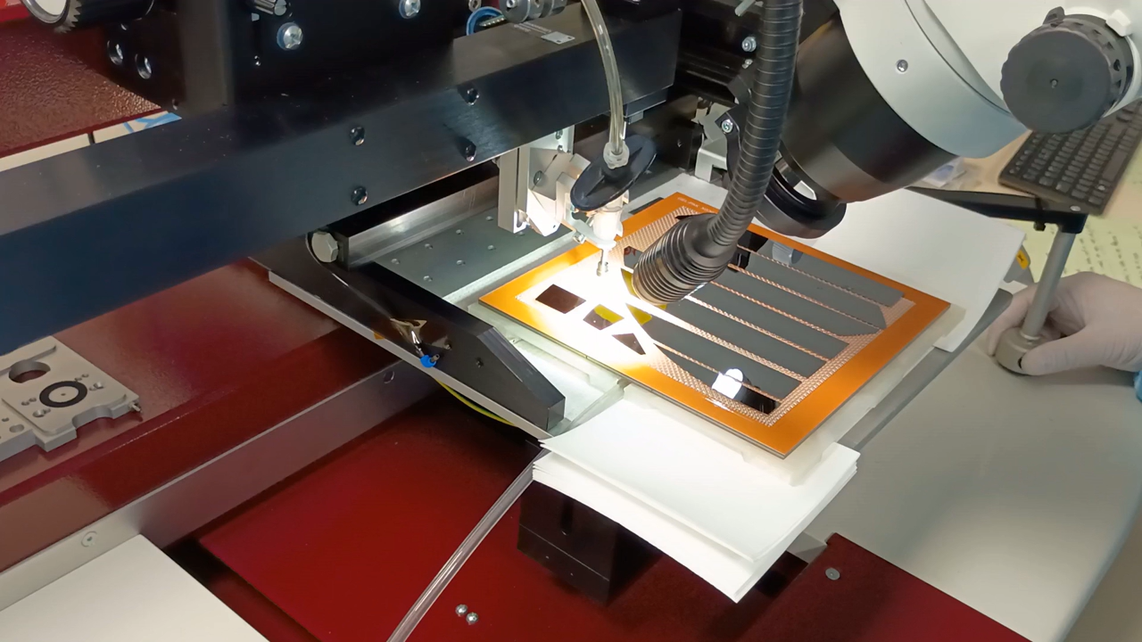
GelPak removal

Slide 10
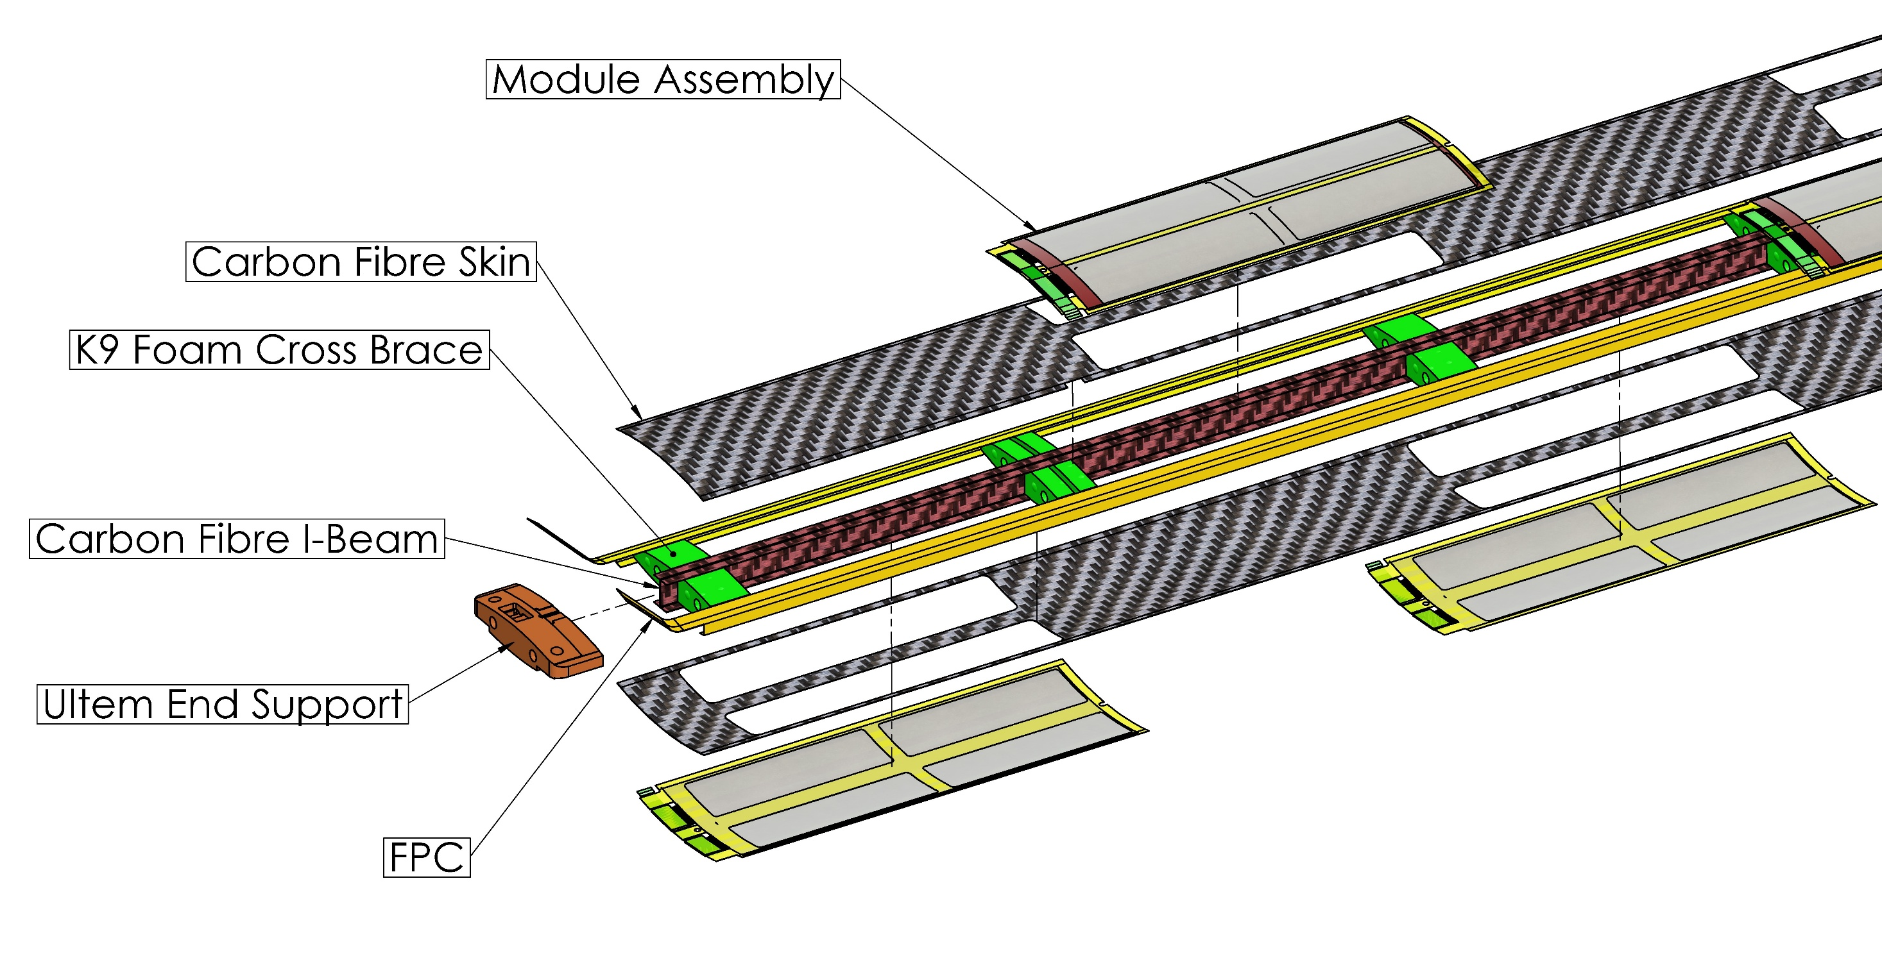
Stave design

