Slide 1
Integration, Installation and Infrastructure (Triple I Group)
TIC Update
Roland Wimmer

Slide 2
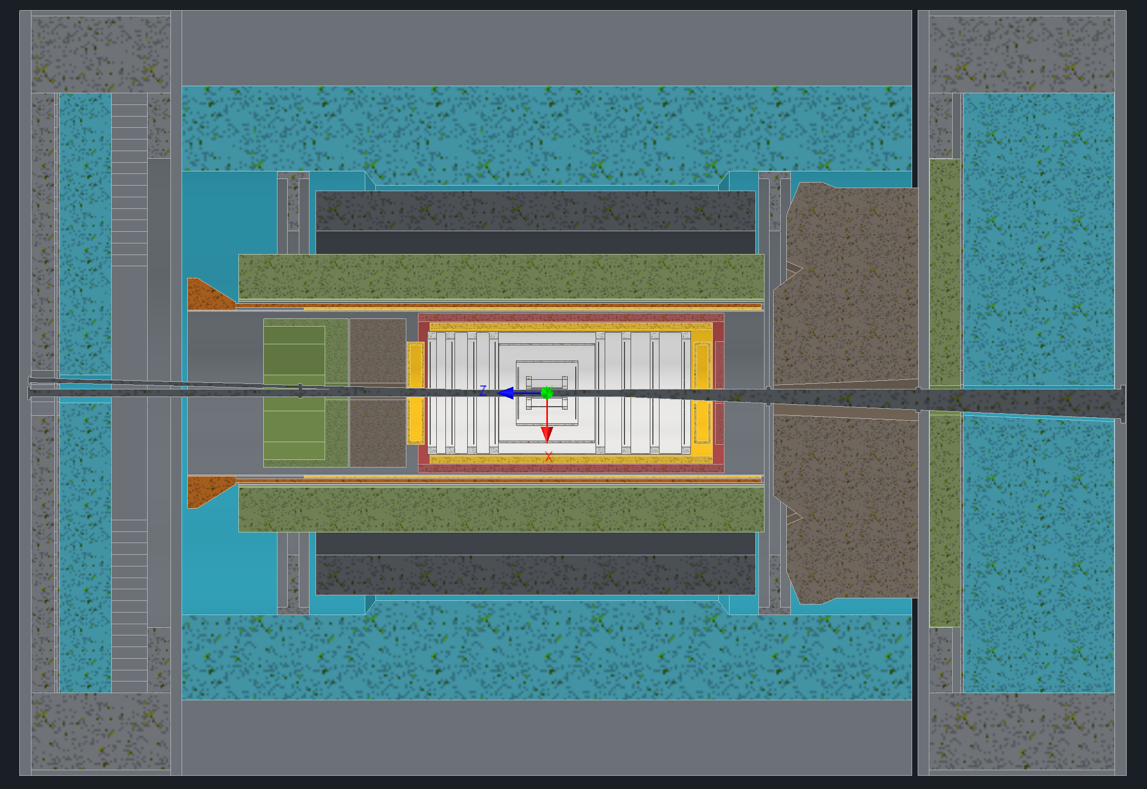
Detector Model Updates
PDR for Integration, Installation and Infrastructure
PST / MPGD Disks / CYMBAL / ToF updates
Beampipe Support
Services Updates

Slide 3
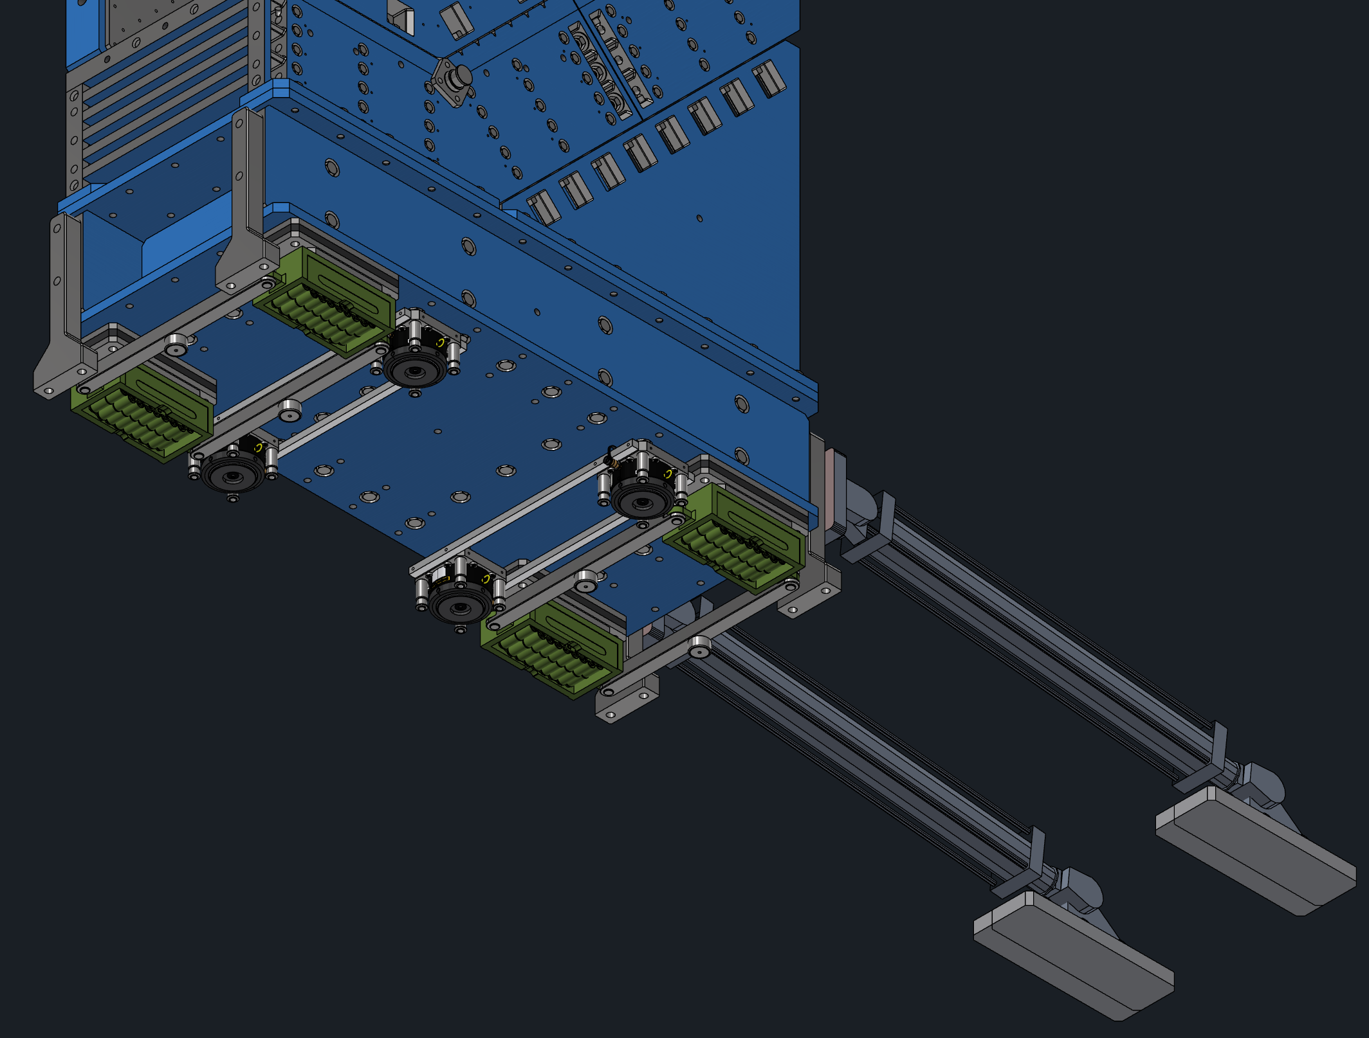
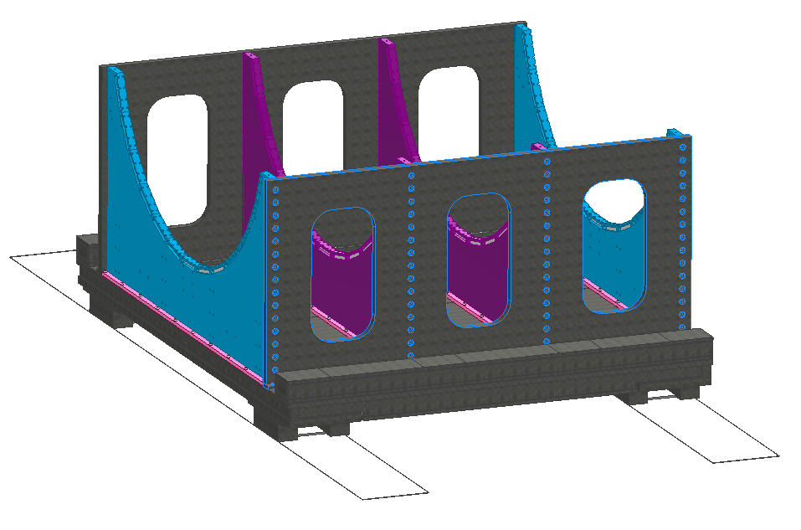
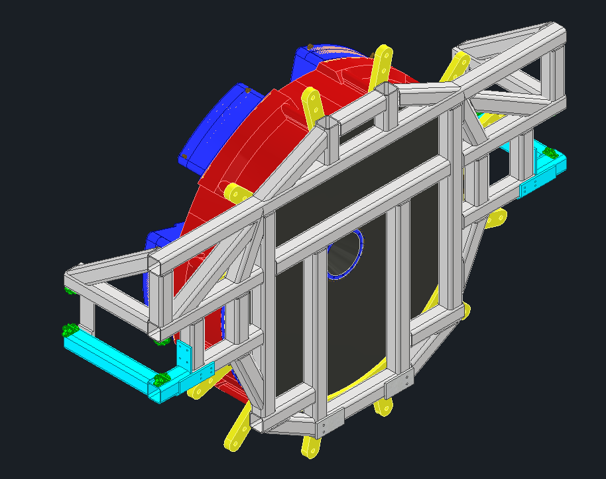
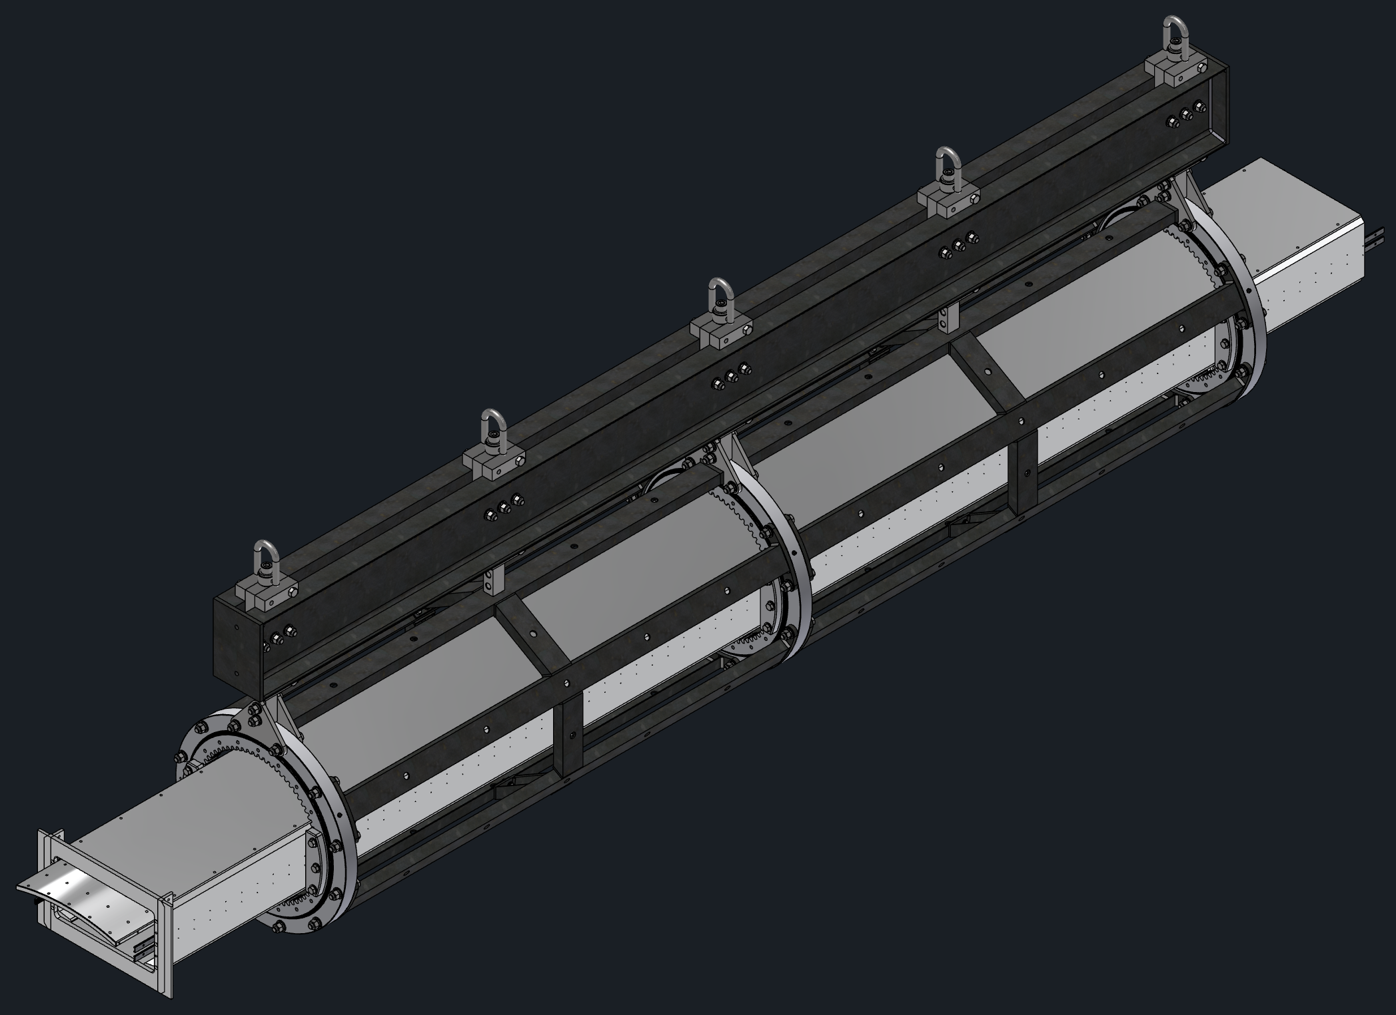
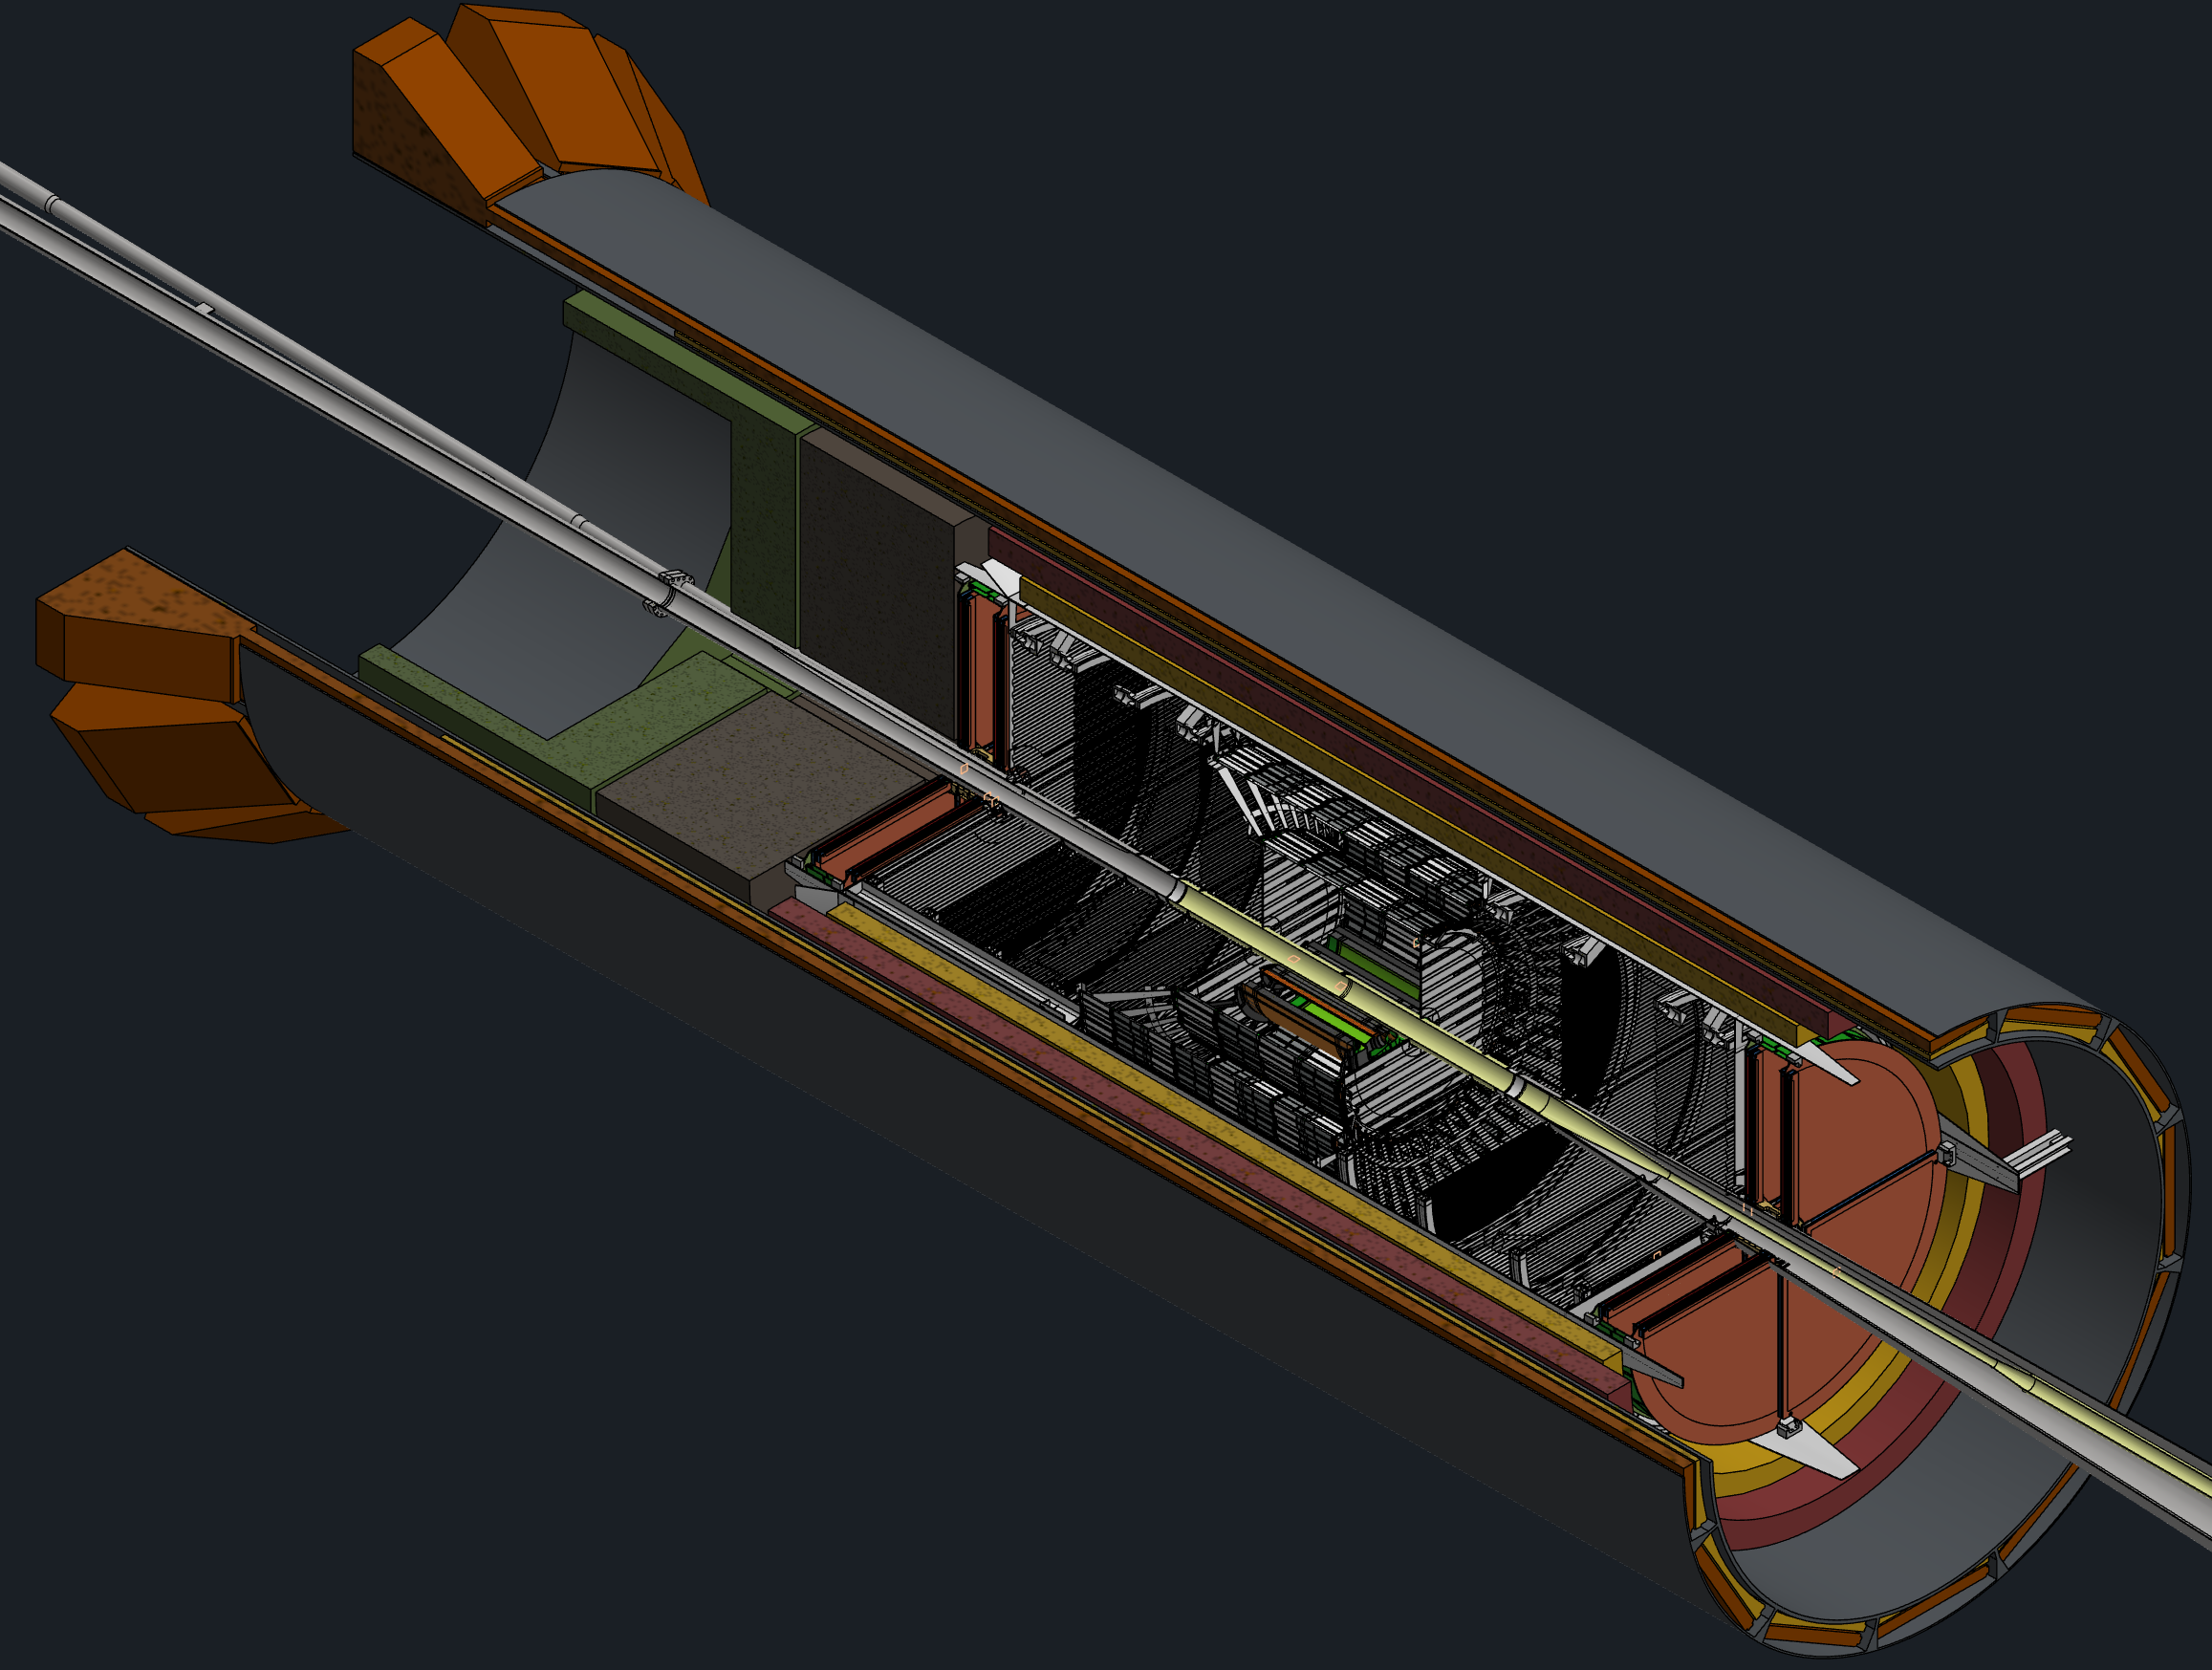
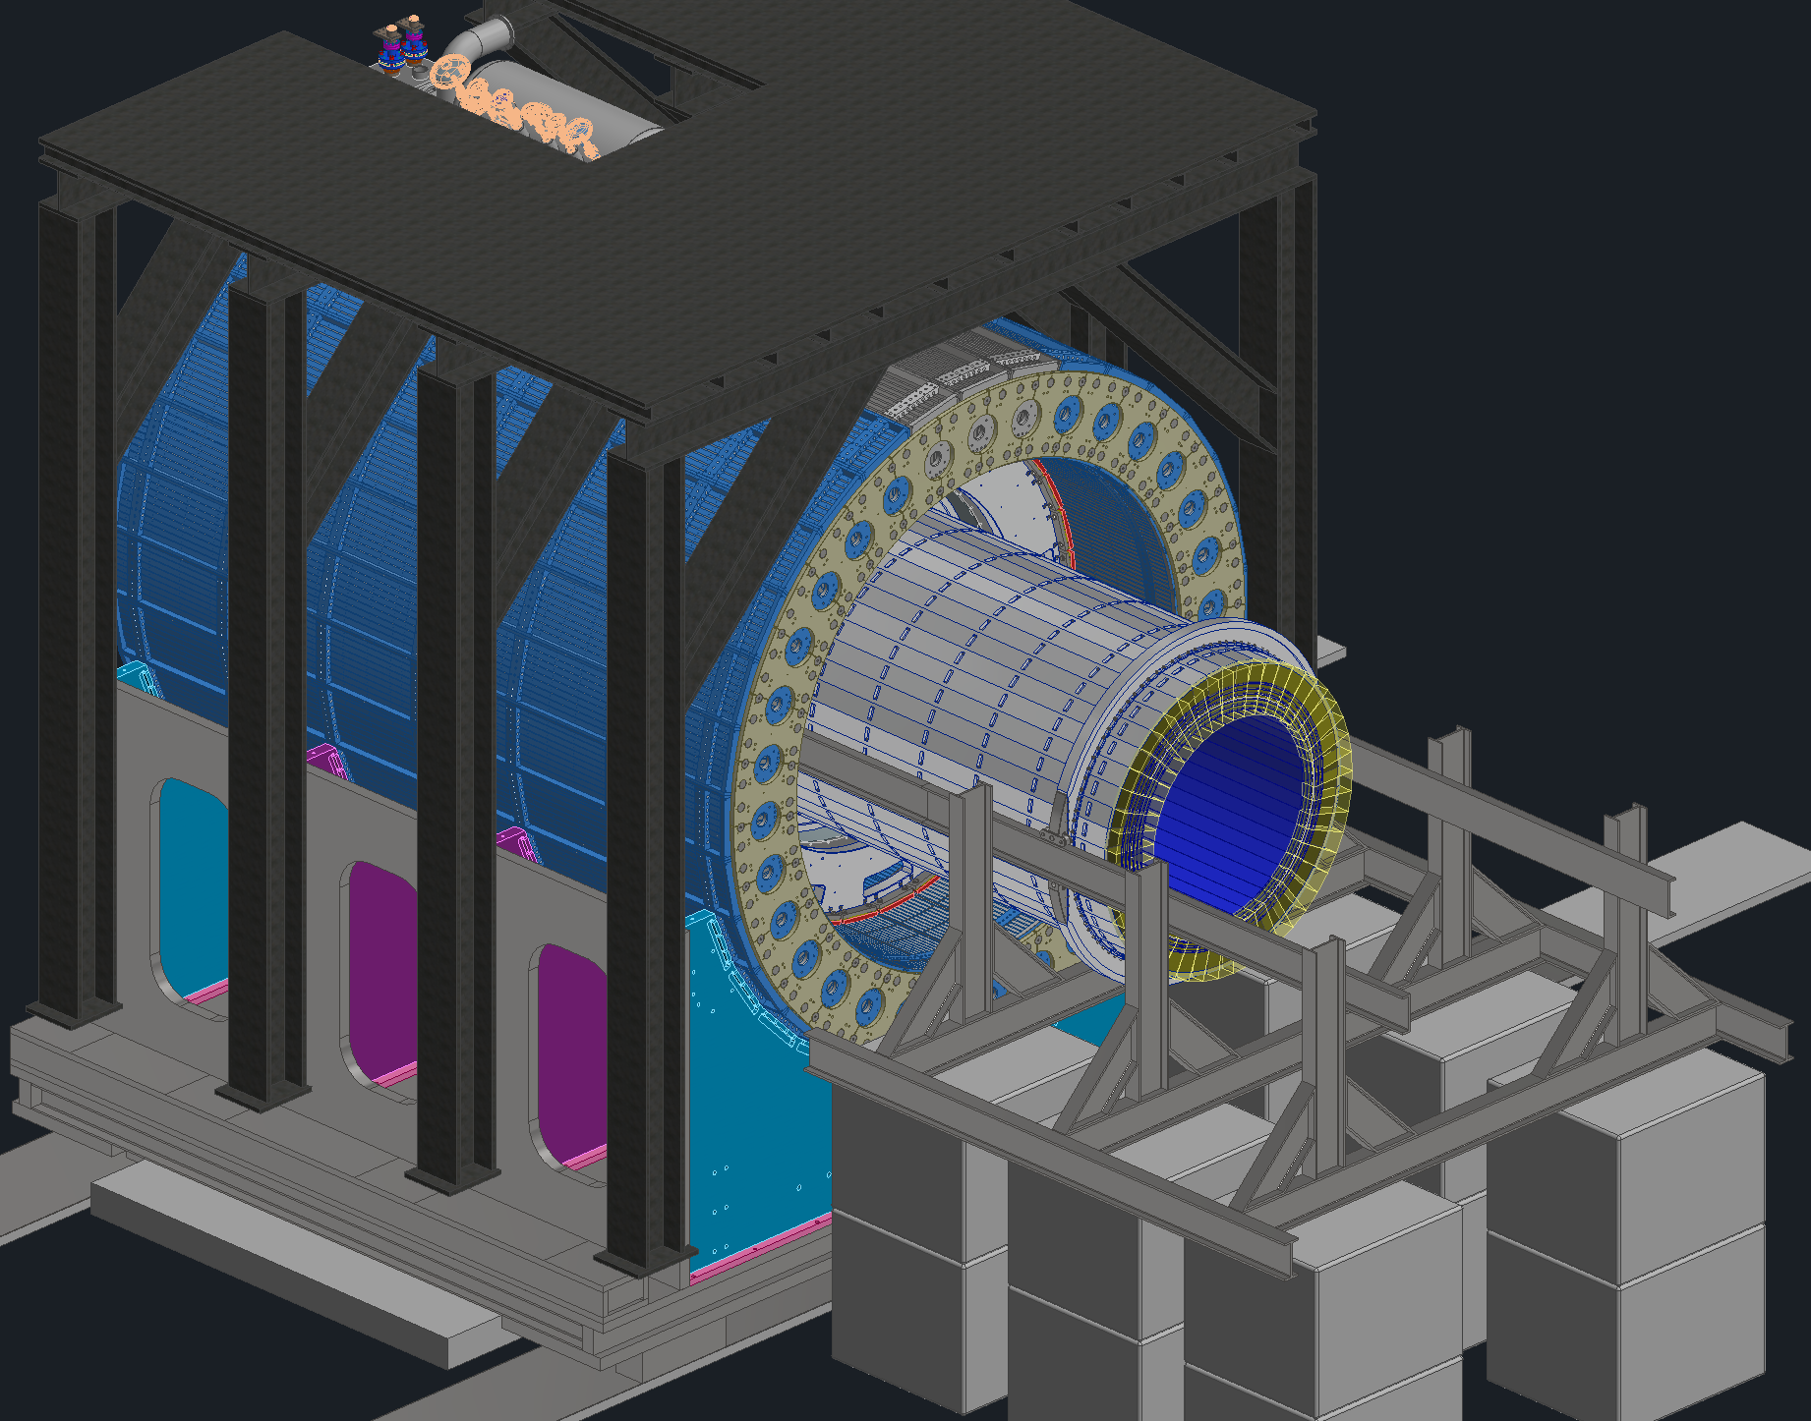
PDR for Integration, Installation and Infrastructure
Barrel Cradle
III PDR Scheduled for December 8th and 9th
Includes all installation tooling, detector structures.14 talks on ~15 detectors, facilities, services and cooling, etc.
Everything is making good progress to reaching 60% design completion.
https://indico.bnl.gov/event/30101/
Endcap Movement
Barrel EMCal Install
dRICH Install
DIRC, MPGD, ToF, Cymbal Install
GST and PST Structure

Slide 4
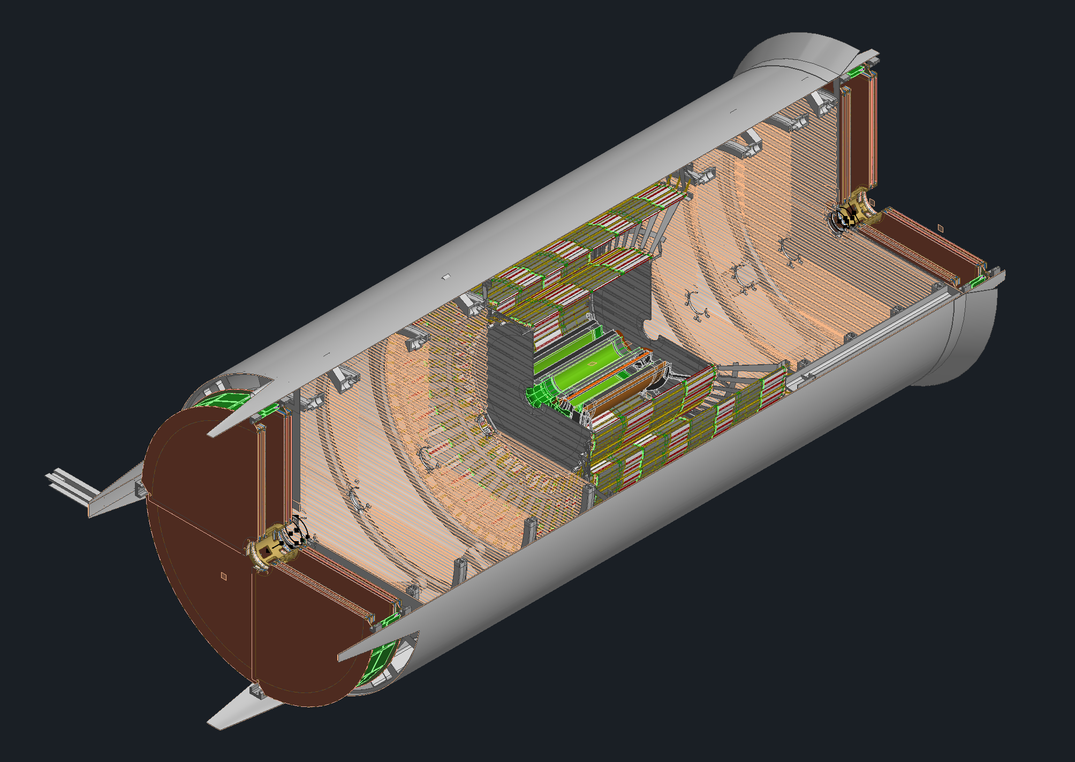
Inner Trackers and their Supports
We’ve had several meetings in the past few weeks with the DSCs from some of the inner trackers
We met with the MPGD group and Ben to figure out their support placement, their inner radii and their service routing
The CYMBAL group had updates on their model and how they need to be supported
We met with the Sushrut and Andy regarding ToF and the GST. No updates here, the ToF is being resegmentated

Slide 5
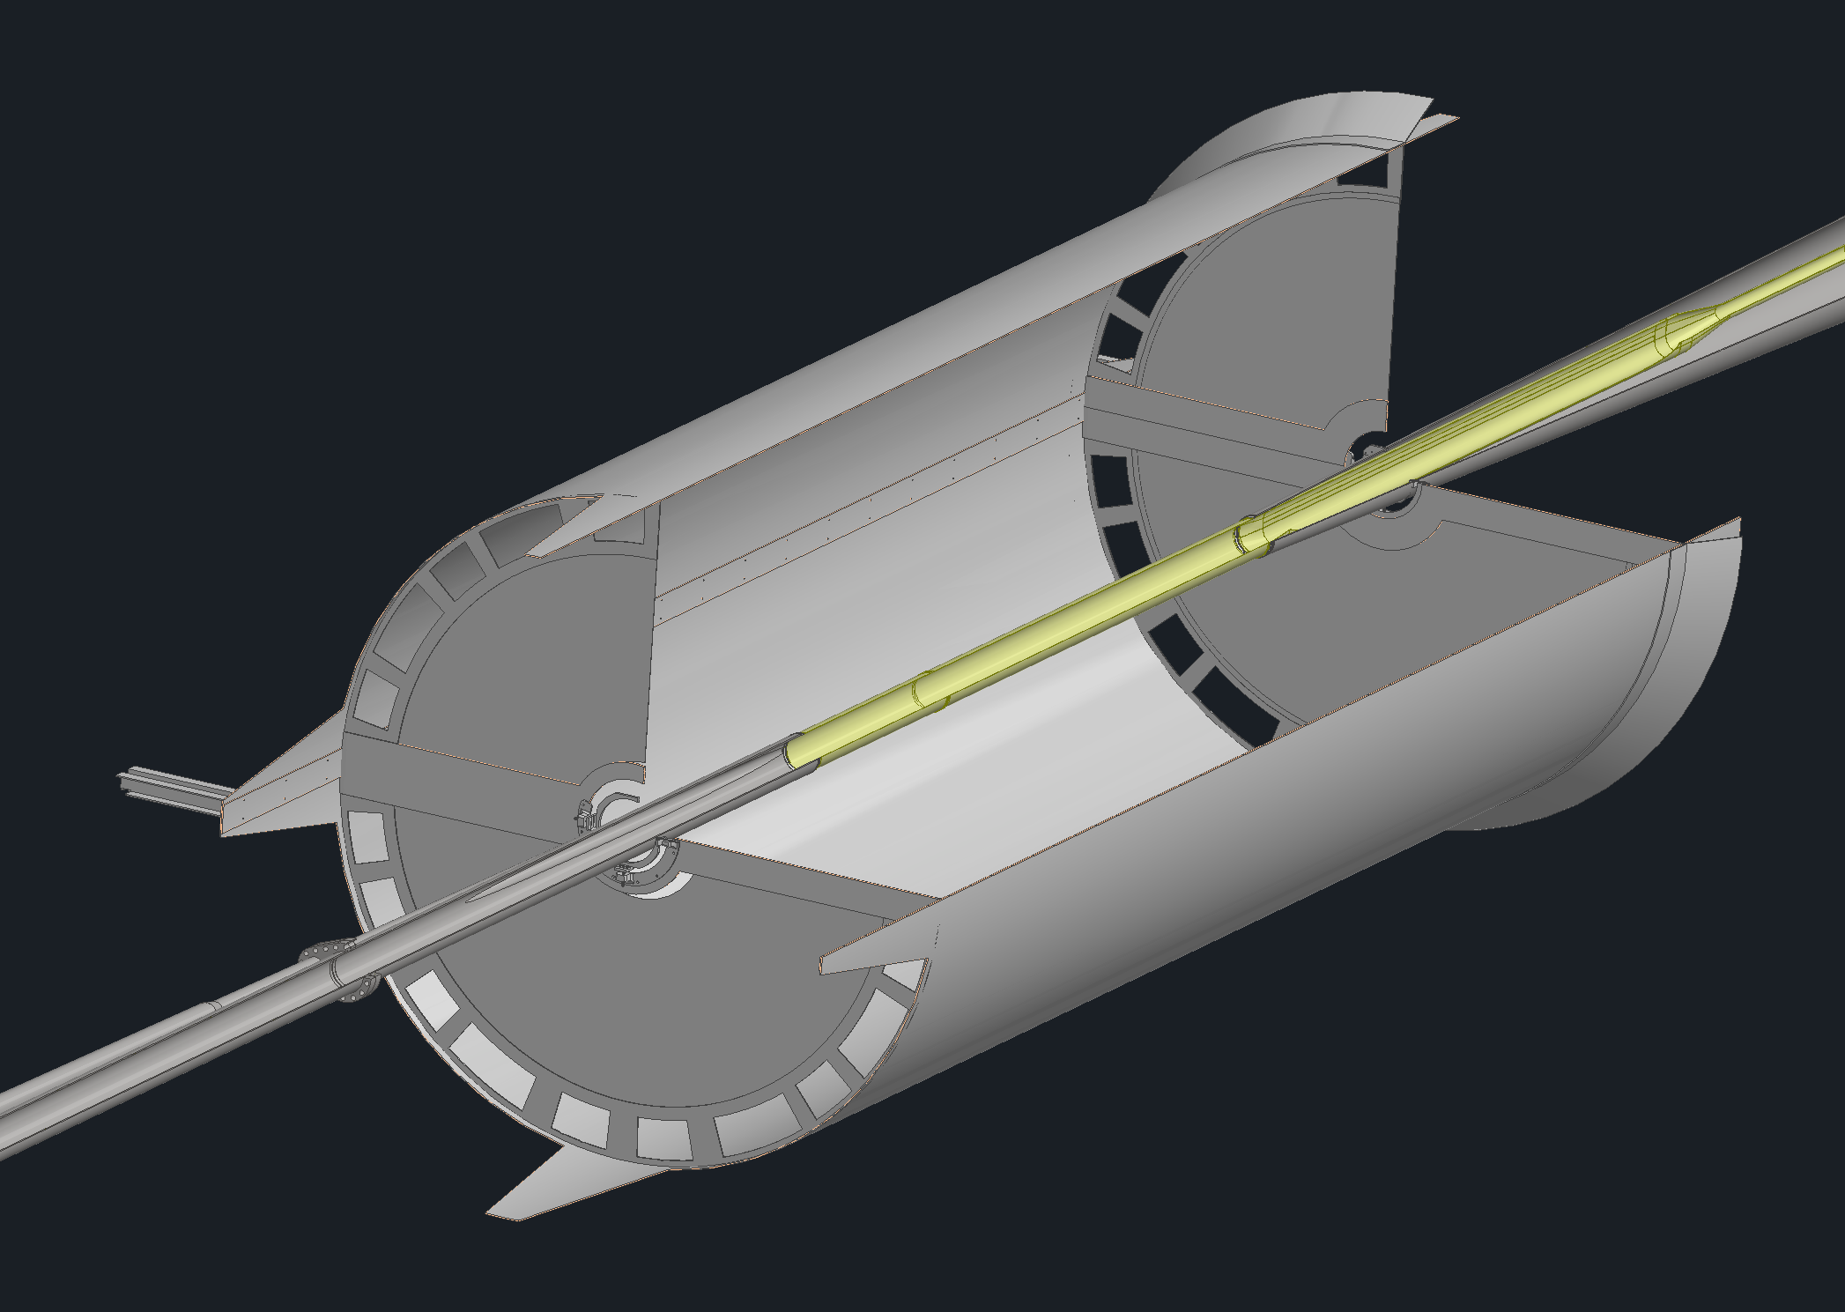
Beampipe Support
Had a meeting two weeks ago regarding the beampipe model and its supports.
Currently working on the supports for the beampipe
Looking into the deflection in the beampipe over the spans of the proposed support locations

Slide 6
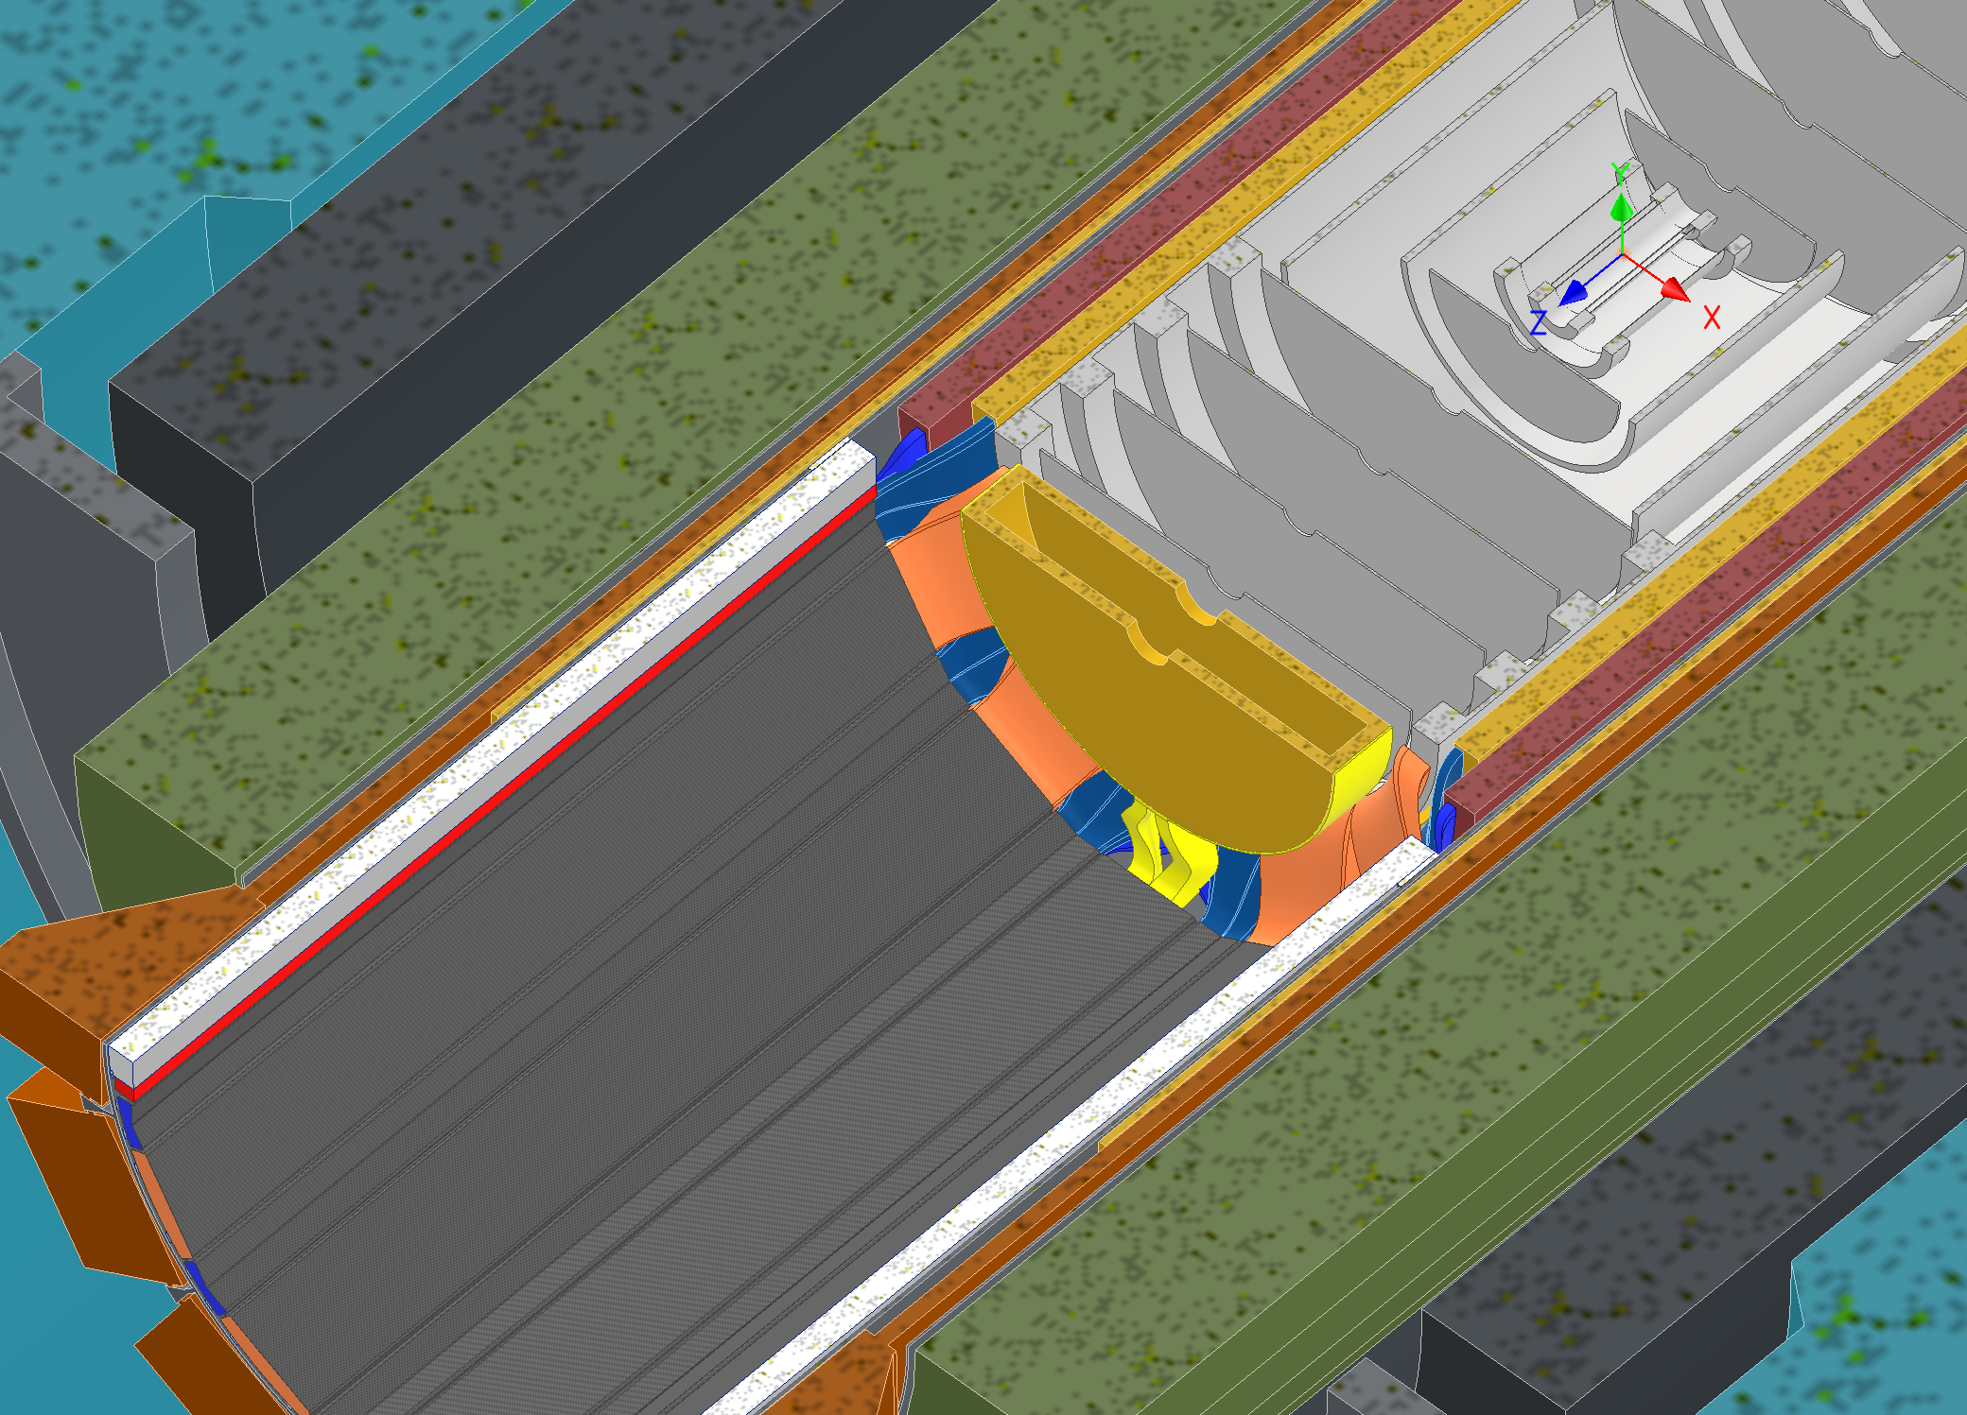
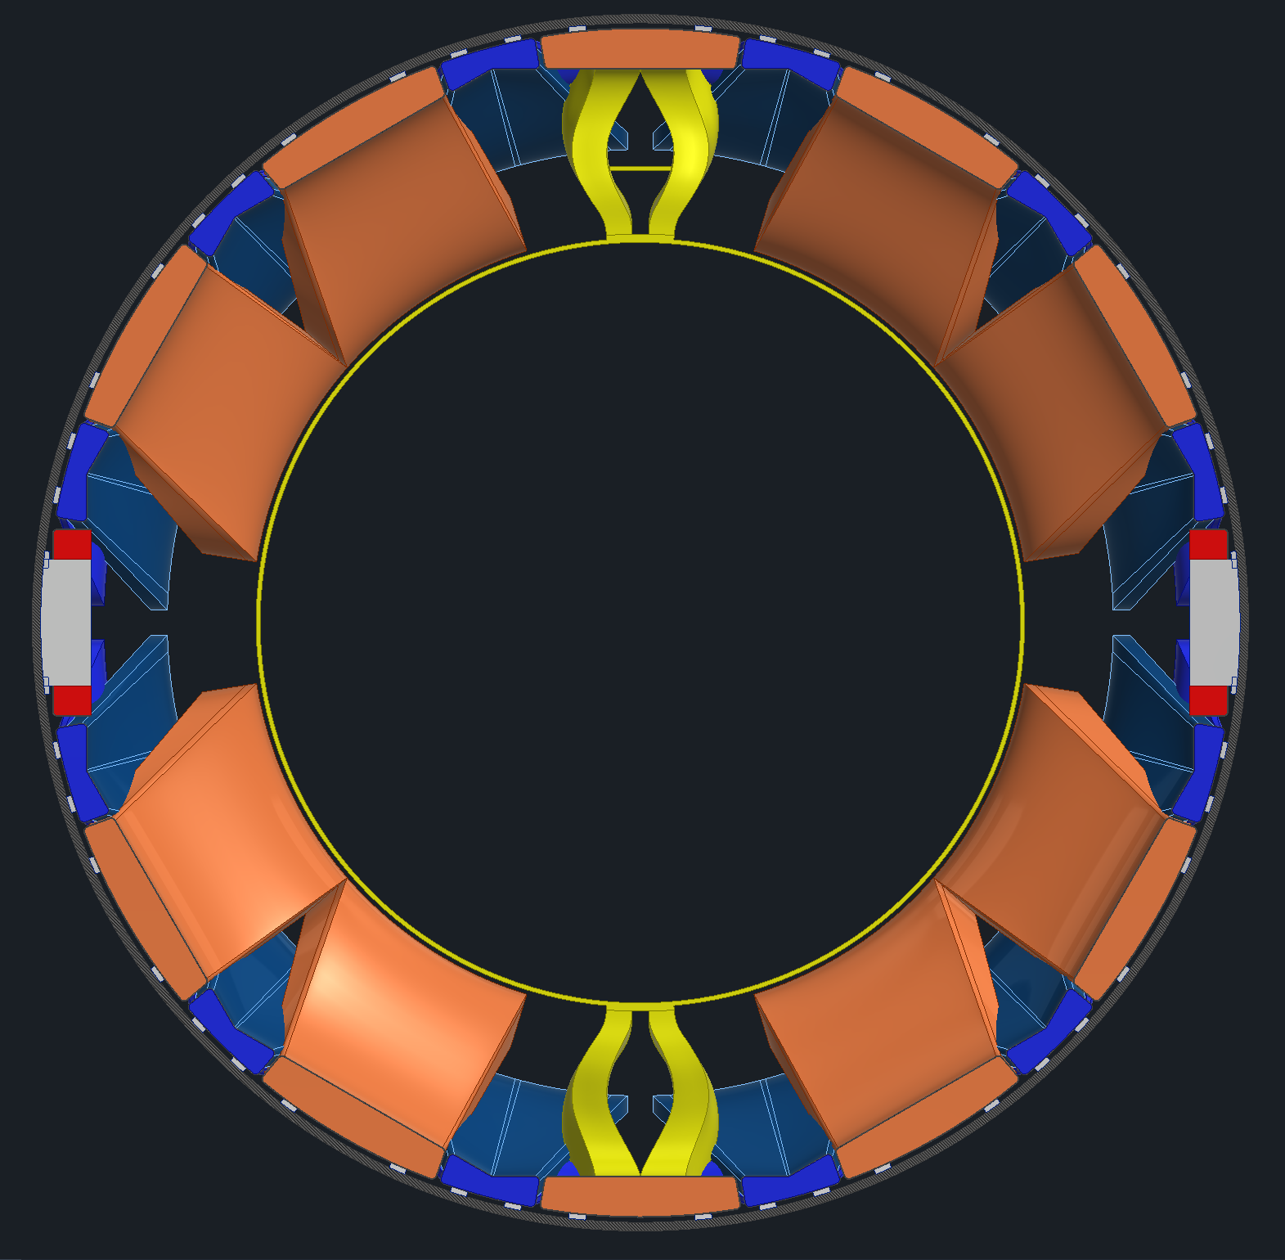
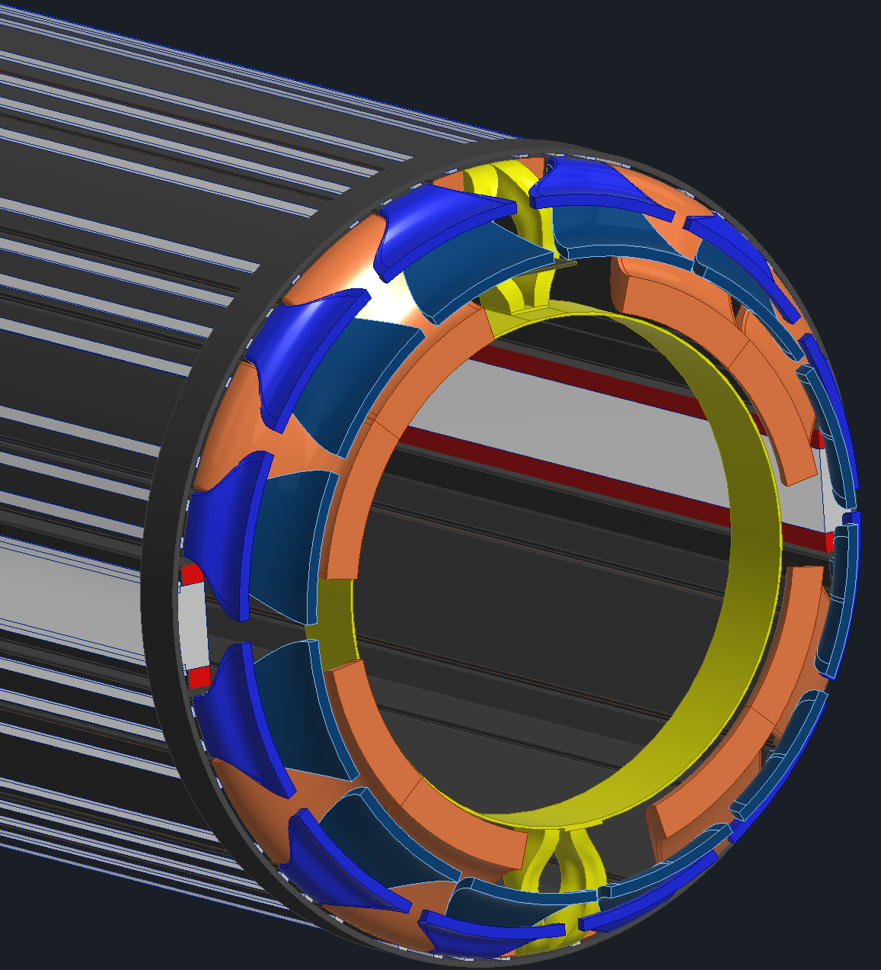
Inner Tracker Services
Looking to make a mockup of the services between the end of the PST on the backward side and the pfRICH after our PDRs
Modeling the services a few different ways to see how they might fit.

Slide 7
Backup Slides

