Slide 1
LUMI Dipole Design
Ian Gildea & Sandesh Gopinath
Jefferson Lab - Magnet Group
2/12/2026

Slide 2
Goal
Preliminary design of Hi-Lumi dipole magnet
Known Requirements:
  Variable field of up to 1Tm
  Length of 1.2m
  < 4 Gauss at electron line
Assumptions:
  Two identical dipole magnets with one power supply (150 KW max)
  No field quality requirement
  No radiation dose effects considered
  Maximum Voltage = 100 V per magnet, Maximum Current Density = 10 A/mm²
  Constant current magnet – no ramping rate requirement
  LCW available pressure drop ~0.6 MPa

Slide 3
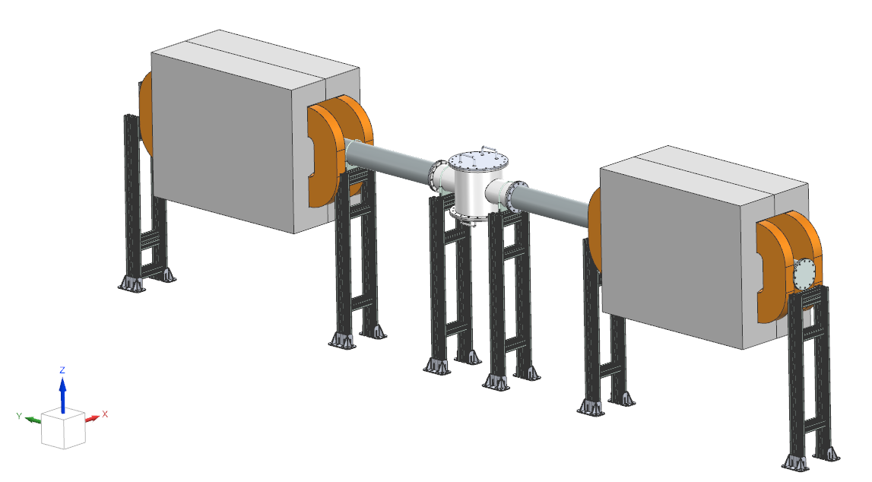
Next Steps (As of 2/9/2026):
60% Design of magnets, performance requirements / specifications / interfaces (if any) ~30% complete
Vendor or production sites (if JLab) - 0% complete
Cost Estimations (including labor) - ~20% complete?
QA or “accept” tests ~0% complete
Mechanical integration with IR and the Vacuum Chamber (including support/mounting to the floor) – 0% complete

Slide 4
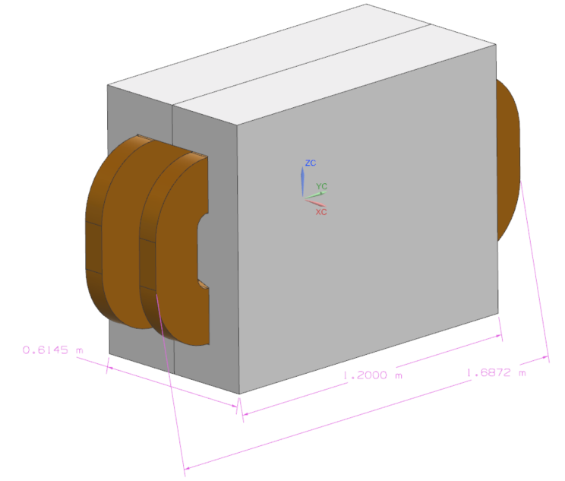
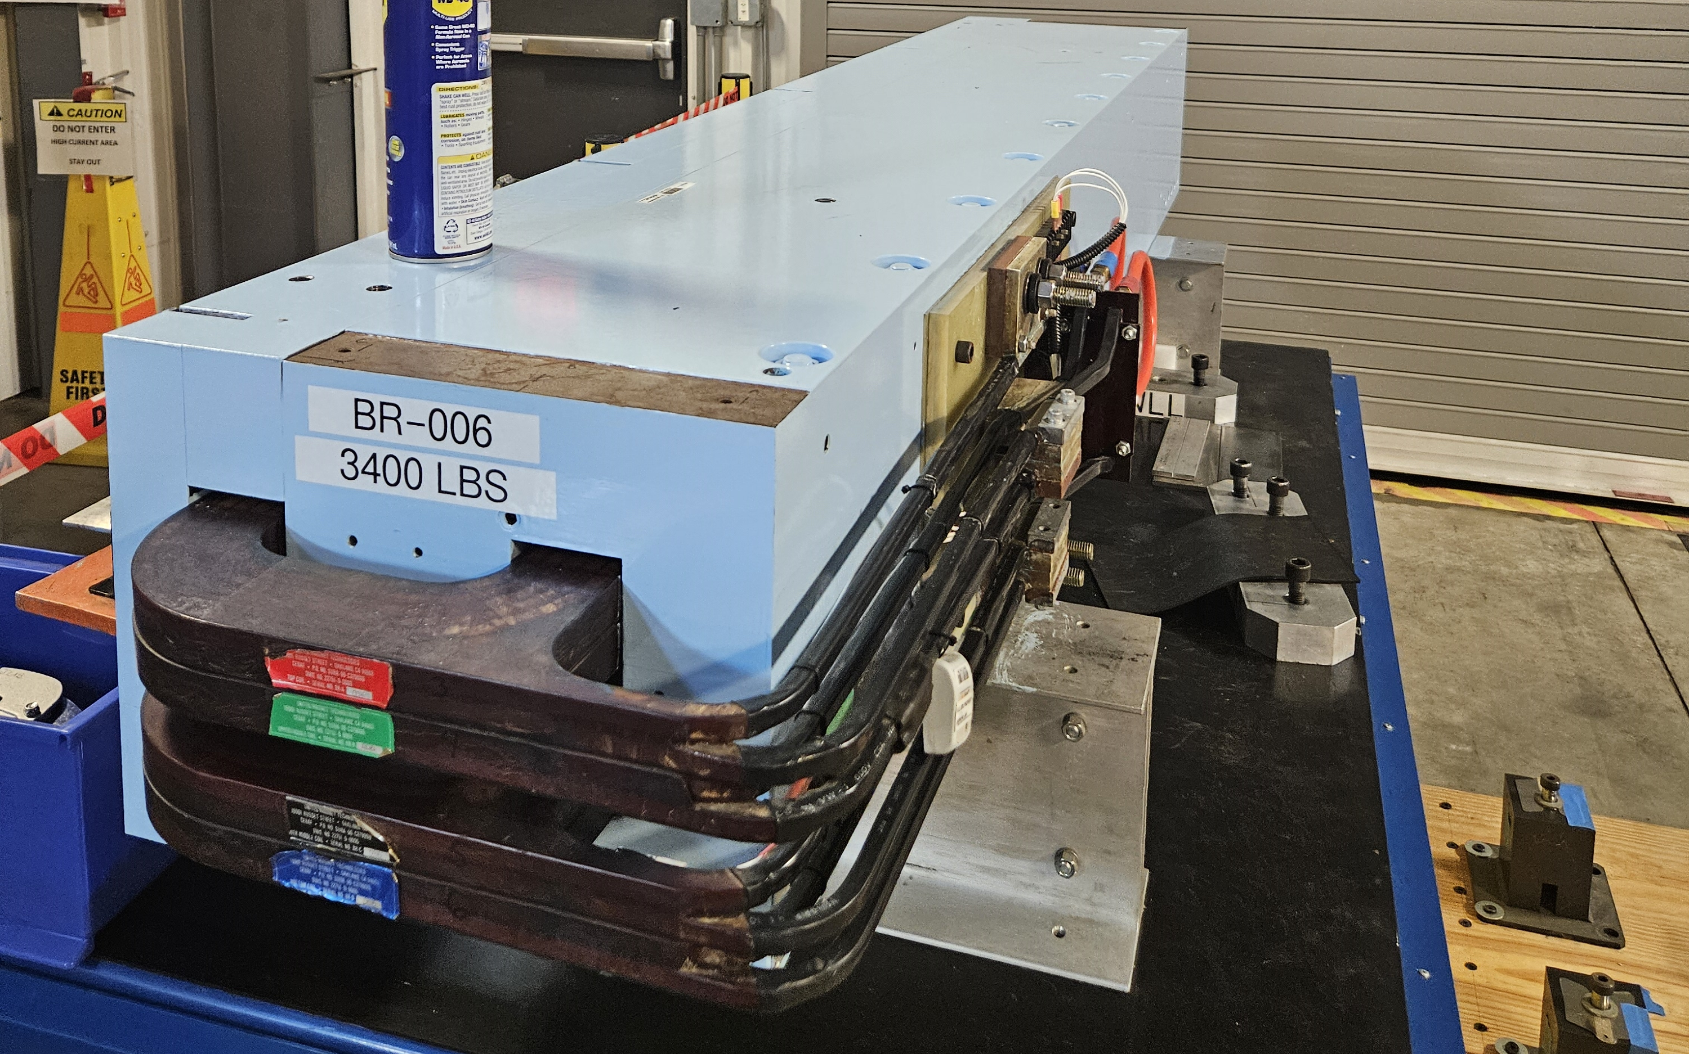
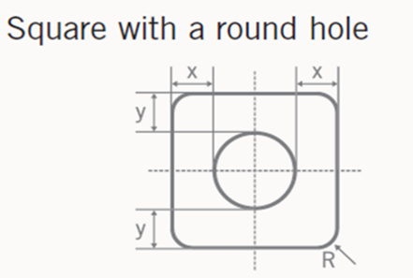
Current Progress
Initial calculations for power requirement, field quality & cooling per magnet
Simulation in Maxwell & OPERA
Design refined to reduce complexity of cooling system & optimize pole
Dipole magnet with two cooling channels per coil

Slide 5
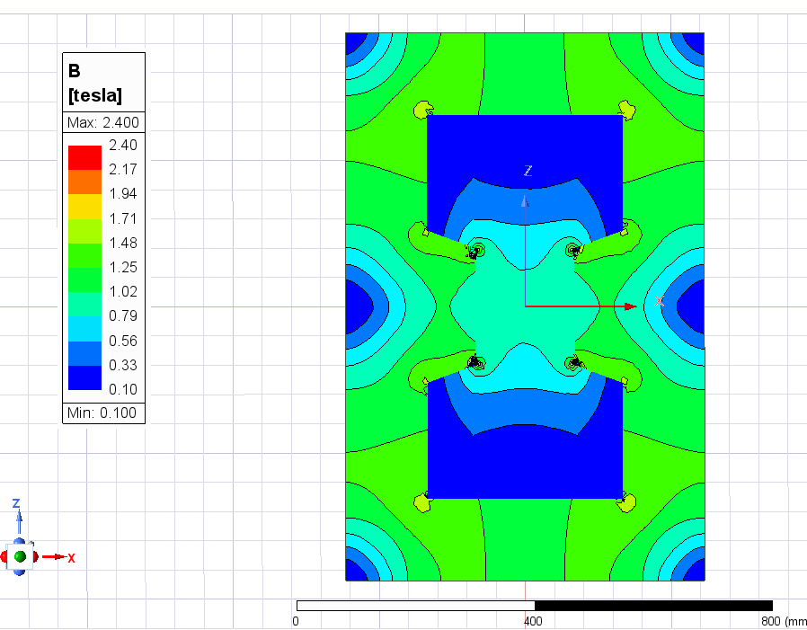
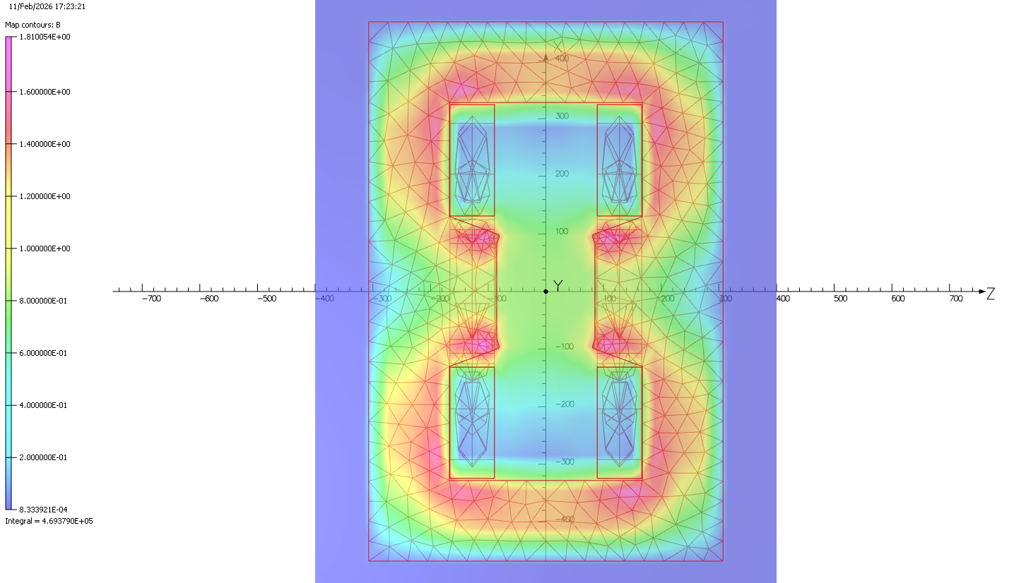
FEA Analysis
Field in the beampipe is approximately 0.82 T (R=7.5 mm)
Integrated Field approximately 1.08 T-m
Further refinement needed to optimize pole shape & integrated field

Slide 6
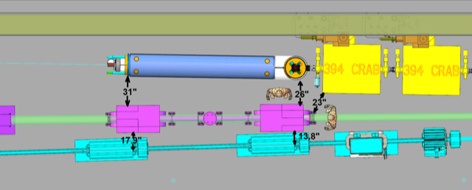
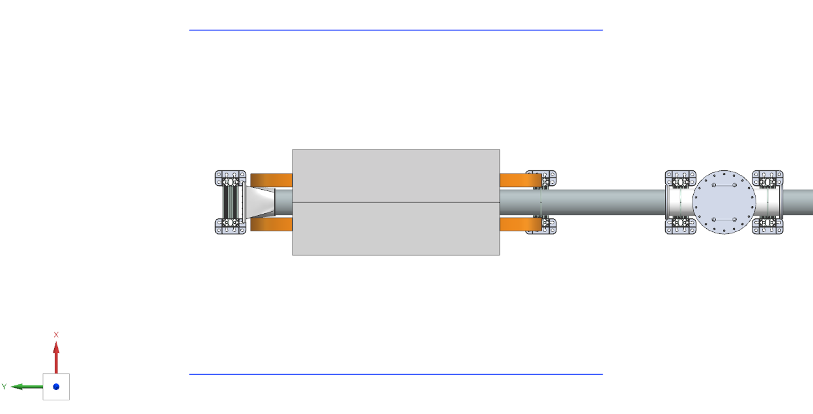
Fringe Field
Requirement: < 4 Gauss at Electron Line
Simulation Results
  ~25 Gauss at CRAB cavity
  Maximum ~100 Gauss 1m from beamline (left/right)
  Shielding may be required if < 4 Gauss is crucial
39” / 1m

Slide 7
Costing
Materials Cost Outline:
  Note: These estimates are not adjusted for inflation and do not include import fees, tariffs or other contingencies.
Item | Description | Cost | Source | Comments
1 | Coil Copper conductor | $ 24,066.00 | MOLLER tm4 COIL, 2021
2 | Coil winding block & mold | $ 31,001.00 | MOLLER tm4 COIL, 2021
3 | Coil potting | $ 26,572.00 | MOLLER tm4 COIL, 2021 | With CTD 101, with vendor feedback on resin cost in 2025
4 | Steel | $ 34,984.00 | Engineering Estimate | Estimated based on 0.134" thick laminate cost of 1008-1010 Steel
5 | Steel machining | $ 17,492.00 | Engineering estimate
6 | Controls | $ 10,000.00 | Engineering estimate | For 4x flow & temp meter
 | Total 1x Magnet | $144,115.00
7 | Power supply | $135,000.00 | Hall C supply, 2021 | 150kW - 1000 Amp, 150 Vdc,100 ppm
 | Total 2x magnet system | $423,230.90
Manufacturing, Labor, Assembly, QA and Installation are currently being costed.

Slide 8

Questions?

