Slide 1

ePIC Collaboration News
J. Lajoie, S. Dalla Torre
November 20th, 2025

Slide 2
Hey John, start the recording….

Slide 3
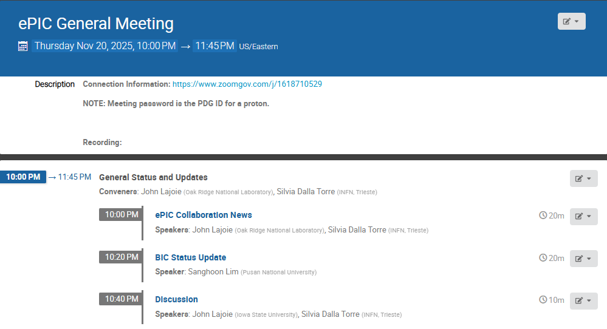
Agenda
Some news from the collaboration and reports from ePIC collaborators

Slide 4





2025 -2026
PDR: DAQ - Slow
Controls
Spring 2026
PDR2: Polarimetry
Week of
Feb 18-19, 2026
DOE OPA Status
5-7th August, 2025
PDR3: IR Integ.
& Aux. Det
March/April 2026
PDR2: Si Tracking Detectors
Week of
Jan 26, 2026
10th Detector Advisory Committee
June 11-13th 2025
ePIC Physics Readiness Workshop
Sept. 17-18th, 2025
PDR: HCals/fwd ECal
Oct. 30-31, 2025
PDR2: Cerenkov PID
April 1-2, 2025
FDR: BABAR DIRC Bar Refurbishment
ePIC Early Physics Workshop
April 24-25, 2025
PDR2: MPGD Detectors
Dec 2025
PDR2: AC-LGAD Detectors
Dec. 2025
ePIC Software and
Computing Review
Oct 6-7, 2025
ePIC Software and
Computing Technical Interchange – May 12th
PDR: Magnet/Cryo Infrastructure
Nov. 4-5th 2025
FDR: Backward
EM Calorimetry
Feb 2026
BIC In-Person Workshop
April 9-11,
2025
SVT Summer
Workfest
June 9-11,
2025
PDR3: Elec./DAQ
Sept. 3-4th, 2025
Frascati
Jan 20-24,2025
ePIC pre-TDR
Next Draft
(Dec 2025)
DOE IPR and ICR, 9-13th March. 2026
Jefferson Lab. July 14-18
BNL
Jan. 20-23
PDR: Integ. + Installation
(inside and outside GST)
Week of Dec. 8th, 2026
Calorimetry
Workshop
June 5-9th, 2025
PDR3: Barrel EMCal
Sept. 17-18th
2025
Detector Baseline Readiness Review
February 3-5,2026
(tentative)
EICO
2-4th April 2025
FDR: Backward & Forward EM Calorimetry, Barrel & Forward HCAL
July 2025
HSF-India/ePIC Workshop
May 13-17th, 2025
6th EIC RRB Meeting
Nov. 4-5th 2025
5th EIC RRB Meeting
June 5-6th 2025
SVT Workfest
Dec 15-19,
2025
CD-2 Review
Late 2026
Detector R&D Day (ePIC/Project)
16-17th April 2025

Slide 5
Detector Reviews & Meetings planned for 2025/2026
Preliminary Design Reviews (60% design maturity equivalent, called PDR, PDR2 or PDR3, pending the subsystem)
  PDR2: Cherenkov-based Particle Identification Detectors (6.10.04; pfRICH, hpDIRC, dRICH) – April 1-2, 2025
  PDR3: Electronics/DAQ-computing (6.10.08. 6.10.09.01) – September 3-4, 2025 (this does not include slow controls)
  PDR3: Barrel EM Cal (6.10.05.02) – September 17-18, 2025
  PDR (60%) Barrel & Forward & Backward HCAL (6.10.05.01; 6.10.06.02; 6.10.06.03) and forward ECAL – October 30-31, 2025
  PDR: Magnet Cryogenics and infrastructure (6.10.07) – November 4-5, 2025 (integrated in overall EIC Project Cryogenics PDR)
  PeerReview: AC-LGAD-based Particle Identification Detectors (focus on sensors) – December 3rd 2025
  PDR: Integration, Infrastructure and Installation (6.10.10) – everything inside & outside GST, includes cradle, HCAL, etc. – Dec. 8-9
  PDR: MPGD Tracking Detectors (6.10.03.02) – aim for Dec. 15
  PDR2: Silicon Tracking Detectors (6.10.03.01) – week of Jan. 26, 2026
  PDR2: Polarimetry (6.10.14) – aim for February 18-19, 2026
  PDR: DAQ-Slow Controls (6.10.09.02) – Spring 2026 – Separated from electronics/DAQ to ensure integration in the collider common platform
  PDR3: IR Integration and Auxiliary Detectors (6.10.11) – March/April 2026 – includes 6.10.14 lumi detector
  PDR2: AC-LGAD-based Particle Identification Detectors (6.10.04; BTOF, FTOF, common systems) – April 2026
Final Design Reviews (FDR):
  FDR: Final Design Review of the BABAR DIRC Bar Refurbishment for the High Performance DIRC Particle Identification Detector – April 1, 2025
  FDR: Backward EM Calorimetry – Mid February 2026
Project Reviews:
  DOE OPA CD-3B Review – January 7-9, 2025
  “Red Team” Review (acts as Director’s Review for DOE OPA Focused Status Review) – May 20-21, 2025
  Comprehensive ePIC/EIC Detector Review by Detector Advisory Committee – June 11-13, 2025
  DOE OPA Focused Status Review – August 5-7, 2025
  Detector Baseline Readiness Review November 12-14, 2025 → postponed to Feb 3 – 5, 2026
  DOE Status Review March 9-12, 2026
  CD2 IPR & ICR June 2026?
Other Meetings:
  EIC International Computing Organization (EICO) – April 2–4, 2025 @BNL
  Detector R&D Day hosted by ePIC and EIC Project – April 16-17, 2025
  Technical interchange meeting with EIC Computing and Software Advisory Committee (ECSAC) – May 12, 2025
  5th RRB Meeting: June 5-6, 2025 – Prague, Czech
  10th DAC Meeting – Comprehensive look to design status and readiness for CD-2. June 11-13, 2025.
  EIC Software & Computing annual review – October 6-7 @ JLab (and Echelon 0–1 mini-workshop on October 8)
  6th RRB Meeting: November 4-5, 2025 - BNL

Slide 6
DOE and EIC Planning Dates
Milestone |  | Milestone
DOE Independent Project Review (IPR) | Jan. 7-9, 2025 | DOE RHIC R&R/Injector Operations Review | Sept. 8-10, 2025
Start Developing Scope of Subprojects | January 10, 2025 | Machine Advisory Committee Meeting | Sept. 16-18, 2025
IR SC Magnet Steering Group Meetings - Monthly | January 17, 2025 | Infrastructure Construction Advisory Committee | October 2025
Project Advisory Committee Meeting | February 11, 2025 | Resource Review Board Meeting (BNL) | Nov. 4-5, 2025
EIC Advisory Board Meeting | February 25, 2025 | Assessments of Baseline Readiness for SPs Detector Interaction Region Accelerator Storage Rings Global and Energy and Luminosity Ramp-Up Electron Injector (follow-up to Apr ‘25 Review) | Nov. 12-14, 2025 Feb. 3-5, 2026 Nov. 18-20, 2025 Jan. 14-16, 2025 February 2026 April 2026
Electron Injector Design and Cost Review | April 8-10, 2025
Infrastructure Construction Advisory Committee | April 16-17, 2025
Project Advisory Committee "Red Team" Review | May 20-21, 2025
Resource Review Board Meeting (Prague) | June 5-6, 2025
Detector Advisory Committee Meeting | June 11-13, 2025 | RHIC Operations Conclude | ~End 2025
EIC Advisory Board Meeting | June 17, 2025 | RHIC Removal and Repurposing (R&R) Starts | ~Early 2026
DOE CD-3B ESAAB Approval | Pending | DOE IPR Comprehensive Review | Mar 9-13, 2026
DOE IPR Focused Status Review | August 5-7, 2025 | DOE CD-2 Detector Subproject Review | ~ June 2026
 |  | DOE CD-2/3 Accelerator Storage Rings | ~ June 2026

Slide 7
Subsystem Reviews
Subsystem | PDR Completed | PDR Scheduled | FDR Completed
Tracking | 40% Si & MPGD | 60% Si week of Jan. 26, 2026 & MPGD Dec. 15, 2025
PID | 40% & 60% hpDIRC, pfRICH, dRICH ToF 40% | ToF Peer review week of Dec. 3rd, 2025, 60% PDR April 2026 | DIRC Bar refurbishment
ECals | 60% bECal, BECal, fECal |  | SiPM & SciFi fECal, BEcal SiPM & PbW04 bECal
HCals | 40% & 60% BHCal & fHCal 40% & 50% bHCal |  | SiPM bHcal & fHcal Lead blocks fHCal
Solenoid | 60% PDR Cryogenics |  | Magnet, Conductor and Power Supply
Electronics | 40%, 50% & 60% |  | VTRX+ & lpGBT
DAQ | 40%, 50% & 60%
Integration- Installation - infrastructure |  | 60% Inner and outer Barrel support-structures on Dec. 8-9, 2025 | electron and hadron endcap support structures
Auxiliary Detectors | 30% & 40% RP, B0, ZDC, Low Q2-Tagger, Lumi. | 60% RP, B0, ZDC, Low Q2-Tagger, Lumi: Late March/early April 2026
Polarimetry | 40% RCS & ESR Compton Polarimeter & HSR Polarimeters | 60% RCS & ESR Compton Polarimeter & HSR Polarimeters aim for February 18-19, 2026.
June 11-13, 2025: Comprehensive Design Review by DAC
Feb 3-5, 2026: Baseline Readiness Assessment review scheduled

Slide 8
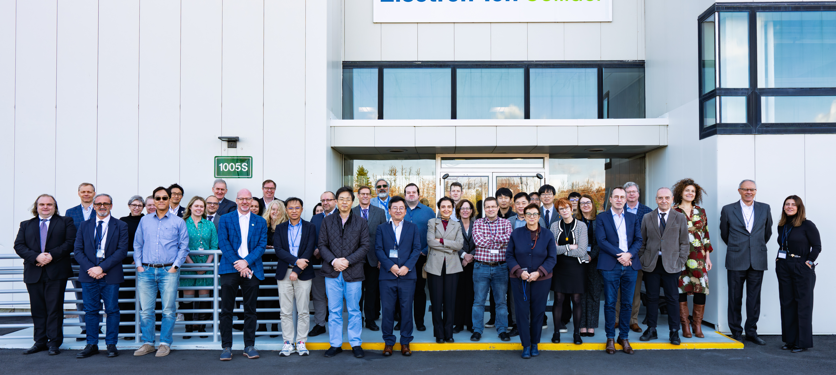
EIC RRB Meeting
November 4-5, 2025 at BNL

Slide 9
Highlights of EIC RRB Meeting
Reports from the EIC Advisory Board and the Detector Advisory Committee
Status and plans for the ePIC detector and the collaboration were presented, including a presentation on the collider (S. Nagaitsev, EIC Technical Director)
In many countries proposals related to EIC in-kind detector contributions are approved or in near-final review process. Discussion of CERN agreement (DOE SC overarching and MOSAIX).
The common funds working group addressed questions and comments from the last meeting, proceeding to investigate concrete steps to establish mechanisms to manage common funds.
The EIC International Computing Organization (EICO) charter and coordination with ECSJI was discussed.

Slide 10
Editorial Board and pTDR
The Editorial Board was established at the July Collaboration Meeting with a mandate evolve the next draft of the pTDR.
John Haggerty and Silvia Dalla Torre (co-chairs)
Rosario Turrisi
Olga Evdokimov
Yulia Furletova
Yongsun Kim
Zhenyu Ye
(Peter Jones)
Ex-Offico:
Thomas Ullrich
Renee Fatemi
Elke Aschenauer
John Lajoie
This is a HUGE effort from both the Editorial Board and the DSC’s and PWG’s – pulling together a document of this scope and breadth is complicated and takes a lot of work!

Slide 11
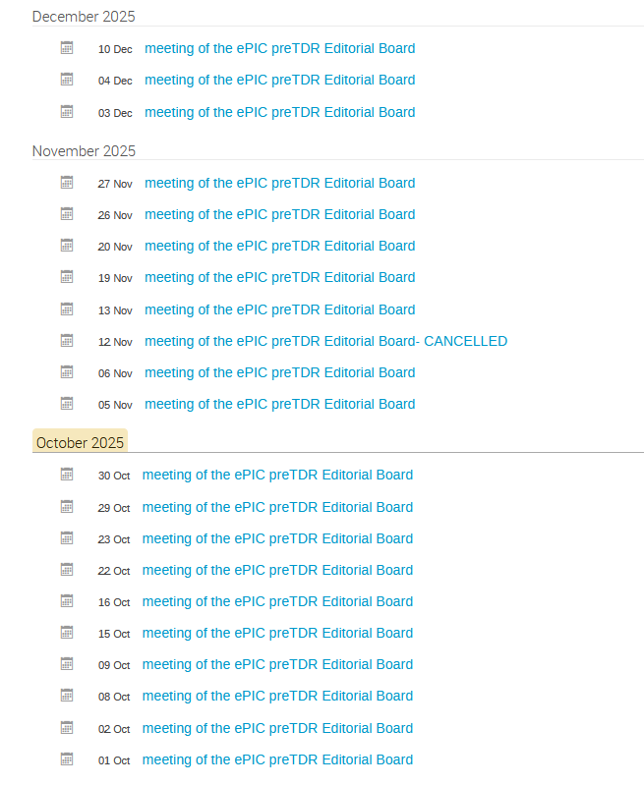
Progress on the preTDR
Version 2.2 of the preTDR posted in Zenodo
Google Form to collect comments from the whole Collaboration
Editorial Board meetings:
  Kick-off: Organizational mtg. Aug 6th
  15 meetings since then
  Extensive EB meeting schedule
  through the rest of the year!
  Editorial Board calendar at : https://indico.bnl.gov/category/683/
Context: the Detector preTDR as a stand-alone document → new document layout

Slide 12
The new layout of the Detector preTDR document
Now available since September 24th
Executive Summary
CHAPTER 1 – Introduction
  About the EIC project and the accelerator complex (high level approach)
CHAPTER 2 – Requirements
  Requirements resulting as an evolution of the YR ones
CHAPTER 3 – Experimental Systems
  Past “chapter 8”
  Presenting the detector subsystems matching the requirements (mainly individual performance)
CHAPTER 4 – Detector Performance for the EIC physics program
  Past “chapter 2”
  Presenting the holistic detector performance by the performance for key physics measurements
CHAPTER 5 – Detector-Accelerator interfaces
  INTEGRATION INTO THE FACILITY
Coming goal:
Next draft of these chapters in 2025

Slide 13
Progress on the preTDR - most recent updates
  Inviting the authors of all sections/subsections (a few of them at each meeting) to discuss their text in detail
  A first pass will be completed by ~ mid November
    A few sections require a second pass
  Authors are further editing in the official overleaf within the new layout
  This further editing phase must be concluded by December 1
  Detail text polishing will follow
  A new more advanced version of the preTDR will be posted in ZENODO before the January ePIC Collaboration Meeting
The Editorial Board greatly appreciates the efforts of all those who are contributing to the pTDR! It’s going to get even more busy over the next month so please do your best to get your contributions into Overleaf so they will be part of the next draft released in December.

Slide 14
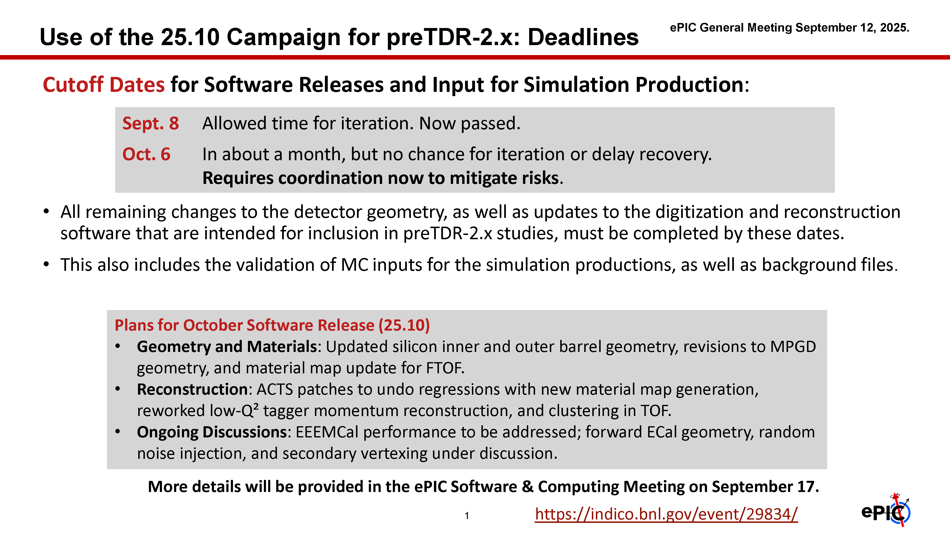
pTDR and October Simulation Campaign
Major focus over the past two months – lots of engagement and activity. Great coordination between S&C, PAC and DSC’s!
Analysis of October campaign ongoing
Discussions ongoing with S&C and all coordinators to organize the effort for 2026.

Slide 15
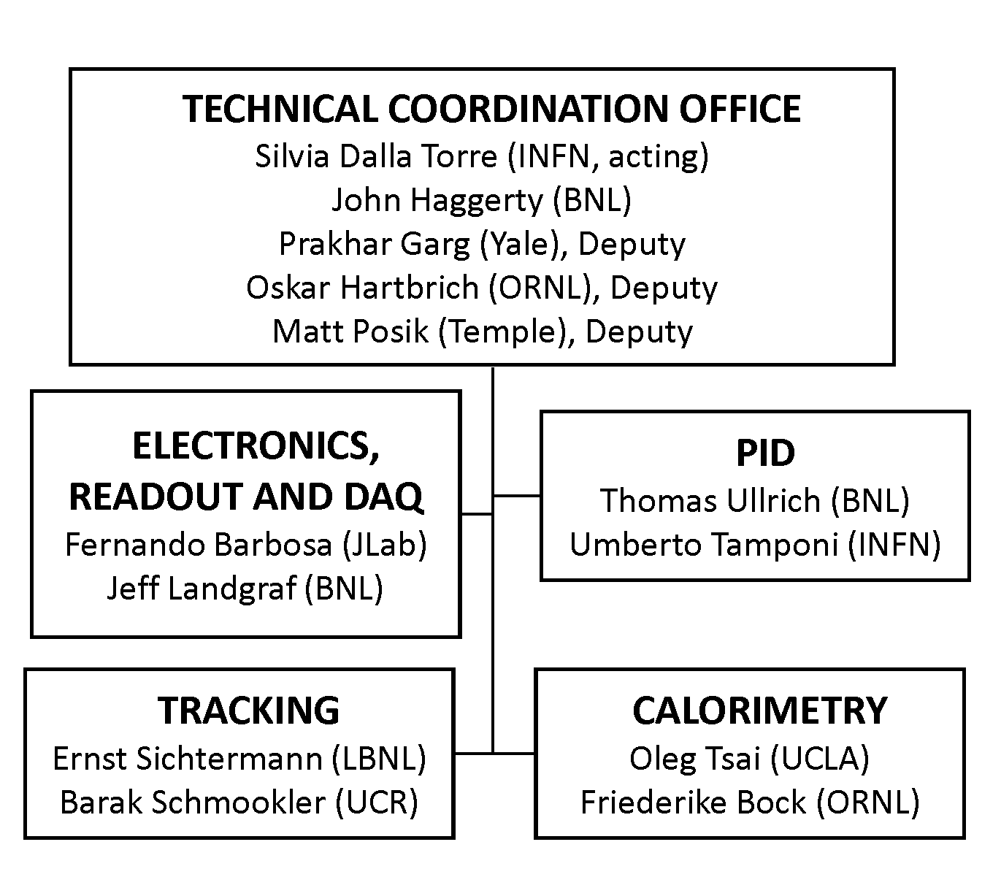
CC WG Charges and Conveners
SP Office wants to focus the CC WG’s on tasks needed to baseline ePIC
  Developed charges for each CC WG, in conjunction with the coordinators and the CC WG conveners
Several of the existing CC WG conveners have been serving for 2+ years and expressed a desire to step down.
Charges in backup slides

Slide 16
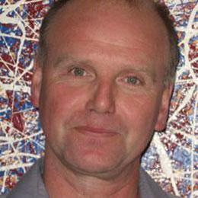
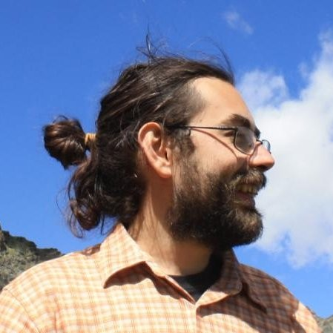
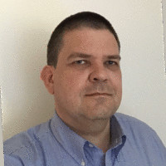
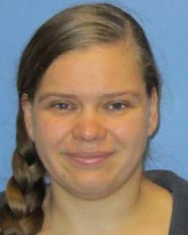
Outgoing CC WG Conveners
A huge thanks from to the outgoing CC WG Conveners for their tireless service!

Slide 17
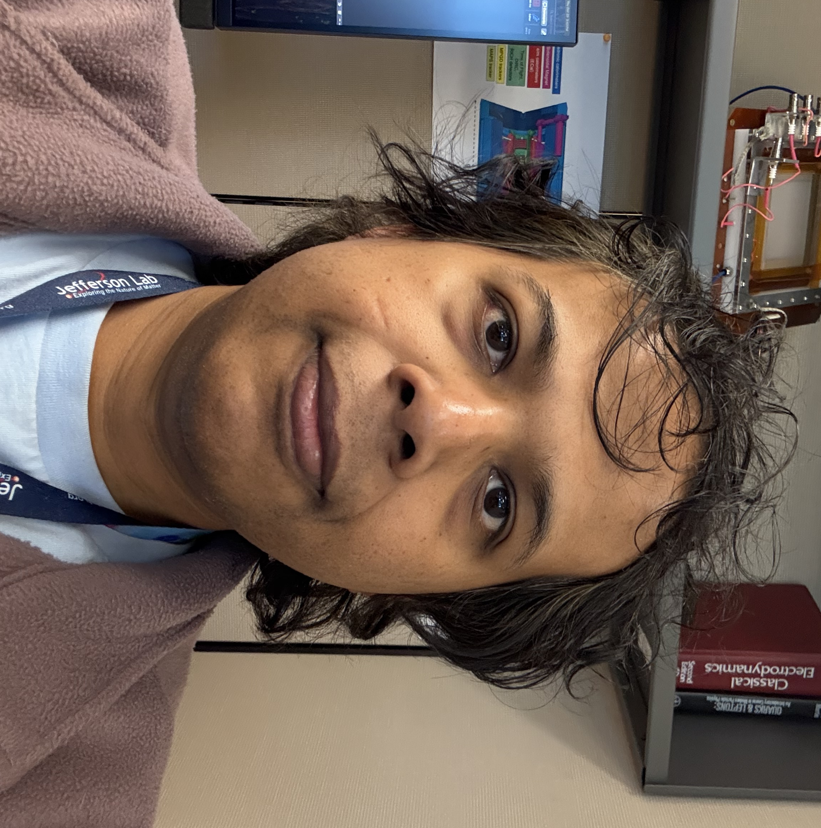

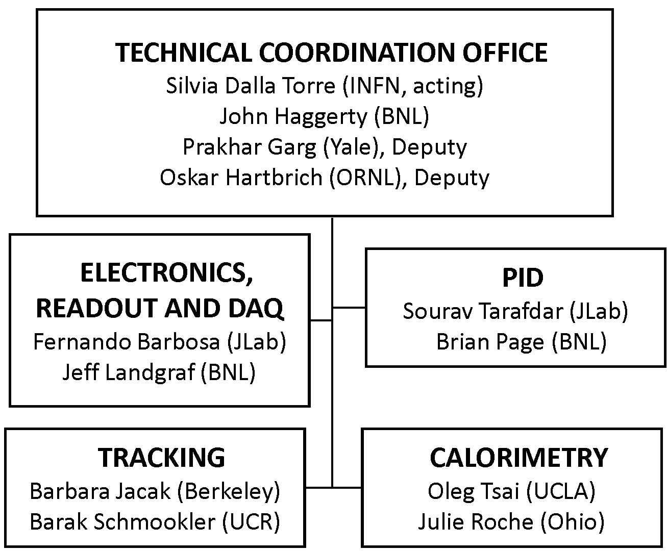
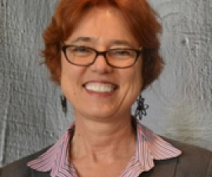
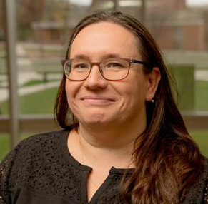
CC WG Nominations
The following individuals are nominated as new CC WG conveners

Slide 18
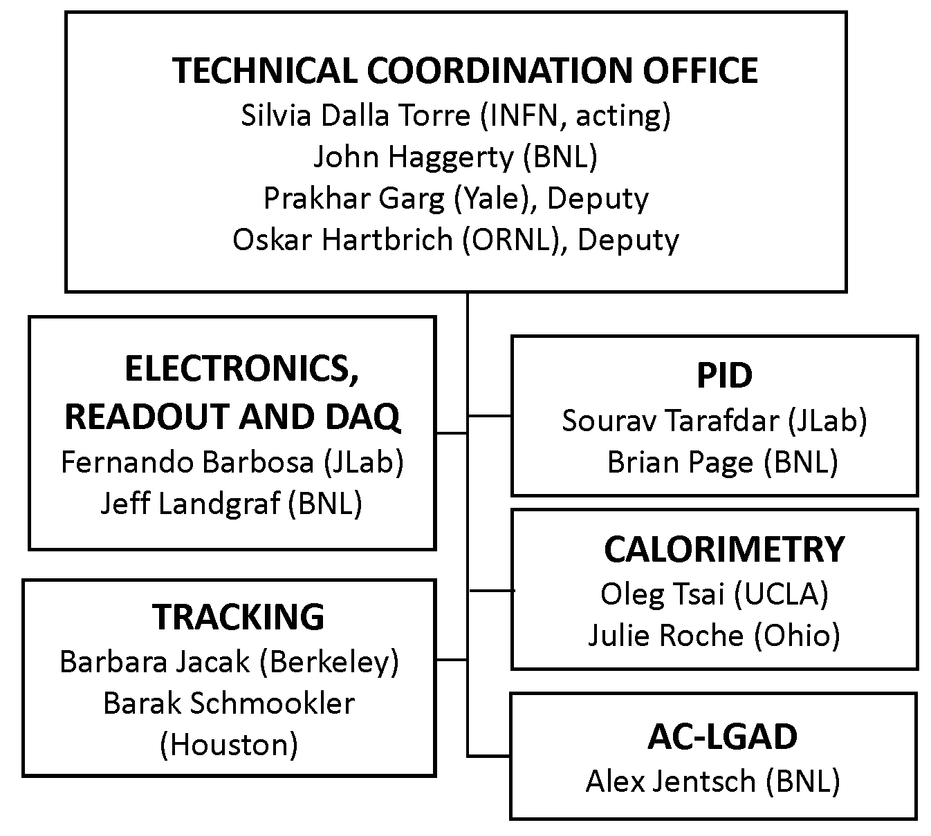

New CC WG : AC-LGADs
This is a real need for a common forum to help coordinate activities across the multiple uses of AC-LGADs in ePIC.

Slide 19
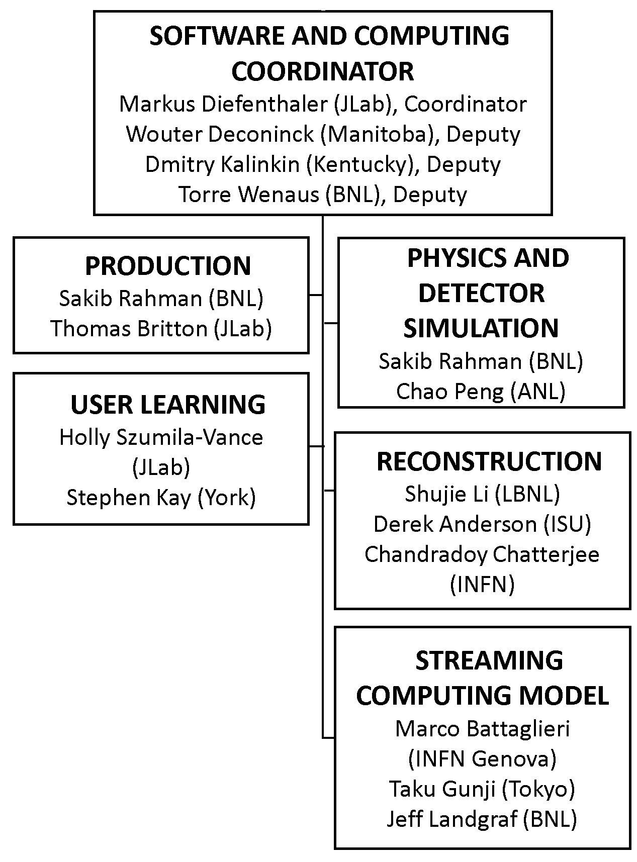
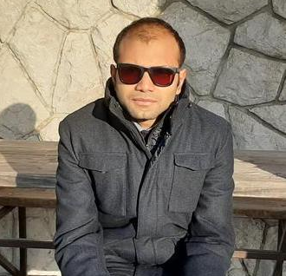
New Reconstruction WG Convener
Chandradoy Chatterjee is nominated as a new Reconstruction WG convener.
Chandra will organize the development of reconstruction software for the PID detectors.

Slide 20
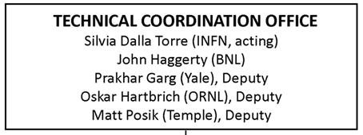
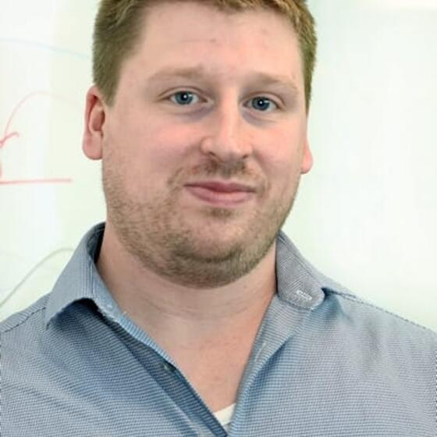
Thank You Matt Posik!
Matt Posik will be stepping down as a Deputy Technical Coordinator. His work to understand the resolution of track projections into the hpDIRC was an early driver for the development of the ACTS tracking and the development of the ePIC software stack. He also made important contributions to the MPGD simulations and is working on the aerogel test stand at Temple.

Slide 21
2026 Collaboration Survey
Emails to CC members are being sent out requesting updates to the 2025 Statements of Service (SoS) and a new statement for 2026.
  Spreadsheet for 2026 is similar to last year’s SoS
  Response requested by October 31, 2025
    If you haven’t responded yet, please do so ASAP!
Some clarifications:
  The 2026 spreadsheet still includes the “Projections” tab. Projections are not requested for 2026, so this can be ignored.
As in last year’s survey, all information you provide will be used strictly for collaboration-related matters.
Contact the Membership Committee if you have any questions:
  Eric Lancon (elancon@bnl.gov) and Carlos Munoz Camacho (carlos.munoz@ijclab.in2p3.fr)

Slide 22
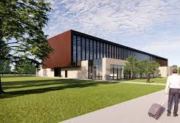
January 2026 Collaboration Meeting
Jan 20-23rd, 2026 at Brookhaven National Laboratory
  In new Science and User Support Center (SUSC)
Event registration available soon
Guest registration for non-US citizens:
https://www.bnl.gov/guv/gis.php
Early-career travel support available
Registration for online participation not required
Workfest proposals due Nov. 28th

Slide 23
DRAFT Block Agenda – Jan 2026
Work in progress – will be updated in Indico soon.
Tues 1/20
Wed 1/21
Thurs 1/22
Fri 1/23
Intro
Plenary
Workfest 1
CC Mtg
Plenary
9AM-Noon
Plenary
Workfest 2
Plenary
Workfest 4
Excursion
1PM-5PM
S&C Plenary
Conf Dinner
Workfest 5 (if needed)
Ldrshp. Team Bldg
6PM-8PM

Slide 24
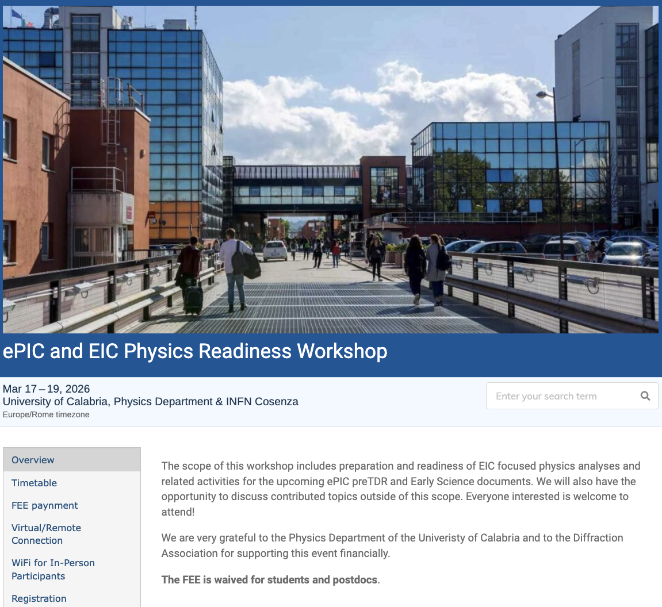
The discussion on performance continues!
Next Physics Readiness Workshop scheduled for March 17-19
  Hosted by the University of Calabria & INFN Cosenza
  Indico: https://indico.bnl.gov/event/30283/
  Hybrid format - Please register even if attending online (select proper option)
  €150 FEE waived for students/postdocs
  Possibility (limited) for ECRs support
The workshop will focus on the finalization of studies and text for the TDR and early science documents

Slide 25
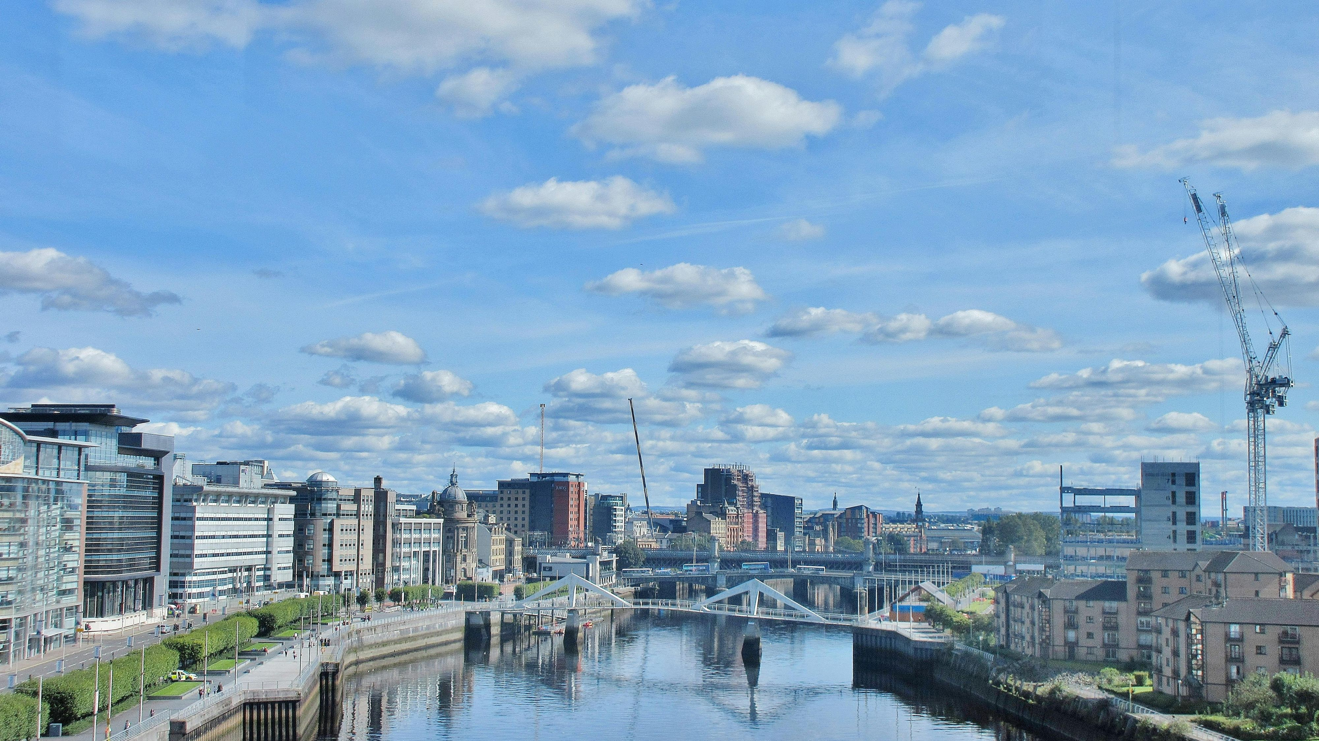
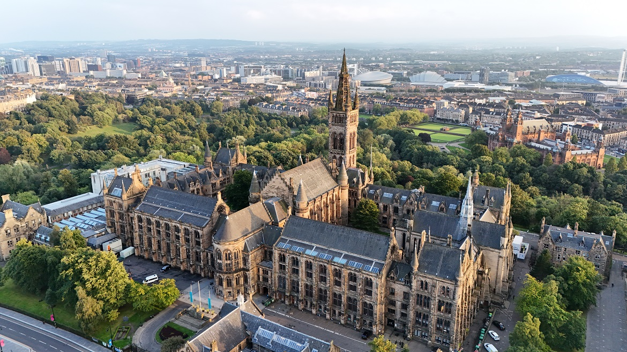
Summer 2026 Joint EICUG/ePIC Meeting
After discussions with the EICUG SC, the ePIC CC Chair/Vice-Chair, and the ePIC Spokespersons and coordinators, we have accepted a bid by the UK to host the Summer 2026 joint EICUG/ePIC meeting at the University of Glasgow July 13-17th , 2026.
More information coming soon!

Slide 26
Conclusion
There is an enormous amount of activity in ePIC, and that activity is increasing rapidly!
  Supporting the EIC project IPR/PDR and DET review process
  Completing the next draft of the pTDR
    This is a whole of the collaboration effort!
  Development of the ePIC Streaming Computing Model
  Physics WG’s developing analysis for pTDR and Early Science WP
Carry this momentum forward into 2026!
Special CC Meeting – November 25th
  https://indico.bnl.gov/event/30154/
Next General Meeting – December 5th (Fri. morning ET)
  Planning a discussion of release of ePIC simulation results

Slide 27


Slide 28
ePIC Resources
Public Website - https://www.bnl.gov/eic/epic.php
Mailing Lists – https://lists.bnl.gov/mailman/listinfo
Indico Agenda - https://indico.bnl.gov/category/402/
  ePIC Software and Computing: https://indico.bnl.gov/category/435/
Wiki - https://wiki.bnl.gov/EPIC
ePIC Software Training:
  Landing Page: https://eic.github.io/documentation/landingpage.html
  Tutorials: https://eic.github.io/documentation/tutorials.html
Mattermost: https://chat.epic-eic.org
ePIC Zenodo Community: https://zenodo.org/communities/epic

Slide 29
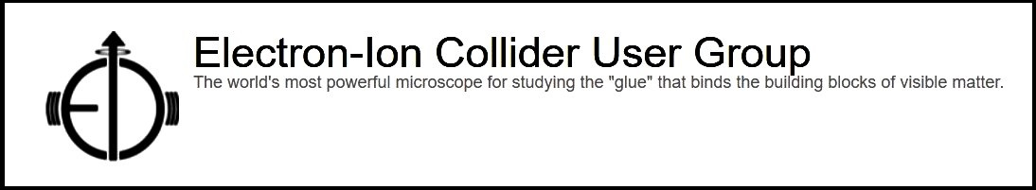

EICUG Membership
The EICUG is a vital organization to promote the interests of the EIC community!
  Without the EICUG we would never have gotten far enough to form ePIC!
Please register your institution!
Check with your EICUG IB representative to get registered as a member
https://www.eicug.org/content/join.html

Slide 30
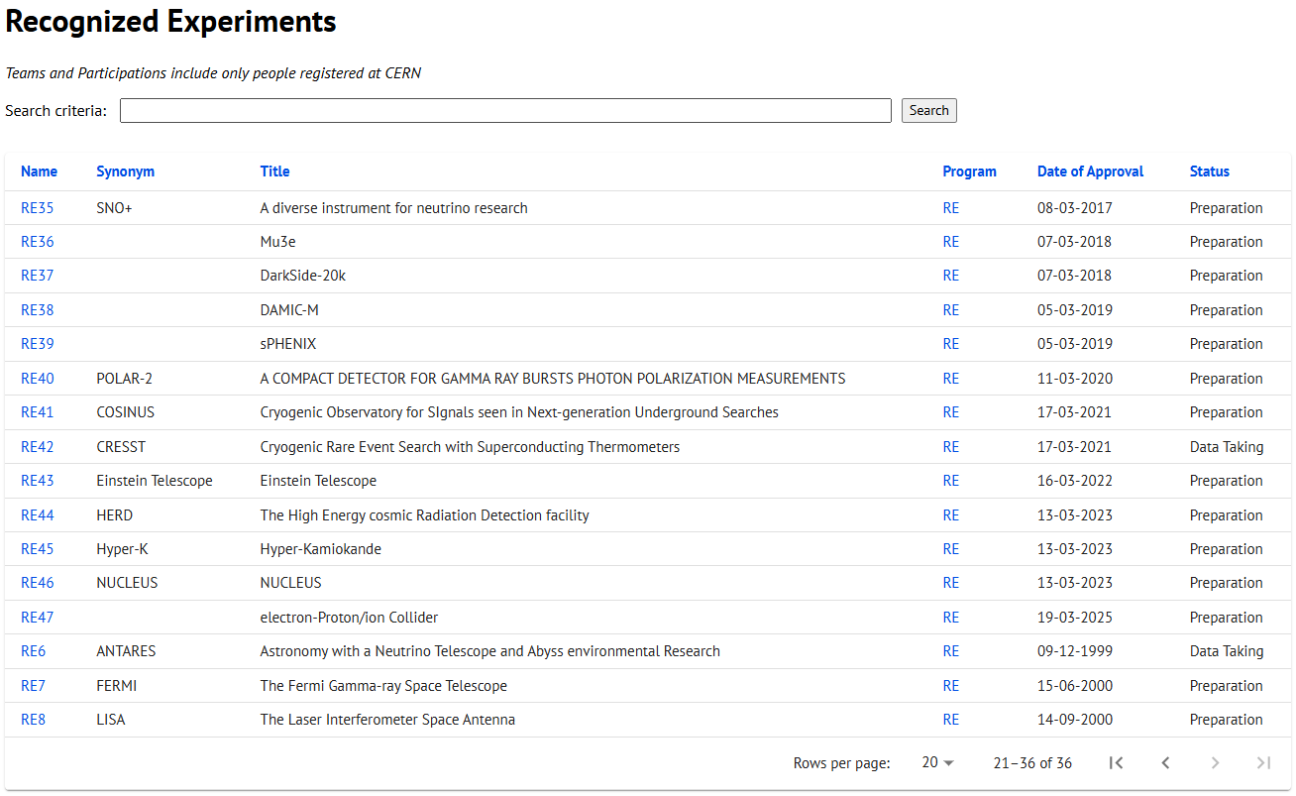
CERN Recognized Experiment Status: RE47
ePIC now appears in the CERN Grey Book database as RE47:
https://greybook.cern.ch/experiment/recognized
Two steps to get ePIC Collaborators registered at CERN:
CC Representative needs to register as team leader with
CERN Users Office:
  https://usersoffice.web.cern.ch/
  https://usersoffice.web.cern.ch/team-leaders-corner
  Users.Office@cern.ch
CC member can then certify registrations of team members
Contact us if you run into problems!

Slide 31
Tracking CC WG
Perform simulations that demonstrate the integrated tracking performance of ePIC, including realistic backgrounds, and meeting the physics requirements in terms of track efficiency, purity, and angular, vertex and momentum resolution.
In collaboration with the Reconstruction Working Group, aid the development of ACTS in ePIC to meet the performance needs.
Integrate the tracking information from BIC first layer in the tracking reconstruction.
Support the DSC’s and PWG’s in performing additional tracking-related studies and updating the tracking requirements.
Foster the development of a broad base of expertise spread throughout multiple institutions within the collaboration.

Slide 32
Calorimetry CC WG
Develop a comprehensive model of the effect of SiPM irradiation on the calorimetry systems. Ideally, this would be a generic model that can be adapted to the specifics of each calorimetry system. This should incorporate knowledge collected in existing and future SiPM irradiation campaigns, including the dark current rates and PDE variations.
In conjunction with the Electronics, Readout and DAQ CC working group use this model to verify the parameters and requirements of the ASICS and discrete readout options for the electromagnetic calorimeters. Quantify the effect on detector performance of the need to raise hit thresholds as dark currents increases.
Verify that the CALOROC meets the dynamic range requirements for all systems, both pre- and post-irradiation. Determine a requirement on the ToA timing of the CALOROC for these systems.
Quantify in a simulation study the effect on detector performance of material in front of the forward and backwards electromagnetic calorimeters, using the latest estimates of service materials.
Assist the Simulations Working Group in developing common approaches to detector digitization and response in simulations
Work with the Reconstruction WG to develop the first implementation of a particle flow algorithm and validate the algorithm.

Slide 33
PID CC WG
Coordinate and facilitate the sharing of information on topics common to all PID subsystems:
  Aerogel test stations and protocols (pfRICH, dRICH);
  Mirror test stations and protocols (pfRICH, dRICH);
  Characterization of HRPPDs and detector requirements (pfRICH, hpDIRC).
  Updated simulation geometry descriptions consistent with the current mechanical design
  Realistic detector response and reconstruction in EICRecon
    IRT2 implementation (pfRICH, dRICH)
    hpDIRC reconstruction integrated in EICRecon
Perform simulations that demonstrate the integrated PID performance of ePIC, including realistic backgrounds, for the following:
  Low-momentum PID performance
  Tracking performance requirements for the hpDIRC
  Electron identification
  Pion rejection, particularly in the barrel
Work with the TOF DSC to determine the requirements of the FCFDv1.
Work with the DSCs to define the requirements for FCFDv2 according to the needs of the pfRICH, hpDIRC.

Slide 34
Electronics, Readout and DAQ
Follow the characterization of the preliminary FEE ASICs coupled to the sensors within the DSC’s. Continue working with the DSC’s to verify the ASIC performance requirements are matched to detector requirements.
Work with the Calorimetry CC WG to verify the parameters and requirements of the ASICS and discrete readout options for the electromagnetic calorimeters are met as the SiPMs are irradiated.
Working with the DSC’s, determine worst case rates for the HCAL insert and ZDC and specify how many ASICS per lpGBT in the detector readout.
Through the DAQ roadmap, in coordination with the Reconstruction WG, support the needs of DSC’s in test benches and test beam configurations.
Continue working with the Streaming Readout WG to develop the full data acquisition chain and interface to Echelon 1, consistent with ePIC requirements.
  Frame builder test setups, Echelon-0 software
Advise the Simulations and Reconstruction WG on the development of digitization in the simulations
Develop the requirements for the ePIC Slow Controls System and summarize these requirements in a technical note. This note will be used by the DSCs to integrate their slow controls with the global ePIC Slow Controls System.
Work with the mechanical engineers to fully develop cooling, grounding and service routing plans, with attention paid to how the detector will be serviced

Slide 35
AC-LGAD Working Group
Coordinate communication and action items between the Far-Forward and TOF DSC’s and the Electronics and DAQ CC WG regarding common interests in sensor development, ASICs, and readout and front-end electronics.
Exploit synergies where possible to reduce and complexity of AC-LGAD subsystems. This includes, but is not limited to:
  Development and characterization of strip and pixel AC-LGAD sensors
  Test beams – establish goals, coordinate common efforts, report results
  Testing of the EICROC and FCFD ASICS and development of readout electronics. Provide a communication link between the ASIC efforts and this WG
Work with the DSC’s and other WG’s to avoid duplication of meetings. Ideally this WG would subsume parts of existing meeting without substantially increasing the overall meeting load
Maintain communication with the EIC project regarding common AC-LGAD efforts within ePIC

