Slide 1
RCDAQ and EICrecon integration
Martin Purschke
with a lot of help from Dmitry, Derek, and Wouter
We have supported EIC-themed test beams with RCDAQ for ages, so taking the data is not an issue.
We have been going on about making a full “in-house” raw data -> EICrecon analysis toolchain
We really want and need to gain experience with a standard ePIC analysis for raw data so people get proficient with the tools that we have
We will also see what features need to be implemented or need improvement
We have 3 data taking campaigns going on, all using RCDAQ and the assorted online monitoring tools:
the ”ePIC ZDC” test beam at the BNL NASA Space Radiation Lab (NSRL);
the BHcal test setup in the Phys. Dept. HighBay area;
the HRPPD high-field test in the BNL Magnet Division (Bldg 902) for the pfRICH

Slide 2
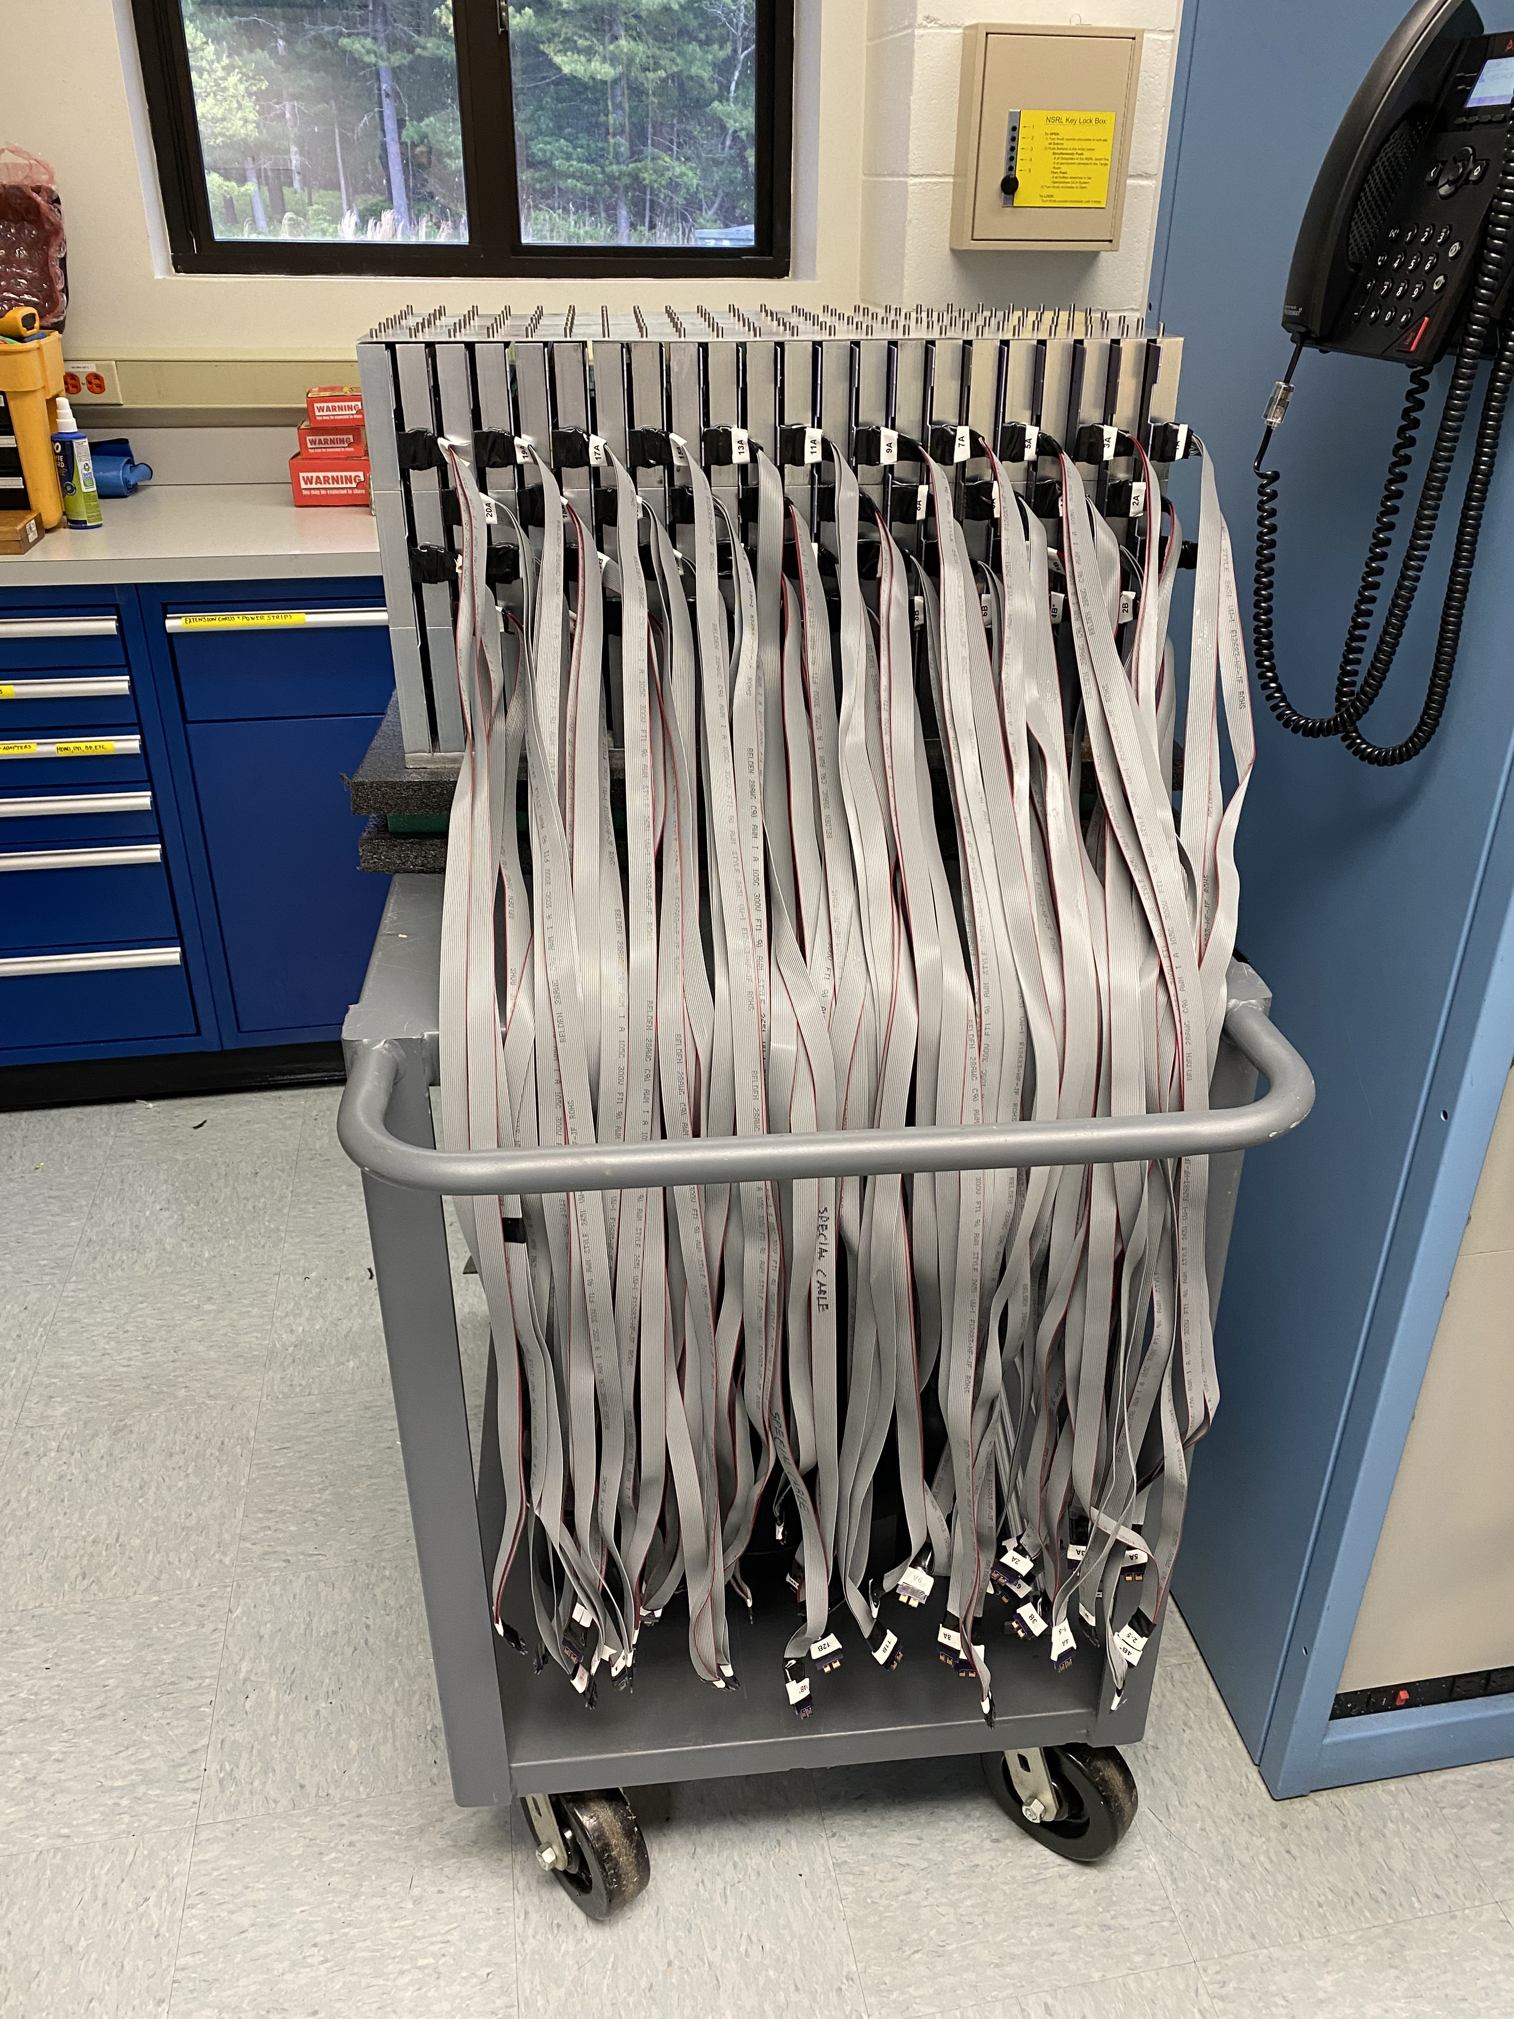
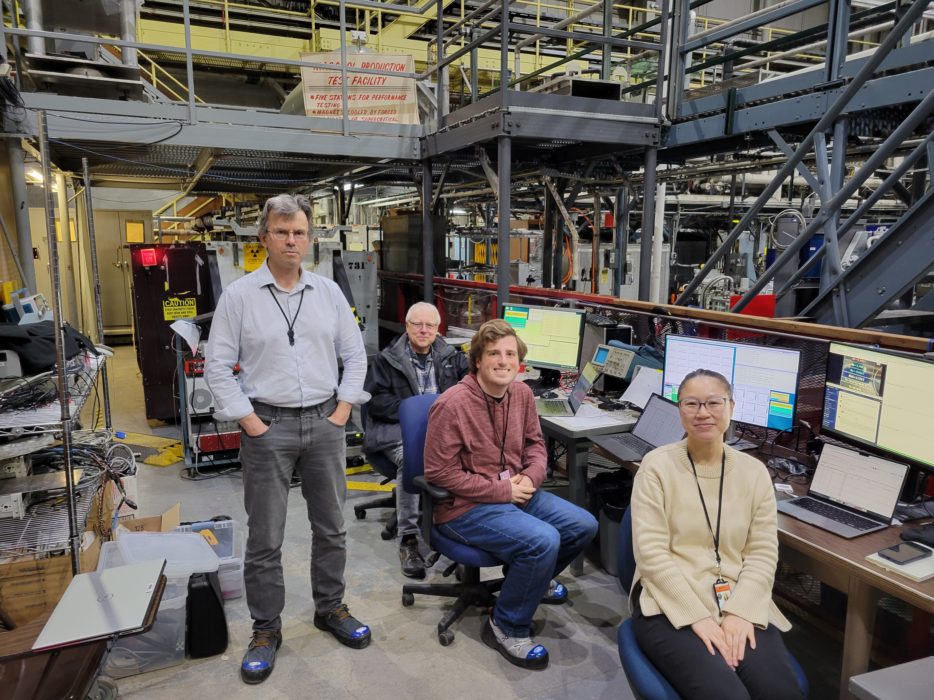
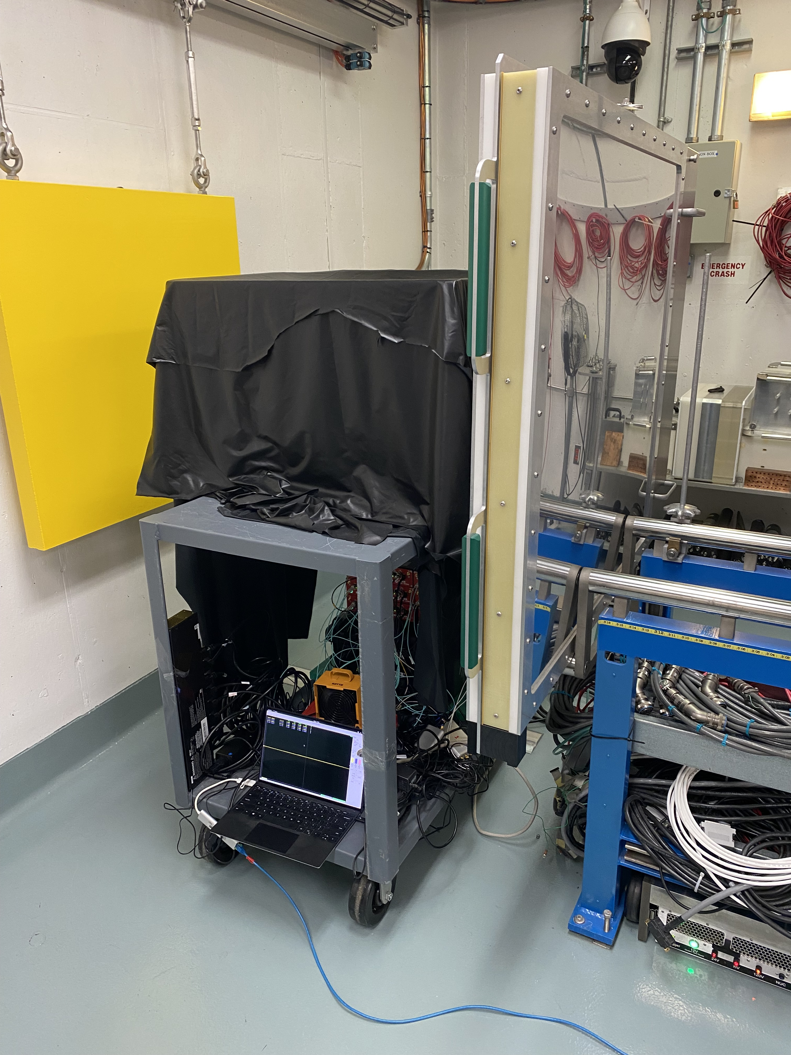
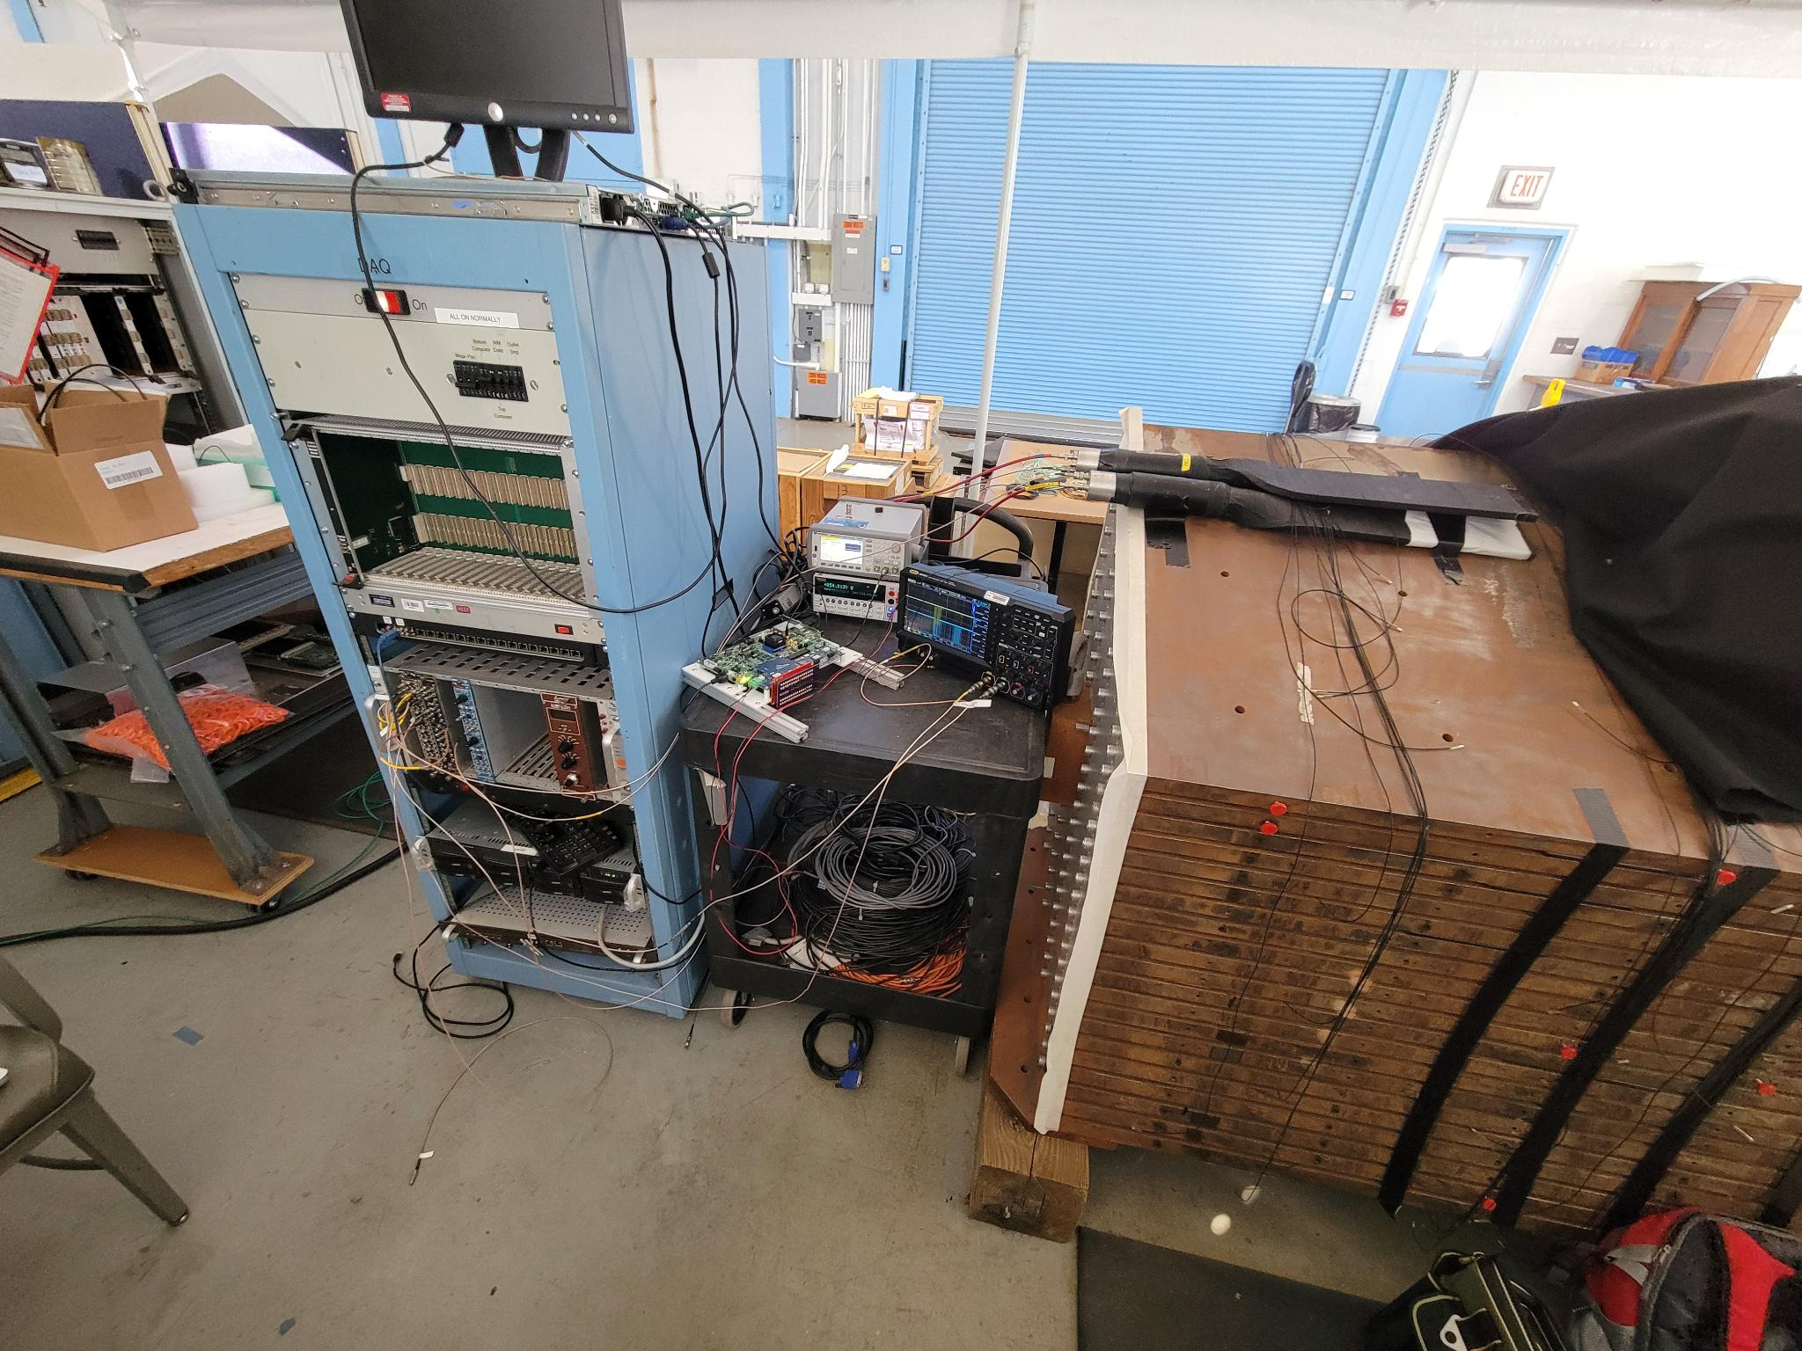
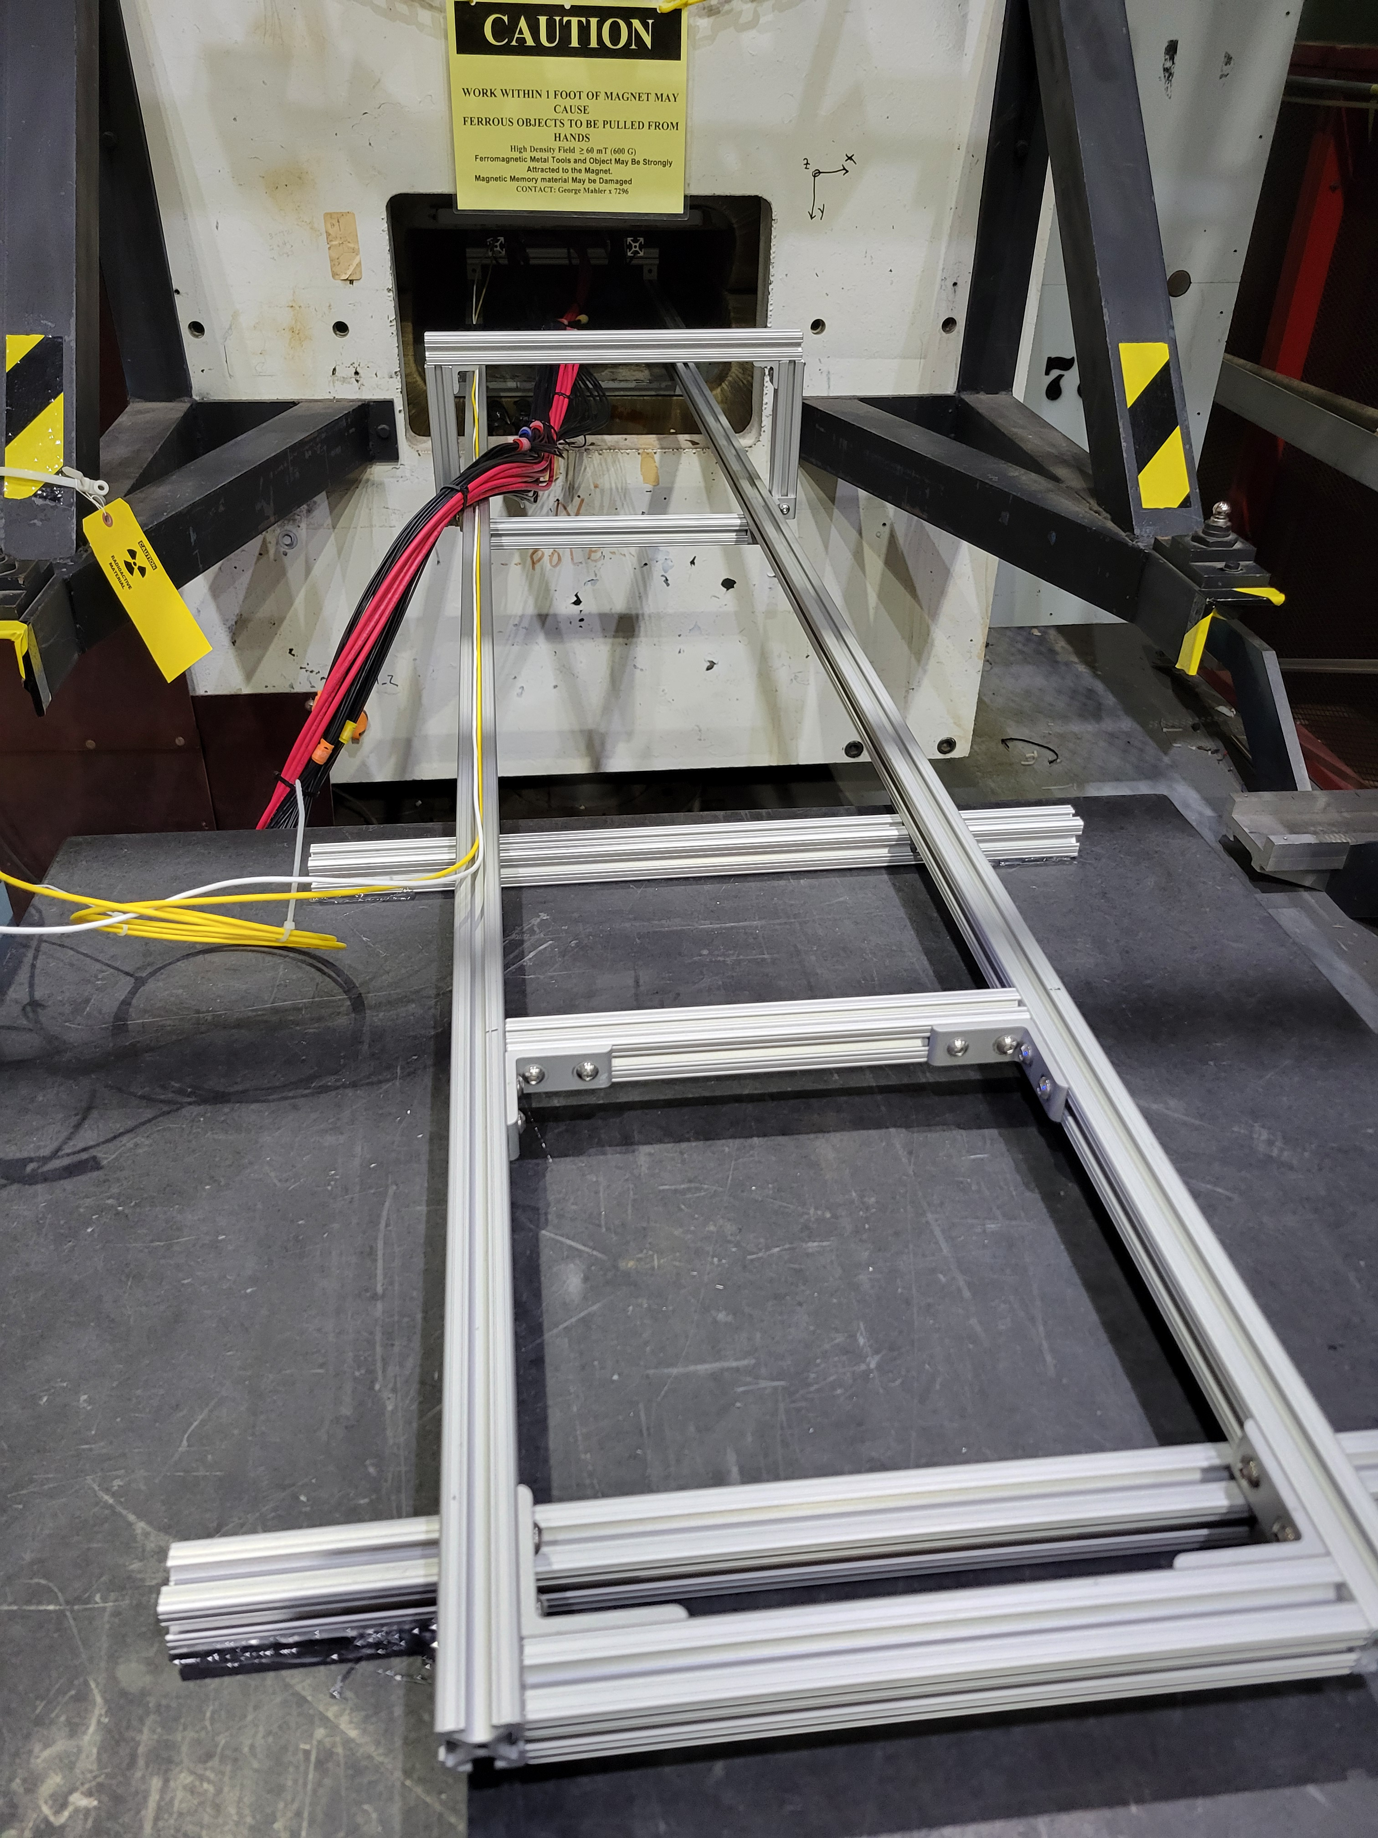
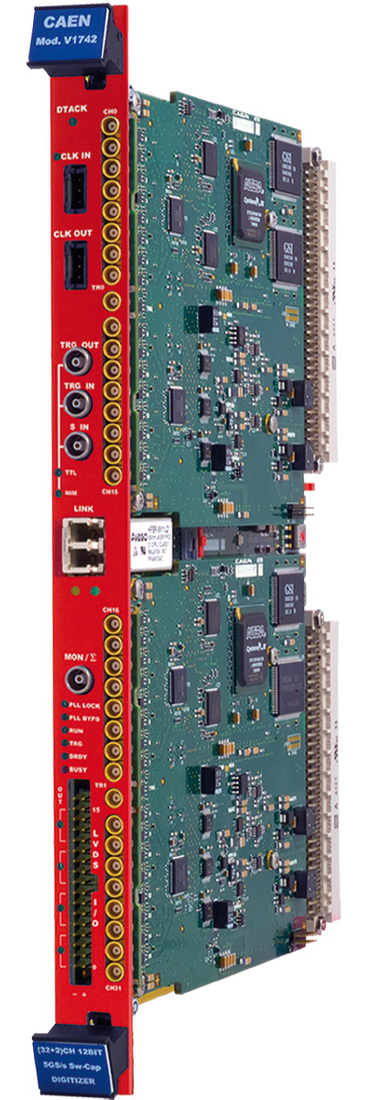
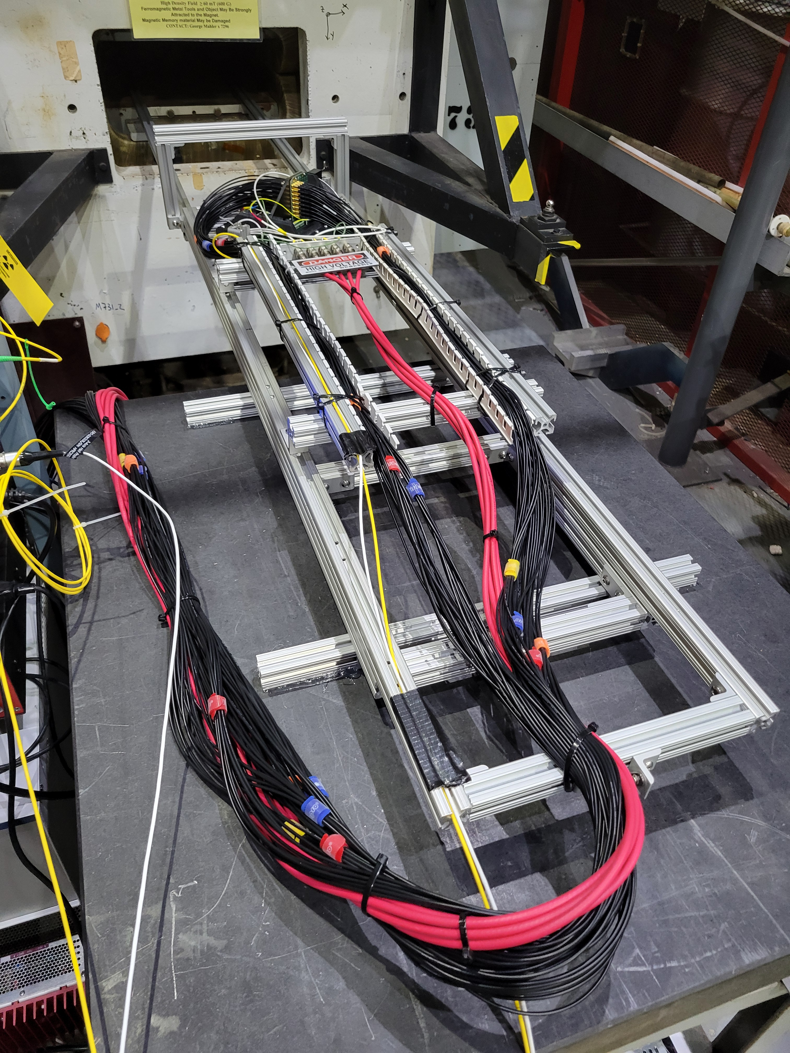
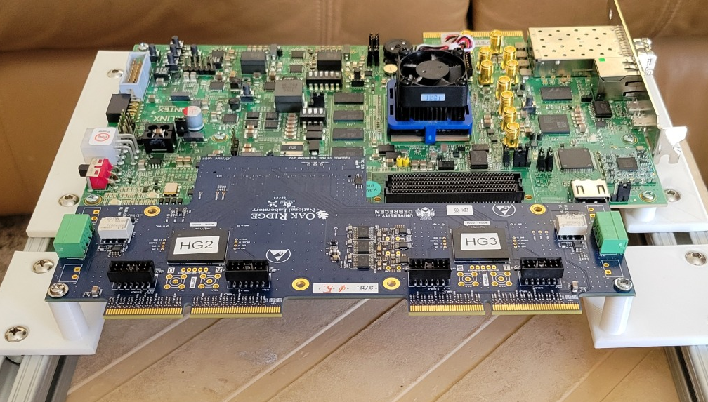
Current Data Taking Campaigns
While the ZDC test is an actual test beam, the HRPPD feels most like an actual one (data taking shifts and all…)
Beam Dump
NSRL Beam
HRPPD High Field Test
ePIC ZDC (UCR Group)
Barrel HCal prototype
H2GCROC3 readout
CAEN V1742 waveform digitizer

Slide 3
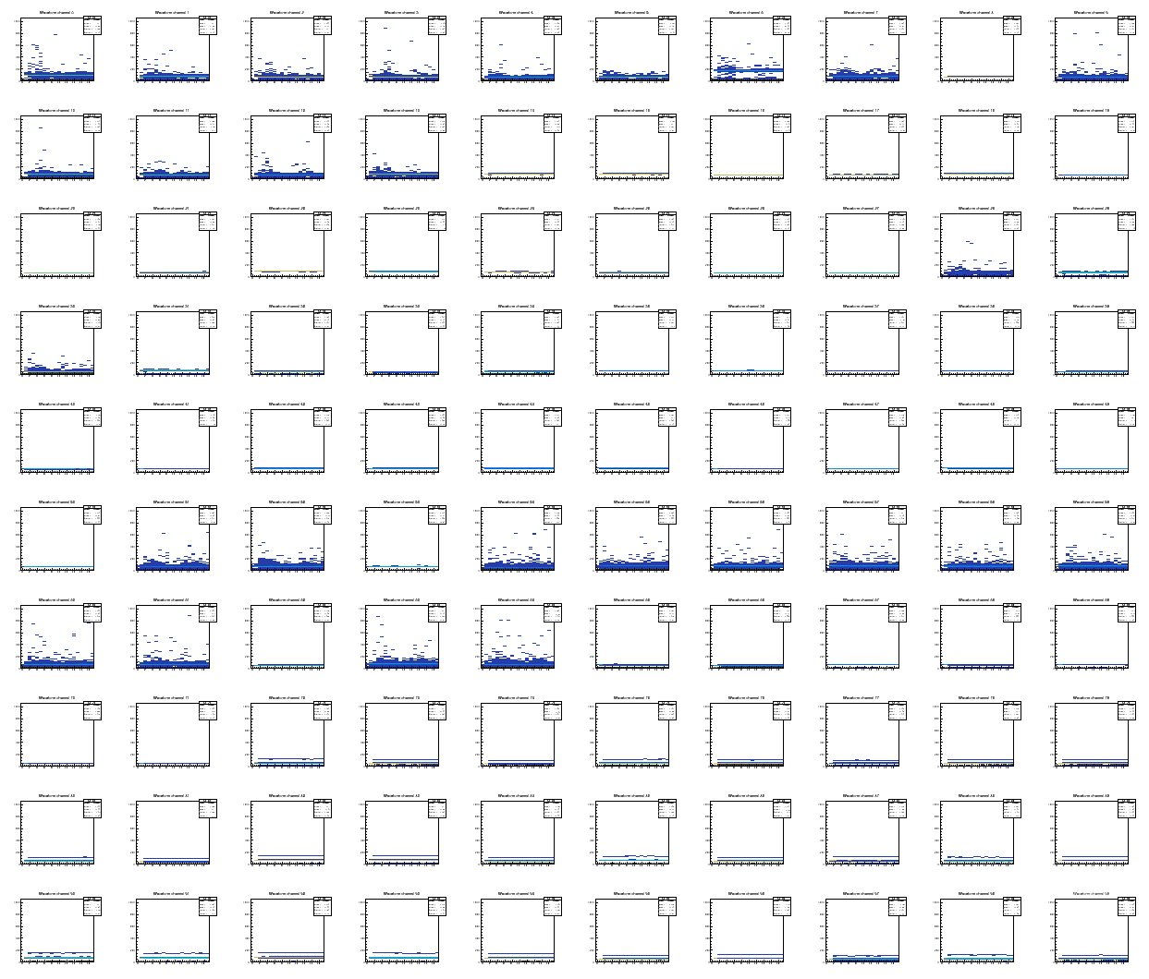
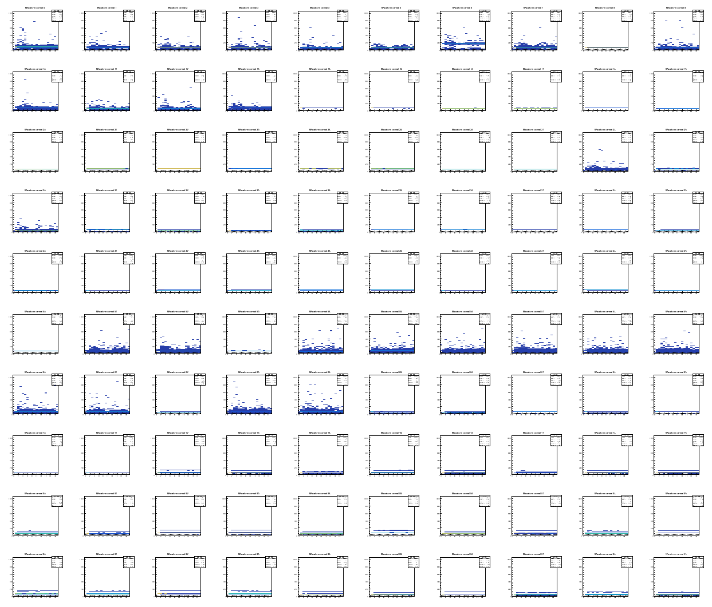
Just to jump way ahead:
Beam Dump
RCDAQ
Data File
H2GCROC3
pmonitor
EICrecon
I re-tooled the existing analysis with EICrecon
This gives identical output/results from both
Native “podio” data input via “JEventSourceRCDAQ”

Slide 4
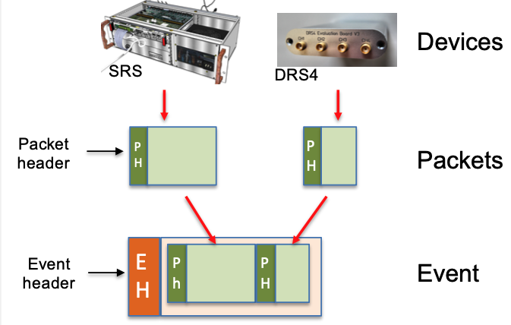
Quick recap of RCDAQ’s data format
You see the data as “Events”, each of which contain “Packets”
“Event” has become a bit of a mis-nomer since we have streaming data, but old names die hard
Each readout device that’s registered with RCDAQ adds a “Packet” to the Event
The devices can be diverse, and usually are
This is from an early EIC-themed test beam at Fermi
Each packet has an ID that uniquely identifies what part of the detector is connected here
The ID is just a number - we typically impose an algorithm to pick IDs
For the H2GCROC3 we (arbitrarily) chose 12001
And with just one device, there is only one packet here:
$ dlist beam_0000004094-0000.evt
Packet 1010 23262 -1 (sPHENIX Packet) 70 (IDSRSV01)
Packet 1020 5126 -1 (sPHENIX Packet) 81 (IDDRS4V1)
$ dlist beam_ZDC-00001112-0000.evt
Packet 12001 36504 -1 (ePIC Packet) 301 (IDH2GCROC3)
Taken straight from the manual

Slide 5
There is no prescribed structure to the Packet payload
For all intents and purposes, the data payload is treated as a binary blob without a fixed structure
That “structure” comes in via data access APIs that standardize the access to the data
It also allows us to change the internal encoding of the payload without breaking user code – the APIs still give you the same answer. Your code will not depend on the inner encoding of the data.
That API keys on the “hitformat”. Change the inner encoding, change the hitformat, make a new decoder.
As we evolve the H2GCROC3 hardware and firmware and the inner encodings, there will be more hitformats coming our way. *
The “301” is just an enumeration and has no further deep meaning. We assign it a mnemonic.
None of those future changes will break our code.
* For the sPHENIX TPC (FELIX) format, we are currently on our 5th hitformat, often for denser packing of the data.
Any reconstruction/user code still works the same.
Packet 12001 36504 -1 (ePIC Packet) 301 (IDH2GCROC3)

Slide 6
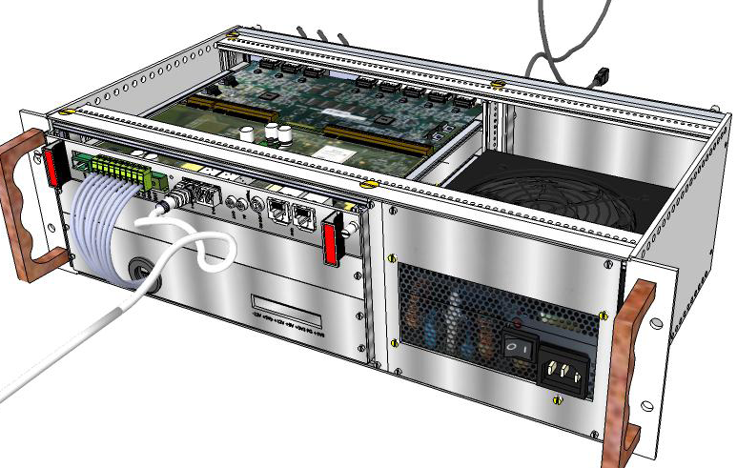
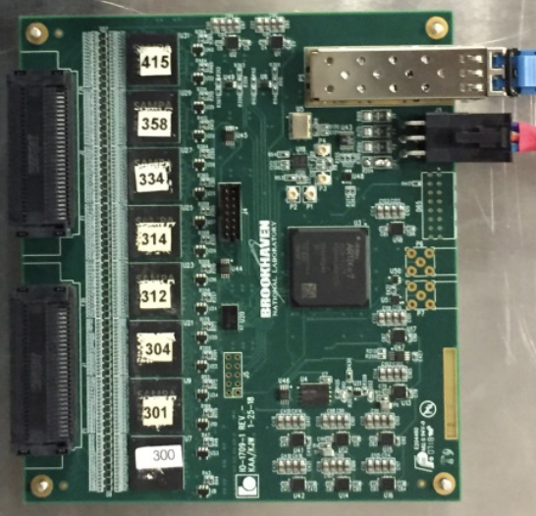
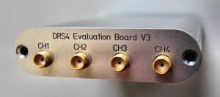
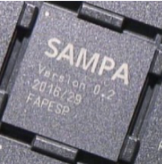
Common Analysis API for Waveform Samplers
What’s a waveform sampler? A thing with many channels, each of which captures a waveform
Your digital scope is a waveform sampler, typically with 4 channels (and a screen attached) ☺
Here are a few examples (all supported in RCDAQ)
If p is a pointer to your Packet object, then
Often the #samples are the same for all channels, so you can get away with asking only once, as I’ll show in the JEventsource code
DRS4 Eval board
SAMPA/SALSA ASIC
H2GCROC3
CERN RD51 SRS System
CAEN V1742 waveform digitizer
p->iValue(0,"CHANNELS") tells you how many channels that device has (H2GCROC3:144)
p->iValue(channel,"SAMPLES") tells you how many samples are present for that channel
p->iValue(c,s) gives you sample s from channel c (different APIs available)

Slide 7
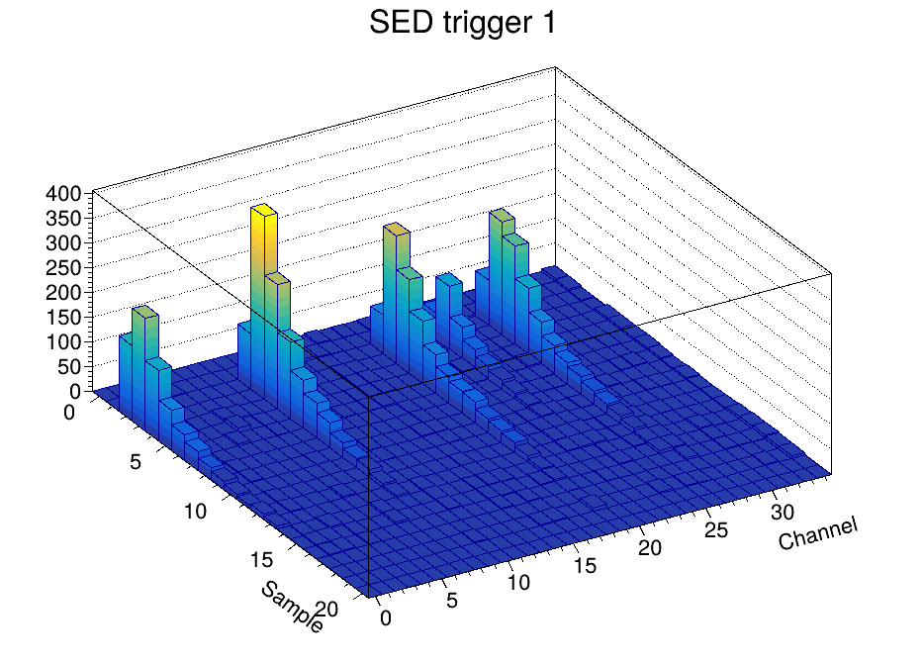
And all those devices can share this kind of code
Packet *p = e->getPacket(12001);
if (p)
{
for ( int c = 0; c < p->iValue(0,"CHANNELS"); c++)
{
for (int s = 0; s < p->iValue(c,"SAMPLES"); s++)
{
h2->Fill(c,s, p->iValue(c,s));
}
}
delete p;
}
I virtually always make what I call the “mlp standard plot” with Single Event Displays
The above code works the same for all of the devices from before

Slide 8
The H2GCROC3 has 2 additional fields
Instead of just a “waveform” vector of ADC values, the H2GCROC3 vector is triplet of
{ADC, “Time of Arrival”, “Time over Threshold”} instead
These are excerpts from the JEventSourceRCDAQ that you can now recognize:
p->iValue(c,s) gives you sample s from channel c
p->iValue(c,s,”TOA”) gives you TOA value s from channel c
p->iValue(c,s,”TOT”) gives you TOT s from channel
int channels = p->iValue(0,"CHANNELS");
int samples = p->iValue(0,"SAMPLES");
// . . .
for (int ch = 0; ch < channels; ch++)
{
edm4eic::MutableRawHGCROCHit obj = coll.create(1200 + ch, 0);
for ( int s = 0; s < samples; s++)
{
uint16_t adc = p->iValue(ch, s);
uint16_t toa = p->iValue(ch, s, "TOA");
uint16_t tot = p->iValue(ch, s, "TOT");
obj.addToSamples({adc, toa, tot, totp, totc});
}

Slide 9
Data access
A simple EICrecon run with our data file as input:
Resulting in a podio root file
$ eicrecon -Ppodio:output_collections=p_1200 beam_ZDC-00001112-0000.evt
*............................................................................*
*Br 6 :_p_1200_samples : Int_t _p_1200_samples_ *
*Entries : 3699 : Total Size= 209008 bytes File Size = 7090 *
*Baskets : 3 : Basket Size= 32000 bytes Compression= 4.21 *
*............................................................................*
*Br 7 :_p_1200_samples.ADC : UShort_t ADC[_p_1200_samples_] *
*Entries : 3699 : Total Size= 192730021 bytes File Size = 56652292 *
*Baskets : 1759 : Basket Size= 25600000 bytes Compression= 3.40 *
*............................................................................*
*Br 8 :_p_1200_samples.timeOfArrival : *
* | UShort_t timeOfArrival[_p_1200_samples_] *
*Entries : 3699 : Total Size= 192747651 bytes File Size = 1664426 *
*Baskets : 1759 : Basket Size= 25600000 bytes Compression= 115.78 *
*............................................................................*
*Br 9 :_p_1200_samples.timeOverThreshold : *
* | UShort_t timeOverThreshold[_p_1200_samples_] *
*Entries : 3699 : Total Size= 192754703 bytes File Size = 1100669 *
*Baskets : 1759 : Basket Size= 25600000 bytes Compression= 175.09 *
*............................................................................*
*

Slide 10
Summary
Full “in-house” analysis toolchain RCDAQ->EICrecon analysis: check.
(that’s what we wanted to demonstrate).
What’s next? (after some more polishing…)
I’ll re-tool another existing analysis (likely the magnet test where I’m currently most invested in) in EICrecon.
  Done for the ZDC beam data as shown before
  Good to be able to compare results that Alexander’s cohort gets and see that it’s the same.
We should have a discussion (not the right forum here I think) about the general strategy for raw data. Raw data have some additional requirements over simulation data, chiefly the meta-data/special events etc
I’ll need some additional classes for the generic waveform samplers, and some mods to HGCROCSample class
Some PRs coming our way…
Add this support (chiefly the ”Event Libraries” that decode the data) to the standard container in some form
Minus some polishing/tooling, and the PRs, we are set.
If you need data taking support, please get in touch and the DAQ group will find you a solution.
✅

Slide 11
Backups

Slide 12
Generic waveform sampler data
You are tempted to use the “sample number” as a proxy for “time”
That assumes that the ASIC’s/FPGA’s system clock absolutely accurately drives the “sample time”
We currently make that assumption in the H2GCROC3 data we take
That is not really true – in each ASIC, the assorted storage cells have a personality and the times are not equidistant. This is from a CAEN 1742 unit running at 5GS, so each time diff should be 200ps – not so.
sample time [ns] ADC time delta
0 0 2093
1 0.199501 2091 0.199501
2 0.399002 2093 0.199501
3 0.598495 2095 0.199493
4 0.797997 2093 0.199501
5 0.997299 2094 0.199303
6 1.1965 2092 0.199203
7 1.3958 2093 0.199295
8 1.5949 2093 0.199104
9 1.794 2095 0.199097
10 1.993 2096 0.198997
11 2.1921 2094 0.199104
12 2.3909 2095 0.198799
...
## An individual sample for generic waveform samplers
edm4eic::GenericWFSample:
Members:
- float timeStamp
- int16_t ADC // [ADC Counts], signed int b/c after pedestal subtraction it can be negative

Slide 13
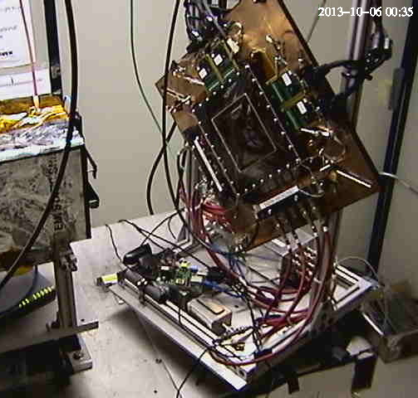
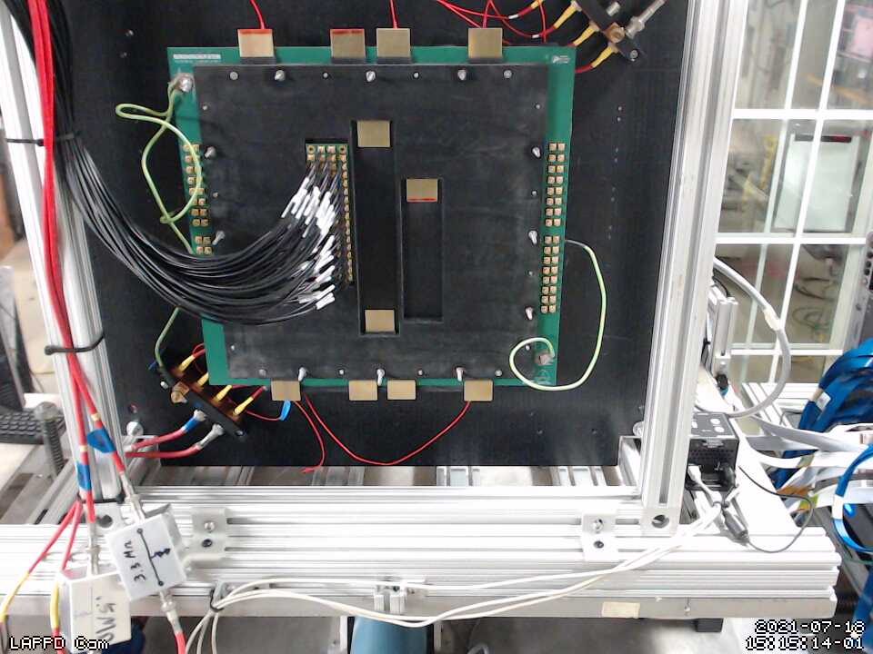
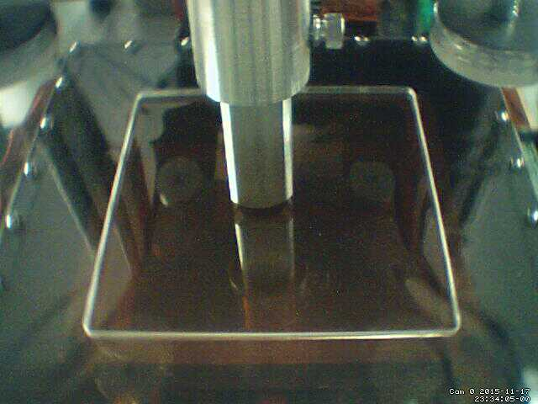
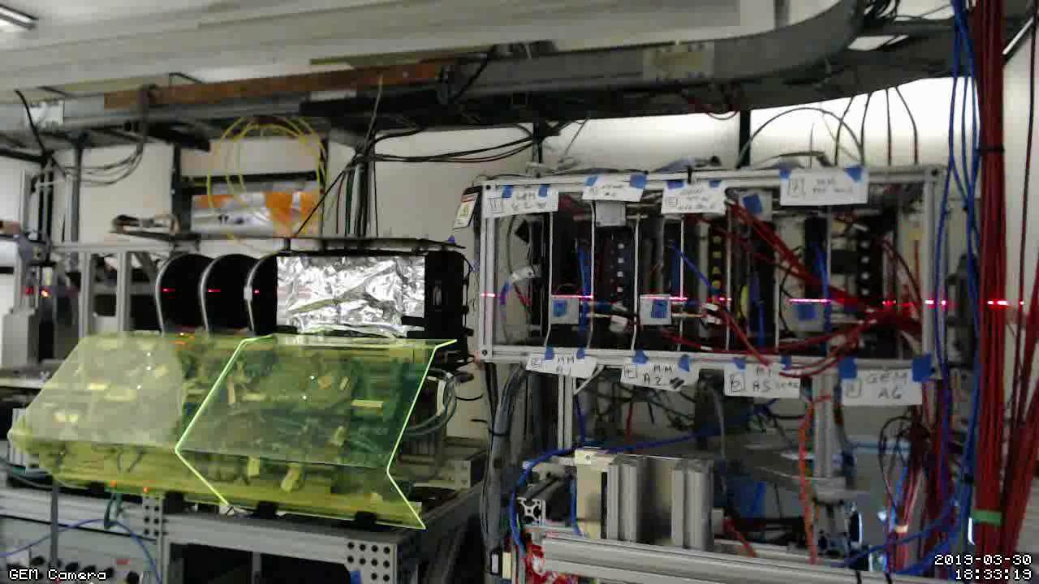
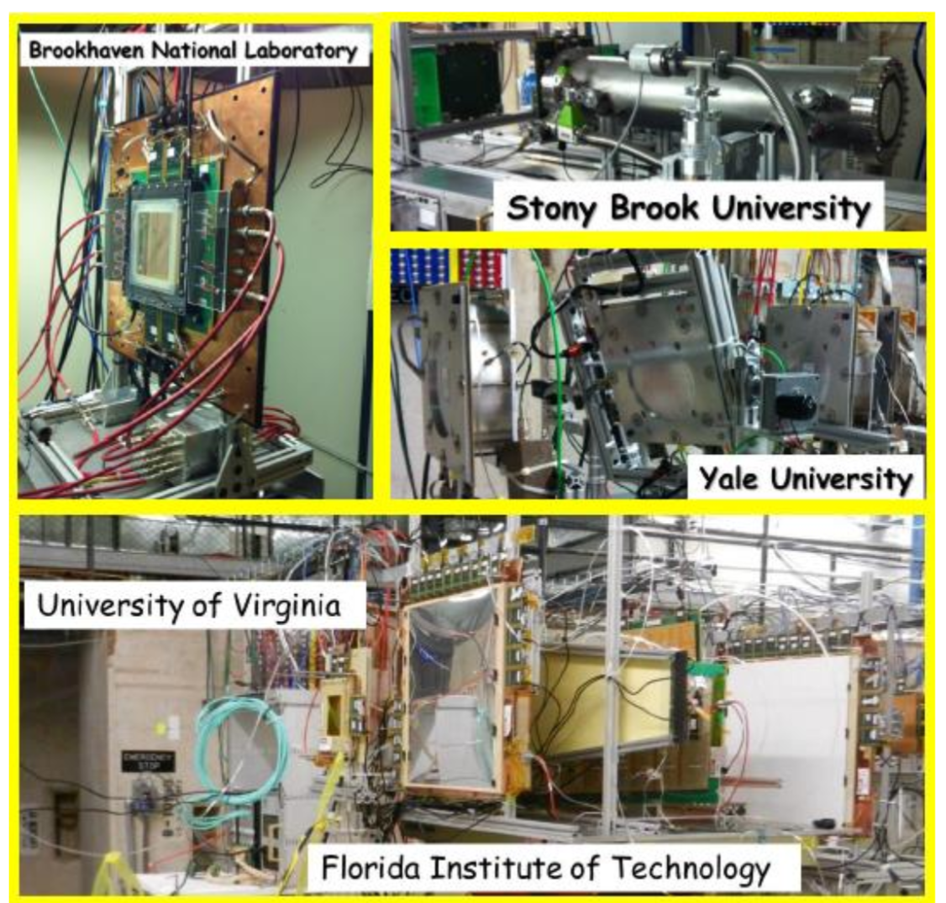
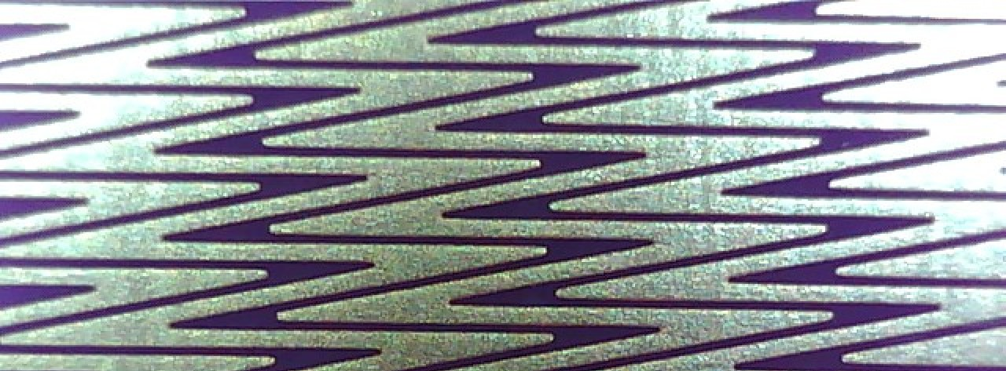
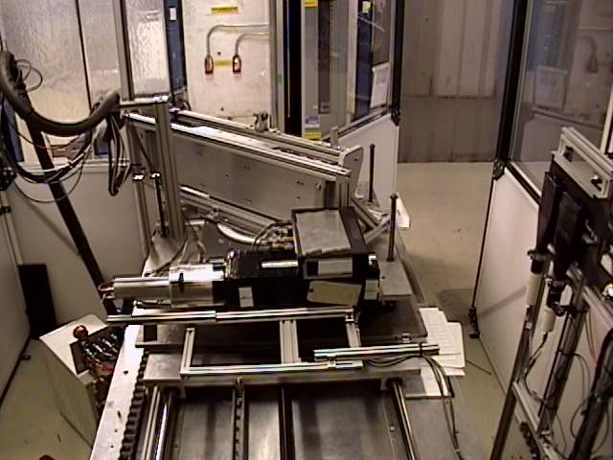
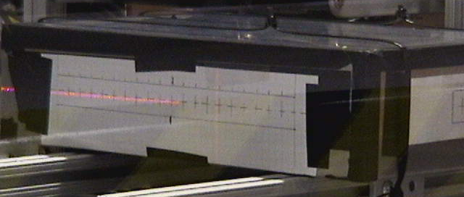
EIC-themed test beams with RCDAQ
The RCDAQ system has been a pillar of EIC-themed data taking for R&D, test beams etc since 2013 – eRD1, eRD6, LDRDs, …
Many active RCDAQ installations in the ePIC orbit + ~30 elsewhere
Usual entry by ease-of-use for standard devices (DRS, SRS, CAEN, …) and support for fully automated measurement campaigns
Manuals and “application notes” at https://www.phenix.bnl.gov/~purschke/rcdaq
MPGD-LDRD (2019)
LAPPD / Kiselev
(2022)
Minidrift TPC (2013)
ZigZag Readout (2016)
PWO prototype (2018)
Dual-sided PWO readout (2017)
FLYSUB consortium (2014)
Thanks to Jin Huang for this collection

Slide 14
PacketID Assignment Example (BHCal)
In sPHENIX we assign each detector system a “Detector Number” – our Hcal happens to be #8
Each detector then can assign packet IDs in the d_nr * 1000 +1 …. d_nr * 1000 +999 range
8001… 8999 for the Hcal. Much more than we need
So we have 8001, 8002, 8007 and 8008 on the west side.
8003, 8004, 8005, 8006 on the east side
All 8 together constitute the data of the entire HCal
8003
8002
E
8004
8001
W
8005
8008
8006
8007
$ dlist /bbox/bbox6/W/HCal/cosmics/cosmics_seb16-064906-0000.prdf
Packet 8001 788 0 (Unformatted) 172 (IDDIGITIZERV3_12S)
Packet 8002 676 0 (Unformatted) 172 (IDDIGITIZERV3_12S)
Packet 8007 753 0 (Unformatted) 172 (IDDIGITIZERV3_12S)
Packet 8008 753 0 (Unformatted) 172 (IDDIGITIZERV3_12S)
The channel mapping for one device /packet repeats for each packet – super-easy to deal with
$ dlist /bbox/bbox7/W/HCal/cosmics/cosmics_seb17-064906-0000.prdf
Packet 8003 746 0 (Unformatted) 172 (IDDIGITIZERV3_12S)
Packet 8004 732 0 (Unformatted) 172 (IDDIGITIZERV3_12S)
Packet 8005 662 0 (Unformatted) 172 (IDDIGITIZERV3_12S)
Packet 8006 690 0 (Unformatted) 172 (IDDIGITIZERV3_12S))

