Slide 1
ePIC Global Timing Unit (GTU) Internal Review
ePIC Clock and Control
Overview of the GTU
GTU design
PCB layout
The Current Status

Slide 2
1. ePIC Clock and Control
1.1 The EIC beam crossing
 | Electron Storage Ring (ESR) | Hadron Storage Ring (HSR) (N_{b}=290) | HSR (N_{b}=1160)
Circumference C [m] | 3833.940 | match T_{rev} | match T_{rev}
Revolution period T_{rev}=C/c [µs] | 12.7886
RF harmonic number h [-] | match HSR | 2520 | 7560
RF bucket spacing T_{b}=T_{rev}/h [ns] NOT bunch spacing!!! | match HSR | 5.075 | 1.692
Number of bunches N_{b} | match HSR | 290 | 1160
Bunch spacing T_{bun} [ns] | match HSR | 40.599 | 10.150
Gap length [ns] | match HSR | 1015 | 1015
        Beam crossing: 98.525 MHz or 10.150ns
        Orbit period: 12.7886 µs or 1260 Beam Crossing
 | ESR | HSR
RMS bunch length σ_{z} [mm/ps] | 7-9/23-30 | 75-60/250-200
RMS momentum spread [10⁻⁴] | 5.8-10.9 | 10.3-6.8
RMS horiz beam size σ_{x} [um] | 100-250
σ_{z}/σ_{x} ratio [-] | 28-90 | 240-750
Electron Beam Energy: 5 – 18 GeV
Proton Beam Energy: 41, 100 – 275 GeV
Luminosity: 10³⁴ cm⁻²s⁻¹

Slide 3
1. ePIC Clock and Control
1.2 The ePIC clocks:
Single clock source, distributed to the whole system
* * * * * * * *
* * * * * * * *
* * * * * * * *
1 1 1 1
1 1 1 1 1 1 1 1 1 1 1 1
1 1 1 1
2 2 2 2
1 1 1 1 1 1 1 1 1 1 1 1
2 2 2 2
EIC_beam_orbit
5 5 5 6
5 5 5 5 5 5 5 6 6 6 6 6
5 5 5 6
7 8 9 0
1 2 3 4 5 6 7 8
3 4 5 6 7 8 9 0 1 2 3 4
7 8 9 0
1 2 3 4
1160 (all or 1/4 with beam)
100 (no-beam /gap)
EIC_BX_Clock, 98.5 MHz
GTU→DAM, 19.7 MHz
(Frequency divided by 5)
ePIC system clock
Fixed delay (divider, cable, PCB delays)
The phase (divider) is determined by the orbit information
39.4 MHz
DAM rec. Clock
98.5 MHz
others

Slide 4


1. ePIC Clock and Control
1.3 The ePIC downlink
ePIC system clock
(19.7 MHz)
GP_{N-1}
GP_{N}¹
GP_{N}²
GP_{N}³
GP_{N}⁴
GP_{N}⁵
GP_{N+1}
GP_{N}, Five 64-bit words, 8b/10b encoding, ➔ 7.88 Gbps, 320-bit per ePIC system clock cycle
The DownLink, DAM → LpGBT (39.4 MHz)
DgP_{N-1}
DgP_{N}¹
DgP_{N}²
DgP_{N+1}
DgP_{N}
LpGBT and VTRx+ dictated package format, extracted (repackaged) from GP_{N}
The DownLink, DAM → RDO (non-LpGBT) (98.5 MHz for example)
DrP_{N-1}
DrP_{N}¹
DrP_{N}²
DrP_{N}³
DrP_{N}⁴
DrP_{N}⁵
DrP_{N+1}
DrP_{N}
RDO dictated package format, extracted (repackaged) from GP_{N}

Slide 5
1. ePIC Clock and Control
1.4 The ePIC uplink
It is more flexible, and can be DAM dependent. Because of the FPGA’s MGT quad structure, the four DAM boards, connected to the same quad MGT, should use the same data format.
The LpGBT to DAM/RDO UpLink is required to be 256-bits (or 128-bits) at 39.4 MHz
A GTU→DAM DownLink example
(at 19.7 MHz)
packet
Word # |  |  |  |  |  | five words per package
Bit(9:0) abcdeifghj- | K28.1_3C 0011111001 x0111110xx | K28.2_5C 0011110101 | K28.3_7C 0011110011 | K28.4_9C 0011110010 | K28.5_BC 0011111010 x0111110xx | Word alignment and bit alignment
Bit(19:10) | GTU_RC | GTU_RC | GTU_RC | GTU_RC | GTU_RC | Synchronous Run Control codes
Bit(39:20) | BX(27:0) Obx(11:0) Orbit(39:0)
Bit(49:40) | DAM | DAM | DAM | DAM | DAM | DAM specific
Bit(79:50) | USER | USER | USER | USER | USER | Extras
Packet GP_{N}
GP_{N}¹
GP_{N}²
GP_{N}³
GP_{N}⁴
GP_{N}⁵
Beam Crossing counters

Slide 6
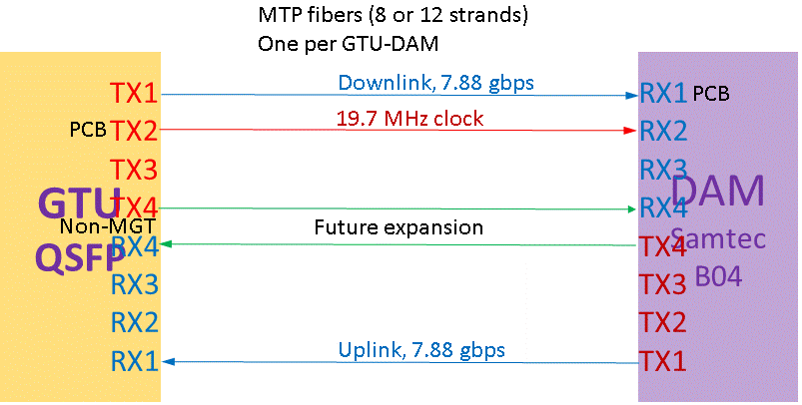
2. Overview of the GTU
2.1 The functional requirements
GTU required:
EIC common platform interface;
Run Control;
~150 DAM interface
Risk mitigation:
Beam vs clock phase monitoring;
Dedicated clock fanout to TOF
Between GTU and DAM (Quad LTI)
Same-length Multimode fibers: 4 Tx/4 Rx (inexpensive, standard, commercially available)

Slide 7
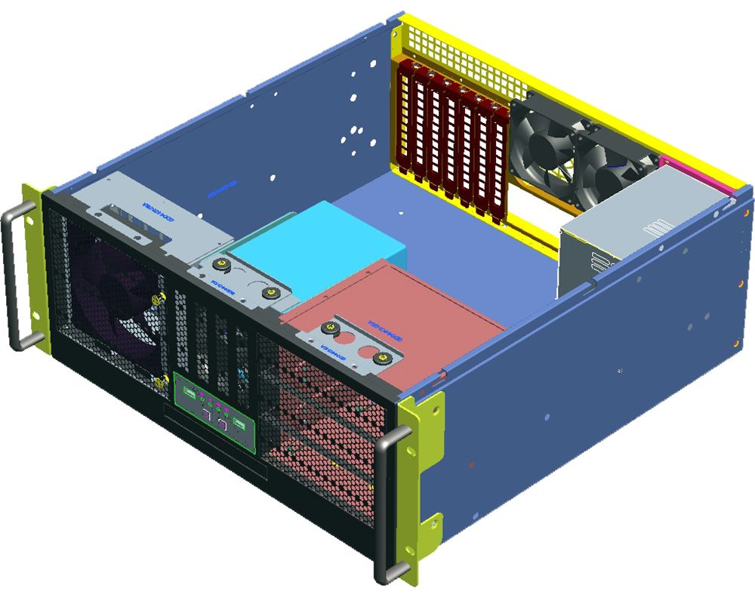

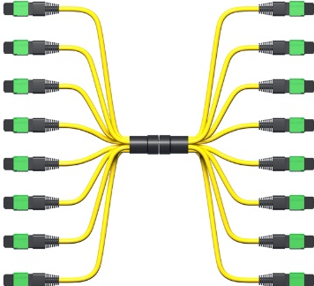
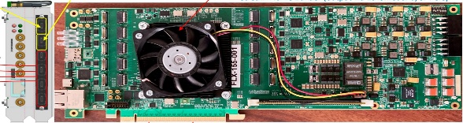
2. Overview of the GTU
2.2 The GTU hardware design
GTU
Up to 144
4U tall, 19” rack mounted
DAQ Room-air cooling
GTU base board
Optic transceiver adaptor boards
Clock monitor board
DAM

Slide 8
2. Overview of the GTU
2.3 GTU power
ATX power modules, +12V, +5V, +3.3V, requires a 110V AC outlet
GTU base board (24-pin ATX power connector and PCIe 8-pin power connectors):
  SOM: +12V
  FPGA HP_IO: LDO mic69502 +3.3V in, +1.8V/+1.5V… out
  FPGA HD_IO: LDO mic69502 +5V in, +3.3V/2.5V/1.8V… out
  Zynq IO: DC-DC OKL-T/6-W5P, +5V in,
Optic Plugin card:
  +3.3V from GTU base board, or
  +12 V from GTU base board or connector, DC-DC ➔ 4V, LDO → 3.3V
2.4 GTU cooling
Front panel room air in (three 12V 120mm fans, plus the ATX power built in fan)
Optional active SOM cooling (heat sink, optional 12V fan)
Back air outlet (back part of the top cover and the back panel, optic plugin cards area)

Slide 9
3. GTU Design
3.1 EIC common platform interface
SMA co-ax cables for Clock and RevTick
SFP interface to EIC Timing Data Link (bypassing the common platform)
3.1.1 (Two) SMA connector for RF clock receiver

Slide 10
3. GTU Design
3.1 EIC common platform interface
3.1.2 Two SMA connectors (differential) RevTick receiver
3.1.3 SFP receiver for TDL
1:4 fanout, then MGT

Slide 11
3. GTU Design
3.2 Clock distribution on the GTU
3.2.1 4:4 cross point switch
3.2.2 Clock fanout
SFP
SMA connector
FPGA’s MGT
VTRx+
SMA connectors
Clock_fanout
Osc.
LpBGT
Will be removed in production GTU design

Slide 12
3. GTU Design
3.2 Clock distribution on the GTU
3.2.3 Clock divider and jitter cleaner
SMA
Clock fanout
Clock
MGT’recClk

Slide 13
3. GTU Design
3.2 Clock distribution on the GTU
Clock_IN
3.2.4 Clock fanout to FPGA/DAM
Si53302
GTUbase
Si53302
Optic plug-in
DAM
Controls
Si5395
Si53302
GTUbase
DAM
Si53302
Optic plug-in
Si53302
GTUbase
DAM
DAM
Si53302
GTUbase
FPGAs
Si53xxx
Si53xxx
Termination
Si5395
MGTs
Si53xxx
Si53302
GTUbase
Si53xxx
Si53xxx
Dedicated Clock fanout plugin

Slide 14
3. GTU Design
3.3 Run-control user interface
XCZU19EG Zynq, ARM®
4 GB DDR4 memory
1000baseT

Slide 15
3. GTU Design
3.4 Slow control/I2C monitiring
XCZU19P Zynq, ARM®
Si5395
SFP
LpGBT
Si570
ADC …
TCA9548
GTUbase
I2C_0
Zynq
TCA9548
Plugin card
TCA9548
GTUbase
TCA9548
GTUbase
I2C_1
KU15Ps
TCA9548
GTUbase
TCA9548
PluginCard
SPI
TCA9548
GTUbase
AD9510
QSFP
FireFly
Clock plugins

Slide 16
3. GTU Design
3.5 DAM control link (downlink/uplink)
XCKU15P
2 x DAM
2 x MGT
4 x d_IO
Plugin Cards for 144 DAM
XCZU19EG
1 x MGT
40 x IO
52 x MGT
104 x d_IO
Supports:
148 DAM
4 RDO
40 x MGT
80 x d_IO
40 GBE
Or 4 x RDO
4 x MGT
XCKU15P
52 x MGT
104 x d_IO
1 x MGT
40 x IO
2 x MGT
4 x d_IO
2 x DAM

Slide 17
3. GTU Design
3.6 Clock monitoring
3.6.1 Beam pickup signal: stand alone PCB design
GTU: Phase Correction
PhaseOrbit (average)
RF-SoC (?)
Phase adjustment:
Si5395 (I2C) : ~70 ps steps
AD9510 (SPI) : ~25 ps steps
Phase#1
Phase#2
Phase#1160
Phase#1
RDO(area) Clock
e⁻ Beam pickup

Slide 18
3. GTU Design
3.6 Clock monitoring
3.6.2 Clock monitoring (another GTU plugin module)
Clock
Fanout
(4)
QSFP opticTRx
(2)
Clock_A
(1)
(2)
Clock_B
(12)
FPGA (SOM)
Clock phase measurement
Clocks’ phases
Clock
Fanout
(10)
FireFly opticTRx
(1)
Clock_C
Fiber loopback, either the spares between GTU and DAM, or the spares between DAM and RDO
Clocks from the GTU base board, and the phase measurement results to the GTU base board

Slide 19
3. GTU Design
3.7 Extras on the GTU
3.7.1 Related to the GTU
10 generic electrical inputs
10 generic electrical outputs
2 optical inputs
2 optical outputs
I2C serial ADC for thermistors
50 mΩ resistors for current monitoring
PS PCIexpress Gen2x4 root complex
SD card
USB, UART etc
3.7.2 exploration
I2C/JTAG via fiber
LpGBT

Slide 20
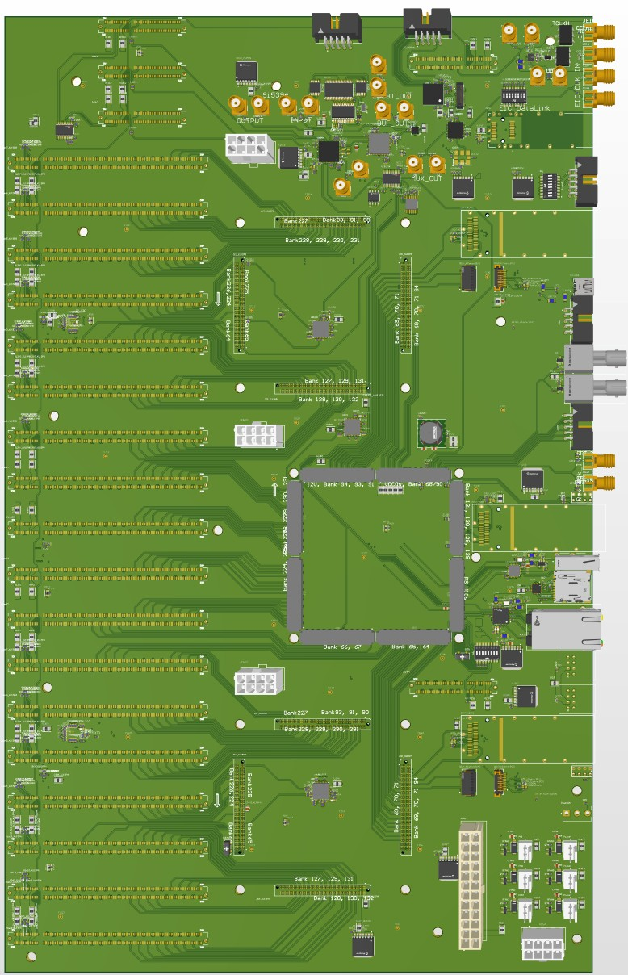
4. PCB layout
4.1 The GTU base board
EIC common platform inputs
GTU user interface (1000BaseT)
40 GBE
/ 4*RDO
2* DAM
Generic IO
Cooling fan (12V)
Clock (phase)
Monitor plugin
ATX power
+3.3V, +5V, +12V
AMD
ZU19EG
MPSOC
AMD
KU15P
SOM#1
AMD
KU15P
SOM#2
4* PCIe +12V power
18* optic transceiver adaptor boards (to DAM)
3* dedicated Clock fanout

Slide 21
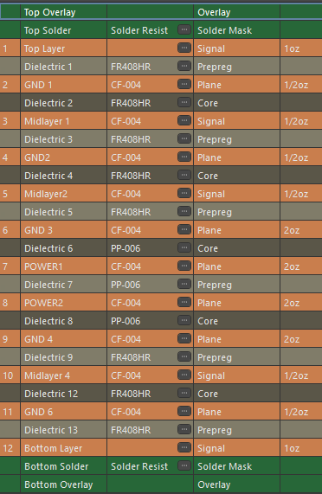
4. PCB layout
4.1.1 GTU base board
425 mm by 262 mm
12 copper layers,
Signal
Ground
Signal
Ground
Signal
Ground
Power 1
Power 2
Ground
Signal
Ground
signal
Signal routing:
Differential 5mil/5mil, impedance: 90Ω ±10%
Single-ended: 10 mils (minimize signal loss)
Through-hole vias 0.4mm/0.2mm (16mil/8mil)
xczu19EG SOM:
xcku15p SOM:
plugin connectors:
SAMTEC, PCIe Gen4 (16 gbps) surface mount

Slide 22
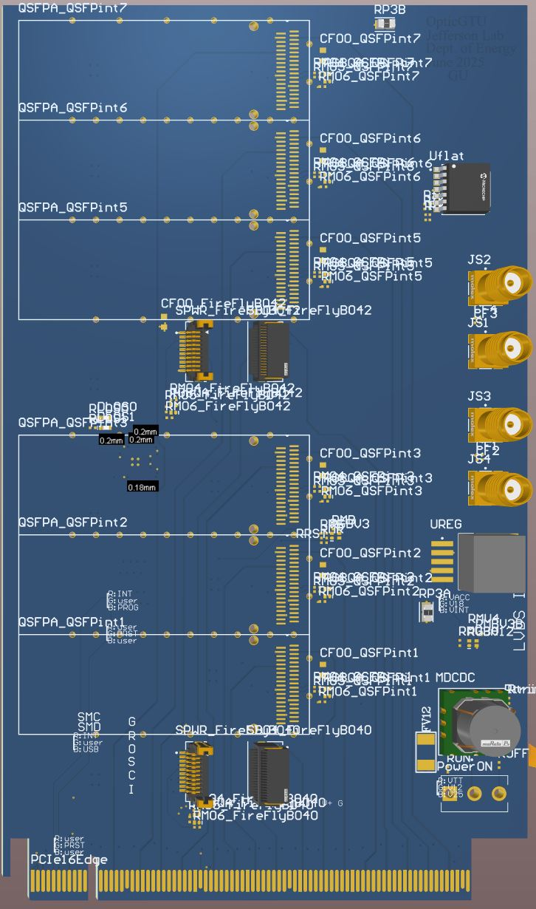
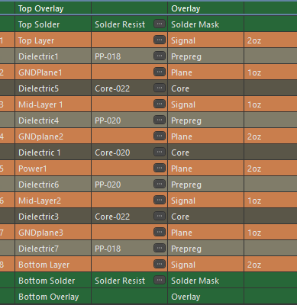
4. PCB layout
4.2 Optic Plugin cards
100 mm by 170 mm
8 copper layers,
Clock fanout: equal length
Difference: <2 mm (10 ps)
6* QSFP
Optic TRx
Choice of QSFP or Firefly modules
2 x Firefly modules
(smaller footprint)
6 x QSFP modules
(less expensive)
2* SAMTEC
Optic TRx
PCIe edge connector
To GTU base board

Slide 23
4. PCB layout
4.3 not planned for the engineering article
PCIe x4 for the phase measurement of the distributed clocks
PCIe x4 for the dedicated clock distribution (1:~200)
Standalone card for the (electron) beam pick up

Slide 24
5. The Current Status
5.1 GTU base board
Fully routed, no design rule violations, needs:
Trace optimization for manufacturing
Silk screen optimization
5.2 Optic Plugin card
Fully routed, no design rule violations, needs:
Trace optimization for manufacturing
Silk screen optimization
5.4 Plan for the engineering article
2x GTU base boards
4x Optic Plugin cards
→ One 4U GTU box
5.3 components in hands
1x 4U rack mounted box
1x ATX 500W power supply
2x Alink ACZU19 SoC modules
2x Alink ACKU15 FPGA modules
5.5 Plan for GTU production
3x 4U_GTU_box (fully populated)
Nx 4U_GTU_box (partially populated)

Slide 25
Thank you
The GTU manual (preliminary version) is attached in the agenda
The firmware and software are starting

Slide 26
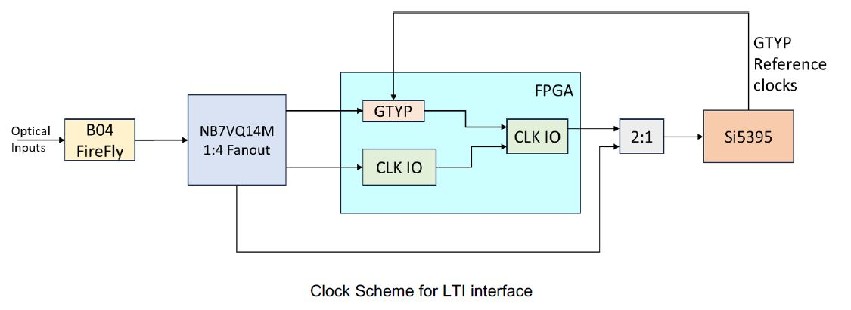
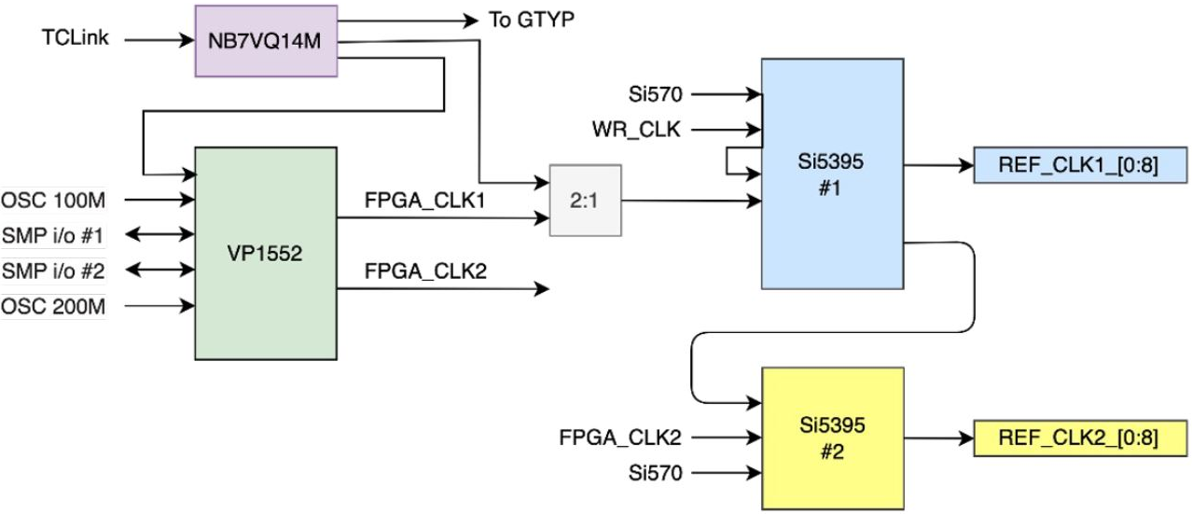
A1: DAM (FLX155) clock interface
Dedicated Clock input,
up to three MGT lanes (Tx/Rx)
MTP multimode 850µm optical
* These two diagrams are from FLX155 presentations

