Slide 1
ePIC Slow Controls / DAQ interface to collider
Jeff Landgraf

Slide 2
Goals / Concepts
Use EPICS implementation
Need to share data seamlessly with collider
  Access to data
  Shared tools where applicable
Slow Controls WBS is “slow controls integration”
  Controlled Hardware is part of Sub-Detector/Electronics WBS
  Detector specific control applications part of Detector WBS
  Shared components of slow controls part of “Slow controls integration” WBS
Integration of EIC/Detector information:
  “Simple Information” will be/must be automatic through EPICS DBs
    “Slow time granulatity” => O(>=1-10sec)
    Availability level sufficient for data integrity, but not sufficient for machine or human protection.
  More stringent requirements for specific data
    This is one of the main topics of this workshop, which is the reason for the choice of speakers (Magnet, Roman Pots, Polarimetry, Safety/Environmental Systems, etc…)

Slide 3
Goals / Concepts (Continued)
AI should be incorporated
  Not yet clear exactly what this means: at very least…
    Integrate Detector State / Collider State / Experiment State with run control
    Incorporate AI with monitoring systems
    Problem prevention / prediction
DAQ interface to collider is through Common Platform
  Minimum signals required
    RF clock. (Jitter < 8 ps, phase stability <500 ps, stable frequency TBD)
    We want both beams, likely to use electron beam for timing
    Rev Tic needed
  Need over some path (Could be DB combined with common platform)
    Filled bunch patterns
    Polarization patterns
  Have discussed obtaining timing directly from induced beam via the BPMs, but this is not part of the baseline, although could be implemented if needed as an upgrade
  Return signals from Detector/DAQ to collider are expected
    ?Potentially via the Common Platform, or other dedicated electronics?
    ?Potentially direct transfers via ethernet?
    Via slow controls path (subject >= 1-10 sec granularity, non-critical availability requirement)

Slide 4
Goals / Concepts (Continued)
Functional organization vs Effect based organization of data
  Functional Organization (typically the simple way…)
    Control/configuration based on the components
      Slow controls handles typically commercial components. Lots of control aspects: power cycling, setting voltage levels, setting fan speeds, setting thermostat parameters etc… These handled by EPICs and by operator Tools (GUIs or scripts). Some have an effect on data stream, others don’t.
      Configuration of digital aspects of the data stream through DAQ/Run Control: pedestals, run modes, components in data stream at a given time. Potentially huge numbers of tracked parameters (15 Billion pedestal values for SVT?) and archived in relational DBs & data files. (Archive name / summary).
      Both combine to “conditions DBs”
  Effect Based Organization of data.
    Organize data by what effect it has on the data stream
    This would be useful for monitoring (AI or otherwise)
    This would require significant stewardship and additional software/hardware components
  Be careful with ideas like “All data” will be available to AI

Slide 5
EPIC Slow Controls Components
Echelon 1 Shared Scope?
Sub Detectors Shared Scope
EIC Controls Shared Scope?
Control GUIs
Alarm Handler
DB Display Interface
User Interfaces
By detector, to specify detector structure, and operating modes
Need to select GUI supported writing packages
Should be configurable to allow monitoring of any Epics data
Time series history for all variables
Selectable correlation
Synergy with collider?
Services
Epics
Server
Archiver
Echelon 0 DB Storage
Echelon XX DB Storage
Small number of LINUX servers
Communicate with Sensors and controls using Soft or Hard IOCs
Communicate with IOCs using ethernet network
Investigate!
  EIC (custom/consult)
  RDB archiver
  SLAC archiver appliance
  Channel Archiver
Assume relational DB such as mysql
Table design needs to have general storage mechanism including schema evolution
Replications of online DB at echelon 1, 2 institutions
Interlocks/SC Shared Scope?
DAQ FEB Control & Monitoring
Sensors
Controllers
Rack Power
Rack-End Circuit Breakers
Subsystems
Expect ~100 DAQ soft IOCs
Configuration of ASICs likely through DAQ configuration files, not EPICs. IOCs insert commands into DAQ link.
Controlled via Ethernet
Internal IOC or Soft IOC running on DAQ room computers
Controlled via Ethernet
Internal IOC or Soft IOC
Types: HV, LV, gas systems, motor control,
PDUs
PLC Based control?
Status is delayed with respect to many parts of system: e.g. no testbeds yet.
  Scale has been surveyed:
    ~ 500k variables to be tracked, 55 TB/year, 70 Mbps network traffic
  Electronics suggestions started, space needed on platform estimated, but needs revision

Slide 6
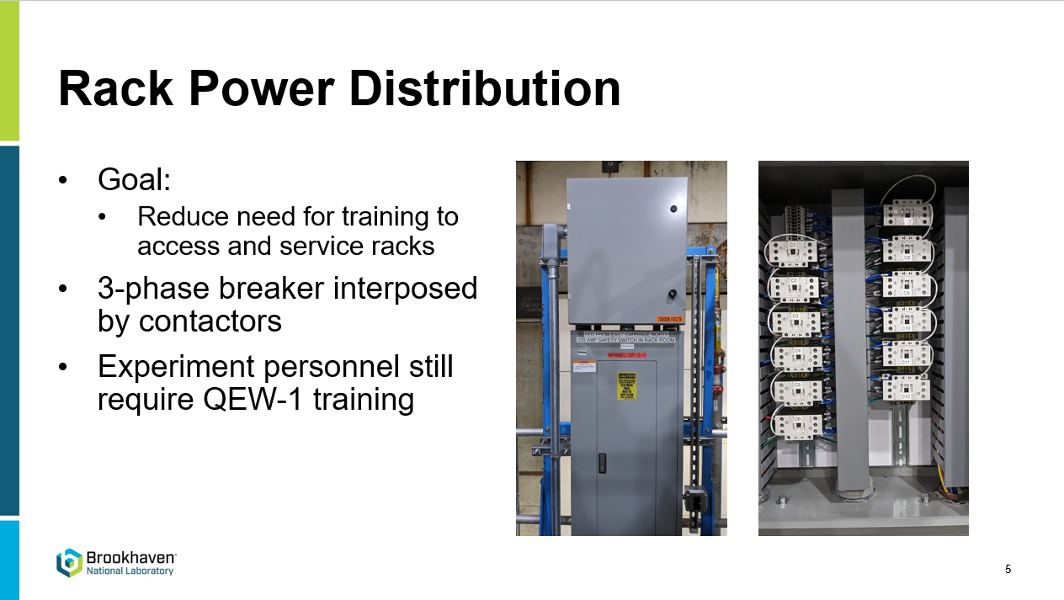
Additional Points
Rack Power Distribution
  Lee Flader outlined PLC based plans for Rack Power Distribution (automating circuit breakers)
Note multiple power control structures:
  Rack Row Circuit Breakers (PLC Control) Not in Slow Control P6, required? (interlock / full control?)
  PLU units at top of rack rows (Potential EPICS Control) Not in Slow Control P6, required?
  Individual units/crates (EPICS control)

Slide 7
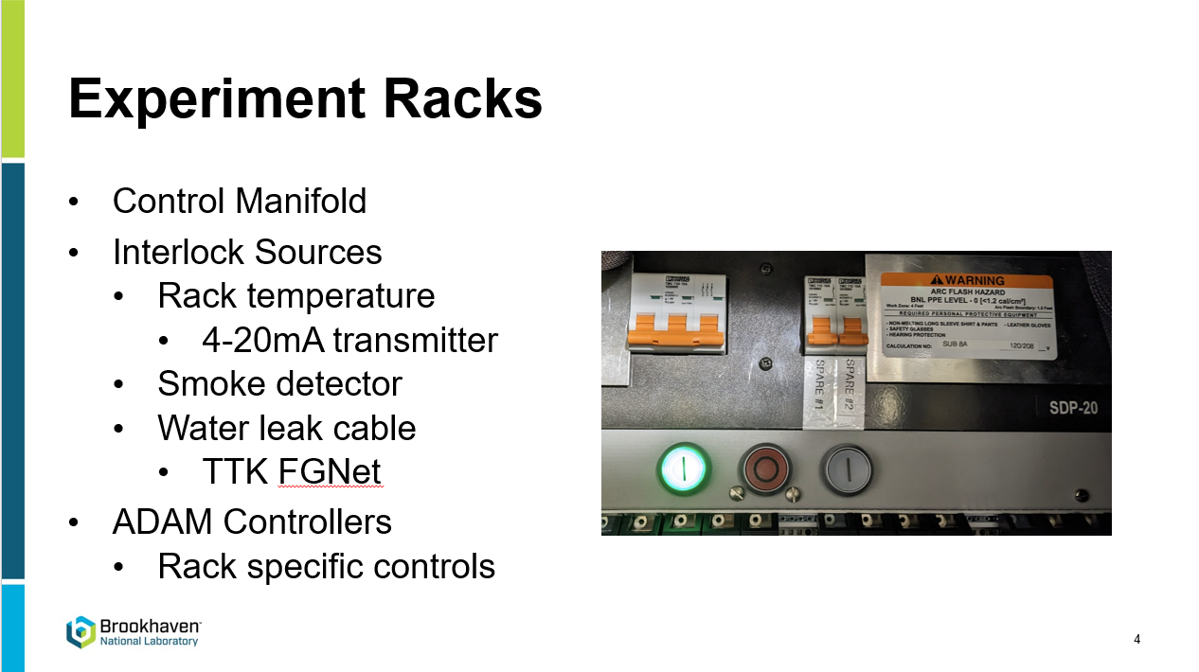
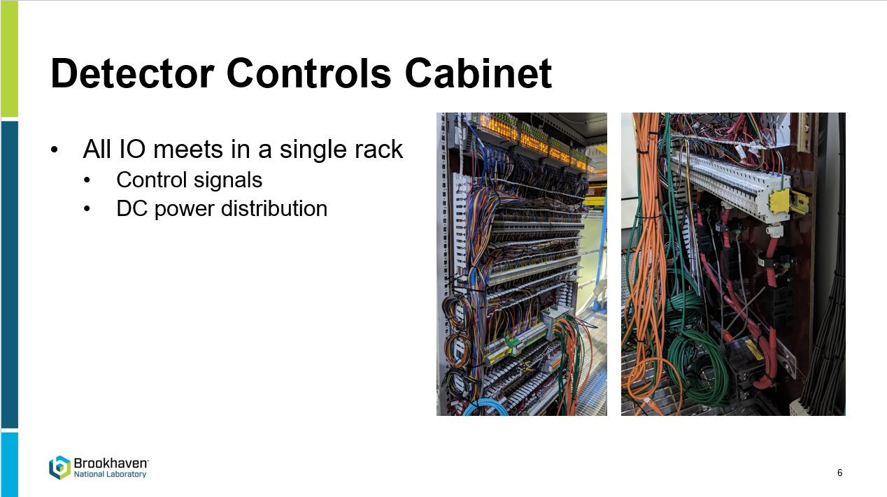
PLC based interlocks
Lee also described interlock systems. These were integrated with the rack power distribution with cost $150-200k
Not in Slow Control WBS P6
Safety Integrity Level (SIL) / Performance Level (PL) might need to be consulted:
IEC-61508
IEC-61511

Slide 8
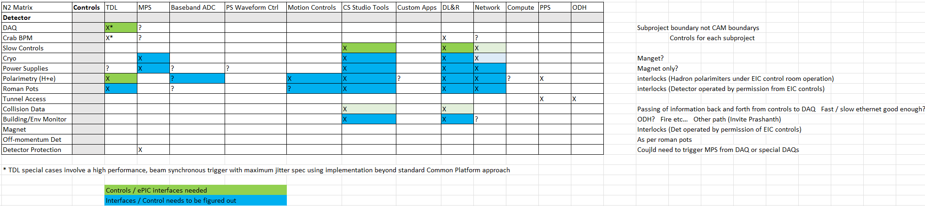
Goals to keep in mind:
This matrix of interfaces from Jim needs to be fleshed with detail and allocated to appropriate subprojects.

