Slide 1
ePIC & Accelerator Controls Interfaces Background
Jim Jamilkowski
6.07.02 L3 Manager, Accelerator Control System
EIC ePIC/Controls Workshop
Nov 13, 2025

Slide 2
Outline
Introduction
Scope Overview and Interfaces
Common Hardware Platform
Timing Data Link & Machine Protection Link
EIC Software Services
Detector Software Services
Networking & Computing
Subsystems Integration
  Cryogenics
  Beam Instrumentation
  Power Supplies
  RF
  Vacuum
  Infrastructure
Interfaces Status / N² Diagram
Summary

Slide 3
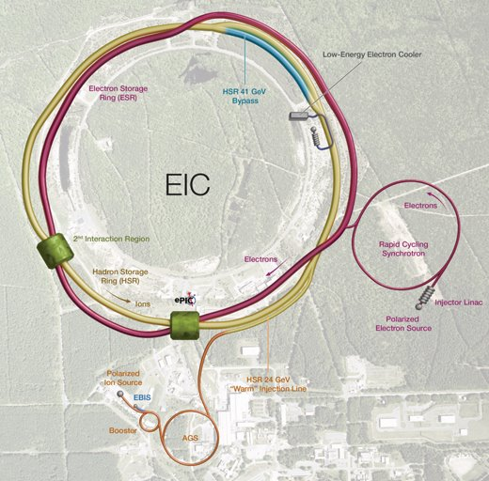
Introduction
EIS Accelerator Controls scope includes either instantiating or customizing standard set of EIC HW and SW tools for each Machine/Subsystem
EIC needs to coordinate operations with the Hadron Injector Chain, which is not part of the Project scope
  Legacy systems use a proprietary scheme
  Referred to by the acronym, ADO
EIC requires a Distribution Hub for timing, machine protection, networking, and selected computing services
  Current plan is to modify space in Bldg. 1003A
  Link needed with Electron Injector System facilities
EIC Distribution Hub
Electron Injector System
X
Hadron Injector Chain

Slide 4
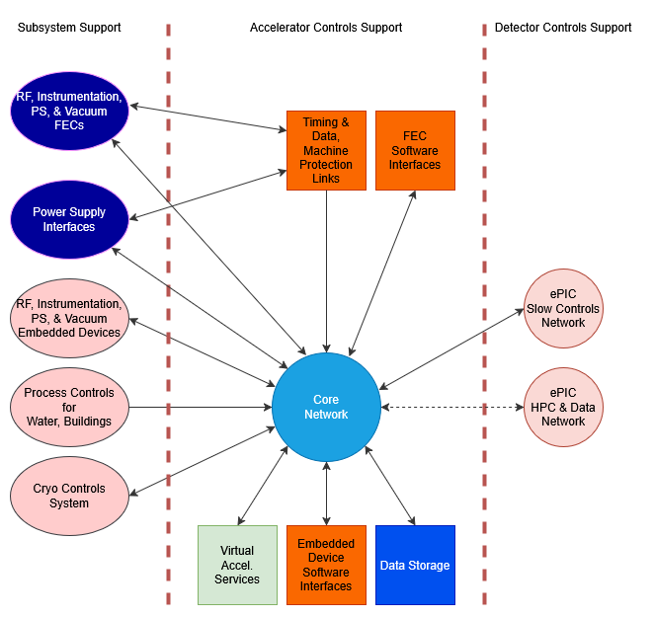
Scope Overview and Interfaces
Accelerator Controls includes
  Providing a Common Hardware Platform Front End Computer design that can be used for many applications
  Supplying Timing and Data Link and Machine Protection System Link services to every location that will require it
  Networking resources for all EIC equipment
  Computing resources for certain systems
    Servers (For general applications, GigE camera processing, etc.)
    Workstations
    Thin-clients
  Software infrastructure to operate accelerator controls
    Includes application and model infrastructure and software development support
      Standard API for accessing EPICS Process Variables (PVs)
      Include access to legacy ADO parameter values, presented as PVs
    Includes virtual accelerator support
    Equipment integration support for selected systems
      Embedded COTS device integration: Water/Building PLCs, Vacuum , etc.
    Data exchange with the Cryo Controls System
Accelerator Controls does not include
  Fiber plant and conduit covered by Infrastructure
  Custom Common Hardware Platform Daughter Card designs, production, and integration for RF or Instrumentation-owned applications
  Power Supply Controller hardware for the electron machines
Excerpt of Interfaces from April '25 EIS Review

Slide 5
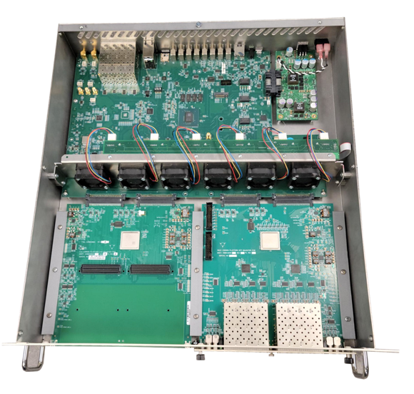
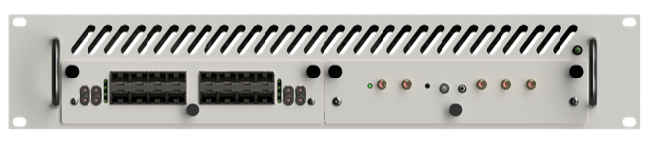
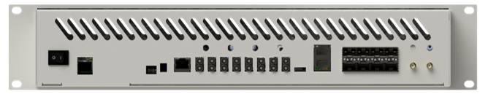
Common Hardware Platform
FPGA-based 2U ‘pizza box’ chassis
The basis for timing and event distribution
Supports two application daughtercards
Integrates application-specific electronics across multiple groups/functions:
  General Instrumentation and Triggers (Controls)
  BPMs
  LLRF
  Power Supply Interfaces (Controls)
SFP Daughtercard
  Supports multiple fiber-optic links
  Standard component for timing and data distribution
  FPGA-based, can also be programmed for custom applications
Top
Front
Back

Slide 6
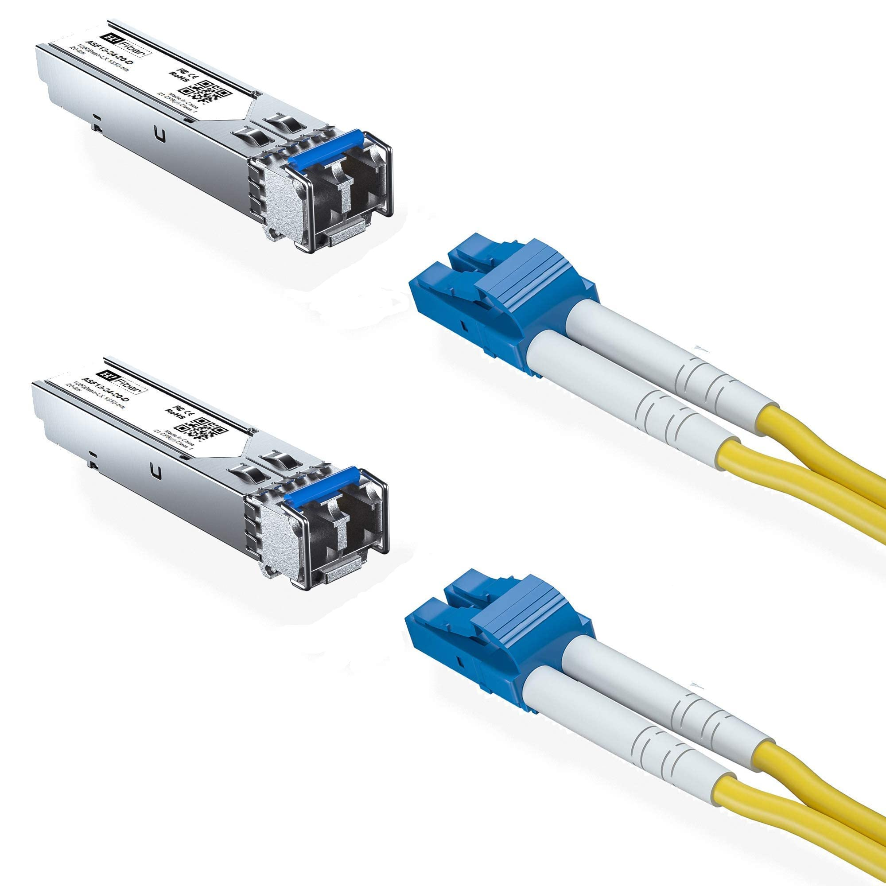
Timing-Data Link (TDL) & Machine Protection Link
Provides timing reference and events throughout the complex
8Gbps link, synchronous to master 100Mhz oscillator
Basis for synchronized timestamping of measurement data
Bidirectional data flow can distribute machine data
Can transmit AC line zero-crossing events (e.g. ‘720Hz events’)
Similar link format can also support Machine Protection status distribution
Both link types rely on the Common Hardware Carrier & SFP Daughtercard designs
Clock signals can also be distributed via alternative formats

Slide 7
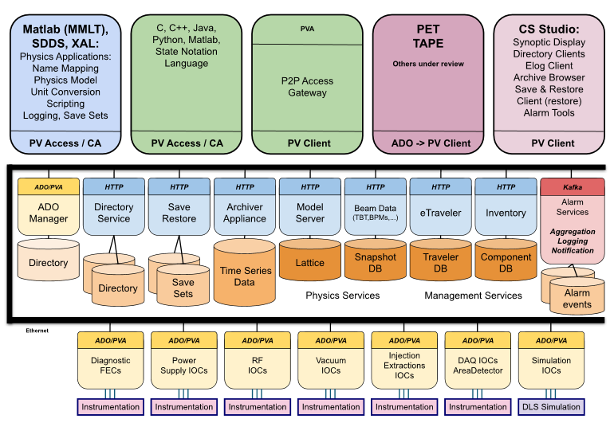
EIC Software Services
We provide…
  Core EPICS7-based software infrastructure
    Primary GUI, CS Studio Phoebus
    Currently testing multiple core services with EPICS IOCs and field devices
    PV Access protocol is preferred over the older Channel Access standard
  Database support for models, etc.
  Virtual accelerator functionality
  Bridge mechanism to the proprietary ADO-based Controls System for the Hadron Injector chain
  Instantiation of general SW tools for machine-specific applications
  Customization of SW tools for machine-specific applications
  Software integration of EIC devices for certain systems… some novel, some familiar
  Multiple programming languages supported for client access tools
    Java
    Python
    C++
  Development environment tools
    GitHub access to "eicorg" (separate from current Detector repo)
    Continuous Integration/Continuous Development functionality under development
    Release processes under development
Standard approach for the entire EIC Project
Software Infrastructure Cartoon

Slide 8
Detector Software Services
Potential services for Detector scope
  Utilize the standard application tools that we're providing for Commissioning for your own Detector-oriented applications
    Full Accelerator live data read access
    Conditional Accelerator live write access (...access restriction model)
    Full Accelerator logged data read access
  Asset management infrastructure
    Component Data Base... demoing now
  Quality assurance infrastructure
    eTraveler... dev work via contractor
  Electronic logkeeping
    evaluating requirements versus existing capabilities
      Elog (C-AD system)
      Olog (Phoebus tool)
  Data logging & retrieval for certain systems
  Sharing of alarm information between Accelerator and Detector groups
On-project AI/ML integration is currently limited to design and development enhancement tools, rather than monitoring/optimization tools for Commissioning

Slide 9
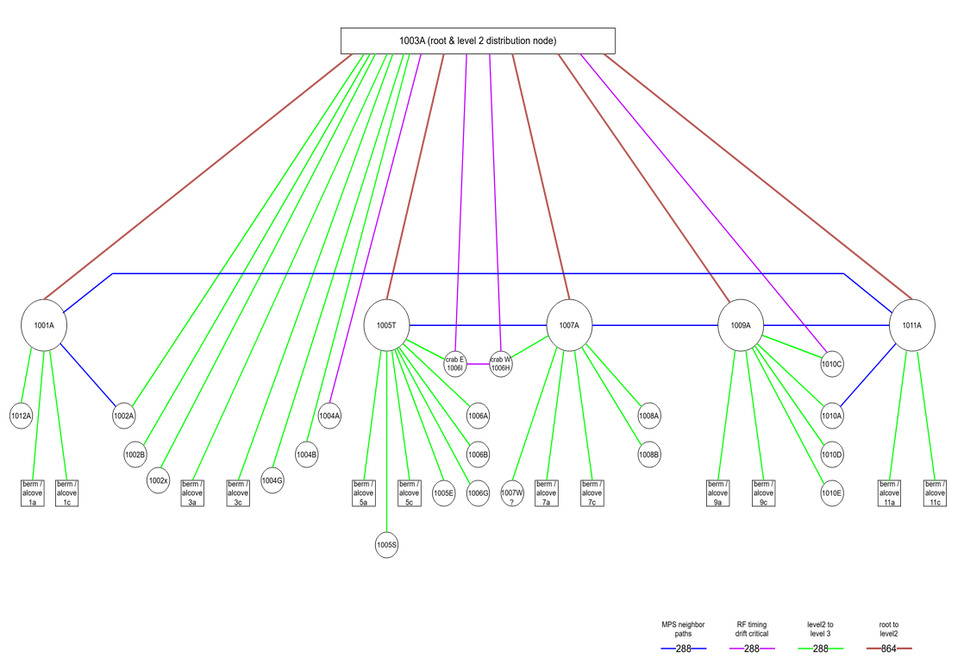
Networking & Computing
We provide…
  Core computing services, proposed to be located at Bldg. 1003A and 725
  RedHat 9 Linux distribution or similar option for servers and workstations
  Workstations and thin-clients for EIC field locations
  Server installation in field locations for specific applications (ex. GigE camera hosts)
  Networking design and management for all Accelerator applications
    How much ePIC scope?... not the DAQ
BNL ITD provides...
  Wifi support
  Switch and support equipment installation and ongoing maintenance
Standard approach for the entire EIC Project
Network & Link Distribution Topology from RoD #38

Slide 10
Cryogenic Systems Integration
RHIC Scheme
We provide a data transfer mechanism
  To Cryo Controls for...
    Insulating vacuum pressure readings
    Voltage tap readings for superconducting magnets
  From Cryo Controls for...
    Temperature readings
    Pressure readings
    Flow readings
...provide data logging & retrieval for correlation with other readings
EIC Scheme
Functionally the same as for RHIC
  Data transfer tool will be updated to support EPICS IOC sources for Accelerator side of collection process
Possible triangular interface for ePIC Cryo system

Slide 11
Beam Instrumentation Systems Integration
RHIC Scheme
We provide Front End Computer standard software interfaces via VME form factor
...provide data logging & retrieval and other standard software services
...provide software integration support for embedded devices
  For example, High Voltage Bias controller for Beam Loss Monitors (BLMs)
...provide software application support for systems
  For example, Blue/Yellow Orbit Display, RHIC Loss Monitor Display
EIC Scheme
Functionally the same as for RHIC
  FEC standard becomes the Common Hardware Platform
  Expecting a new set of standard embedded devices to integrate with the Controls System
  Application tools will be significantly updated
Possible similarities for particular Detector instrumentation scope

Slide 12
Power Supply Systems Integration
RHIC Scheme
We provide Front End Computer standard software interfaces via VME form factor
  Wave Form Generator (WFG)
  Multiplexed ADC (MADC)
...provide data logging & retrieval and other standard software services
...provide software middleware for coordinated ramping of PSs
...provide software middleware and analysis tools for superconducting magnet quench protection
EIC Scheme
Functionally like RHIC
  HSR equipment requires updated version of RHIC WFG and MADC designs
  ESR & EIN equipment will use a new Power Supply Controller box (see next slide)
    PS Group provides the PSC modules
  Magnet quench detection integration support
    ASR scheme leverages portions of RHIC design
    IR scheme requires new development
  Application tools will be significantly updated
Consider for ePIC Magnet PS controls scope

Slide 13
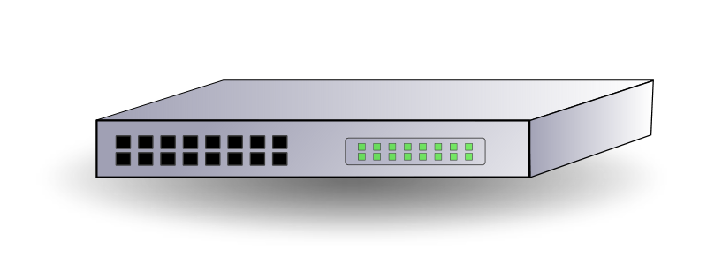
Power Supply Systems: PSC Overview
TDL
‘uplink’
Ethernet Network
CARRIER
PS PSC
Digital | Analog
Timestamped
Readback Data
Reference
Generation
& Readbacks
DAC & ADCs
Analog
Regulation
Power Supply
Reference
Generation
& Readbacks
DAC & ADCs
Analog
Regulation
‘TDL Lite’
Power Supply
SFP Daughtercard
SFP Daughtercard
Reference
Generation
& Readbacks
DAC & ADCs
Analog
Regulation
Power Supply
1 Link per PSC
(not per channel)
Reference
Generation
& Readbacks
DAC & ADCs
Analog
Regulation
‘TDL Lite’
Power Supply
Controls Grp.
PS Group.

Slide 14
RF Systems Integration
RHIC Scheme
We provide Front End Computer standard software interfaces via LLRF pizza box form factor
  Note, this is the predecessor for the Common Hardware Platform designs
...provide data logging & retrieval and other standard software services
...provide software integration support for embedded devices
  For example, Power Amplifier remote interfaces
EIC Scheme
Functionally like RHIC
  FEC standard becomes the Common Hardware Platform
  Provide similar software application support for RF cavity ramping control and monitoring
  Provide embedded device integration support

Slide 15
Vacuum Systems Integration
RHIC Scheme
We provide Front End Computer standard software interfaces via VME form factor
  For digitizing vacuum pressure readings
...provide data logging & retrieval and other standard software services
...provide software integration support for embedded devices
  For example, pump, gauge, and valve remote interfaces
EIC Scheme
Functionally like RHIC
  Update to EPICS IOC interfaces
Possible triangular interface for ePIC Magnet Cryo insulating vacuum or other Detector instrumentation

Slide 16
Infrastructure Systems Integration
RHIC Scheme
We provide software integration support for embedded devices
  For example, building management and water-cooling systems remote monitoring
EIC Scheme
Functionally like RHIC
  Adding new buildings and cooling systems
Possible triangular interface for ePIC Slow Controls or other systems

Slide 17
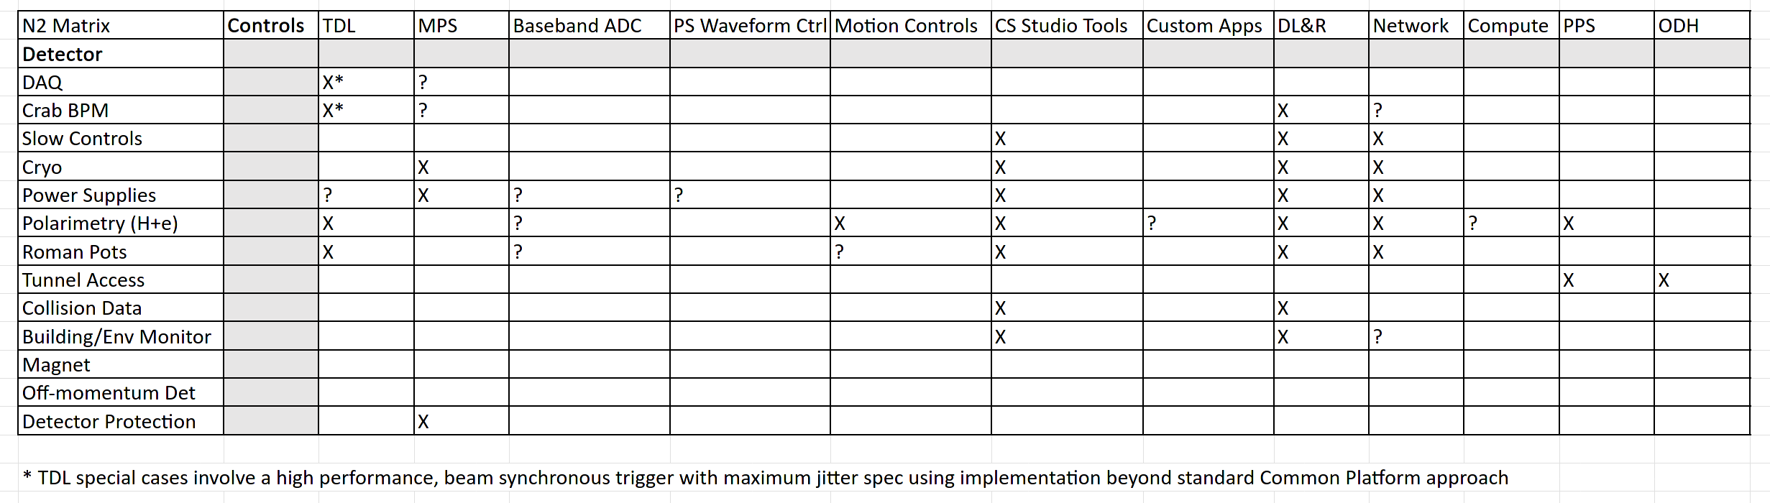
Interfaces Status / N² Diagram
Discussions between our groups have been going on for several years
An N2 table has been started back on Aug 12, 2025, before our last discussion, but we need to complete it, and...
  Flesh out enough details to finalize the initial Interface Requirements Document (IRD) between our groups
  Continue working on the more detailed Interface Control Document (ICD) in the coming months
We requested the addition of a "Controls – Detector" WBS area via Project Change Request (PCR) in 2024
  Budget was ~$1M
  CCB response called for holding a workshop since scope was not entirely clear... which is today's event
  The previous PCR will likely need to be revised and resubmitted

Slide 18
Summary
The RHIC paradigm covers a bunch of existing interfaces, though we have an opportunity to improve on our approaches for EIC
  Better standardization... EPICS/Phoebus/Archiver, etc.
  Retirement of legacy standards
Accel. Controls is developing standard tools and interfaces
  Common Hardware Platform components... many are at first article or beyond
  Timing-Data Link... working on initial demo
  Machine Protection System Link... demo coming soon
  Core software services based on EPICS v7... demoing now
  CS Studio Phoebus GUI application... demoing now
  Computing services... starting to demo
  Networking services... planning EIC approach along with BNL ITD
We've had productive interfaces discussions over the last few years... the most recent was in August
The aim today is to solidify the N² diagram and capture the deliverables for an Interface Requirements Document between our groups
Accel. Controls will likely need to request WBS additions for DET or other subprojects

Slide 19
Thanks to…
  Kyle Kulmatyscki, Mark Lukasczyk,
  Mike Costanzo, Kevin Mernick,
  Seth Nemesure, Kunal Shroff,
  Chanaka De Silva
  …and many more

